Slide 1
Welcome to the Second 2023
Research Retreat
Paolo Giubellino

Slide 2
Objectives of this meeting
Discuss the prospects of research at GSI and FAIR following the Council decisions (taken and expected)
How are the plans for FAIR 2028 developing?
What are the necessary steps we have to take to reach FAIR 2028?
Define the program until 2028
2024 and 2025 are now defined
What science program for 2026 and 2027 (with a look at 2028) ?
Do we already have a vision for the development after 2028 towards „full FAIR“?
Discuss the rapid evolution of plasma physics related to Inertial Laser Fusion and its impact on our activities
Always keeping in mind the limitations in budgets of GSI and FAIR

Slide 3
The July Council-1
The procurement of the CBM dipole was approved.
The ECB v12 was approved.
So we can mark the NUSTAR re-procurements as secured.
But currently financing is only agreed for FS.
The assignment of the CBM DAQ contribution was approved
The management was tasked to provide a milestone plan for PANDA
The approval of FS+ gained substantial momentum, and it was generally agreed Council should aim at approving it at the next meeting, but it is linked to 2 correlated points:
the CSG must assess how much reserve on top of the existing funding is needed to consider FS secured
the non-German shareholders must commit enough funds to cover the reserve above and the additional cost for FS+

Slide 4
The July Council-2
Funds for commissioning have been approved for 2024
It is a modest little more than 5 Millions but it states a principle
The allocation of significant funds for 2025 will require the assessment of the need for 2025 AND the full ramp to operation by the CSG
The commissioning fund approval is very important because is the only path we see to hire personnel for the installation and commissioning of the experiments
Do NOT expect large numbers!
The commissioning funds foresee 300k to start a fellow and associates program
an essential step to develop the community participation to the experiments

Slide 5
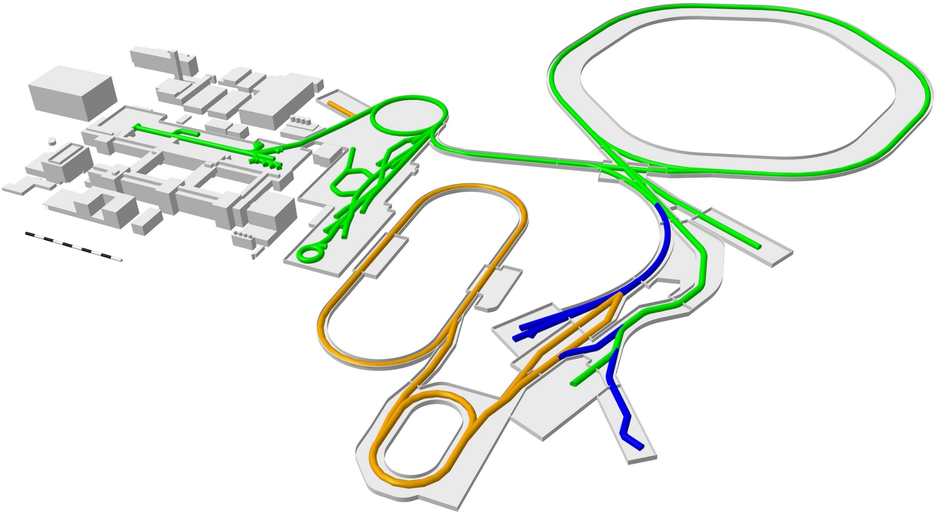
Our vision: FAIR 2028
APPA Laser
SIS100
UNILAC
SIS18
HITRAP
ESR
CBM
CRYRING
Super-FRS
First Science +
Next steps
MSV completion
NUSTAR HEB
Continuation of APPA, CBM and NUSTAR experiments in existing facilities
APPA, NUSTAR and PANDA investigate options for further experiments at green lines

Slide 6
What we would like to hear from you
Dept’s/Collab’s
Plans FAIR 2028: science, equipment
Strategy given constraints on budget and personnel, time plan
Critical items/path
Beam time requirements 2026/27
Beam time Coord./Head Acc. Op.
Outcome retreat, beam time planning
Available beams 2026/27, ions, quality, distribution
Operation modes
Campus development
Plans for exp. halls UNILAC and SIS18

Slide 7
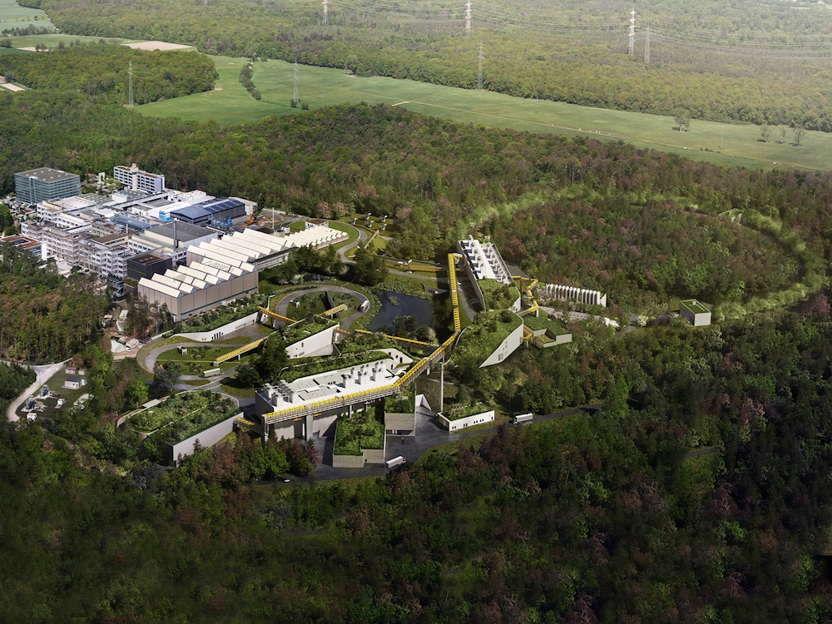
Thank You for making the Open Day a success!

