Slide 1
Grant no. 12135007
Craig Roberts … http://inp.nju.edu.cn/
On the Emergence of Mass
Notes:
20+5

Slide 2
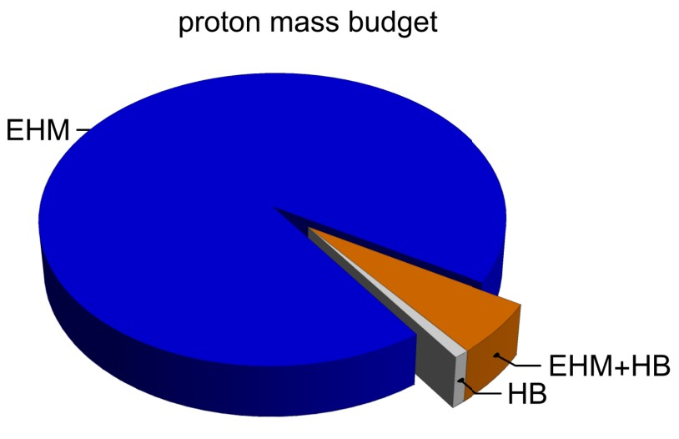
Emergence of Hadron Mass
Standard Model of Particle Physics has one obvious mass-generating mechanism
= Higgs Boson … impacts are critical to evolution of Universe as we know it
However, Higgs boson alone is responsible for just ∼ 1% of the visible mass in the Universe
Proton mass budget … only 9 MeV/939 MeV is directly from Higgs
Evidently, Nature has another very effective mechanism for producing mass:
Emergent Hadron Mass (EHM)
Alone, it produces 94% of the proton’s mass
Remaining 5% is generated by constructive interference between EHM and Higgs-boson

Slide 3
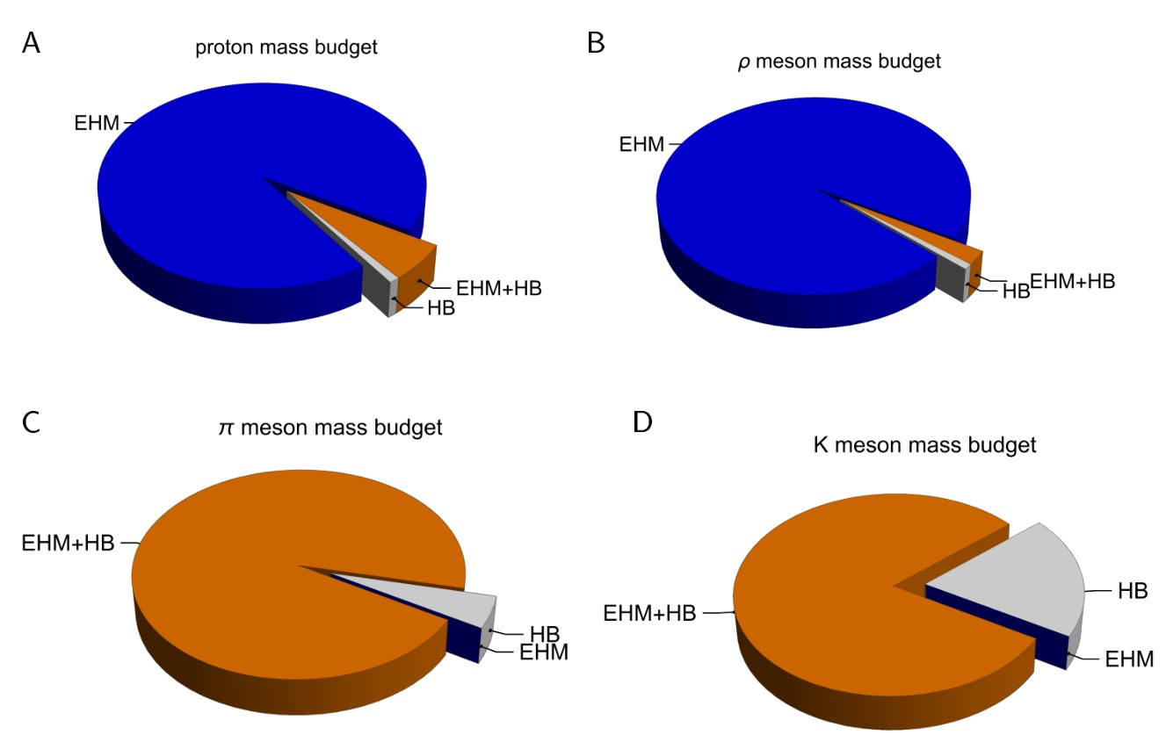
Emergence of Hadron Mass - Basic Questions
What is the origin of EHM?
Does it lie within QCD?
What are the connections with …
Gluon and quark confinement?
Dynamical chiral symmetry breaking (DCSB)?
Nambu-Goldstone modes = π & K?
What is the role of Higgs in modulating observable properties of hadrons?
Without Higgs mechanism of mass generation, π and K would be indistinguishable
What is and wherefrom mass?
Proton and $ρ$-meson mass budgets are practically identical
$π$- and $K$-meson mass budgets
are essentially/completely different from those of proton and $ρ$

Slide 4
Quantum Chromodynamics
$$L= \frac{1}{4}G_{μν}^{a}\left(x\right)G_{μν}^{a}\left(x\right)+\overline{ψ}\left[γ⋅∂_{x}+m+ig \frac{λ^{a}}{2}γ⋅A^{a}\left(x\right)\right]ψ\left(x\right)$$
$$G_{μν}^{a}\left(x\right)=∂_{μ}A_{ν}^{a}(x)−∂_{ν}A_{μ}^{a}(x)−f^{abc}A_{μ}^{b}{(x)A}_{ν}^{c}(x)$$
One-line Lagrangian – expressed in terms of gluon and quark partons
Which are NOT the degrees-of-freedom measured in detectors
Questions
What are the asymptotic detectable degrees-of-freedom?
How are they built from the Lagrangian degrees-of-freedom?
Is QCD really the theory of strong interactions?
Is QCD really a theory? $⇒$ Implications far beyond Standard Model

Slide 5
Strong Interactions in the Standard Model
Only apparent scale in chromodynamics is mass of the quark field
Quark mass is generated by Higgs boson.
In connection with everyday matter, that mass is 1/250th of the natural (empirical) scale for strong interactions,
viz. more-than two orders-of-magnitude smaller
Plainly, the Higgs-generated mass is very far removed from the natural scale for strongly-interacting matter
Nuclear physics mass-scale – 1 GeV – is an emergent feature of the Standard Model
No amount of staring at L_{QCD} can reveal that scale
Contrast with quantum electrodynamics, e.g., spectrum of hydrogen levels measured in units of m_{e}, which appears in L_{QED}

Slide 6
Whence Mass?
Classical chromodynamics … non-Abelian local gauge theory
Remove the current mass … there’s no energy scale left
No dynamics in a scale-invariant theory; only kinematics … the theory looks the same at all length-scales … there can be no clumps of anything … hence bound-states are impossible.
Our Universe can’t exist
Higgs boson doesn’t solve this problem …
normal matter is constituted from light-quarks
the mass of protons and neutrons, the kernels of all visible matter, are 100-times larger than anything the Higgs can produce
Where did it all begin? … becomes … Where did it all come from?

Slide 7
Trace Anomaly
In a scale invariant theory
the energy-momentum tensor must be traceless: T_{μμ} ≡ 0
Regularisation and renormalisation of (ultraviolet) divergences in Quantum Chromodynamics introduces a mass-scale
… dimensional transmutation:
Lagrangian’s constants (couplings and masses) become dependent on a mass-scale, ζ
α → α(ζ) in QCD’s (massless) Lagrangian density, L(m=0)
⇒ ∂_{μ}D_{μ} = δL/δσ = αβ(α) dL/dα = β(α) ¼G_{μν} G_{μν} = T_{ρρ} =: Θ₀
Quantisation of renormalisable four-dimensional theory forces nonzero value for trace of energy-momentum tensor
Trace anomaly
QCD β function … specifies how the coupling “runs”

Slide 8
Trace Anomaly
Knowing that a trace anomaly exists does not deliver much
… Indicates only that a mass-scale must exist
Key Question: Can one compute and/or understand the magnitude of that scale?
One can certainly measure the magnitude … consider proton:
In the chiral limit the entirety of the proton’s mass is produced by the trace anomaly, Θ₀
… In QCD, Θ₀ measures the strength of gluon self-interactions
… so, from one perspective,
m_{p} is (somehow) completely generated by glue.

Slide 9
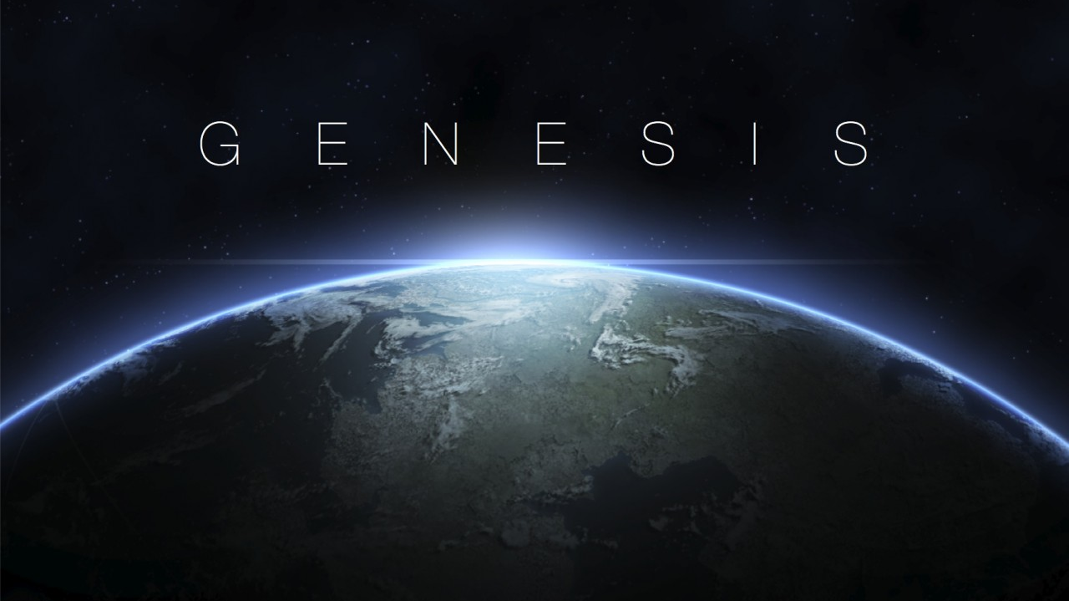

Slide 10
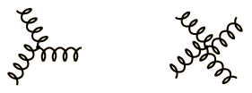
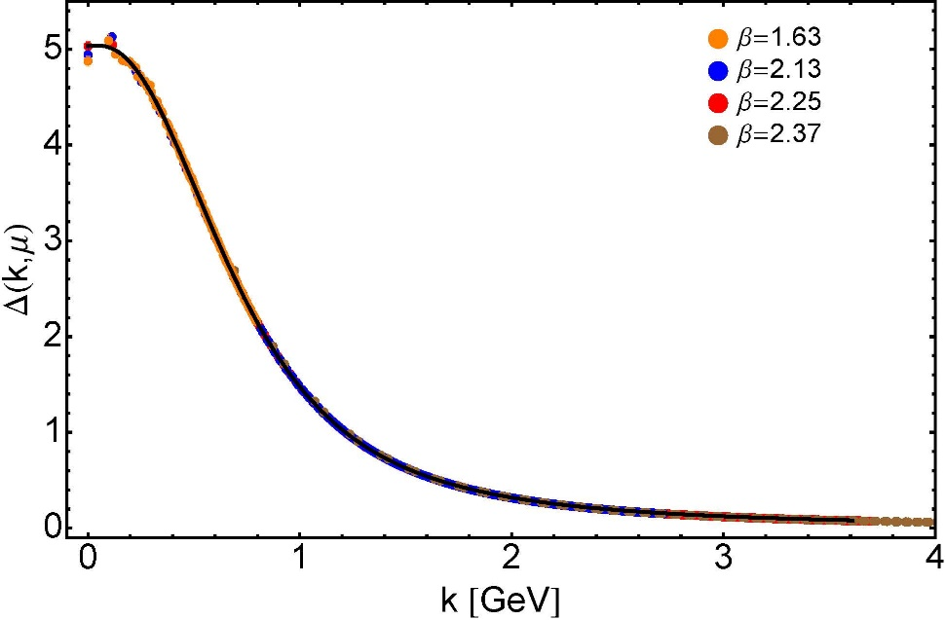
Modern Understanding Grew Slowly from Ancient Origins
More than 40 years ago
Dynamical mass generation in continuum quantum chromodynamics,
J.M. Cornwall, Phys. Rev. D 26 (1981) 1453 … $∼1100$ citations
Owing to strong self-interactions, gluon partons $⇒$ gluon quasiparticles,
described by a mass function that is large at infrared momenta
3-gluon vertex
4-gluon vertex
$$\frac{1}{m_{g}^{2}}$$
Truly mass from nothing
An interacting theory, written in terms of massless gluon fields, produces dressed gluon fields that are characterised by a mass function that is large at infrared momenta
Gluon propagator … continuum and lattice QCD agree
QCD fact
Continuum theory and lattice simulations agree
Empirical verification?

Slide 11
Modern Understanding Grew Slowly from Ancient Origins
EHM means
Gluons are massive
More than 40 years ago
Dynamical mass generation in continuum quantum chromodynamics,
J.M. Cornwall, Phys. Rev. D 26 (1981) 1453 … $∼1050$ citations
Owing to strong self-interactions, gluon partons $⇒$ gluon quasiparticles,
described by a mass function that is large at infrared momenta
3-gluon vertex
4-gluon vertex
$$\frac{1}{m_{g}^{2}}$$
Truly mass from nothing
An interacting theory, written in terms of massless gluon fields, produces dressed gluon fields that are characterised by a mass function that is large at infrared momenta
Gluon propagator … continuum and lattice QCD agree
QCD fact
Continuum theory and lattice simulations agree
Empirical verification?

Slide 12
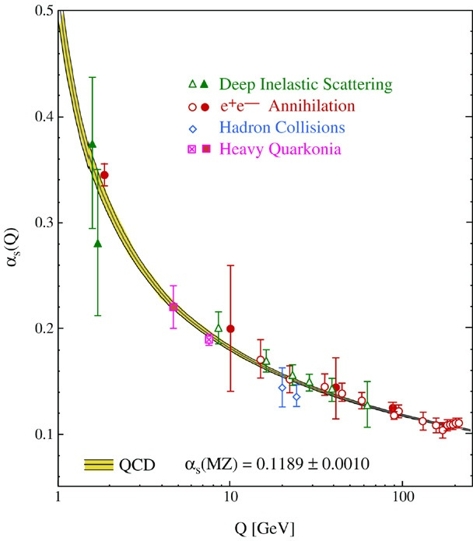
QCD’s Running Coupling
This is where we live
⇐
What’s happening
out here?!

Slide 13
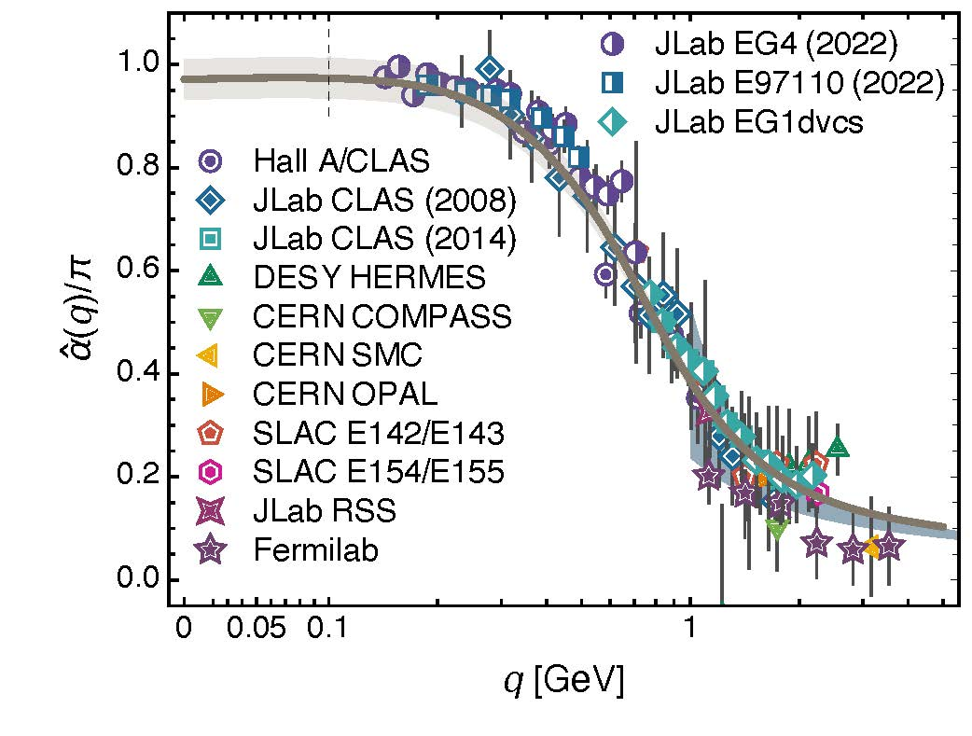
Process independent effective charge = running coupling
W orkshop on Dyson-Schwinger Equations in Modern Mathematics
and Physics (DSEMP2014) Trento, Italy, September 22-26, 2014
Modern theory enables unique QCD analogue of
“Gell-Mann – Low” running charge
to be rigorously defined and calculated
Analysis of QCD’s gauge sector
yields a parameter-free prediction
N.B. Qualitative change in α̂_{PI}(k) at k ≈ ½ m_{p}
No Landau Pole
“Infrared Slavery” picture – linear potential – is not correct explanation of confinement
Below $k∼{{\hat{m}}_{0}}_{ },$interactions become scale independent, just as they were in the Lagrangian; so, QCD becomes practically conformal again
The QCD Running Coupling,
A. Deur, S. J. Brodsky and G. F. de Teramond, Prog. Part. Nucl. Phys. 90 (2016) 1-74
Process independent strong running coupling
Daniele Binosi et al., arXiv:1612.04835 [nucl-th], Phys. Rev. D 96 (2017) 054026/1-7
Effective charge from lattice QCD, Zhu-Fang Cui et al., NJU-INP 014/19, arXiv:1912.08232 [hep-ph], Chin. Phys. C 44 (2020) 083102/1-10
QCD Running Couplings and Effective Charges, A. Deur, S. J. Brodsky, C. D. Roberts – arXiv:2303.00723 [hep-ph]

Slide 14
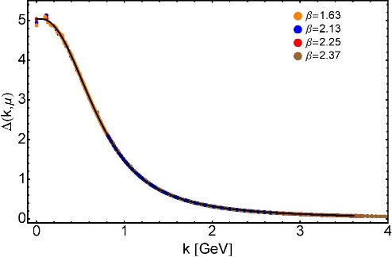
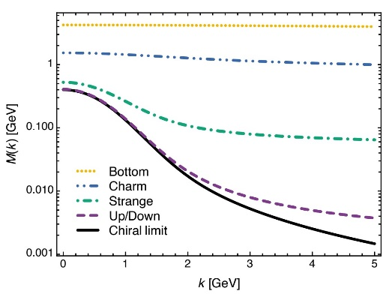
EHM Basics
Absent Higgs boson couplings, the Lagrangian of QCD is scale invariant
Yet …
Massless gluons become massive
A momentum-dependent charge is produced
Massless quarks become massive
EHM is expressed in
EVERY strong interaction observable
Challenge to Theory =
Elucidate all observable consequences of these phenomena
and highlight the paths to measuring them
Challenge to Experiment =
Test the theory predictions so that
the boundaries of the Standard Model can finally be drawn
Three pillars of EHM

Slide 15
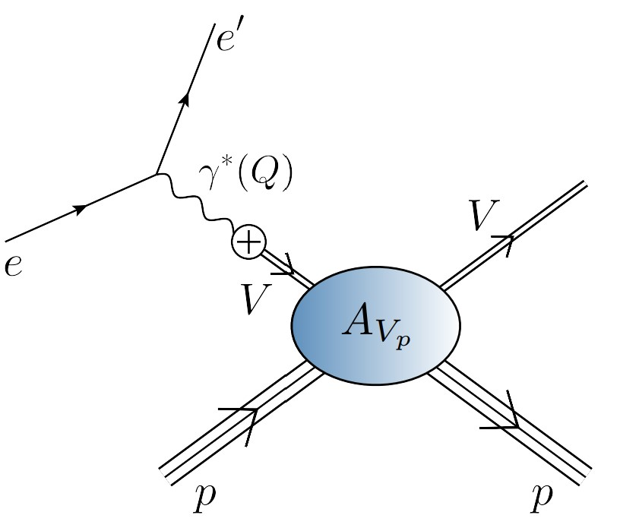
EHM Measurements: How does nucleon mass arise?
One Answer = QCD scale anomaly
Measurement = femtoscopic low-momentum correlation measurements
QCD multipole expansion … J/ψ and/or $Υ$ chromopolarisability relates forward scattering amplitude to a key matrix element in the origin of the nucleon mass problem
viz. the average chromoelectric gluon distribution in the nucleon:
Once considered viable …
electromagnetic vector-meson production reaction ($V=J/ψ, Υ$)
$e+p→e^{′}+V+p$
to access purely hadronic process
$$V+p→V+p$$

Slide 16
EHM Measurements: How does nucleon mass arise?
Once considered viable …
Electromagnetic process ($V=J/ψ, Υ$) … $e+p→e^{′}+V+p$
to access purely hadronic process … $V+p→V+p$
But … contemporary theory explains …
Deciphering the mechanism of near-threshold J/ψ photoproduction, M.-L. Du, V. Baru, F.-K. Guo et al., Eur. Phys. J. C 80, 1053 (2020)
Vector-meson production and vector meson dominance, Yin-Zhen Xu (徐胤禛), Si-Yang Chen (陈斯阳), Zhao-Qian Yao (姚照千) et al., NJU-INP 044/21, arXiv:2107.03488 [hep-ph], Eur. Phys. J. C 81 (2021) 895/1-11
Near threshold heavy quarkonium photoproduction at large momentum transfer, Peng Sun, Xuan-Bo Tong, Feng Yuan, Phys.Rev.D 105 (2022) 5, 054032
There is no objective, model-independent means by which to connect $e+p→e^{′}+V+p$ with $V+p→V+p$
Hence, vector meson photoproduction
does not provide a path to the QCD trace anomaly
Is there a viable alternative?

Slide 17
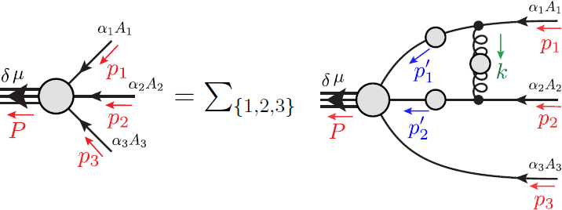
Faddeev Equation for Baryons
Nucleon mass from a covariant three-quark Faddeev equation
G. Eichmann et al., Phys. Rev. Lett. 104 (2010) 201601
Poincaré-covariant analysis of heavy-quark baryons
Si-Xue Qin (秦思学) et al., Phys.Rev. D 97 (2018) 114017/1-13
Unification of Weak and EM form factors of octet baryons
Zhao-Qian Yao (姚照千), et al. – nearing completion

Slide 18
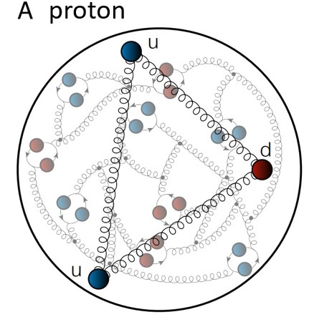
Structure of Baryons
Poincaré covariant Faddeev equation sums all possible exchanges and interactions that can take place between three dressed-quarks
Direct solution of Faddeev equation using rainbow-ladder truncation is now possible, but remains challenging problem – algorithms and numerical analysis

Slide 19
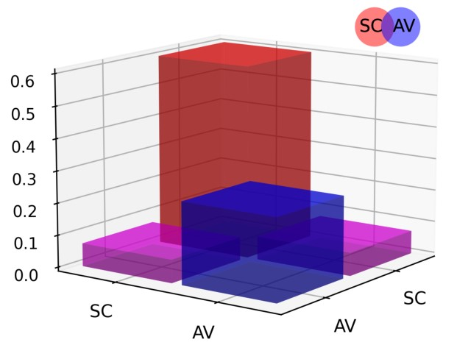
Structure of Baryons
Solution delivers
Poincaré-covariant
proton wave function
Poincaré covariant Faddeev equation sums all possible exchanges and interactions that can take place between three dressed-quarks
Direct solution of Faddeev equation using rainbow-ladder truncation is now possible, but remains challenging problem – algorithms and numerical analysis
For many/most applications, diquark approximation to quark+quark scattering kernel is used
Prediction: owing to EHM phenomena, strong diquark correlations exist within baryons
- proton and neutron … both scalar and axial-vector diquarks are present
CSM prediction = presence of axialvector (AV) diquark correlation in the proton
AV Responsible for $≈40\%$ of proton charge

Slide 20
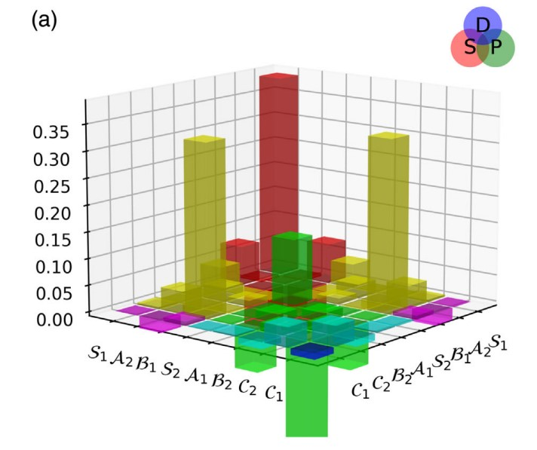
Structure of Baryons
Solution delivers
Poincaré-covariant
proton wave function
Poincaré covariant Faddeev equation sums all possible exchanges and interactions that can take place between three dressed-quarks
Direct solution of Faddeev equation using rainbow-ladder truncation is now possible, but numerical challenges remain
For many/most applications, diquark approximation to quark+quark scattering kernel is used
Prediction: owing to EHM phenomena:
proton wave function is not just S-wave, but contains strong P-wave contributions
CSM prediction = canonical normalization dominated by $S⊗S$, but receives large $S⊗P$ and $P⊗P$
contributions
Non-$S⊗S$make-up 6$0\%$ of proton charge

Slide 21
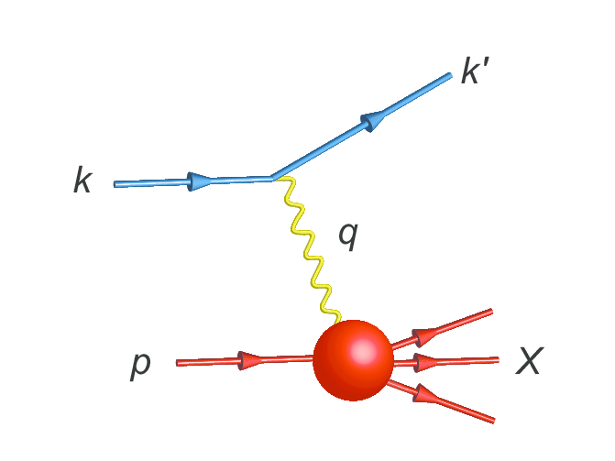
Parton Distribution Functions

Slide 22
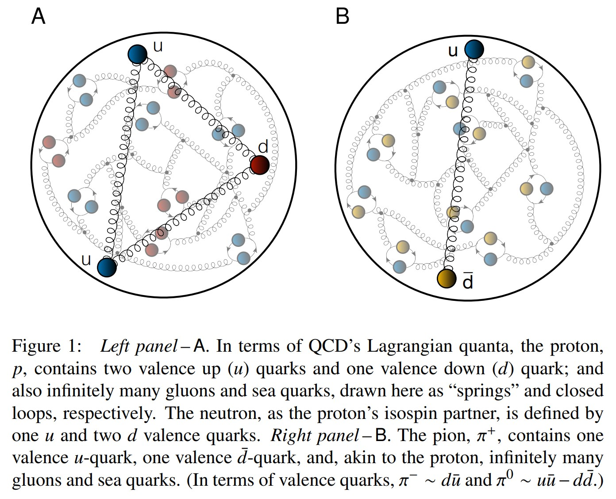
Proton and pion distribution functions in counterpoint
massive
almost massless
Today, despite enormous expense of time and effort, much must still be learnt before proton and pion structure may be considered understood in terms of DFs
Most simply –
What are the differences, if any, between the distributions of partons within the proton and the pion?
The question of similarity/difference between proton and pion DFs has particular resonance today as science seeks to explain EHM
How are obvious macroscopic differences between protons and pions expressed in the structural features of these two bound-states?
proton
pion

Slide 23
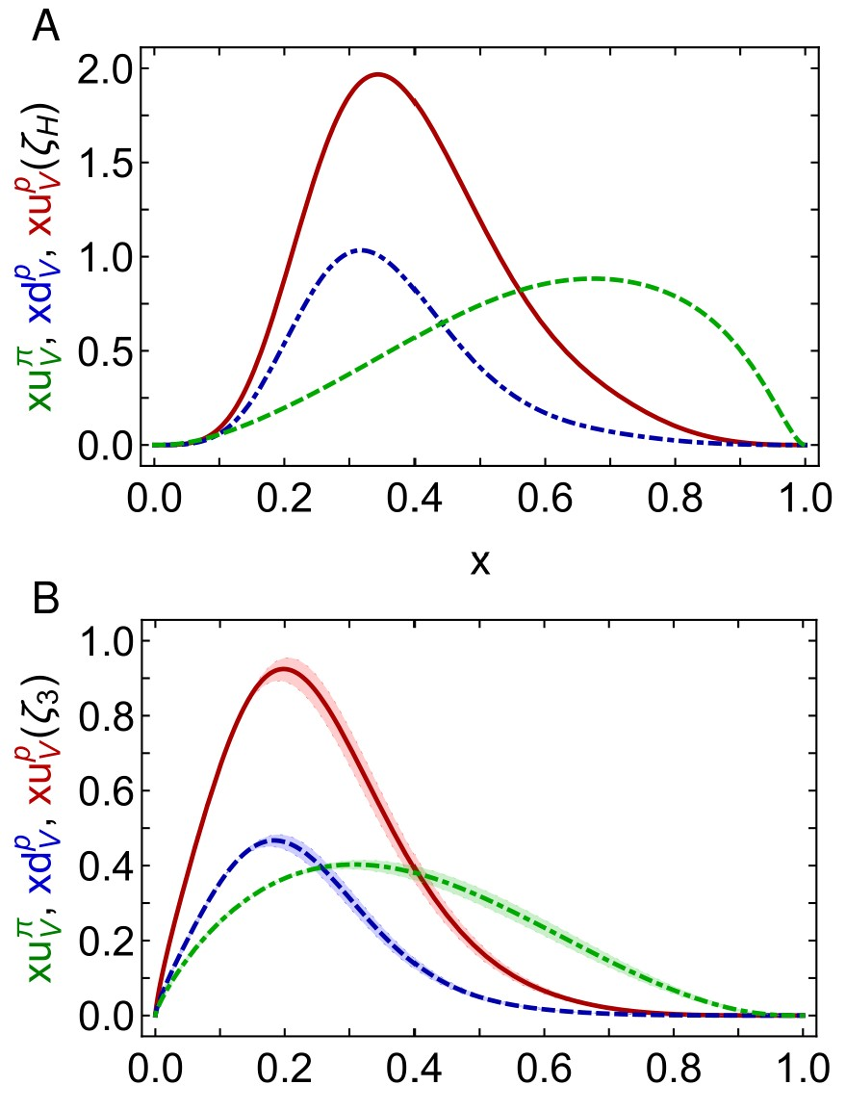
Proton and pion distribution functions in counterpoint
Proton and pion distribution functions in counterpoint, Ya Lu (陆亚) et al.,
NJU-INP 056/22, e-Print: 2203.00753 [hep-ph], Phys. Lett. B 830 (2022) 137130
Symmetry-preserving analyses using continuum Schwinger function methods (CSMs) deliver hadron scale DFs that agree with QCD constraints
Valence-quark degrees-of-freedom carry all hadron’s momentum at $ζ_{H}$:
Diquark correlations in proton, induced by EHM
${⇒u}_{V}(x)≠2d_{V}\left(x\right)$
Proton and pion valence-quark DFs have markedly different behaviour
$u^{π}(x;ζ_{H})$ is Nature’s most dilated DF
“Obvious” because ${\left(1−x\right)}^{2}$ vs. ${\left(1−x\right)}^{3}$ behaviour & preservation of this unit difference under evolution
Also “hidden” = strong EHM-induced broadening
dilation
u in proton
d in proton
u in pion
dilation

Slide 24
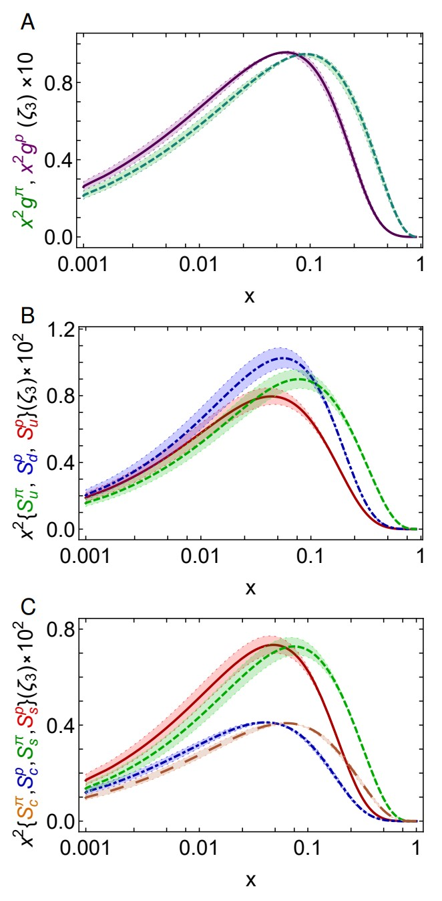
Proton and pion distribution functions in counterpoint – glue and sea
Predicted CSM glue-in-pion DF is confirmed by recent lQCD calculation
[Regarding the distribution of glue in the pion, Lei Chang (常雷) and Craig D Roberts, e-Print: 2106.08451 [hep-ph], Chin. Phys. Lett. 38 (8) (2021) 081101/1-6]
Glue-in-π DF possess significantly more support on the valence domain than the glue-in-p DF
Sea-in-π DF possess significantly more support on the valence domain than sea-in-p DFs.
s and c sea DFs are commensurate in size with those of the light-quark sea DFs
For s-and c-quarks, too, the pion DFs possess significantly greater support on the valence domain than the kindred proton DFs.
These outcomes are measurable expressions of EHM

Slide 25
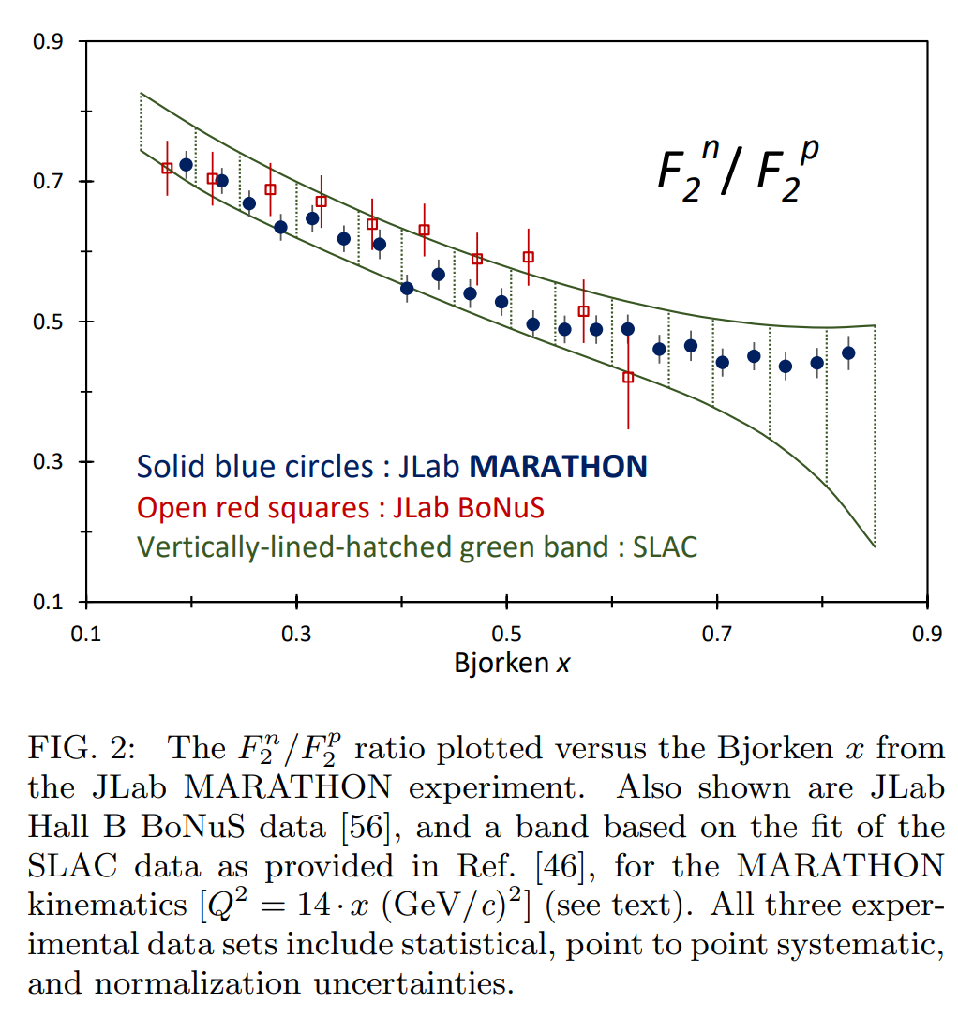
Diquarks & Deep Inelastic Scattering
The ratio of neutron and proton structure functions at large $x$ is keen discriminator between competing pictures of proton structure
Example:
Only scalar diquark in the proton (no axial-vector): ${\lim_{x→1}{\frac{F_{2}^{n}\left(x\right)}{F_{2}^{p}\left(x\right)}=\frac{1}{4}} }_{ }^{ }$
No correlations in the proton wave function (SU(4) spin-flavour) $\lim_{x→1}{\frac{F_{2}^{n}\left(x\right)}{F_{2}^{p}\left(x\right)}=\frac{2}{3}}$
Experiments have been trying to deliver reliable data on this ratio for fifty years!
MARATHON – a more-than ten-year effort, using a tritium target at JLab, has delivered precise results
$0^{+}$only
D. Abrams, et al., Measurement of the Nucleon Fn2/Fp2 Structure Function Ratio by the Jefferson Lab MARATHON Tritium/Helium-3 Deep Inelastic Scattering Experiment – arXiv:2104.05850 [hep-ex],
Phys. Rev. Lett. (2022) in press.

Slide 26
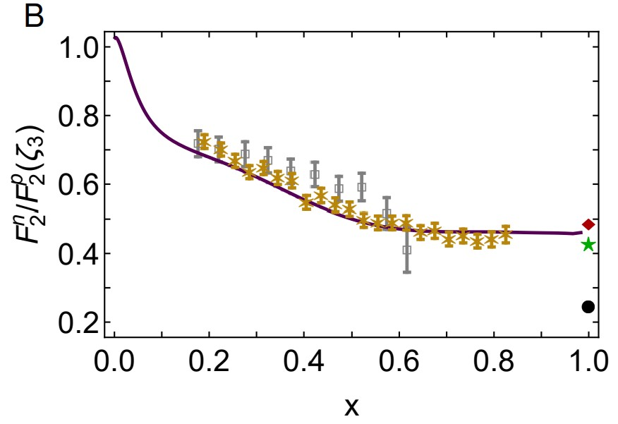
Neutron/Proton structure function ratio
CSM prediction = presence of axial-vector diquark correlation in the proton
Responsible for $≈40\%$ of proton charge
Ratio $1^{+}/0^{+}$ diquarks in proton wave function
is measure of EHM
Structure function ratio is clear window onto $d_{V}(x)/u_{V}(x)$
$U\left(x;ζ\right)=u\left(x;ζ\right)+\overline{u}\left(x;ζ\right)$, $D\left(x;ζ\right)=d\left(x;ζ\right)+\overline{d}\left(x;ζ\right)$
$Σ\left(x;ζ\right)=s\left(x;ζ\right)+\overline{s}\left(x;ζ\right)$+ $c\left(x;ζ\right)+\overline{c}\left(x;ζ\right)$
Comparison with MARATHON data
[D. Abrams, et al., Measurement of Nucleon $F_{2}^{n}/F_{2}^{p}$Structure Function Ratio by the Jefferson Lab MARATHON Tritium/Helium-3 Deep Inelastic Scattering Experiment – arXiv:2104.05850 [hep-ex], Phys. Rev. Lett. (2022) in press]
Agreement with modern data on entire x-domain – parameter-free prediction
Sea quark dominance on x<0.2
Valence quark dominance on x>0.2
🎆 Valence quark ratio in the proton, Zhu-Fang Cui, (崔著钫), Fei Gao (高飞), Daniele Binosi, Lei Chang (常雷), Craig D. Roberts and Sebastian M. Schmidt, NJU-INP 049/21, e-print: 2108.11493 [hep-ph], Chin. Phys. Lett. Express 39 (04) (2022) 041401/1-5: Express Letter
Probability that scalar diquark only models of nucleon might be consistent with available data is 1/141,000

Slide 27
“Intrinsic” Charm
Proton and pion distribution functions in counterpoint, Ya Lu (陆亚) et al.,
NJU-INP 056/22, e-Print: 2203.00753 [hep-ph], Phys. Lett. B 830 (2022) 137130
CSM ${\left\langle x\right\rangle }_{c}^{ζ_{2}}=1.32\left(05\right)\%$, ${\left\langle x\right\rangle }_{c}^{ζ_{3}}=1.86\left(06\right)\%$
cf. Phen. fits ${\left\langle x\right\rangle }_{c}^{ζ_{2}}=1.7\left(4\right)\%$, ${\left\langle x\right\rangle }_{c}^{ζ_{3}}=2.5\left(4\right)\%$
$ζ_{H}=$ scale whereat valence quasiparticle degrees-of-freedom carry all measurable hadron properties
At $ζ_{H}$, Fock space components, which might be interpreted as intrinsic charm, are sublimated into nonperturbatively computed $ζ=ζ_{H}$ Schwinger functions
Significant $c$ quark momentum fraction obtained under nonperturbative evolution from $ζ_{H}$without recourse to “intrinsic charm”
Outcome largely independent of explicit form of nonperturbative effective charge $=α_{1ℓ}(k^{2})$
Recent claims of “intrinsic charm discovery” might be overstated
Notwithstanding size of predicted fractions, CSM $S_{c}^{π,p}(x)$ have sea quark profiles.
One is thus led to re-evaluate what is meant by intrinsic charm in any hadron

Slide 28
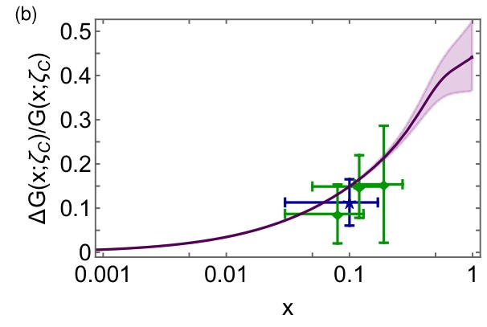
Polarised glue distribution functions at $ζ=\sqrt{3}$GeV
Parameter-free CSM prediction
compared with COMPASS data
C. Adolph, et al., Leading-order determination of the gluon polarization from semi-inclusive deep inelastic scattering data, Eur. Phys. J. C 77 (4) (2017) 209
e.g. average value over data window
$0.167{\left(3\right)}_{CSM}$ cf. $0.113±0.038±{0.036}_{COMPASS}$
Comparison with phenomenological global fits
$$\int_{0.05}^{1}{dx ΔG(x;ζ=10GeV)}=0.199{\left(3\right)}_{CSM}$$
cf. DSSV14: $0.19(6)$
Polarised parton distribution functions and proton spin,
Peng Cheng (程鹏) et al., NJU-INP 073/23, e-print: 2304.12469 [hep-ph]

Slide 29
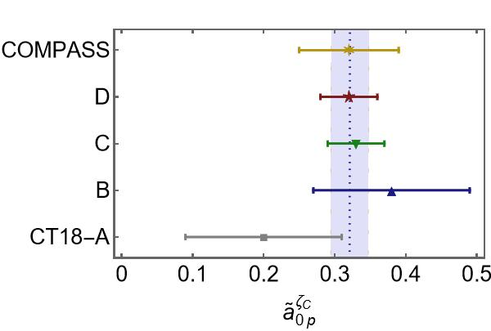
Proton Spin
All-Orders Evolution of Parton Distributions: Principle, Practice, and Predictions
Pei-Lin Yin (尹佩林), NJU-INP 075/23, e-Print: 2306.03274 [hep-ph]
CSM study of proton axial and pseudoscalar charges
$⇒a_{0}≈65\%$of proton spin
carried by valence quark
quasiparticle degrees of freedom at the hadron scale.
Under evolution, this value is independent of scale.
Measurements of the proton spin are sensitive to
non-Abelian anomaly corrected combination $\left(n_{f}=4\right)$
CSM prediction: $a_{0}^{E}\left(ζ=\sqrt{3}GeV\right)=0.32(3)$
COMPASS: $a_{0}^{COMPASS}\left(ζ=\sqrt{3}GeV\right)=0.32(7)$
Parameter-free explanation
of proton spin measurement
Algebraic formula for Glue contribution to proton spin
$ΔG_{p}$ necessarily positive
$ΔG_{p}$Grows faster than 1/${\left\langle x\right\rangle }_{valence}^{2}$

Slide 30
Emergent Hadron Mass
Grant no. 12135007
QCD is unique amongst known fundamental theories of natural phenomena
The degrees-of-freedom used to express the scale-free Lagrangian are not directly observable
Massless gauge bosons become massive, with no “human” interference
Gluon mass ensures a stable, infrared completion of the theory through the appearance of a running coupling that saturates at infrared momenta, being everywhere finite
Massless fermions become massive, producing
Massive baryons and simultaneously Massless mesons
These emergent features of QCD are expressed in every strong interaction observable
They can also be revealed via
EHM interference with Nature’s other known source of mass = Higgs
We are capable of building facilities that can validate these concepts, proving QCD to be
the 1st well-defined four-dimensional quantum field theory ever contemplated
This may open doors that lead far beyond the Standard Model

Slide 31
Emergent Hadron Mass
Grant no. 12135007
QCD is unique amongst known fundamental theories of natural phenomena
The degrees-of-freedom used to express the scale-free Lagrangian are not directly observable
Massless gauge bosons become massive, with no “human” interference
Gluon mass ensures a stable, infrared completion of the theory through the appearance of a running coupling that saturates at infrared momenta, being everywhere finite
Massless fermions become massive, producing
Massive baryons and simultaneously Massless mesons
These emergent features of QCD are expressed in every strong interaction observable
They can also be revealed via
EHM interference with Nature’s other known source of mass = Higgs
We are capable of building facilities that can validate these concepts, proving QCD to be
the 1st well-defined four-dimensional quantum field theory ever contemplated
This may open doors that lead far beyond the Standard Model
There are theories of many things,
But is there a theory of everything?
$${\text{L}}_{Nature}= ?$$

Slide 32
There are theories of many things,
But is there a theory of everything?
$${\text{L}}_{Nature}= ?$$
Thankyou

Slide 34
On the other hand …

Slide 35
Trace Anomaly
In the chiral limit, pion is massless Nambu-Goldstone boson:
⇒
Does this mean that the scale anomaly vanishes trivially in the pion state, i.e. gluons contribute nothing to the pion mass?
Difficult way to obtain “zero”!
Easier to imagine that “zero” owes to cancellations between different operator contributions to the expectation value of Θ₀.
Of course, such precise cancellation should not be an accident.
It could only arise naturally because
of some symmetry and/or symmetry-breaking pattern.

Slide 36
Whence “1” and yet “0” ?
No statement of the question
“How does the mass of the proton arise?”
is complete without the additional clause
“How does the pion remain massless?”
Natural visible-matter mass-scale must emerge simultaneously with apparent preservation of scale invariance in related systems
Expectation value of Θ₀ in pion is always zero,
irrespective of the size of the natural mass-scale for strong interactions = m_{p}

Slide 37
Whence “1” and yet “0” ?
No statement of the question
“How does the mass of the proton arise?”
is complete without the additional clause
“How does the pion remain massless?”
Natural visible-matter mass-scale must emerge simultaneously with apparent preservation of scale invariance in related systems
Expectation value of Θ₀ in pion is always zero,
irrespective of the size of the natural mass-scale for strong interactions = m_{p}
Modern Physics must
Elucidate the entire array of Empirical Consequences
of the Mechanism responsible
so that the Standard Model can be Validated

Slide 38
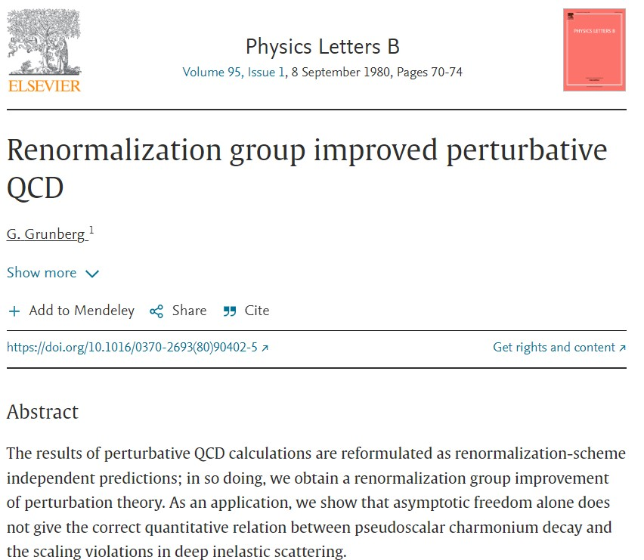
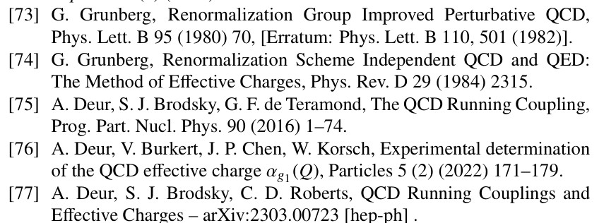
All-orders evolution
All-Orders Evolution of Parton Distributions: Principle, Practice, and Predictions
Pei-Lin Yin (尹佩林), NJU-INP 075/23, e-Print: 2306.03274 [hep-ph]
P1 – In the context of Refs. [73, 74], there exists at least one effective charge, $α_{1ℓ}(k^{2})$, which, when used to integrate the leading-order perturbative DGLAP equations, defines an evolution scheme for parton DFs that is all-orders exact.
CSM Process-Independent charge serves this purpose
Hadron scale, $ζ_{H}$
Scale at which all properties of a given hadron are carried by valence degrees-of-freedom

Slide 39
“Intrinsic” Charm
Proton and pion distribution functions in counterpoint, Ya Lu (陆亚) et al.,
NJU-INP 056/22, e-Print: 2203.00753 [hep-ph], Phys. Lett. B 830 (2022) 137130
CSM ${\left\langle x\right\rangle }_{c}^{ζ_{2}}=1.32\left(05\right)\%$, ${\left\langle x\right\rangle }_{c}^{ζ_{3}}=1.86\left(06\right)\%$
cf. NNPDF ${\left\langle x\right\rangle }_{c}^{ζ_{2}}=1.7\left(4\right)\%$, ${\left\langle x\right\rangle }_{c}^{ζ_{3}}=2.5\left(4\right)\%$
With $ζ_{H}$ being scale at which valence quasiparticle degrees-of-freedom carry all measurable hadron properties, then Fock space components, which might be interpreted as intrinsic charm are sublimated into nonperturbatively computed $ζ=ζ_{H}$ Schwinger functions
Such Fock space components are then interpreted as being members of the set of basis eigenvectors representing a free-field light-front Hamiltonian.
E.g., any QCD solution for dressed quark Schwinger function must contain infinitely many and all possible contributing Fock space vectors.
Putative “intrinsic” components are revealed by evolving $ζ_{H}$ Schwinger functions to higher scales, whereat data interpretation using Fock space expansion is relevant & practicable.
Actual expressions of character of intrinsic charm will depend on sophistication of kernels used to calculate hadron-scale Schwinger functions.
Any reasonable kernels will predict that measurable fraction of proton light-front momentum is carried by $c$ quark sea at all scales for which DF interpretation of data is valid

Slide 40
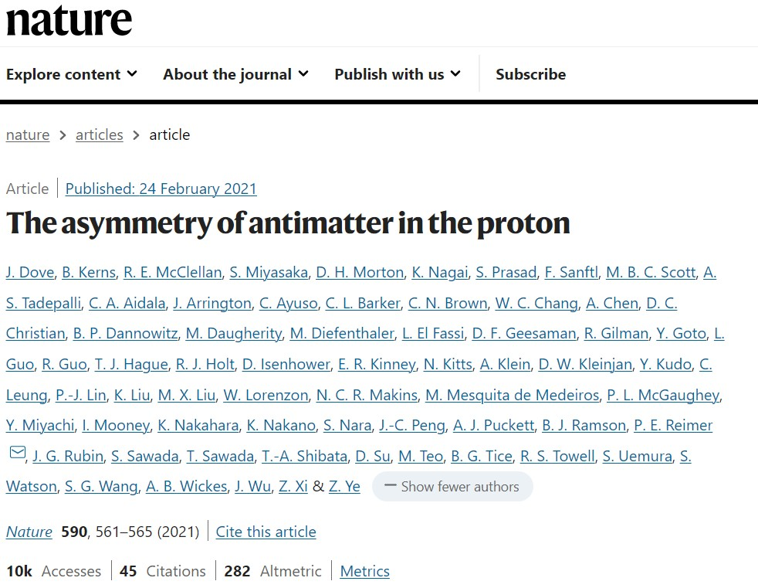

Slide 41
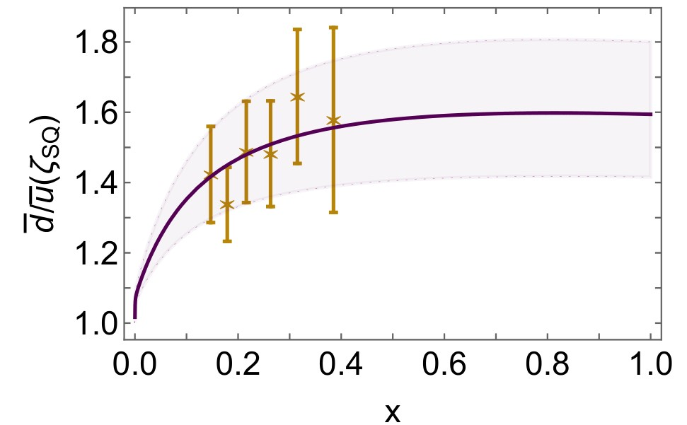
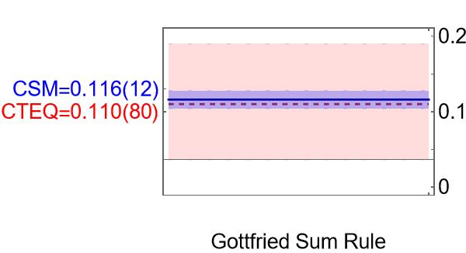
Asymmetry of antimatter in the proton
Proton = u + u + d
$⇒$ Pauli blocking: gluon splitting produces
$d+\overline{d}$ in preference to $u+\overline{u}$
Comparison with SeaQuest data
[J. Dove, et al., The asymmetry of antimatter in the proton, Nature 590 (7847) (2021) 561–565.]
Gottfried sum rule
Most recent result from global fits [CT18]: 0.110(80)
$ζ=2 GeV…{\left\langle x\right\rangle }_{\overline{u}}↓25\% \& {\left\langle x\right\rangle }_{\overline{d}}↑25\%$
Proton and pion distribution functions in counterpoint, Ya Lu (陆亚), Lei Chang (常雷), Khépani Raya, Craig D. Roberts and José Rodríguez-Quintero, NJU-INP 056/22, e-Print: 2203.00753 [hep-ph], Phys. Lett. B 830 (2022) 137130/1-7
Parton distributions of light quarks and antiquarks in the proton, Lei Chang (常雷), Fei Gao (高飞) and Craig D. Roberts, NJU-INP 055/22, e-Print: 2201.07870 [hep-ph], Phys. Lett. B 829 (2022) 137078/1-7

