Slide 1
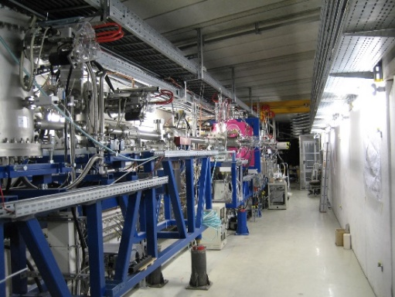
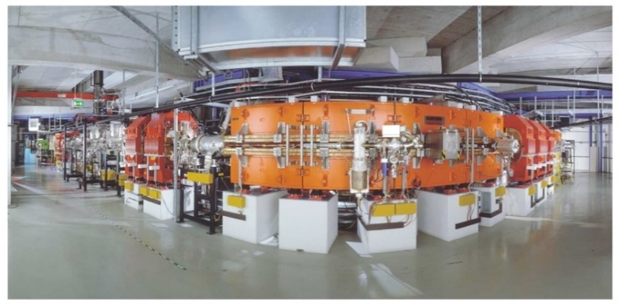
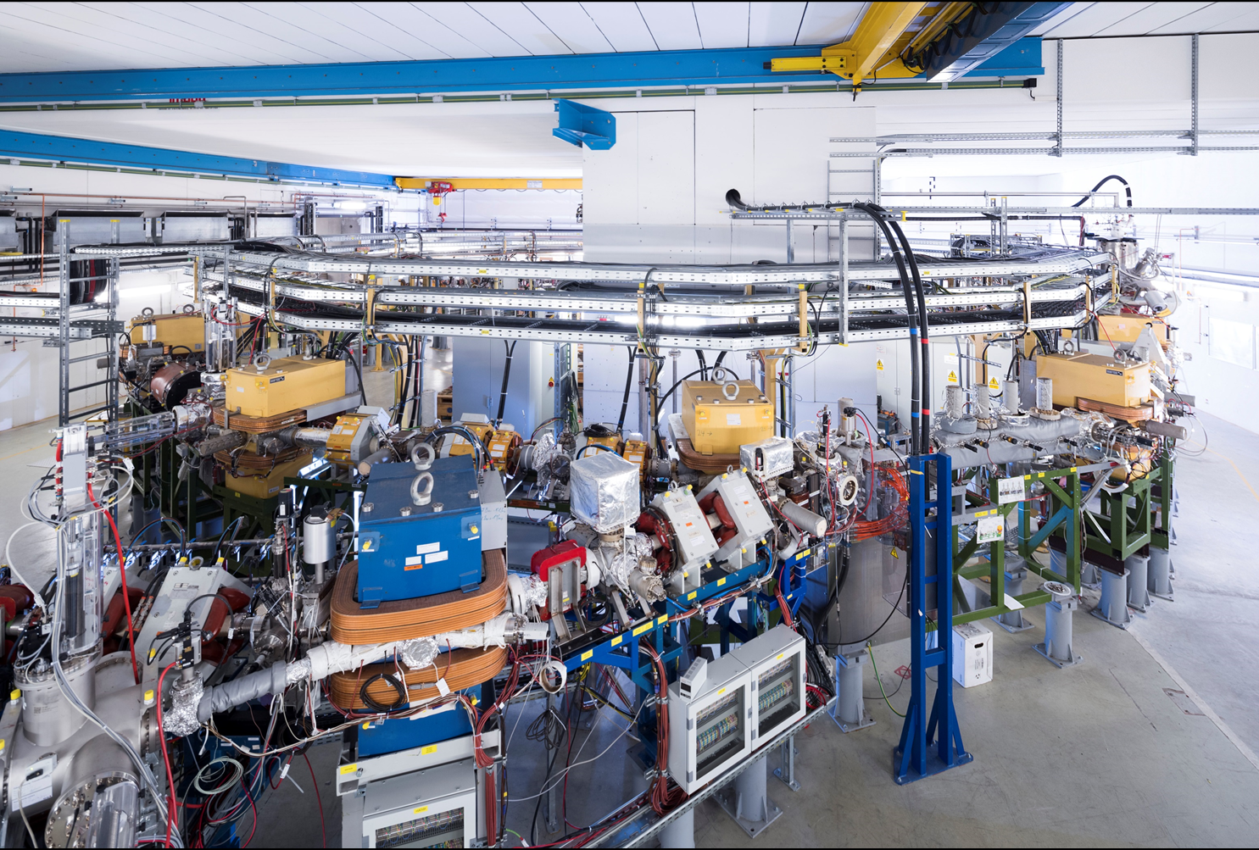
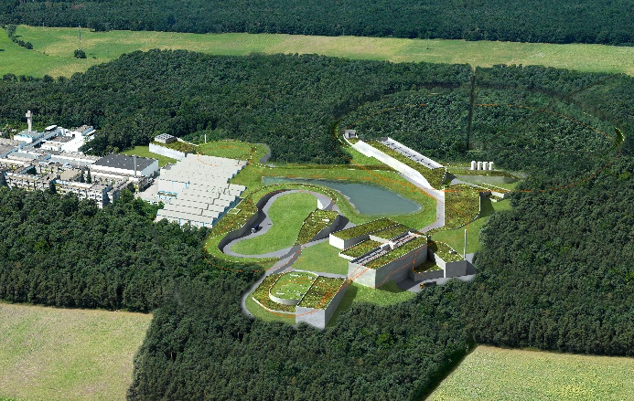
APPA Collaborations
SPARC Progress Report
Storage & Trapping of Cooled Highly Charged, Heavy Ions, and Exotic Nuclei
RRB 12, June 05th & 06th 2023
Alexandre Gumberidze
GSI Darmstadt

Slide 2
FAIR realization: the new staging
FAIR Phase Zero
First Science +
First science ++
MSV completion
SPARC @ FAIR

Slide 3
SPARC at FAIR FS
Laser cooling at SIS100
SPARC program at exiting facilities: ESR, CRYRING and HITRAP
First Science +
First science ++
MSV completion
SPARC@FAIR FS

Slide 4
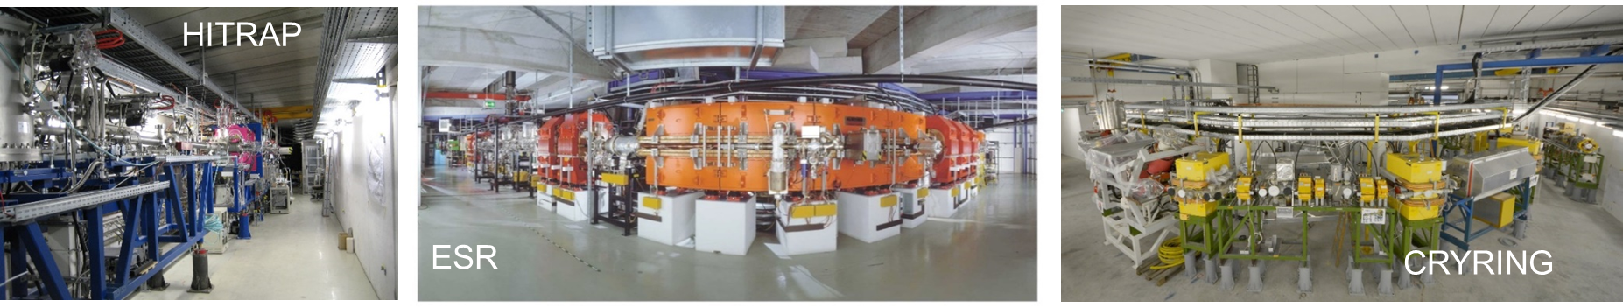
Precision Domain of FAIR: Trapping & Storage of HCI Atomic, Quantum, and Fundamental Physics
HITRAP, CRYRING@ESR, ESR: Existing Facilities of MSV
Worldwide
Unique !
From rest to relativistic energies (up to 4.9 GeV/u)
From single ions to highest intensities
Cooling is the key for precision
CRYRING@ESR: Swedish in-kind to FAIR; in operation since 2020
HITRAP: Re-commissioning has started in 2022

Slide 5

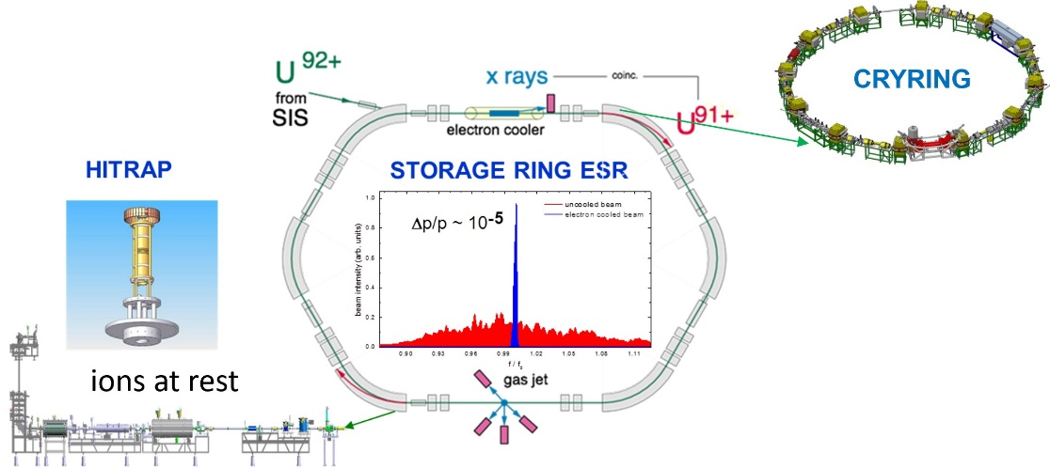
Precision Domain of FAIR: Trapping & Storage of HCI Atomic, Quantum, and Fundamental Physics
HITRAP, CRYRING@ESR, ESR: Existing Facilities of MSV
From rest to relativistic energies (up to 4.9 GeV/u)

Slide 6
Developments since the RRB11
Contributions and contracts:
Funding:
the Giessen university group was awarded additional 47 k€( 2005) for the WP Ion detectors in CRYRING, as part of the previous application for Collaborative German universities program 2021-2024 (VF).
The GSI group secured additional 112 k€ for ultra-high vacuum valves in CRYRING.
Contracts
The assignments for the High Intensity Laser and Laser setup at HESR (Romanian in-kind contribution) and the Internal Jet target for HESR (German in-kind contribution) are on hold (not part of the present staging).
TDRs:
The TDR for the SPARC-BIOMAT at APPA cave is on hold until a definite time line for the cave realization is available.
The Instrumentation_2@CRYRING (not day-one) was discarded as obsolete.
FAIR Final Acceptance:
Jagellonian University, Krakow, transferred its in-kind for the CRYRING (Vacuum system upgrade) to FAIR GmbH. This WP is closed.
The transfer of the CRYRING Installation (German in-kind) is in the signing process.
The Swedish in-kinds (Internal Jet target at CRYRING and SPECTRAP magnet) are in preparation.

Slide 7
Funding SPARC experiments Day-one
RRB12 Day-one experiment funding APPA-SPARC
Experiment | PSP | Total cost [k€, 2005] | Funding [k€, 2005] |  |  | Secured [%]
 |  |  | Secured | EoI | TbA
SPARC Laser Experiments at SIS100 | 1.3.1.1 | 466 | 39 | 427 | 0 | 8,37
SPARC at APPA-cave | 1.3.1.2 | 931 | 780,86 | 0 | 150 | 83,87
SPARC at HESR | 1.3.1.3 | 2726,96 | 2264,46 | 104,5 | 358 | 83,04
SPARC at CRYRING | 1.3.1.5 | 2408,00 | 2336,50 | 71,5 | 0 | 97,03
CRYRING Installation | 1.3.4.2 | 3801,36 | 3801,36 | 0 | 0 | 100,00
Grand Total |  | 10333,32 | 9222,18 | 603 | 508 | 89,25
- additional 689 k€ (2005) are considered secured through the German universities. Total secured amount: 9911,18 k€
- the laser setup at SIS100 has now the highest priority, being in First Science phase.
In the present FAIR staging, SPARC experiments will be carried out at CRYRING, ESR, HITRAP and SIS100.
CRYRING Day-one is 98% secured. The rest is secured through the German VF program for the universities and Swedish contribution.
Existing SPARC components planed for FS++ and MSVc will be used at the existing facilities.
Day-one costs: 10,33 M€ (secured 96% with German VF)

Slide 8
Funding SPARC experiments MSV
RRB12 Status experiment funding APPA-SPARC
Experiment/Project | Prices, K Euro
 | 2005 prices
 | Secured amount * | EoI | To be assigned | Total
SPARC Laser Experiments at SIS100 | 39,00 | 427 | 671,62 | 1137,62
SPARC at APPA cave | 780,86 | 0 | 360 | 1140,86
SPARC at HESR | 2414,50 | 191,5 | 1040 | 3646
SPARC at CRYRING | 3433,50 | 193,5 | 554 | 4181
CRYRING | 3801,36 | 0 | 0 | 3801,36
Grand Total | 10469,22 | 812 | 2625,62 | 13906,84
Full MSV cost: 13,9 M€
Total secured funding: 11,158 k€ (80%)

Slide 9
Country Funding for SPARC experiments
Funding by country : Secured / EoI
[k€, 2005 prices]
SPARC | Germany |  | Japan |  | Poland |  | Romania |  | Sweden |  | UK
 | 5990 | 812 | 263 |  | 800 |  | 425 |  | 2500 |  | 492
Secured: 11,158 M€

Slide 10
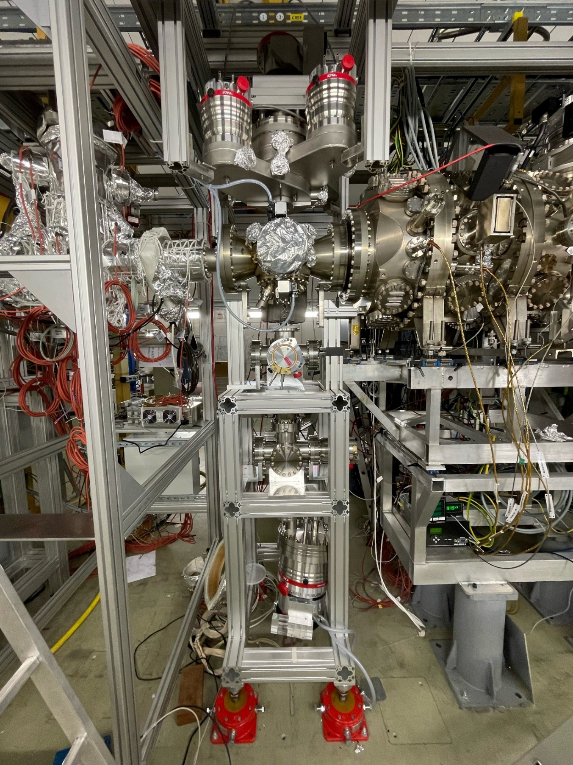



CRYRING@ESR: Internal Jet Target
Commissioning with beam was done in spring 2022.
A beam test performed with the internal jet target in May 2022 showed that the target is fully operational.
Further optimization work, with different gases is requested (He, H₂).
Gas distribution system for H₂ will be finished in 2023.
An upgrade of the pumping system for the target sump is in work.
The target control system must be completed and tested before the beam time in 2024.
To be able to accommodate new setups close to the target, some rearrangement /reinstallation work is ongoing.
ion beam
gas jet

Slide 11

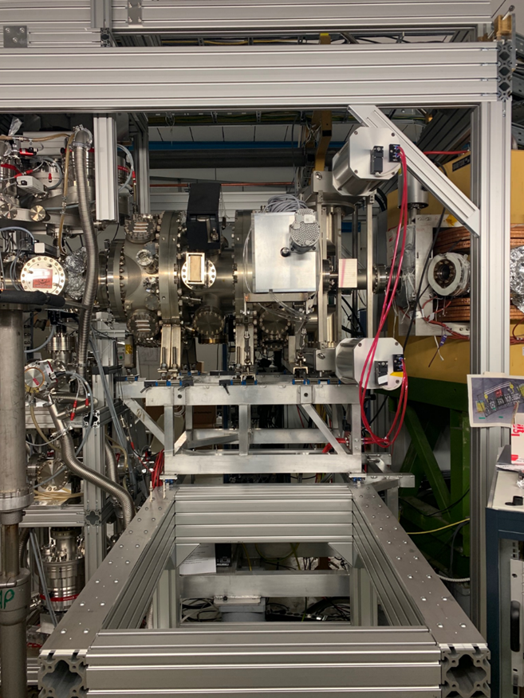

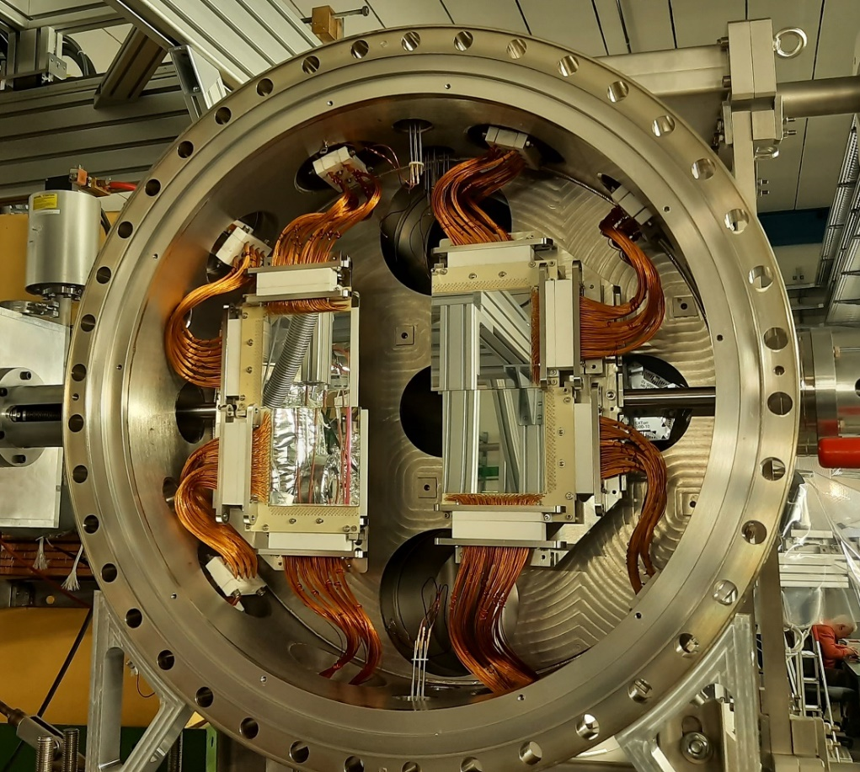
CRYRING@ESR: CARME
After successful commissioning of CARME in 2022, some maintenance work is needed.
For servicing CARME, a dolly was built and installed at CRYRING.
Installation of all the DSSSD detectors (in 2022 only one out of four was installed and was tested with beam).
Backing (low temperature) system: testing after repair and reinstallation.
Preparation for a possible beam time in November-December 2023 with local source ¹⁶O-beam @1MeV/u on He target (approved proposal).

Slide 12
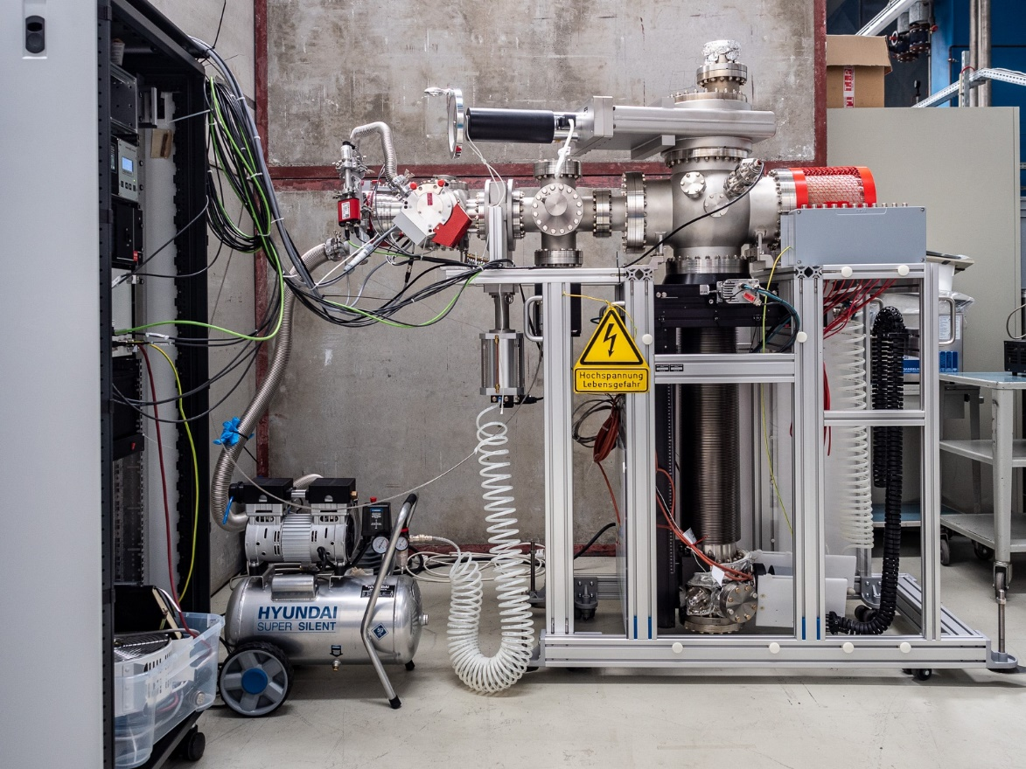
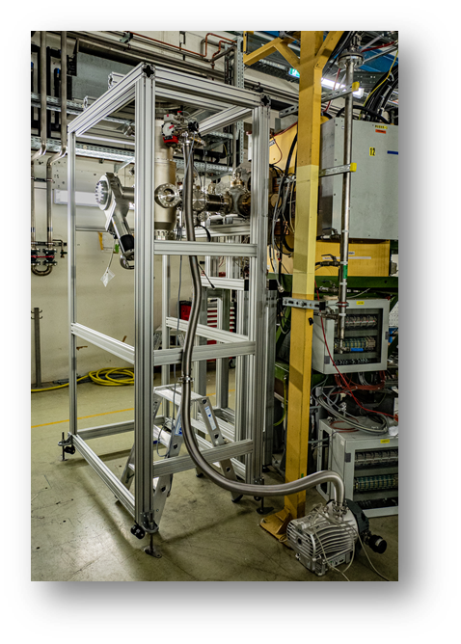
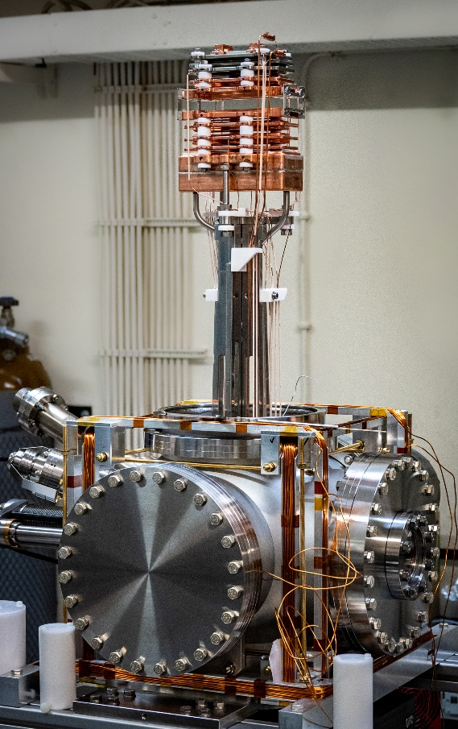


CRYRING@ESR: Electron Target
The transversal electron target is a major setup for CRYRING.
The e-target interaction chamber installed in ring and vacuum tested in 2022.
All target components are available, and were tested off-line.
Components transported to GSI in March 2023.
.
Conditioning of cathode ongoing: the gun already delivers 35mA electron current at 140 V extraction voltage.
Gun installation into CRYRING YR09 scheduled for beginning of July 2023.
The gun control system is presently being programmed.
Commissioning with beam and first experiments in CRYRING to start in 2024.
Off-ring cathode conditioning at GSI
Int,. chamber in ring

Slide 13
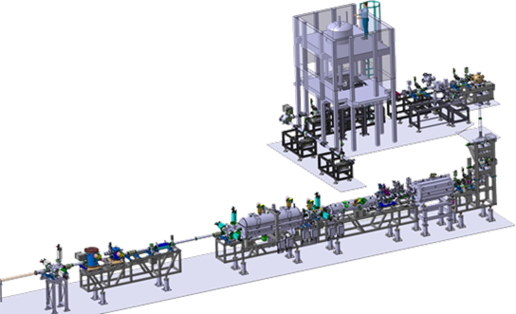
HITRAP re-commissioning
May 2022: start of the HITRAP re-commissioning with the new FAIR control system. The deceleration part up to the cooling trap was successfully put into operation.
The full scope commissioning includes the cooler trap and the low-energy beam transport line. In work! Completion time strongly depends on the available beam time.
The experiment platform is ready to accommodate new experiments; these can be tested off-line with beams from a local ion source.
In parallel the physics program for HITRAP was reviewed: a four-day workshop held in July 2022, attended by over 60 participants, highlighted the large interest of the community for this facility. New setups and beam time proposals where presented.
re-commissioned
in progress

Slide 14
HITRAP capability today
Medium-heavy highly charged ions from EBIT
charge state | any up to ~ 44+ |  | ion type | gasses, some metals
energy | 4 keV/q, adjustable |  | rep. rate | up to 10 Hz
dispersion | +/- 1 eV/q |  | focus size | 5 mm, adjustable
no. ions | 10⁴ – 10⁵ |  | multi user | two simultaneously
Heavy highly charged ions
charge state | any up to 92+
energy | 5-7 keV/u
dispersion | 30% (+/- 1keV/u)
no. ions | 1 … 10⁴ (estim.)
focus size | < 5 mm
rep. rate | 30 sec.
setup time | 3-7 days
!!! Significant resources are still needed:
beam time
man power
for commissioning and normal operation
New setup at HITRAP: Laser lab for
quantum logic spectroscopy for frequency metrology for heavy and simple ions
re-commissioned
in progress
HGF Young Investigator Group 2023-2028, P. Micke, HI Jena
HGF Young Investigator Group 2023-2028, P. Micke, HI Jena

Slide 15
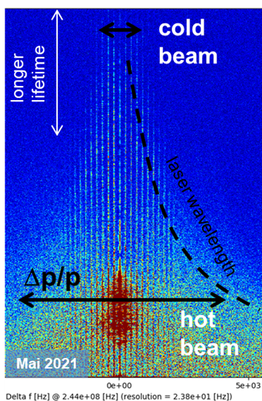
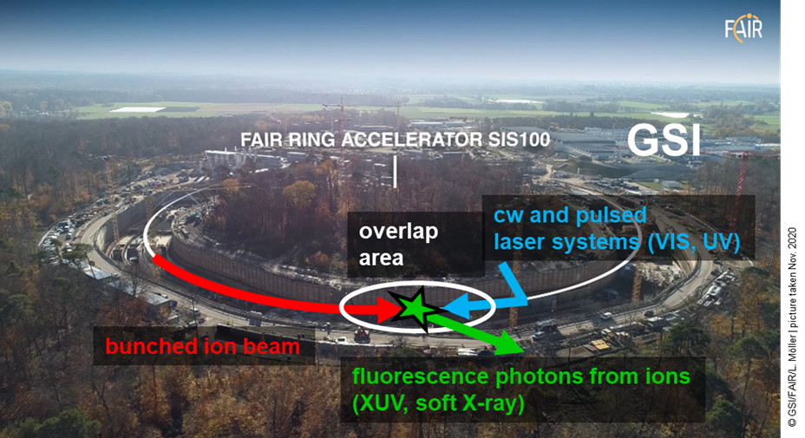
Laser cooling and spectroscopy at SIS100
Laser-cooled relativistic heavy-ion beams (Z = 10 - 60) with γ ~ 12
Only cooling method at SIS100 energies (Δp/p down to 10⁻⁷ in a few sec.)
Extraction of very cold and very short ultra-relativistic ion bunches
World-wide unique!
A common project with the SIS100 team
Part of the experiment infrastructure is available.
The laser systems and the detection system will be provided by partners at Darmstadt, Dresden and Münster universities; funding expected via VF, starting with 2024.

Slide 16
FAIR Phase-0 2024-2025: beam time applications 2022
ID | Title | Facility | Grade | Shifts
G-22-00025 | High-Resolution Electron-Ion Collision Spectroscopy of Berylliumlike Heavy Ions in CRYRING@ESR | ESR-CRYRING | A | 45,0
G-22-00028 | Indirect measurements of neutron-induced reaction cross sections at storage rings | ESR | A | 36,5
G-22-00038 | Dielectronic Recombination-assisted laser spectroscopy: A new tool to investigate the hyperfine-puzzle in Bi^{80+,82+} | ESR | A | 41,5
G-22-00047 | Absolute rate coefficients from dielectronic recombination for the astrophysically relevant ions Ne³⁺ and S³⁺ | CRYRING-intern | A | 54,0
G-22-00052 | Laser Excitation of the ²²⁹Th Nucleus Using Nuclear Hyperﬁne Mixing | ESR | A | 48,5
G-22-00057 | Nanostructuring of monolayer graphene by highly charged ions | ESR-HITRAP | A | 45,0
G-22-00058 | Ion beam and level population dynamics in Mg⁺ laser spectroscopy at CRYRING@ESR | CRYRING-intern | A | 51,0
G-22-00086 | Ultra-high resolution study of the ¹⁵O(α,α)¹⁵O reaction using CARME@CRYRING | CRYRING-intern | A | 36,0
G-22-00095 | Energy determination of the 1s² 2s_{1/2} → 1s² 2p_{3/2} radiative transition in Li-like uranium ions via resonant coherent excitation | ESR-HTA | A | 35,5
G-22-00134 | Precision x-ray spectroscopy of helium-like uranium using metallic magnetic calorimeter detectors | ESR-CRYRING | A | 32,0
A grade:
10 experiments, 425 shifts

Slide 17
FAIR Phase-0 2024-2025: beam time applications 2022
ID | SPARC research progam limited by availability of beamtime
G-22-00029 | X-ray spectroscopy of slow Xe⁵⁴⁺ + Xe collisions | ESR-CRYRING | A- | 36,0
G-22-00037 | Atomic Processes in the Wake of Neutron-Star Mergers: Electron-Ion Recombination of Low-Charged Heavy Ions | CRYRING-intern | A- | 46,0
G-22-00060 | Proton-capture on ⁹¹Nb - A key to the explosive nucleosynthesis of the p nuclei | FRS-ESR | A- | 44,5
G-22-00068 | Towards testing three-loop effects of bound-state QED in heliumlike uranium | ESR | A- | 38,0
G-22-00070 | Dielectronic and trielectronic recombination in sulfur ions | CRYRING-intern | A- | 21,0
G-22-00072 | Commissioning and First Storage Ring Experiments of the CRYRING Transverse Electron Target | ESR-CRYRING | A- | 27,0
G-22-00072 | Commissioning and First Storage Ring Experiments of the CRYRING Transverse Electron Target | CRYRING-intern | A- | 54,0
G-22-00075 | Laser spectroscopy of the (1s² 2s2p) ³P₀ - ³P₁ level splitting in Be-like krypton | ESR | A- | 27,0
G-22-00087 | Astrophysical nuclear reactions between bare ions using FISIC+CARME | CRYRING-intern | A- | 18,0
G-22-00093 | Influence of hyperfine interaction on the nuclear electron capture decay in ¹¹¹Sn | FRS-ESR | A- | 20,5
G-22-00130 | Cooling and precision spectroscopy of ²⁰⁹Bi⁸²⁺ ion ensembles with the ARTEMIS and SPECTRAP experiments at the HITRAP facility | ESR-HITRAP | A- | 63,0
G-22-00140 | High-resolution measurement of the exotic Two-Electron One-Photon decay (TEOP) of the 1s 2s² state in Li-like uranium. | ESR | A- | 24,0
G-22-00152 | Systematic measurement of electron capture cross sections in the unexplored low collision energy regime | ESR-CRYRING | A- | 45,0
G-22-00159 | Fast Ion – Slow Ion Collisions @ CRYRING: Exploring quantum dynamics of N-body systems | ESR-CRYRING | A- | 71,0
G-22-00165 | Heavy Ion Storage Ring Experiments of Nuclear Excitation by Electron Capture (NEEC) | ESR | A- | 27,5
G-22-00172 | Exploring the limits of bunched beam laser cooling of relativistic stored ions, using 3 laser beams (pulsed and cw) | ESR | A- | 39,5
A- grade:
16 experiments,
592 shifts

Slide 18
Summary and Outlook
Focus on FAIR Phase-0 activities at the existing MSV facilities; ESR, CRYRING@ESR, and HITRAP
(Early Science, SPARC low-energy physics program)
Sufficient beam time in FAIR Phase-0 as well as third party funding (e.g. BMBF Verbundforschung) will be essential to keep the scientific community alive. Huge interest of community reflected in numerous submitted proposals at the last G-PAC.
Laser cooling and spectroscopy of relativistic heavy ion beams at SIS100 German VF funding is of utmost importance.
(First Science)
In the longer term, the APPA cave (First Science++) and HESR (full MSV) (SPARC high-energy physics program)
The SPARC collaboration will investigate the possibilities to include the members working on setups for FS++ and MSVc facilities in the present program (FAIR Phase-0, ES, FS). The success of this mitigation depends on the financial support these colleagues will get.

Slide 19
Backup slides

Slide 20
Laser cooling at SIS100
Laser systems funding expected for 2024- 2027
Experiment infrastructure at SIS100 is partly funded.

Slide 21
Construction Status CRYRING Experiments
70% fully or partially commissioned
Missing funding will be applied for at German VF in 2023
+4%
Delayed due to procurement issues and working place at GSI

Slide 22
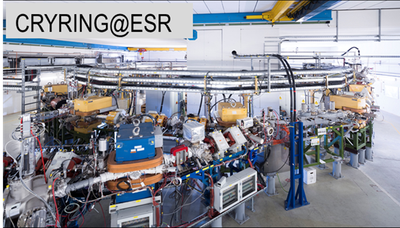
Components beyond Day-one
CRYRING Components

Slide 23
Components beyond ES / FS
Existing Components
Nr. | PSP code | Component | Provider | Staging | Status
1 | 1.3.1.2.2.2 | RCE setup: target chamber | GSI, DE | APPA cave, FSp2 | In use at cave A
2 | 1.3.1.2.2.3 | RCE setup: goniometer | RIKEN, Japan | APPA cave, FSp2 | In use at cave A
3. | 1.3.1.3.5.1.1 + 1.3.1.3.1.5.3 | Calorimeter | U. Heidelberg and U. Jena, DE | HESR, MSVc | In use at the low-energy storage rings
4. | 1.3.1.3.6 | 2D-Polarineter | U. Jena, DE | HESR, MSVc | In use at the low-energy storage rings
5. | 1.3.1.3.11.2 | Laser setup @HESR Subproject 2 / XUV-laser | U. Jena, DE | HESR, MSVc | Planed to be installed at ESR
6. | 1.3.1.3.12.3 | HESR Infrastructure / VUV spectrometer | U. Kassel, DE | HESR, MSVc | Will be used at CRYRING

Slide 24
SPARC members
Total number of members: 418*
Number of German members: 183
Universities: 105
Non universities: 77
Others: countries with less that 1% members (15 countries with <4 persons)
* The collaboration with the Russian partners is suspended since 2022

Slide 25
SPRC Risks: status March 2023
The risks for the APPA-SPARC collaboration were updated in March 2023 along the new FAIR project staging: only risks for ES / FE phases.
For SPARC the following risks have been identified:
Risk ID | PSP code | Risk description | Probability | Risk score | Risk evaluation | Risk response
459 | 1.3.1.1.1.1 1.3.1.1.1.2 | The laser providers, TU Dresden and TU Darmstadt were not granted the needed funding for the period 2021-2024. | 50% | 13 | major | Renewed application for funding for next period (2024 – 2027) at BMBF VF.
439 | 1.3.1.5 | Missing adequate working space at the GSI /FAIR campus for mounting and testing of large experiment components. | 25% | 7 | moderate | A temporary working space (20m²) available in the GSI target hall, close to CRYRING, until end of 2023.

Slide 26

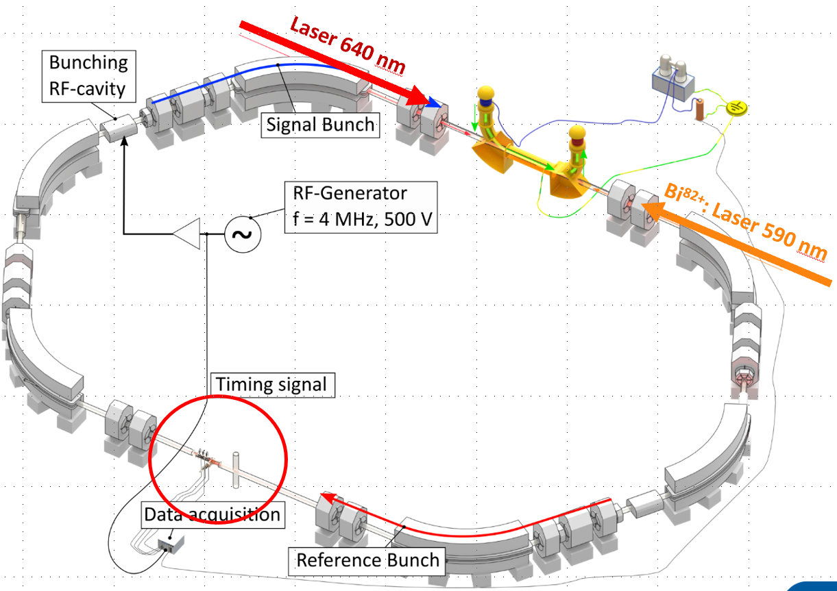
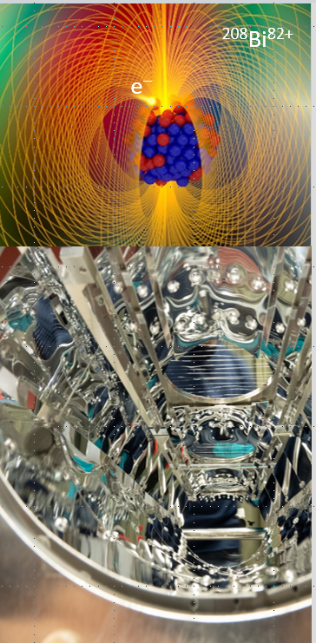
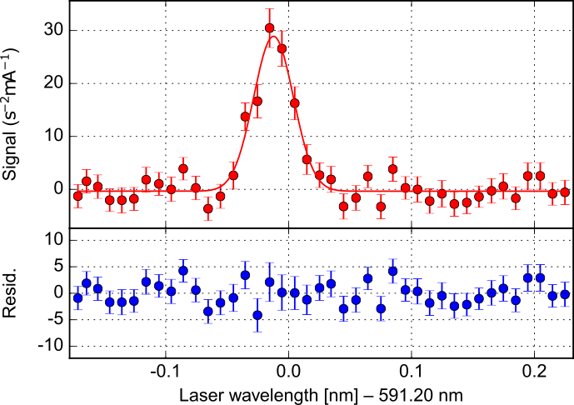
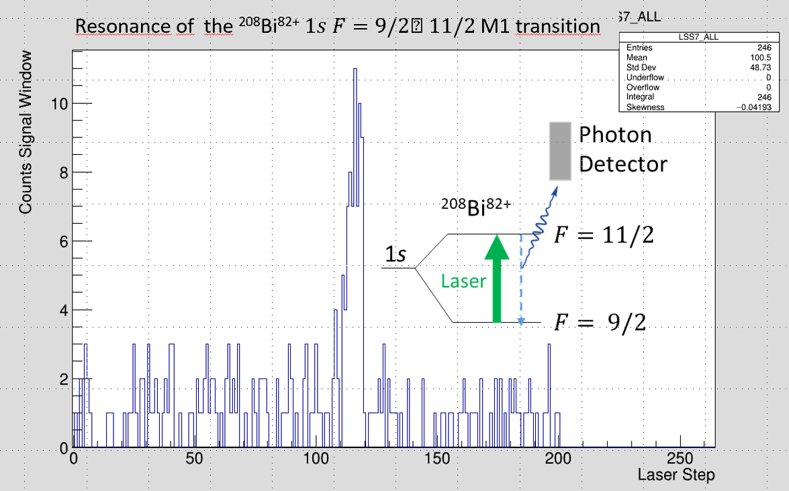

Science at existing facilities SPARC Experiments at ESR
Hyperfine structure of ²⁰⁸Bi⁸²⁺ and ²⁰⁹Bi⁸²⁺
²⁰⁸Bi⁸²⁺
“Hyperfine puzzle”
Jean-Philippe Karr
Nature Physics (2017)
Topics
Precision studies of atomic structure at high Z with stable and exotic beams
Atomic and nuclear astrophysical reactions with primary and secondary beams
Influence of atomic configurations on nuclear decay modes
Nuclear clocks
Premiere: First Laser Excitation of an Accelerator-Produced Isotope in ESR
Nature Communications 8, 15484 (2017)
May 2022
²⁰⁹Bi⁸²⁺
²⁰⁸Bi⁸²⁺

Slide 27
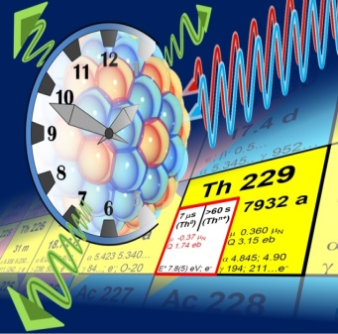
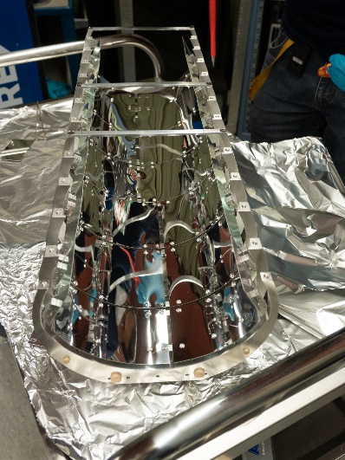
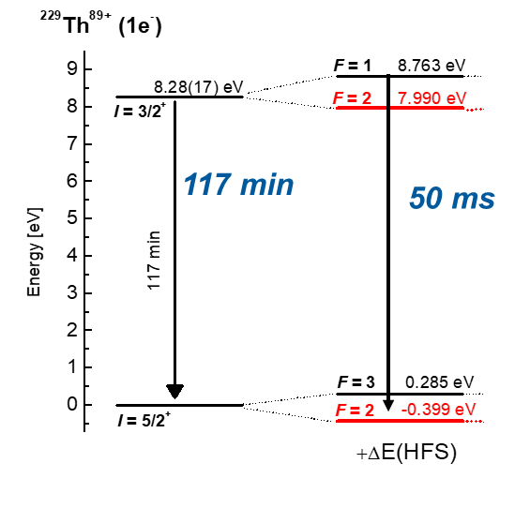
Science at existing facilities SPARC Experiments at ESR
^{229(m)}Th: Nuclear, Optical Frequency Standard (nuclear clock)
Hyperfine spectroscopy of stored ^{229m}Th⁸⁹⁺ ions
H-like ²²⁹Th⁸⁹⁺: Acceleration of nuclear decay by coupling of electrons to nuclear spin (hyperfine interaction).
Achievements
at ESR in 2022
2 • 10⁴ bunched ²²⁹Th⁸⁹⁺ in ESR per 10⁹ ²³⁸U ions in SIS.
Intense „10 eV“-laser exploiting the Doppler Shift.
neutral
[GS]
1e- oder 3e-
²²⁹Th⁸⁹⁺
Foto: C. Brandau
Novel in-ring VUV fluorescense detection system
MgF₂-coated Al-mirrors for the detection of photons bellow 115nm
(Collaboration Fraunhofer IOF, Jena)
ΔE_{HFS}
Feasibility of the measurement method demonstrated
(but due to restrictions only 15-20% of targeted scan range covered)
V. M. Shabaev et al., PRL. 128, 043001 (2022)

