Slide 1











NUSTAR Project Status
12th FAIR-NUSTAR Resources Review Board
FAIR/GSI, Darmstadt, Germany
Jürgen Gerl
NUSTAR Technical Coordinator
FAIR
Finland
France
Germany
India
Poland
Romania
Russia
Slovenia
Sweden
UK
Czech Republic

Slide 2

NUclear STructure Astrophysics and Reactions
What are the limits for existence of nuclei?
  Where are the proton and neutron drip lines situated?
  Where does the nuclear chart end?
How does the nuclear force depend on varying proton-to-neutron ratios?
  What is the isospin dependence of the spin-orbit force?
  How does shell structure change far away from stability?
How to explain collective phenomena from individual motion?
  What are the phases, relevant degrees of freedom, and symmetries
  of the nuclear many-body system?
How are complex nuclei built from their basic constituents?
  What is the effective nucleon-nucleon interaction?
  How does QCD constrain its parameters?
Which are the nuclei relevant for astrophysical processes
and what are their properties?
  What is the origin of the heavy elements?

Slide 3

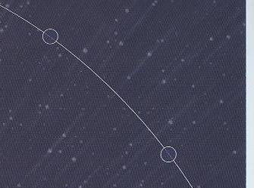
How to get answers?
Study the properties and the behaviour of exotic nuclei!
Ground state
mass, binding energy, spin, parity...
Excited states
energy, spin, moments, transition probability...
Decay
lifetime, energy, modes...
Reaction
kinetics, energy, constituents...
Investigate systematically many isotopes far off stability

Slide 4

NUSTAR - The Project
Complementary Experiments are needed for consistent answers
PSP code | Super-FRS | RIB production, separation, and identification
1.2.2 | HISPEC/ DESPEC | In-beam γ-spectroscopy at low and intermediate energy, n-decay, high-resolution γ-, β-, α-, p-, spectroscopy
1.2.3 | MATS | In-trap mass measurements and decay studies
1.2.4 | LaSpec | Laser spectroscopy
1.2.5 | R³B | Kinematical complete reactions with relativistic radioactive beams
1.2.6 | ILIMA(*) | Large-scale scans of mass and lifetimes of nuclei in ground and isomeric states
1.2.10 | Super-FRS EC | High-resolution spectrometer experiments
1.2.11 | SHE(**) | Synthesis and study of super-heavy elements
1.2.8 | ELISe(#) | Elastic, inelastic, and quasi-free e⁻-A scattering
1.2.9 | EXL(#) | Light-ion scattering reactions in inverse kinematics
(*) NUSTAR experiment using existing FAIR/GSI rings until FAIR rings become available
(**) NUSTAR experiments using FAIR/GSI linear accelerators
(#) Experiments requiring NESR – alternative solutions within FAIR MSV under consideration
Notes:
Our field makes it necessary to create dedicated experiments to perform different types of measurements, which are here briefly described. As all FAIR pillars, NUSTAR is organised as a project, but with different experiments (or sub collaborations) dealing with the different and often complementary techniques.

Slide 5
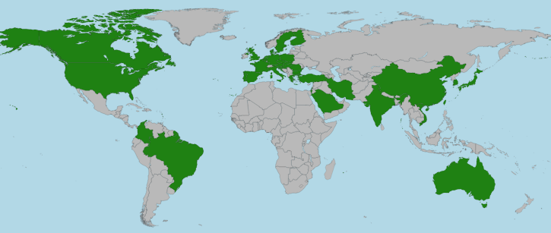
NUSTAR sub-collaborations and members (without Russia)
>640 NUSTAR members
(incl. students, engineers)
EXL
22
ELISe
16
R³B
HISPEC/ DESPEC
Super-FRS
EC
226
> 1000 listed “interested” scientists
> 640 registered members
(incl. students, etc.)
~ 430 senior members
(PhD holder w/o Russia)
> 180 institutes from 36 countries
MATS
241
ILIMA
53
180
LaSpec
SHE
63
75
43
Status: May 2, 2023
Notes:
=RUNDEN(WURZEL(B5/PI());2)

Slide 6
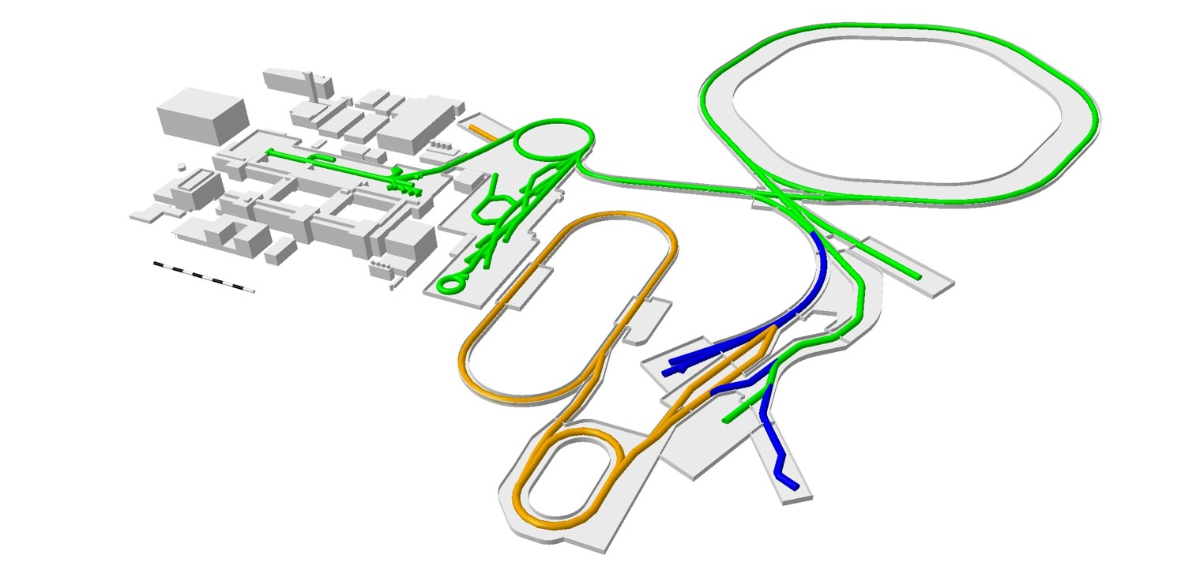
Experimental opportunities for ES/FS
SHE
MATS
ILIMA
LaSpec
Super-FRS EC
HISPEC/DESPEC
First Science +
Next steps
Super-FRS EC
HISPEC/DESPEC
MSV completion
R³B
HISPEC/DESPEC
MATS/LaSpec
Super-FRS EC
Full operation
Limited operation
Possible with additional
cost and effort

Slide 7
NUSTAR requirements:
From Phase-0 to Early and First Science
Facility | U beam intensity/spill at production target
Today at GSI with FRS (Phase 0) | 1...2x10⁹
Early science with Super-FRS and UNILAC/SIS18 | 2...5x10⁹
First Science with SIS100 (after commissioning) | 2x10¹⁰
First Science++ with SIS100 (full intensity) | 3-4x10¹¹
Luminosity
[fb⁻¹]
~0.1
1-2
5
100
Preparation → discovery → detailed studies
0.1 fb⁻¹ → 2-5 fb⁻¹ → 100 fb⁻¹
(near) stability → exotic → very exotic nuclei

Slide 8
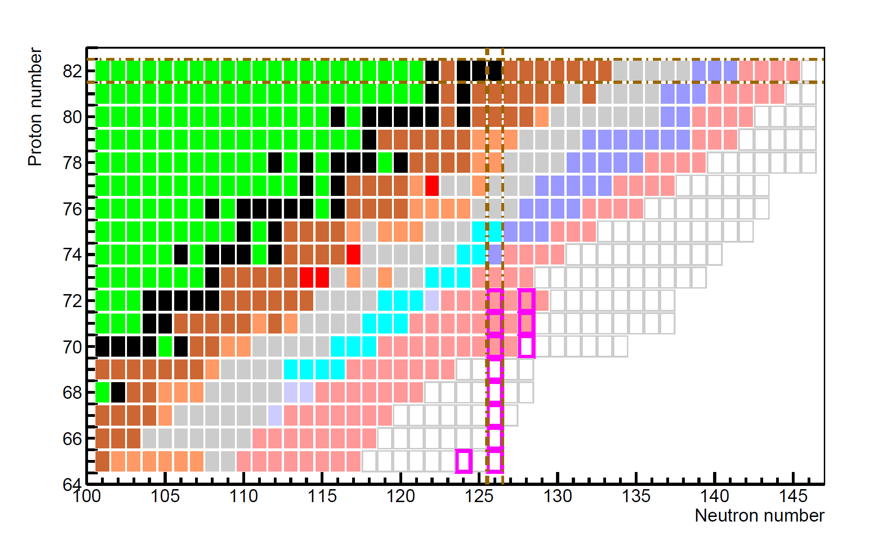
NUSTAR Early Science: New isotopes towards the r-process waiting points at the N=126 shell closure
Understanding the 3rd r-process abundance peak by studying neutron-rich isotopes towards the N=126 shell closure and their ground-state and decay properties
FAIR MSV
First Science
stable isotopes
mass & half-life known
half-life known
mass known
existence known
unknown isotopes
r process waiting point
ES (SIS18 Pb 2x10⁹ /cycle)
FS (SIS100 U 2x10¹⁰ /cycle)
FAIR MSV
Early Science
FAIR MSV
1 atom/d
Notes:
Let me start with the search for and study of new isotopes. On this plot the different colour codes indicate the level of knowledge for neutron-rich isotopes below 208Pb which becomes more and more sparse. The light blue nuclei indicate those which we are rather confident to study already in phase-0 using a Pb beam. Once we can perform experiments at the Super-FRS we will be able to use a U beam for this type of experiments (in view of the better suppression of fission fragments) and attack the dark blue region. We will still need the full FAIR MSV properties to go deeply into the region of the r-process nuclei.

Slide 9
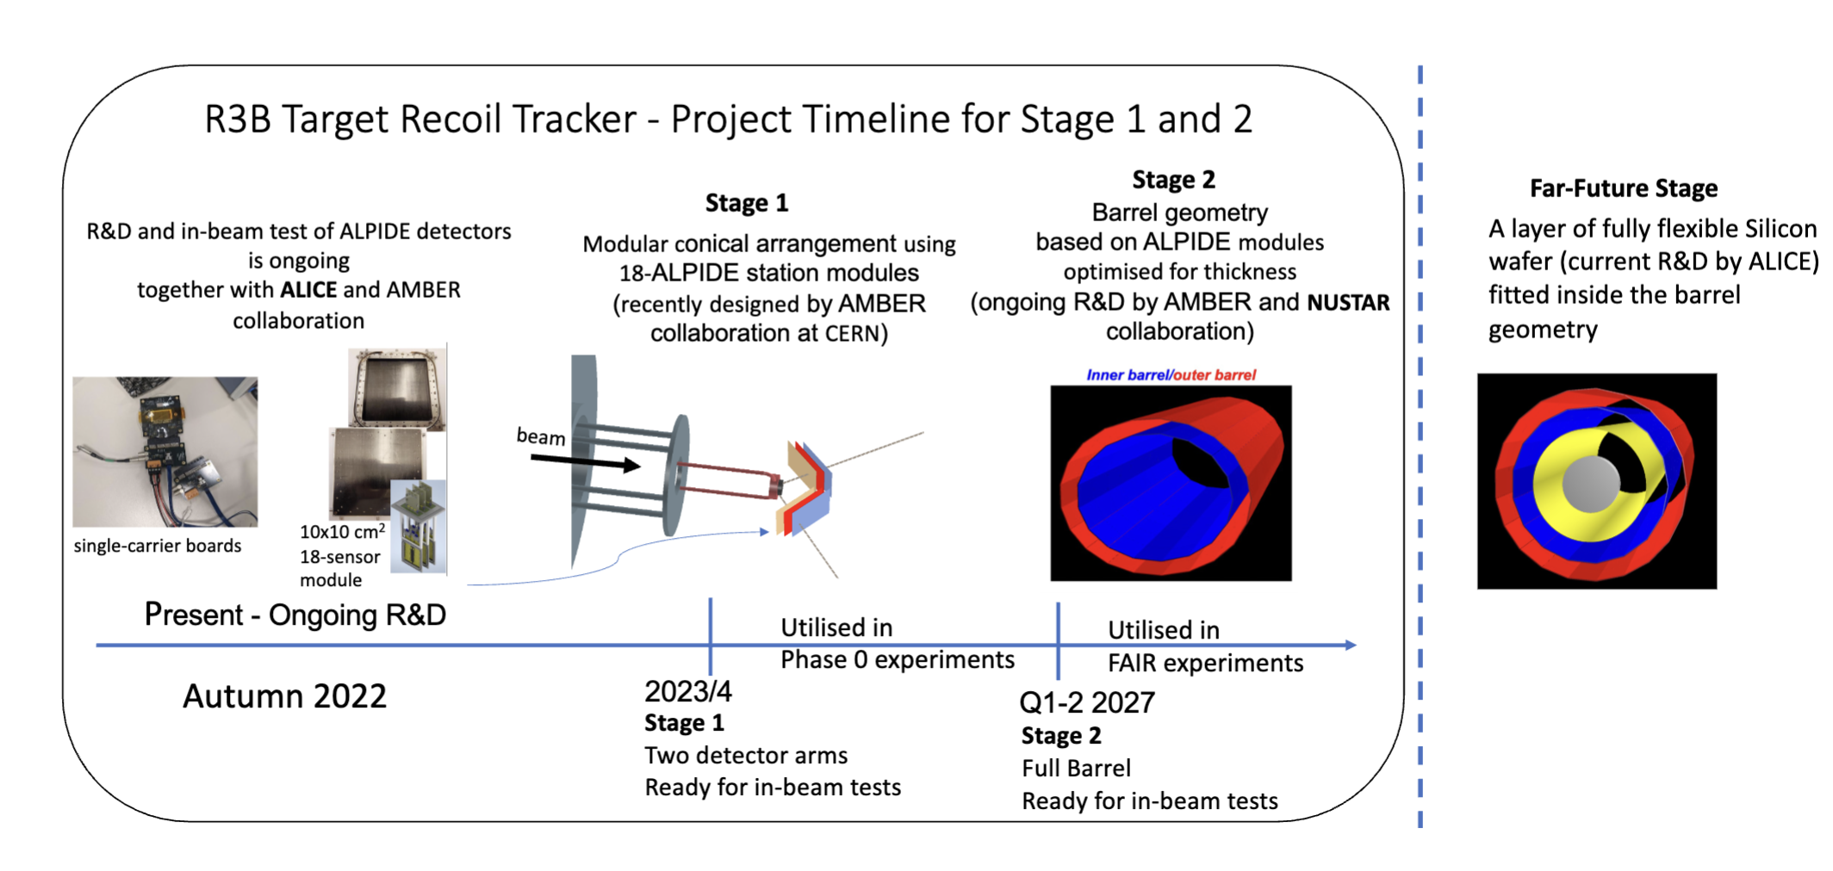
Technical developments
present

Slide 10
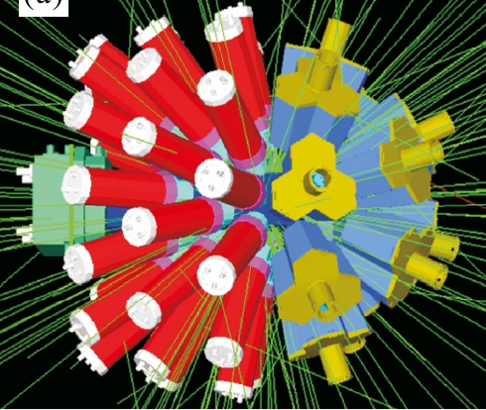
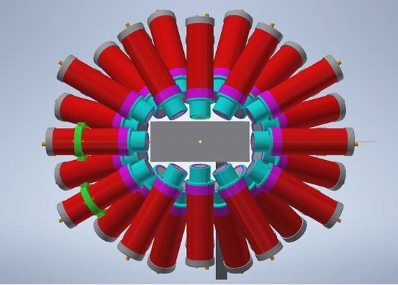
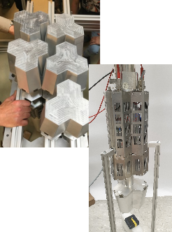
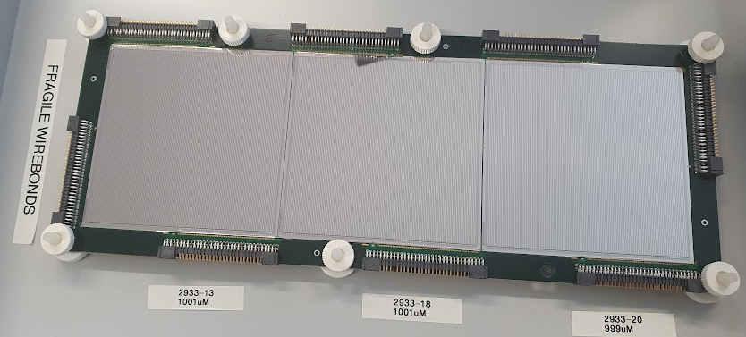
Technical developments
New DESPEC hybrid γ-ray array
12 DEGAS HPGe + 36 FATIMA LaBr₃for fast-timing measurements
Compatible with ‘wide’ 24x8-cm² AIDA Active Stopper + βPlast fast scintillators
Improved efficiency compared with 2021 setup
Plans for front-end improvement of TAMEX electronics for low-energy γ rays

Slide 11
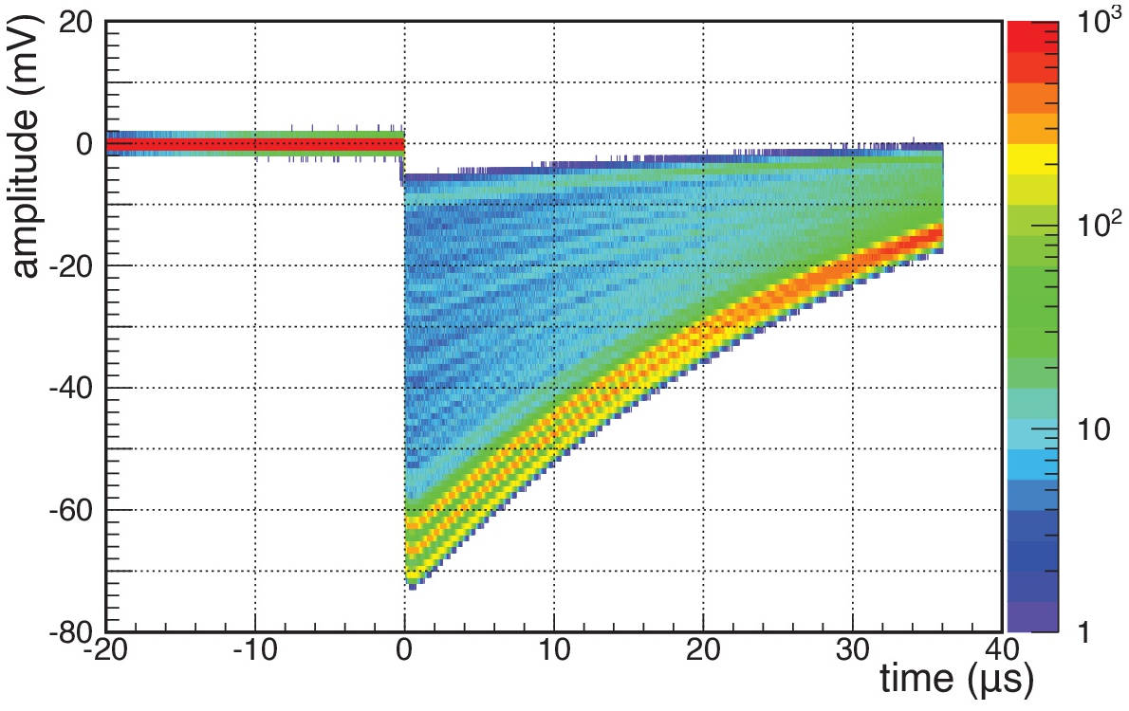
Technical developments
LISA: LIfetime measurements with Solid Active targets
wave forms recorded by high bandwidth oscilloscope
diamond detectors offer the necessary energy resolution and radiation hardness
sc-CVD diamond detectors testing in collaboration with GSI detector lab
triple-α source: energy resolution 0.8%
energy resolution sufficient for identification of one-proton removal events
design and construction of 2×2×2 prototype
ongoing optimization of charge sensitive pre-amplifiers and FEBEX4 DAQ system

Slide 12
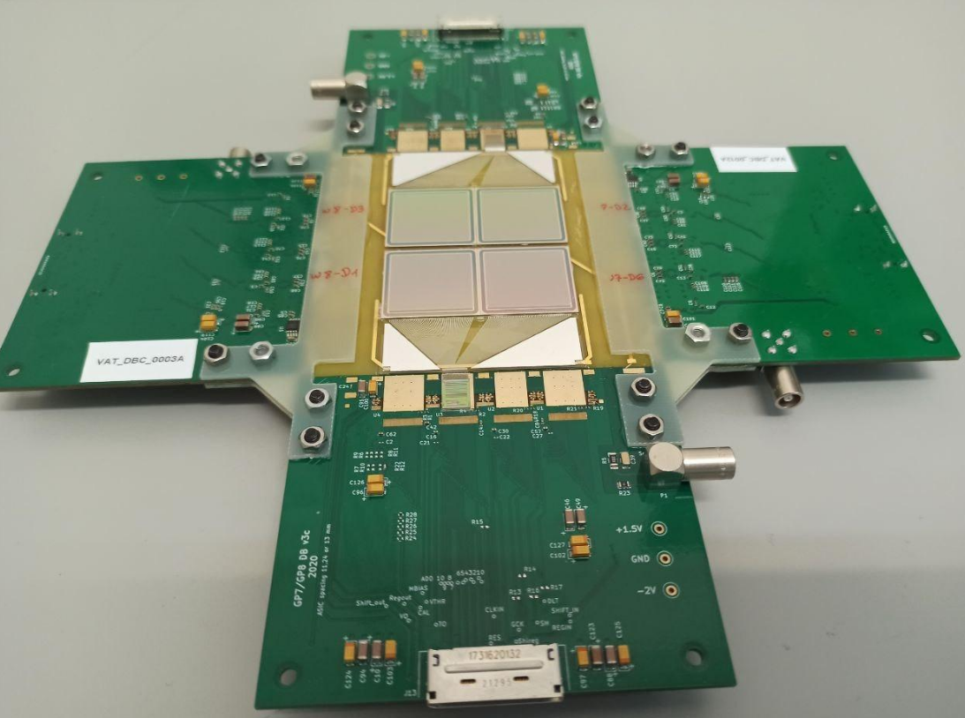
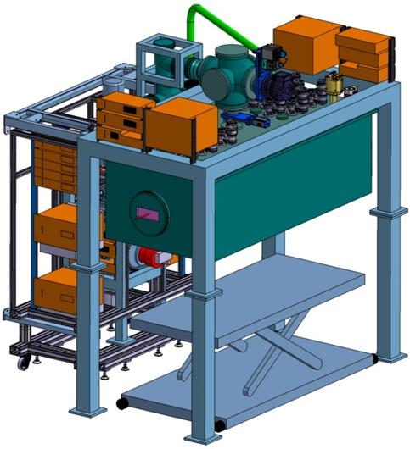
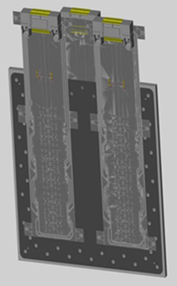

Technical developments
Micro calorimeters for PID
Micro vertex detector for WASA@FRS
Test at the FRS
Design of an array with 4x4 crystals (active detector area 40x40 mm²)
Test with off-line sources and with stable-ion beams: efficiency, tracking capability, IP measurement of nucleus-nucleus collisions
Cryogenic Stopping Cell
Tracking detectors for EXPERT
GSI-FAIR In-Kind Contract signed
First procurements completed, construction started
Construction / assembly will be continued in 2024
Tests with p-beams at COSY Jülich
FOOT micro-strip detectors
ALPIDE tracking station
GADAST readout system
Tracking station with
18 ALPIDE detectors
12

Slide 13
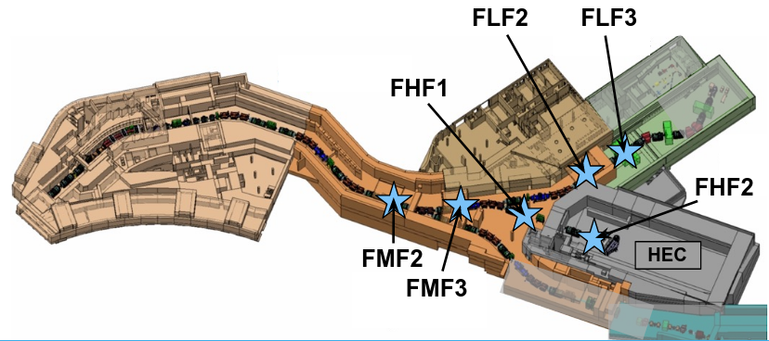
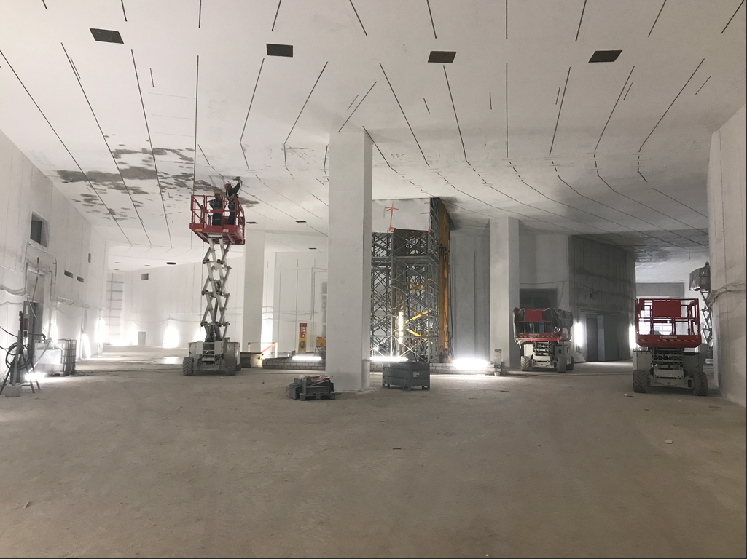
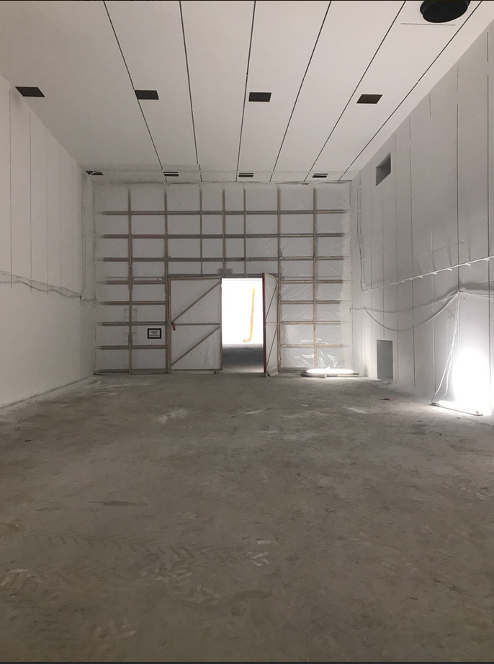
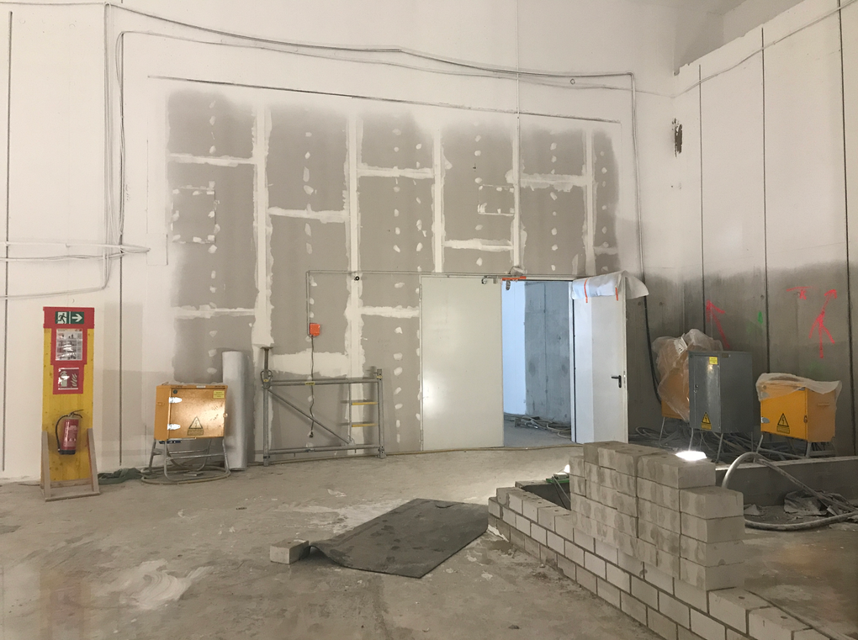
On-site construction update
FLF2
FHF1
Low-energy
Branch
High-energy
Branch
Ring
Branch
26th April 2023

Slide 14
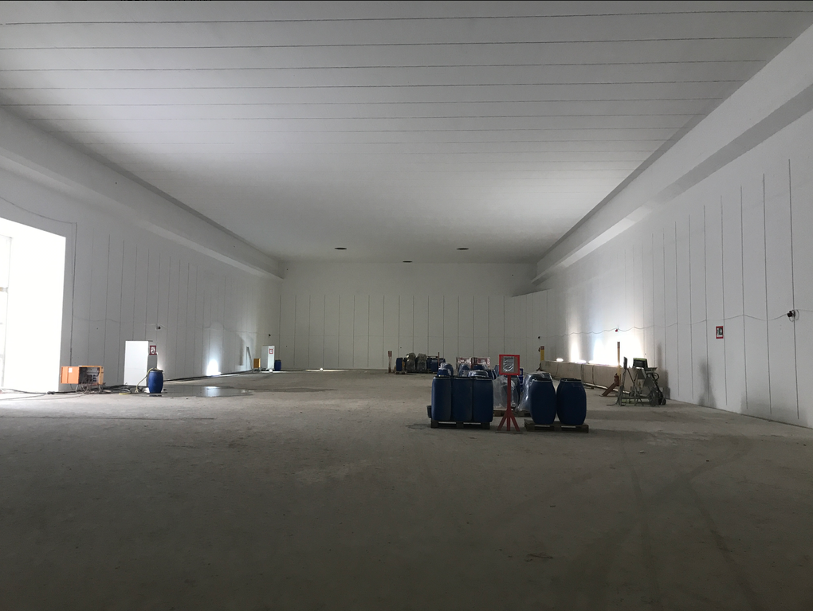
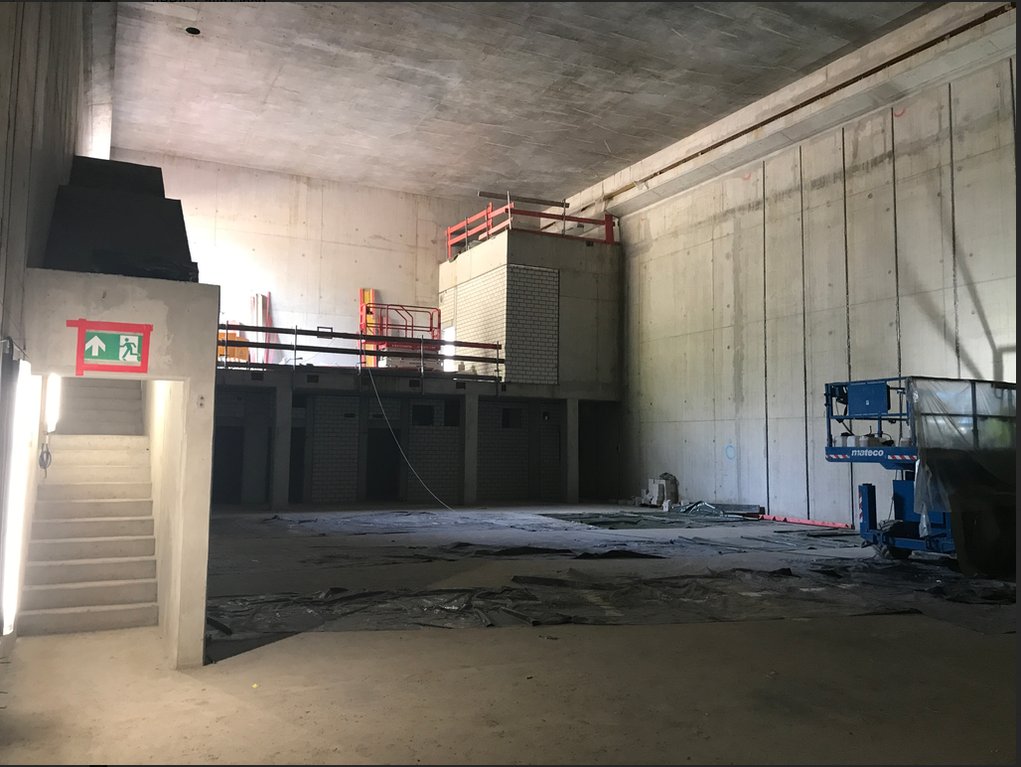
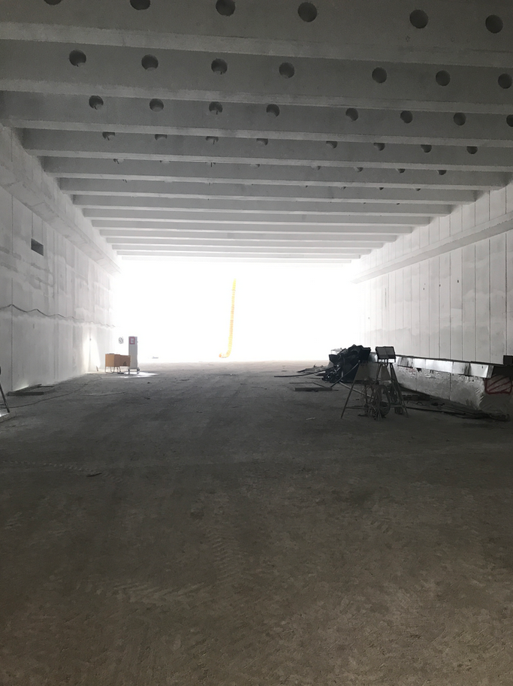
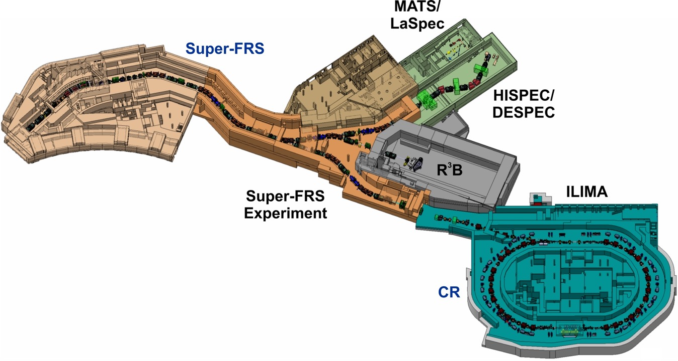
On-site construction update
High-energy Cave
MATS/LaSPEC
Low-energy Cave
MATS/LaSPEC
LEC
HEC
26th April 2023

Slide 15
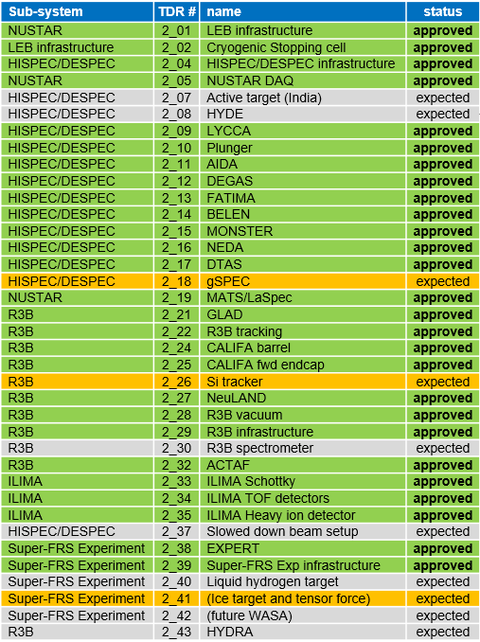
Status of TDRs
27 | approved
0 | submitted
3 | expected
7 | beyond “Day one”
11/2025
11/2025
Expected TDRs:
gSPEC:
  Optional component
  Grant request submitted
Si tracker:
  Funding granted by STFC
  Re-design complete
  TDR expected this year
Ice-target and tensor force detection:
  Funding available
  TDR expected this year
11/2023
06/2023*
07/2024
11/2025
07/2024
06/2023*
07/2025
*funding available/secured
07/2024
15

Slide 16
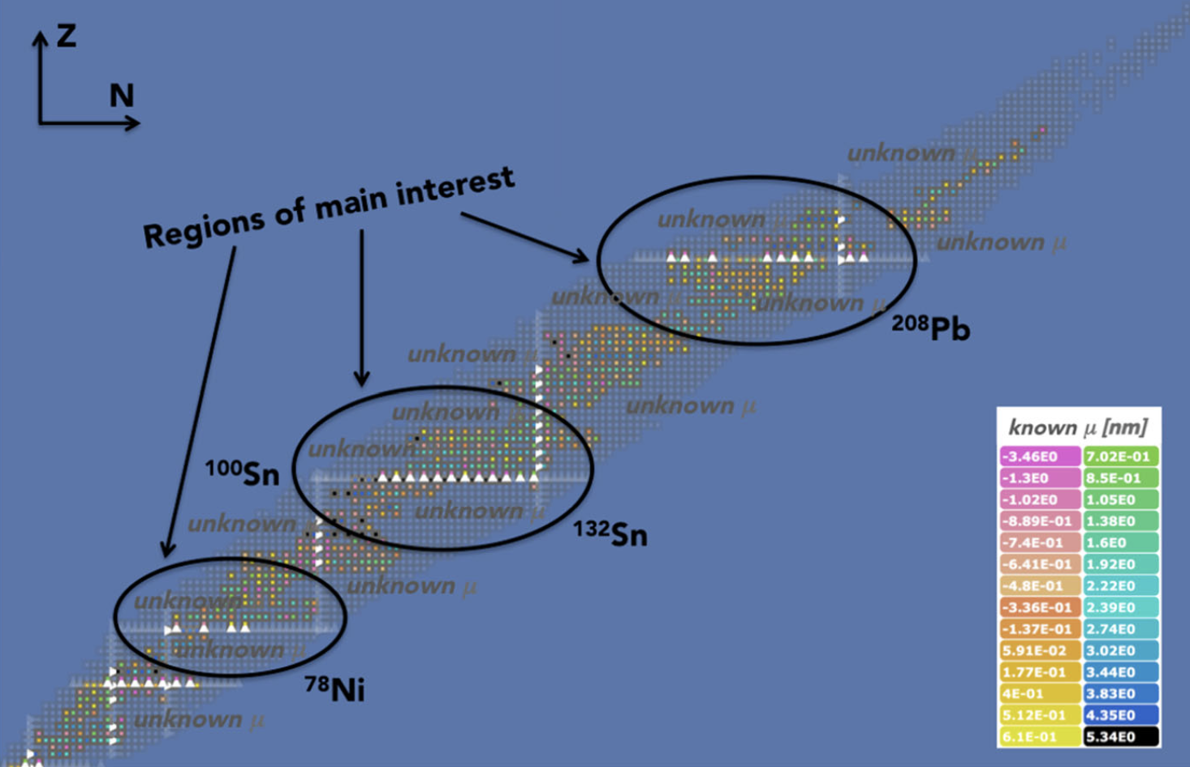
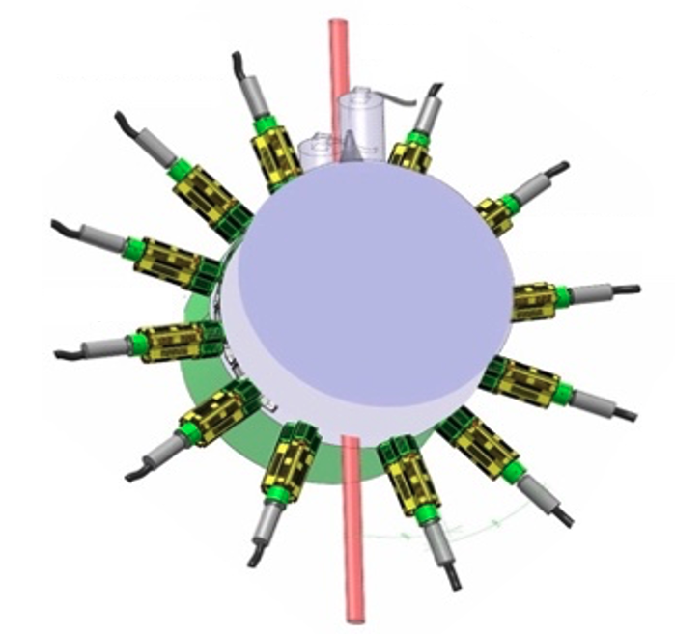
Status of TDRs: Nuclear moments with gSPEC
gSPEC
TDR expected 11/2023
Custom superconducting electromagnet
  fields up to 2T
Custom ancillary and reformatted HPGe detectors with optimized timing properties
Regions around the doubly-magic nuclei
Nuclear m moments of excited isomeric states
Single-particle structure and M1 operator
Collective properties and deformation
gRISING G. Neyens et al., APP, B38, 1237 (2007)
gSPEC R. Lozeva et al., HI, 240, 55 (2019)
16

Slide 17
NUSTAR Risk Register (Top 3)
Risk ID | Scenario | Status | Description | Prob | Risk Score | Status/mitigating actions
642 | ES | Accepted | Re-procurement of experimental components due to termination of Russian contracts (NeuLAND, ACTAF2, PAS) | 99.9% | 15 | Costs to be updated in ECB12, but council decision outstanding
173 | ES | Mitigation ongoing | No budget approved for NUSTAR infrastructure | 20% | 12 | Mitigation: fund to be established via NUSTAR MoU. Delays due to FAIR Scientific Review.
358 | ES | Mitigation ongoing | Detection threshold of Si tracker far too high | 20% | 11 | Mitigation: Modules to be replaced with new design. R&D ongoing, new TDR expected this year.

Slide 18
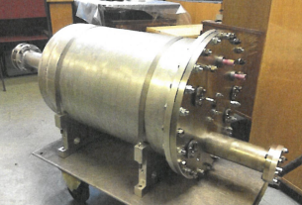
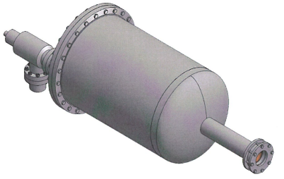
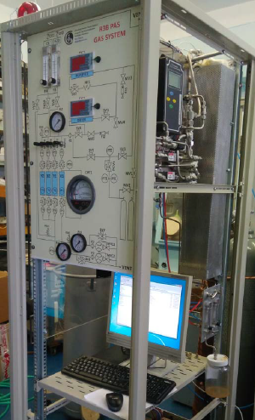
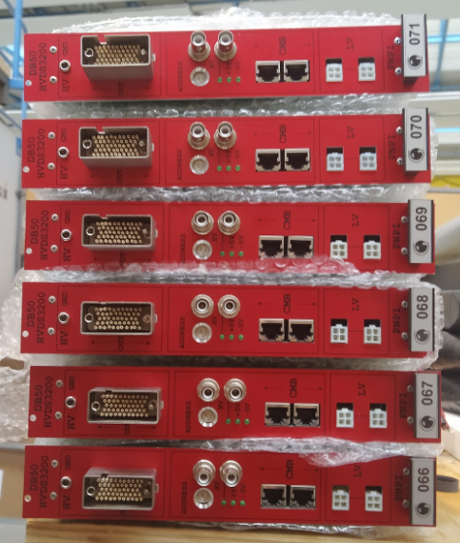
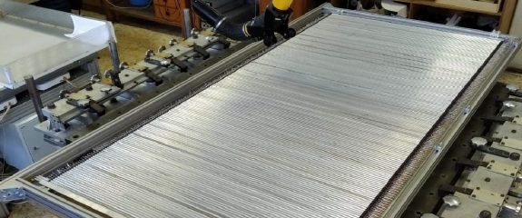
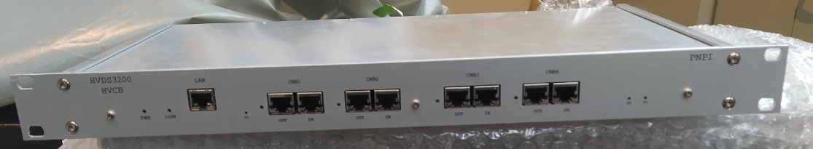
Substitution for Russian in-kind
Active target
ACTAF2
Taken up by other collaborators
Proton Arm
Spectrometer (PAS)
design
chamber at PNPI
Combine with ACTAF1
gas system for PAS
at PNPI
NeuLAND HV
some delivered DB50 modules
straw tubes at PNPI
HV distribution
control board
build new/repair broken
Check new technical solutions

Slide 19
NUSTAR ES Start - NUSTART
NUSTART Experiment
  First experiment at FAIR, involving the entire NUSTAR community
  Will take place inside the High-Energy Cave
  Starting immediately following Super-FRS commissioning
  Simple and compact (<3m in beam direction)
Physics goals and setup to be defined
Part of NUSTART setup to provide verification of PID
Likely to include HPGes
NUSTART
@ FHF2
Possible NUSTART setups
Passive or Active stoppers (e.g., Si-based detectors)
HPGe detectors (e.g., DEGAS)
Ion Catcher
...
HEC
Technical requirements met electrical power, heat dissipation, cooling water, LN2 and other technical gases
No costs beyond current planning foreseen

Slide 20
NUSTAR ES/FS
NUSTAR experiments along high-energy branch of Super-FRS
with SIS18 (ES) and SIS100 (FS) beams
HISPEC/DESPEC
No HISPEC-10 (Slowed-down Beams), MONSTER (limited performance),
AGATA (at FHF2 or FMF2)
AIDA, DEGAS, FATIMA, DTAS, BELEN experiments at FHF1 (or FHF2)
HISPEC/DESPEC
Super-FRS EC
Super-FRS EC
Already planned for operation at FMF2 (EXPERT, tensor force, Super-WASA,...)
and FHF1 (Ion Catcher)
Super-FRS EC
HISPEC/DESPEC
R3B
Experiments as planned in high-energy cave
S-FRS High-Energy Branch focal planes

Slide 21
NUSTAR ES/FS Summary
Setup | Sub-collaboration | Focal Plane
NUSTART | All | FHF2
EXPERT, tensor force, Super-WASA | Super-FRS EC | FMF2
Ion Catcher | Super-FRS EC | FHF1
AIDA, DEGAS, FATIMA, DTAS, BELEN | HISPEC/DESPEC | FHF1/FHF2
R3B Full | R3B | FHF2
Identified costs beyond previous planning:
NUSTAR contribution to LN2 €30k (@2005)
Platform modification €10k (@2005)

Slide 22
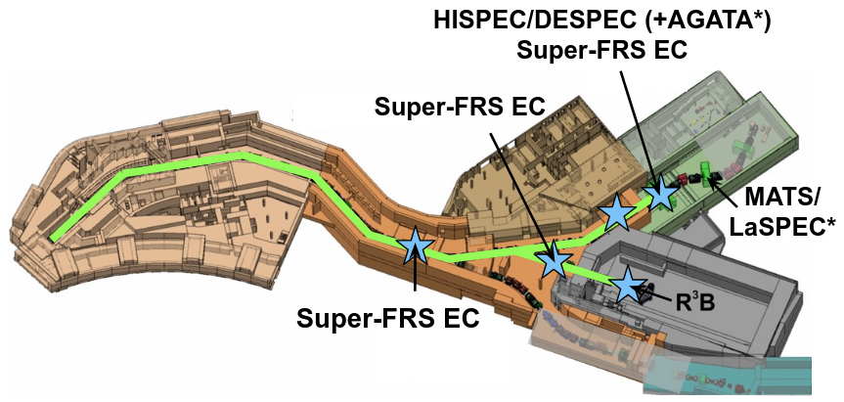
NUSTAR FS: 2-branch opportunity
Super-FRS components mostly available
Separate radiation safety area
Parallel activities within tunnel/HEC and FLF3 possible
Increased flexibility and output
AGATA operation at nominal place
  Part of MATS/LaSPEC program
S-FRS focal planes
*with additional in-kind contributions
Additional components (slits, degraders) needed at FLF2
Data-acquisition hardware (racks etc) needed, estimated cost ~€40k
Short additional LN2 line to FLF3 required, estimated cost ~€5k

Slide 23
Critical to success
Acquiring funding for NUSTAR infrastructure through Common Funds
Fulfilling all formal safety requirements to be able to operate the planned set-ups
Getting sufficient Phase-0 beam time for i) testing FAIR/NUSTAR equipment, ii) gaining further operating experience and iii) training scientists and technicians

Slide 24
Thank you

Slide 25
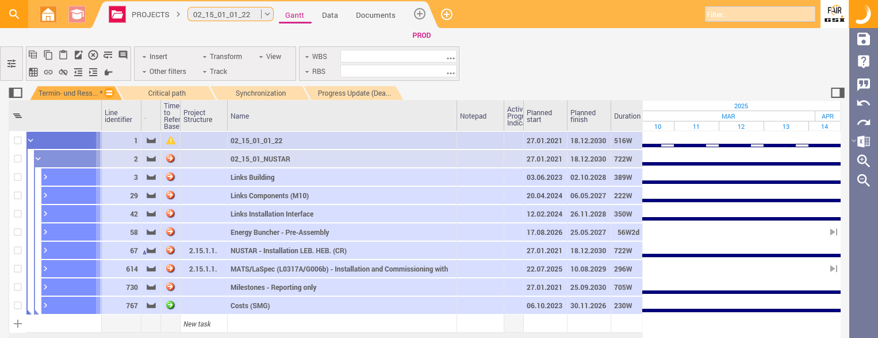
Installation Planning – new tool “Planisware”
New look & feel

Slide 26
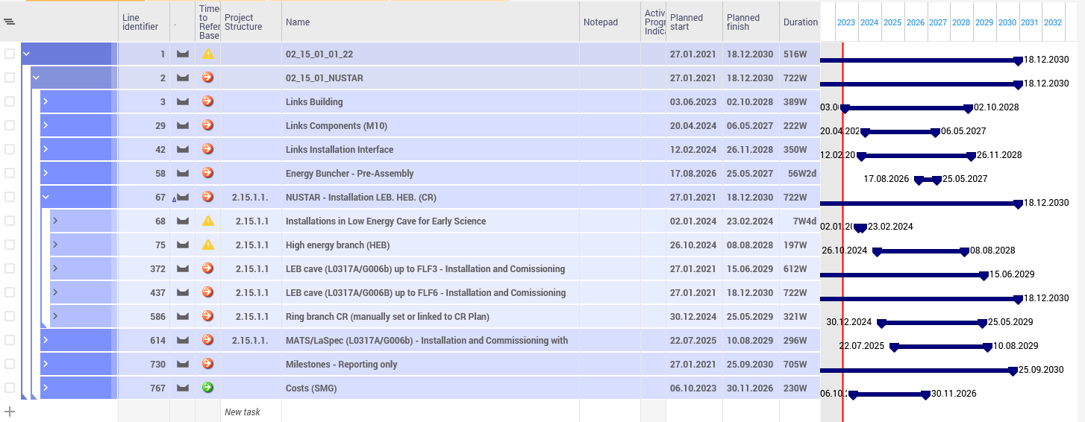
Installation Planning – NUSTAR Overview
Current plan contains complete MSV (migrated from MS Project with status from 08/22)
Updated for now ES/FS staging
Sections relevant to ES/FS are used for re-baselining

Slide 27
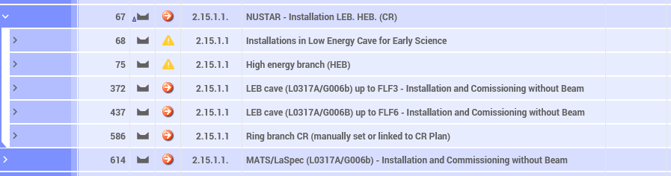
Installation Planning – NUSTAR Status
newly added
updated
New block: operation of the high-energy branch requires installation of components in the low-energy Cave (e.g., cryo components, racks,...)
Relevant parties (inc FSB) are informed
Construction milestones should be provided to define the timeline for the installation and commissioning for those components

Slide 28
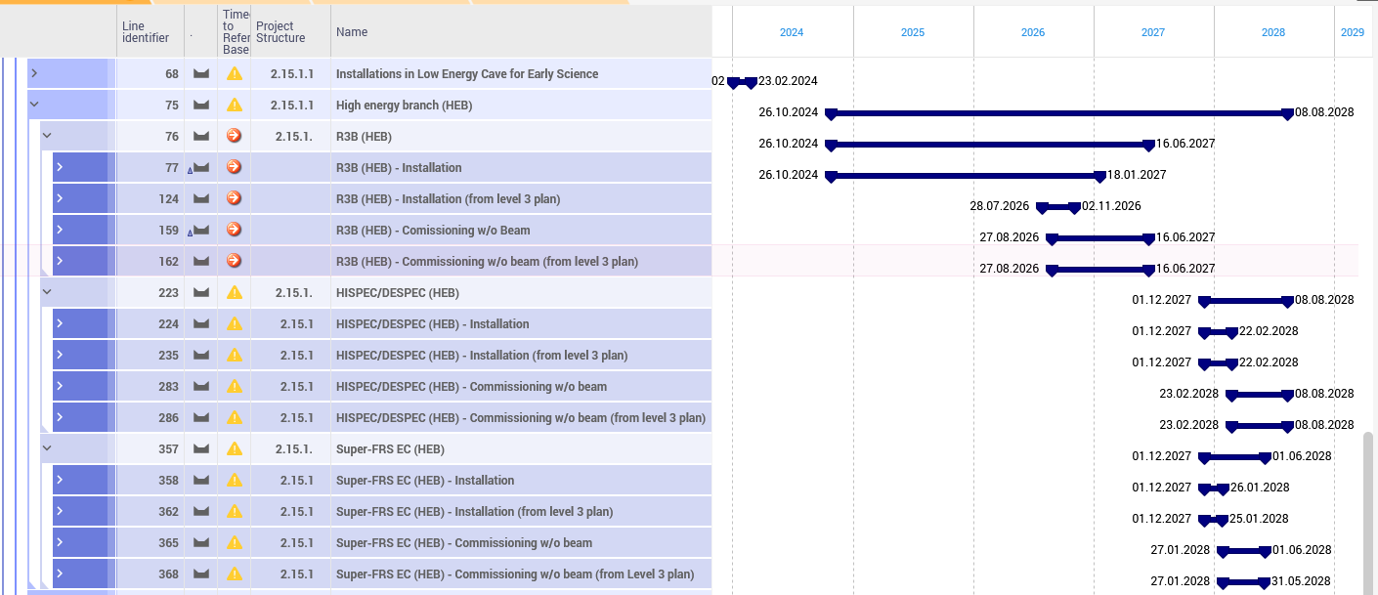
Installation Planning – NUSTAR Status
SFRS ES milestones:
M11 (ready for beam) 30.03.2027
M12 (ready for operation) 30.11.2027

