Slide 1
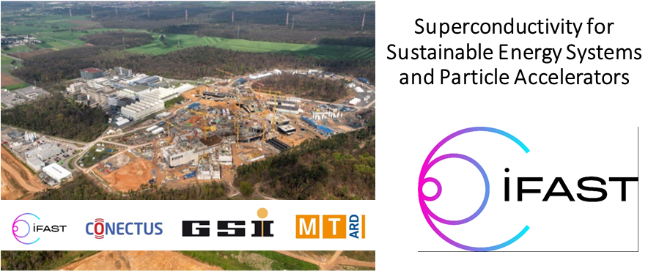
Superconductivity for Sustainable Energy Systems
Accelerator Research and Development
I.FAST Meeting, Darmstadt, 19.10.23
Peter Spiller

Slide 2

GSI involvement in IFAST workpackages
WP8: Innovative superconducting magnets
Objectives
Form a permanent European Strategy Group to discuss the European strategy for HTS magnets for accelerators
Conceptual magnetic design for a CCT scaled demonstrator with new integrated curved coil geometry
Magnet demonstrator construction design and construction of coil former and assembly parts
Choice of ReBCO tape material to be used in a Nuclotron cable for fast-cycling magnets
Manufacture a cable prototype and evaluation of its performance
WP11: Sustainable concepts and technologies
Objectives
Provide guidelines for new accelerator projects for implementing sustainable concepts and technologies.
Identify and introduce sustainable technologies available in industry, and vice-versa
Build and test an industrial prototype of the High Efficiency Klystron.
Manufacture and test prototypes of two PM-based magnets.
8.1 | Coordination and High-Temperature Superconductor (HTS) Strategy Group
8.2 | Preliminary Engineering design of curved Canted Cosine Theta (CCT) magnet
8.3 | Preliminary Engineering design of HTS CCT
8.4 | Construction of curved CCT magnet demonstrator
8.5 | Construction of the HTS CCT magnet demonstrator
8.6 | Development of ReBCO HTS Nuclotron cable
11.1 | Sustainable Concepts for Accelerator driven Research Infrastructures
 | 11.1.1: System Efficiency of Accelerator Concepts
 | 11.1.2: Key Technologies and Components for High Efficiency
 | 11.1.3: Cross Linking Accelerator R&D with Industrial Approaches
 | 11.1.4: Ecological Concepts
11.2 | High Efficiency Klystron Industrial Prototype
11.3 | Permanent Magnet Quadrupoles & Combined Function Magnets for Ultra Low-Emittance Rings
2

Slide 3
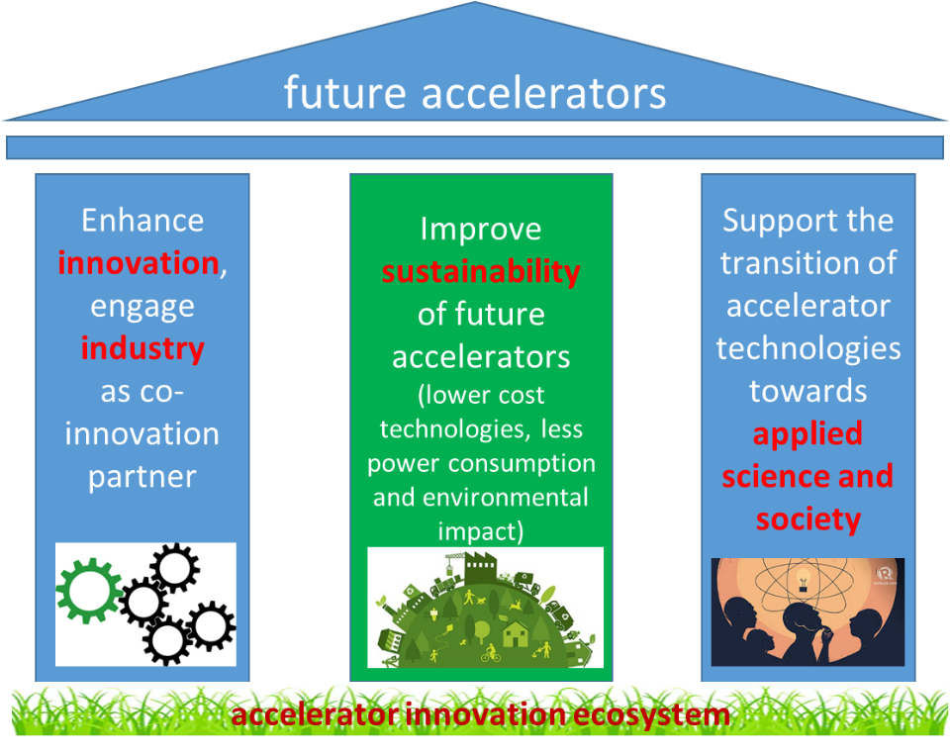

Slide 4
IFAST is fostering Technology Transfer
AIPF - Research institutions/Universities
Developing a communication plan (content and means) encompassing both internal and external communications (AIPF SharePoint utilization, website enhancements and social networks)
Reviewing of the IFAST report on extended industrial contribution in R&D activities
Establishing a long-term co-innovation strategy
• Identifying strategies to engage industry as early as possible in the procurement of products and services needed by research institutions.
• Developing a quantitative assessment framework of Industry-Accademia R&D.
• Discussing new procurement mechanisms adapted to R&D services.
BSBF2024 – Discussing strategies for leveraging BSBF2024 to enhance the visibility and credibility of AIPF, positioning it as a trusted think tank for industry and Academia, offering collective vision and insights.

Slide 5
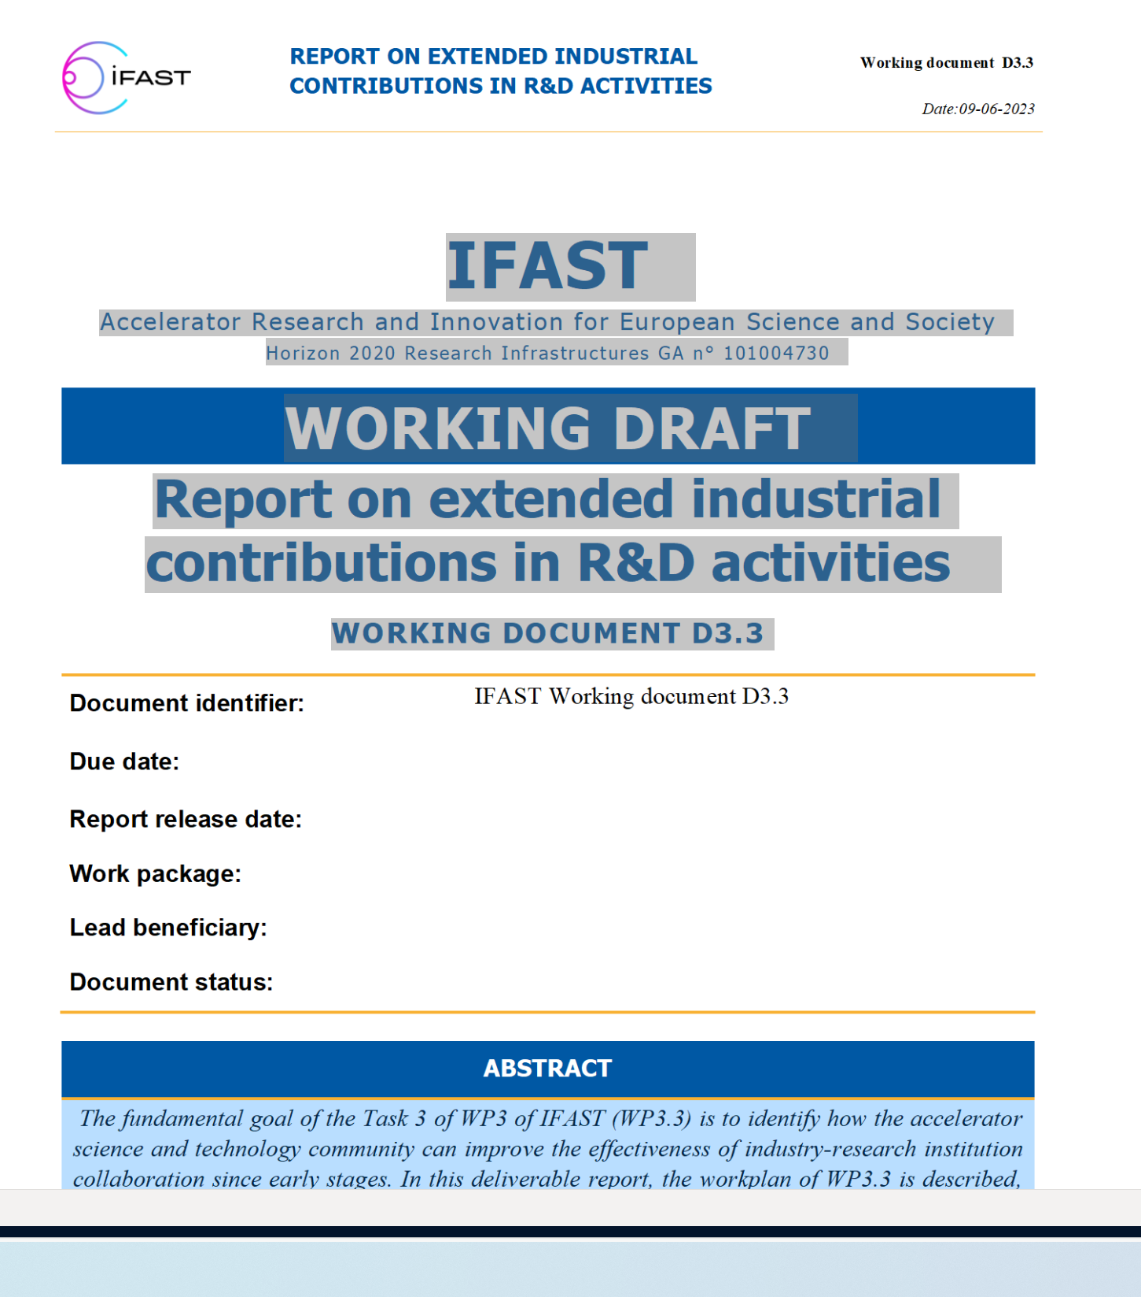
IFAST is fostering Technology Transfer
WP3:
The fundamental goal of the Task 3 of WP3 of IFAST (WP3.3) is to identify how the accelerator
science and technology community can improve the effectiveness of industry-research institution
collaboration since early stages. In this deliverable report, the workplan of WP3.3 is described,
together with a description of the activities done at this period of the project. In particular, the
collection of feedback from industrial partners and RIs.
For such, the working group has arranged a series of meetings with companies with experience in ASc&T and related fields, has iterated with them on their responses and compiled their feedback. Other stakeholders were consulted as well, in particular with the ILOs of a number of European countries.
A number of question are raised to complete the document.

Slide 6
High-tech requires long term collaborations and industry involvement in an early phase of R&D.
One of the biggest challenges for technology transfer and co-innovation with industry is the procurement laws in the European public sector.
The European procurement laws inhibit long term collaborations. In contrary, exclude the continuation of collaborations with a qualified supplier and ask for repeated, time consuming qualification of several different suppliers.
Long term collaboration may effect competition and prices.
The application of these procurement rules created for standard, low tech products to high technology is a missunderstanding (or missing understanding).
Conferences and workshops like the Big Science Business Forum help to foster communication.
Workshops create Opportunities

Slide 7
Sustainability
Sustainable concepts for research infrastructures are a clear I.FAST highlight and contribute to a global R&D drive.
High efficiency klystrons and permanent magnets as key technologies to reduce energy consumption.
AI-based classification of energy consumption as realistic pathway towards assessment of facility’s environment impact.
Increased awareness: Critical materials and life cycle management, importance of public perception of accelerator-related construction and operation.

Slide 8
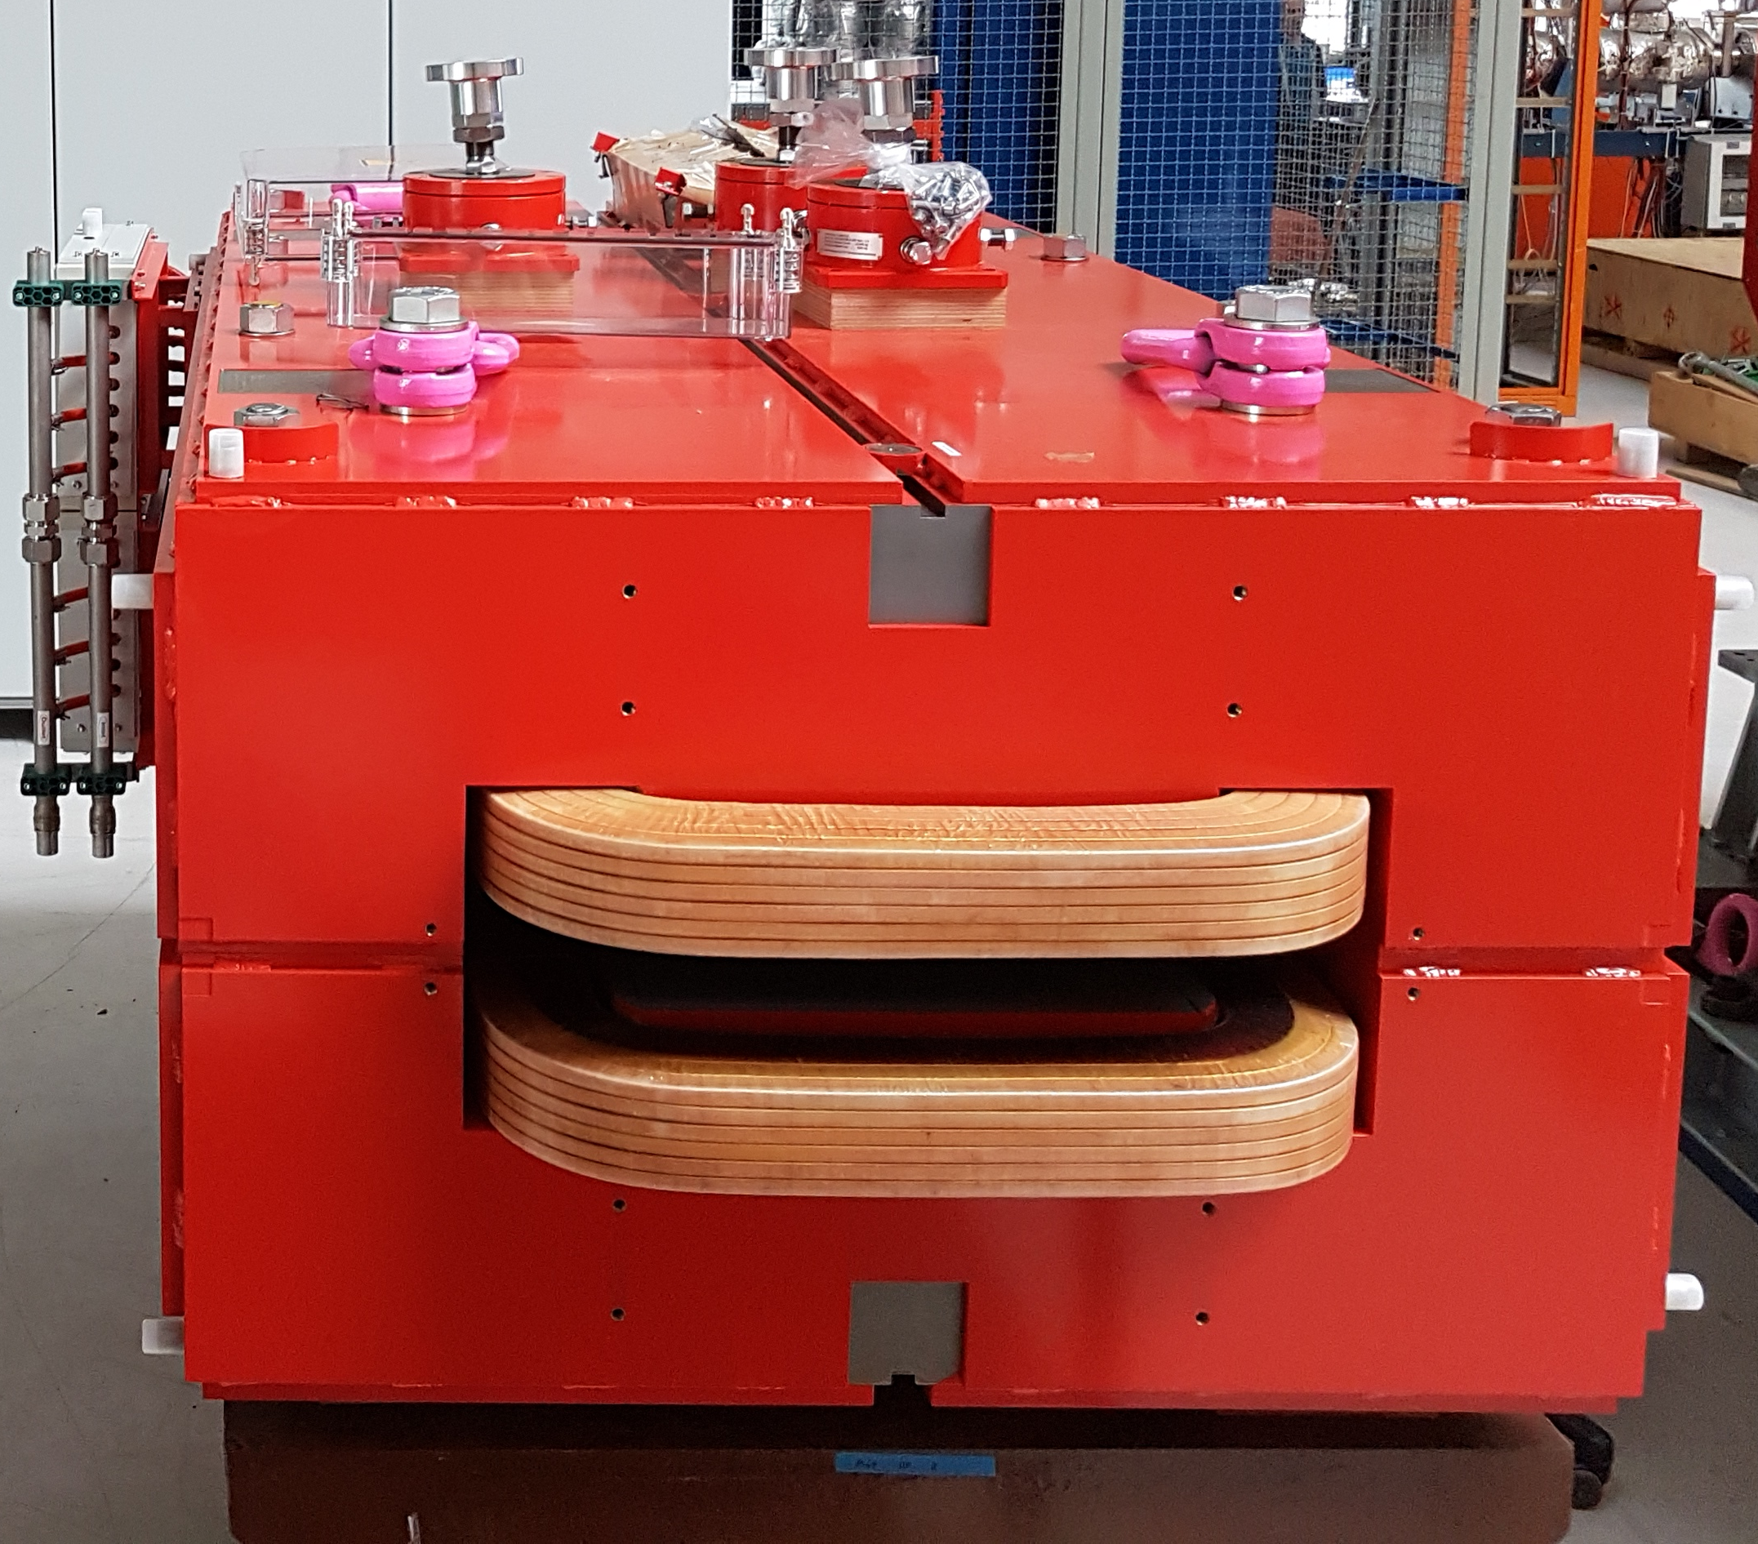
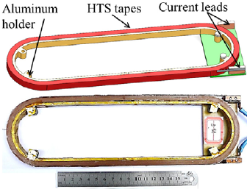
Accelerator facilities are consuming a major amount of energy.
Enhanced energy prices generate a signficant budgetary issue for all European large scale facilities, such as CERN, GSI etc. The Heavy Ion Therapy accelerator in Heidelberg consumes 25 % of the overal clinic energy. Energy price increase, increases the treatment cost per patient.
Reduction of operation and energy cost has been addressed by the science and technology review teams (e.g. MAC) and organisations (e.g. Helmholz).
Concepts for lowering the energy consumption have to be developed and implemented. (GSI has implemented a dedicated project group)
Superconductivity can reduce the energy dissipation of accelerator facilities e.g. by means of HTS energy saving magnetes, s.c. linacs, s.c. power transmission cables (Mg2B cable).

Slide 9
GSI energy saving approaches in high-tech areas
Energy Saving HTS Magnet
Energy Saving s.c. Linac
KI based Power Grid Monitoring System
Sensor Based Energy Monitoring System
Watchdog for Accelerator Devices
Development of an HTS Nuclotron Cable
FAIR Energy Consumption Prediction
Cooling Water Flow Control
Energy Efficient Design of SIS100 and FAIR Cooling System
Energy Efficient beam Transport by High Current Pulsed Magnets
EU IFAST „Sustainable Concepts for Accelerator driven Research Infrastructures“( PSI, CERN, ESS, DESY, GSI )
Paticipation in future EU CARAT program „Green Energy Monitoring for Large-scale Infrastructures (GREMLIN)“
Sustainability INNOVEA in M&T ARD

Slide 10
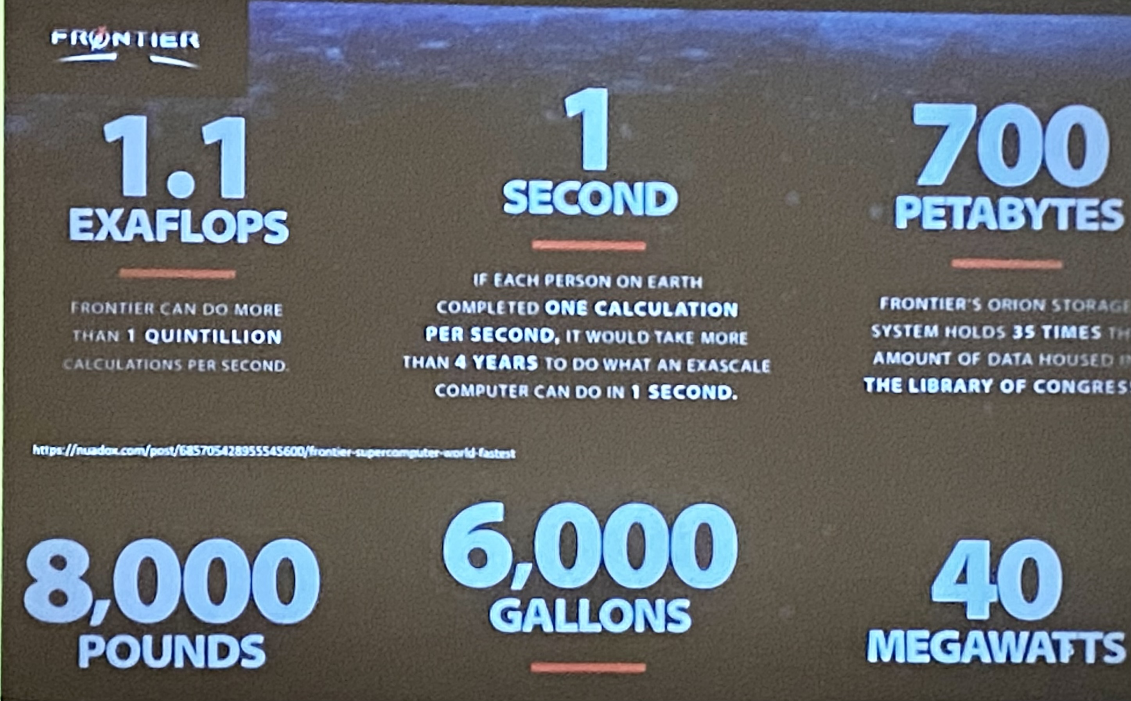
Everything shall become clean electric
The virtual (computing) world becomes as energy consuming as the real world.
Data processing, storage and transport consumes a major faction of the overall electrical energy consumption.
(12% of world wide electric energy production)
„Energiebedarf der Digitalisierung
Droht der Stromkollaps durchs Internet ?“
Exascale computing (oak-ridge, FZJ..)
Provision of controlling power by controlled computing(CPU, cloud etc.)
Energy efficient HPC technologies, e.g. GSI green IT cube

Slide 11
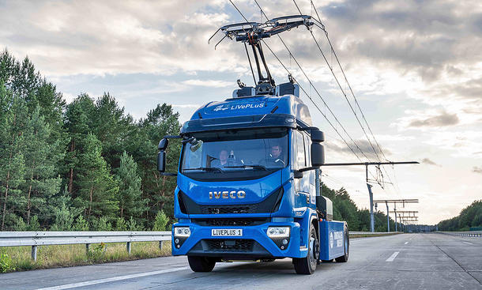
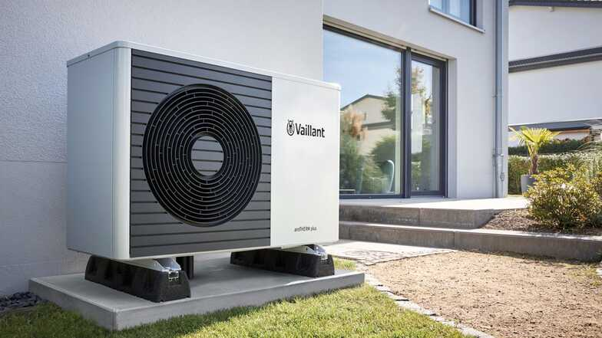

Everything shall become clean electric
Overhead contact line for trucks on German highway A5
Heating by heat pumps
Driving electric cars
All chemical energy shall be replaced by „renewable“ and nuclear energy.
The generation of electric power needs to be doubled (?)in parallel to the withdrawl of chemical energy.
The more electric energy is transported, the more energy is dissipated.
At the end, everything becomes just heat.
How can this work ?
Superconductivity is one of the few options to reduced energy dissipation.

Slide 12
Key words of the workshops
Applications of superconductivity in energy systems
Energy efficiency of accelerator components, including accelerator magnets
Minimization of heat load (e.g. @fast ramping, current leads, cavities..)
Energy efficient accelerator facilities
New superconductor technologies
Superconducting cables and energy transfer
Energy efficient cryogenic systems
"Dual use of accelerator technologies" (for energy systems)
Increase of coolant temperature
Cooperation research and industrial policy (EU funding / HGF funding)
Connectus activities

Slide 13
The workshop
Wednesday:
(Visit of General Electrics Germany and USA and Commenwealth Fusion)
Annual meeting of Connectus at GSI
Welcome receiption
Thursday after Lunch:
Visit of the FAIR/GSI series test facility
Group photo at the STF
Friday after Lunch:
Tour through the FAIR civil construction site including visit of the FAIR cryogenics plant
Discussion forum and joint working groups
For dinner:
Serve yourselve – List of recommendated restaurants in the neighbourhood available

