Slide 1
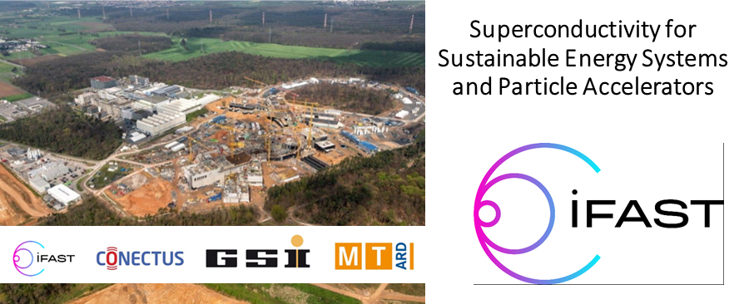




Innovative Superconducting Magnets: IFAST's approach with Canted Cosine Theta based on High-Temperature Superconductor
Ernesto De Matteis,
INFN of Milan (Italy) – LASA
On behalf of my colleagues I.FAST WP8 and INFN-LASA
This project has received funding from the European Union’s Horizon 2020 Research and Innovation programme under GA No 101004730.
Superconductivity for Sustainable Energy Systems and Particle Accelerators
19. October.2023 – GSI, Darmstadt, Germany

Slide 2

Summary
Hadron therapy application: Magnet parameters
IFAST WP8: Scope and demostrators;
CCT based on HTS:
  Preliminary design
  Geometry, magnetic design, quench protection analysis
  AC losses, R&D advancements, Test in the frame of IRIS
Sinergy IRIS-I.FAST
Conclusions
E. De Matteis – Superconductivity for Sustainable Energy Systems and Particle Accelerators - GSI, Darmstadt, Germany, 19 October 2023

Slide 3
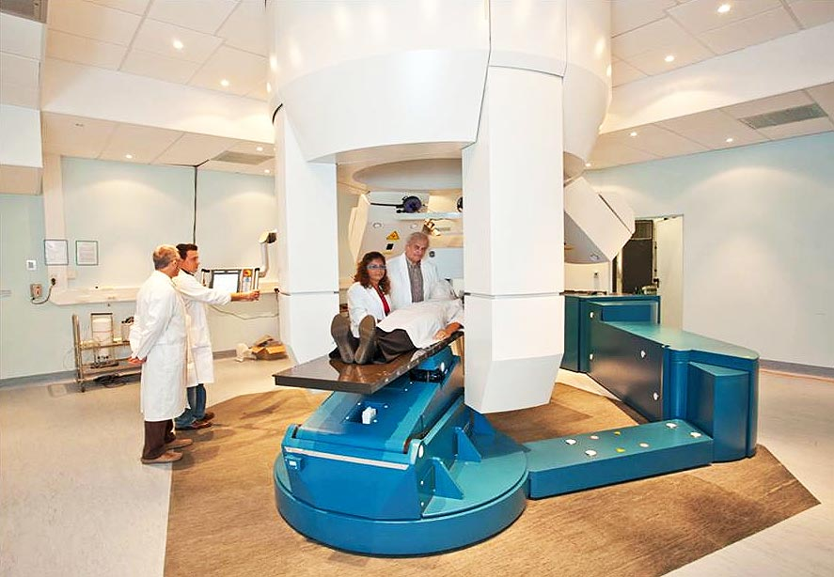
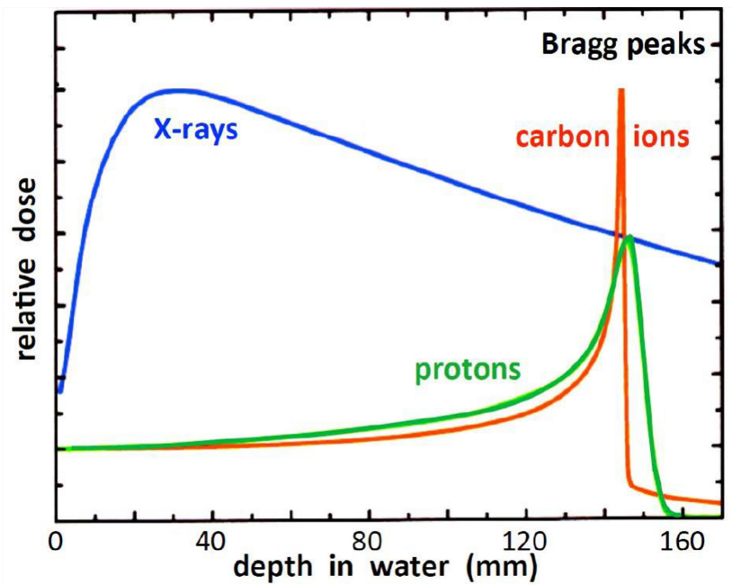
Medical application: Hadron Therapy
Hadron therapy is a medical treatment that uses carbon ions and protons to cure cancer.
Carbon ions are more effective for tumours resistant to traditional therapy and protons, but their use is limited by the size and cost of the needed infrastructure.
The treatment room at CNAO (National Centre for Oncological Hadrontherapy).
Relative dose versus depth for different radiations¹.
¹Collings, Edward W., et al. "Accelerators, Gantries, Magnets and Imaging Systems for Particle Beam Therapy: Recent Status and Prospects for Improvement." Frontiers in Oncology 11 (2022): 737837
E. De Matteis – Superconductivity for Sustainable Energy Systems and Particle Accelerators - GSI, Darmstadt, Germany, 19 October 2023

Slide 4
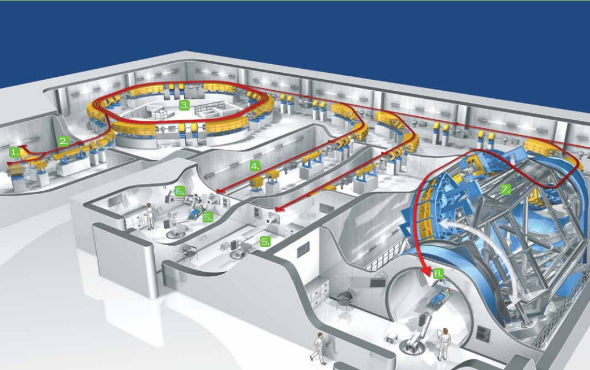
Medical Facilities – dimensions strictly depend on the magnetic field
SEEIST
Accelerator hall in case of standard resistive magnet synchrotron vs case of using SC magnets
Resistive dipoles 1.5 T
Curvature radius of about 4.5 m
HIT - Heidelberg Ion Beam Therapy Center
Four 90 degree dipoles at 3.5 T
Curvature radius of about 2 m
Courtesy of E. Benedetto (SEEIST)
E. De Matteis – Superconductivity for Sustainable Energy Systems and Particle Accelerators - GSI, Darmstadt, Germany, 19 October 2023

Slide 5
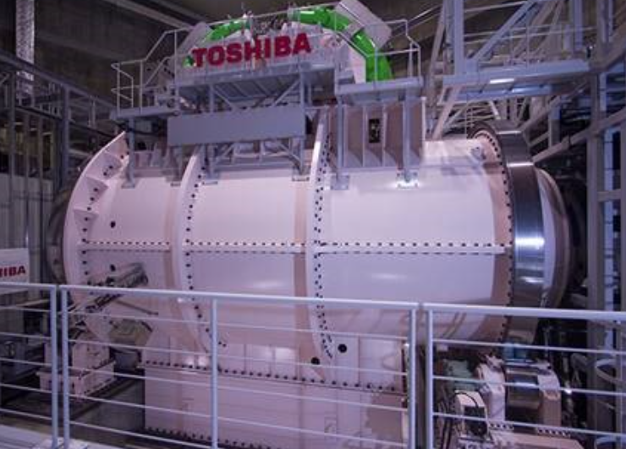
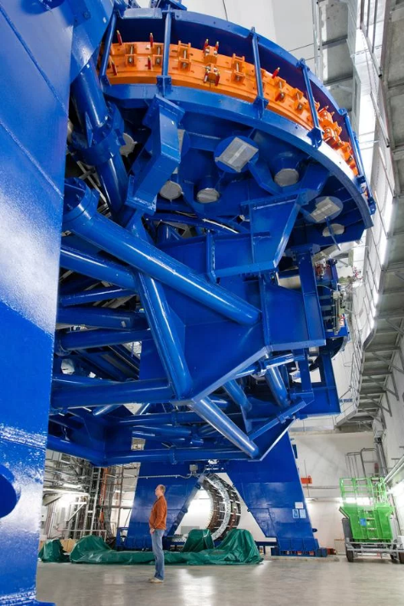
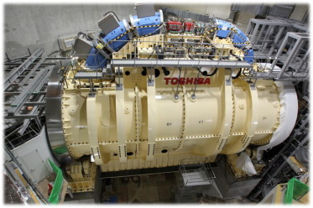
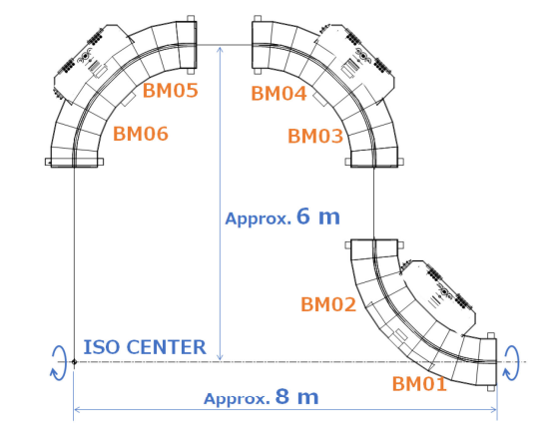
Heavy Ion Therapy Rotating Gantries in the world
HIT - Heidelberg Ion Beam Therapy Center
(first in EU) – normal conducting magnets (B<2 T)
Japan - HIMAC (Heavy Ion Medical Accelerator in Chiba):
First SC Gantry in operation 2018 (B < 3 T);
Yamagata University Gantry:
Second Gantry in operation 2023 (Bmax 3.5 T).
Yamagata
Cryocooled dry SC magnet
HIMAC
25 m long
13 m diameter
600 tons rotation
670 tons total
13 m
300 tons
E. De Matteis – Superconductivity for Sustainable Energy Systems and Particle Accelerators - GSI, Darmstadt, Germany, 19 October 2023

Slide 6
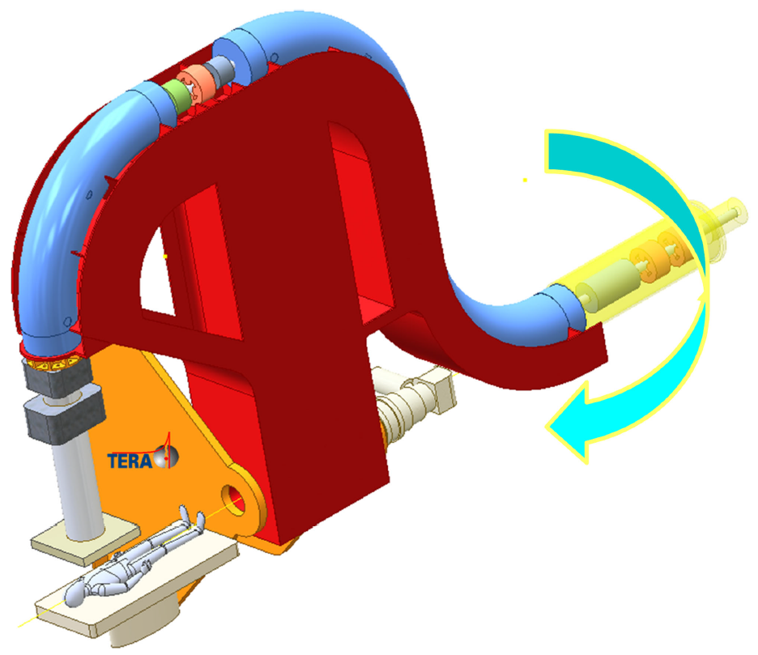
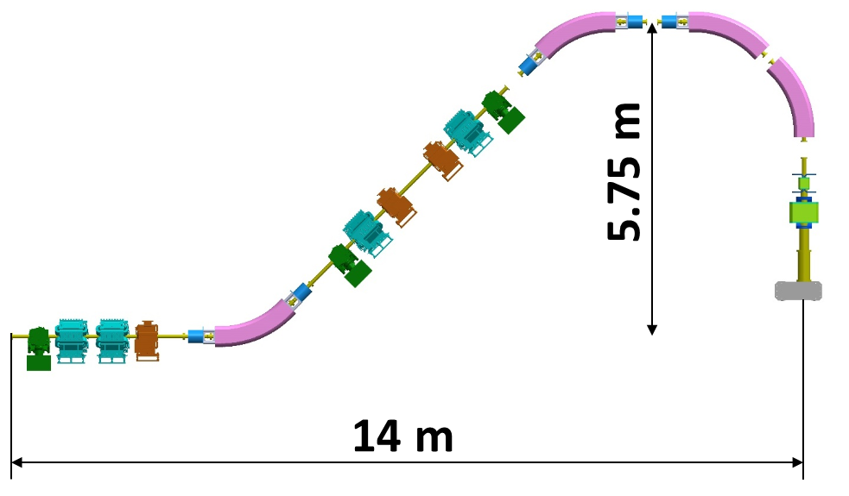
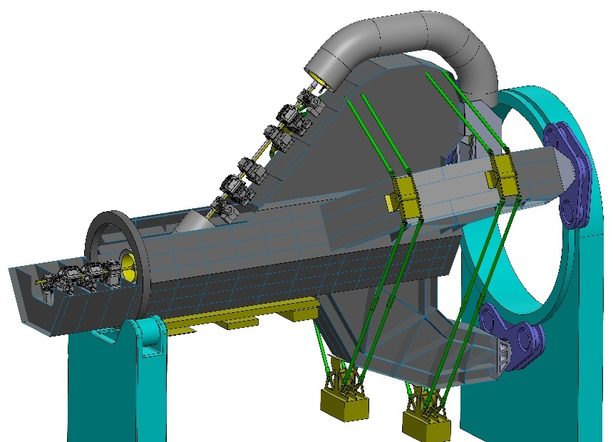
Superconducting magnets for Ion Therapy Gantries and Accelerators
SIGRUM
Main advantages:
Reduction of weight (300 → 50 ÷100 tons)
  Reduce the number of magnets (B = 3→4 T)
Footprint and cost reduction
  Gantry cost is about 25% of facility cost;
  Total cost of facility is about 200-250 Meuro (50 Meuro for the gantry);
  Compact accelerator and gantry → less civil construction.
Reduce Power consumption (SC vs NC magnets);
SC Magnet Target
B = 4 T
Θ=45°
Top = 4.7 K
dB/dt =0.4 T/s
Curv. Radius = 1.65 m
Carbon Ion Beam rigidity Bρ= 6.6 Tm
HITRIplus WP7
Main disadvantage:
Need of cryogenic system (Top > 4.7 K, no liquid helium);
Courtesy of E. Felcini, M. Pullia (CNAO) and L. Piacentini (CERN - Riga)
E. De Matteis – Superconductivity for Sustainable Energy Systems and Particle Accelerators - GSI, Darmstadt, Germany, 19 October 2023

Slide 7











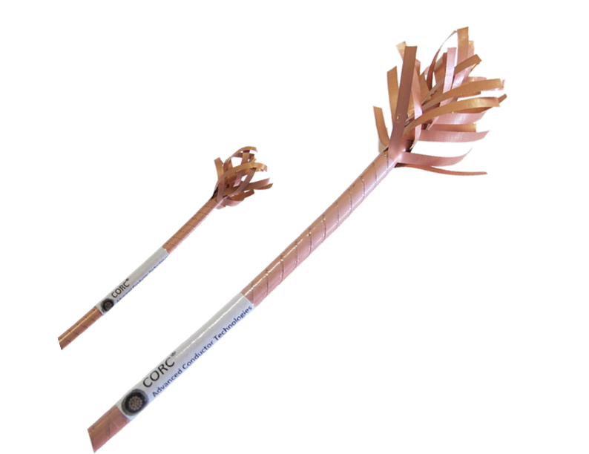


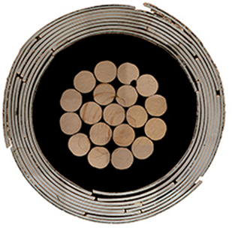
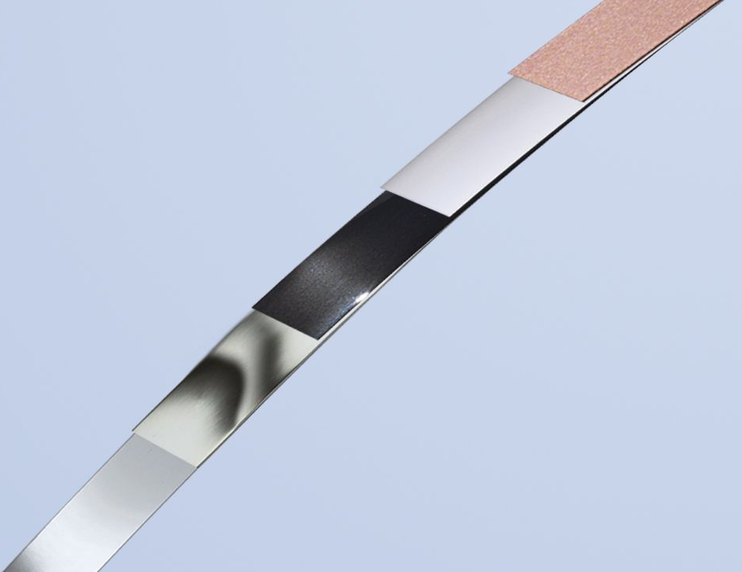
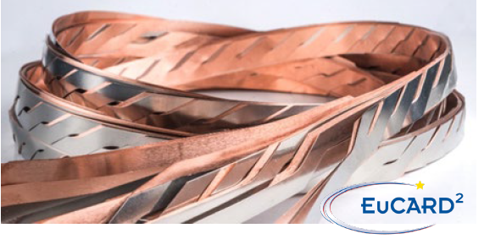
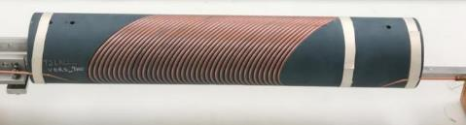
I.FAST WP8 – Innovative superconducting magnets
Form a permanent European Strategy Group, open to worldwide partners, to discuss the European strategy for HTS magnets for accelerators, and to improve Industry involvement in this technology;
Exploring Canted Cosine Theta with HTS superconductor (main goal), preceded by a combined function CCT based on LTS → involving the industries that want to learn about the CCT magnets;
Construction of the two demonstrators: winding and magnet assembly, magnet test and validation
Program based on CORC and CCT layout led by X. Wang & S. Prestemon
CCT dipole
4 T target
Ø =80 mm;
L <= 1000 mm
By Advanced Conductor
Technologies
Outer layer
Courtesy of Xiaorong Wang
12 mm HTS REBCO tape
E. De Matteis – Superconductivity for Sustainable Energy Systems and Particle Accelerators - GSI, Darmstadt, Germany, 19 October 2023

Slide 8
I.FAST - Parameters of magnet demonstrators
Parameters | Values |  | Unit
Magnet type | CCTs |  | -
 | LTS | HTS
Geometry | Straight |  | -
Central magnetic field B₀ | 4 |  | T
Magnetic and physical length | 0.8, 1 |  | m
Bore diameter | 80 |  | mm
dB/dt | 0.4 |  | T/s
Operation temperature | 4.7 | 10 – 20 | K
Loadline margin (@4.7 K) static | 25 |  | %
Superconductor | NbTi | RebCo tape | -
Superconducting Rotating Gantry
Light and compact
weight<100 ton
Cost reduction
Energy saving
Cryogenic system
Carbon Ions beam rigidity
  Magnet parameters as HITRIplus and SIG/SIGRUM (now EUROSIG) programs focused on Hadron Therapy magnet
  Straight geometry → HTS is already difficult enough!
E. De Matteis – Superconductivity for Sustainable Energy Systems and Particle Accelerators - GSI, Darmstadt, Germany, 19 October 2023

Slide 9

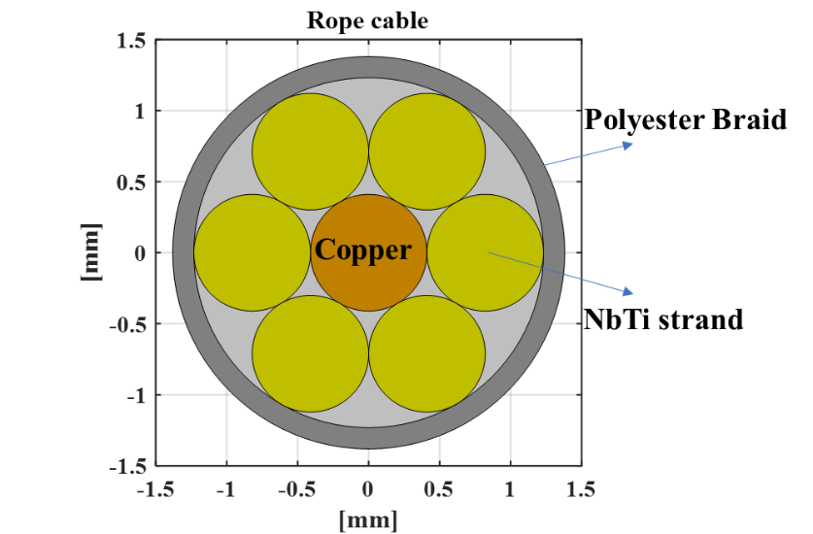
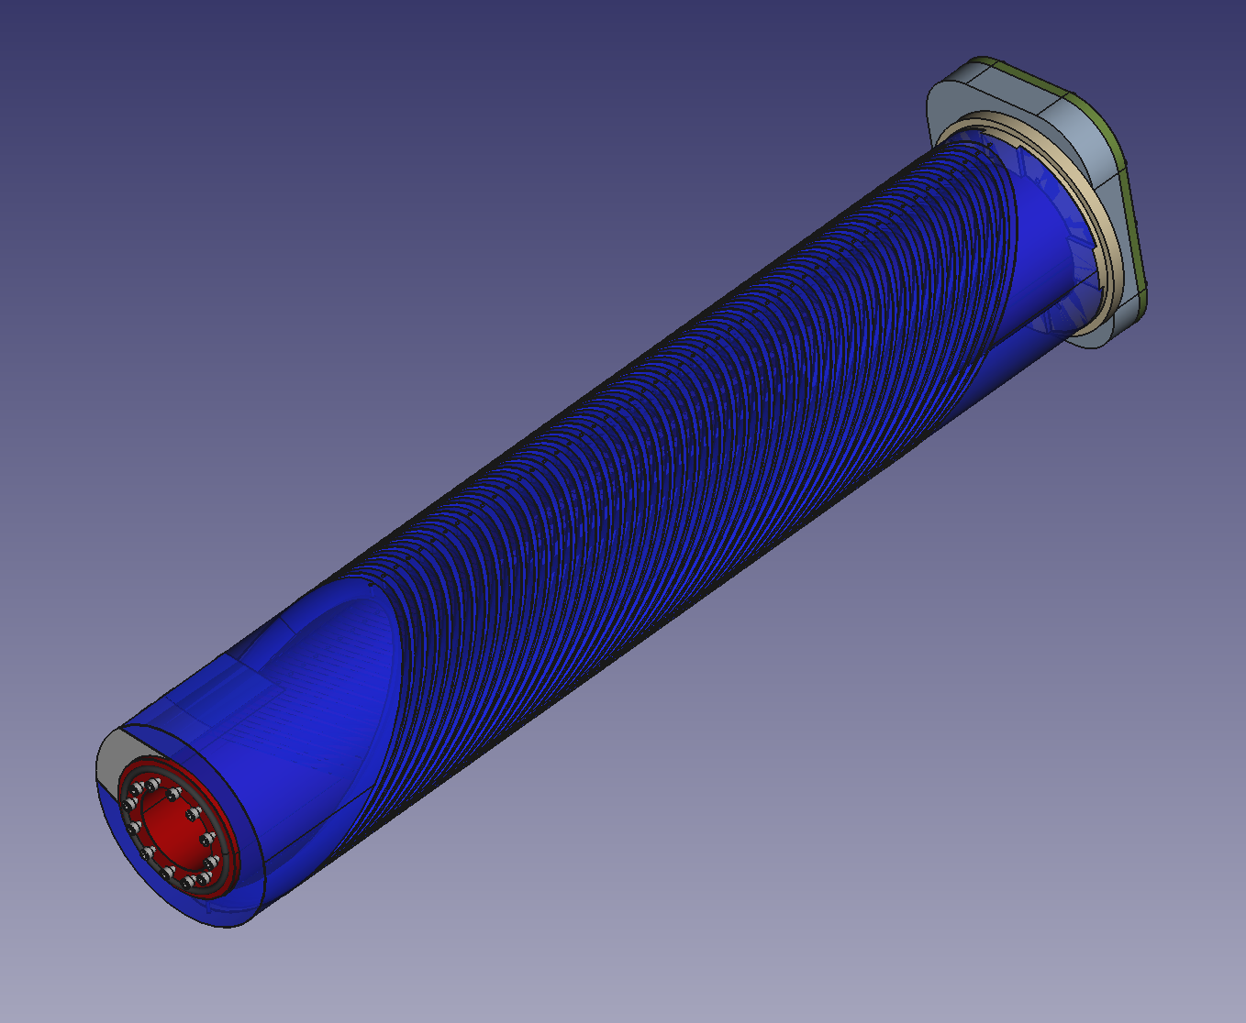
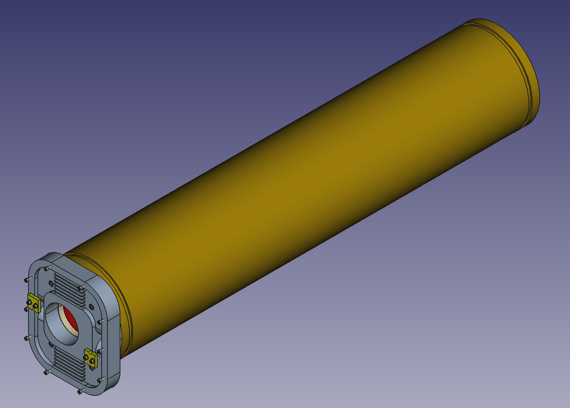
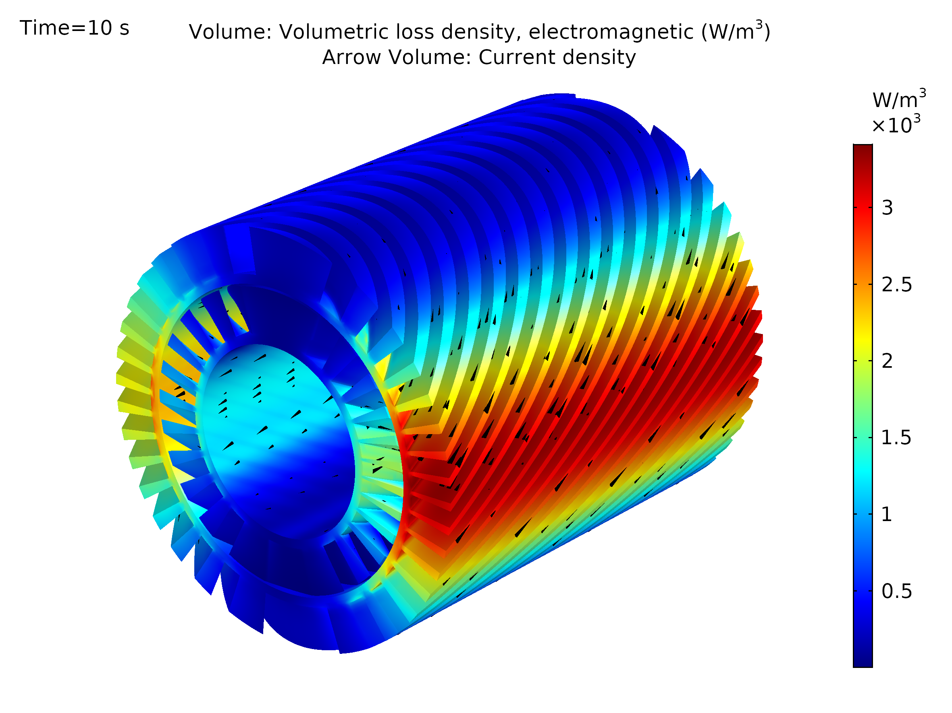
I.FAST WP8 – CCT based on LTS
5.6 mm
Combined CCT based on LTS (rope 6 NbTi + 1 copper strand as HITRIplus):
4 T dipole + 5 T/m quadrupole (important feature to test it for CCT);
Ramped at 0.2- 0.4 T/s → challenge is the heat extraction generated by superconductor, and former;
Straight geometry, Top of 4.5 K, nominal current of 1.5 kA;
Demonstrator for testing the combined feature of CCT and thermal study of AC losses;
Former made in Al-Br, wax impregnation;
No iron yoke on the final demonstrator;
Assembly ready for production (middle of 2024 test).
2x7 ropes
per groove
20 mm
Second layer former
Envelope tube
Splice box
9
E. De Matteis – Superconductivity for Sustainable Energy Systems and Particle Accelerators - GSI, Darmstadt, Germany, 19 October 2023

Slide 10


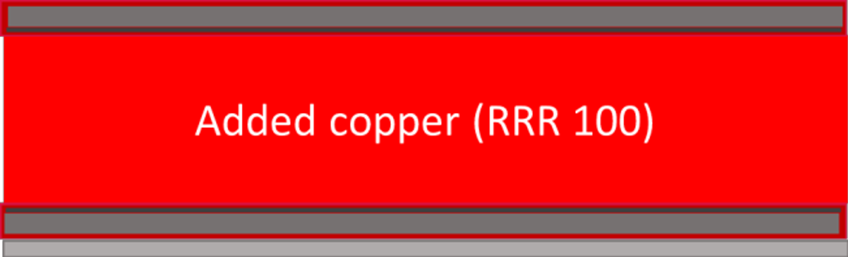
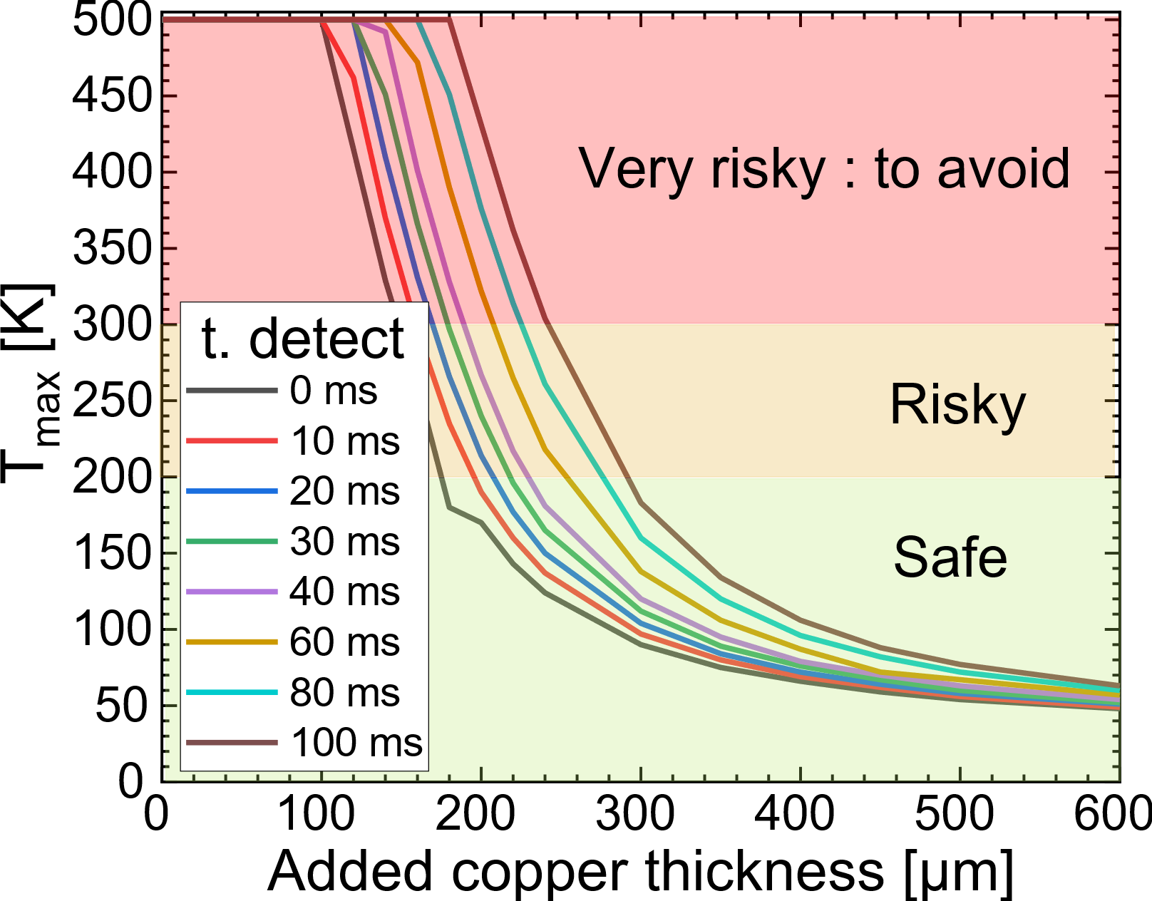
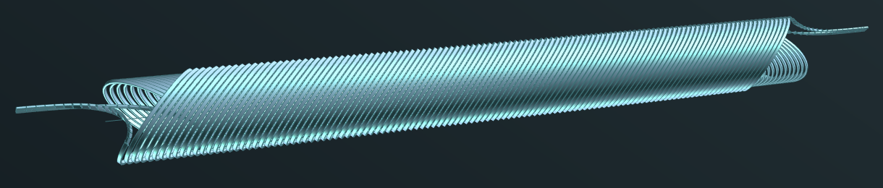
Preliminary Design of HTS CCT Magnet
Work done by Thibault Lecrevisse (CEA)
Report¹ on the conceptual design study of the HTS CCT:
Baseline (4 T dipole @ 10 K, > 15 K of margin);
Superconductor ReBCO (Tapes) – SST Ic = 650 A @ (15 K, 5 T);
Cooling with cryocoolers → low current (< 2kA) to avoid high losses in current leads.
Two preliminary designs (No iron):
“Metal Insulation-like” design with 2 tapes cable (550 A x 2 tapes x 14 cables)
“Insulated-like” design (added copper to the conductor);
The protection aspect is the critical point for both:
No classical protection for the MI;
Vd<5 mV in 13 V, <60 ms detect for the INS, adding more than 260 µm of copper.
4-mm tape
MI cable
INS cable
¹T. Lecrevisse, ‘’Conceptual Design of HTS Magnet’’, IFAST WP8.3 Milestone 33, Zenodo, https://doi.org/10.5281/zenodo.6979877
10
10
E. De Matteis – Superconductivity for Sustainable Energy Systems and Particle Accelerators - GSI, Darmstadt, Germany, 19 October 2023

Slide 11
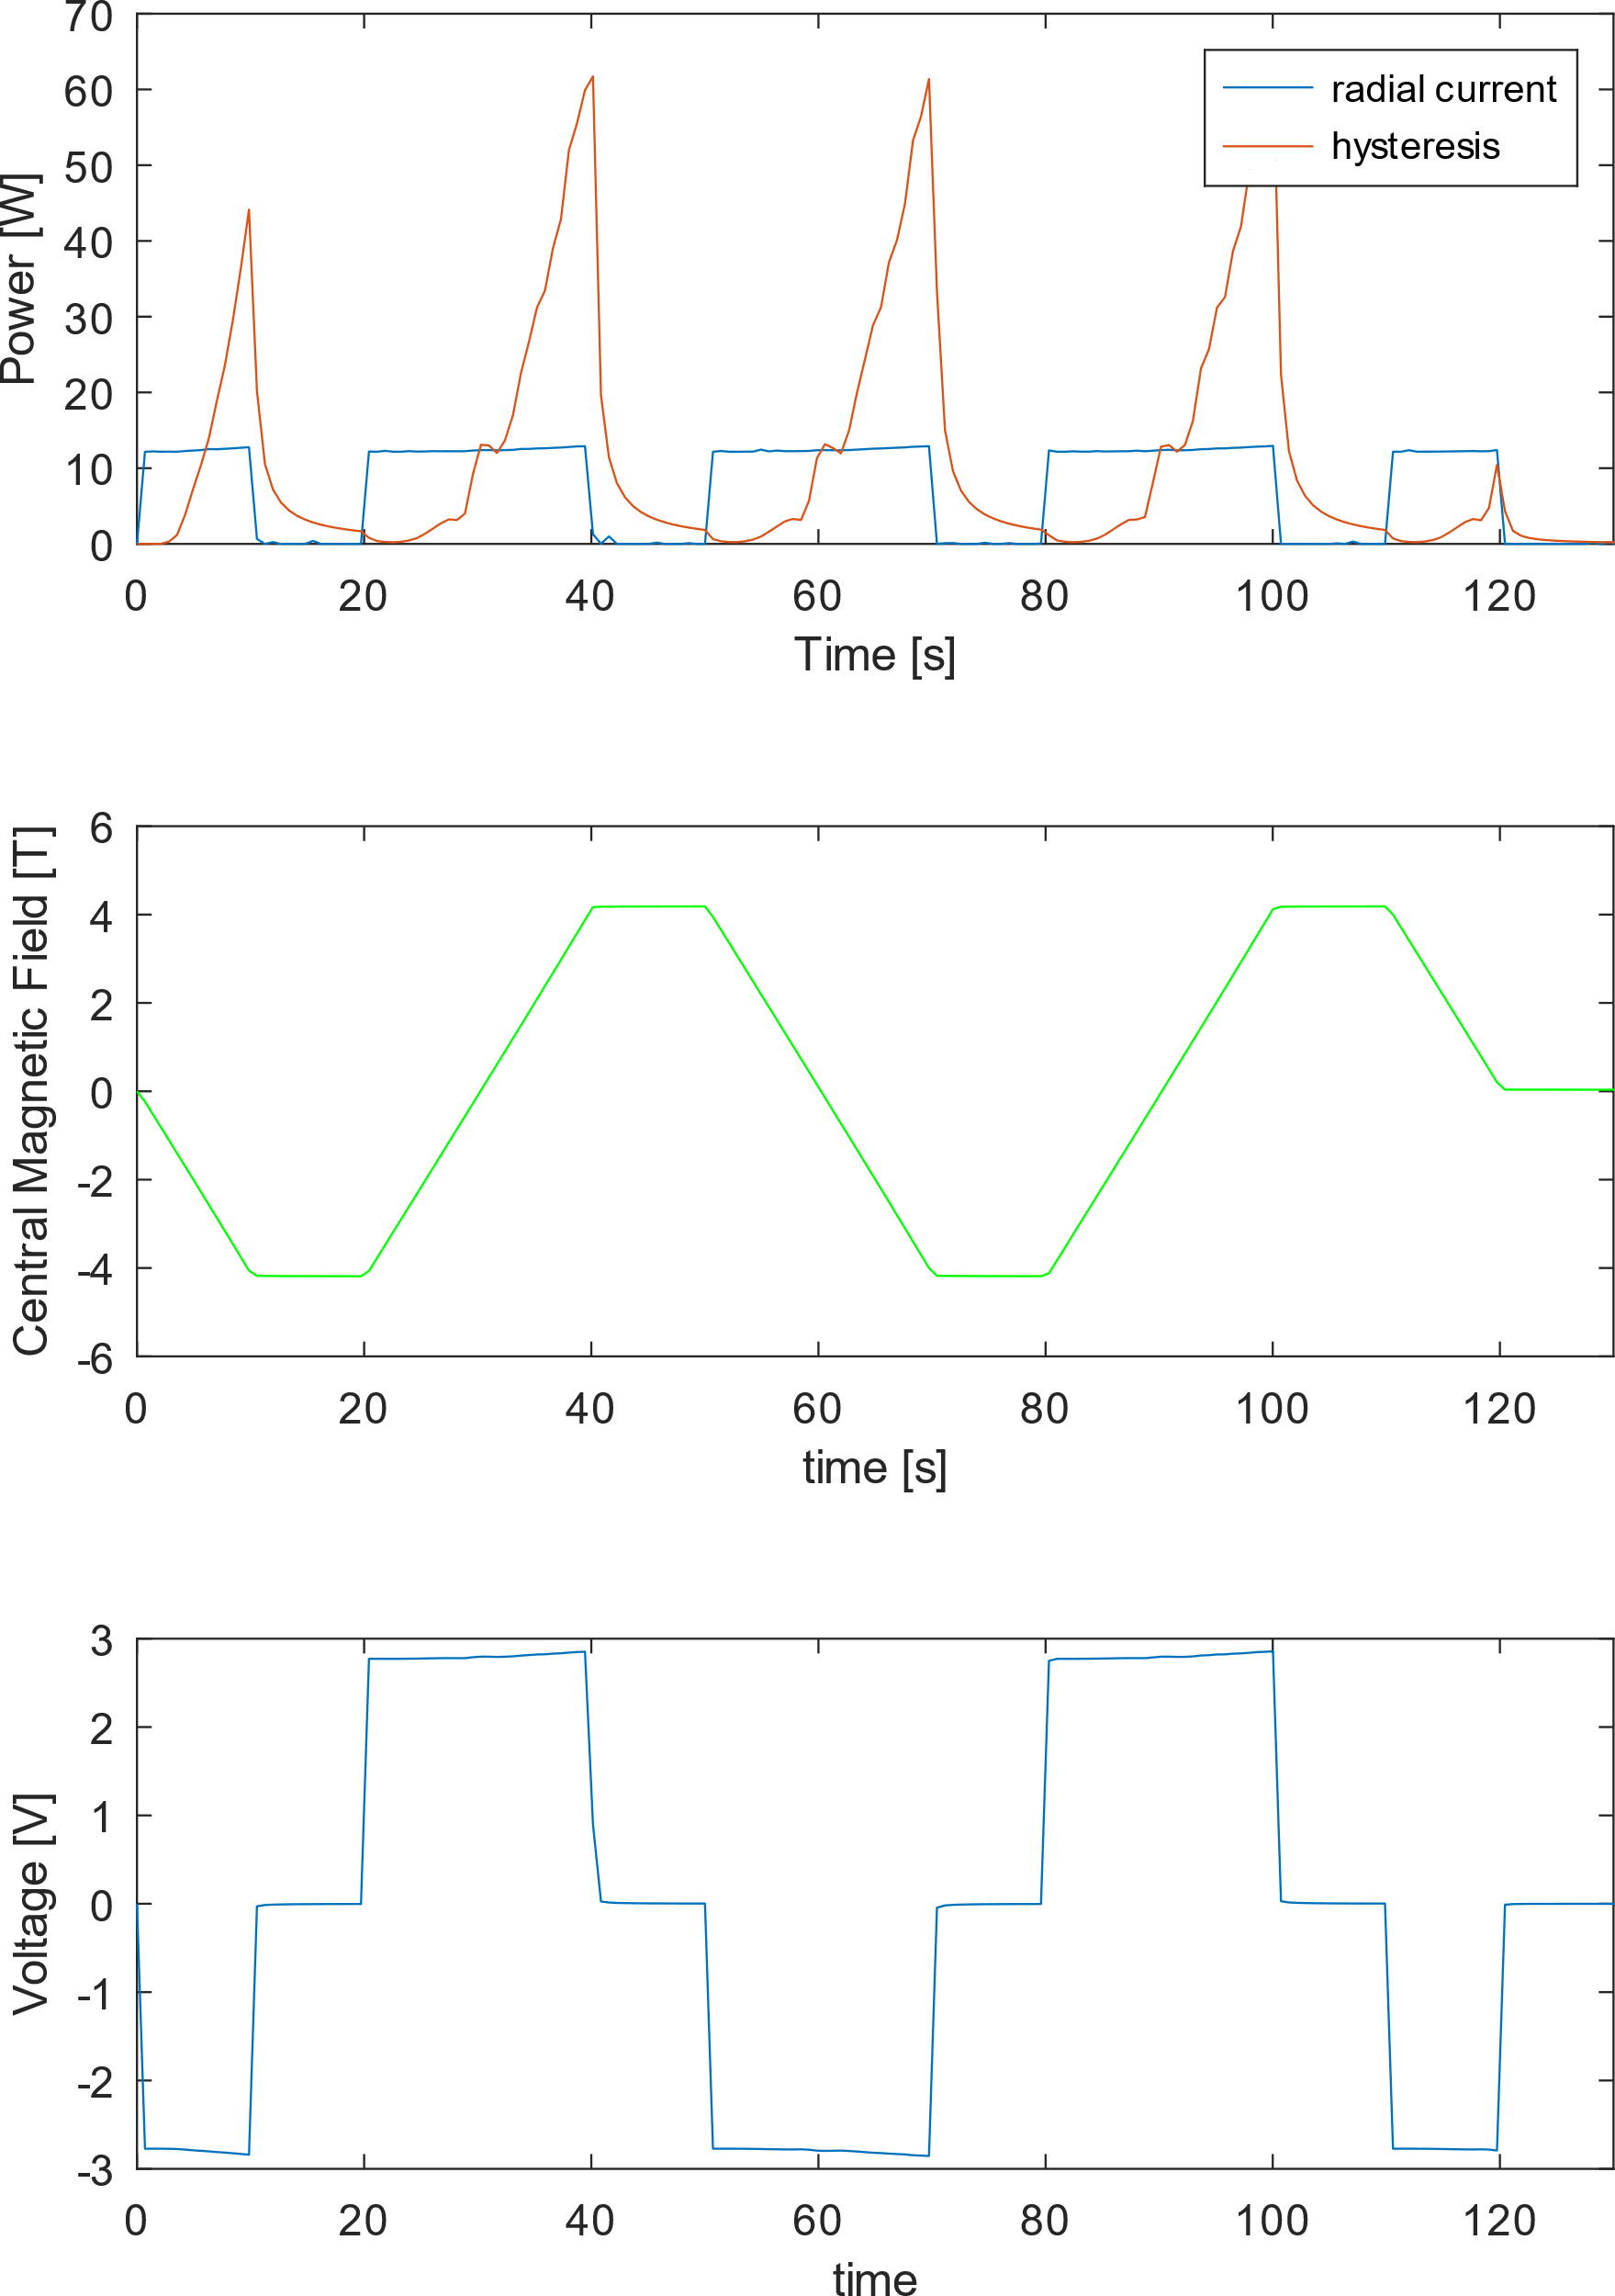
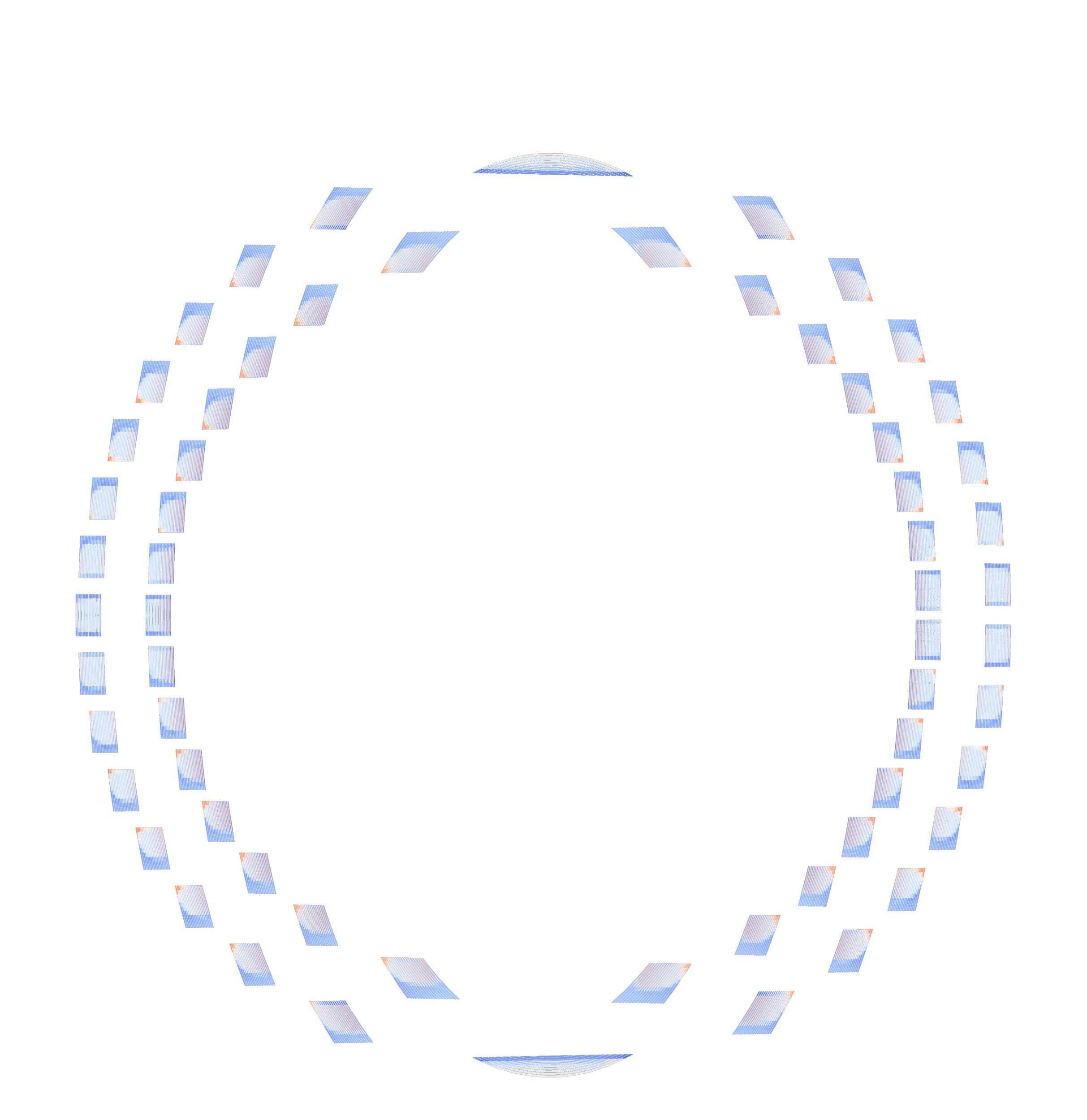
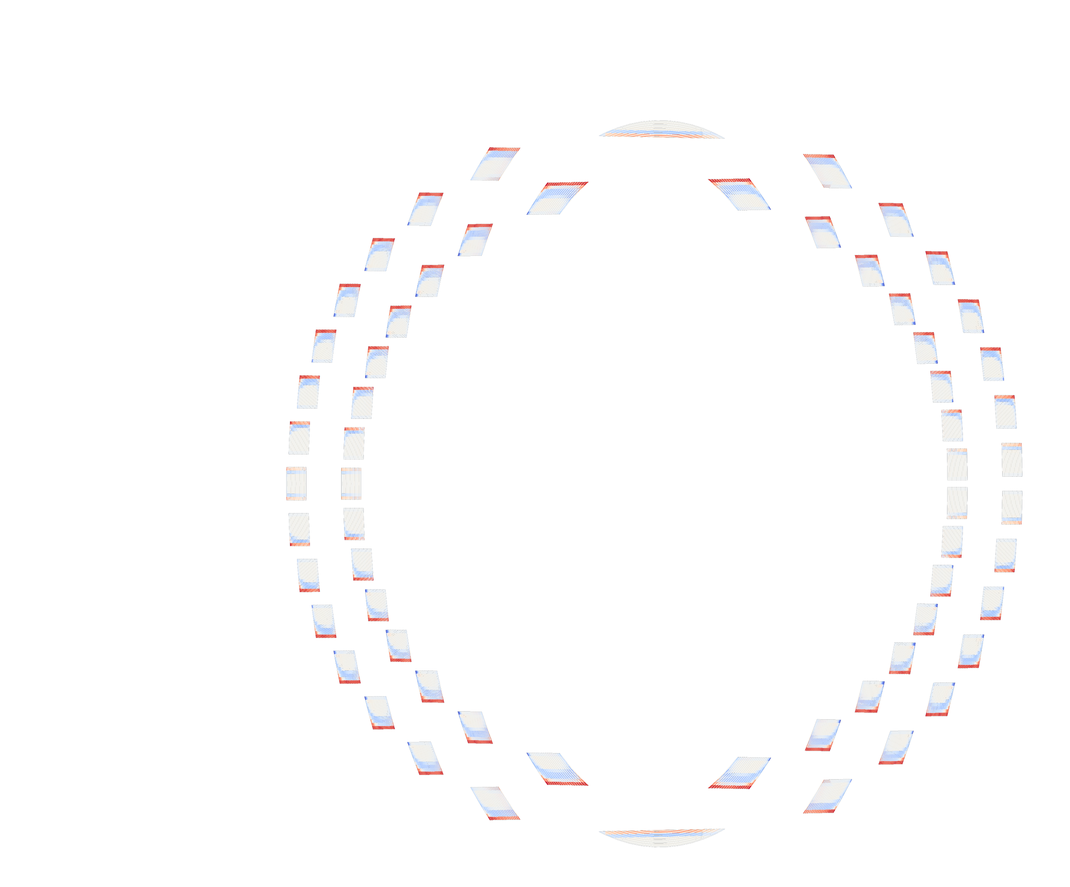
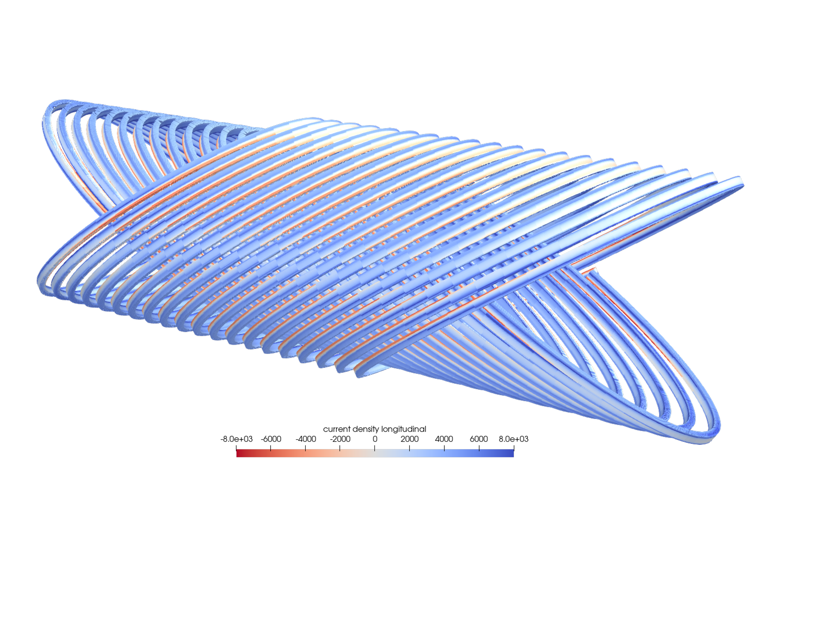
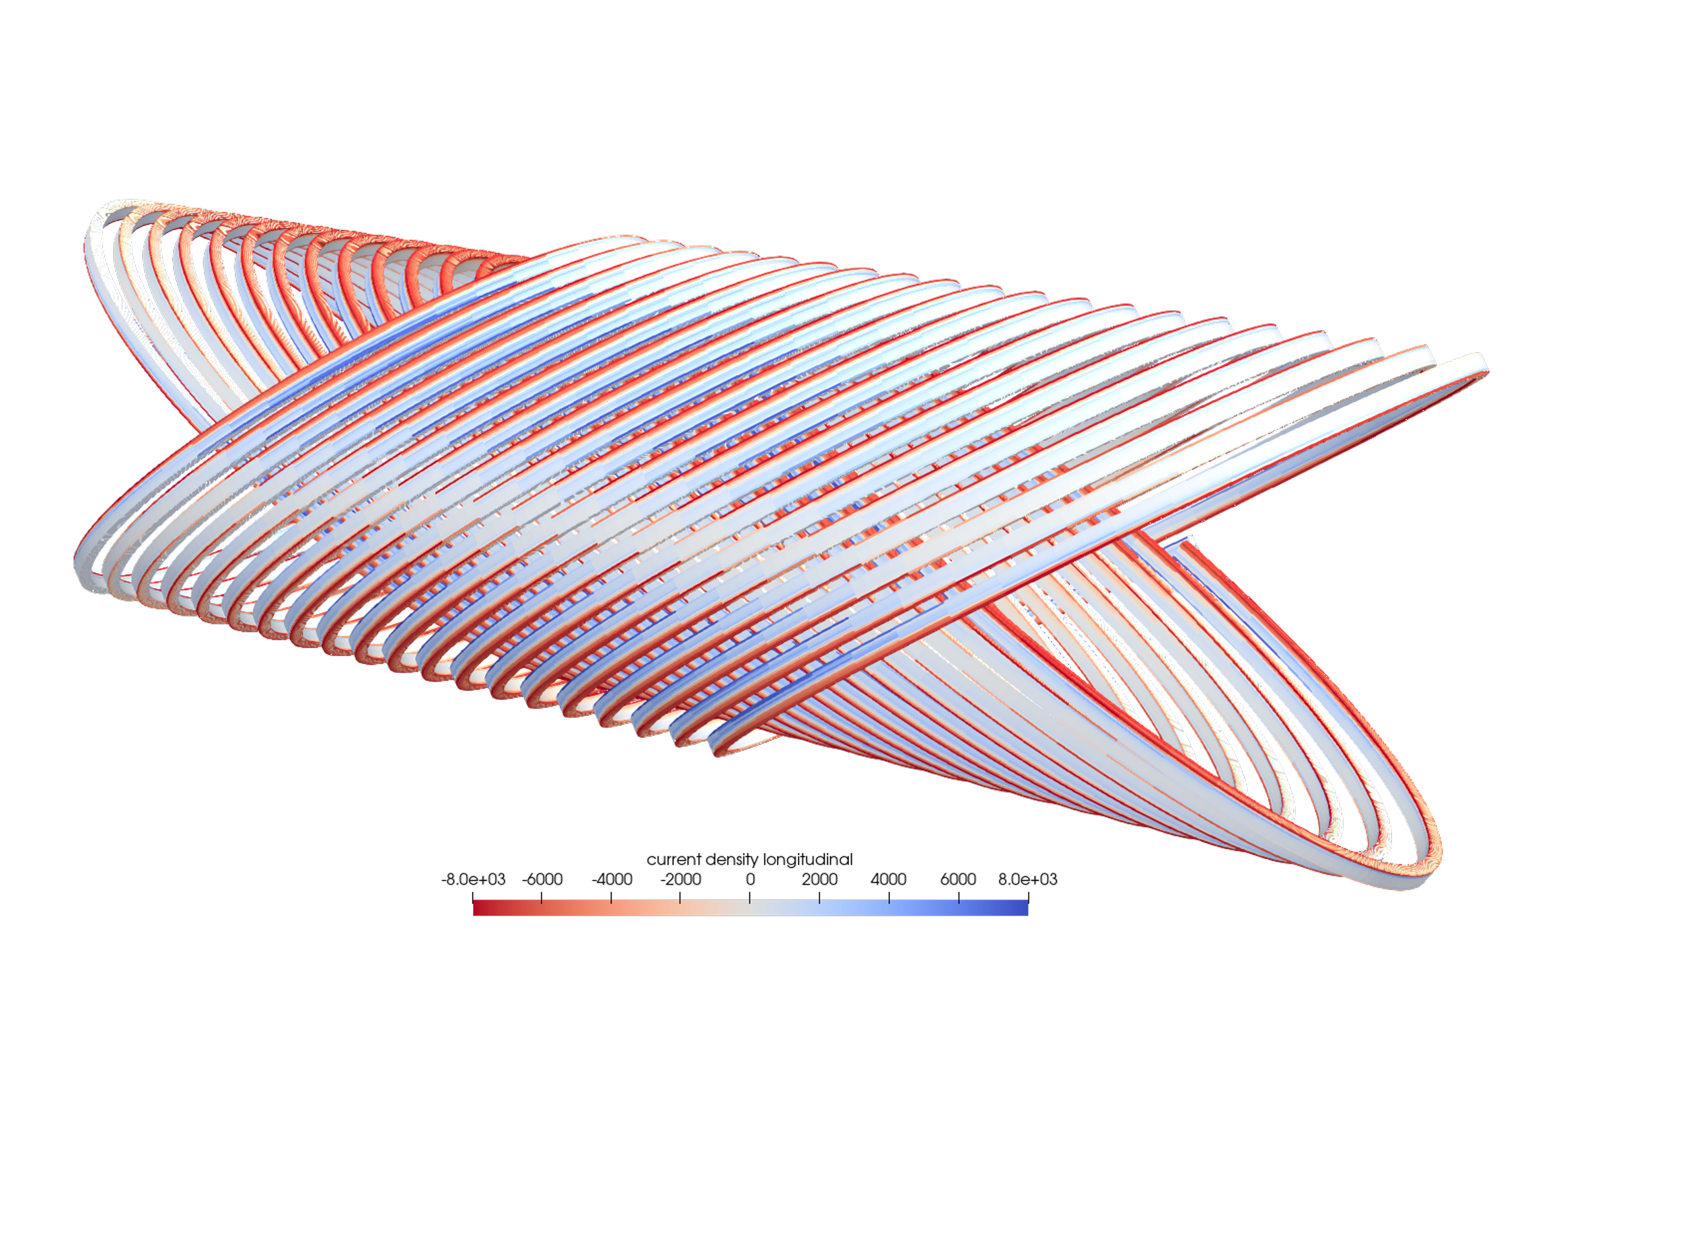
AC losses calculation for preliminary design HTS Magnet
current distribution in subscale model (20 turns) for a ±4 T cycle
t₁
t₂
End of 1° ramp (t₁)
Passing at 0 A (t₂)
High AC losses for the full scale magnet ($\sim$100 W peak for ±4 T cycle, $\sim 5$0 W peak for 0-4 T cycle 25 Ω cm²)
Estimated adiabatic heating in one cycle gives + 8 K
Difficult to extract by cryocoolers at 10 K
11
E. De Matteis – Superconductivity for Sustainable Energy Systems and Particle Accelerators - GSI, Darmstadt, Germany, 19 October 2023

Slide 12
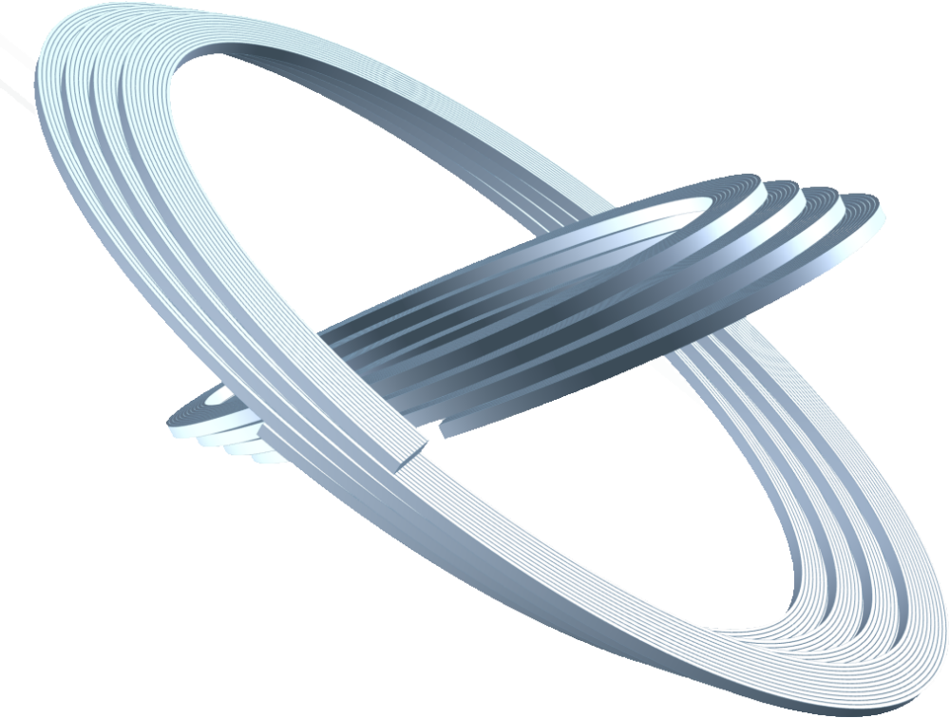


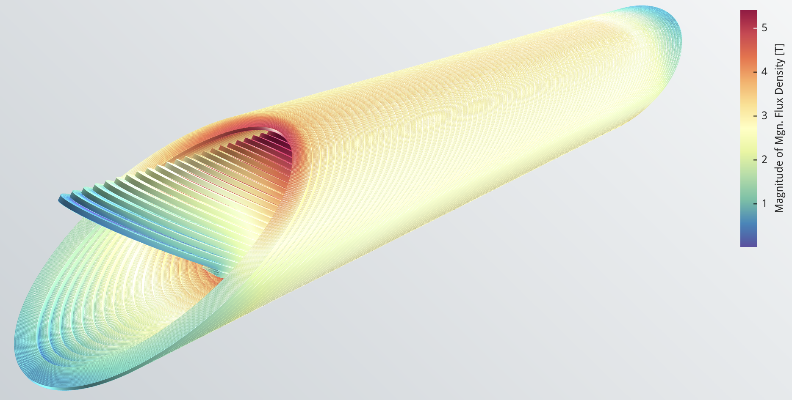
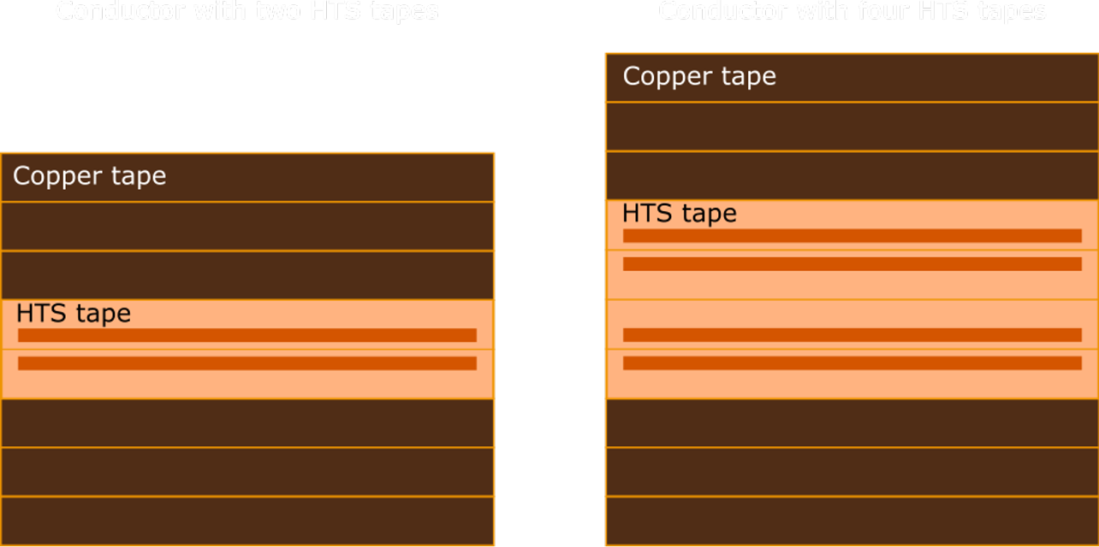
Further design¹ of the HTS magnet
Collaboration between Little Beast Engineering (Jeroen van Nugteren) and INFN LASA
4T dipole with a new Top of 20 K (> 10 K of margin):
Superconductor ReBCO (Tapes) -Fujikura 660 A @ (20K, 5T);
Frenet-Serret frame used for the conductor geometry;
Insulation option for the conductor with Cu stabilizer is pursued.
Two further design options:
2-tapes cable (980 A)
4-tapes cable (1990 A)
Soldering all tapes inside the cable under consideration;
¹S. Sorti, E. De Matteis, ‘’First Engineering design of HTS demonstrator ’’, IFAST WP8 Deliverable 8.3, Zenodo, https://doi.org/10.5281/zenodo.7930115
12
E. De Matteis – Superconductivity for Sustainable Energy Systems and Particle Accelerators - GSI, Darmstadt, Germany, 19 October 2023

Slide 13
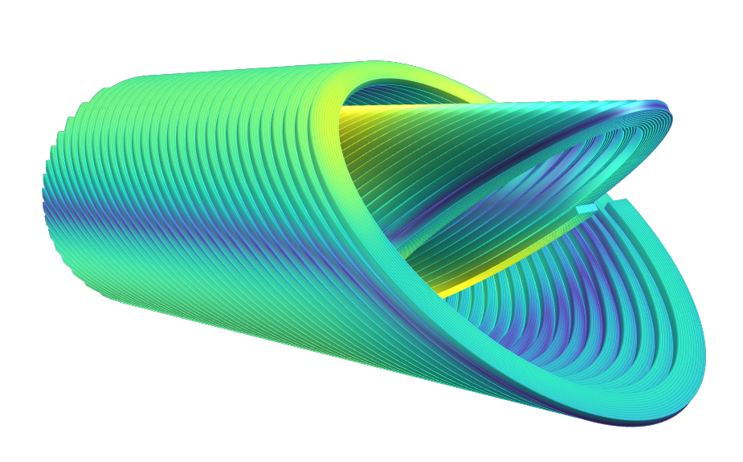
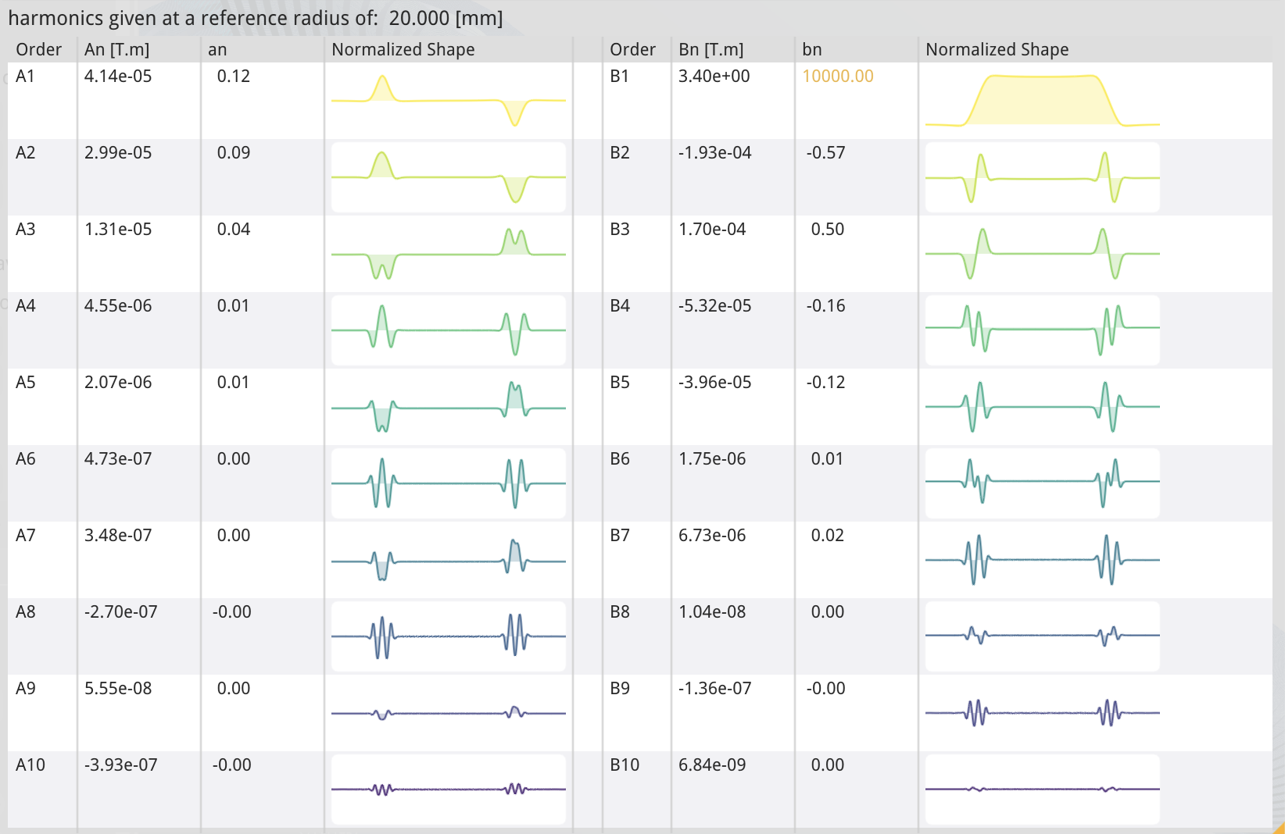
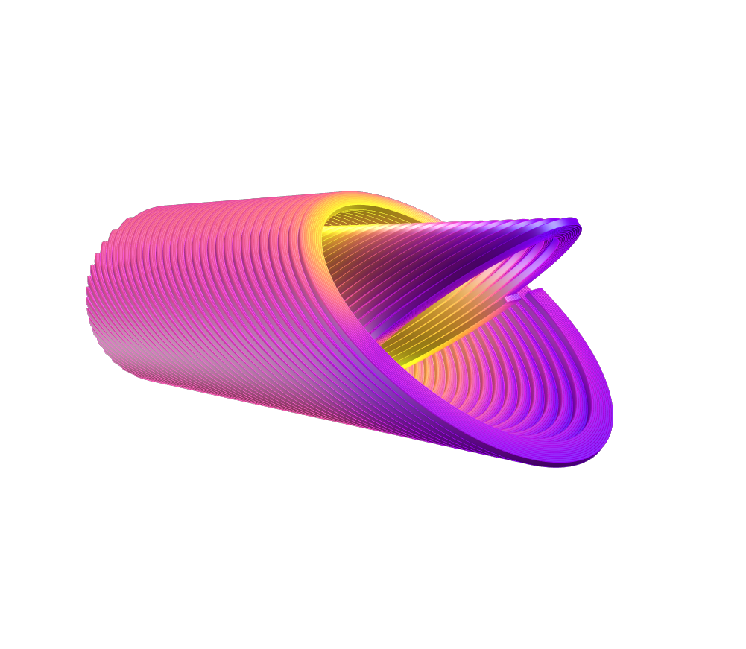
Magnetic design
LOADLINE FRACTION [%]
80
Accelerator-level field-quality (integral below-unit), no iron yoke (shielding open problem);
Loadline margin expectably 20-25% (reference tape has 660 A at 20 K, 5 T with a current-per-tape in cable of 500 A);
70
60
50
40
30
FLUX DENSITY [T]
4.5
4.0
3.5
3.0
2.5
2.0
1.5
1.0
0.5
13
E. De Matteis – Superconductivity for Sustainable Energy Systems and Particle Accelerators - GSI, Darmstadt, Germany, 19 October 2023

Slide 14
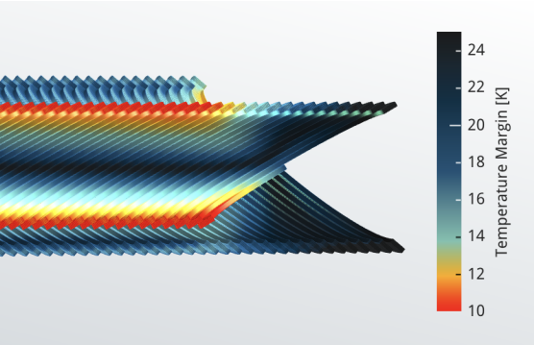
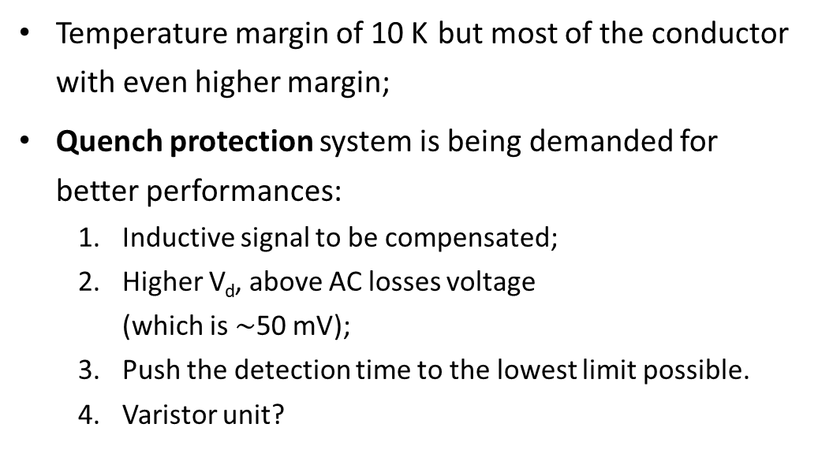
Temperature margin and Quench protection
Temperature margin of 10 K but most of the conductor with even higher margin;
Quench protection system is being demanded for better performances:
  Inductive signal to be compensated;
  Higher V_{d}, above AC losses voltage
  (which is $\sim$50 mV);
  Push the detection time to the lowest limit possible.
  Varistor unit?
 | Two HTS tapes | Four HTS tapes
 | 350 µm | 600 µm | 700 µm
V_{Th} | 0.2 V | 0.2 V | 0.3 V
t_{d} [s] | T_{hot-spot} [K] | T_{hot-spot} [K] | T_{hot-spot} [K]
0.01 | 224 | 224 | 241
0.02 | 235 | 238 | 252
0.03 | 242 | 252 | 264
0.04 | 253 | 268 | 277
0.05 | 263 | 284 | 290
0.06 | 275 | 302 | 304
14
E. De Matteis – Superconductivity for Sustainable Energy Systems and Particle Accelerators - GSI, Darmstadt, Germany, 19 October 2023

Slide 15
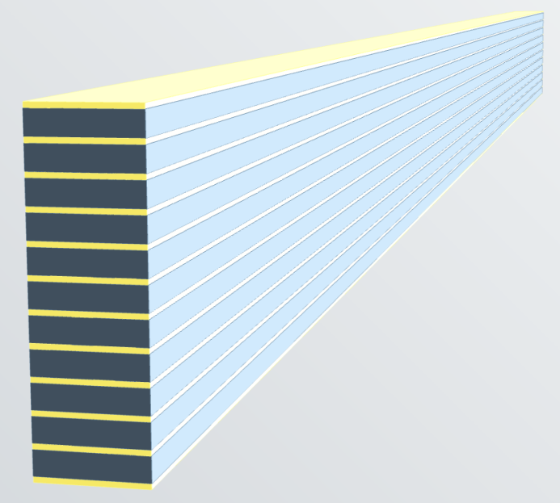
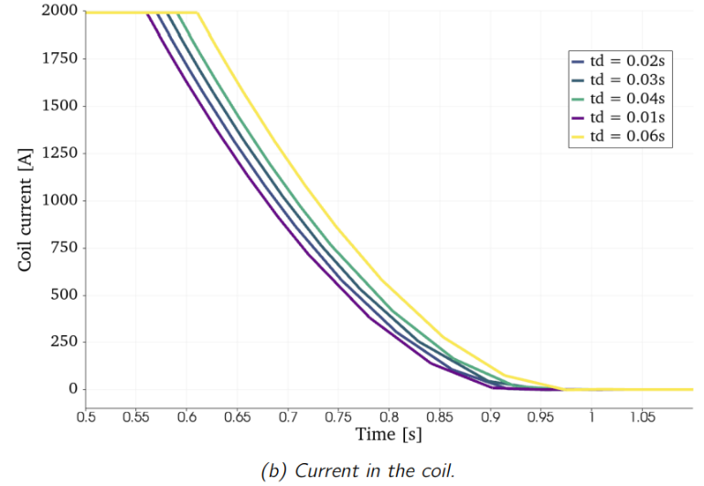
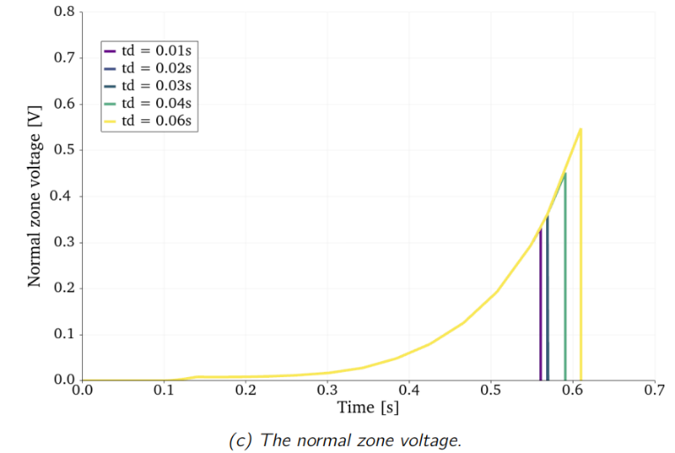
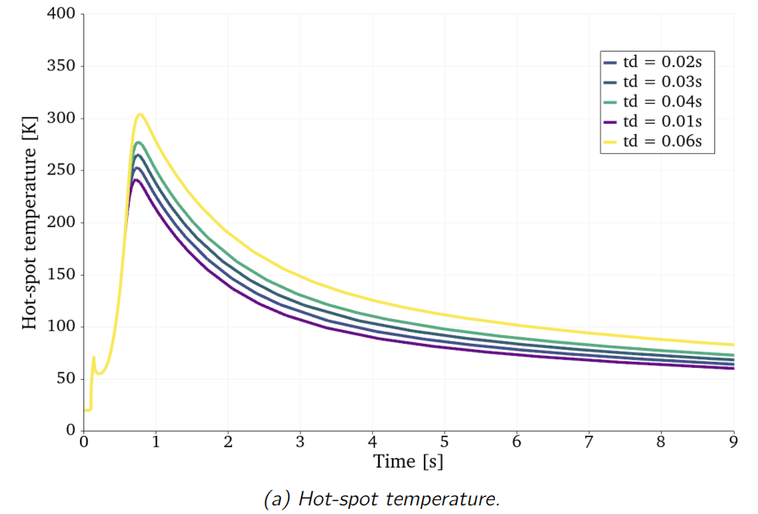
Quench analysis
Adiabatic quench analysis:
A transverse background field of 4 T is applied. The magneto resistance of the copper is also taken into account during.
quench detection voltage threshold of 0.3 V, a protection delay of 20 ms and a protection voltage of 500 V using a varistor unit;
350 μm and 700 μm of Cu stabilizer for the two-tape and four-tape designs, (peak temperature within 250 K).
200 mm long CCT layer with 11 sub-layers, four HTS tapes per sub-layer and 700 µm copper stabilizer, for different quench protection delays.
15
E. De Matteis – Superconductivity for Sustainable Energy Systems and Particle Accelerators - GSI, Darmstadt, Germany, 19 October 2023

Slide 16
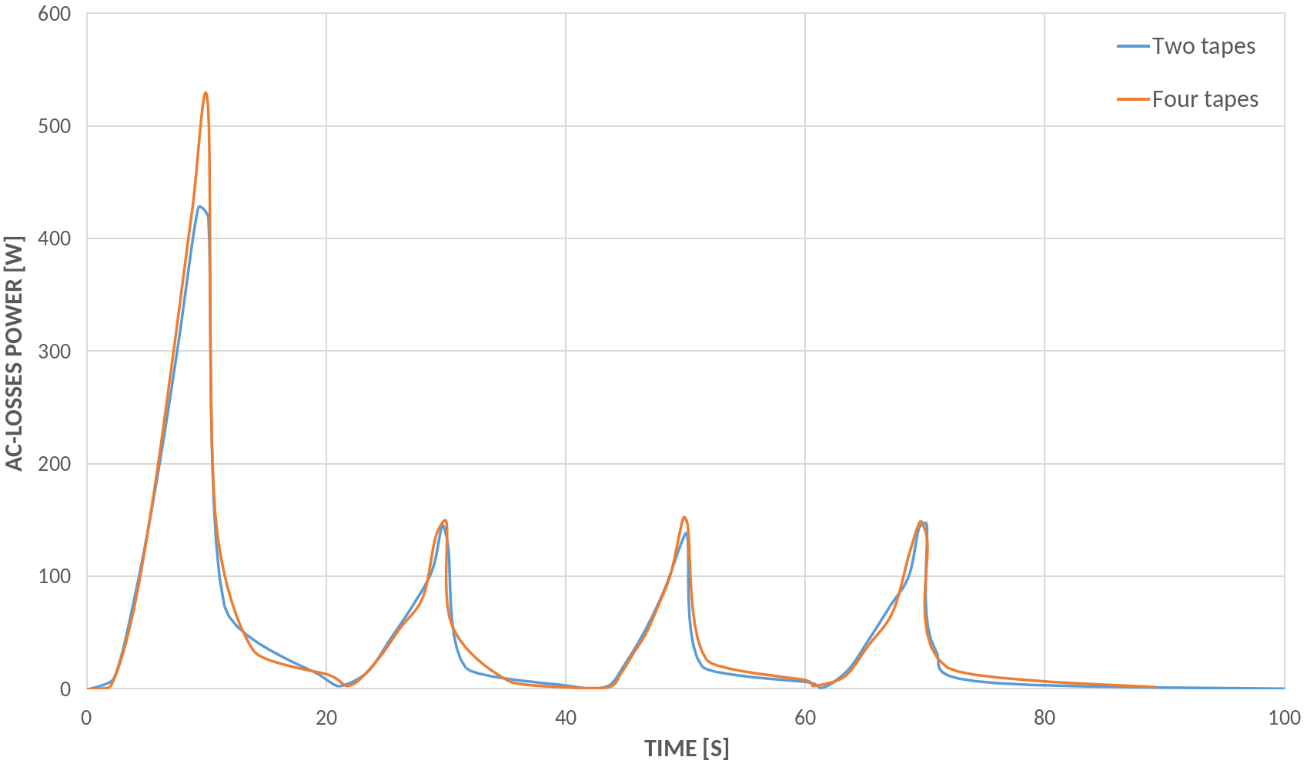
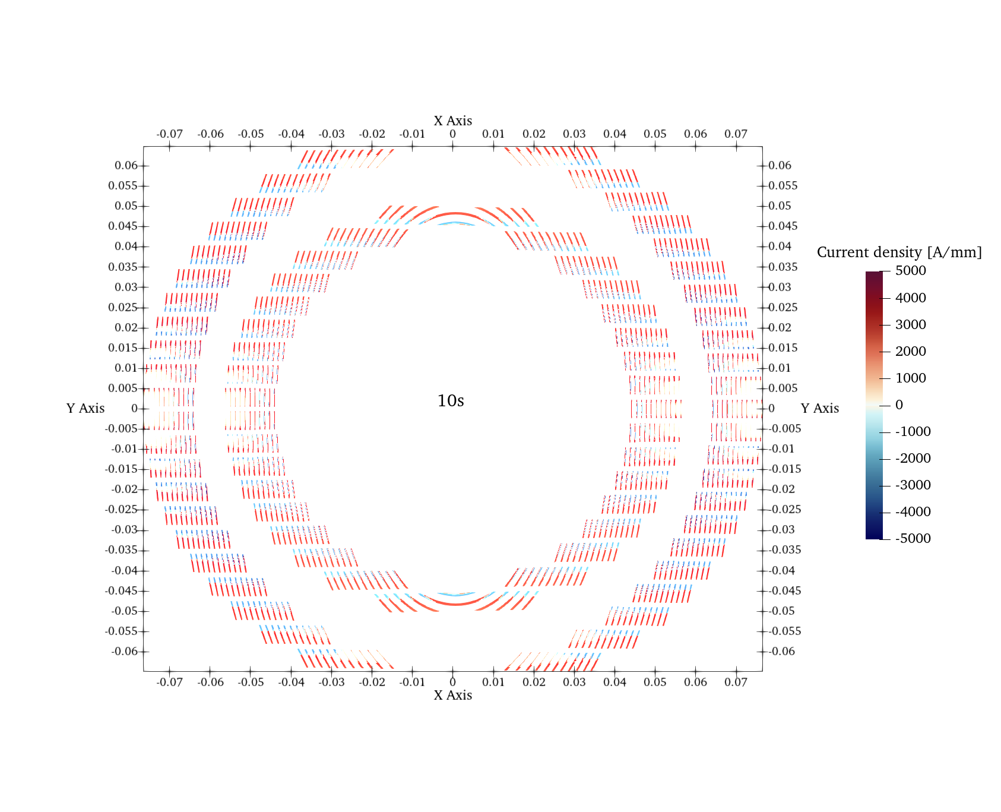
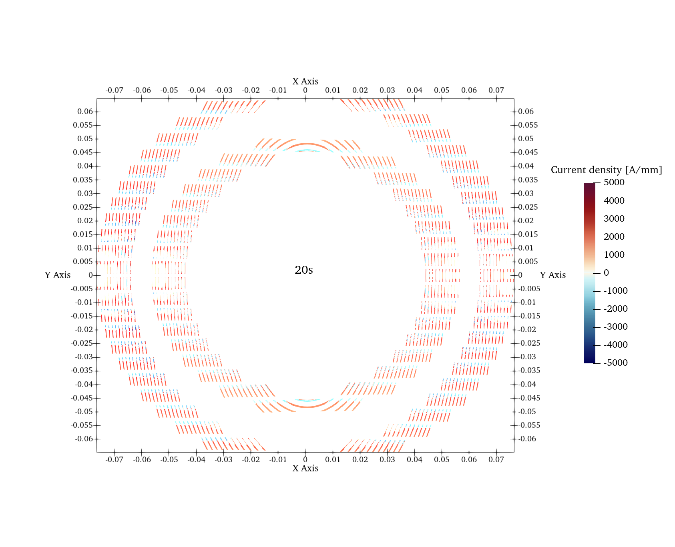
AC losses
The AC-losses during operating for both designs are on average 50 W. This is compatible with a conduction cooling system at 20 K.
1) No need of helium gas;
2) Power efficiency of cryocooler higher at 20 K wrt 4.5 K;
16
E. De Matteis – Superconductivity for Sustainable Energy Systems and Particle Accelerators - GSI, Darmstadt, Germany, 19 October 2023

Slide 17
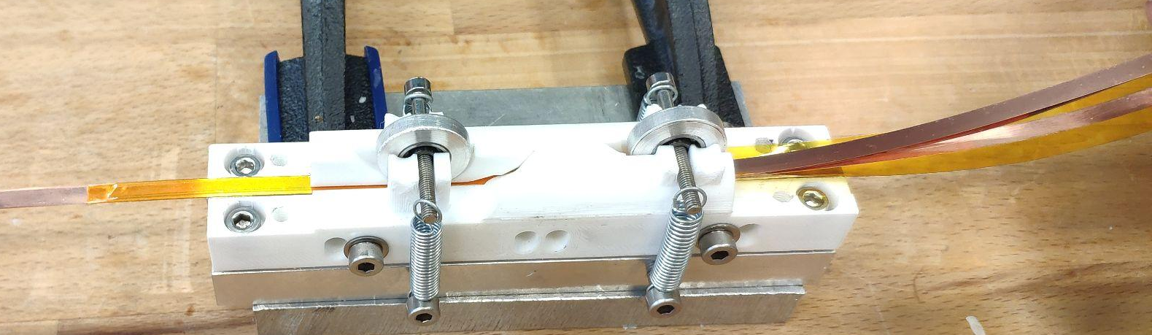
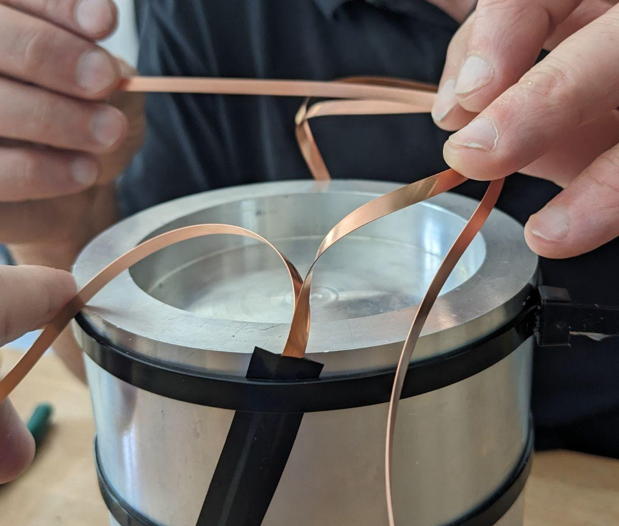
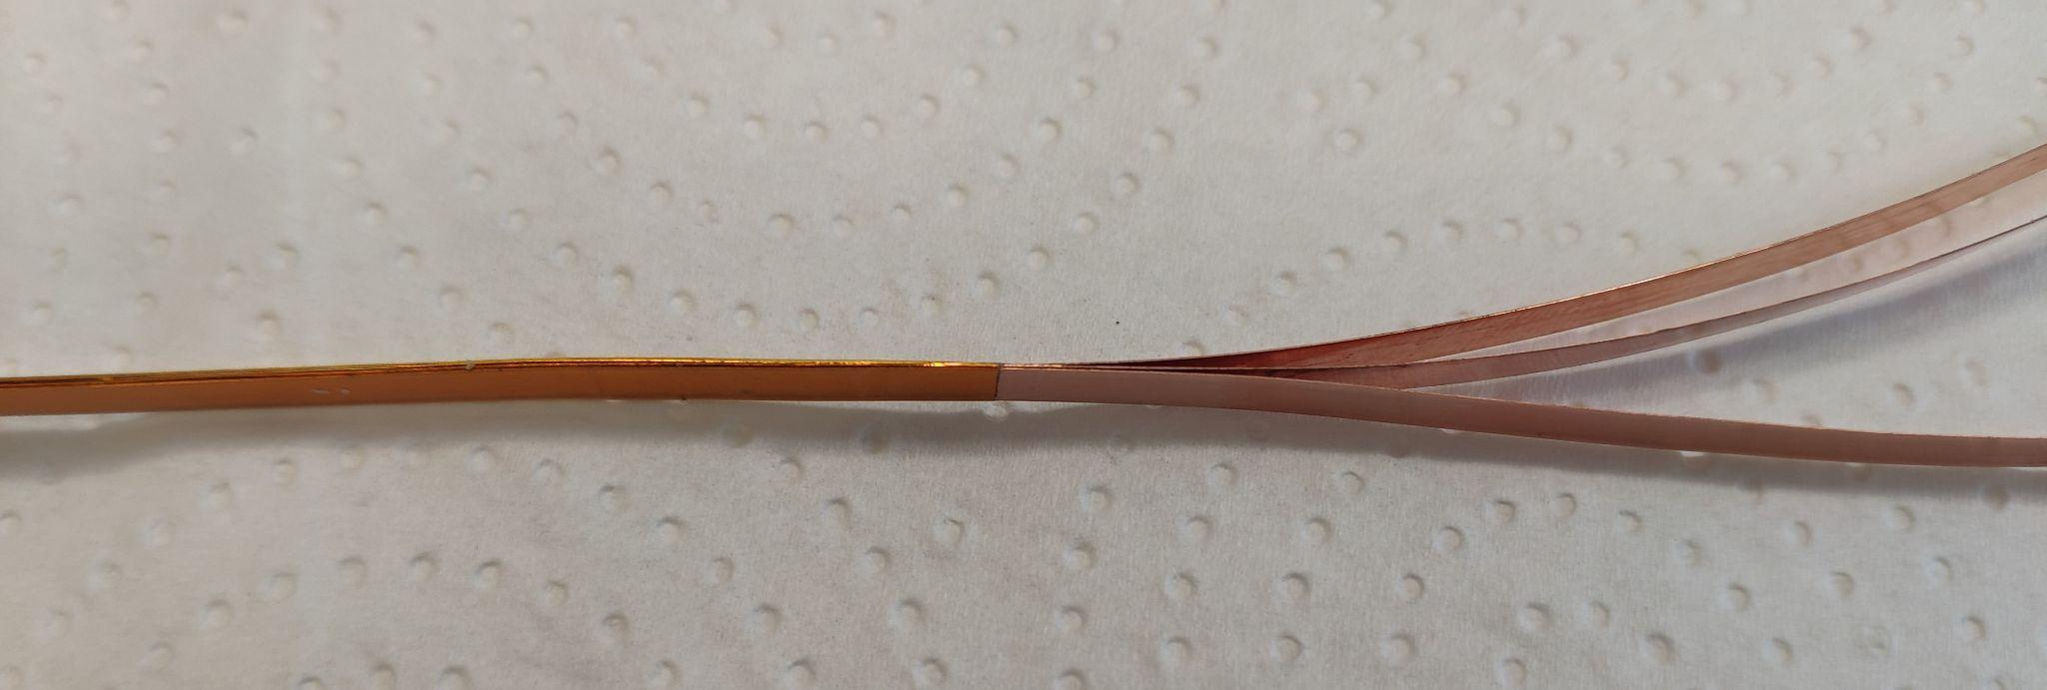
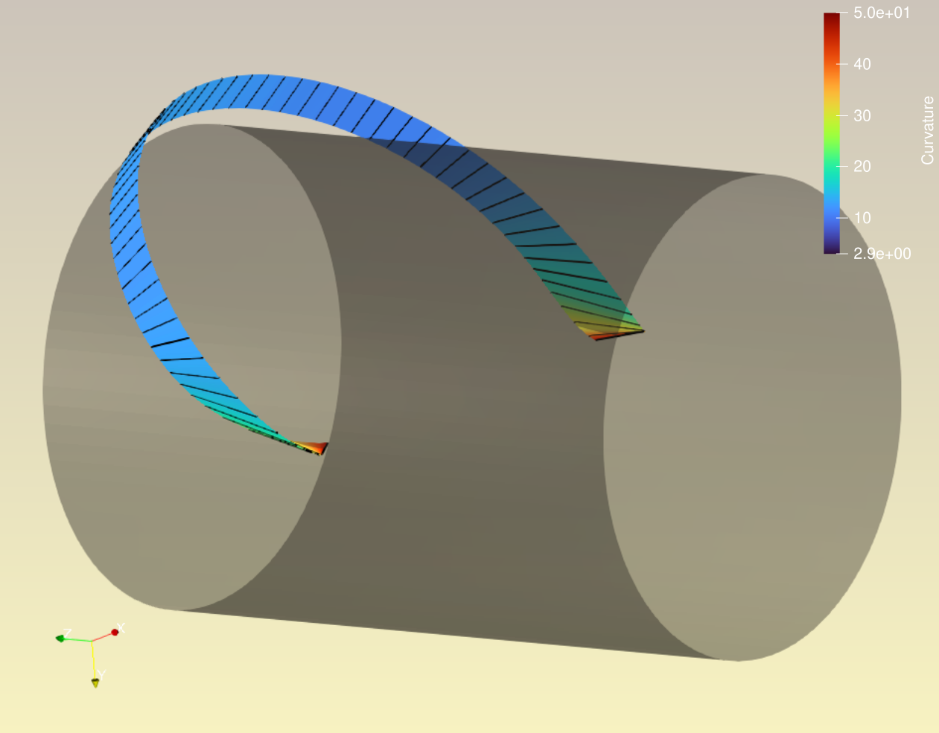
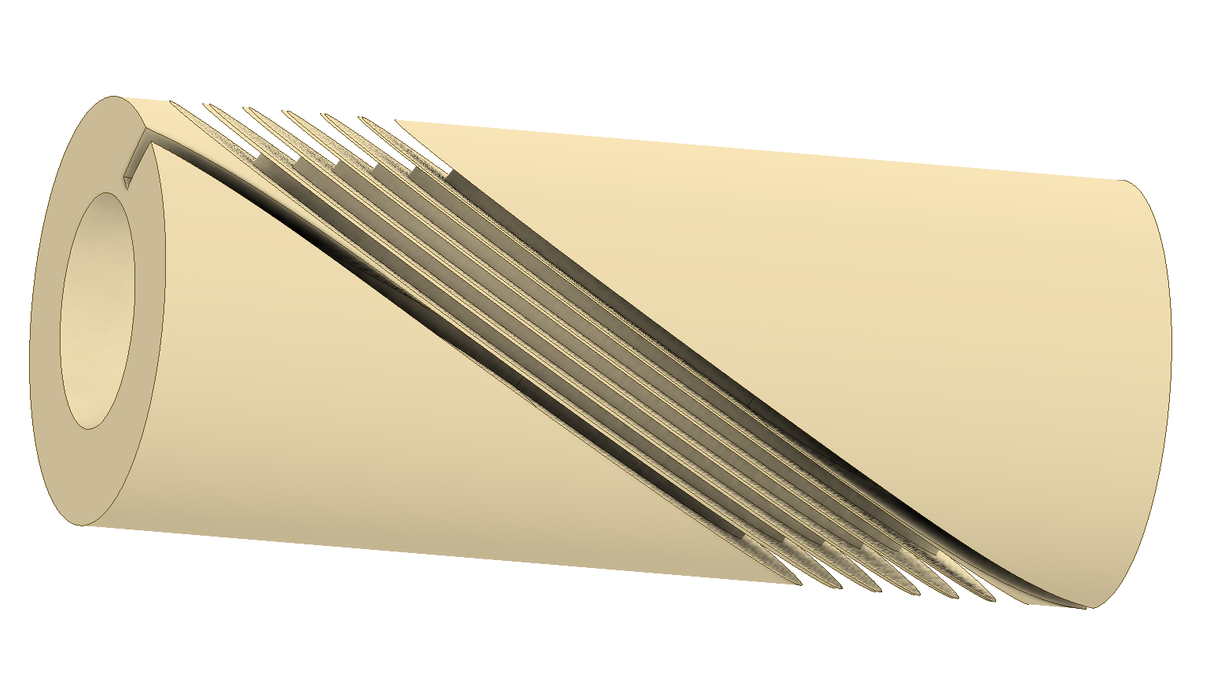
Cabling and former progress
C++ library development for tape geometry optimization
Looking for possible splice geometries
Splice geometry is highly non-trivial
Making short samples of kapton-insulated tape stacks
VBScript macro to build 3D grooves
(C++ → Inventor CAD)
Variable-pitch test former designed w/ optimized start/end sections
17
E. De Matteis – Superconductivity for Sustainable Energy Systems and Particle Accelerators - GSI, Darmstadt, Germany, 19 October 2023

Slide 18
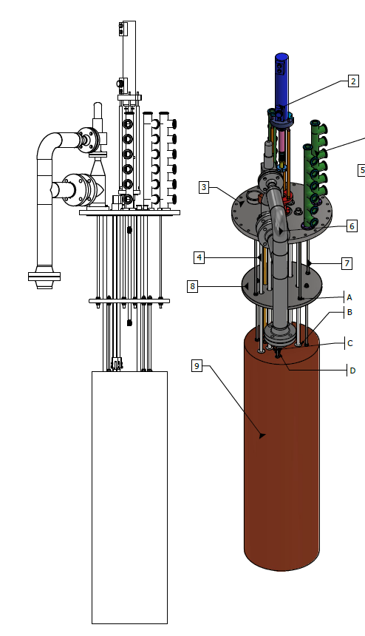

Test facility and HTS tape
Magnet test programmed at INFN-LASA (Milan):
  Upgrade of one test facility at INFN-LASA:
  Customized insert for the HTS CCT (1 kA,10 -50 K);
  Funded in the frame of EU recovery project IRIS (presented this morning by L. Rossi);
The procurement of HTS tape is underway by CERN (A.Ballarino);
  Faraday Factory Japan (about 2.5 km);
  Delivery foreseen in the next months.
18
18
E. De Matteis – Superconductivity for Sustainable Energy Systems and Particle Accelerators - GSI, Darmstadt, Germany, 19 October 2023

Slide 19
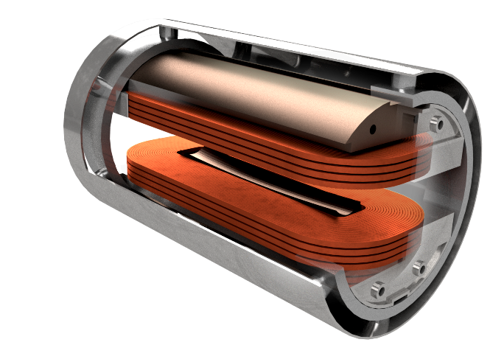

Innovative Research Infrastructure on applied Superconductivity (IRIS) project
ESMA: Energy Saving Magnet for Accelerators to be an HTS, conduction-cooled magnet.
Iron insert
Three main scopes:
  Start a focused program with basic R&D on HTS;
  demonstrator for accelerator-like magnets (transverse fied with accessible bore) employing HTS operating above LHe temperature: 10-20K;
  User magnet for conductor and large current cable testing at INFN Genova (providing background fields in the 2 – 10 T range).
Thermal shield
Racetracks
See talk of L. Rossi (this morning)
Endplates
Central field B₀ (min. accept) | tesla | 10 (8)
Free aperture | mm | $∅$70
Good field region uniformity | N/A | ±1.5%
Good field region extension | mm | H50xV30xL350
Operating temperature | K | 20
Technology-wise it serves both for FCC or Muon-C magnets, but in general for future Accelerator magnets oriented to Energy saving.
19
E. De Matteis – Superconductivity for Sustainable Energy Systems and Particle Accelerators - GSI, Darmstadt, Germany, 19 October 2023

Slide 20



Synergy IRIS - I.FAST (and beyond)
Preparation of the facility for cold measurements;
  I.FAST CCT based on HTS will be a conduction-cooled magnet as ESMA dipole;
Common studies related to the joint/splice technology;
  Tests ongoing at LASA for ESMA;
  Cold measurements for the I.FAST CCT;
Superconducting Magnet Laboratory (SML) – IRIS at LASA:
  New equipment for manufacturing small/medium size SC magnets: winding machines, ovens for heat treatment and impregnation, presses for curing, collaring and welding;
  Additive manufacturing machines (metallic and plastic);
  Mechanical and electrical qualification of the magnets.
Great synergy with projects as I.FAST (especially looking at the future prospects of this and other projects).
20
E. De Matteis – Superconductivity for Sustainable Energy Systems and Particle Accelerators - GSI, Darmstadt, Germany, 19 October 2023

Slide 21
Conclusions
Research and medical accelerators need big size and cost infrastructure;
Superconducting magnets, as CCT, based on superconductor can help make these structures compact and economically sustainable (reduce the power consumption);
IFAST WP8 is oriented to explore CCT magnets based on LTS and HTS (main goal);
IFAST CCT magnet based on ReBCo tape will operate at 20 K, conduction cooled without helium gas temperature range where the power efficiency of the cryocooler increases;
IRIS research infrastructure can work in synergy with projects as I.FAST (especially looking at the future prospects of this and other projects).
21
E. De Matteis – Superconductivity for Sustainable Energy Systems and Particle Accelerators - GSI, Darmstadt, Germany, 19 October 2023

Slide 22

Thank you for your attention!
This project has received funding from the European Union’s Horizon 2020 Research and Innovation programme under GA No 101004730.
email: ernesto.dematteis@mi.infn.it

Slide 23

I.FAST WP8 – Task and timeline (magnets)
WP8 Innovative superconducting magnets | Coordination | Tasks | Task leader | Deputy-task leader
 | E. De Matteis (INFN) T. Lecrevisse (CEA) C. Roux (GSI) | 8.1 - Coordination and HTS Strategy Group | E. De Matteis (INFN) | A. Ballarino (CERN)
 |  | 8.2 – Preliminary Engineering design of combined CCT magnet | E. De Matteis (INFN) | D. Barna (Wigner Inst.)
 |  | 8.3 – Preliminary Engineering design of HTS CCT | S. Sorti (INFN) | A. Ballarino (CERN)
 |  | 8.4 - Construction of combined CCT magnet demonstrator | Fernando Toral (CIEMAT) | D. Barna (Wigner Inst.)
 |  | 8.5 – Construction of HTS CCT magnet demonstrator | A. Echeandia (Elytt) | S. Sorti (INFN)
 |  | 8.6 – Development of ReBCO HTS nuclotron cable | T. Winkler (GSI) | C. Roux (GSI)
Task 8.1
Task 8.2
Task 8.3
Task 8.4
Task 8.5
E. De Matteis – Superconductivity for Sustainable Energy Systems and Particle Accelerators - GSI, Darmstadt, Germany, 19 October 2023

Slide 24




Innovative Research Infrastructure on applied Superconductivity (IRIS) project
Next Generation EU project (PNRR)
Ultimate goal to contribute to Fundamental Physics instrumentation (particle accelerators for post-LHC era) and to Societal Applications for green energy and medical applications.
6 poles for the new or renewed infrastructures: Frascati (INFN), Genova (INFN, CNR-Spin, Unige), Milano (INFN, Unimi – LASA lab), Napoli (Unina), Salento (Unisalento) e Salerno (INFN e Unisa).
LASA (Milano) is the hub and coordinates the activity
SC cables for energy transport
See talk of L. Rossi (this morning)
Courtesy A. Ballarino - CERN
24
Courtesy M. Pullia (CNAO –Italy)
E. De Matteis – Superconductivity for Sustainable Energy Systems and Particle Accelerators - GSI, Darmstadt, Germany, 19 October 2023

Slide 25

Canted-Cosine-Theta (CCT) Magnet
I
I
Current I flows in the two conductors so that the transverse magnetic field components add up and axial field components cancel each other out.
Total magnetic field
of the inner layer
Total magnetic field
of the external layer
+
=
25
E. De Matteis – Superconductivity for Sustainable Energy Systems and Particle Accelerators - GSI, Darmstadt, Germany, 19 October 2023

Slide 26


CCT schematics¹
Former
¹Gabriele Ceruti, “Preliminary Mechanical Design of a Superconducting Magnet Canted-Cosine-Theta (CCT) for a New Gantry for Hadron Therapy”, Master Thesis, 2022. https://cds.cern.ch/record/2808359
26
E. De Matteis – Superconductivity for Sustainable Energy Systems and Particle Accelerators - GSI, Darmstadt, Germany, 19 October 2023

