Slide 1
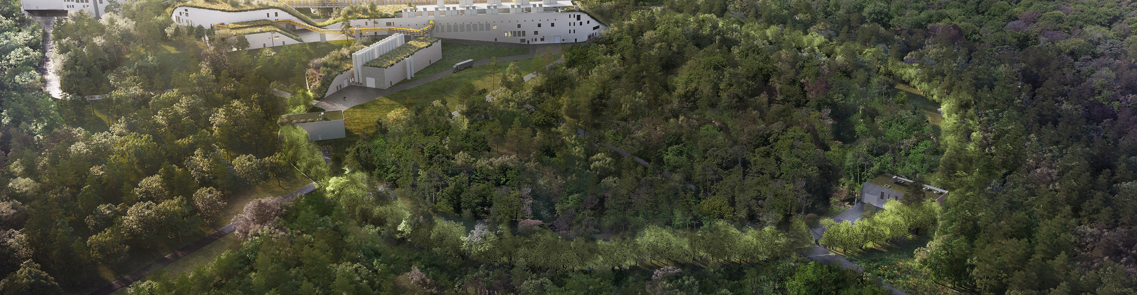


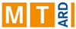


Enhancing Sustainability in Large-Scale Accelerators: Revamping Beam Lines with Superferric Magnets
Superconductivity for Sustainable Energy
Systems and Particle Accelerators
18th-20th October | GSI, Italy
Samuele Mariotto, Lucio Rossi, Stefano Sorti
samuele.mariotto@unimi.it
Ministero
dell'Università
e della Ricerca

Slide 2
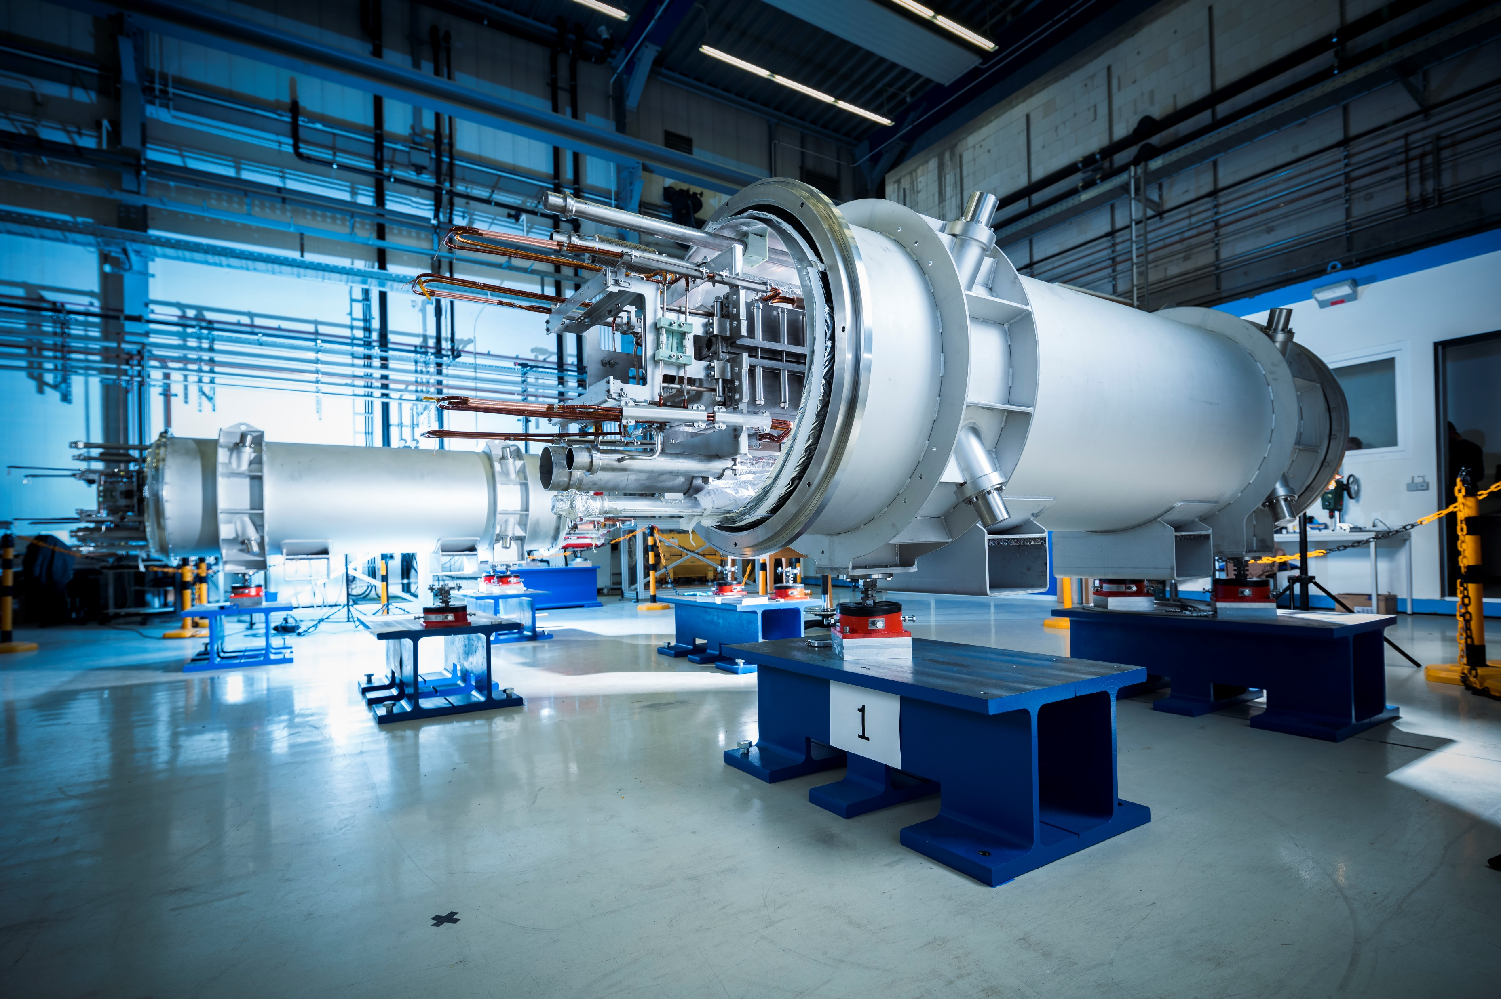
Overview
Energy consumption in particle accelerator
Superconductors instead of copper
PSI Case Study
CNAO Case Study
Conclusions

Slide 3
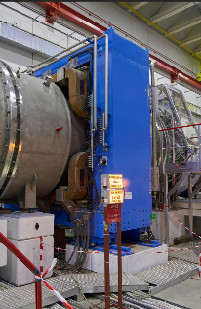
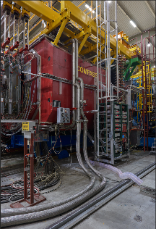

Problem: Large Energy Consumption
Energy consumption of particle accelerator facilities is expected to increase in the future:
Upwards electricity price trend is foreseen
Courtesy D. Tommasini, CERN
Need for «Improvement of energy efficiency»
European Strategy for Particle Physics 2020
«Cryogen-free superconducting magnets instead of common resistive magnet for heavy particles beam lines»
Objectives:
Use of MgB₂ or HTS conductors
Energy consumption 5-20 lower
Work @ T=8-20 K with solid conduction cooling to reduce cryogenic power consumption
MNP33-Dipole
NA62-CERN
7560 MWh
SM2-Dipole
Compass-CERN
6953 MWh

Slide 4
4 Possible ways
Revamping
Reuse the same iron yoke and magnet interfaces substituting copper with superconductors.
  Possible superconducting material for the coil: MgB₂ or HTS conductors
  Cheapest solution
Superferric magnets
Modified iron geometries optimizing the shape to accommodate the superconducting coils and exploit its potential for low power consumption
Coil dominated design
Use HTS conductors for high fields with coil geometries optimized according to beam requirements
  Suitable for higher field values compared to resistive or iron-dominated magnets
  Magnet dimensions reduced
Exotic designs
Compact and combined-function magnets
  Specific design used to reduce space in the beamline and reduction of magnet numbers

Slide 5
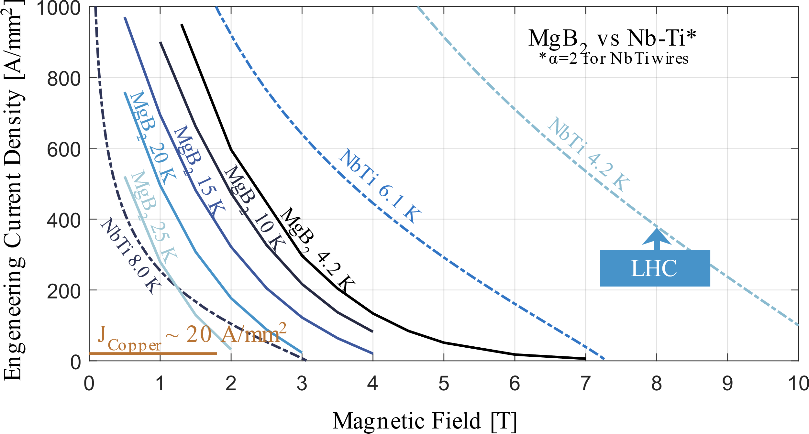
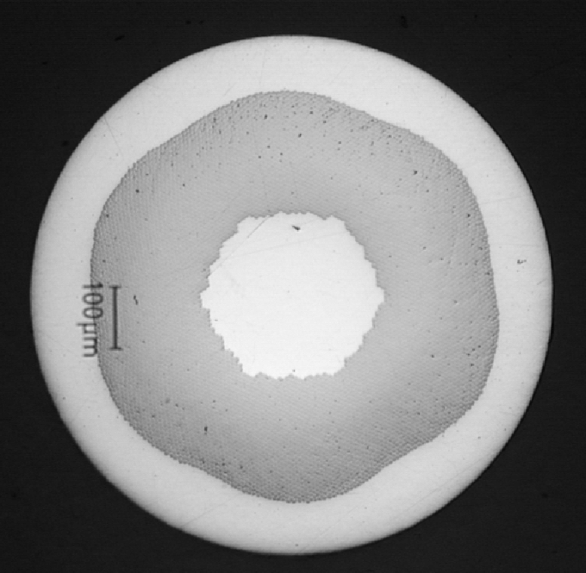

Superconductor Type
Nb-Ti
Nb₃Sn
MgB₂
K. Konstantopoulou, A. Ballarino, A. Gharib, A. Stimac, M. Garcia Gonzalez, A. T. Perez Fontenla, M. Sugano, “Electro-mechanical characterization of MgB2 wires for the Superconducting Link Project at CERN”, 2016, 8, 084005, Superconductor Science and Technology.
Why starting from MgB₂?
Round Wire, Easy winding and cabling, Low cost
WARNING: Strain Sensitivity 0.3% (1 $φ$ mm $↔$ 100 mm radius)

Slide 6

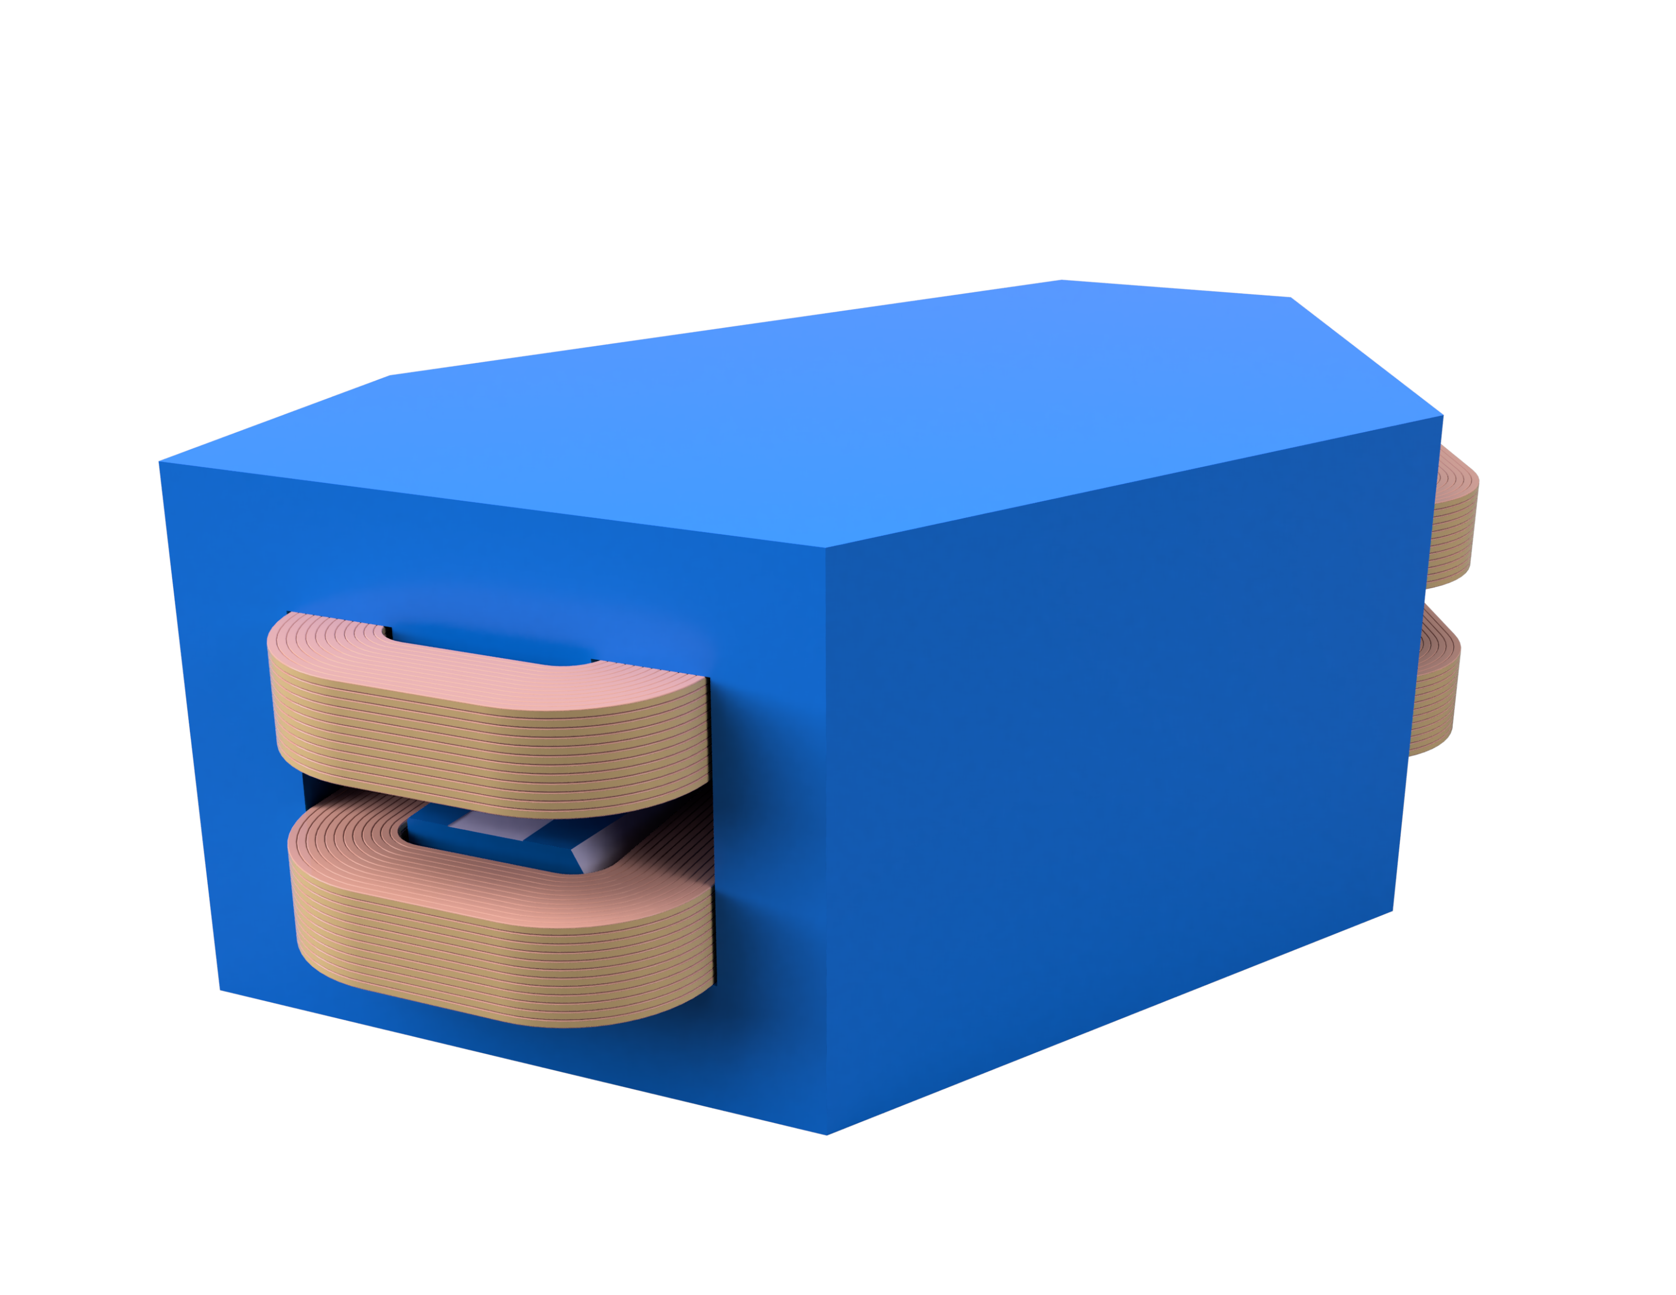
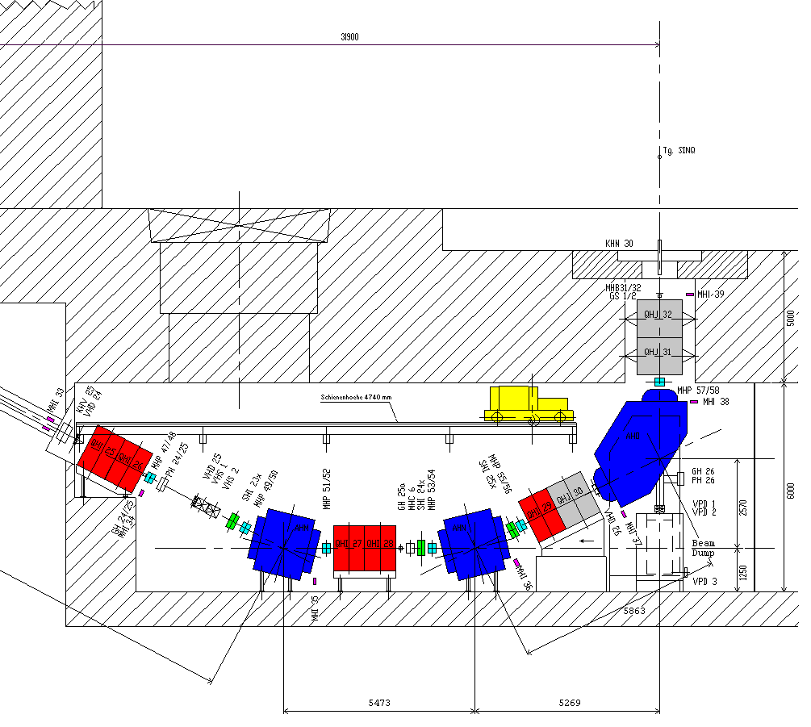
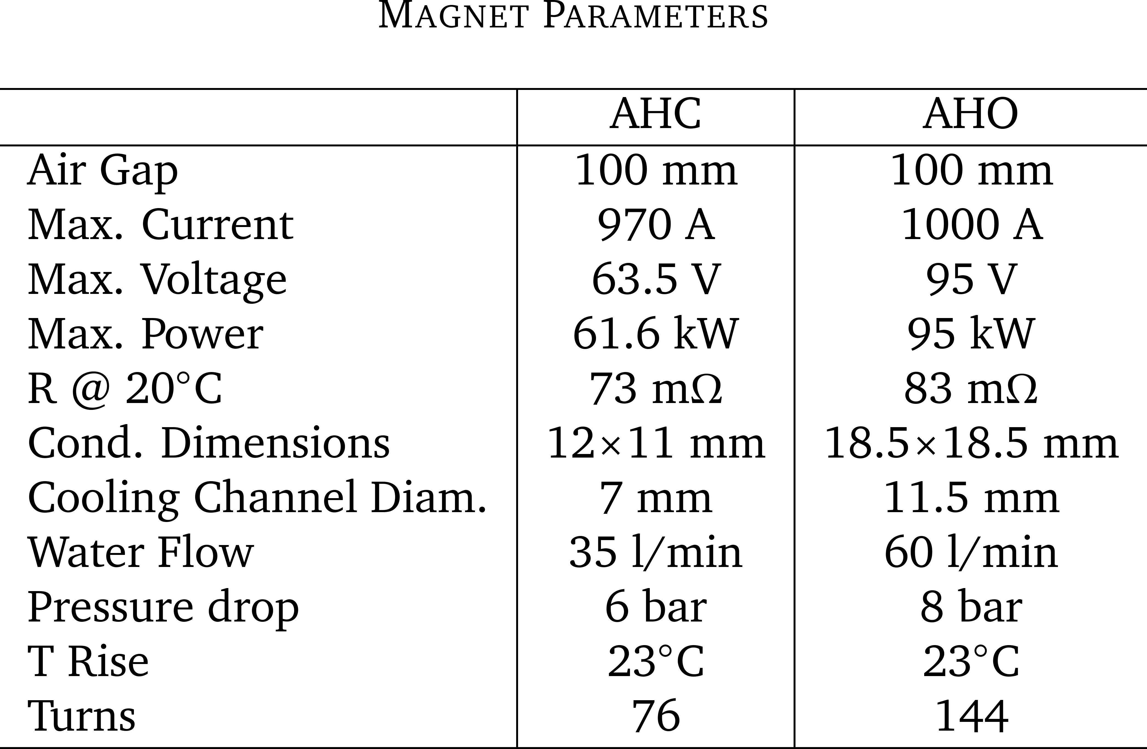
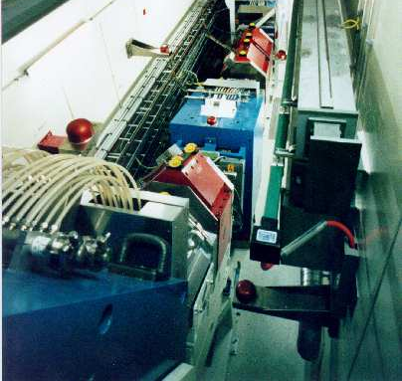
Steady state magnet case study
Iron Yoke
Originally a switching magnet, actually a bending unit before SINQ (Spallation source) with 50 tons of weight.
Produced field of 1.45 T on 2.780 m radius for 64 deg.
Cooling power 190 kW continuously mid-May to mid-Dec.
Copper Coils
715 MWh/year
SINQ beam line facility

Slide 7
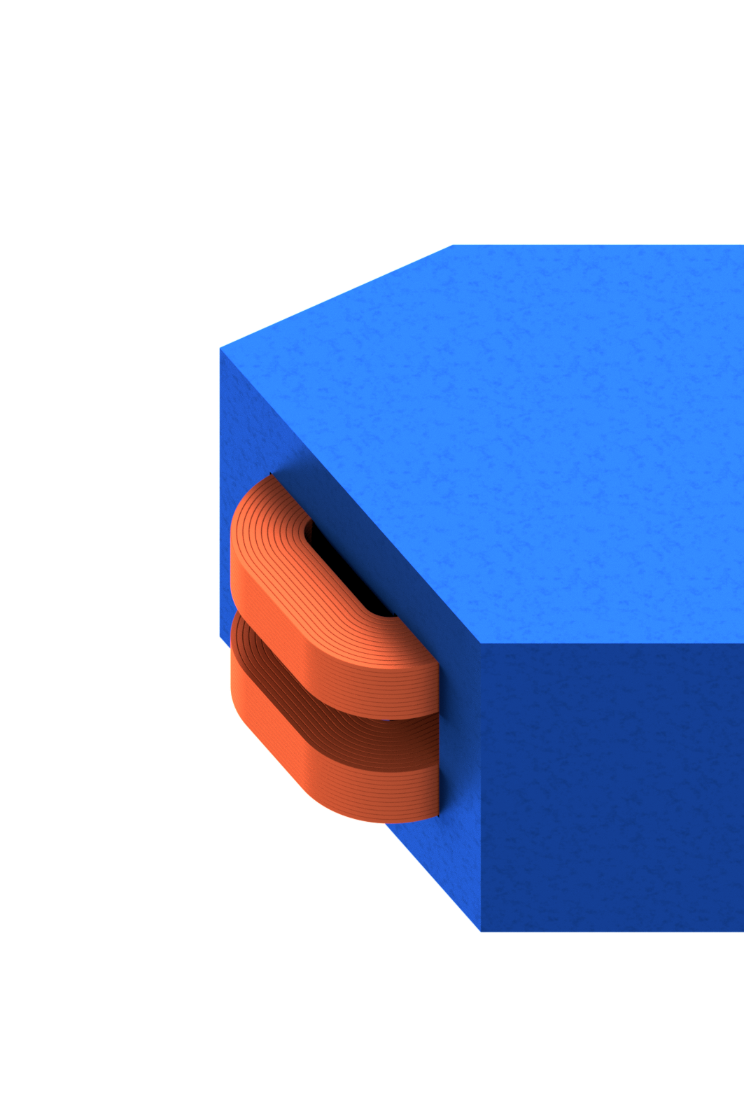
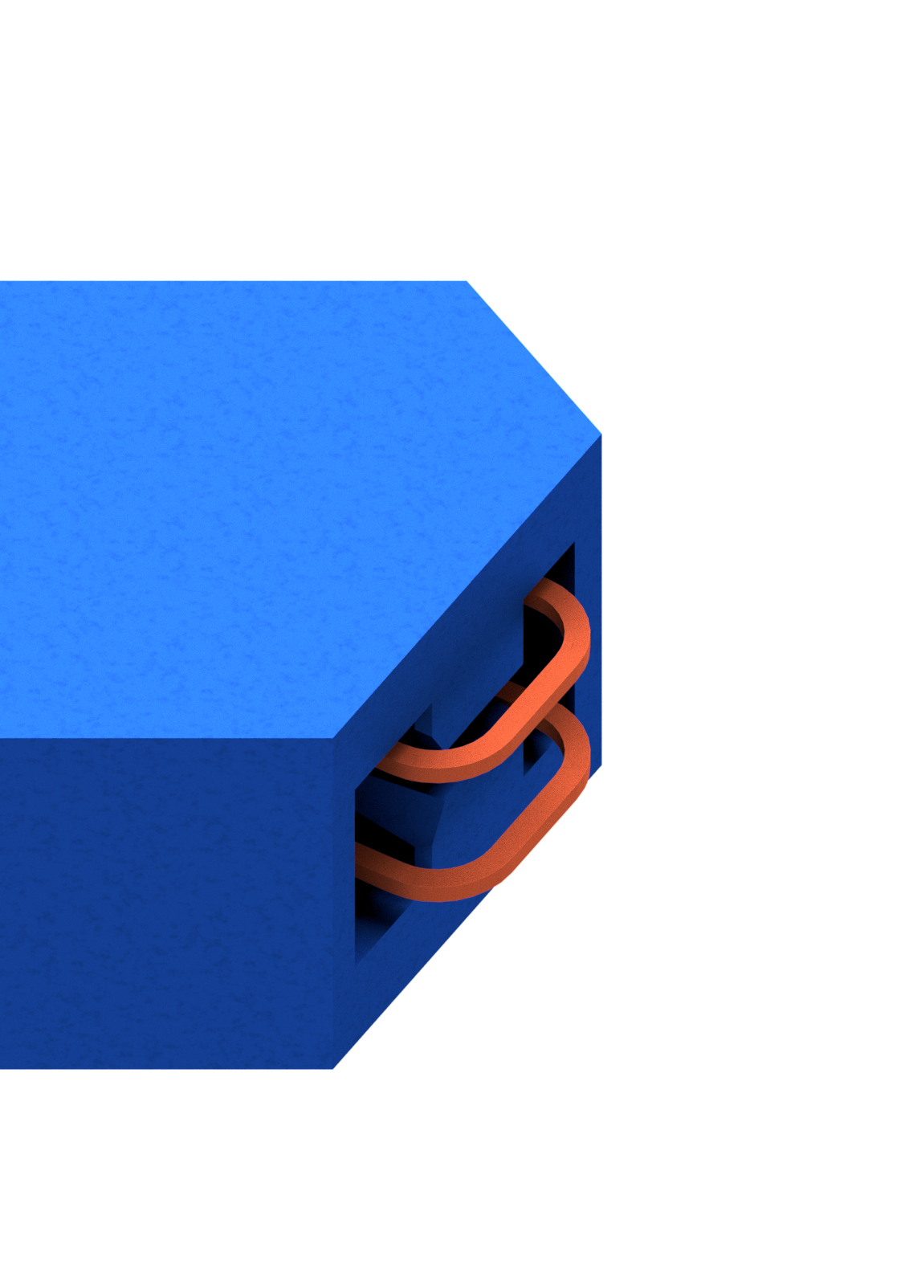
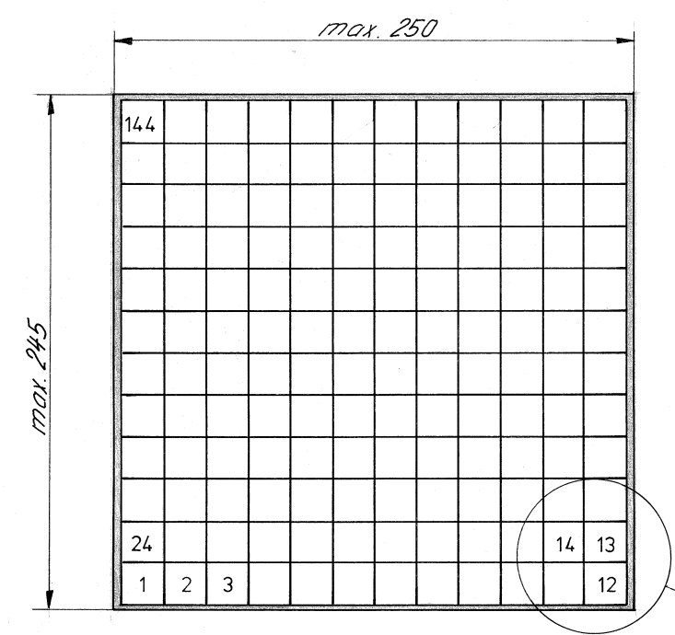
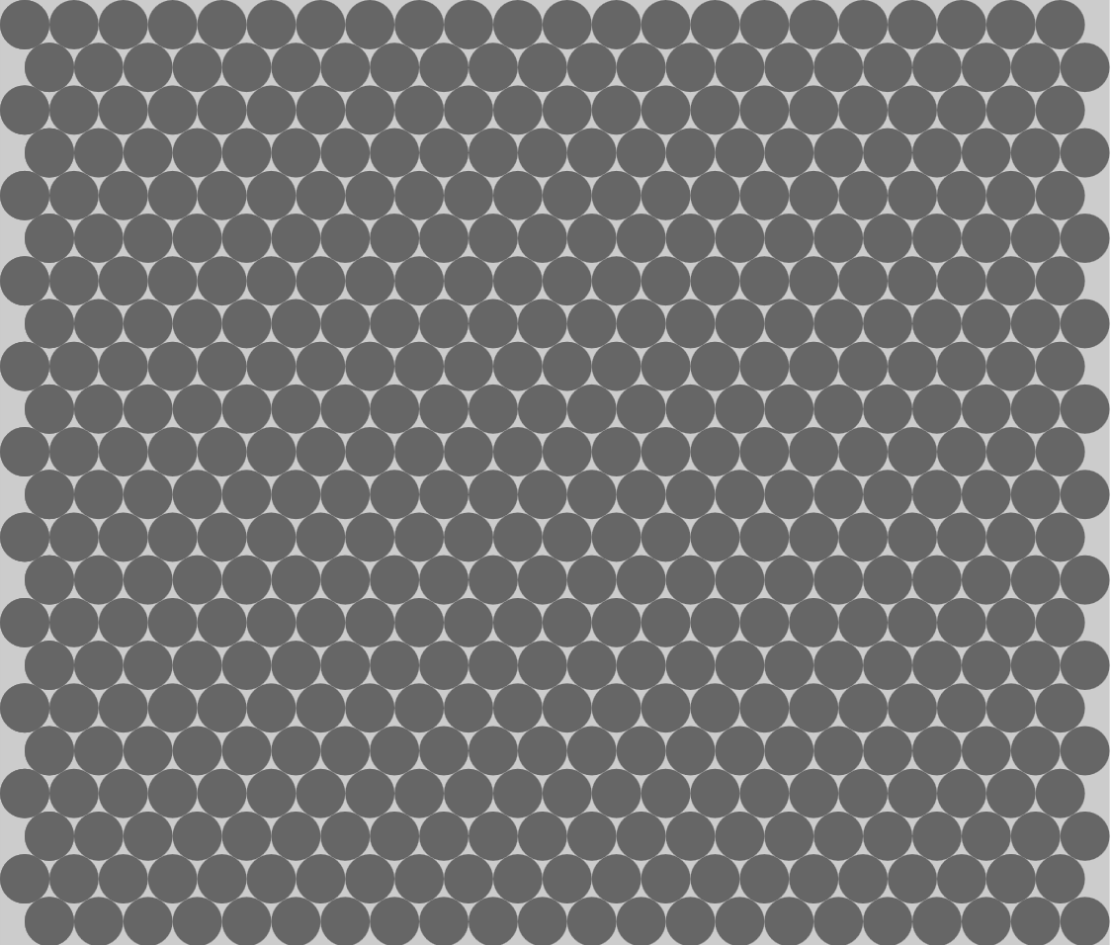
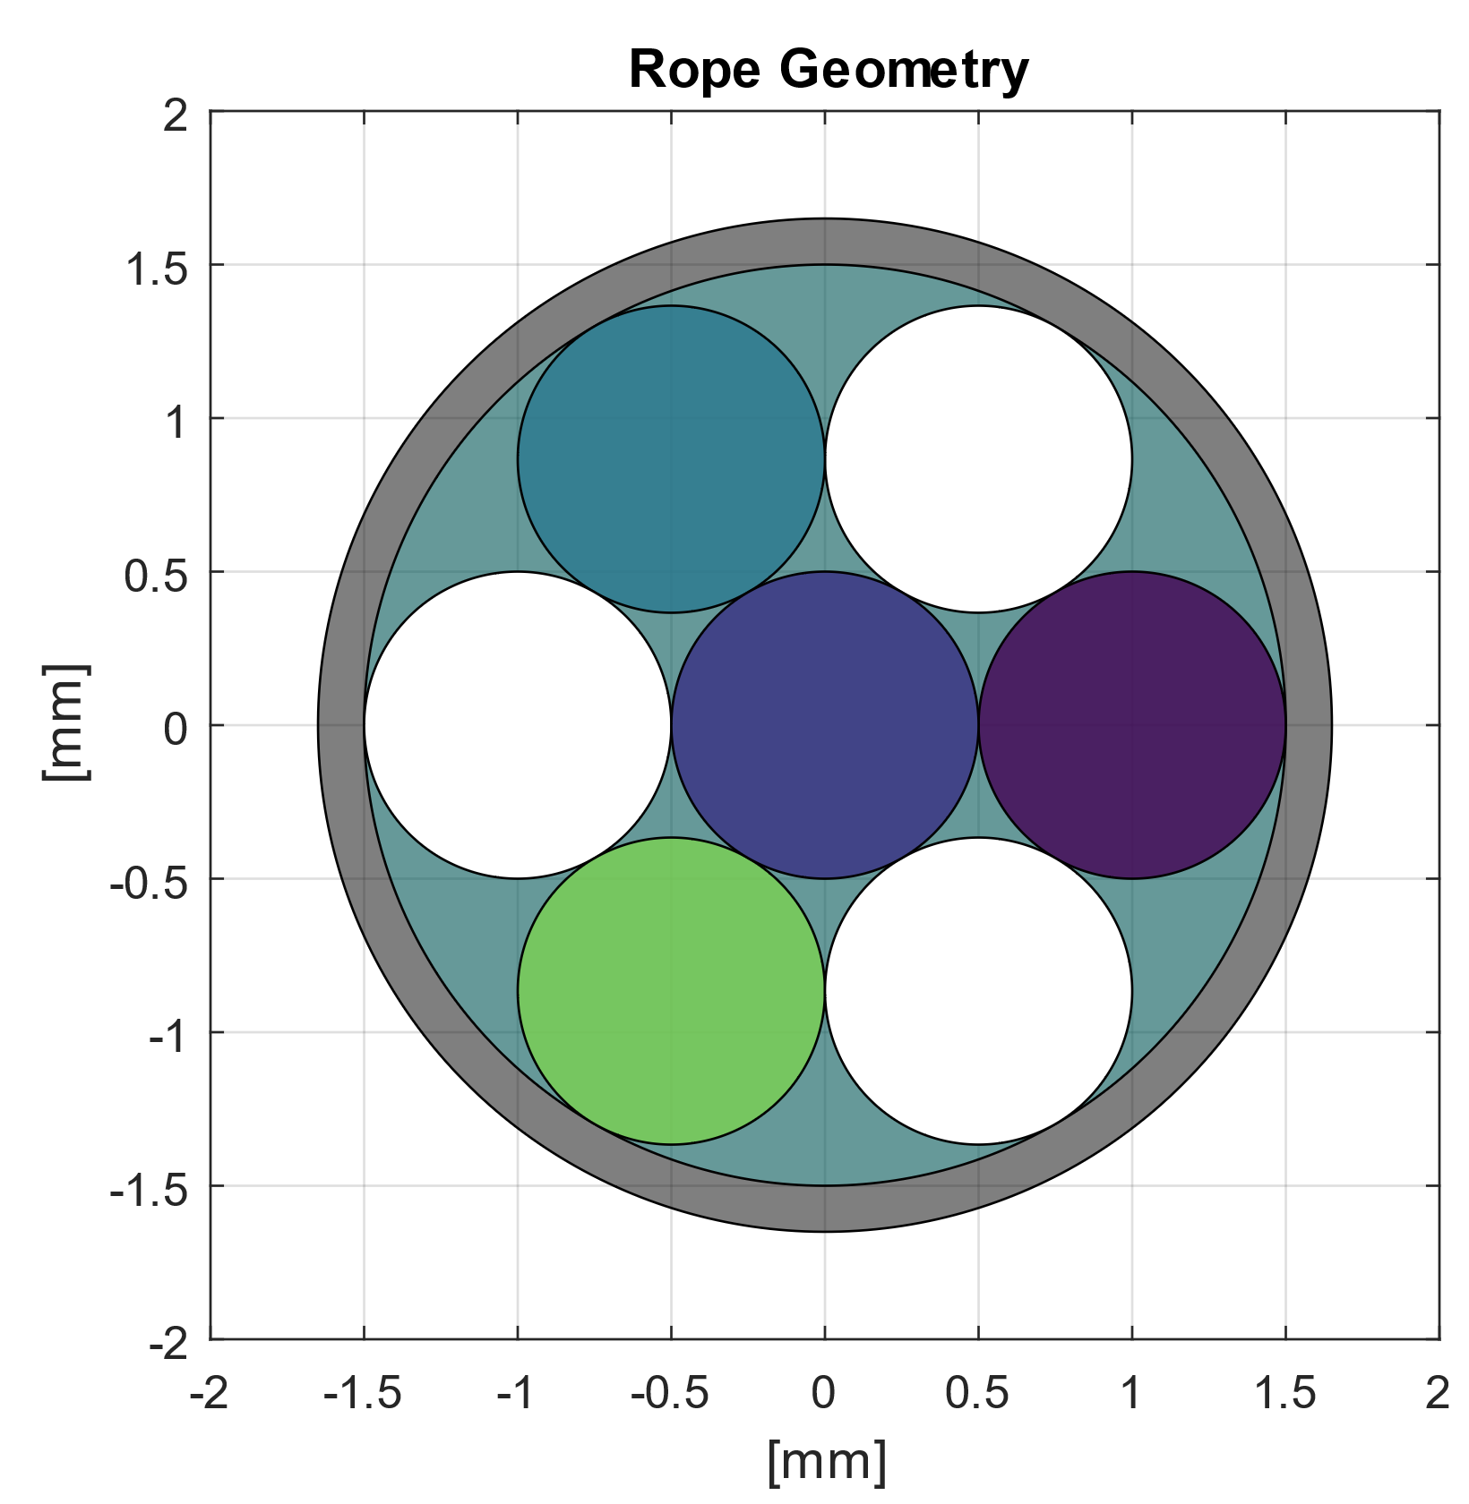
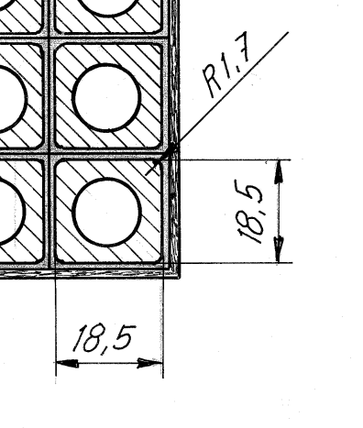
Electromagnetic Design
Target of the electromagnetic design optimization
Magnetic field of 1.45 T at center.
Field quality given by the yoke poles (coil used to magnetize it). Same ampere-turns (144 x 1000 A)
Use of a rope (4 MgB₂ conductors and 3 high-purity copper wires).
  484 ropes carrying 300 A @ 1.2 T (50% margin LL – 8 K temperature margin).
74 mm
63 mm
In scale with resistive coil drawing on the left
MgB₂
Cu

Slide 8
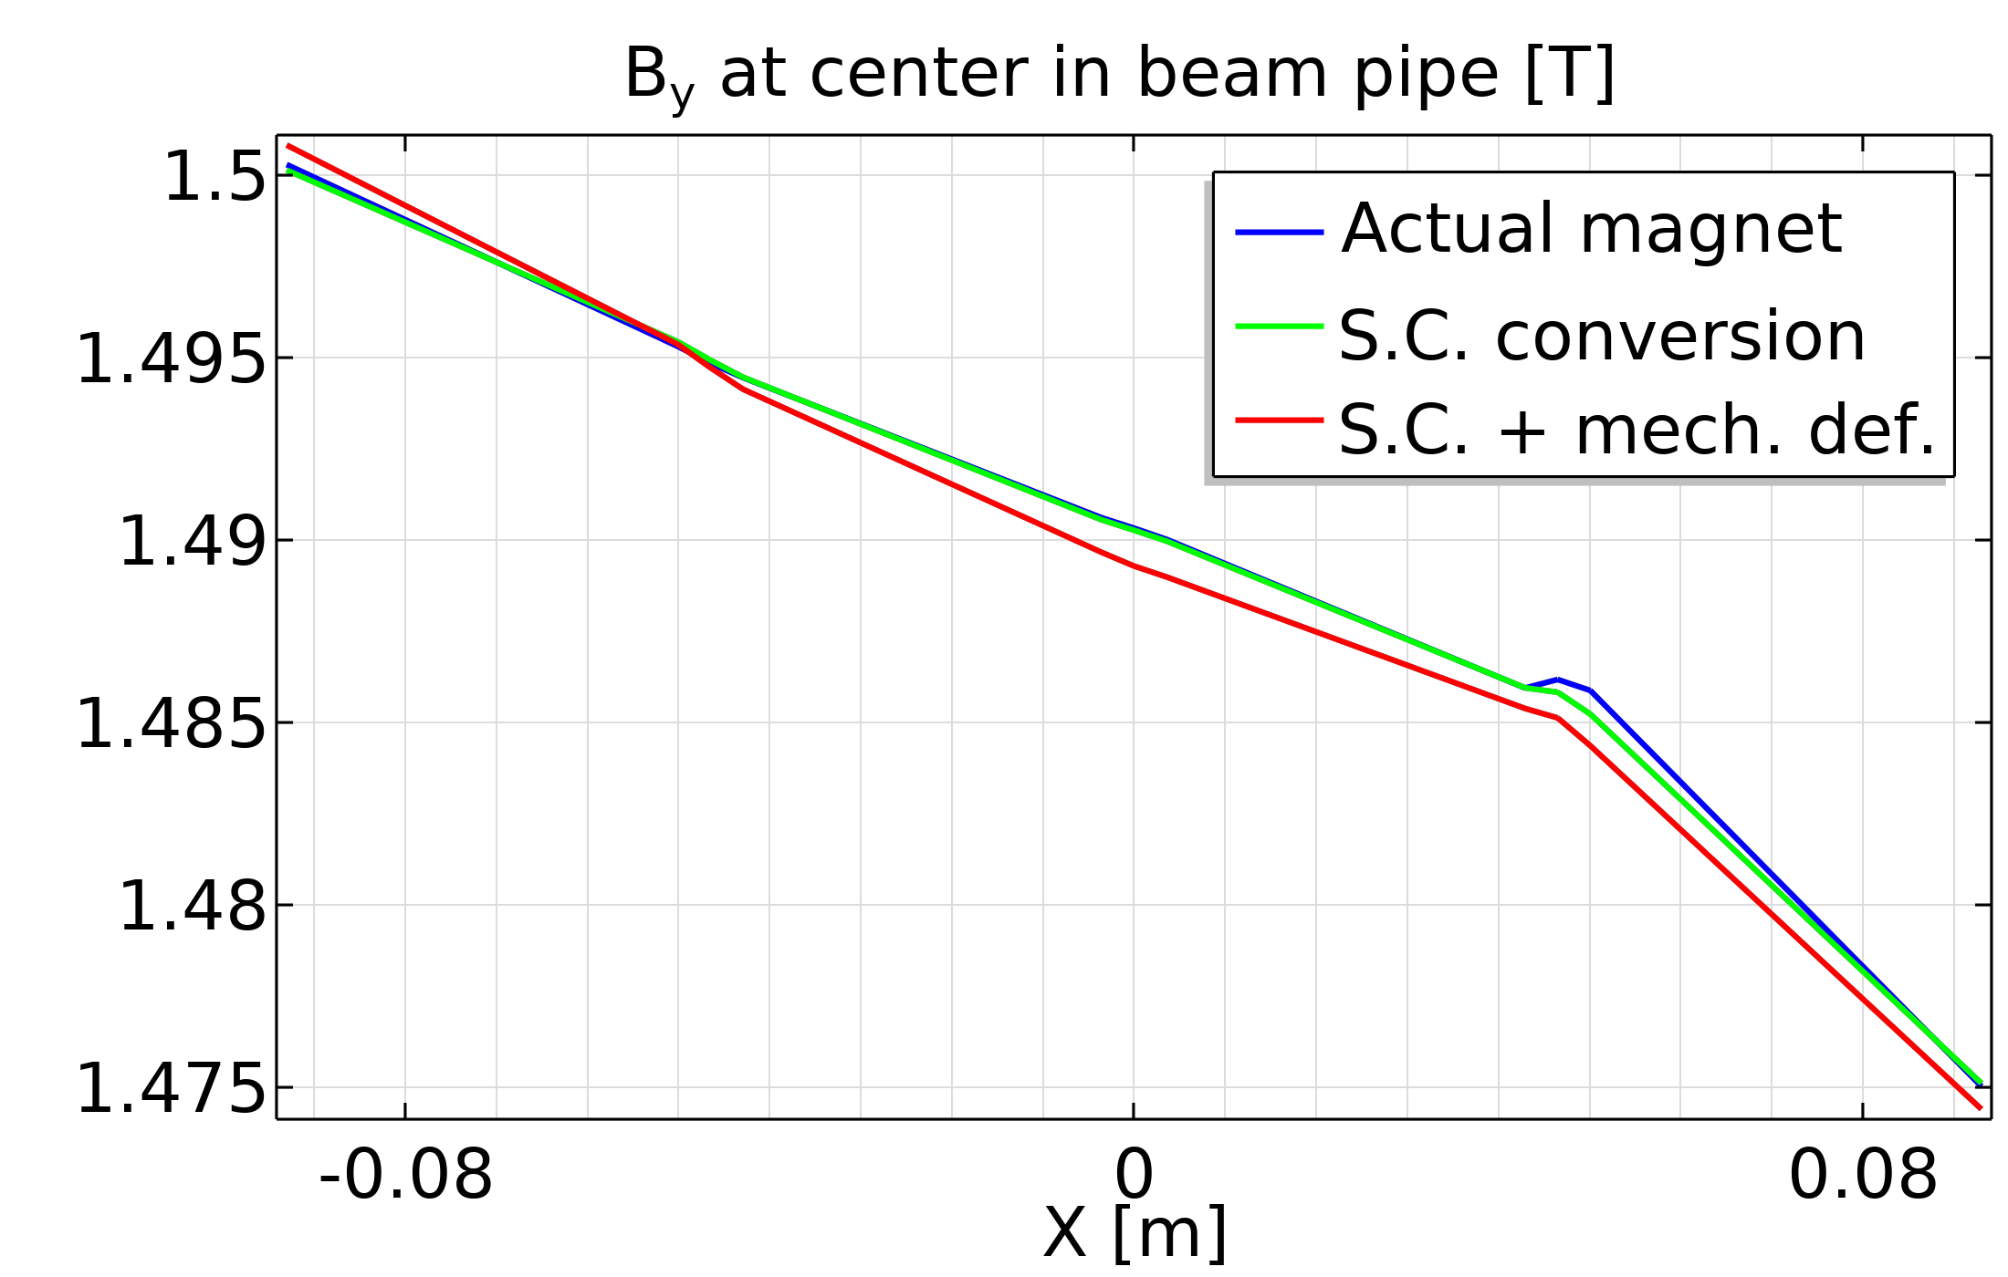
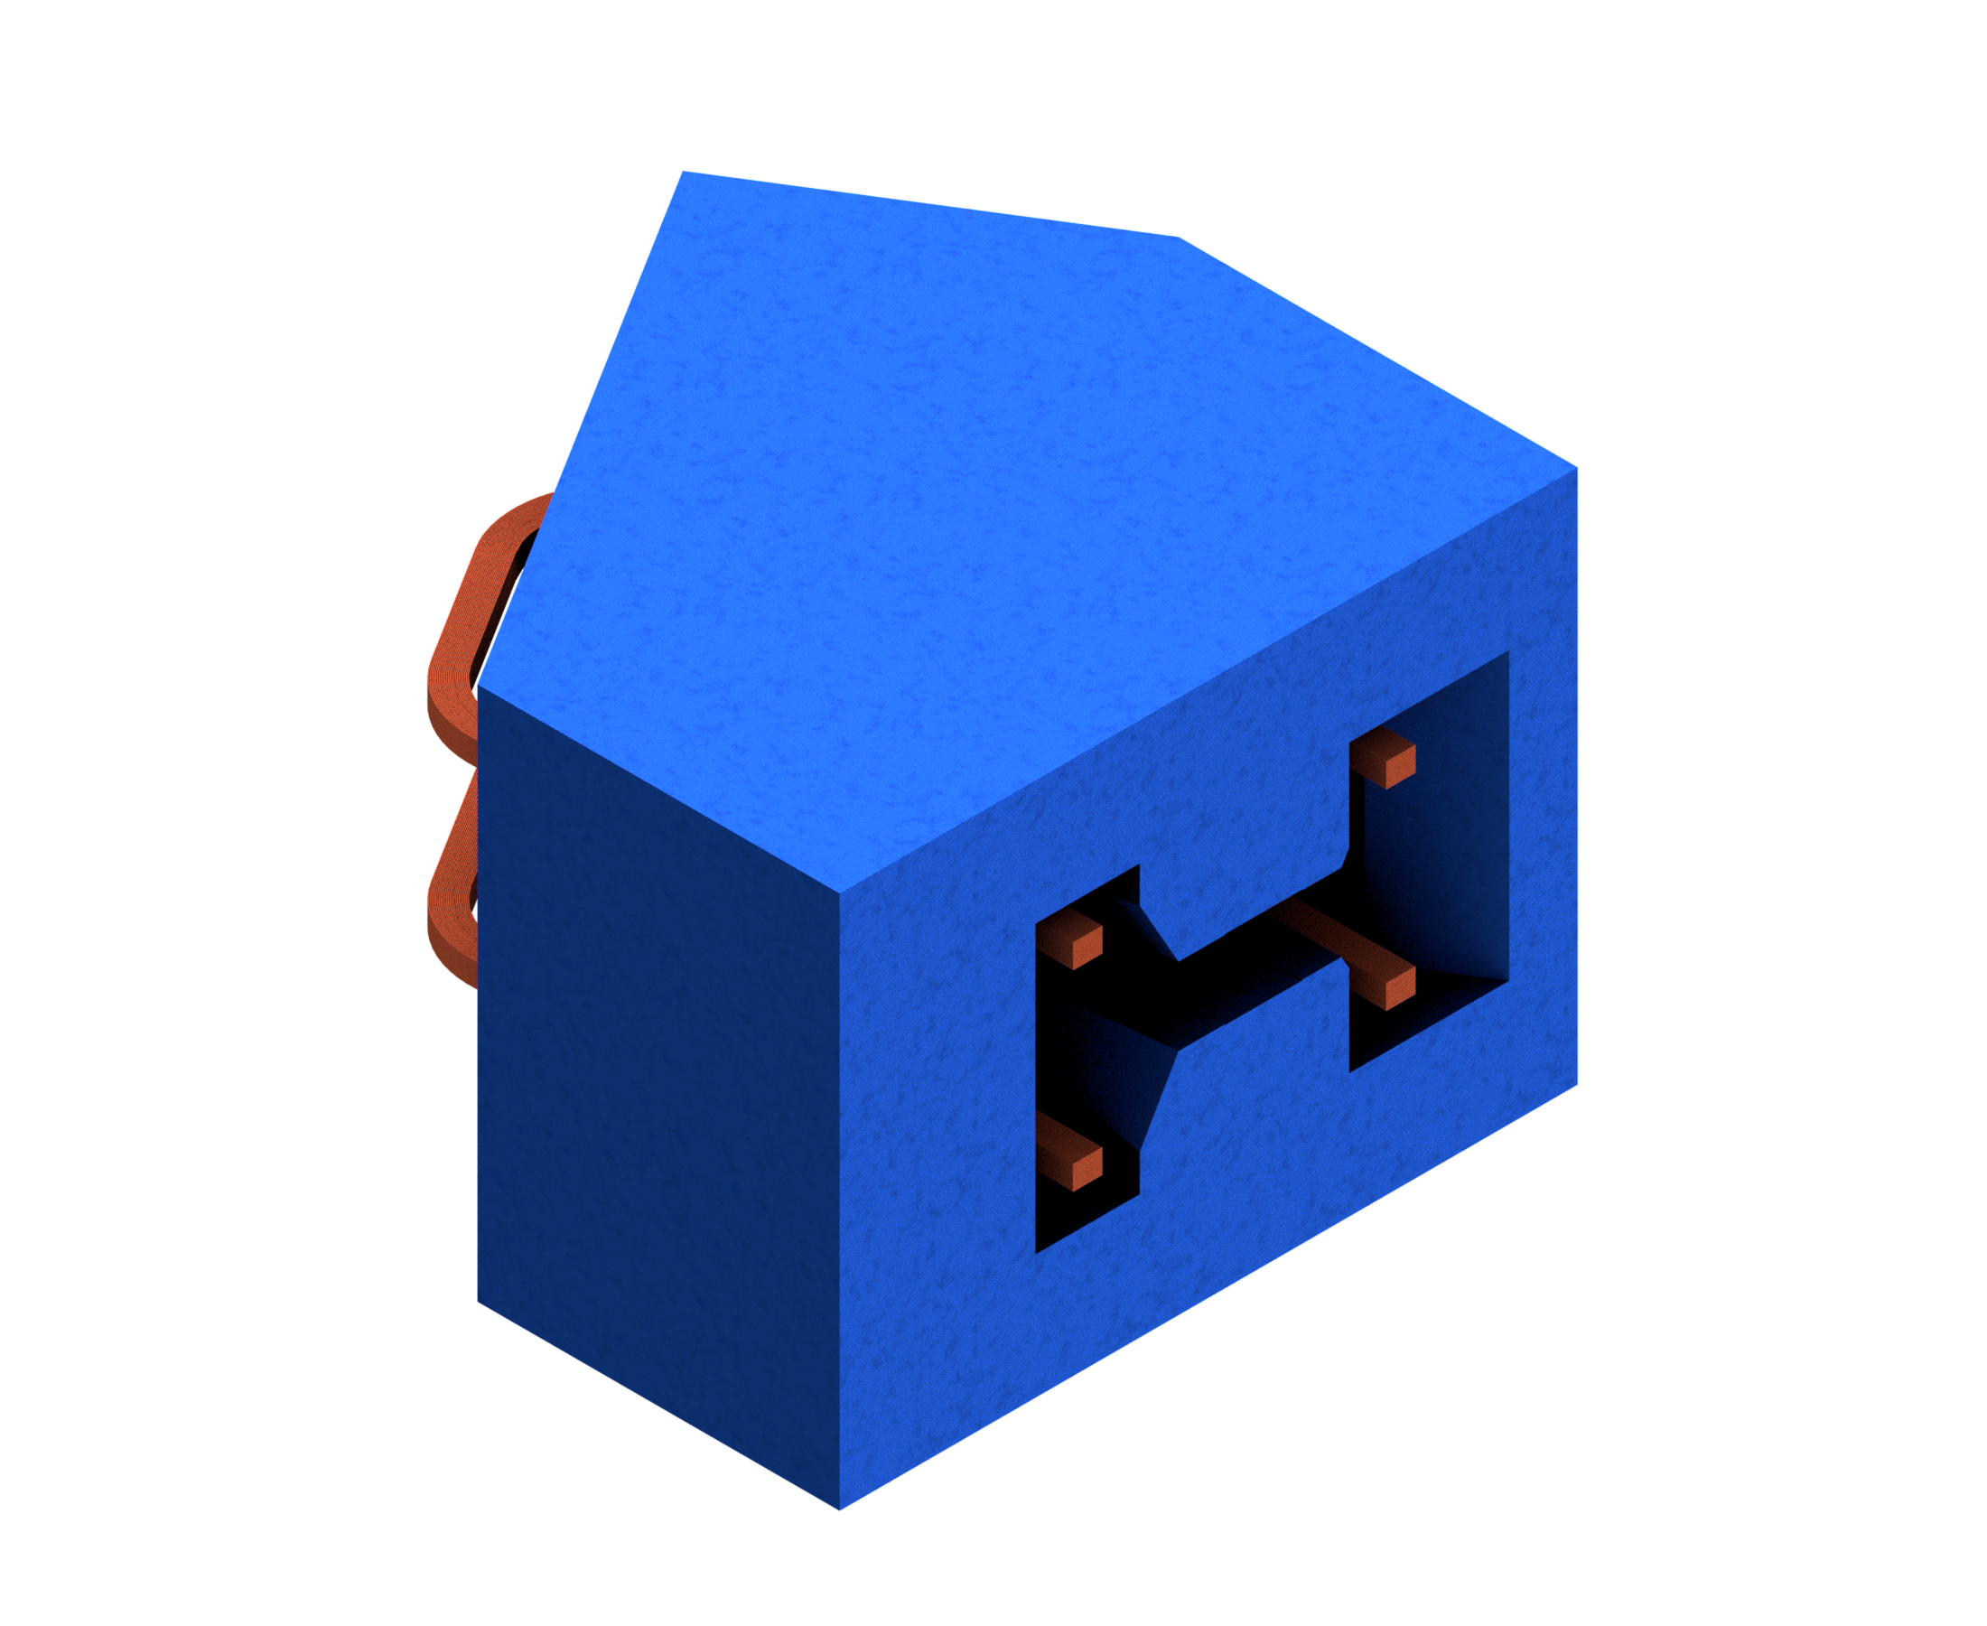
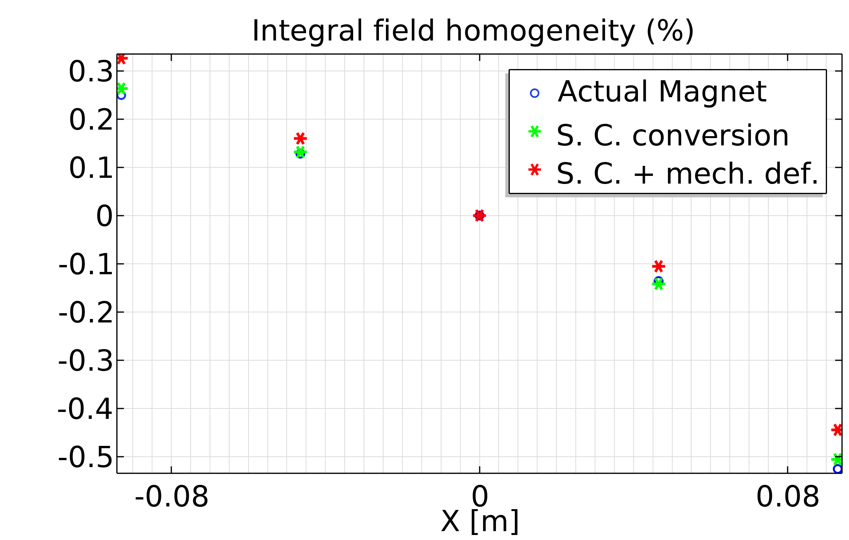
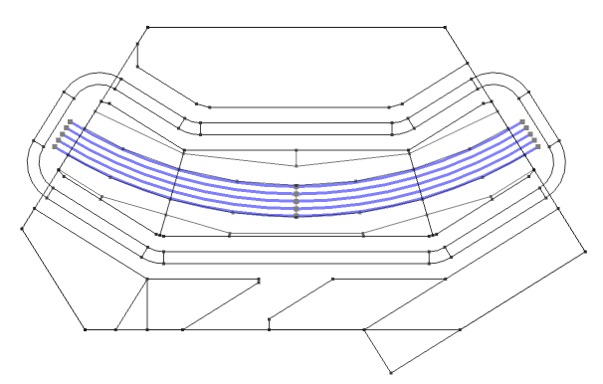
Field Quality
No available requirements on the field quality:
TARGET:
NC design reconstructed FQ
Quality evaluated on the whole length of the magnet on the middle plane
Comparison between different simulation configurations:
  Baseline
  Superconducting Design
  Sup. Des. with mechanical deformations
Y
X
Z
s

Slide 9
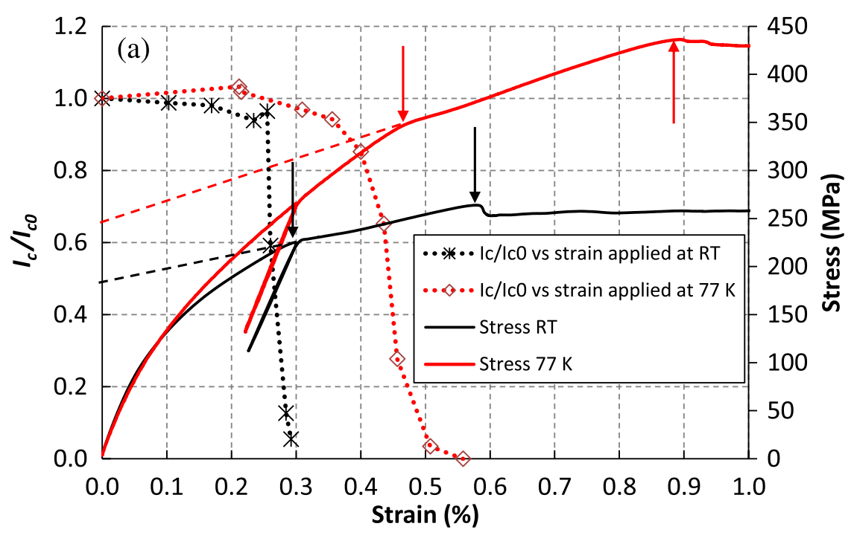
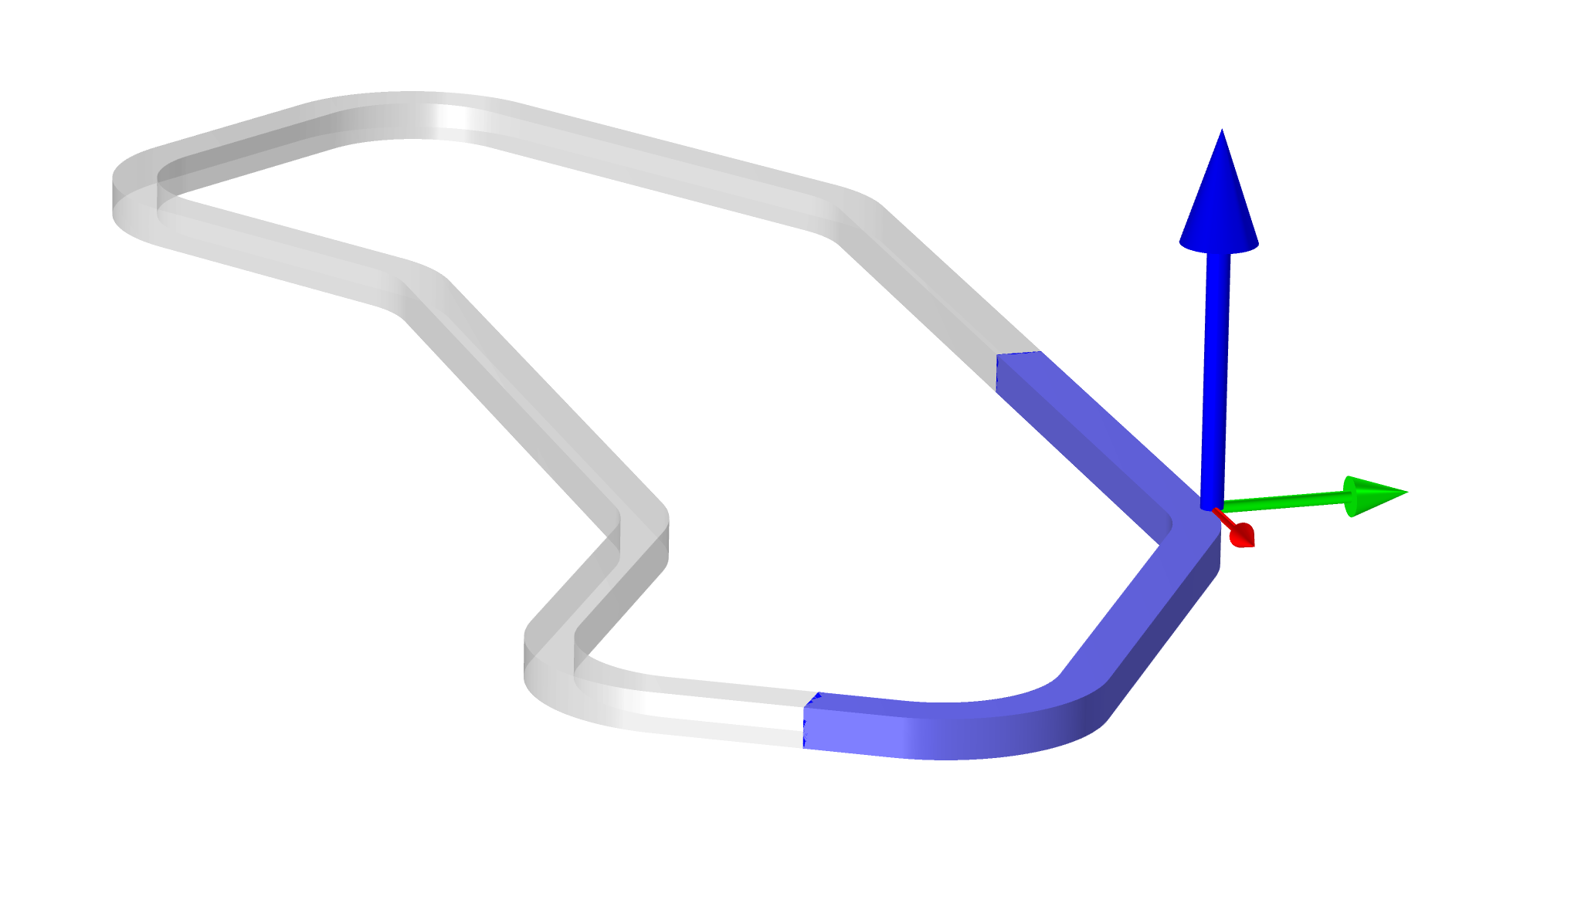
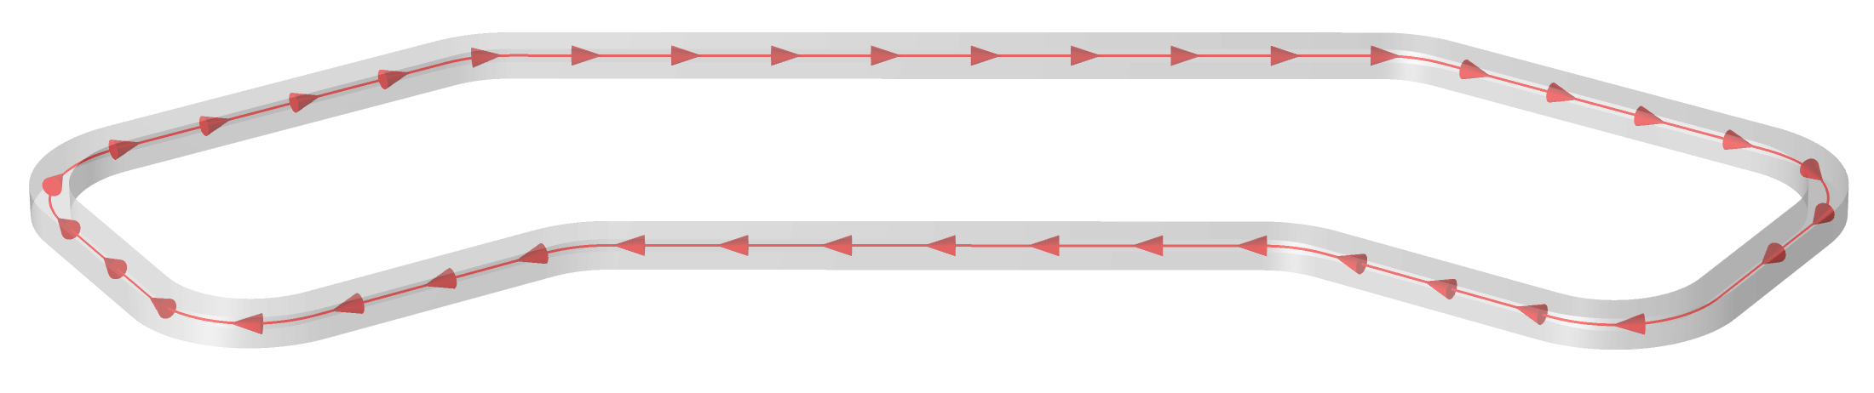



Conductor Mechanics
Targets for the mechanics of the coil are:
  deformation < 1mm (<10 units error with respect to the original magnet)
  strain < 0.2% (degradation of conductor).
Coil is modelled as an orthotropic material by series and parallel stiffnesses in local coordinate system. Components are 22% copper (E = 120 GPa), 29% superconductor (E = 150 GPa), and 49% epoxy resin (E = 6 GPa).
Forces are pushing coils far away from each other.
Reprinted from: Alknes, Patrick, et al. "Mechanical properties and strain-induced filament degradation of ex situ and in situ MgB 2 wires." IEEE Transactions on Applied Superconductivity 26.3 (2015): 1-5.
Forces on quarter (top) coil
$$60 kN$$
Axis ${\hat{e}}_{1}$ of the local coordinate system
$$30 kN$$
$$20 kN$$

Slide 10
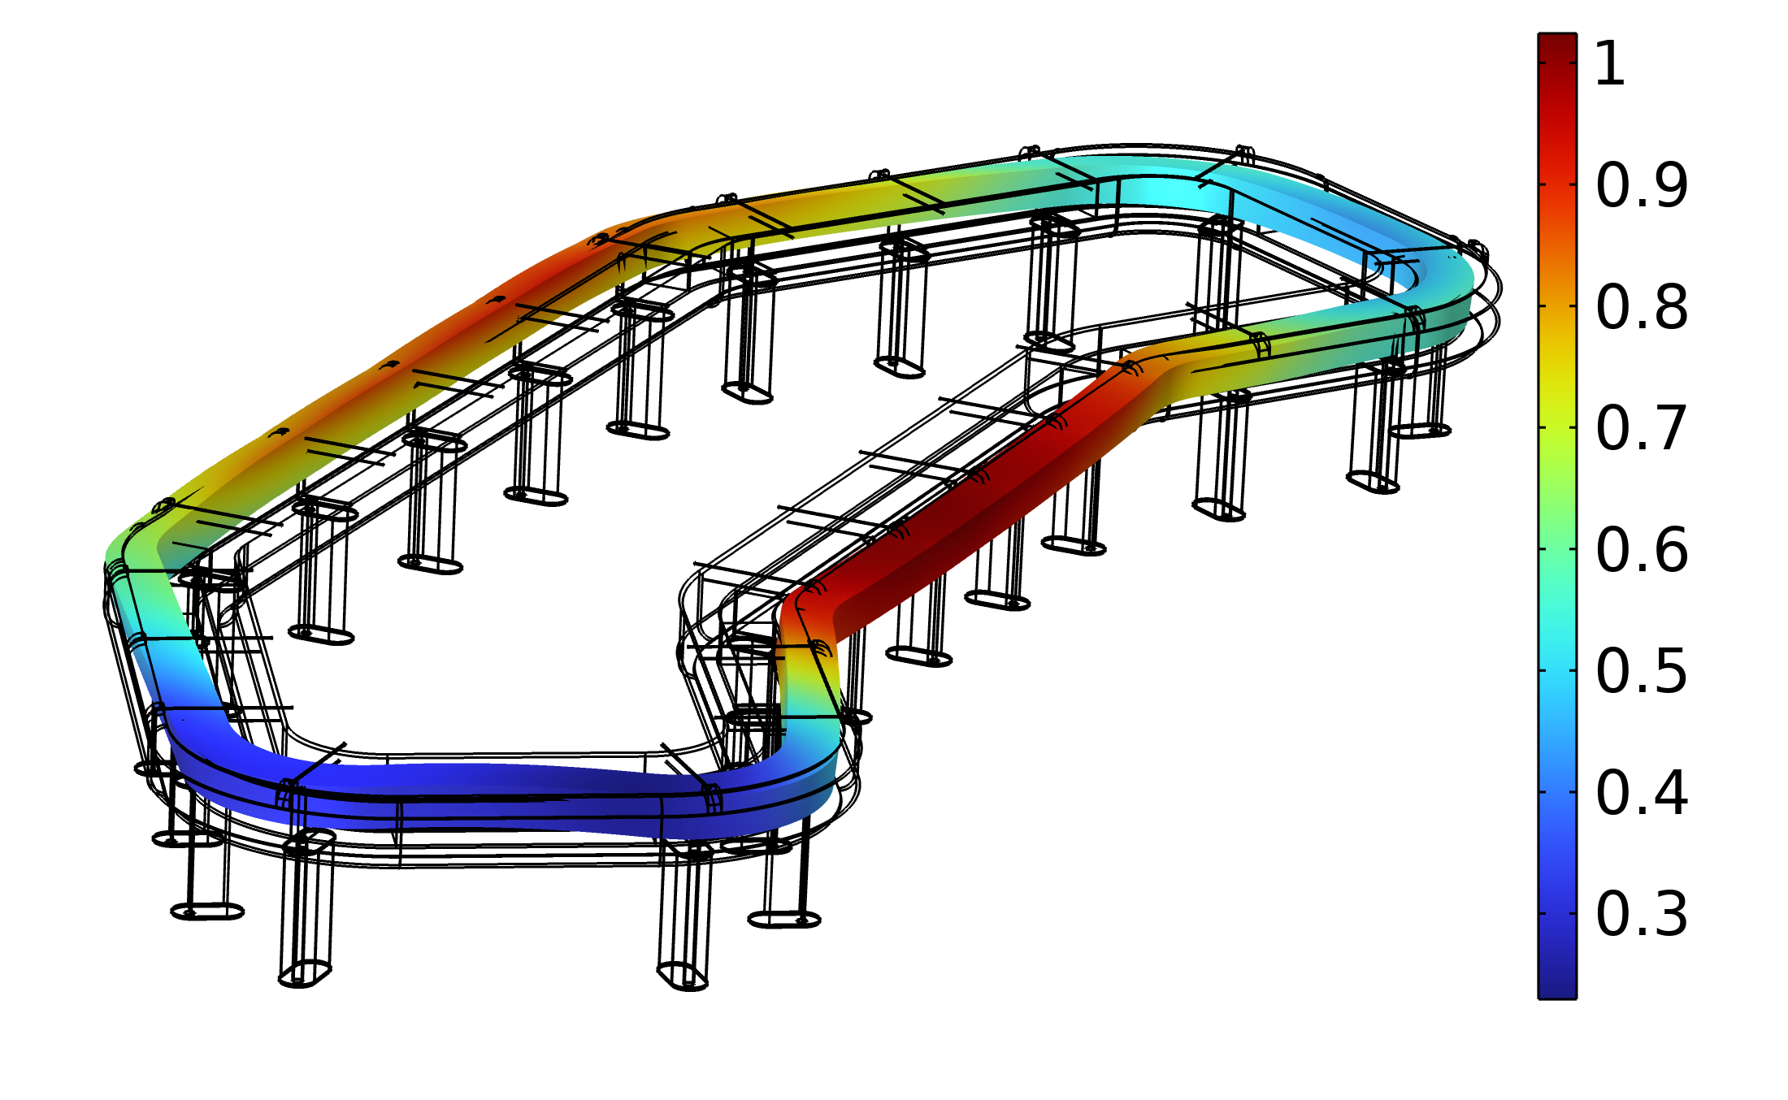
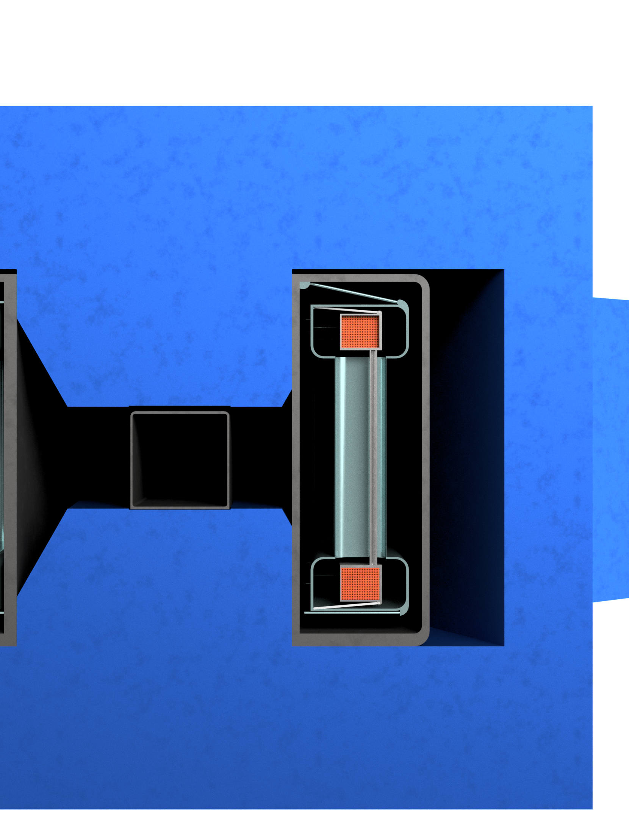
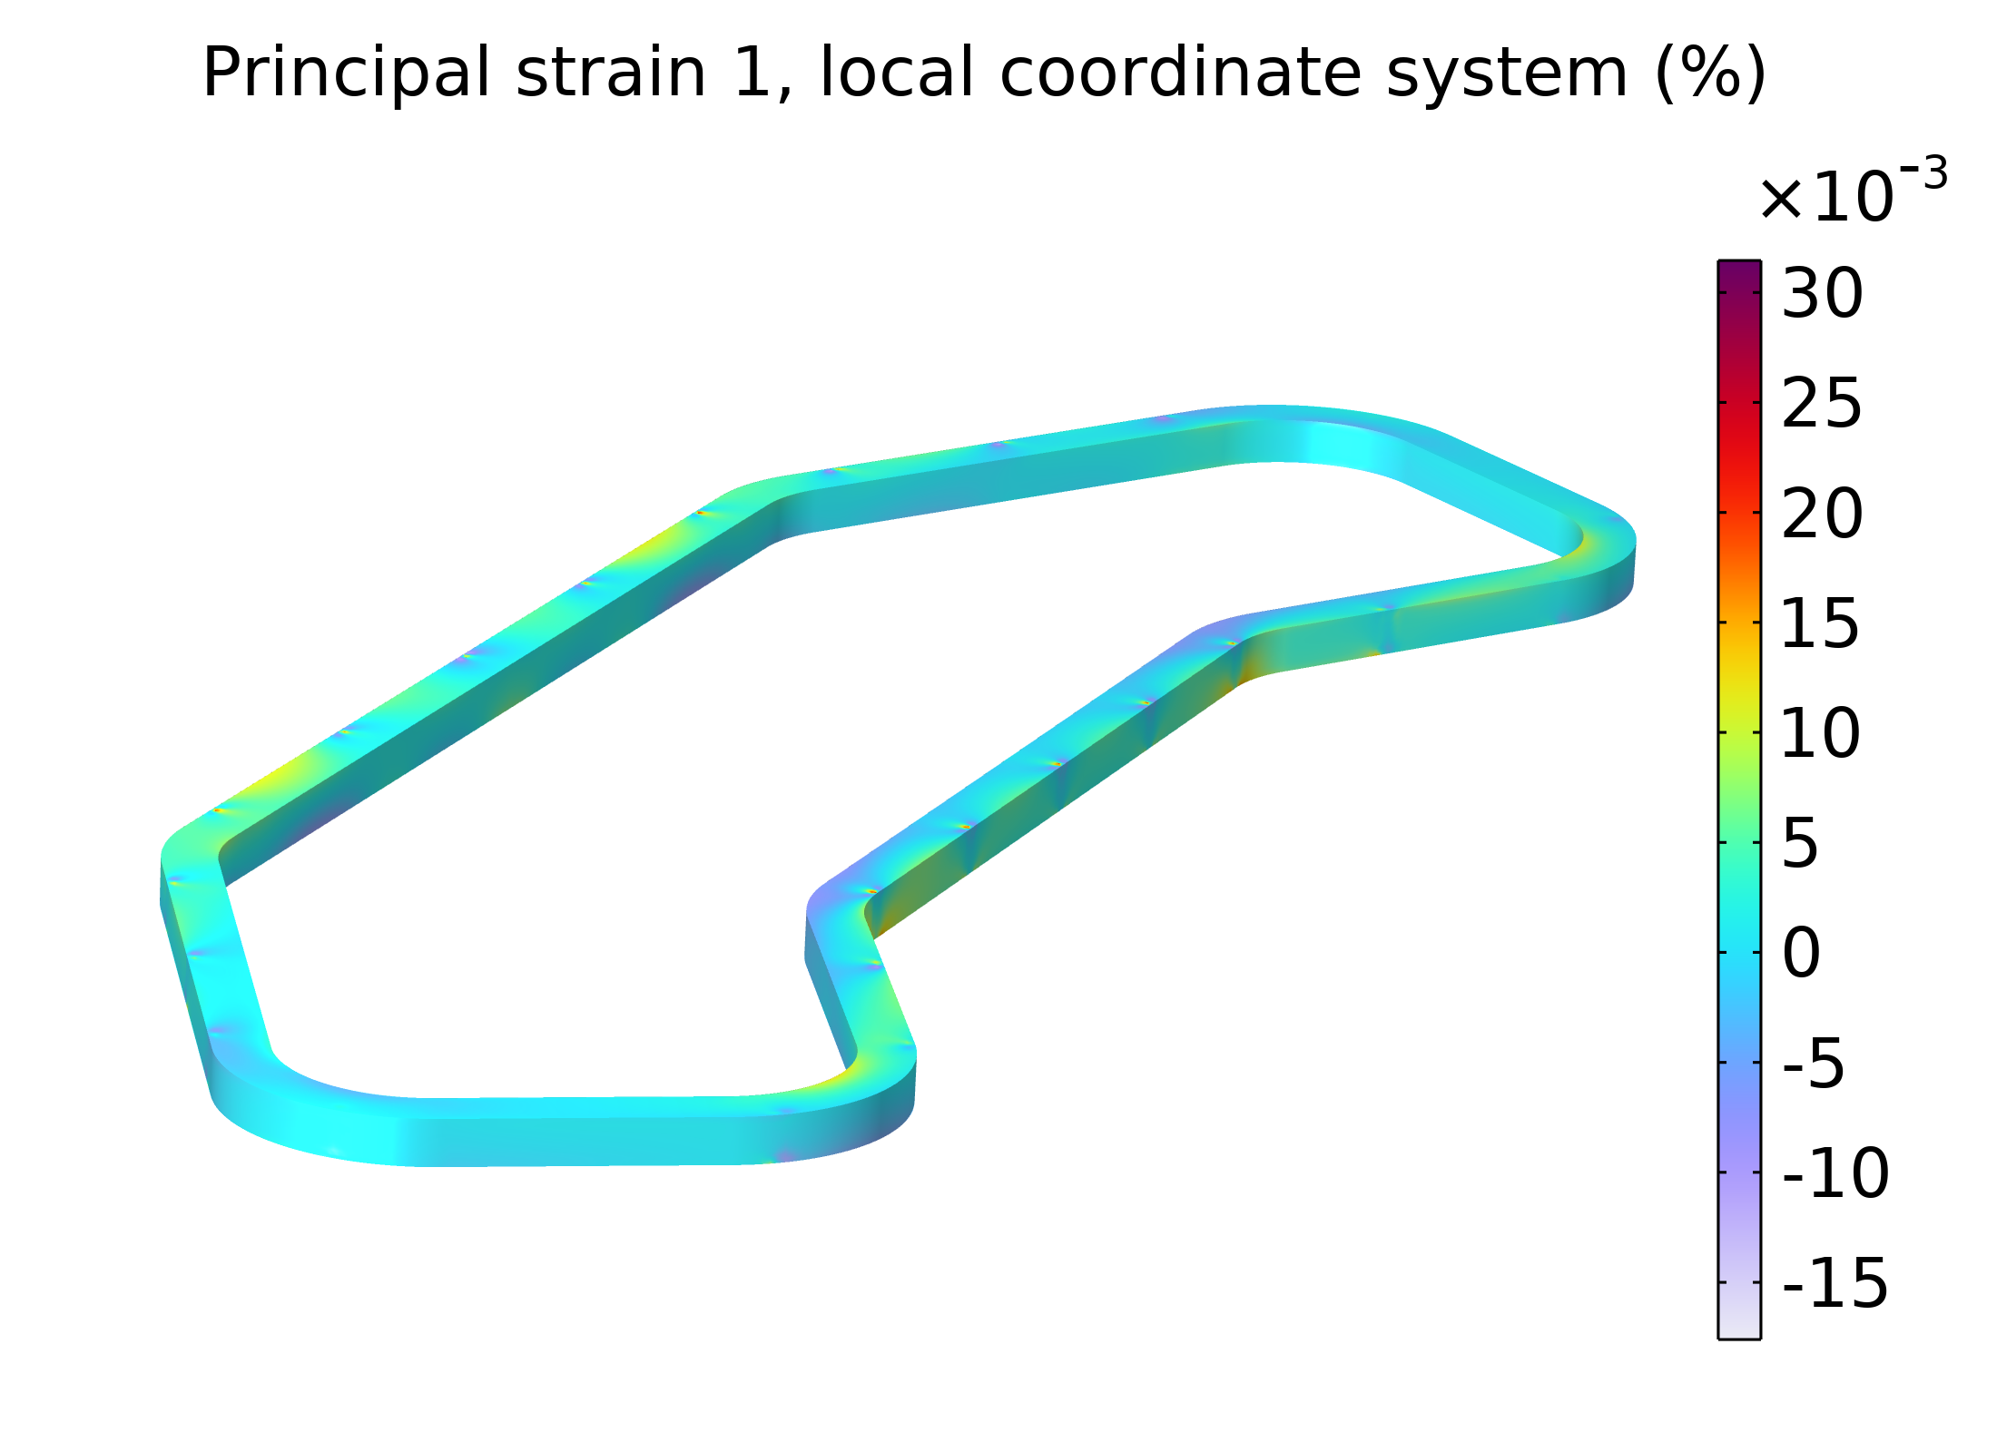
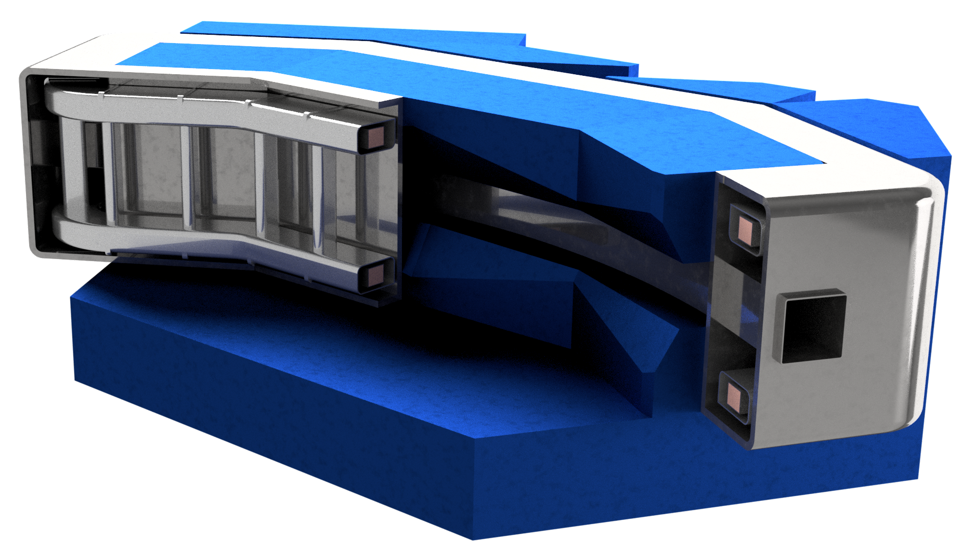
Mechanical Design
Courtesy: Stefano Sorti, UNIMI
Coil Displacement [mm]
CRYOSTAT
3-mm-thick SS 316LN collar around coils to limit deformations.
A distributed set of 48 SS 316LN tie-rods is adopted to sustain mechanically the coil
Same tie-rods concept used for the active aluminum thermal shield (cooled @ 70 K) and coils (@ 20 K).
COIL COLLAR
THERMAL SH.
Principal Strain (%)
Tie - Rods | N | Length (mm) | Diam. (mm)
Coil-shield | 48 | 130 | 4
Shield-cryost. | 48 | 180 | 6

Slide 11
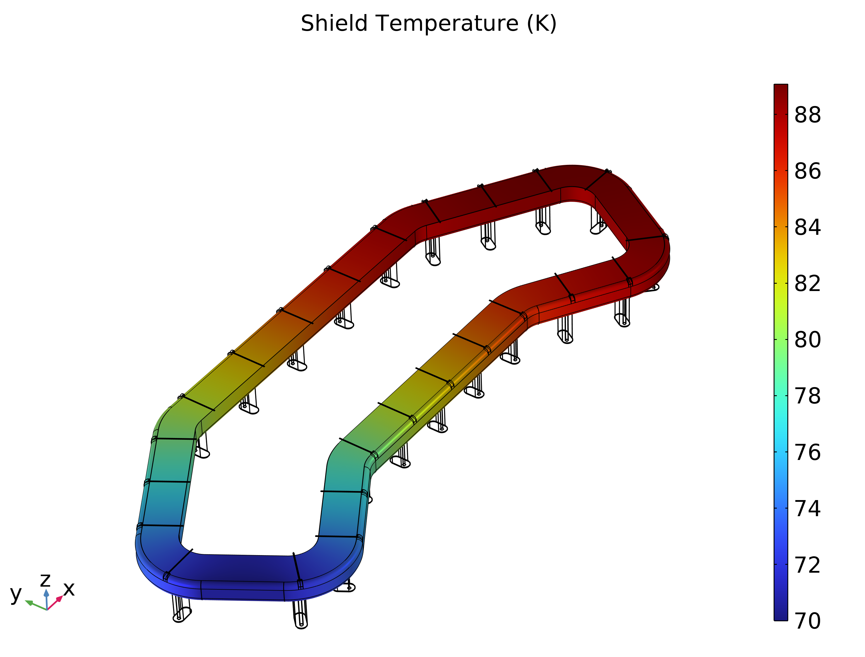
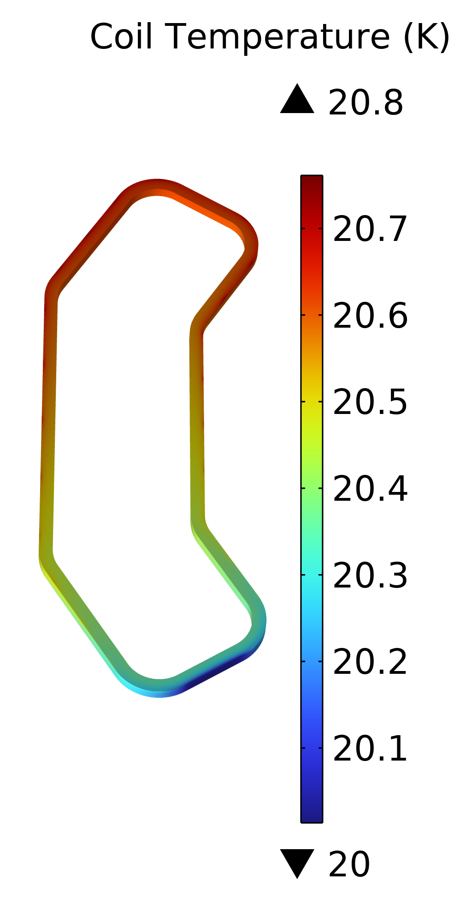
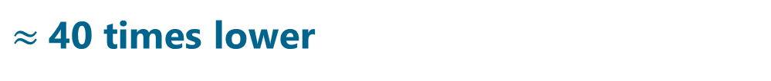
Thermal Design
Cryo B (70 K shield)
Coil thermal conductivity modelled as orthotropic material (Cu 22%, MgB₂ 29% and epoxy resin 49%)
MLI (30 Layers) used to reduce the radiation power on thermal shield
Two-stages current leads with HTS link from 70 K to coil. Heat load from copper-lead pair = 24 W.
Cryocoolers installed on one side of the magnet
Cryo A
(20 K coils)
A: Cryomech Al63 5W @ 20K, P = 3.2 kW
B: Cryomech Al60 48W @ 70K, P = 1.7 kW
MAGNET | Coils @ 20 K | Shield @ 70 K
Q support | 1.35 [W] | 12 [W]
Q Current Leads | 0.2 [W] | 24 [W]
Q radiation | 0.45 [W] | 11 [W]
Q tot | 2 [W] | 47 [W]
Total magnet energy consumption:
5 kW (vs 190 kW resistive).
$≈$40 times lower

Slide 12
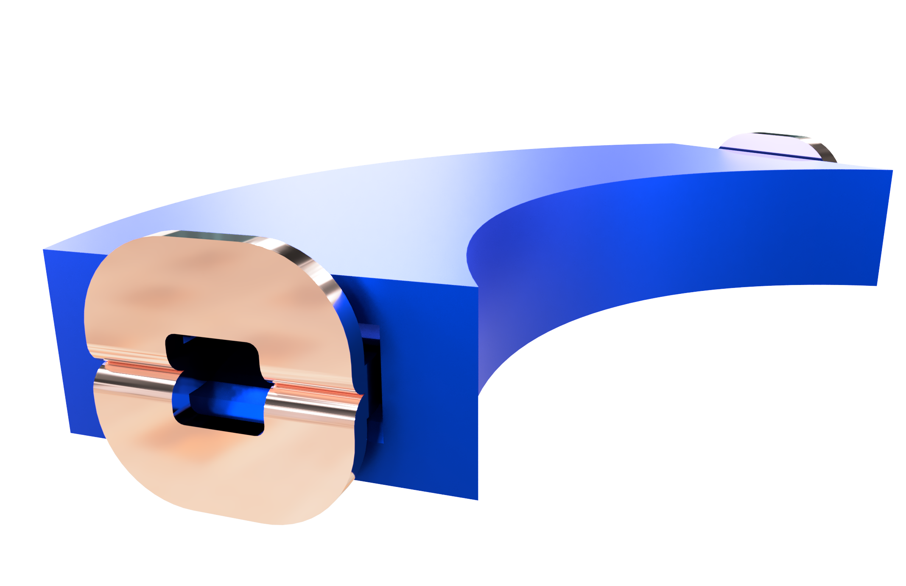
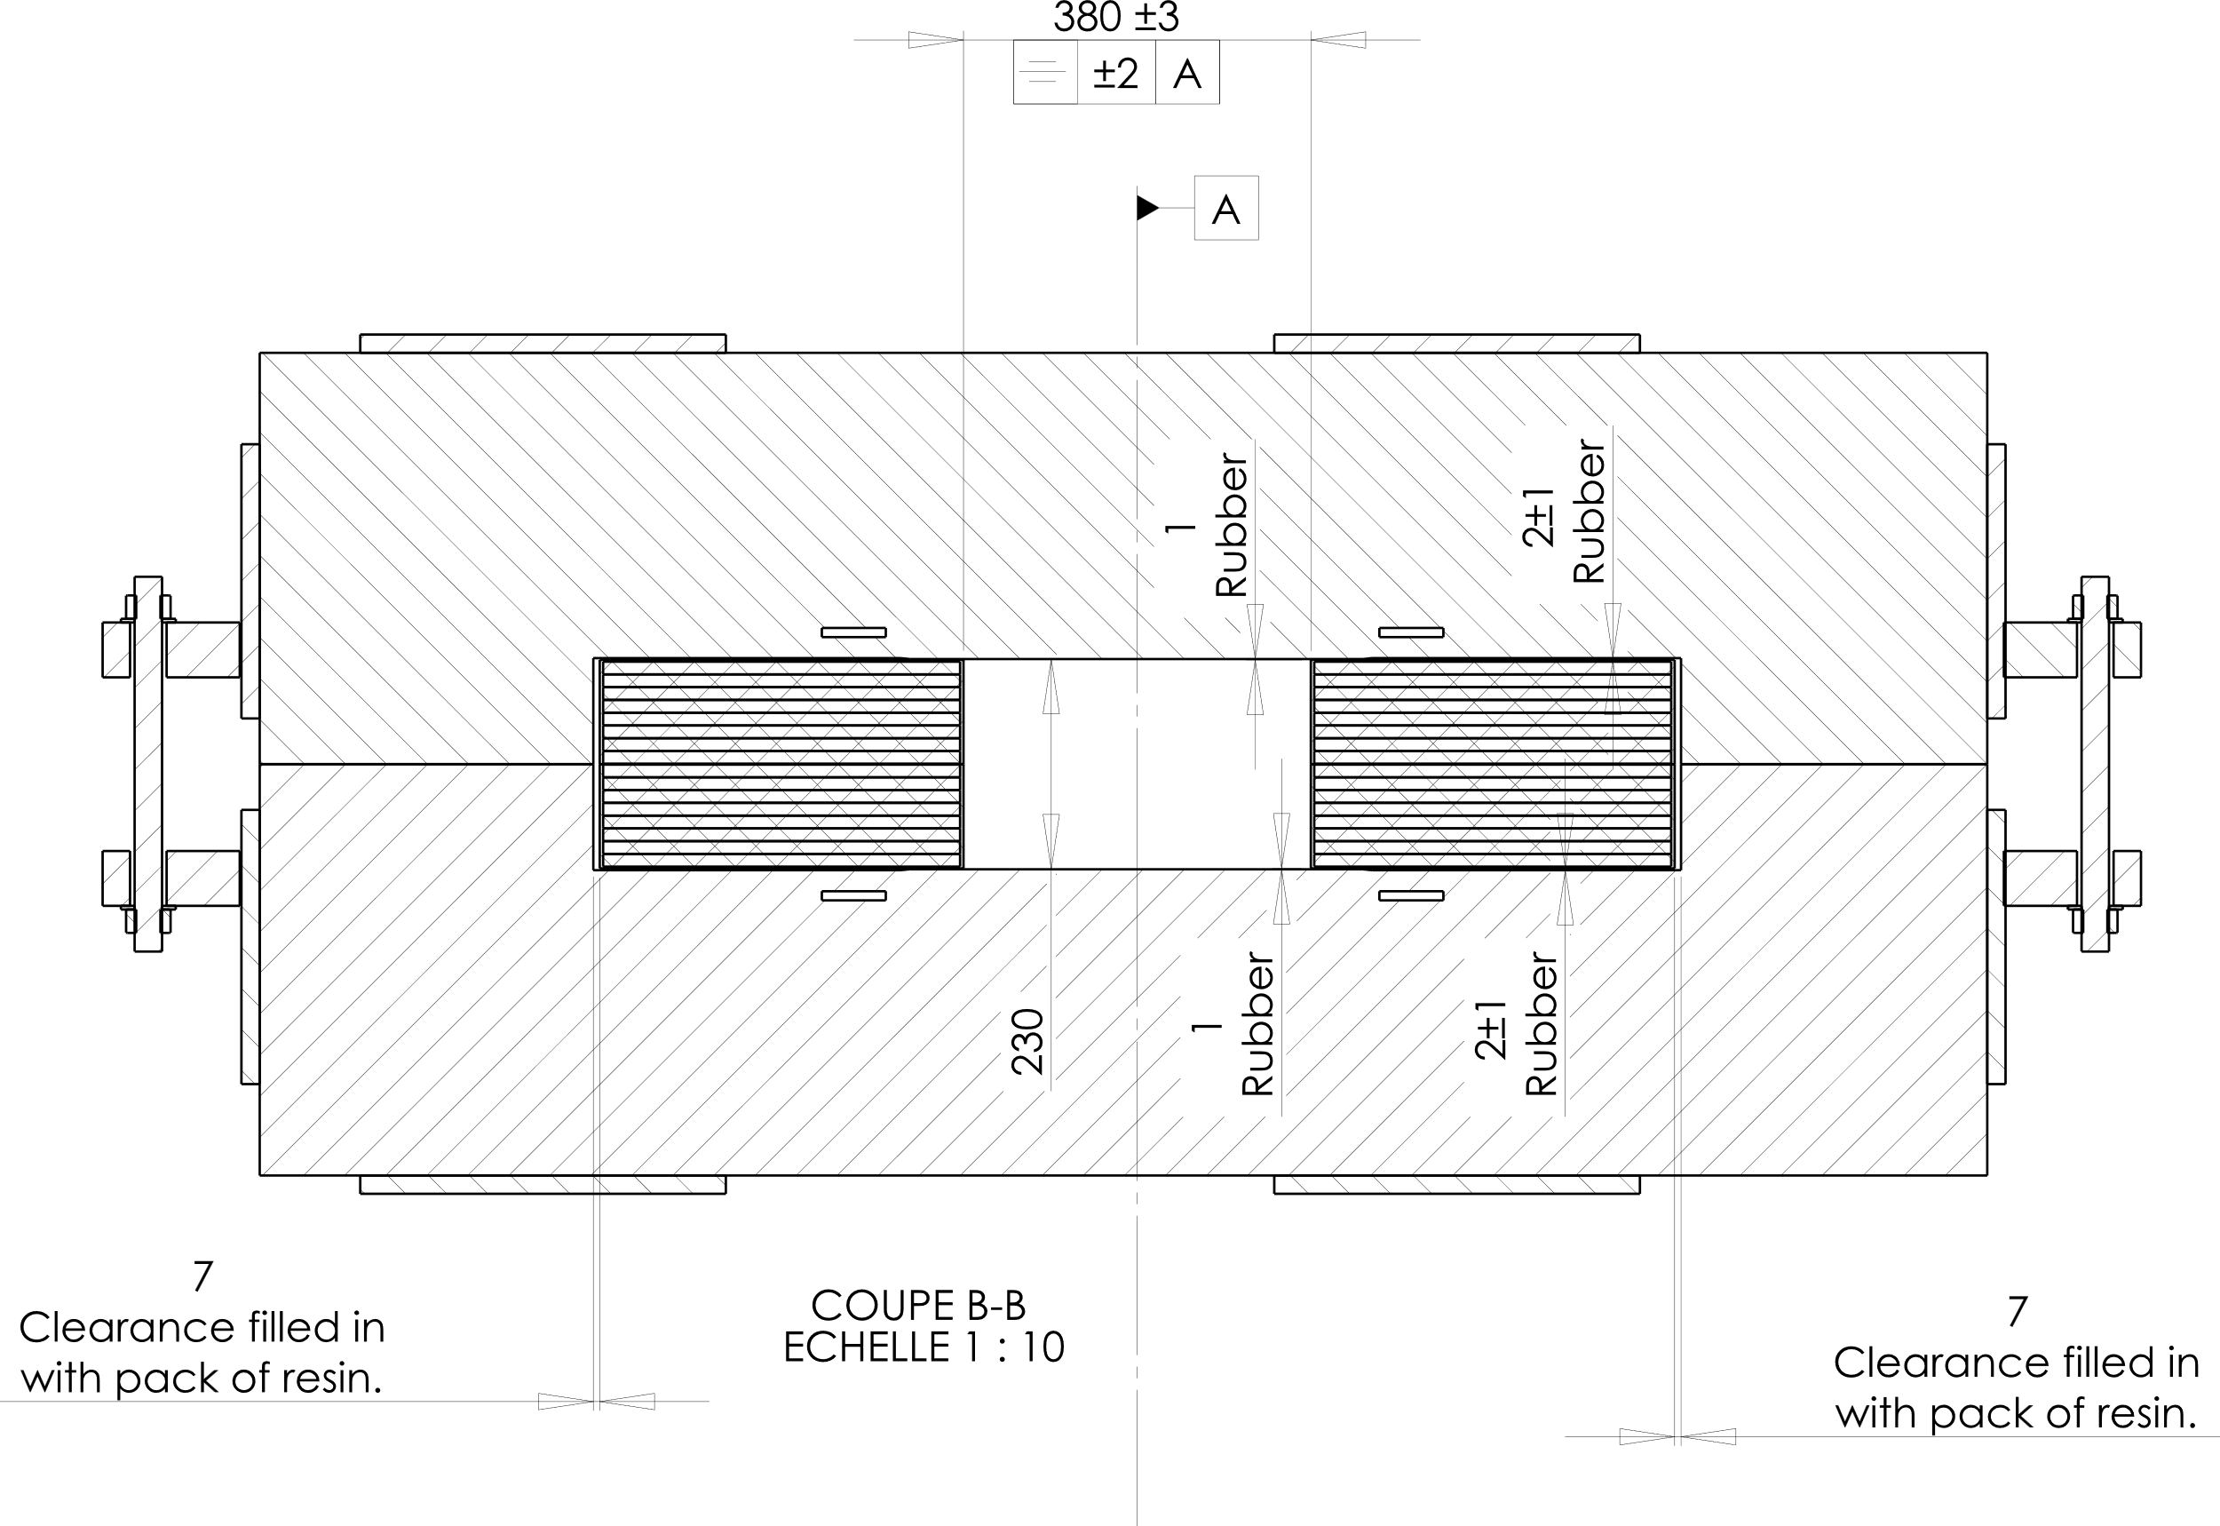
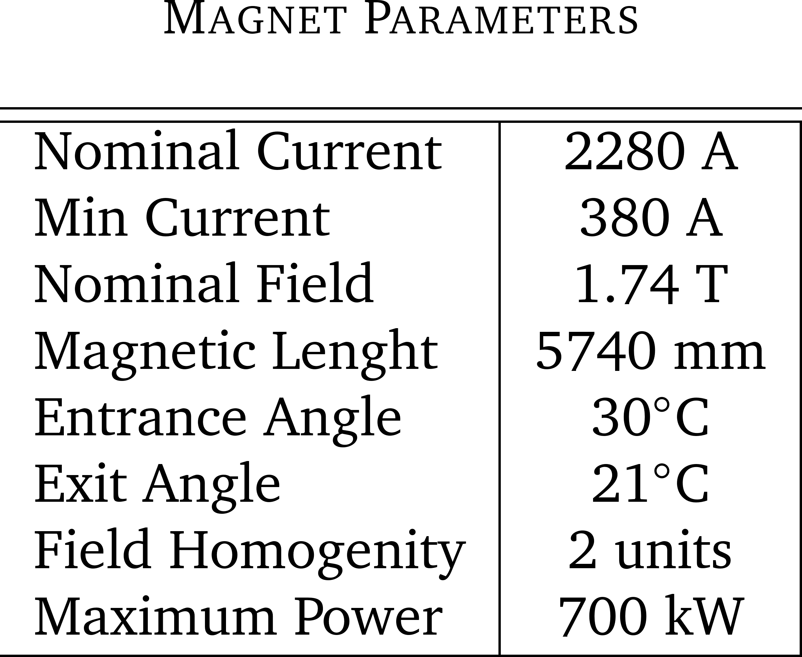
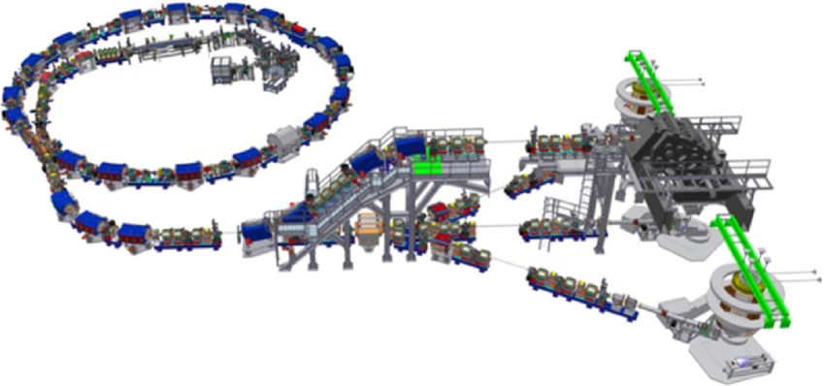
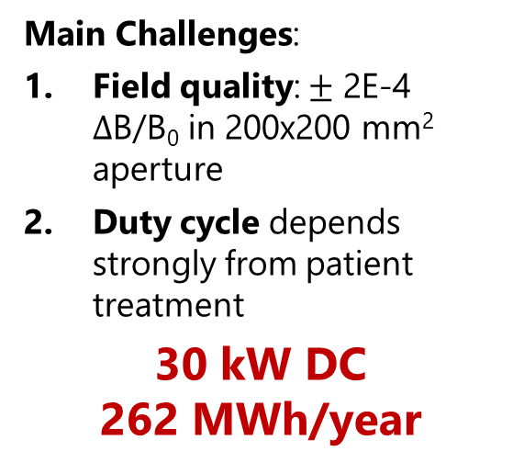
Ramped magnet case study
Copper Coils
Dipolar «Window-Frame» Bending Magnets installed at CNAO. Dimensions of the coil are compatible with minimum bending radius (100 mm) required for MgB₂
6.5 m
Iron Yoke
3.3 m
Main Challenges:
Field quality: $±$ 2E-4 $Δ$B/B₀ in 200x200 mm² aperture
Duty cycle depends strongly from patient treatment
30 kW DC
262 MWh/year
G. Bisoffi et al., “Energy Comparison of Room Temperature and Superconducting Synchrotrons for Hadron Therapy”, in Proc. IPAC'22, Bangkok, Thailand, Jun. 2022, pp. 3080-3083.doi:10.18429/JACoW-IPAC2022-THPOMS049
CNAO accelerator complex

Slide 13
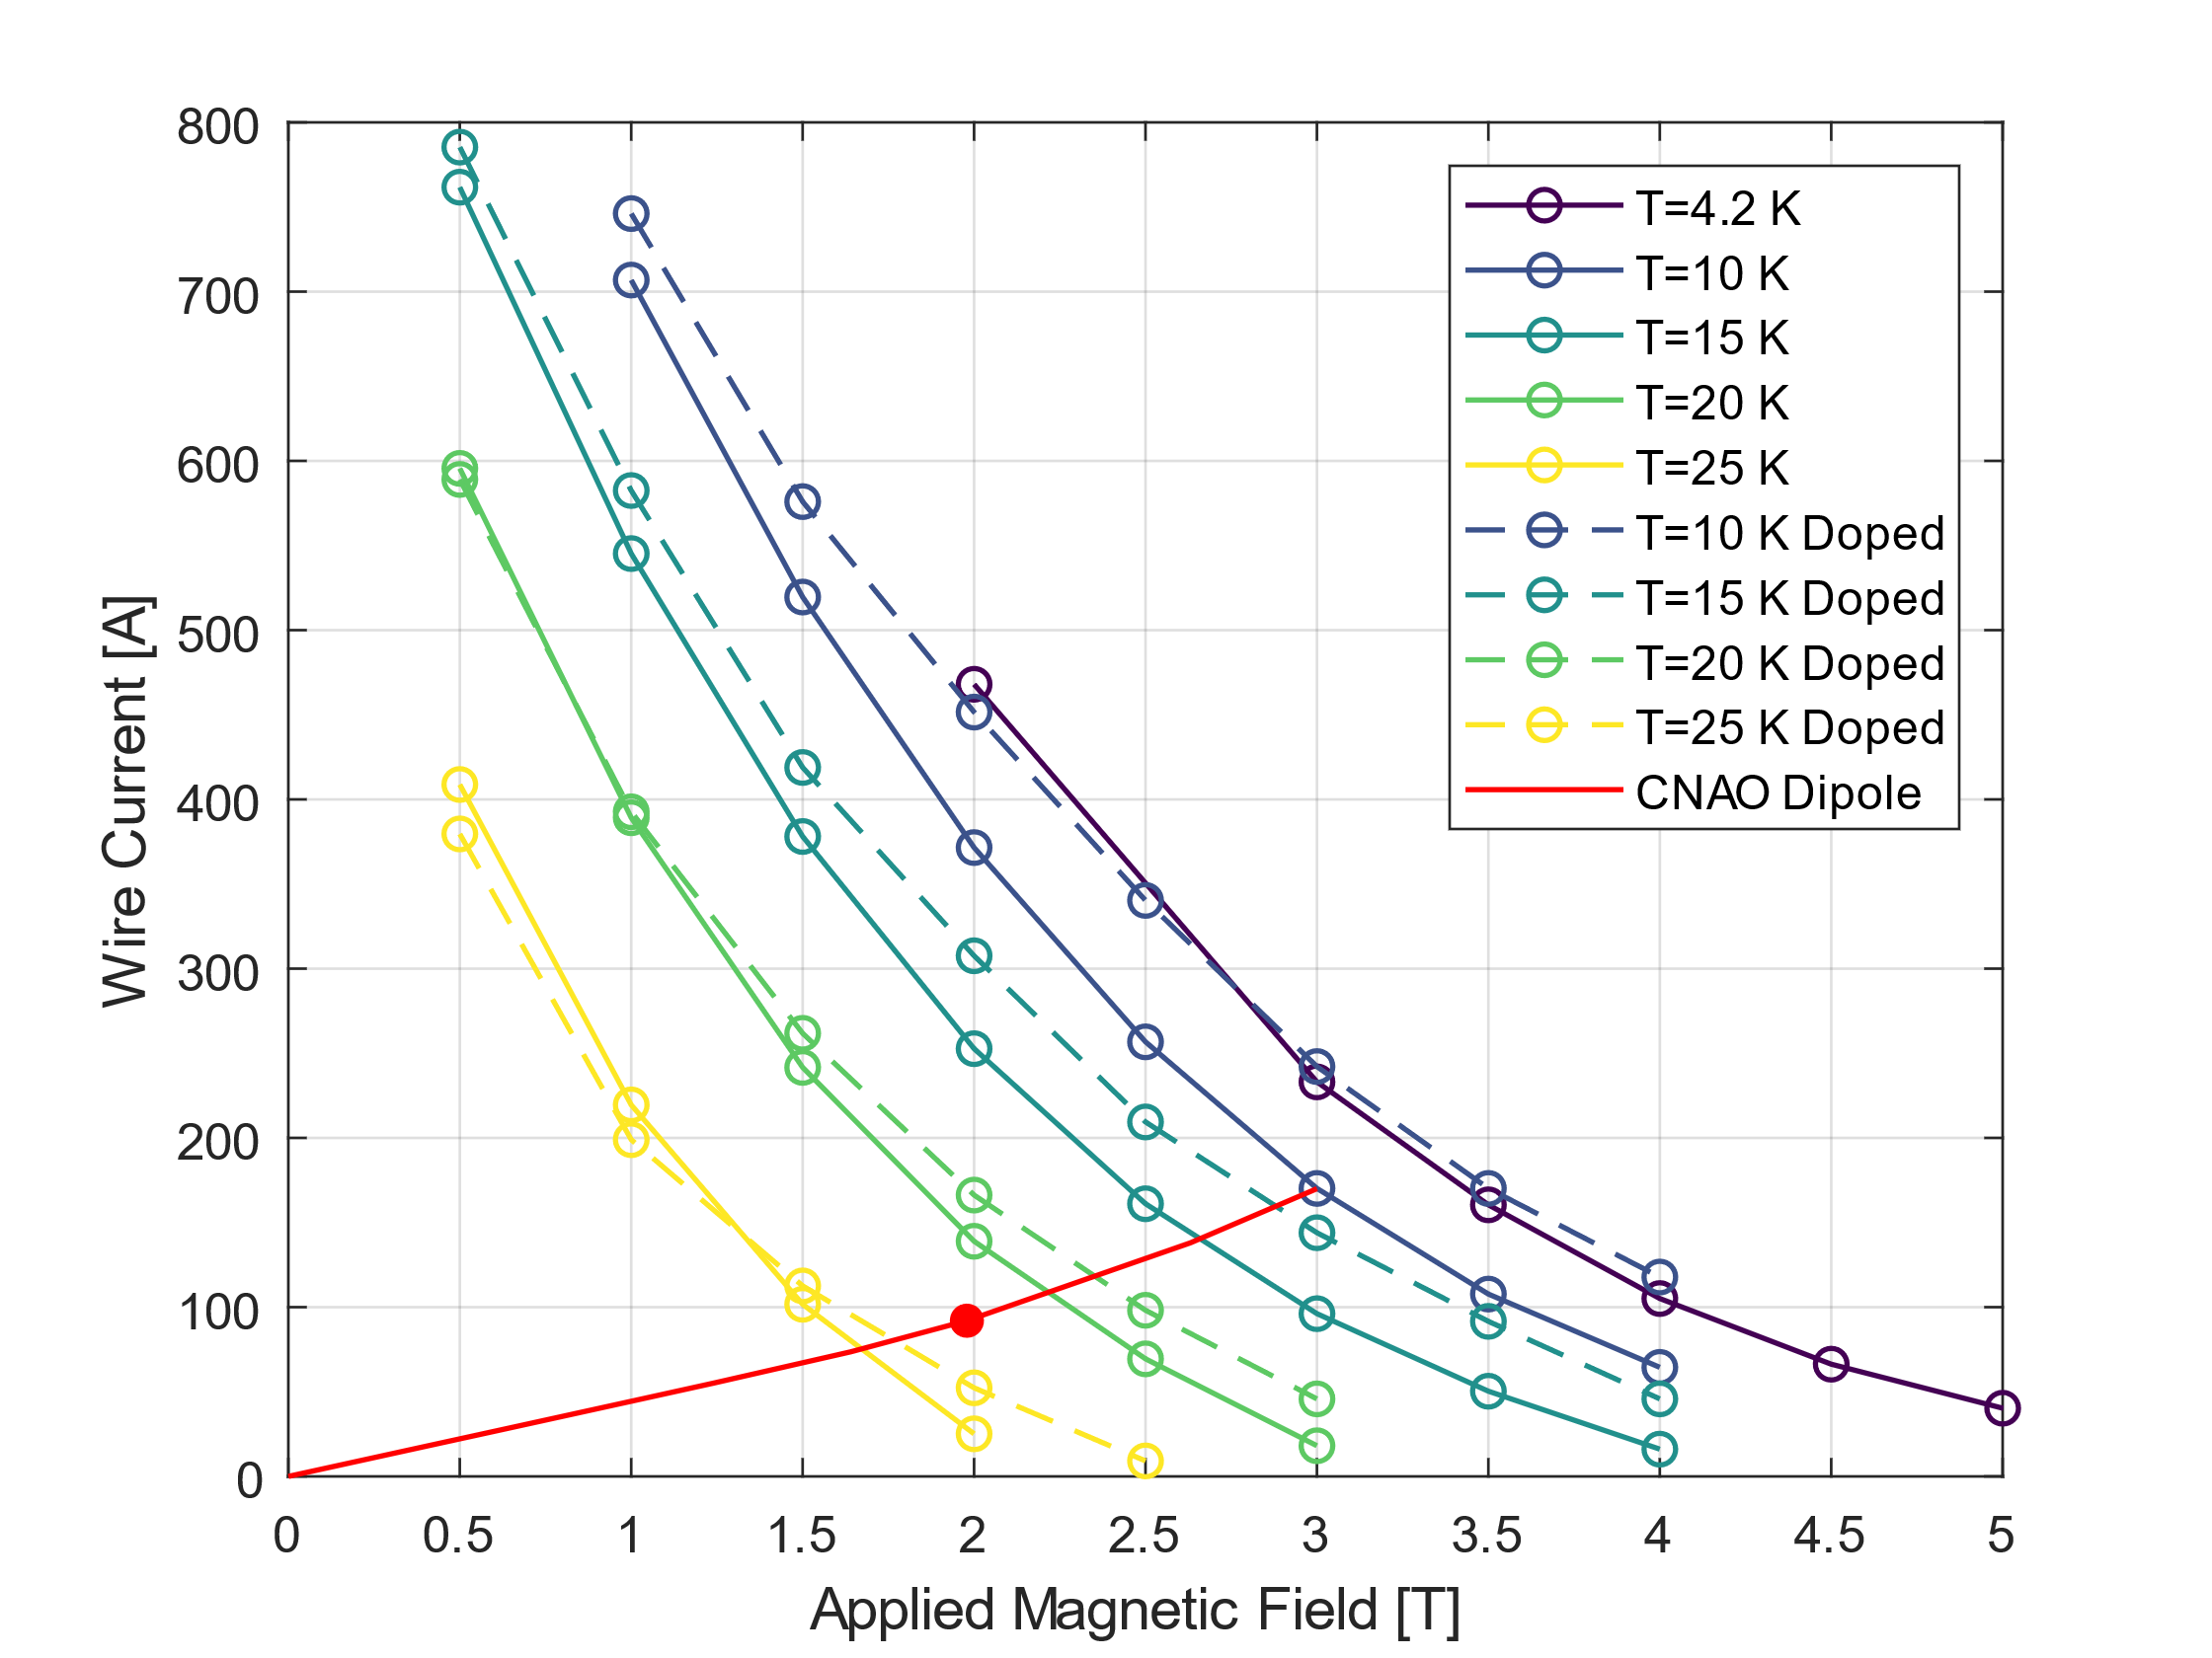
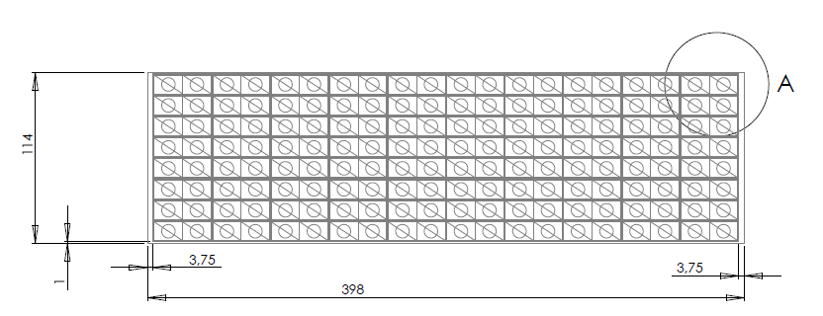
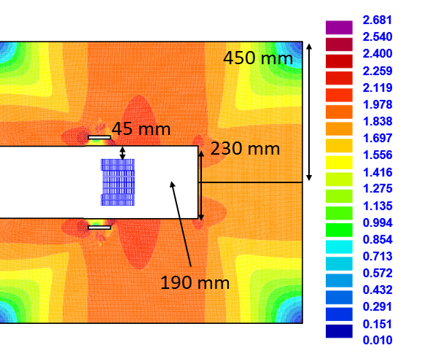
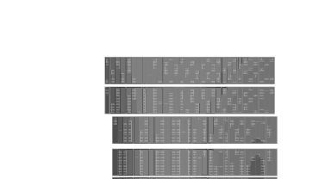
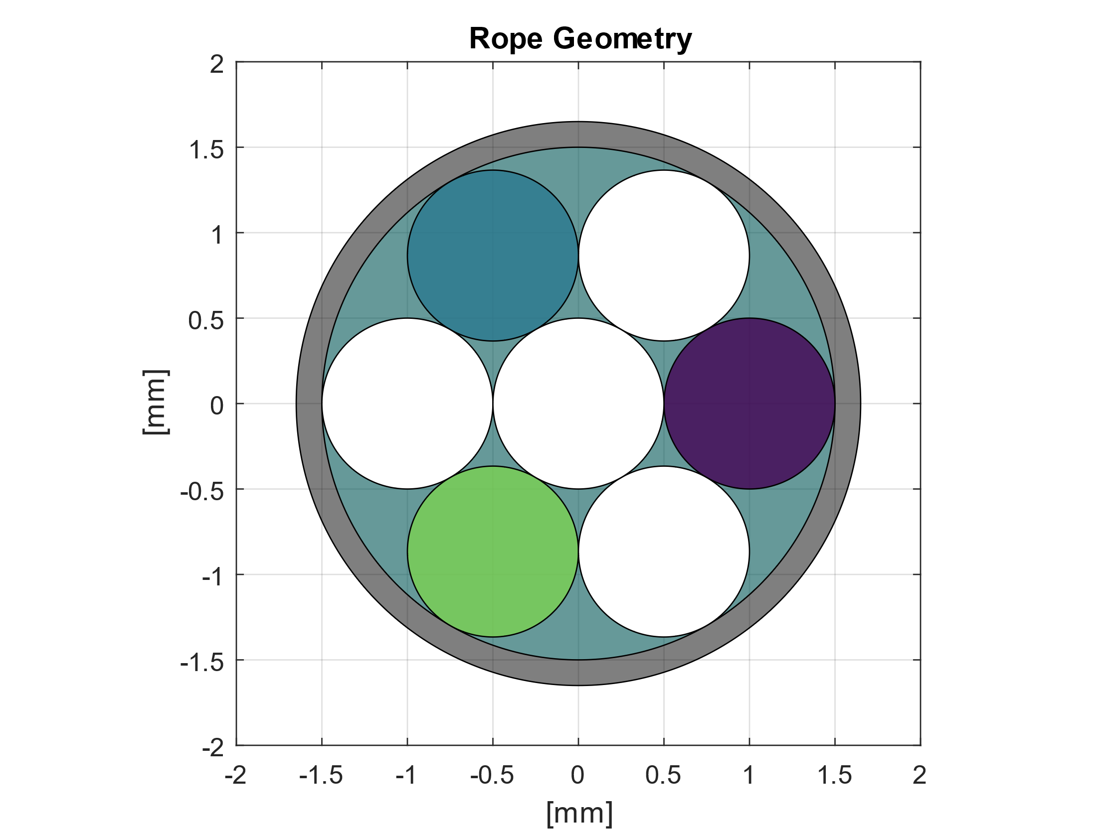
EM Design @ T=10 K
Target of the electromagnetic design optimization:
Magnetic field of 1.74 T at center
Use of a rope (3 MgB₂ conductors and 4 copper wires).
  630 ropes carrying 276 A @ 2 T
  35% margin LL – 13 K temperature margin.
398 mm
106 mm
114 mm
73 mm
MgB₂
Cu

Slide 14
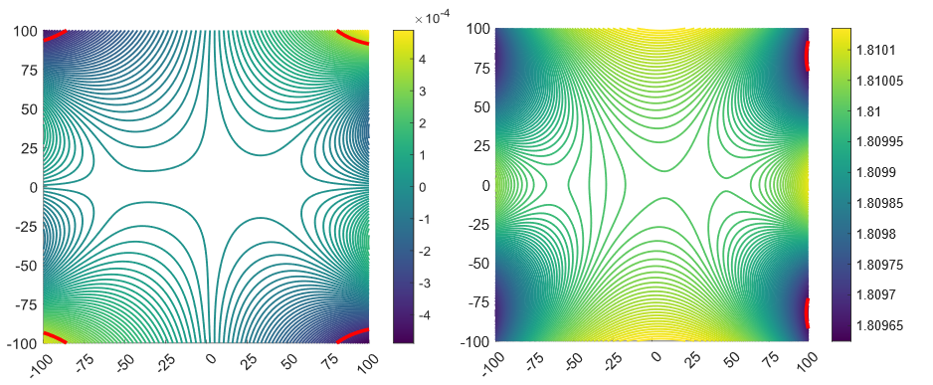
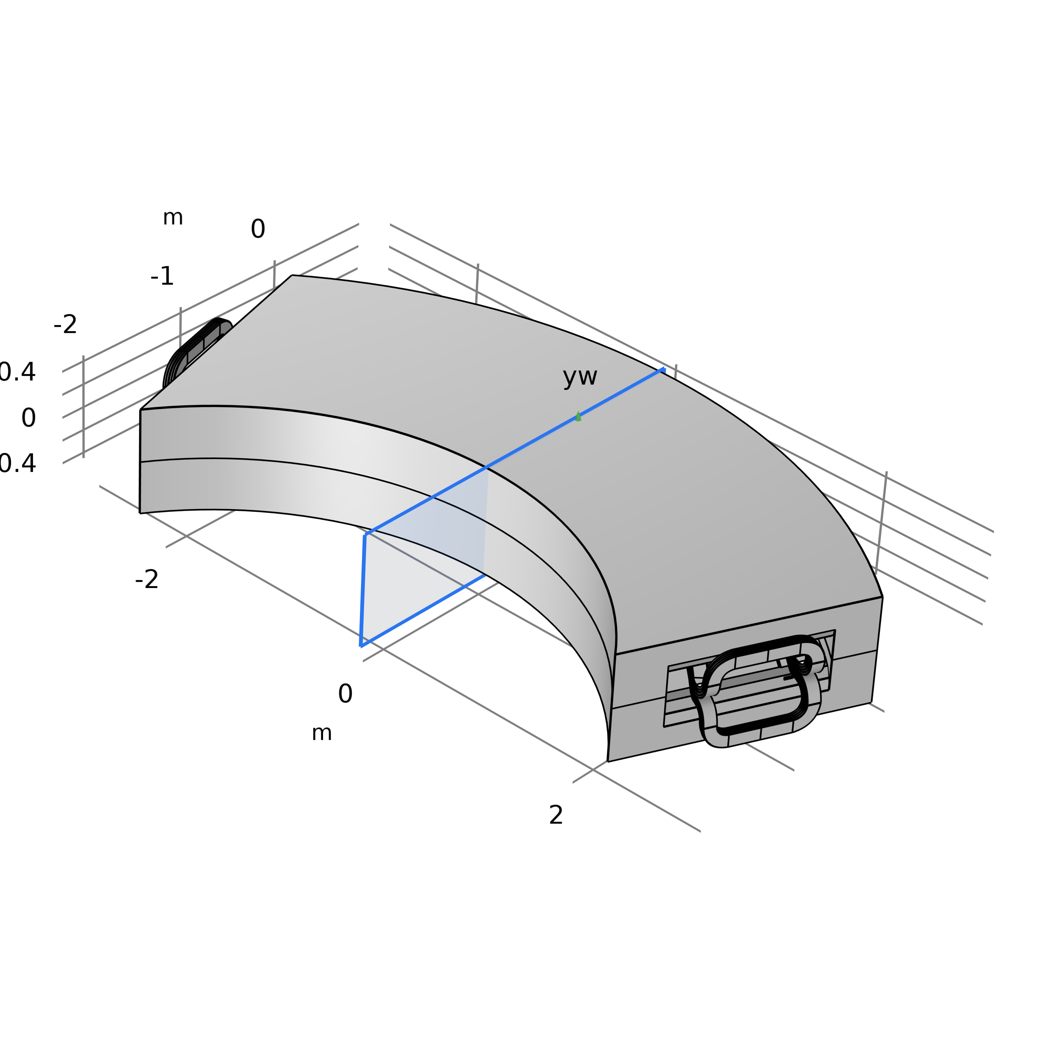
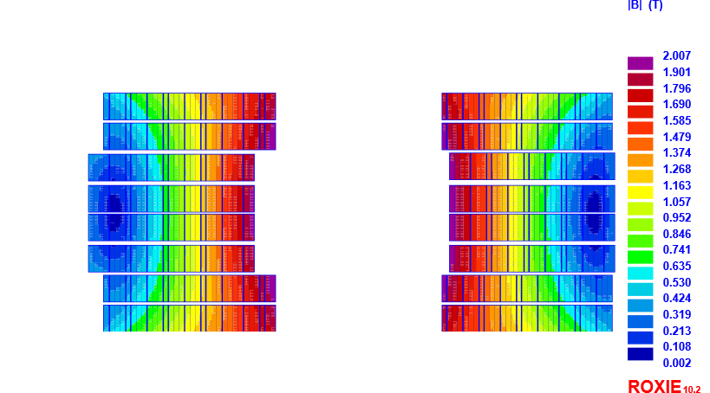
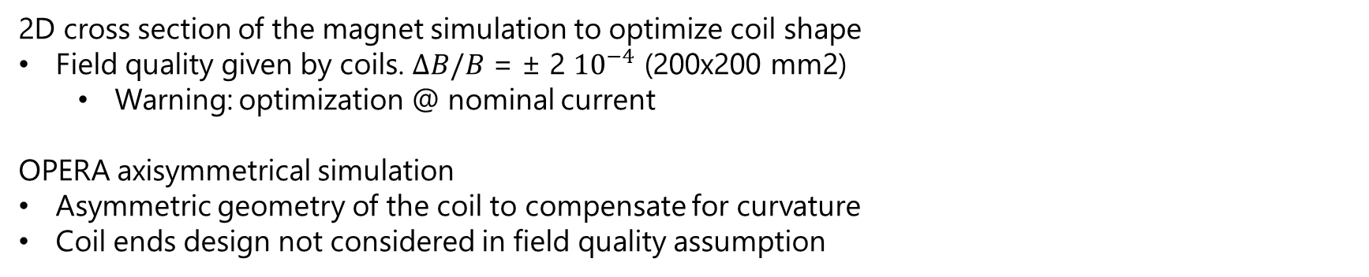
Field quality
2D cross section of the magnet simulation to optimize coil shape
Field quality given by coils. $ΔB/B$ = ± 2 ${10}^{−4}$ (200x200 mm2)
  Warning: optimization @ nominal current
OPERA axisymmetrical simulation
Asymmetric geometry of the coil to compensate for curvature
Coil ends design not considered in field quality assumption
By Field [T]
B_{peak} =2.007 T
y
Bx Field [T]
x

Slide 15
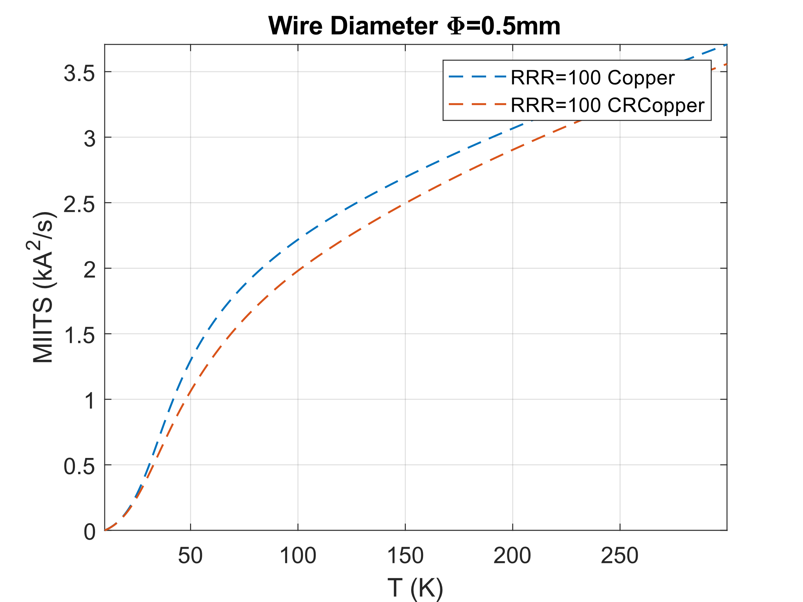
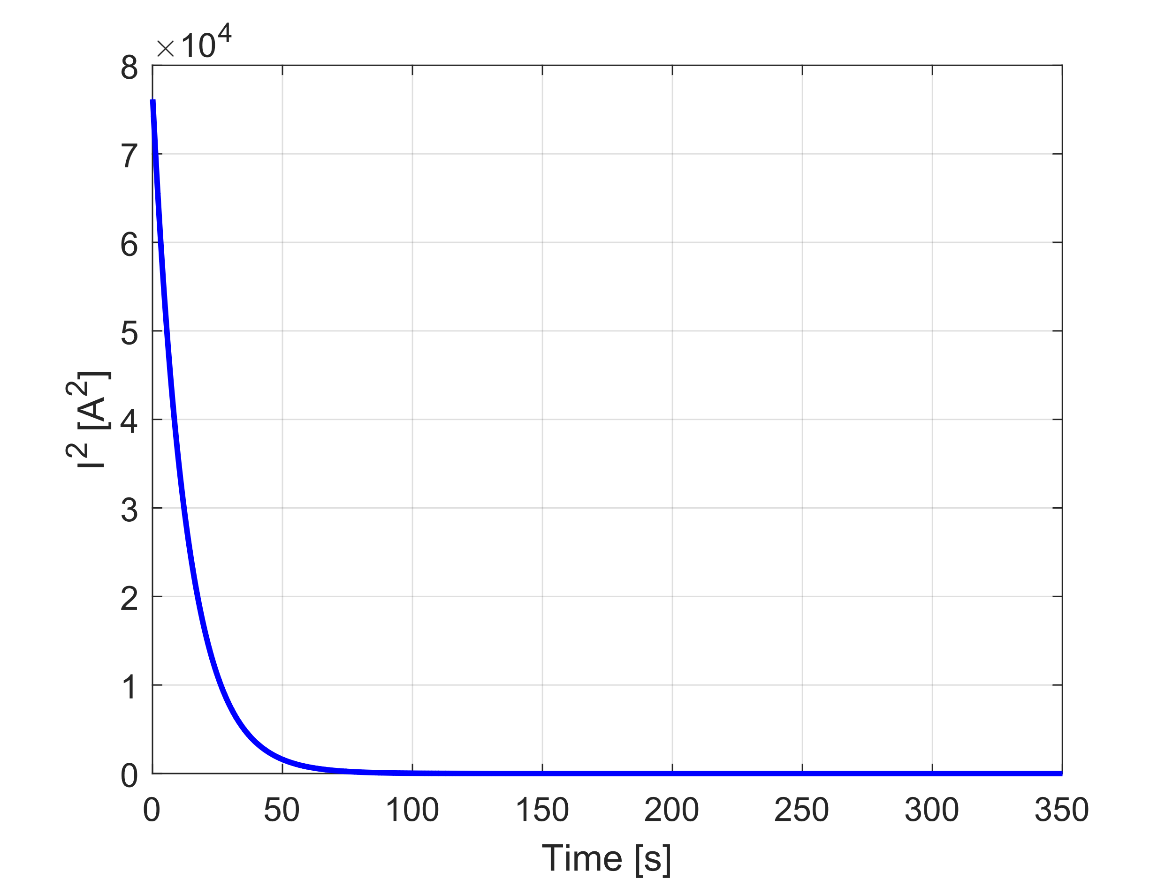

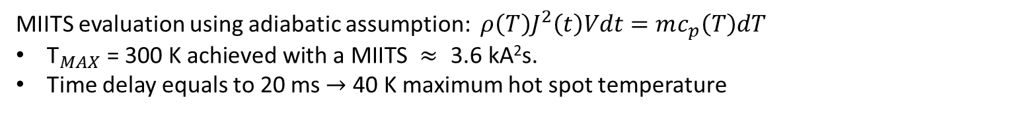
Quench Protection
MIITS evaluation using adiabatic assumption: $ρ\left(T\right)J^{2}\left(t\right)Vdt=mc_{p}\left(T\right)dT$
${\text{T}}_{MAX}\text{ = 300 }\text{K} \text{achieved} \text{with} \text{a} \text{MIITS} ≈\text{ 3.6 }\text{kA}\text{2}\text{s}\text{.}$
Time delay equals to 20 ms $→$ 40 K maximum hot spot temperature
$$R_{d}=\frac{300 [V]}{I_{op}}=1.1Ω$$
40 K
45 K

Slide 16
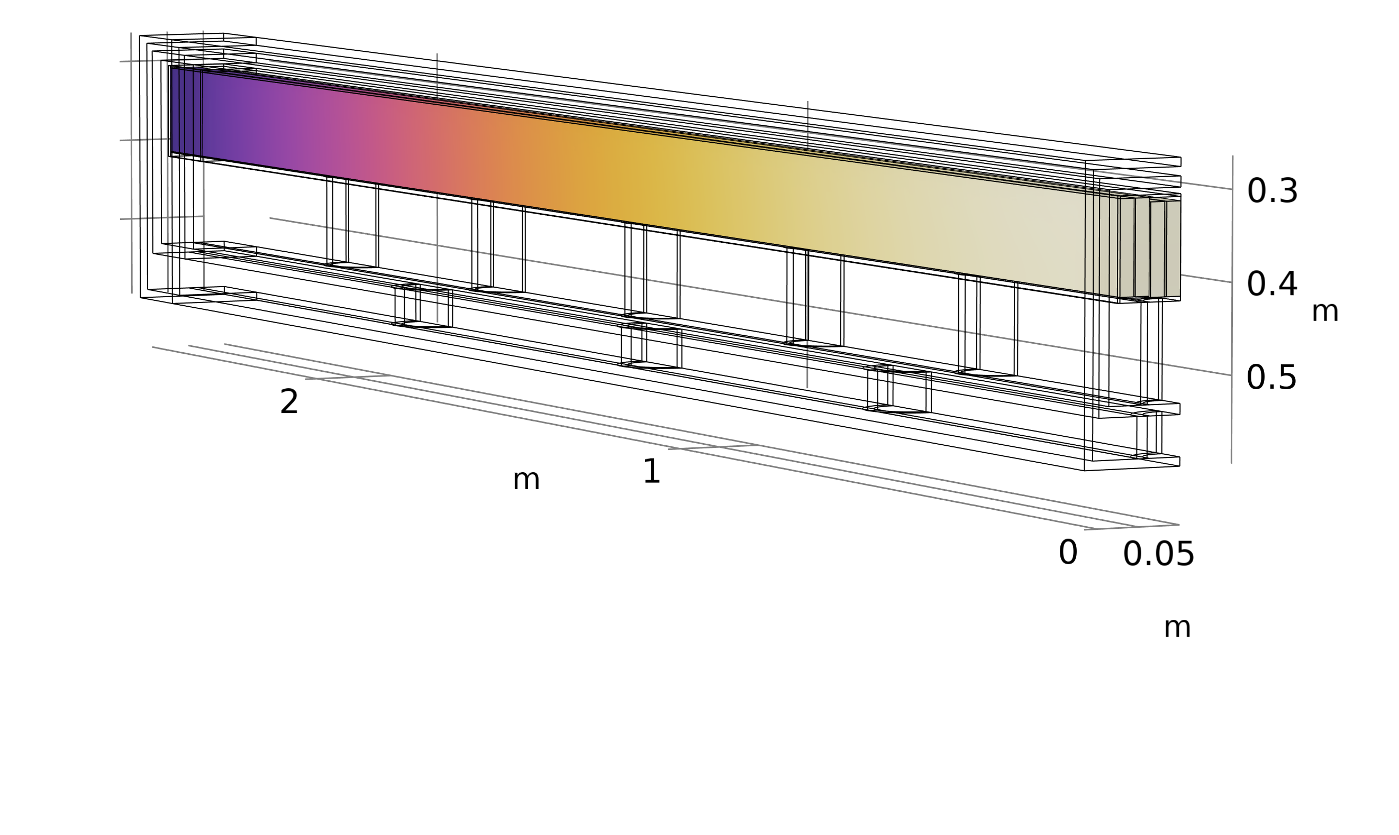
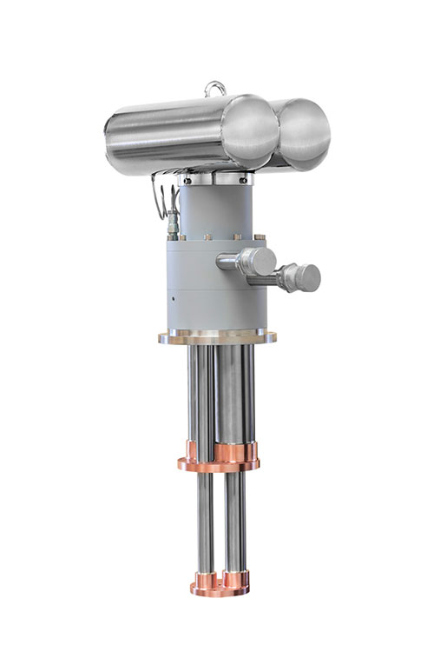


Mechanical and Thermal Design
Simplified straight model Geometry
Optimization of the superconducting coil:
630 Ropes: 4 MgB₂ 1 mm conductors and 3 high-purity copper wires
Nominal current 276 A (resistive coil 2.28 kA 80 channels) @ 2 T peak field (35 % margin)
12.7 K
10 K
Thermal Shield
MAGNET | Coils @ 10 K |  | Shield @ 60 K
Q support | 1.76 [W] |  | 37.9 [W]
Q CL | 0.2 [W] |  | 24 [W]
Q radiation | 0.25 [W] |  | 12.55 [W]
LOSSES | Hyst | IFCC |  | ISCC
 | 1.86 [W/m] | 0.011 [W/m] |  | 0.1 [W/m]
J
Coils 106 x 73 mm
PT425 Cryomech
MgB₂
Cylindrical Supports
Energy saving factor = 2
(15.6 kWDC/year vs 30 kW DC/year)
Cryostat
Detail J
Cu

Slide 17



New Superconductor Design @ 20 K
756 Ropes (+20%) same MgB₂ conductor
Complete 3D simulation
Nominal current 226 A (old design 276 A)
  (14 % margin LL, 3.6 K temperature margin)
Coils Peak Field 1.93 [T]
35 % margin
P1=(2 T, 92 A)
P2=(1.93 T,75 A)
14 % margin

Slide 18



Hysteresis Losses
Volumetric Losses Density
Equivalent magnetization model used to evaluate average hysteretic losses in the conductor.
Filament diameter equals to 55 $μm$
3D static heat map source
Superconductor magnetization parallel to conductor has been neglected
Time averaged Losses | Hyst
Old Design @ 10 K | 37.2 [W]
New Design @ 20 K | 34.2 [W]

Slide 19





IFCC and ISCC Calculation
Volumetric Losses Density
Losses on the conductor averaged on the magnet powering cycle:
Static heat source in the 3D simulation to evaluate regime temperature distribution on the coil
IFCC and ISCC: f ($ρ$_{eff},L_{Pitch})
E Field Potential (V)
Current Density (A/mm²)
φ
x
Time averaged Losses | ISCC | IFCC
Old Design @ 10 K | 2.02 [W] | 0.22 [W]
New Design @ 20 K | 1.55 [W] | 0.17 [W]
Courtesy: Stefano Sorti, UNIMI

Slide 20


Mechanical Design
Coils 110 x 73 mm
Thermal Shield
Bar
5-mm-thick SS 316LN reinforcement bar around coils to limit deformations.
A distributed set of 36 G10 cylindrical supports is adopted to sustain an active aluminium thermal shield (@ 60 K) and coils (@ 20 K).
Cryostat
Cylindrical Supports
 | External Supports | Internal Supports
Diameter | 50 [mm] | 42 [mm]
Thickness | 9 [mm] | 6 [mm]
Length | 47 [mm] | 107 [mm]
Optimization of cylindrical supports dimensions and positioning to minimize conduction heat load on coil and thermal shield but able to withstand 200 MPa of compressive load

Slide 21



Thermal Design
Cryo B (60 K shield)
Aluminum thermal shield (6 mm thickness)
working @ 60 K covered with 30 MLI layers (minimzation of radiation load).
Cryo A
(20 K coils)
Coil modelled as orthotropic material Cu (22%), MgB₂ (29%), epoxy resin (49%)
Cryocoolers installed on both side of the magnet
TS (3.4 kW) 2 AL230
Coils (8.4 kW only for 1/10 of the year) 2 AL60
20 K
MAGNET | Coils @ 20 K |  | Shield @ 60 K
Q support | 1.1 [W] |  | 35 [W]
Q CL | 0.2 [W] |  | 24 [W]
Q radiation | 0.38 [W] |  | 19.52 [W]
LOSSES | Hyst | ISCC |  | IFCC
 | 34.2 [W] | .1.55 [W] |  | 0.17 [W]
Total magnet energy consumption: 4.3 kW (vs 30 kW DC resistive).
21.7 K
$≈$7 times lower
AL230 Cryomech and AL60 Cryomech

Slide 22
Conclusions
Reduction of energy consumption is one of the critical research aspect to be considered for currently and future large accelerator facility sustainability.
Development project based on cryogen-free superconducting magnets
MgB₂ or HTS conductors @ T=20 K
Conduction cooling solutions
Case studies: CNAO 90° Dipole (ramped magnet) and PSI bending dipole (steady-state)
Coil geometry suitable for MgB2 and HTS curvature requirements
3D Models of both magnet already developed using MgB2 rope conductor
Field requirements fulfilled
Steady-state solutions (consumed energy scaling = 1/40)
  can be pushed to 30-50 K with HTS
Ramped magnets (consumed energy scaling =1/7)
  (Heat load and T_{op} balance optimization)
NEXT STEPS
Validation of cable manufacturing on-going
Small magnet demonstrator development

Slide 23


Thank you for the attention
Ministero
dell'Università
e della Ricerca

