Slide 1
Superconducting Magnets from an Industrial Point of View Wolfgang Walter Workshop Superconductivity for Sustainable Energy Systems and Particle Accelerators – GSI 2023-10-19

Slide 2
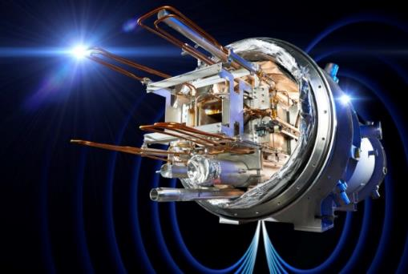
Content
Introduction
Accelerator Magnets at Bilfinger Noell
Accelerator Magnets from Industrial Point of View
Interaction of Labs and Industry in different Project Stages
Requirements from and Support for Industry
Lessons Learned
Summary & Outlook
Summary on Business and Technology
Outlook on Sustainability

Slide 3
Bilfinger
Technologies
Magnet Technologies
Nuclear Technologies
Bilfinger Noell GmbH
Nuclear Waste Treatment Technologies
Engineering & Maintenance
Service and Assembly
Bilfinger Noell GmbH – Innovation is our Tradition

Slide 4
Engineering
Vacuum technology
Cryogenics
Bilfinger
Noell
CORE
COMPETENCES
Multi-physics approach towards complex engineering tasks for custom design solutions
Extensive experience in the design and manufacture of complex UHV components and vacuum vessels
Highly efficient design of both helium and conduction-cooled systems down to 2 K
Series production
Testing capabilities
Magnet technology
Specialized hardware
Optimization of complex manufacturing processes from small-scale to series production
Trained personnel and specialized equipment for cryogenic and vacuum testing in-house
Wide range of experience in superconducting (LTS and HTS) as well as resistive and permanent magnets
Special tooling and equipment including winding and cabling machines and furnaces for impregnation
Bilfinger Noell GmbH – Dr. Wolfgang Walter Workshop Superconductivity for Sustainable Energy Systems and Particle Accelerators – GSI 2023-10-19
Page 4

Slide 5
SERIES production at NOELL A history of performance
DESY HERA
CNRS
LNCMI
GSI SIS100
Dipoles
CERN
LHC
DESY
FLASH
MPI W7-X
STAGE COACH
DESY
PETRA
GSI SIS100
QDM
1824 ’50 1986 ’98 ’99 2008 ’11 ’12 ‘16 ‘18
Bilfinger Noell GmbH – Innovation is our Tradition

Slide 6
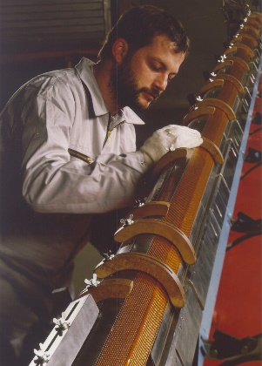
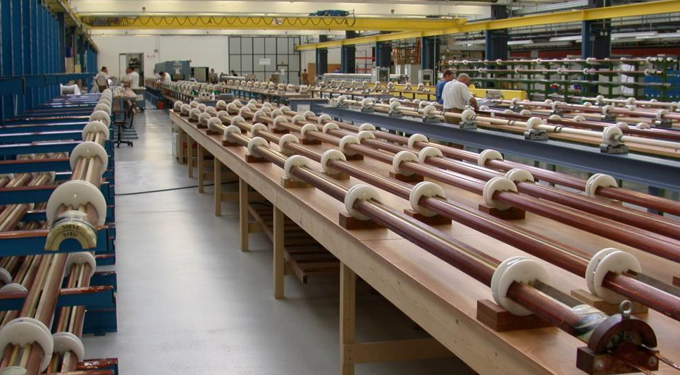
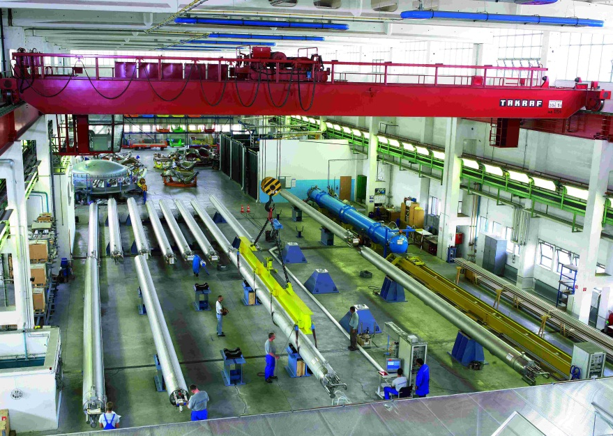
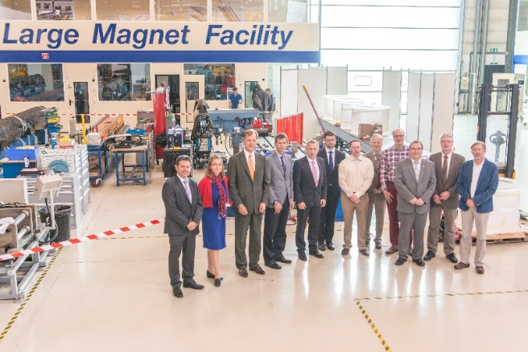
Dipoles for the LHC
Development Phase (Paid learning)
1990: 10 m Prototype Cold Masses
1995: 10 m All Kapton Collared Coil
1999: Preparation for Series Production
Series Production
1999: 30 Cold Masses
2002 - 2006: 386 Cold Masses
16 years from first R&D contract until completion of series
Next Generation Nb3Sn Dipoles
2014 - 2017: Onsite industrial development
in collaboration with Cern
Page 6

Slide 7
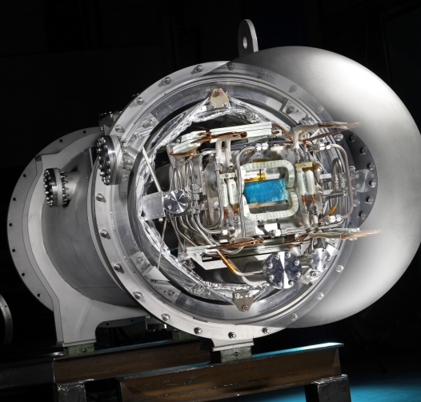
Magnet Sytems for FAIR SIS 100
SIS100 Dipoles:
2004 – 07: EU-FP6 Task:
GSI with partners from institutes and industries
2007 – 08: First straight prototype
2012 – 13: First of series - FOS
Industrial manufacturing of the SC cable
Qualification for the industrial series production
2016 – 20: Series production
Cable production & Manufacturing of 110 dipoles
16 years from first contract until completion of series
Integration of QDM Modules:
2018: First of series - FOS
since 2019: Series production
Page 7

Slide 8
Classical Project Oriented Collaboration
General setup of successful large scale magnet projects always similar:
e.g. LHC Dipoles, FAIR SIS100 Dipols + QDM but also e.g. W7-X coils …
Collaboration between research labs and industry over many years and multiple contracts essential.
TRL 0
TRL 5/6
TRL 7/8
TRL 9
DEVELOPMENT
DESIGN
PROTO TYPING
DEMON STRATOR
INDUSTRIALI SATION
SERIES PRODUCTION
Superconductivity for Sustainable Energy Systems and Particle Accelerators – GSI 2023-10-19
Page 8

Slide 9
Development & Design Phase
DEVELOPMENT
DESIGN
PROTO TYPING
DEMON STRATOR
INDUSTRIALI SATION
SERIES PRODUCTION
Main work-load at Labs
Industrial input valuable:
Industrial feedback from previous projects
Input to cost, risk, industrial feasibility
Early industrial input to the design
Typical industrial contributions:
Analysis of cost, production schedule, industrial feasibility
Participation in design process:
validate manufacturing concept incl. tooling concept
Introduce proven and robust industrial solutions based on manufacturing experience
Superconductivity for Sustainable Energy Systems and Particle Accelerators – GSI 2023-10-19
Page 9

Slide 10
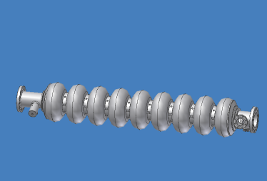
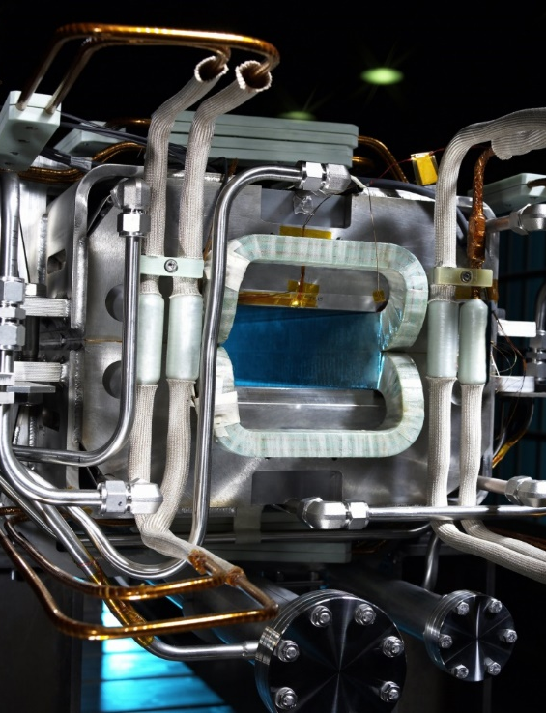
Development & Design Phase - Examples
TESLA / XFEL:
Industrial analysis of production process
Heat treatment of cavities identified as expensive bottleneck in the production
Following DESY R&D work eliminated the bottleneck
FAIR SIS100:
Collaboration of lab and industry on magnet design in FP6 project
Industry identified Aluminumoxide structure as cost driver and manufacturing risk
GSI eliminated the component from the design
Superconductivity for Sustainable Energy Systems and Particle Accelerators – GSI 2023-10-19

Slide 11
Prototyping and Industrialization
DEVELOPMENT
DESIGN
PROTO TYPING
DEMON STRATOR
INDUSTRIALI SATION
SERIES PRODUCTION
Shared work between labs and industry
Prototyping → important step towards hardware!
Importance of industrial prototyping:
Transfer of know-how and experience from labs to industry preferably at industry workshop
Input from industry on robust manufacturing concepts and processes based on series experience
Input from industry on tooling concepts for efficient series production with consistent quality
Mutual design optimization to
Improve consistent magnet quality
Make production process robust and repeatable
Develop quality criteria for series (specify only what’s needed and not more, give margin to work with)
Superconductivity for Sustainable Energy Systems and Particle Accelerators – GSI 2023-10-19
Page 11

Slide 12
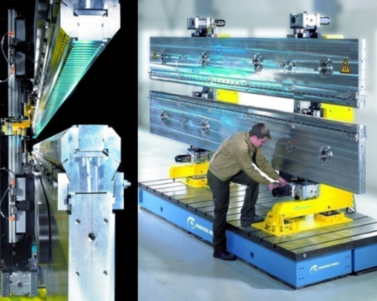
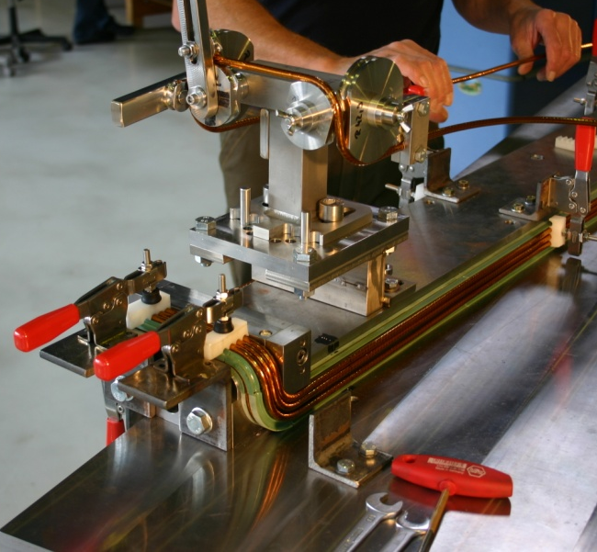
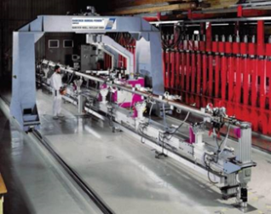
Prototyping Phase - Examples
LHC Main Dipoles:
Transition 1m → 15m long dipoles
Development of tooling and qualification with industrial prototypes (e.g winding machine)
XFEL Undulators:
Manufacturing of industrial prototype undulator with 316LN beam
Manufacturing is feasible but at high cost and risk
Qualification with add. prototype: aluminum beam technically sufficient
FAIR SIS100:
Industrial prototype to qualify (among others):
Kapton as cable insulation (instead of Prepreg)
Use of precisely manufactured G11 structures to position the windings
Robust series production: store-able cable and consistent coil geometry
Superconductivity for Sustainable Energy Systems and Particle Accelerators – GSI 2023-10-19

Slide 13
Series Production
DEVELOPMENT
DESIGN
PROTO TYPING
DEMON STRATOR
INDUSTRIALI SATION
SERIES PRODUCTION
Work load highest at industry.
Important factors for a successful series production
Design freeze prior to series manufacturing
Robust and realistic planning incl. risk mitigation measures by industry, labs and probably sub-contractors including contingencies (schedule, supplies)
Problem solving mechanisms and awareness that small problems can have big effects in a series
Open collaboration and trust
Page 13

Slide 14
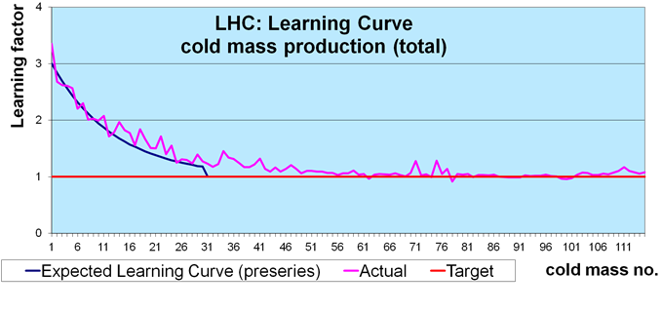
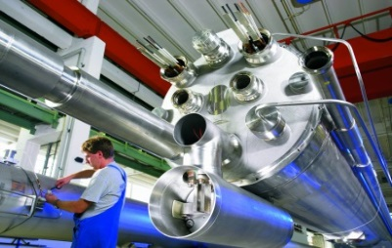
Series Production – Example
LHC:
Largest series production of high field accelerator magnets
Very good and consistant quality produced by industry
Huge bubble project business managed by companies
Industry had freedom to produce at their site with their tooling concepts
Labs assured consistency with test procedures, equipment and monitoring test results.
For Industry:
Spin-off for other industry products is limited
Business itself is interesting project business
Projects are important as experience and reference for other large scale research projects
Superconductivity for Sustainable Energy Systems and Particle Accelerators – GSI 2023-10-19

Slide 15
FAIR SIS100 Dipoles: Experience of GSI and Bilfinger Noell
2004-2007: Development with Industry cable insulation, coil structure
2007-2008: Prototype Dipole 2-layer straight magnet
2012-2013: First of Series (FoS) Dipole 1-layer curved magnet
2013-2016: Cold test and yoke modification
11/2016: Start of SIS100 Dipole series production:
09/2017: First series dipole has been delivered
12/2020: Last series dipole delivered
Early involvement of industry -> more robust design
← Industrial prototype -> verification in industry
← 4-years gap: people left, 1 company out of business…
← Major design change at late stage
← Lead to additional development and qualification
Successful series production in good collaboration between GSI and Bilfinger Noell results in high quality magnets
Superconductivity for Sustainable Energy Systems and Particle Accelerators – GSI 2023-10-19

Slide 16
Requirements from Industry
Basic condition: industry must earn money and must not get bankrupt fullfilling is obligations.
→ Fair sharing of risks and chances is essential! Make risks manageable for companies:
Limit contractual risks to acceptable values
Split technical risks into foreseeable portions using appropriate contractual concepts:
Split contract into stages where only first stage is binding
Cost + fee concept makes sense when quantitative risk is high
Talk and negotiate risks with industry. Use negotiated procedures not submission for calls for tender
Labs will benefit:
→ less risk for industry means less risk provision in offer prices and higher number of competitive offers!
Superconductivity for Sustainable Energy Systems and Particle Accelerators – GSI 2023-10-19

Slide 17
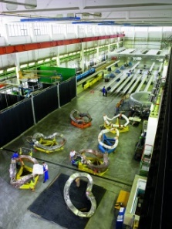
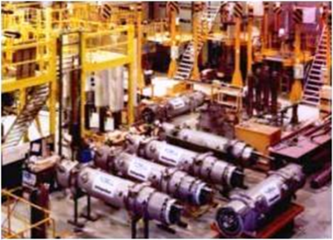
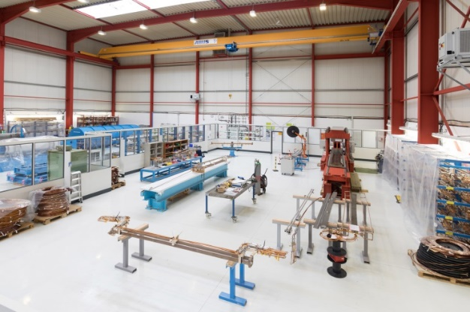
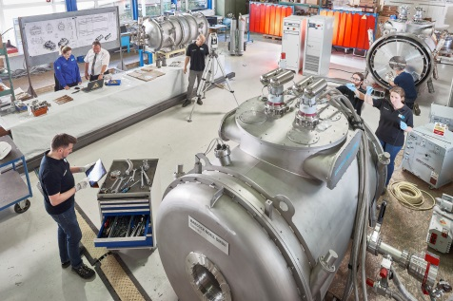
Support Industry
EU: industrial suppliers can manage large scale high-tech magnet projects. Know-how, experience and infrastructure available at the companies.
→This asset should be fostered by EU labs with:
Continuous basic work load for industry to keep and extend industrial know-how.
→This requires a long term strategy and roadmap incl. collaboration of research and industry.
Existing involvement of industry in planning and strategy for big science projects is very welcome by industry.
Perspectives on the future projects (scope, timeline, in-kind situation) are necessary to promote projects in industrial landscape.
→ Continuous information of and collaboration with industry enables industry to be ready for the next big series production of superconducting magnets
Superconductivity for Sustainable Energy Systems and Particle Accelerators – GSI 2023-10-19

Slide 18
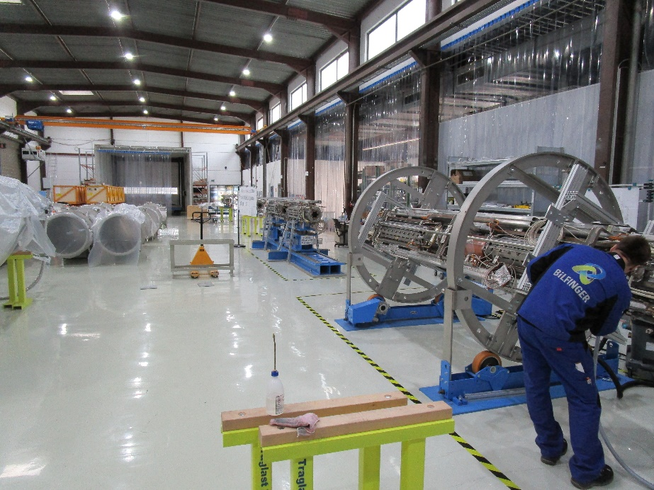
Summary - Business
High field accelerator magnets are a bubble project business with high technical risk
Industry is experienced and available for the task
Fair sharing of risks is important
Industry needs to make profit and must not go bankrupt performing the job
Utilize adequate tools: cost + fee, staged contracts, EU innovation partnership, negotiation procedures
Industrial infrastructure for high field accelerator magnets in Europe is an asset that needs to be protected
Long term roadmap for collaboration is essential to guarantee workload needed to keep this infrastructure

Slide 19
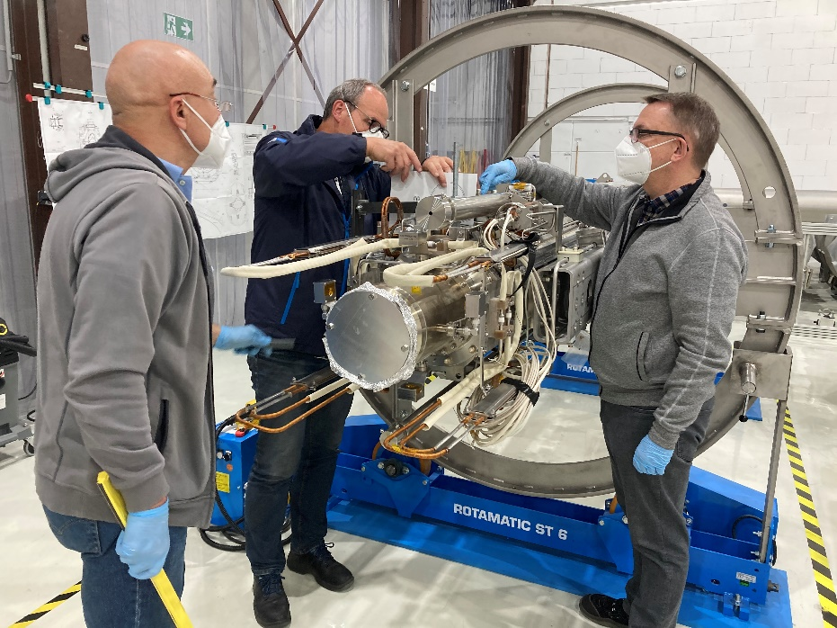
Summary - Technology
To get the most out of the lab & industry partnership it is best to involve industry early in design phase
Labs are most experienced to develop high end magnet designs. Industry can bring in series manufacturing experience and practical aspects to bring up robustness and bring down cost.
Industrial prototyping is a must to transfer know-how from labs to industry and to utilize and develop industrial manufacturing technologies and tooling
Superconductivity for Sustainable Energy Systems and Particle Accelerators – GSI 2023-10-19

Slide 20
Summary - Technology
Series production of high field accelerator magnets is an industrial task.
Industry can work on-site at laboratories but this should be limited to cases where it is absolutely needed. Industry has put a lot of time and work to set up it’s facilities and needs to keep them occupied.
Industry is ready and needs continuous work to maintain this status
Superconductivity for Sustainable Energy Systems and Particle Accelerators – GSI 2023-10-19

Slide 21
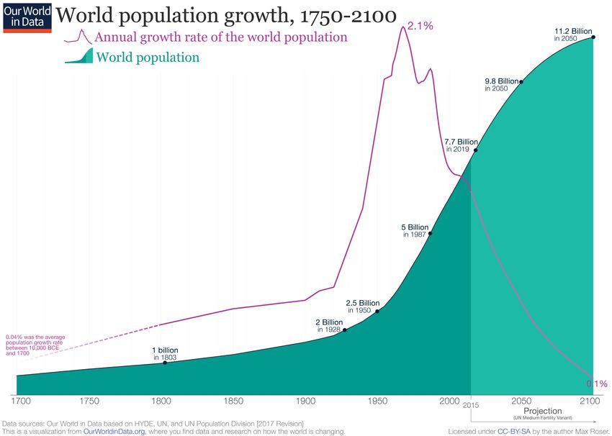
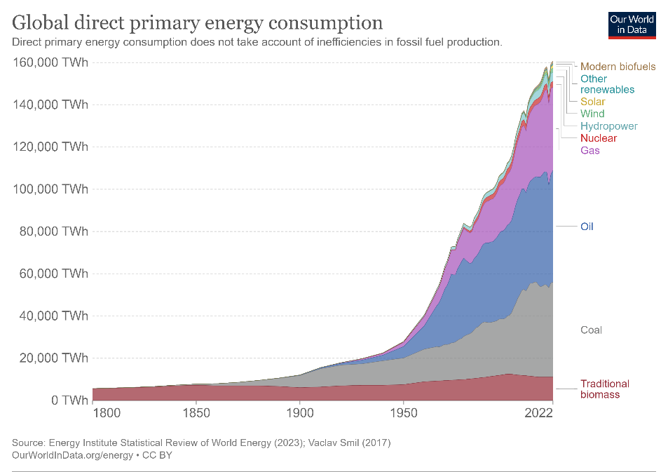
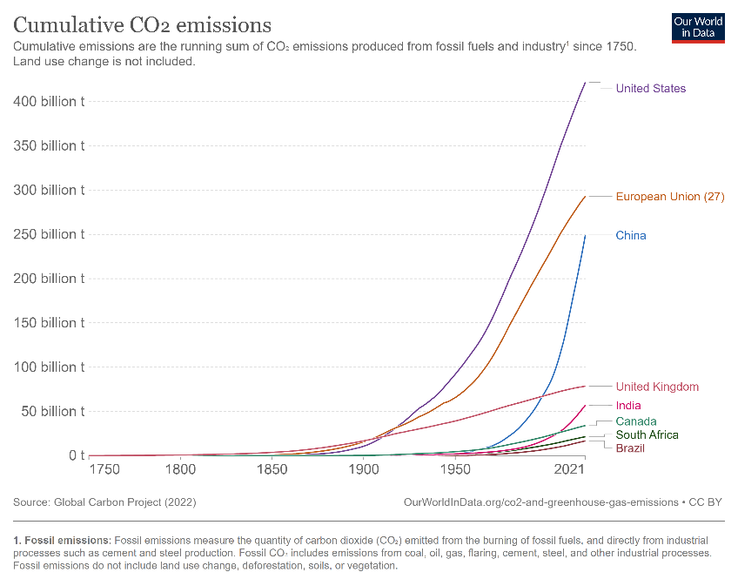
Outlook Sustainability – an Obligation
Our world since the industrial revolution:
Max Roser and Hannah Ritchie (2023) - "How has world population growth changed over time?". Published online at OurWorldInData.org. Retrieved from: 'https://ourworldindata.org/population-growth-over-time'
Hannah Ritchie, Pablo Rosado and Max Roser (2020) - "Energy Production and Consumption". Published online at OurWorldInData.org. Retrieved from: 'https://ourworldindata.org/energy-production-consumption'
Hannah Ritchie (2019) - „Who has contributed most to global CO₂ emissions?". Published online at OurWorldInData.org. Retrieved from: 'https://ourworldindata.org/contributed-most-global-co2'
We have an obligation to future generations to make sustainability our priority.
Let’s work on it!
Superconductivity for Sustainable Energy Systems and Particle Accelerators – GSI 2023-10-19

Slide 22
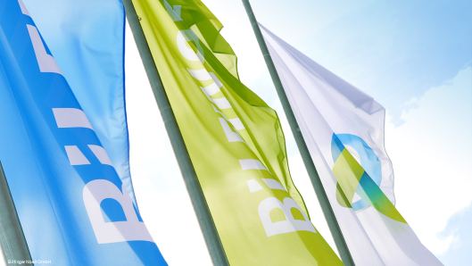
Outlook Sustainability – Superconductivity
Sustainable accelerators: challenge and chance, e.g. technology driver for HTS & cryogenics, development of 3D HTS coil configurations and exploration of novel approaches like revamping resistive Cu magnets with HTS
Spin-off and synergy potential for energy systems, often limited to basic technology and component level, e.g.:
Energy transmission lines → potential for industrial applications
3D coils with compact efficient cooling → interesting for rotating machines
Novel cooling concepts, coolants, coolers could be applied to energy applications
→ Exciting times in Superconductivity ahead of us!
“We are determined to become no. 1 when it comes to increasing efficiency and sustainability for our customers.”
Dr. Thomas Schulz Group CEO at Bilfinger
Superconductivity for Sustainable Energy Systems and Particle Accelerators – GSI 2023-10-19
Notes:
Source of Quote Dr. Th. Schulz: Sustainability: Bilfinger SE
The series production of the dipoles is nearly completed with very good results
For the yoke laser welding is successfully applied to reach the required tolerances
The manufacturing quality is very high and
consistent throughout the whole series
We are just starting now with the QDM and MDP series.
and our goal is supply also these magnets with high quality and in time to GSI.

Slide 23
Sustainability – Accelerators and Energy Systems
Development of sustainable accelerators will push development of technologies relevant also for sustainable energy systems.
However:
Different time-scale for development: accelerators for basic research (>10 years) and commercial energy systems (<5 years)
Technological overlap often limited to basic concepts or components
Suitable forms of collaboration between research and industry must be applied
Superconductivity for Sustainable Energy Systems and Particle Accelerators – GSI 2023-10-19
Notes:
Source of Quote Dr. Th. Schulz: Sustainability: Bilfinger SE
The series production of the dipoles is nearly completed with very good results
For the yoke laser welding is successfully applied to reach the required tolerances
The manufacturing quality is very high and
consistent throughout the whole series
We are just starting now with the QDM and MDP series.
and our goal is supply also these magnets with high quality and in time to GSI.

Slide 24
Sustainability – Accelerators and Energy Systems
Industry needs to be able to make profit and control the risks for upcoming particle accelerator projects. Stage-wise contracting or EU innovation partnerships are suitable concepts.
Industry is also interested to apply spin-offs from accelerator research in energy products:
Common development projects for energy systems
Technology transfer concepts with licencing
…
Looking forward to talk on “Innovation in Cooperation” by Martina Bauer later today and on the group discussion on the topic!
Superconductivity for Sustainable Energy Systems and Particle Accelerators – GSI 2023-10-19
Notes:
Source of Quote Dr. Th. Schulz: Sustainability: Bilfinger SE
The series production of the dipoles is nearly completed with very good results
For the yoke laser welding is successfully applied to reach the required tolerances
The manufacturing quality is very high and
consistent throughout the whole series
We are just starting now with the QDM and MDP series.
and our goal is supply also these magnets with high quality and in time to GSI.

Slide 25
Thanks and Contact
Bilfinger Noell GmbH
Alfred-Nobel-Str. 20
97080 Würzburg
Germany
Phone +49 931 903-0
Fax +49 931 903-6000
noell.info@bilfinger.com
www.noell.bilfinger.com
Registered at Local Court Würzburg, HRB 7156
VAT-Id. No.: DE211420259
Executive Management:
Roland Pechtl
Thank you for your interest,
I’m curious about your feedback!

