Slide 1
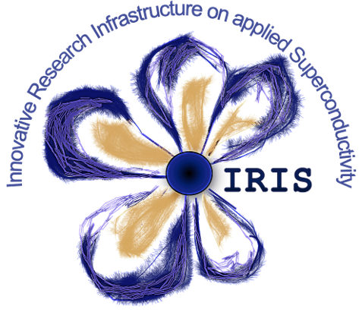
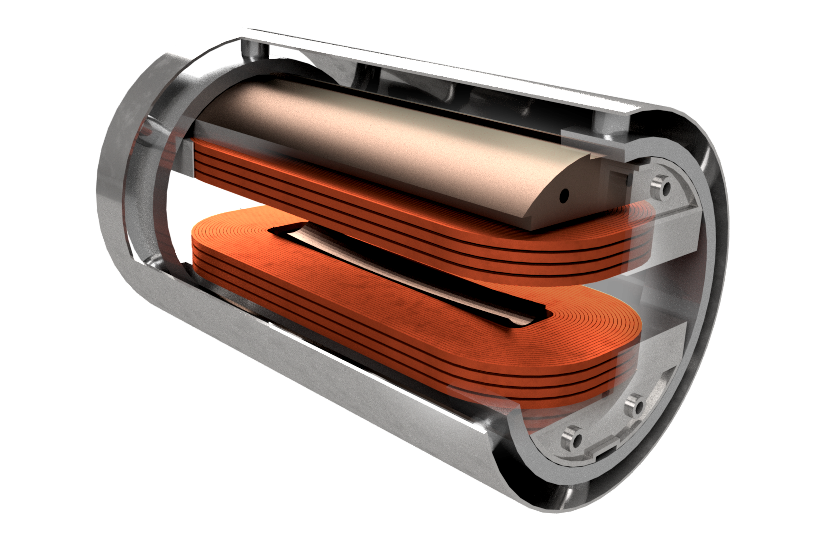
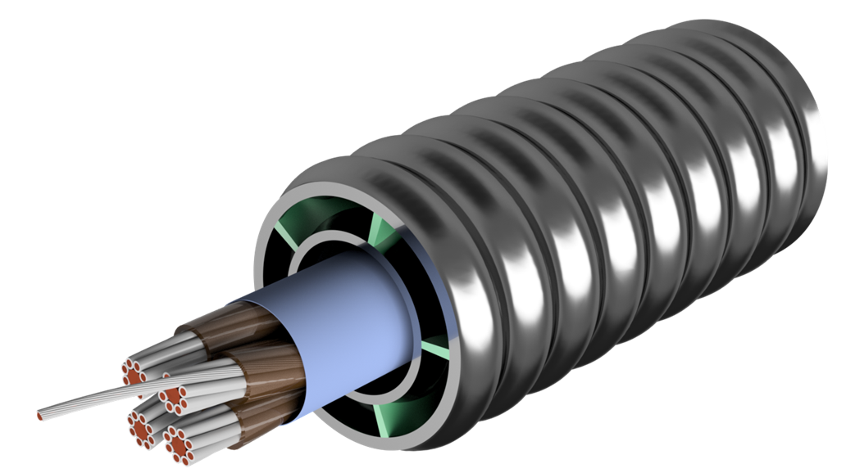


IRIS a new distributed research infrastructure on applied superconductivity
The project IR0000003 – IRIS is supported by the Next Generation EU-funded Italian National Recovery and Resilience Plan with the Decree of the Ministry of University and Research
# 124 (21/06/2022) for the Mission 4 - Component 2 - Investment 3.1.
Lucio Rossi
Università di Milano – Dip. di Fisica
& INFN – sezione di Milano
Laboratorio LASA – Milano
This project has received funding from the European Union’s Horizon 2020 Research and Innovation programme under GA No 101004730.
The 19th of October 2023
Superconductivity for Sustainable Energy Systems and Particle Accelerators Days at GSI

Slide 2
The Program IRIS
Response to a call by the Ministry for University and Research (MUR) under the “Recovery Funds” (PNRR or Next Generation Europe).
Scope: create a new distributed infrastructure in applied superconductivity in Italy by mutualizing existing infrastructures, competences, skills and by expanding them with new laboratories
6 poles for the new or renewed infrastructures: Frascati (INFN), Genova (INFN, CNR-Spin, Unige), Milano (INFN, Unimi – LASA lab), Napoli (Unina), Salento (Unisalento) e Salerno (INFN e Unisa)
  LASA (Milano) is the hub and coordinates the activity

Slide 3
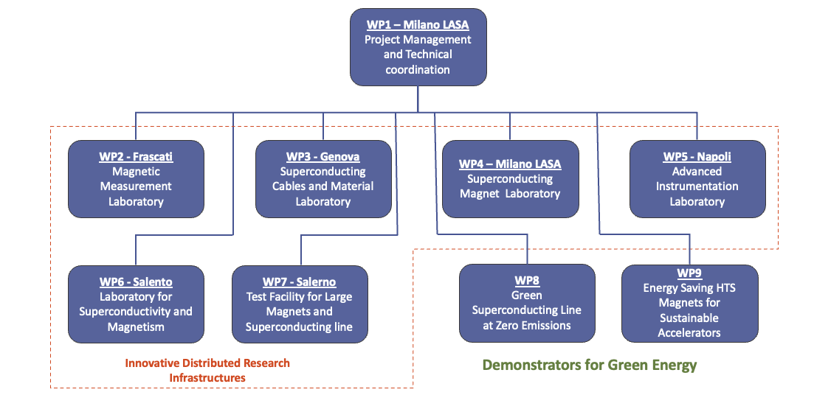
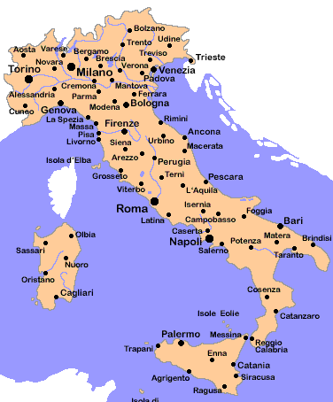







IRIS - Innovative Research Infrastructure on applied Superconductivity

Slide 4
IRIS timeline
Unusually fast for Italian standard…
Avviso MUR n. 3264 del 28-12-20221
Application on 25 February 2022
Negotiation phase with MUR: 10 to 17 June 2022 (resubmission new proposal : 17 June 2022)
Decree of approval: n. 124 of 21 June 2022
Start date of the project: 1 November 2022 (however early expenditure may be admissible for reimbursement)
End of project: 28 April 2025
→ 6 month extension to 30 October 2025 (mentioned in the call)

Slide 5
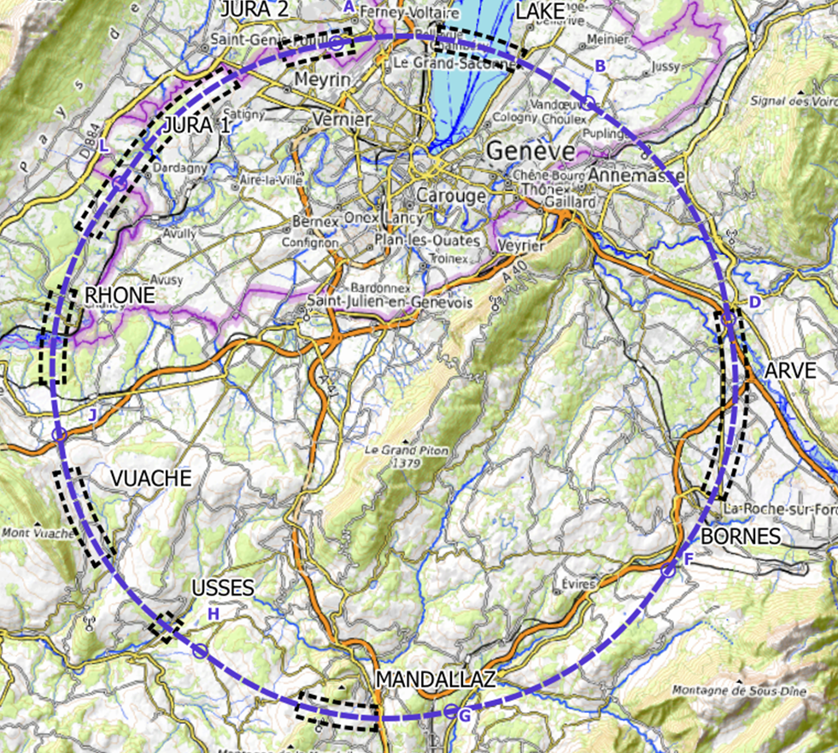
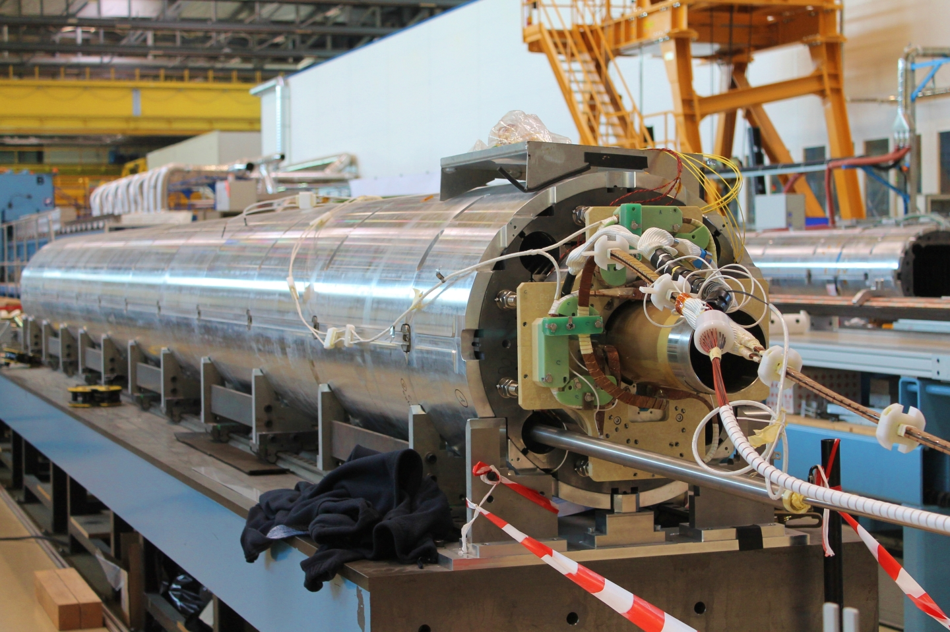
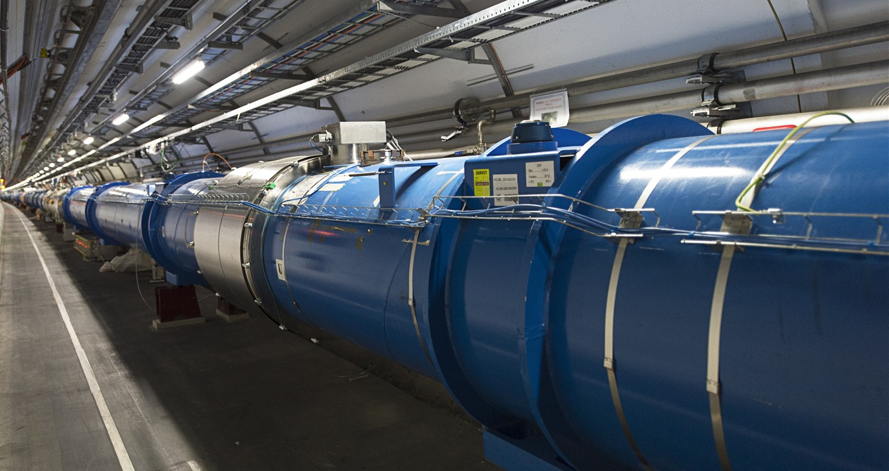
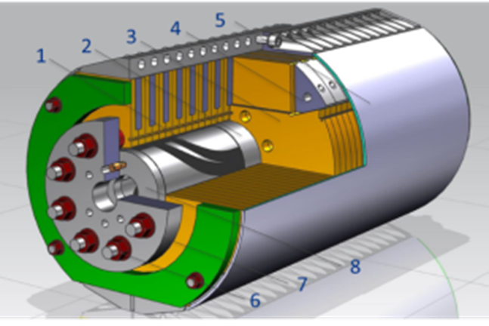
IRIS project scope -1
Fundamental Physics instrumentation
Superconductivity has been instrumental for the discovery of the Higgs boson and its development will be critical for future accelerators and we need of adequate infrastructure to sustain this.
LHC dipoles (8 T) in the tunnel
HiLumi MQXF quad (12 T)
FCC (12-16 T)

Slide 6
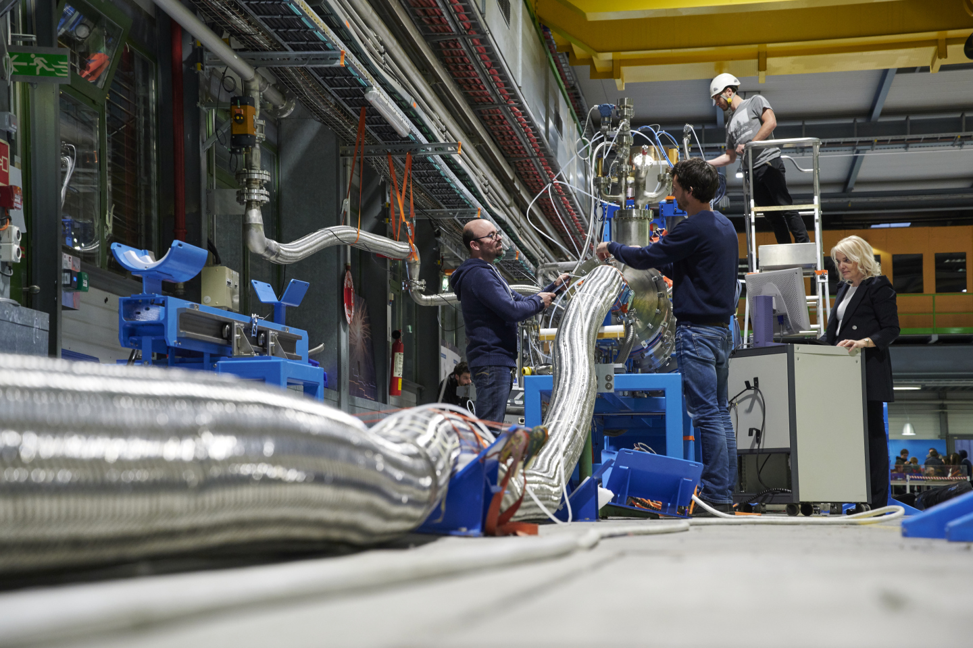
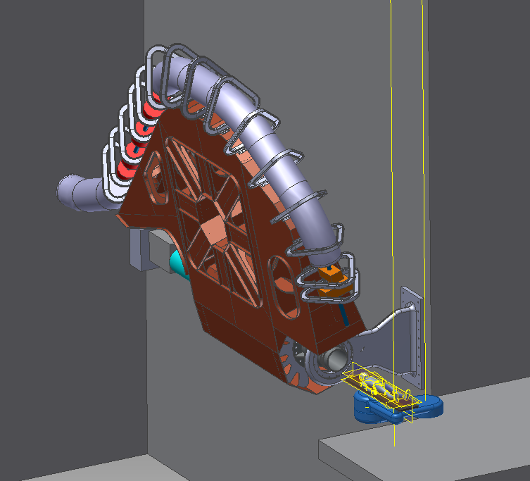
IRIS project scope -2 Societal Applications
Green Energy and Medical
Green : energy transport at 0³ emission and energy saving magnets.
  important for society but also for the sustainability of our research infrastructure
Medical: Superconductivity could play a key role in heavy ion therapy by enabling a rotatable gantry
Training:
  9 people to Int. Acc School and 9 to Erice Acc. School
  20 people at Eucas2023, 12 at MT28, 23 at CAS-Magnets
Courtesy A. Ballarino - CERN
Courtesy M. Pullia (CNAO –Italy)

Slide 7
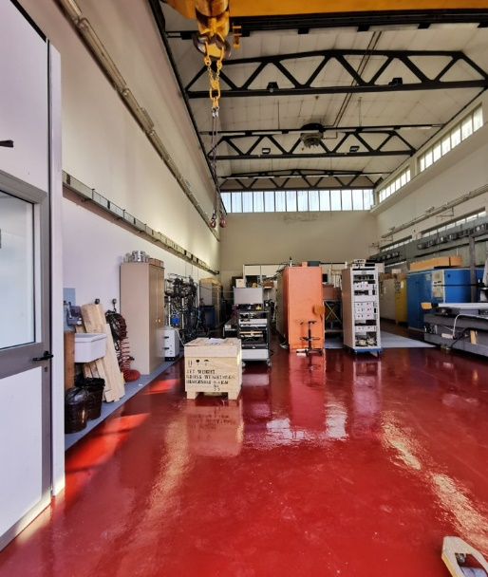
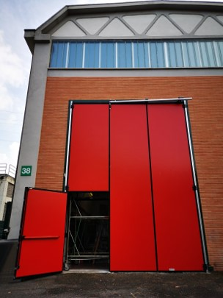
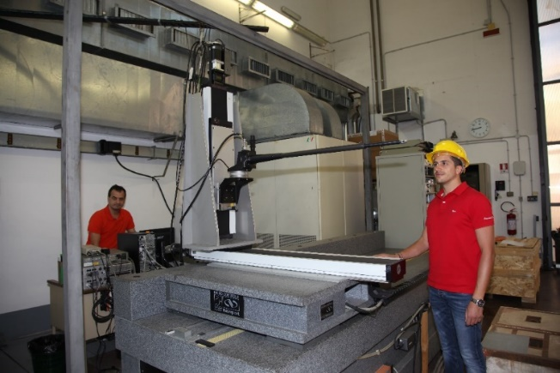
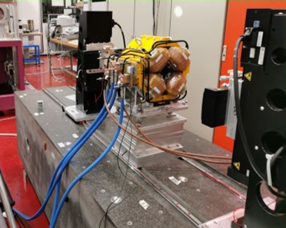
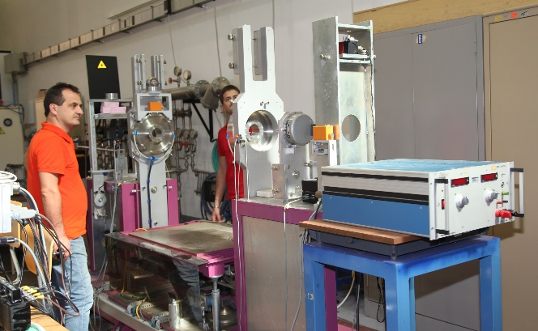
WP2 – Frascati INFN-LNF
WP2- Magnetic Measurements Laboratory @ LNF
The INFN-LNF magnetic measurements laboratory, about 200 m², with 15 T crane has already :
a Hall effect digital teslameter with a 5-axes movement device on a granite bench;
a stretched wire bench for integral measurements of fields and mechanical fiducialization;
a rotating coil multipole measurement system; an NMR teslameter.
Several other ancillary instruments are available, such as gaussmeters, integrators, etc…
Hall probe mounted on the coordinatometer
Stretched wire bench
Rotating coil bench

Slide 8
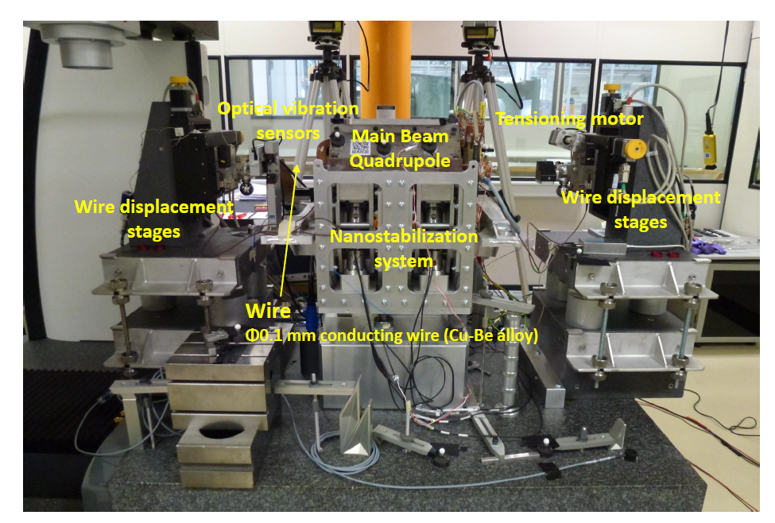
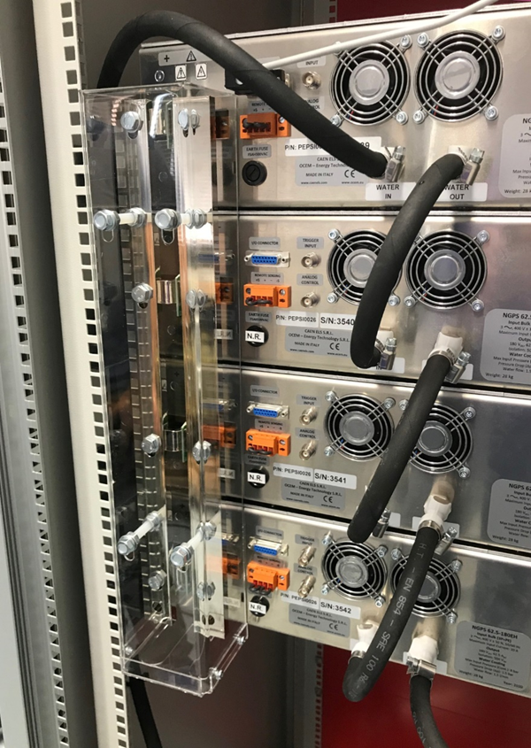
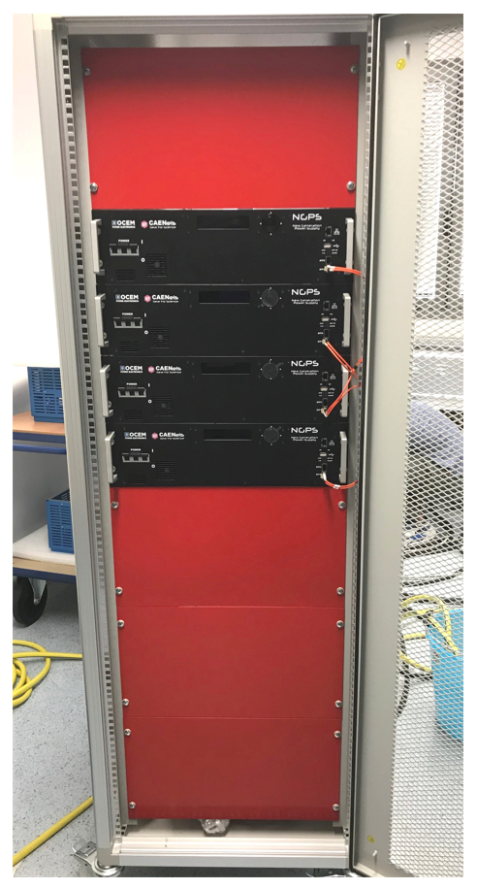
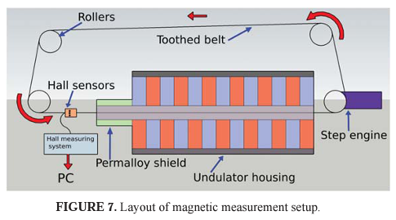
New instruments: Vibrating Wire
Many information can be deducted by measurement at room temperature

Slide 9
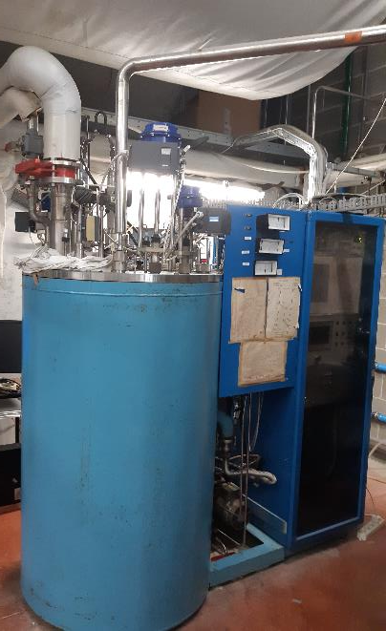
WP3 – Genova INFN, CNR-SPIN, UNIGE-DIFI
Collaboration among the three Institutes has been formalized (ante-IRIS) with a new Joint Research Lab : LabCoR
INFN
  Characterization of very high current cable
  Design of SC magnets for accelerators and Detectors
  R&D on future Magnets
CNR-SPIN
  Study of SC material for applications
  Development of SC wires
UniGe – Phsics Dept.
  Research on SC material

Slide 10
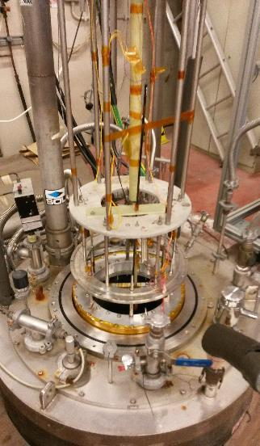
WP3 – Genova –INFN
Renewal and better efficiency of the LHe plant
Renewal of part of the existing laboratory
Purchase and installation of new modern equipment
  New test station for Ic measurements: two companies were contacted.
  New insert and new cryostat for the Ma.Ri.S.A. test facility. The required design by INFN is severely delayed due to lack of personnel
  2 kA power supply for superconducting magnet. The specification is going to be written. at least one reliable supplier has been identified. Order procedure will start by the end of May.
Courtesy R. Musencih
A. Bersani , INFN-GE

Slide 11
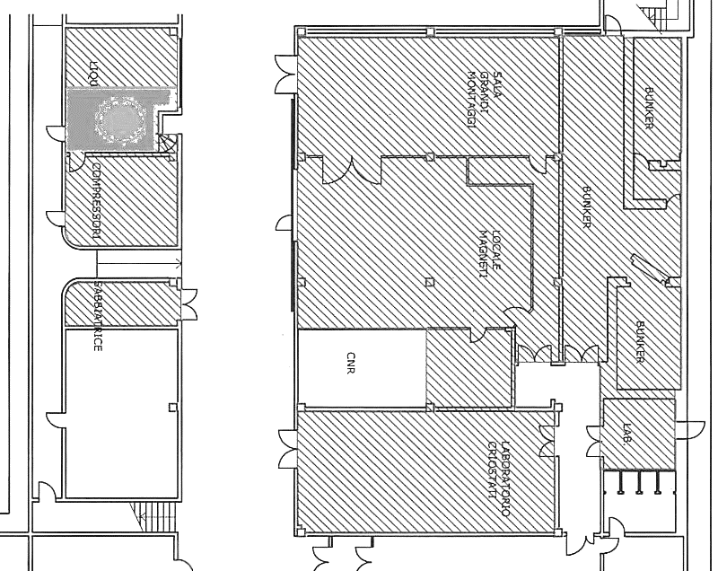
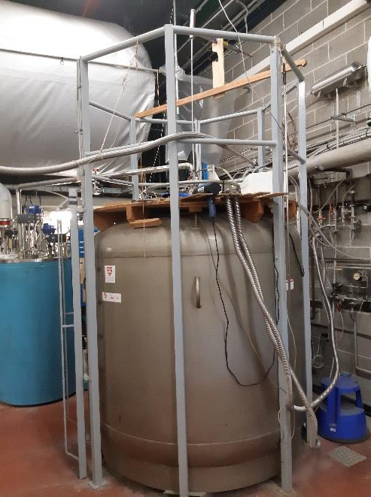

INFN-GE lab LHe plant
Nuovo layout
LP: 3 ‘’ (1,3 bar)
HP: 3/2 ‘’ (10 bar)
HP: 1 ‘’? (10 bar)
Linee 200 bar
Linee di recupero
$$\sim 10 m$$

Slide 12
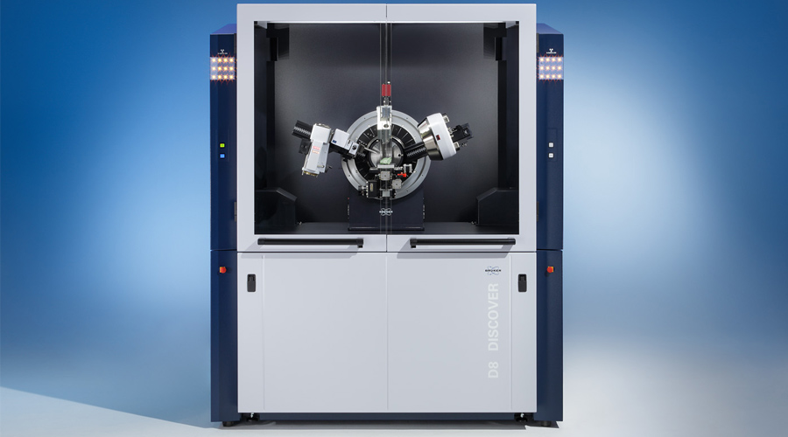
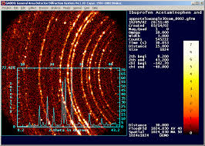
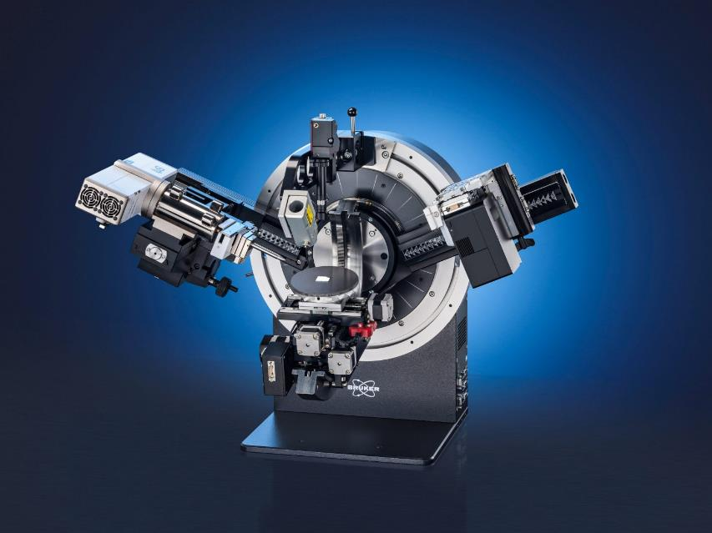
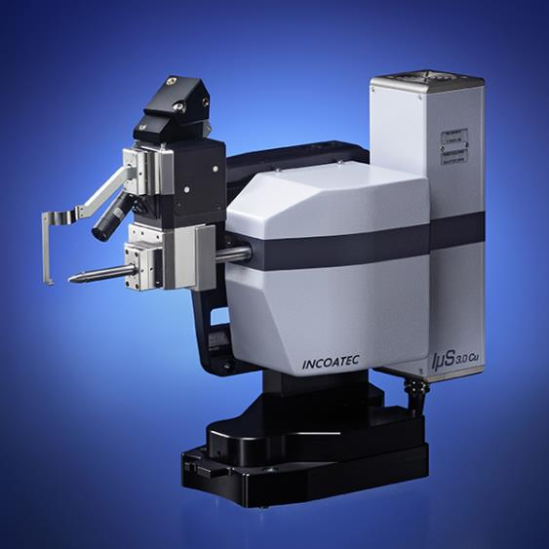
CNR-SPIN Lab
X-Ray diffractometer
Structural analysis of Superconducting materials
Courtesy A. Malagonli, CNR-SPIN GE

Slide 13
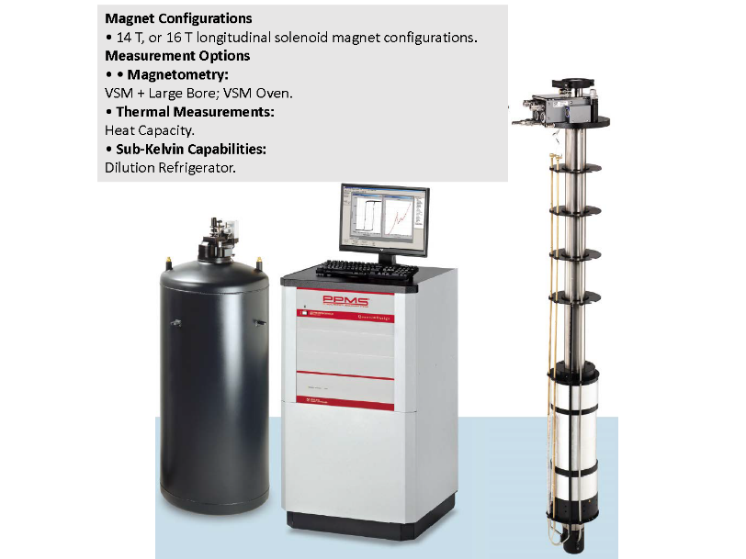
Unige – Physics Dept.
UNIGE Physics Department:
Renewal of cryogenic plant (He gas recovery abd LN distribution)
New test station fo thermal capacity measurements in high magnetic fields for research of new SC materials
Courtesy M. Putti, Univ. of Genova

Slide 14
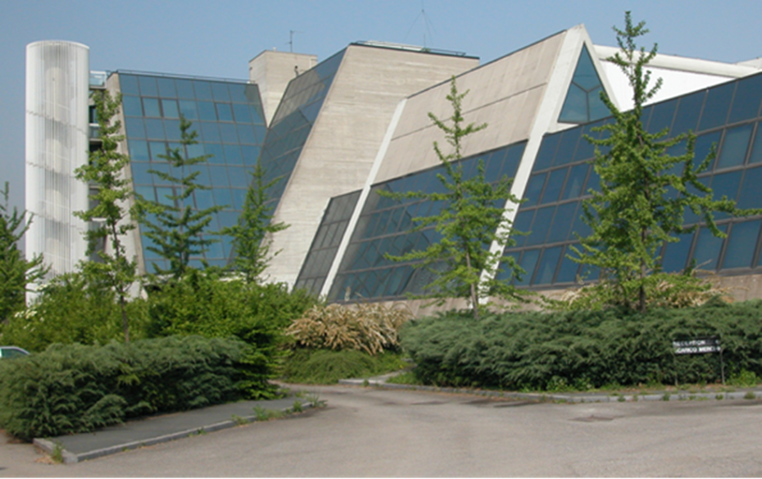
WP4 – Milano LASA - INFN-Milano, UNIMI-DIFI
Laboratorio Acceleratori & Superconduttività Applicata
  SC magnets and SRF cavities
Also photocathodes and other activities (BriXino, radionuclides studies)
(old) LHe plant to be renewed in the next 2 years
About 25 people active in applied superconductivity (before IRIS)
It is “only” a building, not an Institution: it belongs to Unimi, co-managed by INFN-Milano and Unimi-DIFI
It is National R.I. as INFN infrastructure (in the list of PNIR as medium priority)

Slide 15
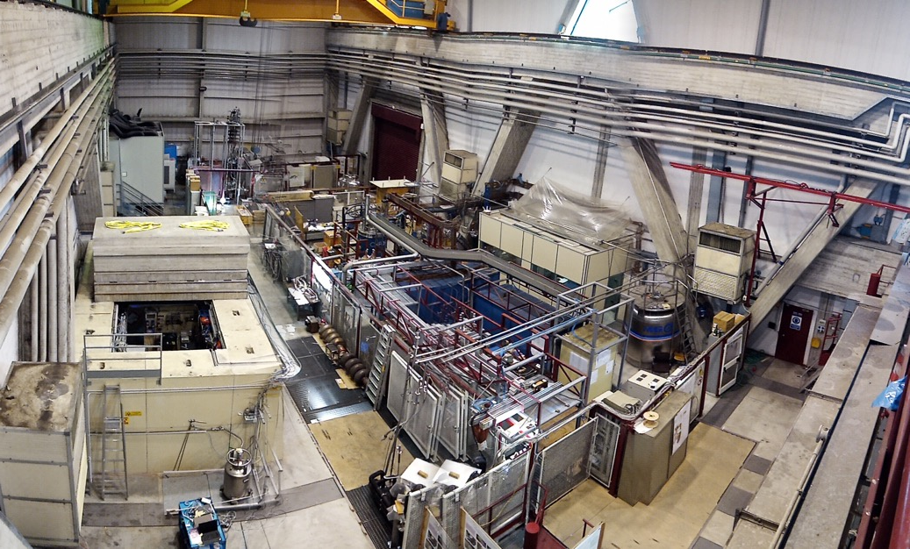
LASA Hall: 800 m²
→ 100 l/h new liquefier will help to boost measurements for High Field Magnets and Hadrontherapy
Test up to 15 kA possible NOW in LHe
IRIS will contribute to rationalize and modernize the infrastructure and to have Cryogen-free cryostat for 10-50 K operation and test of HTS magnets
IRIS upgrades
New Variable temperature Cryostat inside 8 T solenoid with 1 kA leads
New system for ft cool down 300→ 80 K
New cooling system without liquid helium between 10 – 50 K
SRF area
Magnet area
New 30 kA- 40 V Stabilized Power converter
New Variable temperature Cryostat with 2 kA leads

Slide 16
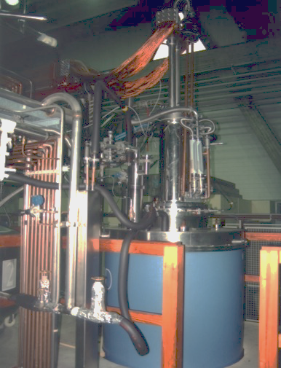
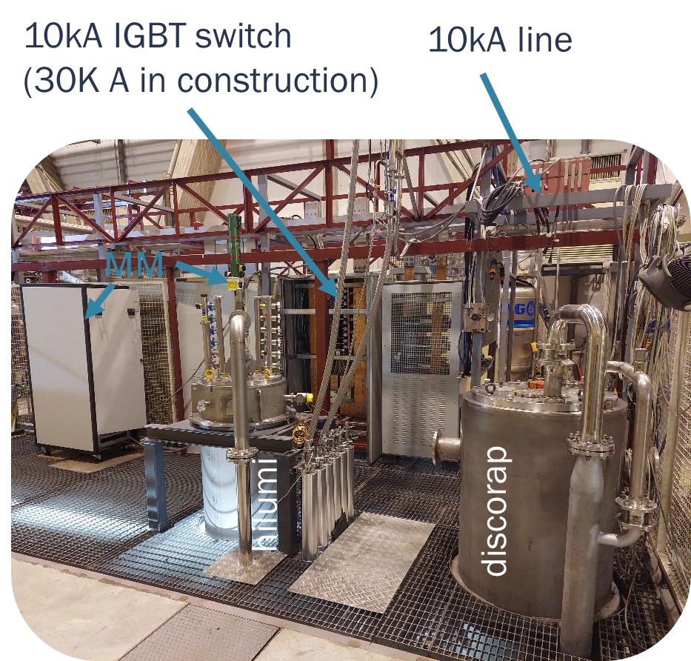
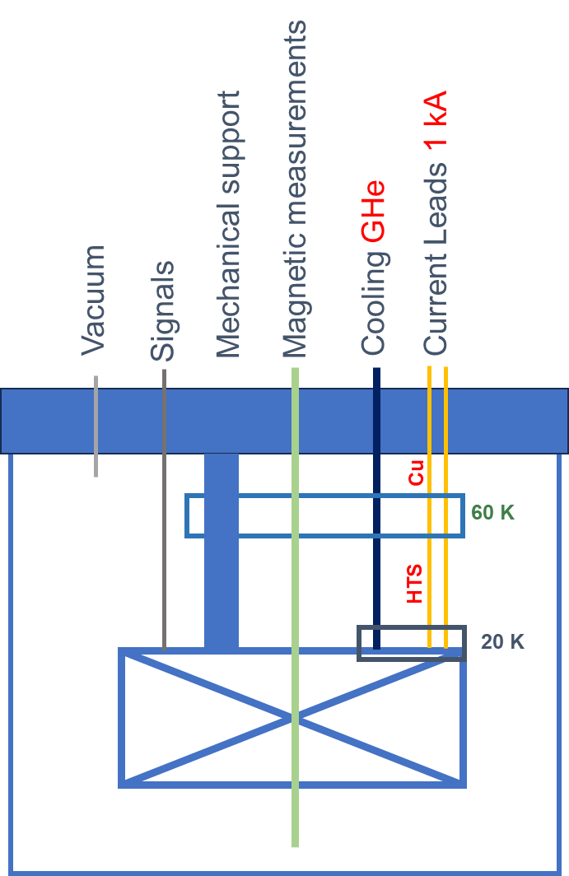
Existing test facility at LASA, will be modified to have VTI for power test at variable temperature 1- 2 kA (and 30 kA in liquid)
Courtesy M Statera INFN-MI-LASA
SOLEMI1 6-8 T

Slide 17
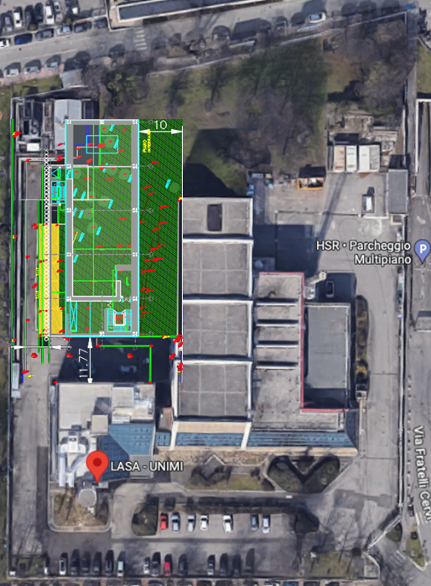
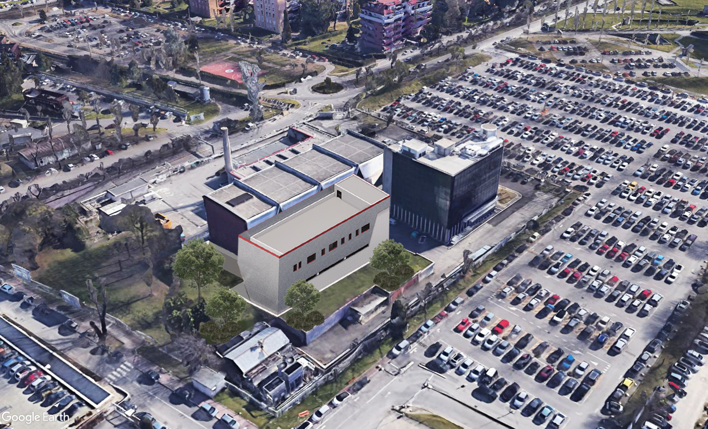
400 m2 surface building, 2 floors: a lab for small (1-2 m) SC magnets with winding, Nb₃Sn reaction oven, impregnation, presses, assembly, metal and plastic AM machine
New IRIS building
Courtesy M. Sorbi
Univ. of Milano and INFN-MI-LASA

Slide 18
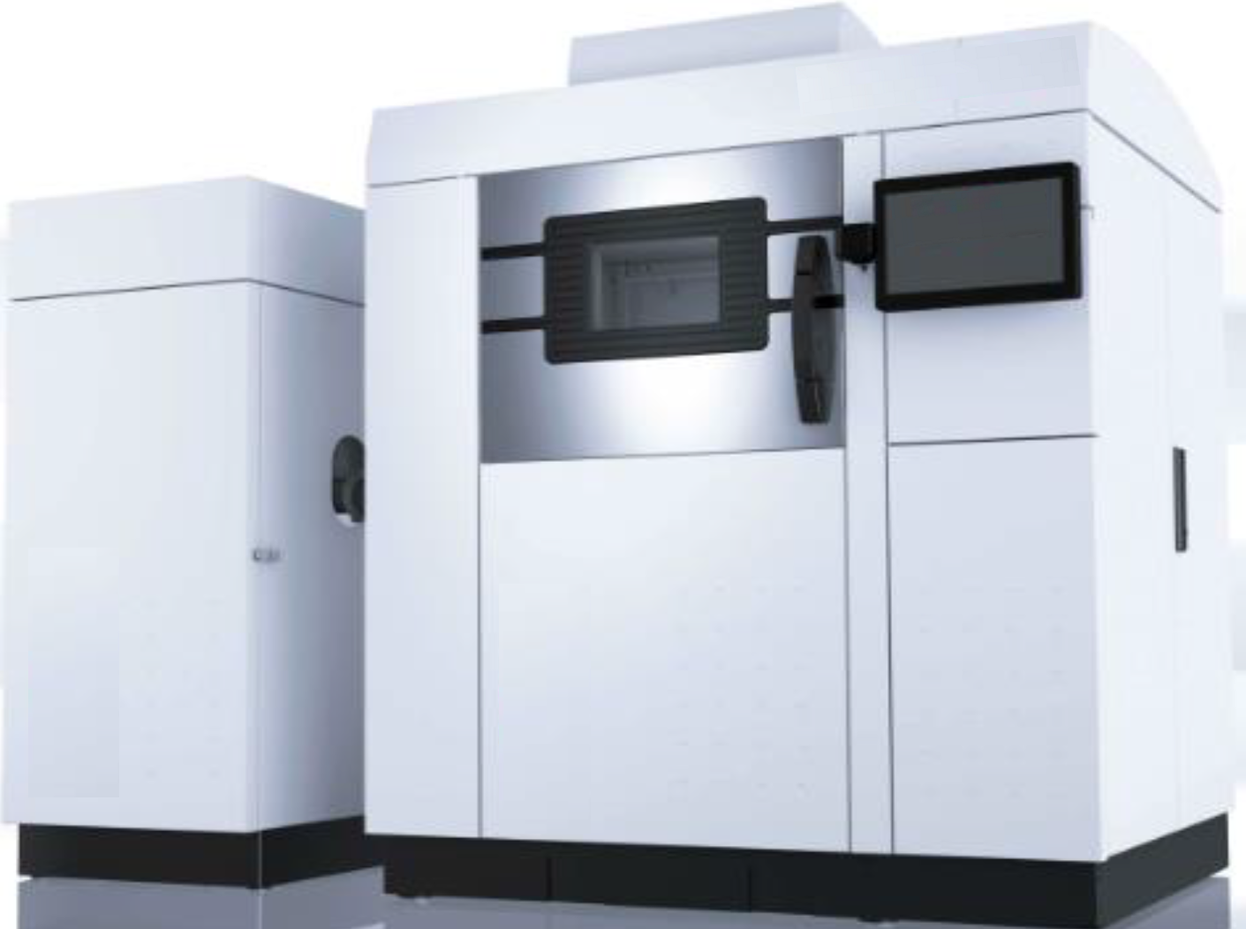
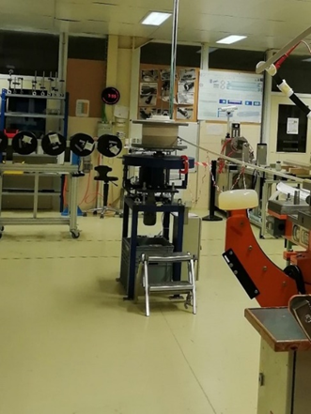
Facilities for the new Sc Magnet Laboratory (SML) in LASA-Milano
AM metals Al, AISI 316, also Cu, Ti (250x250x300mm³) – Winding, curing impregn. Press for SC coil
Courtesy :
Massimilano Cannavo’ INFN-Mi-LASA

Slide 19




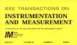
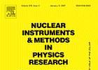

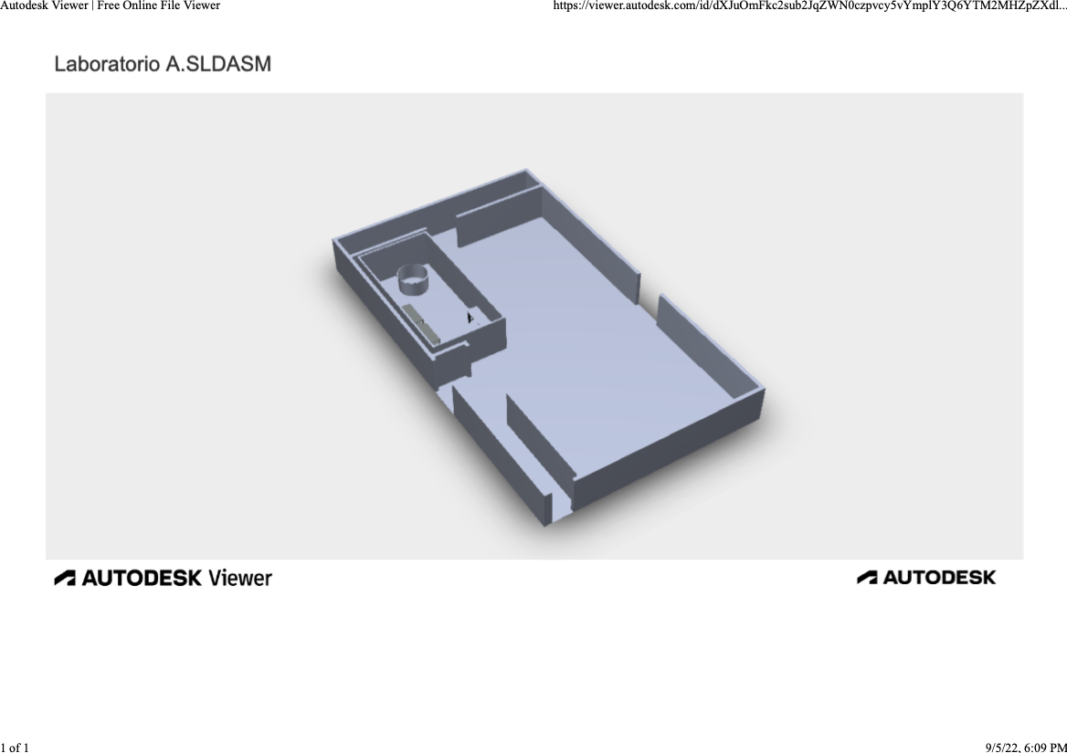
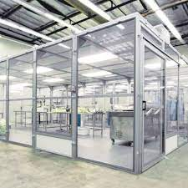
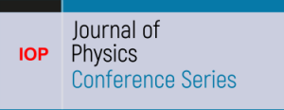






WP5 – Napoli – CIRMIS IMPALAB expertise
Magnetic measurements
Measurements on superconducting cables
Cryogenics
Aims new lab
  Extend the current instrumentation and measurement procedure for superconducting magnets and cable
  Improve the metrological feature of the measure
  Develop new procedures for facing the state of the hard challenge for LTS and HTS
Courtesy P. Arpaia, Univ. of Naples
2x
3x
2x
3x
7x
17.6 m
11.4 m
13x

Slide 20
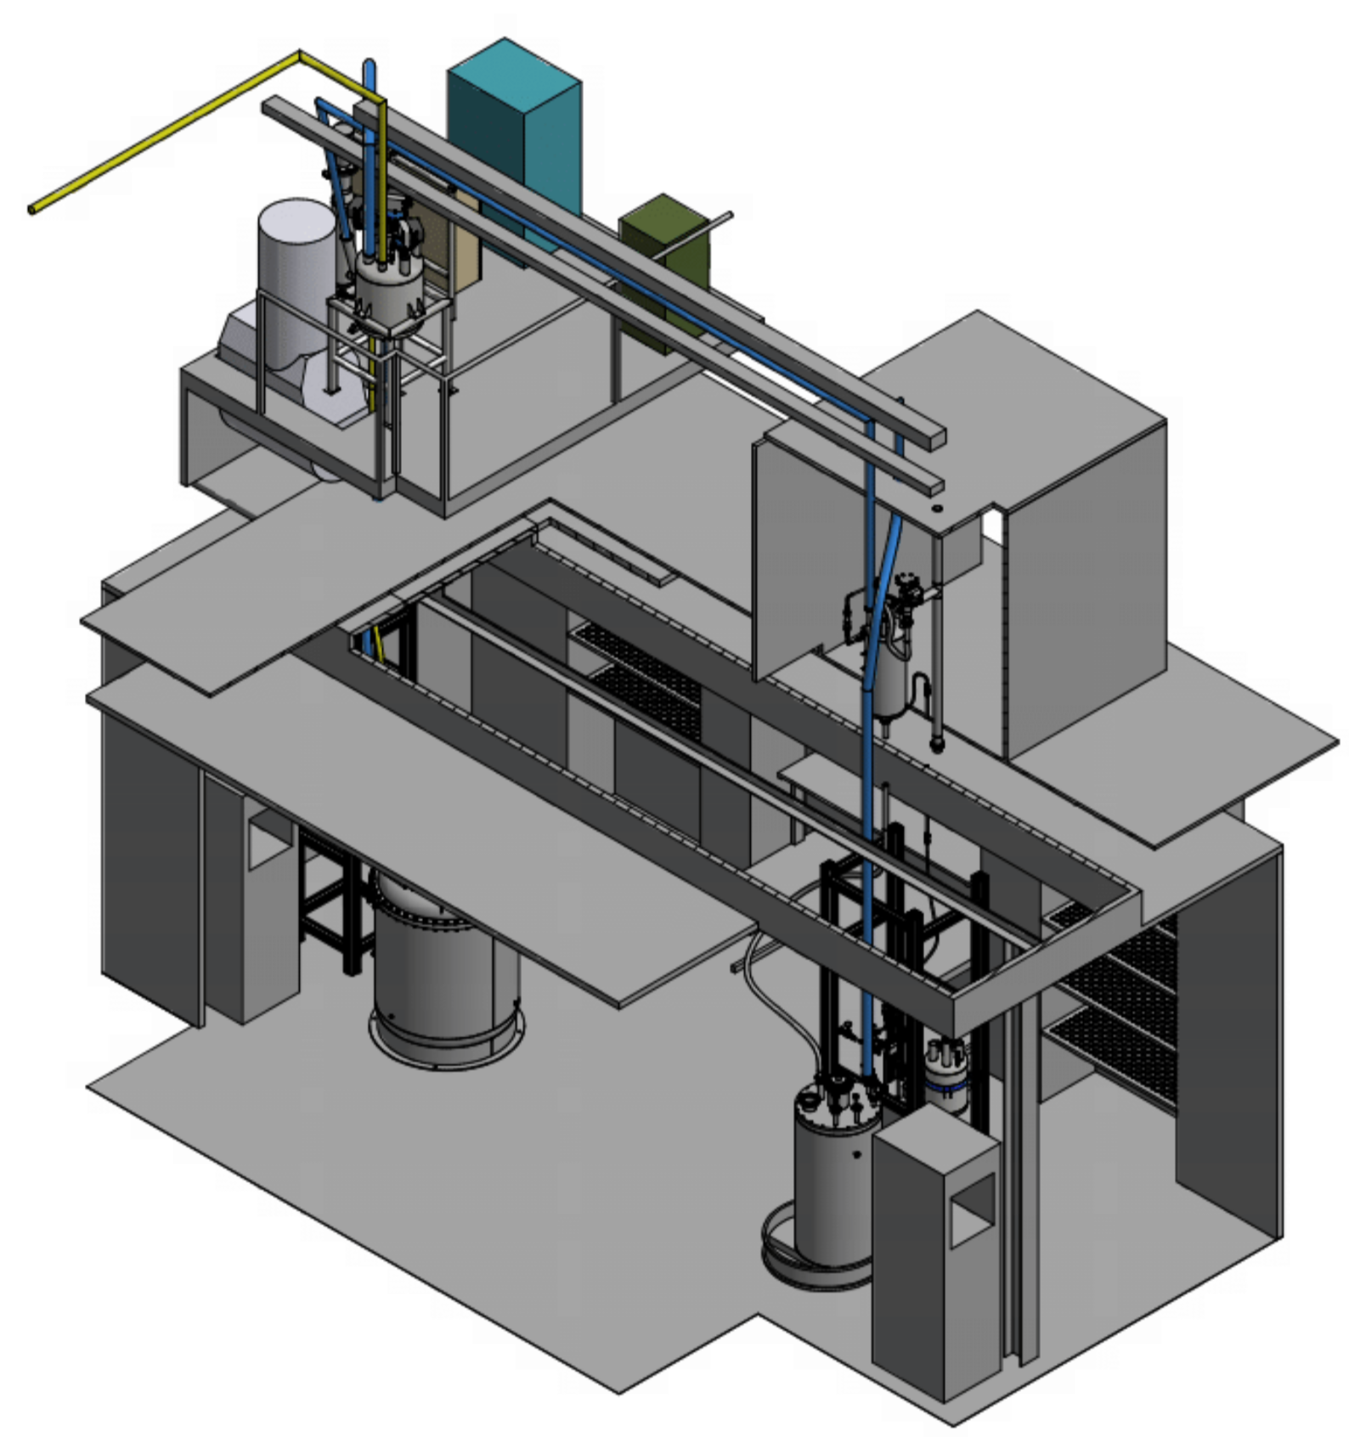
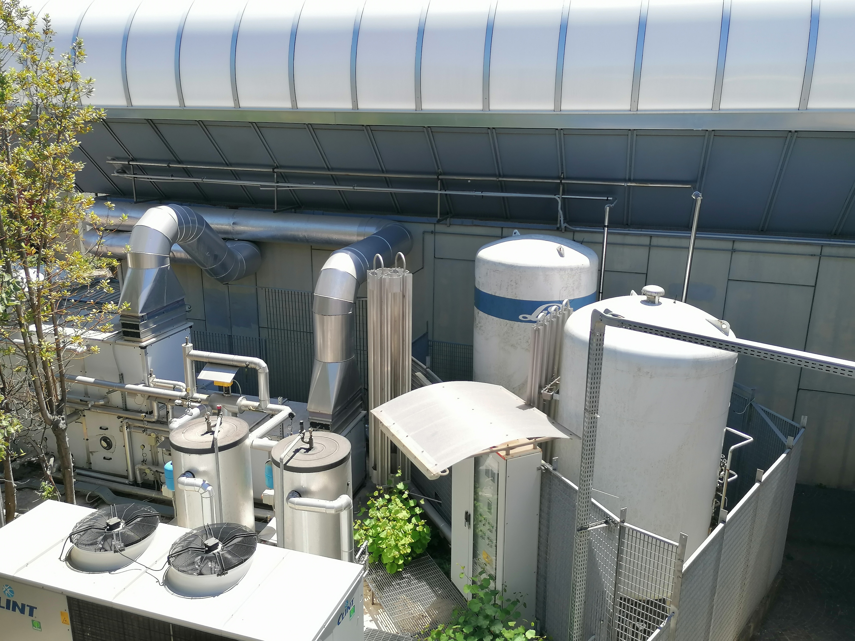
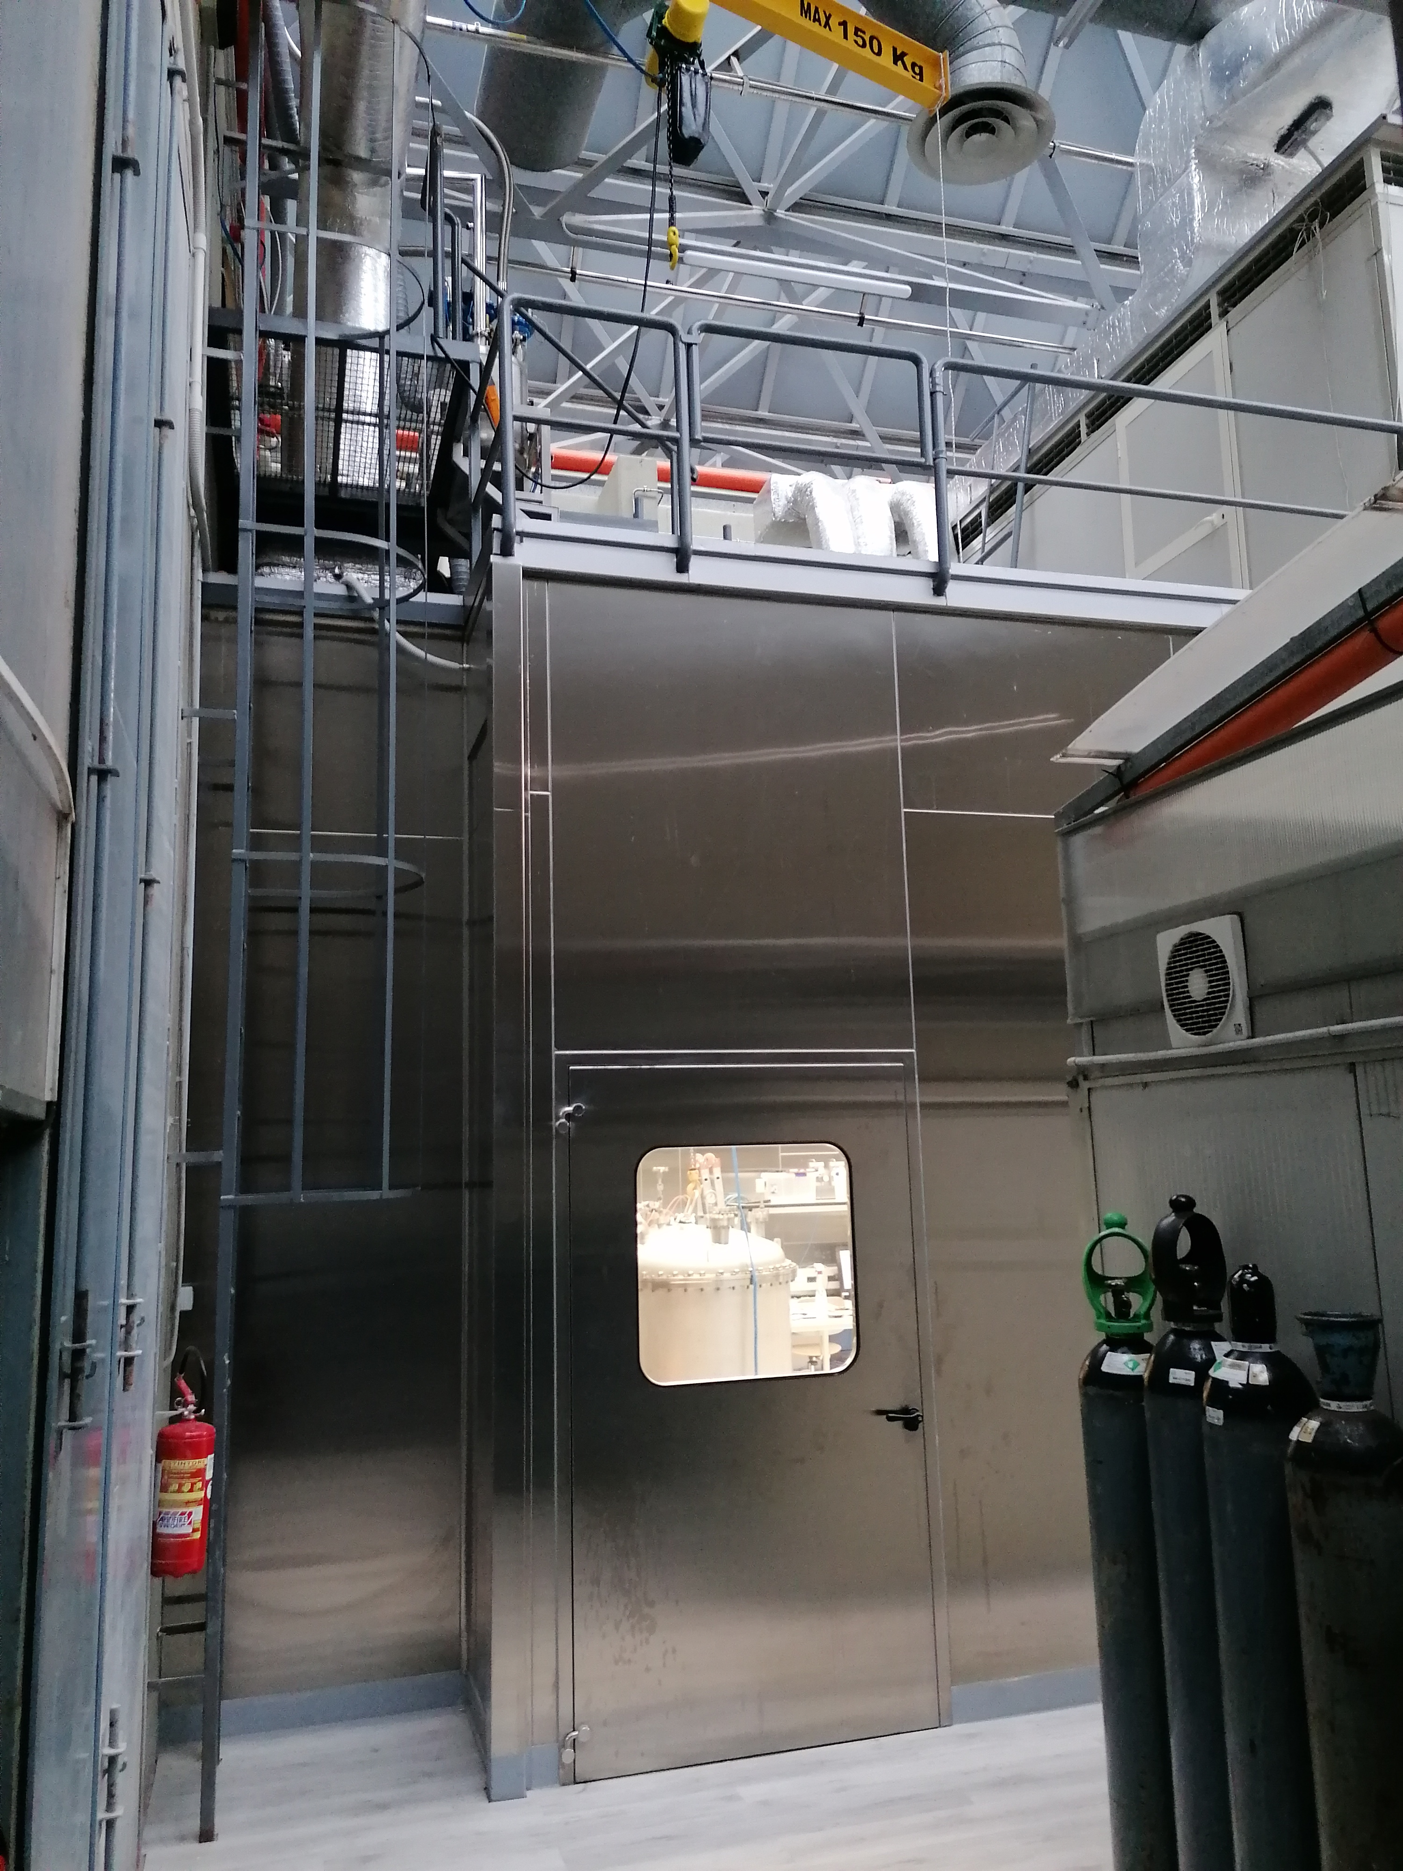
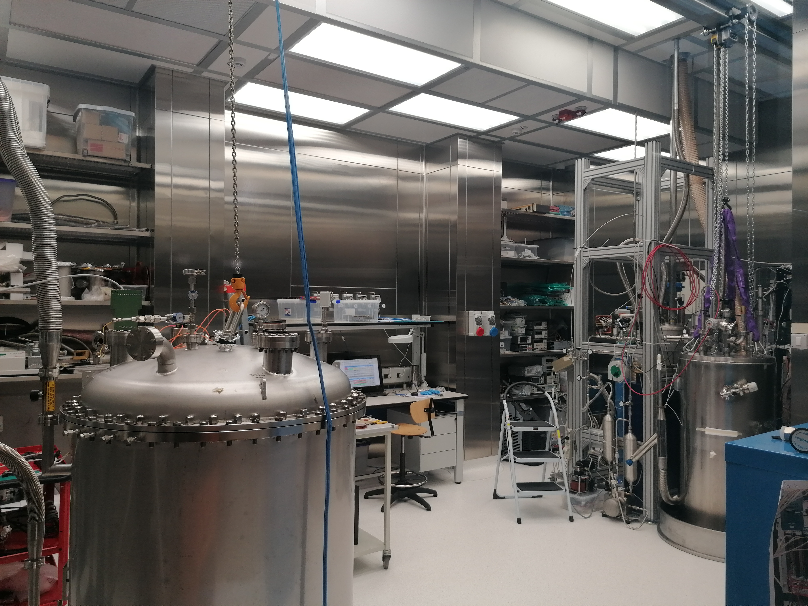
WP5 – Naples CRYOLAB
Light Detectors Test
Stand alone cryo system
Vacuum and cryogenic equipment
New
  Clean area for vacuum system and material deposition (Hardwall clean room approx. 6x4 m2)
  Liquid nitrogen cryostat
  Cryoprobe
  Low-temperature calibration system
  Dry system for low-temperature characterisation
Courtesy G. Fiorillo, Univ. of Naples
Cryogenic liquids storage

Slide 21
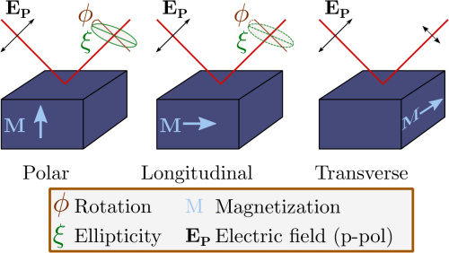
WP5- Naples CNR-SPIN – MOKE
Instrumentation for study SC with magneto-optic Kerr effect (Moke)
Courtesy of F. Miletto
CNR-SPIN, director

Slide 22
WP6 – Salento (Lecce) UNISALENTO- DMF
Magnetometry measurements under external stimuli such as light irradiation and electric fields for the characterization of innovative materials [novel setup expected to attract users working in the fields of advanced magnetic materials with controllable bistable states and investigating the interplay among magnetism and superconductivity] +50% users
Measurements of physical properties of materials (e.g. magnetotransport and measurements of critical currents) in a wide range of temperatures and magnetic fields [novel setup expected to attract users working on spintronics, superconductive devices, sensors/detectors and quantum computation] +50% users
Combined magneto-optical and ferromagnetic resonance measurements [novel setup expected to attract users working in the fields of magneto-optics, magnonics and quantum computation] +30% users
AFM, MFM and PFM microscopy measurements for the characterization of superconducting, magnetic and multifunctional materials novel setup expected to attract users working in the field of advanced functional materials, spintronics and applied superconductivity] + 30% users
Courtesy of G. Maruccio
Univerisy of Salento (LE)

Slide 23
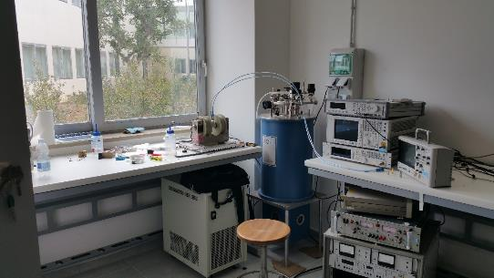
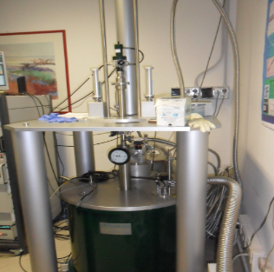











WP6 - Laboratorio di Superconduttività e Magnetismo
Cryogenic superconducting magnet (10.5 T, 0.3-300 K)
Oxford dilution refrigerator (down to 10 mK, vector magnet 6T/1T/1T)
Lakeshore Cryogenic RF probe station (down to 8 K and up to 0.5 T and 70 GHz).
Italian node of the European Infrastructure on Magnetism EMHFL-ISABEL (funded within ISABEL project, H2020-INFRADEV-2018-2020, Grant No. 871106).

Slide 24




WP6 – Salento – Laboratory of superconductivity and Magnetism
development plan
close-cycle superconducting magnet for physical properties measurement
scanning probe microscope for material characterization
close-cycle SQUID magnetometer
split pair cryogen-free magnet system for combined magneto-optical and FMR measurements

Slide 25
WP7 – Salerno
INFN-NA-G.C.Salerno, CNR-SPIN- UNISA
INFN-Salerno with UNISA has built and commissioned a new SC Magnet test facility in the last 5 year, THOR
It is used at present for testing GSI – SIS100 SC multiplets
With IRIS the INFN/Unisa facility will evolve by:
  Increasing the cryogenic power for SC magnets
  Ability to test magnets not only at Supercritical He flow and ability to test magnets of LHC/Hilumi/FCC size (however, no HEII at te moment)
  Adding a new test facility for Green SC Lines : up to 25 kV – 40 kA (1 GW),20 K He gas, with a dugout for cable as long as 140 m

Slide 26


THOR Lab
Courtesy of U. Gambardella,
INFN-Salerno

Slide 27

WP7 – Salerno – INFN & DIFI lab : present and IRIS extension
Present
Future with IRIS

Slide 28


Cable protototype to be installed in Salerno – IRIS WP7 station
Magnet test area
(THOR Lab)
The test station is open to external use, too.
The cable produced in IRIS will serve as “debugging” and qualification of the test station itself.
Support by CESI (Milano) for the test protocols and procedures
Collaboration with RSE (Milano) for matching the electric gris needs
Courtesy of U. Gambardella, INFN-Salerno
And S. De Pasquale, Univ. of Salerno
HV – 25 kV
EPC for 40 kA-10 V

Slide 29

WP7 – Salerno CNR-SPIN
The SPIN Salerno Unit aims to acquire and setting up a magneto-transport measurement system including the application of strain and stress.
The equipment for magneto-transport (e.g. Quantum Design PPMS) consists of a variable temperature (1.9 to 300 K)-field (up to ±9 T) system, designed to perform a variety of automated measurements.
Additional elements to be acquired within IRIS are cryogenic strain and stress cells (e.g. Razorbill Instruments), which are fully compatible with the PPMS probe.
The main goal is to strengthen the capacity for investigating the role of strain/stress on the transport properties of superconducting materials.
Courtsy of A. Cuoco
CNR-SPIN, SA

Slide 30



Demo 1 : Green Sc Line - GSL
(courtesy of A. Ballarino, CERN, archive)
Left: Superconducting Line, in its flexible cryostat, 60 m , 120 kA – low voltage, during successful test in 2020 at CERN for the High Luminosity LHC Project
Right: cabling a sub-element of a MgB₂ cable for High Luminosity LHC Project
Scope: Manufacturing a demonstrator capable of 1 GW DC, operated at 20 K and test it in “operative” conditions in a test facility that will then be available for other projects. 25 kV-40kA, operativ condition - use of round wire MgB₂
Use: beside long-distance large electrical power transmission, significant place in the electric system for HVDC back-to-back system (study for placing the demonstrator in an Italian facility after the PNRR).
We will design the facility and this demo for cooling with He gas; however, in second stage after IRIS, compatibility with LH cooling will be investigated, too.

Slide 31



Talk by M. Statera : 3-LO-SP2-01S
A Magnesium Diboride Test Line Rated 1 GW
GSL specifications
Scope:
Design and supply of the 1Gw GSCL, the cryostat and the power leads
Delivery and installation to Salerno to commission the Test Station
Tender awarded on 26.05.2023 INFN G.E. 13553
To ASG Superconductors S.p.A.
4 x MgB2 conductors
Full redudancy (potential change in connection)
Power transport | 1 GW
Voltage | 25 kV
Operating temperature | 20 K
Line length | 130 m
Expected losses | 3.0 W/m
Overall cable diamater | 105 mm
Cryostat diameter | 250 mm
Bending radius | 2.2 m
Inner pressure | 10 bar
Courtesy S. Maffezzoli Felis,
Univ. La Sapienza Roma
& INFN-Milano-LASA

Slide 32




Design
The design, manifacture and delivery of the cable is a scope of the tendering
EM and mechanical symulations are also performed at LASA
Cryogenic and economic evaluations are performed also by RSE
Configuration comparison
3D Lorentz forces
Single petal magnetic field
S. Maffezoli Felis

Slide 33





Demo 2: ESMA - Energy Saving Magnet for sustainable Accelerators: dipole 10 T; 80 mm; 20 K
Cable in HTS for da 10 kA, developed in the EU collaboration FP7-Eucard2 GA 312453
Courtesy of J. van Nugteren
First small demo at CERN by
J.van Nugteren, G. Kirby and T. Nes
The record field for HTS dipole (with accelerator quality) is Eucard2, 4.5 T stand alone, 16.5 T with background field (then failure)… time to explore HTS for dipoles.
Scope : a dipole rated for
8 T – 80 mm bore – 10-20 K operation as background field for cable test. Controlled Insulation.
As technology driver for 15 T – 20 K operation for FCC or Muon-C
IRIS HTS dipole: 10 T – 20 K
Aperture coil 80X50 mm
700 mm straight section
12 mm wide REBCO tape (stack)
1.2 MJ stored energy
10 K temperature margin
10-15 km of 12 mm wide HTS tape
550 A/mm² cable current density

Slide 34


1) operation of dipole with cryogen-free technology
2) non-insulated (better: Controlled-Insulation) technology in dipoles
Below : a first design with higher field quality now revised to a simpler design
The dipole will be installed in Genova – IRIS WP3 facility for cable test

Slide 35

design with insulated coil
(too much conductor)
Magnet quench is simulated with QLASA. The software is not specific for HTS, further studies are ongoing and thus results shown are preliminary
The coil has been modelled using a geometrical equivalent solenoid and the quench propagation has been calculated analytically assuming an adiabatic behaviour.
Too much SC tape
Added Cu stabilizer | μm | 200 | 300
Detection threshold | mV | 50 | 100
D+S times | ms | 10+1 | 20 + 5
Damp resistor | ohm | 1.5 | 1.5
Max Temperature | K | 240 | 185

Slide 36




Nominal present design based on controlled insuatin with metal tape
Dimensions | 12 mm × 67 µm
Substrate | 40 µm of Hastelloy C276
Copper stabilizer | 2 × 10 µm, RRR>20
Easy-way minimum bend | 10 mm
Allower longitudinal strain | -0.4 % to 0.3 %
I_{c}, 77 K, self-field Ic, 20 K, 15 T | Min. 400 A, average 470 A Min 500 A
Parameter | Unit | Value
Central field | tesla | 10
Free bore dimensions | mm | H80 x V50
Magnet length | mm | 1000
Good field region uniformity | N/A | 1.5%
Good field region extension | mm | H50xV30xL400
Operating temperature | K | 20
Minimum op. temper. for test | K | 10
Maximum current | A | <1000
Courtesy S. Sorti and L. Balconi
Univ. of Milano & INFN-Milano-LASA

Slide 37

This include the personnel specifically hired
It does not include the existing staff working on IRIS

Slide 38


Main tender being contracted to: REBCO tape → Faraday Factory Japan
GSLine general contractor & HTS dipole construction → ASG Genova
Courtesy of B. Di Girolamo – M. Della Torre, INFN-Mi-LASA, IRIS Project

Slide 39


Personnel status (cost category a.)

Slide 40


Training and research in house (cost category f.)
Event | Trainees
IAS Int. acc School | 9
Erice INFn Acc School | 9
Eucas2023 | 22
MT28 | 12
TOT 2023 | 52
ASC | 15
Cryostat design | 10
MT29 | 10

Slide 41

Outlook to the future of IRIS
Construction Phase:2023-2025,
Operation 2026 → 2036 hopefully longer…
Must be partially self-financing
  50% operational money from participating Institutes
  50% external Funding : INFN and Minister (MUR) competitive projects, EU projects, International projects, Industrial partnership)
    Fundamental Physics (accelerators, detectors: performance but also sustainability)
    Energy and Green transition
    Medical applications

