Slide 1
HTS beam transfer magnet
T. Winkler, C. Mühle, C. Roux, P. Spiller, K. Sugita

Slide 2
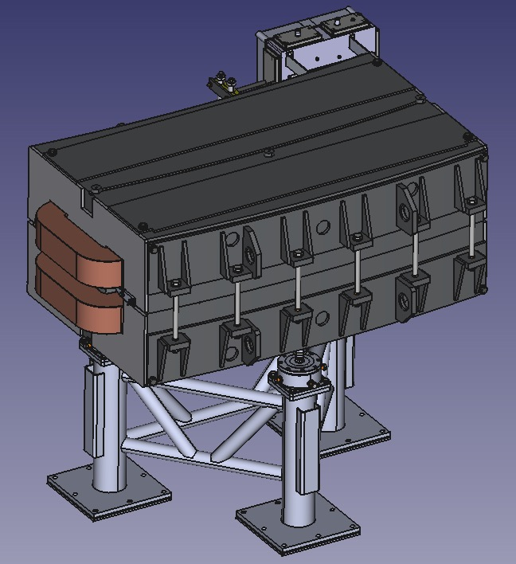
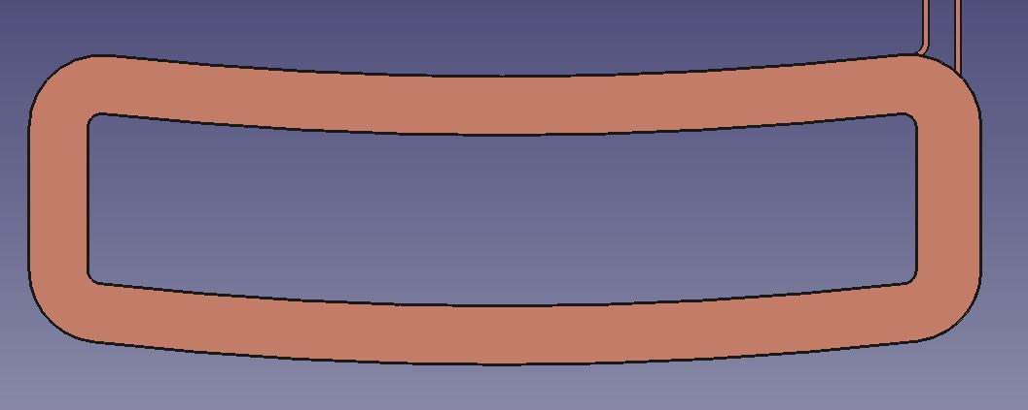
Motivation
Beam transfer magnets at GSI:
DC and fast switching between shots
superferric H-Frame magnets
High energy consumption
(almost) Ideal geometry for pancake coils

Slide 3
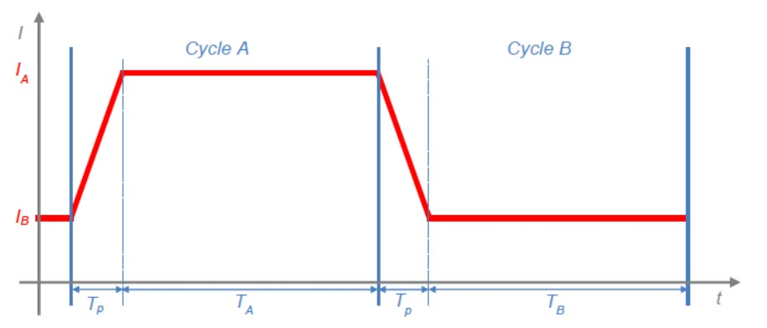
Magnet parameters
Change of infrastructure to be minimized, e.g. same power converter
Coil parameters:
2x 100 turns
535 A, 85.4 V
387.4 mH
DC power: 45.7 kW
Magnet parameters
1.6 T
1 T/s
12.5° at 8 ¼ m radius
Cycle duration
From sec to hours
mainly inductive load
130 V @ 334 A/s (1 T/s)
55.4 kJ

Slide 4
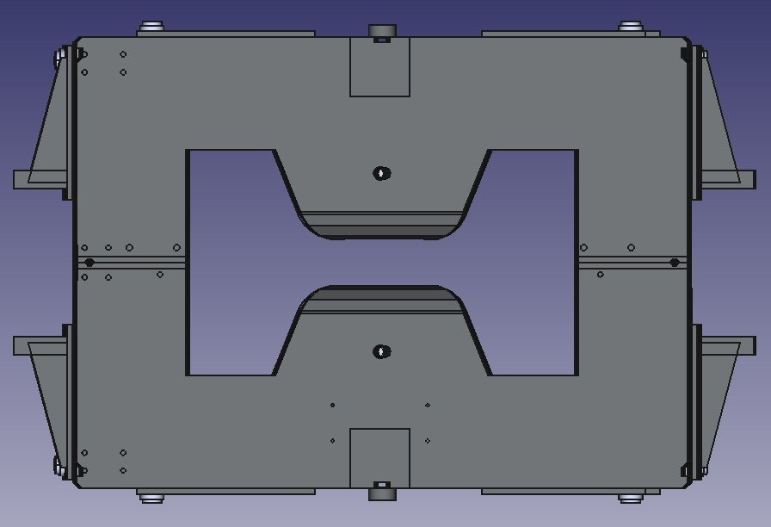
Magnet layout
Idea: “drop-in” replacement of copper coil
High current density in HTS tapes
=> coil will be smaller
Free space can be used for cryostat and cooling

Slide 5
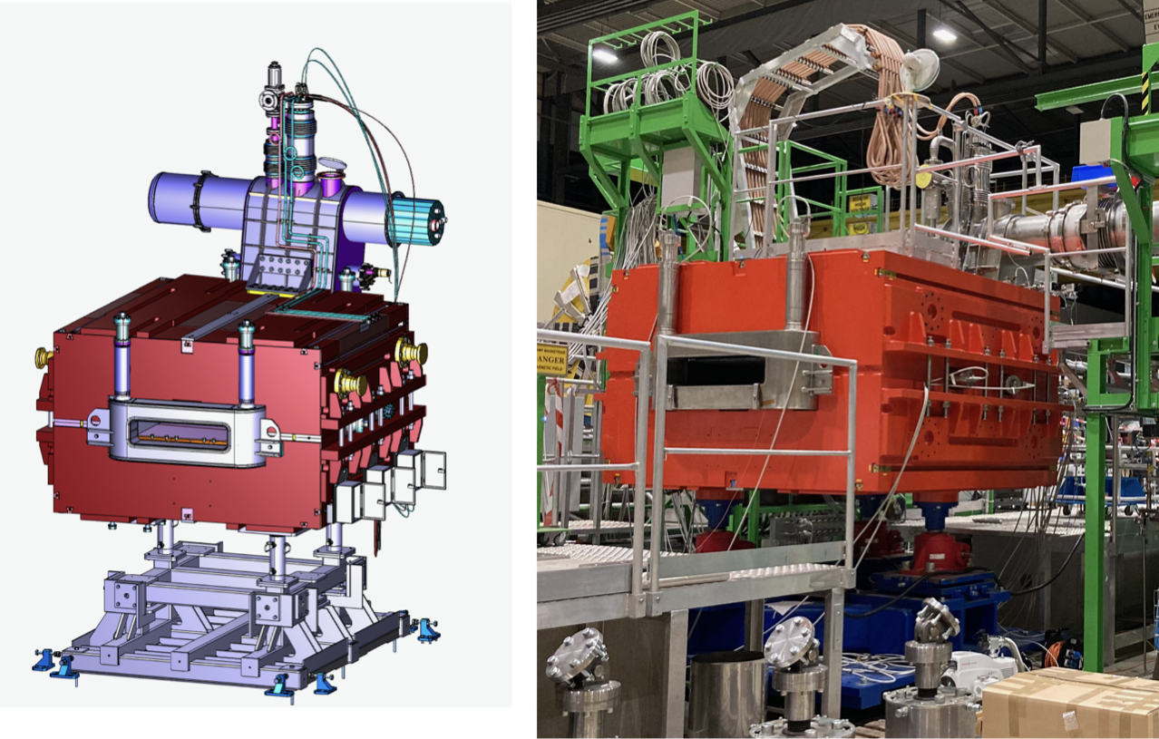
Ongoing Studies
AC loss
Coil layout (cross-section)
Coil position in yoke
Thermo-Mechanical Design
Thermal design for coil and cryostat
Mechanical design for coil and cryostat
Cooler-choice
S-FRS Dipole FoS

Slide 6
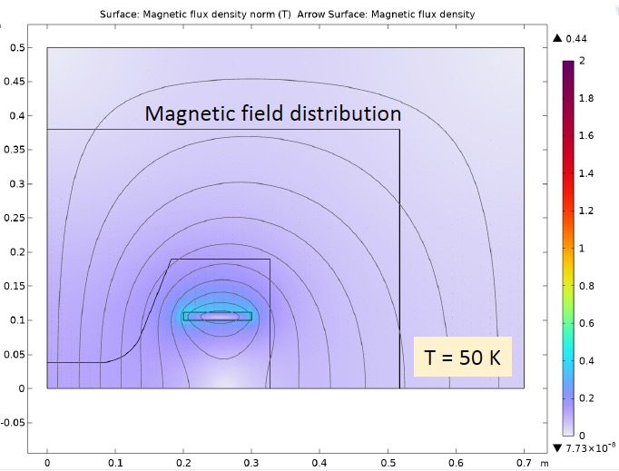
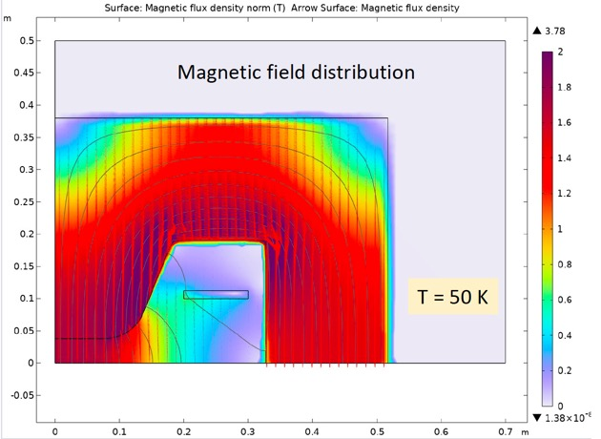
AC loss
J_{C}(T,B,θ) for Theva ProLine tapes
AC loss estimate with high field approximation from last yesterday:
Coil split in two regions:
In yoke
Outside of yoke
Sum: ~1 kJ/cycle

Slide 7
HTS beam transfer magnet
Thank you very much for your attention.
Question?

