Slide 1
The PUNCH4NFDI Project
Ivan Knežević 20th October 2023

Slide 2
The prime goal of PUNCH4NFDI is the setup of a federated and "FAIR" science data platform, offering the infrastructures and interfaces necessary for the access to and use of data and computing resources of the involved communities and beyond. This will help to master the challenges of big data, open data, and FAIR workflows.

Slide 3
Who we are?
42 Partners 20 Co-applicants 22 Participants
Currently more than 130 people
Closely connected to many large data & compute infra-structures
Representing close to 10000 scientists in Germany (KAT, KET, KHuK, RdS)
Universities, Helmholtz, Max Planck, Leibniz

Slide 4
What’s the goal? And for whom?
Milestone 1: An integrated prototype package of dynamic digital research products, the science data platform, and the Compute4PUNCH compute and storage resources (Storage4PUNCH) coupled with single sign-on (AAI) will be provided.
Milestone 2: Data irreversibility solutions - a new kind of science in the age of too-large-to-be-stored data streams.
Milestone 3: The PUNCH4NFDI marketplace including notice board and communication tools as a place for efficient exchange of data management solutions, methods, services, standards, tools, protocols, and software is an offer to the NFDI as part of a federated system of discipline-specific market places.
Milestone 4:Rolling out the PUNCH4NFDI outreach and education programme.

Slide 5
For whom?
For whom?
ATLAS, CMS, CTA…
Small running PUNCH experiments
Future PUNCH experiments
Observatories
Non-PUNCH

Slide 6
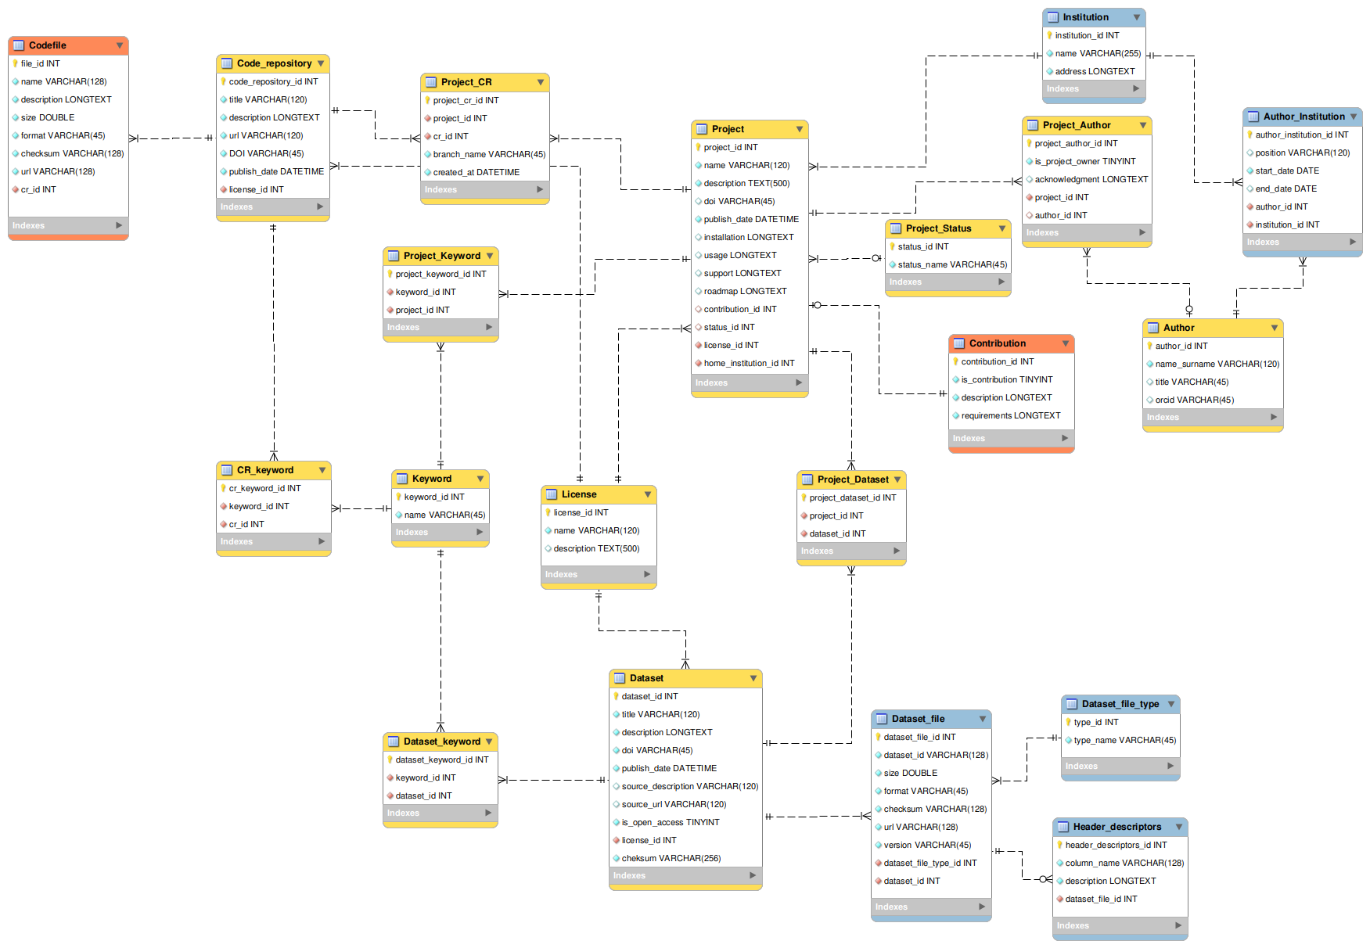
Digital Research Products
General project data
Code repository
Dataset
Minimal Viable Product

Slide 7
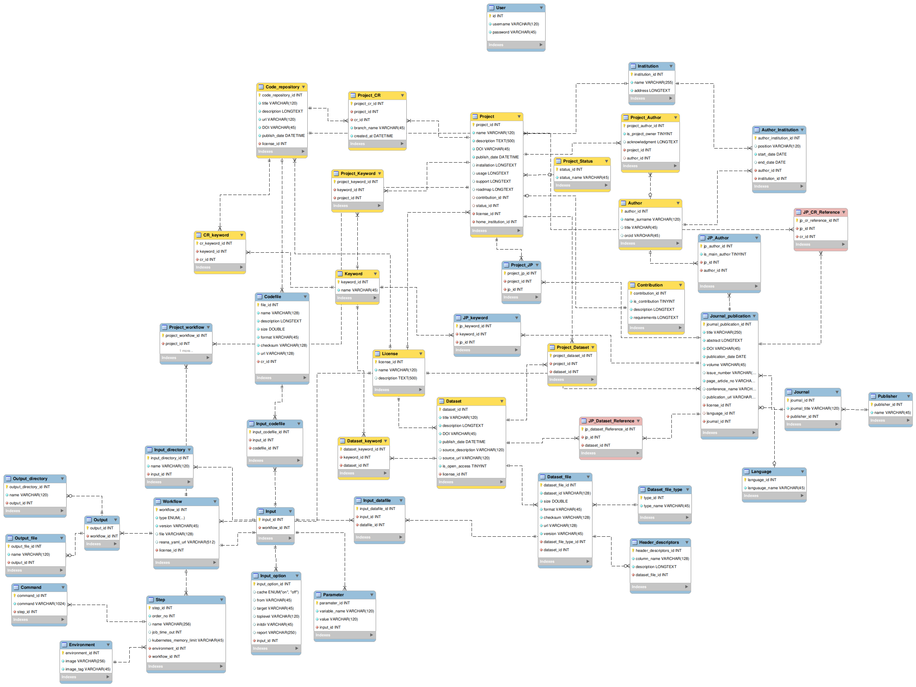
Digital Research Products
Code repository
General project data
Journal publication
Dataset
Workflow

Slide 8
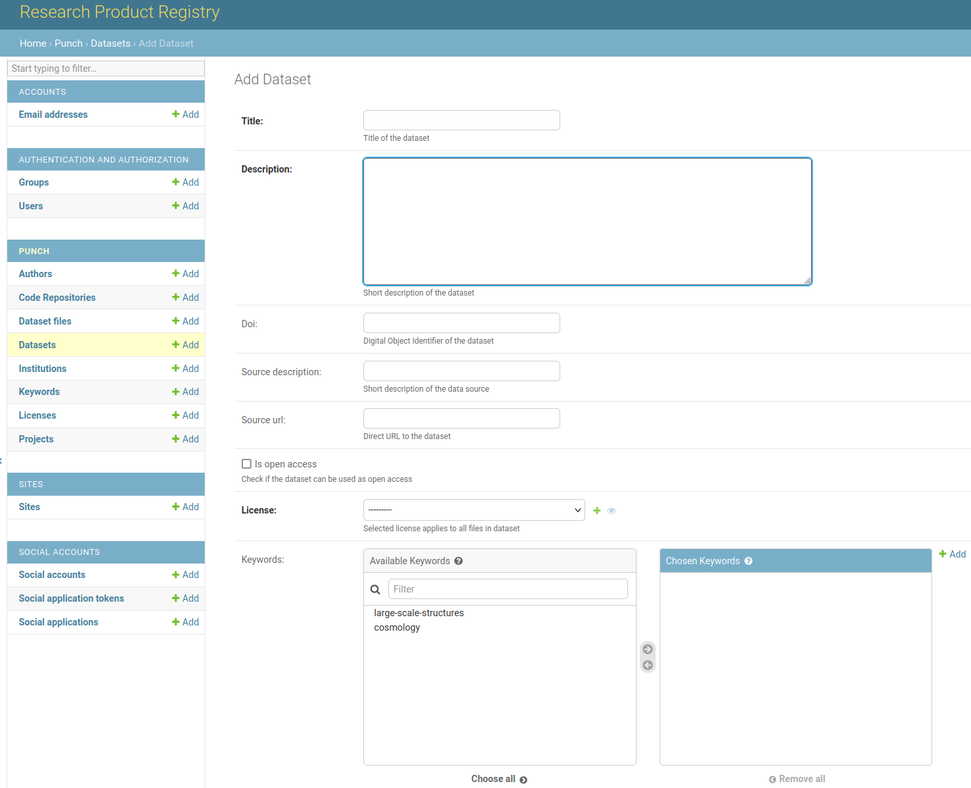
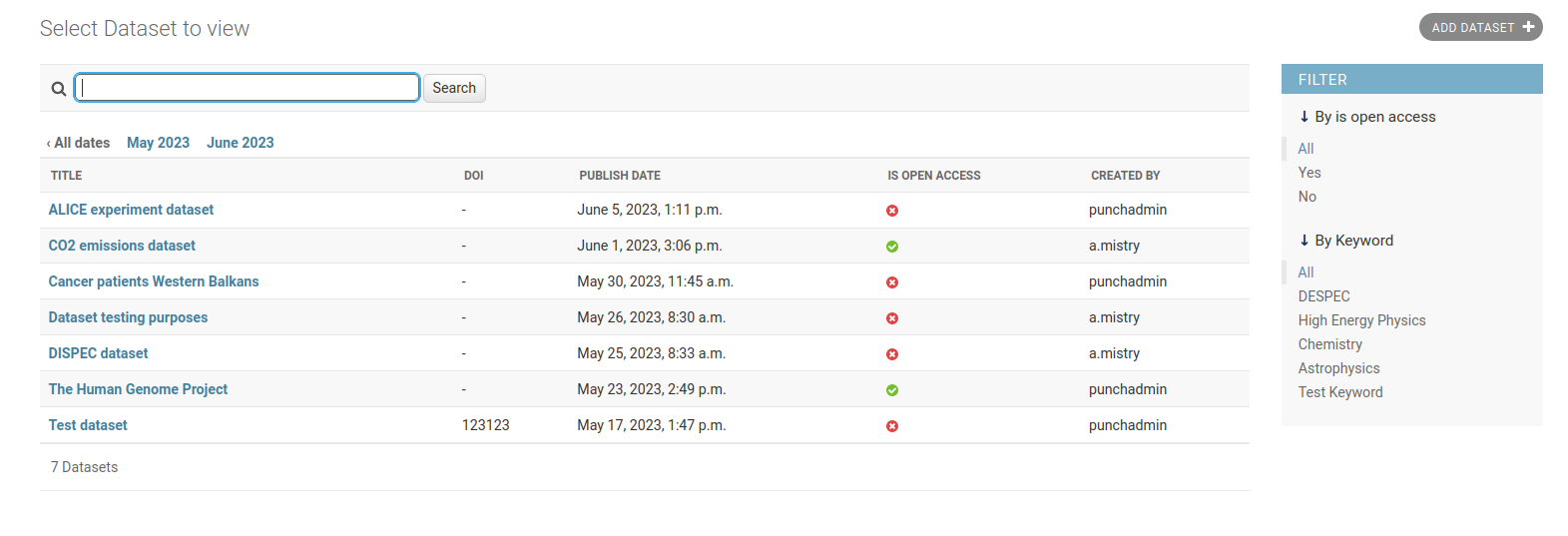
Platform prototype

Slide 9
Federated science data platform
Guarantee reproducibility
Compute4PUNCH
Results visualisation
Save workflow
Write and execute the code
Request computing resources
Storage4PUNCH
Information regarding resource and access rights within the institution
Home institute
Get dataset
PLATFORM
AAI request

Slide 10
GSI involvement in PUNCH4NFDI
Task Area 2 “Data management” – IT department
Automatization and optimization of big data management workflows
Task Area 4 “Data portal” – Research Division
Mapping and collating metadata
Build and operate the science data portal
Task Area 6 “Synergies and services” – IT department
Authorization and authentication infrastructure

Slide 11
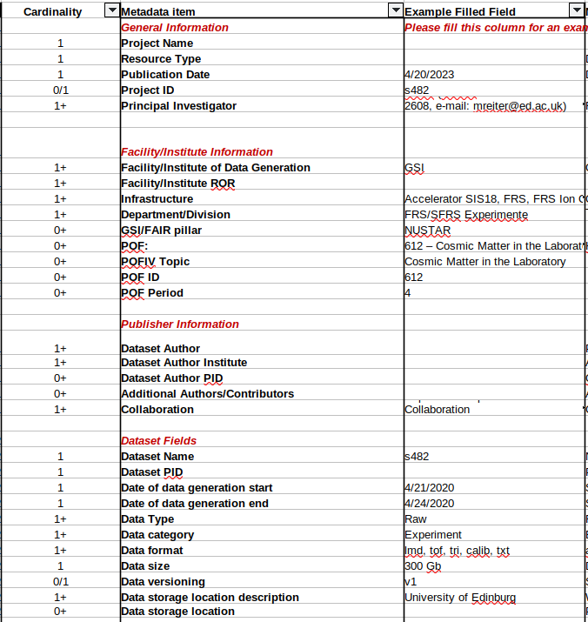
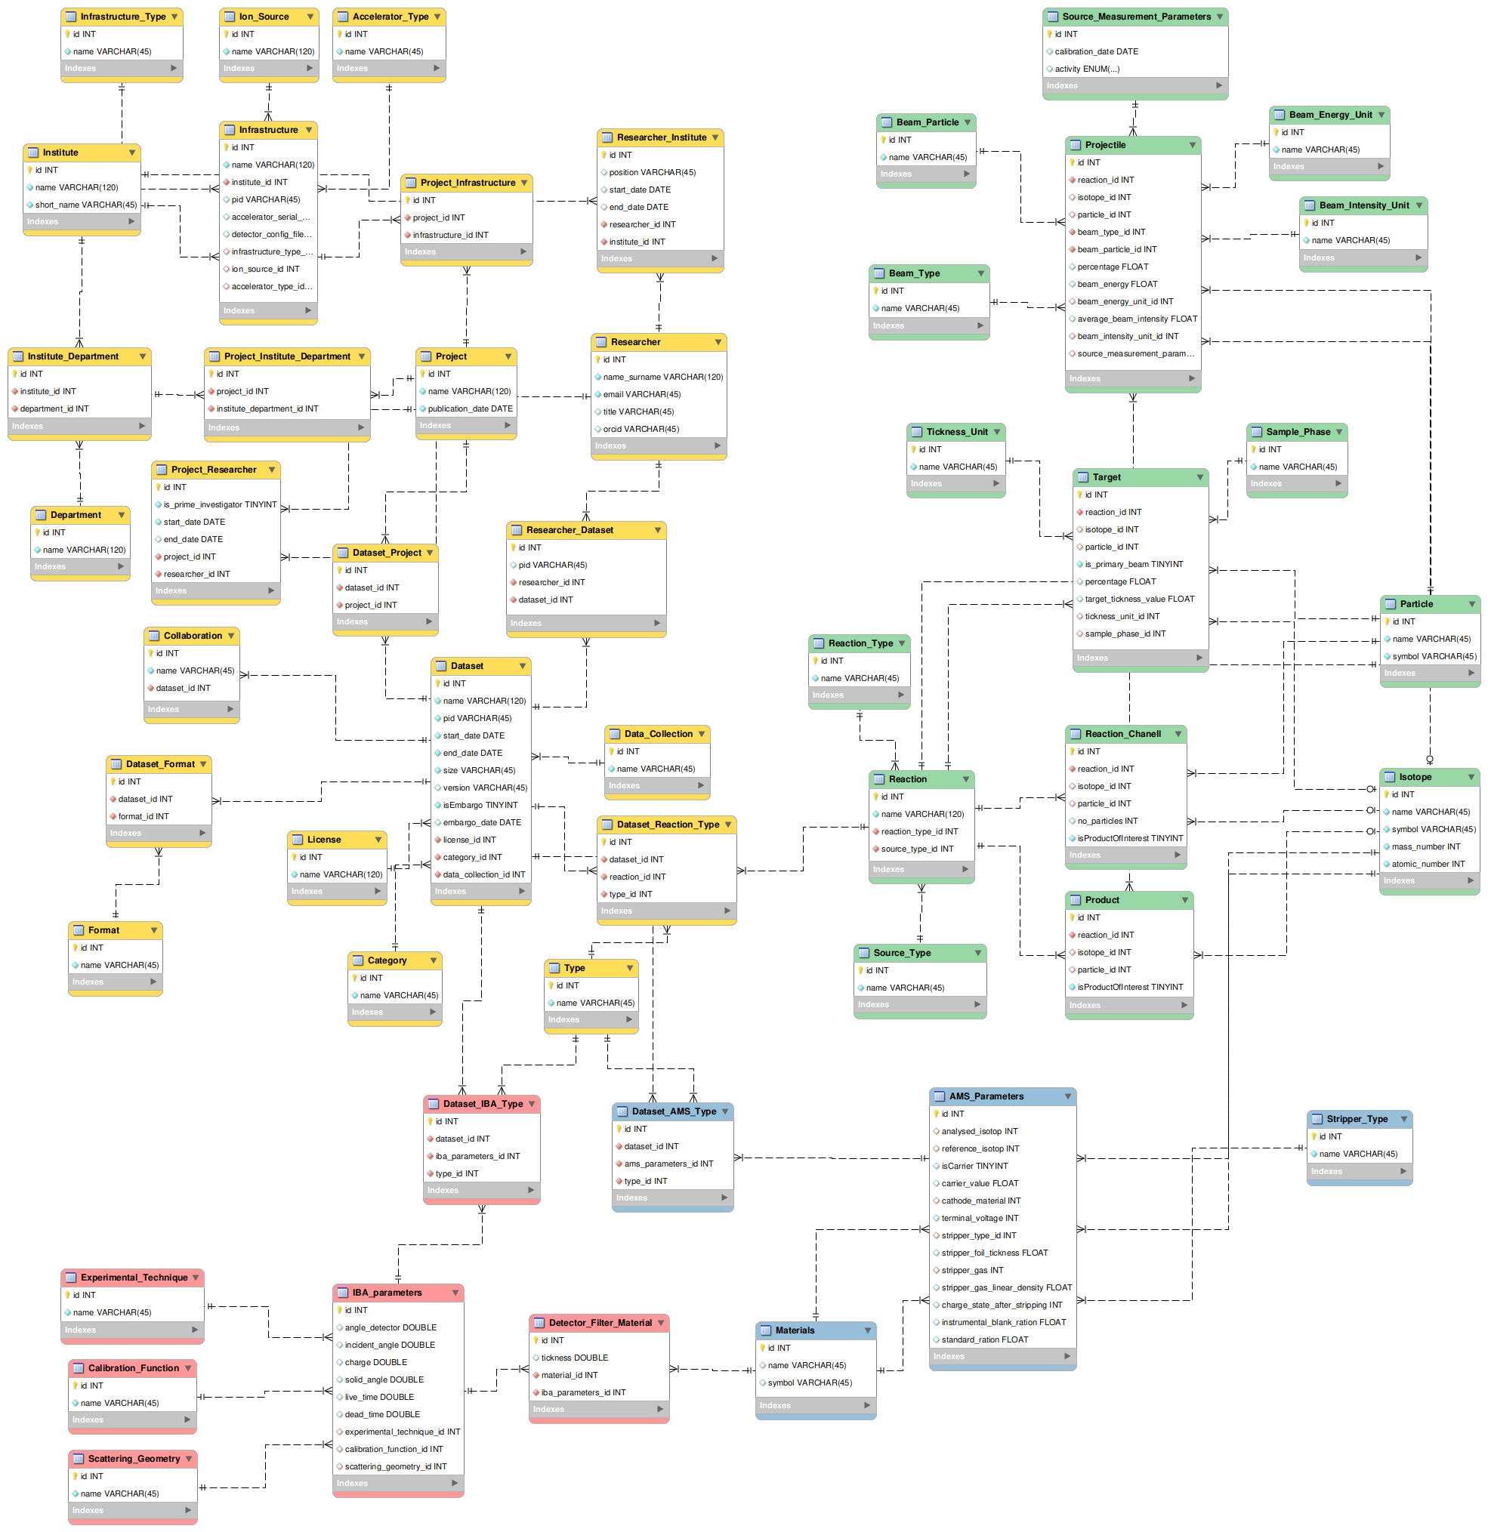
GSI application – experiment metadata schema
List of metadata requirements
Transform the list into an ER diagram
Create a database based on the diagram
Create an interface for data input
Create a common Metadata schema
Use metadata schema for faster data input

Slide 12
GSI application – experiment metadata schema
General data
Nuclear physics experiment
AMS and IBA data
Accelerator Mass Spectrometry
Ion Beam Analysis

Slide 13
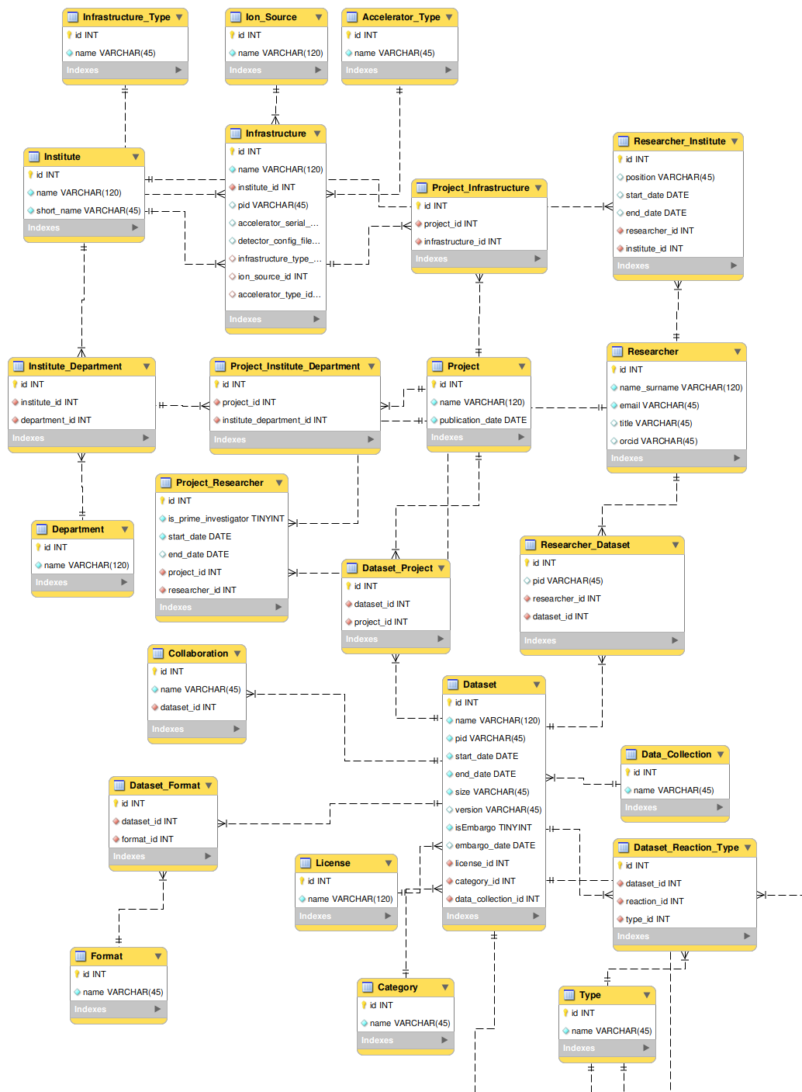
GSI application – experiment metadata schema
Institute
Department
Infrastructure
Ion Source
Researcher
Accelerator
Project
Collaboration
Dataset
License
Reaction type
Data format
Dataset type

Slide 14
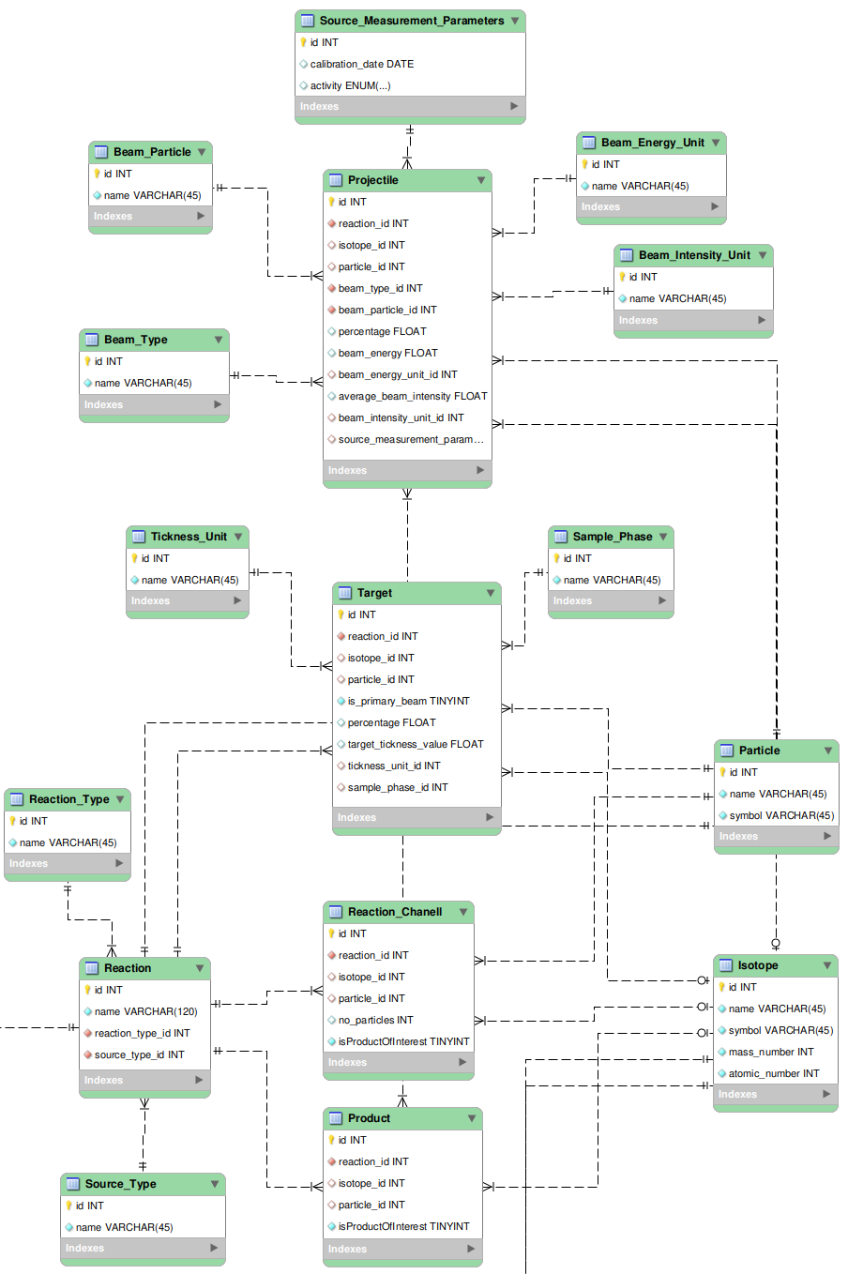
GSI application – experiment metadata schema
Projectile
Measurement parameters
Target
Sample phase
Reaction channel
Target thickness
Product
Isotope
Beam Intensity
Beam type
Particle
Reaction

Slide 15
SUMMARY
PUNCH4NFDI
Science data platform
Resources (compute4PUNCH)
Space (storage4PUNCH)
Facilitate collaboration
FAIR scientific data
Experiment metadata schema
Common schema for nuclear physics accelerator based experiments
Portal for data entry
Automatic metadata schema generation
Automatized metadata import

Slide 16
Thank you for your attention
Questions?

