Slide 1
Choosing the OSS License for your original or derivative work and 3 Pitfalls
Felix Arndt FAIR/GSI Darmstadt
Text is available under the Creative Commons Attribution-ShareAlike License 4.0; additional terms may apply. “Felix Arndt, FAIR/GSI Darmstadt: Choosing the OSS License for your original or derivative work and 3 Pitfalls 2023” https://indico.gsi.de/event/17498/timetable/#b-11279-session-7-open-licenci

Slide 2
Choosing the OSS License for your original or derivative work and 3 Pitfalls
Felix Arndt FAIR/GSI Darmstadt
Text is available under the Creative Commons Attribution-ShareAlike License 4.0; additional terms may apply.

Slide 3
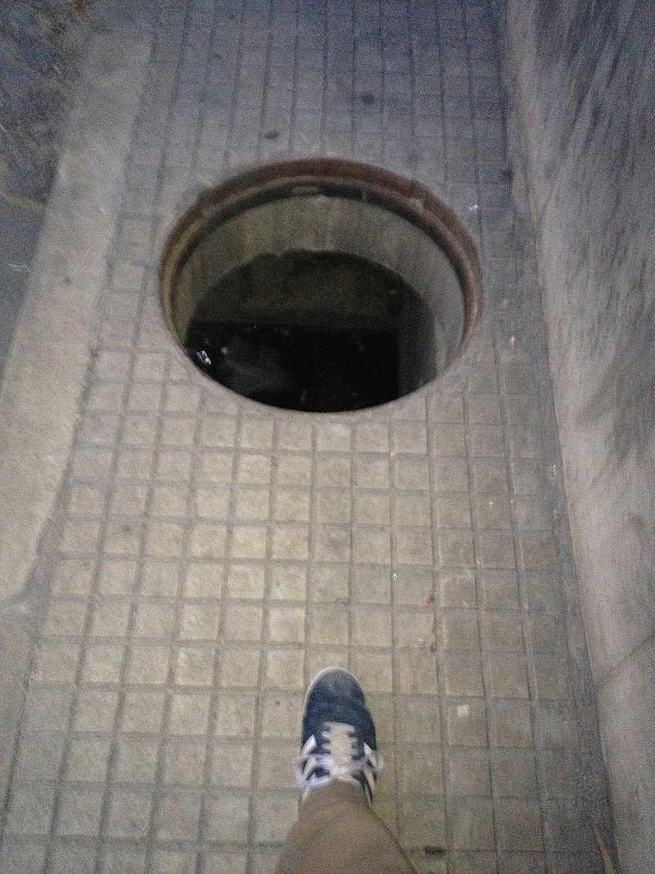
Pitfall in the middle of the road
By Quatchenerlo - Own work,
CC BY-SA 4.0,
https://commons.wikimedia.org/w/index.php?curid=126702479

Slide 4
Pitfall in the middle of the road
https://commons.wikimedia.org/wiki/File:Uncovered_manhole.jpg#/media/File:Uncovered_manhole.jpg
By Quatchenerlo - Own work,
CC BY-SA 4.0,
https://commons.wikimedia.org/w/index.php?curid=126702479

Slide 5
GSI Products fit for “open” licensing
Software (copyright)
Data / Database (no copyright on Data but: Database protection in the EU - Your Europe (europa.eu)
Scientific publications (copyright)
Hardware / Invention (no copyright protection but patent possible)

Slide 6
„Open Source“ Text
Music, Text, Photo CC CC BY 4.0 Deed | Attribution 4.0 International | Creative Commons

Slide 7
Open Source Hardware
CERN OHL CERN Open Hardware Licence Version 2 – Permissive – Open Source Initiative

Slide 8
Open Source Data
CC BY 4.0 Deed | Attribution 4.0 International | Creative Commons
Database protection in the EU - Your Europe (europa.eu)

Slide 9
Open Source Software Licenses
Permissive
Apache Apache License, Version 2.0 – Open Source Initiative FreeBSD The 2-Clause BSD License – Open Source Initiative Modified BSD The 3-Clause BSD License – Open Source Initiative MIT The MIT License – Open Source Initiative
Copyleft
GPL3 GNU General Public License version 3 – Open Source Initiative LGPL GNU Lesser General Public License version 3 – Open Source Initiative

Slide 10
Tools: Choosing a License
Non-Software Licenses | Choose a License Choose a non software license Choose a License (creativecommons.org) CC LICENSE CHOOSER
Choose an open source license | Choose a License Choose an open source license
Licenses – Open Source Initiative OSI Approved Licenses
The Free-Libre / Open Source Software (FLOSS) License Slide (dwheeler.com) The Free-Libre / Open Source Software (FLOSS) License Slide by David A. Wheeler

Slide 11
Common Pitfalls Overview
A Choosing a License
B License Compatibility
C Ownership
D Warranty
E Dual Use

Slide 12
Common Pitfalls Overview
A Choosing a License
B License Compatibility
C Ownership
D Warranty
E Dual Use

Slide 13
Pitfall 1: No copyrighted work
A copyright is a type of intellectual property that gives its owner the exclusive right to copy, distribute, adapt, display, and perform a creative work, usually for a limited time. Wikipedia contributors. Copyright [Internet]. Wikipedia, The Free Encyclopedia; 2023 Oct 16, 20:50 UTC [cited 2023 Oct 19]. Available from: https://en.wikipedia.org/w/index.php?title=Copyright&oldid=1180468403.
Data and Hardware usually has no copyright. It is not creative. To copy your Invention or use your Data is usually free anyhow.
=> If your work isn’t protected licensing may be a waste of time. Ask for legal support.

Slide 14
Pitfall 2: Employer disagrees
Most countries, .. , have created copyright laws in line with the Berne Convention … The creator, or their employer, holds the copyright to this original work and therefore have the exclusive right to make copies, release modified versions, distribute copies, perform publicly, or display the work publicly ..… Unless the original work was in the public domain, a derivative work can only be distributed with the permission of every copyright holder.
Wikipedia contributors. Open-source license [Internet]. Wikipedia, The Free Encyclopedia; 2023 Oct 16, 05:06 UTC [cited 2023 Oct 19]. Available from: https://en.wikipedia.org/w/index.php?title=Open-source_license&oldid=1180366068.

Slide 15
Pitfall 2: Employer disagrees
GSI/FAIR not the author may be entitled to exercise all economic rights in the computer program. Section 69b UrhG:
(1) Where a computer program is created by an employee in the execution of his or her duties or following the instructions of his or her employer, the employer alone is entitled to exercise all economic rights in the computer program, unless otherwise agreed. … => Always ask GSI before licensing OS.

Slide 16
Pitfall 3: Derivative work
Most countries, .. , have created copyright laws in line with the Berne Convention … The creator, or their employer, holds the copyright to this original work and therefore have the exclusive right to make copies, release modified versions, distribute copies, perform publicly, or display the work publicly ..… Unless the original work was in the public domain, a derivative work can only be distributed with the permission of every copyright holder.
Wikipedia contributors. Open-source license [Internet]. Wikipedia, The Free Encyclopedia; 2023 Oct 16, 05:06 UTC [cited 2023 Oct 19]. Available from: https://en.wikipedia.org/w/index.php?title=Open-source_license&oldid=1180366068.

Slide 17
Pitfall 3: Derivative work
In case your (derivative) software builds on other software you need a license agreement with the author of the other (original) software.
Usually this in an open source License.
You need to fully comply with all regulations of the License.
This is easy if the original software is licensed with a permissive license like MIT, BSD, Apache and complicated with copyleft licenses like GPL3.
In general permissive licenses have good license compatibility with most other software licenses.
Due to their non-restrictiveness, most permissive software licenses are compatible with copyleft licenses, which are incompatible with most other licenses.
=> Use license compatibility tools and ask for legal support.

Slide 18
Links:
Non-Software Licenses | Choose a License Choose a non software license Choose a License (creativecommons.org) CC LICENSE CHOOSER
Choose an open source license | Choose a License Choose an open source license
Licenses – Open Source Initiative OSI Approved Licenses
The Free-Libre / Open Source Software (FLOSS) License Slide (dwheeler.com) The Free-Libre / Open Source Software (FLOSS) License Slide by David A. Wheeler
Launching the next stage of the Open Source MR project – Open Source Imaging Open Source MR
News – Open Source Imaging OSI News

