Slide 1
s467 Analysis update
By:Luke Rose, Stefanos Paschalis, Ryo Taniuchi, Marina Petri, Leyla Atar,
Christian Suder
Date:

Slide 2
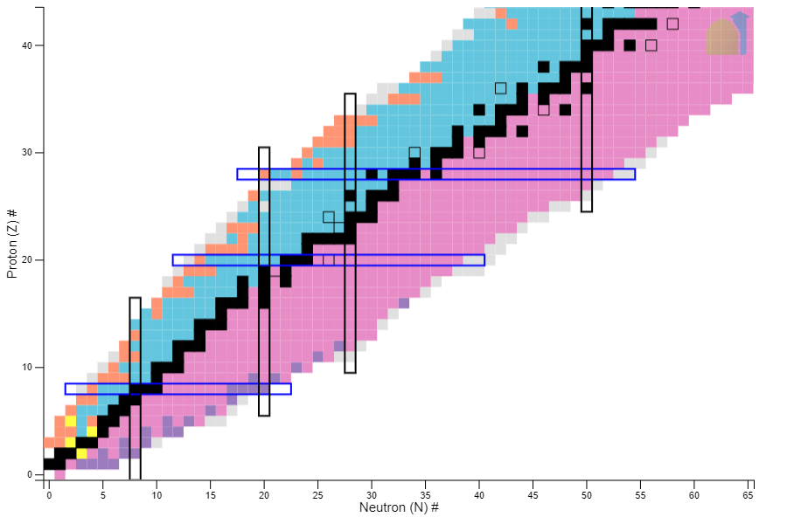
Shell model / single particle states
28
20
Protons and Neutrons arranged in shells.
Magic nuclei: 2, 8, 20, 28, 50, 82, and 126
Exotic nuclei->Far from line of stability
8

Slide 3
Experimental probes
(e,e’p) Only on stable isotopes→ Reduction by (30-40)%
Study with compound target/fragmentation at NSCL see isotope dependence (indirect/compound reaction)
Inverse kinematics of (p,2p) cleaner probe → Extend study to far from stability.
QFS (p,2p) experiments on low mass region-> extended to medium mass region
[1] J.TOSTEVIN & A.GADE, PHYSICAL REVIEW C 103, 054610 (2021)

Slide 4
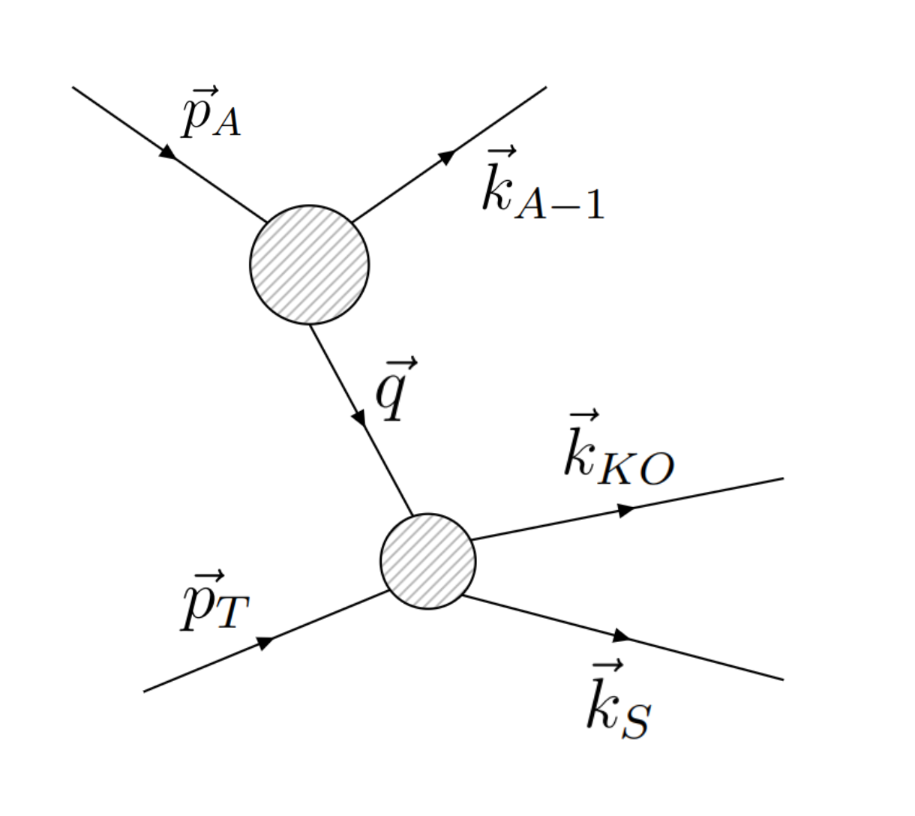
Quasi-free scattering (QFS)
[2] L.ATAR, PHYSICAL REVIEW LETTERS 120, 052501 (2018)

Slide 5
The need for CALIFA
QFS (p,Np)
Inelastic

Slide 6
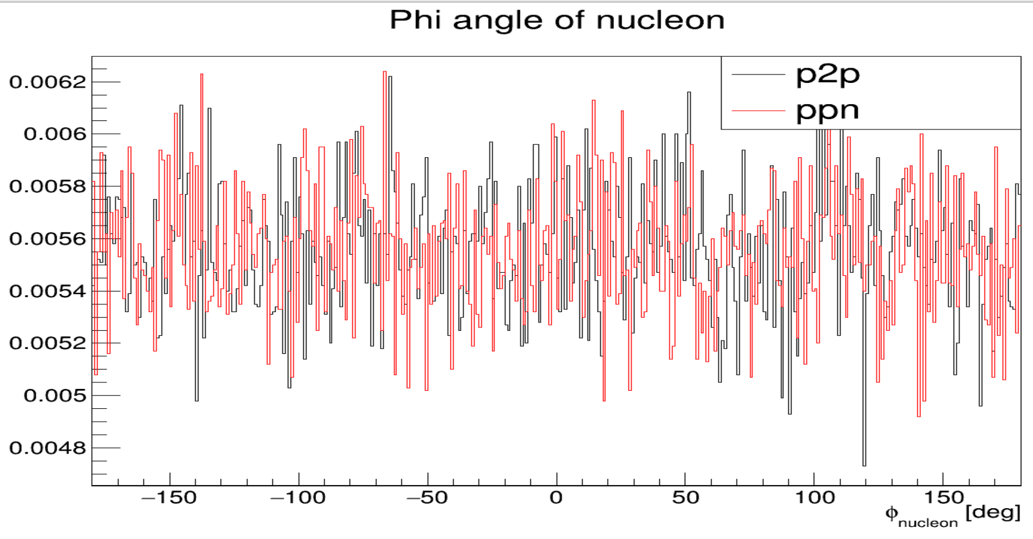
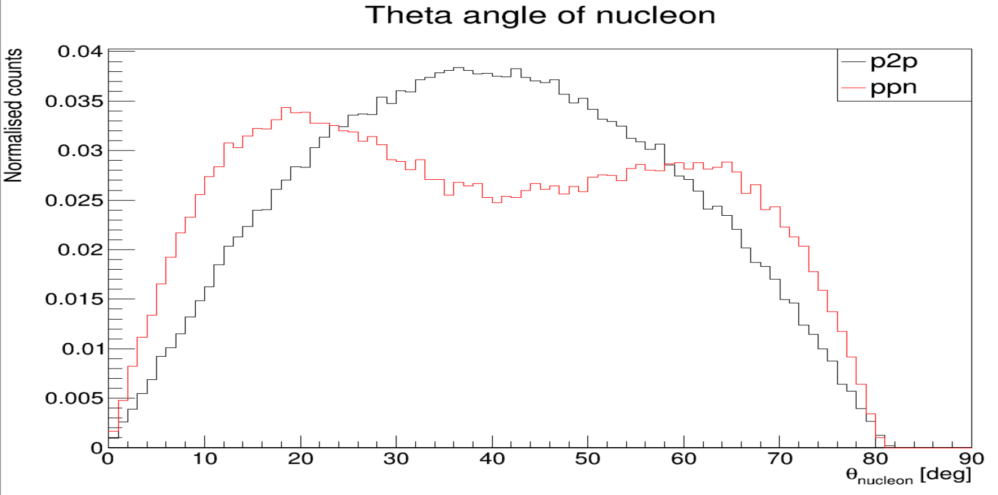
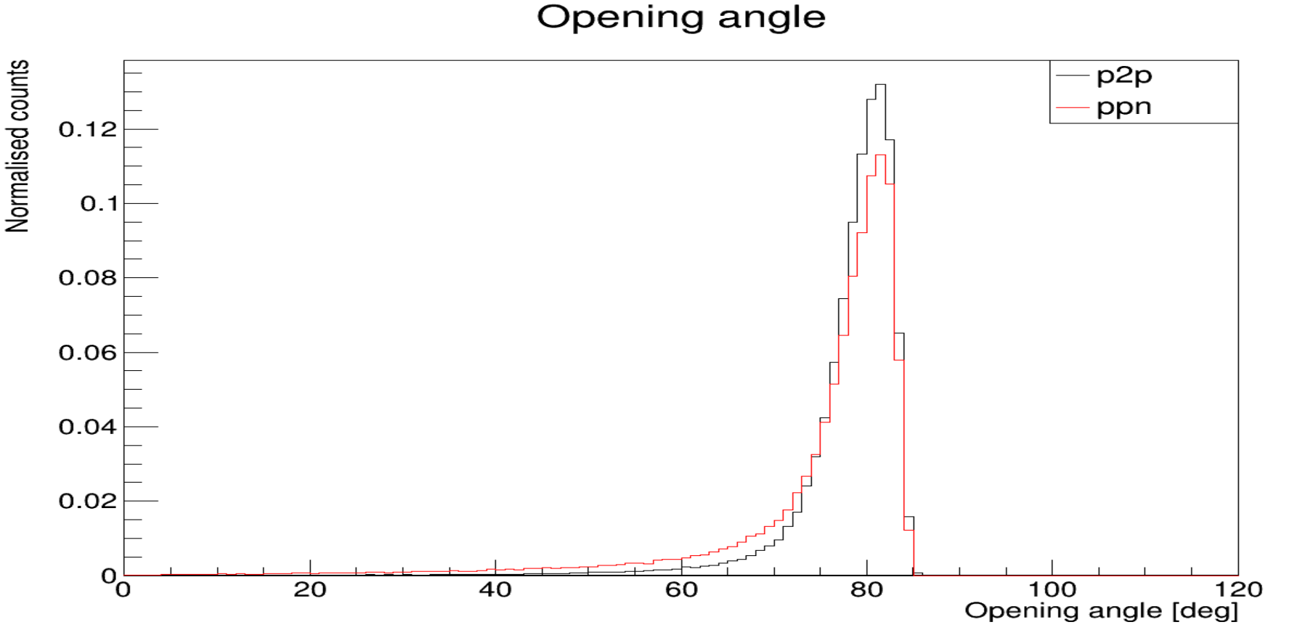
QFS event generator
Normalised counts
Ca40 (p,2p) && (p,pn)
Beam energy: 450 AMeV
Momentum spread :140 MeV/C

Slide 7
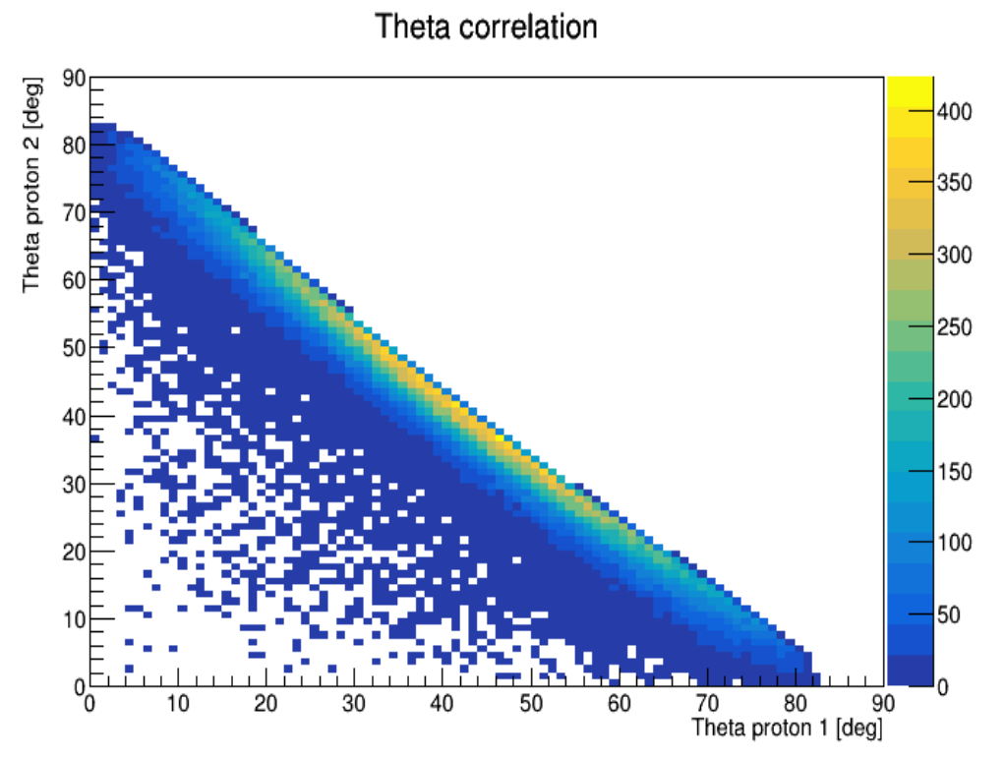
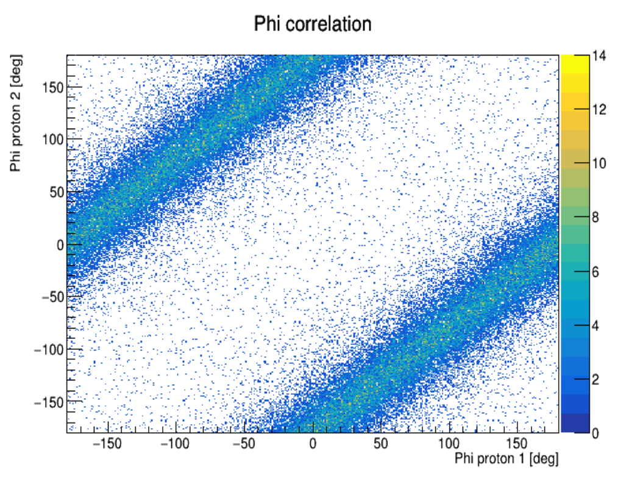
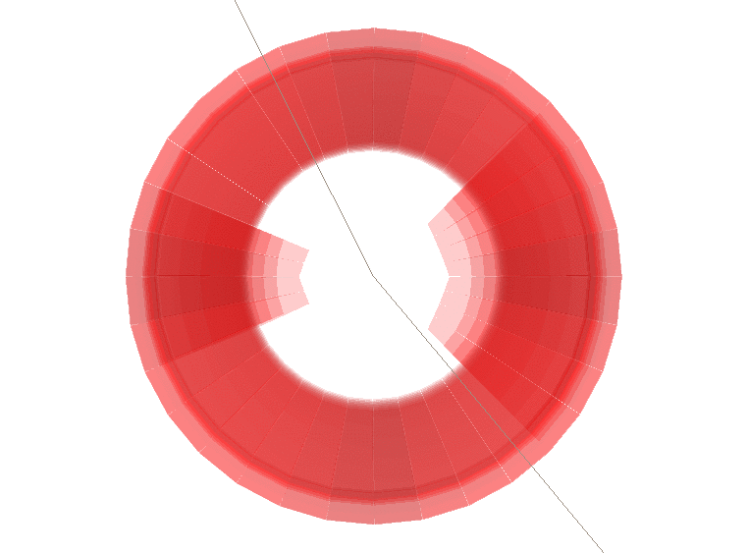
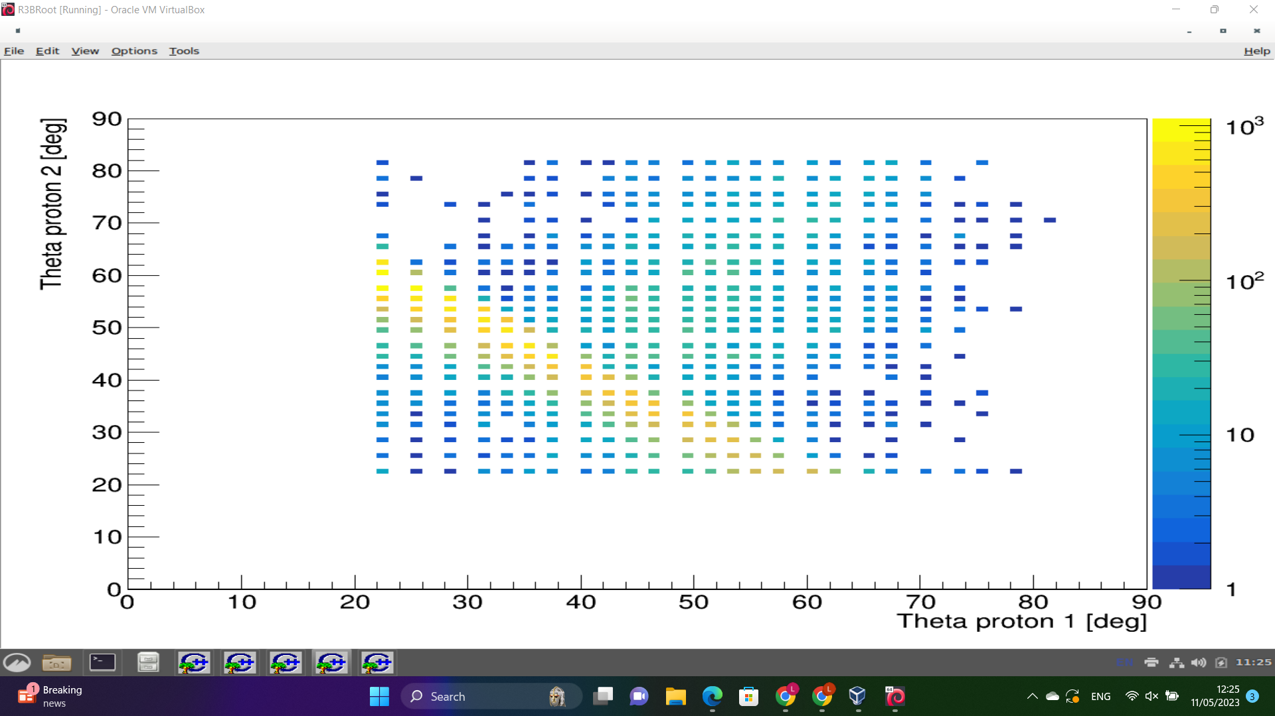
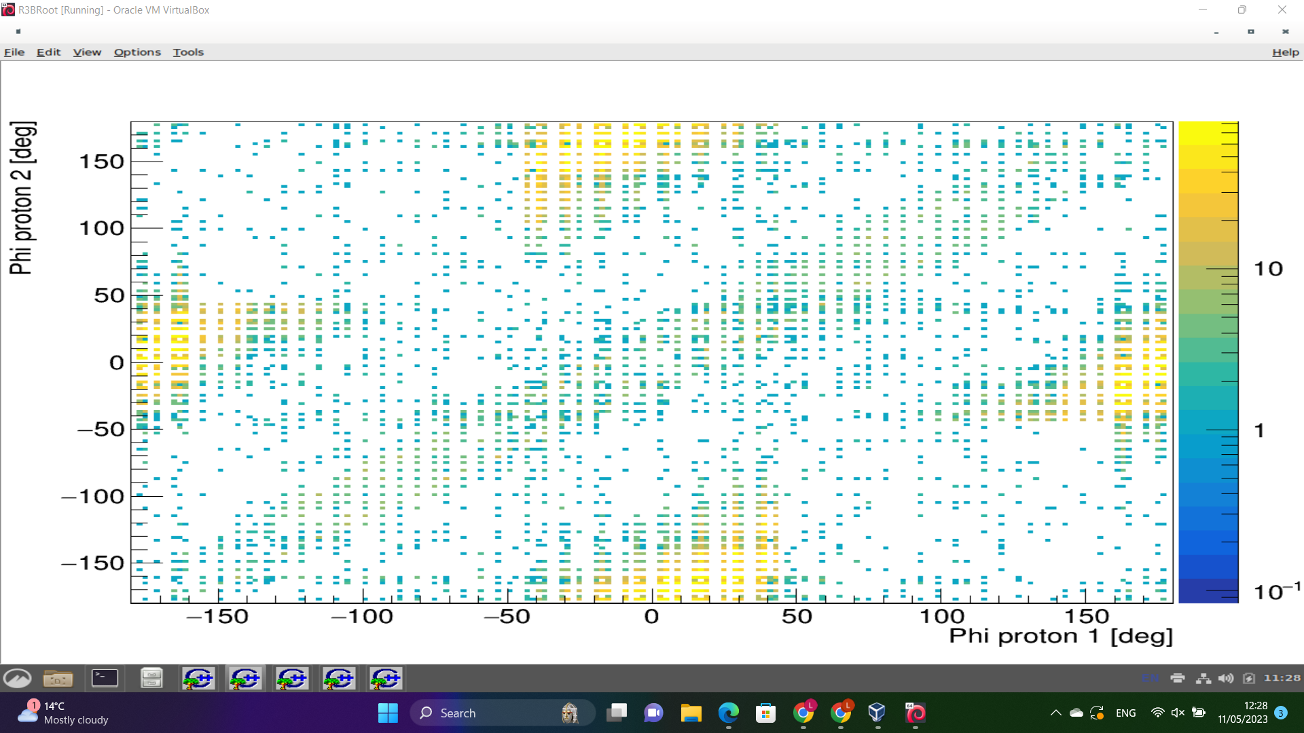
R3BRoot simulation of (p,2p)
Takes seed then passess through geometry.

Slide 8
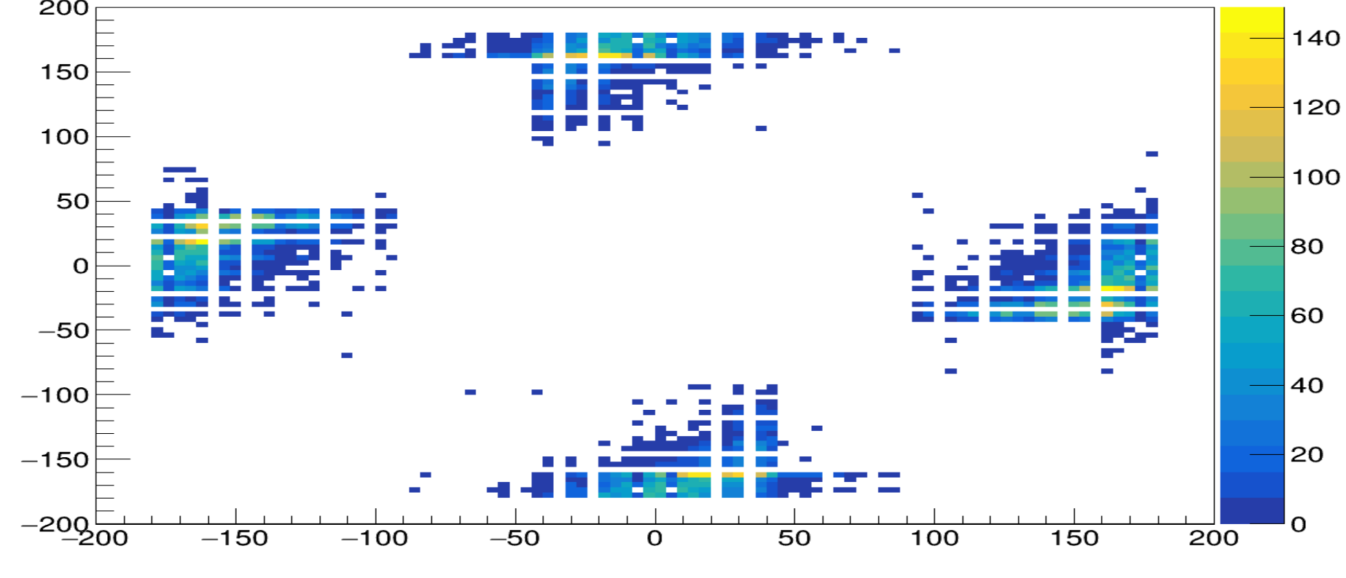
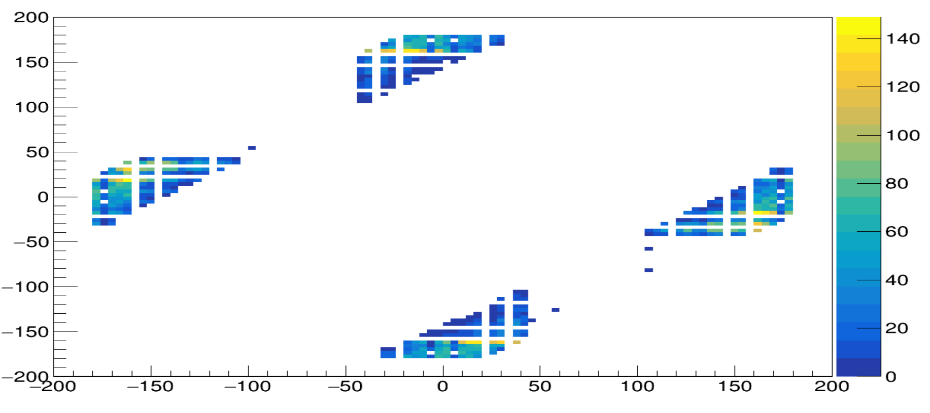
Angular cuts
phi 2 [deg]
Phi correlation - Messel wixhausen
Phi correlation raw output
phi 1 [deg]
phi 2 [deg]
Phi correlation - MW + Phi30 cut
phi 1 [deg]

Slide 9
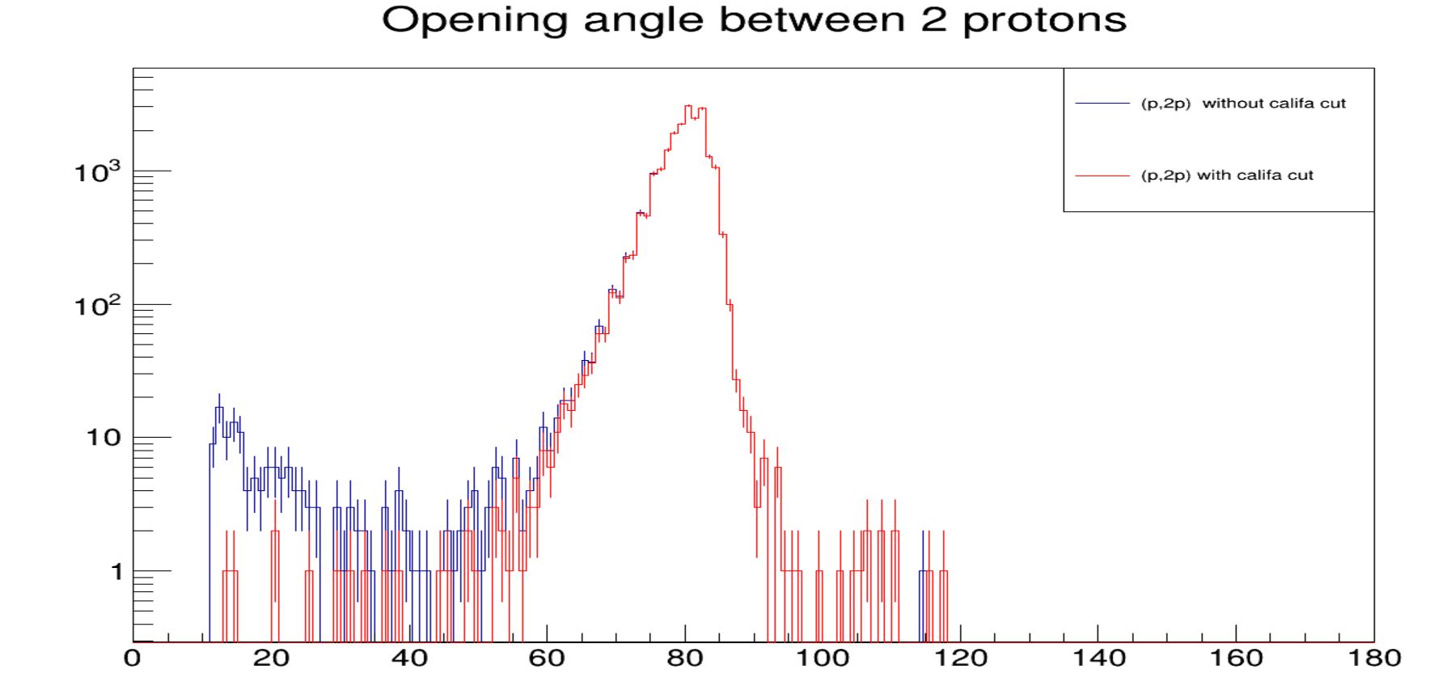
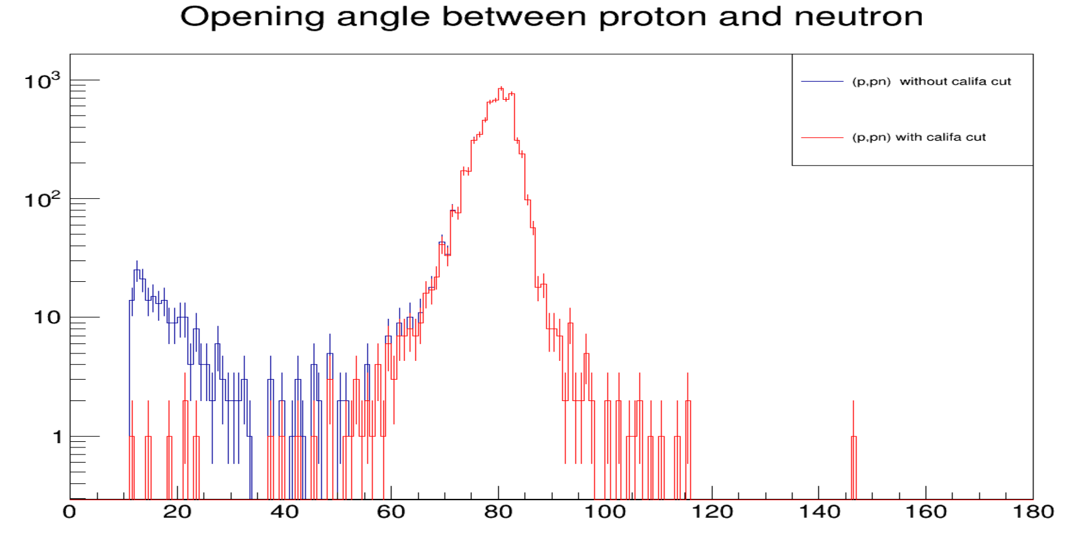
Opening Angle
p1
Counts
Opening angle
p2
Opening angle
Opening angle
Counts
Opening angle

Slide 10
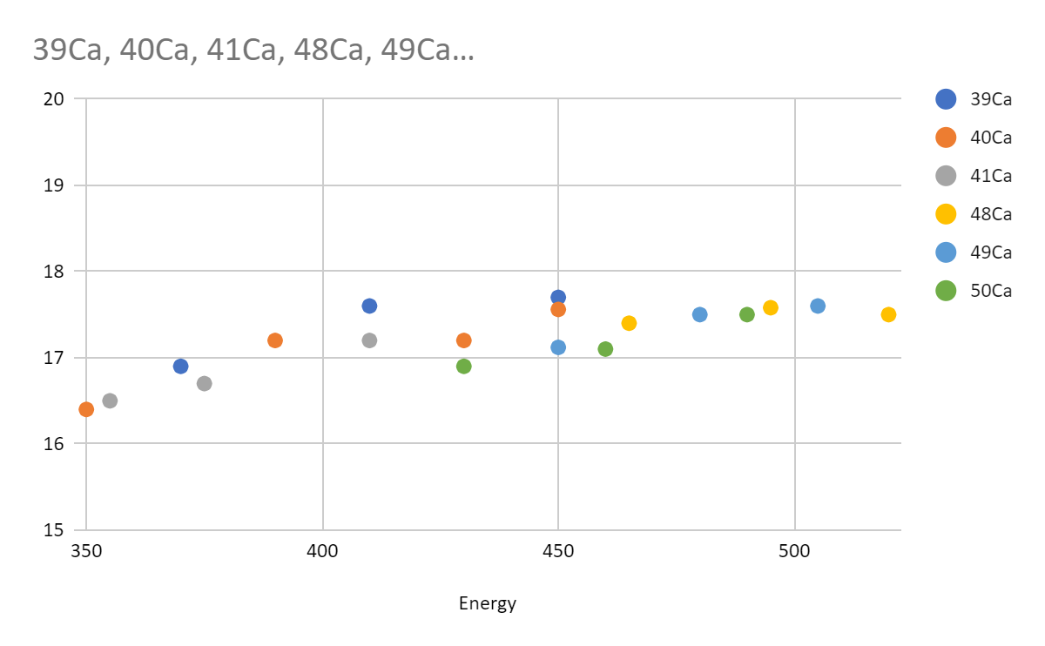
40Ca(p,2p)39K
Efficiencies
Energy | Theta | Phi | Efficiency
20 | Non | Non | 20.94
70 | Non | Non | 16.68
20 | 30 | 30 | 17.56
70 | 30 | 30 | 14.48
20 | 15 | 15 | 11.70
70 | 15 | 15 | 9.68

Slide 11
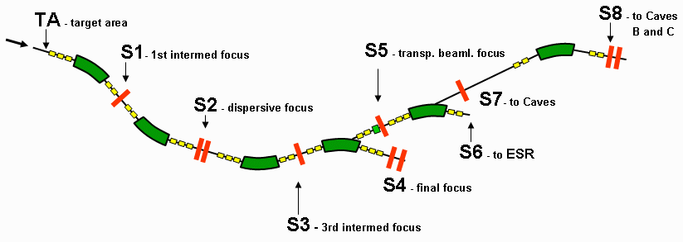
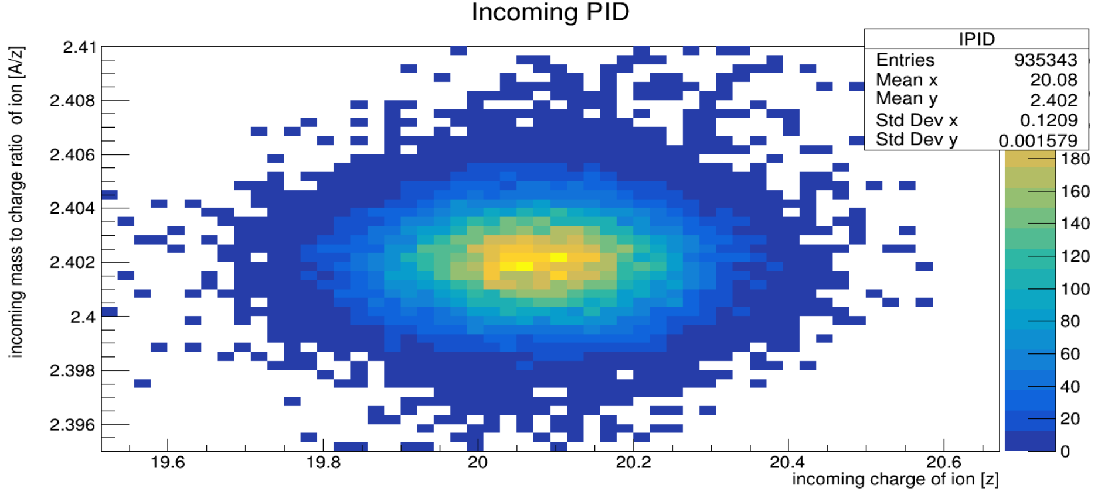
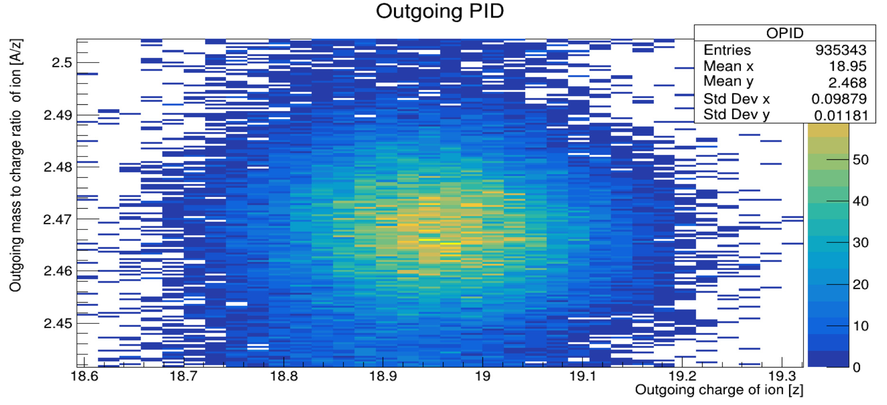
PID Gating for specific reaction Channel
48Ca
(p,2p)
47K

Slide 12
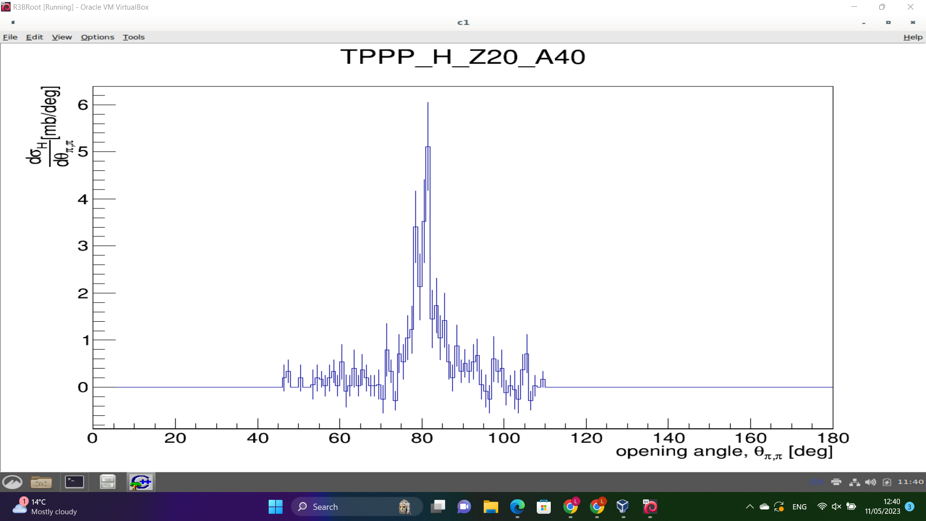
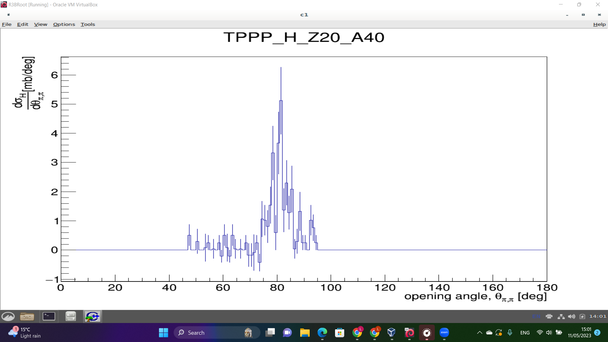
40Ca(p,2p) Differential cross sections corrected efficiencies from simulation
Theta =30 deg
Phi = 30 deg
cs=33.0mb
Theta =15 deg
Phi = 15 deg
cs=30.3mb

Slide 13
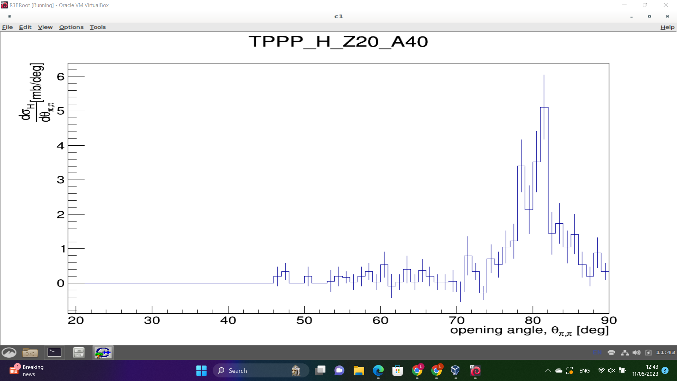
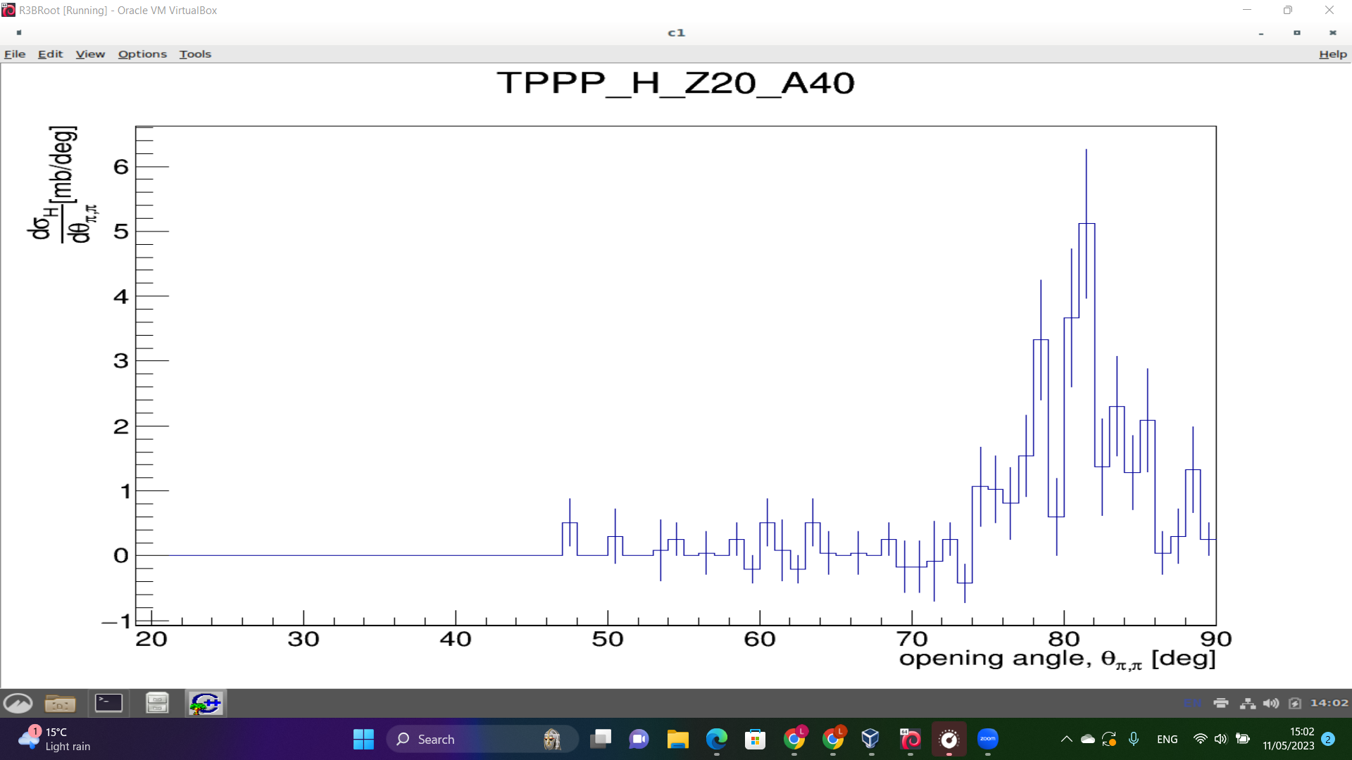
40Ca(p,2p) Differential cross sections corrected efficiencies from simulation - Integrating only over domain from simulation
Theta =30 deg
Phi = 30 deg
cs = 29.2 mb
Cut on simulated qfs region
Theta =15 deg
Phi = 15 deg
cs=28.0 mb
Cut on simulated qfs region

Slide 14
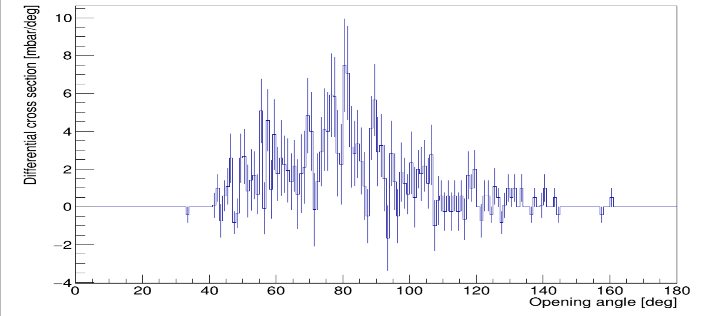
Preliminary (p,pn) using same approach as (p,2p)

Slide 15
Discussion
(p,2p) efficiencies for Ca isotopic chain calculated.
Corrected cross section calculated but cuts affect cross section value .
Preliminary (p,pn) efficiency calculated.
Further work is required to reproduce the differential (p,pn) cross section.
Thank you for your attention

