Slide 1
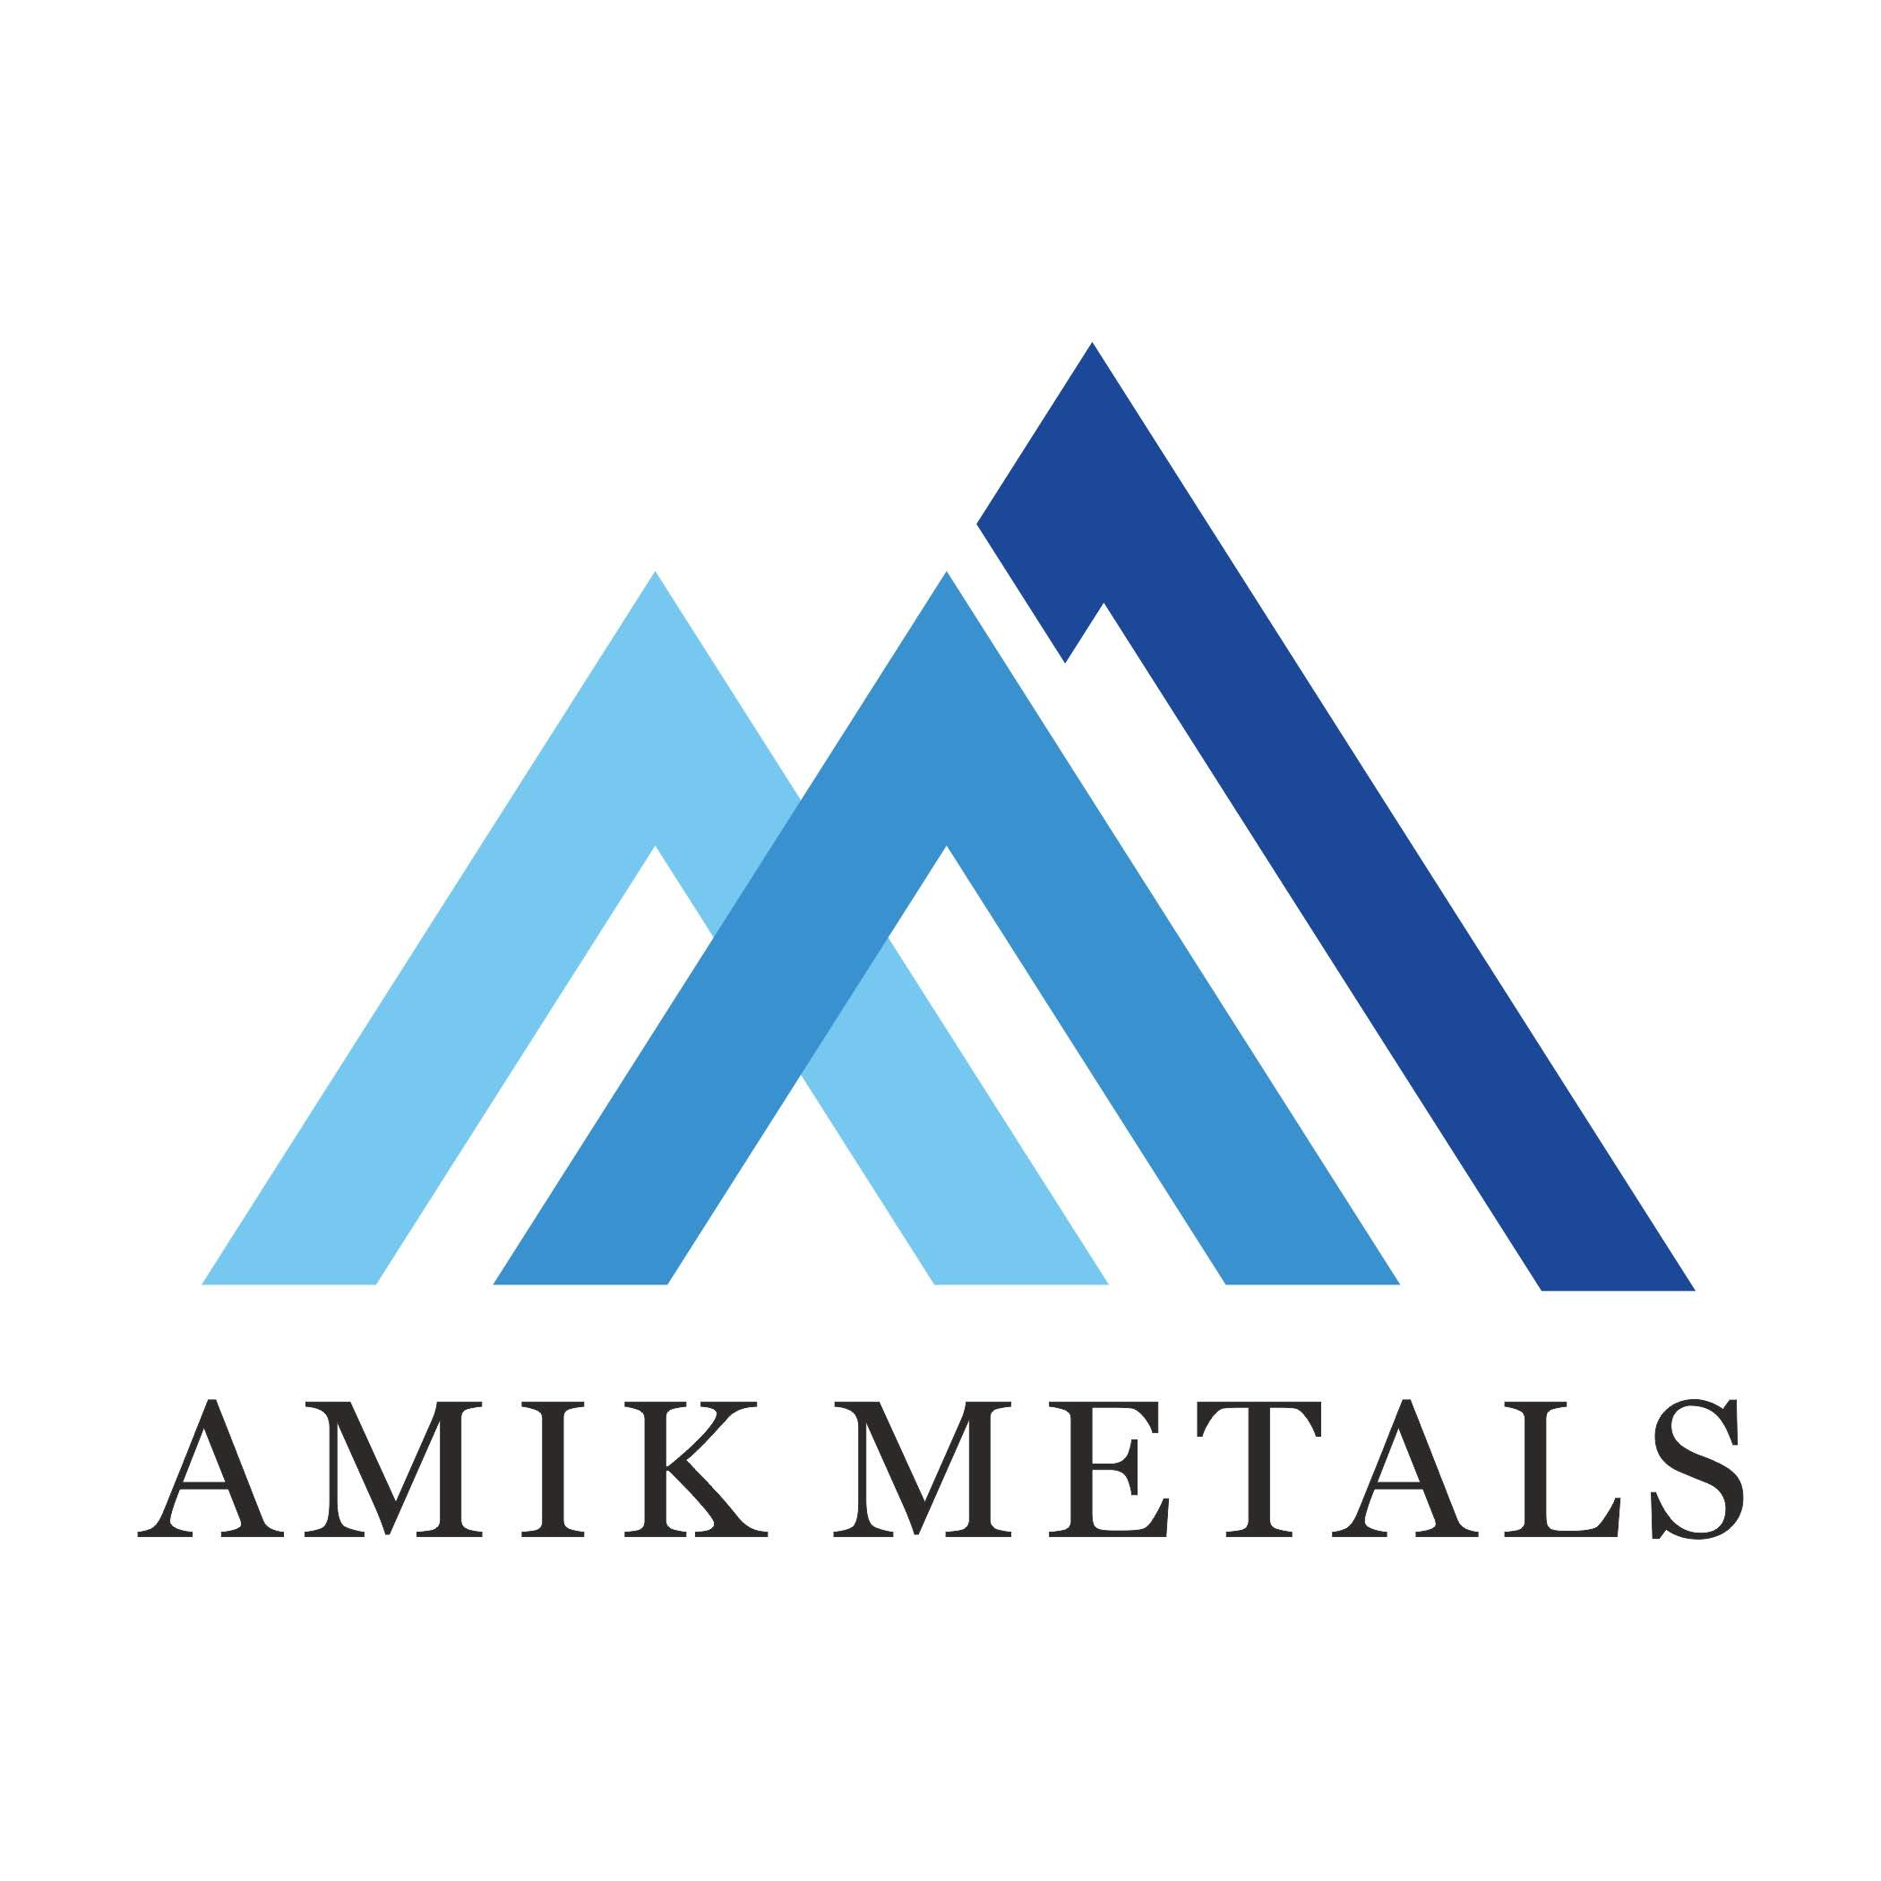


Slide 2
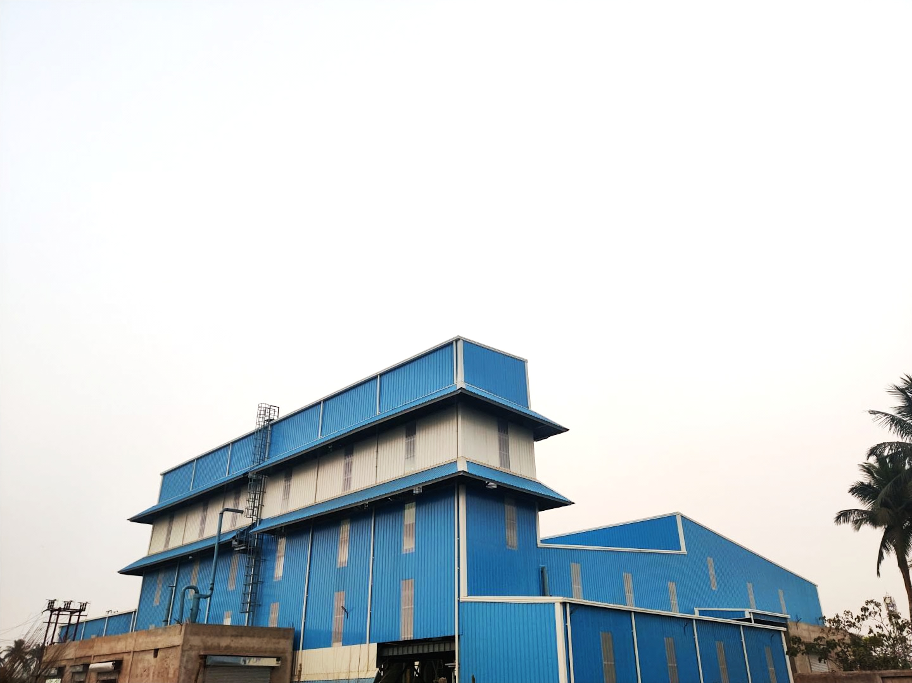
WE ARE
WE SPECIALIZE
WE PROVIDE
A Ferrous Foundry located in Uluberia, 44 kms away from Kolkata. Having State-of-the-art equipment, specialised manpower and a dedicated team of professionals
In Ductile and Malleable Iron Castings
Quality products, On-time delivery, Optimum prices and Dedicated customer service

Slide 3
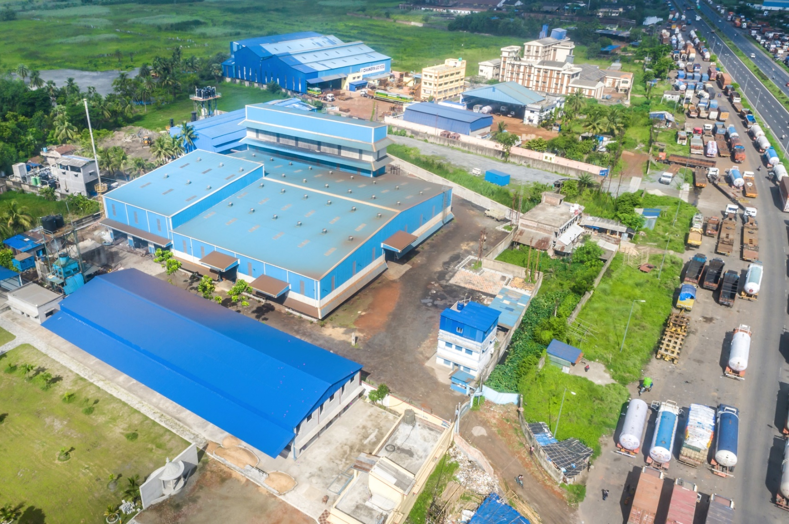
GREENFIELD PROJECT
Commenced production in April 2021 with a capacity of 4,200 MTPA in Phase-I Started exporting to clients in South Korea, USA, Canada, Dubai and Europe.
Integrated latest technology and modern practices with experiential knowledge.
A team with over 100 years of combined experience in the industry led by third generation entrepreneurs
An eco-friendly company that has installed the best-in-class pollution control equipment and uses environmentally sustainable practices.

Slide 4
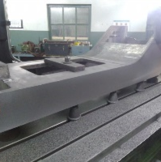

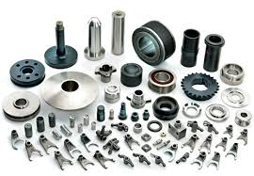

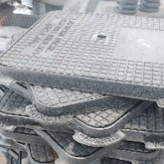
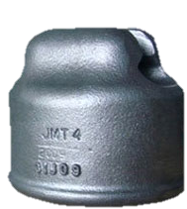
PRECISION PRODUCTS
Ready to use, our products are molded to your satisfaction.
MACHINERY PARTS
Legs
ELECTRICAL FITTINGS
Conduit Body, LQT and Beam Clamps 3/8” onwards,
Clamp Backs
AUTOMOBILE PARTS
Spider Brakes, Arms, Axles, etc
MANHOLES
Covers & Frames 150/150” onwards
PIPE FITTINGS
Elbows, Bends and Reducers
3/8” onwards
INSULATOR CAPS

Slide 5
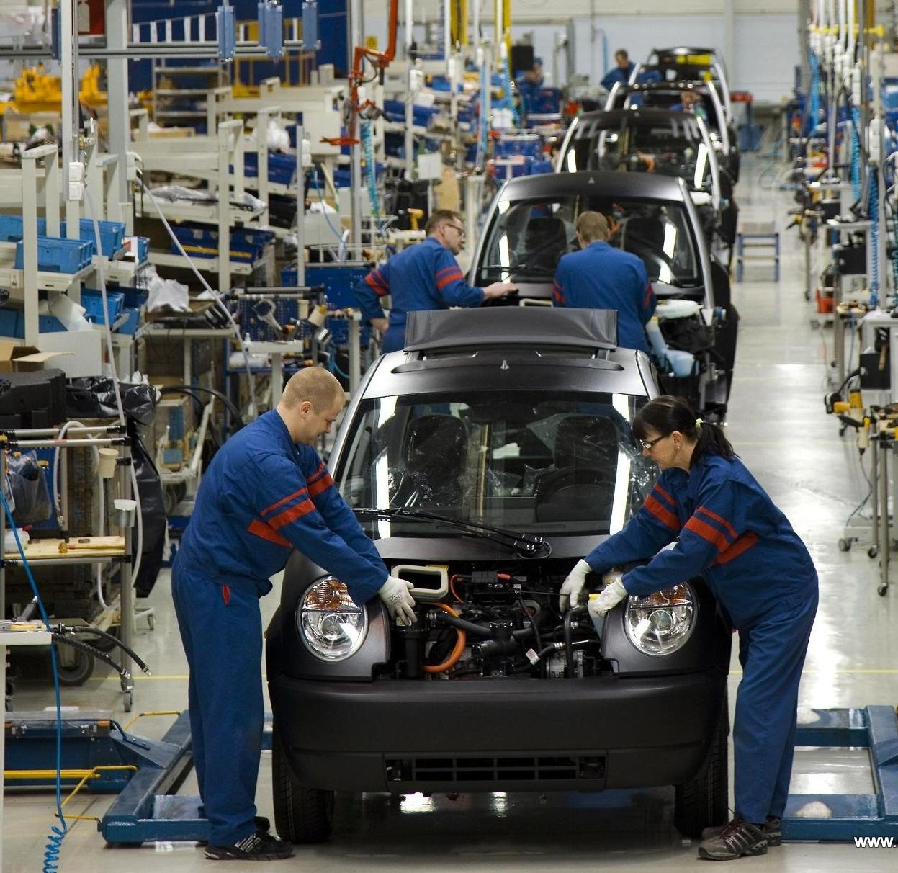
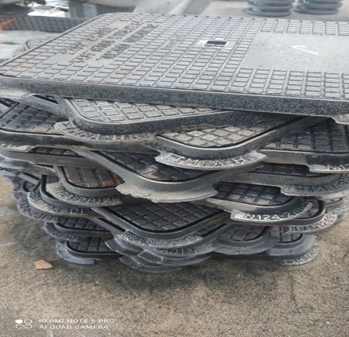
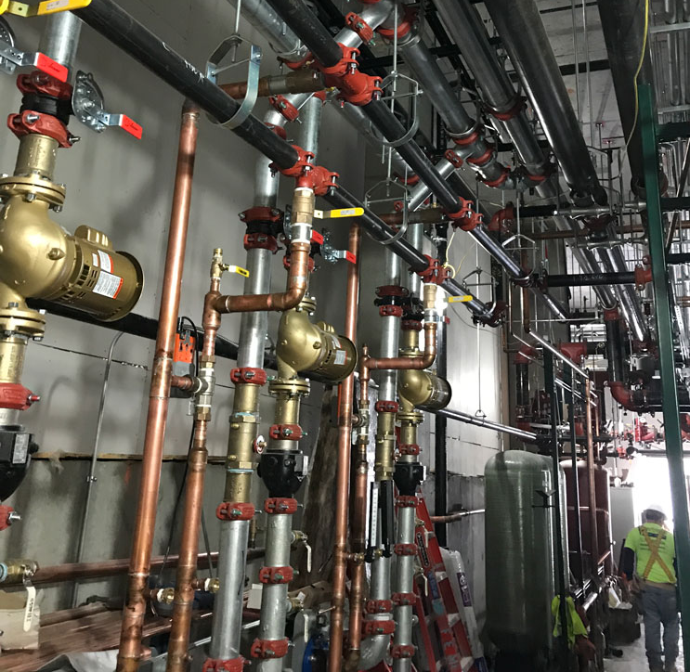
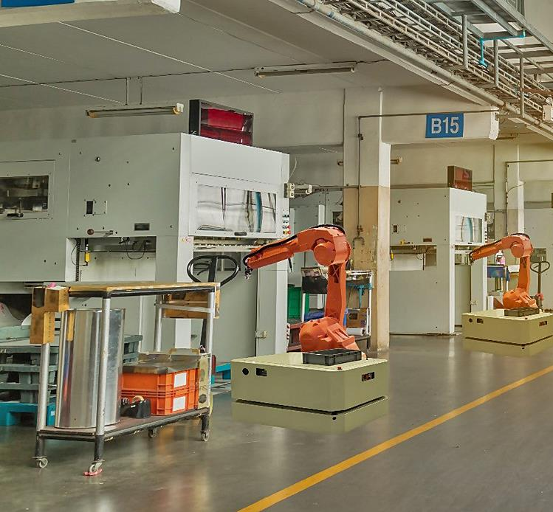
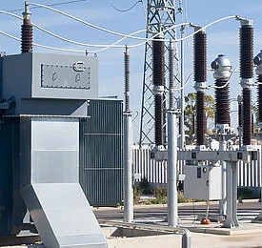
CURRENT SECTORS
AUTOMOBILE
INDUSTRY
ELECTRICAL
AUTOMOBILE
SANITARY
MACHINERY
PLUMBING

Slide 6



WHY US?
Everyone promises you quality, service and price. So what makes our team unique?
STATE-OF-THE-ART MACHINERY
QUALITY
ASSURANCE
SPECIALIZATION

Slide 7
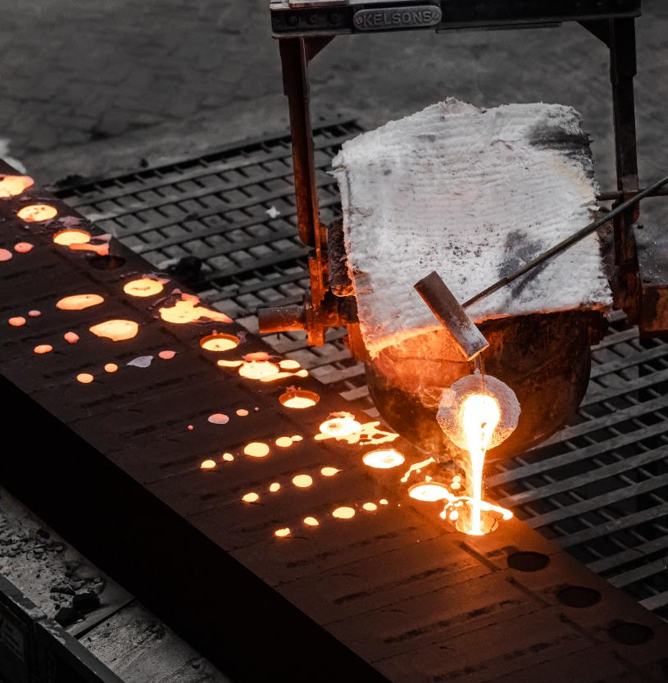
SPECIALIZATION
Most foundries shy away from small castings, saying “it’s tough.” We embraced it.
We specialize in small and precision castings of Ductile and Malleable Iron offering a winning combination of trained manpower, customized machinery, and suitable practices. We provide fully assembled, ready-to-use products.
We have carefully chosen the DISA Vertical moulding machine (box size 650x535mm), and No-Bake hand moulding facility, constructed our pouring system, installed specialized fettling machines, and designed our tools to achieve high volume, cost-effective, and consistent quality in producing smaller castings.

Slide 8
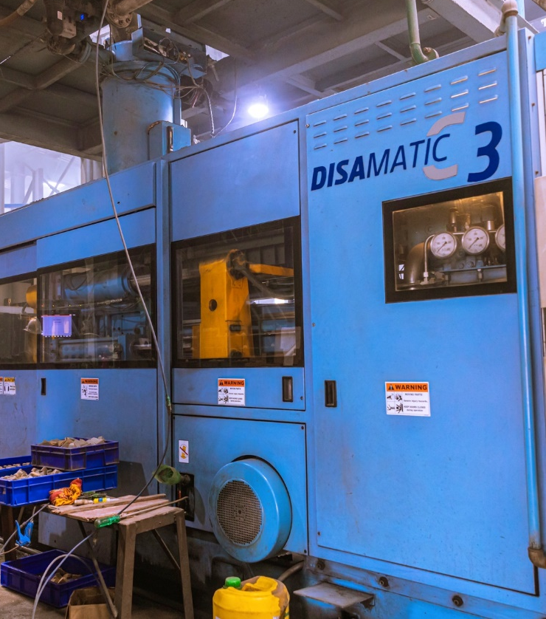
STATE-OF-THE-ART MACHINERY
DISA vertical, flaskless, high-pressure molding line (size 650 X 535)
No-bake hand molding facility 3 MT liquid metal handling capacity
1 MT INDUCTOTHERM Induction Furnace Automatic SREE SAKTHI Sand Plant with 40 MT Capacity
Automatic Tumble and Hanger Type Shot Blasting Machines
COMPAX Cold Box and Resin Sand Core Shooters
Heat Treatment facility HITACHI make Spectrometer
Special Purpose Machines for machining as per requirement

Slide 9
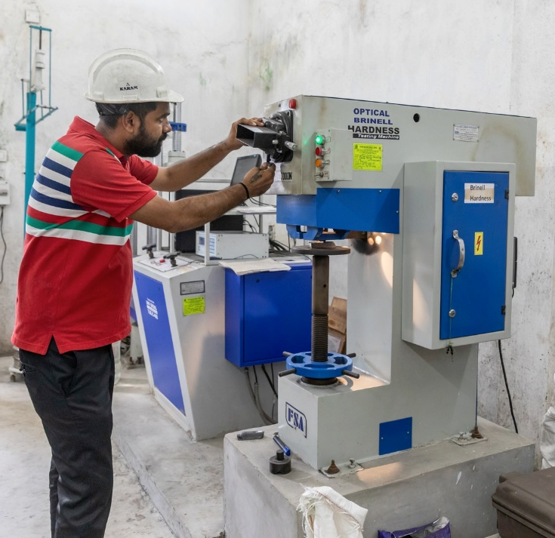
QUALITY ASSURANCE
At AMIK Metals, Quality is our Business.
We have placed stringent quality checks at every step of the process and use the best-in-class scrap, pig iron, sand, and other raw materials.
We have a fully equipped laboratory capable of performing all tests. Equipment includes Hitachi Spectrometer, tensile, hardness, sand, and other testing machines.
We are also ISO 14001:2015, ISO 9001:2015, ISO 45001:2018 and UL certified.

Slide 10
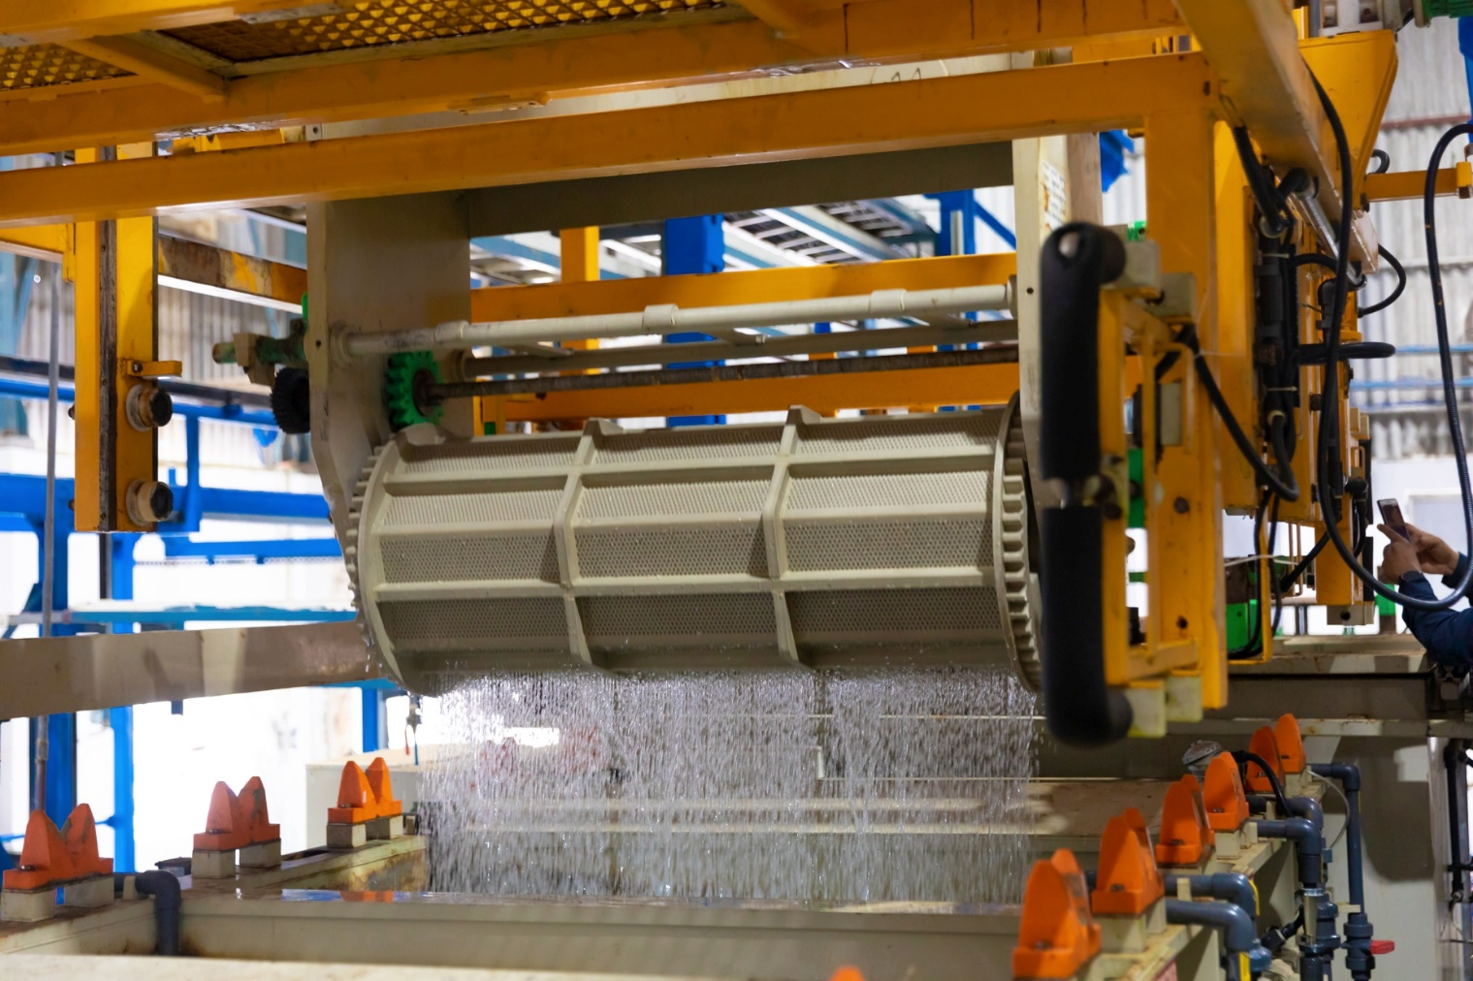
ZINC ELECTRO PLATING UNIT
Completely Automated
Barrel + Rack type
Capacity: 13 MT/day

Slide 11
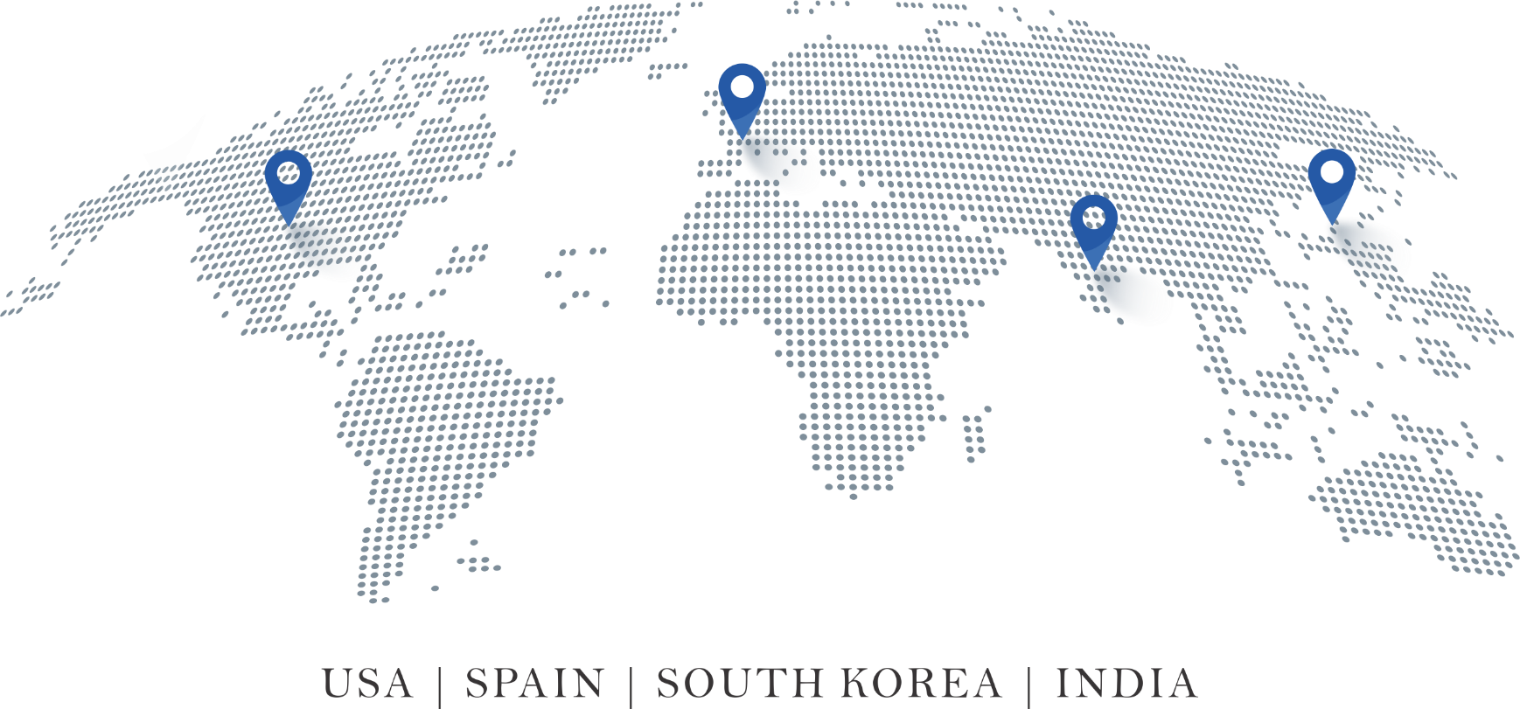

GLOBAL PRESENCE
CANADA | USA | SPAIN | SOUTH KOREA | INDIA

Slide 12
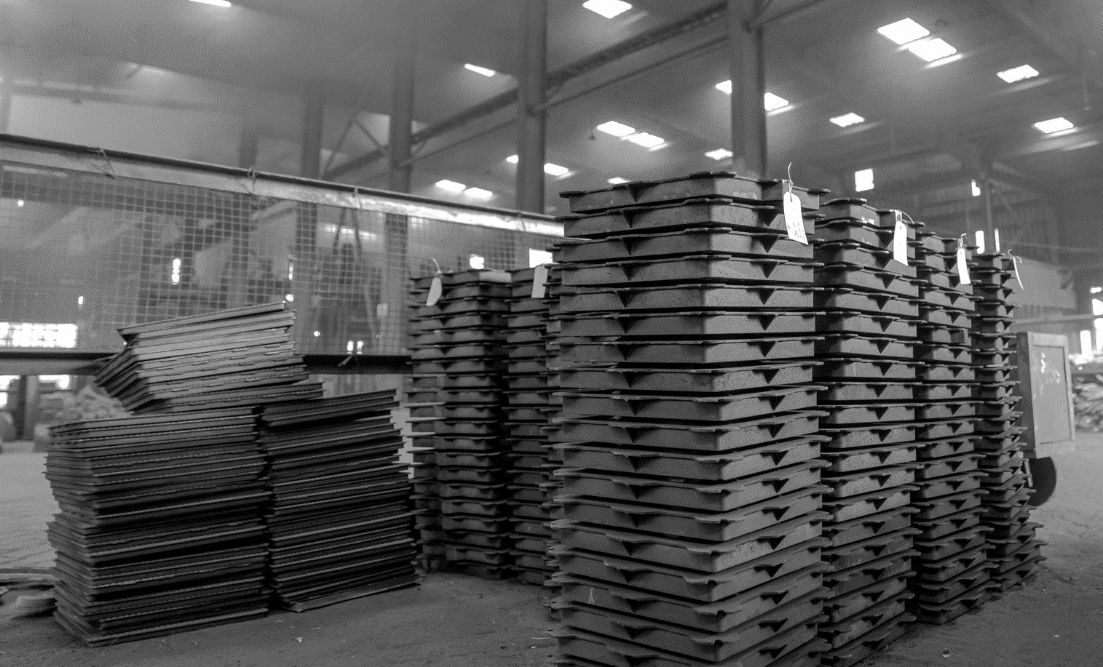
PRODUCT DEVELOPMENT
Custom - build to reality
Quick turnaround time:
6 weeks from tooling confirmation.

Slide 13
WE LOOK FORWARD TO WORKING WITH FAIR AND CONTRIBUTING TO INDIA’S GROWTH STORY
THANK YOU

Slide 14

We look forward to partnering with you
+91 90077 74688
+91 98319 55404
anish@amikmetals.com ankit@amikmetals.com
www.amikmetals.com

