Slide 1
Dutta and Dasgupta
An ISO 9001-2015 partnership FIRM
Manufacturer of precision equipment and process plant assemblies

Slide 2
Profile
Dutta and Dasgupta
Established in 1985
Specialised in
  Press Tools
  Jigs and Fixtures
  Process Plants
  Aerospace Components
  Customised assemblies for VECC

Slide 3
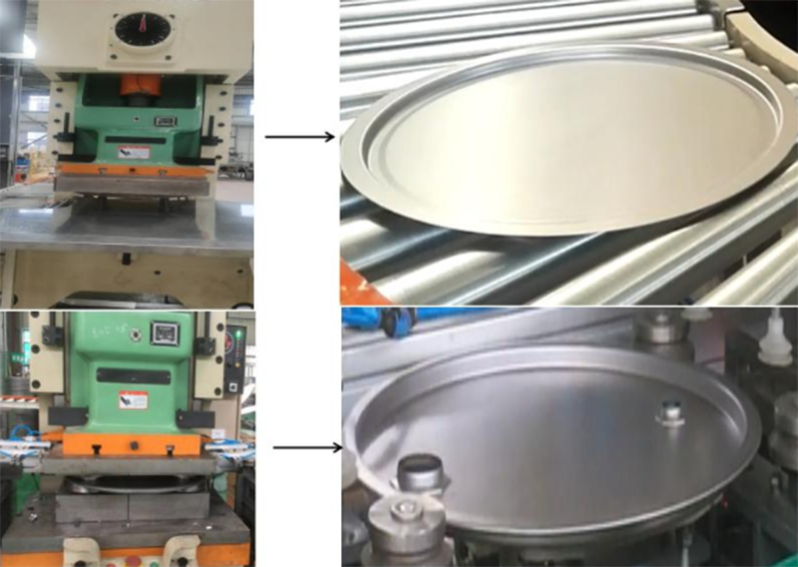
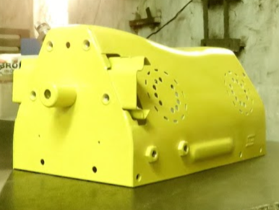
Press Tools
Dutta and Dasgupta
Oil drum cover tool, supplied all over India and abroad
Sheet metal product for ESSAB
Tool
Product

Slide 4
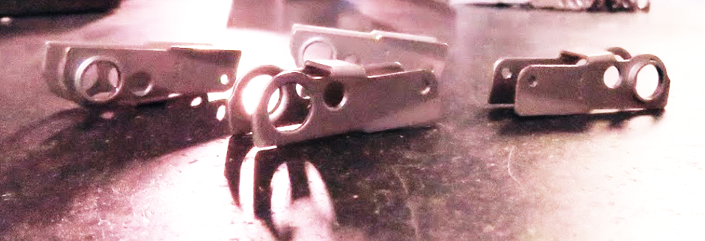
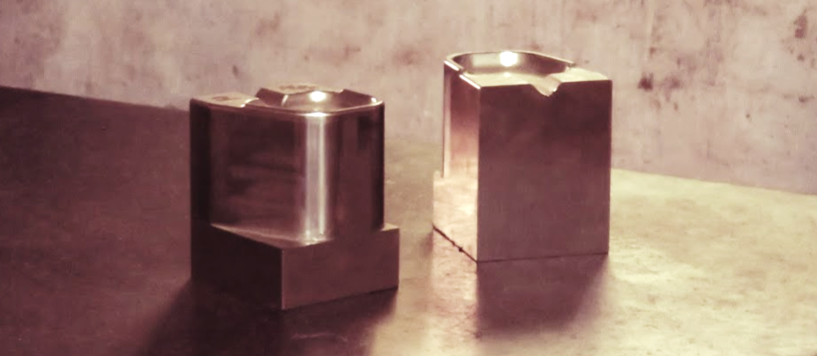
Press Tool
Dutta and Dasgupta
Typical auto component from high-speed tool manufactured by us
Complete tooling done for this Tea Container

Slide 5
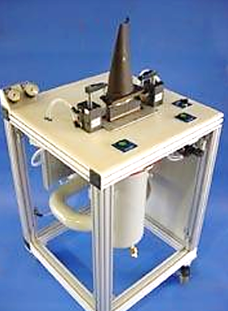
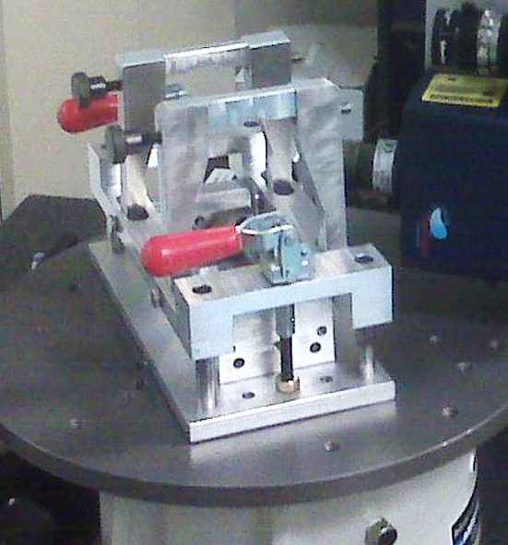
Jiggs and Fixtures
Dutta and Dasgupta
Typical turbine blade manufacturing fixtures supplied to UK

Slide 6
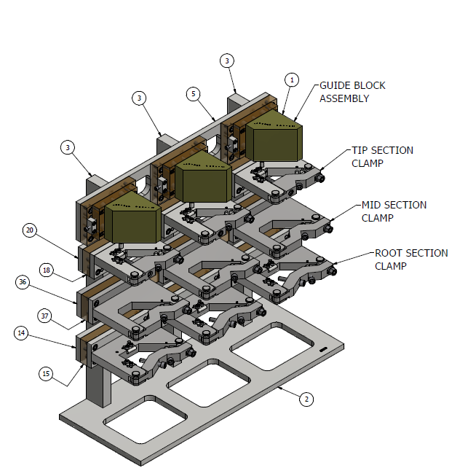
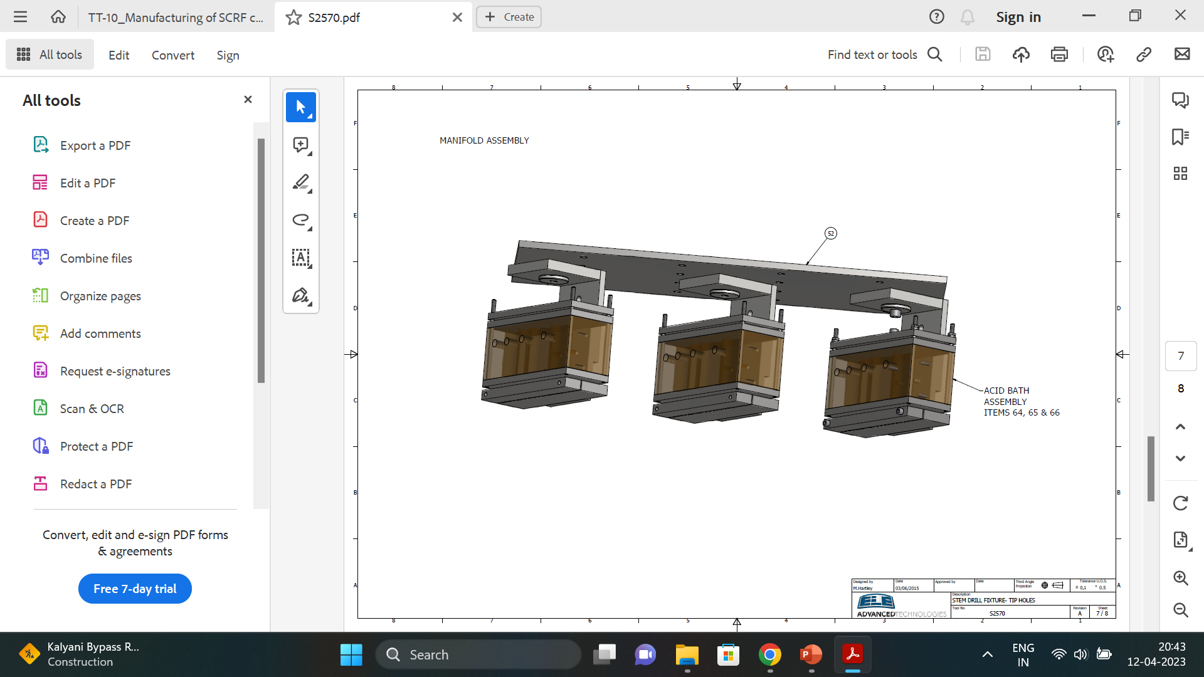
Jiggs and Fixtures
Dutta and Dasgupta
STEM DRILL FIXTURE for cooling whole in steam turbine blades

Slide 7
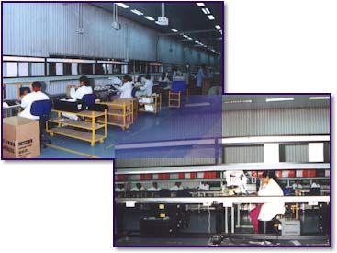
Process Plants
Dutta and Dasgupta
PCB assembly plant for Siemens
Chemical etching plant for electrodes of high voltage vacuum circuit breaker for Alstom
PCB manufacturing plant

Slide 8
Process Plants
Dutta and Dasgupta
Nitrogen Annealing System.
Meant for increasing the magnetic property of the silicon steel Shunt used in Mechanical Energy Meter

Slide 9
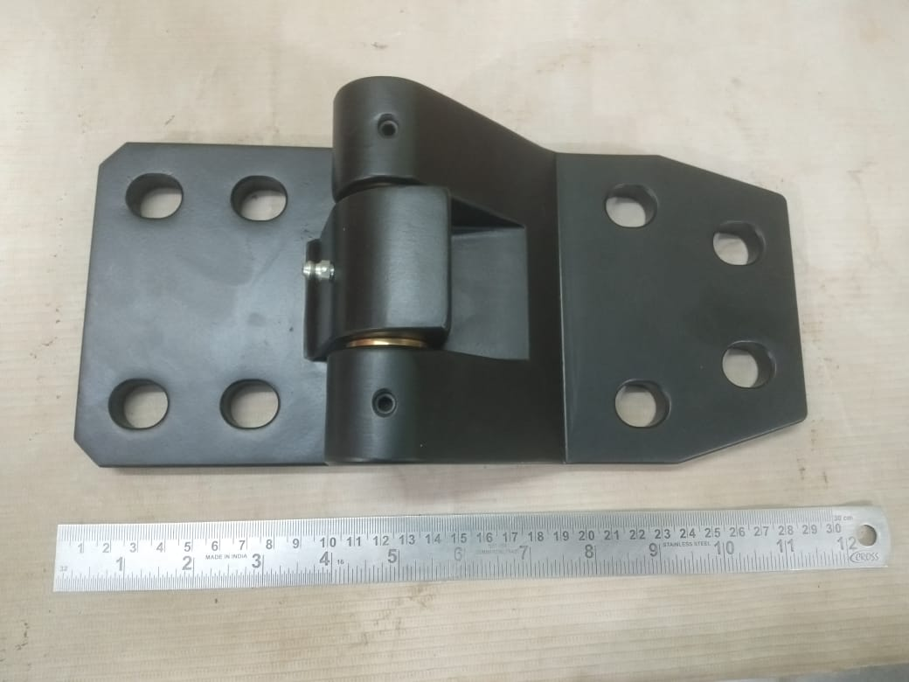
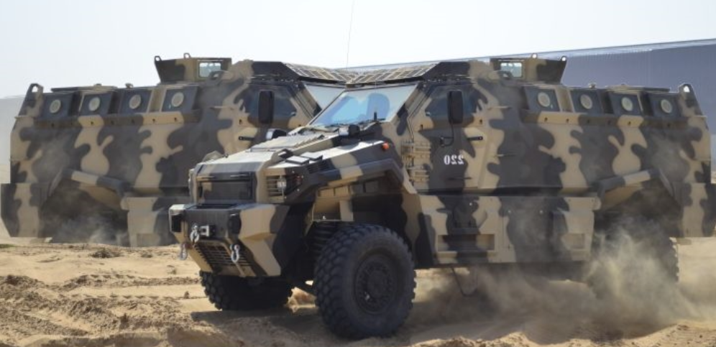
Aerospace Components
Dutta and Dasgupta
Components for Inflation Adapter supplied to UK
Heavy duty Hinges for heavy armoured military vehicles supplied to UAE

Slide 10
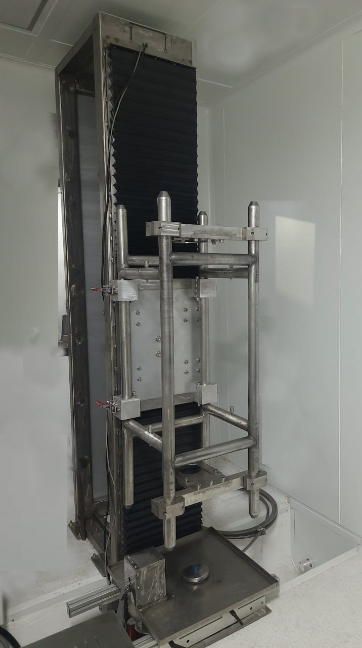
Customised assemblies for Variable Energy Cyclotron Centre
Dutta and Dasgupta
High Pressure Rinsing System for Multicell RF cavity
RF Cavity Component for Inner Conductor Corona Ring Base Assembly of SSC
Inconel Alloy 600 Components for Electrostatic Reflector for K130 Cyclotron

Slide 11
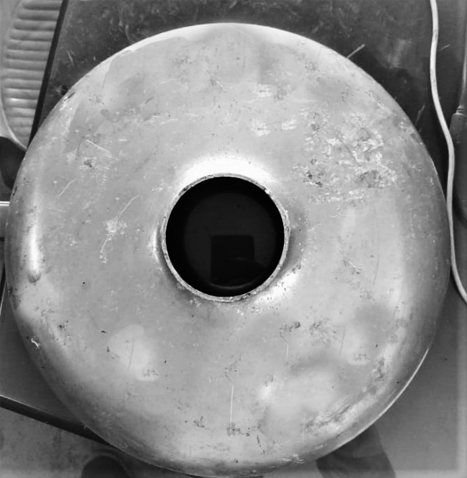
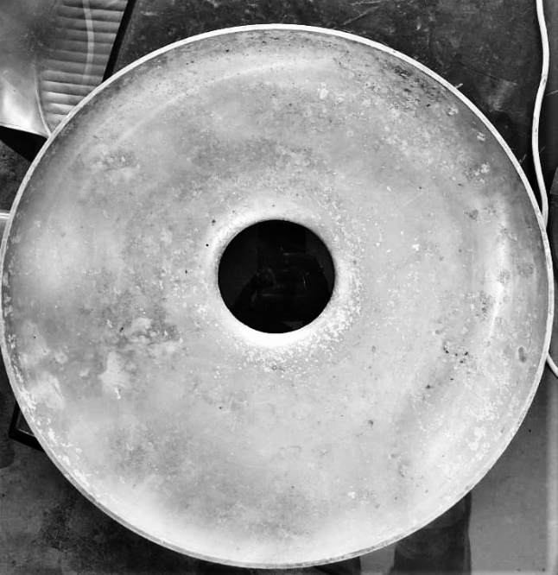
Customised assemblies for Variable Energy Cyclotron Centre
Dutta and Dasgupta
Half Cell for Multicell RF cavity produced with Aluminum/Copper and Niobium

Slide 12
Our Customers
Dutta and Dasgupta
UK – ELE Advanced Technologies ltd.
USA- The Armoured Group, Detroit
Slovakia – For Honeywell Turbo Charger
Hongkong – Bose Lan
UAE – Balmar Lawrie Company, LLC, Streit Security Vehicles

Slide 13
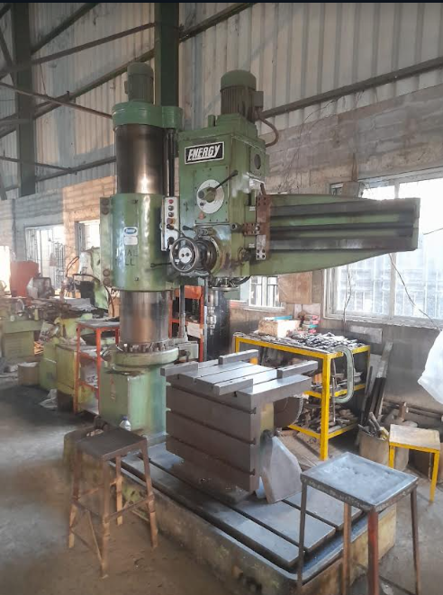
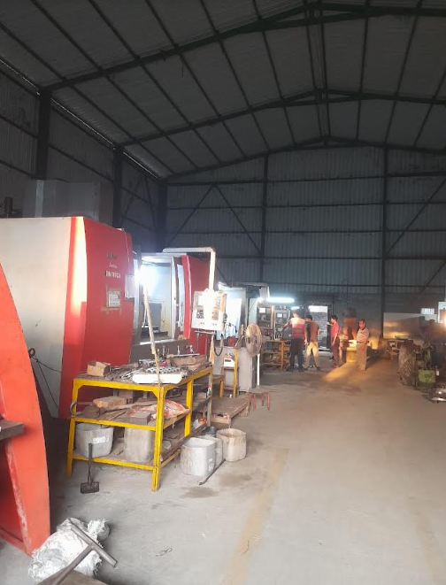
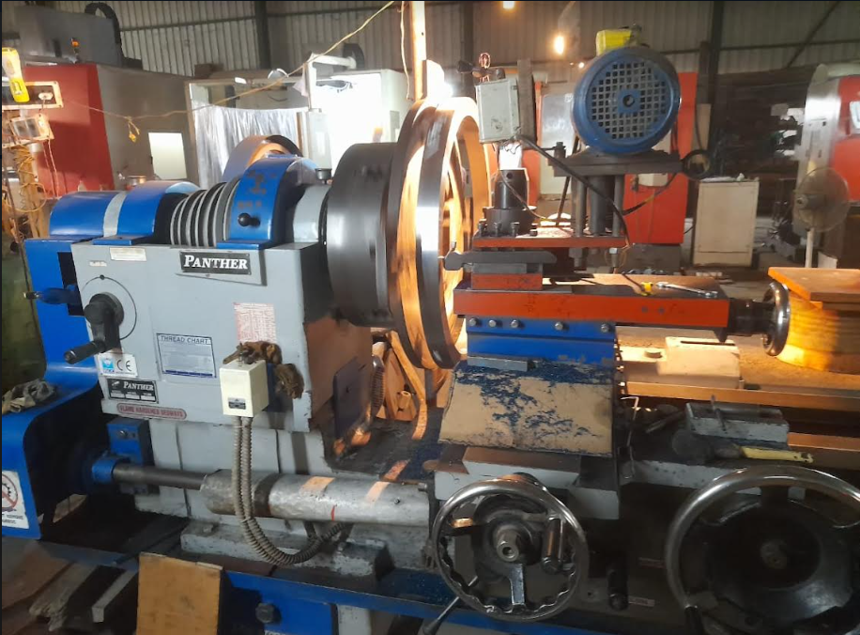
Some of our machineries
Dutta and Dasgupta

Slide 14
Our export networks
Dutta and Dasgupta
UK
USA
Slovakia
Hongkong
UAE

Slide 15
Contact us
Dutta and Dasgupta
107/B/1 Badu Road, Abdalpur, Ramkrishna Pally, Madhyamgram, Kolkata – 700155
Email: duttadasgupta@gmail.com
Mobile:
Mr. A. K. Dutta: 9831041866
Ms. Anwita Dutta Nath: 9432402255
Office: 9875402664

Slide 16
Thank You

