Slide 1
HANS MACHINERIES PVT LTD
PRESENTATION ON INDO-FAIR INDUSTRIAL MEET ON 12.04.2023
Presented By, SAMIK SETT, Managing Director.

Slide 2
ABOUT
HANS MACHINERIES
One of the leading Organizations in the field of Design, Development and Fabrication of various products and equipment catering to BEML, Defence, Atomic Energy & Research, Power plant, Steel Plant, and various other Engineering sectors.
With a total area of 47,526 Sq.Ft. comprising our planning, designing and manufacturing divisions are well equipped with the state of the art technology
An ISO 9001: 2015 certified organization

Slide 3
Organization chart
DIRECTOR
EXECUTIVE DIRECTOR ADVISER/MENTOR
PRODUCTION
(Manager)
DESIGN
& DEVELOPMENT
(Manager)
QUALITY
(Manager)
MARKETING
(Manager)
BUSSINESS
DEVELOPMENT
(Manager)
WORKFORCE– 20Nos
EXECUTIVE– 05Nos
EXECUTIVE – 03Nos
EXECUTIVE – 02Nos
ENGINEER – 02Nos

Slide 4
Own in house Design and Manufacturing Facilities

Slide 5
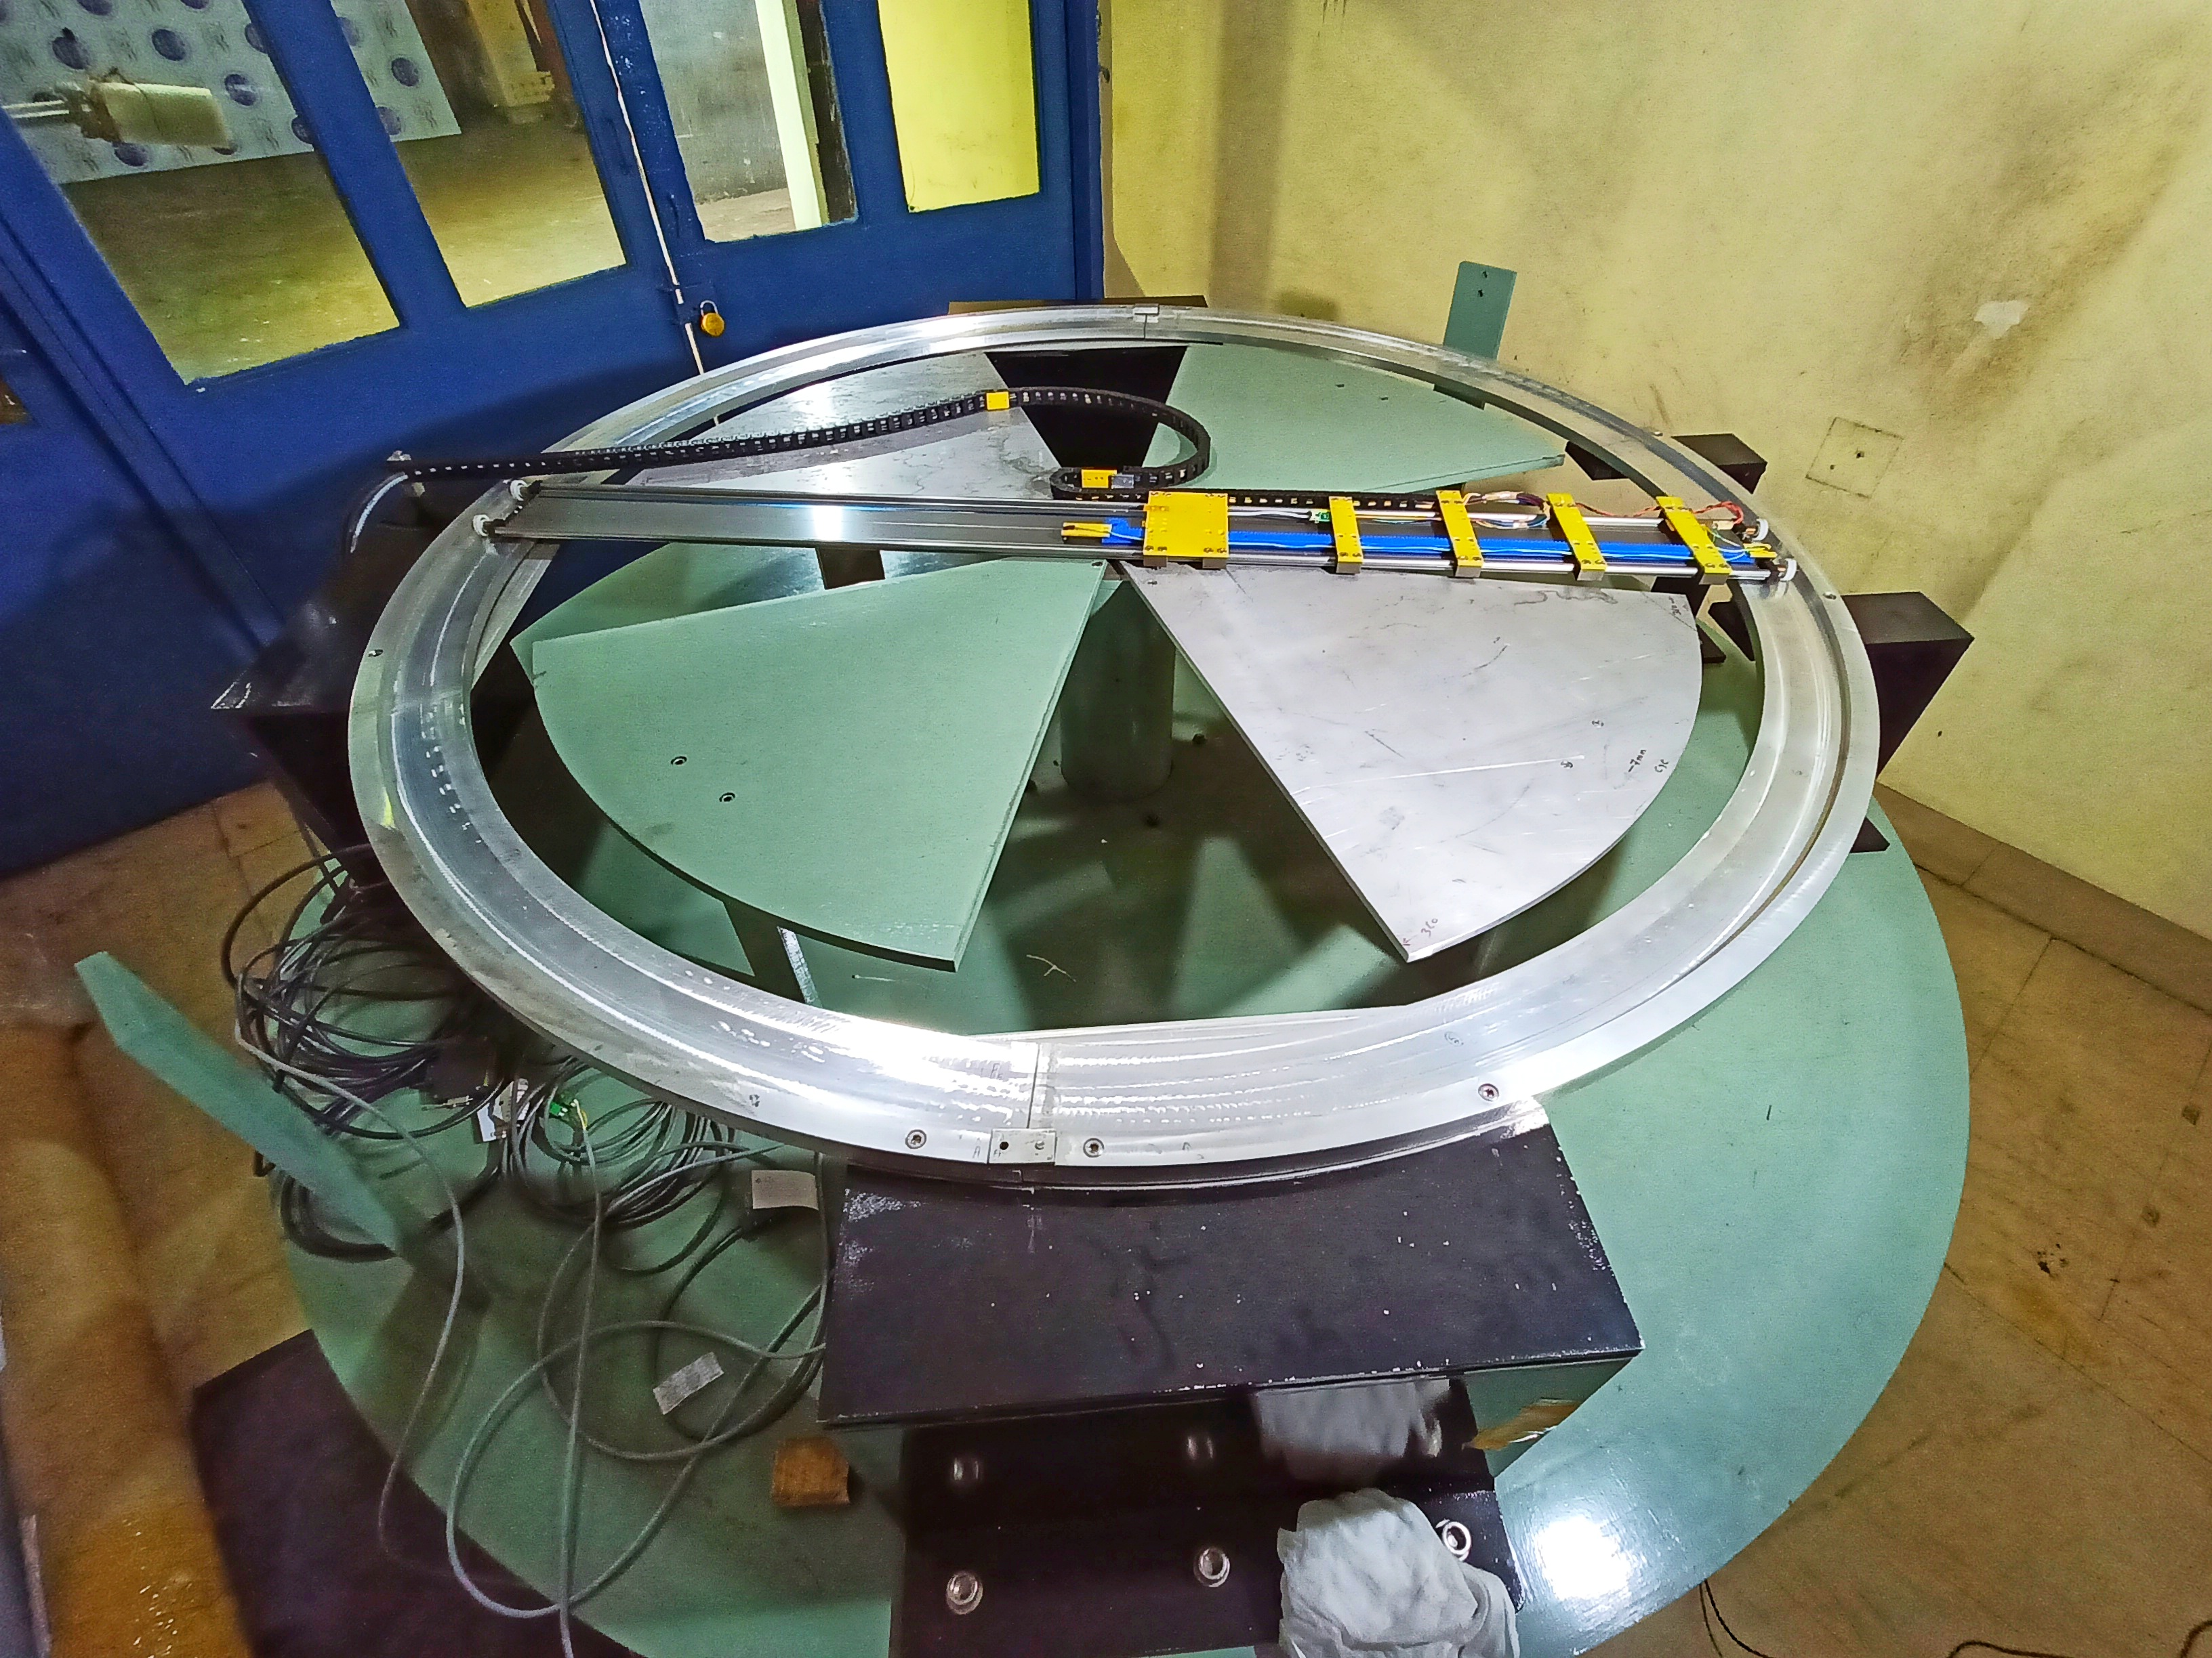
prestigious PROJECTS
VERIABLE ENERGY CYCLOTRON CENTRE
MAPPING DEVICE FOR MEDICAL CYCLOTRON
DIPOLE MAGNET

Slide 6
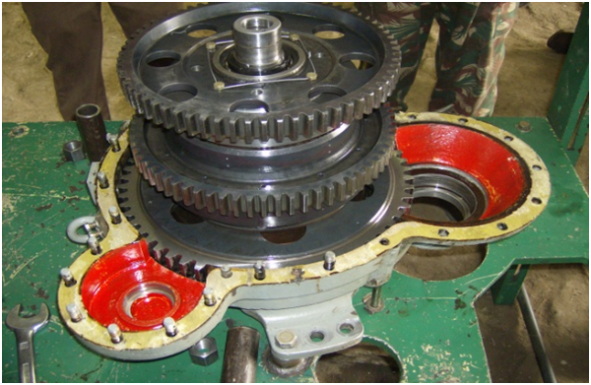
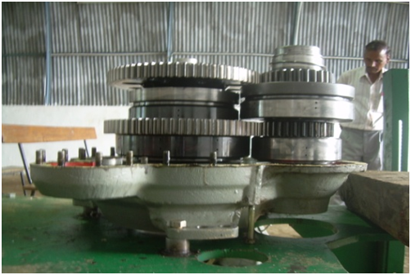
Defence Equipment
WINCHING SYSTEM FOR ARMOURED RECOVERY VEHICLE

Slide 7
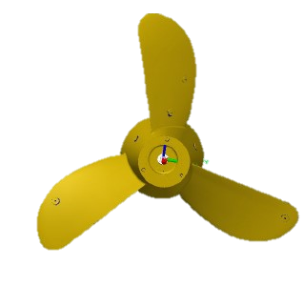
PRESTIGIOUS PROJECTS
DEFENCE RESEARCH ORGANISATION:
Hot Water Generator for Missile Fuelling System
Propeller for AUV ( underwater Drone)
Lifting Beams for handling of Heavy Missile
Assembly Fixture for Heavy Missile

Slide 8
PRESTIGIOUS PROJECTS
MANUFACTURING OF HEAVY DIE & PUNCH TOOLS FOR NUCLEAR BIOLOGICAL SHELTER SEGMENTS
VARIOUS RESEARCH EQUIPMENTS / DIES FOR INSPECTING PROPERTIES OF SHEET METAL FOR “INDIAN INSTITUTE OF TECHNOLOGY , KGP”
AUTOMATION OF FURNACE AT INDRA GANDHI CENTER OF ATOMIC RESEARCH (IGCAR)
INDIGINIZATION OF STEEL PLANE EQUIPMENT AUTO COUPLER

Slide 9
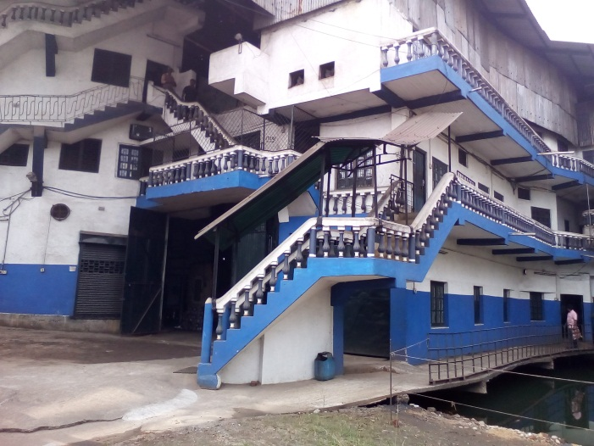
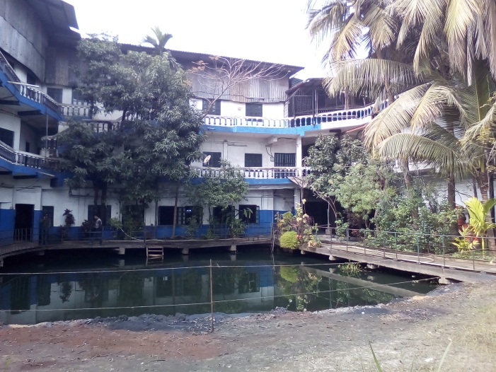
Factory Overview

Slide 10
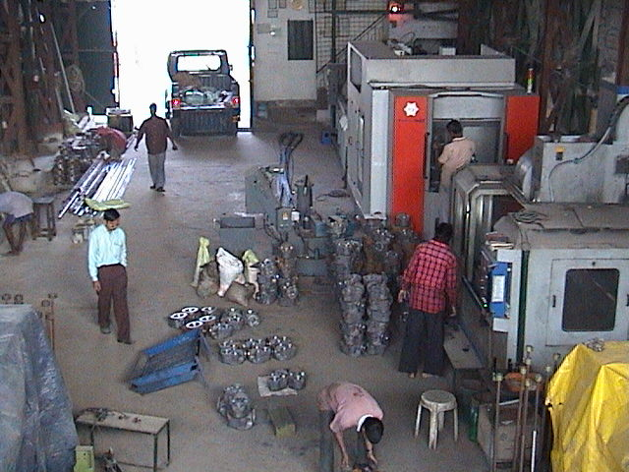
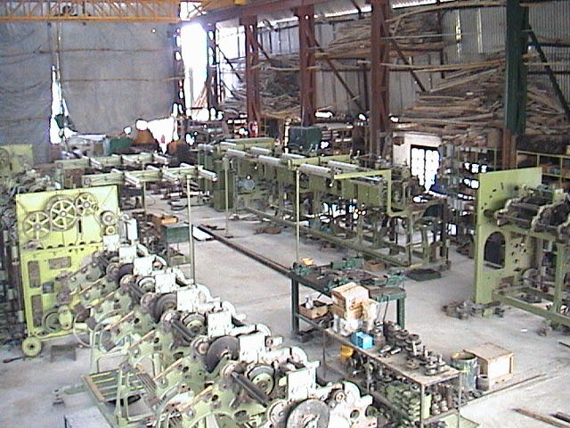
Workshops
MACHINE SHOP
ASSEMBLY SHOP

Slide 11
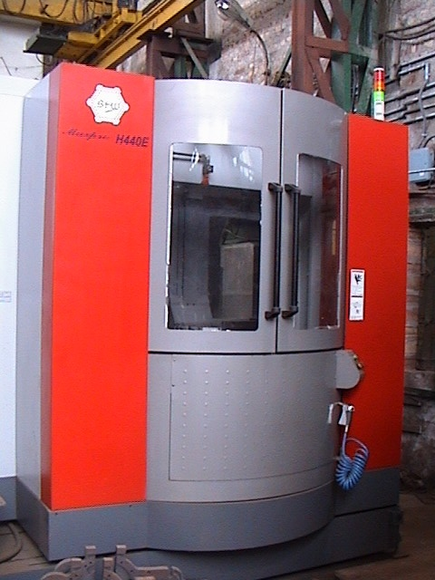
HMC Machine
MAKE – BFW
Table – 400x400mm
X-axis – 560mm
Y-axis – 560mm
Z-axis – 530mm

Slide 12
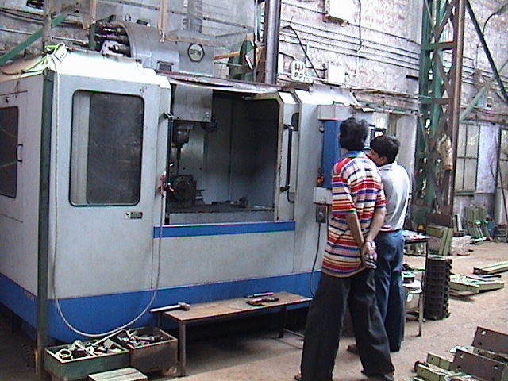
VMC Machine
MAKE – BFW
Table – 510x1200 mm
X-axis – 1020mm
Y-axis – 510mm
Z-axis – 600mm

Slide 13
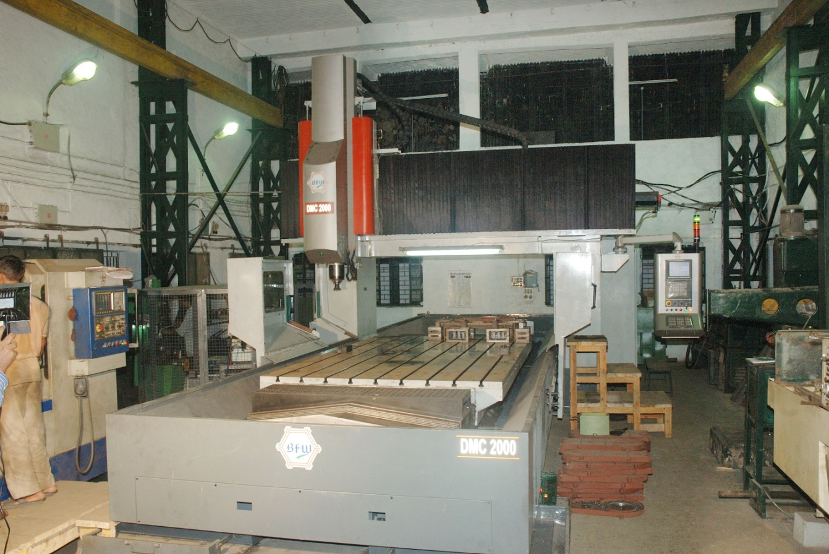
Machine DMC-2000
MAKE – BFW
Table – 2000x3500 mm
X-axis – 3700mm
Y-axis – 2800mm
Z-axis – 750mm

Slide 14
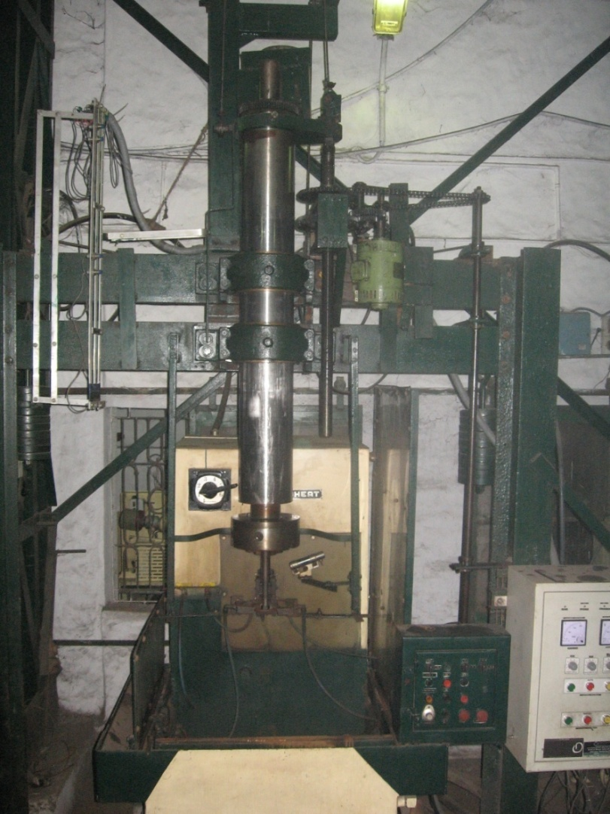
Machine Induction Hardening
Freq - 30 kHz.
Power - 50 Kw.
Max coil - ɸ125 mm
Max job len. - 1.5m

Slide 15
List of Machineries
C.N.C. VERTICAL MACHINING CENTRE – 1 NO. (3700MM X 2200MM X 1000MM).
C.N.C. VERTICAL MACHINING CENTRE – 1 NO. (1020MM X 510MM X 600MM).
C.N.C. VERTICAL MACHINING CENTRE – 1 NO. (800MM X 550MM X 500MM).
C.N.C. HORIZONTAL MACHINING CENTRE – 1 NO. (530MM X 530MM X 560MM).
C.N.C. TURNING CENTRE – 1 NO.
(600MM X Ø 250MM).
C.N.C. VERTICAL TURNING CENTRE – 1 NO.
(Ø 1250MM X 380MM) .
Cont…

Slide 16
INDUCTION HARDENING MACHINE – 1 NO. (50KW, 30KHZ BOTH STATIC & SCAN HARDENING).
ROTARY SURFACE GRINDING MACHINE – 1 NO. (Ø 630MM)
SURFACE GRINDING MACHINE – 1 NO. (350MM X 150MM)
BAND SAW MACHINE – 1 NO. (4100 X 34 X 1.1MM)
PNEWMATIC TAPPING MACHINE – 1 NO. (CAPACITY M3–M27).
UNIVERSAL GEAR HOBBING MACHINE – 2 NOS.
(24” DIA.) .
UNIVERSAL MILLING MACHINE – 1 NO.

Slide 17
Manpower Details

Slide 18
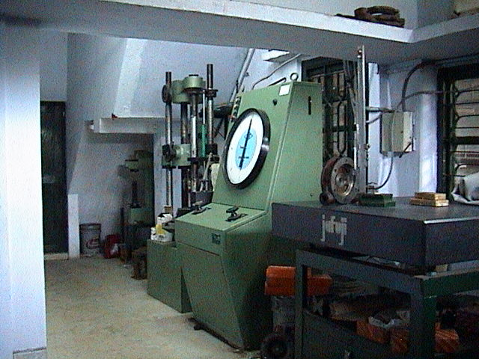
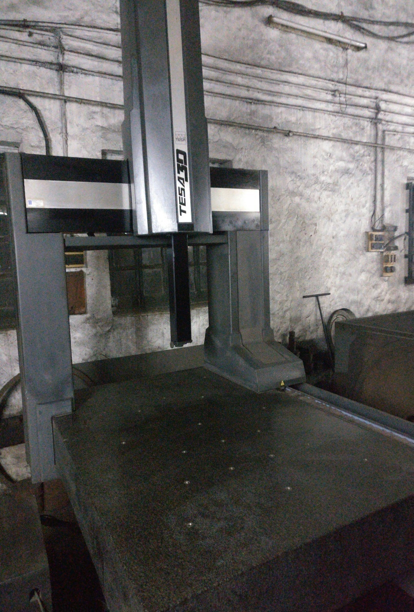
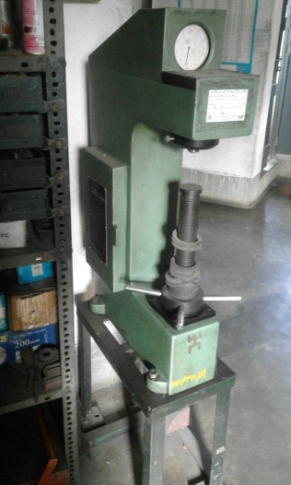
Quality Lab
UNIVERSAL TESTING MACHINE
COORDINATE MEASURING MACHINE
ROCKWELL HARDNESS TESTER

Slide 19
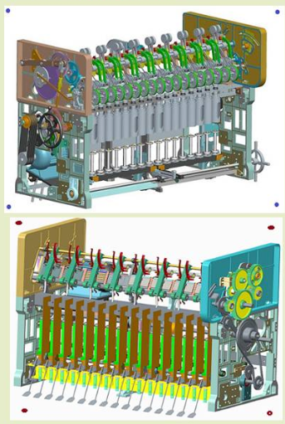
Design Facility
Design Software
AutoCAD for 2D & 3D Modeling
CREO parametric for 3D Modeling and Analysis
Indigenous 3D model for ring spinning machine for jute textile

Slide 20
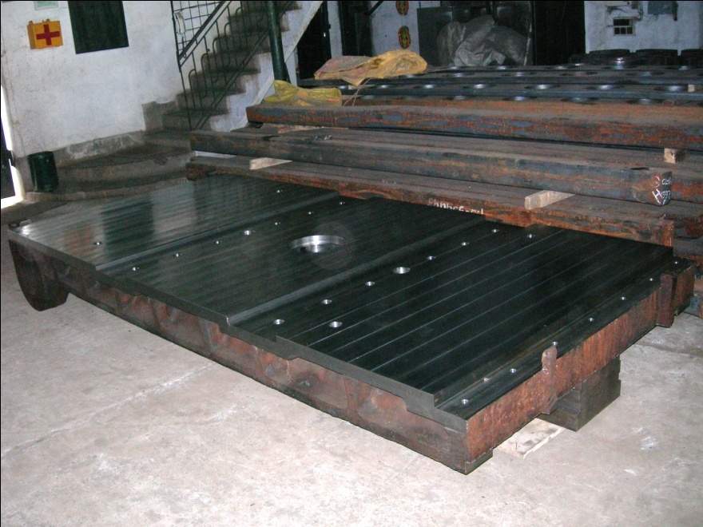
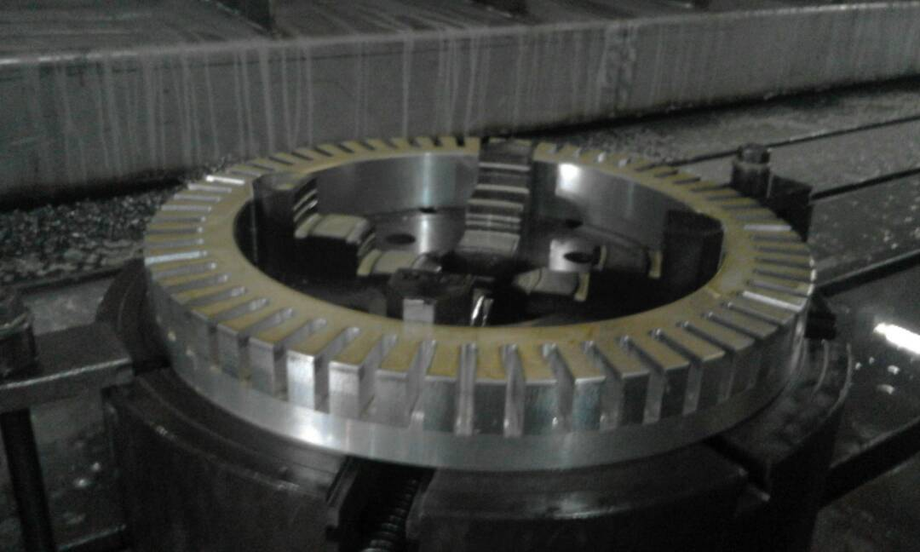
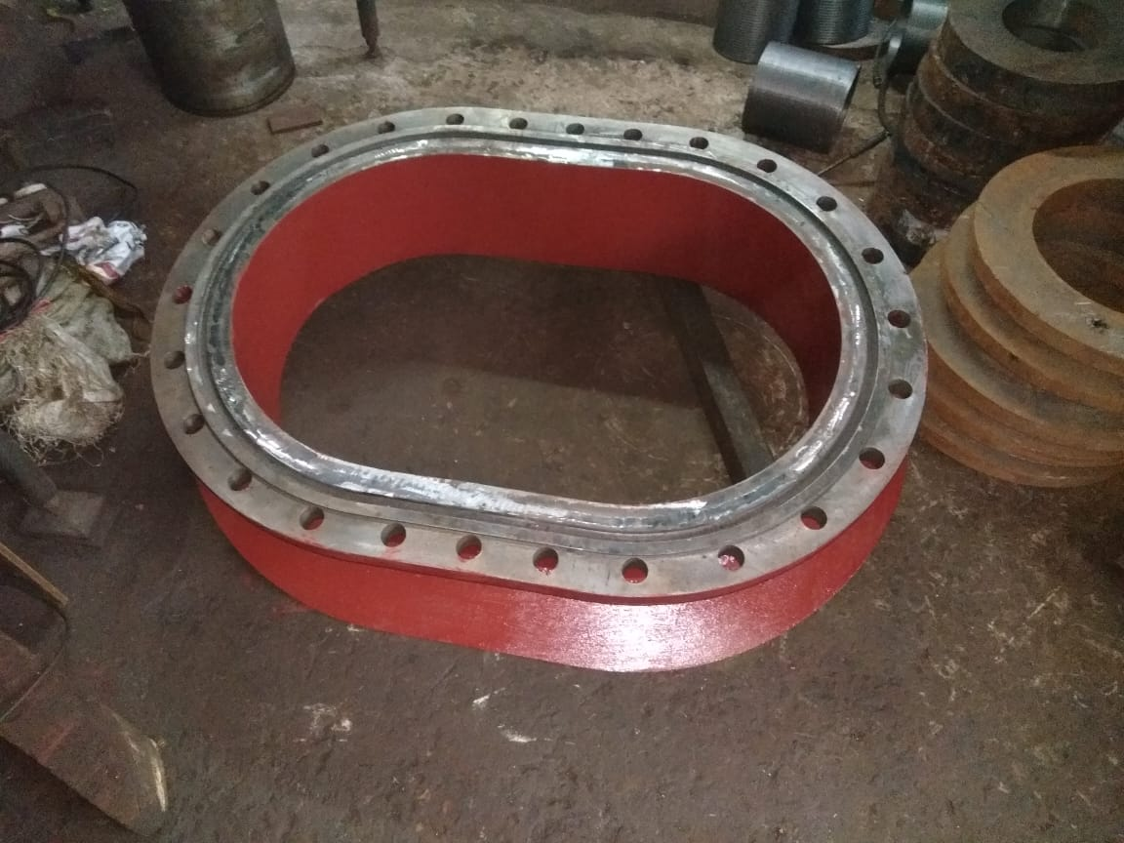
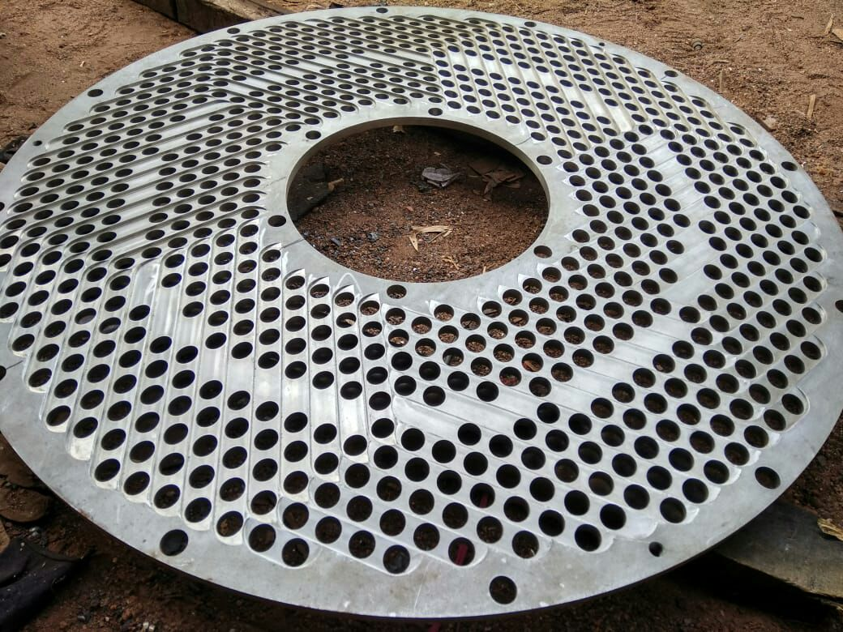
PRODUCTS
(Heavy Engineering)

Slide 21
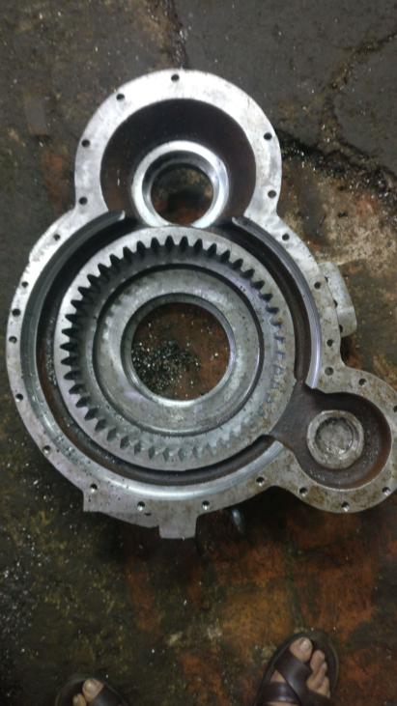
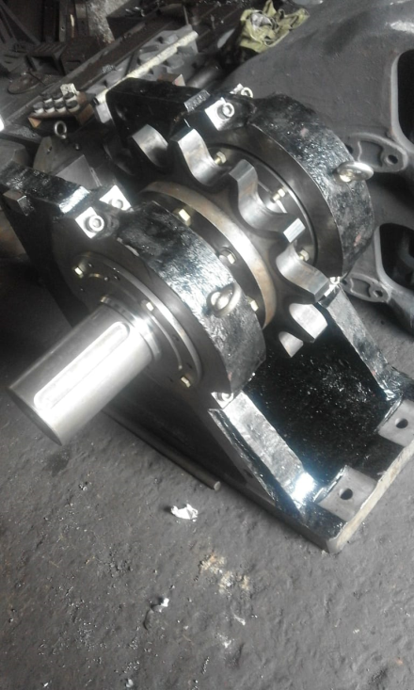
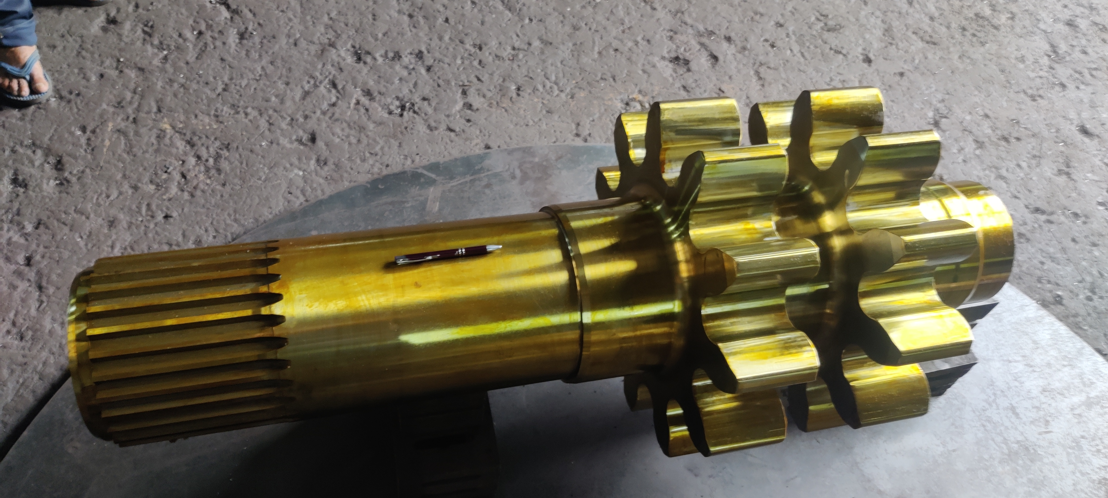
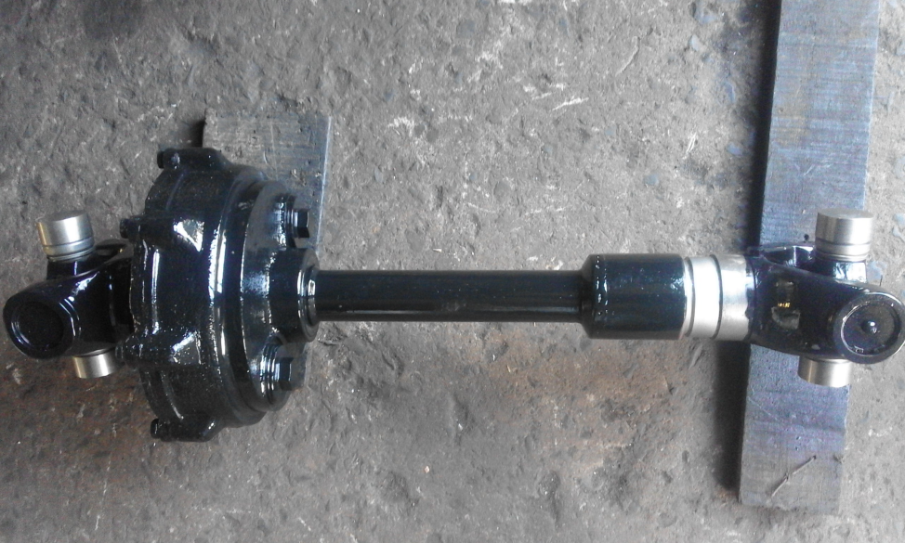
POWER TRANSMISSION ENGINEERING
Gear Box
Winch Reducer
Propeller Shaft

Slide 22
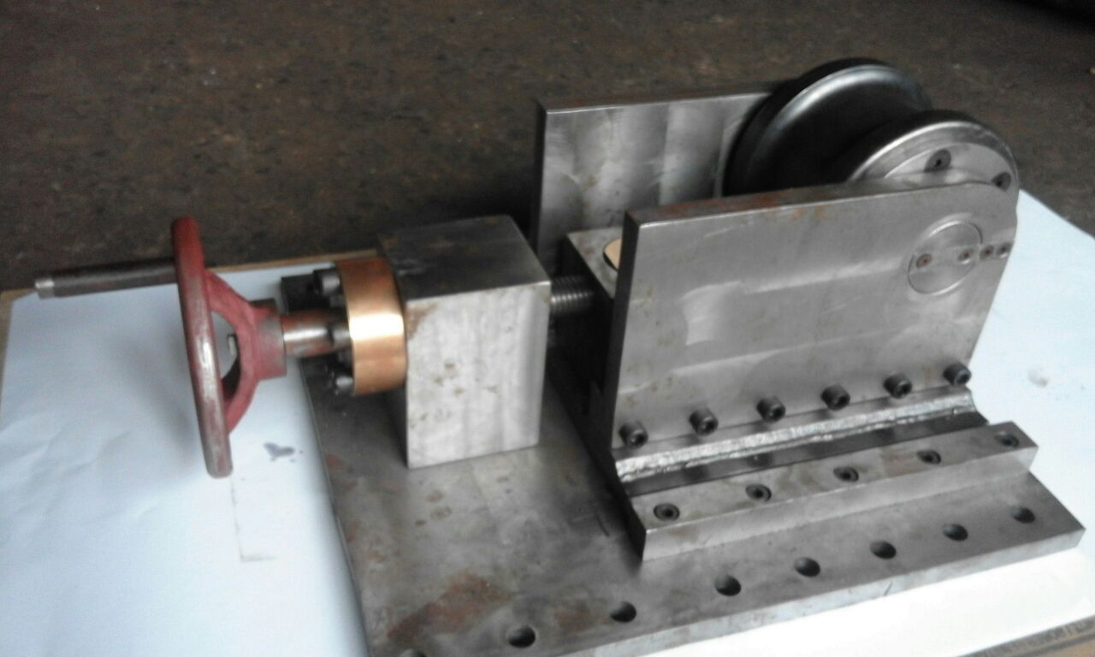
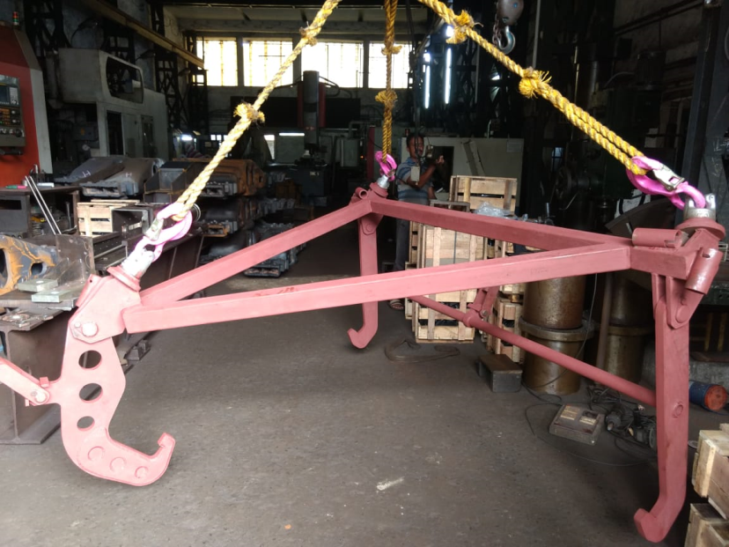
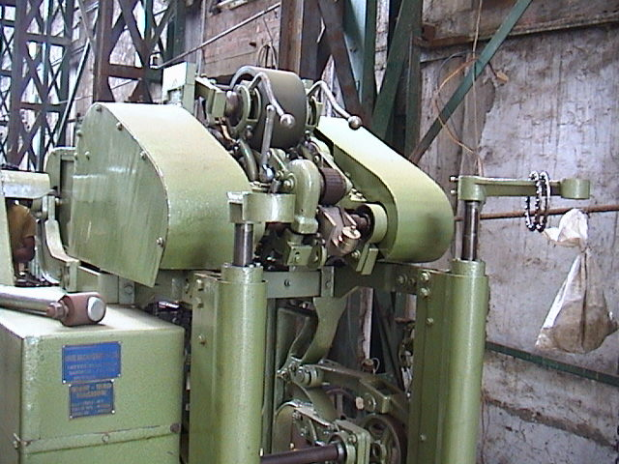
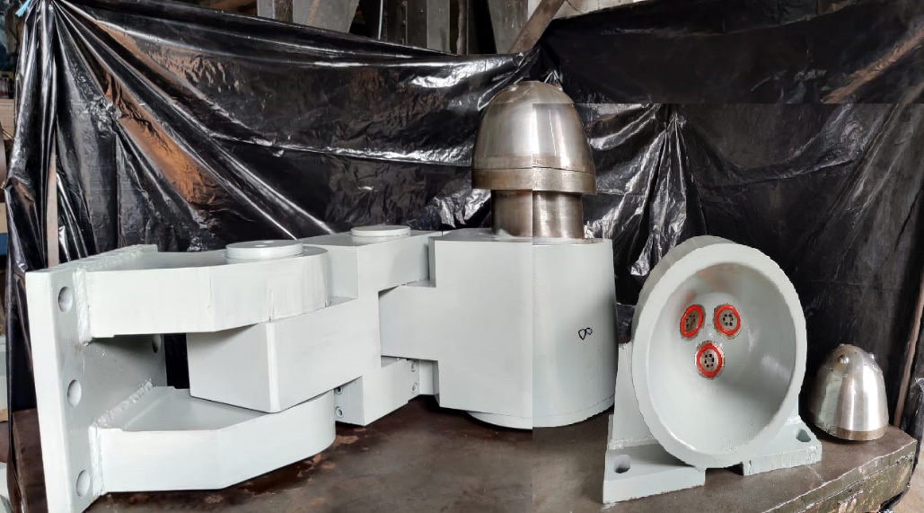
CUSTOMISED EQUIPMENTS

Slide 23
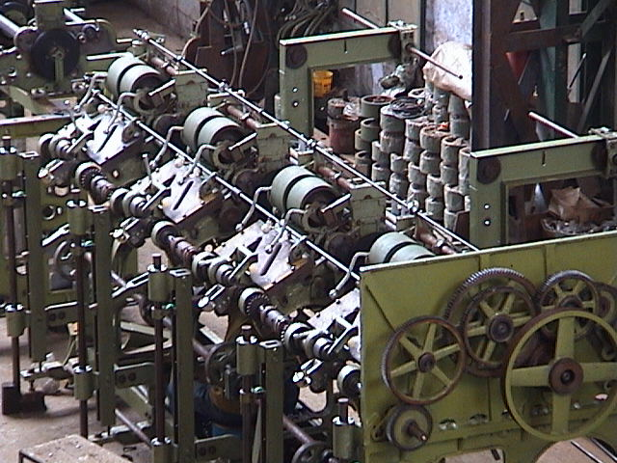
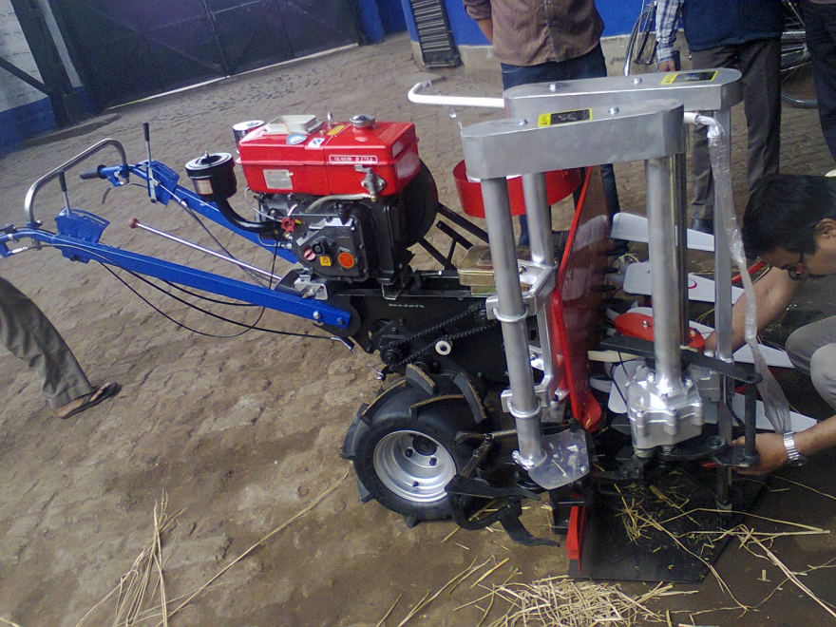
INDIGENEOUS ENGINEERING
The Rotary Faller Gill Drawing Machine was design & developed in the year 1998 and since then the company has sold about 300 machines.
RICE REAPER
Design and Developed by Hans Machineries

Slide 24
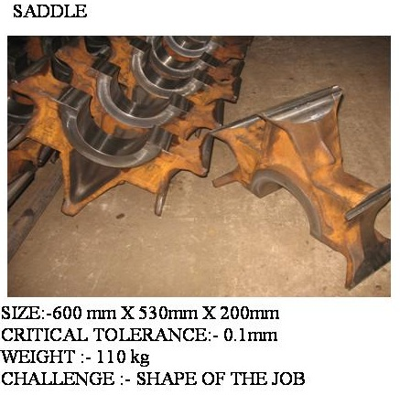
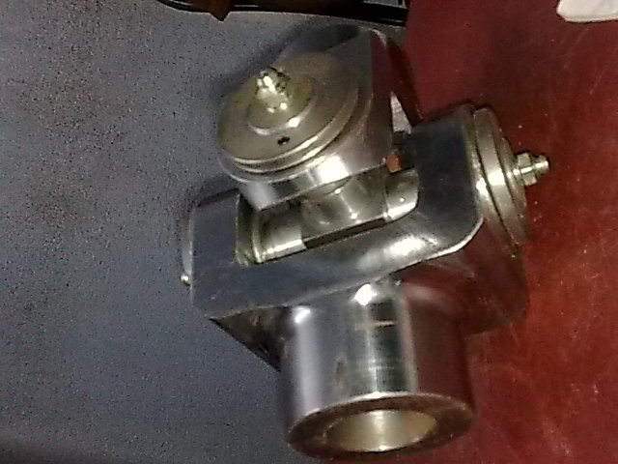
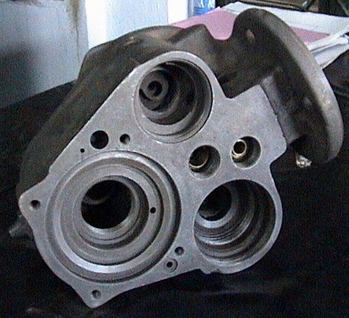
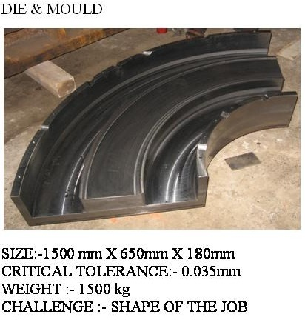
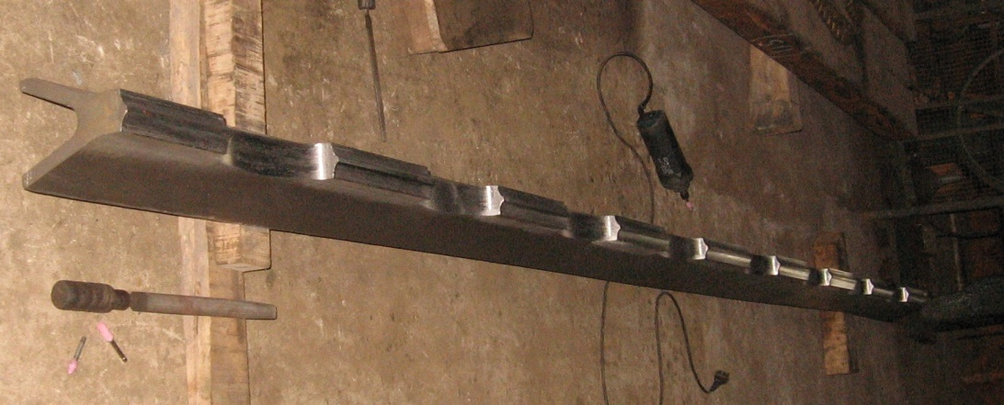
PRECISION ENGINEERING

Slide 25
Major Clients

Slide 26
HANS MACHINERIES PVT LTD
Thank you
To Reach us:
www.hansmachineries.com
samiksett@hanspl.com
Phone : +91-033-2679 2105
Mobile : +91-9432357682
Satyen Bose Road, Banipur Howrah-711304 West Bengal, India Phone : +91-033-2679 2105 Mobile : +91-9432357682

