Slide 1



Index
Company Profile
Main Infrastructure and Capabilities
  Manufacturing Capabilities
  Quality Assurance Capabilities
  Design Capabilities
Major Projects Executed
Major EPC Projects Executed
Kay Bouvet Engineering Ltd.
| 2
Kay Bouvet Engineering Ltd.

Slide 2
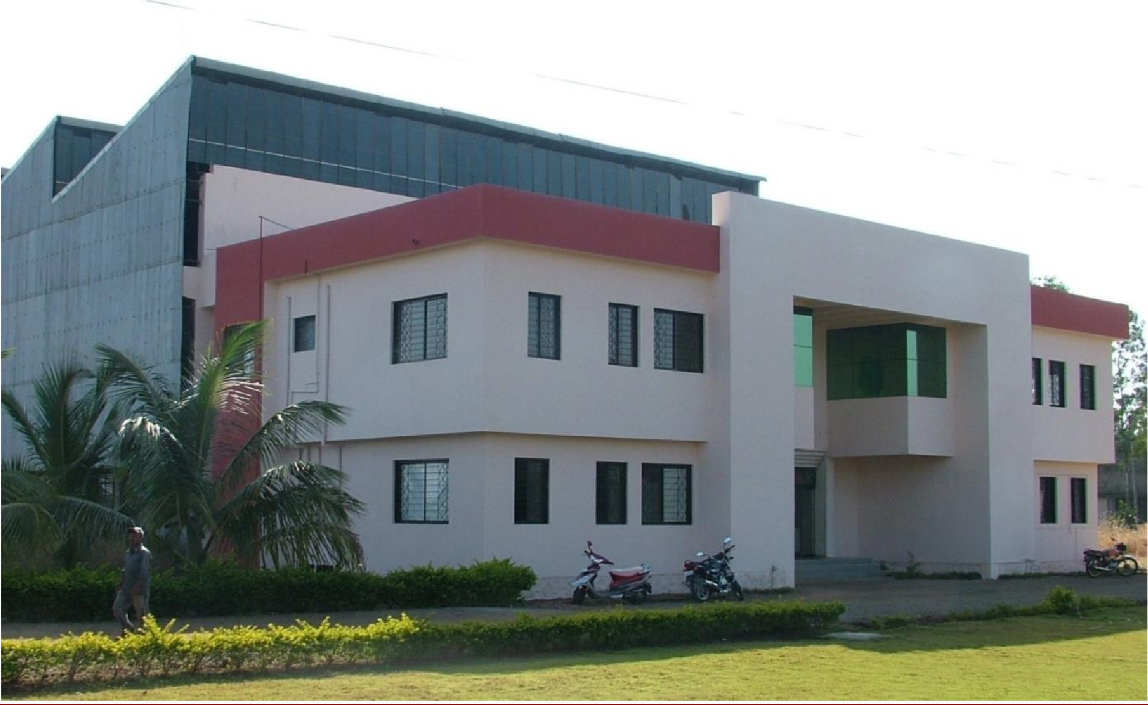

Company profile
Kay Bouvet Engineering Ltd.

Slide 3






More than 40 years of experience in heavy machinery manufacturing
1975
First manufacturing facility in Satara (Maharashtra)
Total workforce: 20 employees
1995
Accredited by National Co-operative Development Corporation (NCDC) for execution of Sugar Plants on an EPC basis
1999
Established the Special Products Division for Department of Atomic Energy jobs
2012
Established collaboration with the Defence Research and Development Organisation (DRDO)
2014
Started serving the Indian Space Research Organisation (ISRO)
2016
Accredited by the Nuclear Corporation of India Limited (NPCIL) as an
EPC supplier to its nuclear programme and receipt of first EPC order
Today
5 offices: Satara, Pune, Chennai, Delhi, Yamuna Nagar
3 Manufacturing facilities in Satara and Yamuna Nagar
Total workforce: over 800 employees
| 3

Slide 4
Kay Bouvet is divided into two divisions, focusing on large scale nuclear, space and defence projects
Special Products Division
Nuclear division – collaboration with the Department of Atomic Energy
Space division – collaboration with the Indian Space Research Organization (ISRO)
Defence division– collaboration with the Defence Research & Development Organization (DRDO)
General Heavy Engineering – collaborations with Danieli, Shapoorji Pallonji, SMS Group & ESSAR Steel, amongst others
Sugar Division
Turnkey Sugar plant projects development
Sugar Machinery & EPC Expansion Projects
Co-Generation power plants & Ethanol distillery plants
| 4

Slide 5
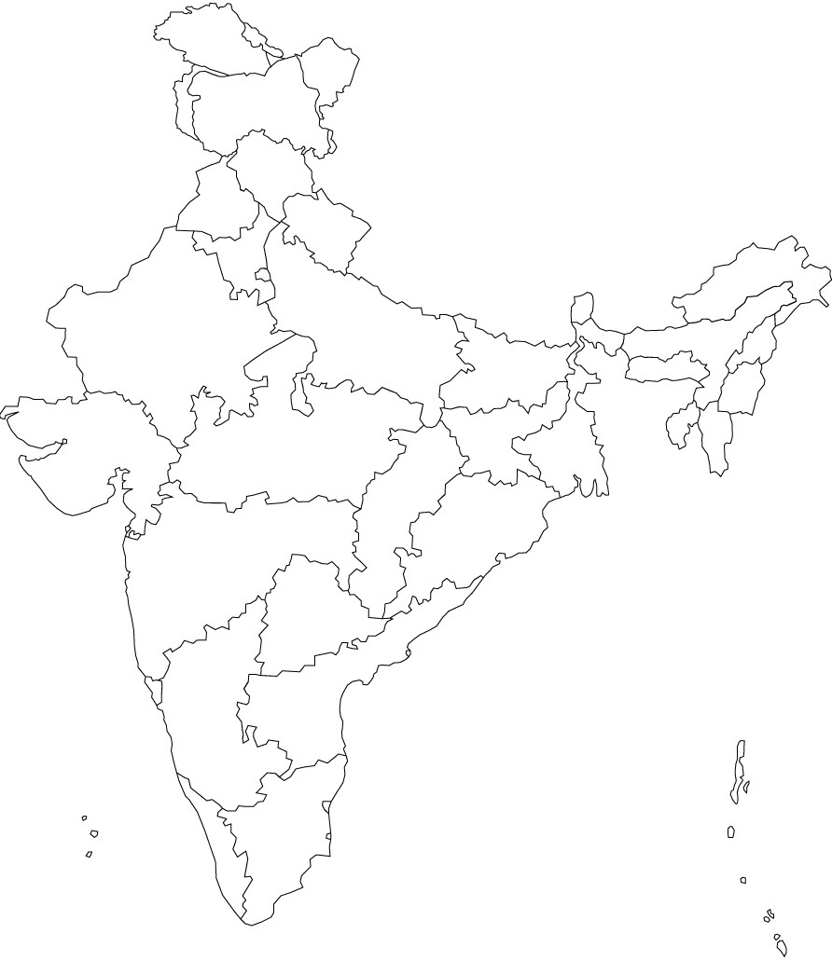






Our office network covers the main business hubs in India
Yamuna Nagar
Branch Office – Marketing, Design &
Production
Manufacturing Unit II
Delhi
Branch Office – Marketing
Pune
Branch Office – Marketing & Design
Satara
Main Office – Headquarters
Manufacturing Units I & III
Chennai
Branch Office – Marketing
| 5

Slide 6



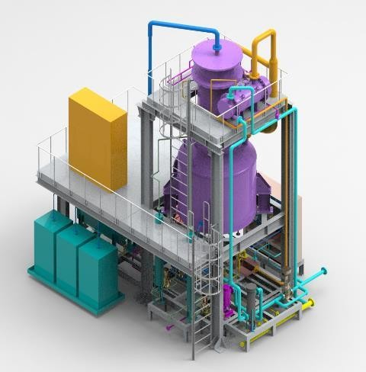
Kay Bouvet Engineering qualifications
Quality ISO 9001: 2015 certified company AS 9100 C (aerospace manufacturing) ASME U & R Stamp Scale Material handling capacity of up to 200 Tons More than 800 employees EPC contract for waste management package for RAPP 7&8 Innovation Design and analysis carried out for numerous projects Ammonium perchlorate fuel processing facilities Test rig for SAARJA launcher system Loading and handling system for submarine Brine Concentrator Desalination Prototype | AS 9100C U & R Stamp
| 6

Slide 7
ASME U Stamp
ISO 9001 2015

Slide 8
EIL Registration

Slide 9
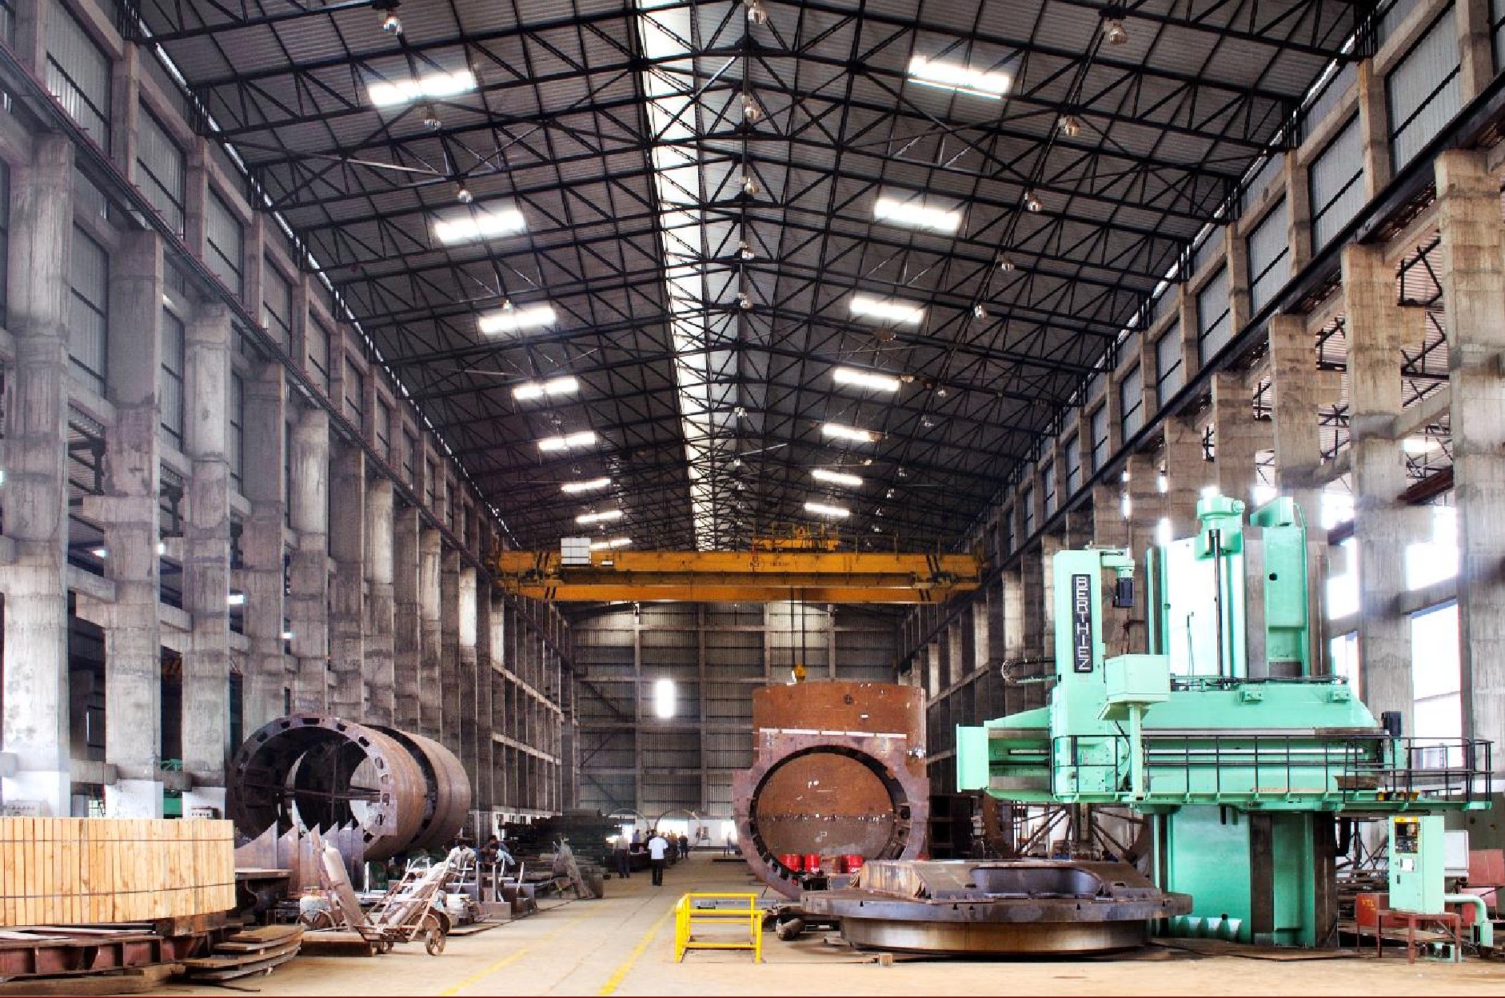
Main Infrastructure and Capabilities
Kay Bouvet Engineering Ltd.

Slide 10

Manufacturing Capabilities
Kay Bouvet Engineering Ltd.

Slide 11
Kay Bouvet has the necessary capabilities to manufacture equipment of any scale for the steel industry
Main Machinery Qualifications
Quality
ISO 9001: 2008 certified company
AS 9100 C (aerospace manufacturing)
ASME U & R Stamp
Precision
Nuclear Calandria qualification – 1 of only 4 companies in India to be able to manufacture the most critical component in a Nuclear Plant
Scale
Currently manufacturing all machinery for 8400 TCD Sugar Plant turnkey project
Over 200 Tons single piece handling capacity
Timely delivery
Team of experienced engineers in the manufacturing of heavy equipment
Advanced welding capabilities coupled with thorough reporting to minimize repairs
Process | Maximum Dimension | Maximum Weight
CNC VTL | Table Swing -10400 mm Max Height -3500 mm | 90 Tons
CNC Horizontal Boring Machine (BFT 180) | X-34000 mm Y-4000 mm Z-1800 mm | 200 Tons
CNC Horizontal Boring Machine (FB 180) | X-13000 mm Y-6000 mm Z- 1850 mm | 200 Tons
VMC (B02DSL) | X- 1250 mm Y- 630 mm Z- 700 mm | 4.5 Tons
CNC Lathe (SR 2000) | Center Dist – 6000 mm Swing Over Bed- 2000mm | 70 Tons
Plate Bending with DRO | Width-2500 mm | ---
Cutting (Stainless Steel) | 5000 mm x 2000 mm | ---
CNC Cutting | 15000 mm x 2500 mm | ---
Heat Treatment Furnace | 13 m x 8.5 m X 7.5 m | 150 Tons
Hydraulic Press with Manipulators | Dia-5500 mm | 1000 Tons

Slide 12
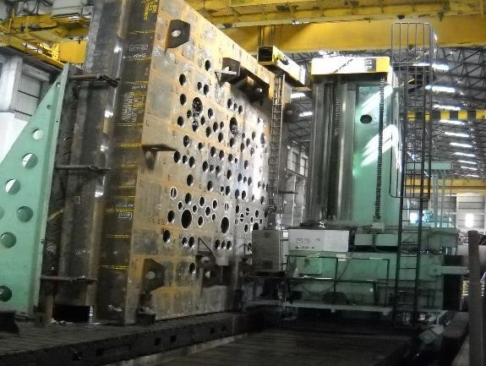
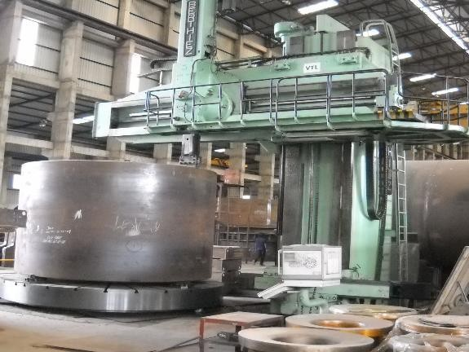
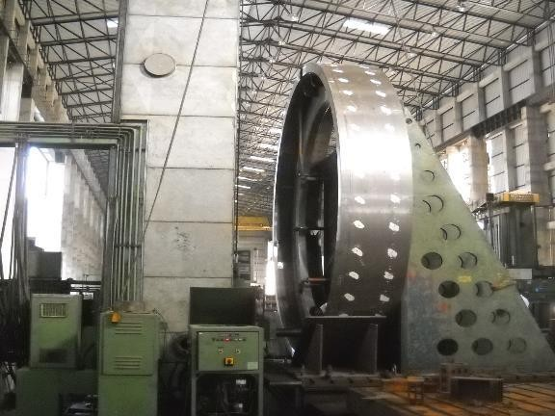
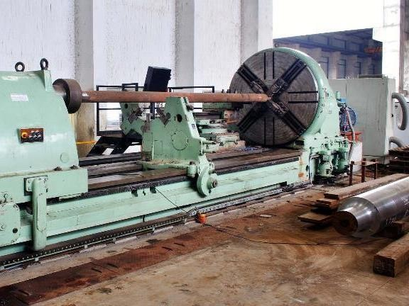
Examples of machining work in our workshop
Machining of Top Hatch Beam on CNC HBM
Machining of D₂O Storage Tank on
CNC VTL
Machining of Annular Ring on Froriep CNC HBM
CNC Lathe (Skoda)

Slide 13
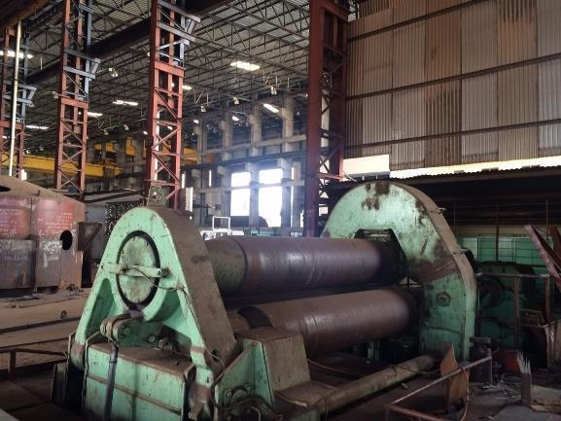
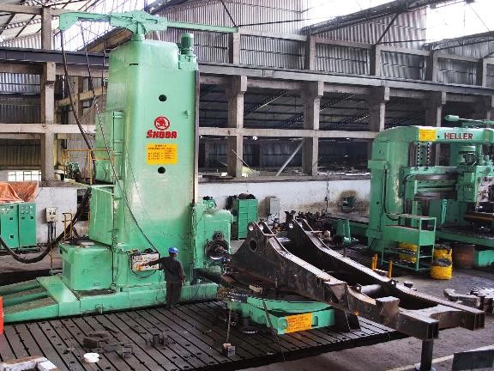
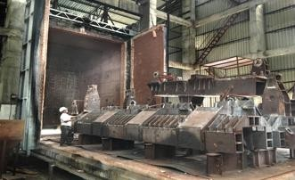
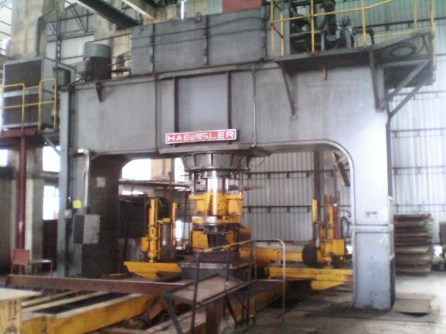
Examples of facilities in our workshop (1/2)
Plate Bending Machine
Horizontal Boring Machine
Stress Relieving Furnace
Hydraulic Press

Slide 14
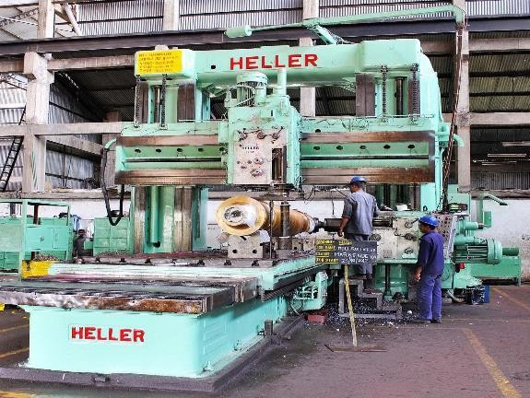
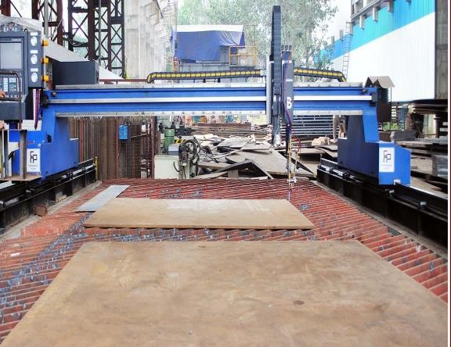
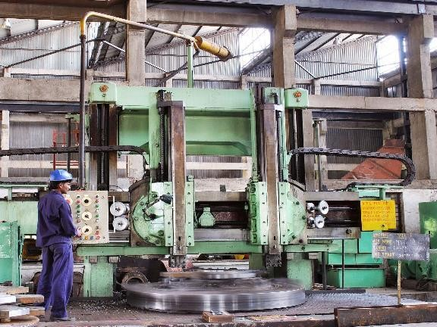
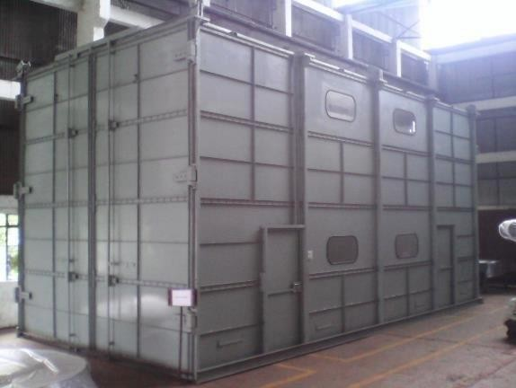
Examples of facilities in our workshop (2/2)
Plano Miller
CNC Cutting Machine
Vertical Turning Lathe
Clean Room – 100000 ppm

Slide 15
We have experience in working with a wide range of specialized materials
S No | Materials Grade | Grade/Type
1 | Carbon Steel | IS 2062 Gr A, B & C, A 36
 |  | SA 516 Gr 60, 70
 |  | EN 24, EN 8, EN 19
 |  | St 52, 42, 37
 |  | IS 513 CR2
2 | Stainless Steel | SS 304, 304L, SS 321
 |  | SS 410
 |  | SS 316, 316L, 316LN
 |  | UNS S32304, UNS S32750
3 | Alloy Steel | 15CDV6, 17-4PH, L43, 11-10PH
 |  | Maraging Steel, SA 517 Gr F, SA 592 Gr F
4 | Aluminum Alloy | 6061T651, 5052H32, 1100H11
5 | Titanium | SB 338 Gr 2, TI6AL4V

Slide 16
Quality Assurance Capabilities
Kay Bouvet Engineering Ltd.

Slide 17
Quality Assurance Capabilities
In House Testing Facilities
X-ray Machine with 25mm penetration
Pit Room for storage of RE source
Dark Room, Film Viewers & Densitometer for RE Films
Helium Leak Examination
Ultrasonic Examination
Ultrasonic Thickness Measurement
Magnetic Particle Examination
Liquid Penetrant Examination
Hydrostatic testing
Pneumatic testing
Tensile testing
Bend testing
Impact testing
Hardness testing
Out Source testing facilities
Gamma Ray Radiography
Micro Test
IGC Test
Chemical Test

Slide 18
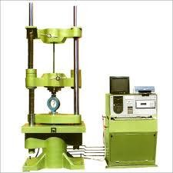
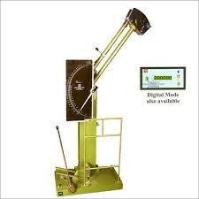
In-house UTM and Impact Testing Machines
Specifications
Calibrated by National Accreditation Board for Laboratories (NABL)
Model RKUTE-20
Maximum Capacity 200 KN
Accuracy of Measurement ± 1.0%
Piston Movement 0.1 mm
Extensometer B2 Class

Slide 19
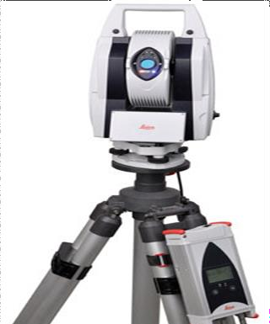
Other quality assurance facilities
LEICA ABSOLUTE TRACKER AT402
Absolute Distance Performance
Resolution: 0.1 μm
Accuracy (MPE): +/- 10 μm (+/- 0.00039”) Repeatability (MPE): +/- 5 μm (+/- 0.0002”)
Range
Infinite Horizontal Rotation: +/-360˚ Infinite Vertical Rotation: +/- 145˚ Typical Working Volume (ø): 320 m
Environmental
Dust/Water: IP54
Operating Temperature: 0˚C to +40˚C Relative Humidity: Max. 95% Altitude: -700 to 5500 m

Slide 20
Design Capabilities
Kay Bouvet Engineering Ltd.

Slide 21
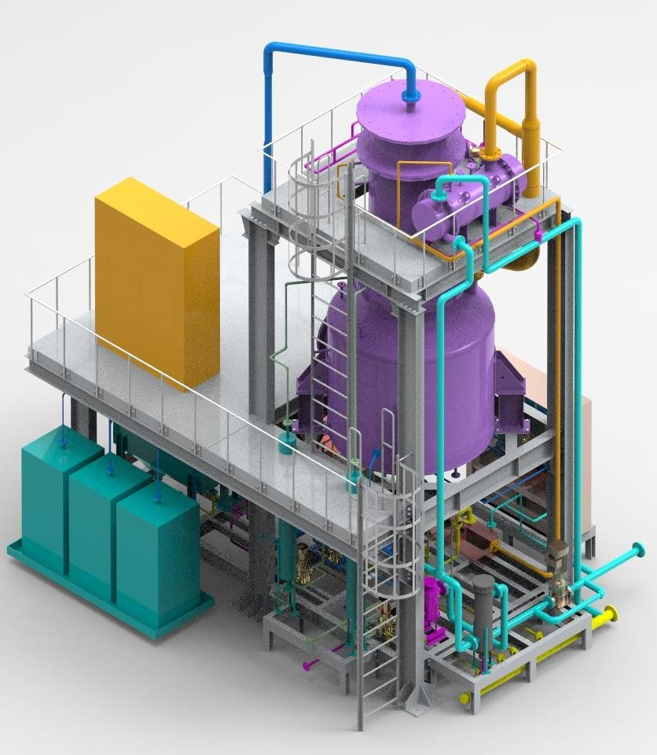
Design Capabilities
Qualifications
Several years of experience in designing high quality systems using the latest design & analysis tools
3D CAD Modelling
Finite element analysis (static structural, seismic, thermal & fatigue)
Piping design & analysis

Slide 22
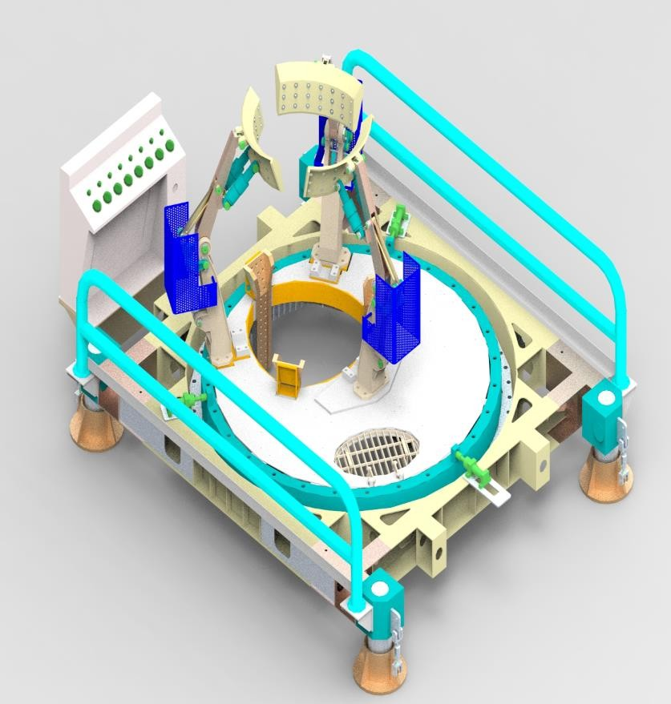
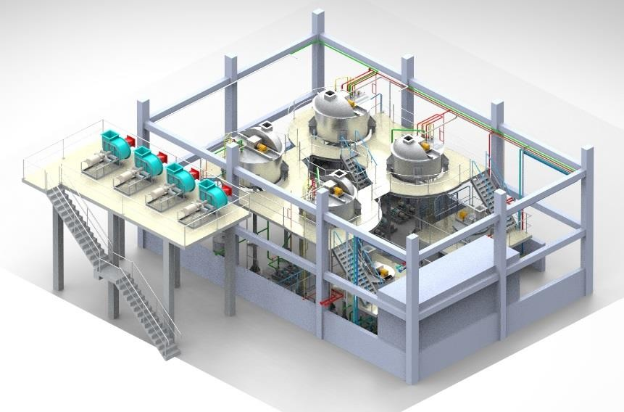
Design Capabilities
Experience
Heat Exchangers for Waste Management
Plant (NPCIL)
Brine Concentrator Unit (BARC)
Test Rig for Launcher (R&DE)
Loading and Handling System (R&DE)
AP Recovery Plant (VSSC)
AP Processing Facility (VSSC)
Propellant tanks (IPRC)
Fixtures for Spent Fuel Trays (NPCIL)
Reactor Building doors (NPCIL)
FM Service Cart (NPCIL)
Fixtures & tooling for precise fabrication and machining

Slide 23
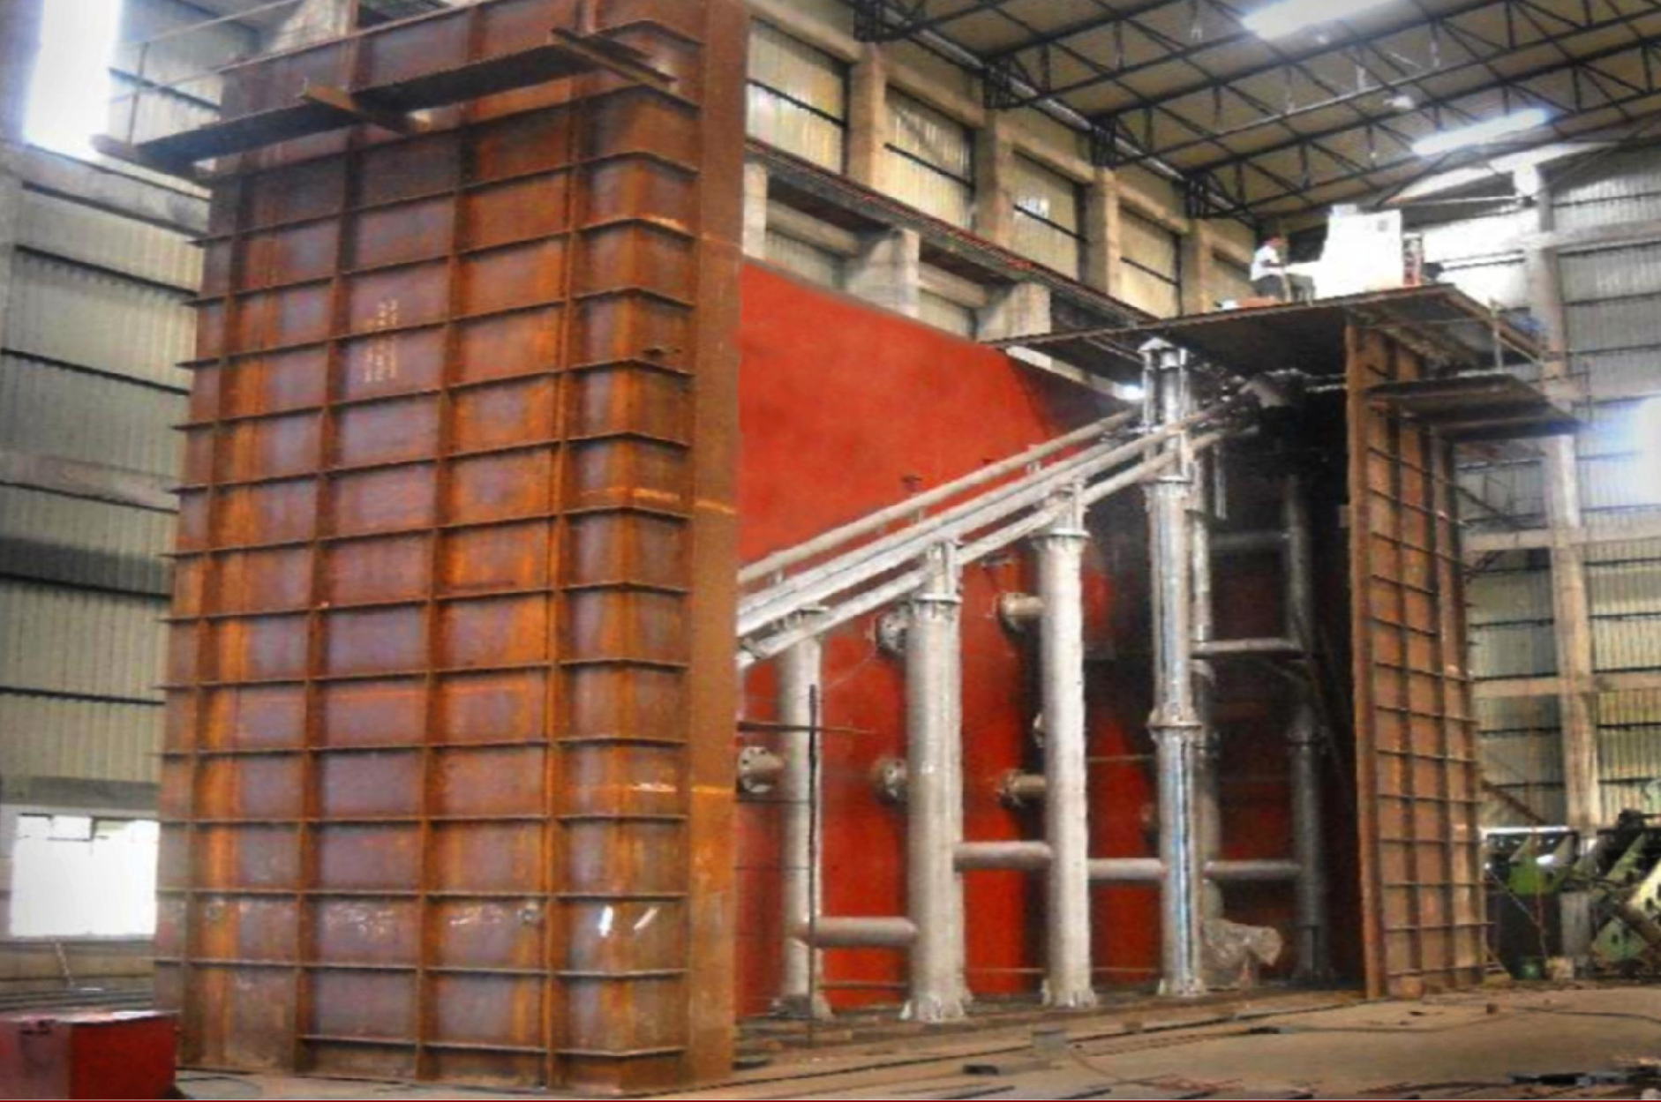
Major projects executed for the Nuclear Industry
Kay Bouvet Engineering Ltd.

Slide 24
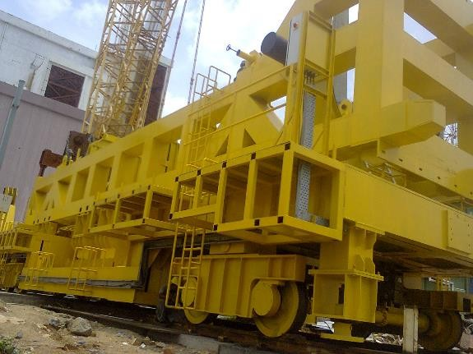

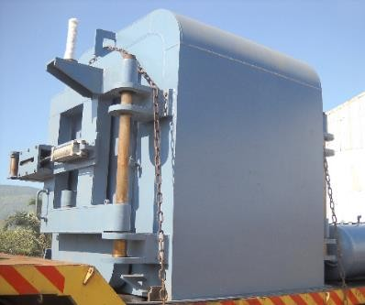

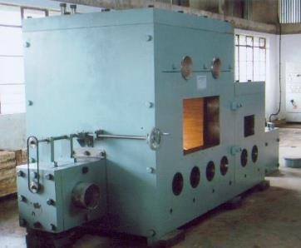

Kay Bouvet has been working for more than 15 years with the Department of Atomic Energy
Major Projects for the NPCIL
ECCS Tanks
D2O Storage Tanks
Air Locks
FM Service Cart
EPC Waste Management Package
Top Hatch Beam
Roll on Shield
Spent fuel trays
Calandria Assemblies
Major Projects for BHAVINI
Under Water Trolley
Partition Door
FTC Vessels
Shielding Doors
Air Locks
ARDM Flask
Carriage in MAL
Top Shield Platform
IHX Shielding Platform
Containers for spent fuel rods and storage rack
Major Projects for BARC
Dilution Hot Cell
Pump Hot Cells
Blister Assemblies
Shielding Doors
Brine Concentrator

Slide 25
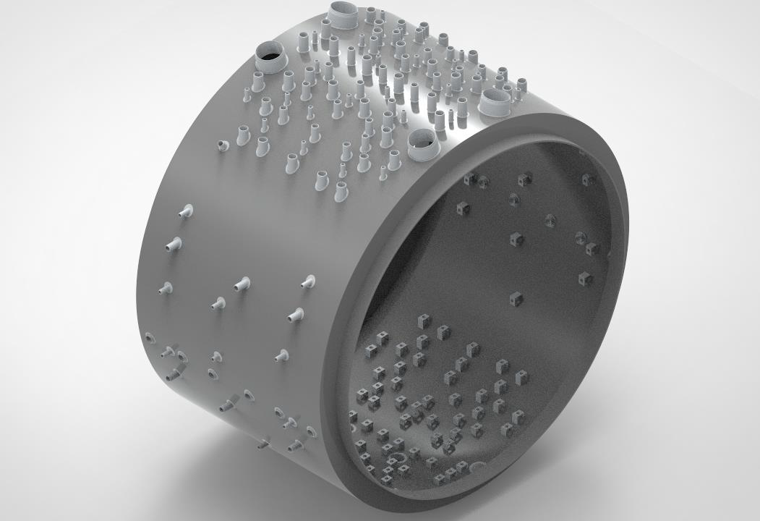
Major project for NPCIL
Calandria Assemblies and its associated components for
GHAVP 1 &2
MOC : SS 304 L
Special plates imported from
Slovania with cobalt control below 0.03%
Dia - 7840 mm
Height- 5280 mm

Slide 26
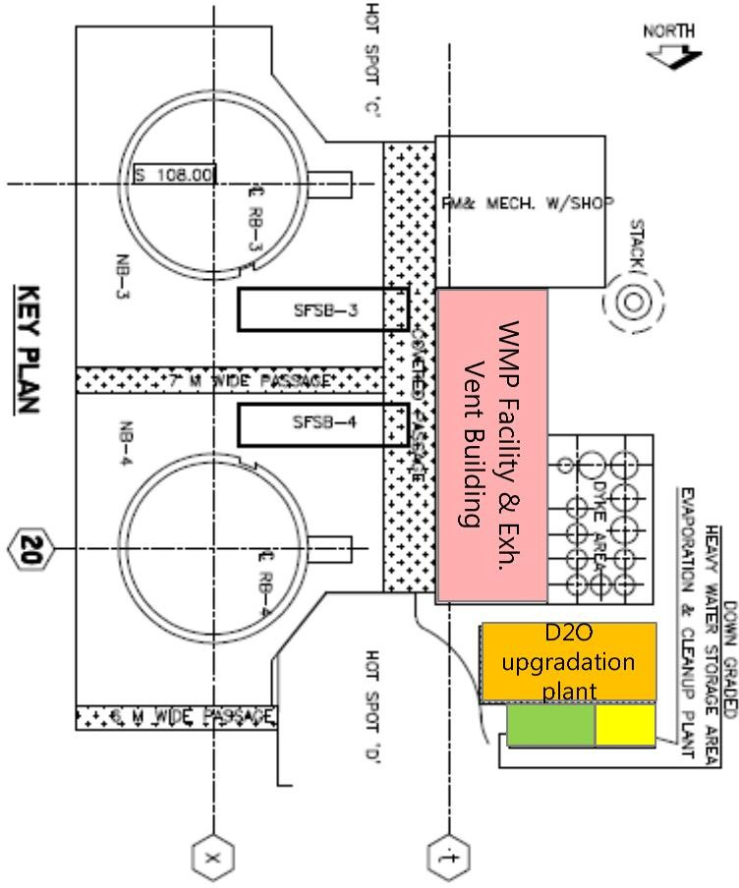
Nuclear Industry:
EPC Package for Heavy Water Upgradation plant and Waste Management System for RAPP 7&8
Heavy Water Upgradation Plant (UGP)
Heavy Water Upgrading Plant Heavy Water Evaporation and Cleanup System Downgraded Heavy Water Storage Facility
Waste Management Plant (WMP)
Liquid Effluent Segregation System Evaporation System Resin Transfer and Fixation system Laundry System Decontamination System Active Drainage system

Slide 27
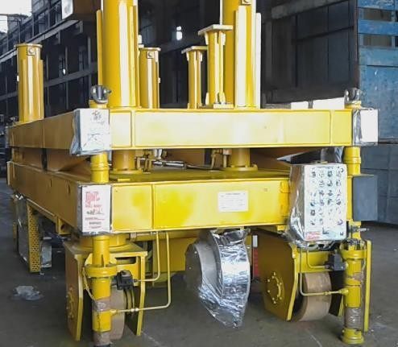
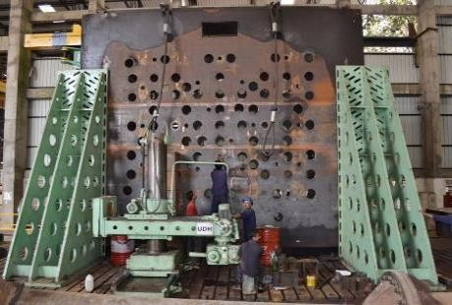
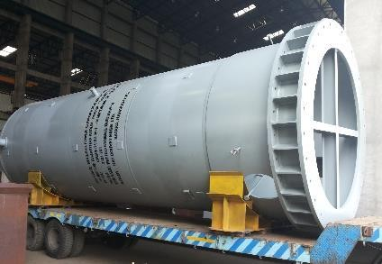
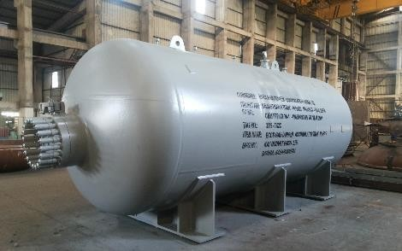
Major projects executed for NPCIL
Fueling Machine Service Cart
Top Hatch Beam
Heavy Water Storage Tanks
ECCS Accummulator Tanks

Slide 28
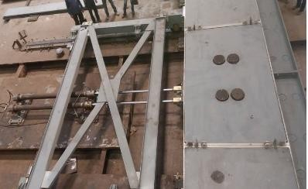
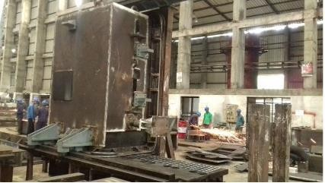
Major projects executed for NPCIL
Roll on shields for reactor building
Roll on shield under functional testing
FT room area door under performance testing

Slide 29
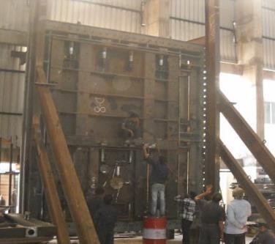
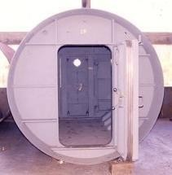
Major projects executed for NPCIL
Air Locks for Nuclear Reactor Building

Slide 30
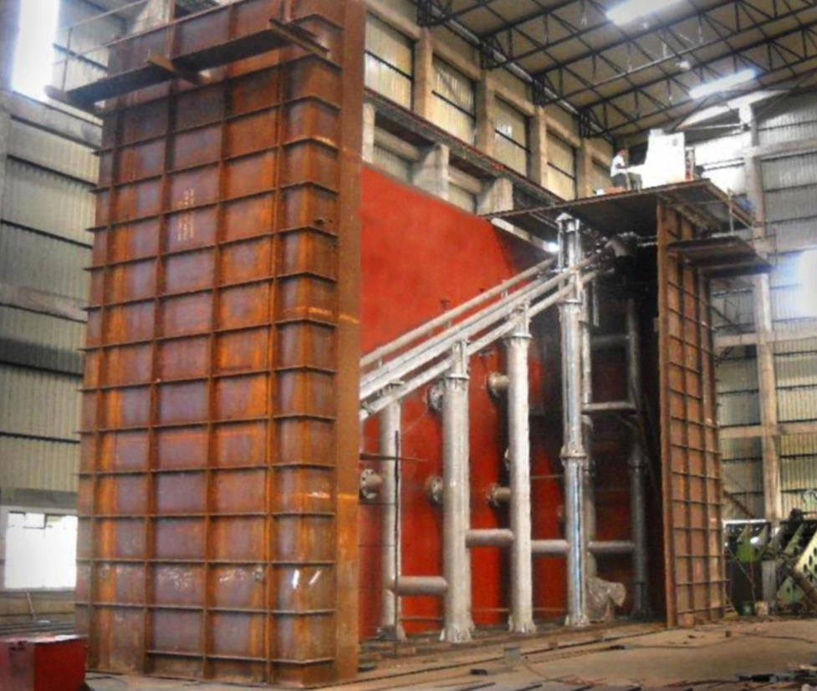
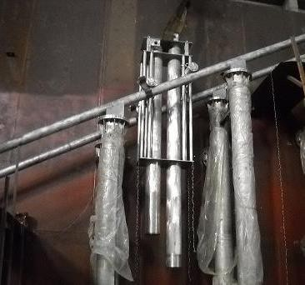
Major projects executed for BHAVINI Prototype Fast Breeder Reactor
Under Water Trolley
Material: SS304L Size: 12m x 4m x 9m
Rail middle support columns aligned to 26.7° along 12 m length

Slide 31
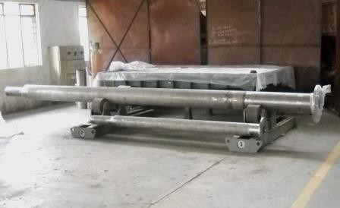
Major projects executed for BHAVINI Prototype Fast Breeder Reactor
FTC Vessels-
Concentricity within 0.5mm through 8 meter length Acceptance criteria for local leak rate - 1.0 X 10⁻⁶ mbar.lit/sec., fitted with Heaters from M/s Thermocoax, France and M/s VAT, Switzerland make Gate Valves

Slide 32
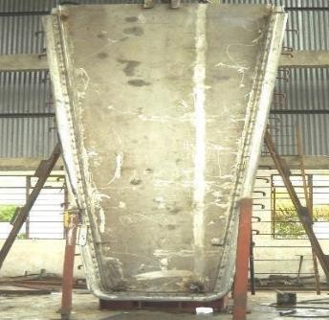
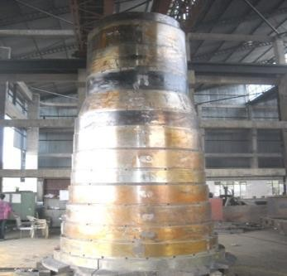
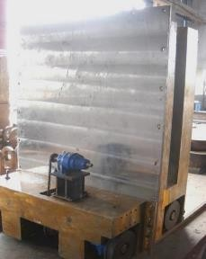
Major projects executed for BHAVINI Prototype Fast Breeder Reactor
Partition door
Shielding IHX
Shielding Door

Slide 33
Major projects executed for BHAVINI Prototype Fast Breeder Reactor
Carriage In Main Air Lock
Dimensions- 20m x 5m x 3m Weight – 300 Tons

Slide 34
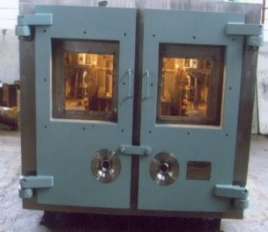
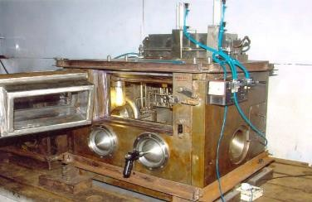
Major projects executed for BARC
Dilution Hot Cell
Pump Hot Cell
Blister Assembly

Slide 35
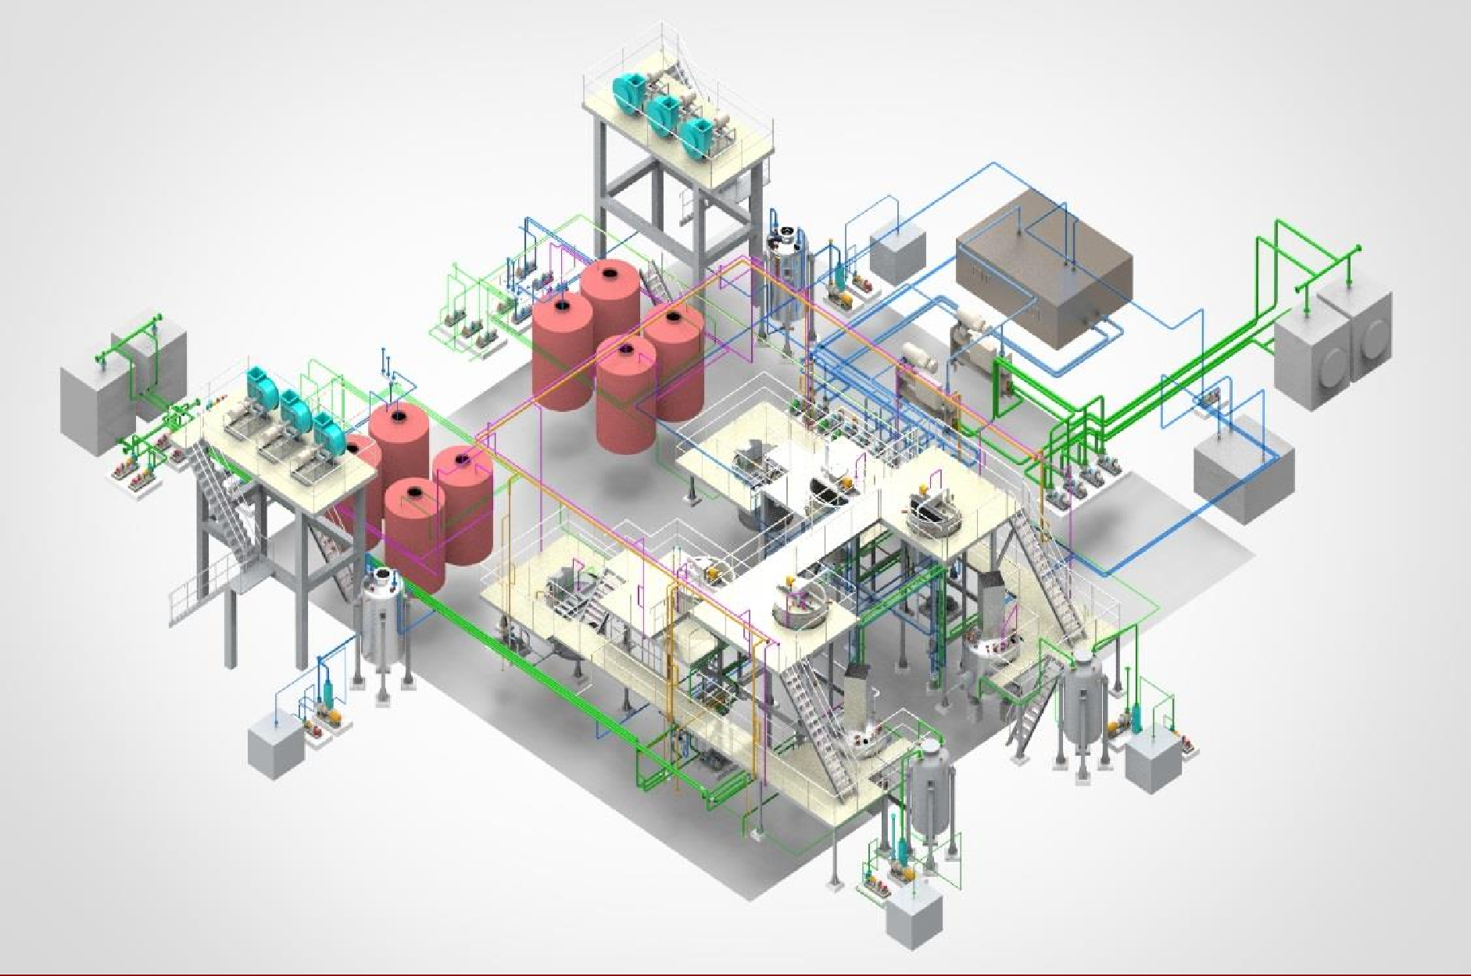
Major projects executed for the Space Industry
Kay Bouvet Engineering Ltd.

Slide 36
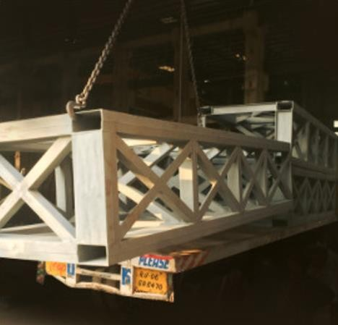

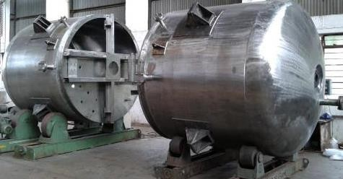
Major projects for the Indian Space Research Organization
Second Vehicle Assembly Building
Revamping of AP Recovery Plant
New Process Facility of AP Processing Plant
DD2 Jacketed Reactors

Slide 37
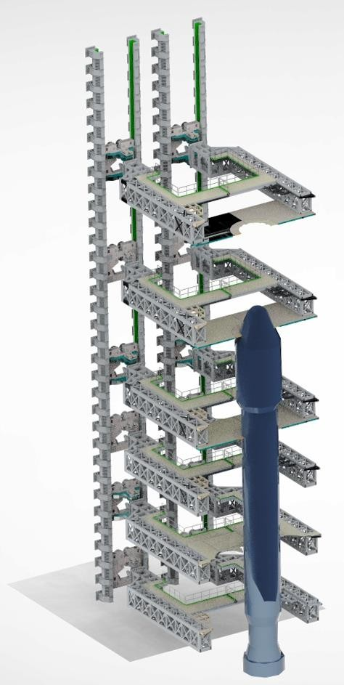
Major projects for ISRO
Second Vehicle Assembly Building
74m high guide columns
Folding and swinging platforms at
various levels
Vertically Repositionable
Replaceable platforms for GSLV MK- II and MK-III
Total Assembly weight: 3500 T

Slide 38
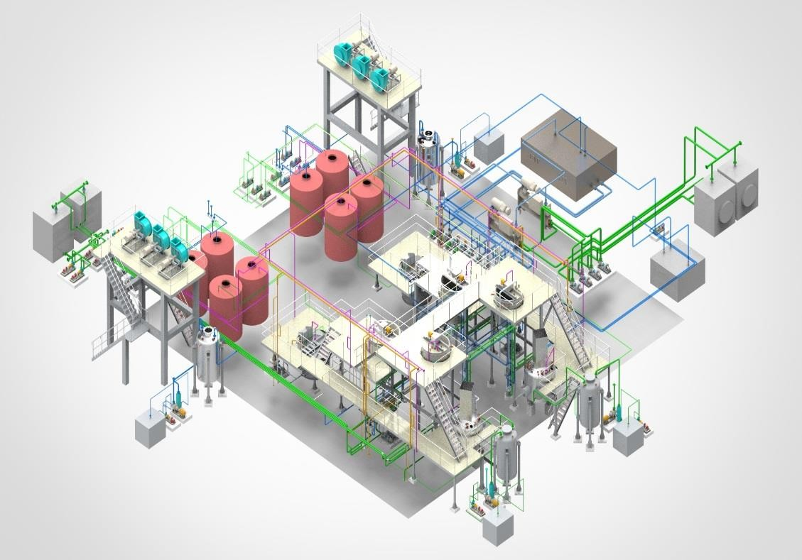
Major EPC projects for ISRO
VSSC Ammonium Perchlorate Processing Facility (New)
Produces wet AP from Sodium Perchlorate and Ammonium Chloride by various process operations like
  Ammonium Chloride dissolution,
  Double Decomposition reaction
  Crystallization,
  Recrystallization and Vacuum filtration
  Fluidised Drying
Turnkey project consisting of design, fabrication, supply, testing and commissioning
Automated control through PLC
MOC :SS316L

Slide 39

Major EPC projects for ISRO
VSSC Ammonium Perchlorate Recovery Plant
Increases AP yield by recovering AP from Crude Mother Liquor
Turnkey project consisting of design, fabrication, supply, testing and commissioning of:
  Evaporators (Titanium Gr2)
  Crystallisers (SS316L)
  Pumps
  Piping
  Structural framework
Automated control through
PLC

Slide 40
Major projects for ISRO
PSO XL Rocket Motor Casings
Material: 15CDV6
Shell OD: 1000 mm
Shell Thickness: 3.5 mm
Overall Assembly Length: 11868.5 mm
Controlling of Shell Ovality within 2 mm.
Organisation: VSSC

Slide 41
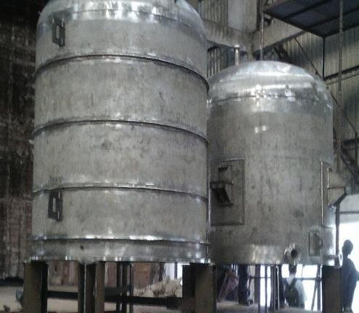


Major projects executed for ISRO
DD2 Jacketed Reactors
•
•
Dimensions: Dia 2000 mm X 20 mm Thk
Material: SS 316 LN
After SR of shell, final diameter achieved: 2000 ± 4mm for inner shell & 2140 ± 5 mm for outer shell

Slide 42

Major projects executed for the Defence Industry
Kay Bouvet Engineering Ltd.

Slide 43


Major projects for the Defence Research & Development Organization (DRDO)
LRDE
  Antenna Mechanical Vehicle
VRDE
  Dummy Canisters
R&DE
  Metallic Canisters
  Loading and Handling System
  Test Rig
  BAPL
  Brahmos Booster Motors

Slide 44


Major projects executed for DRDO - Antenna Mechanical Vehicle for DRDO
Antenna Main Frame with cooling pipes
12.5 m x 4.5 m x 650 mm
Weight: 12 Tons
Flatness within 0.1 mm achieved
Assembly of Slew Bearing on Turntable
Rotation of antenna on turntable up to 330º
Tilt up to 70º
Extremely wide detection range
Antenna Mechanical Vehicle
Completely automated operation
Detects incoming missiles from a distance of up to 600km
Sends signal to 10 Indian missiles to intercept hostile missiles mid-air

Slide 45

Major projects executed for DRDO
Metallic Canisters
Plates: SA 517 Gr F
Forgings: SA 592 Gr F
Max length of shell:
3200mm
8mm shell thickness capable of withstanding 33 bar internal pressure
ID tolerance : 1460 +0.5mm

Slide 46

Major projects executed for DRDO – Loading & Handling System
Loading System Handling System
Pads of base anchor to be levelled within a flatness accuracy of 0.05mm using optical level
Design validation and Finite Element Analysis carried out using ANSYS
Main Materials
Plates: SA 517 Gr F Forgings: SA 592 Gr F

Slide 47


Major projects executed for DRDO – Test Rig for SARJA II Launcher
Design of all high pressure components based on ASME Sec VIII (up to 50 bar pressure)
Design validation and Finite Element Analysis carried out using ANSYS for various load cases

Slide 48


B2 Shell Assembly- MOC 11-10 PH Steel
Dia: 516 mm X 4871 mm Long, Proof pressure tested at 149.6 bar
B1 Inner & Outer Shell assembly (TI6AL4V) Dia 596 X Length 397 mm
B1 Outer Shell Assembly (TI6AL4V) Dia 596 X Length 397 mmk
Proof pressure tested at 126.5 bar
Project executed for Brahmos Aerospace

Slide 49


Kay Bouvet Engineering Ltd.
N-3, Addl MIDC, Satara, Maharashtra, India. 415004
+91 2162 240653, 54, 55 | info@kaybouvet.com www.kaybouvet.com

