Slide 1

Welcome
TRIDENT AUTO COMPONENTS PVT. LTD.
WARMLY WELCOMES ALL DELEGATES
Dt.- 12th APR 2023

Slide 2
Company Profile

Slide 3
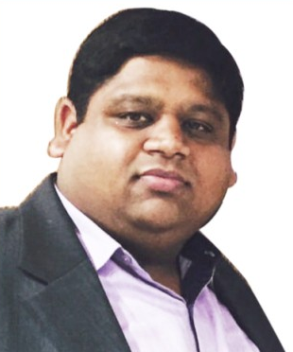
Company Profile
Trident Auto Components Pvt. Ltd (TACPL) was established in the year 1997. Since then, over the last two decades, the organization has been continuously growing in the field of Precision Machining to Heavy Fabrication of Rail Products & supplying to the Indian Railways. Manufacturing also persists for the Power Sector, Infrastructure and various other Verticals under the leadership of Mr. Shishir Poddar. The organization is now structured with a state-of-the-art Manufacturing facilities and powered by more than 75 Engineers & Professional Management Team comprising of more than 400 Employees
Trident Auto Components Pvt. Ltd. is now all set to enter into the Indian Defence, Atomic Energy & Aerospace sector to serve the nation for the decades to come.
Trident Promoters also own M/s KTL Automobiles Ltd. a renowned Trading House Group in different states of India viz. Uttar Pradesh, Madhya Pradesh, Rajasthan. The group turnover is all is approx. 1800 Crores INR (225 Million USD).
Mr. Shishir Poddar
(Managing Director)

Slide 4
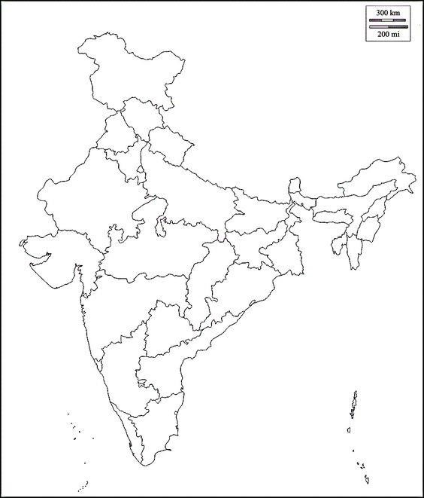
Manufacturing & Our Customer Footprints in Pan India
TACPL is a professionally managed company having its reg. office at B-16 Udyog Kunj, UPSIDC Industrial Area, Site-5, Panki Kanpur.
Due to its commendable performance, the org. made further development and established its new manufacturing units at village Umran, Rania Kanpur Dehat in the year 2012. Thereafter, the org. got another opportunity to grow and it established a new unit in the year 2017.
IR
IR
MHPL India Pvt. Ltd,
Registered Office
B-16, UDYOG KUNJ UPSIDC SITE-V, Kanpur(U.P.)-208022
IR
TACPL Unit-I,
Chak No. -235, Village Umran, Rania, Kanpur Dehat (U. P.) -209311
IR
IR
BHEL
TACPL Unit-II,
ARAZI NO.-313, 317 & 318 VILLAGE
UMRAN, RANIA, KANPUR DEHAT (U.P.)– 209311.
BHEL
IR
BHEL
Our Manufacturing Footprints
DRDO
BHEL
DRDO
Our Customers
IR
DST

Slide 5
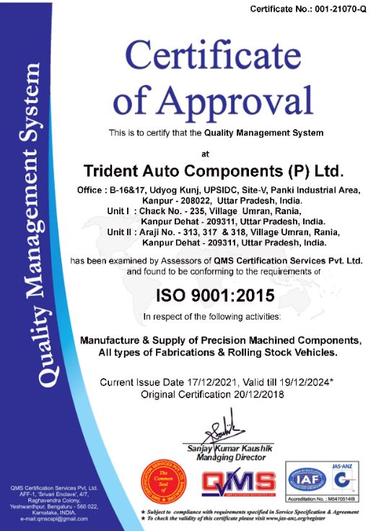
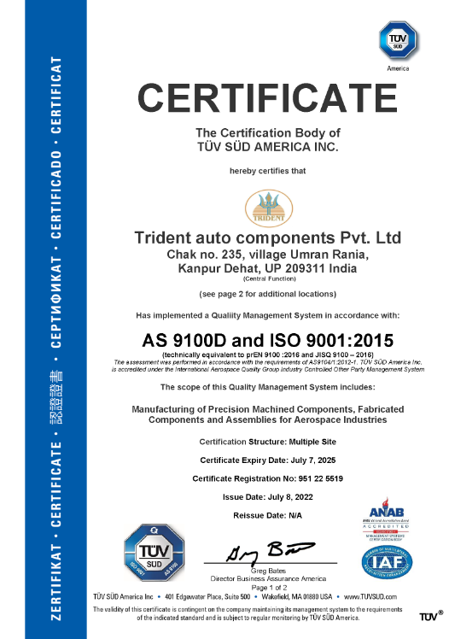
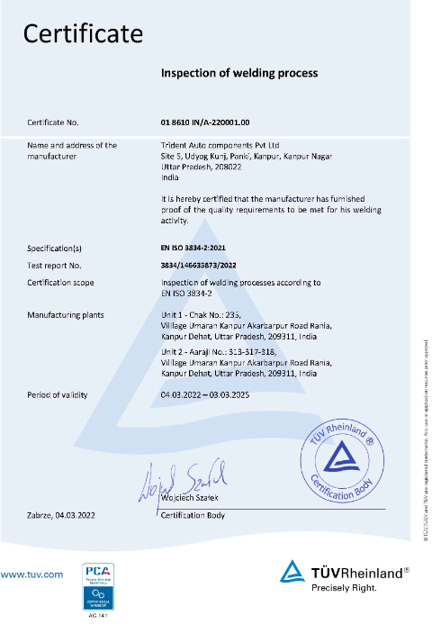
ACCREDITATIONS AND STANDARDS
1.
Quality Management System
2.
Quality Management System
3.
Quality Management System for Welding
Quality Management System in line with the requirement of ISO 9001:2015
Quality Management System in line with the requirement of AS 9100 Rev. D
Quality Requirement for Fusion Welding of Metallic Material ISO 3834
In Process to seek EN:15085 Certification.

Slide 6
Plant Information
The Registered-office is located at B-16 Udyog Kunj, UPSIDC Industrial Area, Site-5, Panki Kanpur.
TACPL Manufacturing Unit-I is spread within 10000 sq. mtr. area approx. equipped with latest Plant & Machineries for manufacturing of precision machined components and a dedicated bogie manufacturing shop. The Unit 1 is well equipped with a Office Block comprising of various departments like Engineering, Finance, Human Resource, Administration, Marketing as well as Customer Support Team, etc.
TACPL Manufacturing Unit-II is spread within 30000 sq. mtr. area. The Unit is under expansion where cumulative area shall be approx. 55000 sq. mtrs. The Unit is a dedicated Car Body Manufacturing Unit (Complete Shell Assy.). This unit is a Heavy Fabrication Unit equipped with material cutting, bending, welding machines supported by motorized manipulators, calibrated beds, customized fixturing and special purpose machines all meant to manufacture locomotive shells, coach shells, track machines, etc.

Slide 7
Details Of Unit-I
TACPL Unit-I,
Chak No. -235, Village Umran, Rania, Kanpur Dehat (U. P.)
Precision Machining Unit & Medium Fabrication Manufacturing Unit

Slide 8
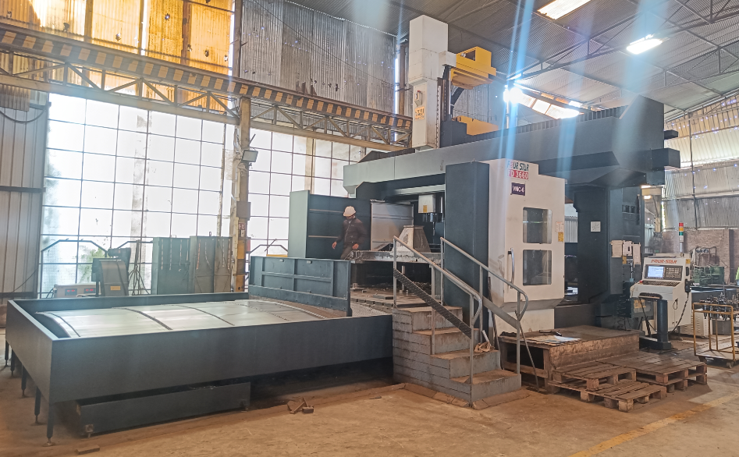
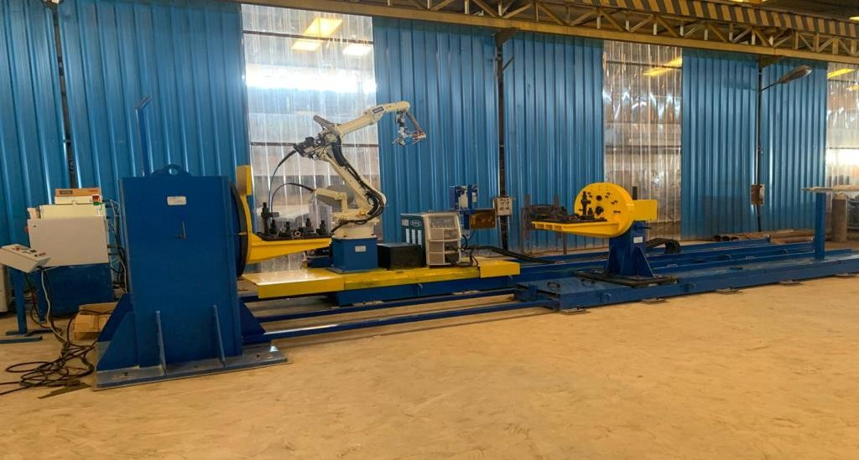
Plant Equipment’s-Precision Machining with Fabrication
CNC 5-Axis Vertical Machining Centre
Robotic Welding Machine with Laser Eye
Key Specification
Sr. No. | Model | SD-3670+SF
1. | Make | Hosabettu Four Star
2. | Bed Size | 6x2.8M
3. | Range Capacity | In X Axis-6.5M In Y Axis-3.6M In Z Axis-1.4M
Key Specification
Sr. No. | Model | N86L1-CEFN
1. | Make | OTC DAHEN Corporation
2. | Machine | Z543821918
3. | Qty. | 01Nos.

Slide 9
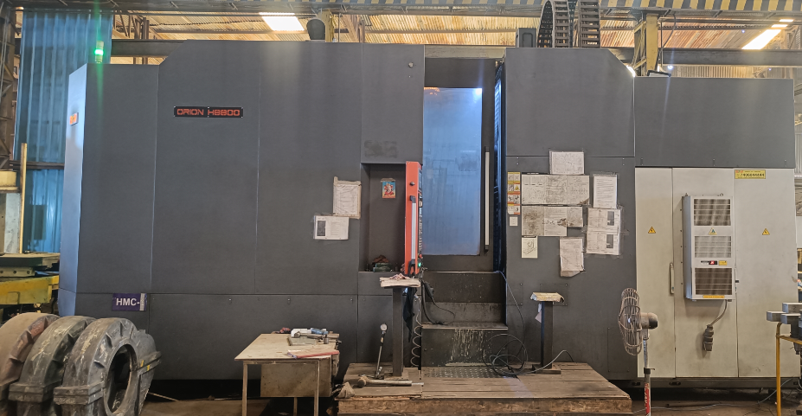
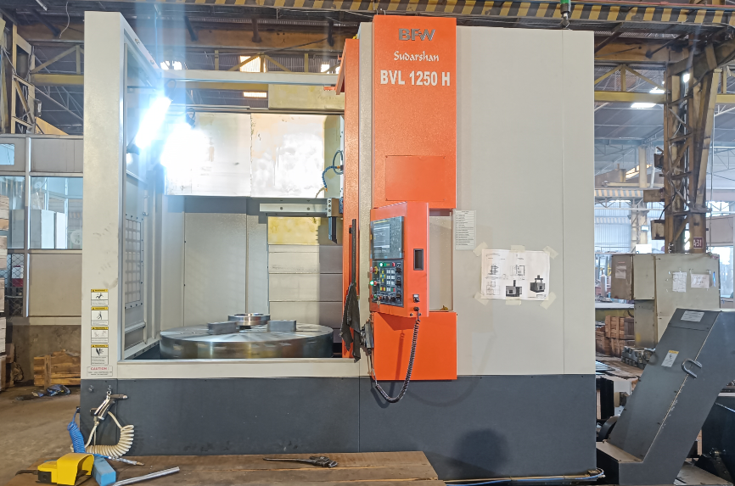
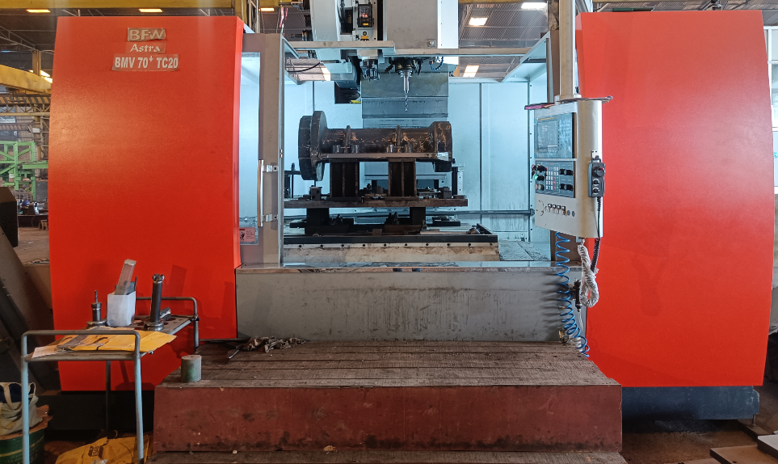
Plant Equipment's (Machine Shop)
CNC Horizontal Machining Center
CNC Vertical Turret Lathe Machine
CNC Vertical Machining Center
Key Specification
Sr. No. | Model | ORION H8800
1. | Make | BFW
2. | Bed Size | 800X800 MM
Key Specification
Sr. No. | Model | BVL 1250H
1. | Make | BFW
2. | Spindle Speed | 50-250RPM
3. | Chuck Dia. | Up to Ø1250mm
Key Specification
Sr. No. | Model | Vajra BMV70TC20+
1. | Range Capacity | In X Axis- 1.6M In Y Axis- 0.91M In Z Axis- 0.81M
2. | Table Size | 1700x710mm
3. | Spindle Speed | 6000RPM

Slide 10
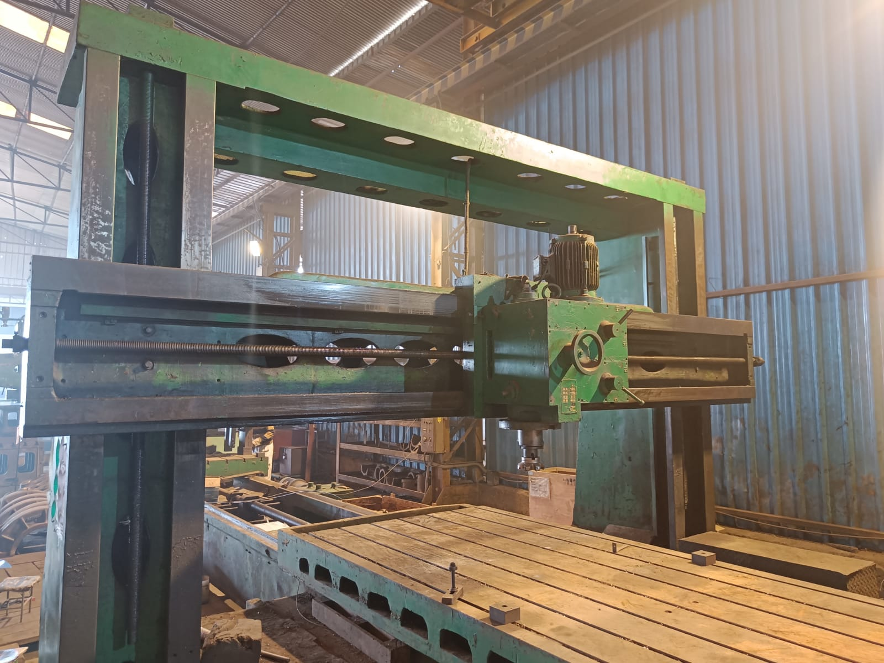
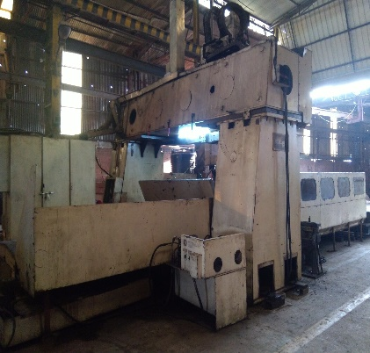
Plant Equipment's (Machine Shop)
CNC Plano Miller with Horizontal attachment
CNC Vertical Machining Center with Horizontal Boring Swivel Arrangement
Key Specification
Sr. No. | Make | Nungen
1. | Make | BFW
2. | Range Capacity | In X Axis- 8000 mm In Y Axis- 3000 mm In Z Axis- 1300 mm
Key Specification
Sr. No. | Make | Wadkin
1. | Table Size | 4000x3000mm
2. | Spindle Speed | 20-1250 RPM

Slide 11
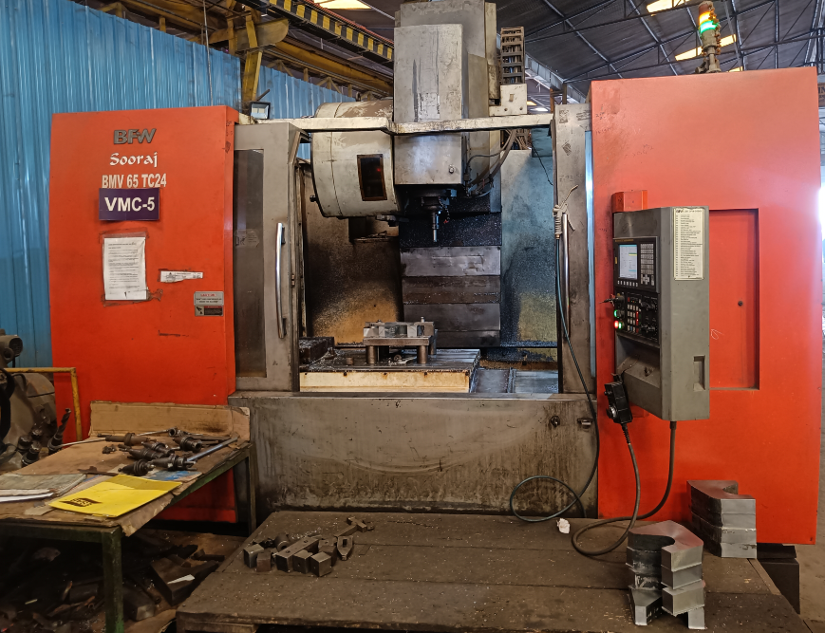
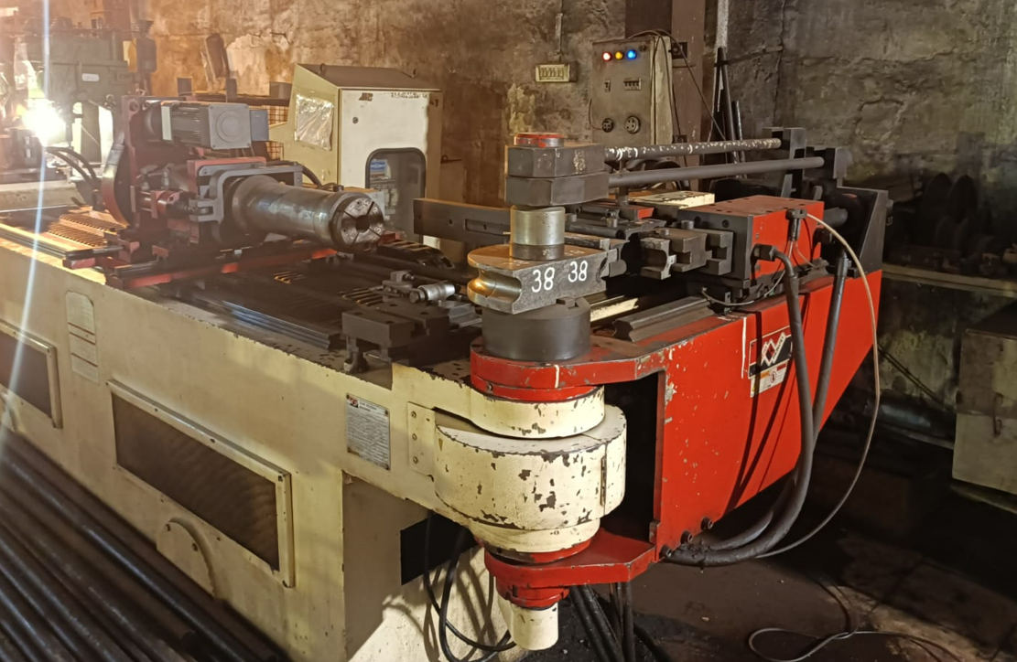
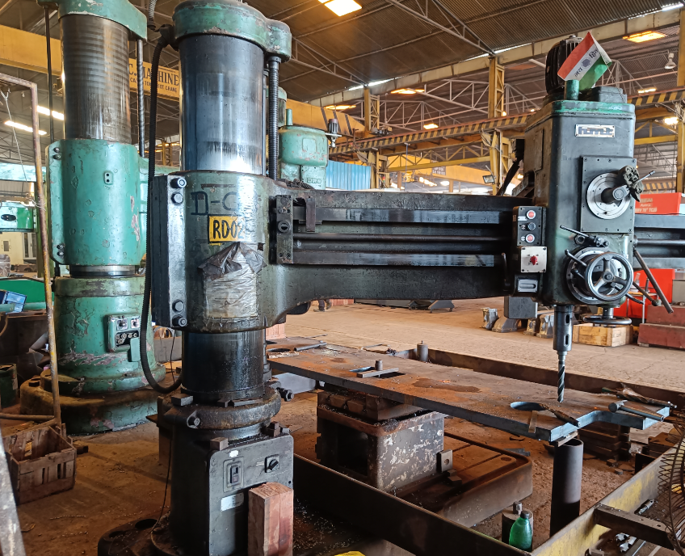
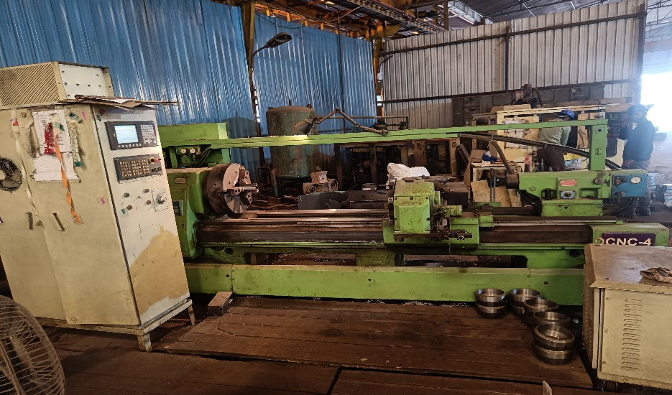
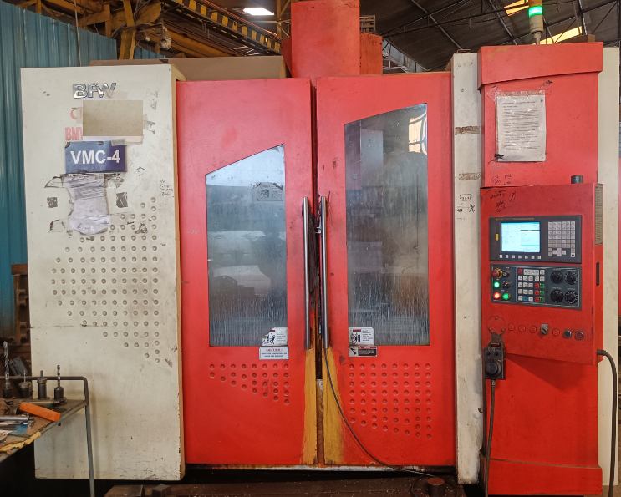
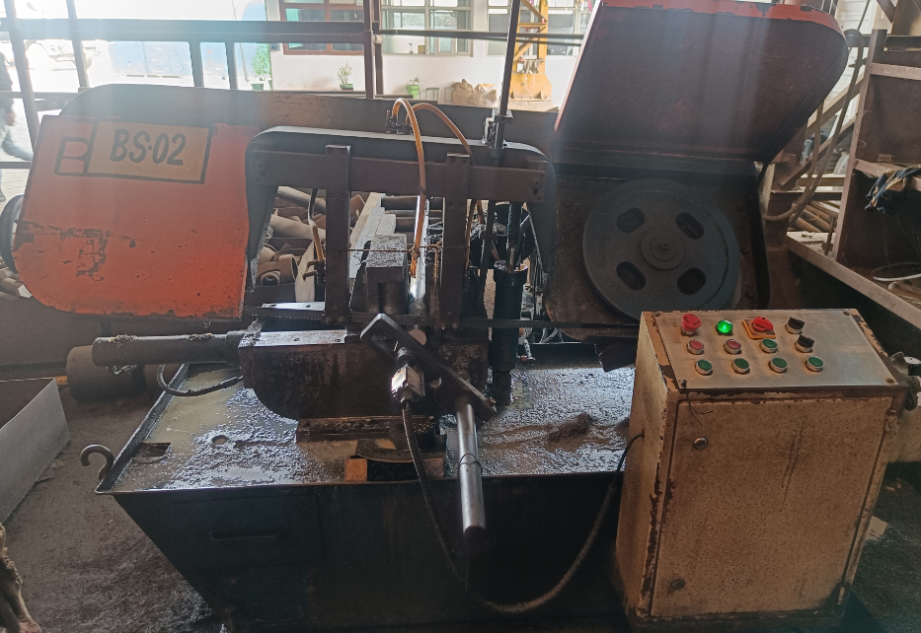
Plant Equipment's (Machine Shop)
VMC
CNC Pipe Bending Machine
Radial Drill Machine
CNC Lathe Machine
VMC
Band Saw Machine

Slide 12
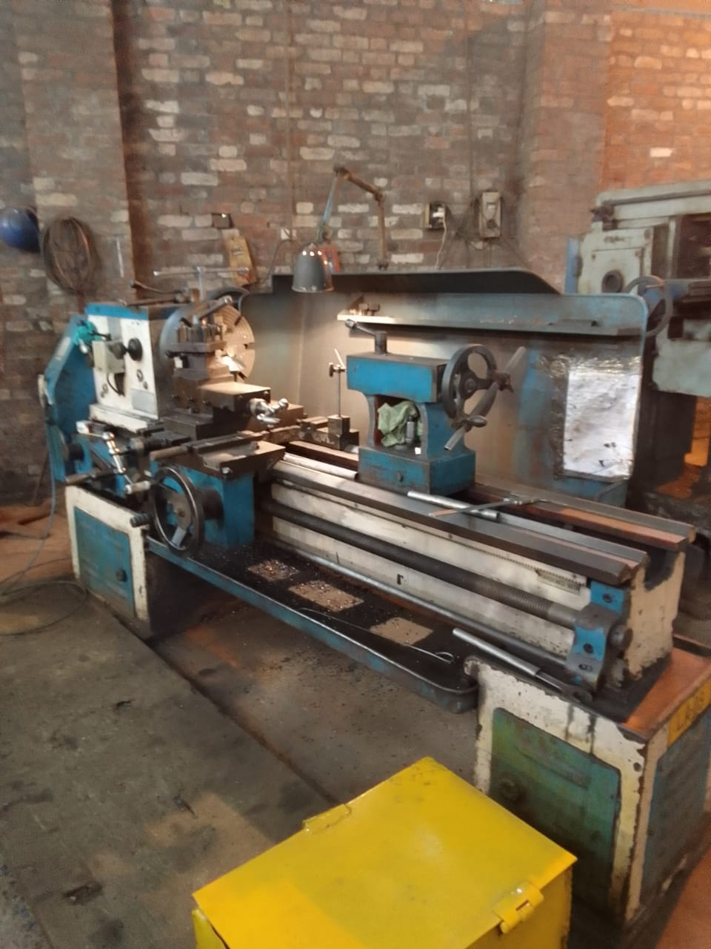
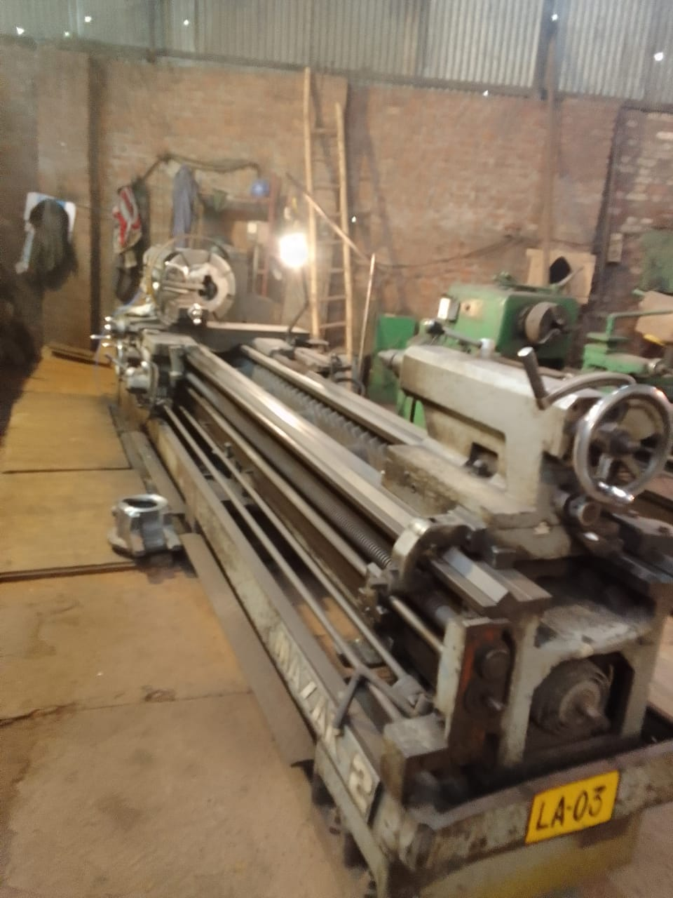
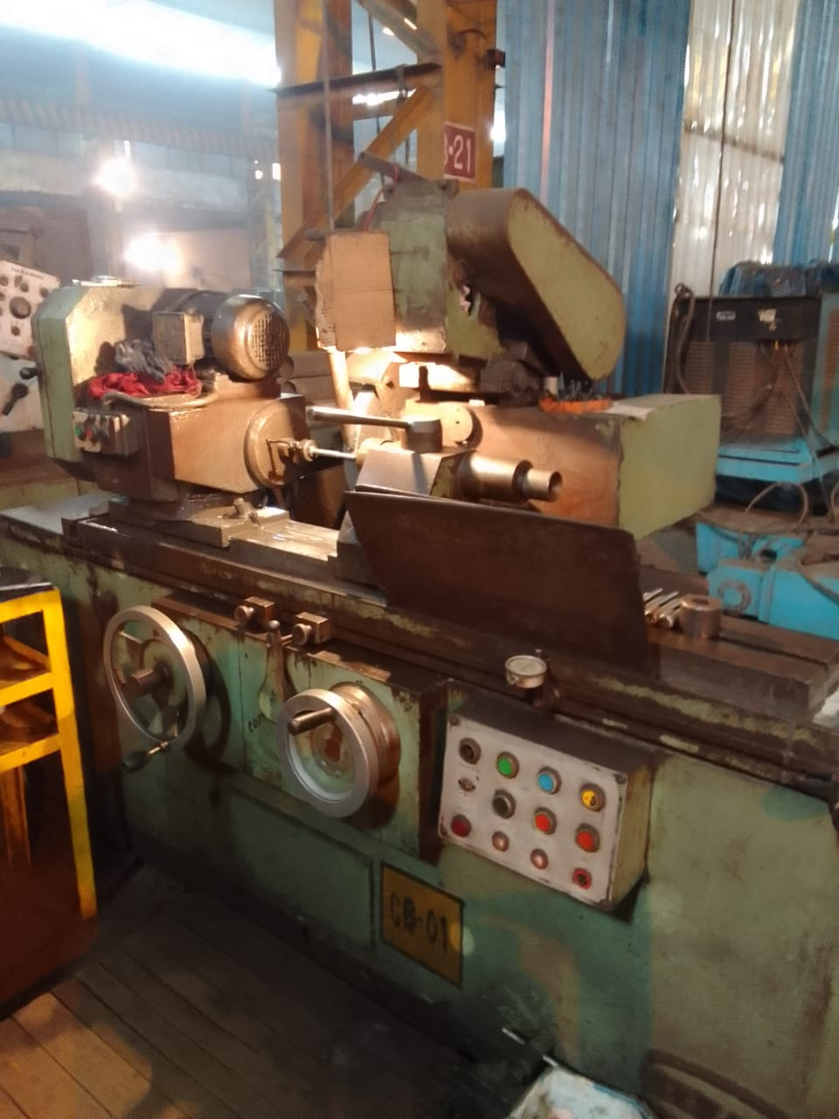
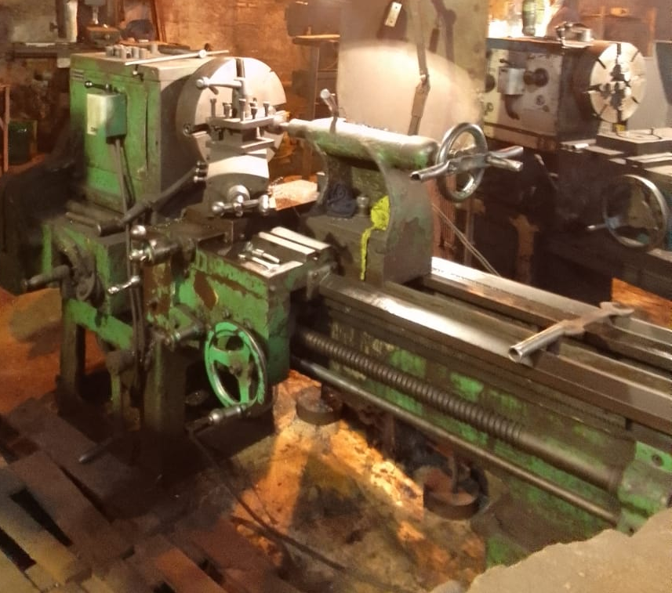
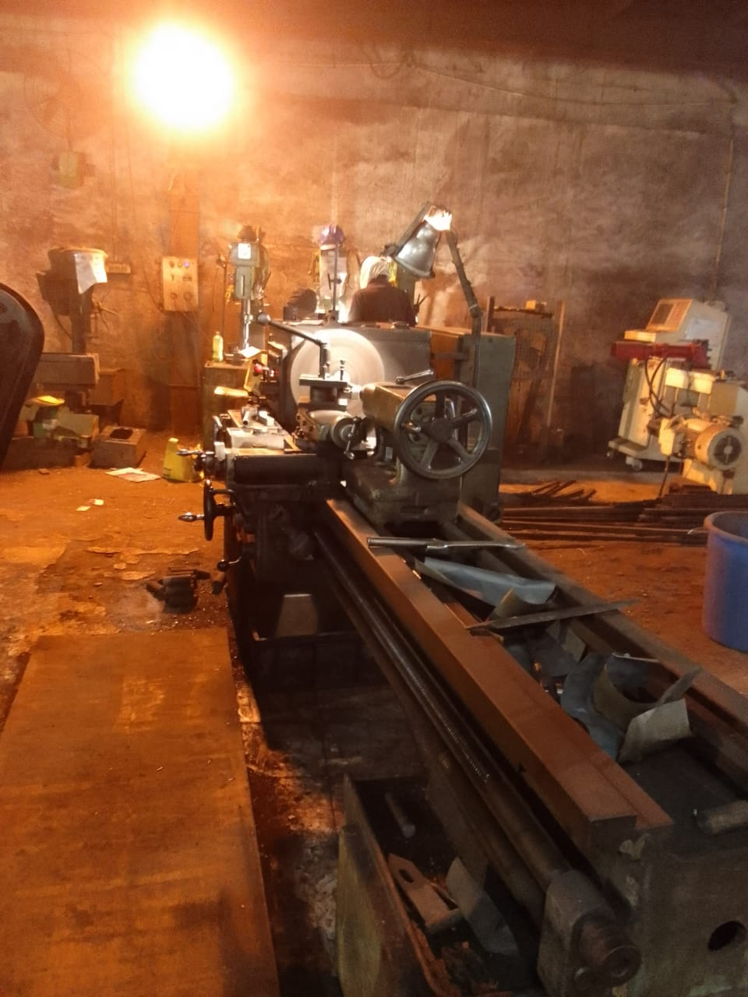
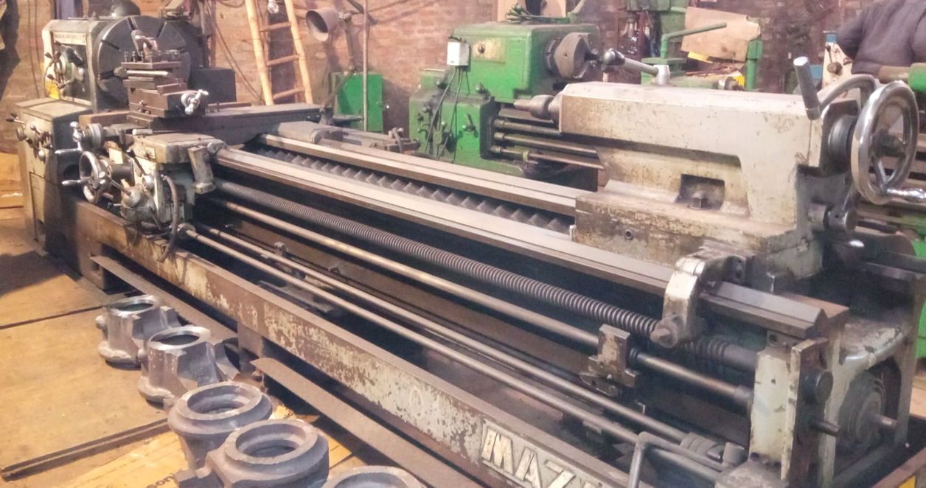
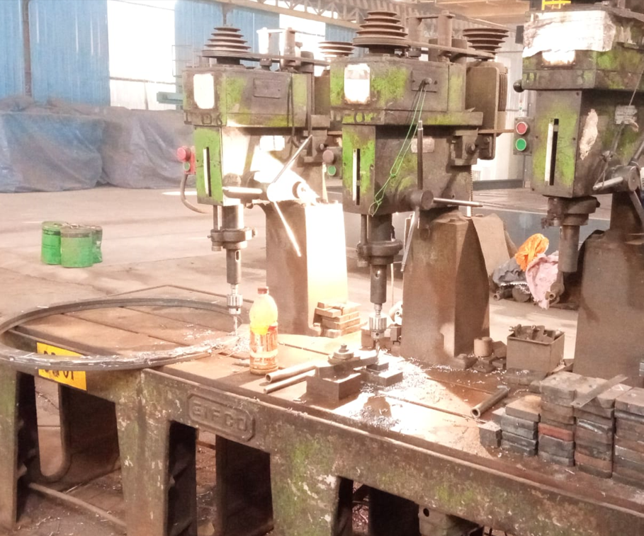
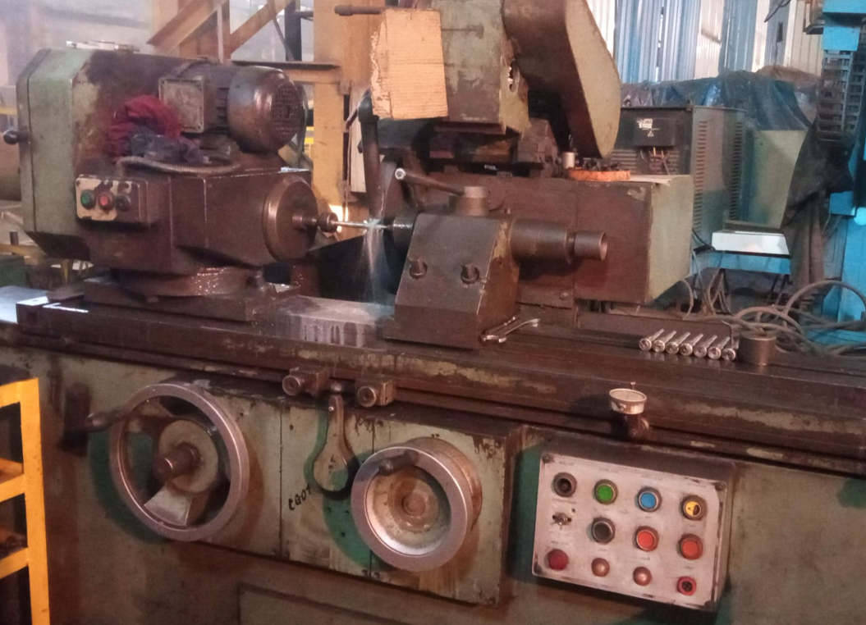
Plant Equipment's(Conventional Machines)

Slide 13

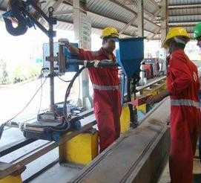
Plant Equipment's (Welding Type)
MIG/MAG Welding
Submerged Welding
Key Specification
Sr. No. | Make | ESAB, MOGRA, ADOR
1. | Capacity | Up to 500Amps
2. | Qty. | 75Nos.
Key Specification
Sr. No. | Make | Mogra
1. | Amps. | 1200
2. | Electrode Wire Dia. | Upto 5.4 mm
3. | Track Facility | 10 mtrs

Slide 14
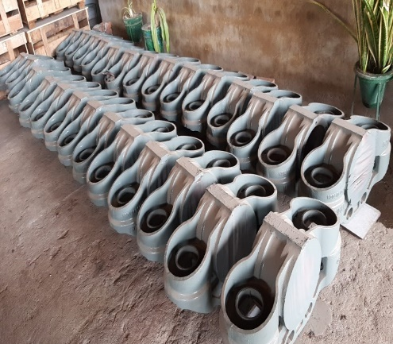
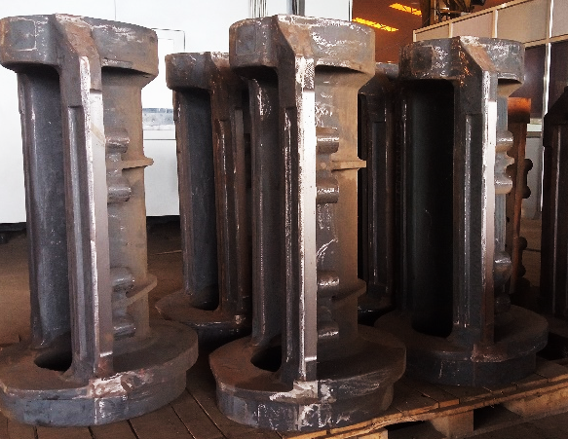
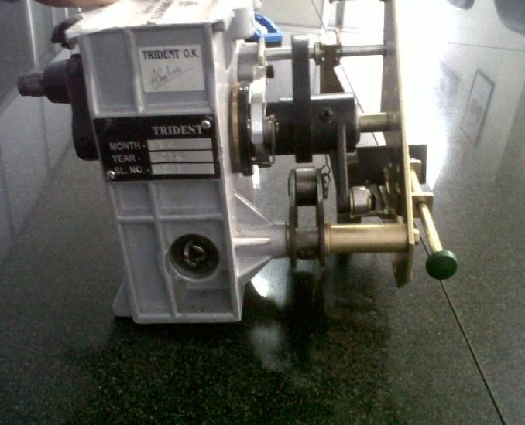
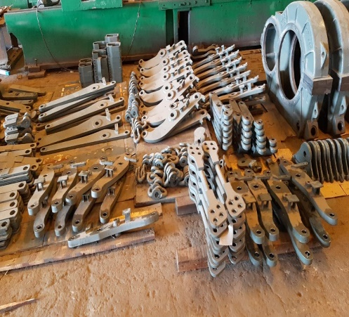
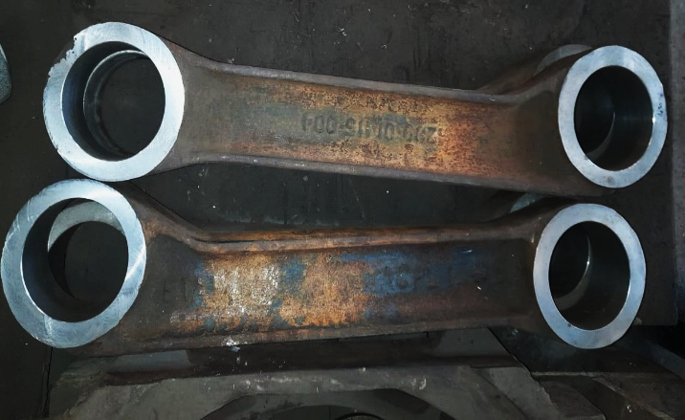
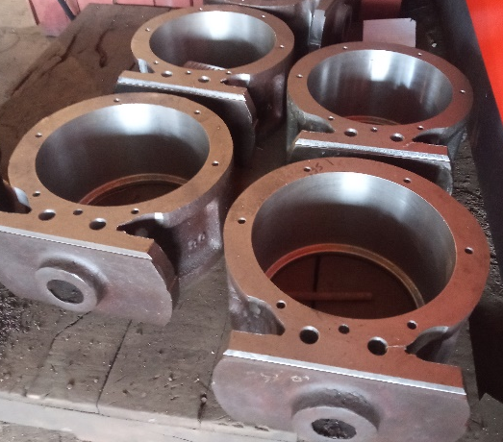
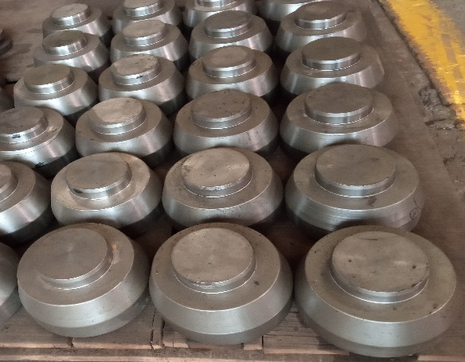
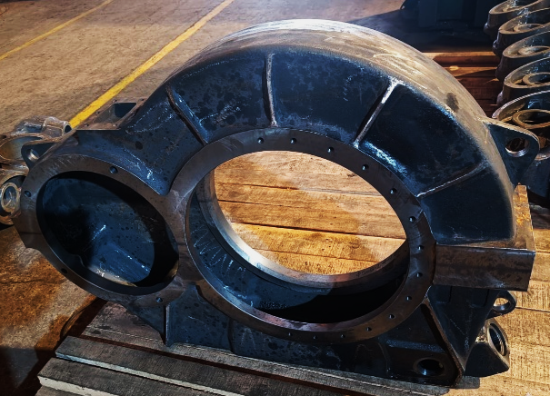
Our Existing Products
Precision Machined Components
Axle Box (WAG-9HC & WAP-7)
Motor Suspension Tube
Closing Unit for Vacuum Circuit Breaker
Brake Rigging Kit
Housing
Spring Guide
Gear Case
Wheel Set Guide

Slide 15
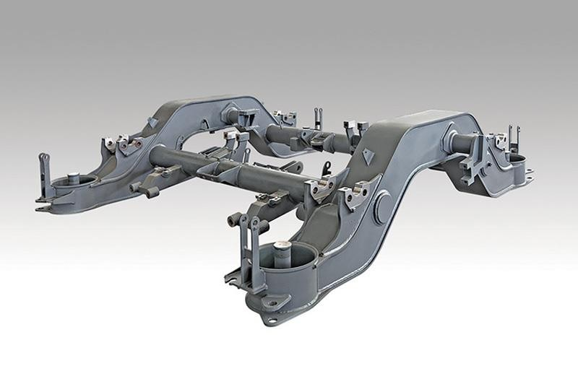
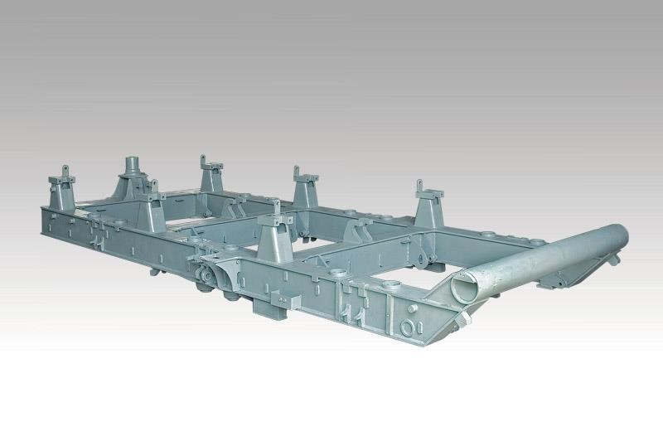
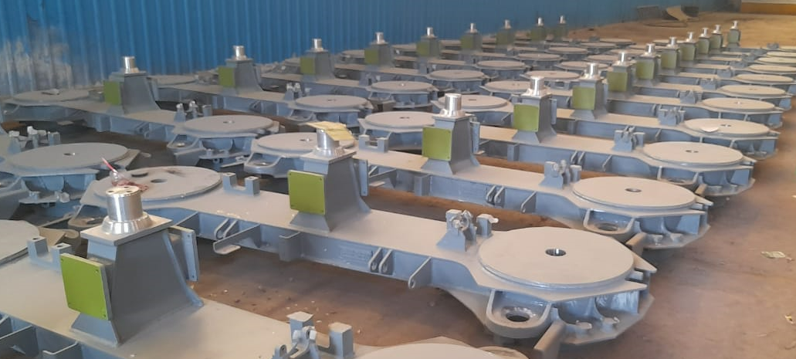
Our Existing Products
Fabricated Products
Bogie frame for Coach
Bogie frame for Locomotive
Bogie Bolster

Slide 16
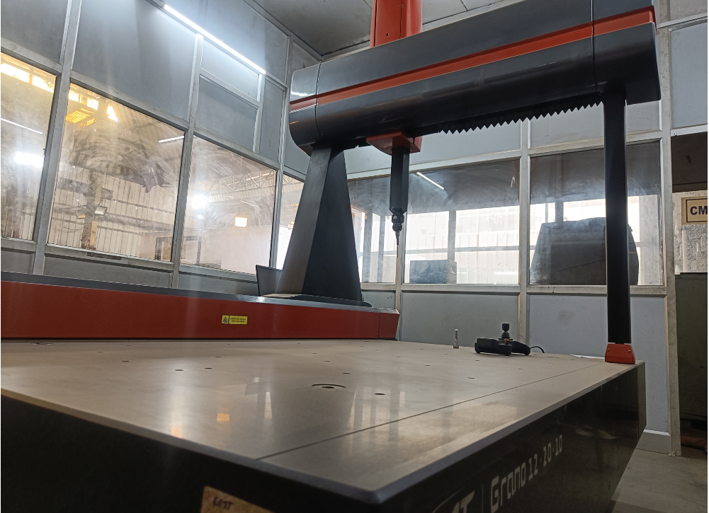
Plant Equipment's (Inspection)
Coordinate Measuring Machine (CMM)

Slide 17
Details of Unit-II
TACPL Unit-II,
ARAZI NO.-313, 317 & 318 VILLAGE
UMRAN, RANIA, KANPUR DEHAT (U.P.)
Heavy Engineering Unit & Self Propelled Vehicle Manufacturing Unit

Slide 18
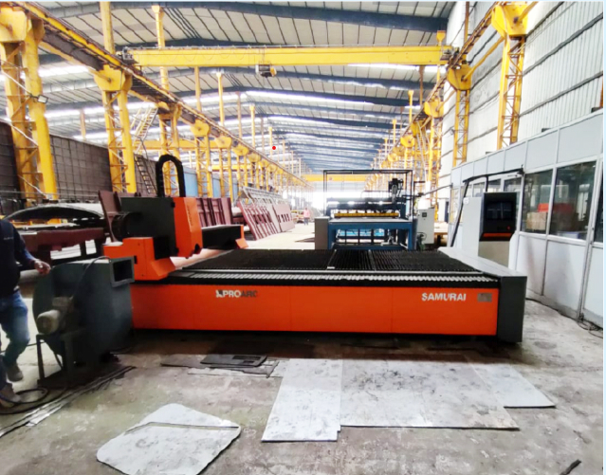
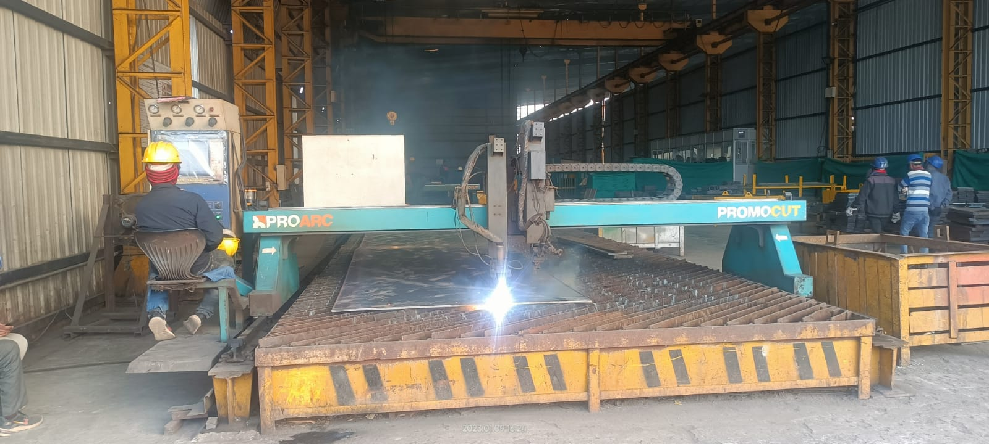
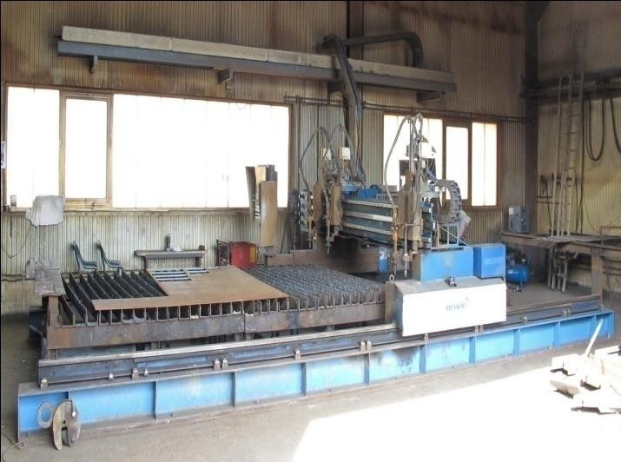
Plant Equipment's (Cutting Type)
CNC Fiber Laser Cutting Machine
CNC Plasma/Oxy Fuel Cutting Machine
Key Specification
Sr. No. | Model | PROARC Samurai Fiber
1. | Cutting Width | Up to 2000mm
2. | Cutting Length | Up to 3500mm
3. | Controller | Cypcut
4. | Laser Head | Raytools Autofocus with Open table
5. | Qty. | 01 No.
Key Specification
Sr. No. | Make | MESSER & HYPERTHERM
1. | Bed Size | 3500x12500mm
2. | Cutting Length | Up to 12300mm
3. | Cutting by Plasma | Up to 25mm
4. | Cutting by Flame | Up to 150mm
5. | Qty. | 07 Nos.

Slide 19
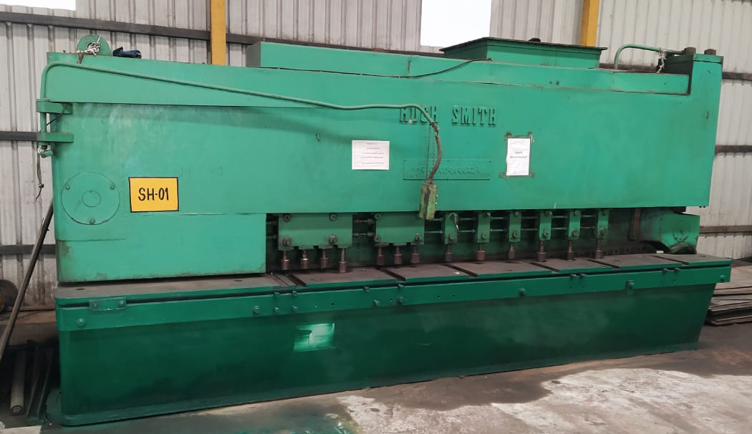
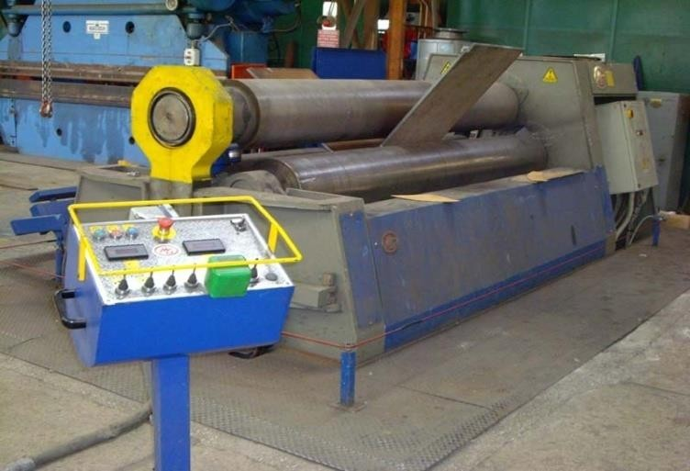
Plant Equipment's (Cutting & Rolling)
Shearing Machine
Plate Rolling Machine
Key Specification
Sr. No. | Make | Hugh Smith
1. | Cutting Width | Up to 3000mm
2. | Cutting Thickness | Up to 20 mm
3. | Qty. | 01 No.
Key Specification
Sr. No. | Make | TMT
1. | Rolling Width | Up to 2000mm
2. | Qty. | 01 No.

Slide 20
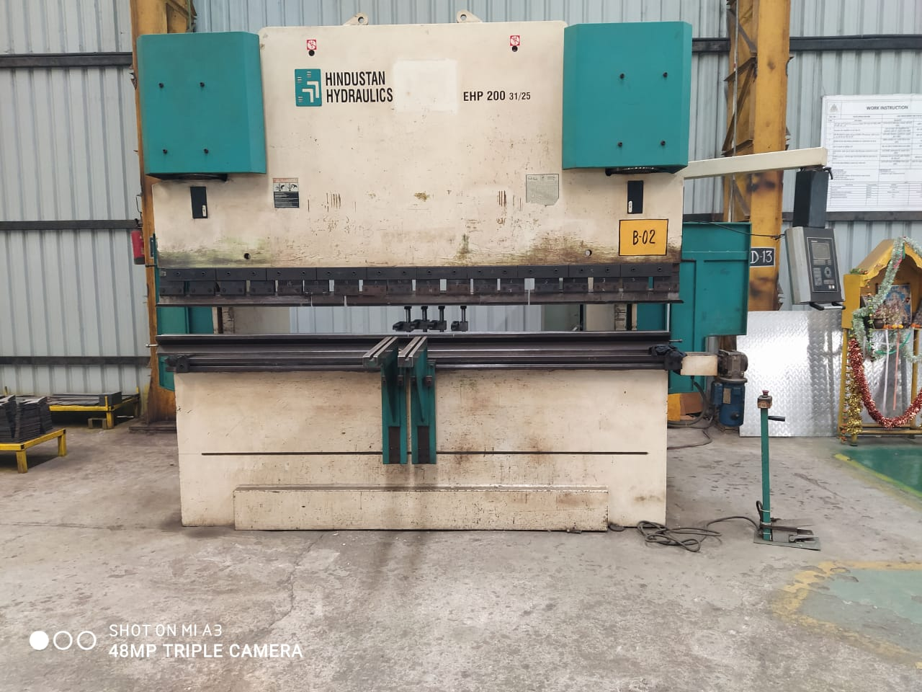
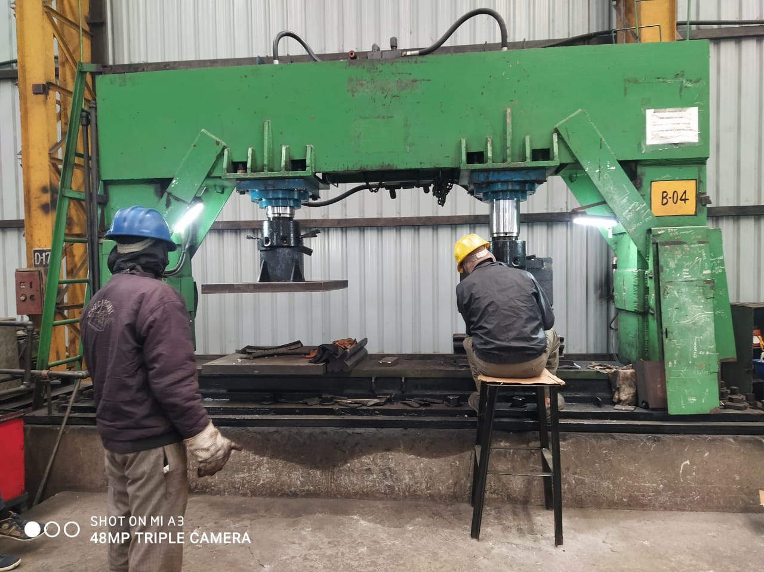
Plant Equipment's (Bending)
CNC Press Brake
Hydraulic Press
Key Specification
Sr. No. | Make | AMADA & HINDUSTAN HYDRAULICS
1. | Bed Size | 3000mm
2. | Capacity | 220 Tonns
3. | Qty. | 02 No.
Key Specification
Sr. No. | Make | RKF
1. | Bed Size Legth | 3000mm
2. | Capacity | 400 Tonns
3. | Qty. | 02 Nos.

Slide 21
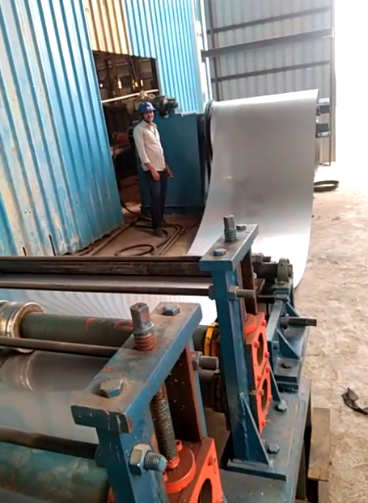
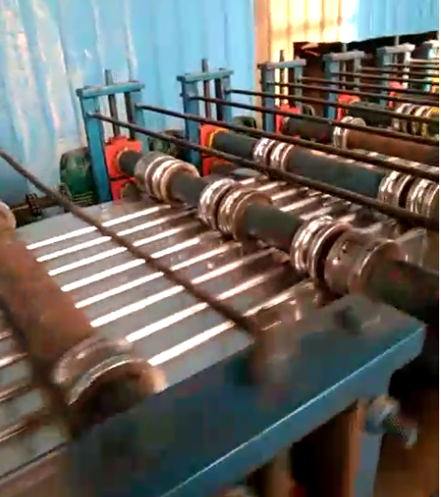
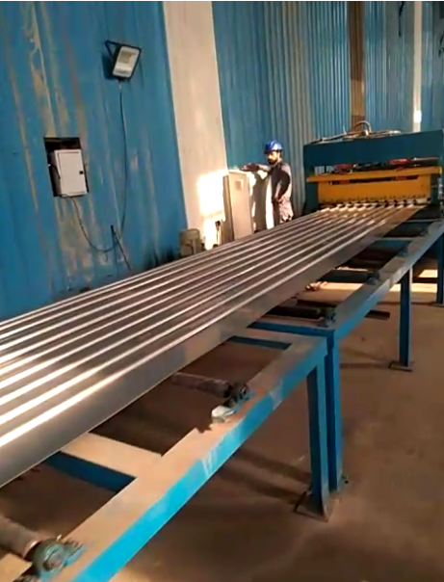
Plant Equipment's (Cold Rolled Formed {CRF})

Slide 22
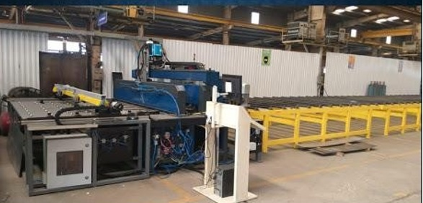

Plant Equipment's (Welding Type)
Laser Welding Machine
Spot Welding Machine
Key Specification
Sr. No. | Make | Naga Welders
1. | Type | PLC Based Auto/Manual Spot Welding
2. | Machine X & Y axis | Up to 15M. & 2M.
3. | Capacity | Up to 4 mm
Key Specification
Sr. No. | Make | Naga Welders
1. | Type | PLC Based Auto/Manual Spot Welding
2. | Machine X & Y axis | Up to 20M. & 1.6M.
3. | Capacity | 108~172 KVA

Slide 23

Plant Equipment's (Welding Type)
TIG Welding
MIG/MAG Welding
Key Specification
Sr. No. | Make | Super Sonic
1. | Capacity | Up to 300Amps
2. | Qty. | 10 Nos.
Key Specification
Sr. No. | Make | ESAB, MOGRA, ADOR
1. | Capacity | Up to 500Amps
2. | Qty. | 75 Nos.

Slide 24


Furnace
Stress Relieving Furnace
Blasting Unit
Key Specification
Sr. No. | Make | Kashyap
1. | Capacity | 700 °C
2 | Inner Size Length | 7000 mm
3 | Inner Size Width | 4000 mm
4 | Inner Size Height | 3000 mm

Slide 25


Our Existing Products
Fabricated Products
Locomotive Car Body
Coach Car Body

Slide 26




Our Existing Products
Fabricated Products
Coach Underframe
Coach End-Wall
Coach Side-Wall
Coach Roof

Slide 27

Our Existing Products
Self Propelled Rail vehicles
Utility Track Vehicle (UTV)

Slide 28



NDT Testing
Ultrasonic Testing
Liquid Penetration Test
Magnetic Particle Inspection
Radiographic Testing (RT) outsourced form Bhabha Atomic Research Centre (BRAC) approved agencies.

Slide 29



Handling Facility
Motorized Trunnions for 2 Stages of Under frames
EOT Crane Lifting capacity ranging from 5 MT up to 50 MT
Hydraulic Mobile Cranes of 9 MT to 14 MT capacity.

Slide 30
Reason to Choose Trident
Engineering & Development-: TACPL has a dedicated Engineering Department responsible for QAP, Production Process Plan, Continual Development & Implementation of changes, if required. TACPL over the years has grown from a small component manufacturer to largest Railway Car Body manufacturer for Indian Railways. TACPL has also designed and developed Diesel Hydraulic Self Propelled Track Maintenance Equipment which is working satisfactorily with Indian Railways from past 5 years. Our technical team has the intention and appetite to do much more.
Innovation and Versatility -: TACPL has always been keen on Innovation and New Developments. TACPL is continuously upgrading and adding infrastructure to work on Projects where continual improvement and innovation is desired. TACPL is focused to develop and manufacture critical components required by Ministry of Science and Technology procured through its subsidiaries in the field of Atomic Energy/Nuclear Energy.
Infrastructure-: TACPL is equipped with ample space, latest plant and machinery, professional young team guided by senior management, engineering software like solid works cad and cam, finance and back up of the same, etc.

Slide 31
Reason to Choose Trident
Capacity & Capability-: TACPL has the capacity to manufacture approx. 20000 MT per Annum of Fabrication and has a wide Precision Machining Facility too. TACPL has the capability to design and manufacture critical components for the Atomic Power/Nuclear Power Industry.
Reliability-: TACPL has always won the trust of their customers ensuring secrecy of drawings, designs, etc. Moreover commitment honoring has always been a credential for us. TACPL is relied upon by its Valuable Customers for their commitments and trust. TACPL has a strong bonding with its Valuable Customers and is always appreciated for its reliability.
Dedicated Customer Support Service-: TACPL has always been transparent with respect to their valued customers ensuring prompt actions towards their initiations and changes. Every Customer is backed by a dedicated nodal person responsible for all coordination and action.

Slide 32



Awards
High Performance in Vendor Rating received From BHEL
World Business Conclave

Slide 33



Awards
Awards received from MSME
Awards received from MSME
Young Entrepreneur Awards
received form TIE UP

Slide 34
Word of Thanks-Beam Stopper
We would like to thank the Government of India for providing us the opportunity to manufacture the Beam Stopper which is a part of the FAIR Project.
We are highly obliged to GSI/FAIR for considering us, a part of such a prestigious project
A special thanks to BOSE institute for rewarding us the Project-BEAM CATCHER
Further we would like to appreciate efforts of CMERI for guiding us in the development of project.
We assure GSI/FAIR for the timely completion of BEAM CATCHER project with installation at GSI site within stipulated time

Slide 35

Our Special Project-Beam Stopper
Super FRS fragment separator
The beam stoppers are a part of the Super-FRS fragment separator
Scope of Beam Stopper
The scope of the Beam Stopper is to stop high intensity beam with proper cooling.
Requirement of Beam Stopper
Total 3 nos. of Beam Stopper shall be manufactured for the Super-FRS FAIR project
Beam Stopper

Slide 36
Beam Stopper Project Status
Order Placed
Detailed study of drawings completed and Manufacturing Process initiated.
Bill of material completed
Manufacturing
Process
Process plan for parts and sub-assembly completed
Procurement of specified raw material is initiated
Vacuum cavity development is in process for the validation of geometrical and dimensional measurements
Inline production of Vacuum Cavity is expected to be initiated by the end of this month.
Project was awarded to M/s Trident Auto Components Private Limited on – December-2022.

Slide 37


Thank You
NAMASTE

