Slide 1
Status report about
PWO production at CRYTUR
Valerii Dormenev
Justus-Liebig-Universität, II. Physikalisches Institut, Giessen, Germany

Slide 2
CRYTUR starts PWO production in summer 2014
June 2016: The production of crystals with geometry of PANDA EMC was started
824 samples with PANDA geometries were
produced by CRYTUR,
809 samples were accepted
TYPE | Number | Produced | Rejected
3L | 74 | 73 | 1
3R | 1 | 1 | 0
4L | 71 | 71 | 0
4R | 69 | 69 | 0
5L | 66 | 66 | 0
5R | 69 | 69 | 0
6L | 53 | 53 | 0
6R | 47 | 47 | 0
7L | 69 | 69 | 0
7R | 69 | 68 | 1
8L | 51 | 51 | 0
8R | 48 | 48 | 0
10L | 6 | 4 | 2
10R | 0 | 0 | 0
11L | 98 | 88 | 10
11R | 33 | 32 | 1
Total | 824 | 809 | 15

Slide 3
Distribution of the transmittance

Slide 4
Distribution of the transmittance @ 360 nm

Slide 5
Distribution of the transmittance @ 420 nm

Slide 6
Distribution of the transmittance @ 620 nm

Slide 7
Distribution of radiation induced absorption coefficient

Slide 8
Distribution of the Light Yield

Slide 9
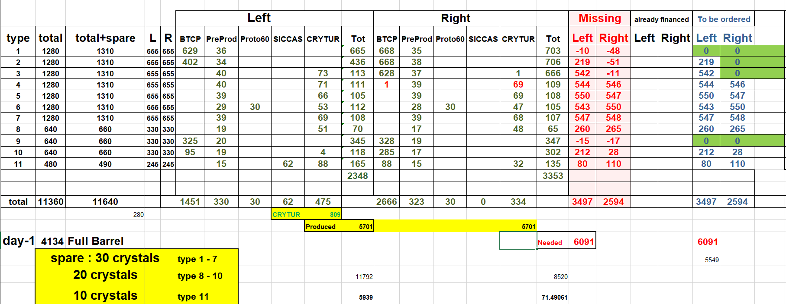
Crystal production status
Production for two slices is completed
129 crystals (3L, 4L/R, 5L/R, 6L/R, 7L/R types) are needed to complete 3rd slice
402 crystals (3L, 4L/R, 5L/R, 6L/R, 7L/R, 8L/R types) are needed to complete 4th slice
Number of needed crystals
to complete 8 slices : 2158/2225
to complete 12 slices : 3962/4073
to complete 16 slices : 6091

Slide 10
Crystal production status
Production for two slices is completed
129 crystals (3L, 4L/R, 5L/R, 6L/R, 7L/R types) are needed to complete 3rd slice
402 crystals (3L, 4L/R, 5L/R, 6L/R, 7L/R, 8L/R types) are needed to complete 4th slice
Number of needed crystals
to complete 8 slices : 2158/2225
to complete 12 slices : 3962/4073
to complete 16 slices : 6091

Slide 11
Summary
824 crystals with PANDA EMC geometry (3L/R-11L/R) were produced by CRYTUR and tested in Giessen
809 are satisfied to PANDA specification
15 crystals were rejected due to dk(420 nm) values. All other parameters satisfied to PANDA specification
Production of 23 crystals as a compensation for raw materials is in progress. After that production for PANDA EMC will be stopped
Production for two slices is completed
129 crystals (3L, 4L/R, 5L/R, 6L/R, 7L/R, 8L) are needed to complete 3rd slice
402 crystals (3L, 4L/R, 5L/R, 6L/R, 7L/R, 8L/R types) are needed to complete 4th slice
Number of needed crystals
to complete 8 slices : 2225
to complete 12 slices : 4073
to complete 16 slices : 6091
New contract with CRYTUR is needed

