Slide 1
Probing the Equation of State of Neutron-rich Matter
.
William Lynch
FRIB and MSU Department of Physics and Astronomy
C.Y. Tsang et al., (2023)
Motivation for EoS studies
Observables
Results from previous experiments observations.
What may be next?

Slide 2
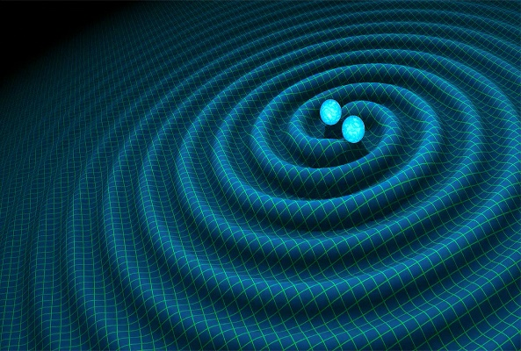
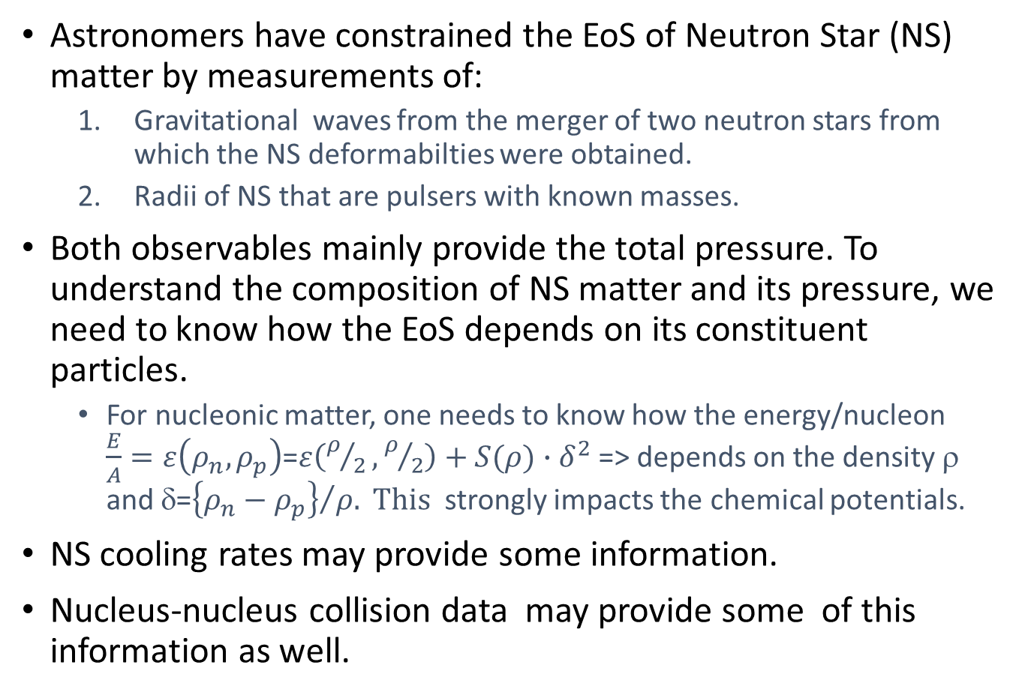
Goal: Determine how the NS EoS depends on the NS composition ⇔ clarify the role of nuclear physics.
Astronomers have constrained the EoS of Neutron Star (NS) matter by measurements of:
  Gravitational waves from the merger of two neutron stars from which the NS deformabilties were obtained.
  Radii of NS that are pulsers with known masses.
Both observables mainly provide the total pressure. To understand the composition of NS matter and its pressure, we need to know how the EoS depends on its constituent particles.
  For nucleonic matter, one needs to know how the energy/nucleon $\frac{E}{A}=ε\left(ρ_{n},ρ_{p}\right)$=$ε\left(ρ/2,ρ/2\right)+S(ρ)∙δ^{2}$ => depends on the density ρ and δ=${\left\{ρ_{n}−ρ_{p}\right\}}/{ρ. This }$ strongly impacts the chemical potentials.
NS cooling rates may provide some information.
Nucleus-nucleus collision data may provide some of this information as well.
Visualization of a NS merger and the gravitational waves it generates
Visualization of hot-spots on the 1.4 solar mass Pulser J0030+0451.

Slide 3
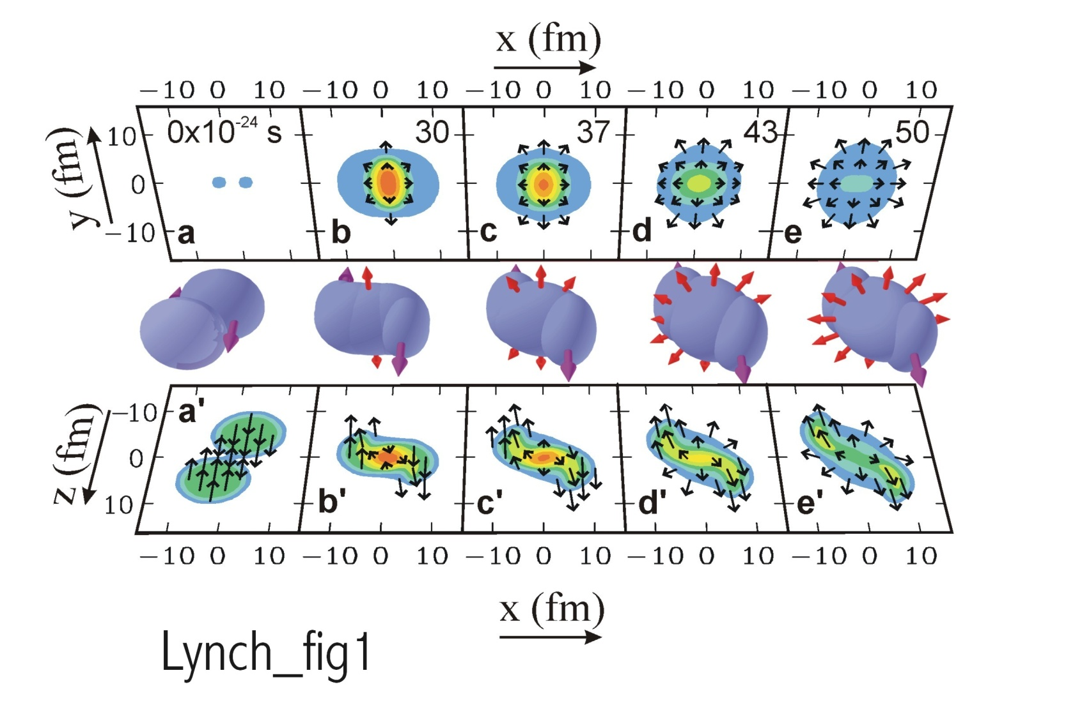
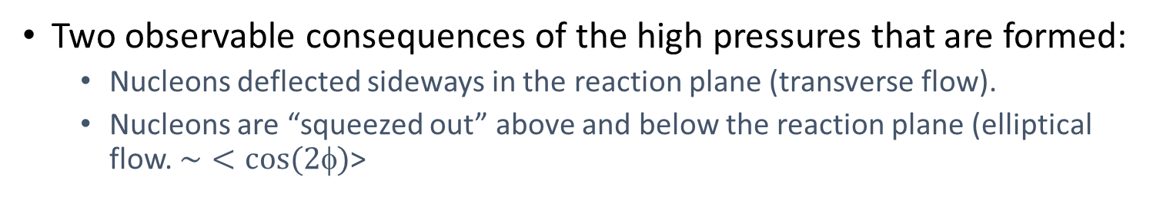
“Proof of principle” : Constraints on the Symmetric matter EoS.
Au+Au collisions E/A = 1 GeV)
Danielewicz et al., Science 298,1592 (2002).
pressure contours
Graphical representation of results from actual calculated collisions with BUU transport theory.
density contours
Two observable consequences of the high pressures that are formed:
  Nucleons deflected sideways in the reaction plane (transverse flow).
  Nucleons are “squeezed out” above and below the reaction plane (elliptical flow. $\sim <cos⁡(2φ)$>

Slide 4
Determination of symmetric matter EOS from elliptical flow, v2, and transverse flow, v1, in nucleus-nucleus collisions
  in plane
Danielewicz et al., Science 298,1592 (2002).
  out of plane
The curves labeled by K represent calculations with parameterized Skyrme mean fields
  They are adjusted to find the pressure that replicates the observed elliptical flow.
The curves labeled by K represent calculations with parameterized Skyrme mean fields
  They are adjusted to find the pressure that replicates the observed transverse flow.
Symmetric Matter EoS varied to reproduce flow data in a multi-parameter space (K_{sat}, Q_{sat}, m*/m, σ_{nn})

Slide 5
Constraints from collective flow on EOS at ρ>2 ρ₀
See Talk by
A. Sorensen
today.
Danielewicz et al., Science 298,1592 (2002).
A Sorensen, et al., Prog. Part. and Nucl. Phys. (2023).
Recent flow constraints (Le Fevre) extend the constraints to lower densities
Beam Energy Scan (BES) data (in green) can potentially produce high precision flow data but neglects the influence of nucleon effective masses. This leads to an over-estimate of the pressure from the symmetric matter EoS.
Left Panel: This constraint on the symmetric matter EoS also requires constraints on m* and σ_{NN}.
Flow indicates the increase of pressure of the EOS with increasing density.

Slide 6
Quest to obtain symmetry energy (SE) constraints from structure and HI collisions
Observables sensitive to Symmetry Energy (SE) are often expressed in terms of Taylor expansion coefficients:
Many analyses limited their studies to the correlations between S and L and stopped there.
The figure shows a frequently shown representation of the constraints in terms of a correction between the values obtained for L and S₀ by fitting various observables with a variety of symmetry energy functionals.
More quantitative information can be obtained by Bayesian or Pearson Correlation analyses etc. which identify the sensitive quantity and density at which it is constrained.

Slide 7
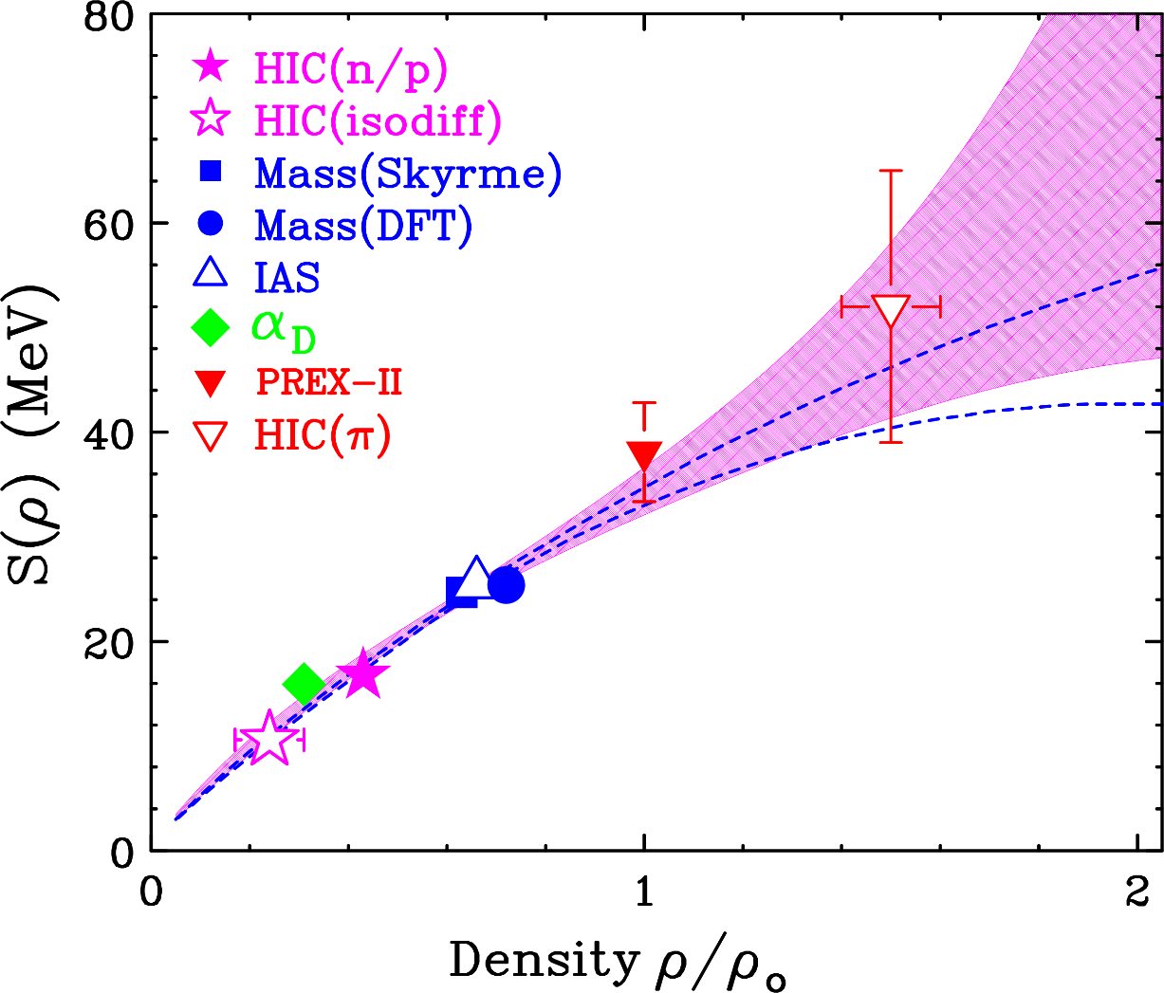
Obtaining Symmetry Energy (SE) constraints from structure and HI collisions
This requires you to:
Choose a technique to analyze the SE constraint and to determine the density probed by the observable.
Determine what quantity each observable constrains at the sensitive density, ρ_{s,} such as S(ρ_{s}), P_{sym}(ρ_{s} )= L(ρ_{s} )* ρ_{s} /3, L(ρ_{s} ), … and constrain that quantity at the sensitive density ρ_{s} where the SE was constrained.
On the left I show the symmetry functional obtained after performing such studies for 10 different observables and constraining the symmetry energy via a Bayesian analysis with this information.
The trend is statistically consistent with the symmetry energy extracted by Danielewicz and Lee (DL3).
W.G. Lynch and M.B. Tsang PLB 830, 137098 (2022)

Slide 8
List of constraints on the SE used in the fits:
Constraint | ρ/ρ₀ | S(ρ) (MeV) | L₀₁ (MeV) | L (Mev) | K_{sym} (Mev) | P_{sym} (MeV/fm³)
Masses | 0.63 | 24.7±0.8
Masses | 0.72 | 25.4±1.1
IAS | 0.66 | 25.5±1.1
HIC (I_{diff}) | 0.22 | 10.3±1.0
α_{D} | 0.31 | 15.9±1.0
HIC(n/p) | 0.43 | 16.8±1.2
PREXII | 0.67 |  | 71.5±22.6
HIC(π) | 1.45 | 52±13 |  | 79.5±38 | 47±256 | 10.9±8.7
HIC(n/p flow) | 1.5 |  |  | 85±0.8 | 96±390 | 12.1±8.4
W.G. Lynch and M.B. Tsang PLB 830, 137098 (2022)

Slide 9
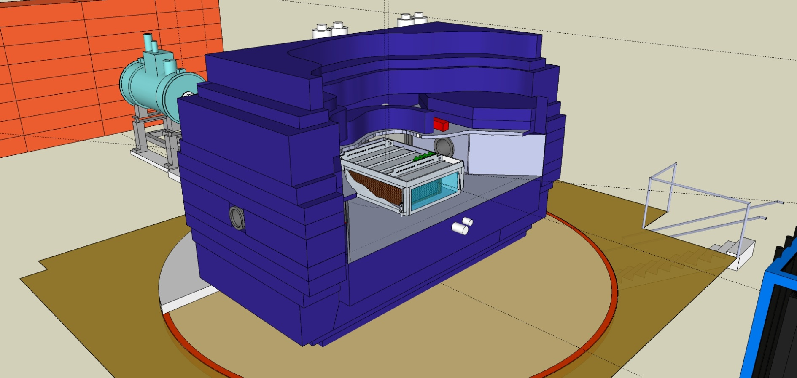
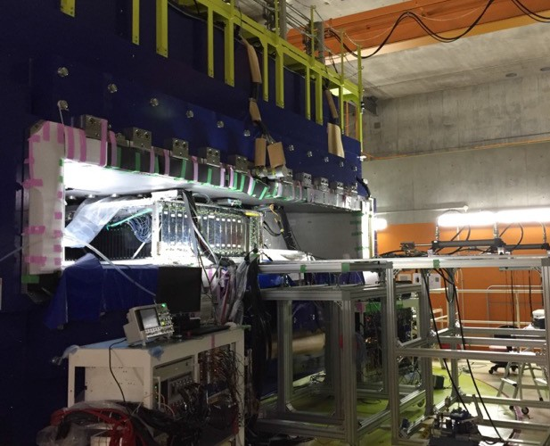

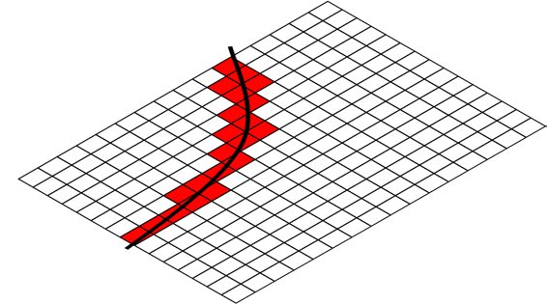
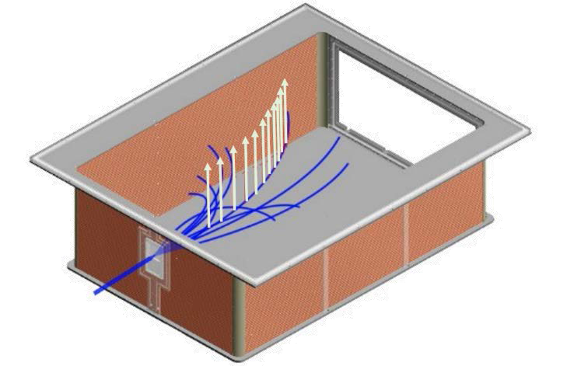
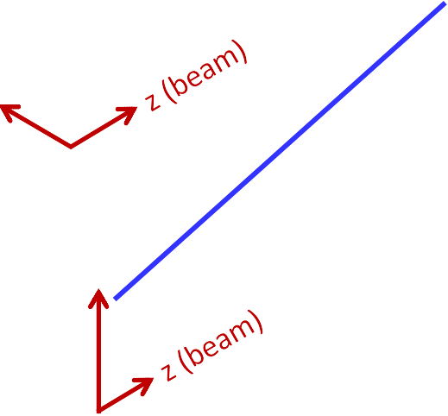

NIMA 784 (2015) 513
SπRIT-TPC
for the measurement of charged particles in HIC
SAMURAI dipole magnet
80cm
B field
We measured both pion production and flow.
Here, I focus discuss only the pion production.
Flow talk: Mizuki (today), Tsang (Thurs)
53cm
E field
x
y

Slide 10
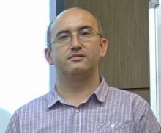
Pion Spectral Ratios
Estee et al, PRL 126, 162701 (2021)
The pion spectra at high p_{T} reflect the accelerations of the nucleons due to the local and non-local isovector mean field potentials that control the symmetry energy.
The discrepancy may reflect the contribution of non-resonant pion production that is neglected in the current calculations. The discrepancy is independent of the asymmetry of the system. This discrepancy is absent in the pion spectral double ratio.
Raising the bombarding energy is an important test of this interpretation because it will decrease the relative contributions of non-resonant pion production and check and reduce the role of the Δ potentials.
Dan Cozma: dcQMD
Shaded region show calculated double ratio for for L=77±28 MeV
See Talk by
D. Cozma
on Tues.
Dan Cozma

Slide 11
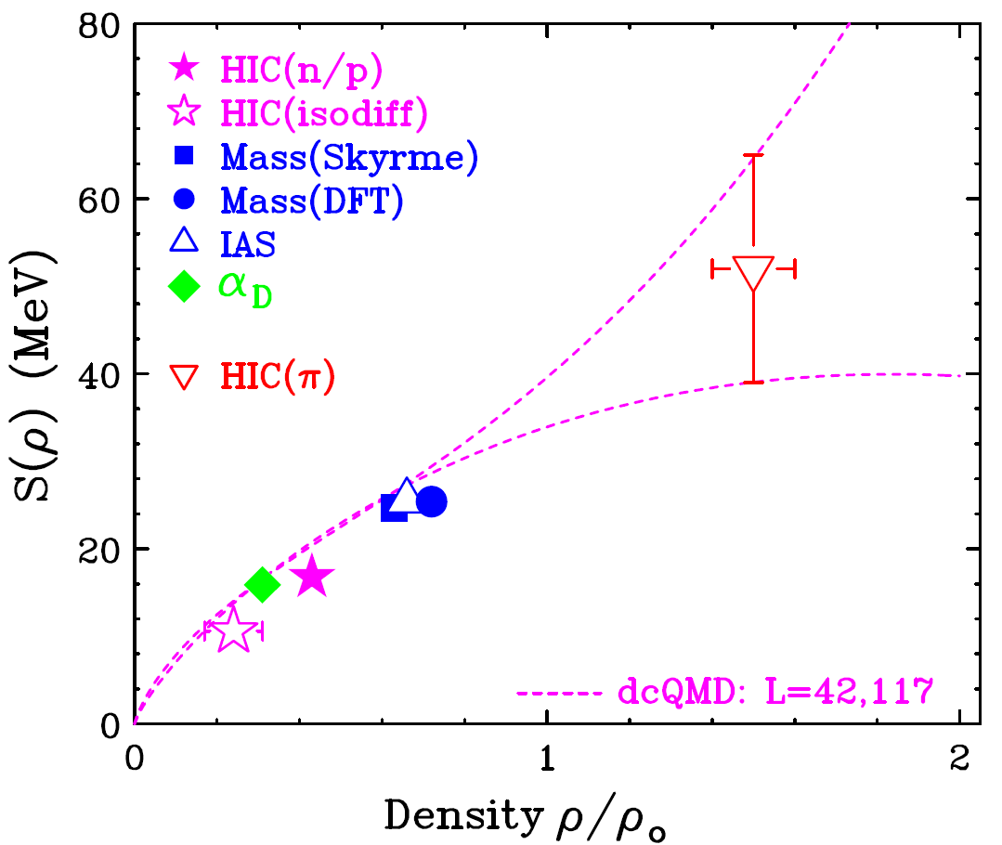
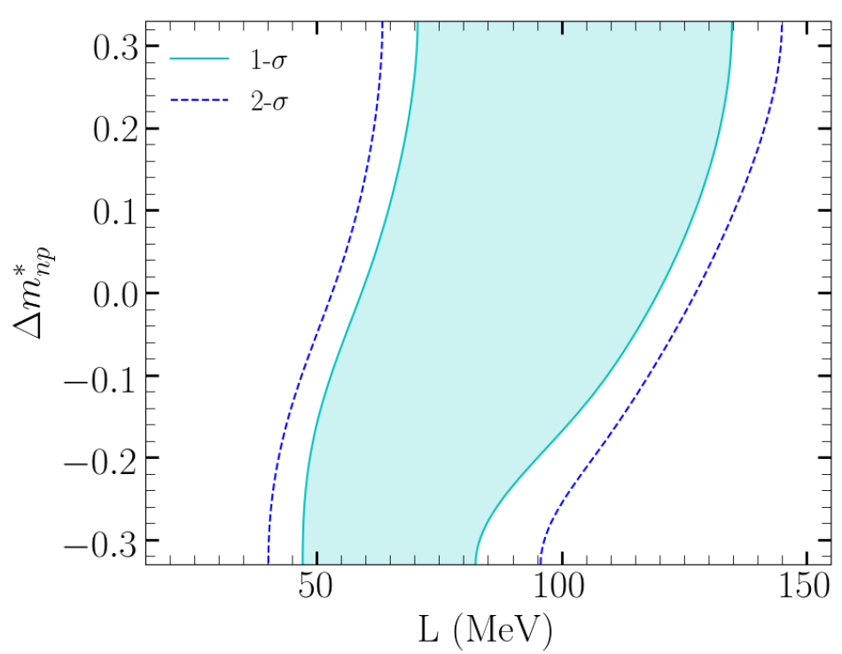
Constraints from pion spectral ratios
Estee et al, PRL 126, 162701 (2021)
Dan Cozma: dcQMD

Slide 12
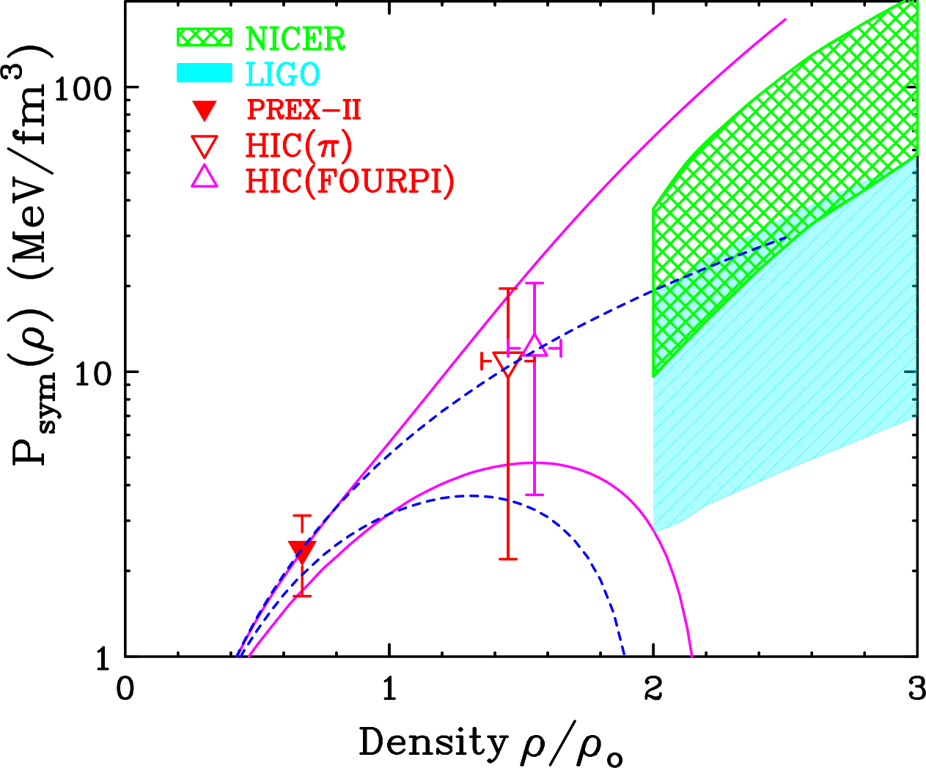
Bayesian Determination of pressure
Some observables like neutron skins or collective flows are sensitive to L or the pressure.
In our analyses, these were the neutron skins of nuclei, flows and, to some extent, pion production.
To compare to representative values for symmetry pressures consistent with NICER radii or LIGO deformabilities, we took their Neutron star EoS and subtracted the experimental symmetric matter EoS. These neutron star densities and pressures are rough and included only for illustration.
W.G. Lynch and M.B. Tsang PLB 830, 137098 (2022)

Slide 13
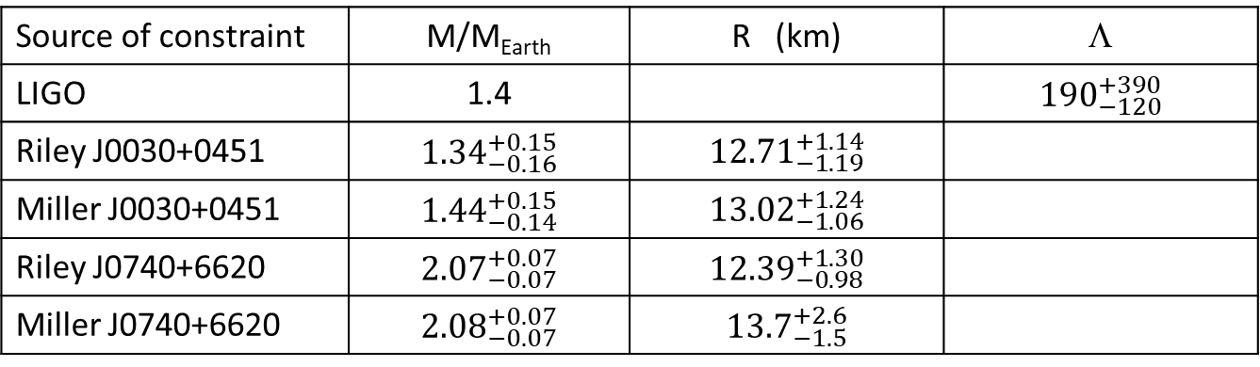
Applying constraints from neutron stars and flow from the symmetric matter EoS
What happens when you combine such Symmetry Energy constraints with symmetric matter, NICER and LIGO-VIRGO constraints?
C.Y. Tsang et al., (2023)
Source of constraint | ρ (fm⁻³) | P_{SM} (MeV/fm³) | K_{nm}
Flow (Science) | 0.32 | 10.1±3.0
Flow (Fopi) | 0.32 | 10.1±2.8
GMR systematics | 0.16 |  | 230±30 MeV
Source of constraint | M/M_{Earth} | R (km) | Λ
LIGO | 1.4 |  | $${190}_{−120}^{+390}$$
Riley J0030+0451 | $${1.34}_{−0.16}^{+0.15}$$ | $${12.71}_{−1.19}^{+1.14}$$
Miller J0030+0451 | $${1.44}_{−0.14}^{+0.15}$$ | $${13.02}_{−1.06}^{+1.24}$$
Riley J0740+6620 | $${2.07}_{−0.07}^{+0.07}$$ | $${12.39}_{−0.98}^{+1.30}$$
Miller J0740+6620 | $${2.08}_{−0.07}^{+0.07}$$ | $${13.7}_{−1.5}^{+2.6}$$

Slide 14
Results of combined Bayesian analysis for nuclear and neutron star data:
C.Y. Tsang et al., (2023)
Symmetric matter pressure
Symmetry energy
Symmetry pressure
Trends of the nuclear data are reproduced

Slide 15
Results of combined Bayesian analysis for nuclear and neutron star data:
C.Y. Tsang et al., (2023)
Symmetric matter pressure
Symmetry energy
Symmetry pressure
The experimental and astronomical trends are well reproduced.
While uncertainties of experimentally constrained symmetry energy remain large, it allows for direct Urca Cooling, which is a possible explanation of the rapid cooling.
Cassiopia A. (L, B. Leinson, MNRAS 511, 5843-5848 (2022)) .
Talk by
L. Suleiman tomorrow

Slide 16
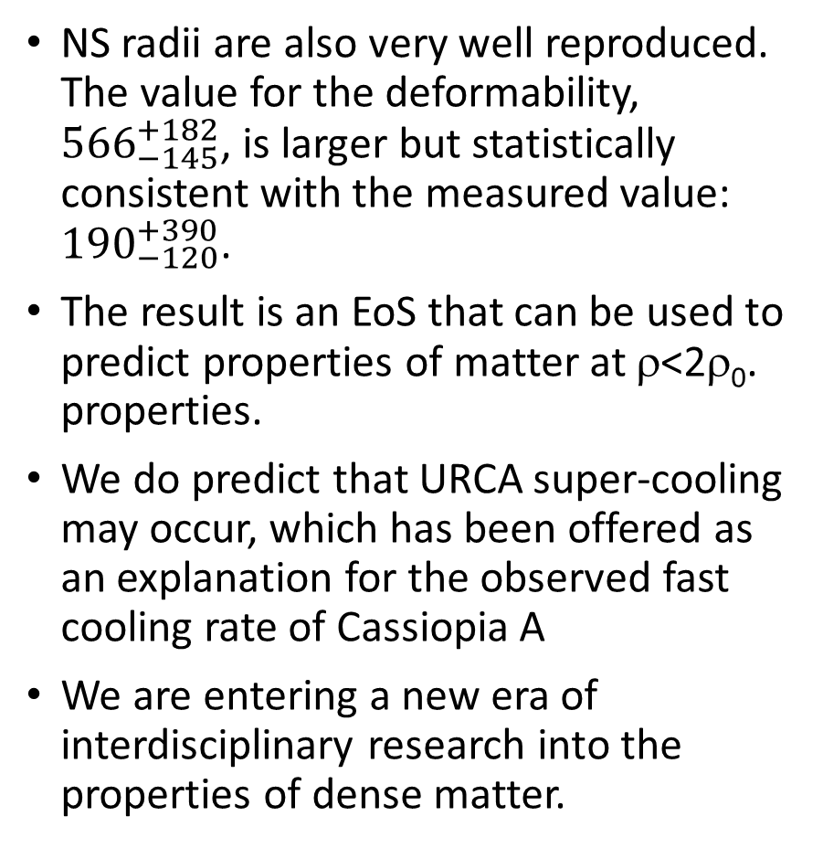
Results for Astrophysical Data
NS radii are also very well reproduced. The value for the deformability, ${566}_{−145}^{+182}$, is larger but statistically consistent with the measured value: ${190}_{−120}^{+390}$.
The result is an EoS that can be used to predict properties of matter at ρ<2ρ₀. properties.
We do predict that URCA super-cooling may occur, which has been offered as an explanation for the observed fast cooling rate of Cassiopia A
We are entering a new era of interdisciplinary research into the properties of dense matter.
C.Y. Tsang et al., (2023)

Slide 17
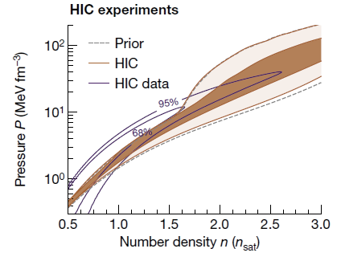
Difference between our NS EoS and that of Huth et al.,
Huth et al. chose the prior distribution given by χEFT. That prior distribution completely excludes the stiffer EoS’s preferred by the flow data at 0.5<ρ/ρ₀<1.5 included in the Bayesian Analysis. Without their restrictive prior, the results would be more similar at all densities
Huth et al.,
Nature 606, 276 (2022).
C.Y. Tsang et al., (2023)
χEFT prior
prior
post
Talk by A. Le Fevre
Tue. Afternoon

Slide 18
Summary and Outlook
Neutron star
There are now several examples of how to combine experimental data, astrophysical data and theory to extract meaningful information about the nuclear EoS.
Combining high density constraints with constraints at low density from nuclear structure, reactions and astronomy leads to a statistically consistent picture.
Both our work and the recent work of [Huth et al, Nature 606, (2022) 275] illustrate the power of combining constraints involving nuclear reactions, nuclear structure, and neutron star observations

Slide 19

































Jon Barney
Justin Estee
Suwat Tangwangchoen
Masanori Kaneko
JungWoo Lee
Genie Jhang
Yan Zhang
Pawel Lasko
RenSheng Wang
Tommy Tsang
https://groups.nscl.msu.edu/hira/cosmic/SpiritTPC.html

Slide 20
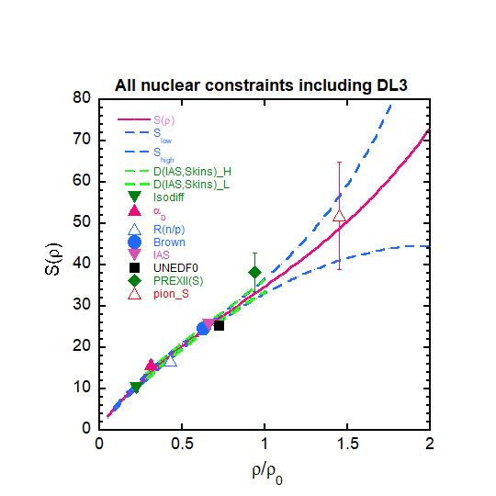
How does the purely nuclear symmetry energy compare to that from Danielewicz with IAS and Isovector skins from charge exchange reactions?
Answer is that they are similar symmetry energies
10 nuclear constraints.
\

Slide 21
Constraining the Symmetry energy
Early symmetry energy constraints focused on correlations between

Slide 22
Obtaining Symmetry Energy (SE) constraints from structure and HI collisions
Explored with SπRIT
Find observables sensitive to Symmetry Energy (SE)
Often, this sensitivity is expressed in terms of Taylor expansion coefficients:
Choose a technique to analyze the SE constraint, such as Bayesian inference, Pearson correlations, crossover technique, analysis of the correlations of fit parameters along curves of constant χ².
Determine what quantity each observable constrains at the sensitive density, ρ_{s,} such as S(ρ_{s}), P_{sym}(ρ_{s} )= L(ρ_{s} )* ρ_{s} /3, L(ρ_{s} ), … and at the sensitive density ρ_{s} where the SE was constrained.
Combined these constraints with constraints from other sources to obtain the symmetry energy over a range of densities
Symmetric Matter Observable | ρ/ρ₀ | Symmetry Energy Observable | ρ/ρ₀
GMR | .95-1.05
Elliptical flow | 1.5-4.5 | Elliptical flows | ~1.5
Transverse flow | 1.5-4.5 | Transverse flows | ~1.5
 |  | Spectral ratios (n/p) (d/p),(t/p)
 |  | Isospin diffusion | 0.17-0.31
 |  | Pion p_{T} spectra | ~1.45

Slide 23
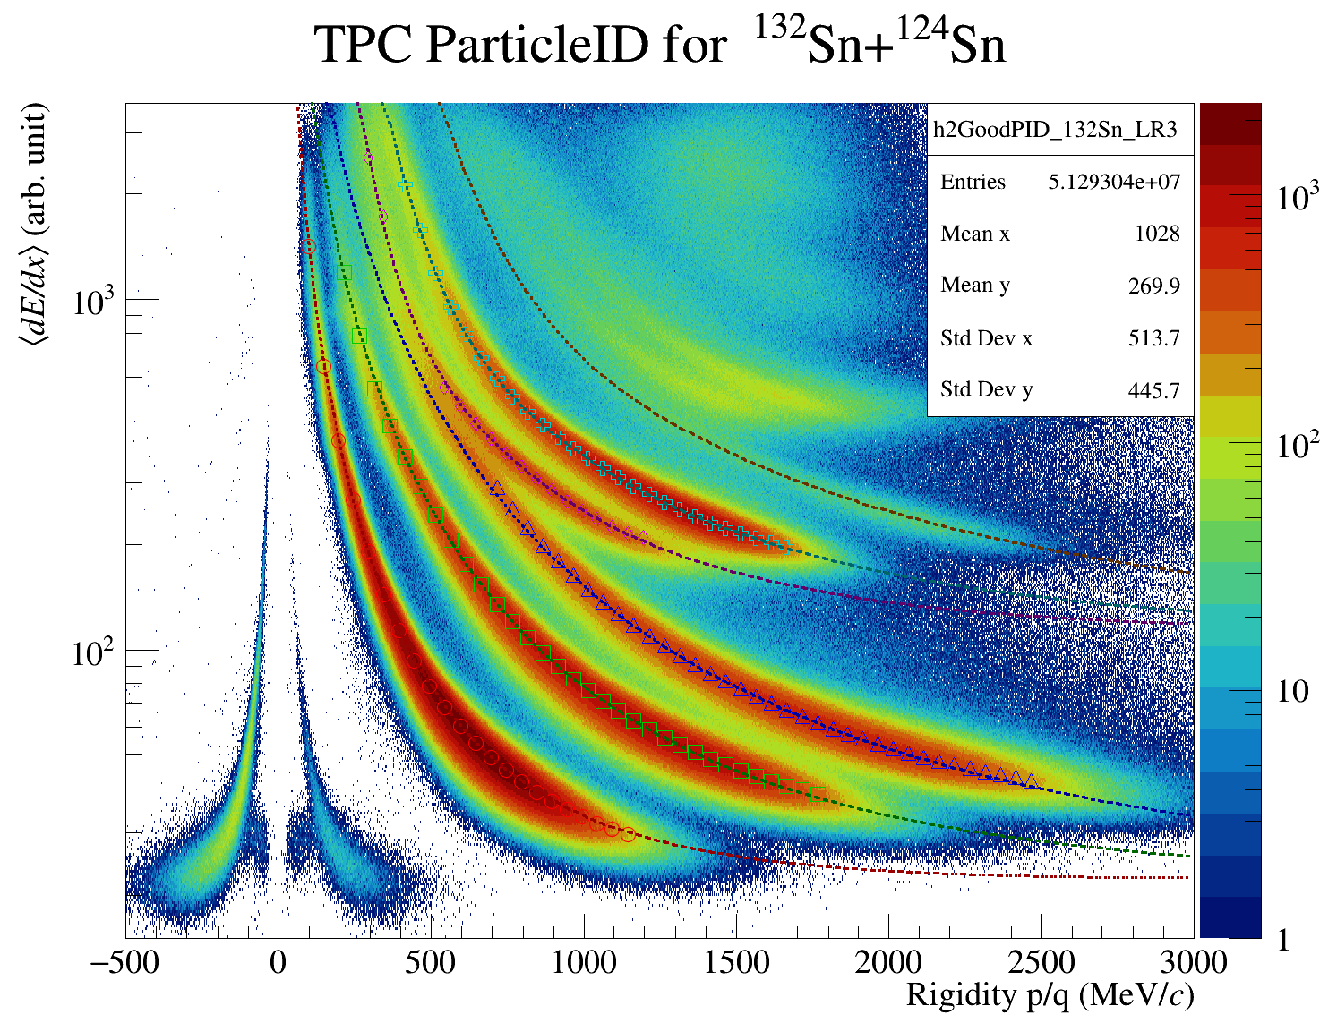

Particle identification by TPC
¹³²Sn + ¹²⁴Sn E_{beam}=270 AMeV
Use of wire plane allowed use of more distance pads to correct for saturation effects on high z particles.
Achieved an linear response over an effective dynamic range of about 4000 to one.
⁷Li
⁶Li
⁶He
³He
⁴He
t
d
π⁻
π⁺
p

Slide 24
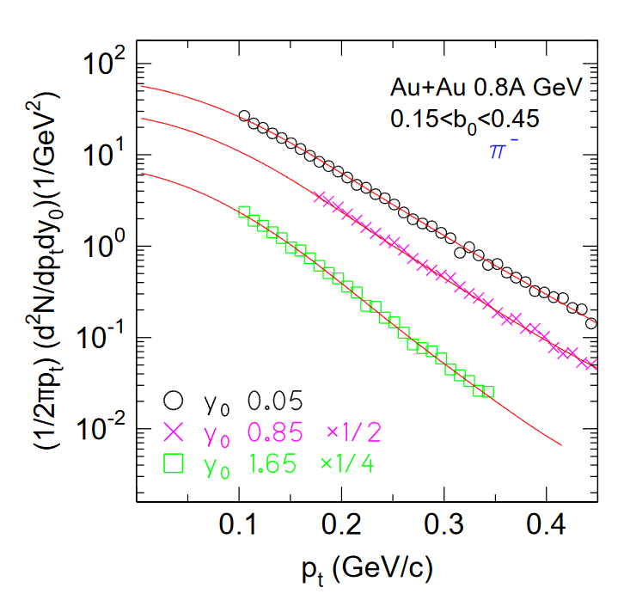
Previous calculations optimized the Δ potentials to describe Au+Au collisions at 400 MeV
Extrapolated region
See Talk by
D. Cozma
on Wed.
Spirit data are the first data which measures the full pion spectra to a high degree of accuracy
Previous data sets (FOPI) were not measured to peak in the pion spectra to low pion energies
  Around 55% of their data is extrapolated to low energies using theory.
  The variations in the predictions for total pion multiplicities strongly reflect differences in the the mean field potentials for Δ baryons, without which the total multiplicities cannot be predicted.
  Mean field potentials for Δ baryons are adjusted in current analyses to reproduce the observed pion multiplicities.

Slide 25
Obtaining Symmetry Energy (SE) constraints from structure and HI collisions
Find observables sensitive to Symmetry Energy (SE)
Often, this sensitivity is expressed in terms of Taylor expansion coefficients:
Choose a technique to analyze the SE constraint, such as Bayesian inference, Pearson correlations, crossover technique, analysis of the correlations of fit parameters along curves of constant χ².
Determine what quantity each observable constrains at the sensitive density, ρ_{s,} such as S(ρ_{s}), P_{sym}(ρ_{s} )= L(ρ_{s} )* ρ_{s} /3, L(ρ_{s} ), … and at the sensitive density ρ_{s} where the SE was constrained.
Combined these constraints with constraints from other sources to obtain the symmetry energy over a range of densities
W.G. Lynch and M.B. Tsang PLB 830, 137098 (2022)

Slide 26
Previous calculations optimized the Δ potentials to describe Au+Au collisions at 400 MeV
Extrapolated region
See Talk by
D. Cozma
on Wed.
Spirit data are the first data which measures the full pion spectra to a high degree of accuracy
Previous data sets (FOPI) were not measured to peak in the pion spectra to low pion energies
  Around 55% of their data is extrapolated to low energies using theory.
  The variations in the predictions for total pion multiplicities strongly reflect differences in the the mean field potentials for Δ baryons, without which the total multiplicities cannot be predicted.
  Mean field potentials for Δ baryons are adjusted in current analyses to reproduce the observed pion multiplicities.

Slide 27
Details of the parameterizations of symmetric matter EoS and the symmetry energy
For the symmetric matter EoS we use:
Here
The exact expressions for E_{kin} and S_{kin} are include because their Taylor expansions have radii of convergence = n₀ due to their branch cut singularies at n=0.
Note that E_{kin} and S_{kin} are inversely proportional to the isoscalar and isovector effective masses, respectively.

Slide 28
New constraint on isovector effective mass from flow
Measurements:
Comparison of experiment to calculations.
Transverse and elliptical flow for neutron rich ¹³²Sn+¹²⁴Sn, neutron-deficient ¹⁰⁸Sn+¹¹²Sn, and stopping (varxz) in ¹¹²Sn+¹²⁴Sn collisions.
Performed Bayesian analysis with the pion constraint on L as a prior distribution.
The flow values are somewhat larger for the more isospin asymmetric ¹³²Sn+¹²⁴Sn system.
The post distribution suggests a strong dependence on the effective mass difference and favors L=76 ±29 MeV and
Model dependence of this result?

Slide 29
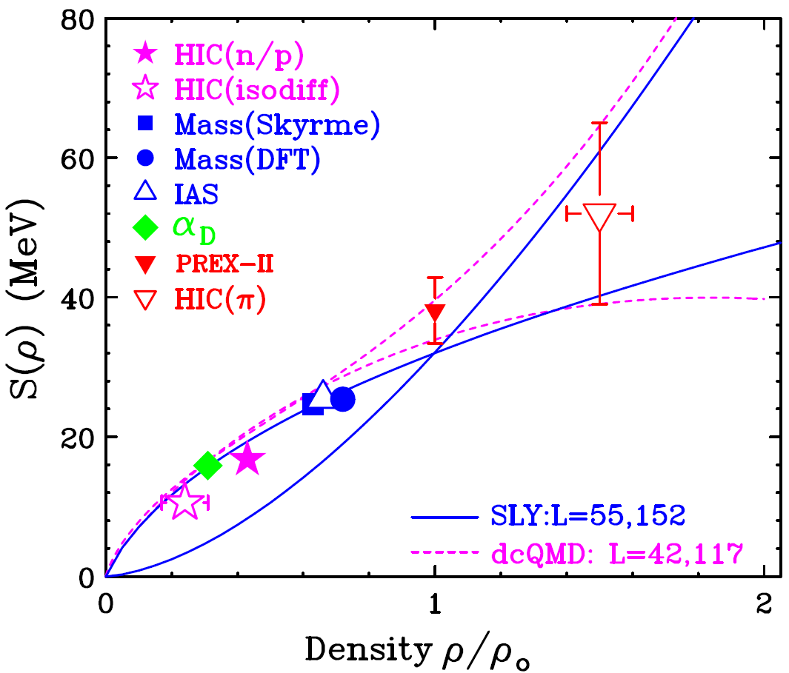
Exception: State of the art AMD transport code that calculates clusters dynamically
Transport model Symmetry energy functions
Ratios of light cluster spectra
M. Kaneko, A.Ono et al. PLB 822146681 (2021)
Describes cluster production and also the overall
density dependence of symmetry energy more poorly
Brown for SLY L=55 agrees better with the overall symmetry energy constraints.

Slide 30
Nuclear structure problem: Cluster production
Complication: Cluster production influences the calculations of nucleon emission below E/A=400 MeV. Most current transport models don’t properly take BE of clusters with A≥4 into account.
This is not a large problem at high energies where the large entropies suppress the emission of such clusters. If necessary, one can either combine neutrons into clusters at low “freezeout” densities or break them up to make “coalescence invariant” neutron and proton yields, eg. for neutrons:
M. Oertel, et al Rev. Mod. Phys. 89, 015007-1 (2017)
To go beyond this approximation, one can increase the number of species in the transport code to include light particles and heavier fragments
This is challenging because these clusters and fragments do not exist in dense matter. They are produced at ρ< ρ₀/2 by nucleation (A<5) and spinodal decomposition (A>3).
Notes:
FOr lack of time, I will present the data in terms of the double ratio that i discussed earlier. At energies less than 40 MeV check this value, we have an increasing contribution from light bound clusters such as d,t 3h3 and alphas that the imquand theory does not predict accurately beaue it deos not have the correct QM binding energies for example. So to extend our comparison to theory to lower energies we combined both theory and experiment in coalexcenc invariant neutron adn proton spectra. we see that we have small enough error bards to distinquish the effets of the effective masses. Let’ s see what other calculations provide
Add key for regions of effective mass.

Slide 31
Obtaining Symmetry Energy (SE) constraints from structure and HI collisions
This requires you to:
Choose a technique to analyze the SE constraint, to determine the density probed by the observable.
Determine what quantity each observable constrains at the sensitive density, ρ_{s,} such as S(ρ_{s}), P_{sym}(ρ_{s} )= L(ρ_{s} )* ρ_{s} /3, L(ρ_{s} ), … and constrain that quantity at the sensitive density ρ_{s} where the SE was constrained.
On the left I show the symmetry functional obtained after performing such studies for 10 different observables and constraining the symmetry energy via a Bayesian analysys with this information.
The trend at is statistically consistent with the symmetry energy extracted by Danielewicz and Lee (DL3).
W.G. Lynch and M.B. Tsang PLB 830, 137098 (2022)

Slide 32
Bayesian Determination of pressure
Some observables like neutron skins or collective flows are sensitive to L or the pressure.
In our analyses, these were the neutron skins of nuclei, flows and, to some extent, pion production.
To compare to representative values for symmetry pressures consistent with NICER radii or LIGO deformabilities, we took their Neutron star EoS and subtracted the experimental symmetric matter EoS. These neutron star are rough and included only for illustration.
W.G. Lynch and M.B. Tsang PLB 830, 137098 (2022)
(n/p)

