Slide 1
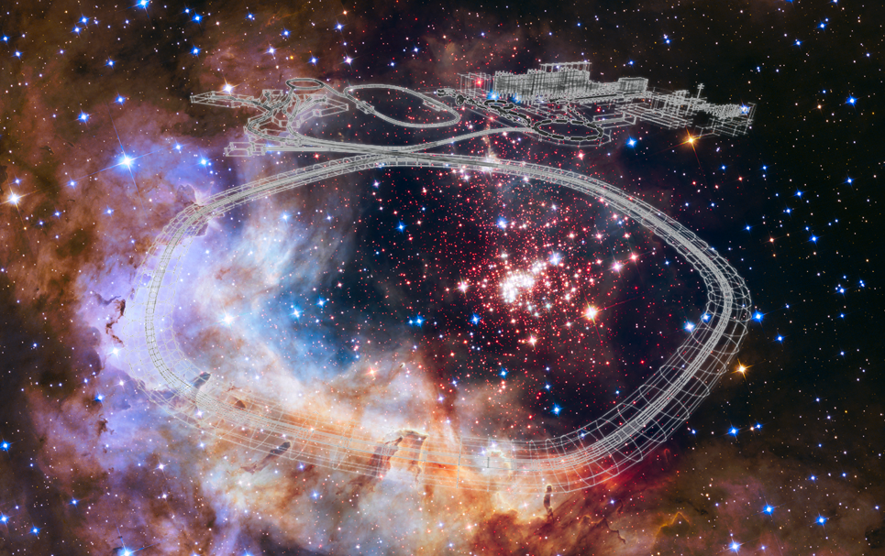


Welcome to GSI and FAIR
NUSYM23
Paolo Giubellino

Slide 2
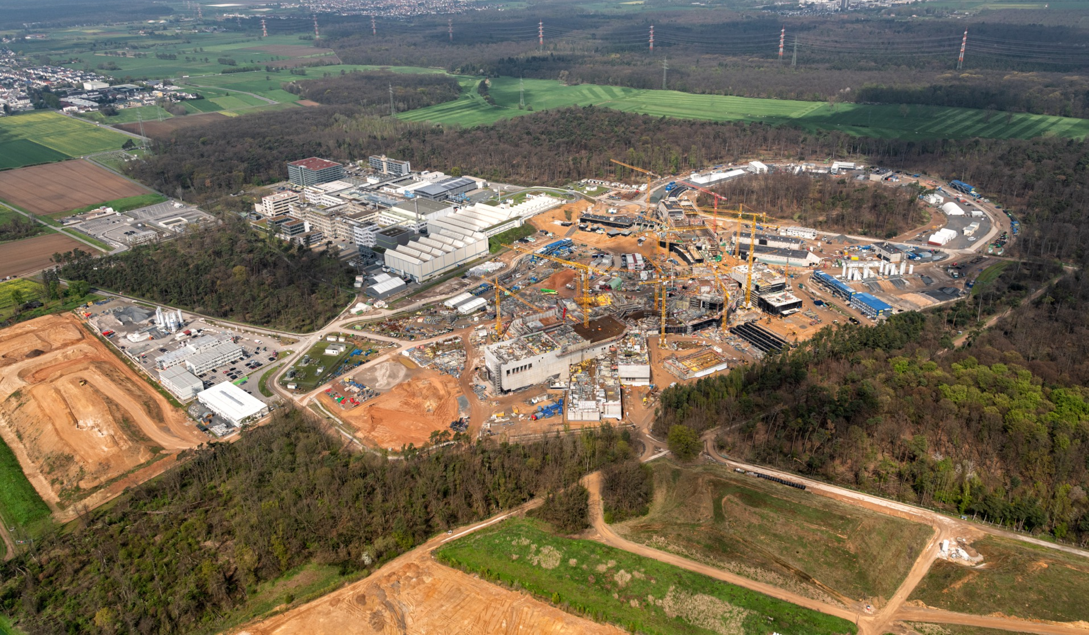
Where do we stand? Concrete works in North and South areas finished by end of the year
SIS100
CRYO 2
APPA
CBM
S-FRS
NUSTAR LEB
NUSTAR HEB
See next presentation
Movie on https://edms.cern.ch/file/2893949/LATEST/FAIR*.mp4
April 2023

Slide 3
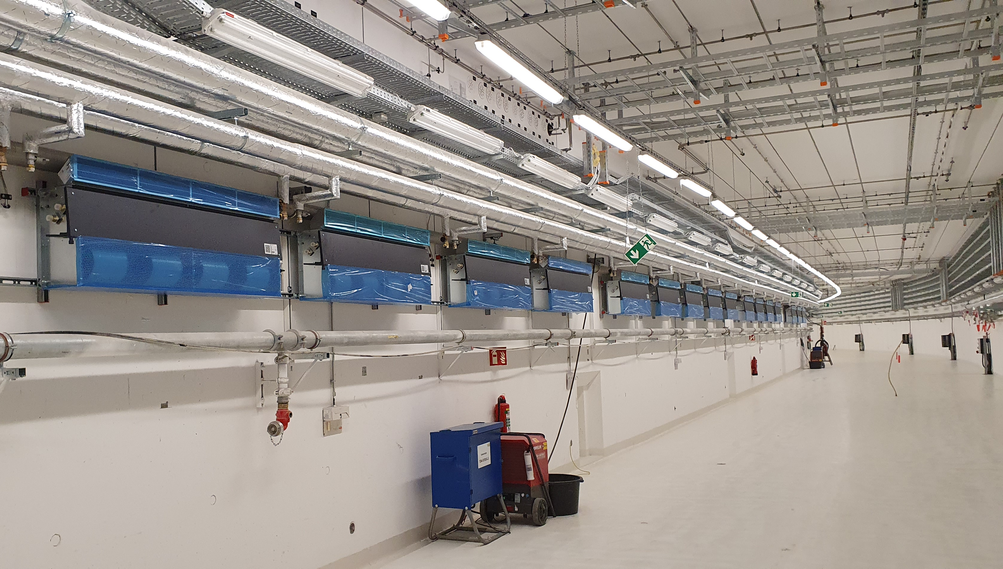
FAIR SIS100 accelerator tunnel

Slide 4
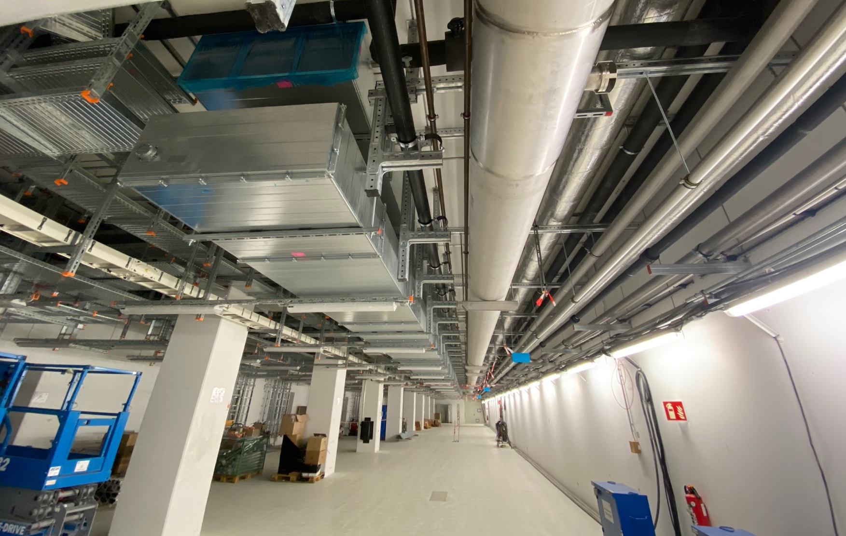
FAIR SIS 100 supply tunnel
April 2023

Slide 5
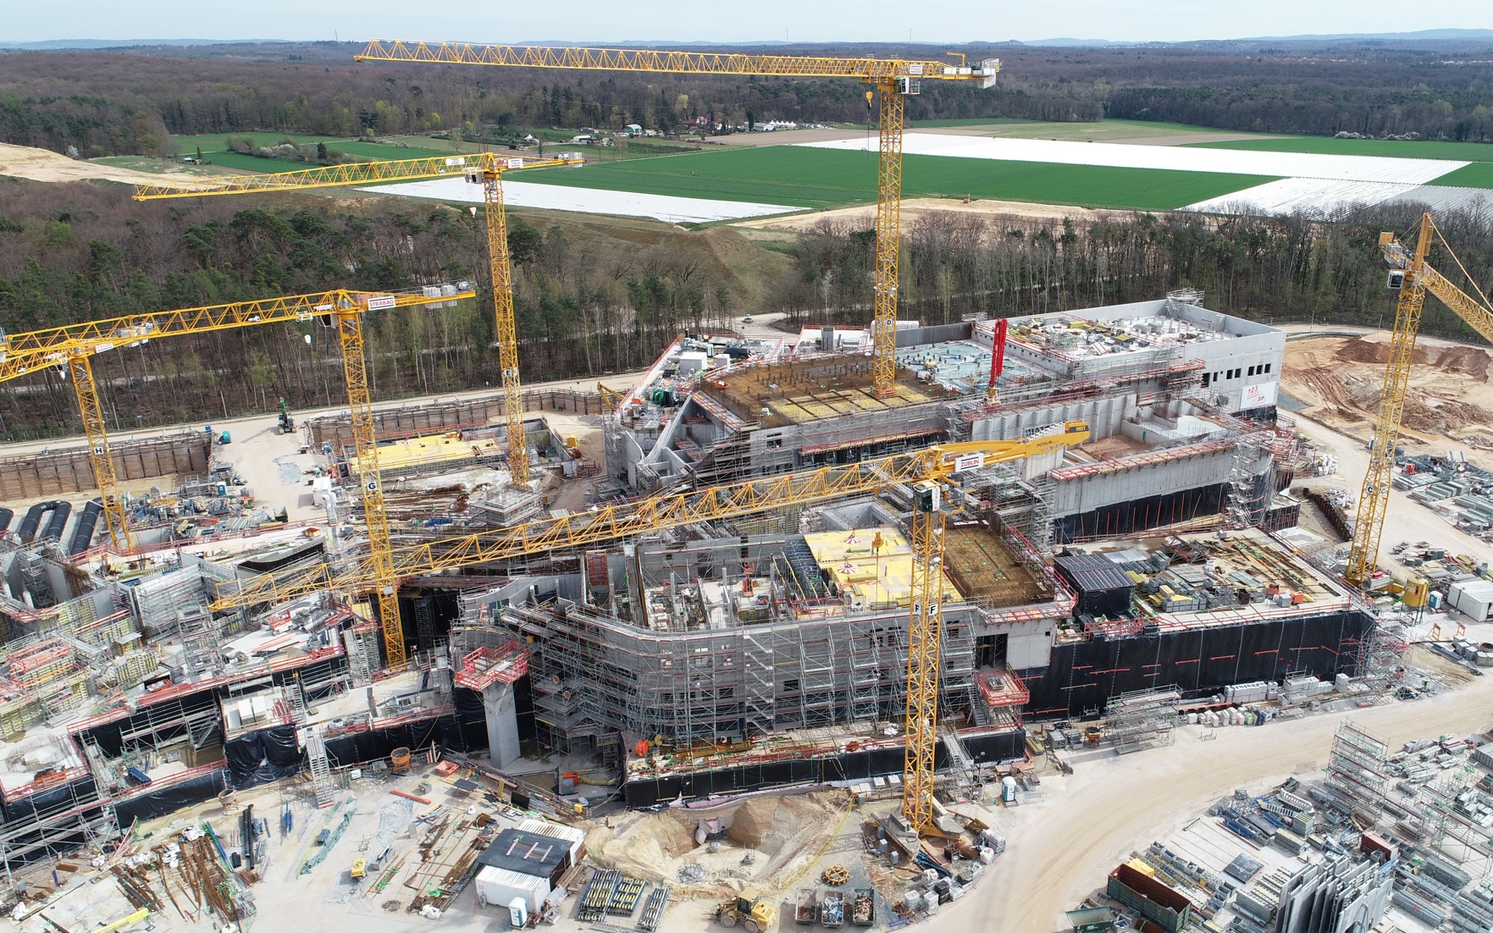
FAIR Area South

Slide 6
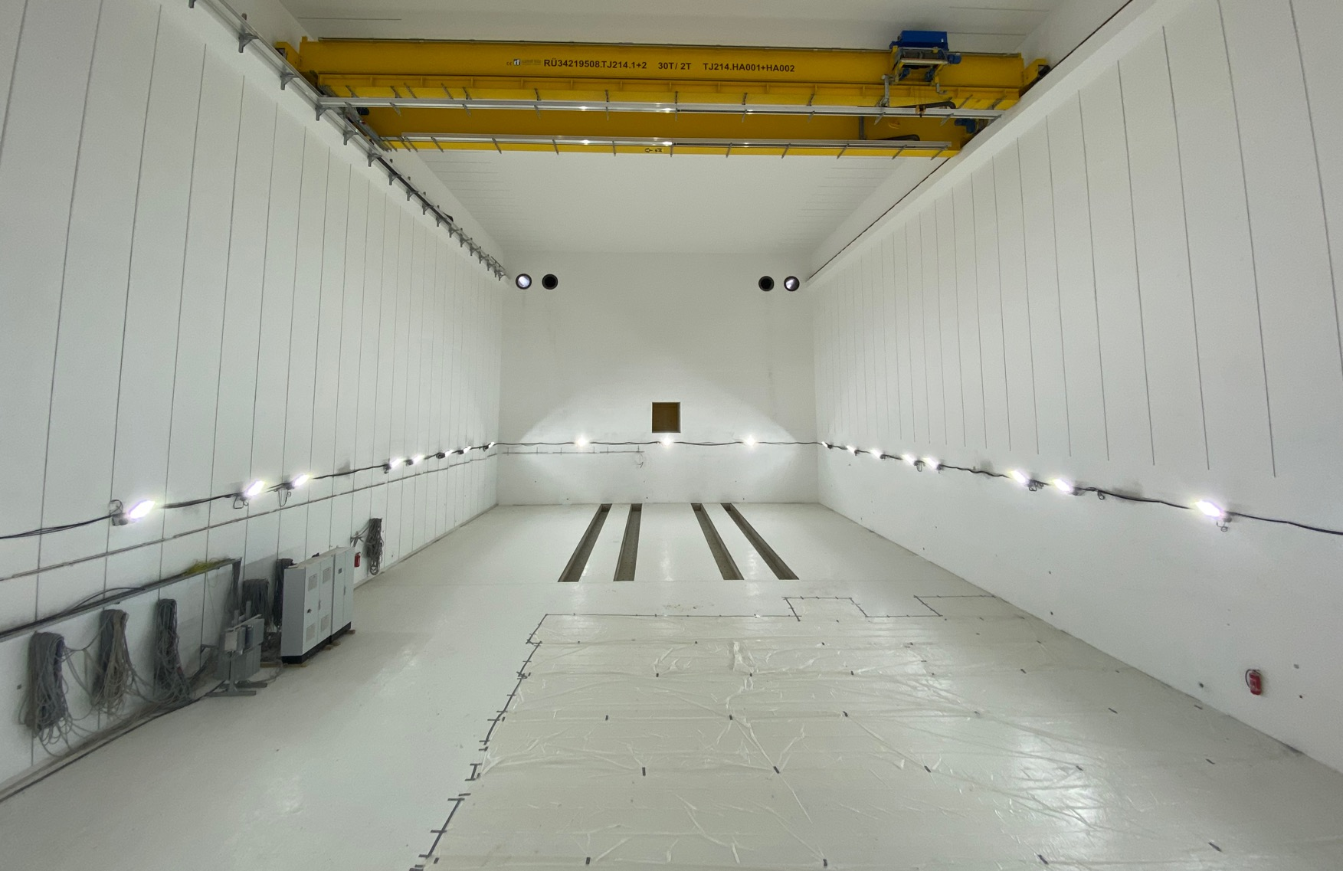
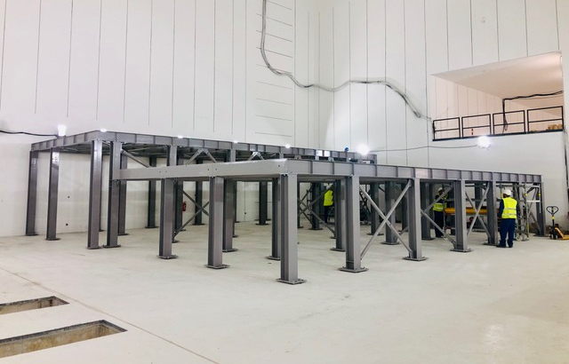
FAIR CBM Cave

Slide 7
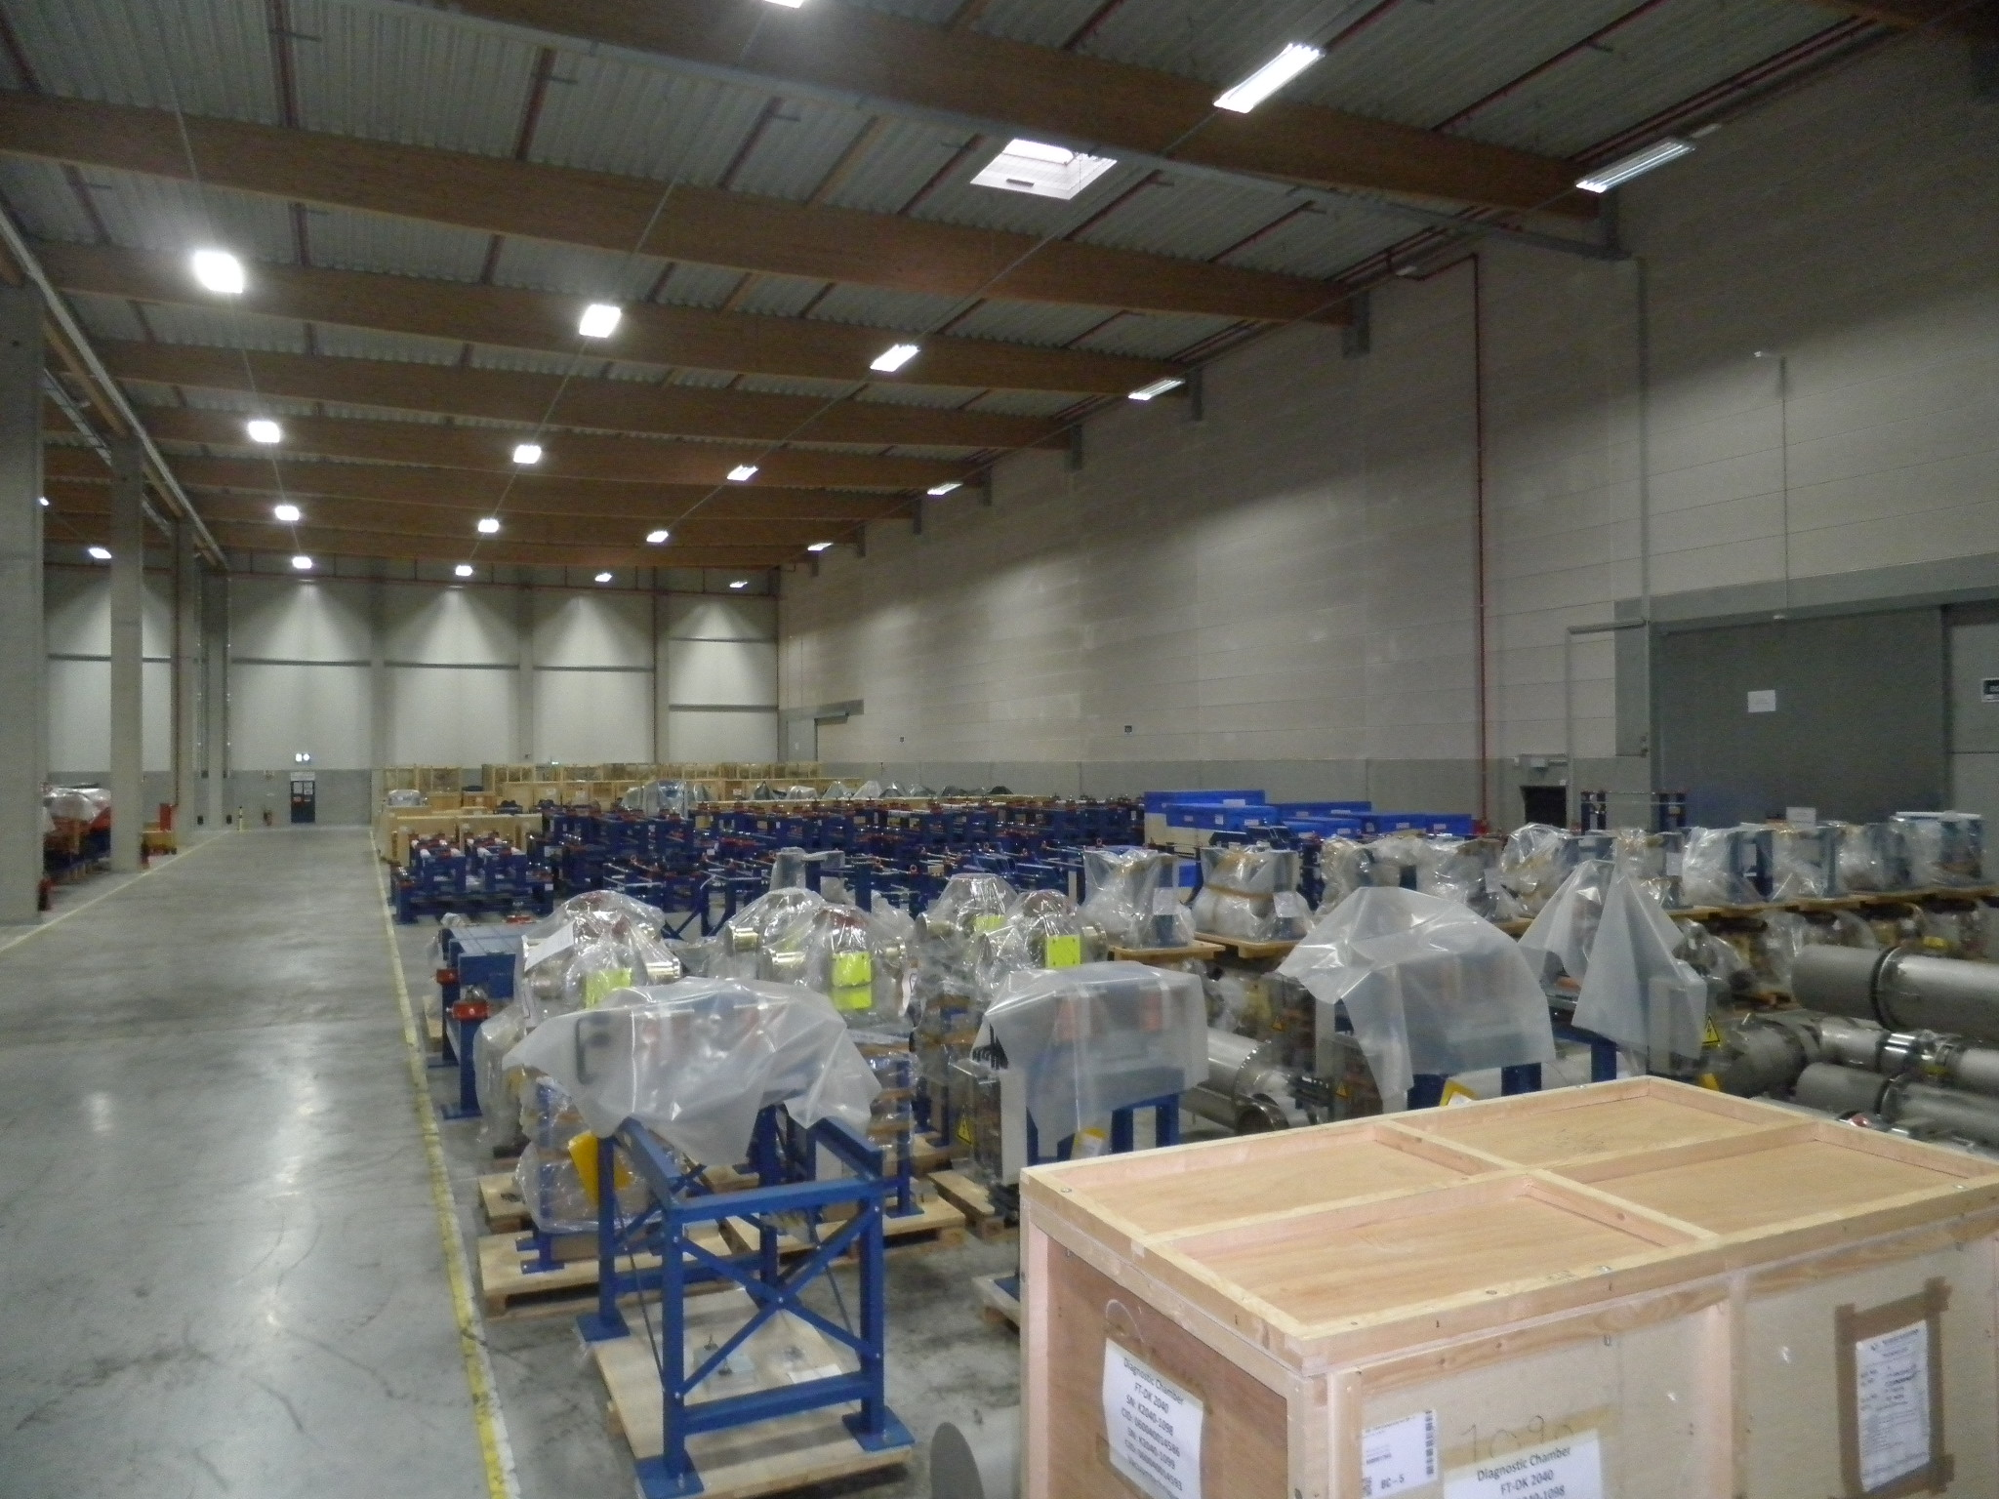
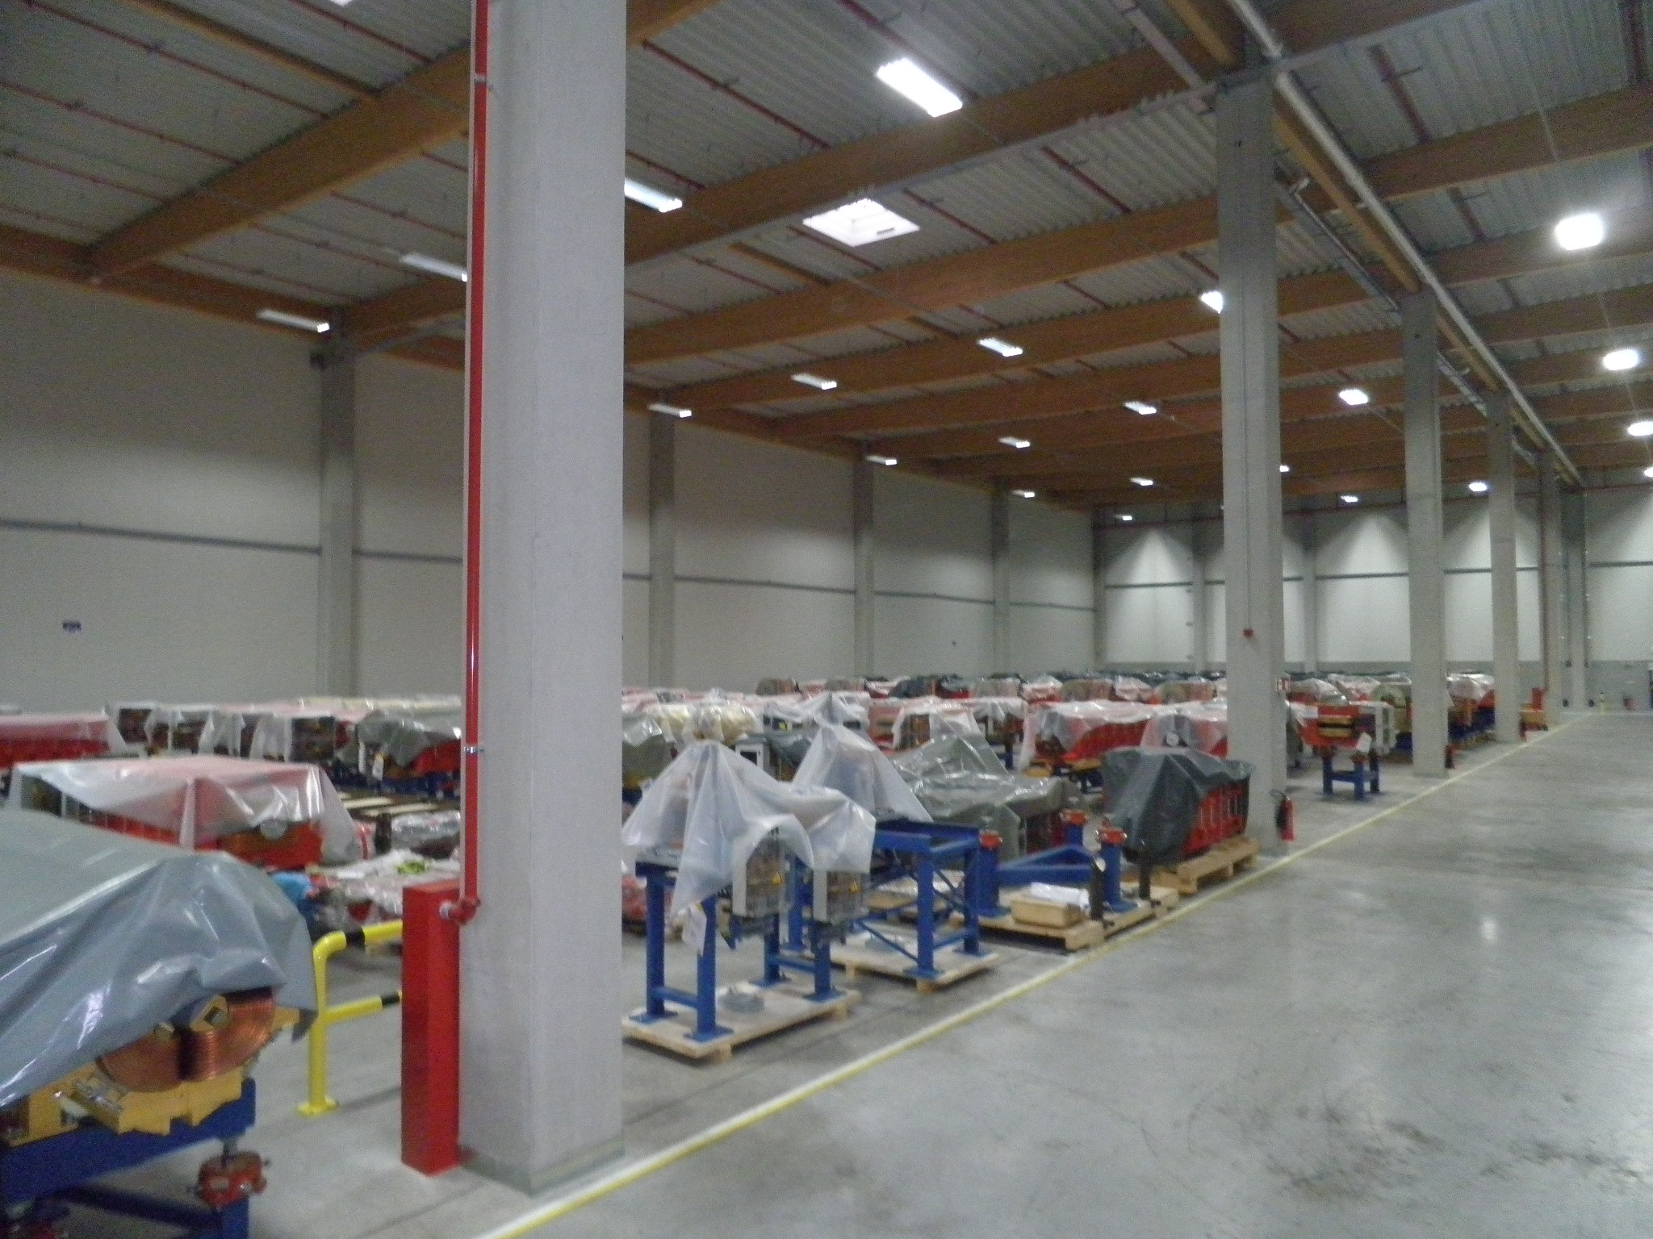
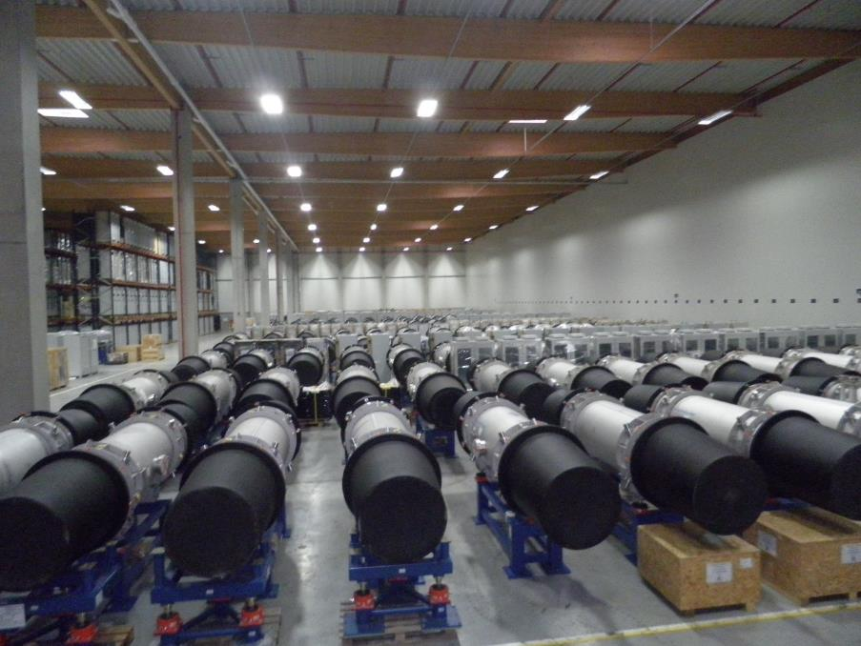
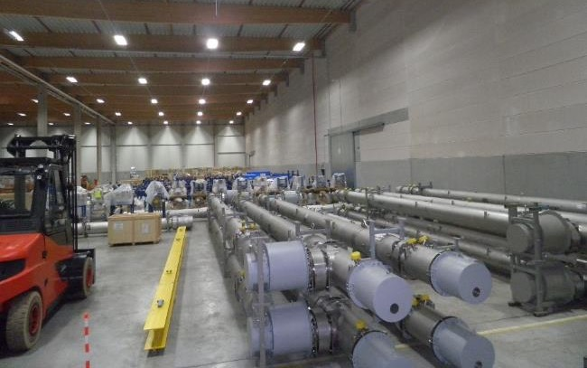
Accelerators: delivery of components continues steadily
Storage area: approx. 9.900 m²
4.195 objects (Components, assemblies, boxes, etc.)
50% of SIS100 components stored
90% of HESR components stored
7

Slide 8
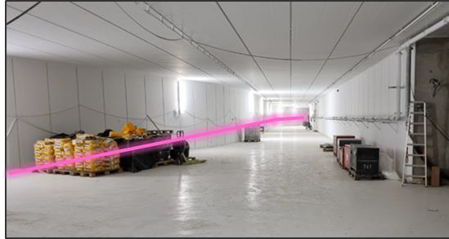
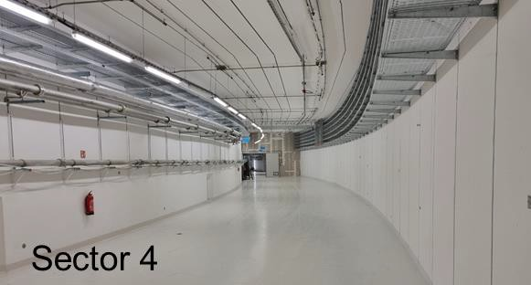
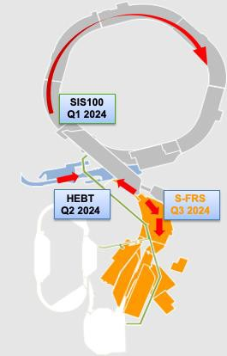
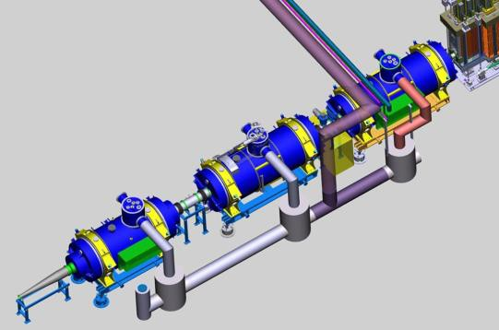
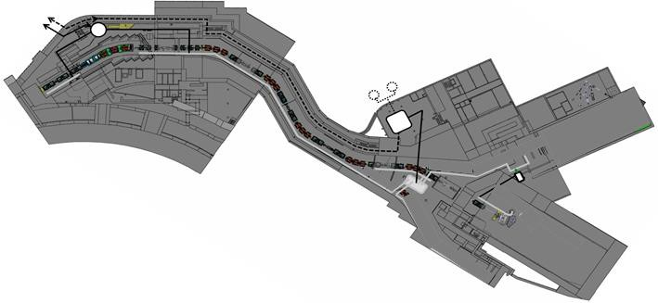
Status of FAIR Accelerators
Start of installation at four locations in 2024
HEBT
PT

Slide 9
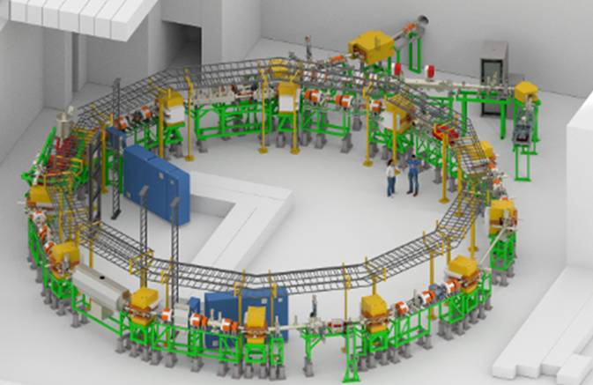
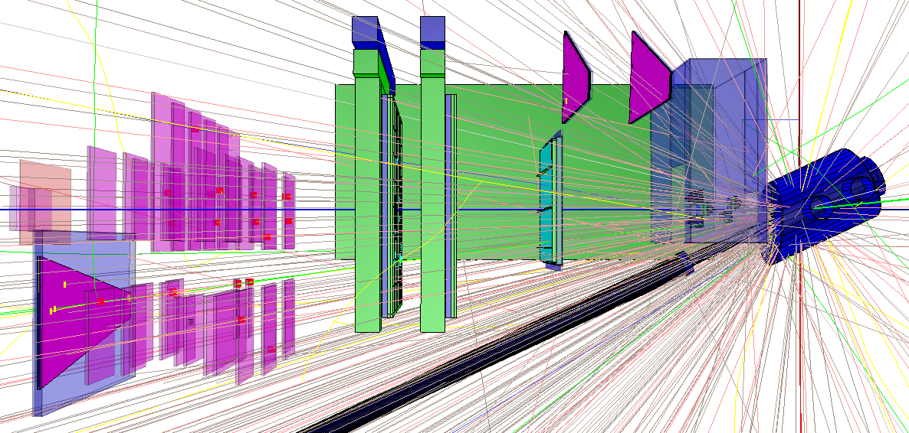
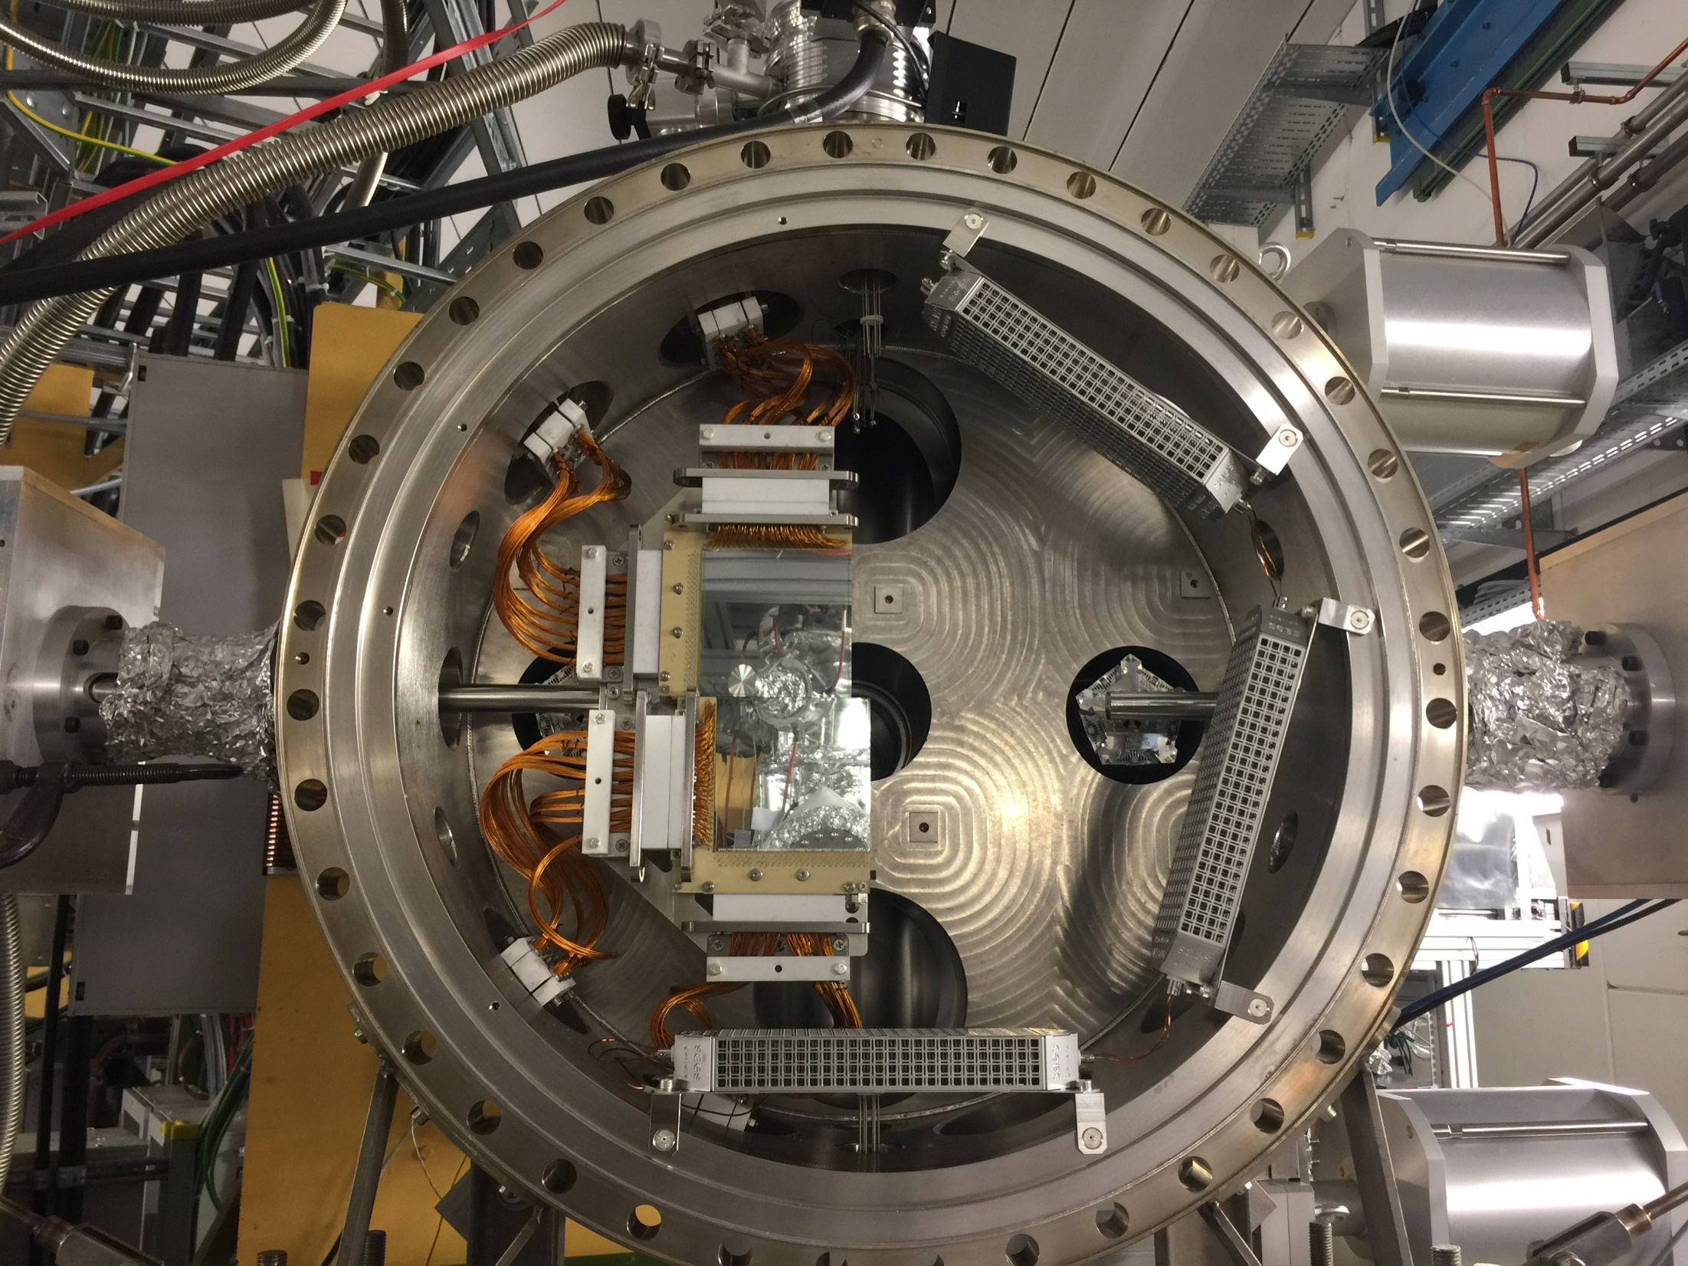
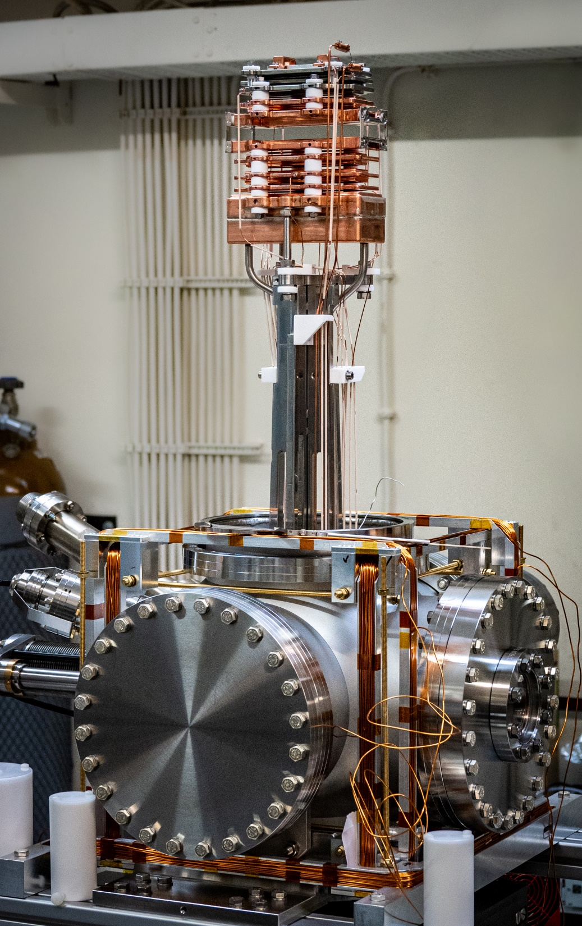
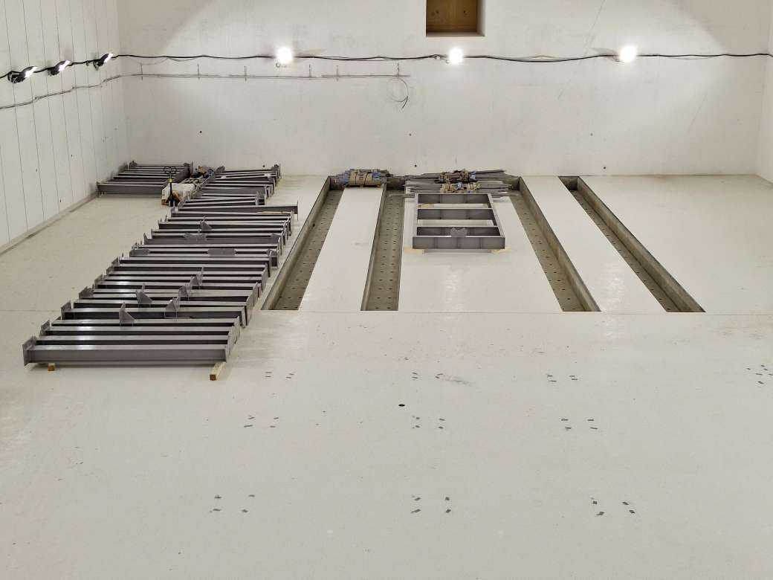
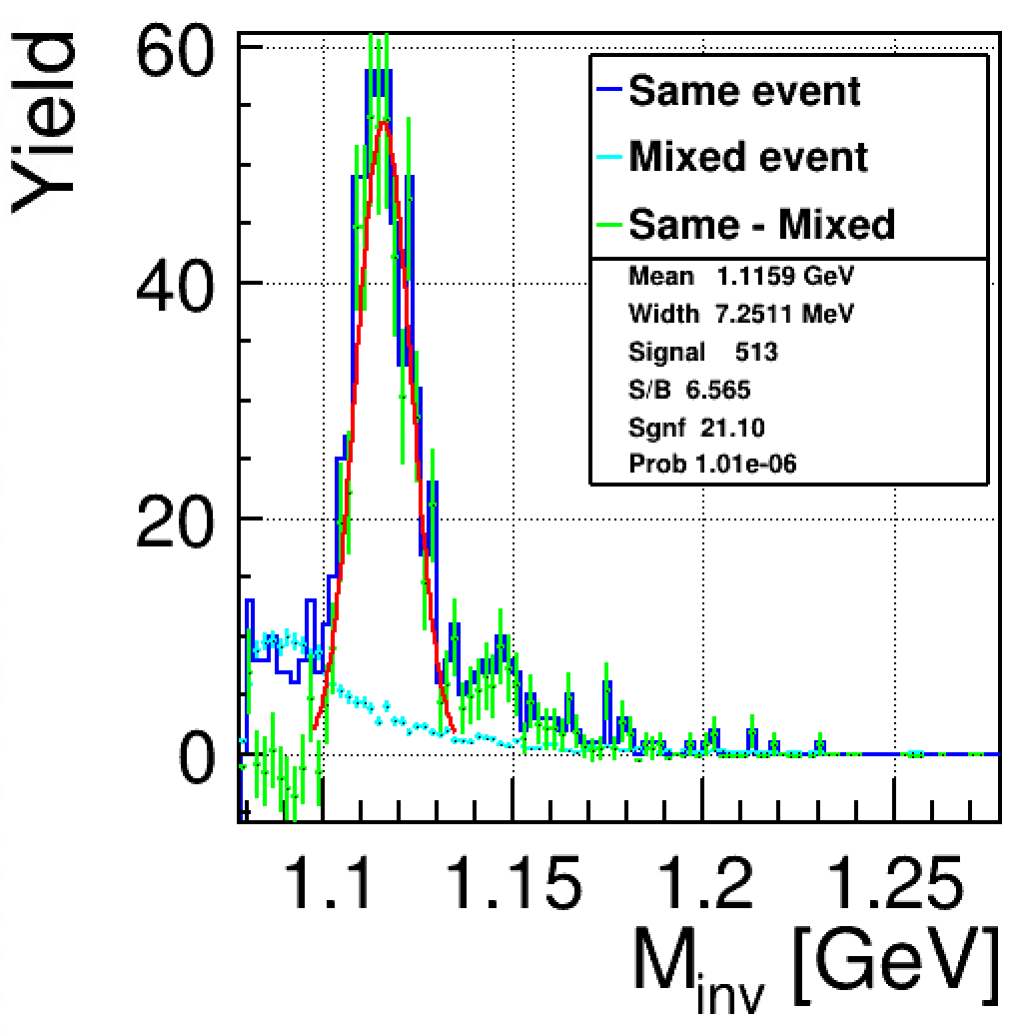
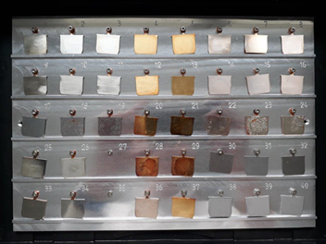

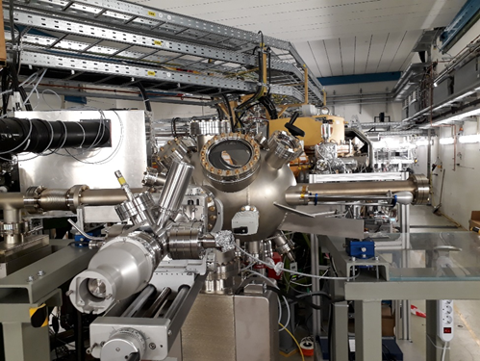


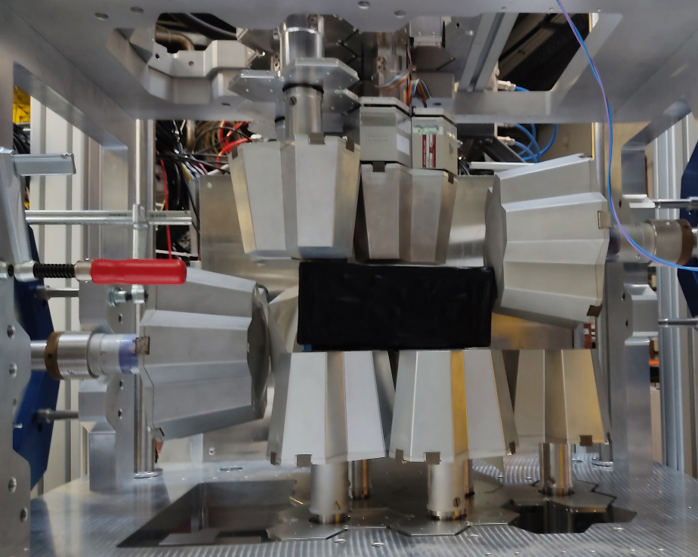
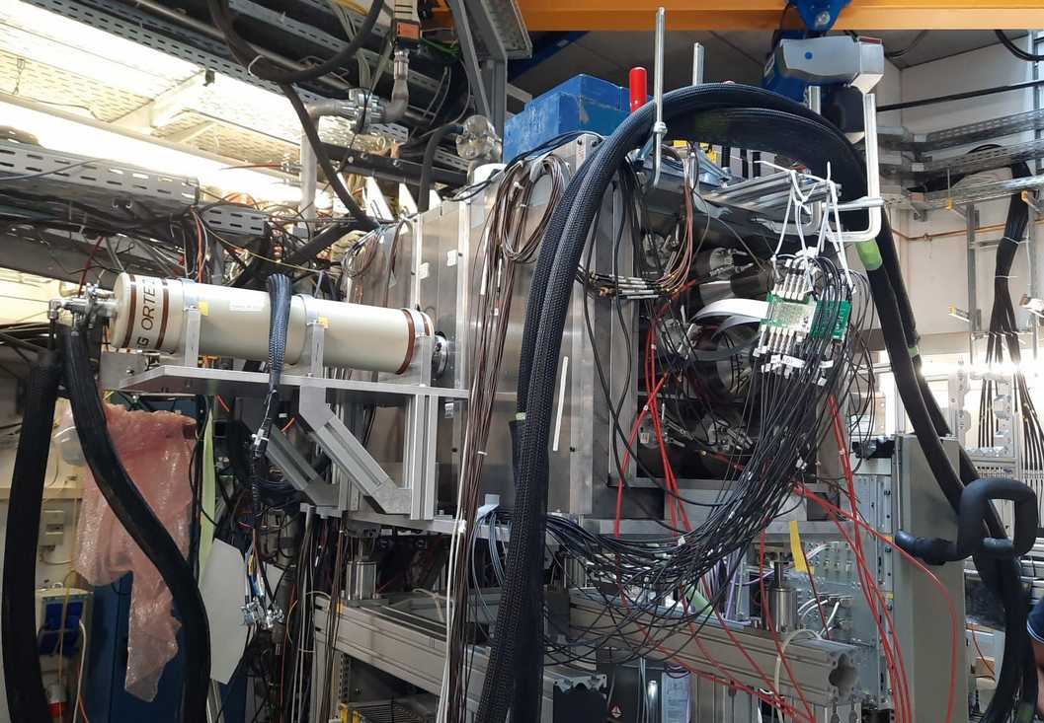
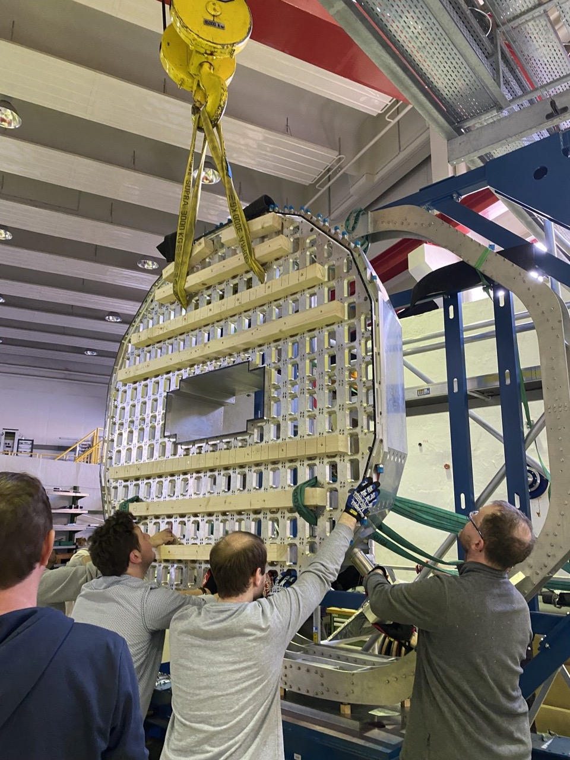

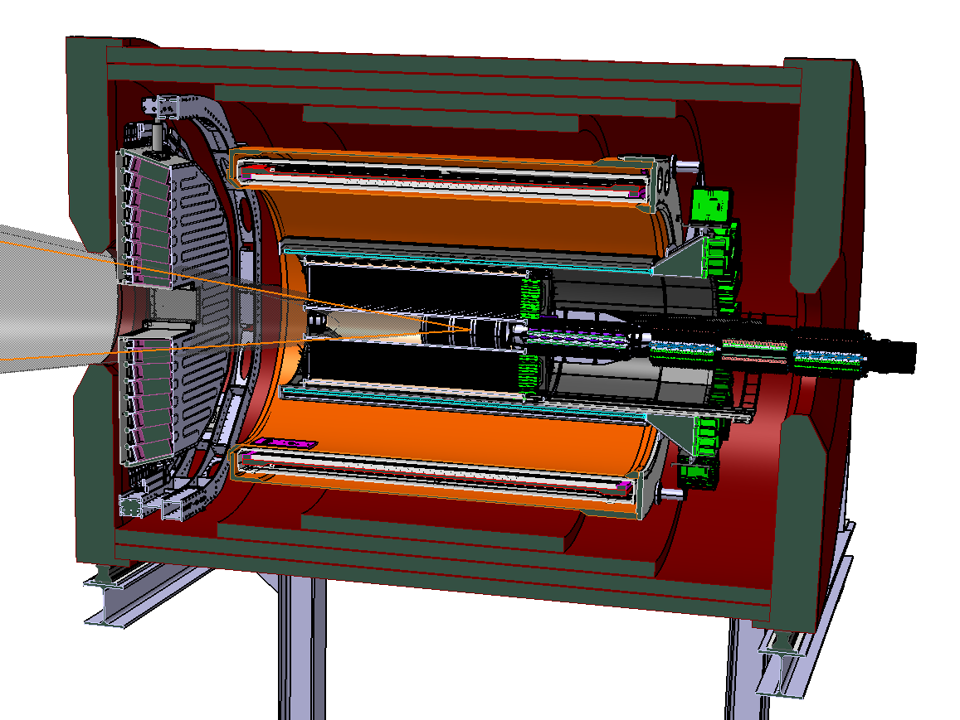
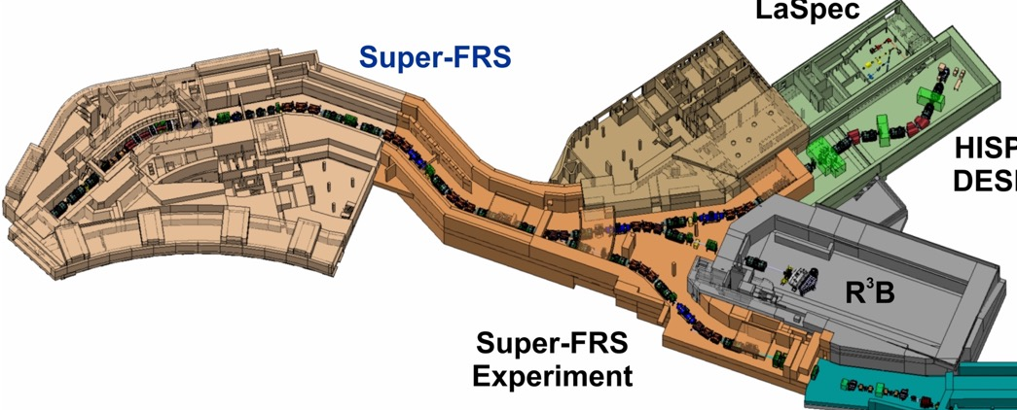
Experiment Construction
APPA
CBM
Phase-0 at CRYRING
SPARC
MAT
Effort to best use the part of FAIR which will be available by 2028
NUSTAR
PANDA
DESPEC
HISPEC/DESPEC
Super-FRS EC
Super-FRS EC
HISPEC/DESPEC
9

Slide 10
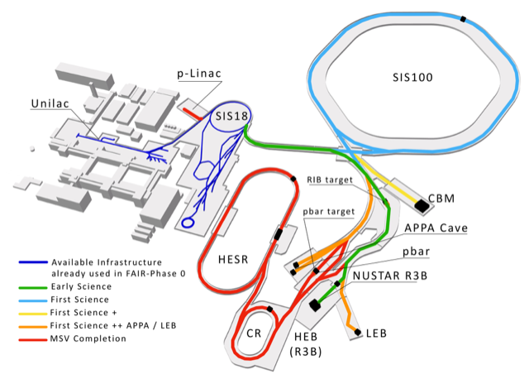
Current status following FAIR Council decisions in March 2023
Due to budget constraints a Scientific Review panel was tasked by the FAIR Council in 2022 to perform a “First Science and Staging Review of the FAIR Project”.
The Scientific Review panel recommended in October 2022 that the scenario FS+ (SIS100, Super-FRS-HEB and CBM) would be the most appropriate starting scenario to achieve world leading science.
FAIR Council decided on 9th & 10th March 2023 to use the additional funds provided by Germany to proceed with FS and to make further decisions on FS+ based on the contributions by other shareholders in future meetings, possibly already in July 2023. Council stated that “the realisation of the MSV… …remains the aim of the FAIR-Project”
until 2028 (ES,FS,FS+)
after 2028

Slide 11
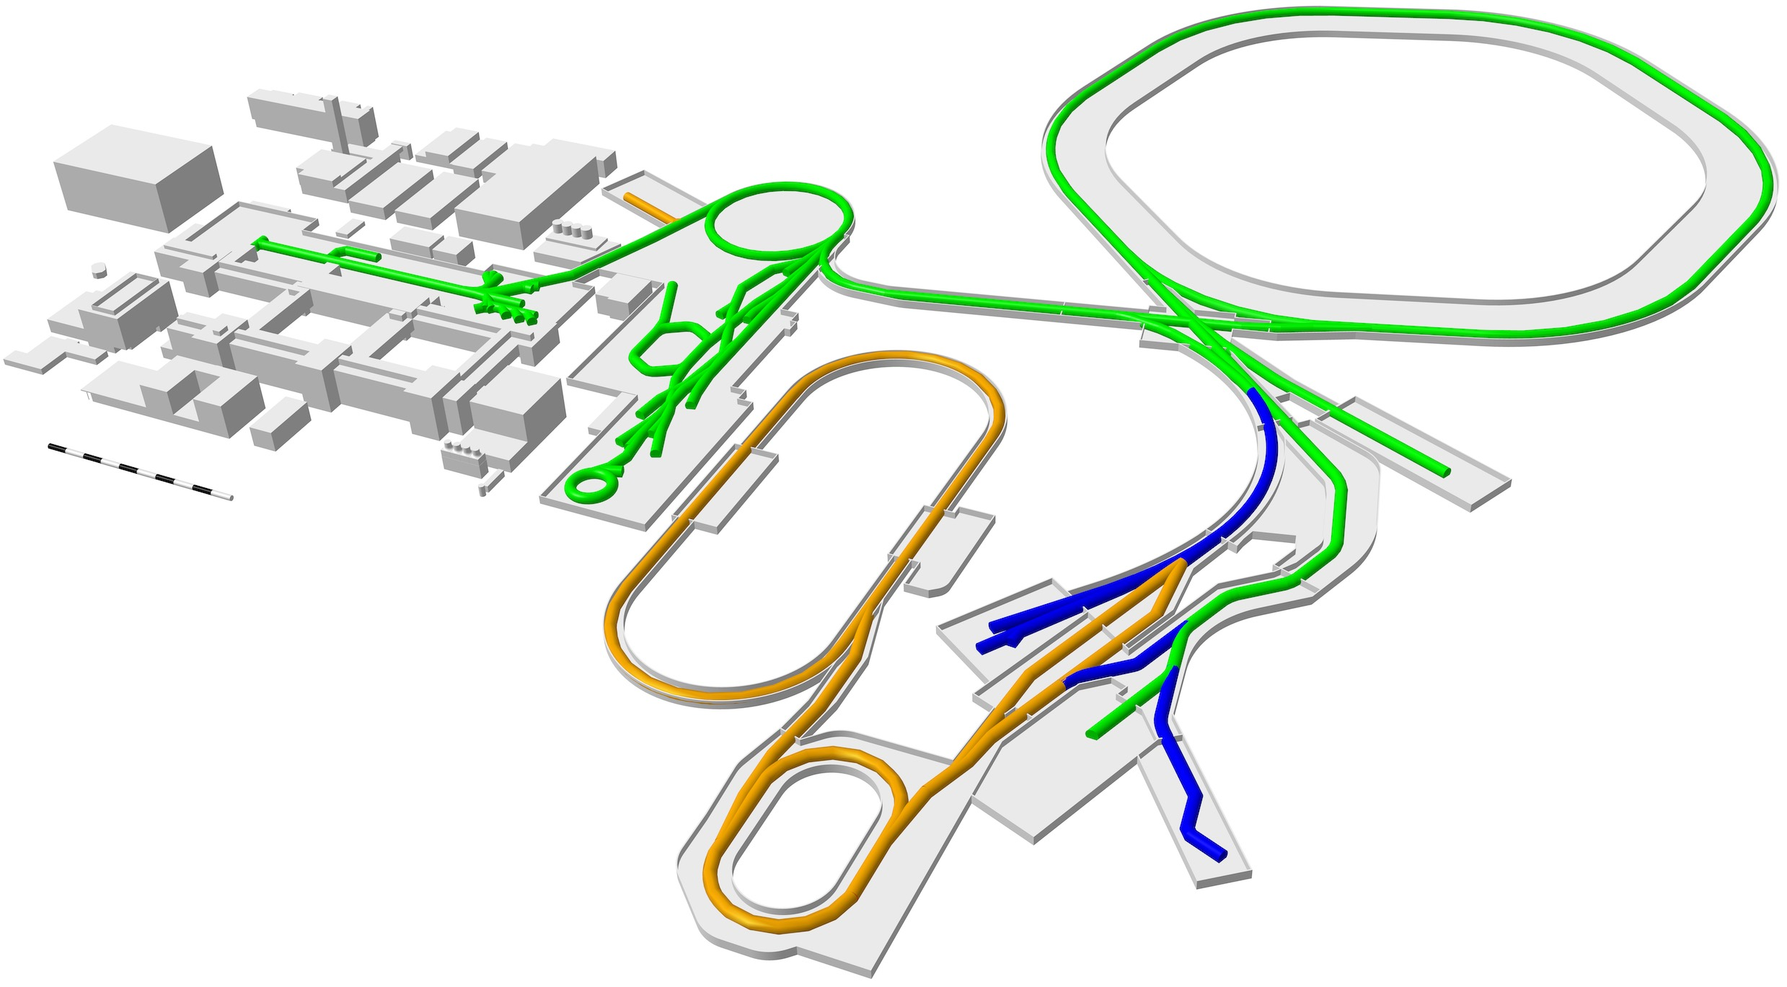
FAIR 2028
APPA Laser
SIS100
UNILAC
SIS18
HITRAP
ESR
CBM
CRYRING
Super-FRS
First Science +
Next steps
MSV completion
NUSTAR HEB
Continuation of APPA, CBM and NUSTAR experiments in existing facility
APPA, NUSTAR and PANDA investigate options for further experiments at green lines
11

Slide 12
Our vision for the medium-term future: FAIR 2028
FAIR in 2028 will feature the most valuable science program which can be hosted in the FS+ infrastructure.
The „FAIR 2028“ science program will include:
  APPA experiments at the low-energy rings, at SIS100, at the caves at SIS18 and UNILAC with and at PHELIX and a limited set of experiments which could be hosted at all the caves served by SIS100
  NUSTAR at the Super FRS with SIS100 beams, plus SHE and MATS experiments at UNILAC and ILIMA at the low-energy rings
  CBM at the new cave with SIS100 beams, and HADES at SIS18
  PANDA is developing a hadron physics program to be carried as bridge towards the program with antiprotons, when possible using the caves and beams available at GSI/FAIR and synergies with other experiments.
12

Slide 13
Evolution towards FAIR 2028
Up to 2025 we continue with FAIR the annual block of continuous beamtime for Phase-0, from 2026 onwards we enter the mixed-mode of Phase-0 with the commissioning of the new beamlines.
Annual beamtime for science will increase progressively, to reach full year operation from 2028 onwards.
Some experiments at the Super-FRS will start already in 2027 using SIS18 beams („Early Science“)
We will try to keep a broad research programme on campus, which will also serve the long-term goals of FAIR.
The construction of further components towards the completion of the MSV will require additional funding. If provided by ~ 2026, the MSV could be completed by 2031-2032. The timetable is dictated by the availability of funds
13

Slide 14

Ongoing early science program: FAIR Phase-0
up to 90 % speed of light
Started in 2019, annual runs of ~110 days until FAIR operation in 2027
Ion species: H⁺,..., U⁹²⁺
heavy-ion synchrotron
SIS 18
linear accelerator
UNILAC
PHELIX
M-branch
Z6
Fragment Separator
HHT
Ion
sources
storage ring ESR
8 % - 15 % speed of light
SHE
X0
HITRAP
HADES
Cave A
miniCBM
CRYRING
R3B
124 proposals with more than 1700 participants from 45 countries received in 2022
The facility continues to develop: new Ion Source for HITRAP, refurbishment of the ESR…

Slide 15
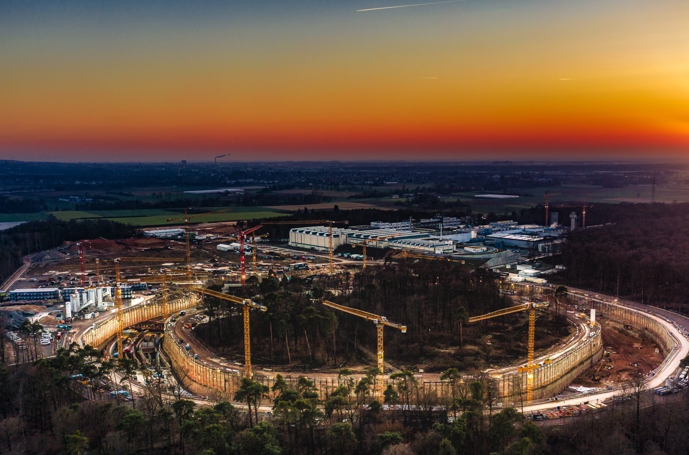
Thank you!!
Herzlichen Dank !
Photo: C. Betz

