Slide 1
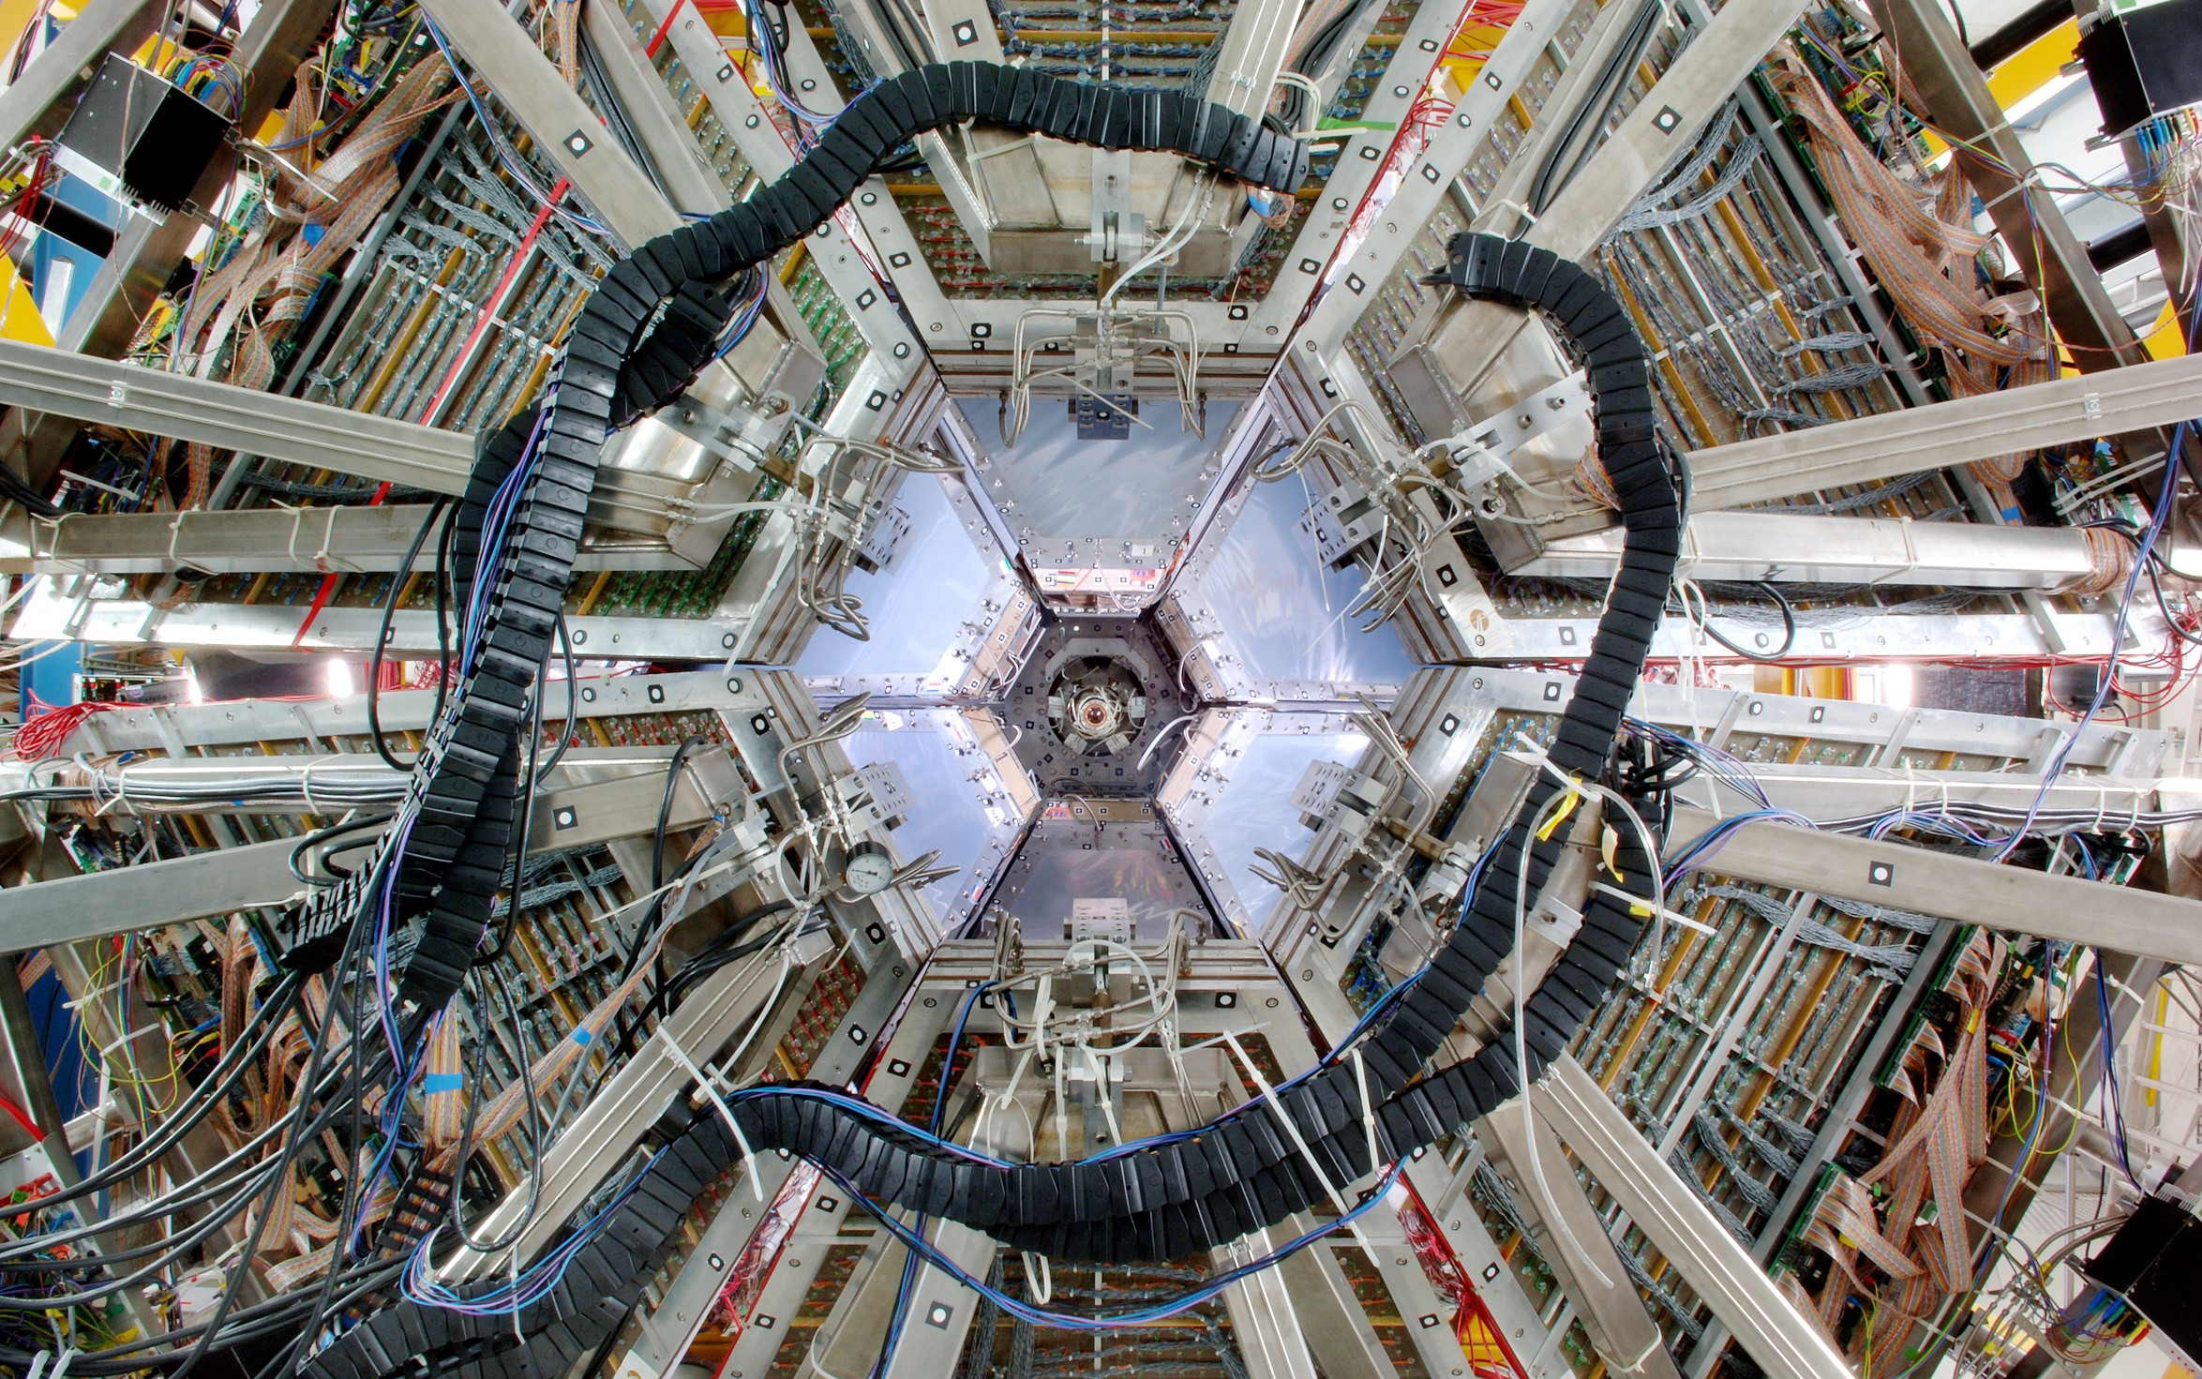
Welcome
to the GSI and FAIR international research center
FFAAIRIR GmbGmbHH || GSGSII GmbGmbHH
1

Slide 2
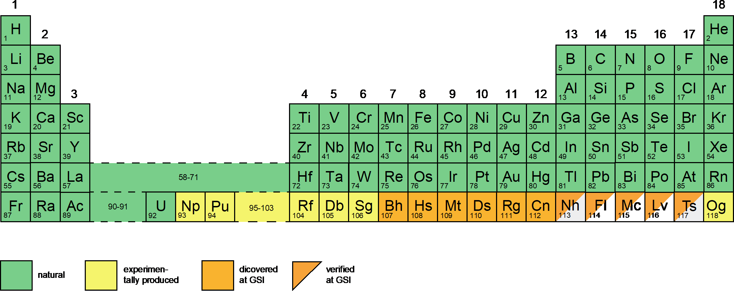
An historic research center
bohrium
hassium
meitnerium
darmstadtium
roentgenium
copernicium
FAIR GmbH | GSI GmbH

Slide 3
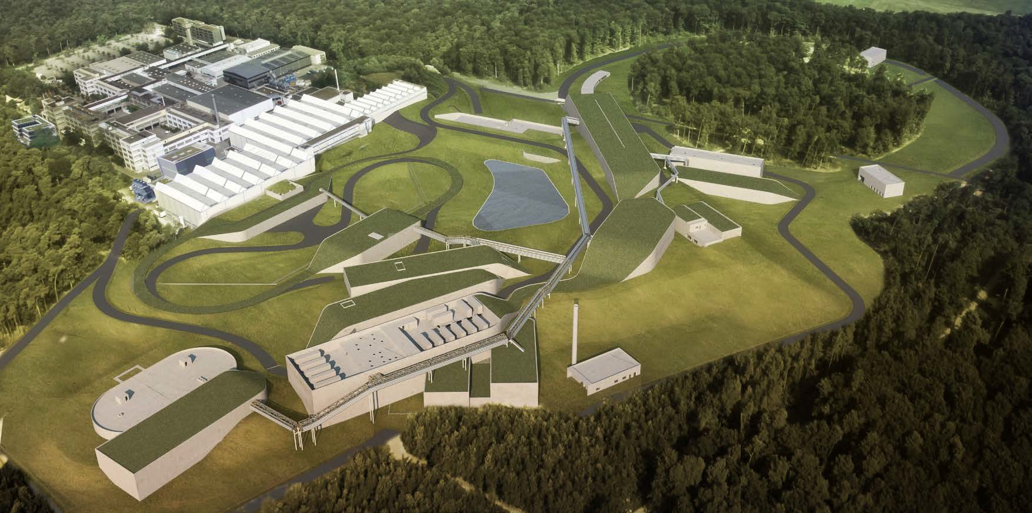
Based on Accelerator facilities
World-leading accelerator laboratory for decades
Unique research in physics and applications
Milestone in the European research roadmap (ESFRI)
Top priority in the European nuclear physics community
FAIR GmbH | GSI GmbH

Slide 4
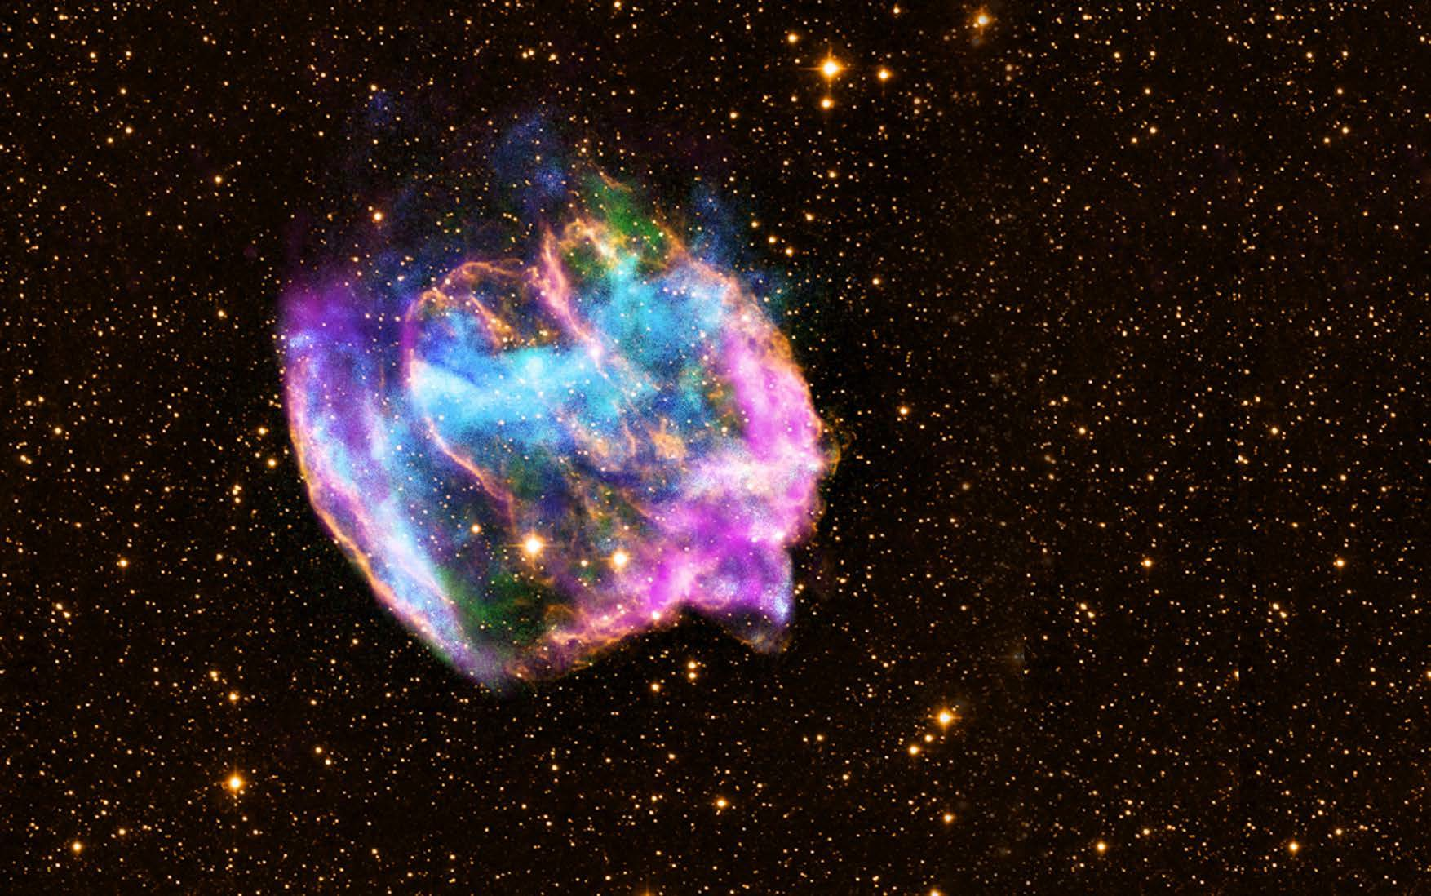
We explore the universe…
FFAAIRIR GmbGmbHH || GSGSII GmbGmbHH

Slide 5
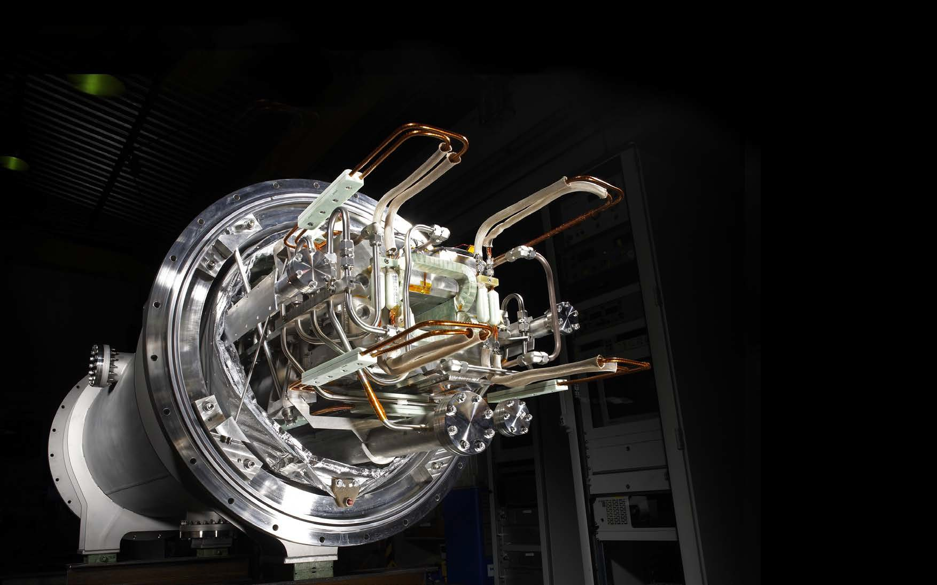
… in the lab.
FFAAIRIR GmbGmbHH || GSGSII GmbGmbHH

Slide 6
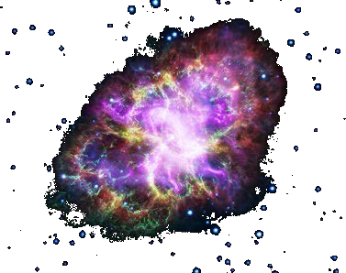
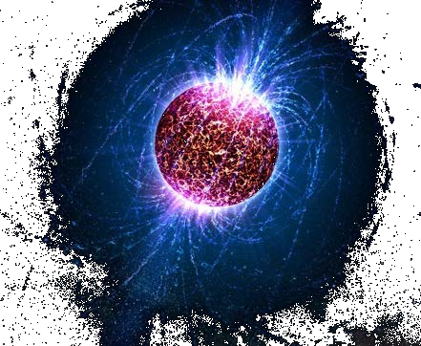
Our objective:
Foto: NASA, ESA, G. Dubner (IAFE, CONICET-University of Buenos Aires) et al.; A. Loll et al.; T. Temim et al.; F. Seward et al.; VLA/NRAO/AUI/NSF; Chandra/CXC; Spitzer/JPL-Caltech; XMM-Newton/ESA; and Hubble/STScI (oben), Penn State University (unten)
Creating extreme conditions existing in the universe with heavy ion accelerators
To find answers to fundamental questions about the Universe : The Universe in the lab ...
FAIR G
mbH | GSI GmbH

Slide 7
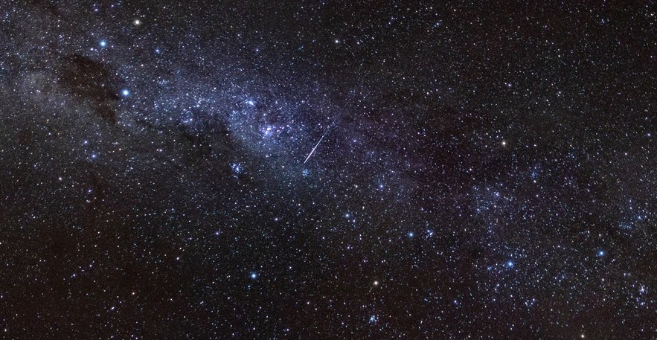
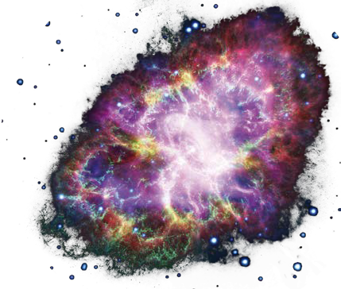
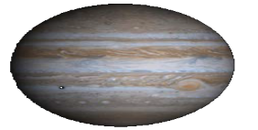
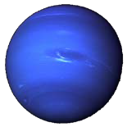
4 research pillars
Where are heavy elements created?
What is in the interior of a neutron star?
NUSTAR
CBM
PANDA
APPA
Fotos: Uranus, Jupiter, Erde Quelle: http://de.wikipedia.org
Glueballs:
What are protons and neutrons made of?
What is the structure of hadrons?
How do materials behave under high pressure?
FAIR GmbH | GSI GmbH

Slide 8
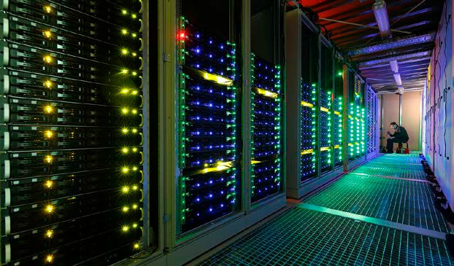
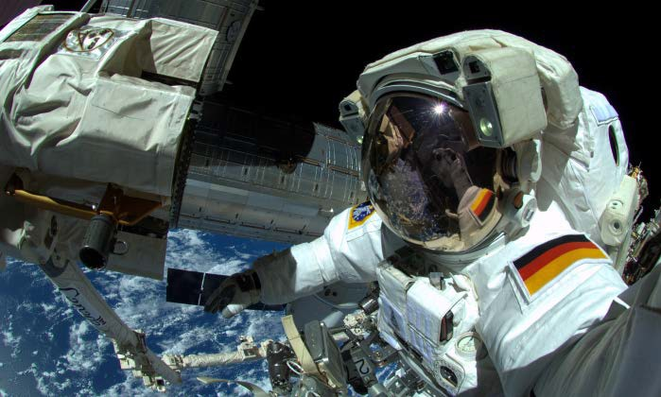
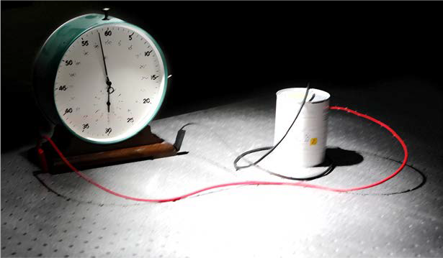
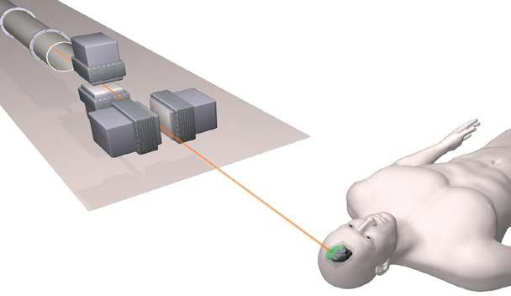
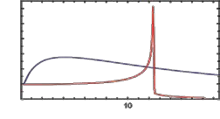
... with direct applications
High-performance and scientific computing, big data, green IT
Space radiation protection, unique facility for simulation, collaboration with ESA
100 %
Tumor
Schädigung
harte Röntgenstrahlung
Ionen- strahl
50 %
0 %
2
6 10
Eindringtiefe [cm]
14
18
Development of nuclear clock: Promising candidate thorium-229
Innovation in Cancer Treatement
FAIR GmbH | GSI GmbH
8

Slide 9
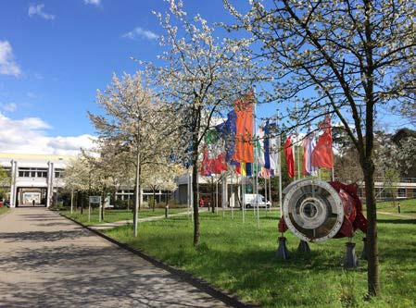
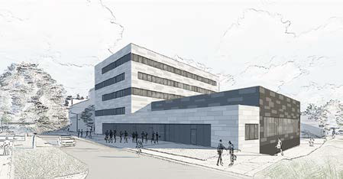
GSI GmbH – Facts and Figures
GSI GmbH – Helmholtzzentrum für Schwerionenforschung
Member of the Helmholtz-Gemeinschaft Deutscher Forschungszentren e.V. (HGF) consisting of 18 Zentren
Founded in 1969
Shareholders: German federal government (90%), Hesse (8%), Rhineland-Palatinate (1%), Thuringia (1%)
Budget 2021
Overall (incl. HIJ, HIM): about 197 m€
thereof non-institutional (project funding, revenues …): 44 m€
Employees: about 1.500 (incl. HIJ, HIM)
FAIR GmbH | GSI GmbH

Slide 10
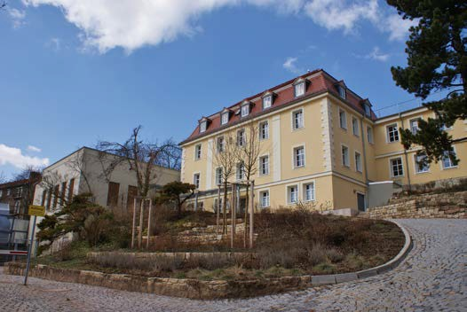
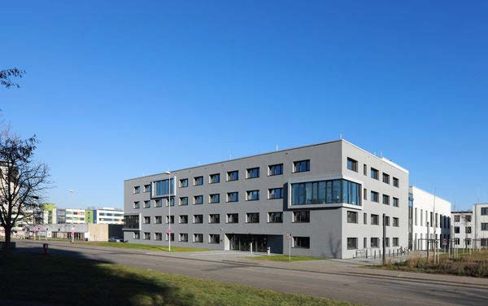
GSI – Helmholtz-Institute Jena und Mainz
Helmholtz-Institut Jena (HIJ)
The HIM was founded in June 2009
Located on the campus of
Johannes Gutenberg-Universität Mainz
Budget: 7.2 m€
Employees: about 65
Helmholtz-Institut Mainz (HIM)
The HIM was founded in June 2009
Located on the Campus of Friedrich-Schiller-Universität Jena
Budget: 6.8 m€
Employees: about 50
FAIR GmbH | GSI GmbH

Slide 11
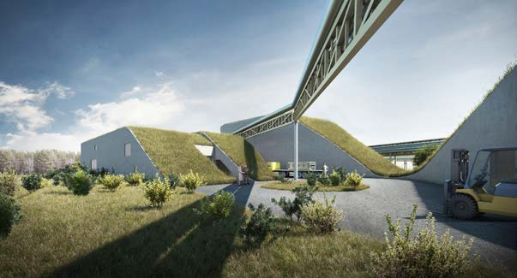
FAIR GmbH – Facts and Figures
FAIR GmbH – Facility for Antiproton and Ion Research
Founded in 2010
Shareholders
Germany (70.2 %), Russia (17.5 %), India (3.5 %),
France (2.6 %), Poland (2.4 %), Finland und Sweden (1.4 %) Romania (1.2 %), Slovenia (1.2 %).
The United Kingdom is associated, the Czech Republic is aspirant partner.
Budget 2021
For the construction of the Modularized Start Version (MSV) – 3.1 bn€
Employees 2021
FAIR employees: 103
Thereof secondments from GSI: 39
FAIR GmbH | GSI GmbH

Slide 12
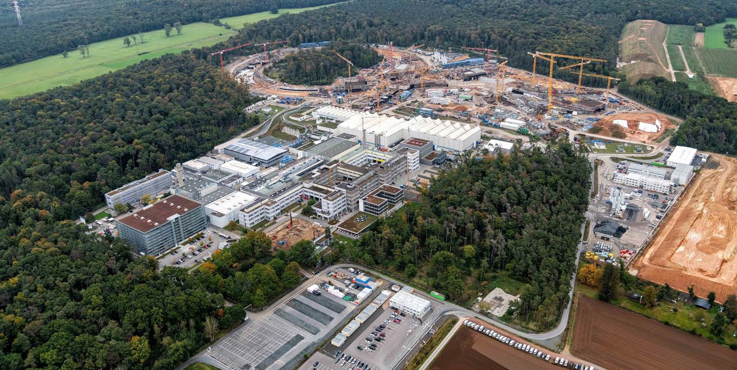
GSI GmbH – Helmholtzzentrum für Schwerionenforschung FAIR GmbH – Facility for Antiproton and Ion Research
Integrated organization FAIR and GSI under one management since 2017
Employees on location: approx.1450
FAIR GmbH | GSI GmbH

Slide 13
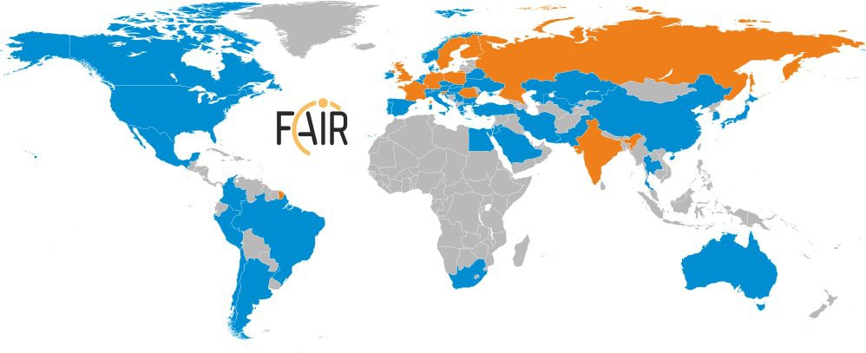
FAIR: a World-wide project
FAIR governed by international convention
9 shareholders:
• + 1 associated partner:
• + 1 aspirant partner:
Over 3000 Scientists and Engineers from all over the world
More than 200 institutions from 53 countries are involved with their scientists (orange + blue)
16
FAIR GmbH | GSI GmbH

Slide 15
FAIR Construction volumes
2 million m³ 600,000 m³
65,000 tons
of steel
to be utilized
of earth
to be moved
of concrete
to be used
As much as for 5,000 single-family homes
As much as eight Frankfurt soccer stadiums
As much as nine Eiffel Towers
17

Slide 16
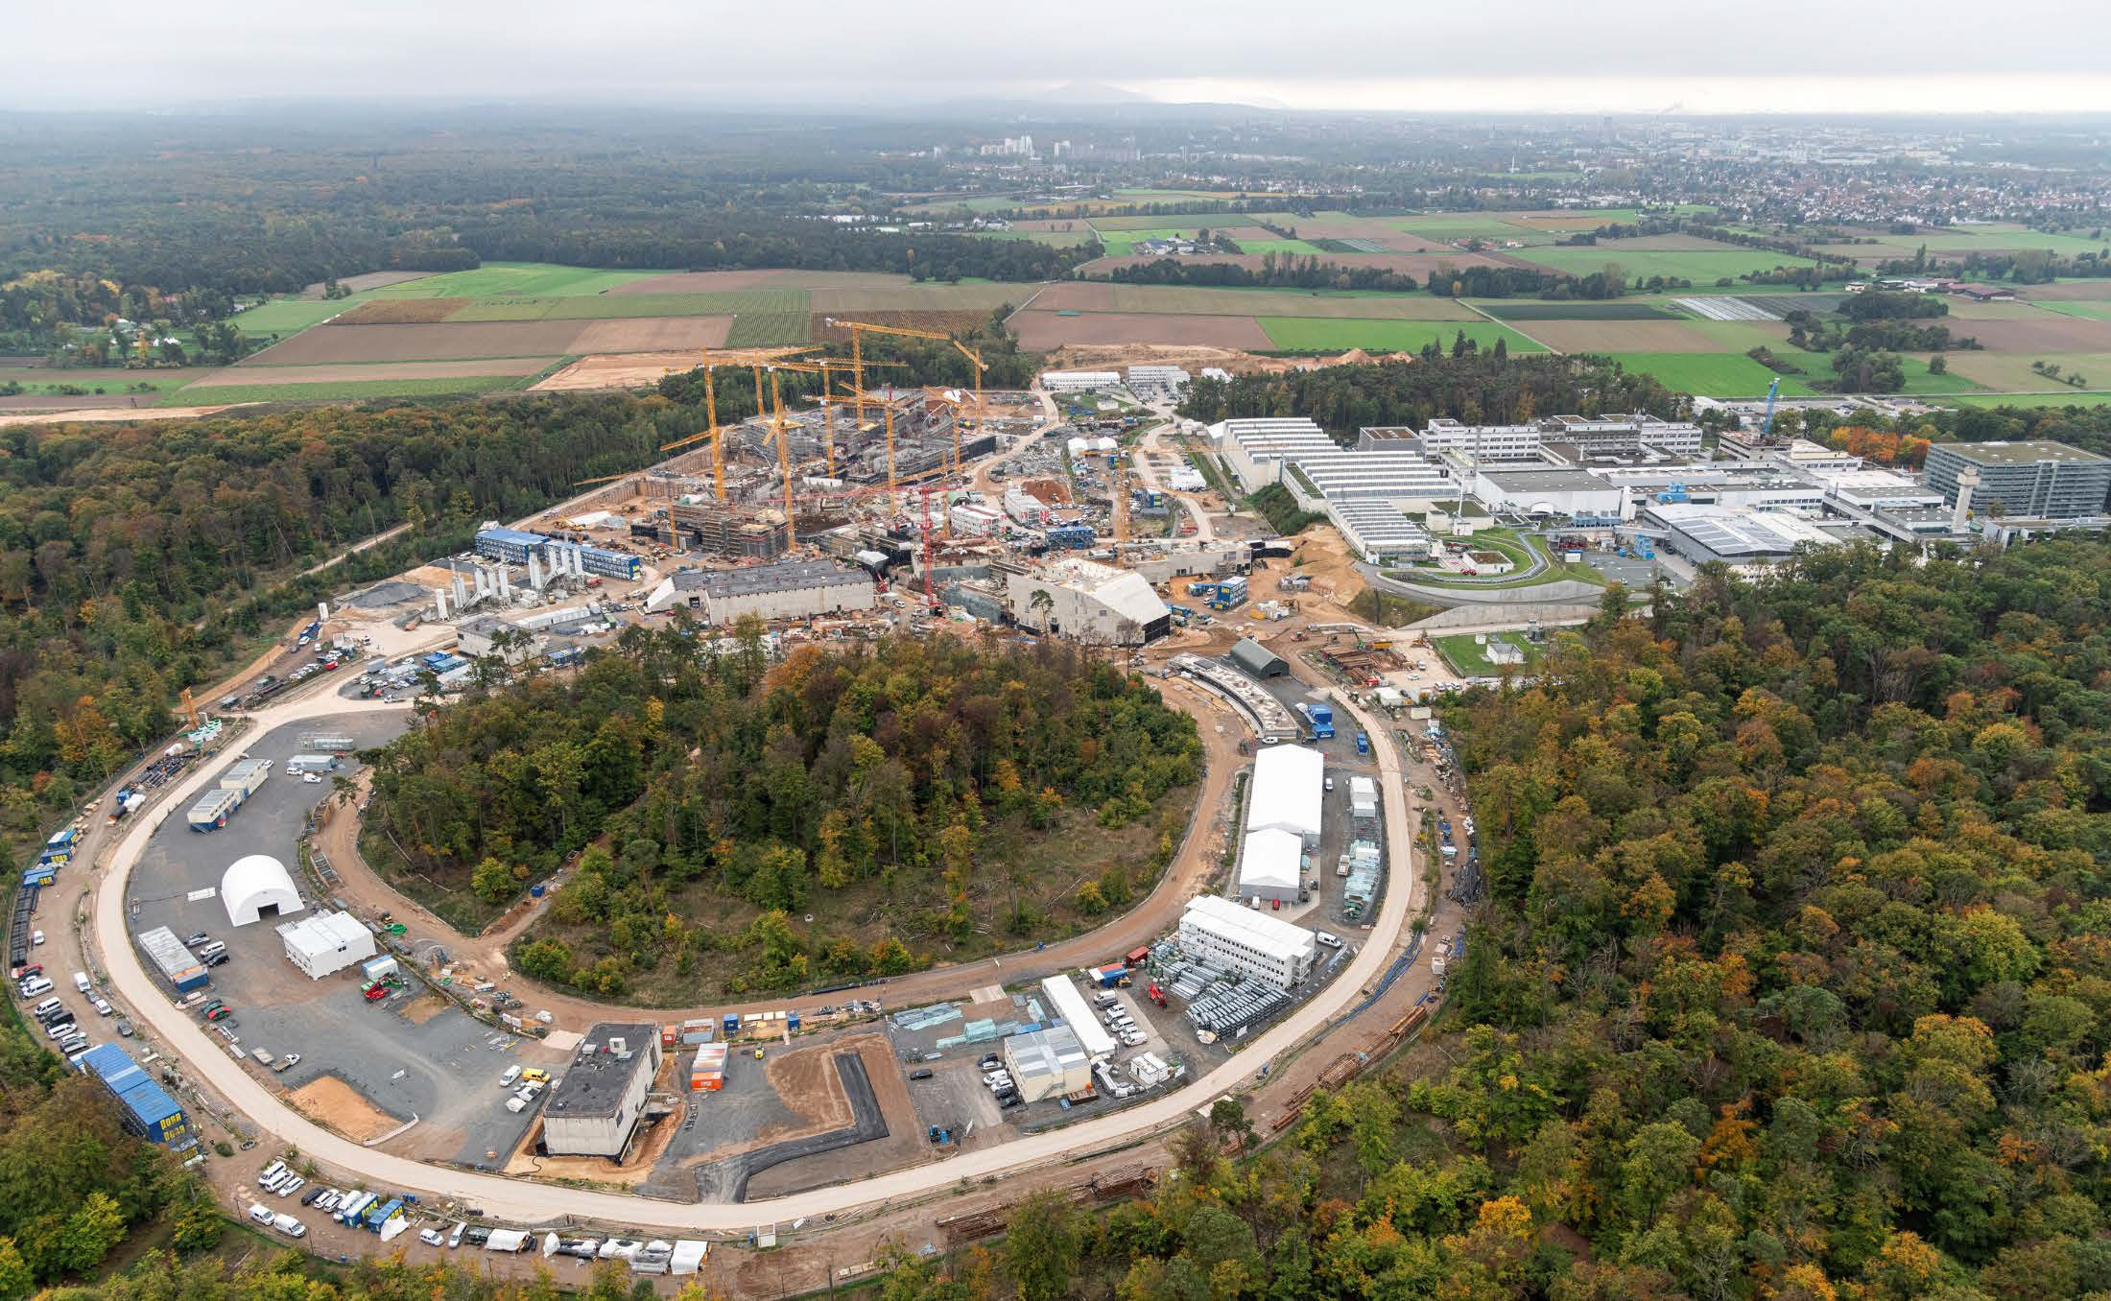
Civil Construction
Civil Construction continues to progress
October, 2022
Drone videos available via www.gsi.de
FAIR GmbH | GSI GmbH

Slide 17
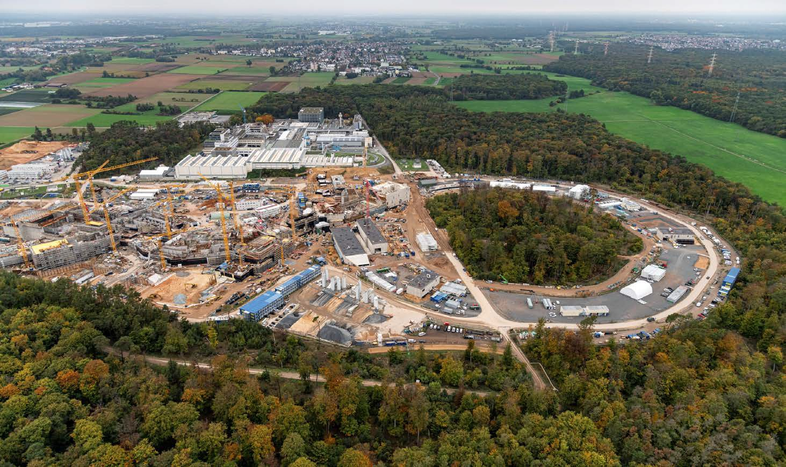
FAIR Site (Oct. 2022)
FAIR GmbH | GSI GmbH

Slide 18
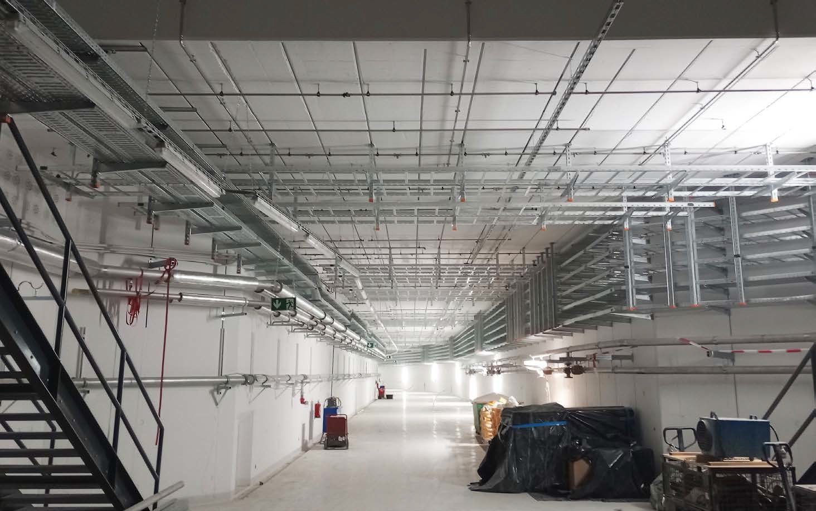
FAIR Accelerator tunnel
FAIR GmbH | GSI GmbH

Slide 19
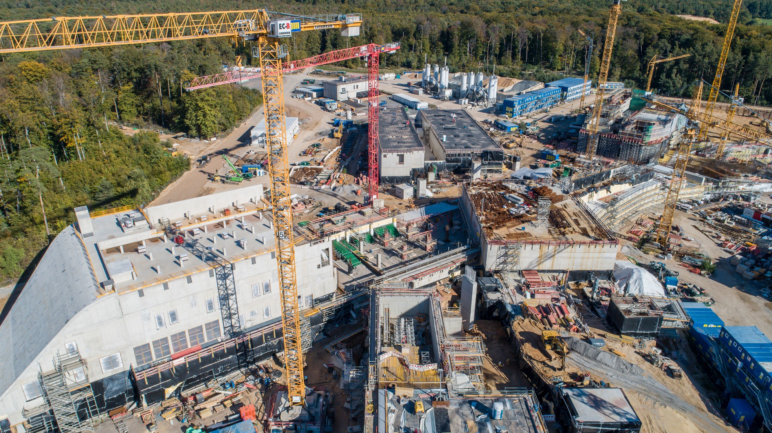
FAIR Transfer Building (Oct. 2022)
FAIR GmbH | GSI GmbH

Slide 20
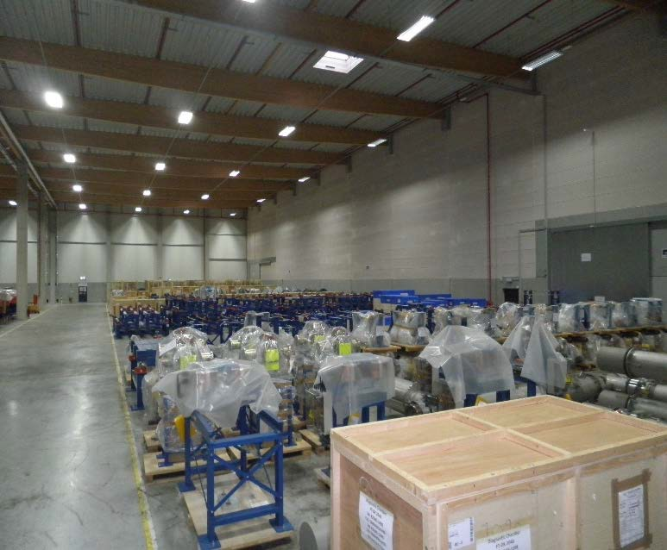
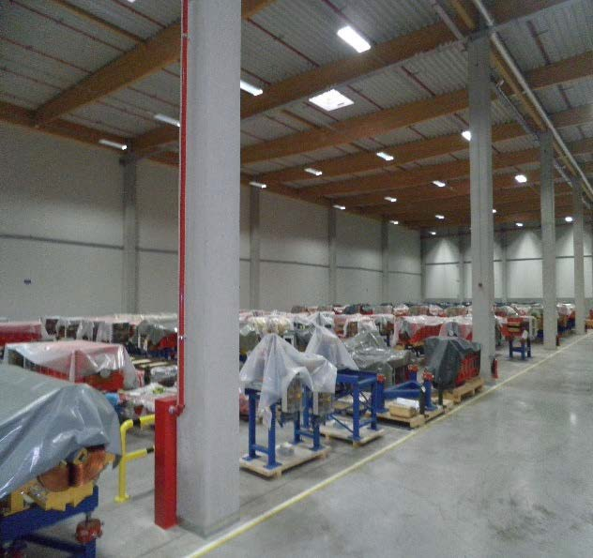
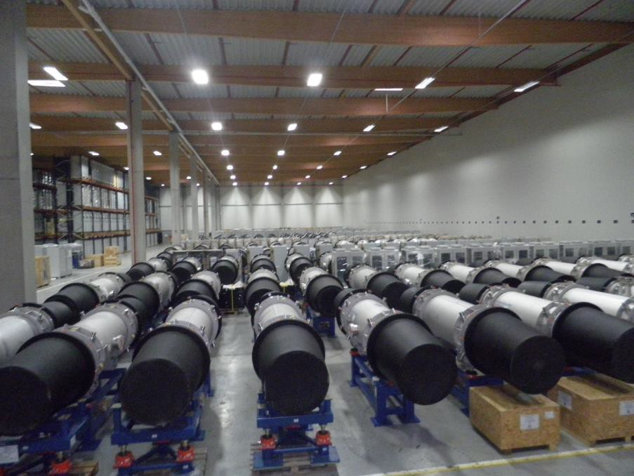
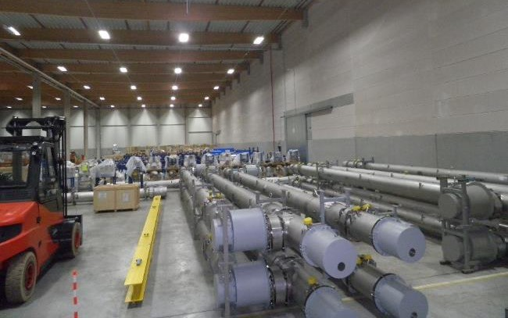
Accelerators:
delivery of components continues steadily
Storage area: approx. 9.900 m²
4.195 objects (Components, assemblies, boxes, etc.)
50% of SIS100 components stored
90% of HESR components stored
FAIR GmbH | GSI GmbH
22

Slide 21
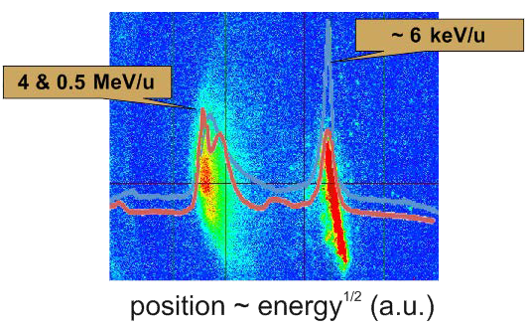
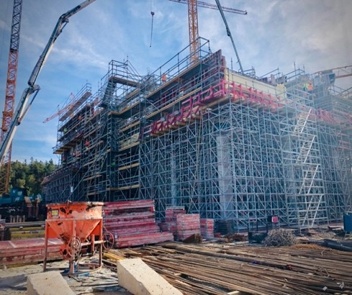
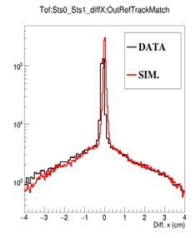
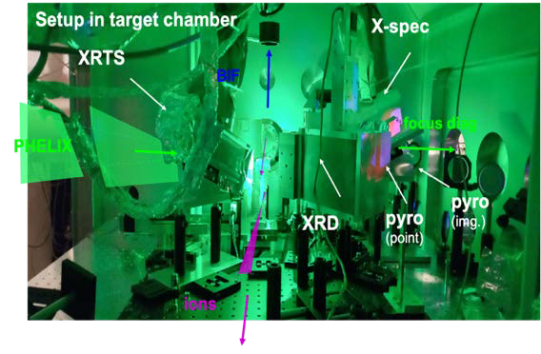
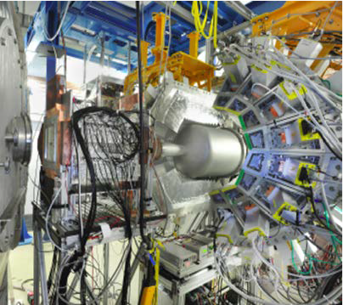
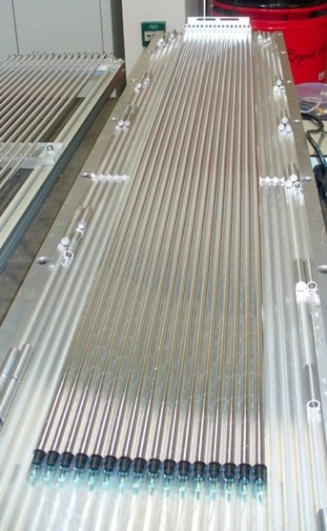
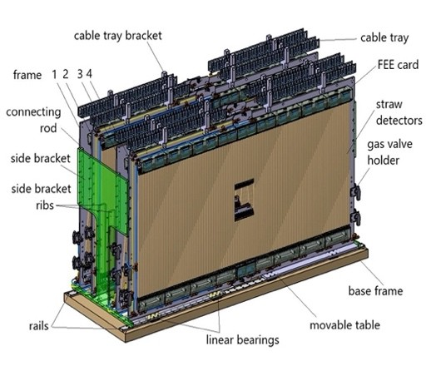
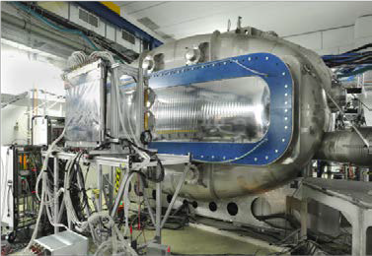
Experiment Construction and USE
HITRAP
commissioning
APPA
CBM
HED@FAIR
diagnostics
mCBM performance
R3B: LH2 target, CALIFA, GLAD
Forward tracker
NUSTAR
PANDA
FAIR GmbH | GSI GmbH

Slide 22
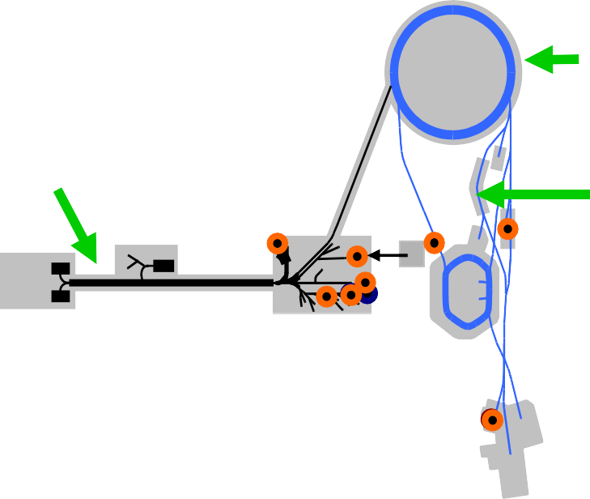
Early science program FAIR Phase-0
Started in 2019, annual runs of
~110 days until FAIR operation
up to 90 % speed of light
Ion species: H⁺,..., U⁹²⁺
heavy-ion synchrotron SIS 18
linear accelerator UNILAC
PHELIX
M-branch
Z6
Fragment Separator HHT
Ion sources
storage ring ESR
8 % - 15 % speed of light
X0 HITRAP
SHE
HADES
miniCBM
R3B
Cave A
CRYRING
Science while commissioning FAIR
world class scientific experiments
commissioning of detectors and accelerators
development of human capital
FAIR GmbH | GSI GmbH

Slide 23
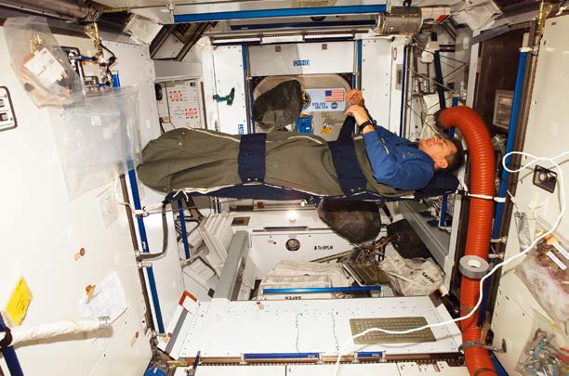
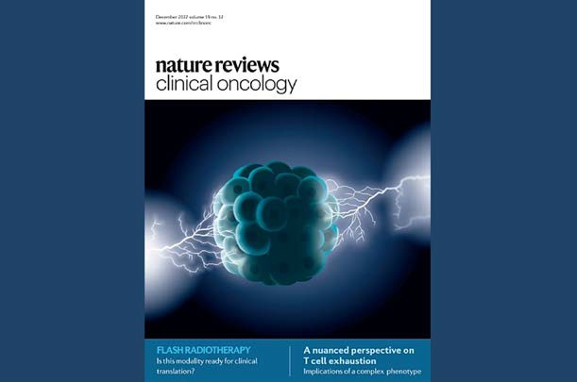
Research highlights of GSI/FAIR in 2022
APPA
© NASA
APPA
Health of astronauts
FLASH cancer therapy
Experiments demonstrate, that artificial hibernation could protect astronauts from cosmic radiation
Large international response in the media, e. g. Forbes (USA)
W. Tignanelli et al., Radiotherapy&Oncology, Vol.175, P185-190 (2022)
Short, highly intense ion pulses for effective and gentle tumor therapy
Title story of the most important oncology journal
M.-C. Vozenin, Nature Reviews Clinical Oncology 19, 791-803 (2022)
23
FAIR GmbH | GSI GmbH

Slide 24
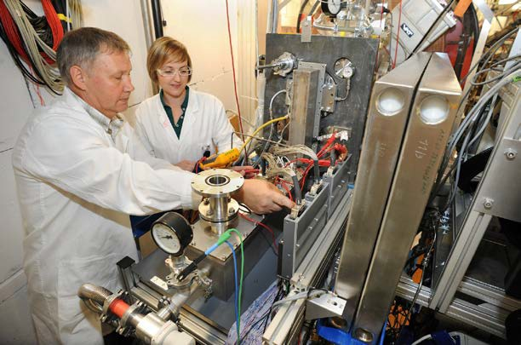
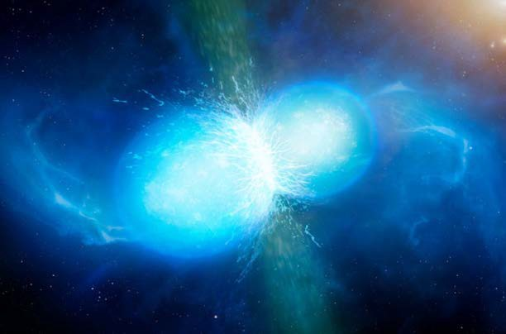
Research highlights of GSI/FAIR in 2022
© University of Warwick/Mark Garlick/ESO
NUSTAR
APPA/CBM/NUSTAR/PANDA
Pushing the boundaries of the periodic table
Origin of the chemical elements
Theoretical work regarding gravitational waves and the synthesis of elements in neutron star mergers
Recently honored with Leibniz Award, ERC Advanced Grant, ERC Synergy Grant
Determination of the properties of the heaviest chemically studied element so far, element 114, by experimenting with only eight atoms existing for fractions of a second
A.Yajushev et al., Front. Chem., (2022)
K. Langanke et al., Frontiers in Physics (2021), DOI 10.1088/1361-6633/abf207
O.Just et al., Monthly Notices of the Royal Astronomical Society, Vol. 509 (2022), P1377–1412 A.Bauswein et al., Phys. Rev. Lett. 125, 141103
24
FAIR GmbH | GSI GmbH

Slide 25
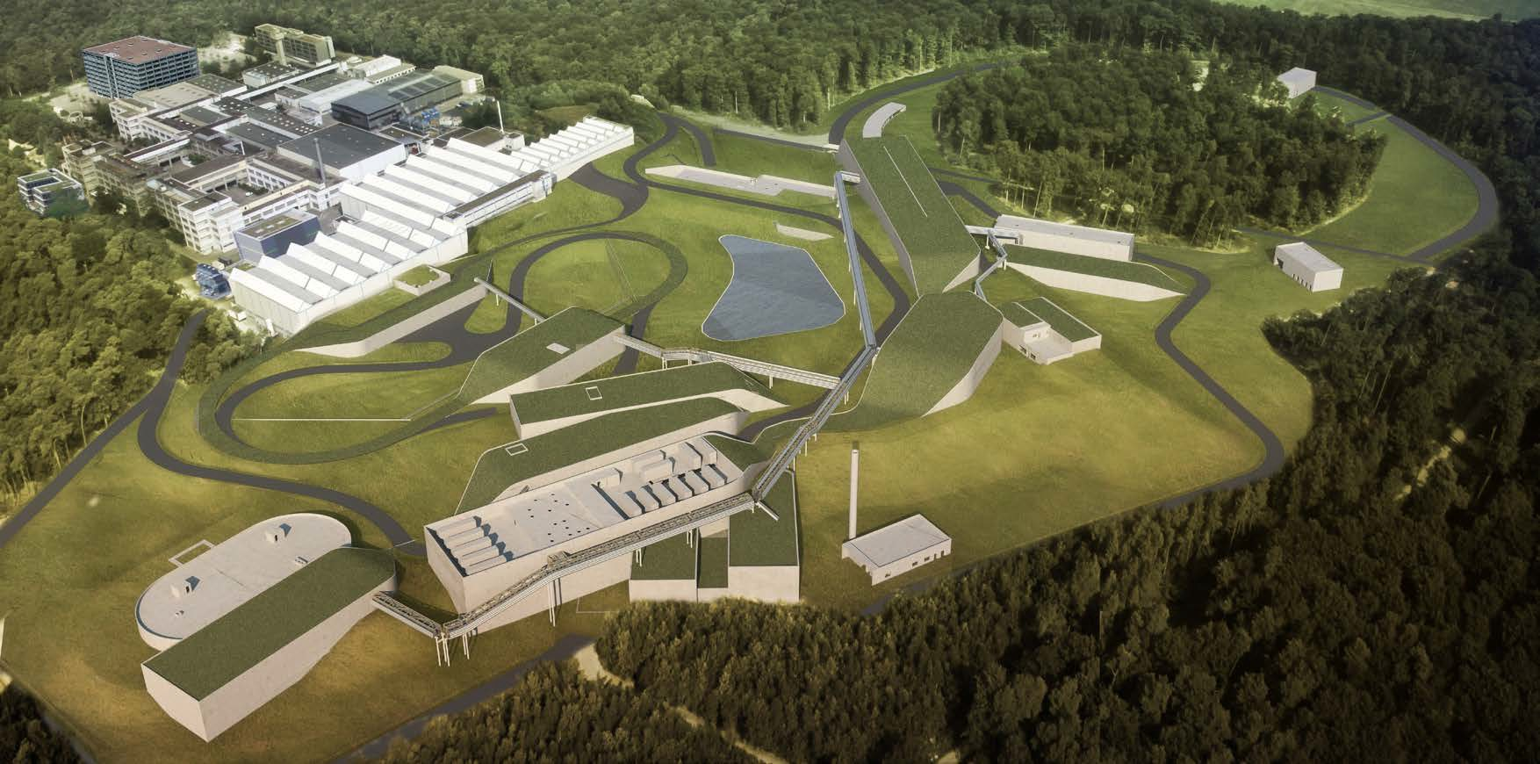
GSI Helmholtzzentrum für Schwerionenforschung FAIR: Facility for Antiproton and Ion Research
Thank you!
FAIR GmbH | GSI GmbH
27

