Slide 1
Future facilities and experiments
Discussed open question at Future facilities and detector projects (Day 1 of NuSym23) → some raised points (G. Verde)
FRIB status and perspectives (Z. Chajecki)
Status and perspectives at Spirit, Asy-Eos, HADES, CBM, new observables (P. Senger)

Slide 2
Key questions by speakers: facilities and projects (discussed on Sep 18)
Discussed Facilities
HIRFL (China), FAIR/GSI (Germany), FRIB (USA), RAON (S. Korea), RIKEN (Japan)
Discussed Projects
Asy-EoS-II@GSI, HADES-CBM@GSI,FAIR, Spirit@Riken, CEE@HIRFL, EoS@FRIB, FAZIA@GANIL/FRIB, LAMPS@RAON

Slide 3
Raised questions (facilities)
Beam Energy Scan important (high densities, flows, more probes..)
  Ex: HADES@GSI in 2024, Asy-EoS@GSI, early INDRA campaigns at GANIL, STAR@RHIC...
  Important also with RIBs at FRIB (scan on 𝜌, T, time-scales, …)
  Demanding beamtime: are we doing a good job in writing convincing proposals?
  Use/construct detection systems that can work at higher rates?
Energy range
  FAIR, FRIB, FRIB400, RAON… → RIBs at E/A>150 MeV (supra-saturation densities)
  About FRIB: How far can we push above 200 MeV per nucleon? FRIB/FRIB400 vs FAIR
  RIBs at E/A=50-100 MeV for RIBs?
    Open questions still exist (see Eurisol physics cases)
    Degrade beams to reduce E/A? (at FRIB and GSI) → Reduced beam quality… → Improve Monitoring?
    RAON beams around Fermi energies (SIB and RIB)?

Slide 4
Raised questions (projects)
Neutron detection
  New developments? (e.g. at INFN-LNS/CT, others)
  n-𝛾 discrimination, improved efficiency? event-by-event? (n-p Femtoscopy and flows)
Invariant mass spectroscopy: granularity, angular res., wide range elect…?
  RE: ex. early high density probes (ex. Σ⁻/Σ⁺ for primordial pions @ CBM)
  IE: In-medium nuclear structure at 𝜚< 𝜚₀ (ex. Hoyle state decay into 3𝛼’s…)
Detectors for both participants and spectators
  Event characterization (b, reaction plane, flows, stopping, etc.)
    existing “4pi” detectors: INDRA@GANIL, CHIMERA@LNS, FOPI, HADES/CBM@FAIR, LAMPS@RAON, CEE@HIRFL, NIMROD@TAMU…→ FRIB?
  Spectators important? Profit from low thresh. w PS, … → phase transitions are back?
  New TPC projects for pions and other probes? (FRIB, RIKEN)
  New and better flow measurements?
Need for HPC and repositories…, models+filters (theory and experiments)
Need for human-power!
Need for a coherent international action (a paper of statements, other…)?

Slide 7








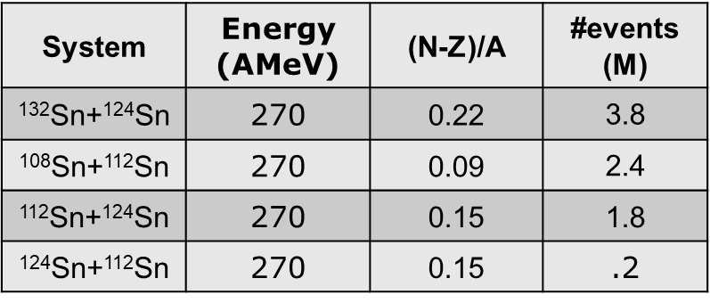
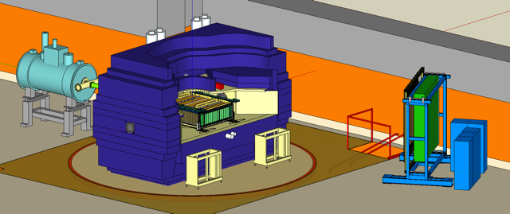
Collaboration
Symmetry energy up to about 1.5 ρ₀
Beam direction
G. Jhang et al., J. Korean Phys. Soc. 69 (2016) 144
R. Shane et al., Nucl. Instr. and Meth. A 784 (2015) 513

Slide 8
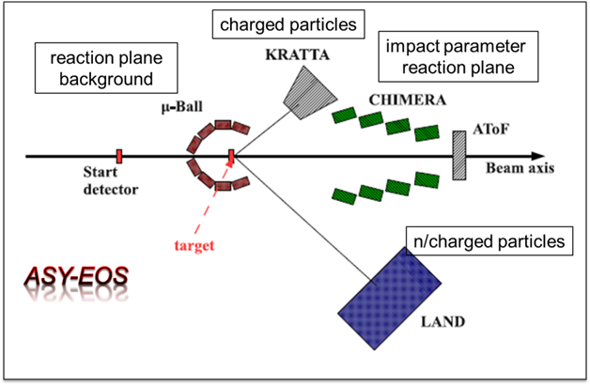
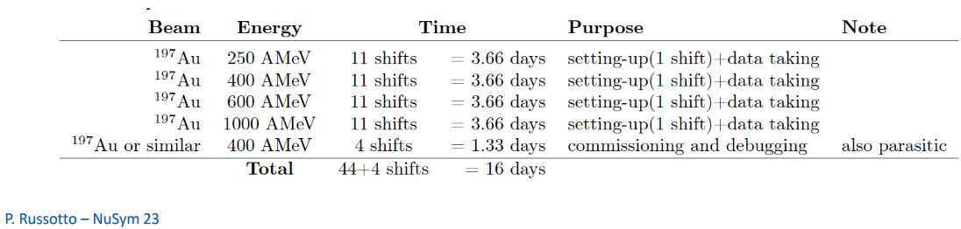
Symmetry energy up to about 2.5 ρ₀

Slide 9
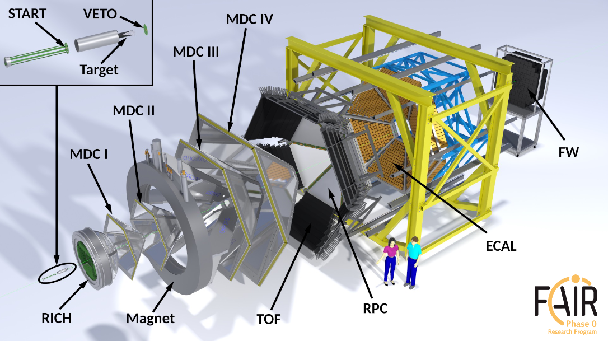
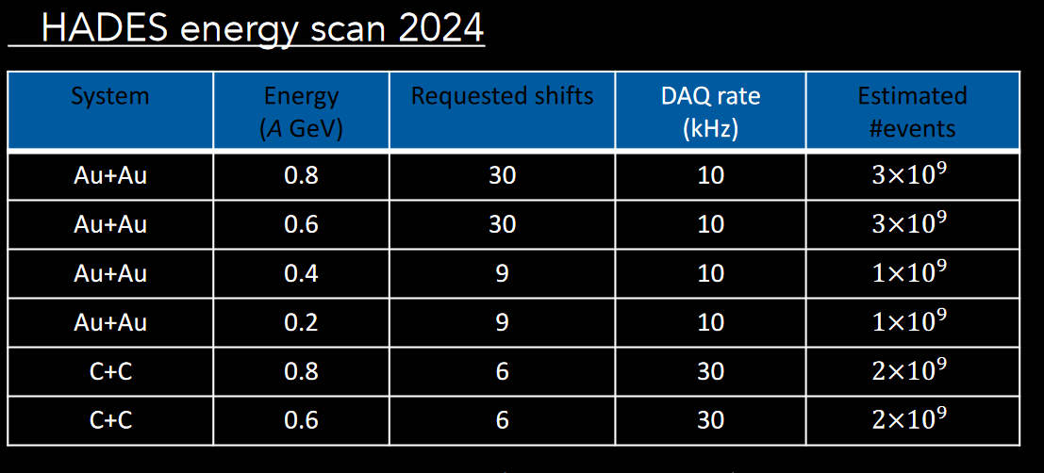
EOS up to about 2.5 ρ₀

Slide 10
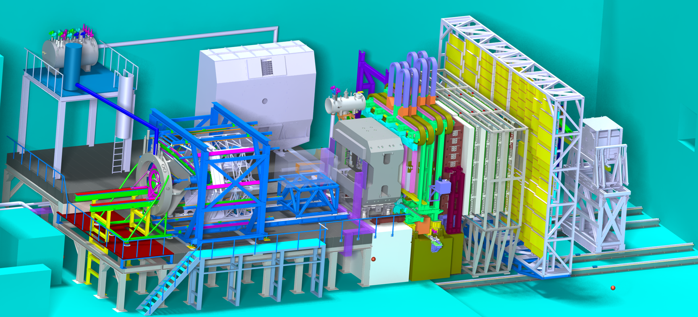
The Compressed Baryonic Matter (CBM) Experiment at FAIR
EOS up to 4-5 ρ₀
Phase transition?
MUCH
particle ID
RICH
TOF
HADES
event plane
e⁻e⁺
μ⁻μ⁺
Magnet
STS
MVD
PSD
TRD
beam
e⁻e⁺
Tracking
Interaction rates up to 10 MHz → free-streaming readout → online track and event reconstruction

Slide 11
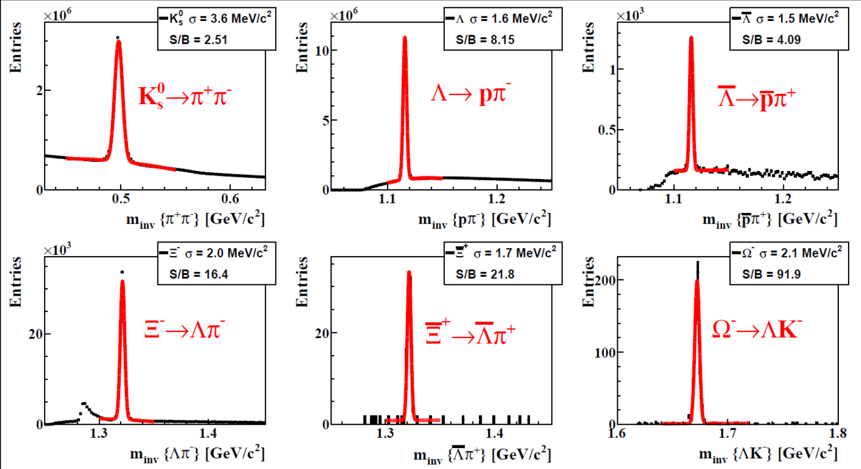
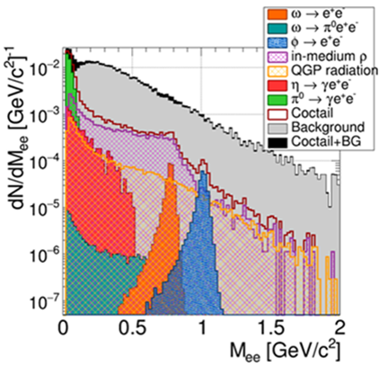
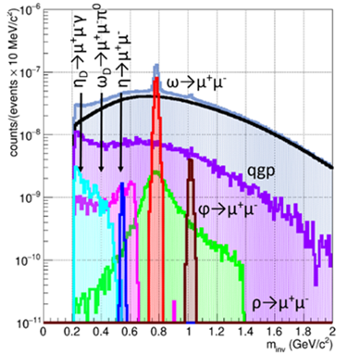
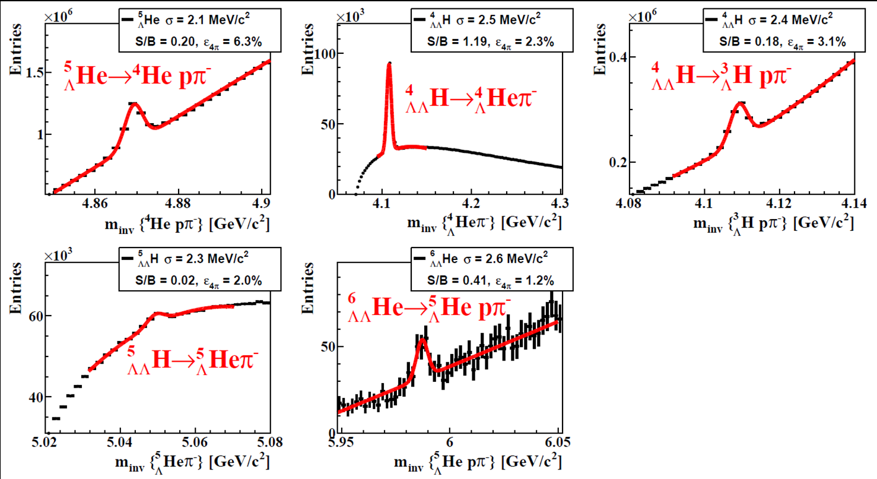
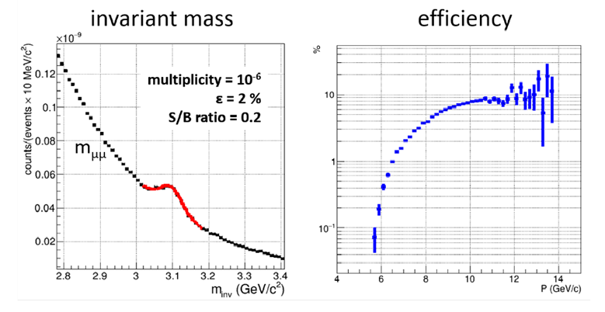
CBM physics performance studies for Au+Au collisions
Strange particles Au+Au 10A GeV (5 M events)
e⁺e⁻ pairs (left) and μ⁻μ⁺ pairs (right) Au+Au 8A GeV
(double-Lambda) Hypernuclei Au+Au 10A GeV
Subthreshold charm production N∗→J/ψ+N Au+Au 10A GeV
ΛN, ΛΛN interactions
hyperons in neutron
stars ?

Slide 12

New probe of the high-density EOS:
subthreshold production of multi-strange (anti-)hyperons
via sequential strangeness exchange reactions
0
1
2
3
4
5
6
7
8
9
10
11
12
13
E_{thr,NN} (GeV)
SIS18
SIS100
K^{+,0}, Λ⁰, Σ
K⁻
Ξ^{-,0}
Ω⁻
$$Λ^{0}\overline{Λ^{0}}$$
Ξ⁺
Ω⁺
pp → K⁺nΣ⁺
pp → K⁺pΛ⁰
pn → K⁺pΣ⁻
Isospin-dependent strangeness-exchange cross sections in UrQMD
Σ⁺Λ⁰→ Ξ⁰ p
Σ⁻ Ξ⁰ → Ω⁻ n
G. Graef,
J. Steinheimer,
F. Li, M. Bleicher,
Phys. Rev. C 90, 064909 (2014)
pp → K⁺pΛ⁰
pp → K⁺pΛ⁰
pn → nK⁺Σ⁰
Λ⁰Λ⁰→ Ξ⁻ p
Σ⁰ Ξ⁻ → Ω⁻ n
pp → K⁺nΣ⁺
pn → K⁺pΣ⁻
pp → K⁺pΛ⁰
Σ⁺Σ⁻ → Ξ⁻ p
Λ⁰ Ξ⁻ → Ω⁻ n

Slide 13
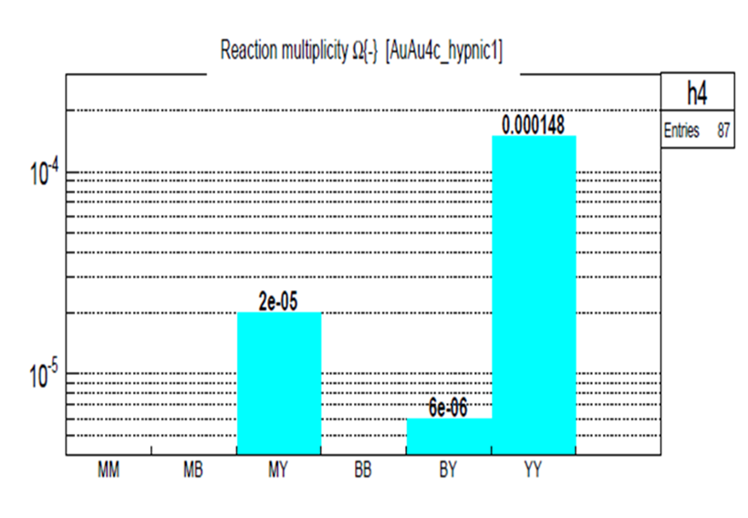
New probe of the high-density EOS:
subthreshold production of multi-strange (anti-)hyperons
via sequential strangeness exchange reactions
0
1
2
3
4
5
6
7
8
9
10
11
12
13
E_{thr,NN} (GeV)
SIS18
SIS100
K^{+,0}, Λ⁰, Σ
K⁻
Ξ^{-,0}
Ω⁻
$$Λ^{0}\overline{Λ^{0}}$$
Ξ⁺
Ω⁺
pp → K⁺nΣ⁺
pp → K⁺pΛ⁰
pn → K⁺pΣ⁻
Ω⁻ production in 4 A GeV Au+Au
Σ⁺Λ⁰→ Ξ⁰ p
Σ⁻ Ξ⁰ → Ω⁻ n
pp → K⁺pΛ⁰
pp → K⁺pΛ⁰
pn → nK⁺Σ⁰
Λ⁰Λ⁰→ Ξ⁻ p
HYPQGSM
calculations
K. Gudima et al.
Σ⁰ Ξ⁻ → Ω⁻ n
pp → K⁺nΣ⁺
pn → K⁺pΣ⁻
pp → K⁺pΛ⁰
Σ⁺Σ⁻ → Ξ⁻ p
Λ⁰ Ξ⁻ → Ω⁻ n

Slide 14
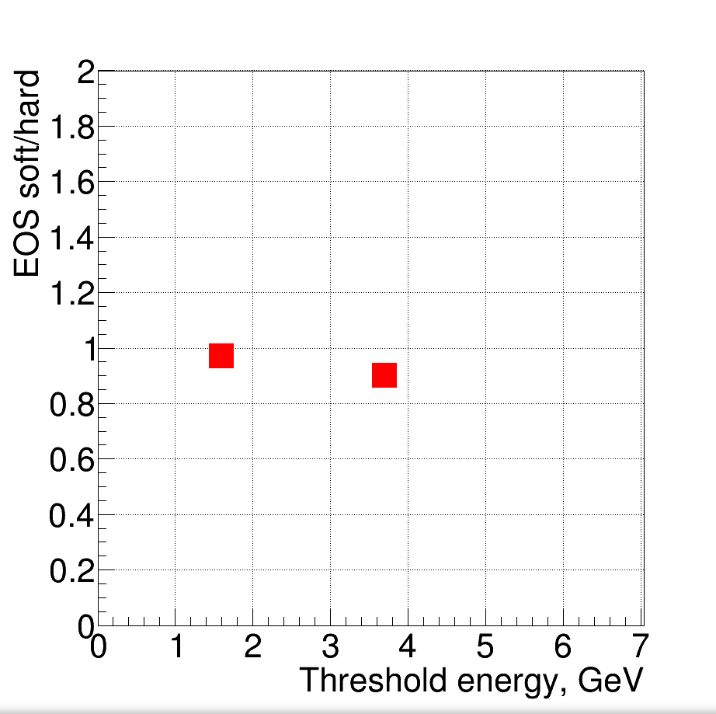
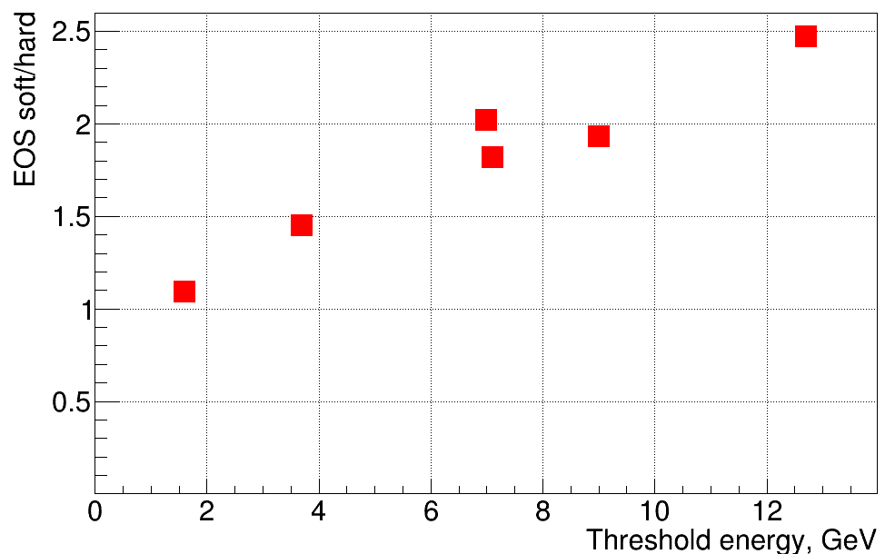
New probe of the high-density EOS:
subthreshold production of multi-strange (anti-)hyperons
via sequential strangeness exchange reactions
Hyperon yield in heavy ion collisions at 4A GeV: soft EOS (K=240 MeV) / hard EOS (K=350) MeV
Au+Au
4A GeV
C+C
4A GeV
Ω⁻
Ω⁺
Ξ⁺
Λ
Ξ⁻
Λ
Ξ⁻
Λ
PHQMD: J. Aichelin et al., Phys. Rev. C 101 (2020) 044905
With crossover transition to quark matter above ε = 0.5 GeV/fm³ (∼ 3 ρ₀)

