Slide 1
A SHOT ON NArCoS
THE NEW NEUTRON HODOSCOPE
PAGANO EMANUELE VINCENZO
(LNS-INFN)

Slide 2
NArCoS (Neutron Array for Correlation Studies)
Idea for a new Neutron Hodoscope
To realize a prototype of detector able to detect at the same time charged particles and neutrons with high energy and angular resolution for reaction studies and applications
Detector
Physic cases
Candidate: The plastic scintillator EJ276-Green Type (ex EJ299-33) (3x3x3cm³)
1 cluster: 4 consecutively cubes -> 3x3x12 cm³
Neutron detection efficiency ≈ 50% for the prototype
Reading the light signal: Si-PM and digitalization
Modular, reconfigurable (in mechanic and electronic)
Discrimination of n/γ from PSD (but also light charged particles)
Energy measurement from ToF (Δt≤0.5 ns with L_{ToF}≈1÷1.5m)
TOF measured using the RF of the CS or with an ancillary MCP (low intensity exotic beams)
Neutron-particles correlations (HBT)
Reaction Dynamics and time scale
Symmetry Energy in EoS of nuclear matter
Nuclear structure of unbound exotic nuclei
In medium nuclear interaction
Nuclear astrophysics (neutron stars and nucleosynthesis processes)
Medical application (neutron production cross section, differential cross sections)
NArCoS
≈ 12 cm
300 μm
DSSSD 32x32
300 μm
6.4 cm
CP
3x3x3cm³
32 strip back
T
EJ276G
32 strip front
n
6.4 cm
Δstrip = 2 mm
Interstrip = 0.1 mm
SiPD
50/75 cm
100/150 cm
E. V. Pagano. LNS-INFN
NuSym23 – GSI Darmstadt, Germany - 22 September 2023
1

Slide 3
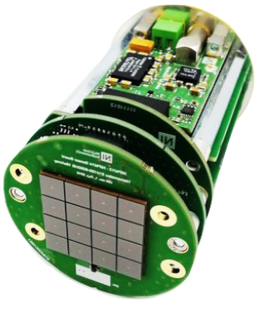
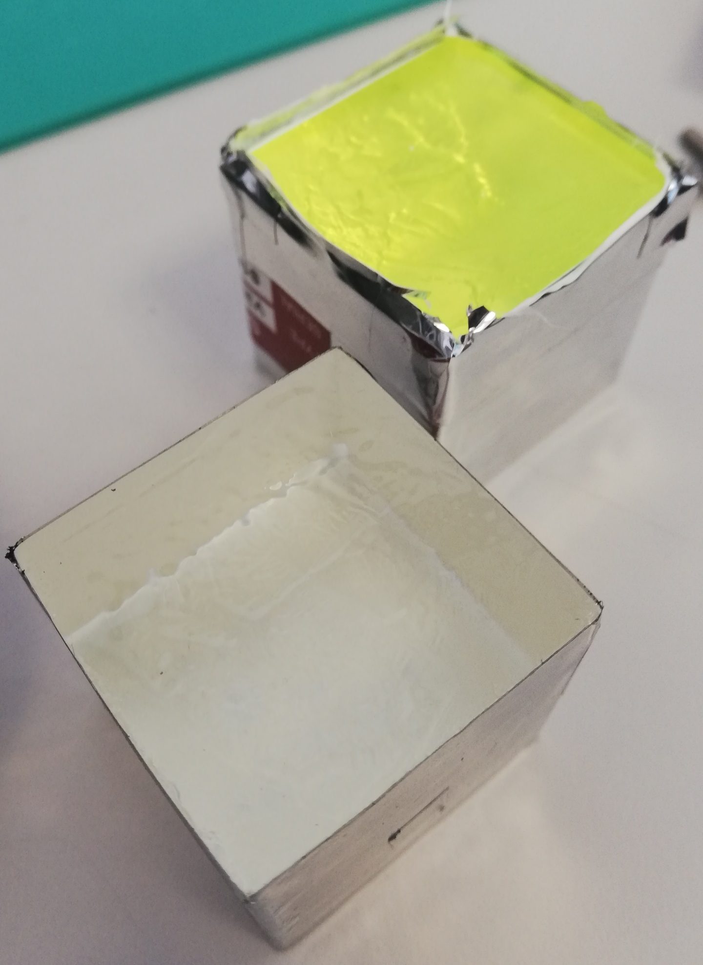
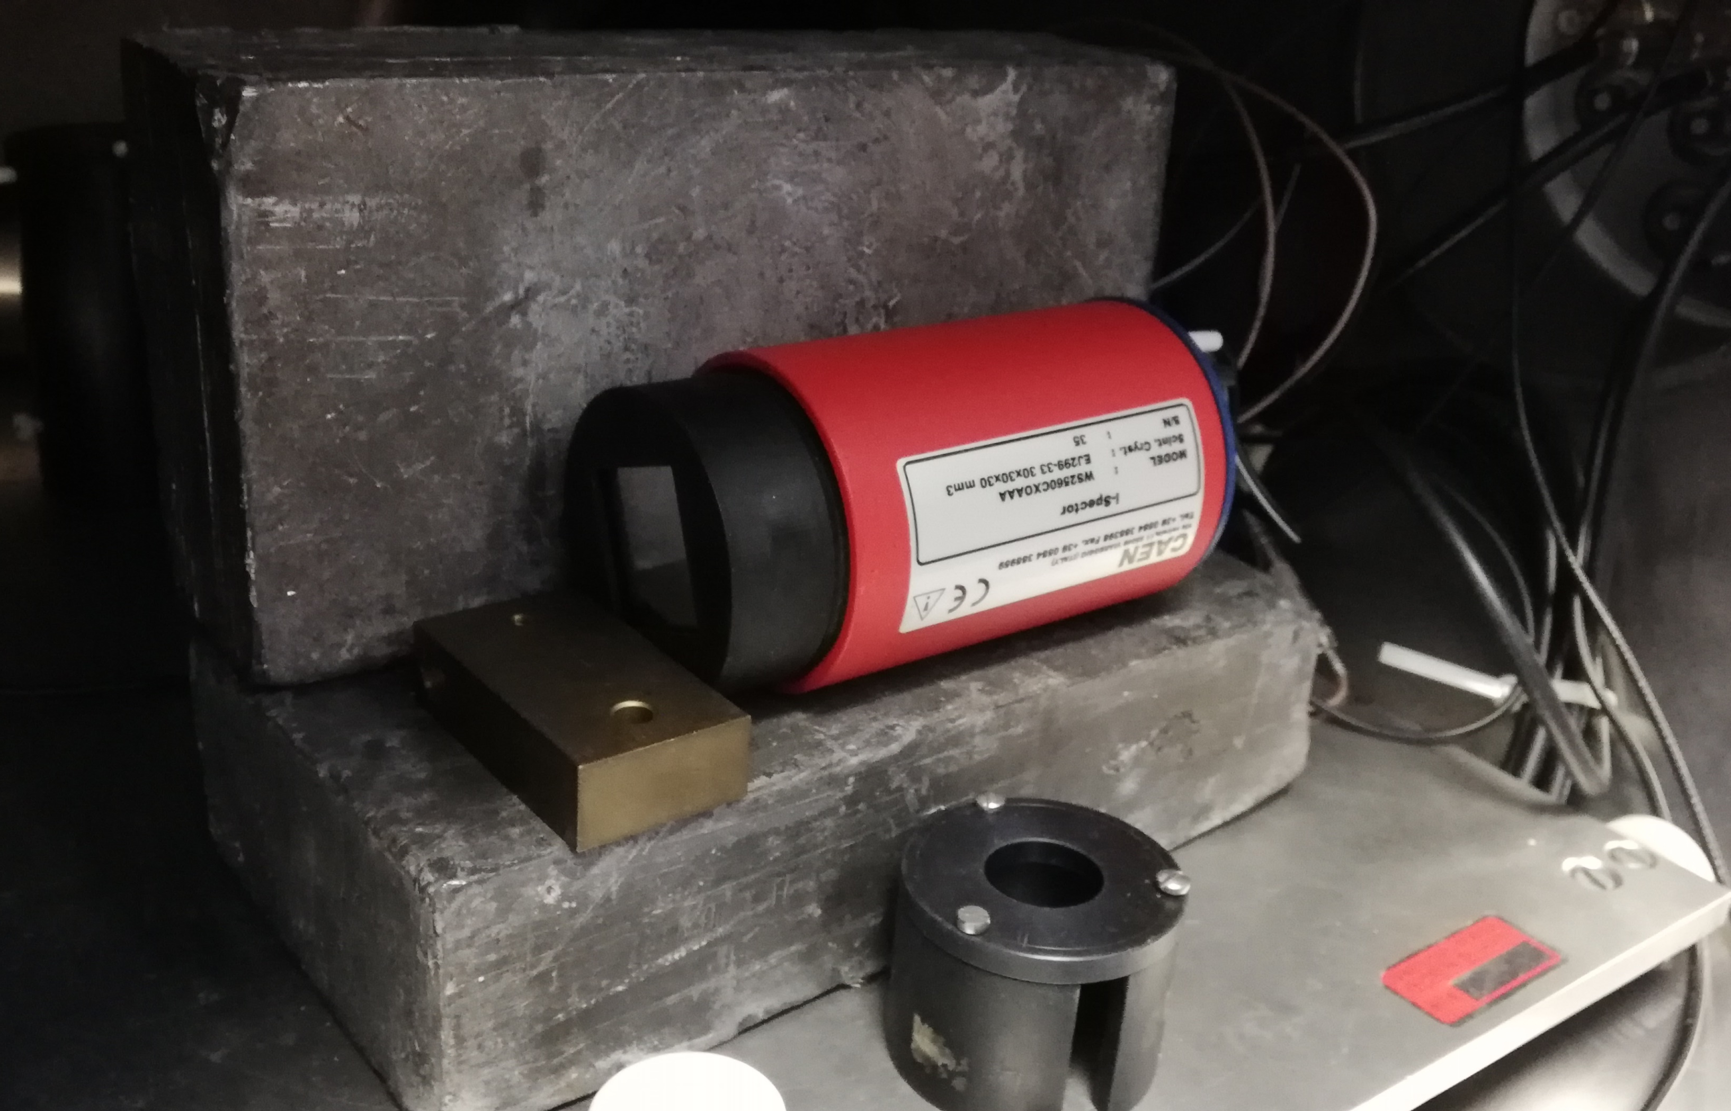
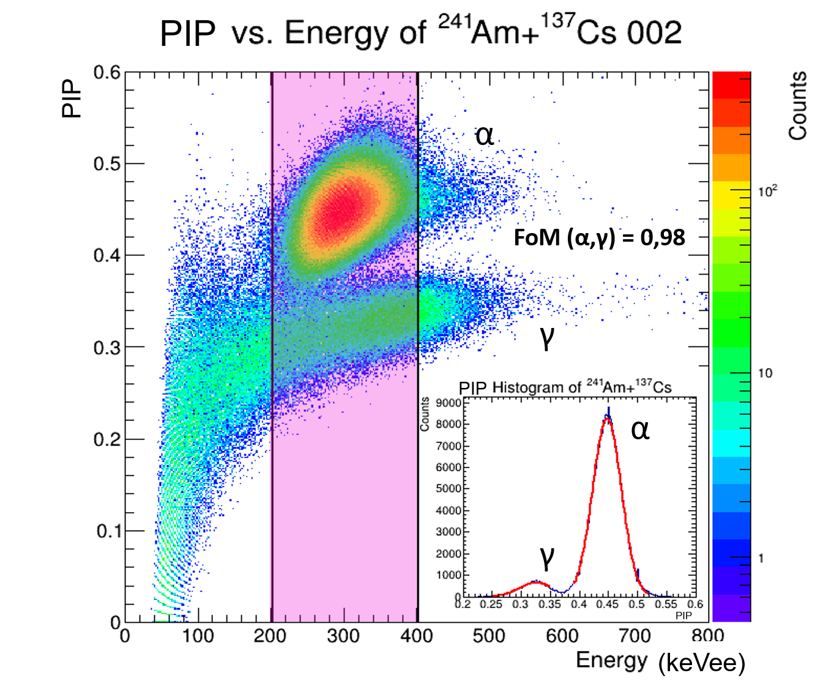
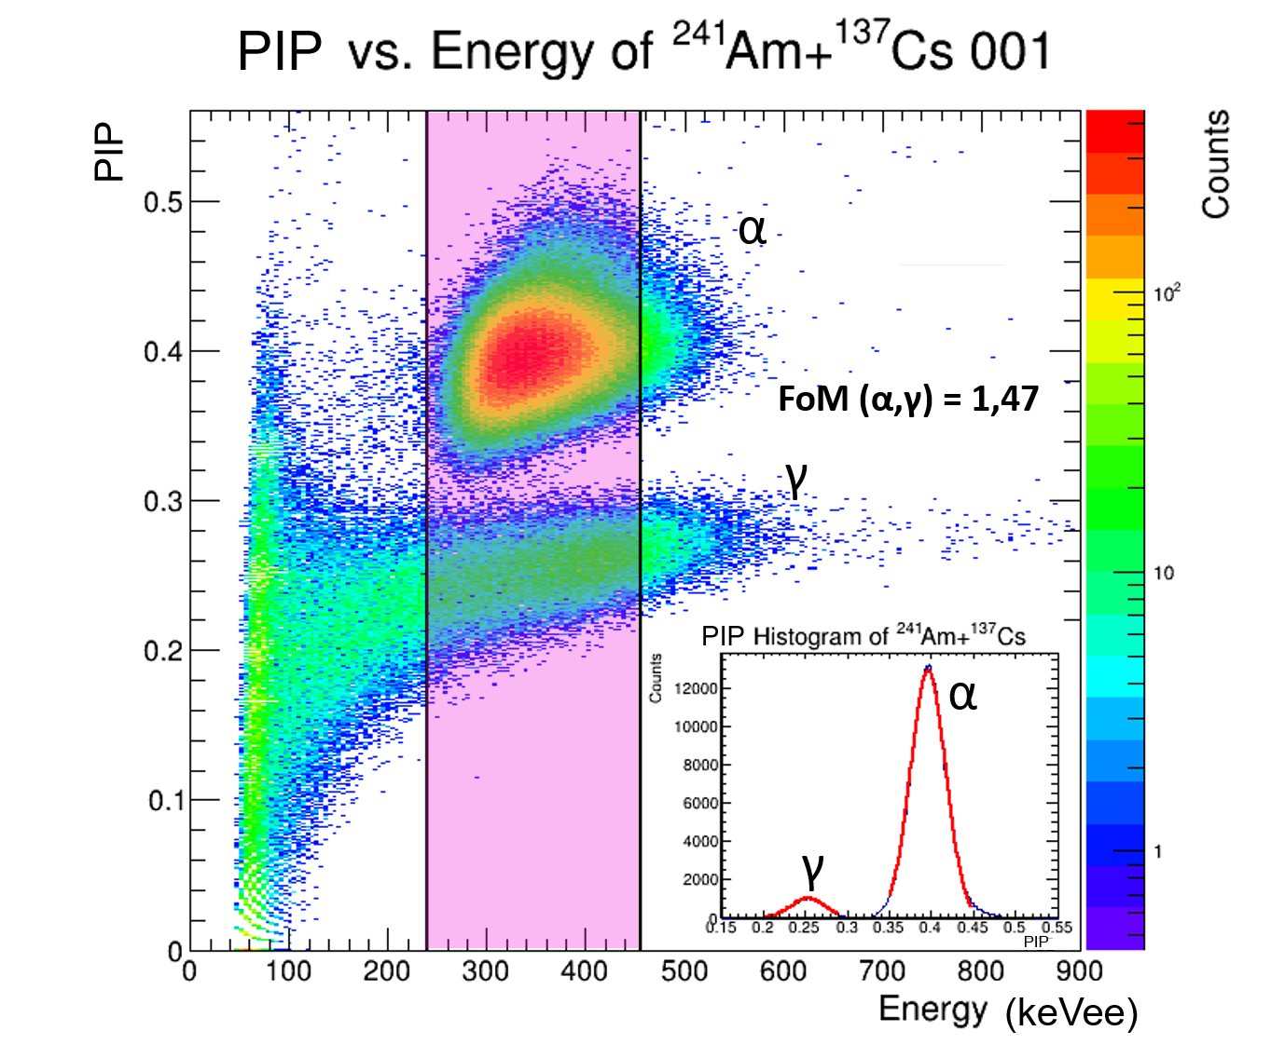
PSD studies using sources
Detector Configurations:
EJ-276G + PMT
EJ-276 + i-Spector
EJ-276G + i-Spector
Lab measurements with radioactive sources:
Vacuum Chamber
Pb shield
Gamma sources: ¹³³Ba, ¹³⁷Cs, ⁶⁰Co, ¹⁵²Eu
Alpha source: ²⁴¹Am
Digitizer from CAEN
E.V.Pagano, G. Politi, A. Simancas et al., in preparation
Example of signal and integration windows
Particle Identification Paramenter
$$PIP=1-\frac{Q_{fast}}{Q_{tot}}=\frac{Q_{slow}}{Q_{tot}}$$
Results
Detector | FoM
i-Spector + EJ-276 | 0.98
i-Spector + EJ-276G | 1.47
PMT + EJ-276G | 1.03
Pagano E.V. et al., N.S., Nucl. Instrum. Methods A, 889 (2018) 83-88
Pagano E.V. et al., N.S., Nucl. Instrum. Methods A, 905 (2018) 47-52
Pagano E.V. et al., IL NUOVO CIMENTO 41 C (2018) 181
Pagano E.V. et al., JPS Conf. Proc. 32, 010096 (2020)
Pagano E.V. et al., IL NUOVO CIMENTO 43 C (2020) 12
Pagano E.V. et al., J. Phys.: Conf. Ser. 1643 (2020) 012037
Pagano E.V. et al., IL NUOVO CIMENTO 45 C (2022) 64
EJ-276 + i-Spector
EJ-276G + i-Spector
E. V. Pagano. LNS-INFN
NuSym23 – GSI Darmstadt, Germany - 22 September 2023
2

