Slide 1

Overview
of the EOS program
at FRIB
Zbigniew Chajęcki
Western Michigan University

Slide 2
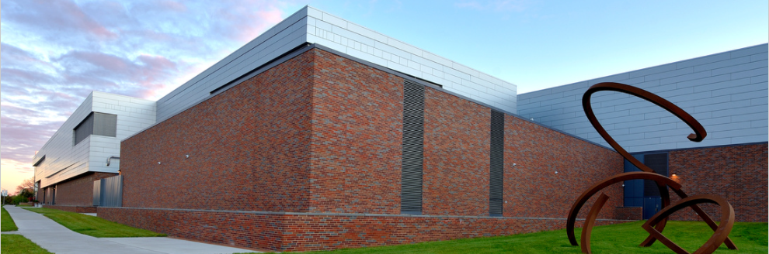
Facility for Rare Isotope Beams
FRIB is a $730 million scientific user facility funded by the Department of Energy Office of Science (DOE-SC), Michigan State University, and the State of Michigan
FRIB Project started in 2008, concluded on budget and ahead of schedule in January 2022, ribbon cutting and first experiments started in May 2022
FRIB is a DOE-SC user facility for world-unique rare isotope research supporting the mission of the Office of Nuclear Physics in DOE-SC
Rare isotopes are combinations of protons and neutrons that do not naturally exist on earth – they are made in stars and FRIB can make them until they decay
FRIB enables scientists to make discoveries about the properties of these rare isotopes in order to better understand the physics of nuclei, nuclear astrophysics, fundamental interactions, and applications for society

Slide 3
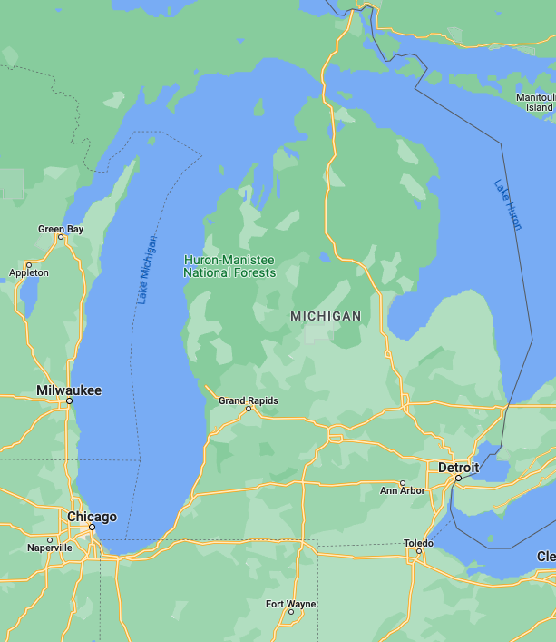
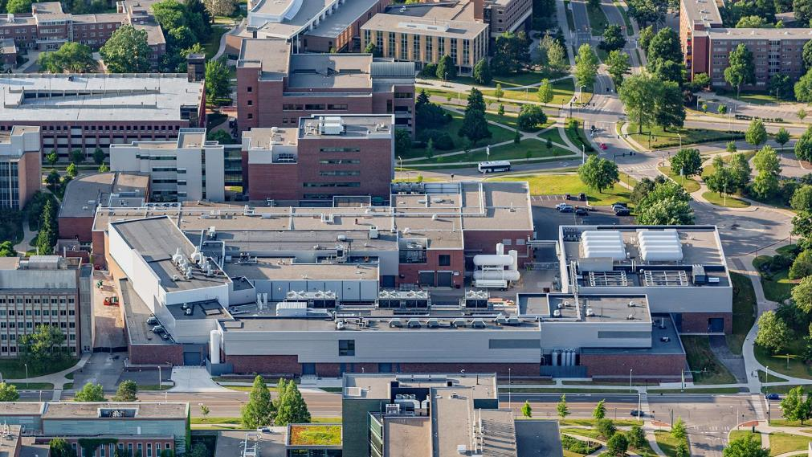



FRIB Site

Slide 4
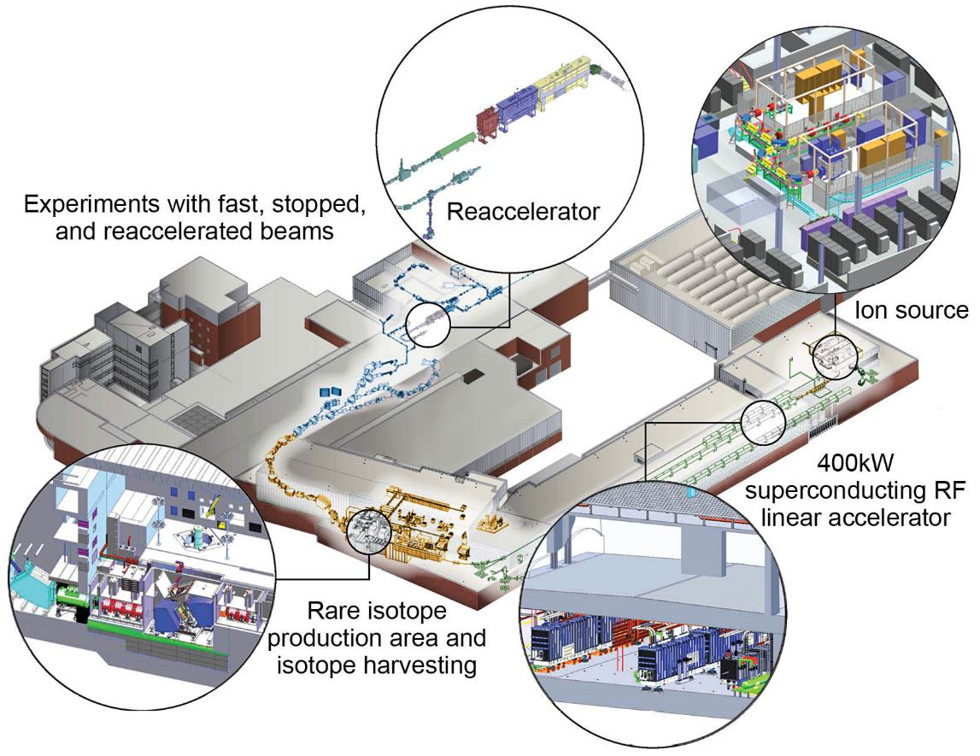
Optimized for Science with Fast, Stopped and Reaccelerated Rare Isotope Beams

Slide 5
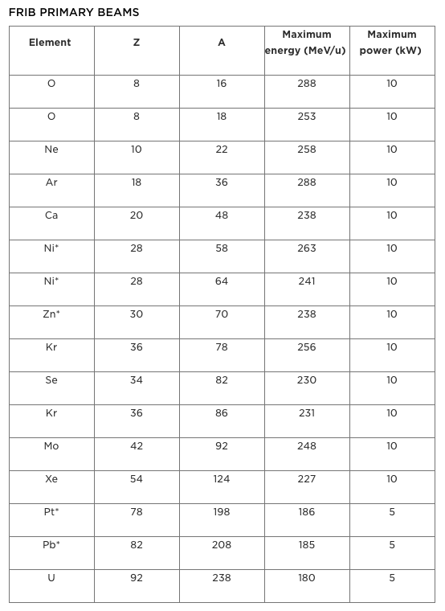
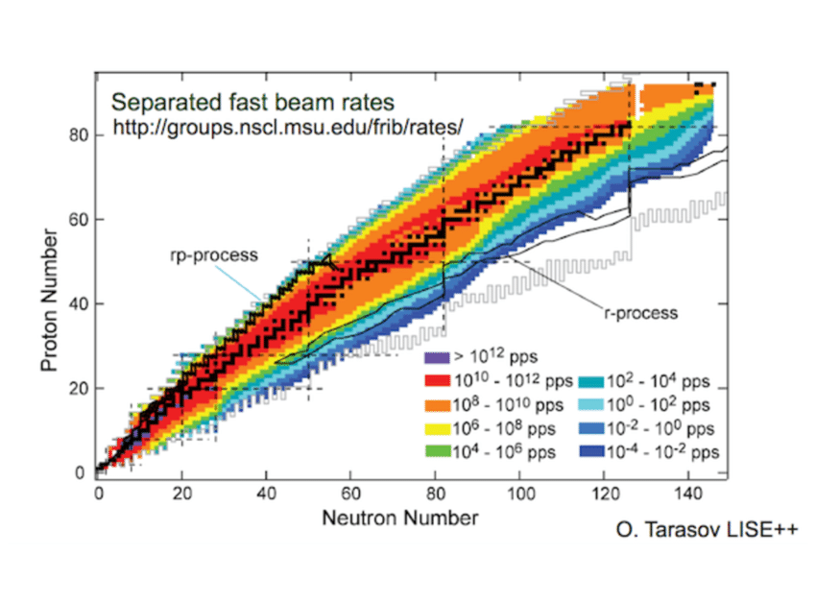
Available beams (for PAC2)
Projected secondary beam intensities at FRIB with full power estimated with the program LISE++.
https://frib.msu.edu/users/beams/index.html
Notes:
List available beams and energies

Slide 6
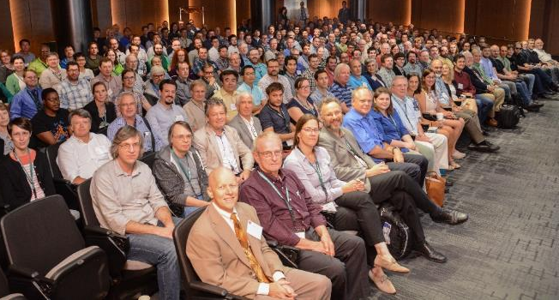
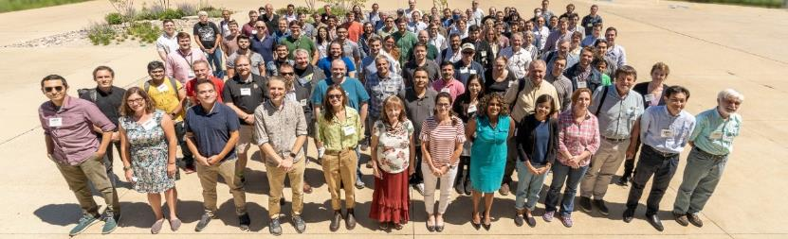

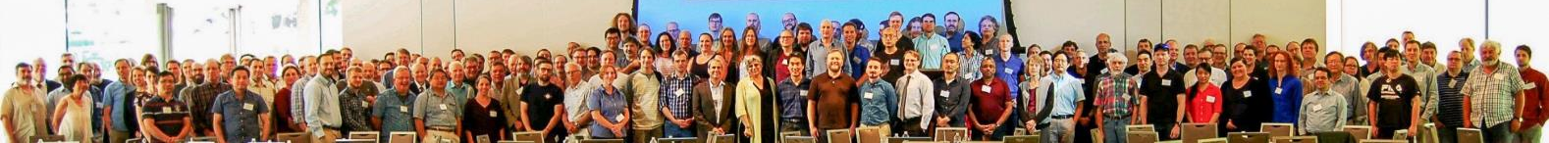
1,800 Users Engaged and Ready for Science fribusers.org
Users organized as part of independent FRIB Users Organization (FRIBUO)
  Chartered organization with an elected executive committee
  1,800 members (125 U.S. colleges and universities, 12 national laboratories, 51 countries) as of 31 January 2023
  22 working groups on instruments
First experiments have begun
  February 2021: 82 proposals received representing
  597 scientists
  August 2021: FRIB Program Advisory Committee (PAC1)
  May 2022: First user experiments
  January 2023: 84 proposals received representing 611 scientists
  March 2023: FRIB Program Advisory Committee (PAC2)
User needs and high user satisfaction are important to FRIB
  ISO 9001 quality systems to assess user satisfaction
Annual meetings
  User meeting (three days with 200-300 participants)
» August 2022: Meeting hosted by ANL
» August 2023: Meeting hosted by FRIB

Slide 7




FRIB Enables Scientists to Make Discoveries Science Aligned with National Priorities
Properties of atomic nuclei
Develop a predictive model of nuclei and their interactions
Many-body quantum problem: intellectual overlap to mesoscopic science, quantum dots, atomic clusters, etc.
Astrophysics: What happens inside stars?
Origin of the elements in the cosmos
Explosive environments: novae, supernovae, X-ray bursts…
Properties of neutron stars
Tests of laws of nature
Effects of symmetry violations are amplified in certain nuclei
Societal applications and benefits
  Medicine, energy, material sciences, national security
Science is aligned with national priorities articulated by
Nuclear Science Advisory Committee to
DOE and NSF Long Range Plan for Nuclear Science (2015)
National Research Council Decadal Survey of Nuclear Physics (2012)
National Research Council Rare Isotope Science Assessment report (2006)
Opportunities articulated in
Nuclear Science Advisory Committee SC 2015 Long Range Plan for the DOE-NP Isotope Program
Notes:
FRIB Defines and Delivers on National Priorities and is Aligned with National Priorities
Covers variety of topics from structure to reactions with implications for astrophysics including EOS of Neutron Stars

Slide 8
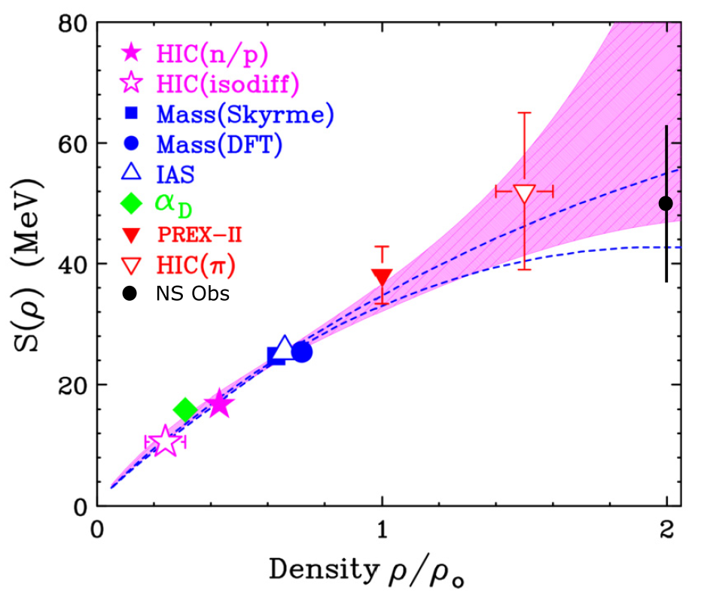
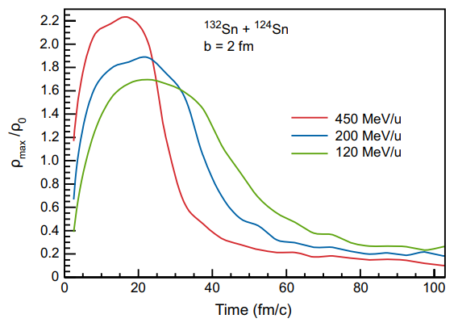
EoS Studies at FRIB
Goal: Comprehensive nuclear matter EOS: density and momentum (effective mass) dependence of nuclear potentials
Lynch, Tsang, PLB 830, 137098 (2022)
FRIB Upgrade Whitepaper
Z. Chajęcki - NuSYM 2023 - GSI, Sep 18-22, 2023

Slide 9
First EOS approved experiment at FRIB
Measuring the isospin dependence of the nucleon effective mass at supersaturation density
^{56,70}Ni+^{58,64}Ni @ 175 MeV/u
Main goals of the experiment are to measure
Energy spectra for light-charged particles and neutrons
Precise single and double n/p ratio
(including coalescence invariant ratios)
Transverse and elliptic flow
Collaboration between:
MSU: K. Brown, W. Lynch, B. Tsang
WMU: Z. Chajecki
INFN: G. Verde, D. Dellaquila, I. Lombardo
IN2P3: A. Chbihi, D. Gruyer, Q. Fable, C. Ciampi, F. Quentin, J.-E. Ducret
Texas A&M: K. Hagel, A. Mcintosh

Slide 10
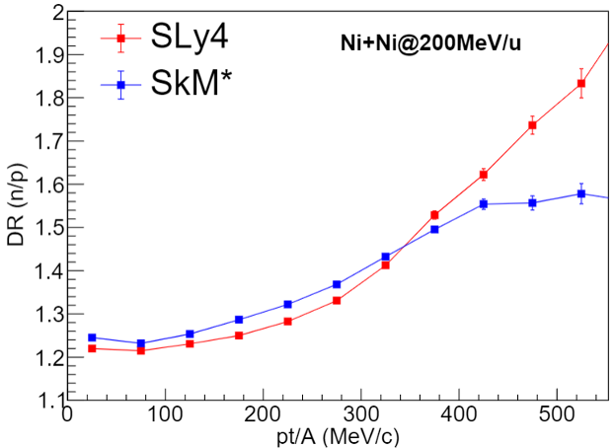
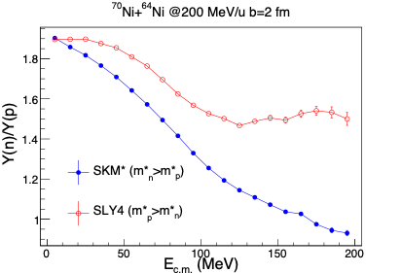
n/p ratios
^{56,70}Ni+^{58,64}Ni @ 175 MeV/u
The spectral ratios will be used to obtain a constraint on isospin dependence of the nucleon
effective masses.
Notes:
ImQMD @ 200 MeV

Slide 11
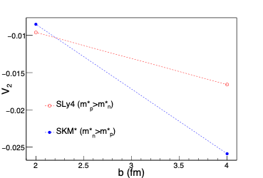
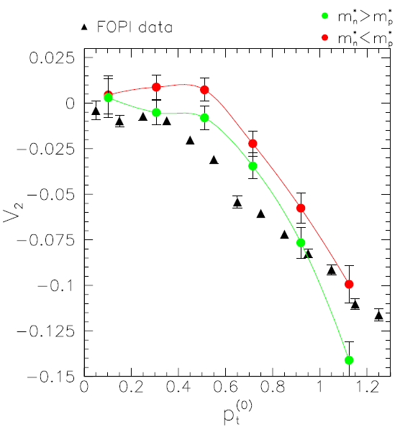
Elliptic flow
Elliptic flow in ¹⁹⁷Au +¹⁹⁷Au collisions
at 250 MeV/u as a function of p_{t}
The transverse and elliptic flow will be used to place constraints on the pressure due to the symmetry energy
At larger b v₂ shows sensitivity to the effective mass
GSI experiments showed sensitivity of the elliptic flow to the symmetry energy
M. Di Toro, S.J. Yennello, and Bao-An Li, EPJ A30, 153–163, 2006
Notes:
V2 scales with (A_{T}^{1/3}+A_{p}^{1/3}). Predictions in Ni+Ni will be smaller by a factor of 0.68

Slide 12
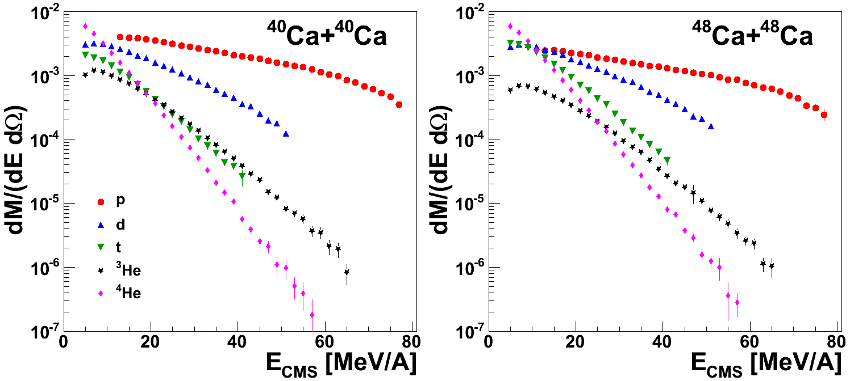
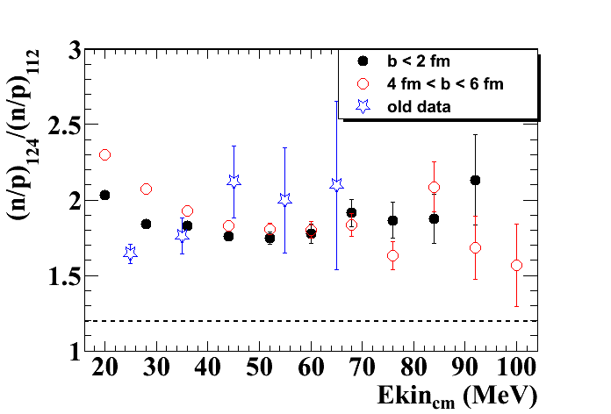
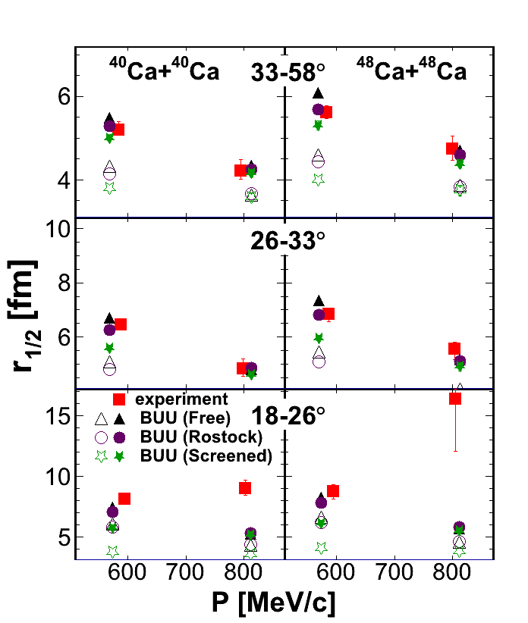
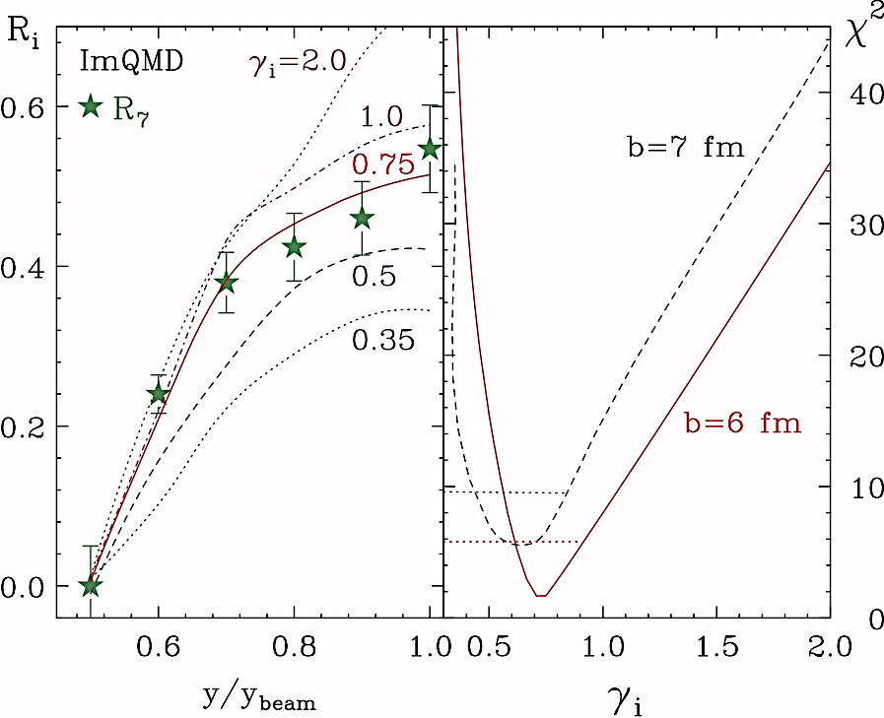
What we hope to learn from HIC collisions?
(Double-)
ratios
Isospin diffusion
Observables
Spectra
Femtoscopy
Flow
Transport model ingredients
Symmetry energy |  | ✔ |  | ✔ | ✔
Effective mass |  | ✔ |  | ? | ?
Cross section | ✔ | ✔ | ✔ | ✔ | ✔
Cluster production | ✔ | ✔ | ✔ | ✔ | ✔
Our approach: Use different isotopes
(fix Z of your initial system and vary N)

Slide 13
Our experiment

Slide 14
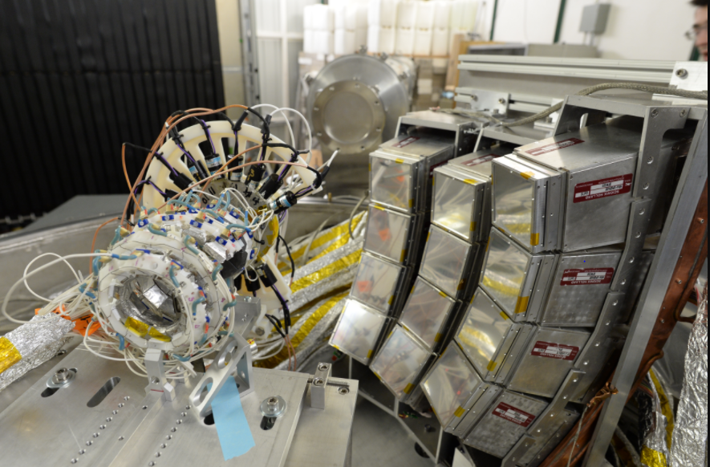
Our (previous) Experimental setup
NW
VW
HiRA
FA
Beam
Microball
13

Slide 15
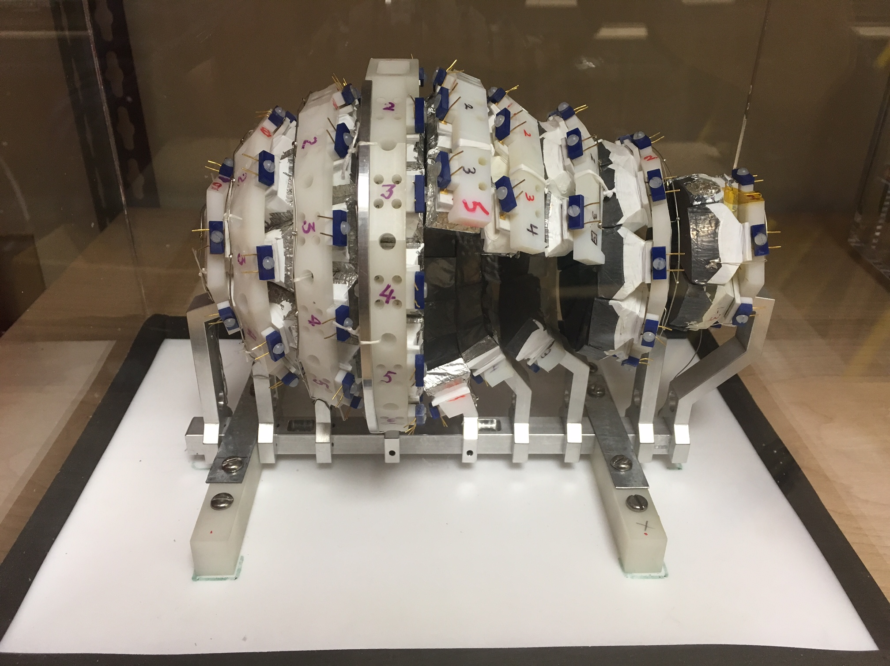
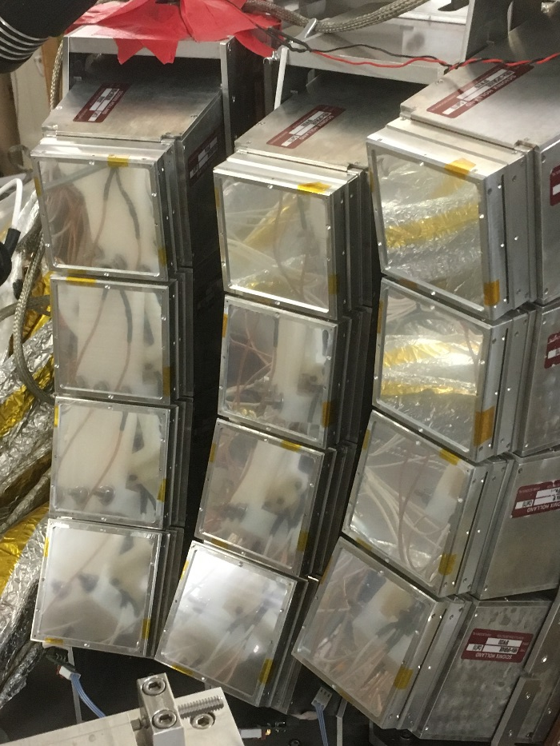
Experiment: Charged particle detection
Upgraded HiRA10
Microball
Replaced by a new multiplicity/reaction plane detector
12 Silicon-CsI(Tl) telescopes
Each telescope has 4, 10-cm CsI(Tl) crystals and a 1.5mm thick DSSD with 32 strips on each side
At ~50 degrees off the beam axis, covers ~30 to ~70 degrees
Rings of CsI Crystals
Used as a Multiplicity trigger
Used for impact parameter determination
The hole is for HiRA detector
14

Slide 16
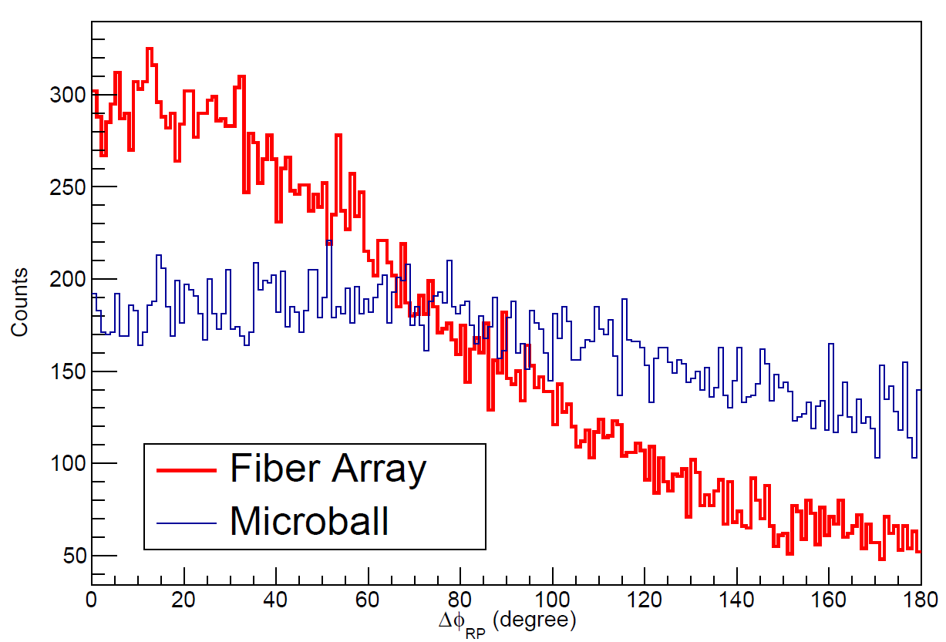
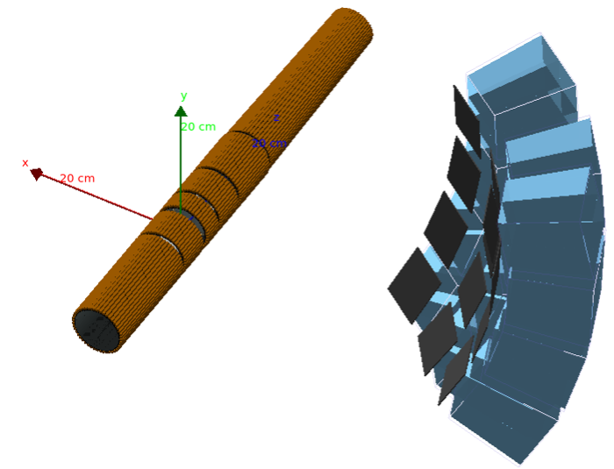
Experiment: Charged particle detection
Fiber Array
No need to remove a section of the detector that overlaps with the HiRA Si Array due to minimal energy loss in the FA material
Complete azimuthal coverage will allow reaction plane determination

Slide 17
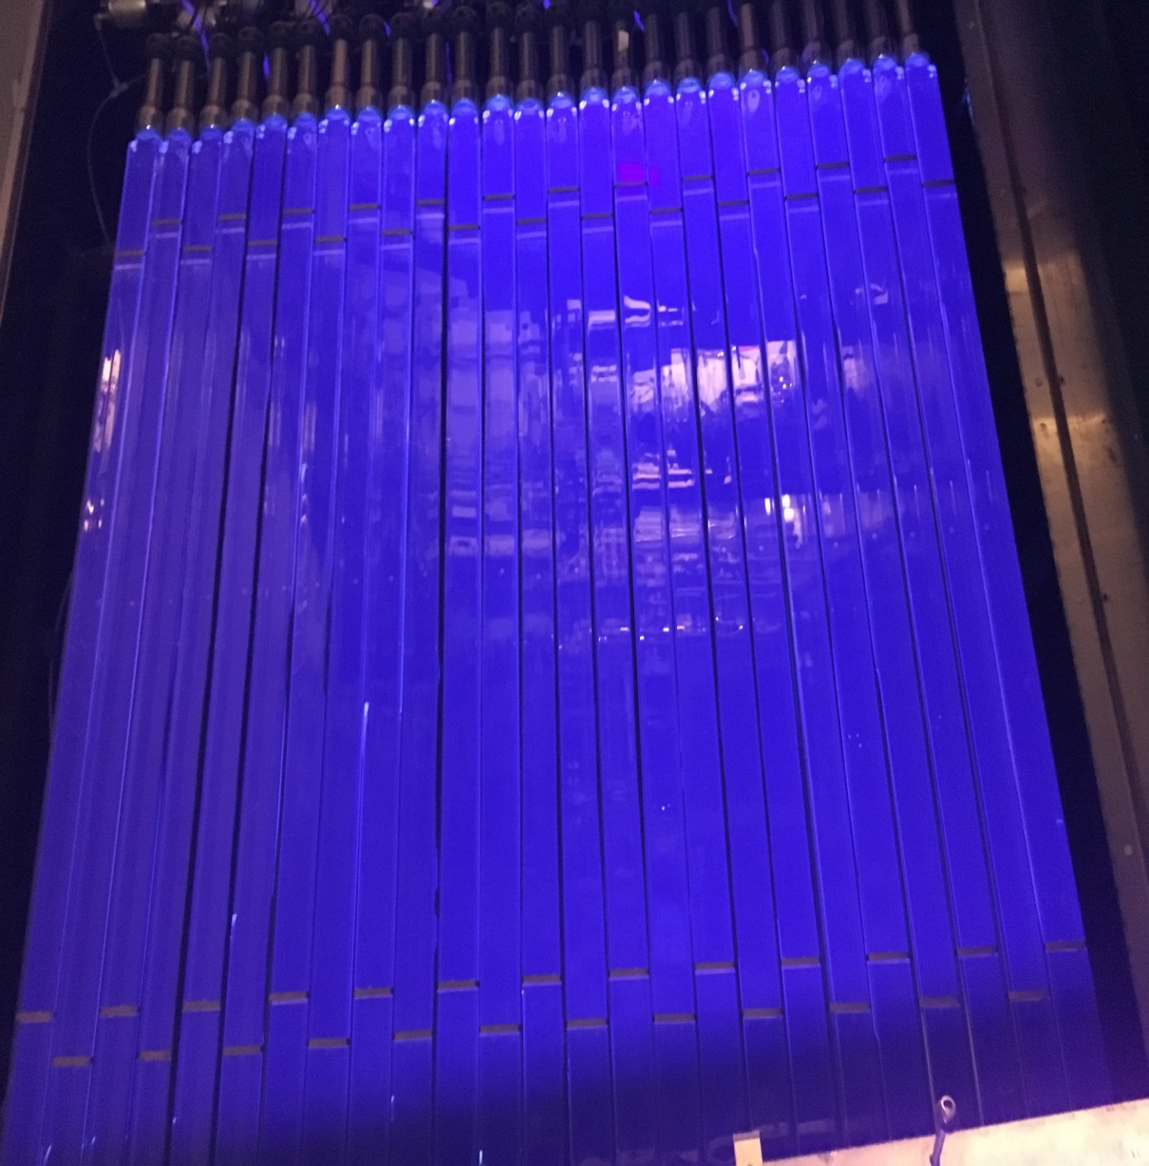
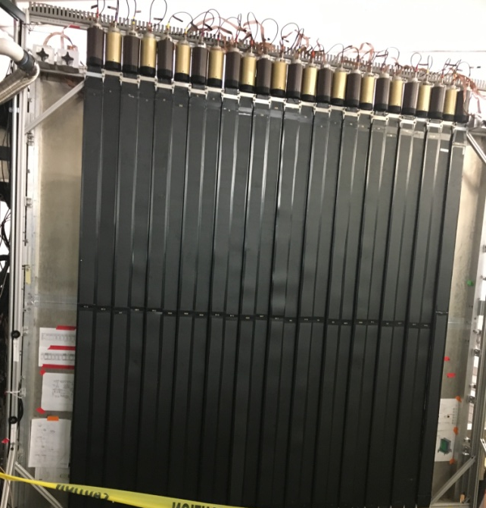
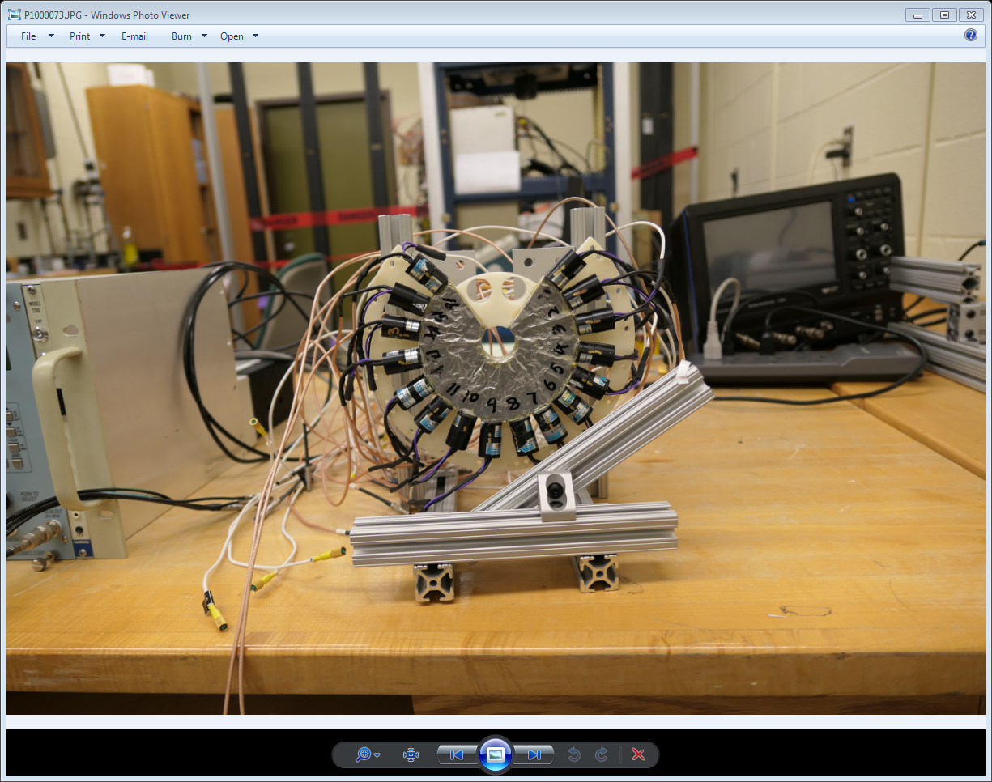
Neutron Detection
Neutron Walls
Proton Veto Wall
Forward array
Made at WMU
25 Plastic Scintillator bars
Used to remove charged particles from the NW Spectra
18 Plastic scintillator wedges
Used as the start time for the neutron time of flight
UPGRADED
Use EJ-309 liquid scintillator for Pulse Shape Discrimination
16

Slide 18
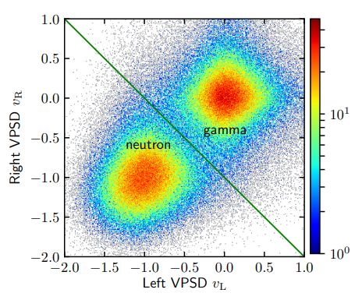
Large Area Neutron Array (LANA)
LANA is comprised of:
  Two Walls of 25 scintillator bars
    2 meters long, 7.7 cm square cross-section
    NE-213 liquid scintillator → Being replaced with EJ-309 (No more xylene!)
~8 cm position resolution
500 ps time resolution
~10% detection efficiency
Excellent Neutron/Gamma discrimination
F. C. E. Teh et al., IEEE Transactions on Nuclear Science 68 vol 8, 2294 (2021)

Slide 19
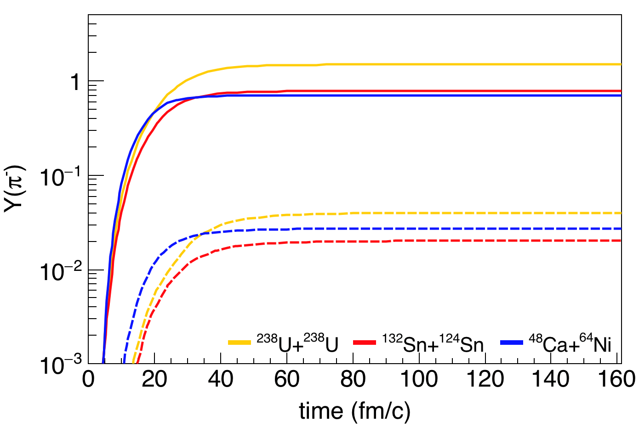
EoS: pion production at high densities
Advantages:
The detection of all charged reaction products will uniquely allow both the low and high density channels to be measured simultaneously providing the requisite experimental consistency that is lacking in the current data.
Due to the wide variety of exotic beams available at FRIB, collision systems with large isospin asymmetries can be studied.
This provides a unique opportunity to study the density dependence of the symmetry energy in the 1-2ρ₀ regime where data is currently lacking thus bridging the existing density and knowledge gap.
FRIB-400
FRIB

Slide 20
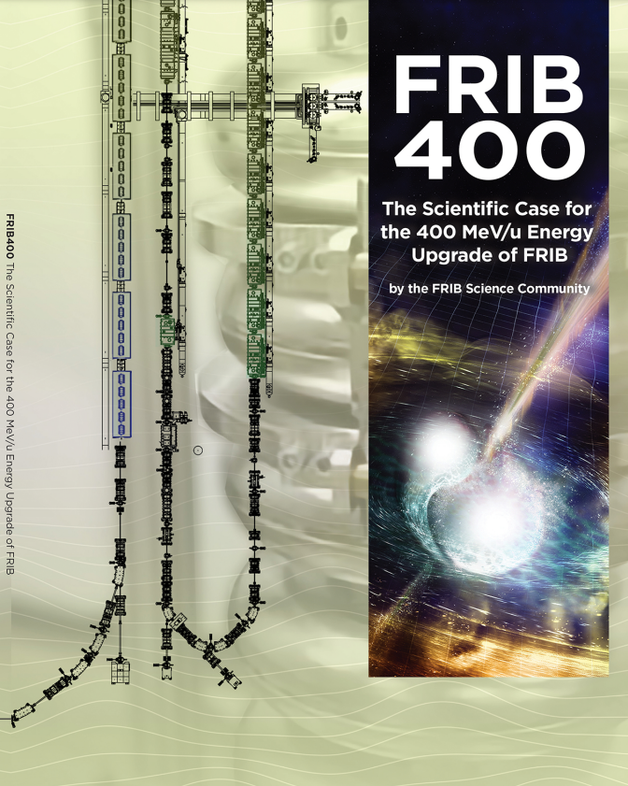
FRIB400 Upgrade
  Three main motivations for FRIB 400 (from whitepaper)
  Charge exchange
  Neutron stars- Equation of state (EOS) physics
  Quasi-free scattering
  EOS physics is essential for FRIB 400
  Pion rates will go up by the order of magnitude
Notes:
He beam pipe at NA61/SHINE
Vertex distribution along the beam axis (p+p@158GeV/c) with and without the He beam pipe

Slide 21
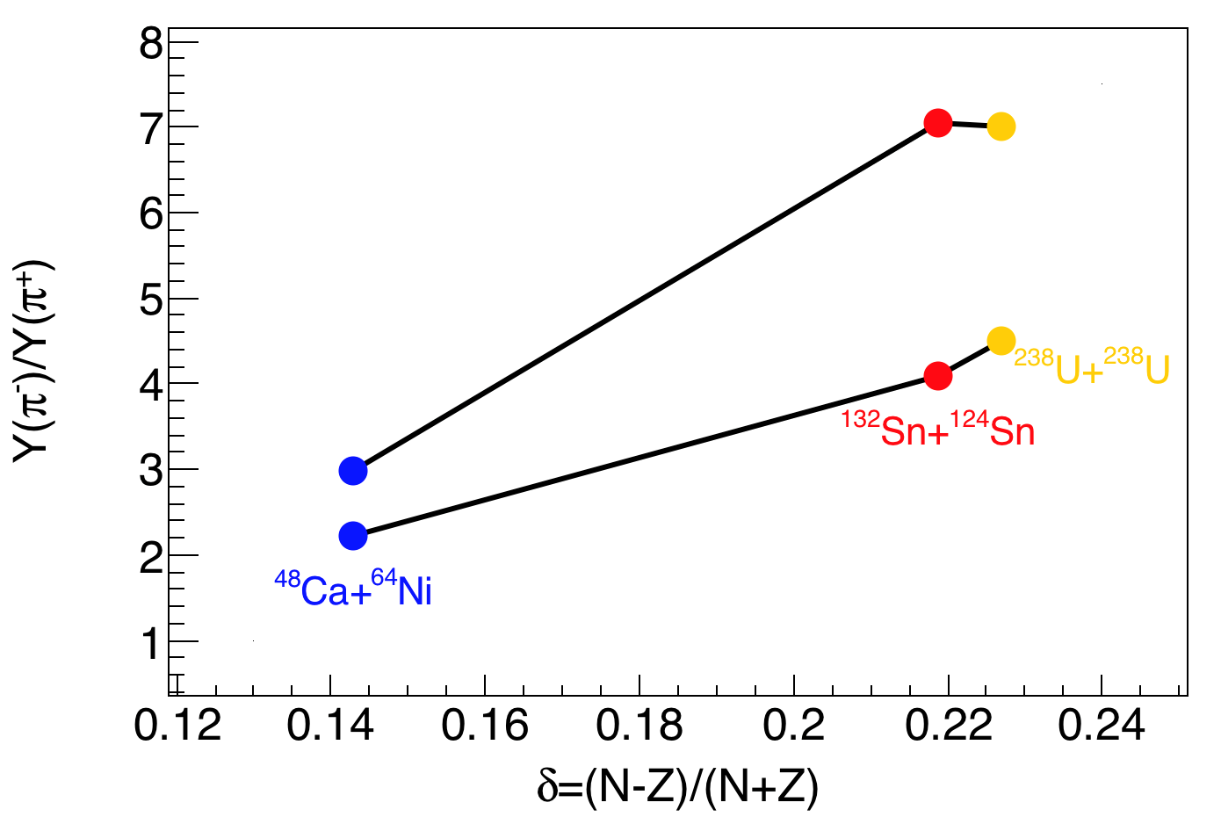
EoS: pion production at high densities
Advantages:
The detection of all charged reaction products will uniquely allow both the low and high density channels to be measured simultaneously providing the requisite experimental consistency that is lacking in the current data.
Due to the wide variety of exotic beams available at FRIB, collision systems with large isospin asymmetries can be studied.
This provides a unique opportunity to study the density dependence of the symmetry energy in the 1-2ρ₀ regime where data is currently lacking thus bridging the existing density and knowledge gap.
FRIB-400
FRIB
FRIB-400
FRIB400 will boost intensities, asymmetry and pion cross-sections
Intensity increase: Allow explorations of more asymmetric systems.
Energy increase: yields increase exponentially above pion thresholds
Regions at ρ>1.8ρ₀ become more extensive
FRIB

Slide 22
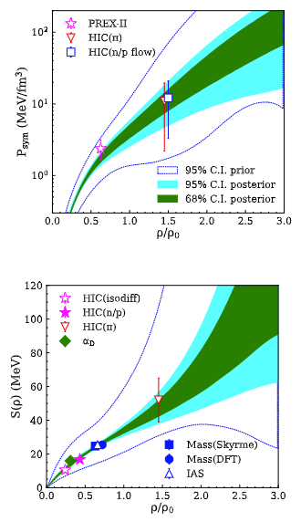
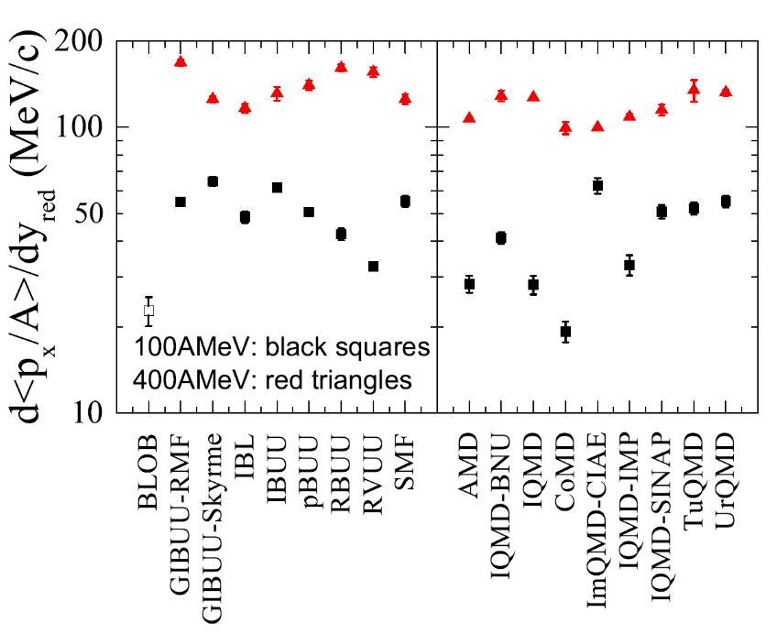
Opportunities and challenges for EOS at FRIB
Goal:
Comprehensive nuclear matter EOS from crust to outer core is in sight
EOS at FRIB:
More precision symmetry energy data at 1.5-2.5 ρ₀
Primary observables:
pion and n/p differential flow→ Symmetry
energy
proton flow→ symmetric matter constraints
What we need:
Investment in detector development to measure pions, charged particles and neutron with high granularity ➡ Time Projection Chamber for FRIB

Slide 23
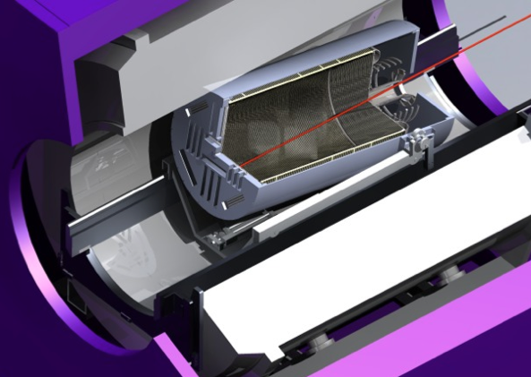
Requirements for TPC at FRIB
Placed inside the solenoid magnet
Improves tracking and PID
good resolution at low-energy
thick target
4π acceptance of reaction products
(improves reaction plane determination)
Minimize the particle energy loss
Good vertex resolution
Multitrack event reconstruction
(including close track separation: track merging, track splitting)
Possibility of using auxiliary detectors (neutron wall, detectors for heavier fragments)
“removal” of δ-electrons
Avoid saturation of the electronics when beam enters the active volume
Run detector in both Active Target and solid target mode
Primarily based on design of AT-TPC detector at NSCL

Slide 24
(Why) do we need AT-TPC?
The early conceptual design of AT-TPC suggested it could function as an active target for both low energy reaccelerated beams and for fast fragmentation beams.
The actual AT-TPC solenoid, however, requires it to be housed in a massive iron magnetic shield, which is not portable and too large to be installed e.g. in the S800 beam line or s2 vault.
An Optimized AT-TPC for fast beam experiments leads to different design decisions
than the current AT-TPC.
The detector would consist of a gas filled volume at pressures ranging from 0.2 to 1 atm contained within a stainless-steel cylinder with a length of 120 cm and radius of 35 cm.
Notes:
Most notably

Slide 25
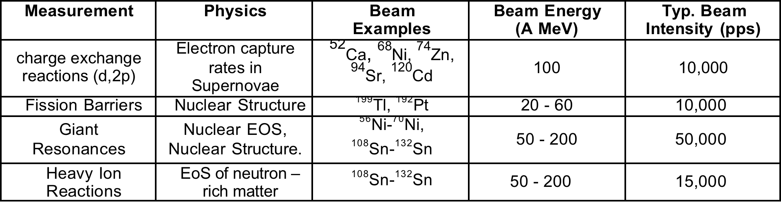
AT-TPC with fast beams
Two modes of operation
the active target mode
Detector mode .
High efficiency
Low thresholds
Fission
Charge exchange
Giant resonances .
Detection of products created in collisions
between isospin asymmetric heavy ions
Detector can handle high intensity beams
Equation of state of nuclear matter
(density dependence of the symmetry energy)
Scientific program

Slide 26
Summary
FRIB and FRIB 400 will enable new experimental constraints on the nuclear EOS at high density
  The first EOS experiment at FRIB is approved
An optimized and portable Active Target detector is essential to accommodate a broad experimental program and the coupling to a wide range of equipment the science requires
  Essential at FRIB 400 to measure pions
  Another TPC for HRS is also being discussed
Opportunities for research and collaboration at FRIB
Notes:
Mention: tracking software, reaction plane

Slide 27
….

Slide 28
Current constraints on EOS
W.G. Lynch and M.B. Tsang, PLB 830 137098, 2022
Notes:
The beams at FRIB and the work proposed here are particularly timely due to recent groundbreaking
observations of the GW170817 binary neutron-star merger event by LIGO/VIRGO [4] and precision mea-
surements of the mass-radius relation by NICER. Both the NS deformability from the merger event and the
NS mass-radius correlation provide information about how the NS EoS depends on density but not about
its asymmetry (δ) dependence, which is governed by the symmetry energy. The science of the LIGO and
NICER observations can be made more impactful if the experimental investigations of the symmetry energy
term of the nuclear EoS that are described in this proposal are approved and performed
sing Bayesian analysis with the combined existing experimental constraints (shown by the symbols in
panel a, b & d in Fig. 1) and the LIGO/Virgo [11] and the NICER astronomical constraints [12–14] (shown
in panel c), we obtain the data-centric constraints on the symmetry energy, symmetric mass EoS and NS EoS
from 0.22ρ0 < ρ < 3.0ρ0, represented by the dark green (68% CI) and light blue (96% CI) shaded regions in
Fig. 1.

