Slide 1
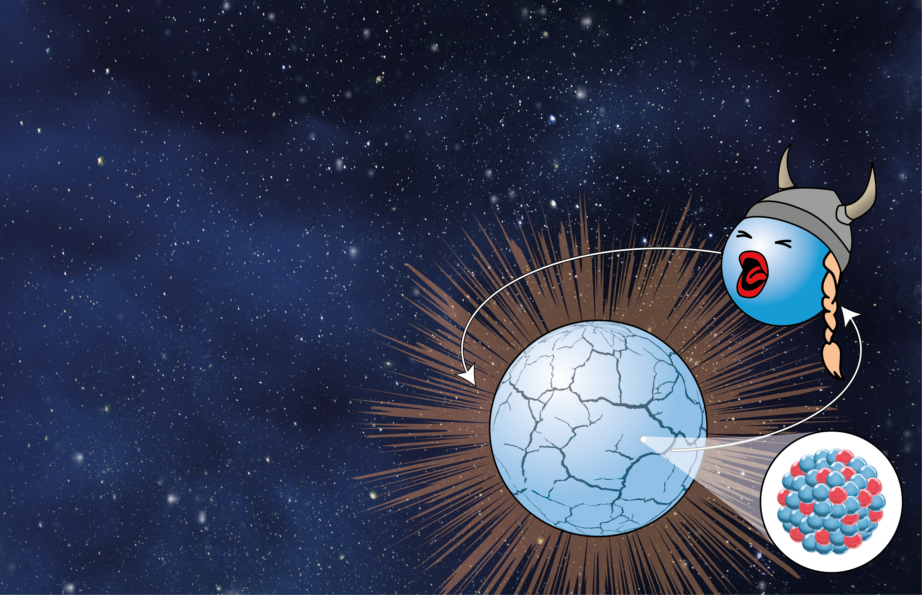
Probing nuclear physics with neutron star mergers
Resonant shattering flares and nuclear symmetry energy
NuSym23, GSI, Darmstadt
September 19, 2023
David Tsang, Duncan Neill, University of Bath
With Will Newton (Texas A&M-Commerce),
Hendrik Van Eerten (U. Bath), Geoffery Ryan (Perimeter Institute), Rebecca Preston (Texas A&M-Commerce)

Slide 2
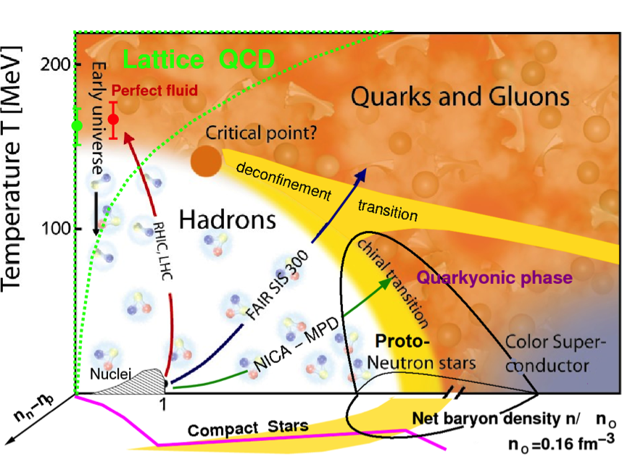
https://web.infn.it/CSN4/IS/Linea3/STRENGTH/

Slide 3
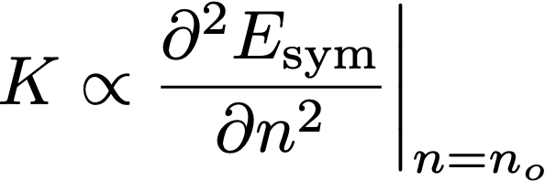
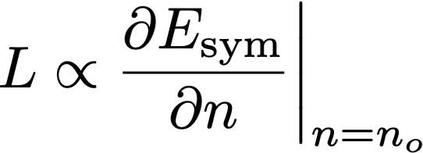
(Cold) Infinite Nuclear Matter Equation of State
Pure Neutron Matter
Symmetric Nuclear Matter
(Equal Protons and Neutrons)
Energy
Nuclear Symmetry
Energy:
0
Saturation Density
Baryon Density

Slide 4
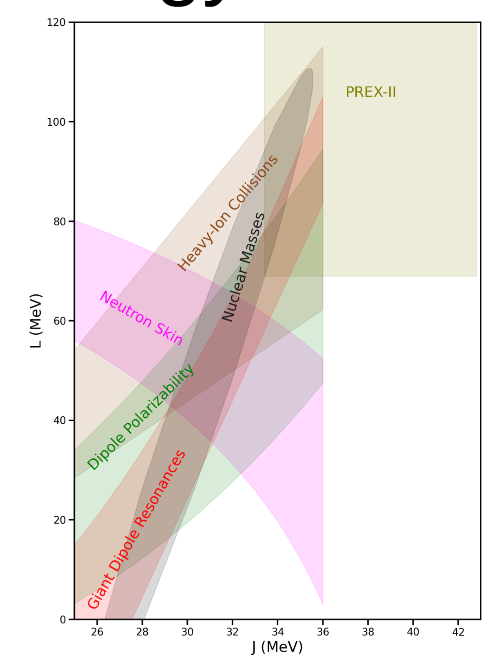
Symmetry energy constraints from
terrestrial experiments
How can we measure Symmetry
Energy with astrophysics?

Slide 5
Which regions of a neutron star tell us about which physics?

Slide 6
(Cold) Infinite Nuclear Matter Equation of State
Pure Neutron Matter
Caplan & Horowitz (2017)
Symmetric Nuclear Matter
(Equal Protons and Neutrons)
Energy
Nuclear Symmetry
Energy:
0
Saturation Density
Baryon Density

Slide 7
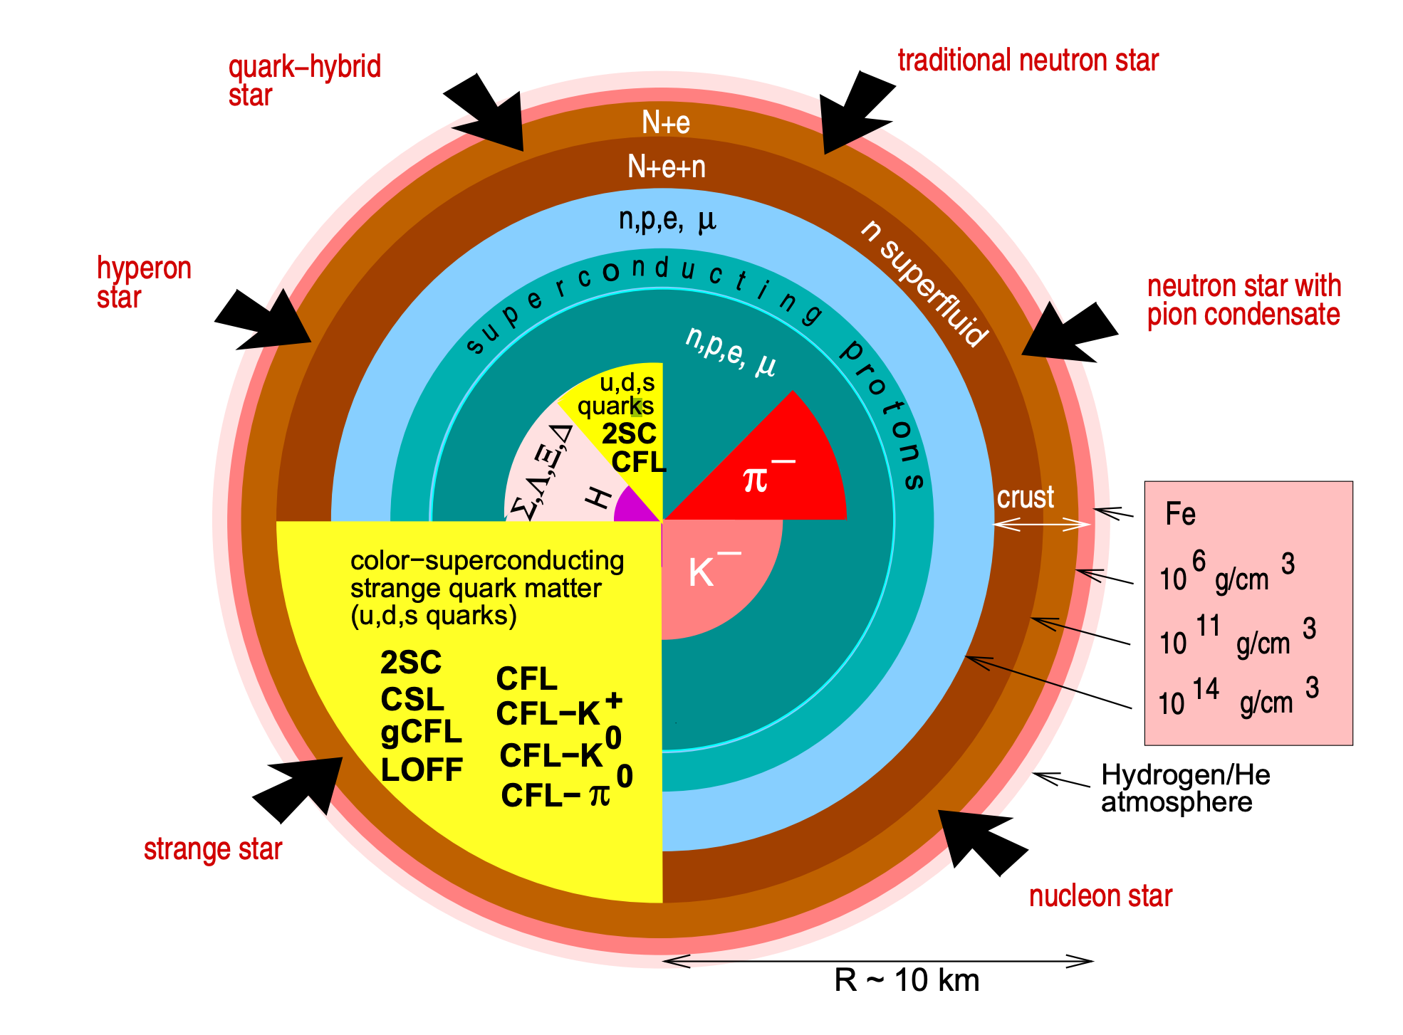
Weber 2004, arXiv:astro.ph/0407155

Slide 8
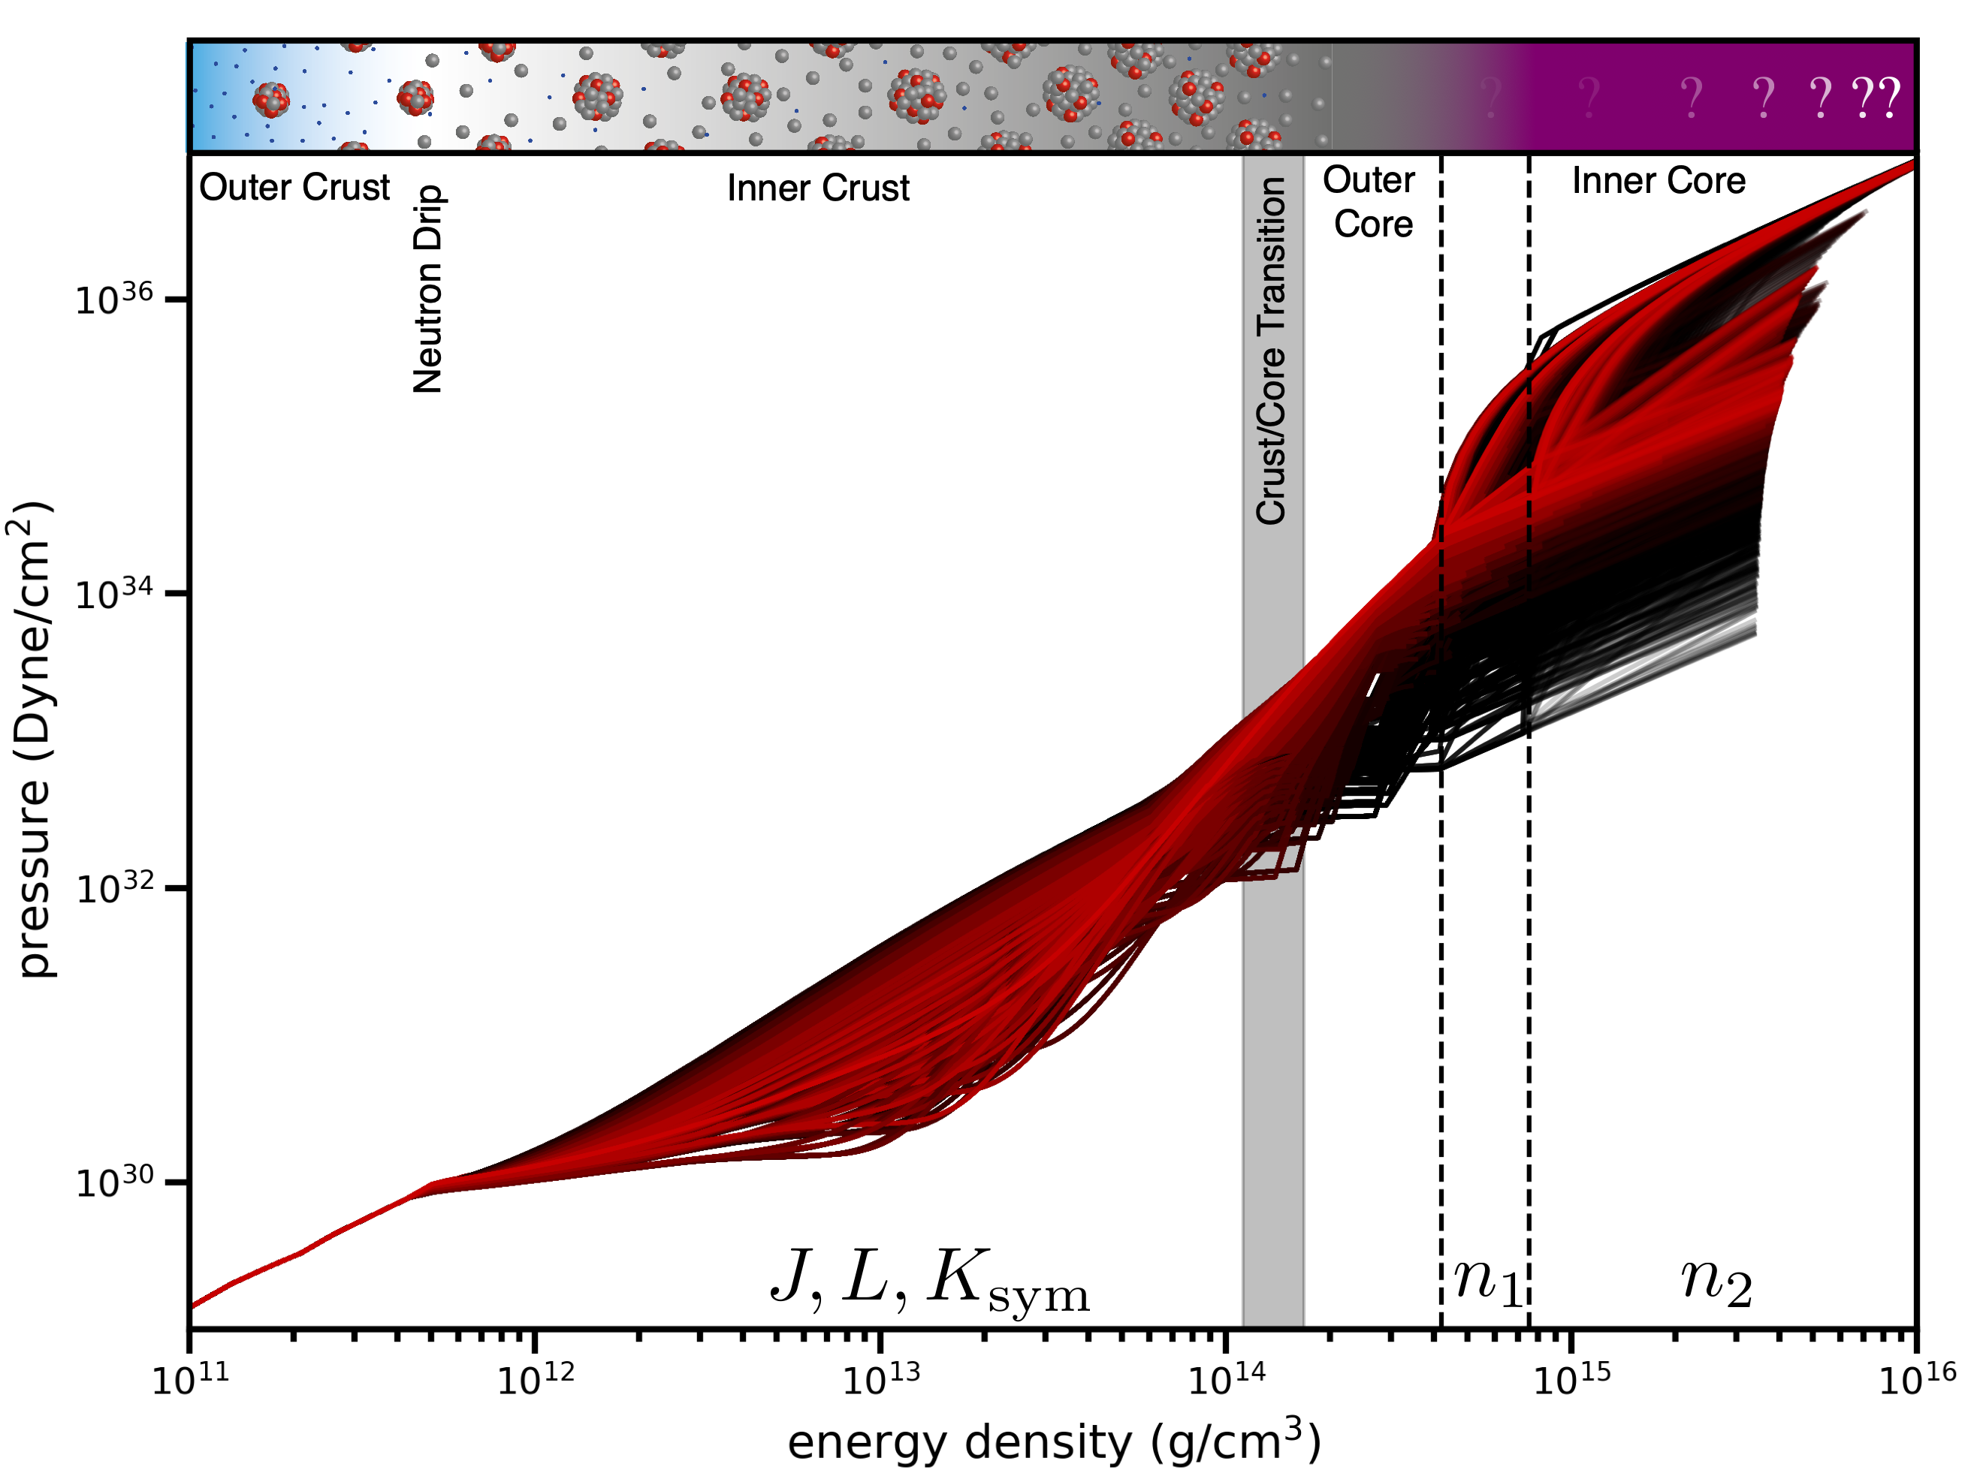
Parameterised Crust and Core EOS
Piecewise
Polytrope
Ext. Skyrme EDF
BPS
Neill, Preston, Newton & DT (2023), PRL, 130, 112701
Based on EOSs from Balliet et al, 2021, ApJ 918:79

Slide 9
What multi-messenger observables can we use?

Slide 10
Kilonovae and Short Gamma Ray Bursts tell us a lot about the messy post-merger physics!
But it’s difficult to extract info about the neutron star progenitors themselves…

Slide 11
Tidal deformability, M-R, Mmax, f-mode mostly functions of core properties
(~1.5 no for 1.4 solar mass)
LIGO/Virgo (2018) PRL 121, 161101
S. Reddy, U. of Washington

Slide 12
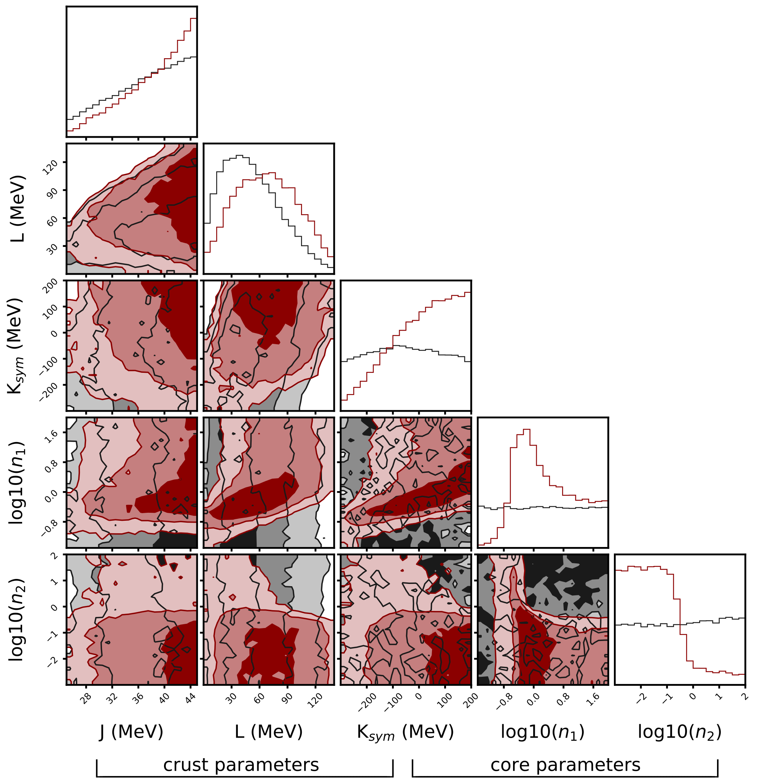
Nuclear Physics
Viable NS Prior
NICER/GW170817
Posteriors
Contain almost no information about
inner/outer crust
Neill, Preston, Newton & DT (2023), PRL, 130, 112701

Slide 14
McDermott et al 1988

Slide 15
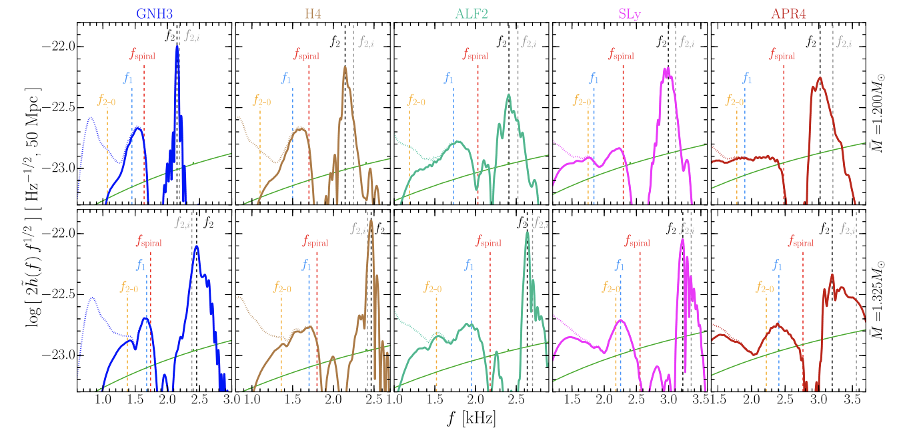
GW “Spectroscopy” of a HMNS Remnant
Rezzolla & Takami (2016)

Slide 16
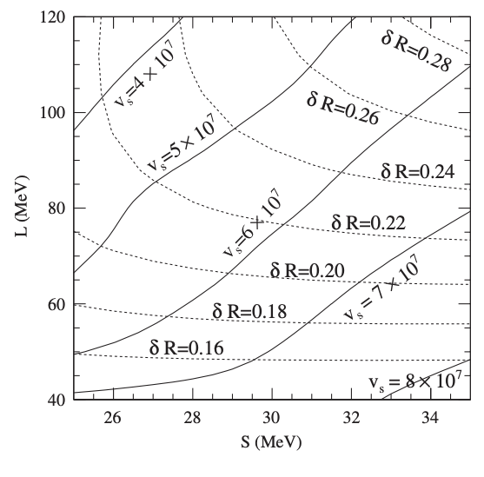
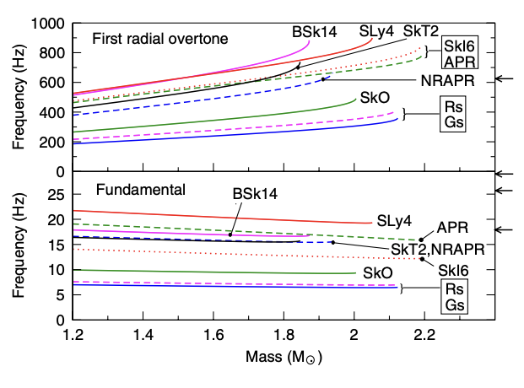
Giant Magnetar Flare Oscillations (toroidal shear modes?)
Steiner & Watts, 2009

Slide 17
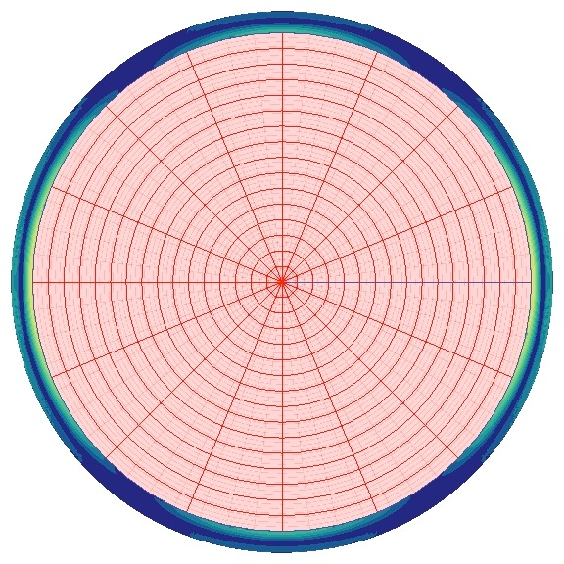
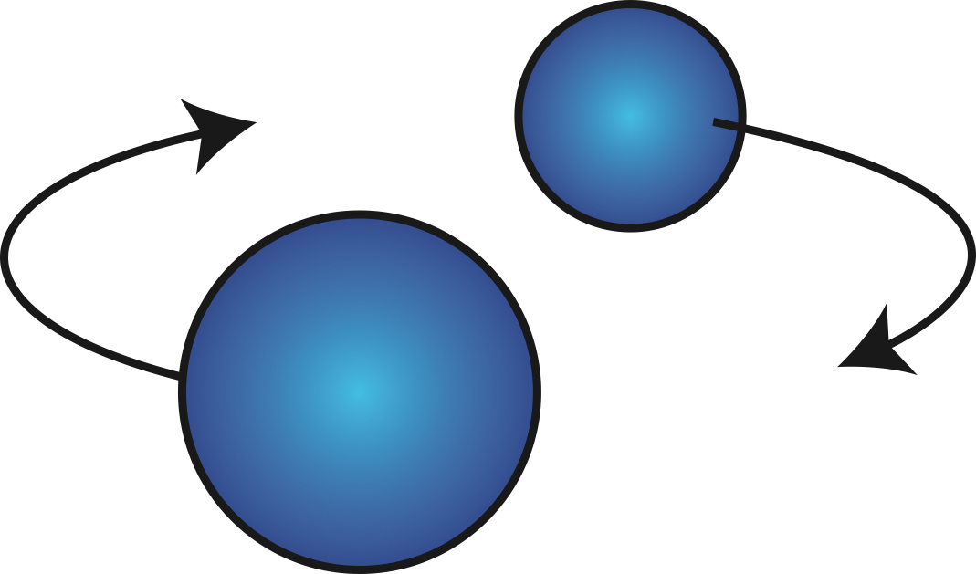
Tidal Resonance
Orbit
Resonance
Mode

Slide 18
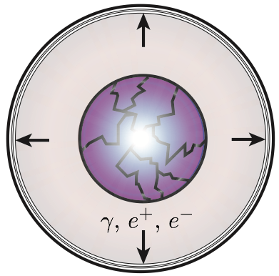
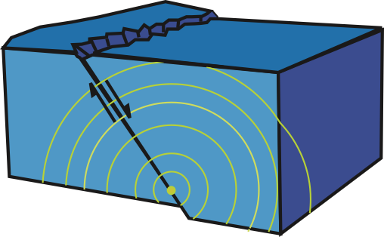
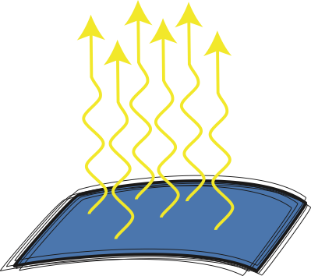
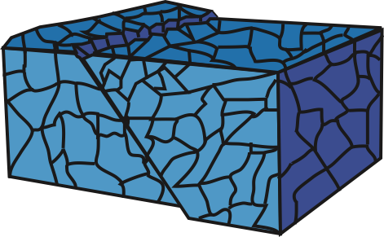
Resonant Shattering Flares
Orbit
Resonance
Mode
Cracking
Colliding
Pair-Fireballs
Seismic
Magnetic Field
Seismic (shattered)
DT, et al. (2012) PRL 108, 011102
DT (2013) ApJ 777, 103
Neill, DT, Van Eerten, Ryan, & Newton (2022) MNRAS in press

Slide 19
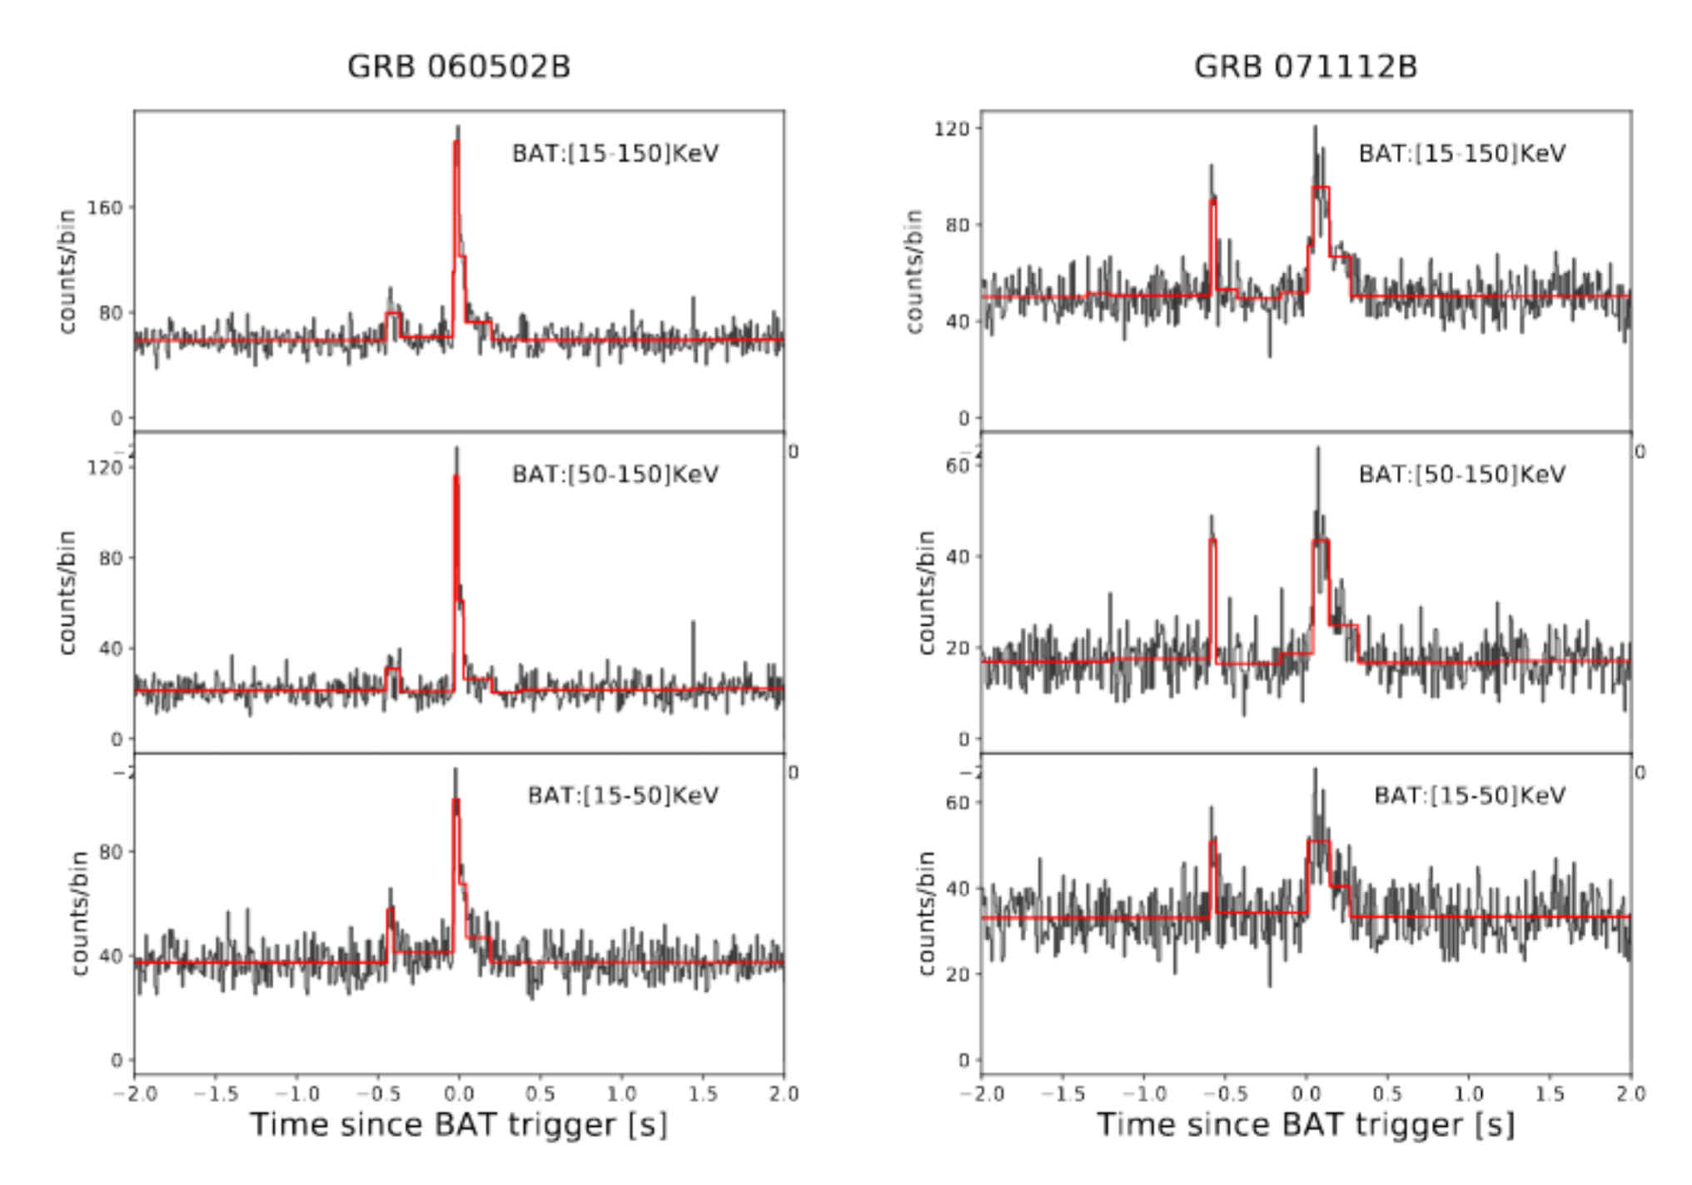
Some SGRBs have precursors…
Zhong et al. (2019) ApJ 884, 25

Slide 21
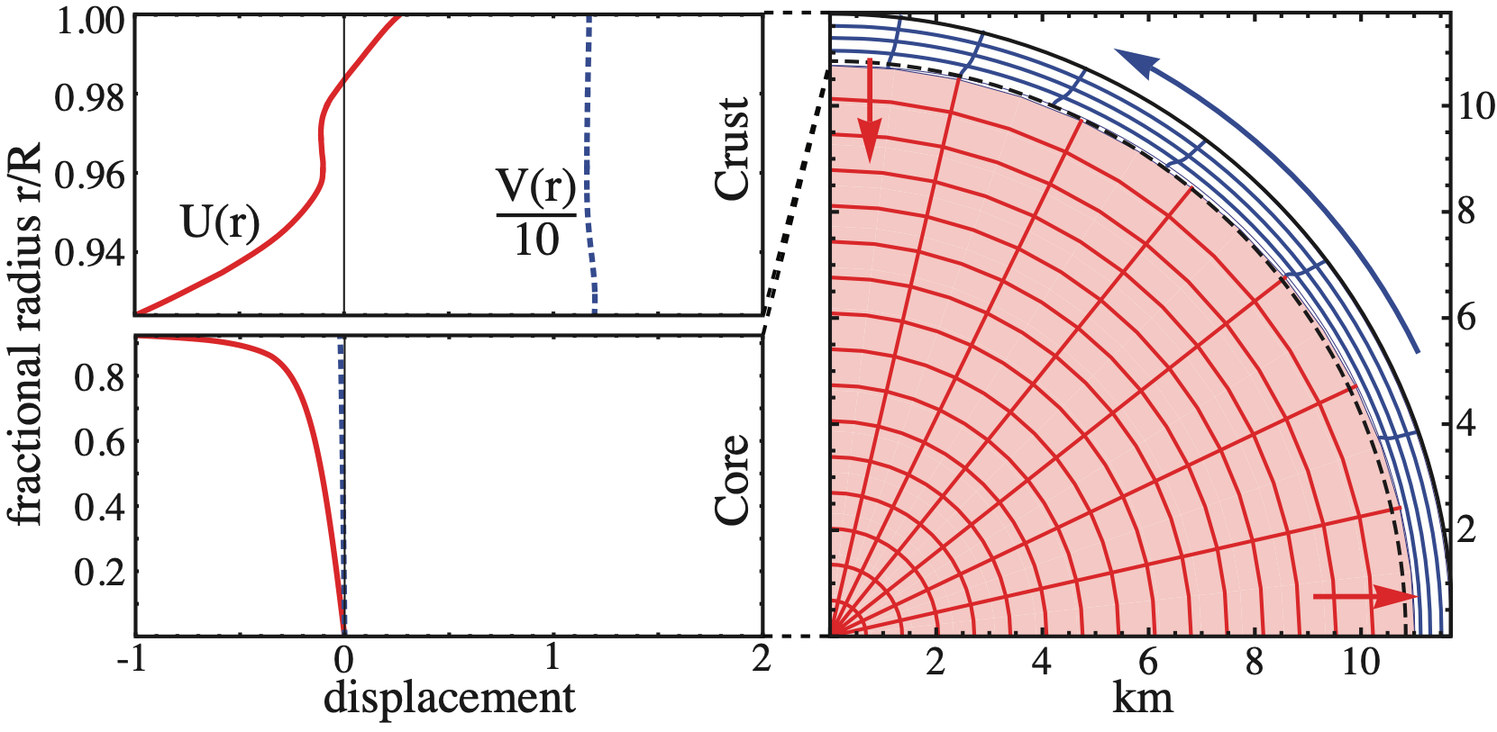
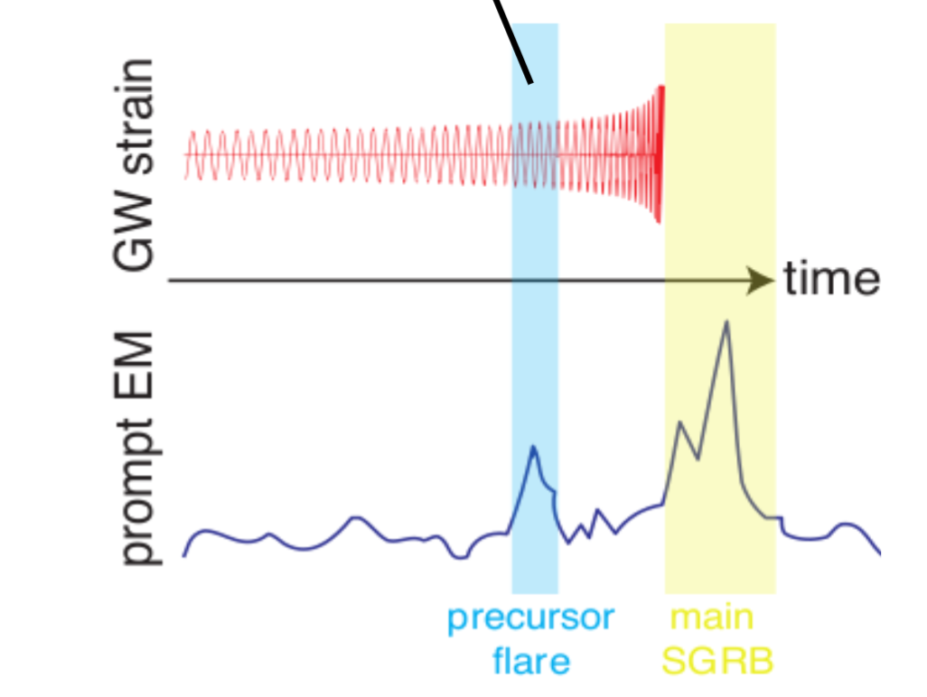
Resonant Shattering Flares
2i2
l = 2 crust-core
interface mode
Orbit
Resonance
Mode
Cracking
fmode ~ 100Hz
DT et al. (2012) PRL 108, 011102 (2012)
Colliding
Pair-Fireballs
Seismic
Magnetic Field
Seismic (shattered)
DT, et al. (2012) PRL 108, 011102
DT (2013) ApJ 777, 103
Neill, DT, Van Eerten, Ryan, & Newton (2022) MNRAS

Slide 22
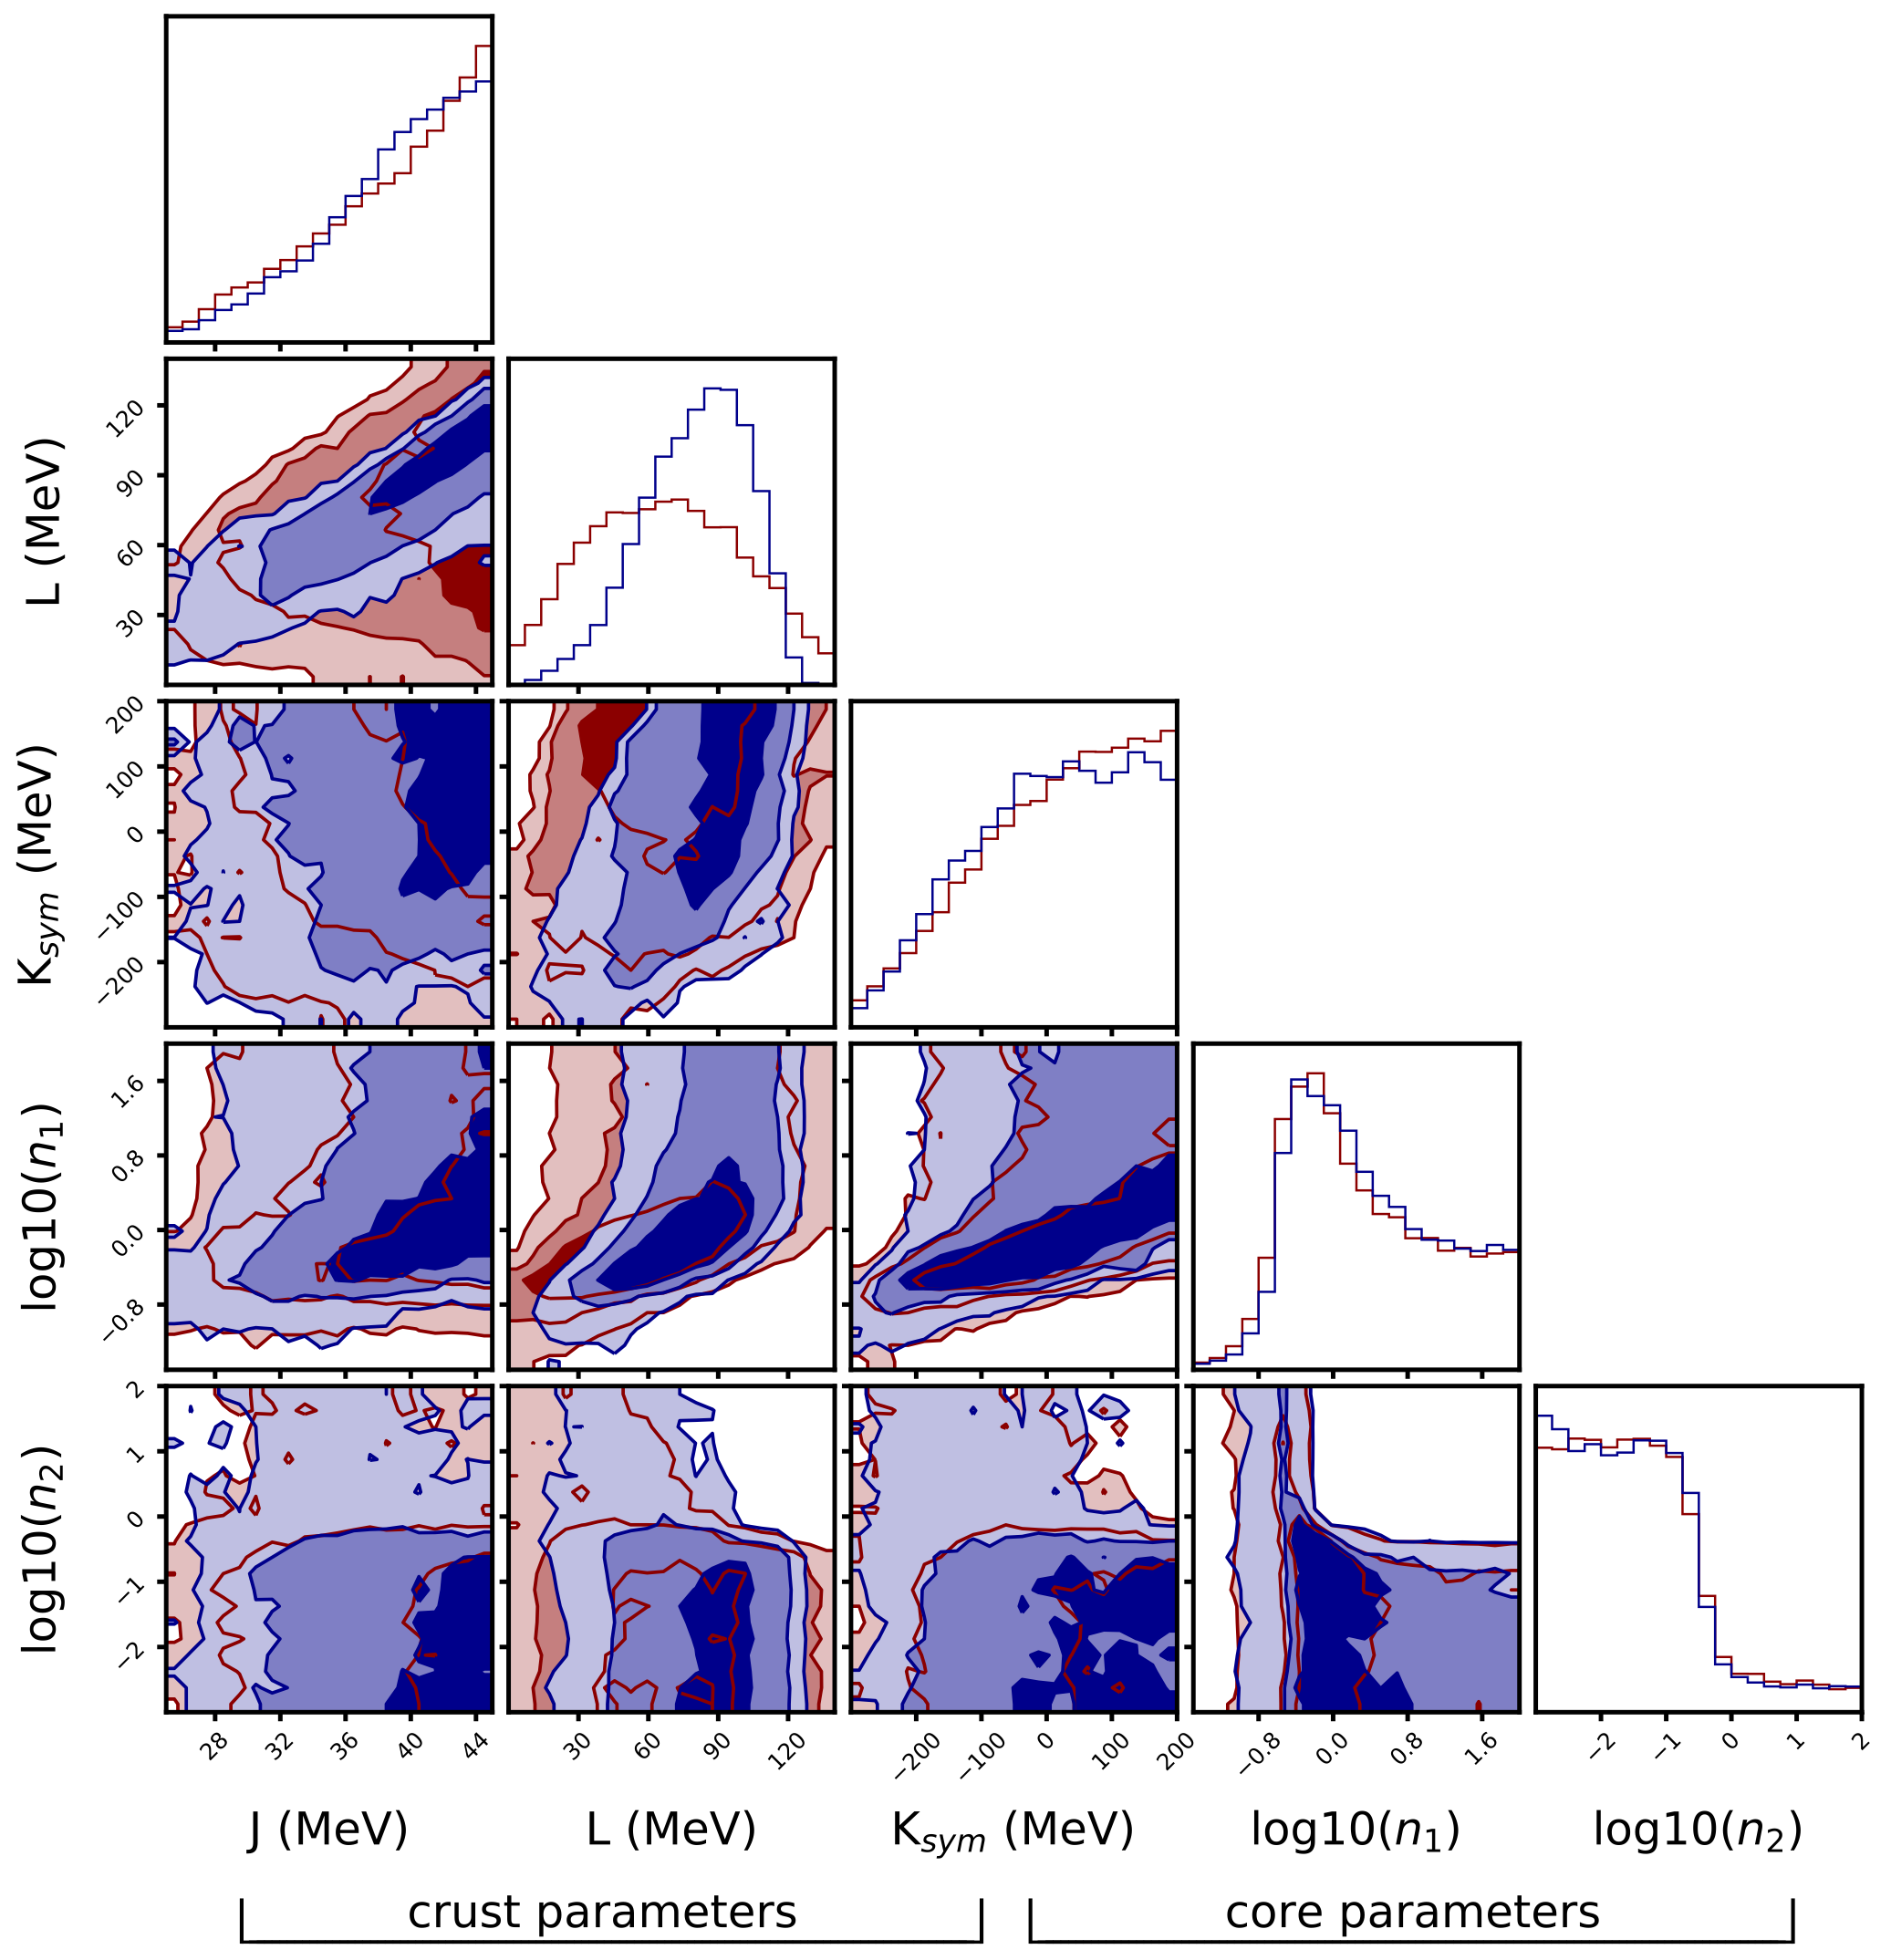
Causality NICER GW Prior
250 Hz RSF Posterior
Neill, Preston, Newton & DT (2023), PRL, 130, 112701

Slide 23
Causality NICER GW Prior
250 Hz RSF Posterior
Neill, Preston, Newton & DT (2023), PRL, 130, 112701

Slide 24
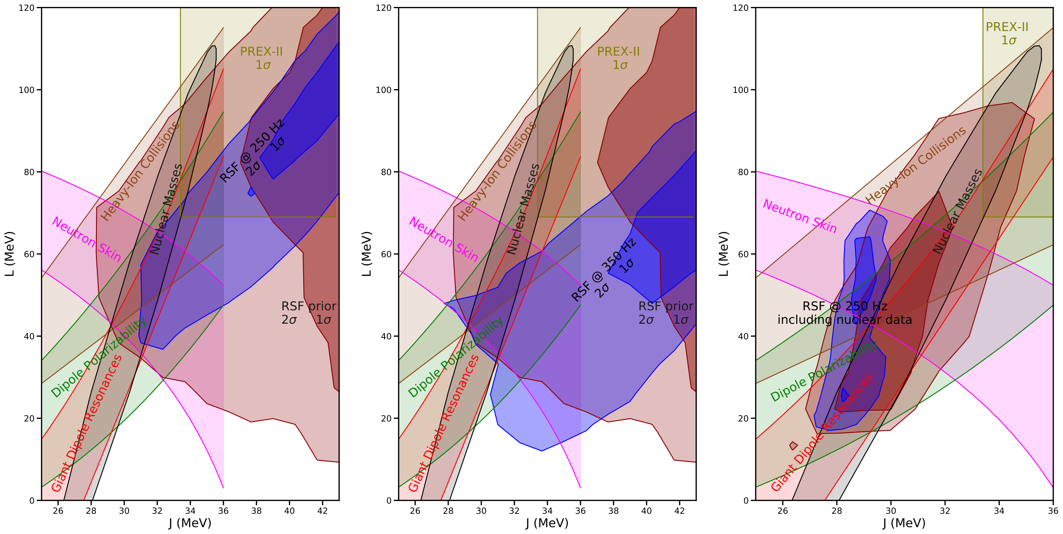
Coincident RSF detection can provide constraints
on symmetry energy at crust/core transition ~0.5 no
Neill, Preston, Newton & DT (2023), PRL, 130, 112701

Slide 25
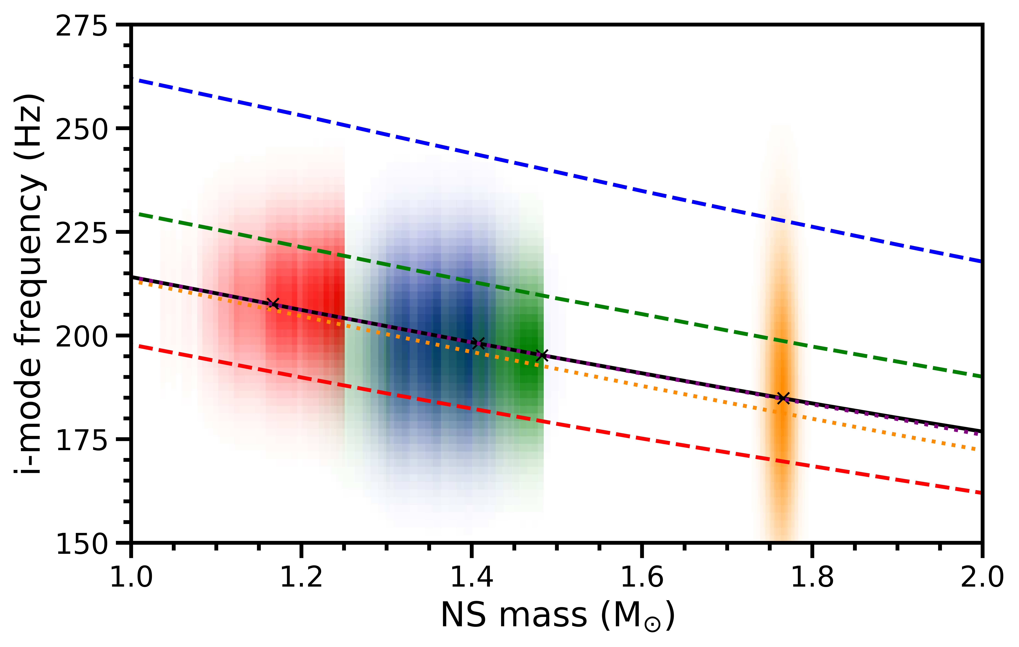
PRELIMINARY

Slide 26
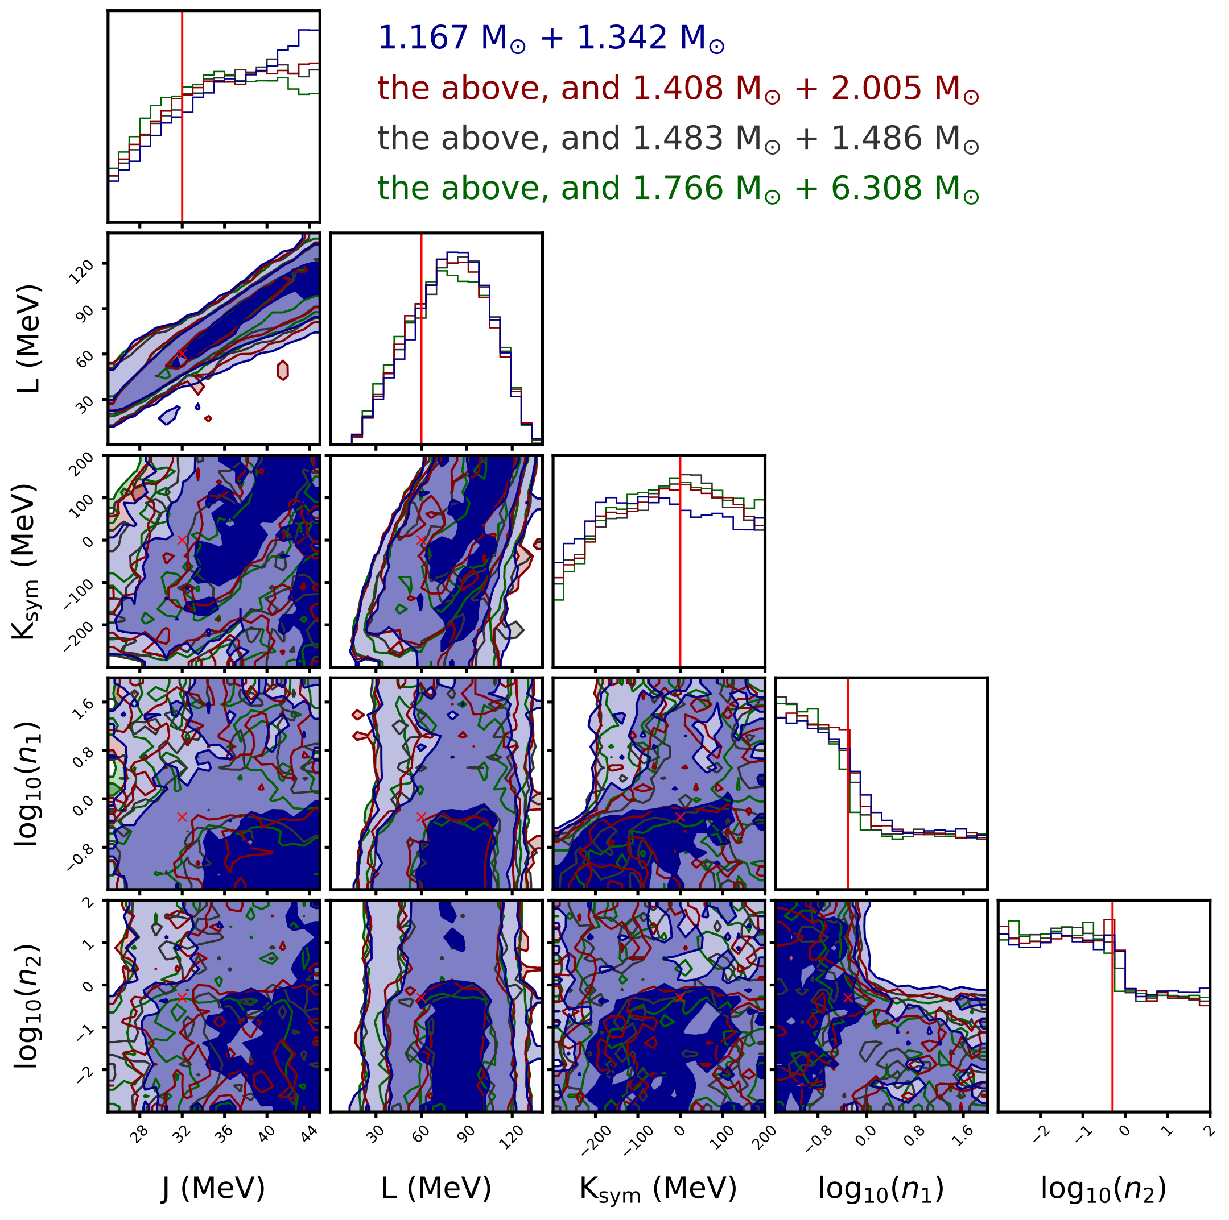
PRELIMINARY

Slide 27
What are the prospects for detecting RSFs?

Slide 28
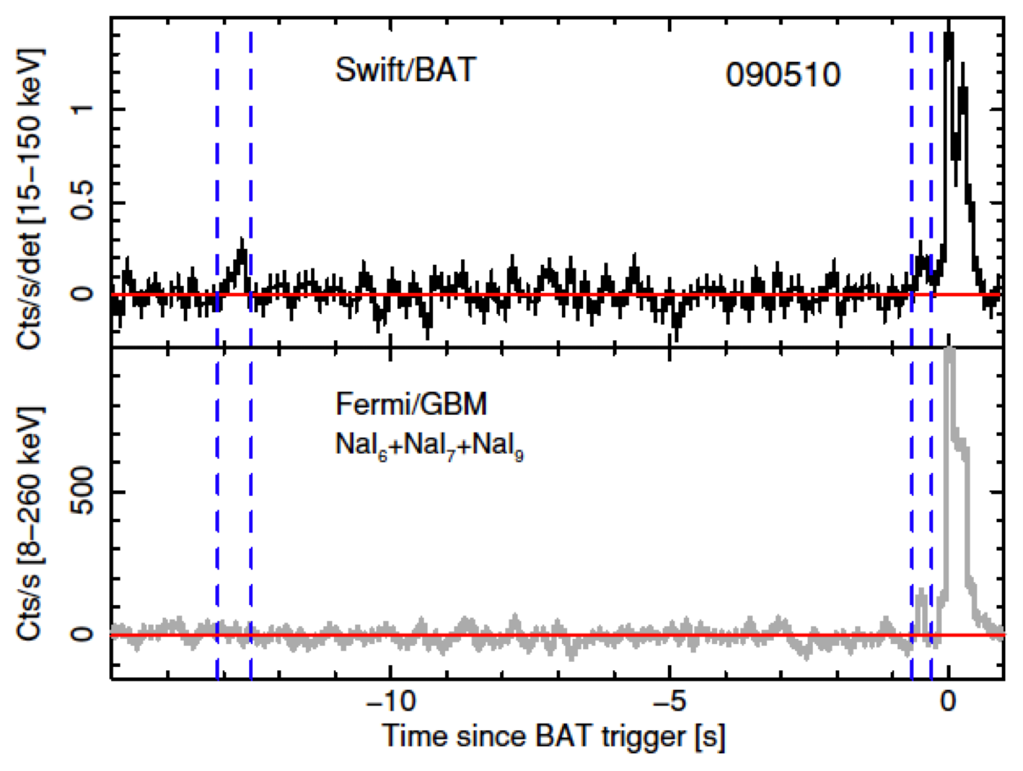
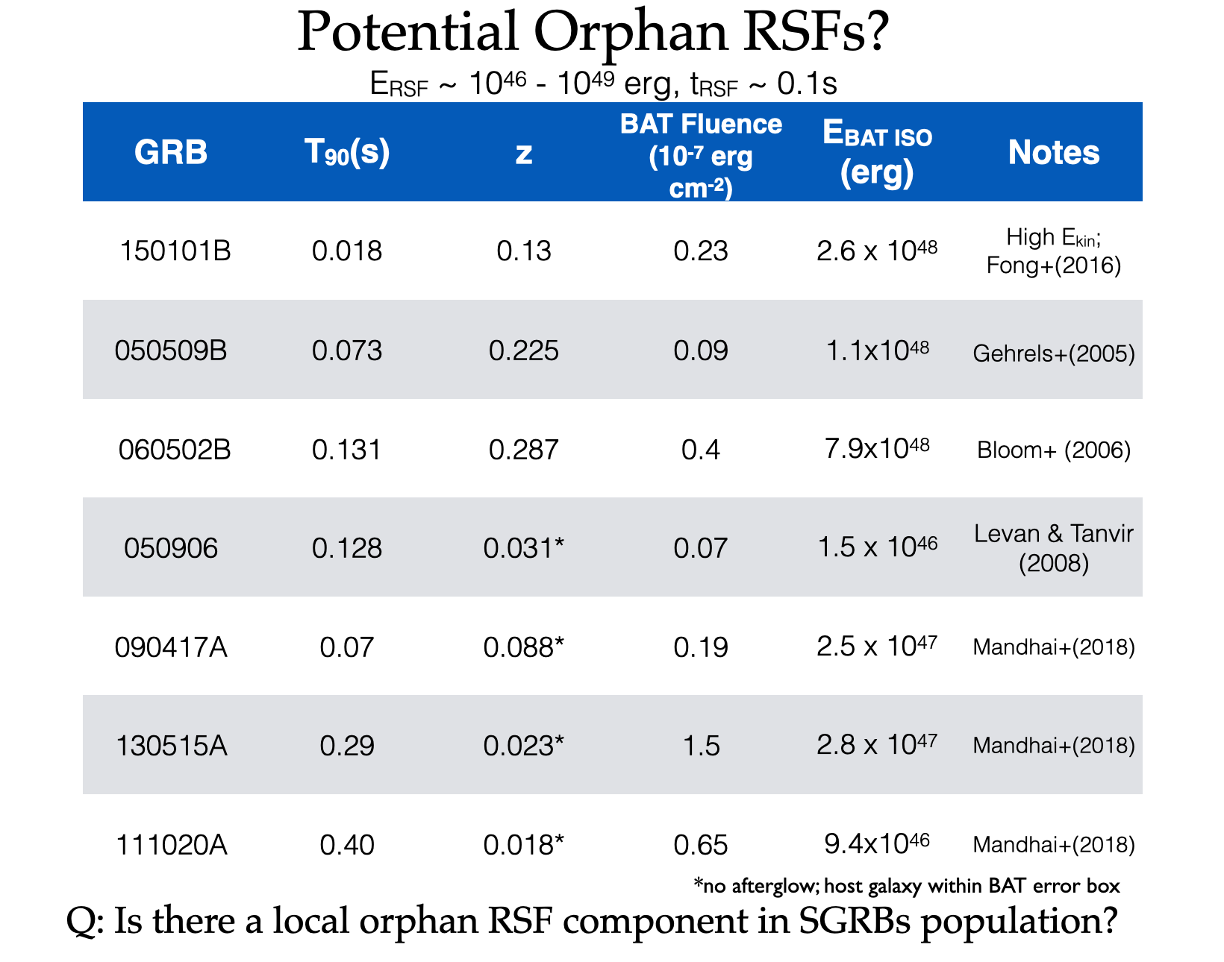
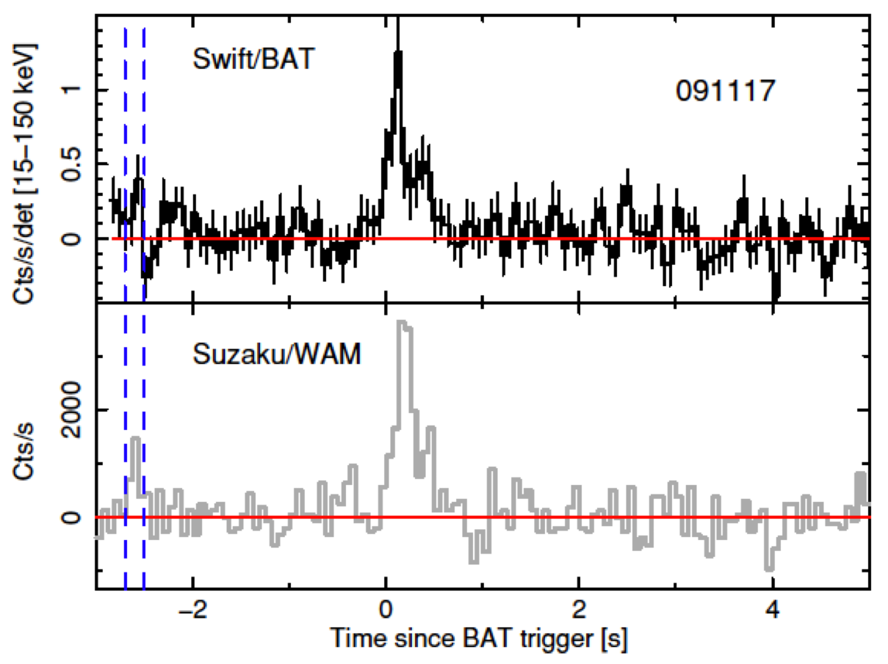
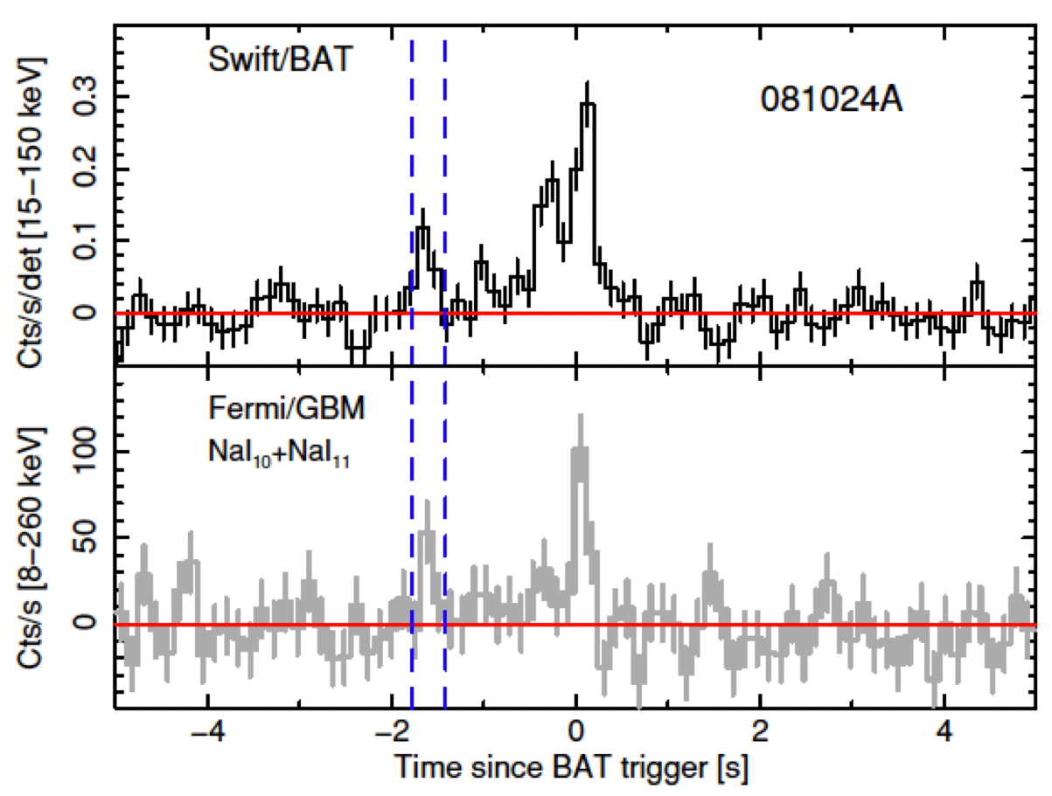

Slide 29
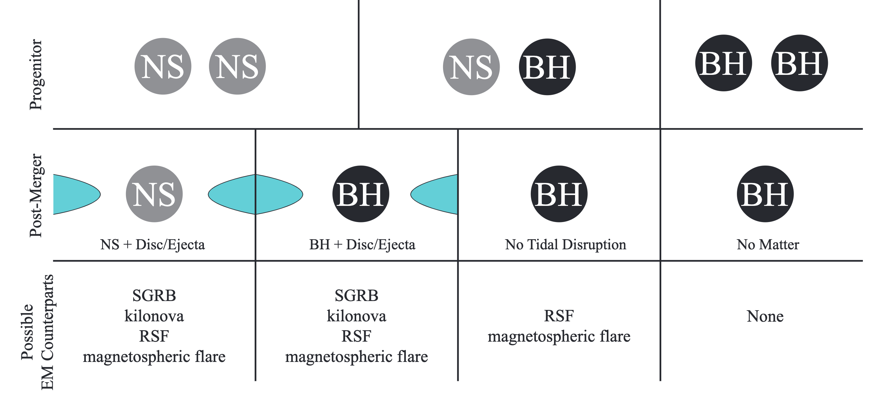
Neill, DT, Van Eerten, Ryan, & Newton (2022) MNRAS, 514, 4

Slide 30
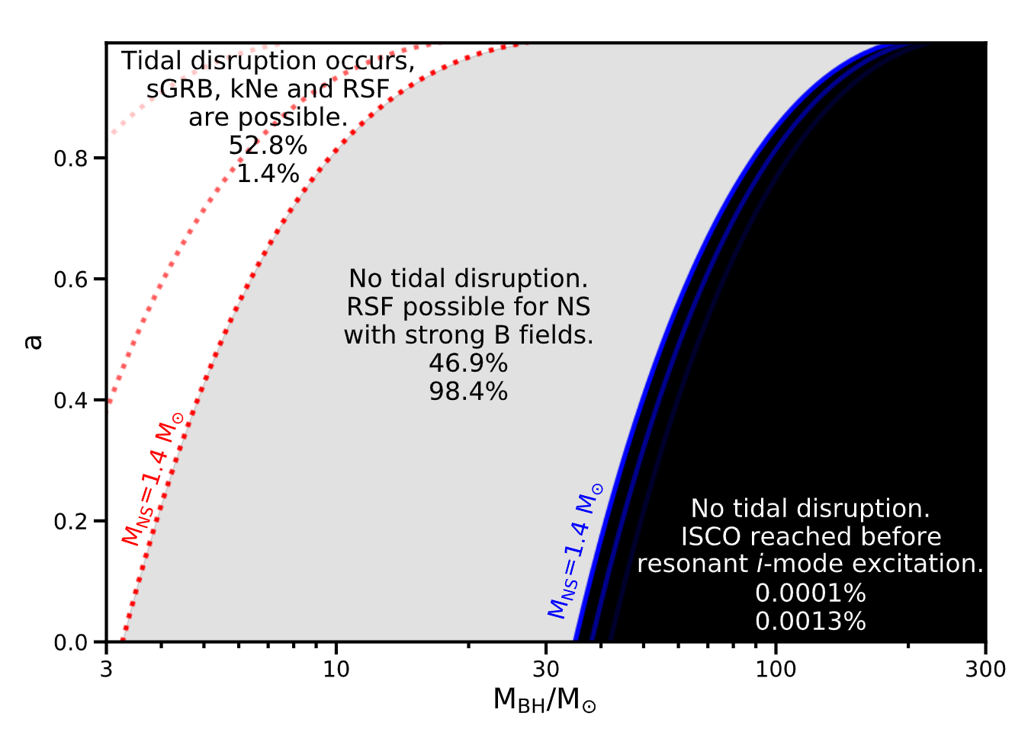
See also recent RNAAS note by Sylvia Biscoveanu
Neill, DT, Van Eerten, Ryan, & Newton (2022) MNRAS, 514, 4

Slide 31
Resonant Shattering Flares
Orbit
Resonance
Mode
Cracking
Colliding
Pair-Fireballs
Seismic
Magnetic Field
Seismic (shattered)
DT, et al. (2012) PRL 108, 011102
DT (2013) ApJ 777, 103
Neill, DT, Van Eerten, Ryan, & Newton (2022) MNRAS, 514, 4

Slide 32
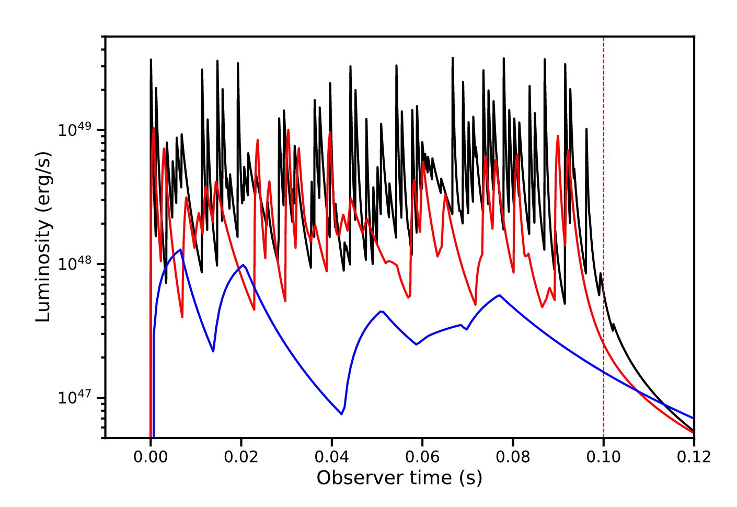
Non-thermal emission from shell collisions
10^{14.5} G
resonance width
10¹⁴ G
10^{13.5} G
Neill, DT, Van Eerten, Ryan, & Newton (2022) MNRAS, 514, 4

Slide 33
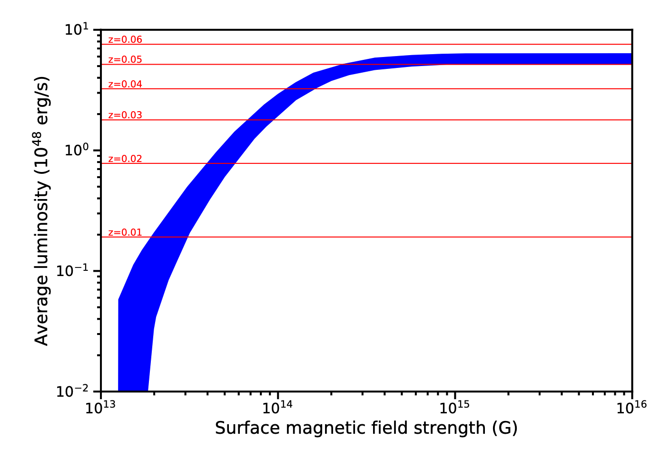
Approximate Fermi/GBM detection limits
Neill, DT, Van Eerten, Ryan, & Newton (2022) MNRAS, 514, 4

Slide 34
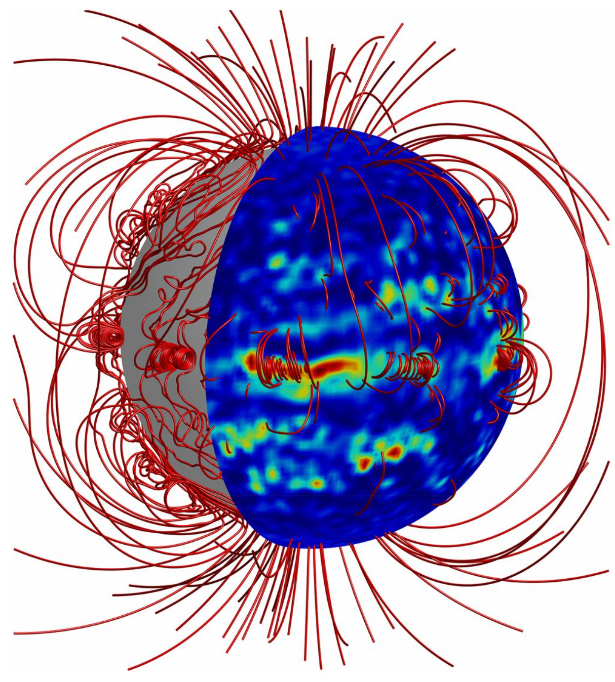
Gourgouliatos, Wood, & Hollerbach (2016) PNAS, 113, 15, 3944

Slide 35
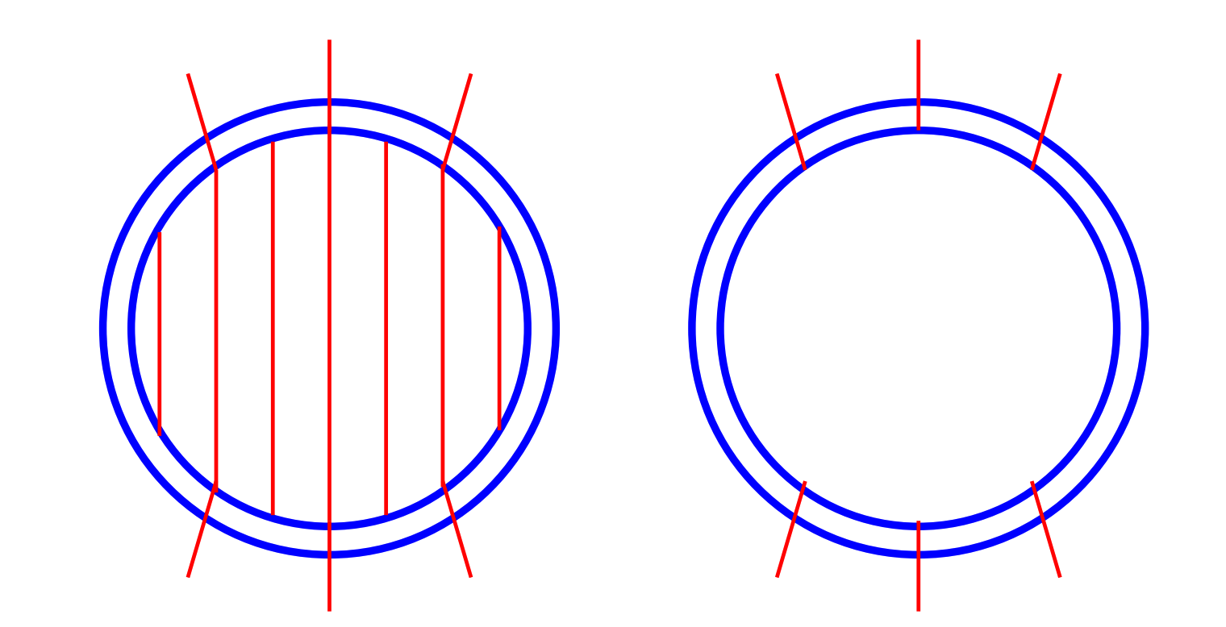
Fields are long lived if
they thread the core
Fields decay in < 10⁶ years if
anchored only in the crust
Ho, Andersson & Graber (2017) PRC, 96, 065801
Konenkov & Geppert (2000) MNRAS, 313, 1, 66

Slide 36
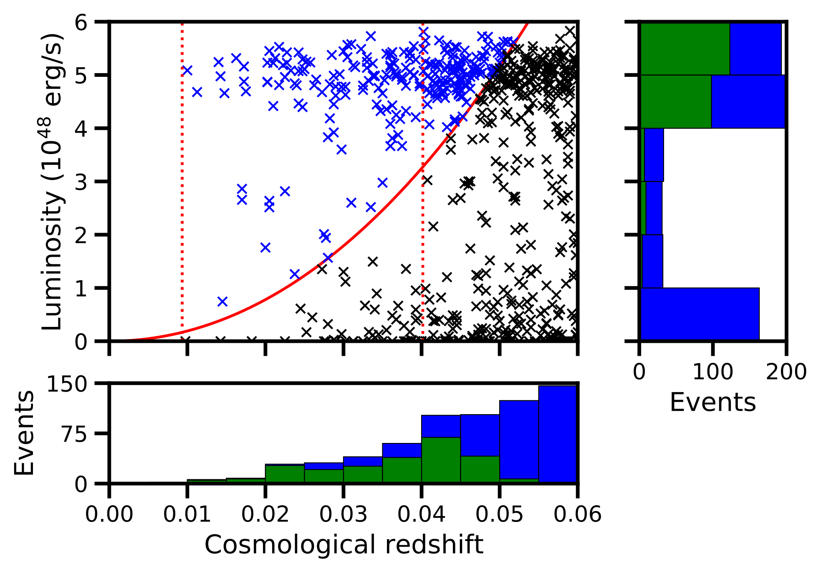
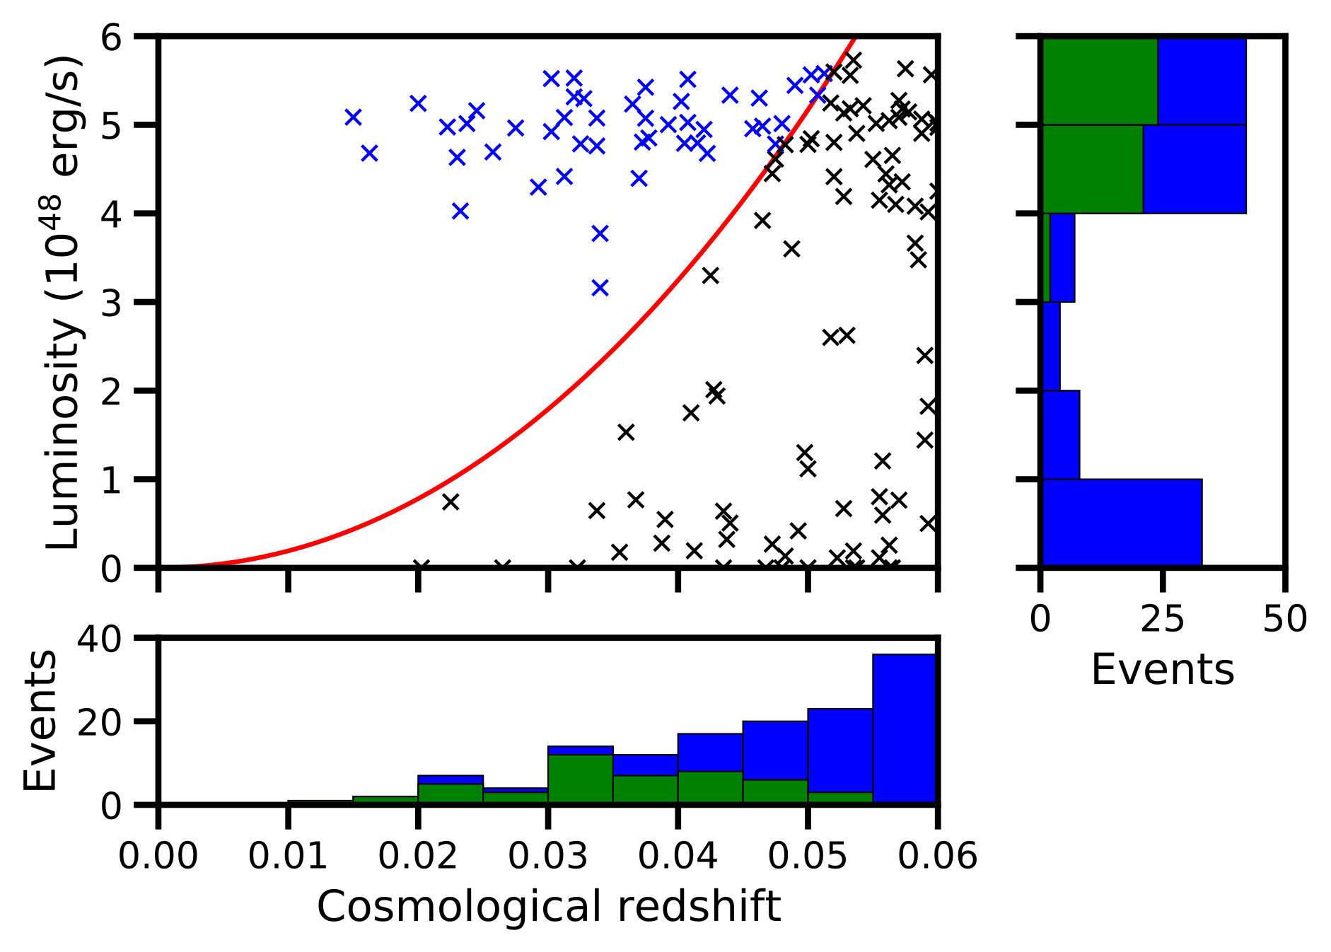
Fermi detection limit
Up to ~25 per year
Up to ~5 per year
Neill, DT, Van Eerten, Ryan, & Newton (2022) MNRAS, 514, 4

Slide 37
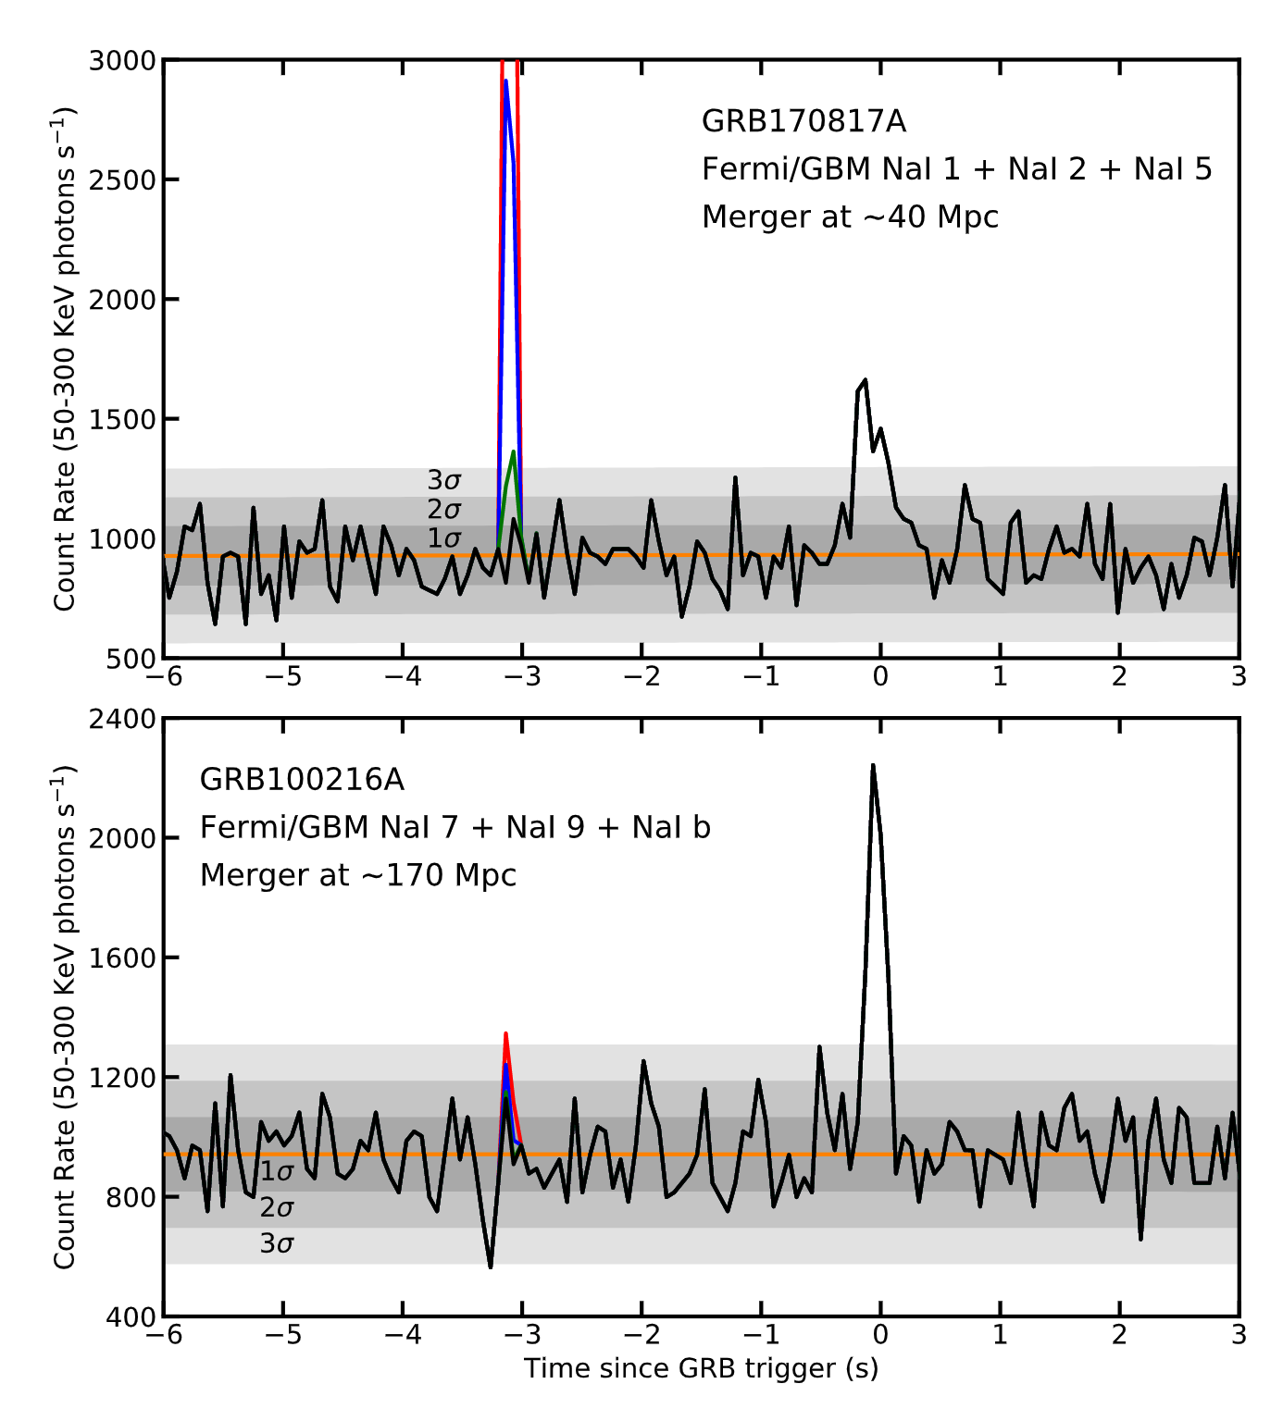
10^{14.5} G
10¹⁴ G
10^{13.5} G
Neill, DT, Van Eerten, Ryan, & Newton (2022) MNRAS, 514, 4

Slide 38
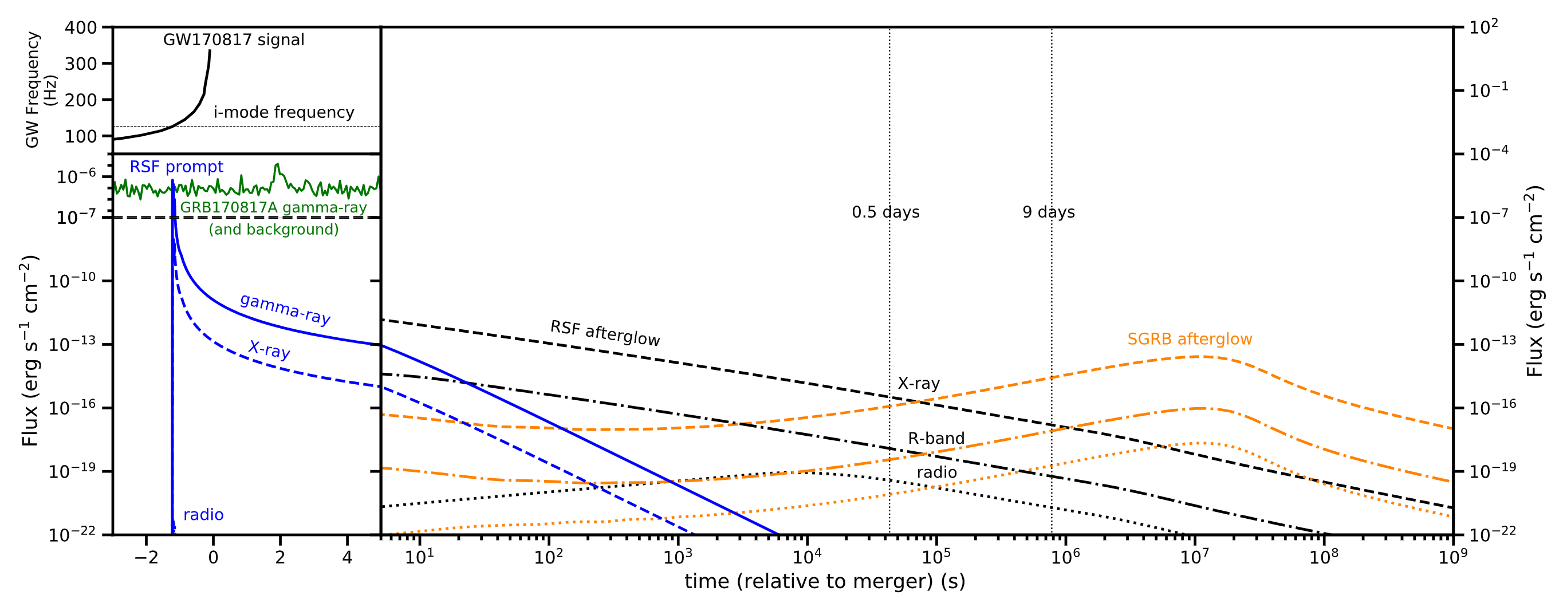
No detectable precursor implies
Neill, DT, Van Eerten, Ryan, & Newton (2022) MNRAS, 514, 4

Slide 39
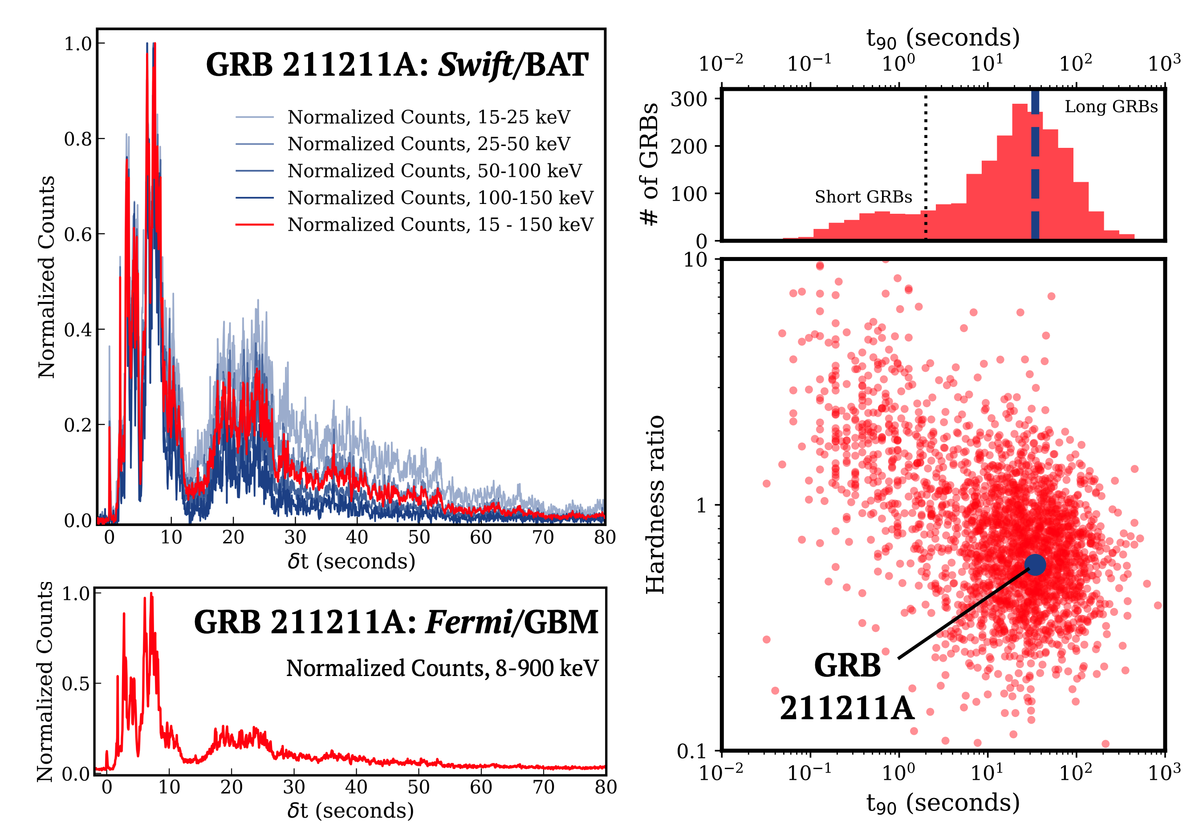
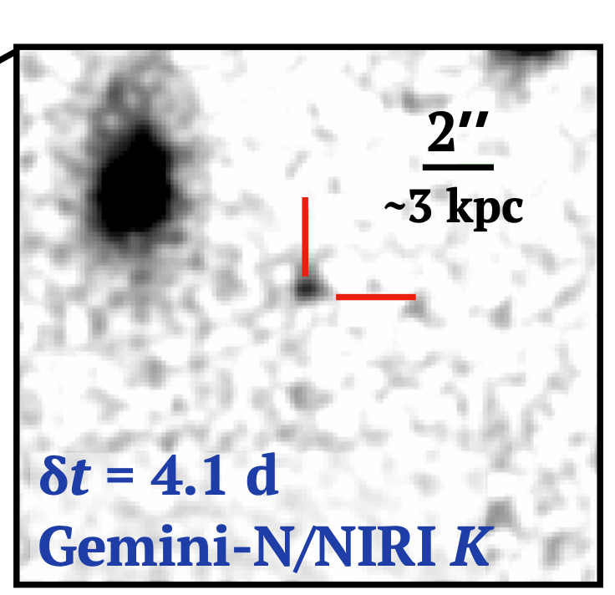
Associated Kilonova!
Rastinejad+ (2022) arXiv:2204.10864

Slide 40
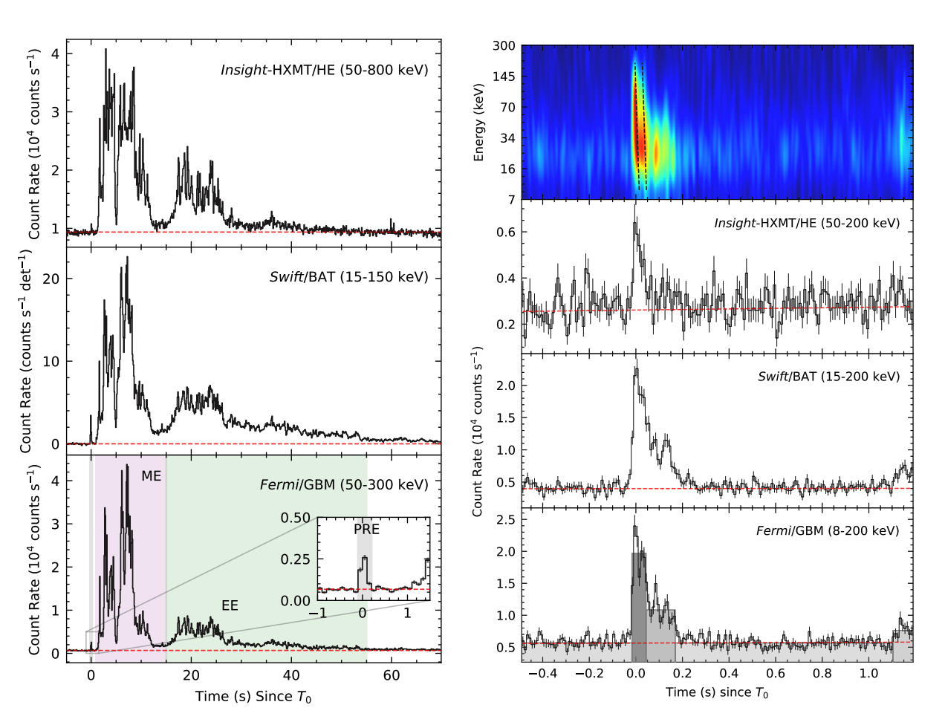
Xiao+ arXiv:2205.02186

Slide 41
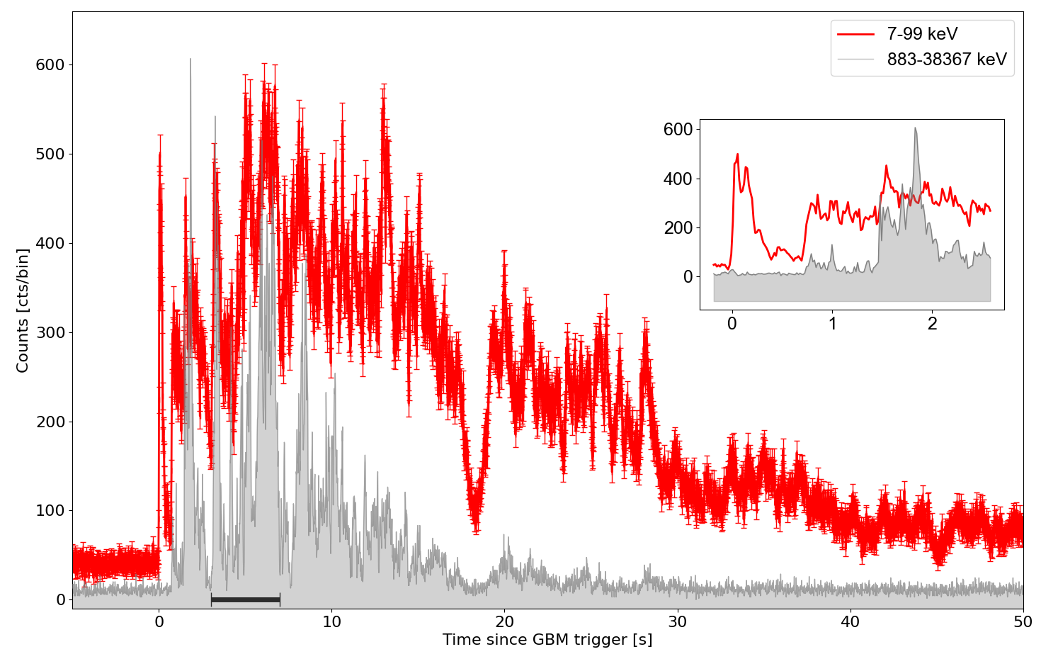
GRB230307A
PRELIMINARY
Dichiara et al in prep

Slide 42
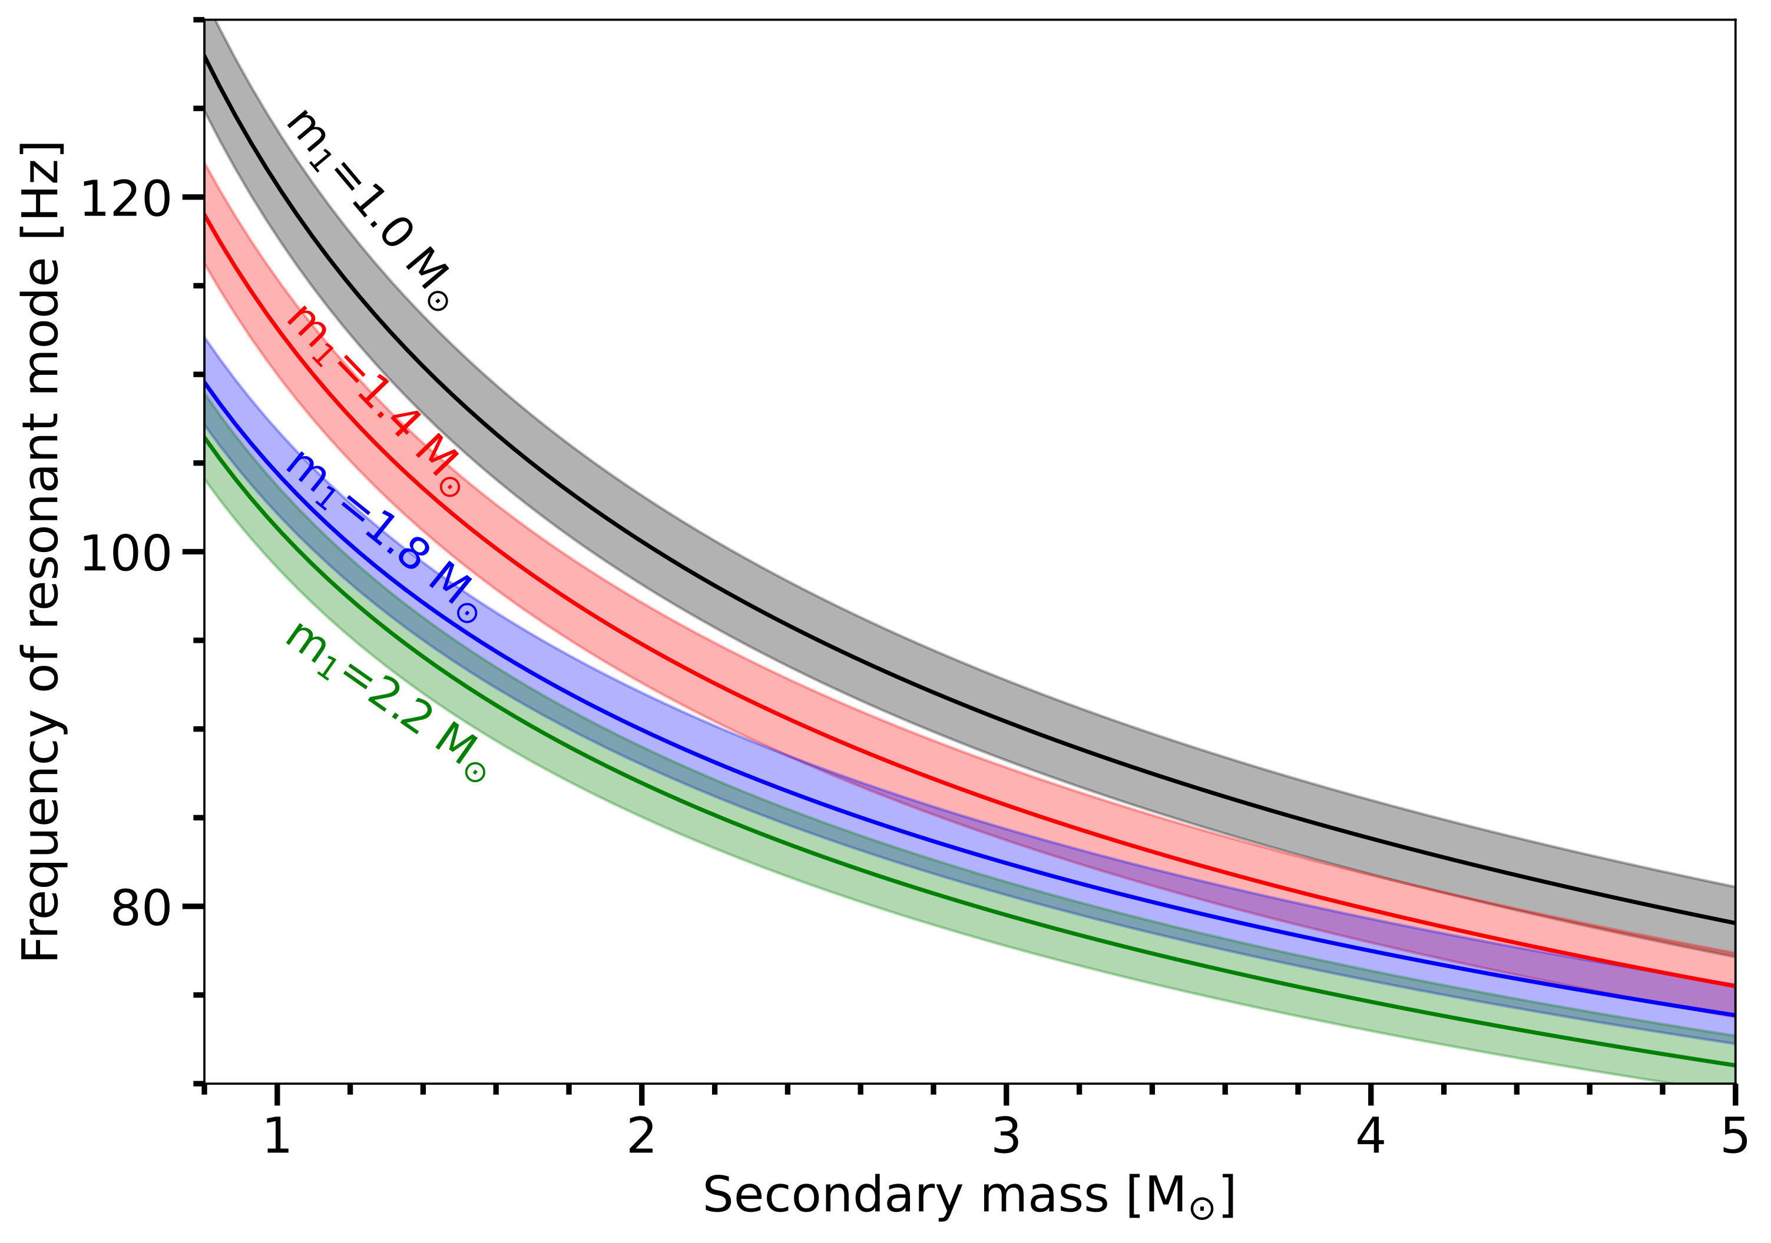
PRELIMINARY

Slide 43
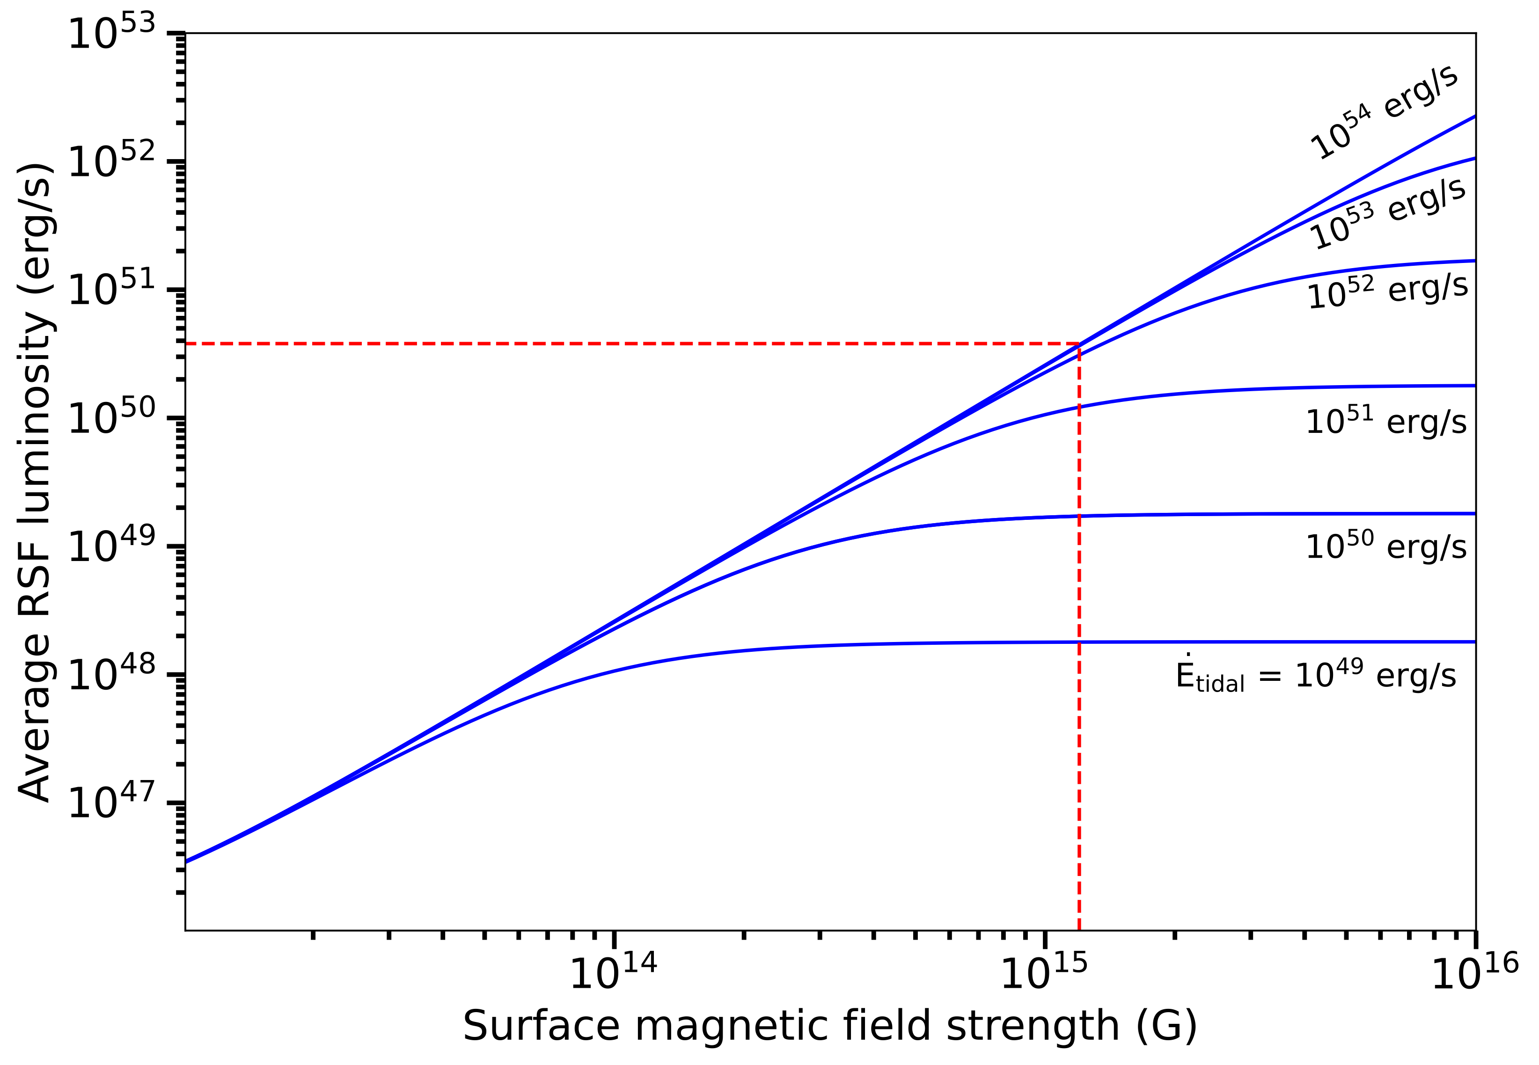
PRELIMINARY

Slide 44
Summary & Key Question:
The inner core of a neutron star is very uncertain: may or may not be nucleonic
Symmetry Energy is important, but most core-dominated observables likely do not probe Symmetry Energy!
It is best probed near the core/crust boundary.
RSFs are tidally induced resonances that cause Gamma-Ray flares
RSFs naturally probe the crust-core boundary (~ 1/2 saturation)
Asteroseismology is great for probing different regions
Which astro-observables are best suited
to constrain dense matter physics at
different densities?

Slide 45
Conclusions
Nuclear physicists want to understand many-body interactions of bulk nuclear matter
Symmetry Energy is diff in binding energy between symmetric nuclear matter and pure neutron matter
The inner core of a neutron star is very uncertain: may or may not be nucleonic
Symmetry Energy is important, but most core-dominated observables do not probe Symmetry Energy!
It is best probed near the core/crust boundary.
RSFs are tidally induced resonances that cause Gamma-Ray flares
RSFs naturally probe the crust-core boundary (~ 1/2 saturation)
Let’s build collaboration to probe the different regions of neutron stars and the different physics
Asteroseismology is great for probing different regions

Slide 46
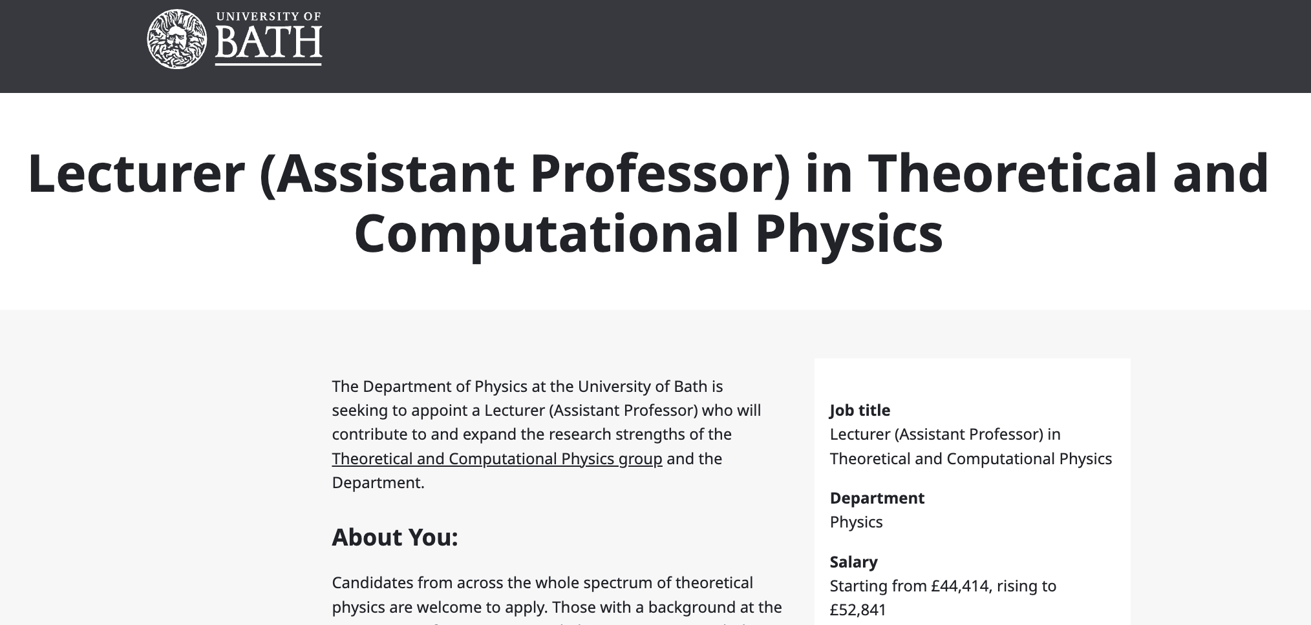
Bath Physics is Hiring!
+ An Astrophysics Lectureship to be advertised soon

Slide 47
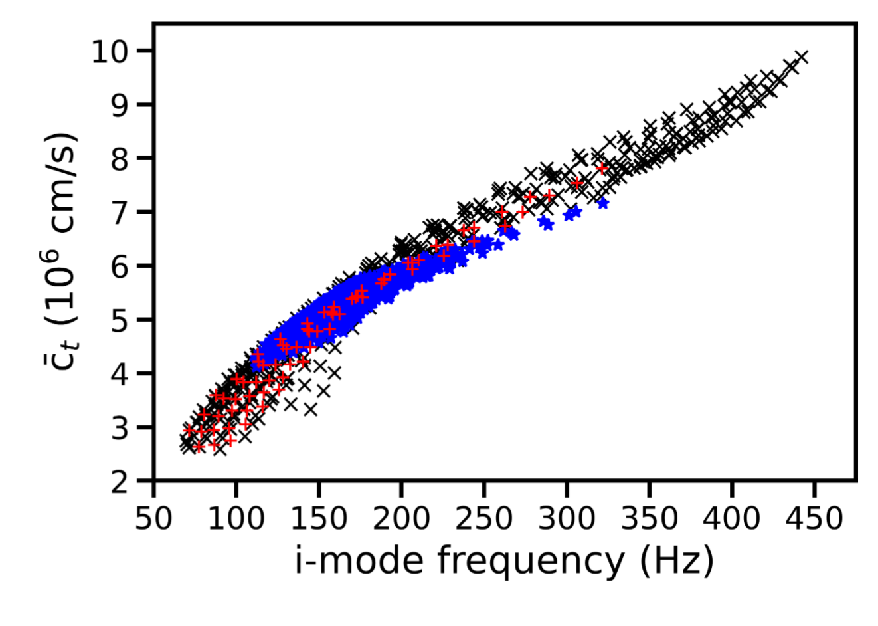
Density weighted average shear speed
Neill, Newton, & DT (2021), MNRAS 504, 1, 1129

