Slide 1
TITLE LIDE
International Symposium on Nuclear Symmetry Energy(NuSym 23)
GSI, Darmstadt, 18-22nd Sept, 2023
Tidal Heating as a direct probe of strangeness inside Neutron Stars
Suprovo Ghosh
Doctoral student, Supervisor : Prof. Debarati Chatterjee
IUCAA, Pune , India
Collaborators :
Bikram Pradhan (IUCAA),
Prof. Debarati Chatterjee(IUCAA)

Slide 2
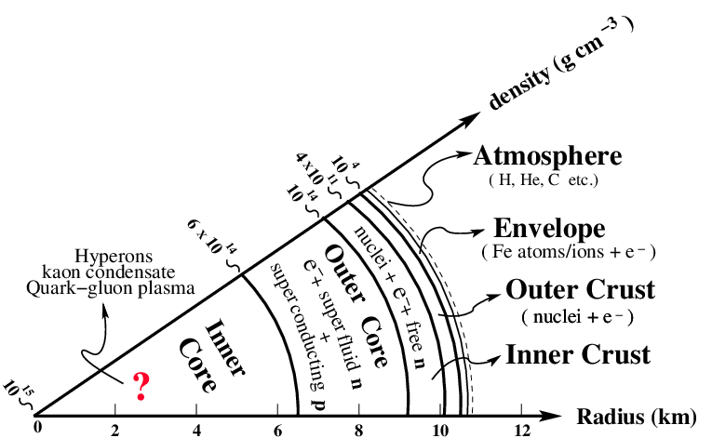
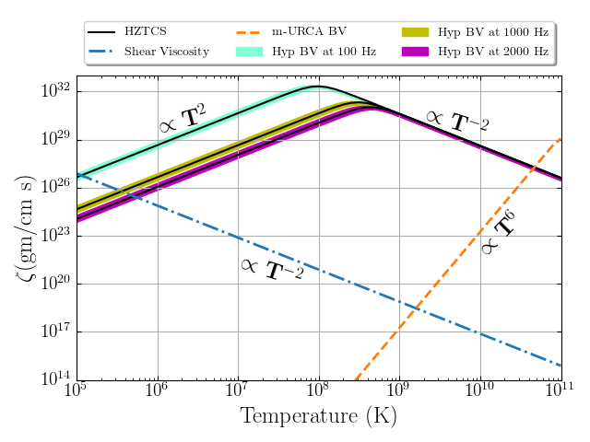
Tidal Heating due to viscosity of nuclear matter
Strange matter like hyperons can be stable components inside the high density NS Core.
Signature of Hyperons in gravitational wave data ?
Tidal heating due to viscous dissipation during binary NS inspiral.

Slide 3
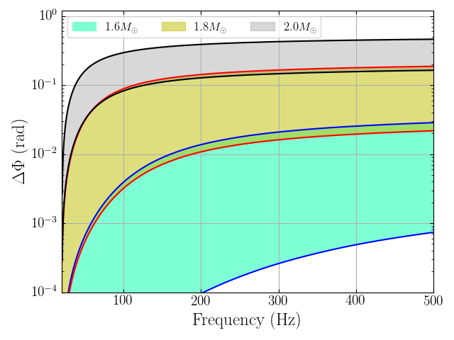
Effect in GW signal and Detectability
Heat the star upto 0.1-1 MeV before merger but not high enough to require inclusion of thermal corrections to the EoS.
Additional torque to the viscous dissipation of energy will lead to a total change in the number of cycles.
Current phase uncertainty estimates is ~0.02 rad for A+ and 10⁻³ rad for Cosmic Explorer (CE).
Detectable for high mass NS in future generation detectors!!

Slide 4
To Know more about tidal heating and strange matter inside Neutron stars , Please visit the poster .

