Slide 1
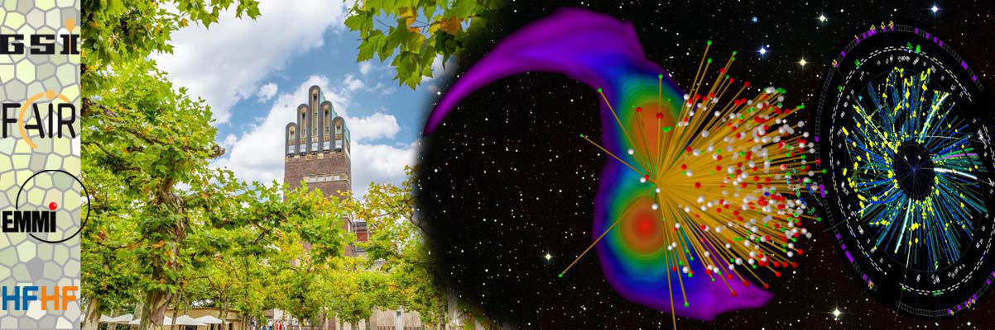
Refinements of the transport models and the constraints on symmetry energy
Yingxun Zhang
China Institute of Atomic Energy
XIth International Symposium on Nuclear Symmetry Energy, NuSYM23, GSI, Darmstart, Germany 2023.9.18-22

Slide 2
Outline
1, Debates on the constraints of symmetry energy and the findings
  Insight on transport models: Transport model evaluation project
2, Refinement on the transport models （ImQMD and UrQMD）
  Refine the transport models: initialization, mean field, collisions, Pauli blocking
3，Model dependence and effective mass splitting
  b-distribution with selected events sample (two observables)
  The probed density by pion and flow
  Uncertainty in physics: effective mass splitting
4, Summary and outlook

Slide 3
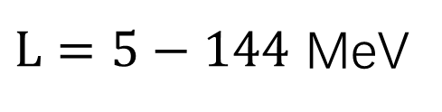
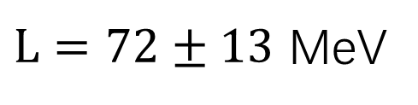
Debates on the constraints of symmetry energy
P. Russotto, et al., Phys. Rev. C 94(3), 034608 (2016)
$L=72±13$ MeV
B. A. Li, PRL 88, 192701 (2002)
$L=5−144$ MeV
Pi-/Pi+,
1, Strong model dependence, Why?
2, Which density region is probed?
Z.G.Xiao, PRL102, 062502(2009)
W.M.Guo, GCYong etal, PLB738,397

Slide 4
  Model comparison: Transport model evaluation project
3, difference between BUU and QMD.
Flow: BUU is great than QMD，400AMeV, 15% difference
1: Initialization ？
2: collisions and pauli blocking

Slide 5
1, give a benchmark on how to treat the attempted collision√
2, difference on the successful collision rate, Pauli blocking？

Slide 6
QMD，nonlinear density dependent interaction term
BUU， Lattice treatment

Slide 8
2. Refinement of the transport models （ImQMD and UrQMD）

Slide 9
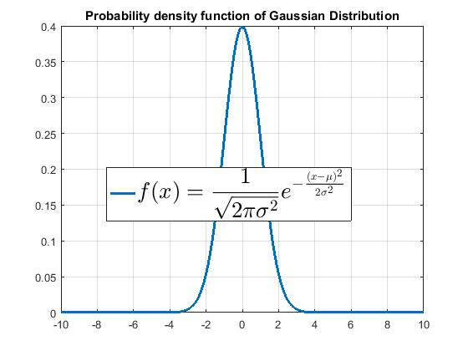
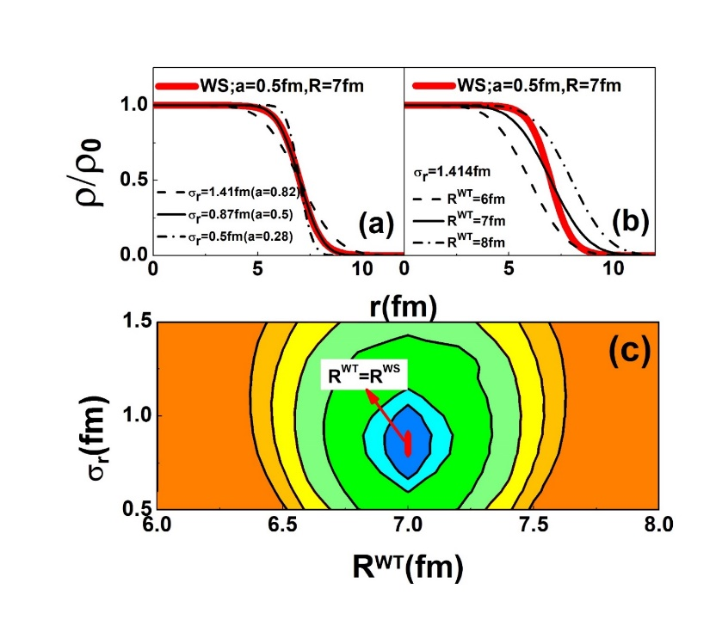
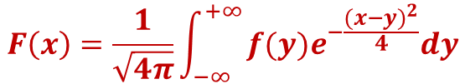
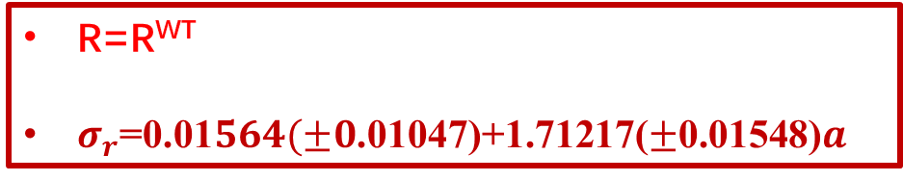
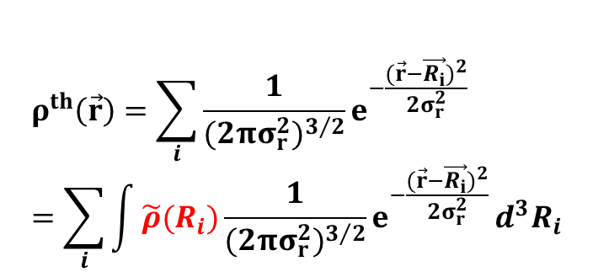
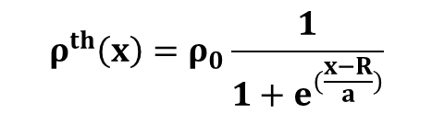
Initialization
QMD类模型中初始化再现
How to reproduce the WS density profile in QMD-type model?
Junping Yang, Yingxun Zhang*, et al., PRC104, 024605 (2021)
$$ρ^{th}\left(\vec{r}\right)=\sum_{i}{\frac{1}{{(2πσ_{r}^{2})}^{3/2}}e^{−\frac{{(\vec{r}−\vec{R_{i}})}^{2}}{2σ_{r}^{2}}}}=\sum_{i}{\int{\tilde{ρ}(R_{i})\frac{1}{{(2πσ_{r}^{2})}^{3/2}}e^{−\frac{{(\vec{r}−\vec{R_{i}})}^{2}}{2σ_{r}^{2}}}}d^{3}R_{i}}$$
$$ρ^{th}\left(x\right)=ρ_{0}\frac{1}{1+e^{(\frac{x−R}{a})}}$$
Weierstrass transformation, determine the centroid distribution
R=R^{WT}
$σ_{r}$=0.01$564(±0$.01047)+1.71217($±$0.01548)$a$

Slide 10
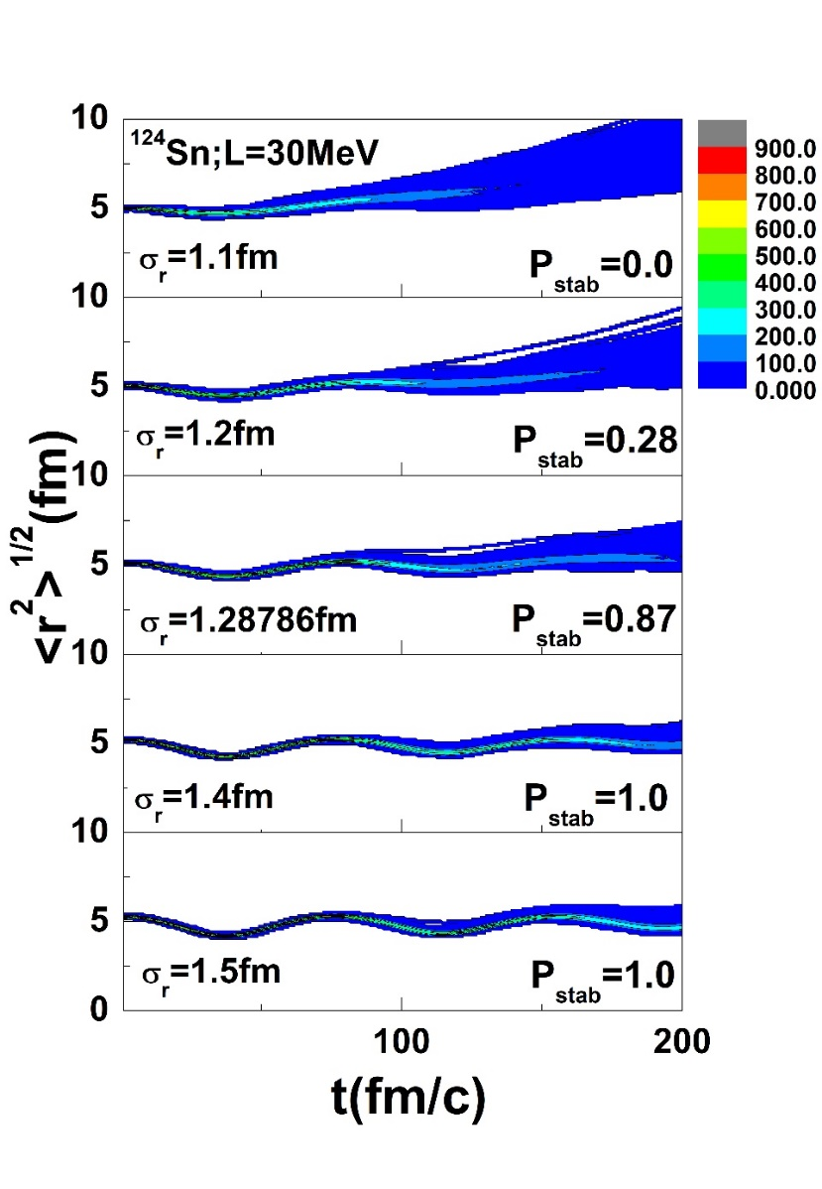
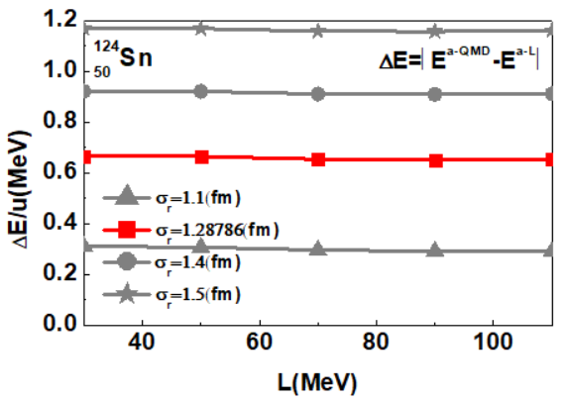
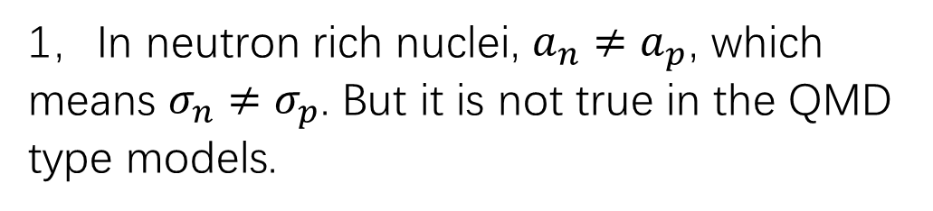
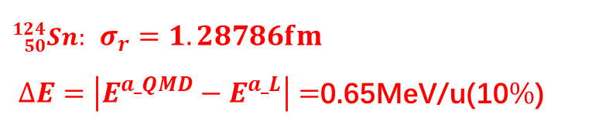
Can not be directly used in the QMD models!
1，In neutron rich nuclei, $a_{n}≠a_{p}$, which means $σ_{n}≠σ_{p}$. But it is not true in the QMD type models.
2， Small width can reproduce the density profile, but has bad stability of initial nuclei
${}_{50}^{124}{Sn}:$ $σ_{r}=1.28786fm$
$∆E=\left|E^{a_QMD}−E^{a_L}\right|=$0.65MeV/u(10$\%$)
3，The sampled nuclei have about 10% pseudo-excitation, with the wildly used width

Slide 11
Sample the nucleons within R and binding energy , which are calculated with the RDV method.
restricted density variational method (RDV)-calculate the initial density distribution and binding energy
Liu Min et al 2006 Chin. Phys. Lett. 23 804

Slide 12
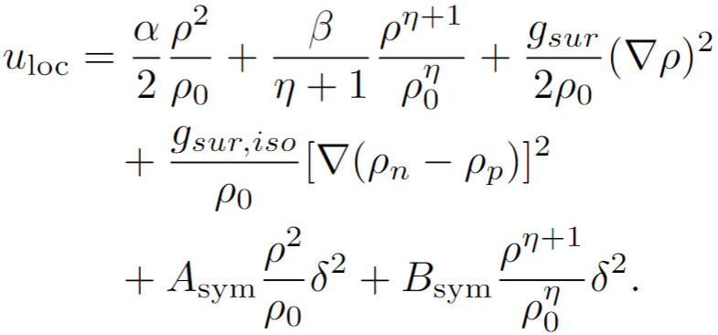
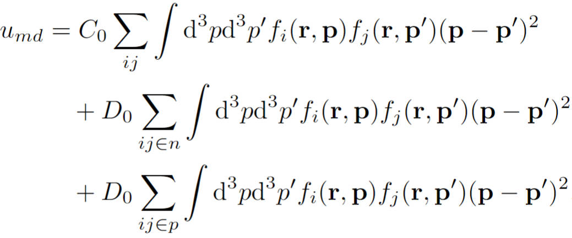
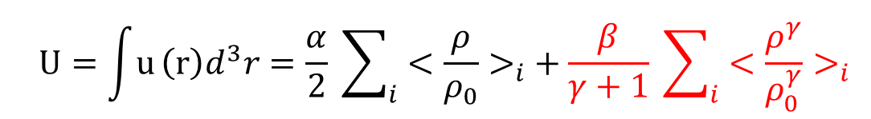
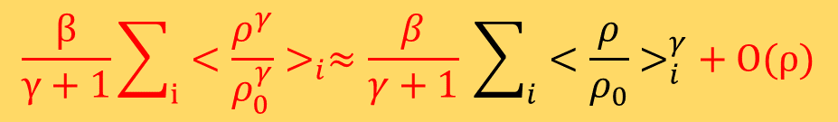
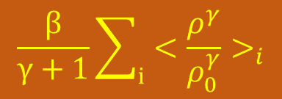
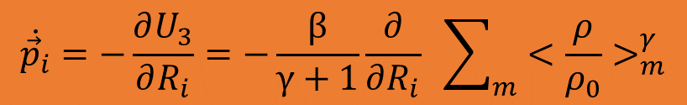
Mean field part
Density dependent interaction term in Mean field part
$$\frac{β}{γ+1}\sum_{i}{<{\frac{ρ^{γ}}{ρ_{0}^{γ}}>}_{i}≈\frac{β}{γ+1} \sum_{i}{<{\frac{ρ}{ρ_{0}}>}_{i}^{γ}}}+O(ρ)$$
$$\frac{β}{γ+1}\sum_{i}{<{\frac{ρ^{γ}}{ρ_{0}^{γ}}>}_{i}}$$
$$\dot{{\vec{p}}_{i}}=−\frac{∂U_{3}}{∂R_{i}}=−\frac{β}{γ+1}\frac{∂}{∂R_{i}} \sum_{m}{<{\frac{ρ}{ρ_{0}}>}_{m}^{γ}}$$
ImQMD-L

Slide 13
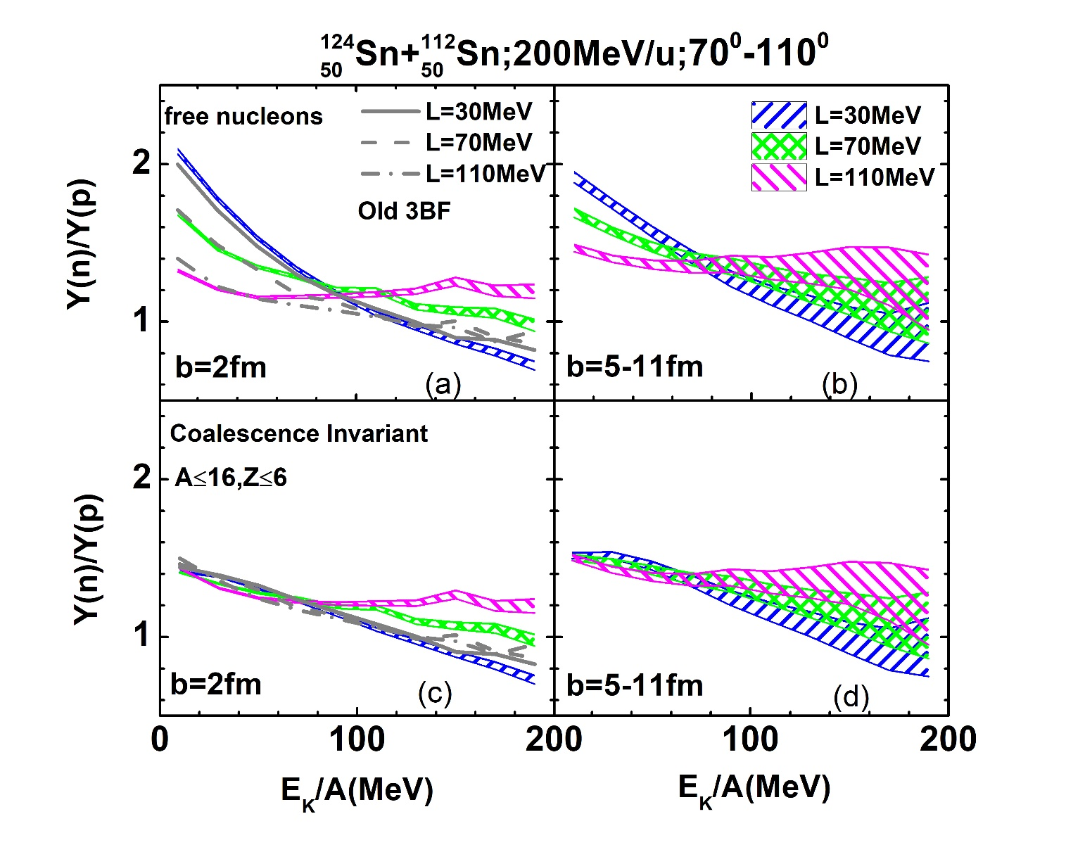
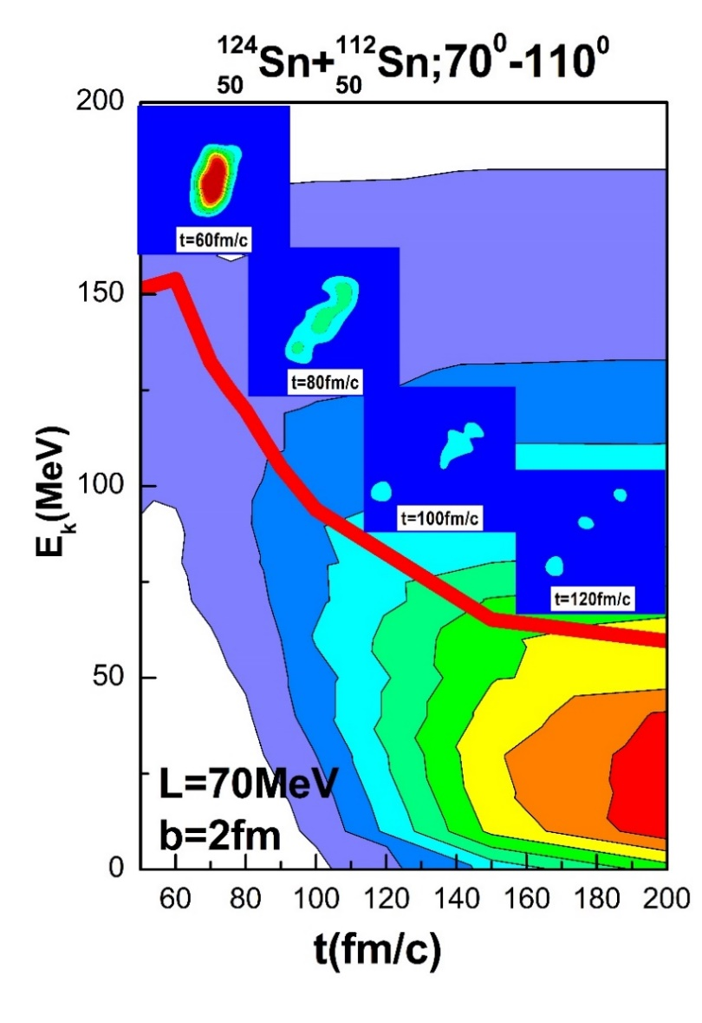
Junping Yang, Yingxun Zhang*, et al., PRC104, 024605 (2021)
n/p ratios at high kinetic energy region carries the information of symmetry energy at high enisty

Slide 14
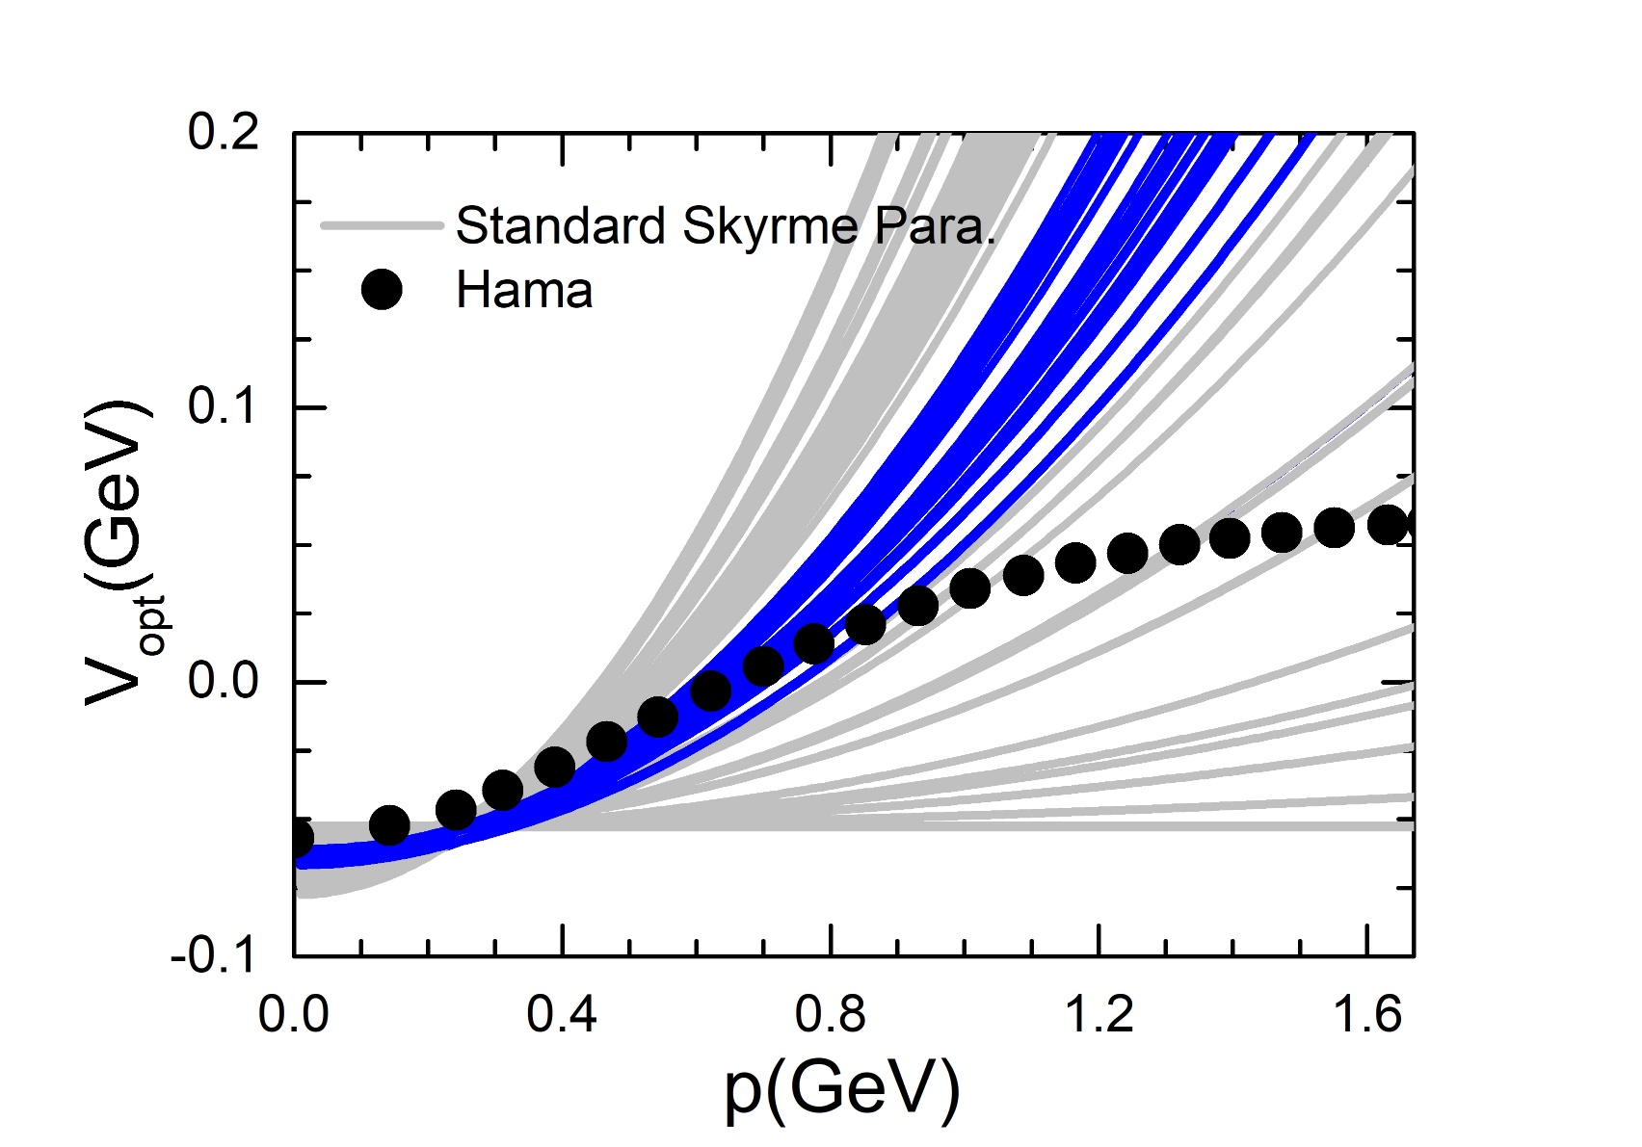
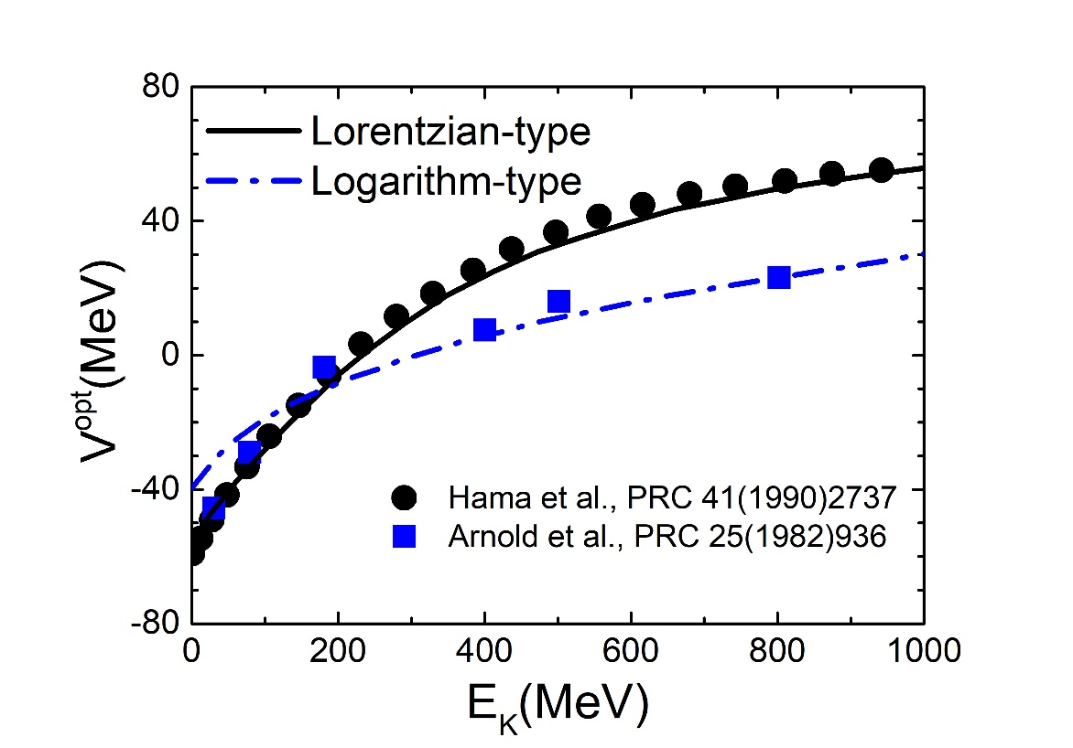
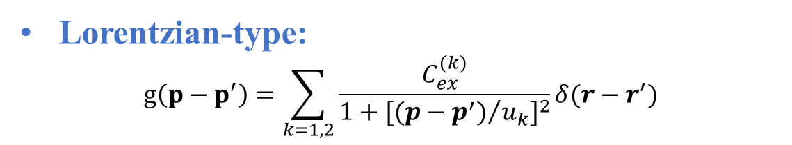
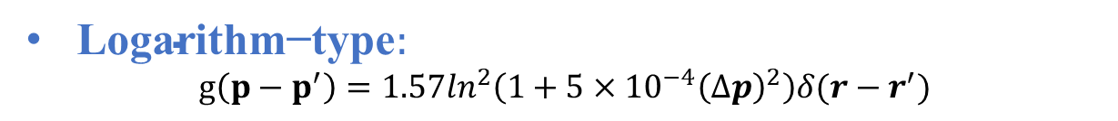
Momentum dependent interaction
$\text{Logarithm}\text{−}\text{type}:$
$$g\left(p−p^{′}\right)=1.57\ln^{2}\left(1+5×{10}^{−4}{\left(∆p\right)}^{2}\right)δ(r−r^{′})$$
Lorentzian-type:
$$g\left(p−p^{′}\right)=\sum_{k=1,2}{\frac{C_{ex}^{(k)}}{1+{[{(p−p^{′})}/{u_{k}}]}^{2}}}δ(r−r^{′})$$

Slide 15
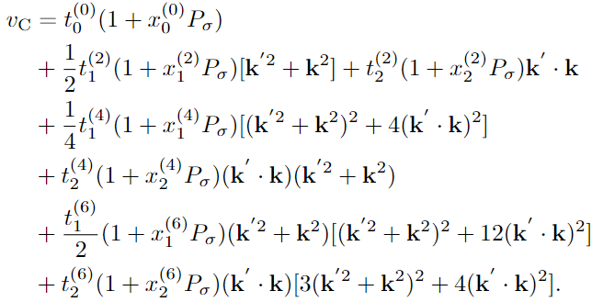
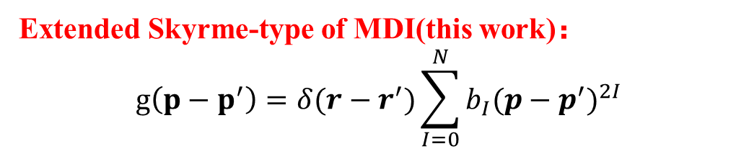
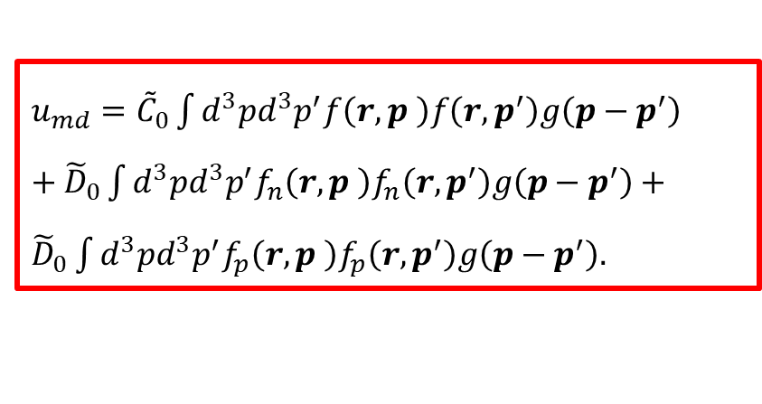
“It is possible to expand a finite range interaction in terms of a zero range like and such an expansion converges”.[B. G. Carlsson and J. Dobaczewski. Phys. Rev. Lett. 105, 122501 (2010).]
Extended Skyrme-type of MDI(this work)：
$$g\left(p−p^{′}\right)=δ(r−r^{′})\sum_{I=0}^{N}{b_{I}{(p−p^{′})}^{2I}}$$
$u_{md}={\tilde{C}}_{0}\int{{d^{3}pd}^{3}p^{′}f\left(r,p \right)f\left(r,p^{′}\right)g\left(p−p^{′}\right)}$ $+{\tilde{D}}_{0}\int{{d^{3}pd}^{3}p^{′}{f_{n}\left(r,p \right)f}_{n}\left(r,p^{′}\right)g\left(p−p^{′}\right)}+{\tilde{D}}_{0}\int{{d^{3}pd}^{3}p^{′}{f_{p}\left(r,p \right)f}_{p}\left(r,p^{′}\right)g\left(p−p^{′}\right).}$

Slide 16
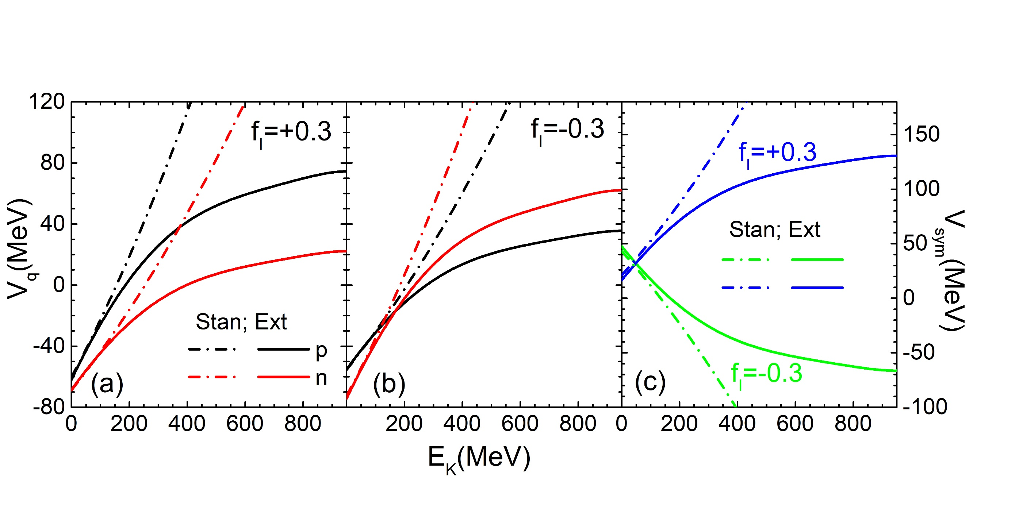
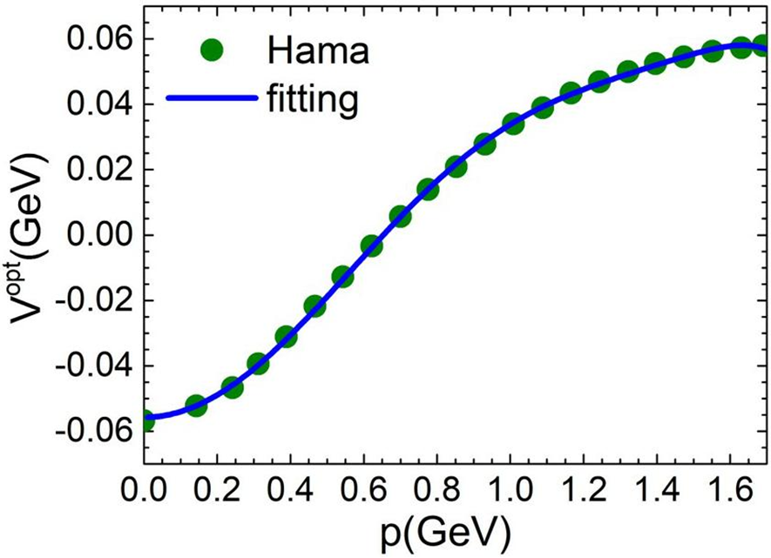
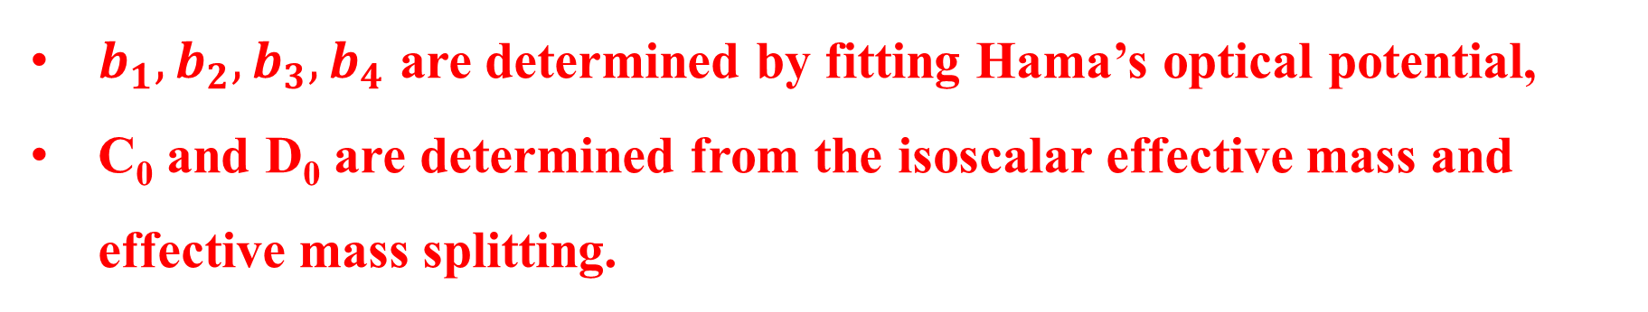

$b_{1},b_{2},b_{3},b_{4}$ are determined by fitting Hama’s optical potential,
C₀ and D₀ are determined from the isoscalar effective mass and effective mass splitting.
$$f_{I}=\frac{m}{m_{s}^{∗}}−\frac{m}{m_{v}^{∗}}$$
$$f_{I}>0, m_{n}^{∗}<m_{p}^{∗}$$
$$f_{I}<0, m_{n}^{∗}>m_{p}^{∗}$$
Junping Yang, Yingxun Zhang et. al., in preparation

Slide 17
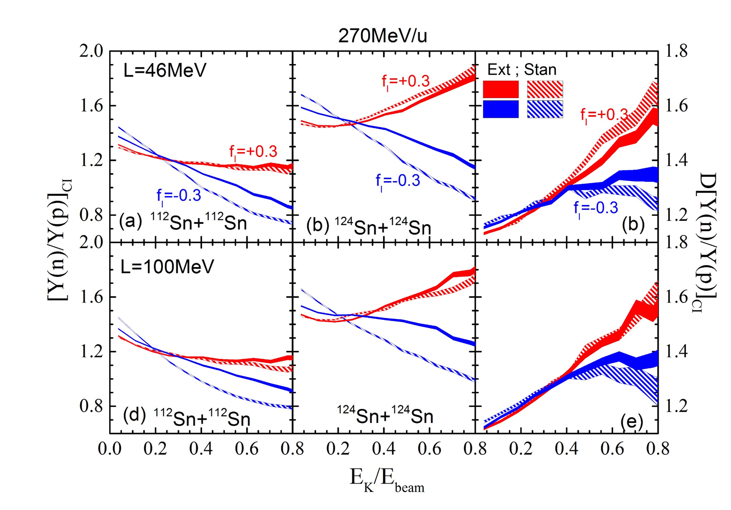
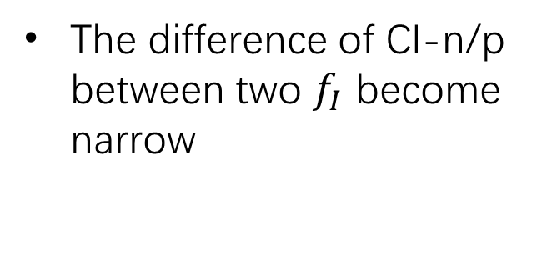
The single particle potential $V_{q },$the symmetry potential $V_{sym }$ and CI-n/p :
Junping Yang, Yingxun Zhang et. al., in preparation
The difference of CI-n/p between two $f_{I}$ become narrow

Slide 18

Collision part
A new Pauli blocking occupation probability algorithms
$$P_{block}=1−(1−P_{i})(1−P_{j})$$
Xiang Chen, Yingxun Zhang, et al, in preparation
Preliminary results

Slide 19
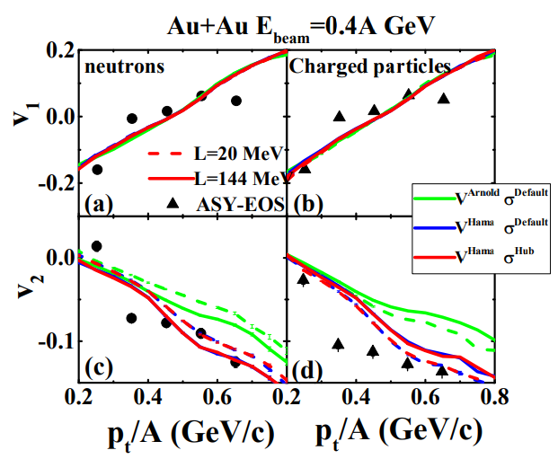
Some refinements in UrQMD
Update the form of MDI, describing the v1 and v2 better than use the MDI obtained from Arnold data
Update the MDI from Arnold’s data to Hama’s data
YYLiu, YXZhang, et al., submitted to PRC

Slide 20
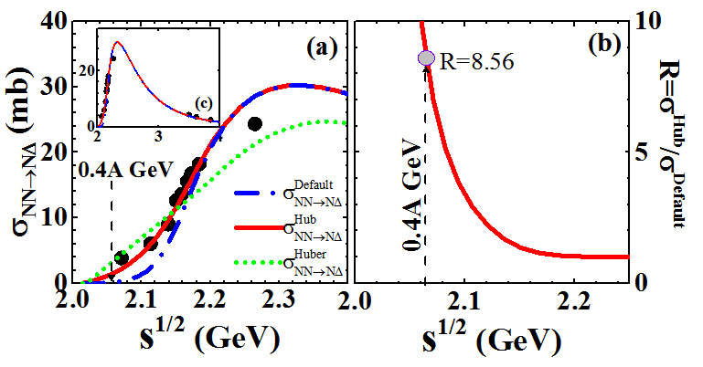
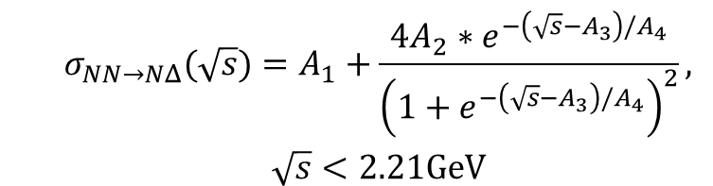
Refinement of the transport models- Cross section of NN-ND
$$\begin{matrix} & σ_{NN→NΔ}(\sqrt{s})=A_{1}+\frac{4A_{2}∗e^{−\left(\sqrt{s}−A_{3}\right)/A_{4}}}{{\left(1+e^{−\left(\sqrt{s}−A_{3}\right)/A_{4}}\right)}^{2}}, \\ & \sqrt{s}<2.21GeV\end{matrix}$$
1, Y. Cui, Y. X. Zhang, and Z. X. Li, Chin. Phys. C 44, 024106 (2020).
2, YY. Liu, et al. Phys.Rev.C 2021

Slide 21
3，Model dependence and effective mass splitting

Slide 22

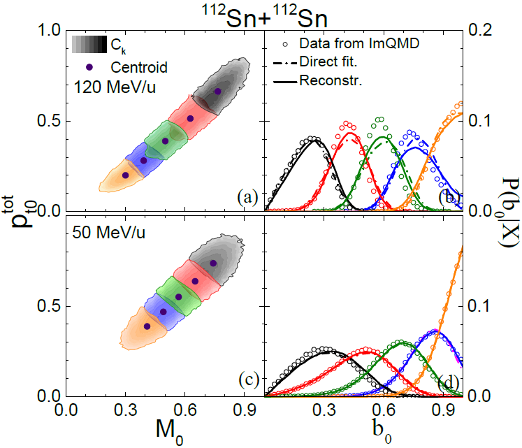
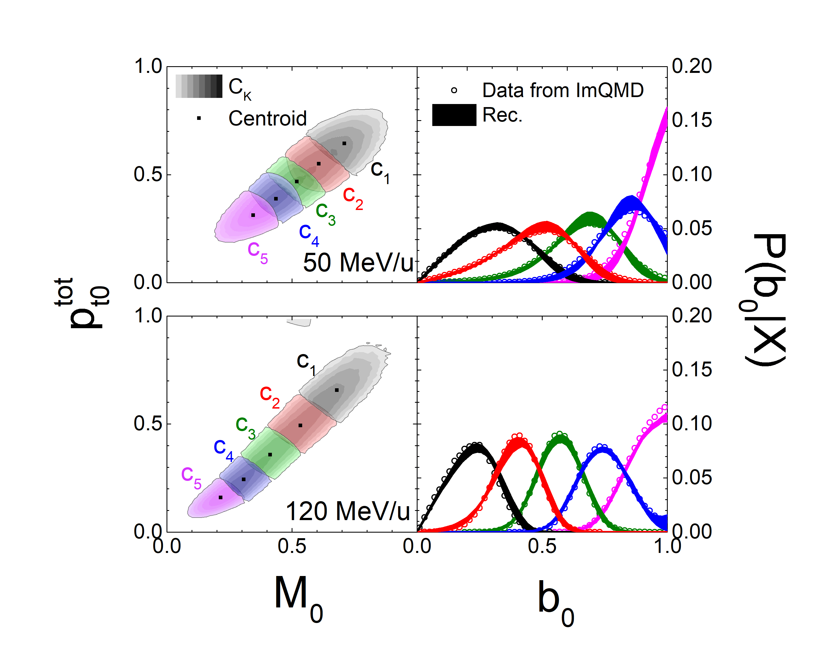
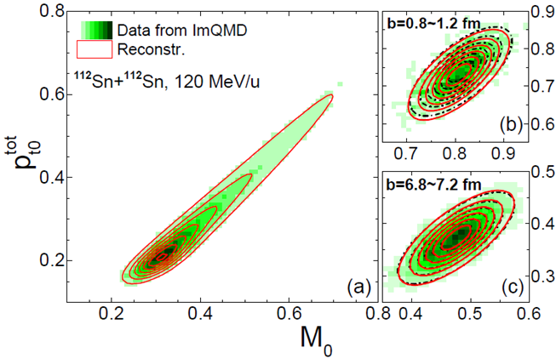
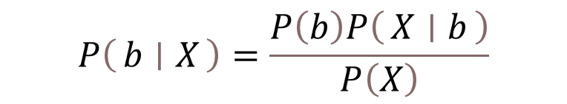
  Reconstructing b-distribution as in experiments
Reconstructing b-distribution from two observables
$$P\left(b ∣ X\right)=\frac{P\left(b\right)P\left(X ∣ b\right)}{P\left(X\right)}$$
Xiang Chen, et al., PRC108,034613(2023)
Gaussian distributions according to dynamics.
With angle cuts
Gaussian distribution according to the central limit theorem.

Slide 23
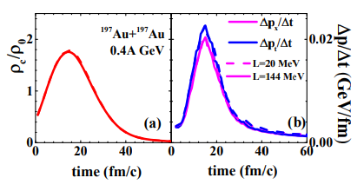
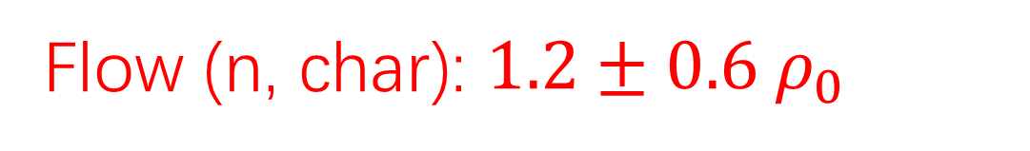
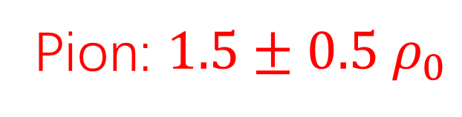
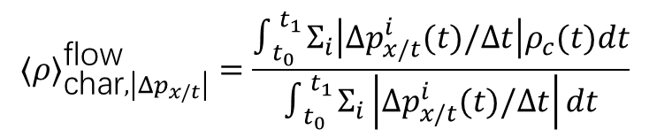
  Flow and pion probed density
YYLiu, et al., PRC103, 014616(2021)
$$⟨ρ⟩_{\text{char},\left|Δp_{x/t}\right|}^{\text{flow} }=\frac{∫_{t_{0}}^{t_{1}} Σ_{i}\left|Δp_{x/t}^{i}(t)/Δt\right|ρ_{c}(t)dt}{∫_{t_{0}}^{t_{1}} Σ_{i}\left|Δp_{x/t}^{i}(t)/Δt\right|dt}$$
Flow (n, char): $1.2±0.6 ρ_{0}$
Pion: $1.5±0.5 ρ_{0}$

Slide 24
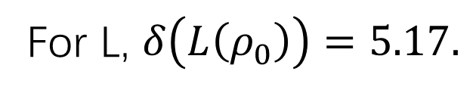
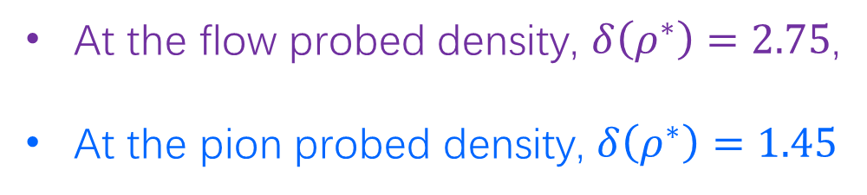
  Model dependence
no model dependence, =1
YYLiu, et al, submitted
At the flow probed density, $δ\left(ρ^{∗}\right)=2.75$,
At the pion probed density, $δ\left(ρ^{∗}\right)=1.45$
For L, $δ\left(L\left(ρ_{0}\right)\right)=5.17.$

Slide 25
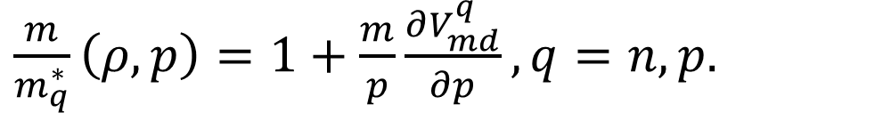
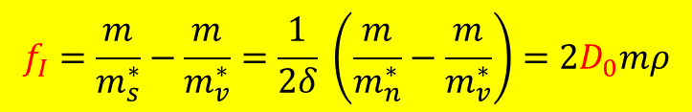
Effective mass splitting
$\frac{m}{m_{q}^{∗}}\left(ρ,p\right)=1+\frac{m}{p}\frac{∂V_{md}^{q}}{∂p},q=n,p.$
Junping Yang, et al, in preparation
For Standard Skyrme interaction,
$$f_{I}=\frac{m}{m_{s}^{∗}}−\frac{m}{m_{v}^{∗}}=\frac{1}{2δ} \left(\frac{m}{m_{n}^{∗}}−\frac{m}{m_{v}^{∗}}\right)=2D_{0}mρ$$
Different effective mass splitting can give the same density dependence of symmetry energy

Slide 26

A new probe that is directly related to the effective mass splitting
$$=2f_{I}δ/T$$

Slide 27
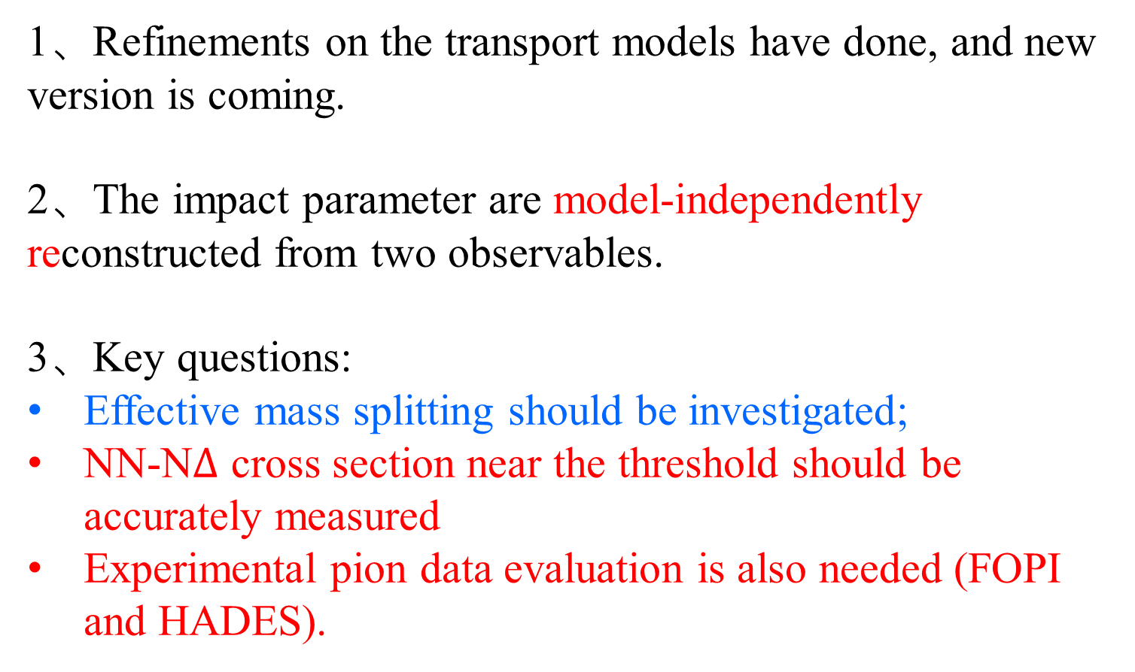
4, Summary and outlook
1、Refinements on the transport models have done, and new version is coming.
2、The impact parameter are model-independently reconstructed from two observables.
3、Key questions:
Effective mass splitting should be investigated;
NN-N$Δ$ cross section near the threshold should be accurately measured
Experimental pion data evaluation is also needed (FOPI and HADES).

Slide 28
Collaborators:
Xiang Chen, Junping Yang, Ying Cui, Yangyang Liu, Li Li, Zhuxia Li,
Yongjia Wang, Qingfeng Li
TMEP collaborations
Thanks for your patience!

