Slide 1
Impact of symmetry energy on sound speed and spinodal decomposition in dense neutron-rich matter
Nai-Bo Zhang
Southeast University
Collaborator：Bao-An Li
NuSym23· GSI Darmstadt · 09.18-09.22

Slide 2
Outline
Introduction
A parameterized EOS describing nuclear matter
Constraints on the EOS and $E_{sym}$
Conclusion

Slide 3
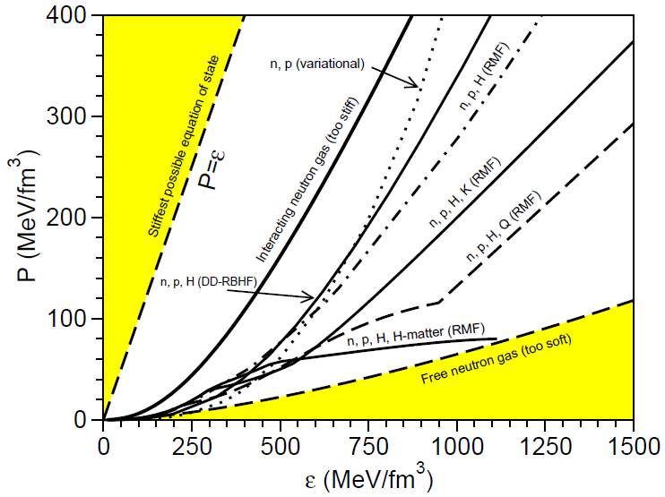
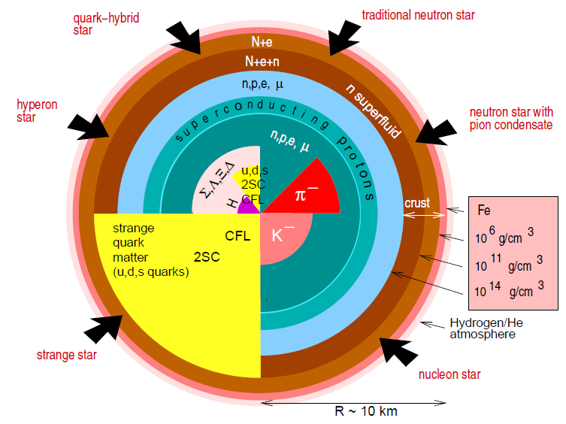
Introduction
TOV
Weber et al. PPNP 54, 193 (2005)

Slide 4
Introduction
Theoretical models
Equation of state
(energy density as functions of pressure)
Structure equations
Neutron star observations

Slide 5
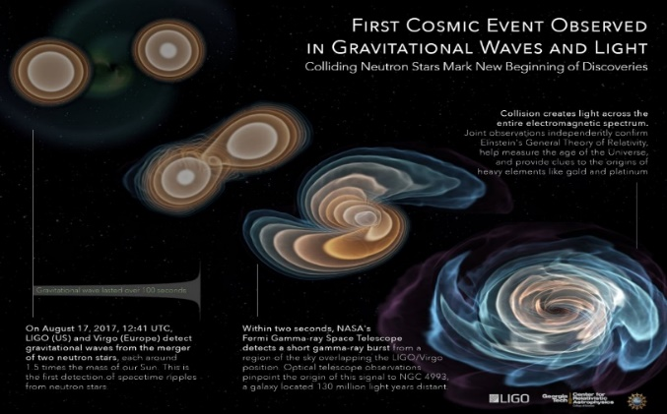
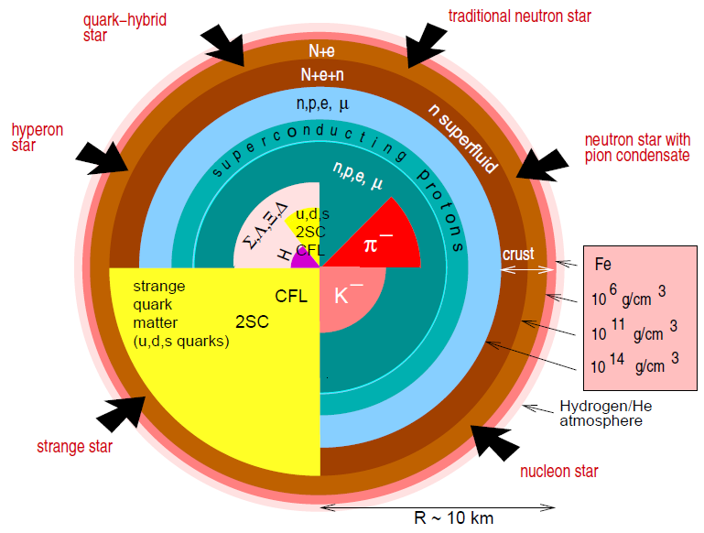
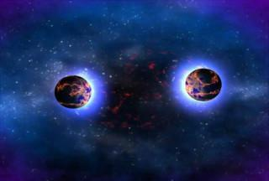
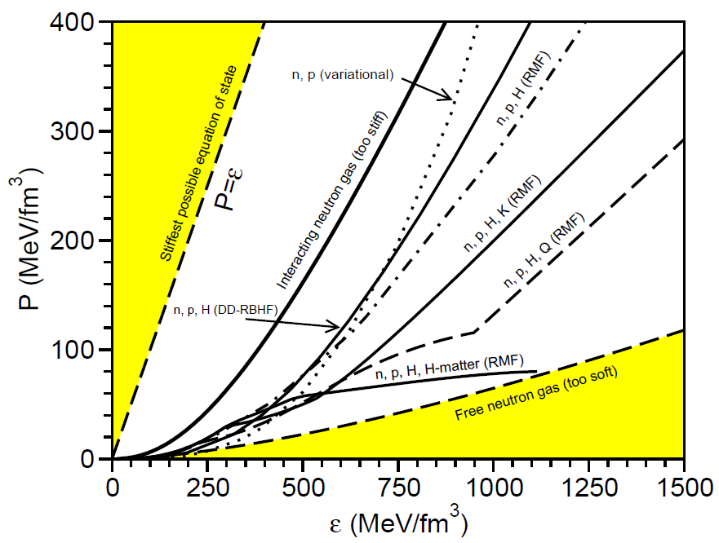
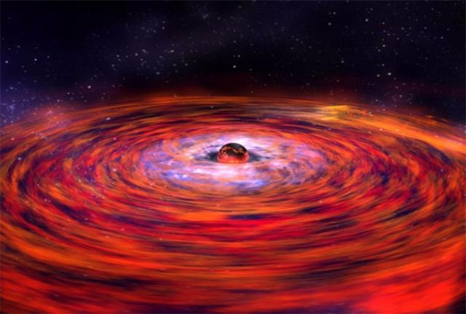
Introduction
Binary neutron star merger
npeμ
Hyperon
Phase transition
Quark
Tidal deformability
Binary neutron star system
Mass
Observations of X-ray
Radius

Slide 6
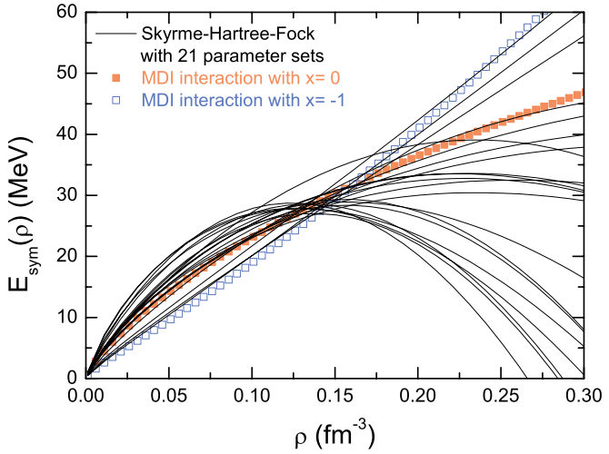
Symmetry energy
The most uncertain part of EOS is from symmetry energy
$$E_{sym}\left(ρ\right)=E_{b}\left(ρ, δ=1\right)−E_{b}\left(ρ, δ=0\right)$$
EOS of PNM
EOS of SNM
$$δ=\frac{ρ_{n}−ρ_{p}}{ρ}$$
Isospin asymmetry:
To constrain the high density symmetry energy is an important/urgent problem to be solved;
Li, B. A., et al. Physics Reports, 464, 113 (2008)

Slide 7
Symmetry energy
How does the symmetry energy affect neutron star properties?
The proton fraction $x_{p}$ is determined by the $E_{sym}(ρ)$ through chargeneutrality and beta-equilibrium conditions:
$$x_{p}=0.048{\left[\frac{E_{sym}\left(ρ\right)}{E_{sym}\left(ρ_{0}\right)}\right]}^{3}\left(ρ/ρ_{0}\right){\left(1−2x_{p}\right)}^{3}$$
The pressure in the npe matter at beta equilibrium:
$$P\left(ρ,δ\right)=ρ^{2}\left[\frac{dE_{0}\left(ρ\right)}{dρ}+\frac{dE_{sym}\left(ρ\right)}{dρ}δ^{2}\right]+\frac{1}{2}δ\left(1−δ\right)ρE_{sym}\left(ρ\right)$$
The crust-core transition density and pressure is determined by setting theincompressibility of neutron star matter =0:
$$K_{μ}=ρ^{2}\frac{d^{2}E_{0}}{dρ^{2}}+2ρ\frac{dE_{0}}{dρ}+δ^{2}\left[ρ^{2}\frac{d^{2}E_{sym}}{dρ^{2}}+2ρ\frac{dE_{sym}}{dρ}−2E_{sym}^{−1}{\left(δ\frac{dE_{sym}}{dρ}\right)}^{2} \right]=0$$

Slide 8
A parameterized EOS
The total energy density ε(ρ, δ) of charge-neutral npeμ matter at β equilibrium can be written as
The baryonic energy density can be written as
$ε\left(ρ,δ\right)=ε_{b}\left(ρ,δ\right)$+ $ε_{l}\left(ρ,δ\right)$
baryon
lepton
$$ε_{b}\left(ρ,δ\right)=ρE\left(ρ,δ\right)+ρM_{N}$$

Slide 9
A parameterized EOS
E(ρ, δ) can be approximated as
$$E\left(ρ,δ\right)≈E_{0}\left(ρ\right)+E_{sym}\left(ρ\right)δ^{2}$$
Energy per nucleon in SNM
Symmetry energy
$$E_{0}\left(ρ\right)=E_{0}\left(ρ_{0}\right)+\frac{K_{0}}{2}{\left(\frac{{ρ−ρ}_{0}}{3ρ_{0}}\right)}^{2}+\frac{J_{0}}{6}{\left(\frac{{ρ−ρ}_{0}}{3ρ_{0}}\right)}^{3}$$
$$E_{sym}\left(ρ\right)=E_{sym}\left(ρ_{0}\right)+L \left(\frac{{ρ−ρ}_{0}}{3ρ_{0}}\right)+\frac{K_{sym}}{2}{\left(\frac{{ρ−ρ}_{0}}{3ρ_{0}}\right)}^{2}+\frac{J_{sym}}{6}{\left(\frac{{ρ−ρ}_{0}}{3ρ_{0}}\right)}^{3}$$
NBZ et al. APJ, 859, 90 (2018); NBZ & Li APJ, 879, 99 (2019); EPJA, 55, 39 (2019); JPG, 46, 014002 (2019); APJ, 893, 61 (2020); APJ in press (2021); Xie & Li APJ, 883, 174 (2019); APJ, 899, 4 (2020); Li et al. EPJA, 55, 117 (2019); Universe, 7, 182 (2021)......

Slide 10
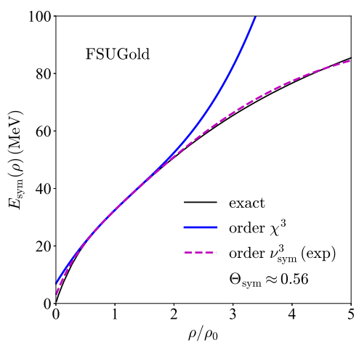
Converge problem
When ρ is larger than about 2ρ₀, the converge problem appears for Taylor expansion
They can be seen as free parameters need to be determined by the observations of neutron stars
Cai & Li PRC 103, 054611 (2021)

Slide 11
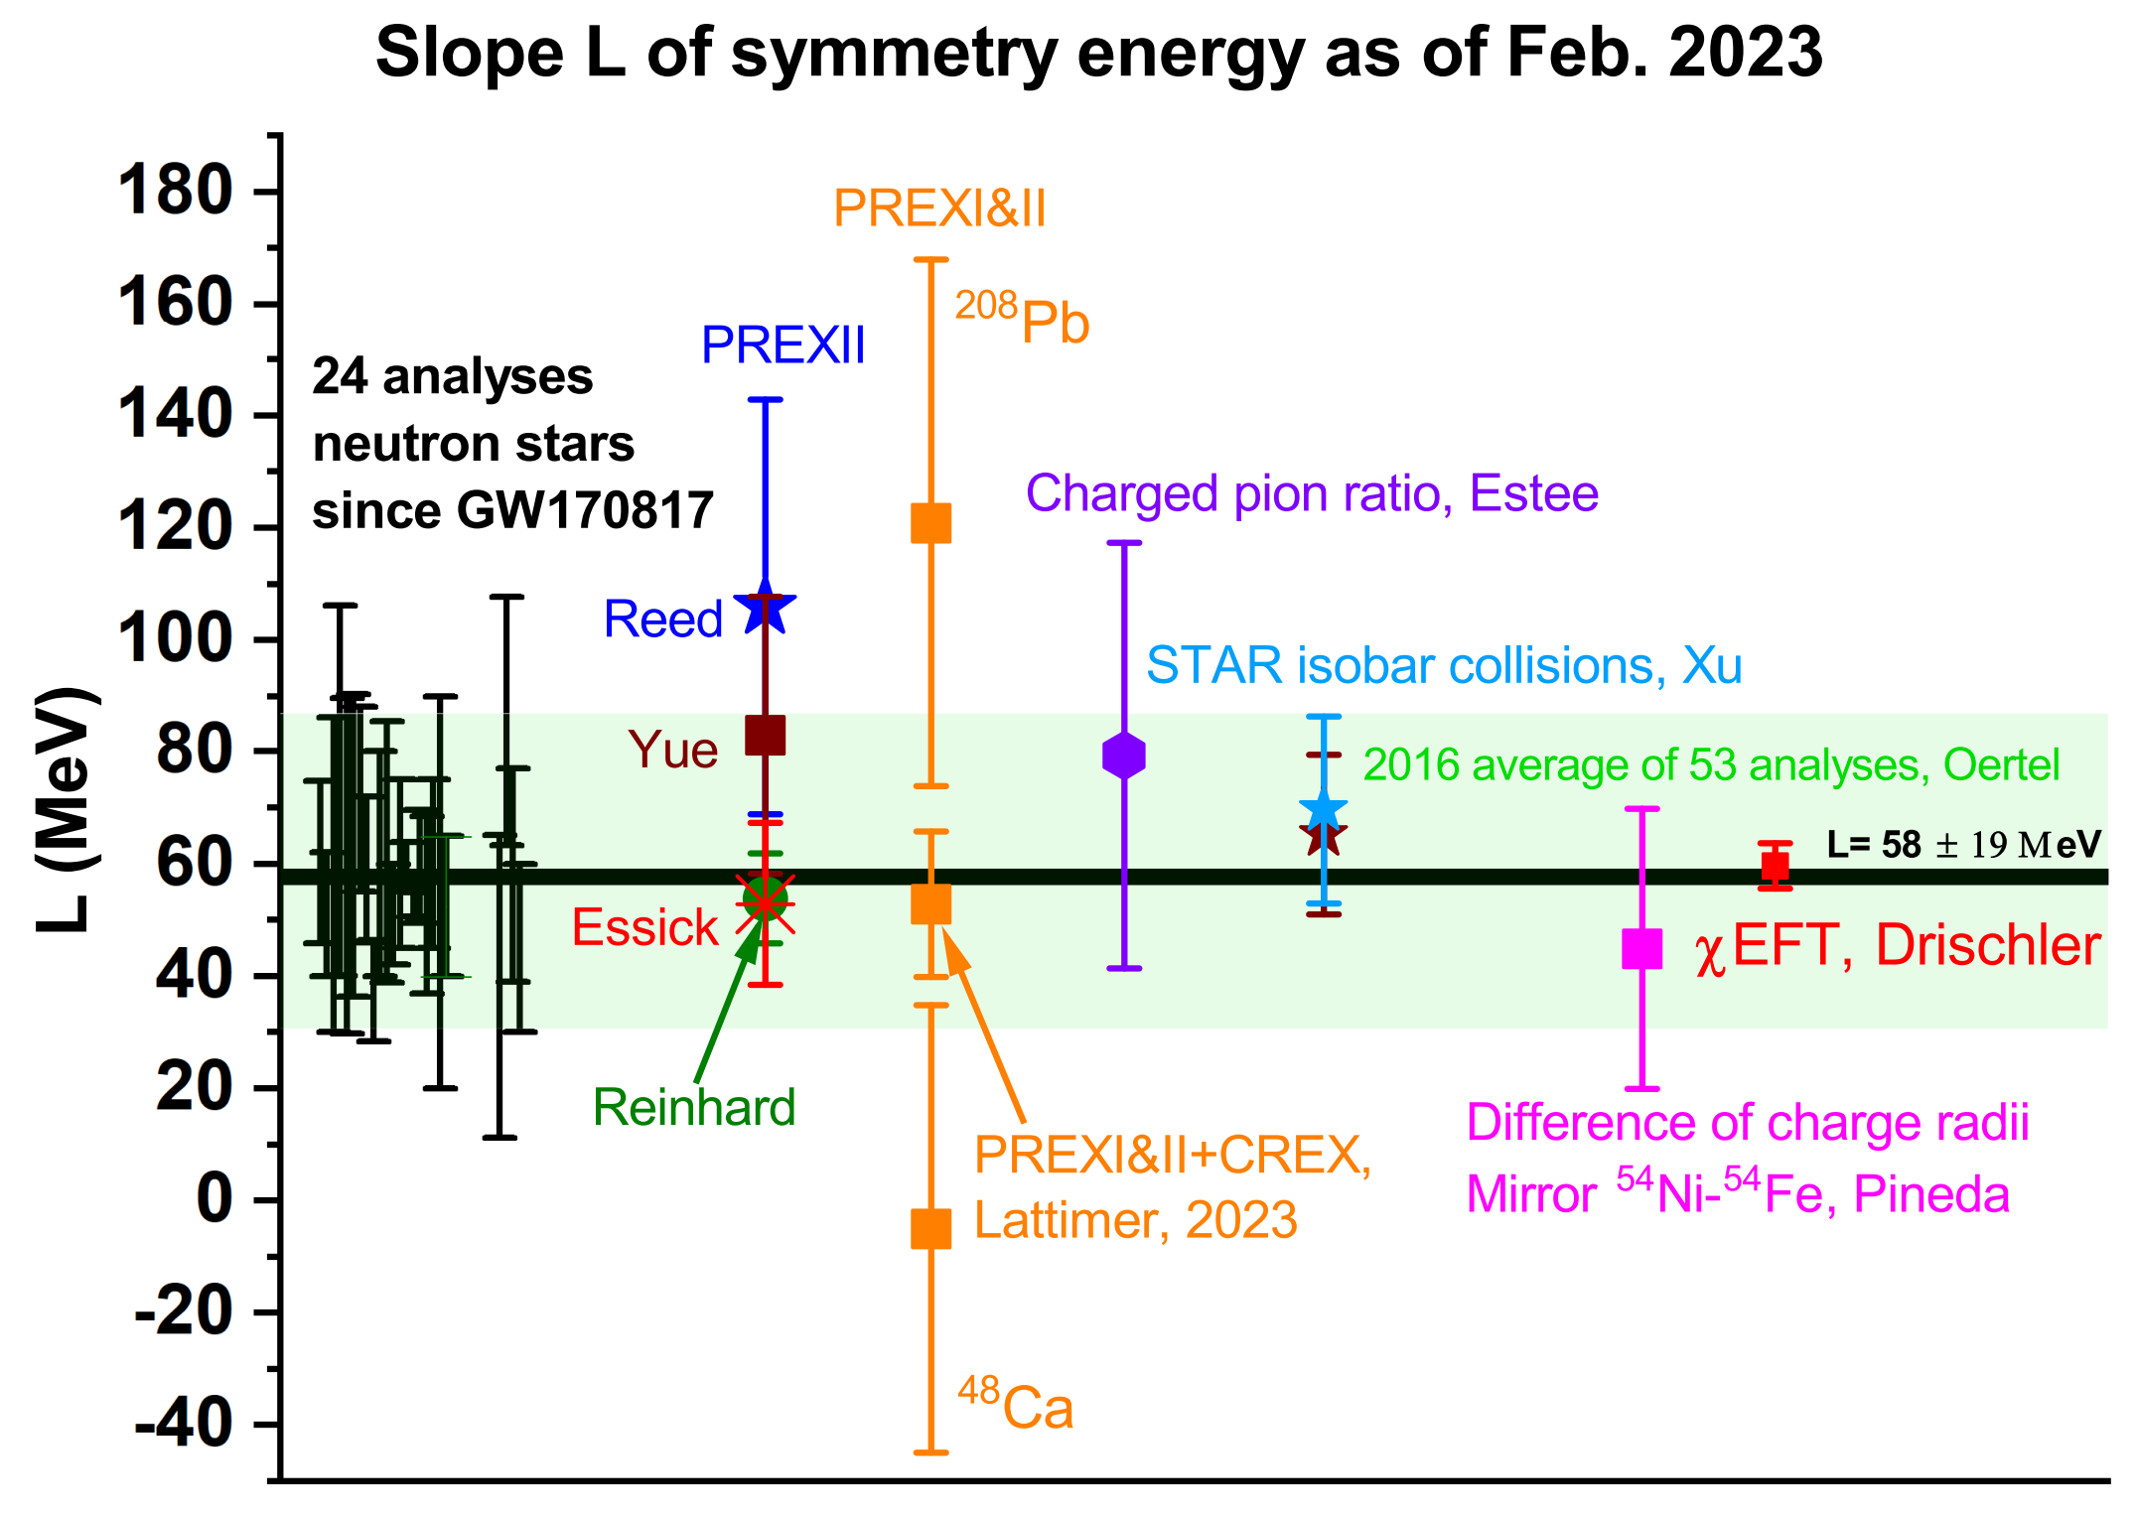
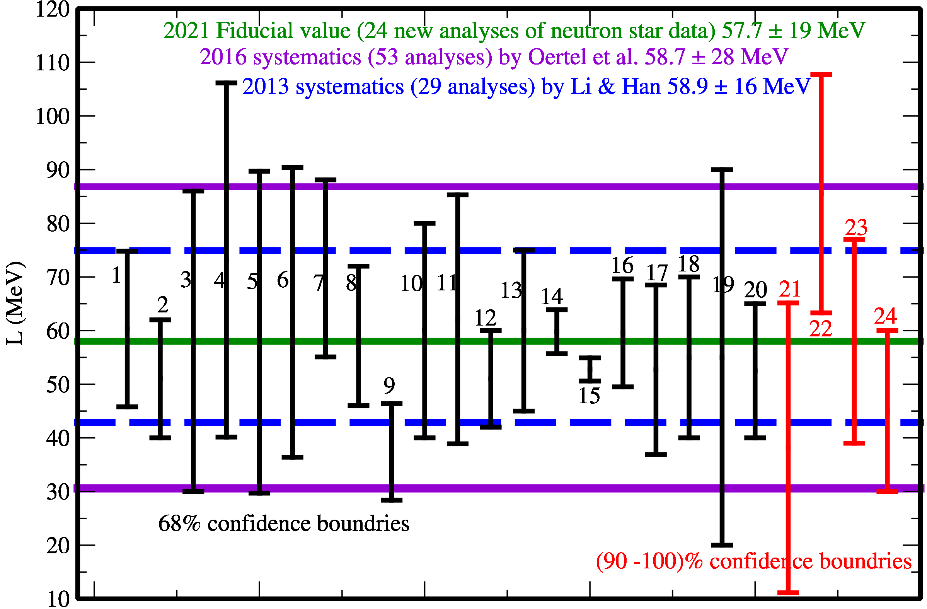
A parameterized EOS
The L maintains around $60±20$ MeV.
There are diverse opinions in understanding the PREX and CREX results in the community.
Li et al. Universe 7, 182 (2021); NBZ & Li EPJA 59, 86 (2023)

Slide 12
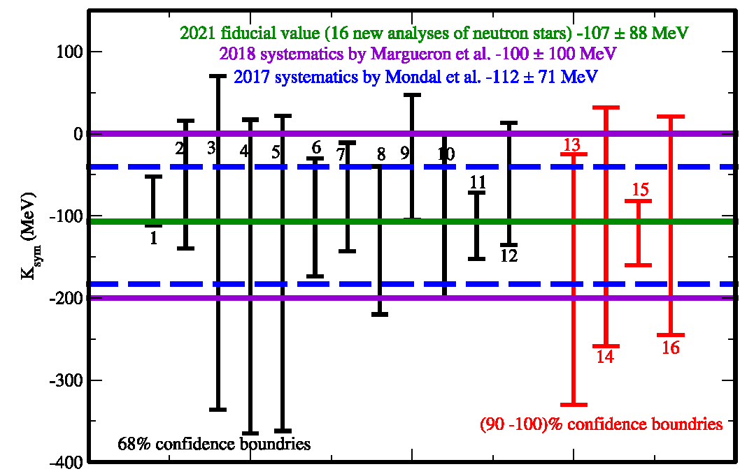
A parameterized EOS
The uncertainties of $K_{sym}$ is around $−100±100$ MeV.
$$E_{0}\left(ρ\right)=E_{0}\left(ρ_{0}\right)+\frac{K_{0}}{2}(\frac{{ρ−ρ}_{0}}{3ρ_{0}})^{2}+\frac{J_{0}}{6}(\frac{{ρ−ρ}_{0}}{3ρ_{0}})^{3}$$
$$E_{sym}\left(ρ\right)=E_{sym}\left(ρ_{0}\right)+L (\frac{{ρ−ρ}_{0}}{3ρ_{0}})+\frac{K_{sym}}{2}(\frac{{ρ−ρ}_{0}}{3ρ_{0}})^{2}+\frac{J_{sym}}{6}(\frac{{ρ−ρ}_{0}}{3ρ_{0}})^{3}$$
Li et al. Universe, 7, 182 (2021)

Slide 13
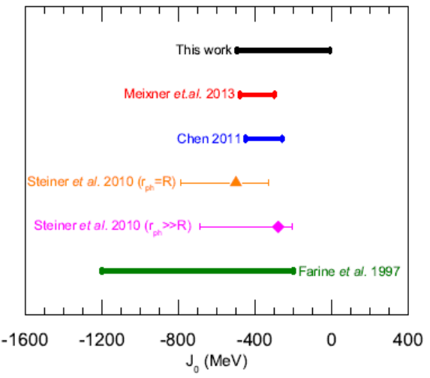
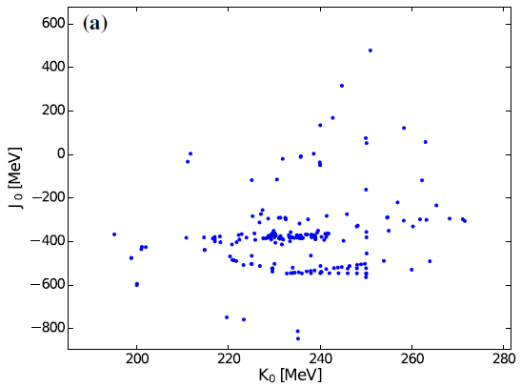
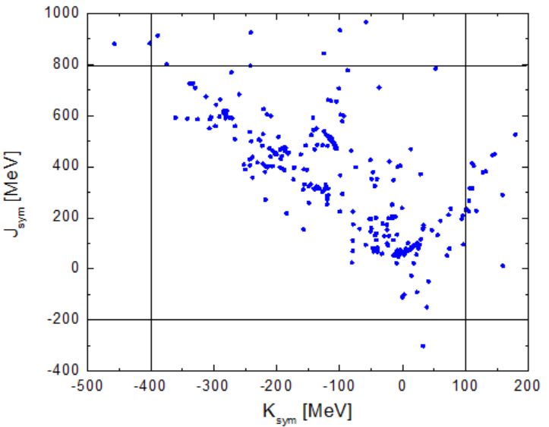
A parameterized EOS
$$E_{0}\left(ρ\right)=E_{0}\left(ρ_{0}\right)+\frac{K_{0}}{2}(\frac{{ρ−ρ}_{0}}{3ρ_{0}})^{2}+\frac{J_{0}}{6}(\frac{{ρ−ρ}_{0}}{3ρ_{0}})^{3}$$
$$E_{sym}\left(ρ\right)=E_{sym}\left(ρ_{0}\right)+L (\frac{{ρ−ρ}_{0}}{3ρ_{0}})+\frac{K_{sym}}{2}(\frac{{ρ−ρ}_{0}}{3ρ_{0}})^{2}+\frac{J_{sym}}{6}(\frac{{ρ−ρ}_{0}}{3ρ_{0}})^{3}$$
Cai & Chen NST 28, 185 (2017)
Zhang et al. NST 28, 181 (2017)

Slide 14
Bayesian analysis
Directly reverse TOV
Bayesian analysis
Theoretical models
Constrain?
Equation of state
(energy density as functions of pressure)
Structure equations
Steiner et al. 2010; Alvarez-Castillo et al. 2016; Özel et al. 2016; Raithel et al. 2017; Raaijmakers et al. 2018; Riley et al. 2018; Lim & Holt 2019; Greif et al. 2019; Miller et al. 2019; Landry & Essick 2019; Xie & Li 2019; Xie & Li 2020…
Neutron star observations

Slide 15
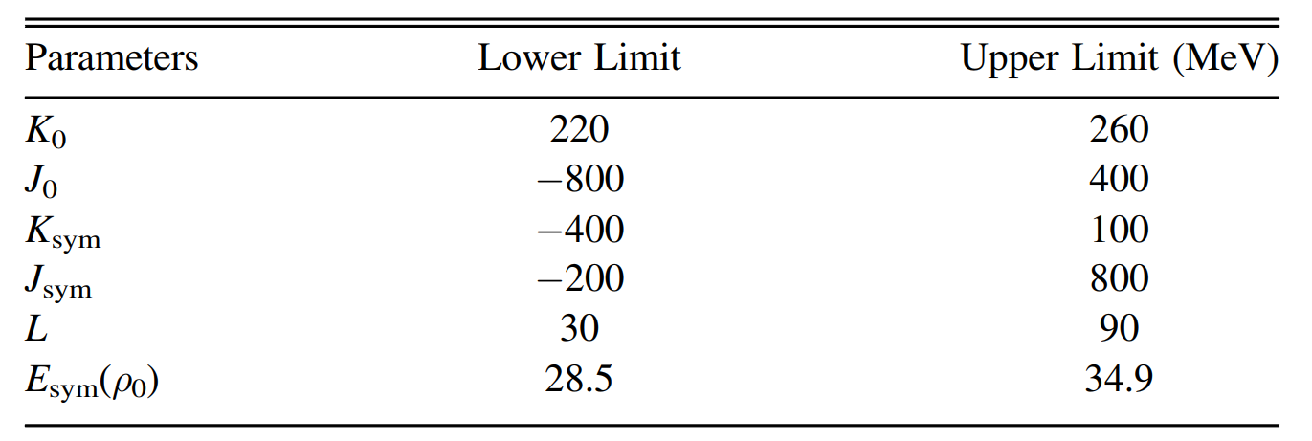
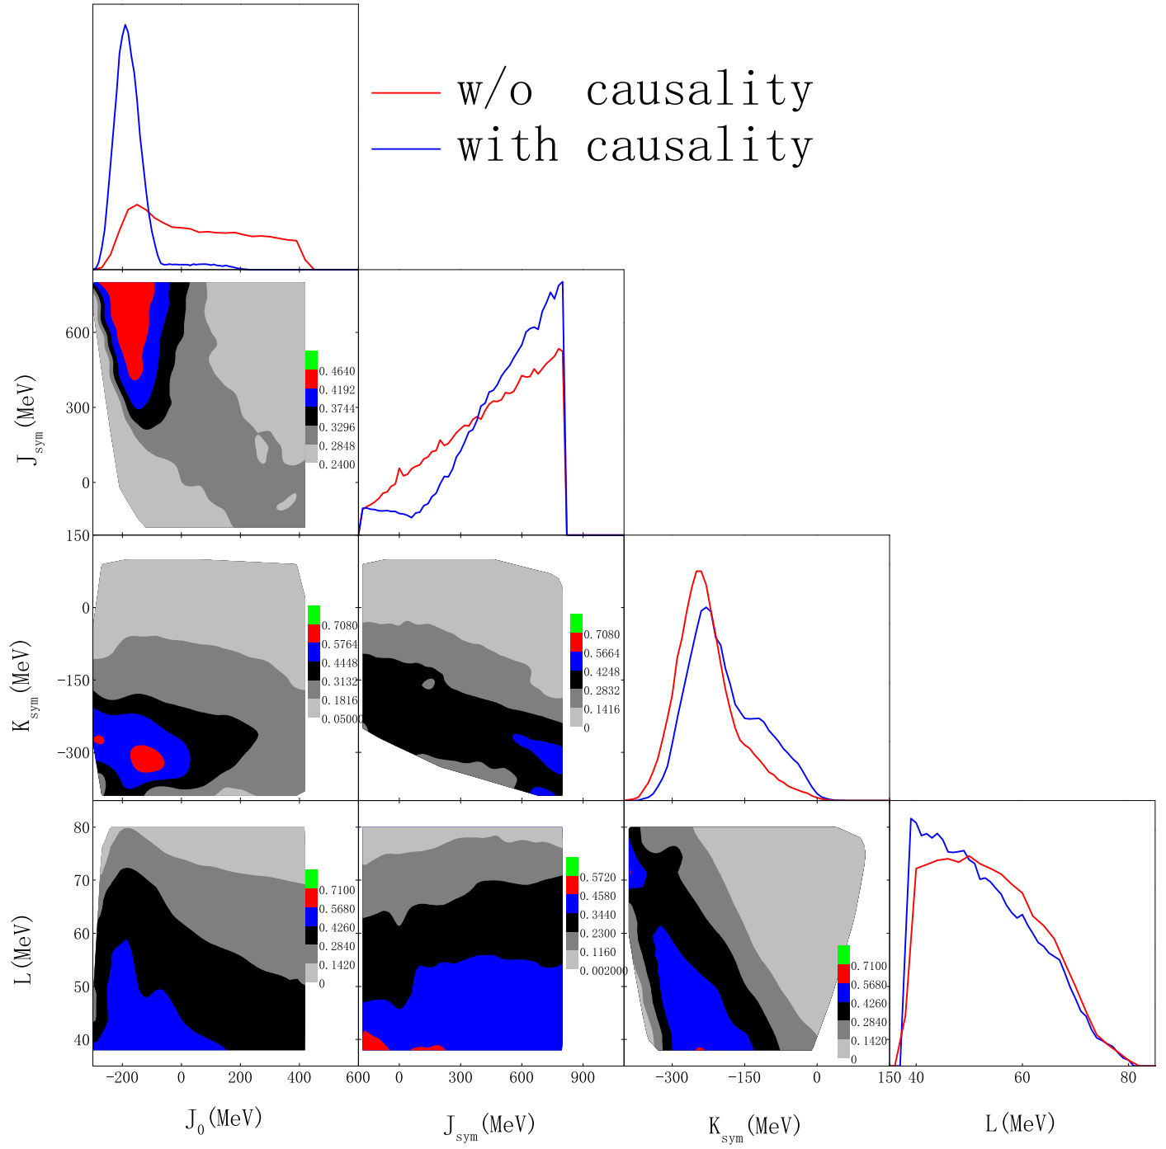
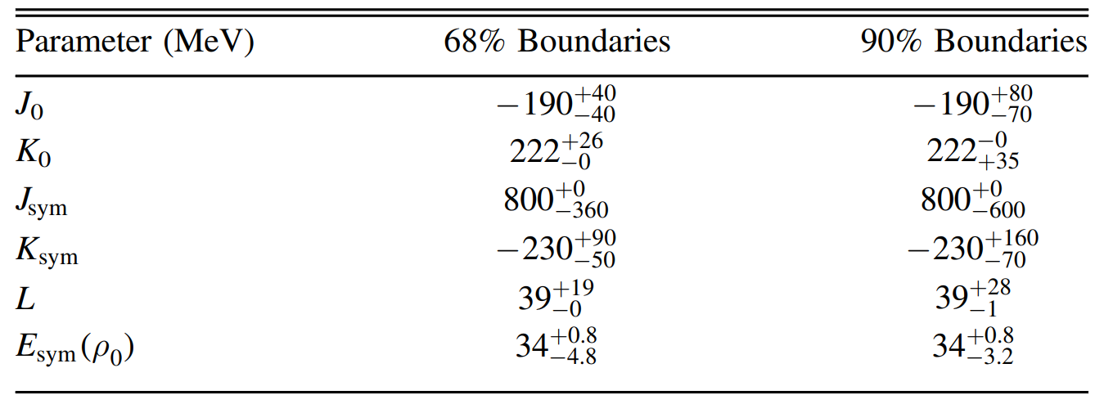
Bayesian analysis
Xie & Li APJ 883, 174 (2019)

Slide 16
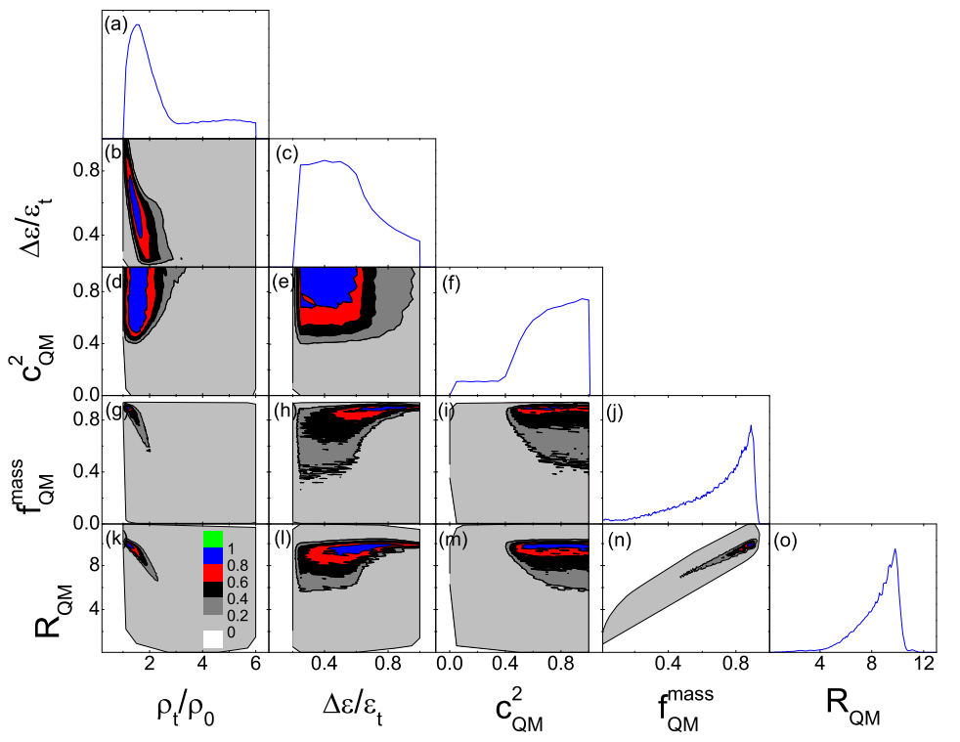
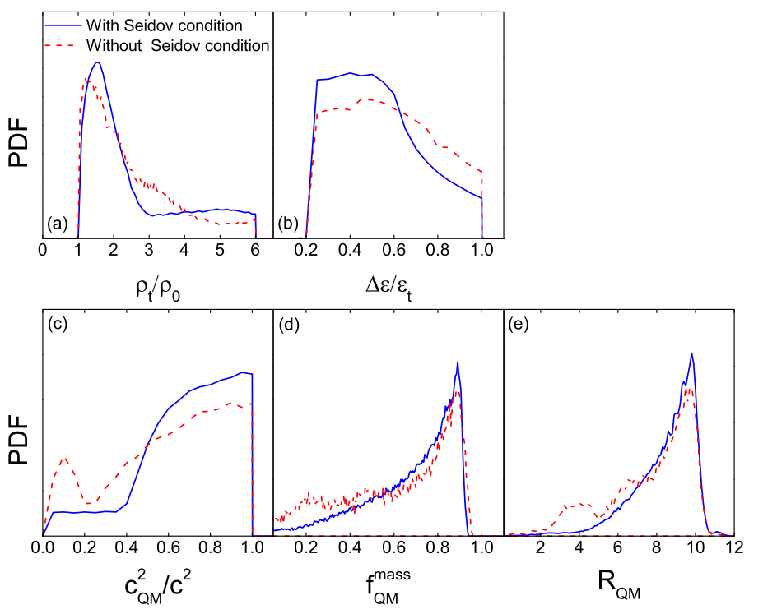
Bayesian analysis
Xie & Li PRC 103, 035802 (2021)

Slide 17
Bayesian analysis
Directly reverse TOV
Bayesian analysis
Theoretical models
This approach provides a visual representation of the effects of each model parameter on the observables or the constraints on the model parameter space provided by the latter
Constrain?
Equation of state
(energy density as functions of pressure)
Structure equations
Steiner et al. 2010; Alvarez-Castillo et al. 2016; Özel et al. 2016; Raithel et al. 2017; Raaijmakers et al. 2018; Riley et al. 2018; Lim & Holt 2019; Greif et al. 2019; Miller et al. 2019; Landry & Essick 2019; Xie & Li 2019; Xie & Li 2020…
Neutron star observations

Slide 18
Theories VS observations
Binary neutron star merger
$Λ_{1.4}<427$ (68%)
Abbott et al. PRL 121, 161101 (2018)
Binary neutron star system
$$M_{max}<2.08±0.07 M_{⊙}$$
Fonseca et al. APJL 915, L12 (2021)
Observations of X-ray
$10.62≤R_{1.4}≤12.83$ km
Lattimer & Steiner EPJA 50, 40 (2014)

Slide 19
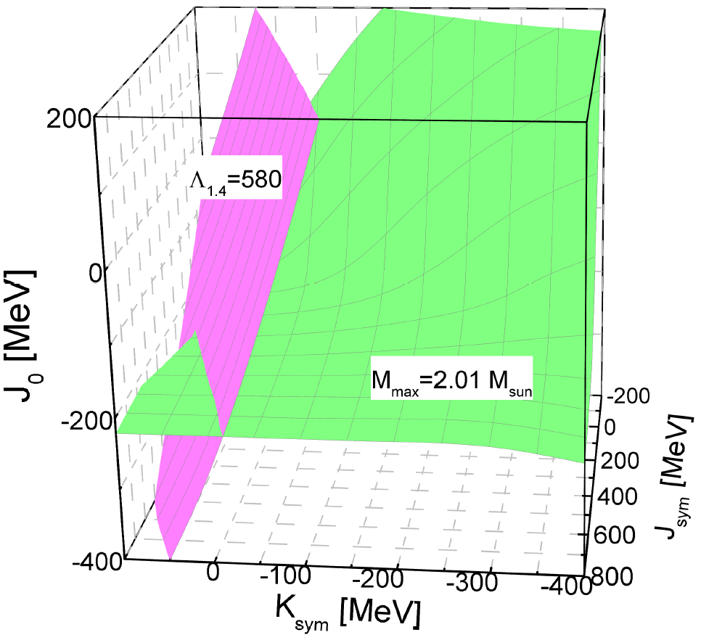
Inversion of observations
$$E_{0}\left(ρ\right)=E_{0}\left(ρ_{0}\right)+\frac{K_{0}}{2}(\frac{{ρ−ρ}_{0}}{3ρ_{0}})^{2}+\frac{J_{0}}{6}(\frac{{ρ−ρ}_{0}}{3ρ_{0}})^{3}$$
$$E_{sym}\left(ρ\right)=E_{sym}\left(ρ_{0}\right)+L (\frac{{ρ−ρ}_{0}}{3ρ_{0}})+\frac{K_{sym}}{2}(\frac{{ρ−ρ}_{0}}{3ρ_{0}})^{2}$$
$$+\frac{J_{sym}}{6}(\frac{{ρ−ρ}_{0}}{3ρ_{0}})^{3}$$
Fix K_{sym},
and J_{sym},
vary J₀
TOV
Observation
Mass, radius……

Slide 20
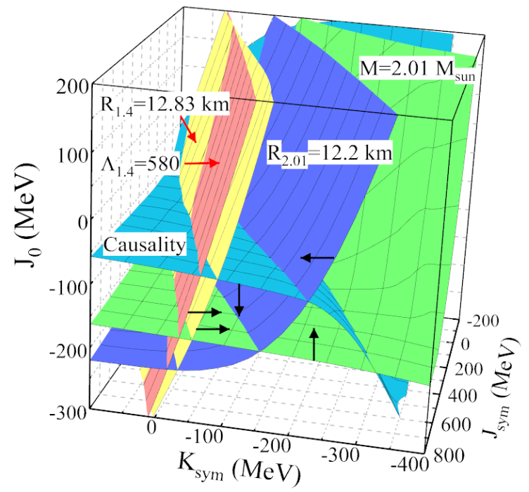
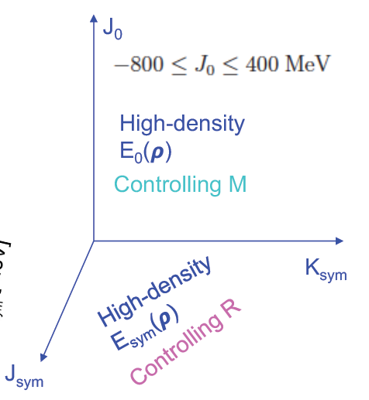
Observational constraints
M=2.14 $M_{sun}$
$$E\left(ρ,δ\right)≈E_{0}\left(ρ\right)+E_{sym}\left(ρ\right)δ^{2}$$
$$E_{0}\left(ρ\right)=E_{0}\left(ρ_{0}\right)+\frac{K_{0}}{2}(\frac{{ρ−ρ}_{0}}{3ρ_{0}})^{2}+\frac{J_{0}}{6}(\frac{{ρ−ρ}_{0}}{3ρ_{0}})^{3}$$
$$E_{sym}\left(ρ\right)=E_{sym}\left(ρ_{0}\right)+L (\frac{{ρ−ρ}_{0}}{3ρ_{0}})+\frac{K_{sym}}{2}(\frac{{ρ−ρ}_{0}}{3ρ_{0}})^{2}+\frac{J_{sym}}{6}(\frac{{ρ−ρ}_{0}}{3ρ_{0}})^{3}$$
Li et al. Universe 7, 182 (2021)

Slide 21
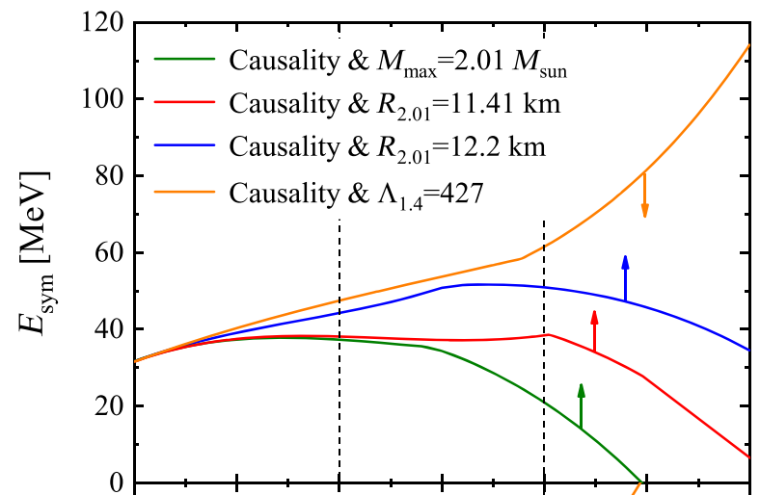
Observational constraints
Upper limit from GW170817
Lower limits from PSR J0740+6620
Miller’s lower limit
Riley’s lower limit
M=2.01 $M_{sun}$only
NBZ & Li APJ 921, 111 (2021)

Slide 22
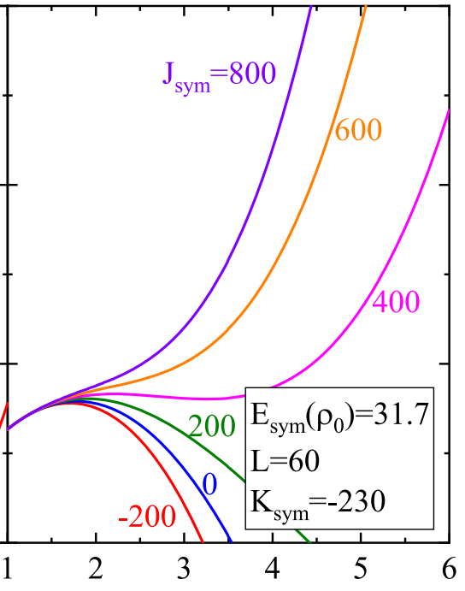
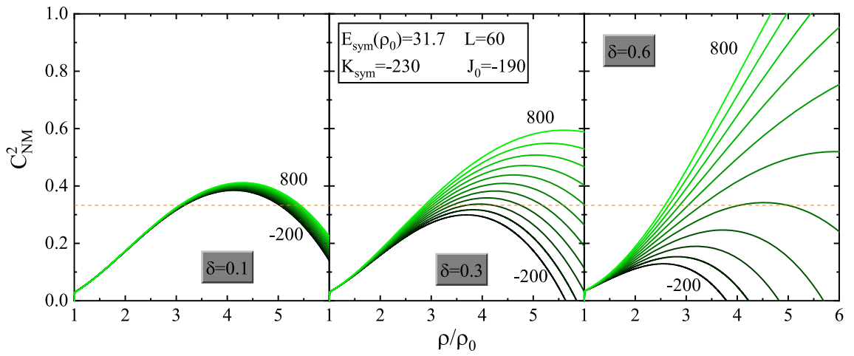
Sound speed
Adiabatic
Equilibrium
$$C_{NM}^{2}={\left(\frac{∂P}{∂ε}\right)}_{δ}$$
$$C_{s}^{2}=\frac{dP}{dε}$$
Relevant for
heavy-ion
reactions
Relevant for
neutron stars at
$β$-equilibrium
NBZ & Li EPJA 59, 86 (2023)

Slide 23
Adiabatic sound speed
$$C_{NM}^{2}={\left(\frac{∂P}{∂ε}\right)}_{δ}$$
Adiabatic
NBZ & Li EPJA 59, 86 (2023)

Slide 24
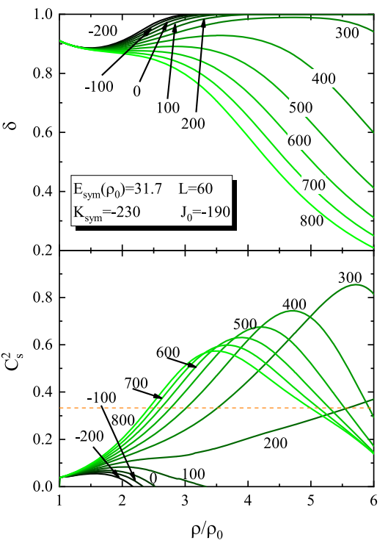
Equilibrium sound speed
$$C_{s}^{2}=\frac{dP}{dε}$$
Equilibrium
$$ε_{b}\left(ρ,δ\right)=ρE\left(ρ,δ\right)+ρM_{N}$$
$$E\left(ρ,δ\right)≈E_{0}\left(ρ\right)+E_{sym}\left(ρ\right)δ^{2}$$
NBZ & Li EPJA 59, 86 (2023)

Slide 25
Equilibrium sound speed
$$C_{s}^{2}=\frac{dP}{dε}$$
Equilibrium
$$ε_{b}\left(ρ,δ\right)=ρE\left(ρ,δ\right)+ρM_{N}$$
$$E\left(ρ,δ\right)≈E_{0}\left(ρ\right)+E_{sym}\left(ρ\right)δ^{2}$$
Stiff $E_{sym}$
NBZ & Li EPJA 59, 86 (2023)

Slide 26
Equilibrium sound speed
$$C_{s}^{2}=\frac{dP}{dε}$$
Equilibrium
$$ε_{b}\left(ρ,δ\right)=ρE\left(ρ,δ\right)+ρM_{N}$$
$$E\left(ρ,δ\right)≈E_{0}\left(ρ\right)+E_{sym}\left(ρ\right)δ^{2}$$
Soft $E_{sym}$
NBZ & Li EPJA 59, 86 (2023)

Slide 27
Properties of hybrid star
The constant speed of sound is used to simulate the EOS of quark matter
All the hadronic Equation of State parameters are fixed at their currently known most probable values.
Any EOSs selected in this work should satisfy: $M_{max}>2.01 M_{⊙}$, $R_{2.01}>11.41$ km or $R_{2.01}>12.2$ km, and $Λ_{1.4}<427$.
Alford et al. PRD 88, 083013 (2013); Chamel et al., A&A 553, A22 (2013); Zdunik & Haensel A&A 551, A61 (2013)
Miller et al. APJL 918, 28 (2021); Riley et al. APJL 918, L27 (2021); Abbott et al. PRL 121, 161101 (2018)

Slide 28
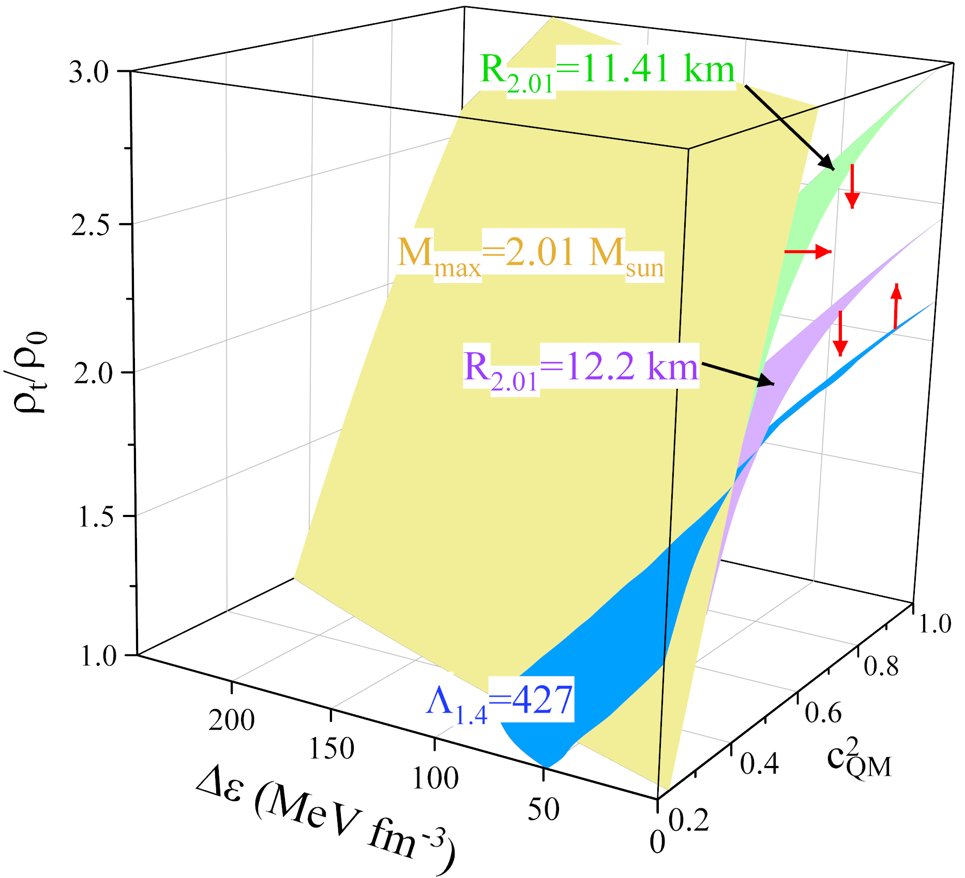
Properties of hybrid star
The surfaces of $M_{max}=2.01M_{⊙}$, $R_{2.01}>11.41$ km and $R_{2.01}>12.2$ km converge at the front bottom corner.
The $Λ_{1.4}<427$surface intersects with other surfaces as $ρ_{t}/ρ_{0}$and $c_{QM}^{2}$ increase.
The enclosed parameter space can satisfy all observational constraints or physical conditions considered.
NBZ & Li PRC 108, 025803 (2023)

Slide 29
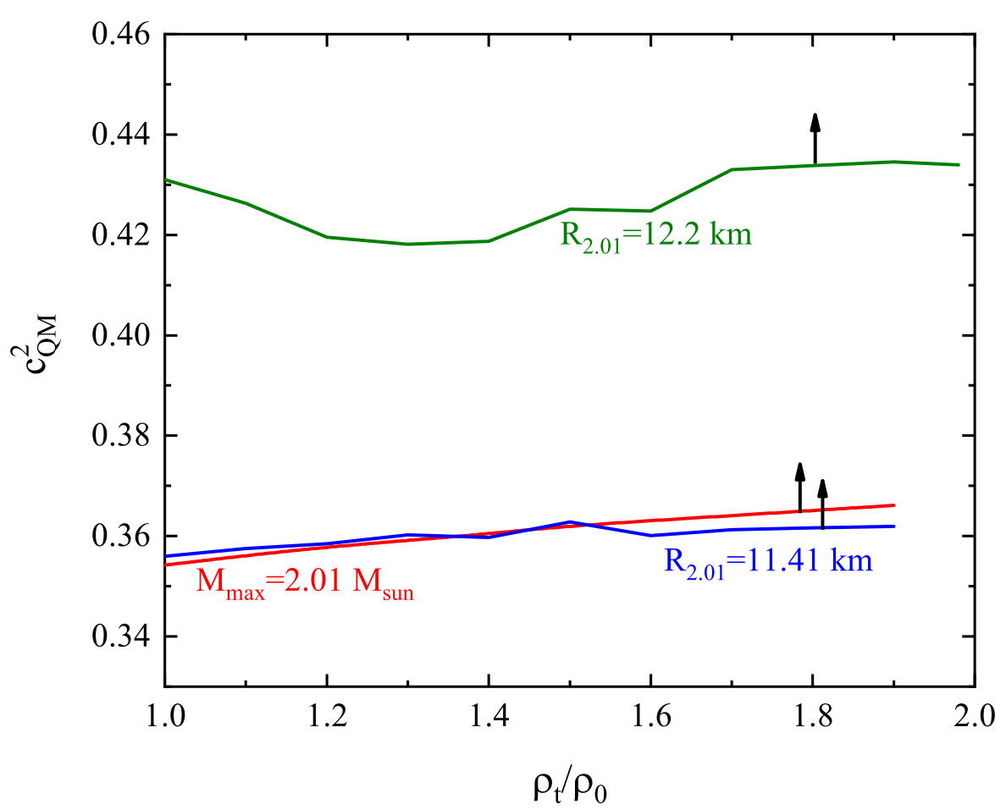
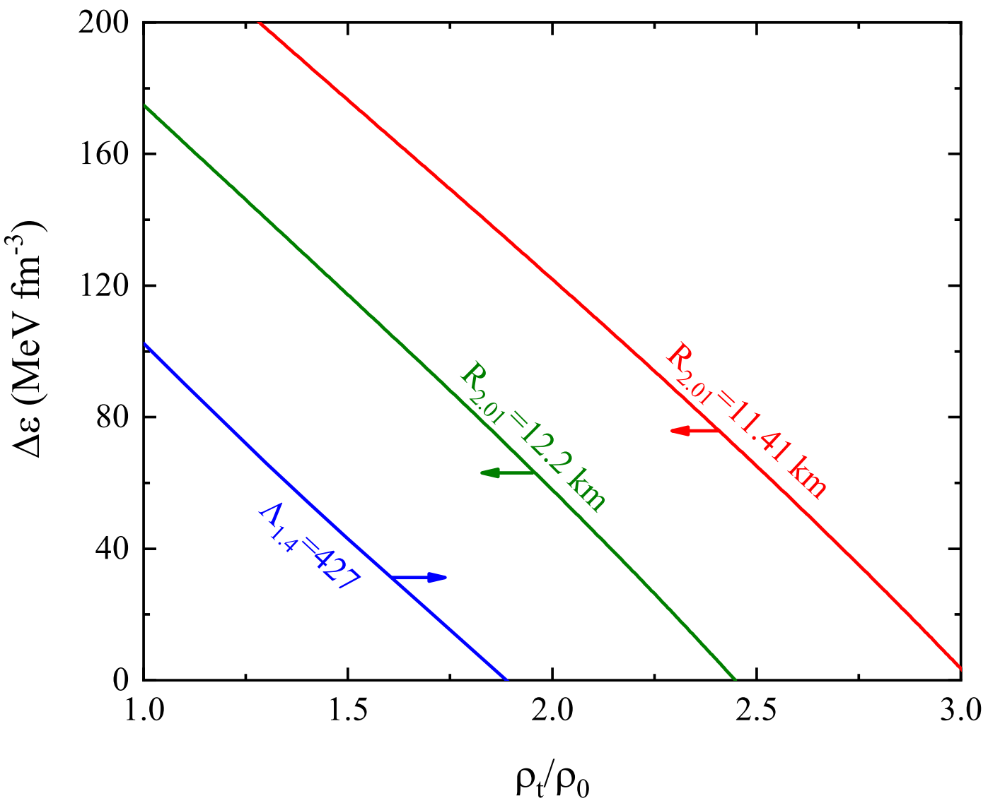
Properties of hybrid star
$c_{QM}^{2}$is found to have a lower limit of 0.35 and 0.43, respectively.
The upper limits of $ρ_{t}=ρ_{0}$ and $∆ε$ are found to be 3.03 (2.45) and 231 (175) MeV $fm^{−3}$.
NBZ & Li PRC 108, 025803 (2023)

Slide 30
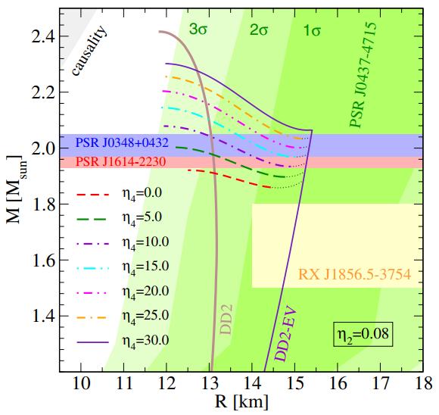
Twin star
Twin star: two stars have the same mass, but different radii.
$∆ε=350$ MeV ${\text{fm}}^{−3}$ is the lowest value that generates a visible difference between the hadronic maximum and the hybrid star minimum of about 0.1 $M_{⊙}$.
Christian & Schaffner-Bielich APJL 894, L8 (2020)
Benić et al. A&A 577, A40 (2015)

Slide 31
Twin star
Twin star: two stars have the same mass, but different radii.
$∆ε=350$ MeV ${\text{fm}}^{−3}$ is the lowest value that generates a visible difference between the hadronic maximum and the hybrid star minimum of about 0.1 $M_{⊙}$.
Christian & Schaffner-Bielich APJL 894, L8 (2020)

Slide 32
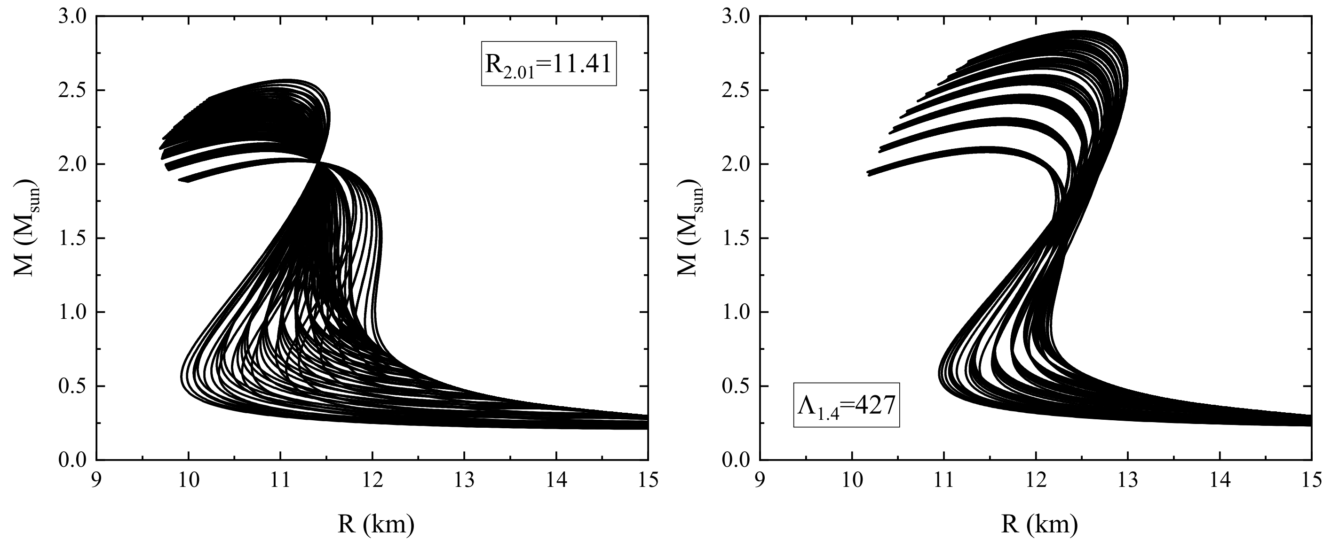
Twin star
No twin stars can be observed within the parameter space constrained by the observations selected in the present work and thus the presence of twin star is disfavored.
NBZ & Li PRC 108, 025803 (2023)

Slide 33
Conclusions
Based on the observations of neutron star, we constrain the properties of a parameterized EOS describing nuclear matter and the properties of first-order hadron-quark phase transition;

Slide 34
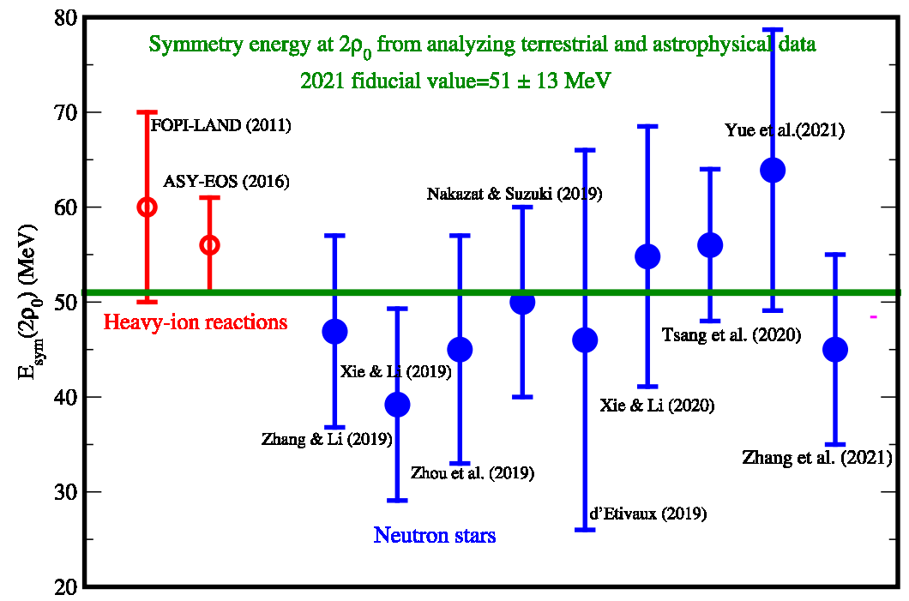
Conclusions
Key question: As the most uncertain part of EOS, how to constrain the symmetry energy, especially at 2-3 $ρ_{0}$?

Slide 35
Thanks For Your Attention!

