Slide 1
NuSym23: XIth International Symposium on Nuclear Symmetry Energy
Darmstadt (Germany), 18-22 September 2023, GSI Helmholtz Centre for Heavy-Ion Research GmbH
Nuclear matter and neutron stars from the relativistic
Brueckner-Hartree-Fock theory in the full Dirac space
Sibo Wang (王锶博)
Department of Physics, Chongqing University, China sbwang@cqu.edu.cn
Collaborators: Hui Tong, Xiaoying Qu, Chencan Wang, Qiang Zhao, Peter Ring, Jie Meng

Slide 2
Content
Introduction
Relativistic Brueckner-Hartree-Fock theory
Nuclear matter properties
Neutron star properties
Summary

Slide 3
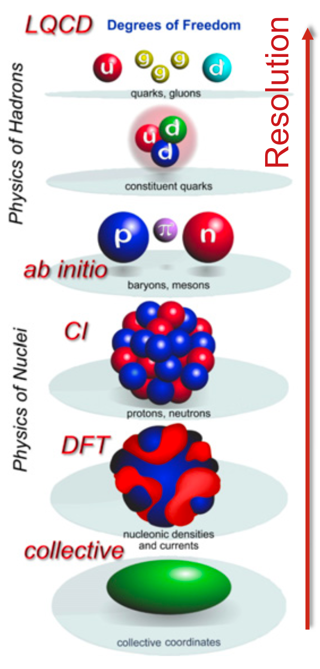
Many-body calculation from realistic NN interaction
Realistic Inter.
AV18, CD-Bonn,
$χ$EFT, LQCD…
Many-body System
Nuclear Matter
& Finite Nuclei
Empirical values
& Experimental data
Many-body app.
NCSM, CC, QMC,
IM-SRG, BBG, NLEFT…
W. Nazarewicz JPG 43, 044002 (2016)

Slide 4
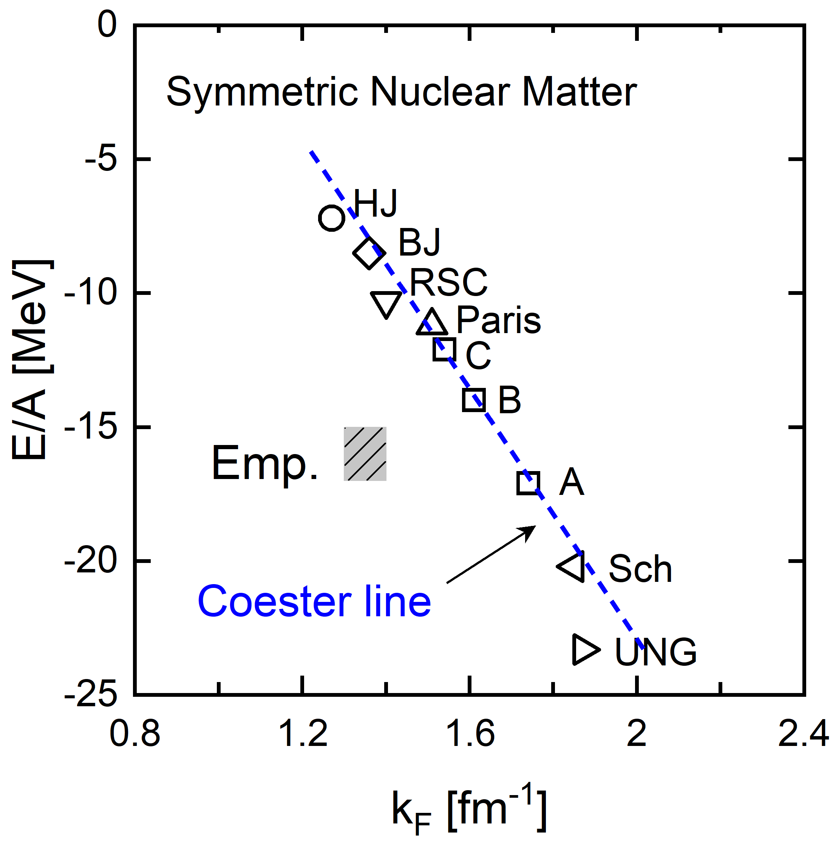
Brueckner-Bethe-Goldstone theory
Brueckner-Bethe-Goldstone (BBG) theory is an important many-body approach
Day, RMP 39, 719 (1967), Baldo and Maieron, JPG 34, R243 (2007), Shen et al., PPNP 109, 103713 (2019)
Sum up ladder diagrams to infinity
Truncate at two hole-line level
$→$Brueckner-Hartree-Fock (BHF) theory
BHF$+NN$ ✗ $→$ BHF$+3NF$

Slide 5
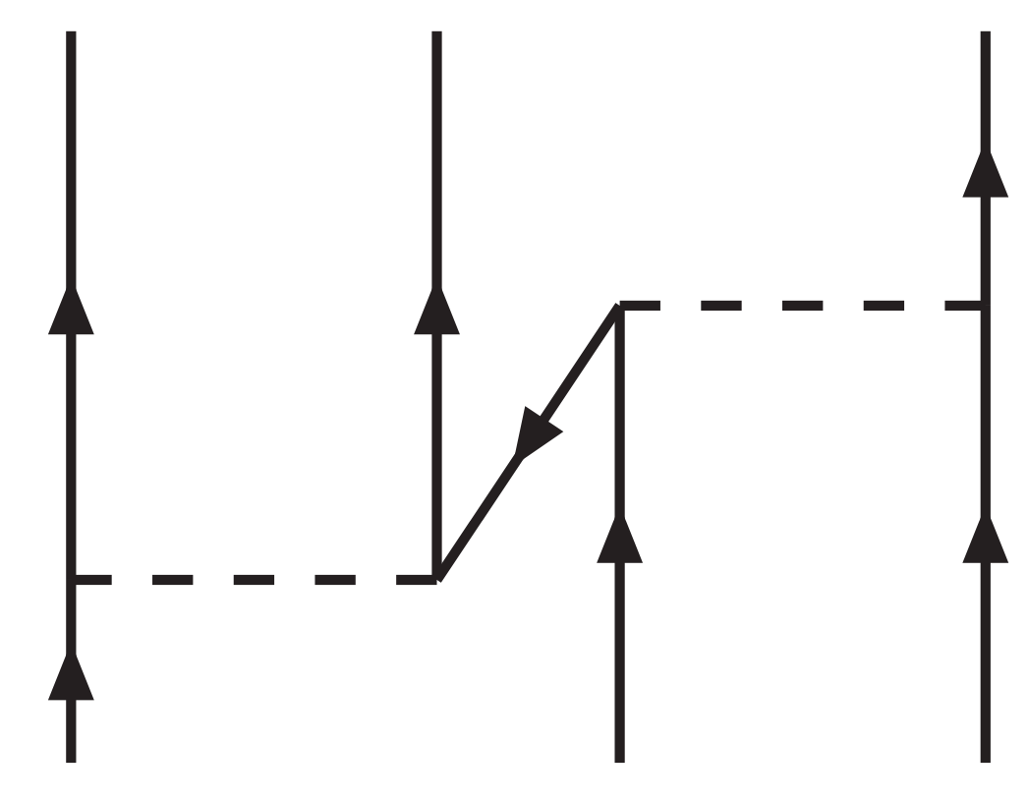
Relativistic effects in nuclear matter saturation
Extension to Relativistic BHF theory
Relativistic effects vs 3NF
Three-nucleon force due to virtual
nucleon-antinucleon excitation ($Z$-diagram)
Sammarruca et al., PRC 86, 054317 (2012)
BHF$+NN$ ✗ $→$ RBHF$+NN$ ✓
Brockmann and Machleidt, PRC 42, 1965 (1990)

Slide 6
Neglection of negative-energy states in the literature
Problem for RBHF theory with neglection of negative-energy states
Ambiguities due to additional approximations
Ruins of predictive power as an ab initio method
Momentum-independence approximation PRC 42, 1965 (1990)
Projection NPA 648, 105 (1999)

Slide 7
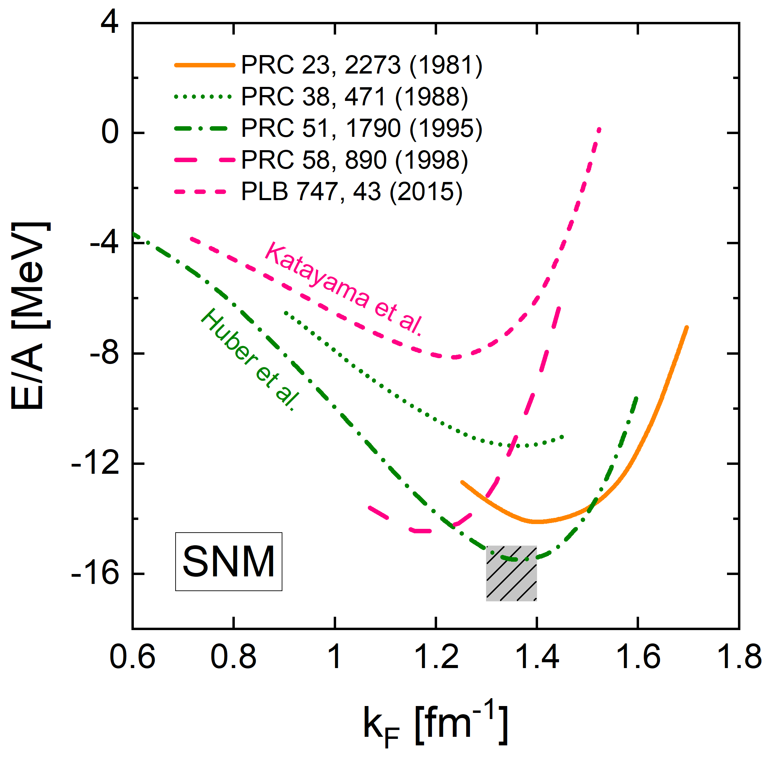
The RBHF theory in the full Dirac space
Self-consistent solution in the full Dirac space has been missed for 40 years
Perturbation theory
HEA: Anastasio et al., PRC 23, 2273 (1981)
Green’s Function method
Ho2: Poschenrieder et al., PRC 38, 471 (1988)
Bonn A: Huber et al., PRC 51, 1790 (1995)
Attempts in RBHF calculation
Gross OBEP: Jong et al., PRC 58, 890 (1998)
Bonn A: Katayama et al., PLB 747, 43 (2015)
$→$ in this work: self-consistent solution of the RBHF theory in the full Dirac space

Slide 8
Content
Introduction
Relativistic Brueckner-Hartree-Fock theory
Nuclear matter properties
Neutron star properties
Summary

Slide 9
Dirac equation in nuclear matter
$$\left\{α⋅p+β[M+𝒰(p)]\right\} u\left(p,s\right)=E_{p}u(p,s)$$
Single-particle potential
$$𝒰\left(p\right)=U_{S}\left(p\right)+γ^{0}U_{0}\left(p\right)+γ⋅\hat{p}U_{V}\left(p\right)$$
scalar
timelike
spacelike
$$[α⋅p^{∗}+βM_{p}^{∗}]u\left(p,s\right)=E_{p}^{∗}u(p,s)$$
Effective quantities
$$M_{p}^{∗}=M+U_{S},{ p}^{∗}=p+{\hat{p}U}_{V}\left(p\right), { E}_{p}^{∗}=E_{p}−U_{0}(p)$$
$$u\left(p,s\right)=\sqrt{\left(E_{p}^{∗}+M_{p}^{∗}\right)/2M_{p}^{∗}} {\left[1, σ⋅p^{∗}/\left(E_{p}^{∗}+M_{p}^{∗}\right)\right]}^{T}χ_{s}$$
Positive-energy
Negative-energy
$$v\left(p,s\right)=γ^{5}u(p,s)$$
$$\sum_{s}{u\left(p,s\right) \overline{u}\left(p,s\right)−v\left(p,s\right) \overline{v}\left(p,s\right)}=1_{4×4}$$

Slide 10
Extract the single-particle potentials
Nucleon-nucleon scattering Thompson equation in the nuclear medium
$$\left[\begin{aligned}G^{++++} \\ G^{−+++}\end{aligned}\right]\left(q^{′},q | P,W\right)=\left[\begin{aligned}V^{++++} \\ V^{−+++}\end{aligned}\right]\left(q^{′},q | P\right)$$
$$+\int{\frac{d^{3}k}{{\left(2π\right)}^{3}}}\left[\begin{aligned}V^{++++}, 0 \\ V^{−+++}, 0\end{aligned}\right]\left(q^{′},k | P\right)\frac{Q\left(k,P\right)}{W−E_{P+k}−E_{P−k}}\left[\begin{aligned}G^{++++} \\ G^{−+++}\end{aligned}\right]\left(k,q | P,W\right)$$
Matrix elements of the single-particle potential operator
$$Σ^{hh^{′}}\left(p\right)=⟨\overline{h}|𝒰\left(p\right)|h′⟩=\int{\frac{d^{3}p^{′}}{{\left(2π\right)}^{3}}}\frac{M_{p^{′}}^{∗}}{E_{p^{′}}^{∗}}{\overline{G}}^{h+h^{′}+}(q,q|P,W), h,h^{′}=+,−$$
Scalar and vector components of single-particle potential
$U_{S}\left(p\right)=\frac{Σ^{++}\left(p\right)−Σ^{−−}\left(p\right)}{2}$
$U_{0}\left(p\right)=\frac{E_{p}^{∗}}{M_{p}^{∗}}$ $\frac{Σ^{++}\left(p\right)+Σ^{−−}\left(p\right)}{2}−\frac{p^{∗}}{M_{p}^{∗}}Σ^{−+}\left(p\right)$
$U_{V}\left(p\right)=−\frac{p^{∗}}{M_{p}^{∗}}$ $\frac{Σ^{++}\left(p\right)+Σ^{−−}\left(p\right)}{2}+\frac{E_{p}^{∗}}{M_{p}^{∗}}Σ^{−+}(p)$
No ambiguities!

Slide 11
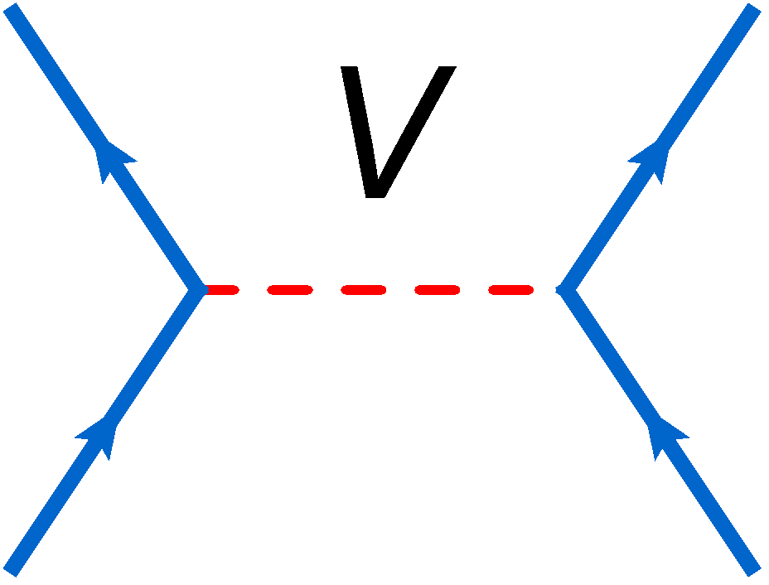
Difficulties when considering negative-energy states
One: calculation of NN matrix elements
Two: solution of Thompson equation
Only positive
$$G^{++++}=V^{++++}$$
$$V^{++++}=$$
$$η$$
$$π$$
$$+ V^{++++}\left(\frac{Q}{e}\right)G^{++++}$$
$$σ$$
$$δ$$
$$ω$$
$$ρ$$
Full Dirac space
$$\left[\begin{aligned}G^{++++} \\ G^{−+++}\end{aligned}\right]=\left[\begin{aligned}V^{++++} \\ V^{−+++}\end{aligned}\right]+\left[\begin{aligned}V^{++++}, 0 \\ V^{−+++}, 0\end{aligned}\right]\frac{Q}{e}\left[\begin{aligned}G^{++++} \\ G^{−+++}\end{aligned}\right]$$
$$V^{++++}, V^{−+++},V^{++−+}$$
$$\left[\begin{aligned}G^{++−+} \\ G^{−+−+}\end{aligned}\right]=\left[\begin{aligned}V^{++−+} \\ V^{−+−+}\end{aligned}\right]+\left[\begin{aligned}V^{++++}, 0 \\ V^{−+++}, 0\end{aligned}\right]\frac{Q}{e}\left[\begin{aligned}G^{++−+} \\ G^{−+−+}\end{aligned}\right]$$
$$V^{−+−+}, V^{+++−},V^{−++−}$$
$$\left[\begin{aligned}G^{+++−} \\ G^{−++−}\end{aligned}\right]=\left[\begin{aligned}V^{+++−} \\ V^{−++−}\end{aligned}\right]+\left[\begin{aligned}V^{++++}, 0 \\ V^{−+++}, 0\end{aligned}\right]\frac{Q}{e}\left[\begin{aligned}G^{+++−} \\ G^{−++−}\end{aligned}\right]$$
Three: complexity for calculating $Σ^{−+}$ than $Σ^{++}$ Anastasio et al., PRC 23, 2273 (1981)

Slide 12
Nuclear matter bulk properties
Binding energy per nucleon
$$E/A(ρ,α)=\frac{1}{ρ}\sum_{s,τ}{\int_{0}^{k_{F}^{τ}}{\frac{d^{3}p}{{\left(2π\right)}^{3}}}\frac{M_{p,τ}^{∗}}{E_{p,τ}^{∗}}}\left\langle {\overline{u}}_{τ}\left(p,s\right)\left|γ⋅p+M\right|u_{τ}\left(p,s\right)\right\rangle −M$$
$$+\frac{1}{2ρ}\sum_{s,s^{′},τ,τ′}{\int_{0}^{k_{F}^{τ}}{\frac{d^{3}p}{{\left(2π\right)}^{3}}}\int_{0}^{k_{F}^{τ′}}{\frac{d^{3}p^{′}}{{\left(2π\right)}^{3}}}\frac{M_{p,τ}^{∗}}{E_{p,τ}^{∗}}}\frac{M_{p′,τ′}^{∗}}{E_{p′,τ′}^{∗}}$$
$×\left\langle {\overline{u}}_{τ}\left(p,s\right){\overline{u}}_{τ′}\left(p′,s′\right)\left|{\overline{G}}^{++++}(W)\right|u_{τ}\left(p,s\right)u_{τ′}\left(p′,s′\right)\right\rangle$
Saturation properties
$$E/A\left(ρ,α\right)=E/A\left(ρ,0\right)+E_{sym}\left(ρ\right)α^{2}+𝒪(4)$$
$$E/A\left(ρ,0\right)=E/A\left(ρ_{0},0\right)+\frac{K_{∞}}{2}{\left(\frac{ρ−ρ_{0}}{3ρ_{0}} \right)}^{2}+\frac{Q_{0}}{6}{\left(\frac{ρ−ρ_{0}}{3ρ_{0}} \right)}^{3}+𝒪(4)$$
$$E_{sym}\left(ρ\right)=E_{sym}\left(ρ_{0}\right)+L\left(\frac{ρ−ρ_{0}}{3ρ_{0}} \right)+\frac{K_{sym}}{2}{\left(\frac{ρ−ρ_{0}}{3ρ_{0}} \right)}^{2}+𝒪(3)$$

Slide 13
Content
Introduction
Relativistic Brueckner-Hartree-Fock theory
Nuclear matter properties
Neutron star properties
Summary

Slide 14
Unique determination of nuclear matter properties
Binding energy per nucleon and single-particle potentials in the full Dirac space
Wang, Zhao, Ring, and Meng, PRC 103, 054319 (2021), Wang, Tong, and Wang, PRC 105, 054309 (2022)
Bulk and single-particle potentials are determined uniquely in the full Dirac space

Slide 15
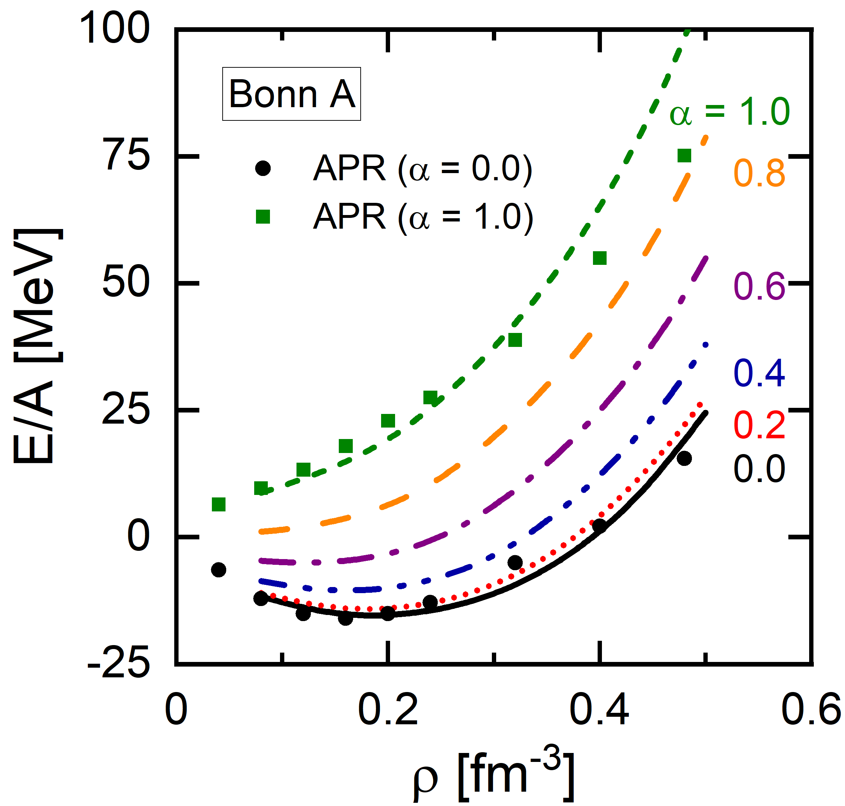
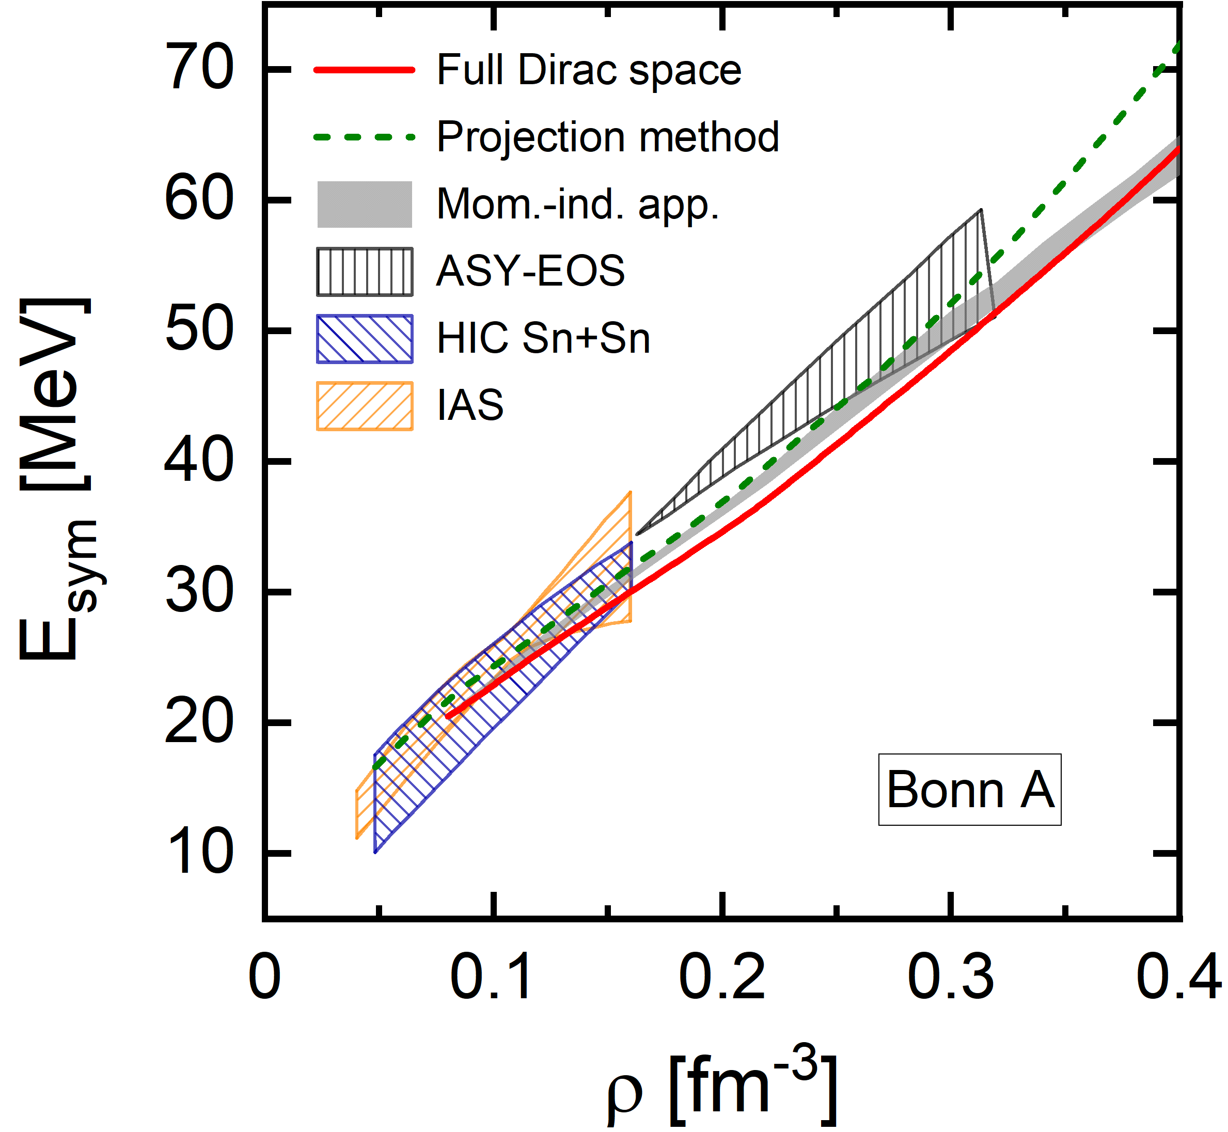
Nuclear matter saturation properties
Tong, Wang, and Wang, ApJ 930, 137 (2022)
Wang, Zhao, Ring, and Meng, PRC 103, 054319 (2021)
Saturation: $(0.188 fm^{−3}, −15.40 MeV)$
$(E_{sym}, L)=$ $(33.1 MeV, 65.2 MeV)$
Empiric: $(0.16±0.01 fm^{−3}, −16±1 MeV)$
Empiric: $(31.7±3.2 MeV, 58.7±28.1 MeV)$

Slide 16
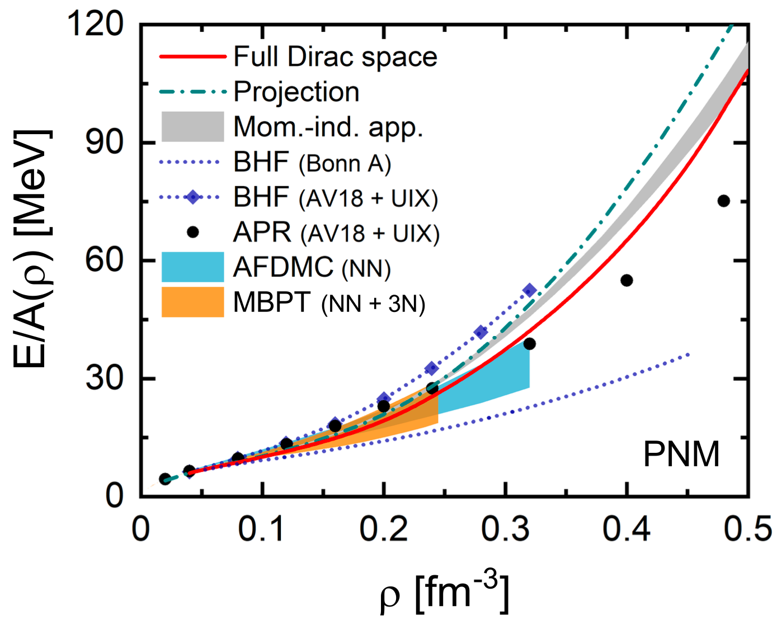
Benchmark calculation for pure neutron matter
Binding energy per nucleon obtained by the RBHF theory in the full Dirac space
Importance of full Dirac space
Repulsive relativistic effects
Uncertainty of AFDMC:
MC statistical & chiral expansion
Uncertainty of MBPT:
Many-body perturbation & chiral expansion & $Λ∼400−500 MeV$
$consistence for ρ≤0.3 {fm}^{−3}$
Qu, Tong, Wang, and Wang, Sci. China-Phys. Mech. Astron. 66, 242011 (2023)

Slide 17
Content
Introduction
Relativistic Brueckner-Hartree-Fock theory
Nuclear matter properties
Neutron star properties
Summary

Slide 18
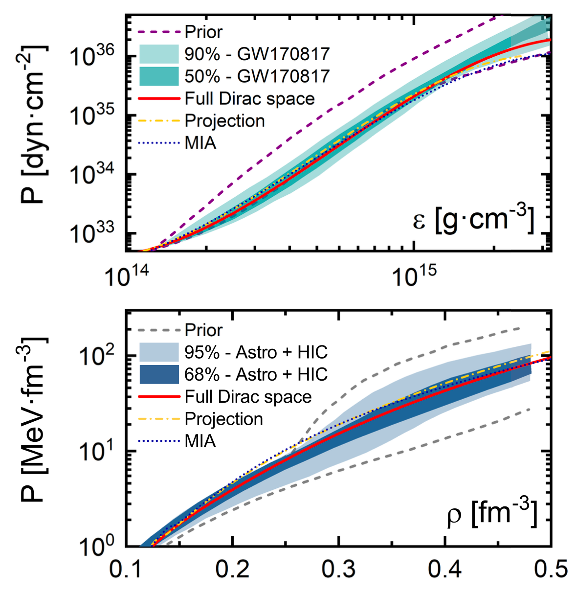
Equation of state for neutron star
Equation of state for neutron star calculated with RBHF theory in full Dirac space
Qu, Tong, Wang, and Wang, Sci. China-Phys. Mech. Astron. 66, 242011 (2023)
Band from Phys. Rev. Lett. 121, 161101 (2018)
Band from Huth, Nature 606, 276 (2022)
EOS：spectral parametrization
GW170817
Causality and thermodynamic stability
$M_{max}≥1.97M_{⊙}$
EOS: $χ$EFT + QMC + speed of sound
Astrophysical observations
HIC: FOPI + ASY-EOS
$M_{max}≥1.9M_{⊙}$

Slide 19
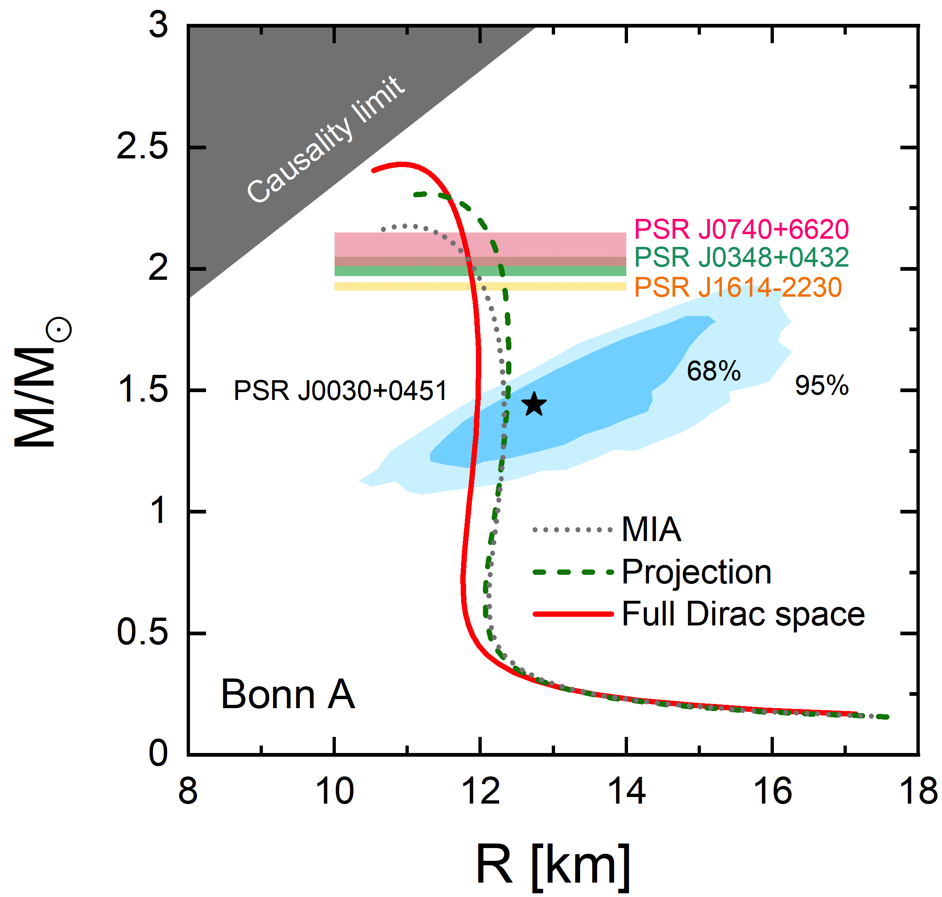
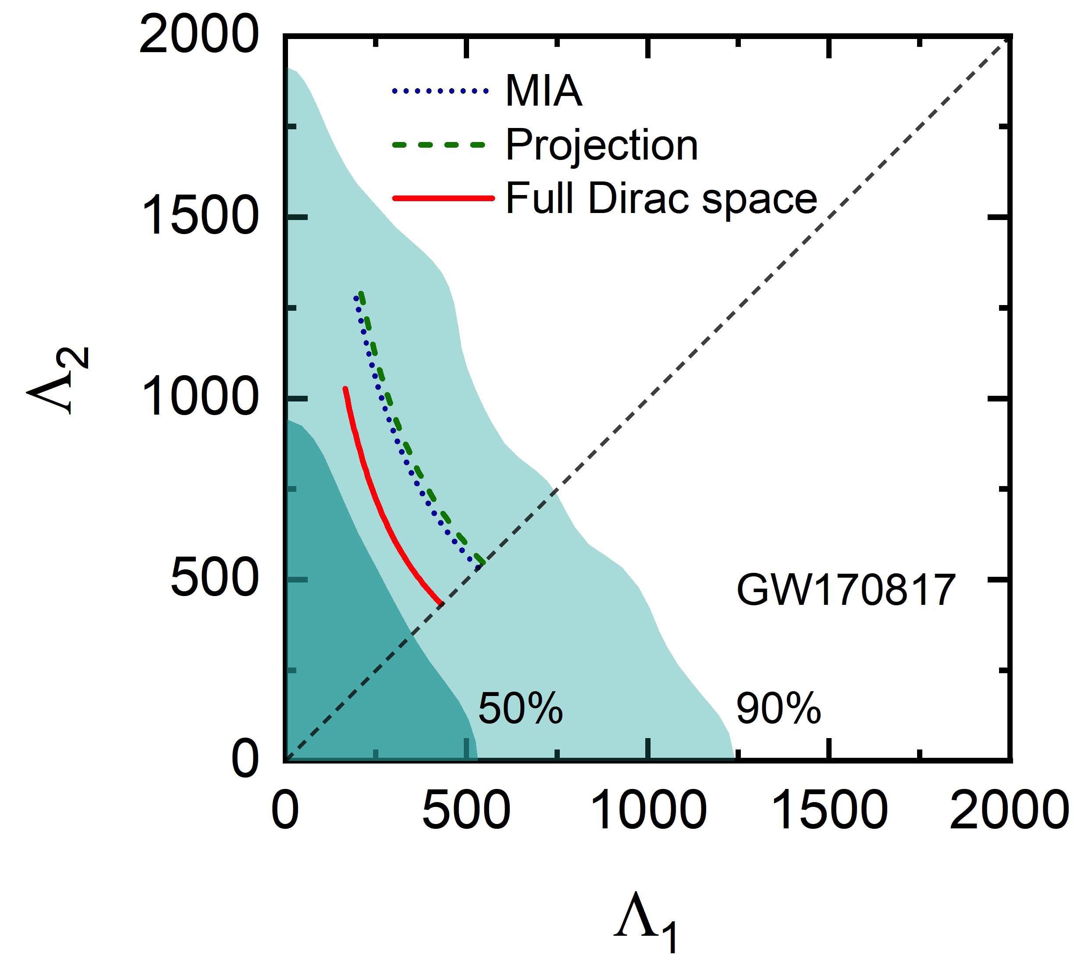
Neutron star mass-radius relation and tidal deformability
Mass, radius, and tidal deformability of neutron stars in the full Dirac space
$$R_{1.4⊙}=11.97 km, M_{max}=2.43 M_{⊙}, Λ_{1.4⊙}=376$$
Tong, Wang, and Wang, ApJ 930, 137 (2022)
Qu, Tong, Wang, and Wang, Sci. China-Phys. Mech. Astron. 66, 242011 (2023)

Slide 20
Summary
The self-consistent solution of the RBHF theory in the full Dirac space is achieved
Additional approximation in the literature is avoided
Nuclear matter properties (binding energy, symmetry energy)
$$ρ_{0}=0.188 fm^{−3}$$ | $$E/A\left(ρ_{0}\right)=−15.40 MeV$$
$$E_{sym}\left(ρ_{0}\right)= 33.1 MeV$$ | $$L = 65.2 MeV$$
Neutron star properties (mass, radius, tidal deformability)
$$R_{1.4⊙}=11.97 km$$ | $$M_{max}=2.43 M_{⊙}$$ | $$Λ_{1.4⊙}=376$$
Key question: How to improve current results: three-hole-line, relativistic chiral force

