Slide 1





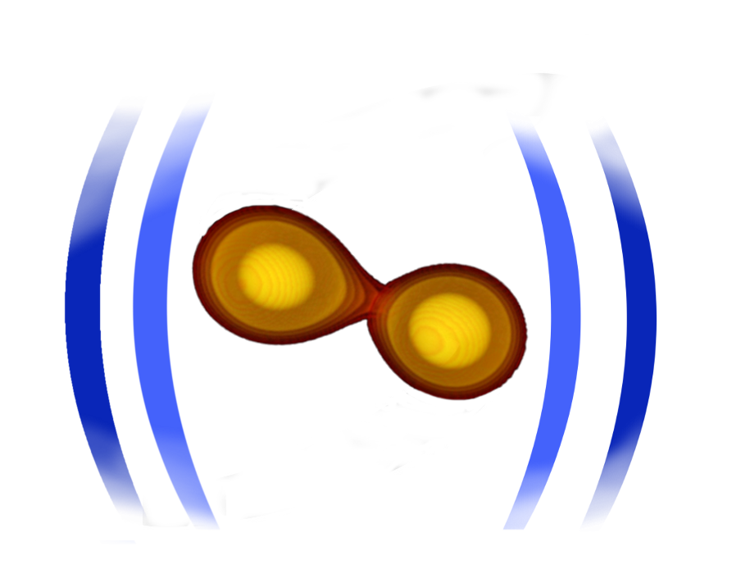





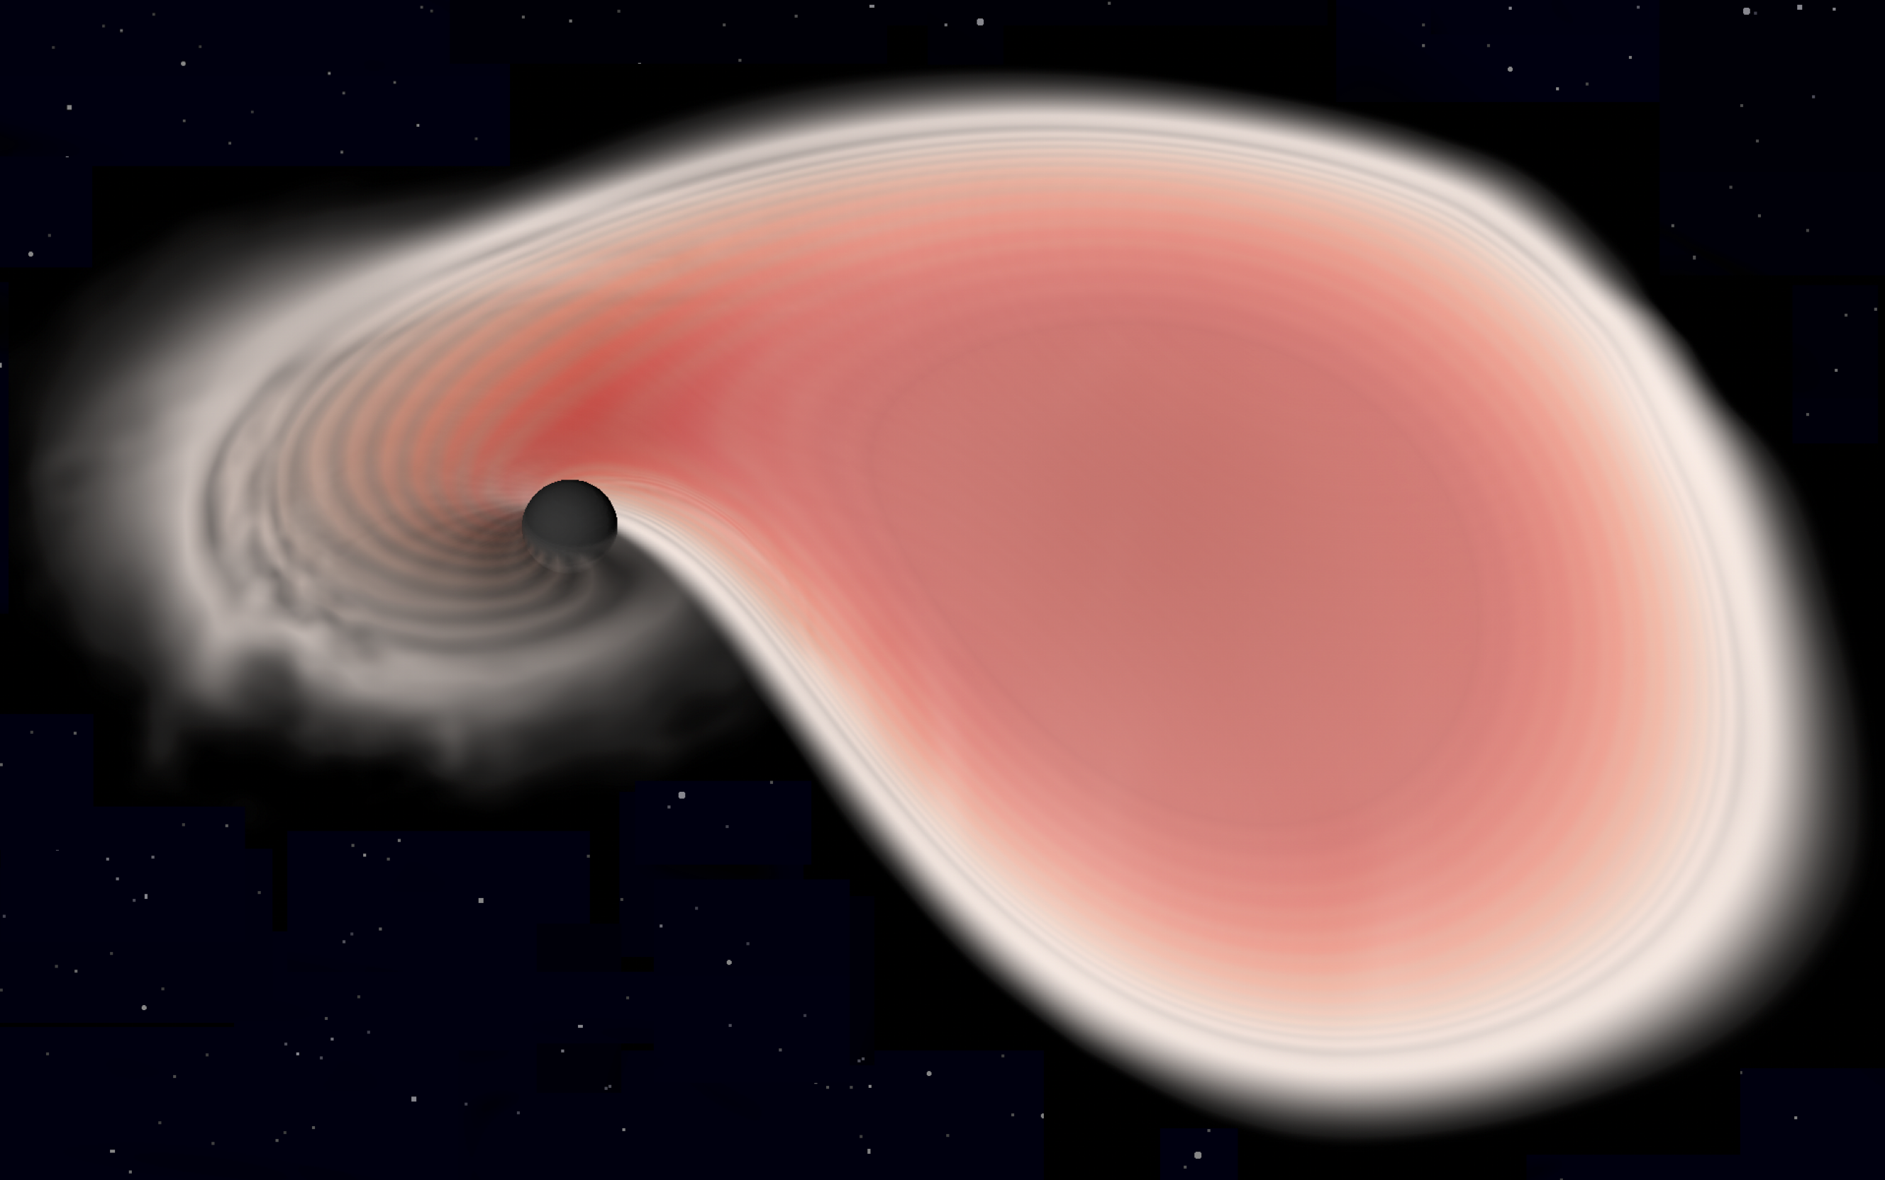
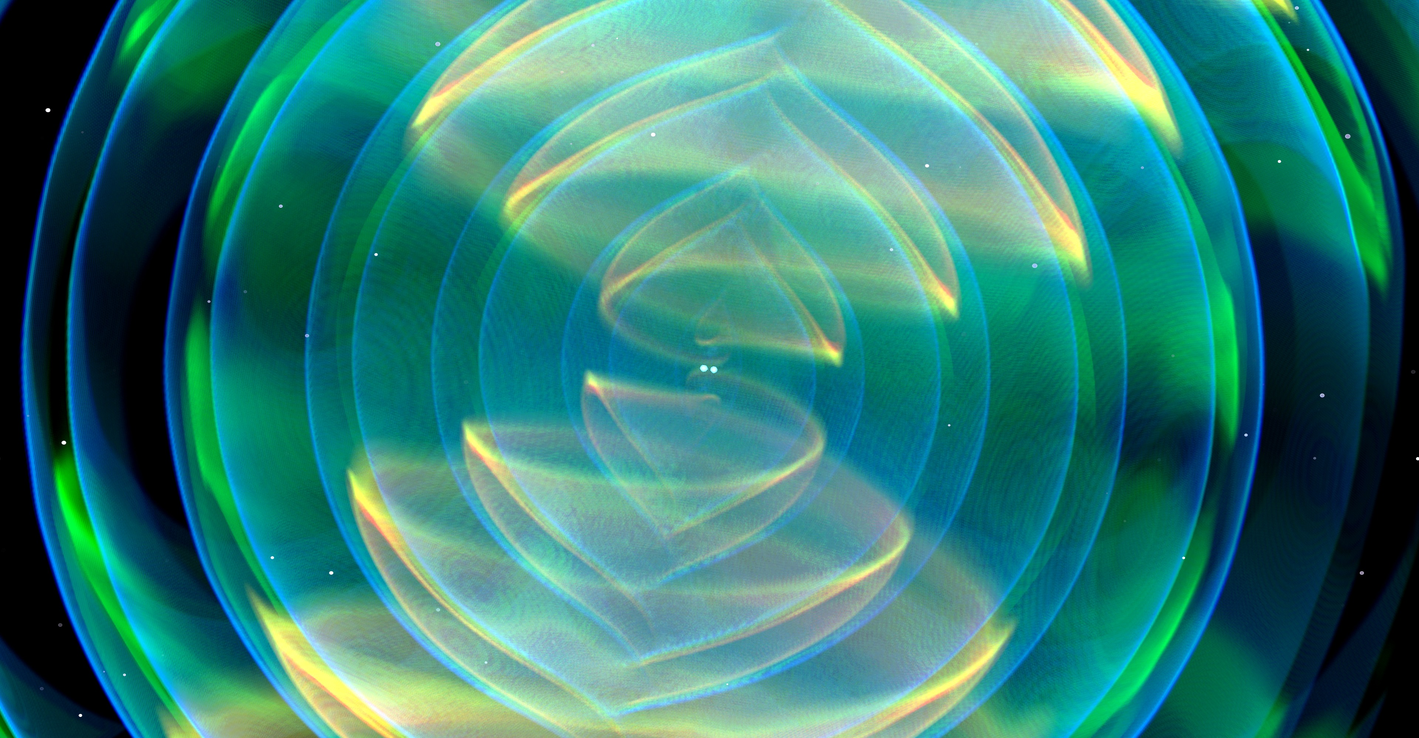
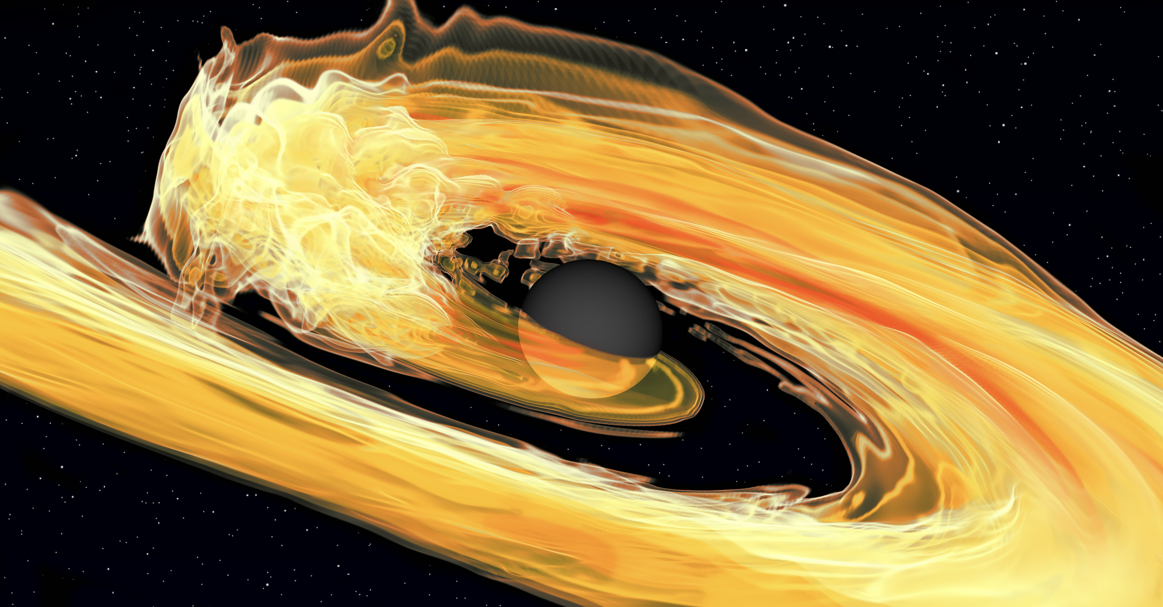
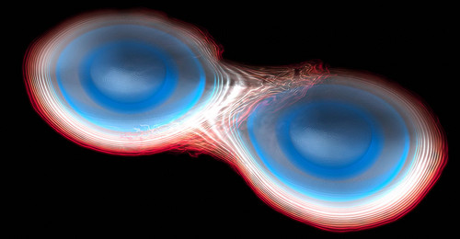
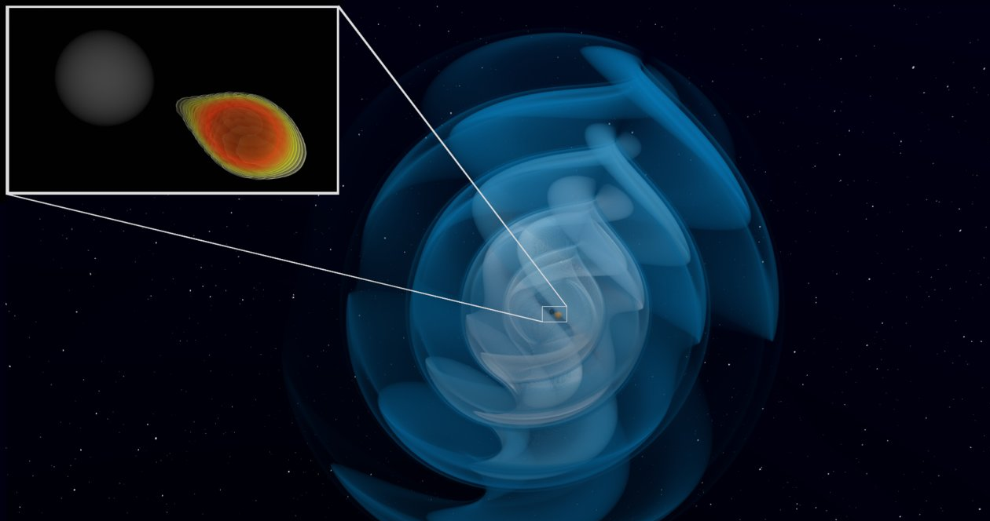
Combining nuclear physics and multi-messenger observations
Tim Dietrich
University of Potsdam
Max Planck Institute for Gravitational Physics
special thanks to Hauke Köhn
21th of September 2023

Slide 2
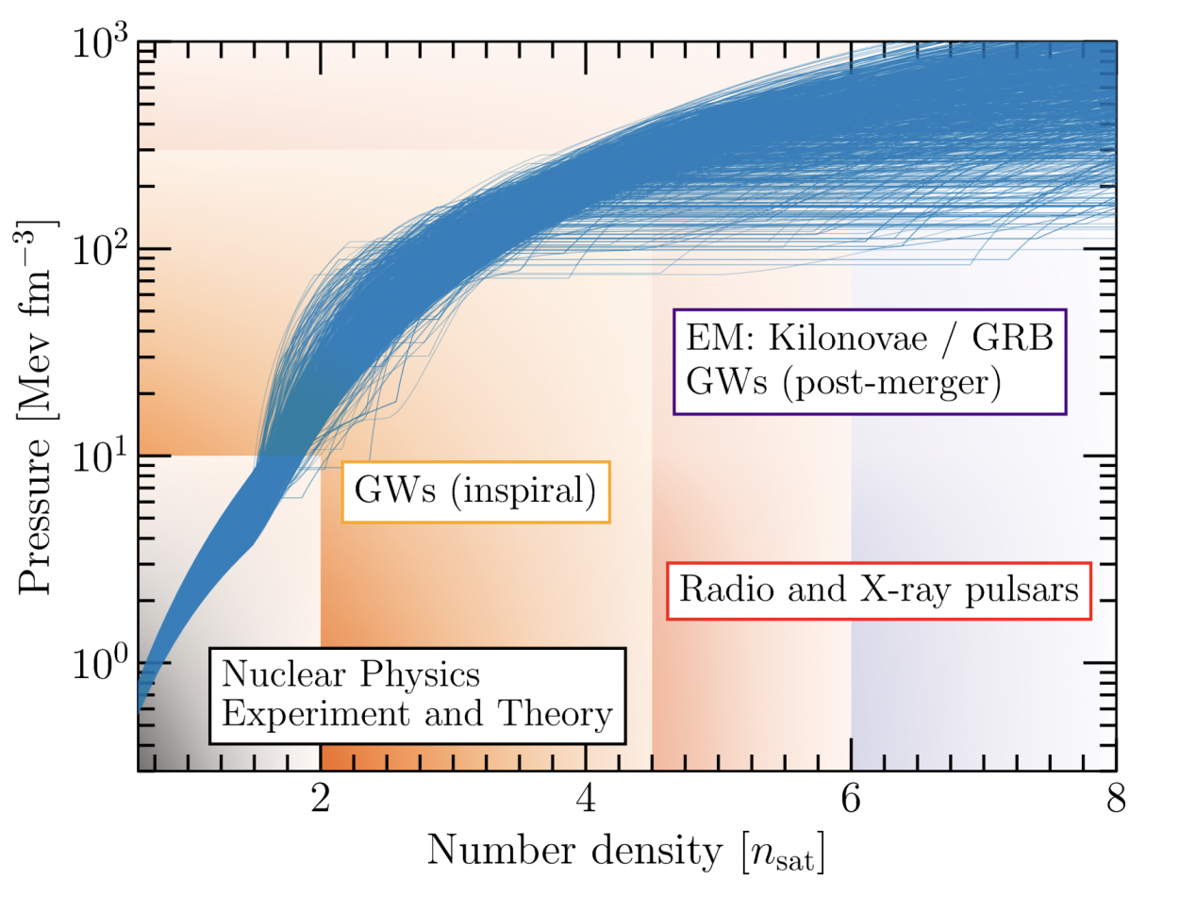
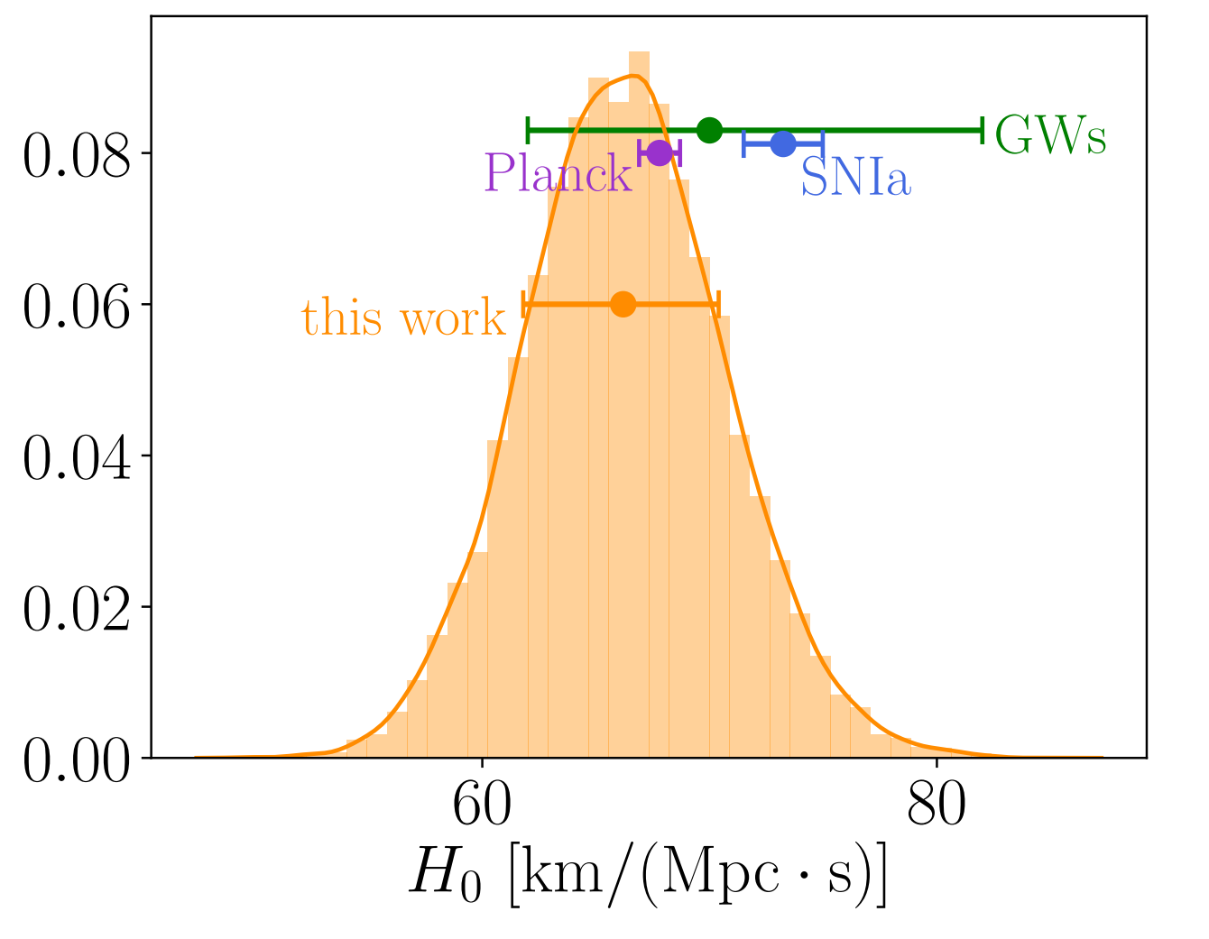
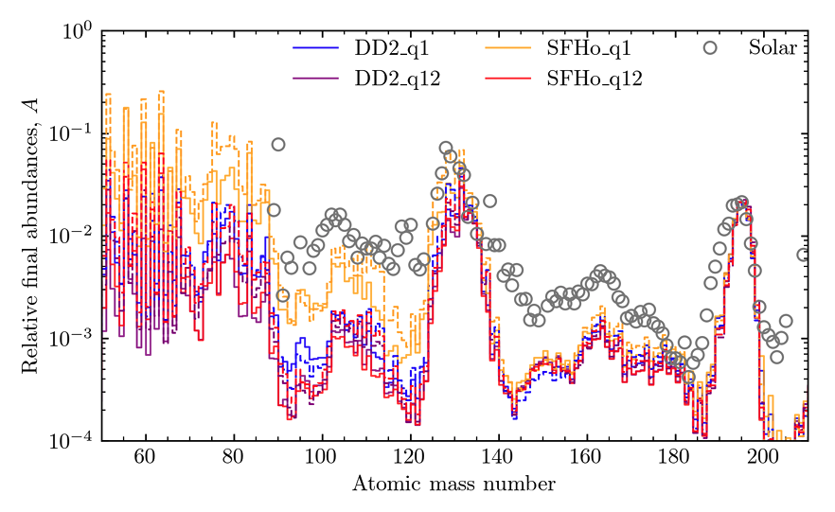
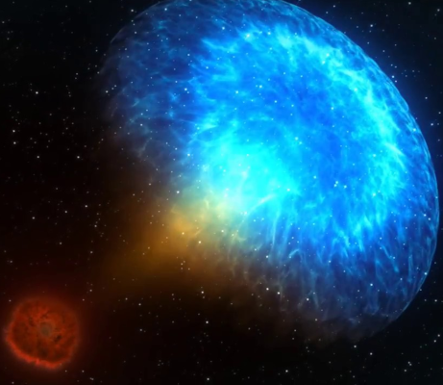





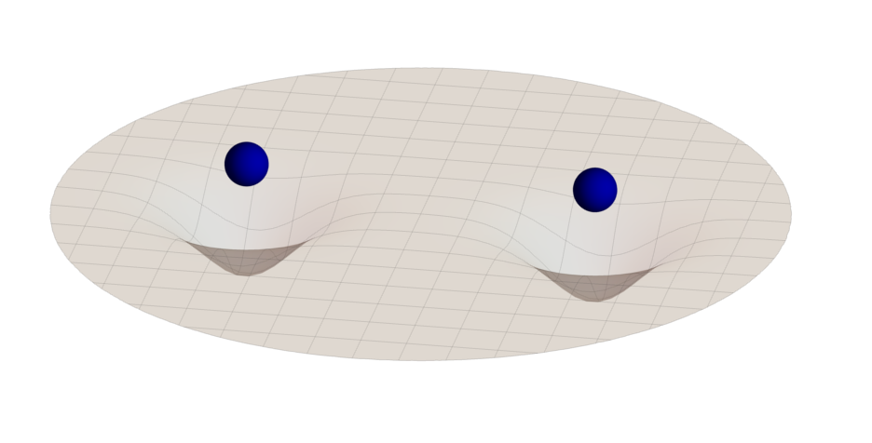
Science Cases of Neutron Star Research
Equation of State
Hubble Constant
Heavy element formation
Pang et al., Nature Communication (accepted)
TD et al. Science, Vol. 370, Issue 6523, pp. 1450-1453
Schianchi et al., 2307.94572
High-Energy astrophysics
Tests of General Relativity
NASA

Slide 3
Science Cases of Neutron Star Research
Equation of State
Hubble Constant
Heavy element formation
Pang et al., Nature Communication (accepted)
TD et al. Science, Vol. 370, Issue 6523, pp. 1450-1453
Schianchi et al., 2307.94572
High-Energy astrophysics
Tests of General Relativity
NASA

Slide 4
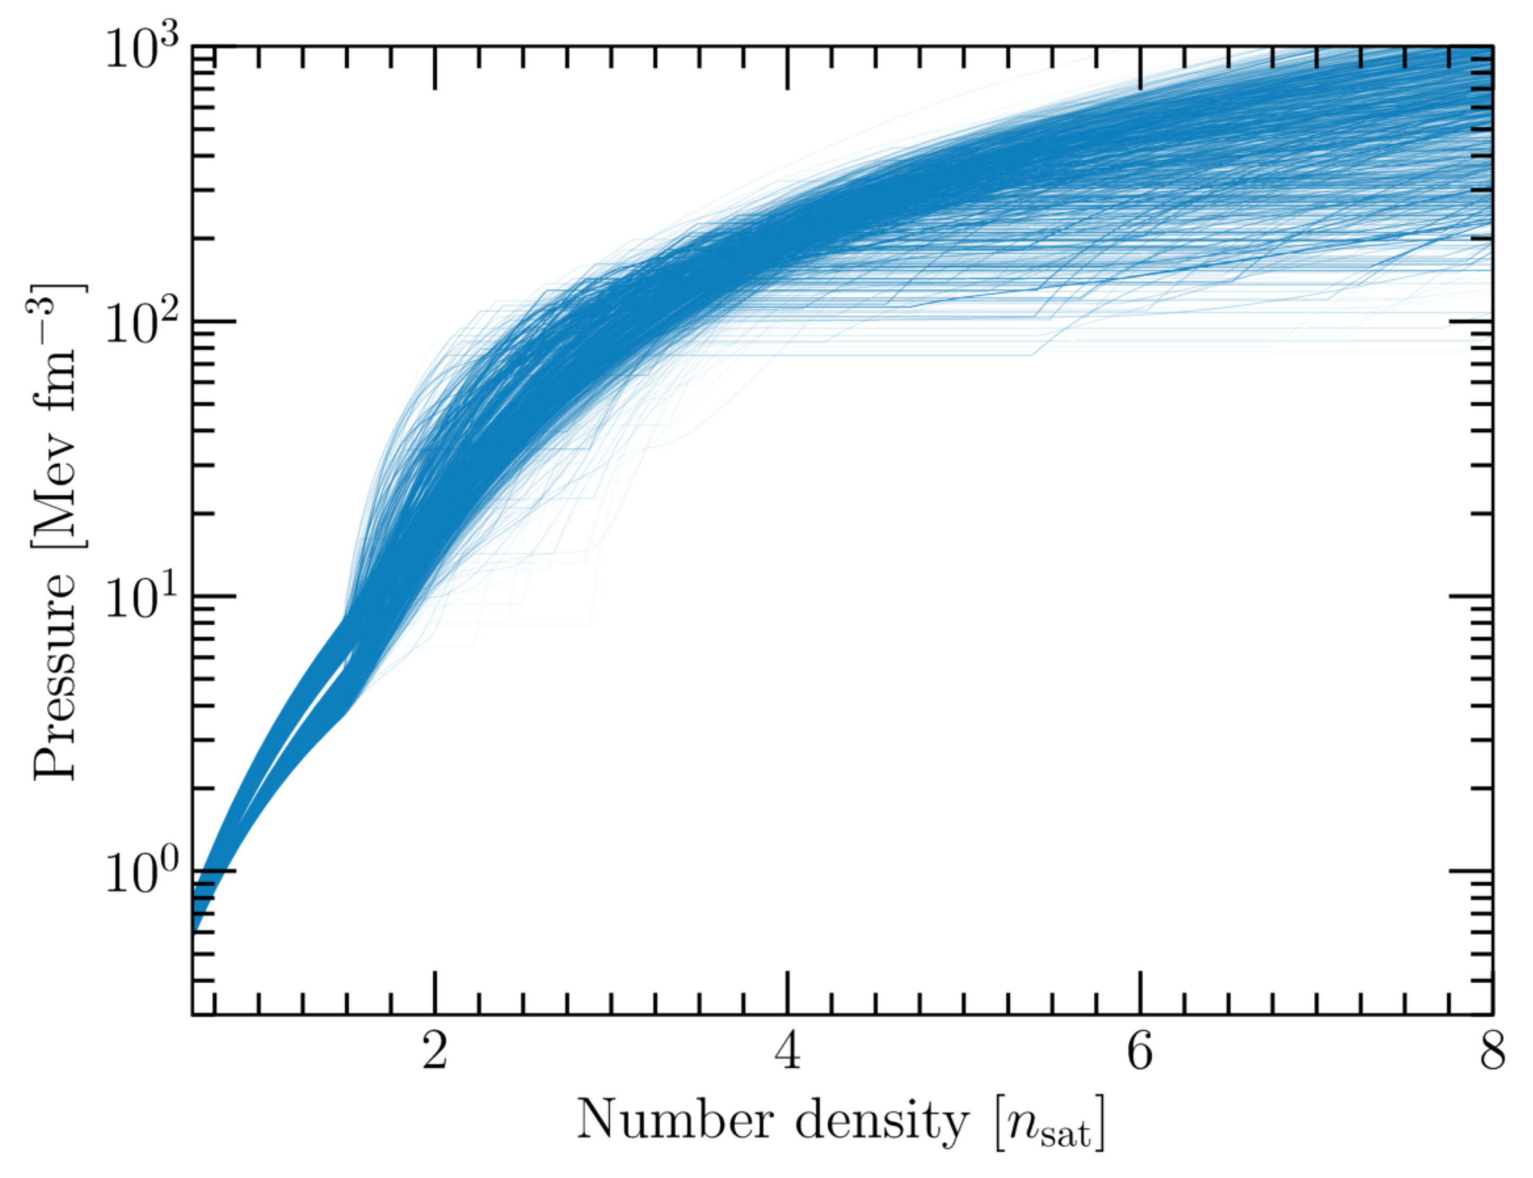
Constraining the supranuclear-dense Equation of State
nuclear-physics computations

Slide 5
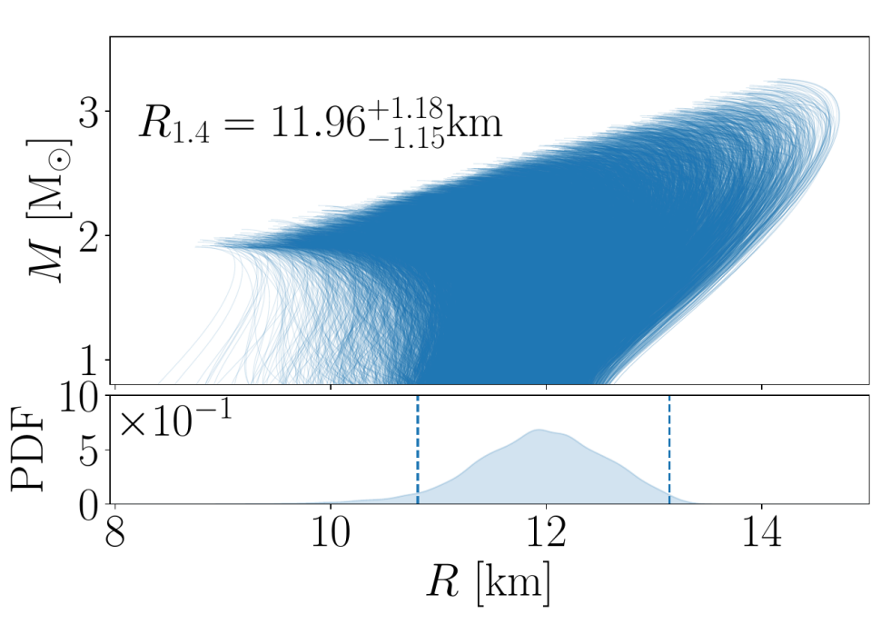
Constraining the supranuclear-dense Equation of State
nuclear-physics computations
astrophysical observations
General Relativity
non/slowly rotating
stars

Slide 6
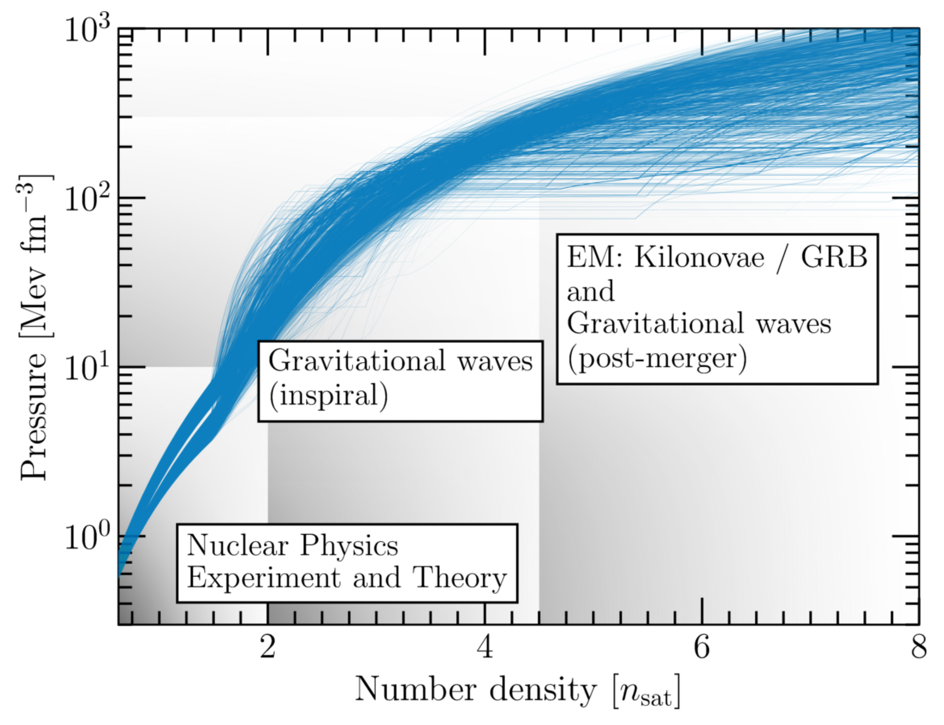
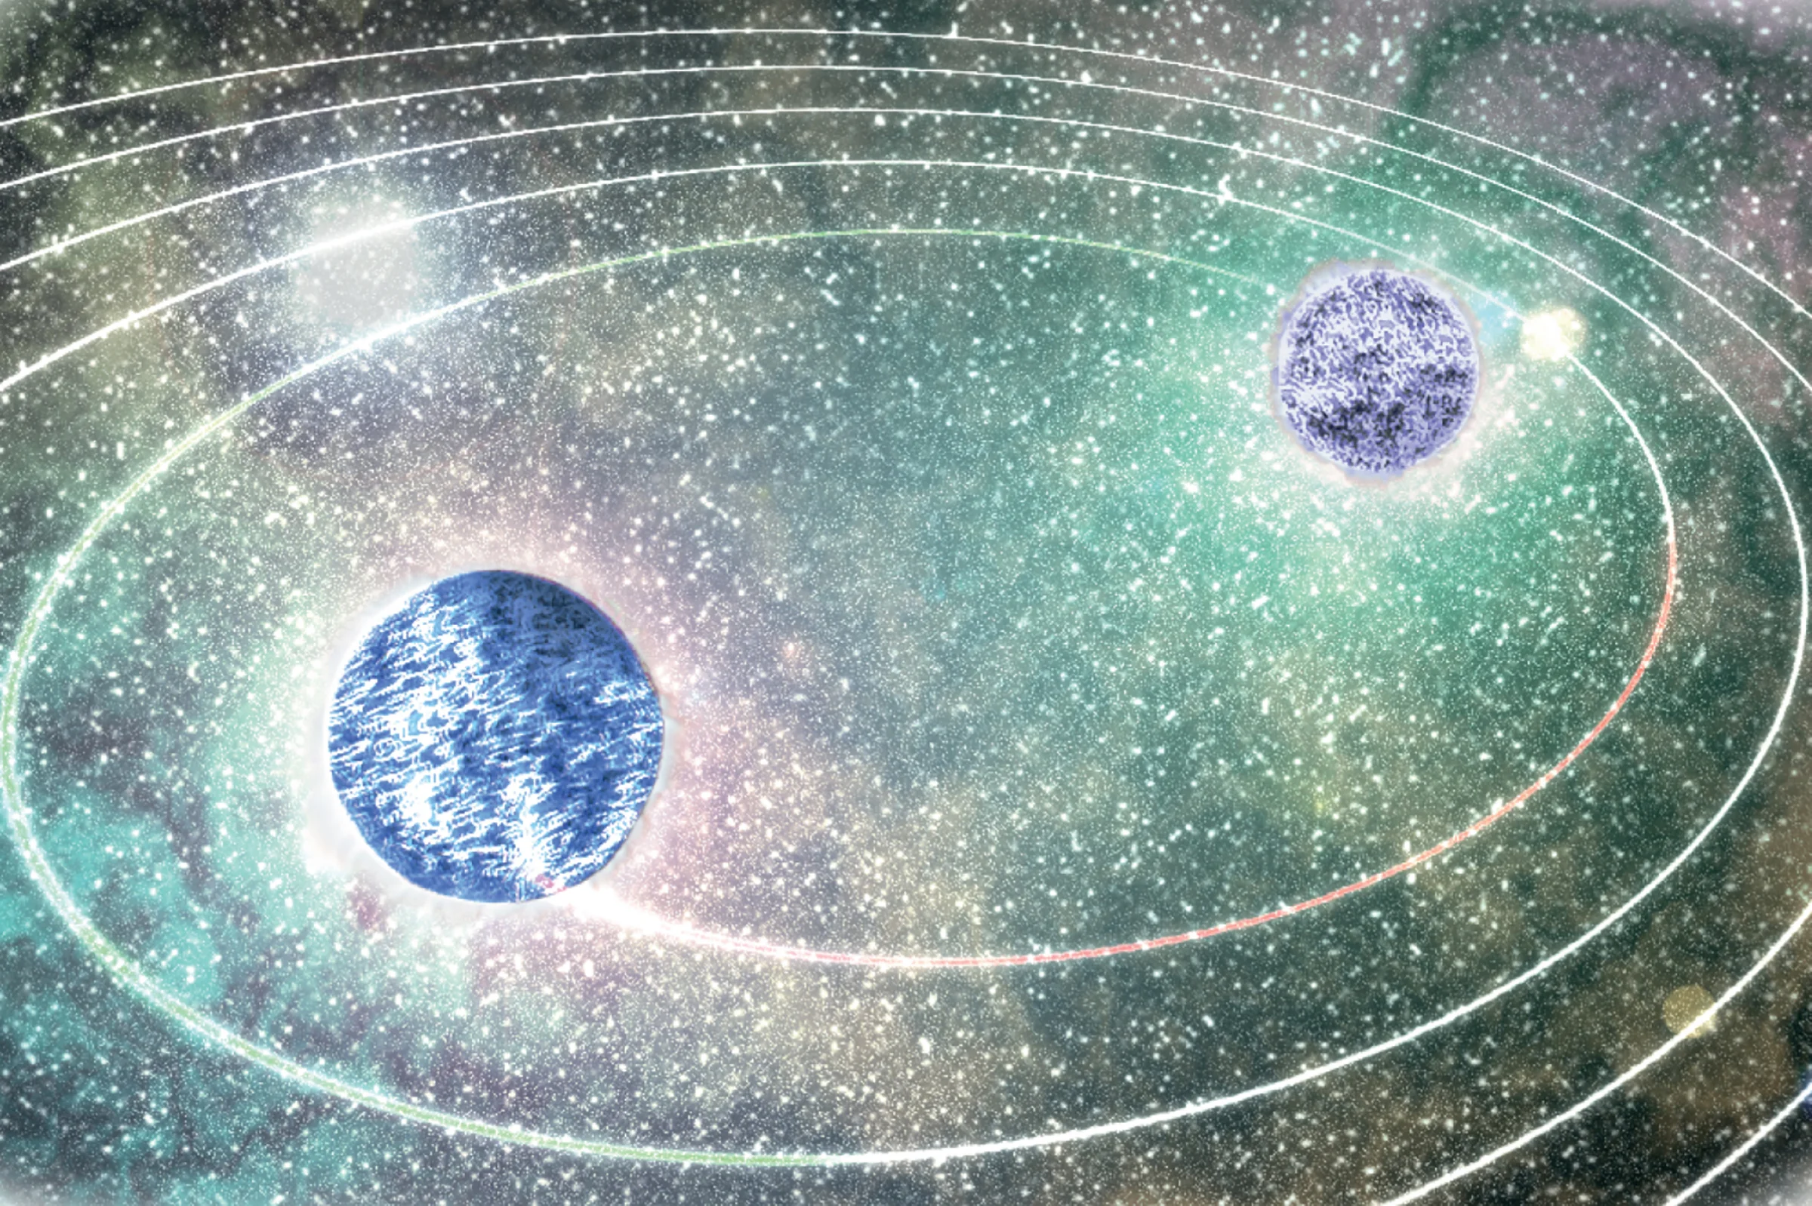
Constraining the supranuclear-dense Equation of State
How to study neutron stars?
nuclear-physics computations
astrophysical observations
General Relativity
non/slowly rotating
stars
Single Neutron Stars:
- X-ray observations of rotating neutron stars
- radio measurements of rotating neutron stars
Binary mergers:
- gravitational waves
- gamma-ray, X-ray, ultraviolet, optical,
infrared, radio observations

Slide 7
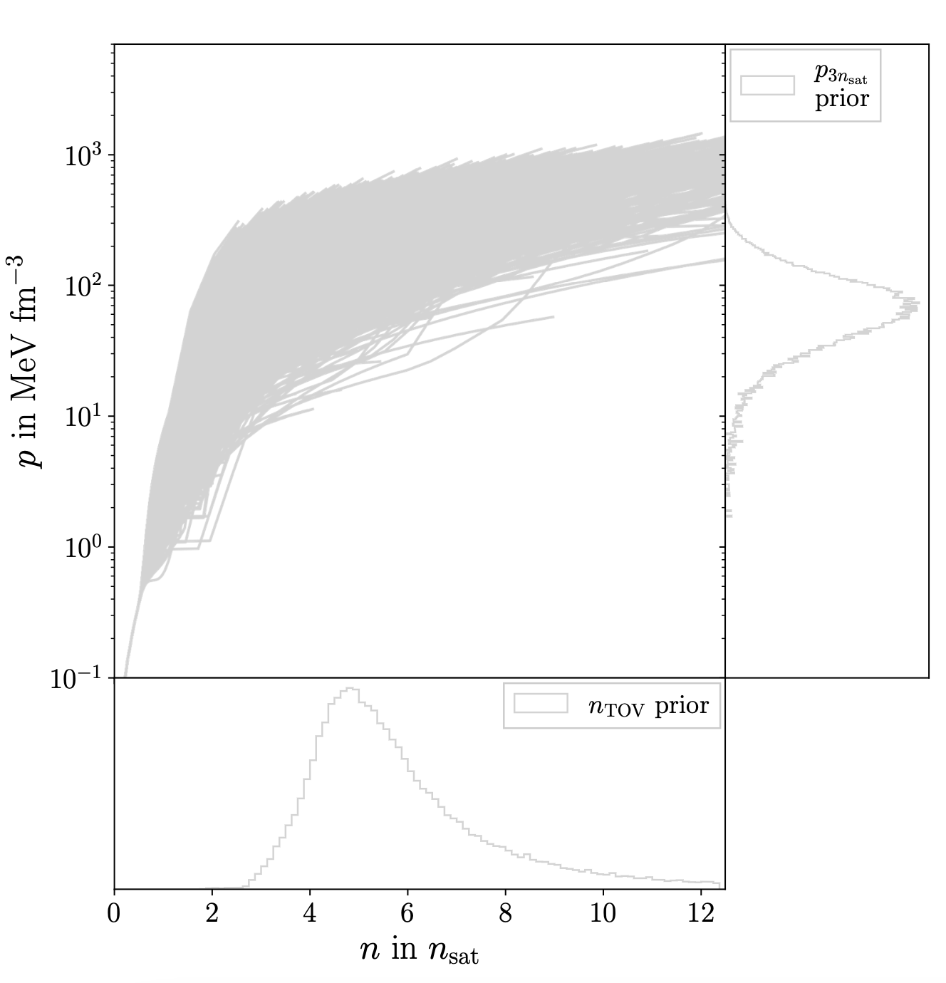
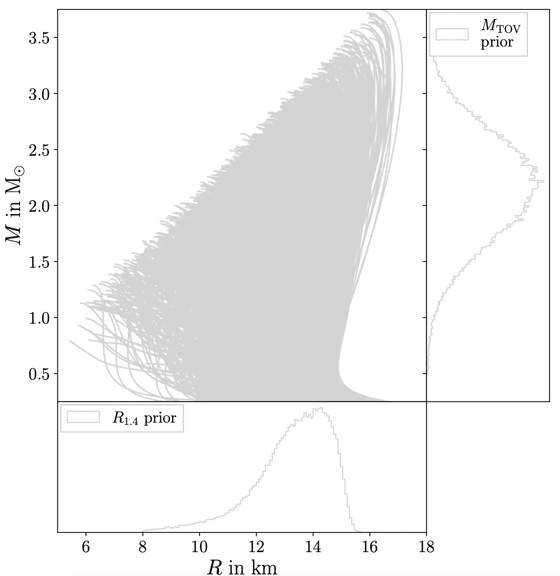
Starting point
cf. talk by Rahul Somasundaram

Slide 8

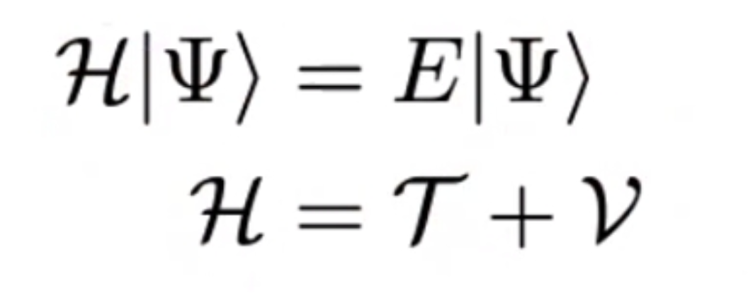
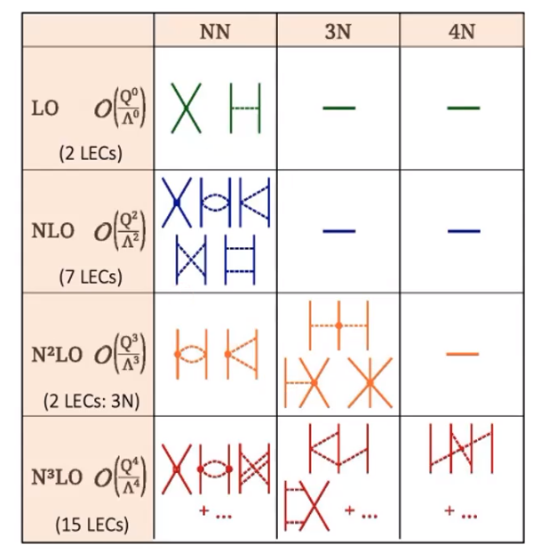
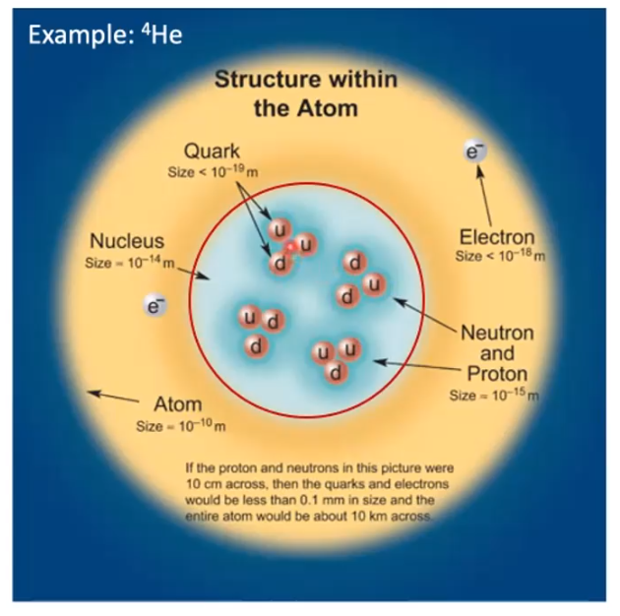
chiral EFT
Chiral effective field theory
cf. talk by Rahul Somasundaram

Slide 9
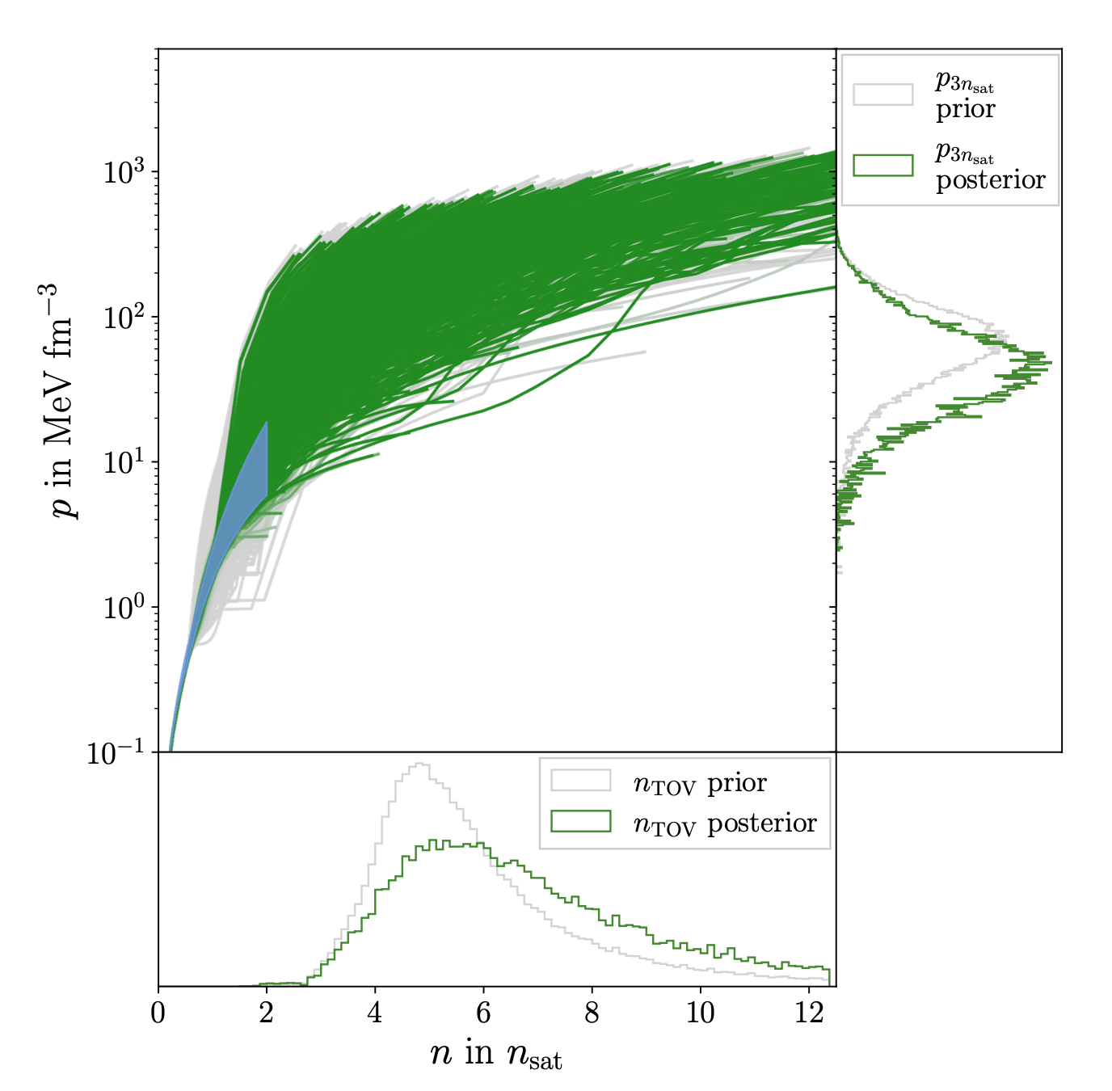
chiral EFT
Chiral effective field theory
cf. talk by Rahul Somasundaram

Slide 10
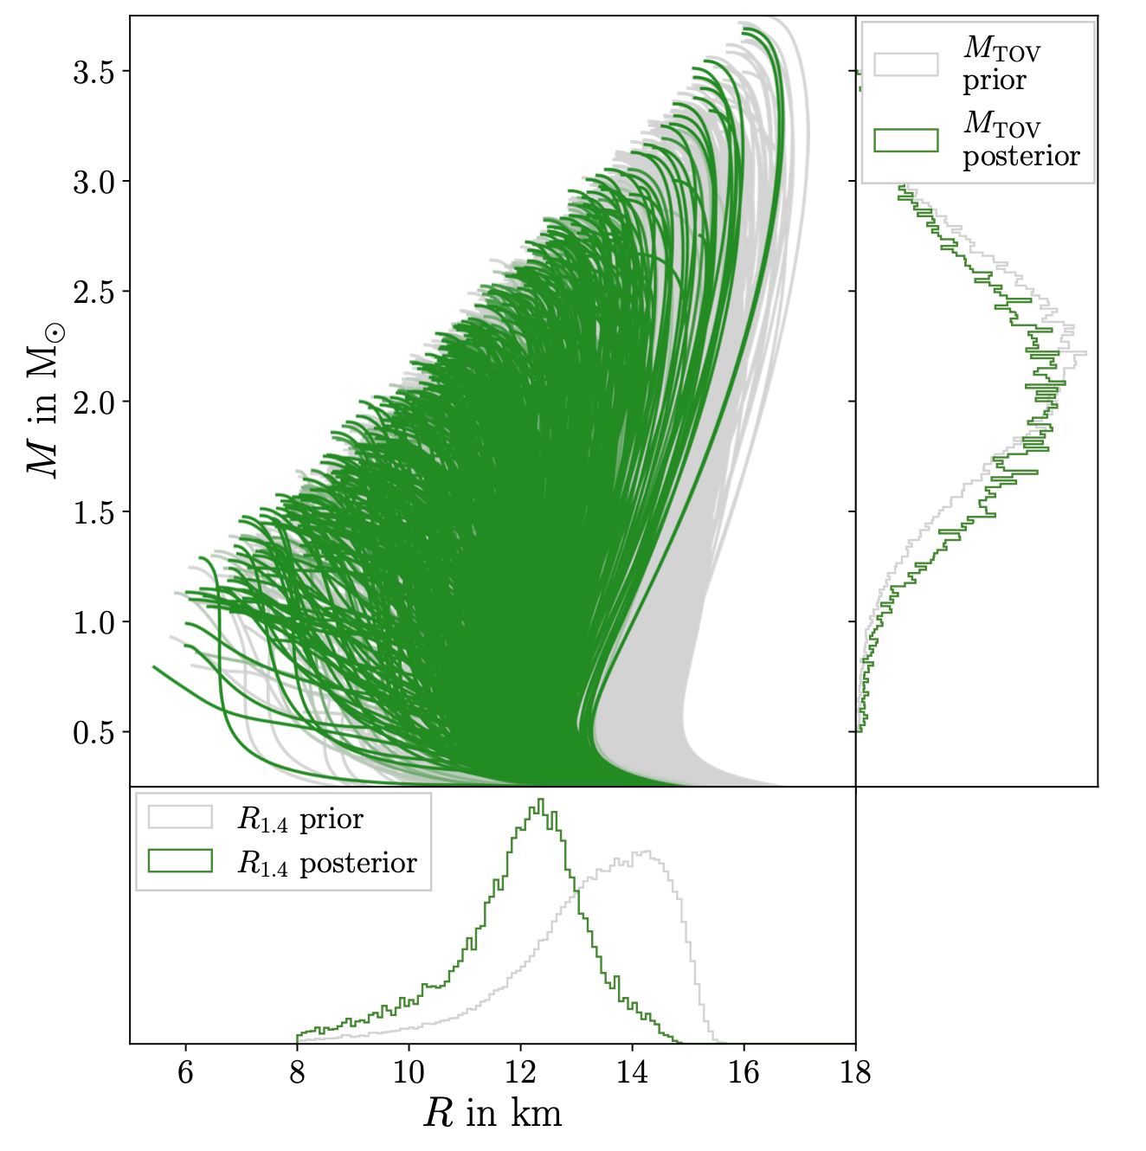
chiral EFT
Chiral effective field theory
cf. talk by Rahul Somasundaram

Slide 11
chiral EFT
Chiral effective field theory
Note: also pQCD information provide information at high densities
cf. talk by Rahul Somasundaram

Slide 12
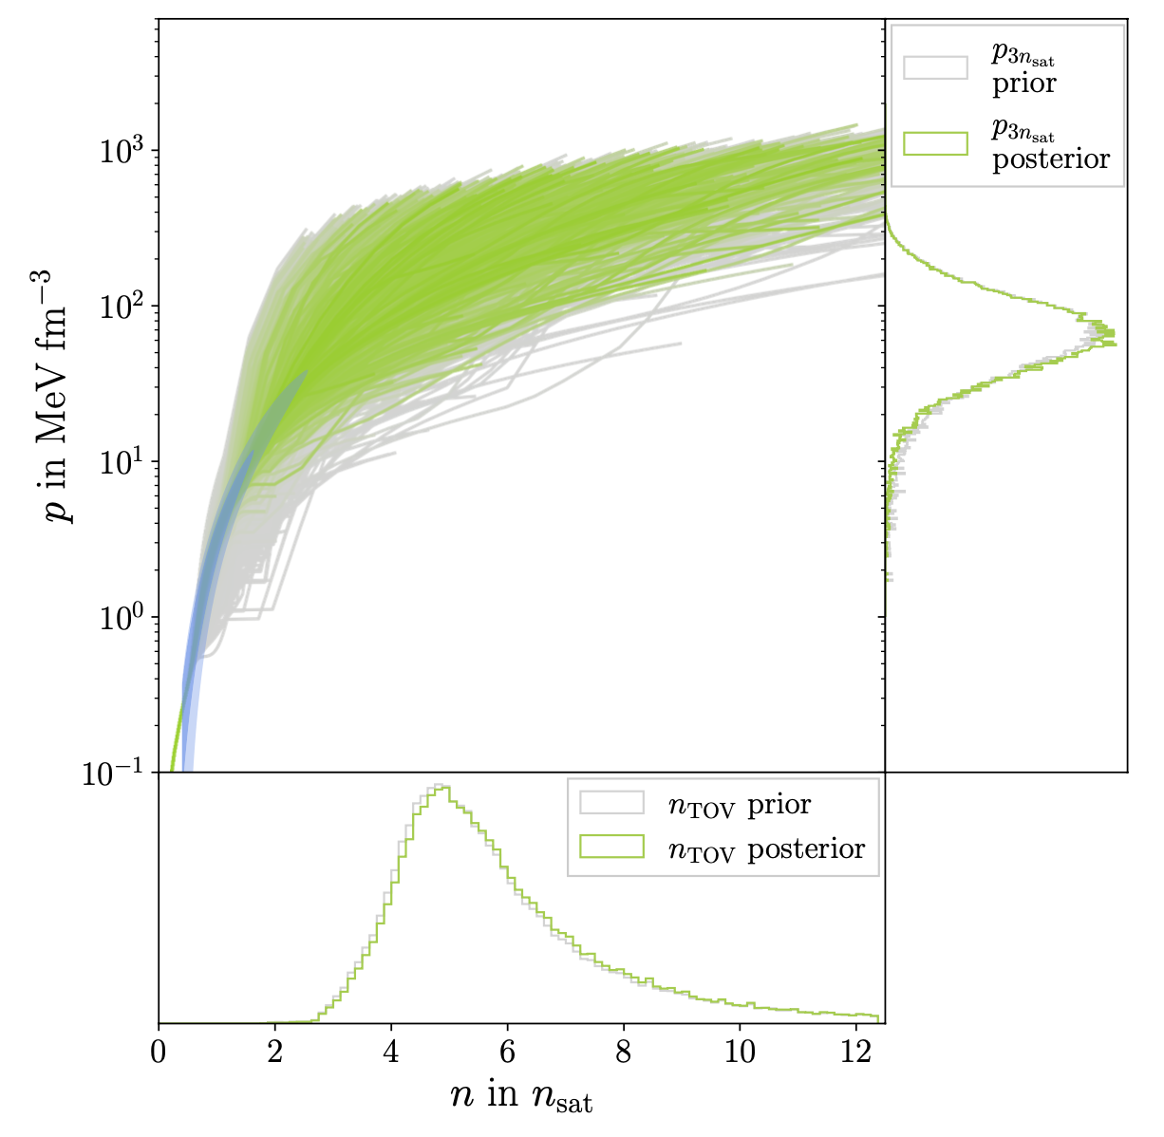
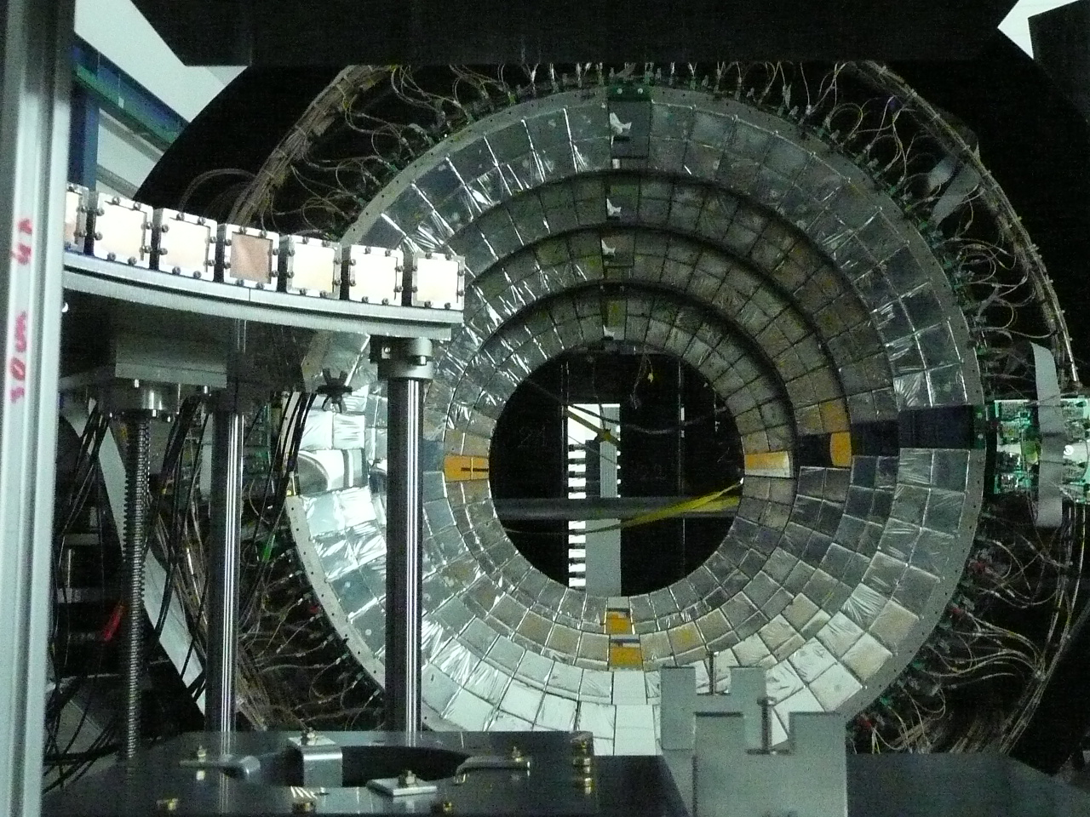
HIC
HIC
cf. talk by Peter Pang
Image: W. Trautmann

Slide 13
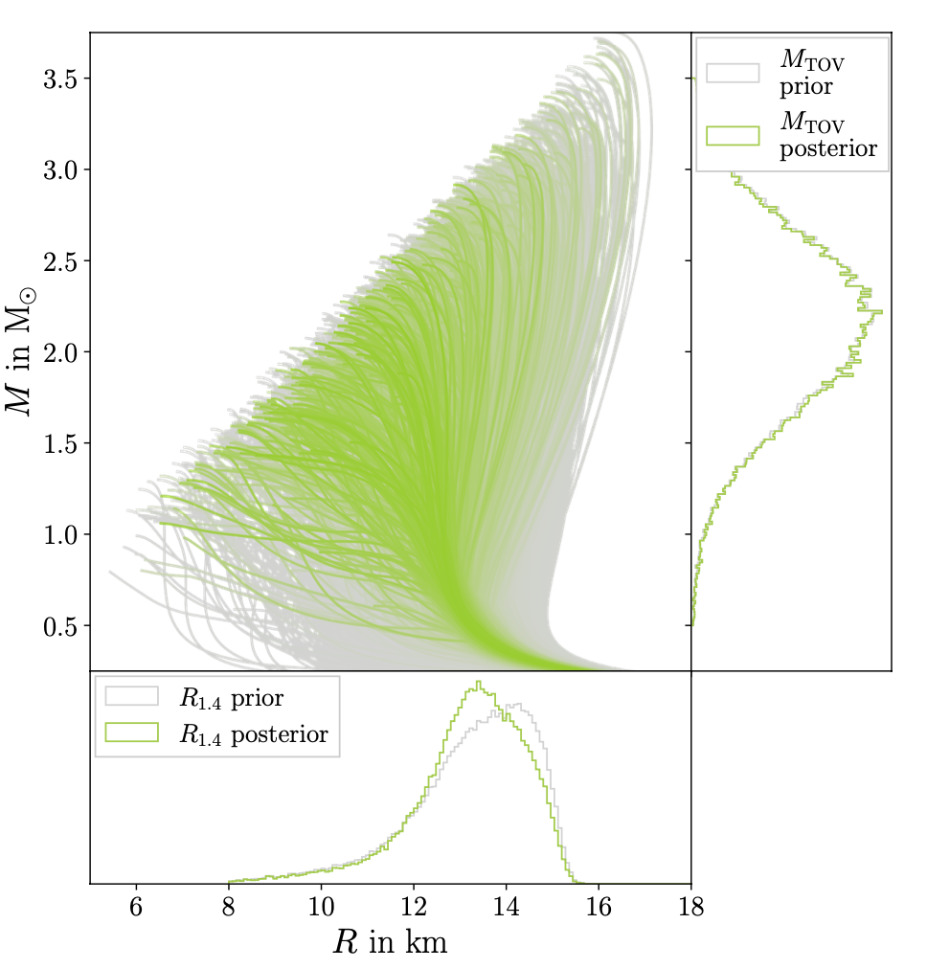
HIC
HIC
cf. talk by Peter Pang
Image: W. Trautmann

Slide 14
HIC
HIC
Note: also experiments such as PREX can be used for EOS constraints
cf. talk by Peter Pang
Image: W. Trautmann

Slide 15
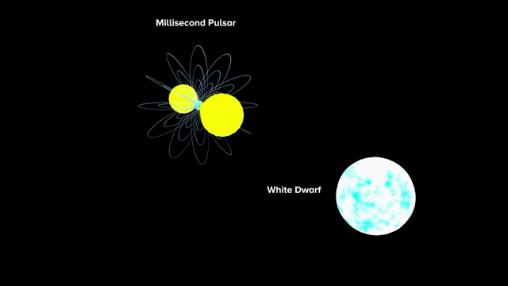
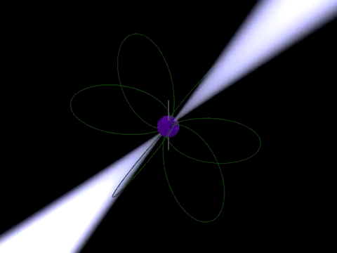
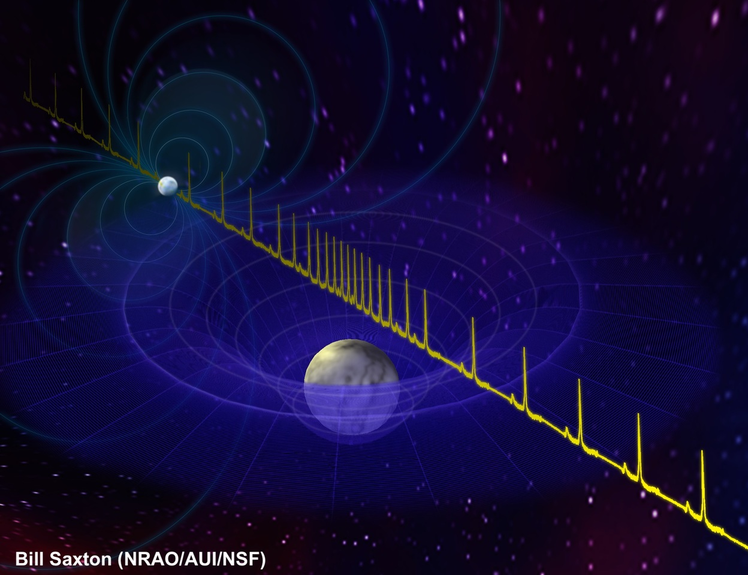
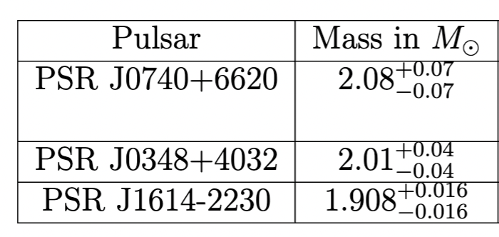
Radio pulsars
Radio Pulsars
Kramer et al.
Kramer et al.
Measurement of massive pulsars through Shapiro time delay

Slide 16
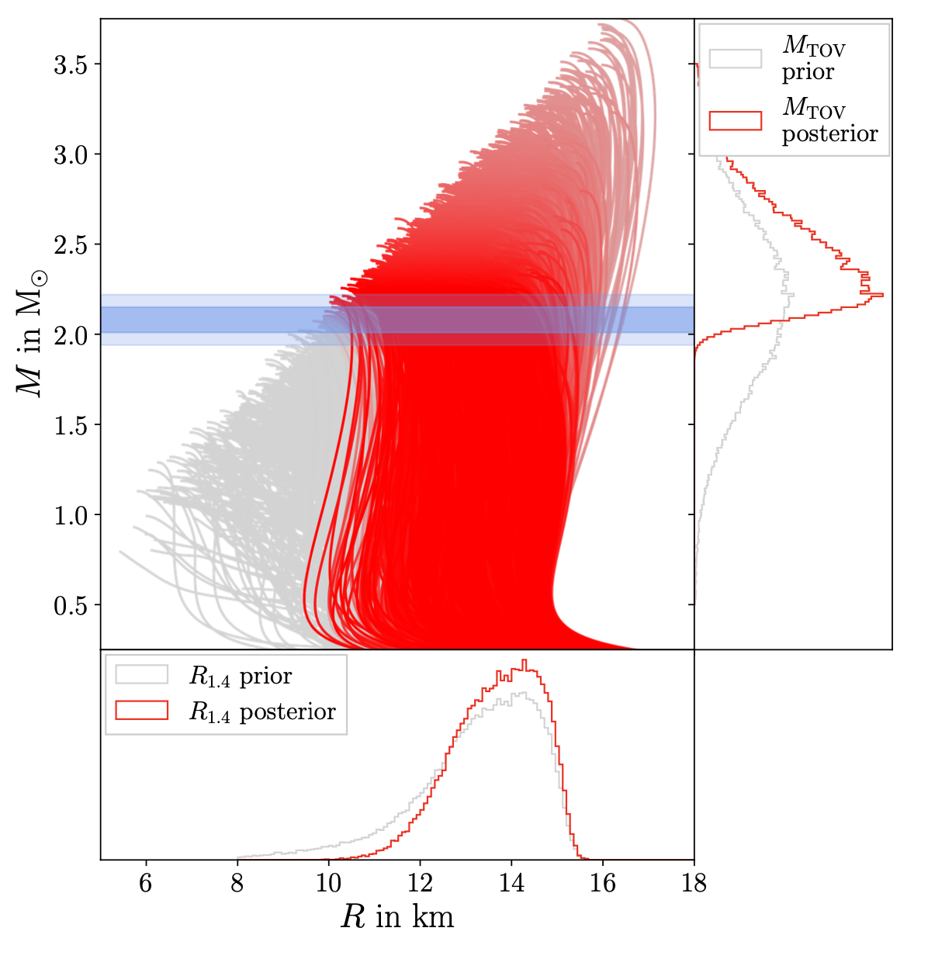
Radio pulsars
Radio Pulsars
Measurement of massive pulsars through Shapiro time delay
PSR J0740+6620

Slide 17
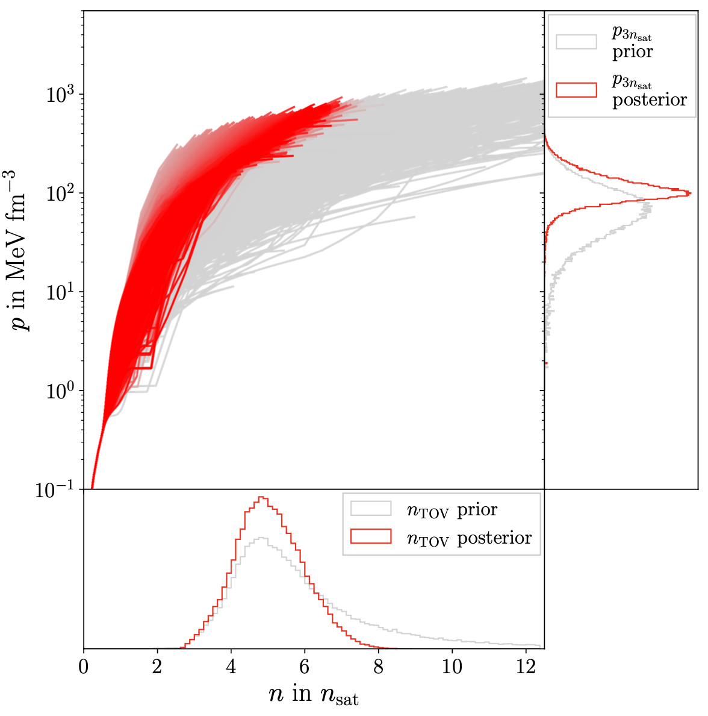
Radio pulsars
Radio Pulsars
Measurement of massive pulsars through Shapiro time delay
PSR J0740+6620

Slide 18
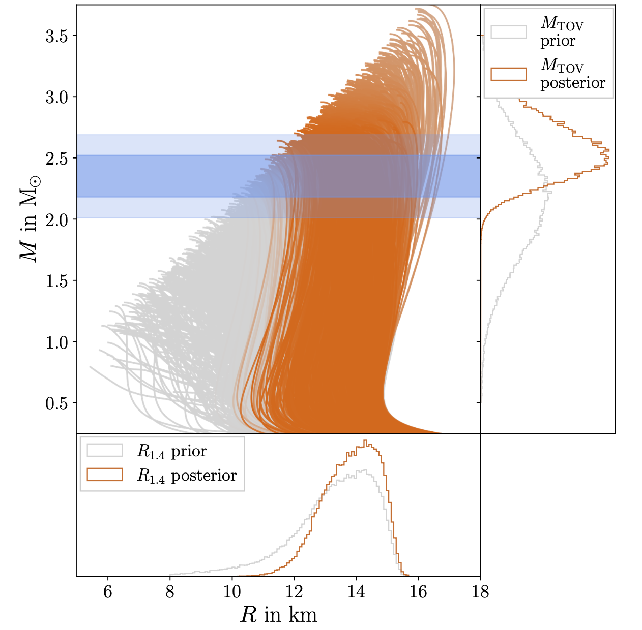

Black Widows
The Black Widow PSR J0952-0607
Romani et al., APJL 934 L17
NASA

Slide 19
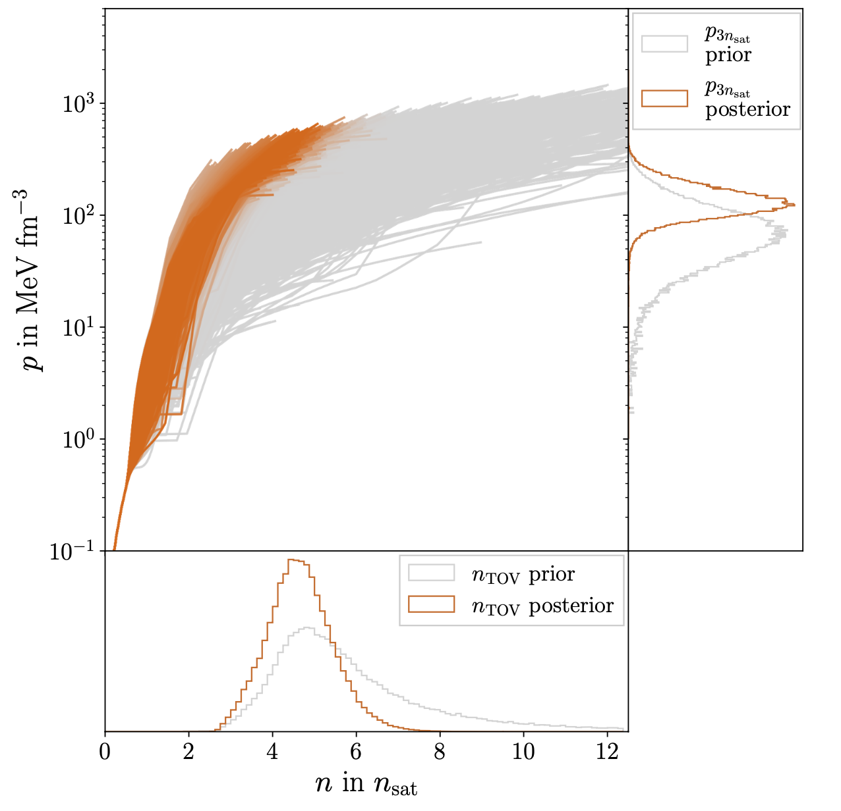
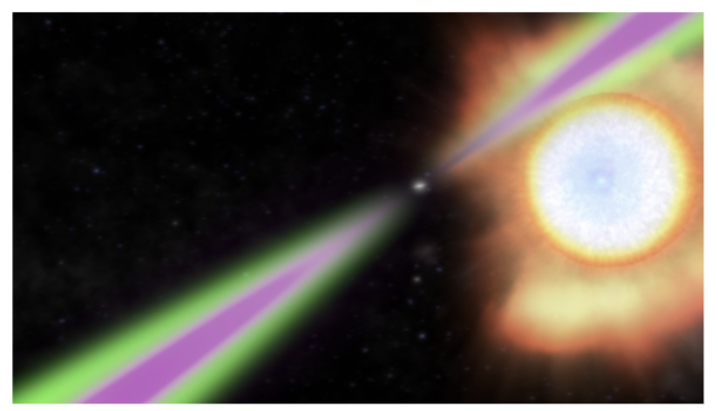
Black Widows
The Black Widow PSR J0952-0607
Romani et al., APJL 934 L17
NASA

Slide 20
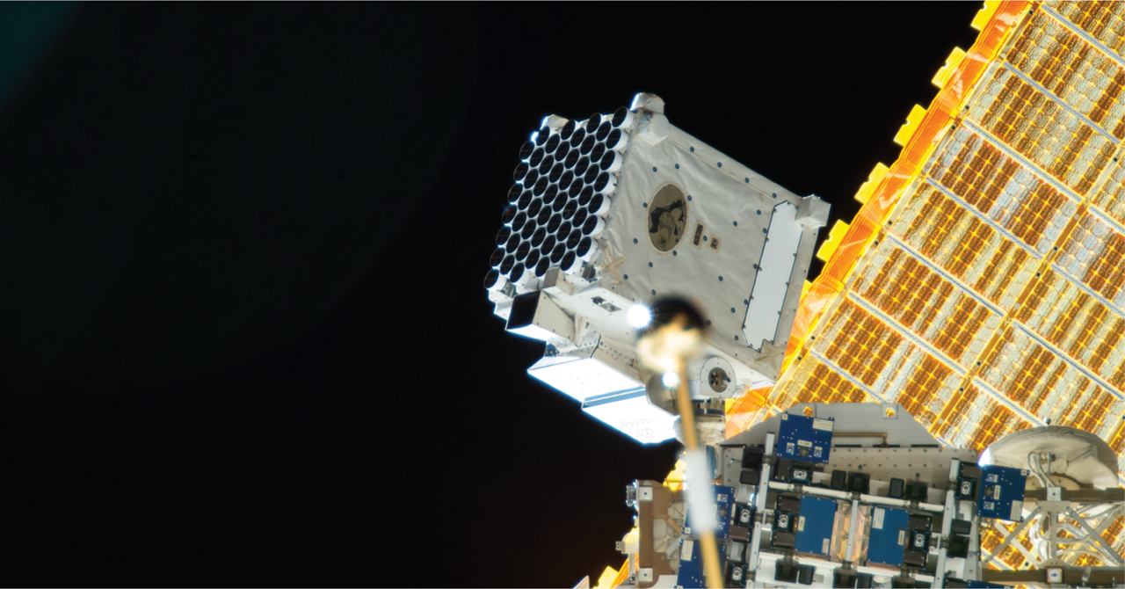
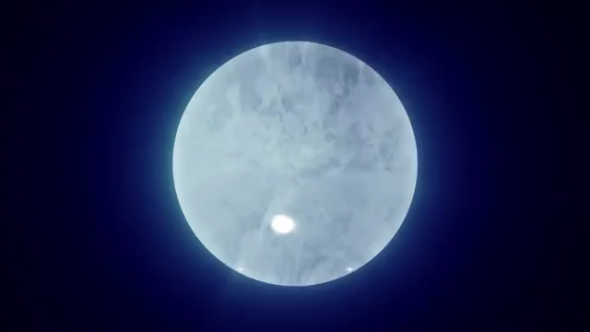
NICER
X-ray measurements with NICER
NASA
NICER data analyzed by University of Amsterdam and Maryland
NASA
caveat: relatively large modelling uncertainty

Slide 21
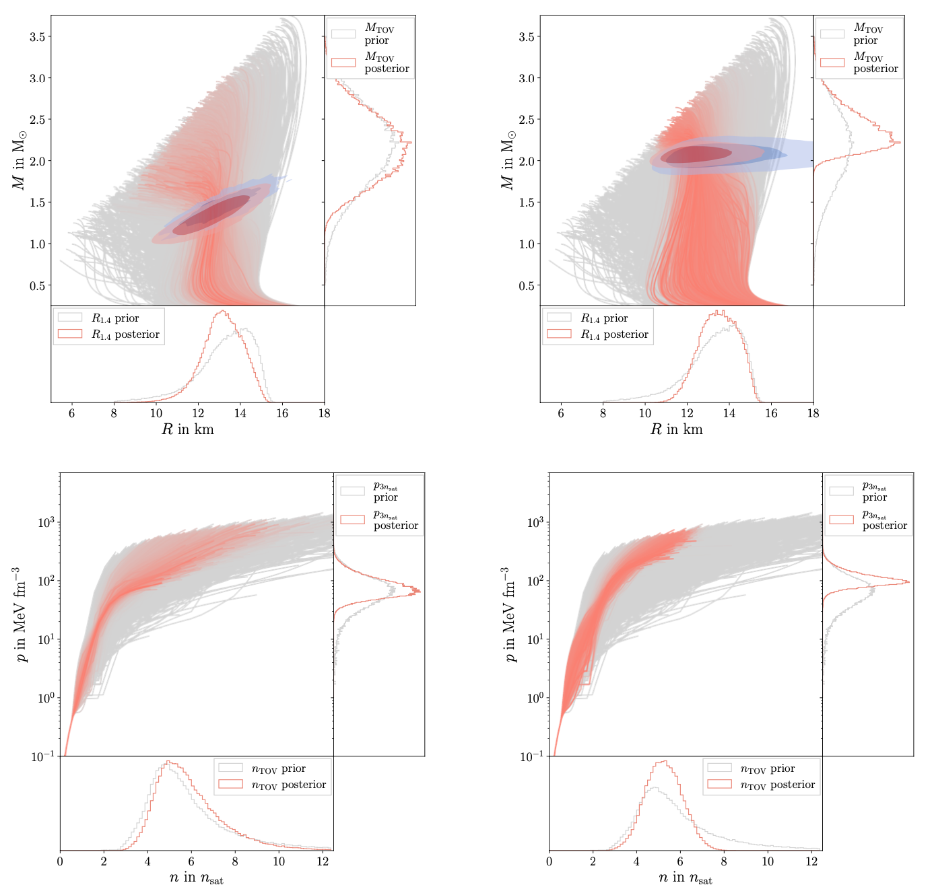
NICER
X-ray measurements with NICER
PSR J0030+0451
PSR J0740+6620
caveat: relatively large modelling uncertainty

Slide 22
NICER
X-ray measurements with NICER
PSR J0030+0451
PSR J0740+6620

Slide 23
NICER
X-ray measurements with NICER
Note: There are also also X-ray measurements e.g., HESS J1731-347 or 4U 1702-429
PSR J0030+0451
PSR J0740+6620

Slide 24

BNS mergers
Binary Neutron Star Mergers
gravitational wave emission

Slide 25
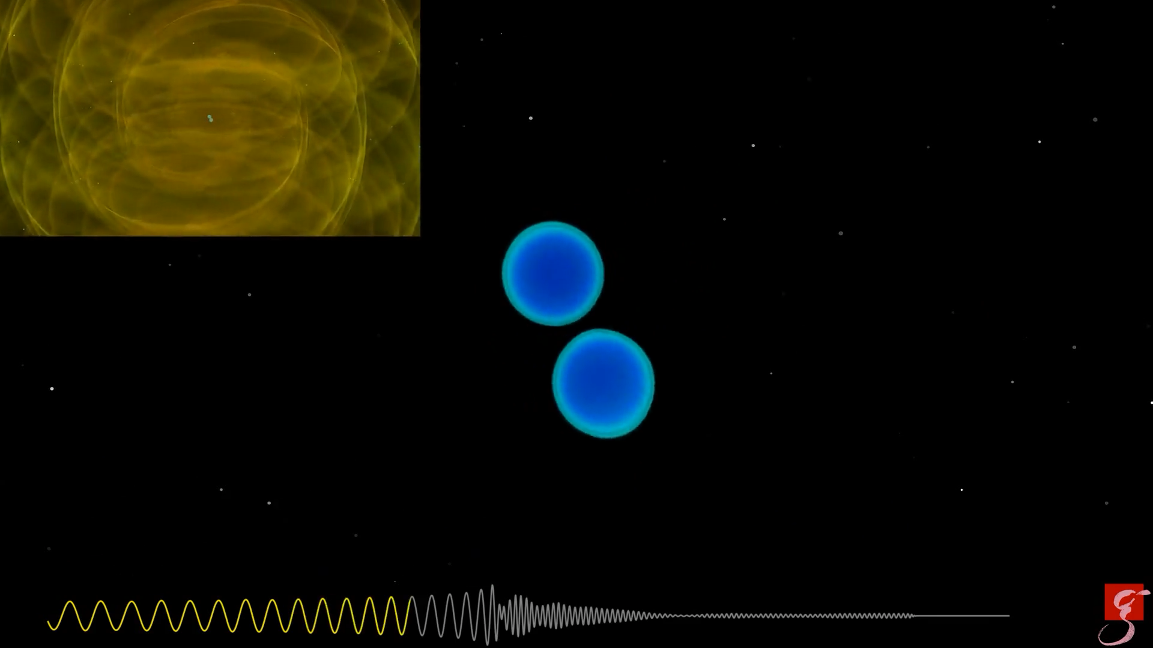
BNS mergers
Binary Neutron Star Mergers
gravitational wave emission
deformation before merger, ejection of material, heavy element production

Slide 26
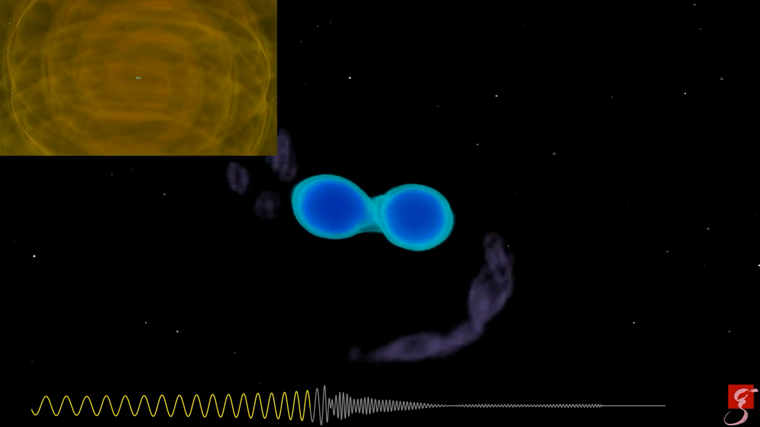
BNS mergers
Binary Neutron Star Mergers
gravitational wave emission
deformation before merger, ejection of material, heavy element production
black hole formation
70 milliseconds

Slide 27

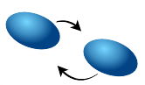


Gravitational Wave Analysis
GW170817
determines tidal deformability

Slide 28
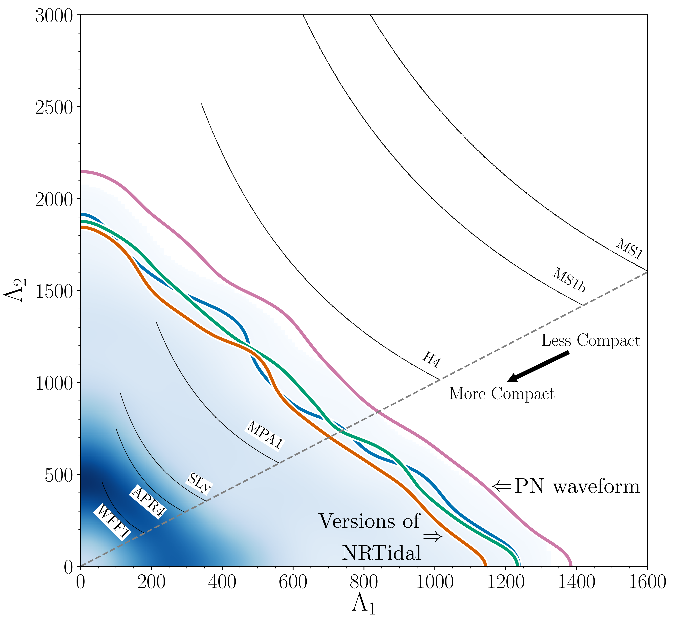
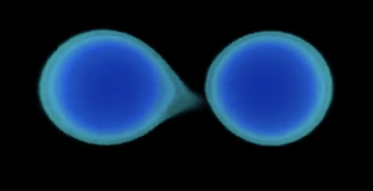
Gravitational Wave Analysis
c
GW170817
determines tidal deformability
→ no assumption about the
type of the compact object
Phys.Rev. X9 (2019) 011001

Slide 29
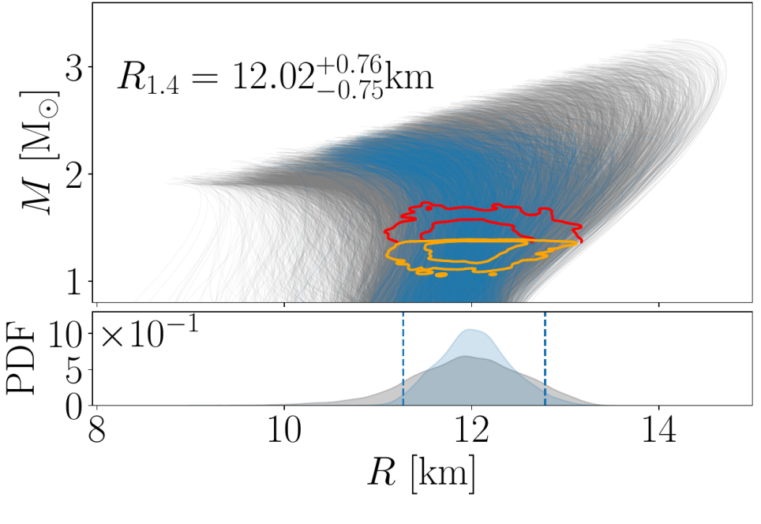
Gravitational Wave Analysis
c
GW170817
determines tidal deformability
Assumption: The merging objects were neutron stars
TD et al. Science, Vol. 370, Issue 6523, pp. 1450-1453

Slide 30
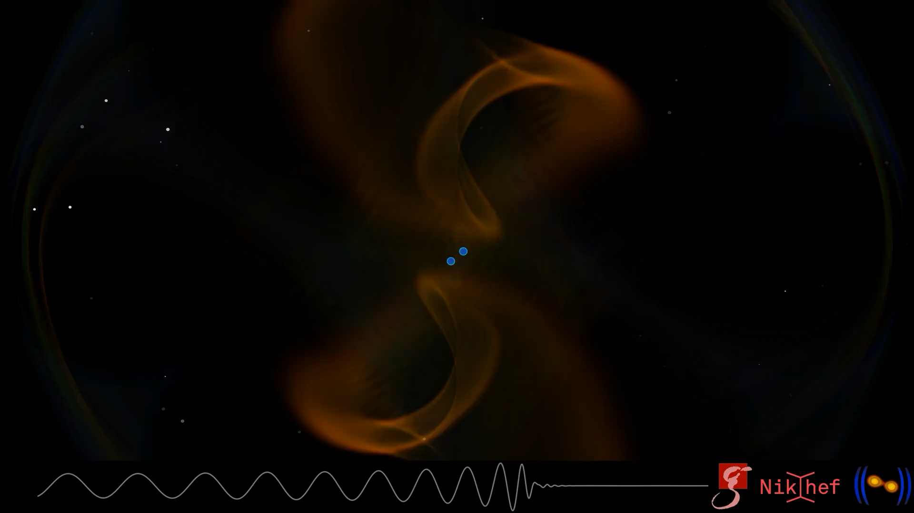

Slide 31
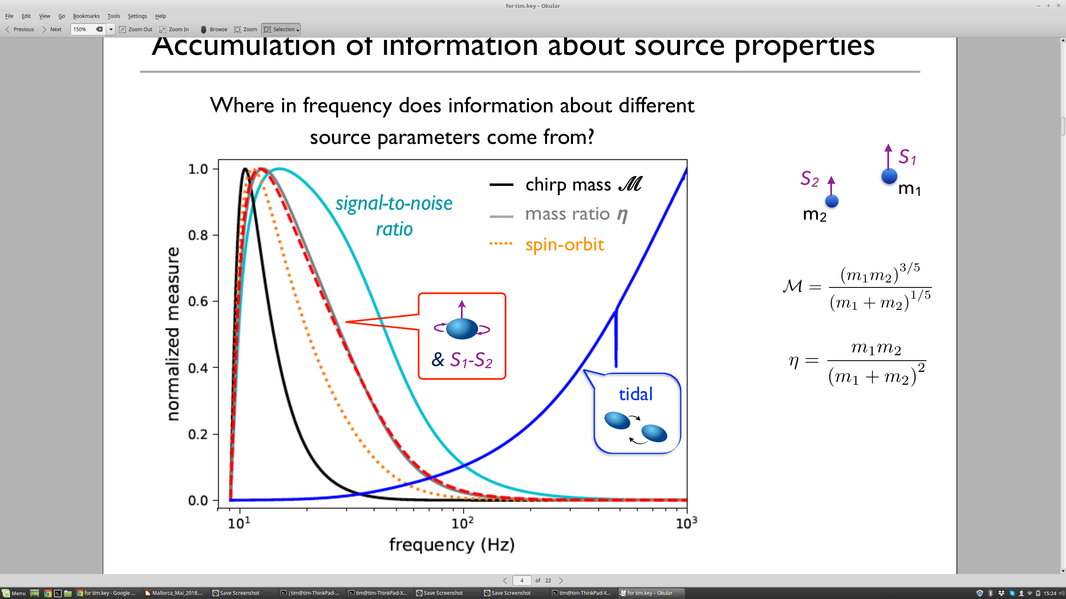
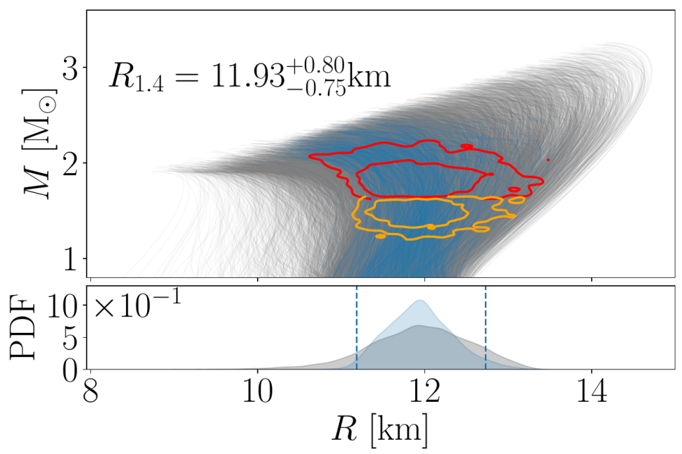
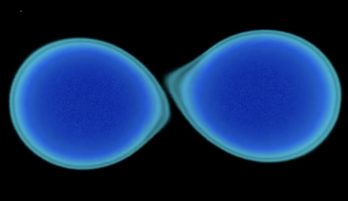
Gravitational Wave Analysis
c
GW190425
TD et al. Science, Vol. 370, Issue 6523, pp. 1450-1453

Slide 32
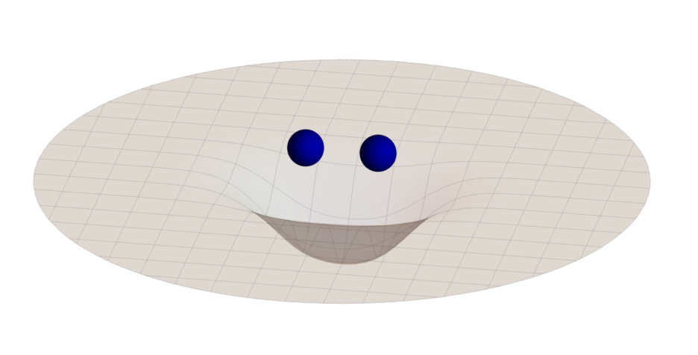
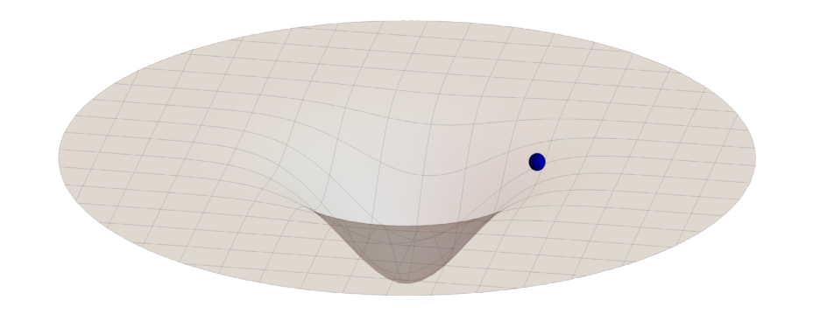
Inspiral waveforms
Various models
N.Kunert et al., PRD105 (2022) 6, L061301

Slide 33
Inspiral waveforms
Various models
N.Kunert et al., PRD105 (2022) 6, L061301

Slide 34
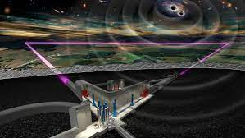

Inspiral waveforms
Various models
Einstein Telescope
N.Kunert et al., PRD105 (2022) 6, L061301

Slide 35

Looking into the future
Numerous science studies about the best configuration for the Einstein Telescope, cf.
Iacovelli et al., arXiv: 2308.12378,
Pucher et al., PRD 108 (2023) 2, 023018,
Branchesi et al., JCAP 07 (2023) 068
We expect to detect about 100 000 BNS mergers per year
Einstein Telescope

Slide 36

Looking into the future
The Einstein Telescope will allow us to test e.g., three-nucleon interactions, cf.
Rose et al., PRC 108 (2023) 2, 025811
Sabatucci et al., PRD 106 (2022) 8, 0832
Einstein Telescope

Slide 37

Looking into the future
Hot EOS
We will be able to observe (for a few signals) the postmerger phase which allows us to extract information about the hot EOS.
Einstein Telescope

Slide 38


EM Signals – Kilonova
- neutron rich ejecta produce heavy r-process elements
- pseudo-black body radiation from r-process elements
- mergers are major sites for the formation of heavy elements
Schianchi et al., 2307.94572
Notes:
38

Slide 39

Photometric lightcurves
Notes:
39

Slide 40

Photometric lightcurves
Notes:
40

Slide 41



Photometric lightcurves
1.) compute lightcurves for a set (grid) of ejecta properties with a radiative transfer code
2.) interpolate within this grid through Gaussian Process Regression or a Neural Network
Ejecta Parameters
Ejecta Parameters
Ejecta Parameters
Notes:
41

Slide 42

Photometric lightcurves
1.) compute lightcurves for a set (grid) of ejecta properties with a radiative transfer code
2.) interpolate within this grid through Gaussian Process Regression or a Neural Network
3.) link ejecta properties through numerical-relativity predictions to the binary properties
Notes:
42

Slide 43


Combining
- chiral effective field theory
radio pulsar measurements
X-ray NICER measurements
gravitational waves
kilonova observations
HIC
TD et al. Science, Vol. 370, Issue 6523, pp. 1450-1453
Huth et al., Nature 606 (2022) 276-280
cf. talk by Peter Pang

