Slide 1

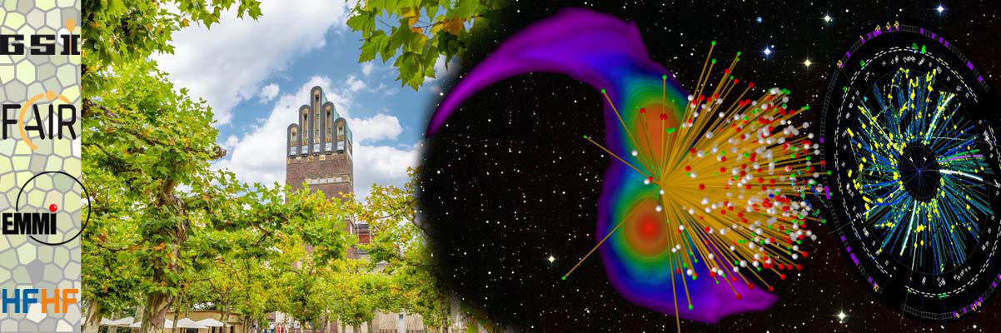
Extracting the nuclear EOS from nuclear collisions with transport simulations
Maria Colonna
Laboratori Nazionali del Sud (Catania)
XIth International Symposium
on Nuclear Symmetry Energy – Nusym23
September 18-22, 2023 GSI - Darmstadt (Germany)

Slide 2
Outline
EOS, dissipative HIC and transport theories (BUU-like and
QMD-like models)
Fragmentation at Fermi energies: fluctuations, isospin observables
and impact of clustering
HIC at relativistic energies: meson vs. light cluster emission

Slide 3
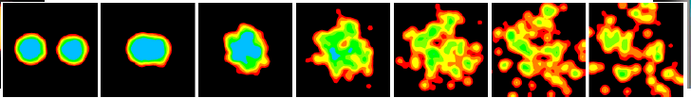
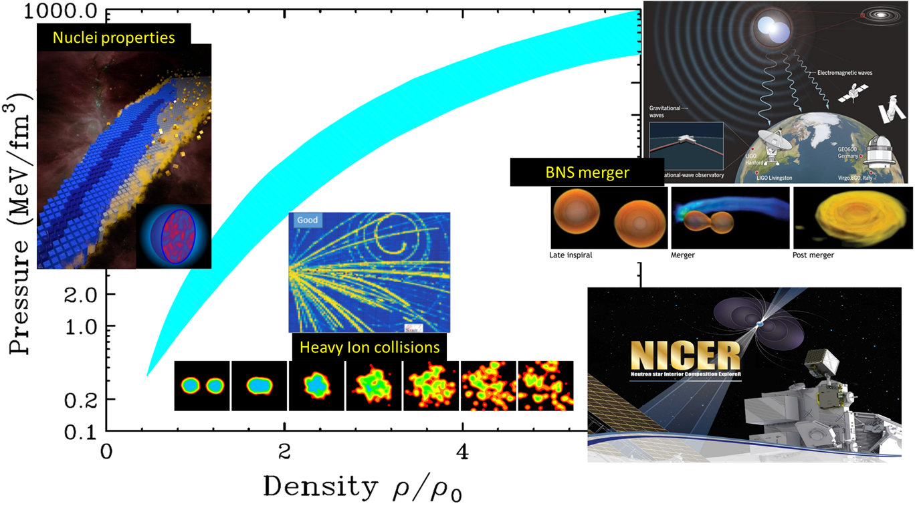
Dissipative reactions provide a unique opportunity to create
in laboratory transient states of nuclear matter in several
conditions of density and temperature
Femto-nova explosion created by heavy ion collisions !
from A. Ono
Explore the nuclear matter
phase diagram
and access the nuclear
Equation of State (EOS)
The EOS of asymmetric nuclear matter

Slide 4
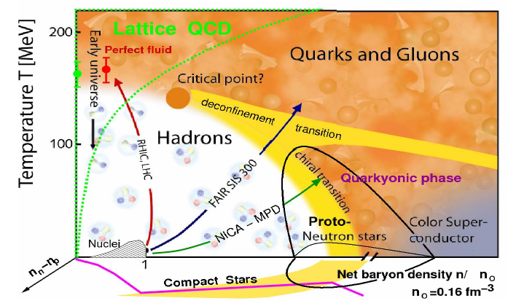
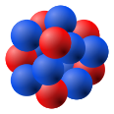
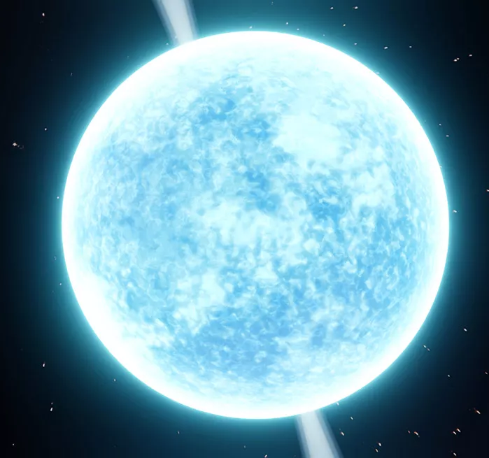
Tentative “Paths” with
Heavy Ion Collisions:
From dilute (liquid-gas)
phase to high baryon
and isospin density
The Phase Diagram of Strongly Interacting Matter
D.Blaschke
asymmetry
axis
Treatment of many-body dynamics
Transport theories EOS Phenomenology of Heavy Ion Collisions
low ρ, T high ρ, T
0.05 GeV/A
0.5 GeV/A
E_{beam}

Slide 5
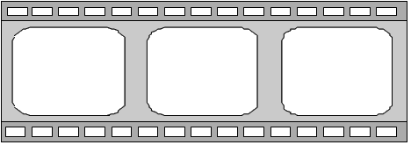
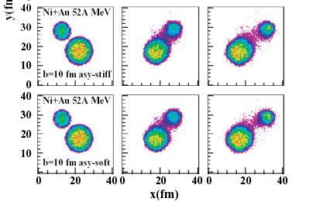
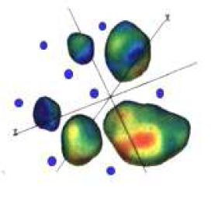
The nuclear many-body problem
Mean-field (one-body) dynamics
Two-body correlations
one-body
density matrix
two-body density matrix
one-body
Mean-field
Residual interaction
Time evolution
ρ₁ : one-body density
iħ
TDHF
ETDHF
Average effect of the residual interaction
Fluctuations

Slide 6




Boltzmann-Langevin dynamics: Semi-classical approximation
Transport equation for the one-body distribution function f
Chomaz, Colonna, Randrup
Phys. Rep. 389 (2004) Baran, Colonna, Greco, Di Toro
Phys. Rep. 410, 335 (2005)
Lin and Danielewicz, PRC 99 (2019)
M. Colonna, PPNP 113 (2020)
(semi-classical analog of Wigner function)
k
δk
Vlasov
BUU
Residual interaction:
stochastic NN collisions
SMF, BLOB models: Napolitani, Colonna
PLB726(2013)
Molecular Dynamics approaches (AMD, QMD, UrQMD,…)
A.Ono, Phys.Rev.C59,853(1999)
Zhang and Li, PRC74,014602(2006)
J.Aichelin, Phys.Rep.202,233(1991)
M. Papa et al., PRC64, 024612 (2001)
Jun Xu, PPNP 106 (2019)
stochastic NN collisions
+ clusters
A.Ono, PPNP 105 (2019)

Slide 7
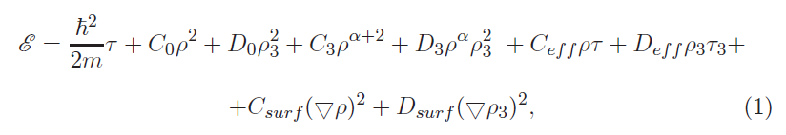

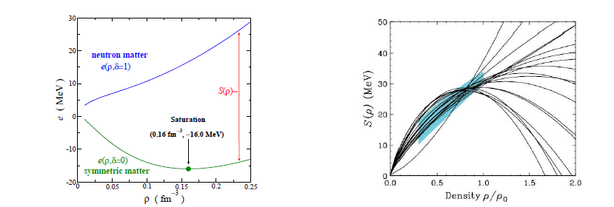


The nuclear effective interaction
Energy density ε = E/V
ex: Skyrme eff. interaction
+ S.O. + pairing
Kinetic energy densities
For homogeneous matter at equilibrium EOS
soft
Symmetry
Energy
S(ρ) = C_{sym} (ρ)
stiff
compressibility K_{sat}
ex: Meta-modeling
    $$E_{meta}\left(ρ,δ=0\right)≈E_{sat}+\frac{1}{2}K_{sat}x^{2}+\frac{1}{6}Q_{sat}x^{3}+\frac{1}{24}Z_{sat}x^{4}+…$$
$$x=\frac{ρ−ρ_{0}}{3ρ_{0}}$$
E/A (ρ, δ) = E/A (ρ, δ=0) + S(ρ)δ² + O(δ⁴)
δ = $\frac{ρn−ρp}{ρ}$

Slide 8
Fermi Energies (30-60 MeV/u)
low density regime

Slide 9
Beyond the independent particle picture:
from fission to fragmentation at Fermi energies
Fragment evolution
@ Fermi energies (BLOB)
Quantum SMF:
sampling initial zero-point motion
+ m.f. trajectories
surface + volume instabilities !
Napolitani, Colonna
EPJ,117 (2016)
Tanimura, Lacroix, Ayik
Phys. Rev. Lett. (2017), EPJA52(2016)
M.Bender et al., JPG 47 (2020)
Ren, Vretenar et al., PRL 128 (2022)
E
from A.Staszczak
NPA 994 (2015)
²⁵⁸Fm

Slide 10
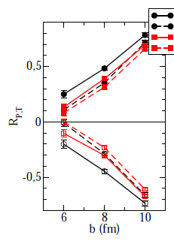
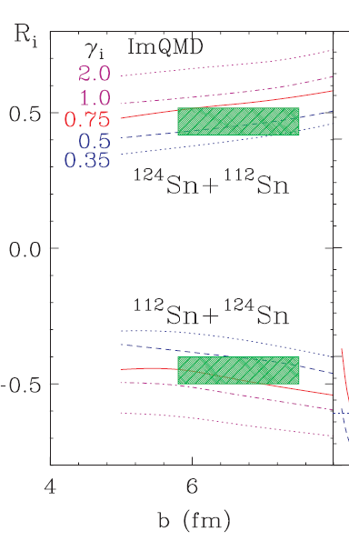
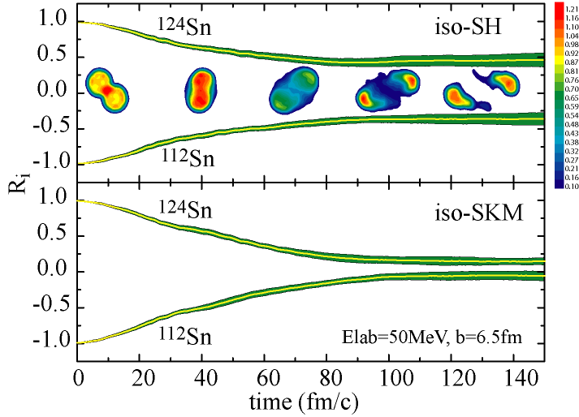

Fragmentation and isospin transport at Fermi energies (I)
symmetry energy
derivative
PLF
∇δ
TLF
Difference between
neutron and proton flow:
δ = $\frac{ρn−ρp}{ρ}$
→ Isospin diffusion: Asymmetry flow between projectile (PLF) and target (TLF)
stiff
stiff
¹²⁴Sn +¹¹²Sn, 50 AMeV
MSU data
R=1 no diffusion
soft
data
soft
R= 0 equilibrium
B.A. Li, L.W. Chen, Phys. Rev. C 72,
064611 (2005)
SMF
ImQMD
data
40
t (fm/c)
120
J. Rizzo et al., NPA(2008)
E. Galichet et al., PRC (2010)
B. Tsang et al., PRL 102 (2009)
Lynch & Tsang PLB 137098 (2022)

Slide 11
Fragmentation and isospin transport at Fermi energies (II)
Difference between
neutron and proton flow:
neck
δ = $\frac{ρn−ρp}{ρ}$
Isospin migration: Asymmetry flow from projectile (PLF) and target (TLF)
towards low-density neck
symmetry energy
derivative
Properties of ‘dynamically emitted’ (Dyn) neck fragments
b = 6 fm
E. De Filippo et al., PRC(2012)
( L = 75 MeV )
BLOB
(backward – forward) PLF emission
Dyn fragments
35 AMeV
stiff
soft
AMD
→ INDRA-VAMOS
Q.Fable et al.,
PRC 106 (2022)
New experiments
@ FRIB
PLF
FAZIA data
TLF
Napolitani, Colonna EPJ,117 (2016); P.Napolitani, NuSYm2022
S.Piantelli et al., PRC 103 (2021)

Slide 12

Higher order correlations and clustering
Explicit cluster degrees of freedom in transport theories:
analogy with real-time Green’s function theory → formation of light clusters,
treated as explict degrees of freedom
→ AMD, pBUU (Danielewicz and Bertsch, NPA 533, 712 (1991) - BUU (R.Wang et al, arXiv:2305.02988 and PRC2023)
Ex: α particles (loss term)
+ in-medium effects (Mott momentum)

Slide 13
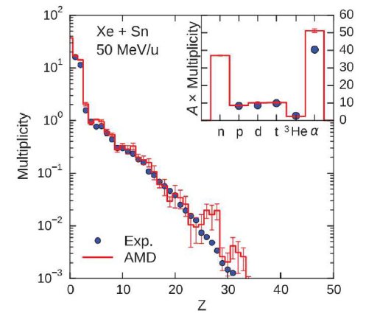
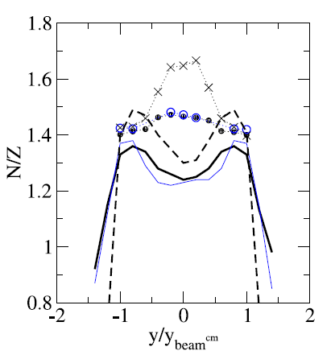
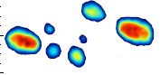
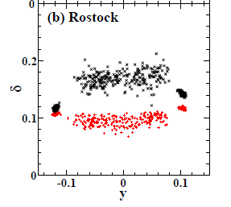
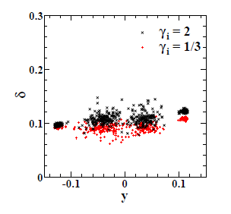
Effects of clustering on fragment features
central
IMF charge distribution well reproduced
by QMD models
and stochastic mean-field models
Light cluster production is sensitive to the
treatment of (higher order) n-n correlations
K. Zbiri, et al., PRC 75 (2007) 034612
Napolitani, Colonna
EPJ,117 (2016)
N/Z of IMF
AMD + clusters
A. Ono, Il Nuovo Cimento C 39 (2016) 390
A.Ono, PPNP 105 (2019)
N/Z of IMF
b= 6 fm
SMF
stiff
¹²⁴Sn +¹¹²Sn, 50 AMeV
soft
w/o clusters
(clusters)
ΔI
pBUU
stiff
ImQMD
Cluster effects
(d,t,He³)
soft
rapidity
Colonna et al, EPJ. A 50 (2014) 30, PPNP 2020
Coupland et al., PRC 84, 054603 (2011)

Slide 14
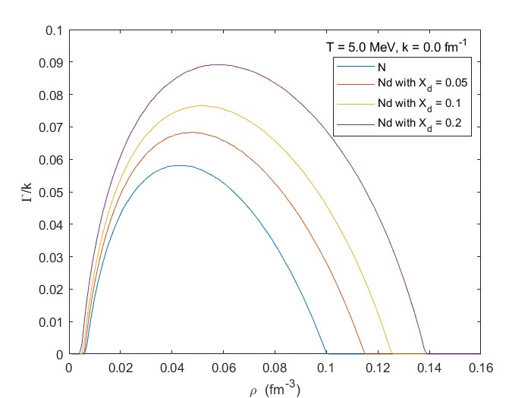
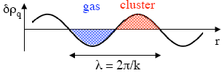
Impact of light clusters on spinodal instabilities
Linearized Vlasov equations for unstable nuclear matter including deuterons:
→ Faster instability growth in presence of light clusters
Response to density perturbations
T = 5 MeV
fragments
preliminary
Instability growth rate
Wang, Burrello, Colonna,
in progress

Slide 15
Relativistic Energies
(0.1 – 1 GeV/u)
high density regime

Slide 16
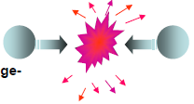
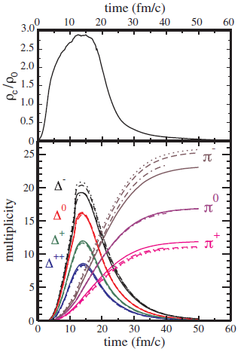
Impact of clustering on reaction dynamics at relativistic energies
Meson production can probe
the high density phase
Interplay with cluster emission !
stiff
E/A ~ 1 AGeV
soft
symmetry energy
¹³²Sn +¹²⁴Sn, 270 AMeV
@ RIKEN
→ Pion ratios
AMD
Ikeno, Ono, Nara, Onishi,
Phys. Rev. C 93 (2016)
Phys. Rev. C101 (2020)
Ferini et al, PRL97 (2006)

Slide 17
Summary and perspectives
Transport theories are crucial tools to link the nuclear effective interaction (and
EoS) to physical observables emerging from the HIC phenomenology
→ Strong synergy between theory and experiments
Comparison of transport models: TMEP project
towards model-independent predictions → robust constraints from HIC
Synergy with structure studies (same DFT often employed in structure and
reaction studies)
Merging constraints from structure, HIC and astrophysics
→ consistent description of all phenomena governed by the EOS
A. Sorensen et al., arXiv:2301.1325
Perspectives: higher order correlations
- Mechanisms of light clusters emission (important at both Fermi and
relativistic energies)
short range correlations (off-shell transport dynamics ?)
J.Lehr et al., PLB483 (2000) 324-330 S.Burrello and S.Typel, EPJA58 (2022) 120
W. Cassing, E.L. Bratkovskaya, PR 308 (1999) 65-233

Slide 18
Back-up slides

Slide 19
Meson production at relativistic energies: pion ratios
¹⁹⁷Au + ¹⁹⁷Au, 400 MeV/A, central collisions
soft
The π⁻/π⁺ratio follows the
N/Z ratio of the high density
matter
(being larger in the soft case)
stiff
stiff
soft
symmetry energy
Open problems …
π⁻/π⁺
- Δ and π potentials
Threshold effects can
reverse the trend !
soft
Hong & Danielewicz, PRC 90 (2014)
Guo et al., PRC 91 (2015)
Feng, EPJA 53 (2017)
Zhang & Ko, PRC 95 (2017)
Cozma, PRC 95 (2017)
Cozma and Tsang, EPJA309 (2021)
stiff
RBUU
(Song & Ko)
Width of Δ resonance
(off-shell transport)
……
M.D.Cozma et al., PLB 753 (2016)
Song & Ko, PRC 91 (2015)
Ferini et al., PRL 97 (2006)
W. Cassing, E.L. Bratkovskaya,
Phys.Rept. 308 (1999) 65-233

Slide 20
Meson production at relativistic energies: pion ratios
… short range correlations, clustering
stiff
soft
AMD
Ikeno, Ono, Nara, Onishi,
Phys. Rev. C 93 (2016)
Phys. Rev. C101 (2020)
symmetry energy
dcQMD
→ Exp data
→ Δ potential
fitted to data
stiff
@ RIKEN
Pion
ratio
soft
Transverse mom.
distribution
J.Estee et al., MD Cozma,
PRL 126 (2021)
0
200
400
Transverse momentum p_{T}(MeV/c)

Slide 21
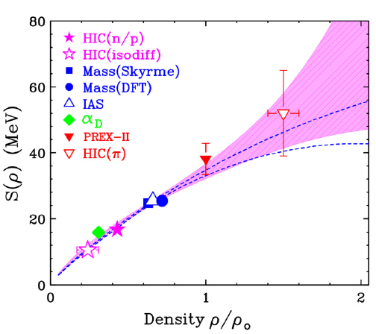
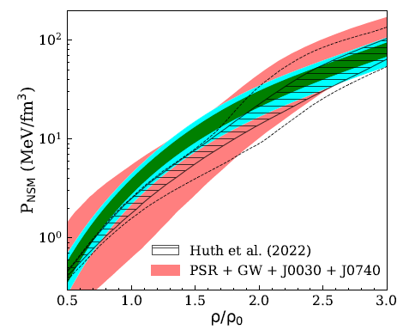
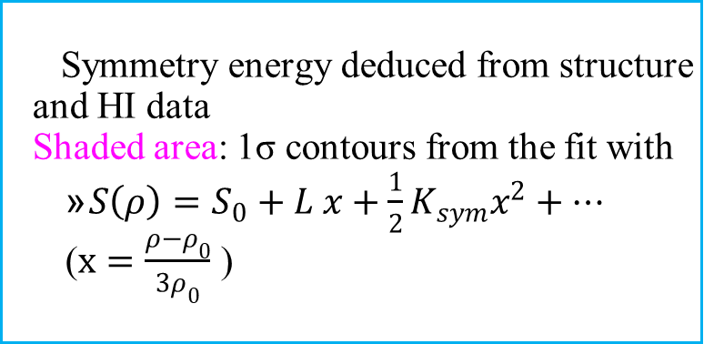
SE from structure, nuclear reactions and astrophysics
  Symmetry energy deduced from structure and HI data
  Shaded area: 1σ contours from the fit with
    $S\left(ρ\right)=S_{0}+L x+\frac{1}{2}K_{sym}x^{2}+…$
    ($x=\frac{ρ−ρ_{0}}{3ρ_{0}}$ )
Lynch & Tsang PLB 137098 (2022)
C.l. 68%
C.l. 95%
The pressure of neutron star matter
from a Bayesian analysis with:
only astro observations (red)
astro + structure + HIC data
(green and light blue)
Constraints from
nuclear structure +
HIC data !
C.Y.Tsang, INT Workshop – December 2022
S. Huth et al., Nature 606, 276 (2022)

Slide 22
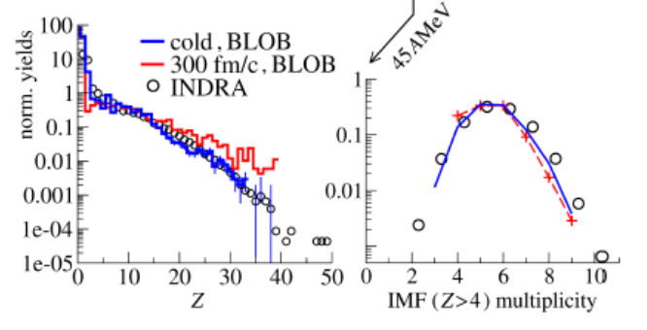
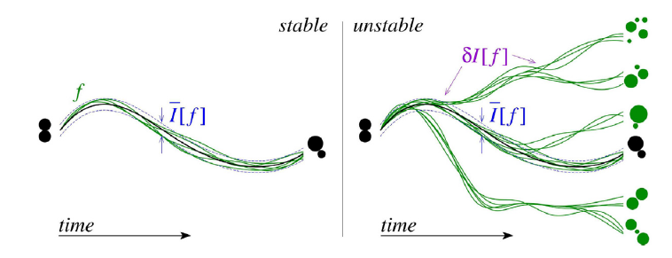
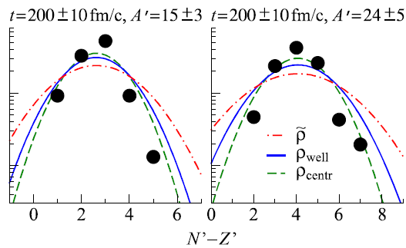

time
The role of fluctuations
Crucial role in presence of instabilities:
Symmetry breaking and fragment formation
→ Sensitivity to incompressibility K
Napolitani, Colonna
EPJ,117 (2016)
M.Colonna, PPNP113 (2020)
BLOB results
¹³⁶Xe + ¹²⁴Sn, central E/A = 45 MeV/A
Fluctuations lead to variances for fragment
distributions (ex: isotopic distributions)
yields (a.u.)
→ lower density
Napolitani, Colonna
PRC96, 054609 (2017)
δ = N – Z
symmetry energy

Slide 23
Heavy Ion Collisions: fragment emission
time
Density fluctuations
are amplified by the
unstable mean-field
¹³⁶Xe + ¹²⁴Sn, central E/A = 45 MeV/A
BLOB results
Napolitani, Colonna EPJ,117 (2016) M.Colonna PPNP113 (2020)
IMF charge distribution well reproduced
by QMD models
and stochastic mean-field models (K = 240 MeV)
AMD + clusters
K. Zbiri, et al., PRC 75 (2007) 034612
A. Ono, Il Nuovo Cimento C 39 (2016) 390
A.Ono, PPNP 105 (2019)

Slide 24
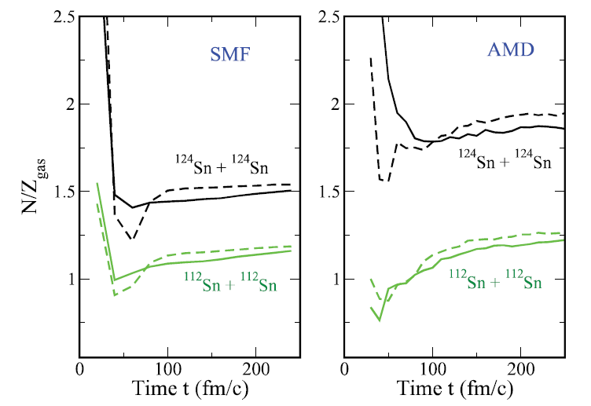
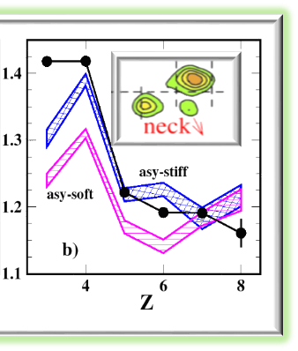
Effects of clustering on fragment features
N/Z _{gas}
central
A<5
A<5
Clustering effects more pronounced
in QMD → protons are bound in
heavier clusters
Larger N/Z of the «gas» phase
IMF are less n-rich in QMD
soft
stiff
Colonna, Ono, Rizzo
PRC 82 (2010) 054613
N/Z of IMF
E. De Filippo et al., PRC(2012)
A. Pagano et al., EPJA56 (2020)
b= 6 fm
¹²⁴Sn +¹¹²Sn, 50 AMeV
w/o clusters
(clusters)
ΔI
pBUU
<N/Z>
stiff
Cluster effects
(d,t,He³)
soft
SMF
Sn + Ni, 35 AMeV (LNS data)
Coupland et al., PRC 84, 054603 (2011)

Slide 25
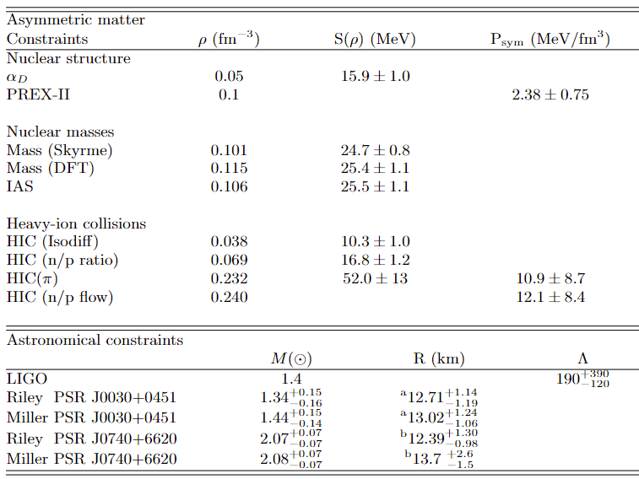
Constraints from structure, nuclear reactions and astrophysics
Z.Zhang and Chen., PRC 92 (2015)
B.T.Reed et al., PRL 126 (2021)
B.A.Brown (Skyrme), PRL 111 (2013)
Kortelainen et al (DFT), PRC 85 (2012)
Danielewicz et al, NPA 958 (2017)
B. Tsang et al., PRL 102 (2009)
J.Estee et al., MD Cozma,
PRL 126 (2021)
GW
B.P. Abbott et al., PRL 121 (2018)
Astro.Jou.Lett. 887 (2019)
M, R
Astro.Jou. 887 (2019)
Astro.Jou.Lett. 918 1.27(2021)
Astro.Jou.Lett. 918 1.28(2021)
C.Y.Tsang, Nusym22 conference (Catania)

Slide 26
Challenges for transport theories: TMEP
Quite complex: simulations with many technical details
Model dependence for some observables
Establish a sort of systematical theoretical error
Transport Model Evaluation (Comparison) Project -- TMEP
About 30 participants
Core group:
MC (Catania)
Dan Cozma (Bucharest)
Pawel Danielewicz & Betty Tsang (MSU)
C-M Ko and Z.Zhang (Texas A&M)
Akira Ono (Sendai)
Jun Xu (Shanghai)
Herman Wolter (Munich)
Yingxun Zhang (Beijng)
→ Calculations of Nuclear Matter
(box with periodic boundary conditions)
A.Ono et al., PRC 100, 044617 (2019)
M. Colonna et al., PRC, 104, 024603 (2021)
in progress

