Slide 1

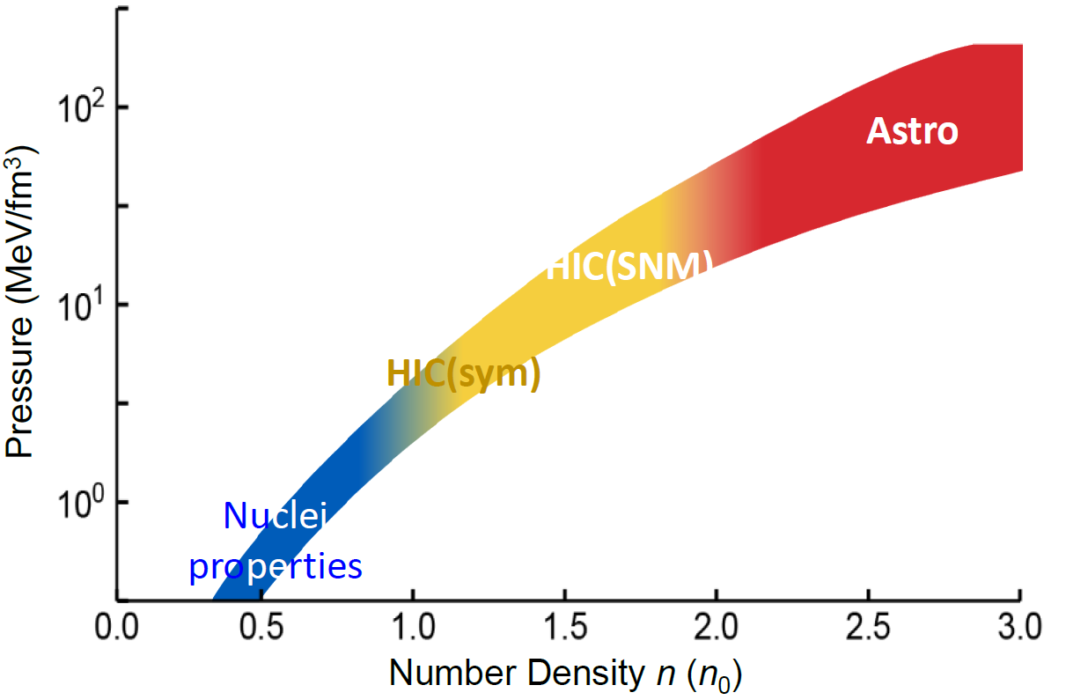
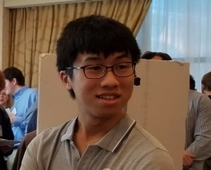
Tommy Tsang (Tsangc@FRIB.MSU.EDU)
The Nuclear Equation of State from experiments and Astronomical Observations
NuSym2023
GSI, Darmstadt
September 18-22, 2023zzz
PNM EOS

Slide 2
Betty Tsang (Tsang@FRIB.MSU.EDU)
The Nuclear Equation of State from Experiments and Astronomical Observations
Talk outline
Provide some details in extracting the nuclear EOS from experiments and astronomical observations
Sensitivity study on PREX and HIC measurements
New results on np effective mass splitting
New results on isoscaling
Summary
NuSym2023
GSI, Darmstadt
September 18-22, 2023
Overview talk on Monday by Bill Lynch
“Probing the EOS of n-rich matter”

Slide 3
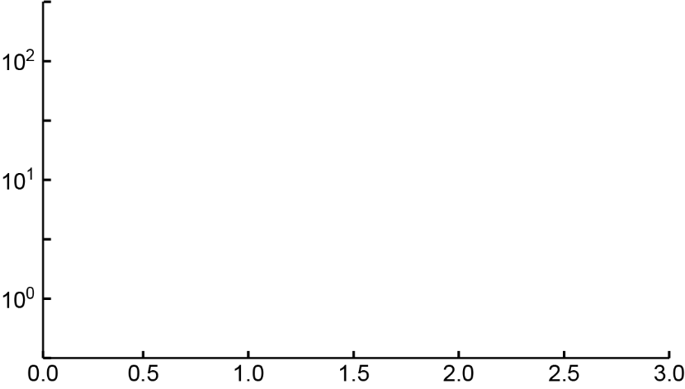

ε(ρ,δ=1)=ε(ρ,δ=0)+S(ρ)
Experimental & Astronomy Constraints
PNM
SNM
sym
PREX-II, IAS
Mass(Skyme)
Mass(DFT)
HIC(π)
HIC(n/p flow)
Λ(GW)
R(1.4M⊙)
R(2M⊙)
Pressure (MeV/fm³)
α_{D}
HIC(n/p)
HIC(FOPI),HIC(DLL)
HIC(isodiff)
n₀
E_{SAT}
K_{SAT}
Number Density n (n₀)

Slide 4
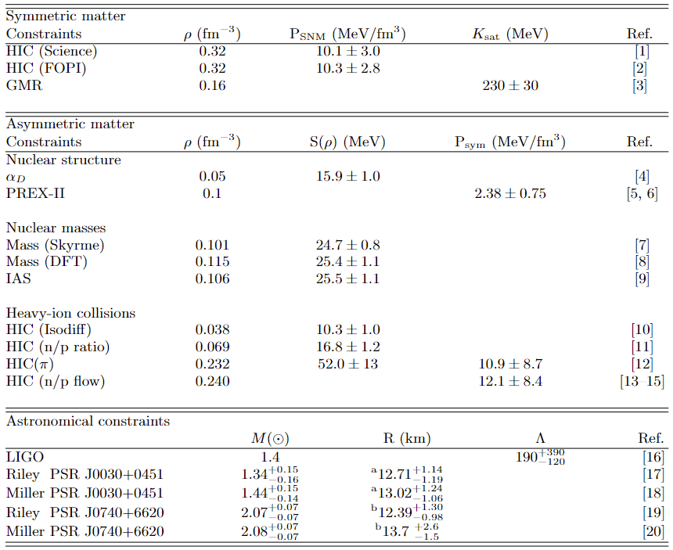


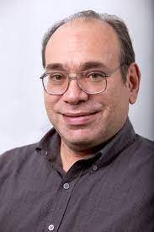
Nuclear structure, reactions, & Astro (15) constraints
Tommy Tsang
Bill Lynch
Rohit Kumar
Chuck Horowitz

Slide 5
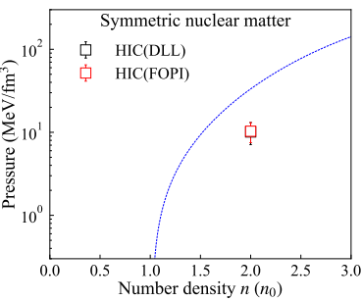
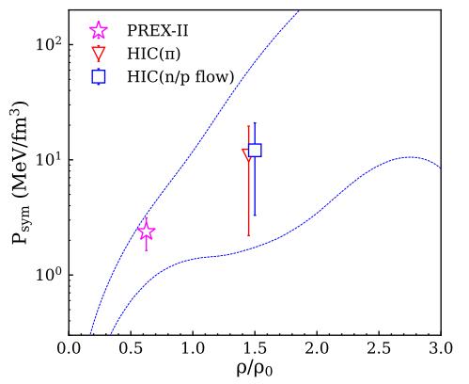
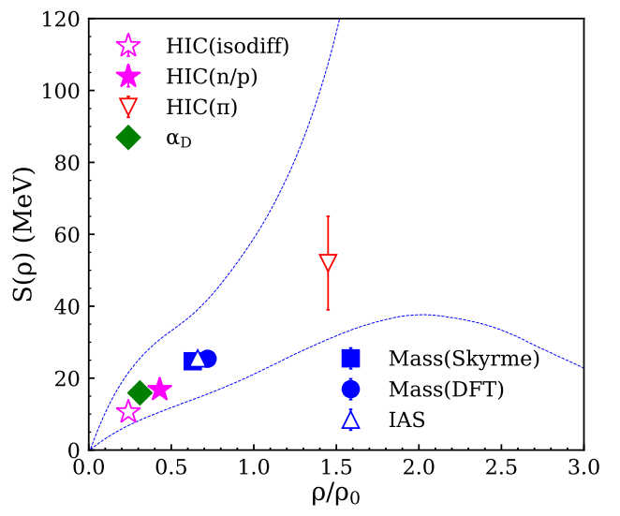
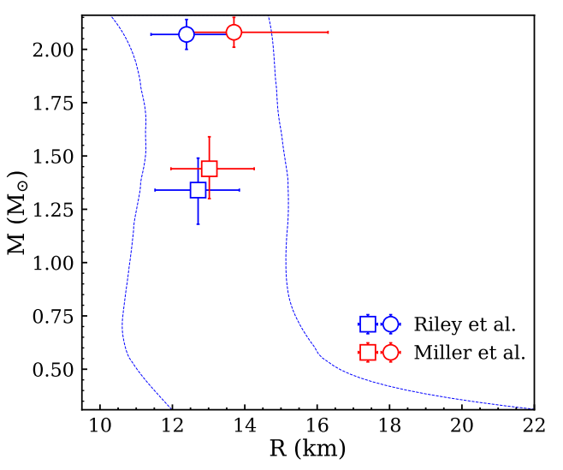
Nuclear structure, reactions, & Astro (15) constraints
EOS
PRIORS
NS model
Bayesian analysis
EOS parameters
Posteriors
with uncertainties

Slide 6




EOS parameters from metamodeling
E(ρ,δ) = E_{is}(ρ) + δ²⋅ E_{iv}(ρ); δ = (ρ_{n}- ρ_{p})/ (ρ_{n}+ ρ_{p}) = (N-Z)/A

Slide 7
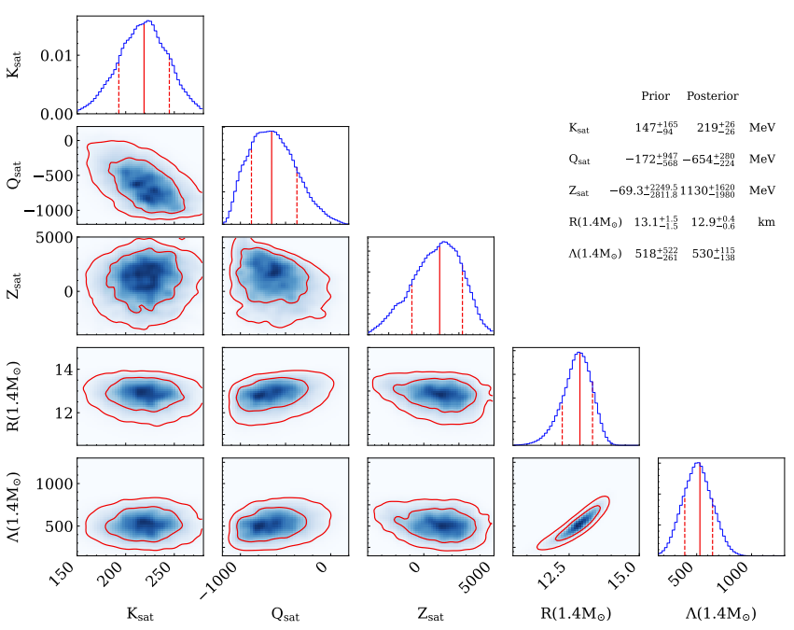
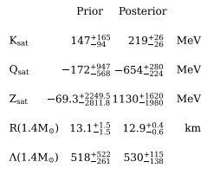
E(ρ,δ) = E_{is}(ρ,0) + δ²⋅ E_{is}(ρ,0); δ = (ρ_{n}- ρ_{p})/ (ρ_{n}+ ρ_{p}) ∝(N-Z)/A

Slide 8
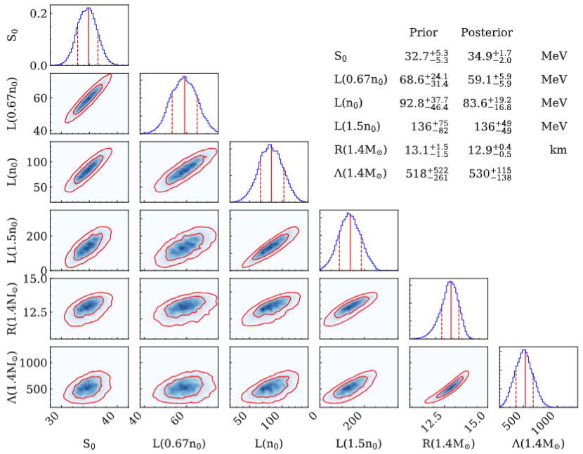
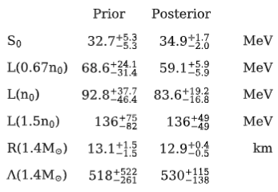
E(ρ,δ) = E_{is}(ρ,0) + δ²⋅ E_{is}(ρ,0); δ = (ρ_{n}- ρ_{p})/ (ρ_{n}+ ρ_{p}) = (N-Z)/A

Slide 9
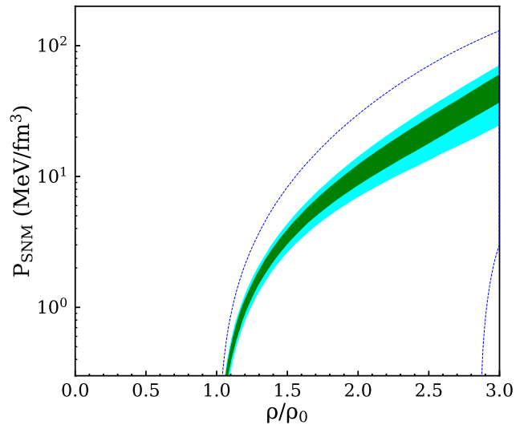
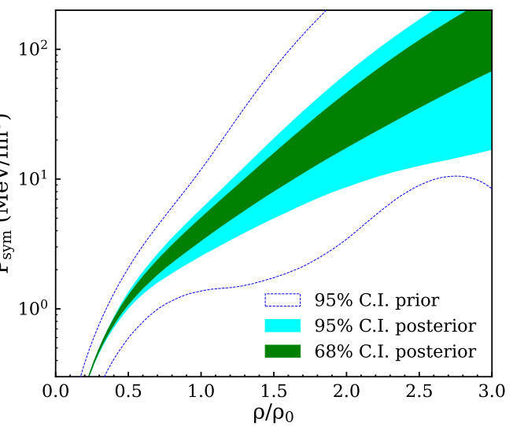
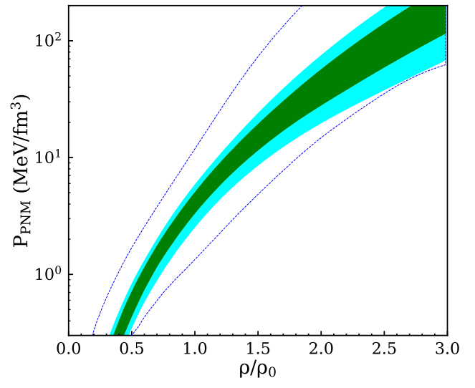
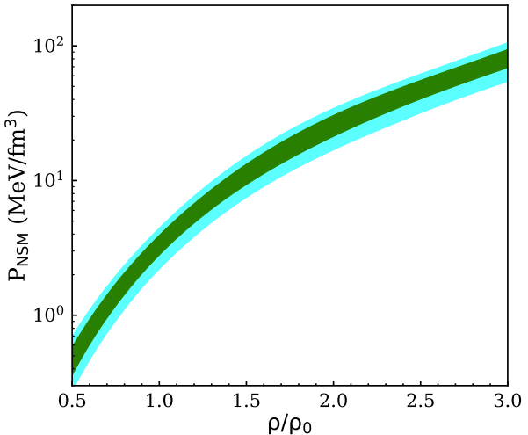
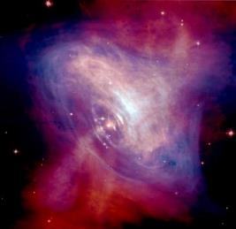
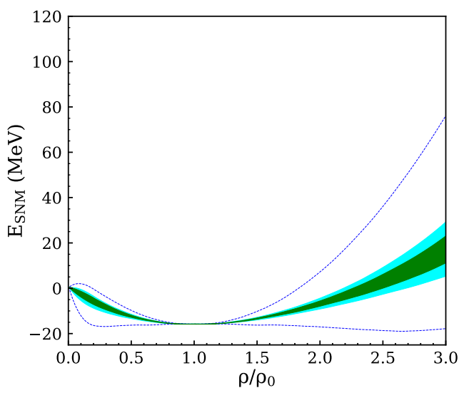
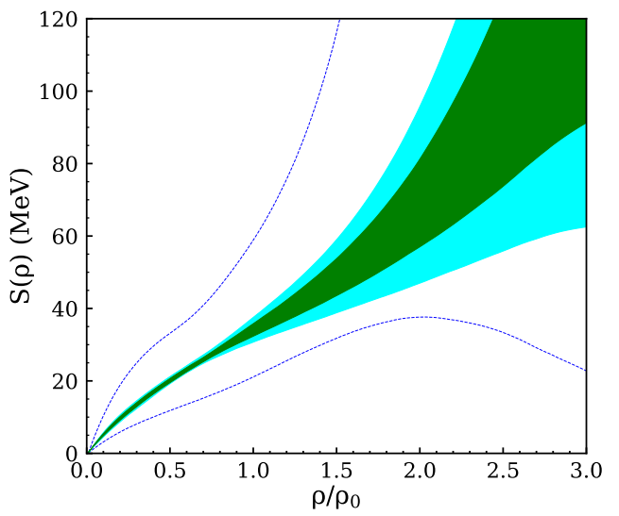
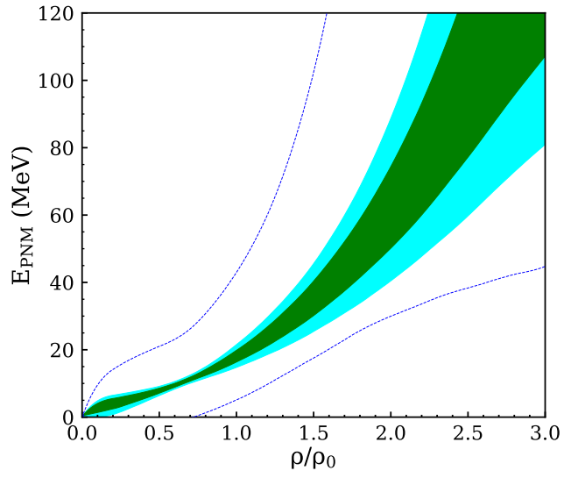
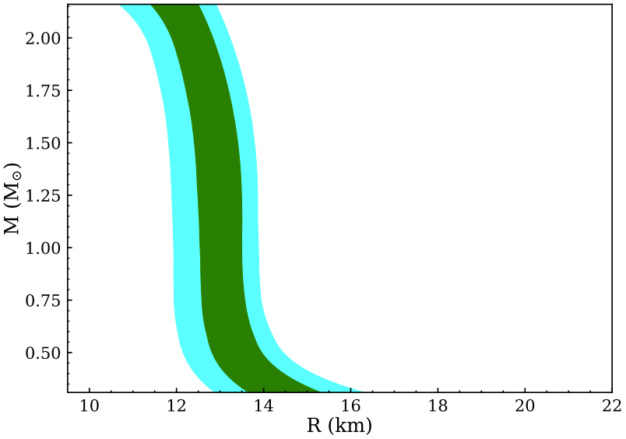
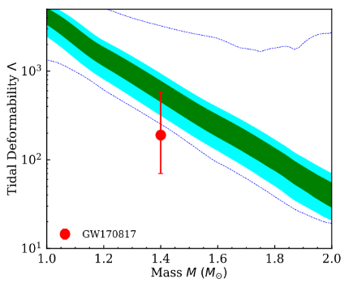
Equation of State of nuclear matter
E(ρ,δ) = E_{SNM}(ρ,0) + δ²⋅S(ρ); δ = (ρ_{n}- ρ_{p})/ (ρ_{n}+ ρ_{p}) = (N-Z)/A
Symmetric
Nuclear
Matter
Symmetry
Term
Pure
Neutron
Matter
Neutron Star Matter
Pressure (MeV/fm³)
Eo=-16 MeV;ρ₀=0.16
Ko=220±27 MeV
Qo=-669±305-218
So=-34±1.7 MeV
L=79±16 MeV
Energy (MeV)
1.4 solar mass
R=13±0.5 (km)
Λ=576±161
Ksym=0±115-86 MeV
Density (ρ₀)

Slide 10
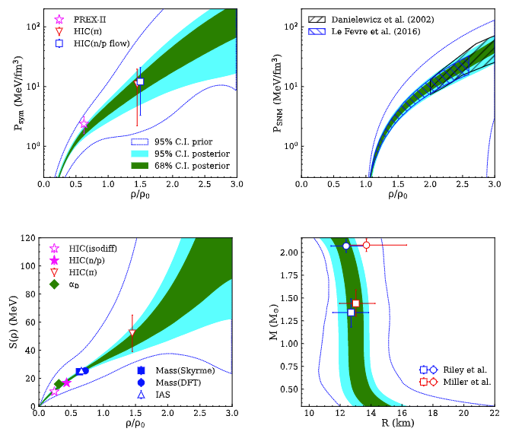
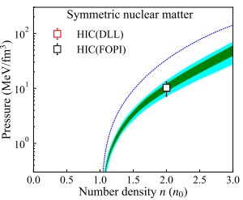
Posteriors of the parmeterized EOS using Bayesian analysis of the constraints + NS model.
68% & 95% distributions and agreements with data
P_sym > P_SNM
Symmetry term has large uncertainties at high densities

Slide 11
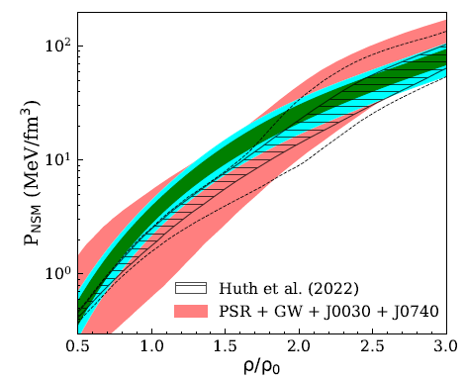
Comparisons with other neutron star EoS
Legred et al., Phys. Rev. D 104, 063003 (2021)
Non-parametric equation of states as priors.
Astrophysical observations are used as constraints
Huth, Pang et al., Nature 606, 279 (2022)
Prior distribution from the Chiral Effective Field theory (upto 1.5n₀); constant speed of sound model >1.5n₀.
Include HIC(FOURPI) & astrophysical observations as constraints

Slide 12
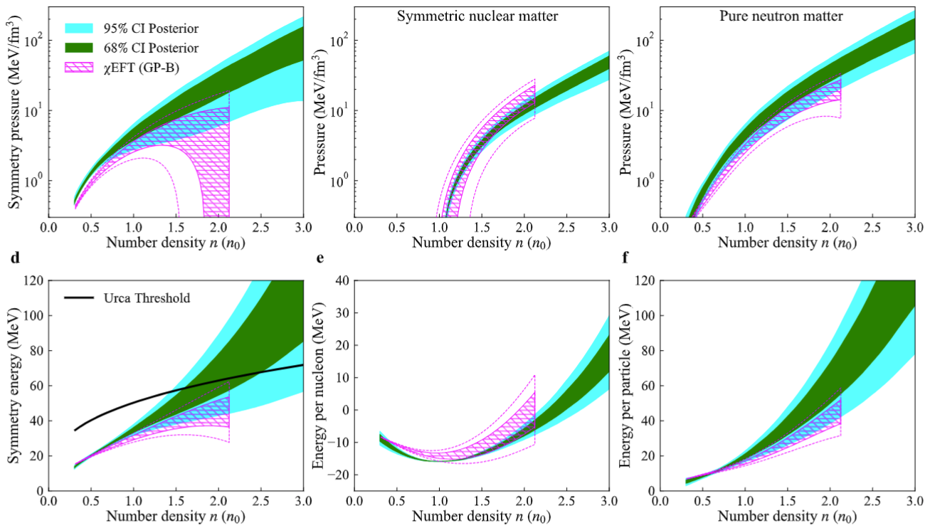

Challenges & Opportunities: Benchmarks for nuclear Theories
PRL 125, 202702 (2020); PRC 102, 054315 (2020); PRL 122, 042501 (2019)
Christian Drischler

Slide 13
ε(ρ,δ=1)=ε(ρ,δ=0)+S(ρ)
Sensitivity Studies
PREX-II, IAS
Mass(Skyme)
Mass(DFT)
HIC(π)
HIC(n/p flow)
Λ(GW)
R(1.4M⊙)
R(2M⊙)
Rohit Kumar
Pressure (MeV/fm³)
α_{D}
HIC(n/p)
HIC(FOPI),HIC(DLL)
HIC(isodiff)
n₀
E_{SAT}
K_{SAT}
Number Density n (n₀)

Slide 14
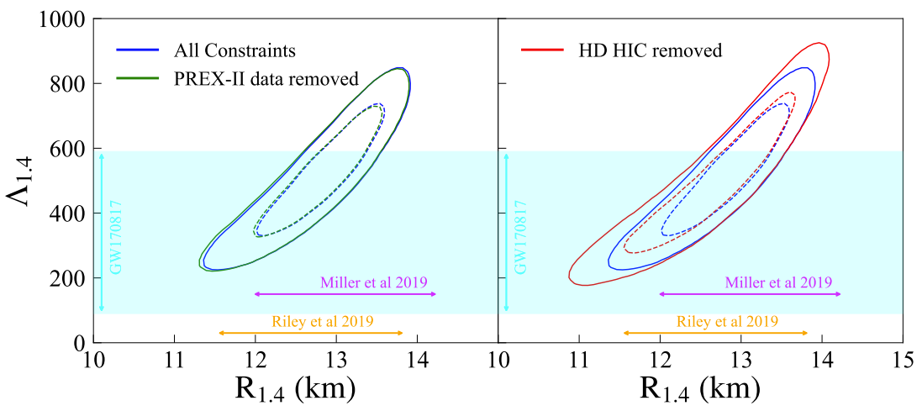
Sensitivity Studies
Rohit Kumar
Without PREX constraints,
there is little to no effect.
Without high density HIC constraints, uncertainties are much larger

Slide 15
Sensitivity Studies
Rohit Kumar
Without PREX constraints,
There is little to no effect.
Without high density HIC constraints, uncertainties are much larger

Slide 16


































Estee et al, PRL 126, 162701 (2021)
HIC(π)@1.5ρ₀
Jon Barney
Justin Estee
Suwat Tangwangchoen
Masanori Kaneko
JungWoo Lee
Genie Jhang
Yan Zhang
Pawel Lasko
RenSheng Wang
Tommy Tsang
https://groups.nscl.msu.edu/hira/cosmic/SpiritTPC.html

Slide 17
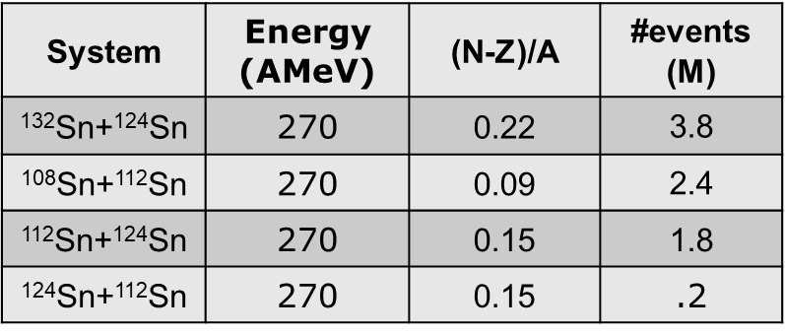
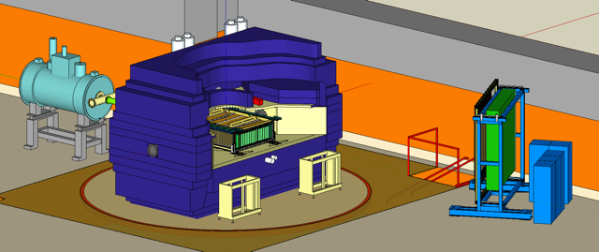
Collaboration
Beam direction
G. Jhang et al., J. Korean Phys. Soc. 69 (2016) 144
R. Shane et al., Nucl. Instr. and Meth. A 784 (2015) 513

Slide 18
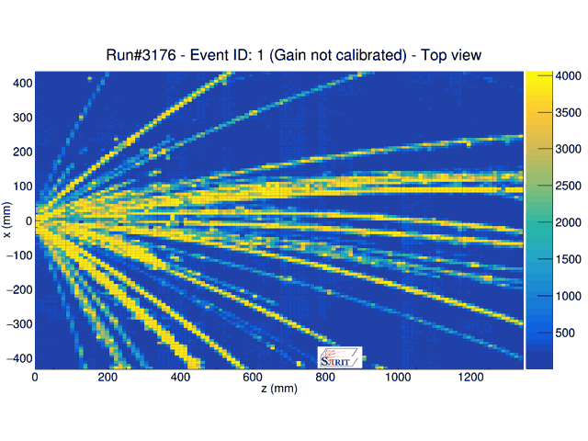
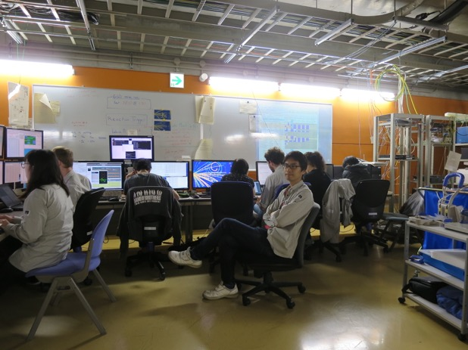
Collaboration
During the experiment
G. Jhang et al., PLB 813, 136016 (2021).
J. Estee et al., PRL 126, 162701 (2021).
M. Kaneko et al., PLB 822, 136681(2021).
M. Kaneko et al., NIMA 1039 167010(2022).
J.W. Lee et al. EPJA, 58 201(2022)
R. Shane et al., NIMA 784, 513 (2015).
G. Jhang et al., JKPS 69, 144–151 (2016).
S. Tangwangchoren et al. NIMA 853, 44–52 (2017).
P. Lasko et al., NIMA 856, 92 (2017).
T. Isobe et al., NIMA 899, 43 (2018).
J. Estee et al., NIMA 944, 162509 (2019).
C.Y. Tsang et al. NIMA 959, 163477 (2020).
J.W. Lee et al., NIMA 965, 163840 (2020).
J. Barney et al., RSI 92.6, 063302 (2021).

Slide 19
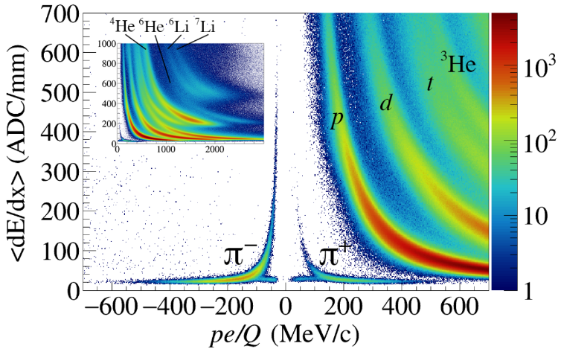
Collaboration
Observables from charged pion ratios
132Sn+124Sn
108Sn+112Sn
at 270 MeV/u
G. Jhang et al., J. Korean Phys. Soc. 69 (2016) 144
R. Shane et al., Nucl. Instr. and Meth. A 784 (2015) 513

Slide 20

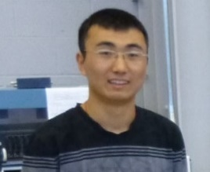

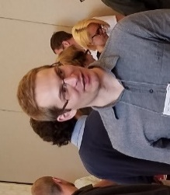
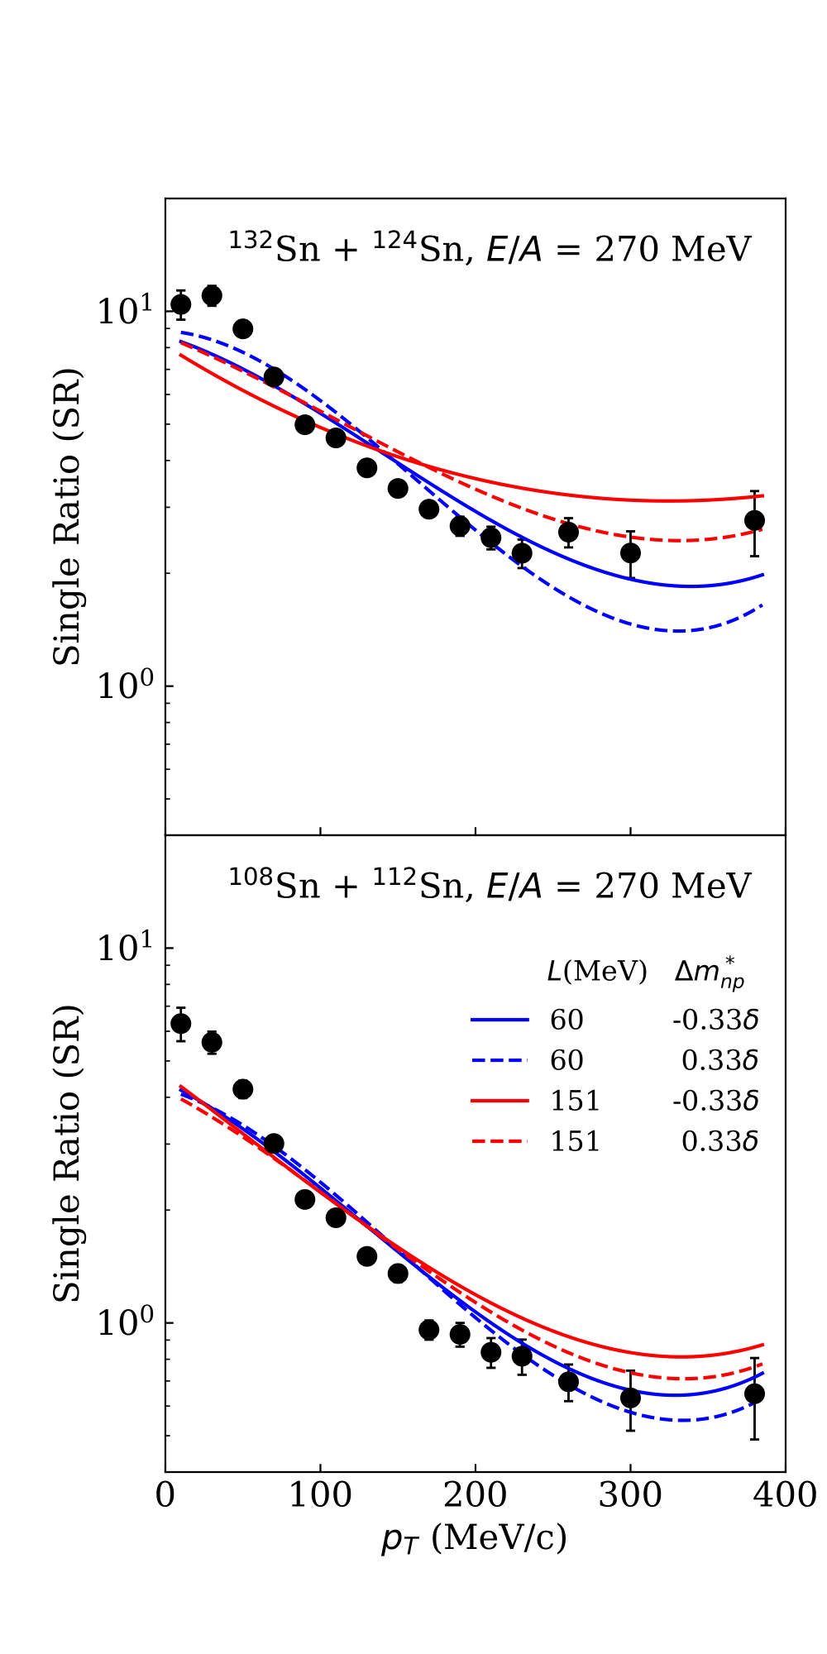
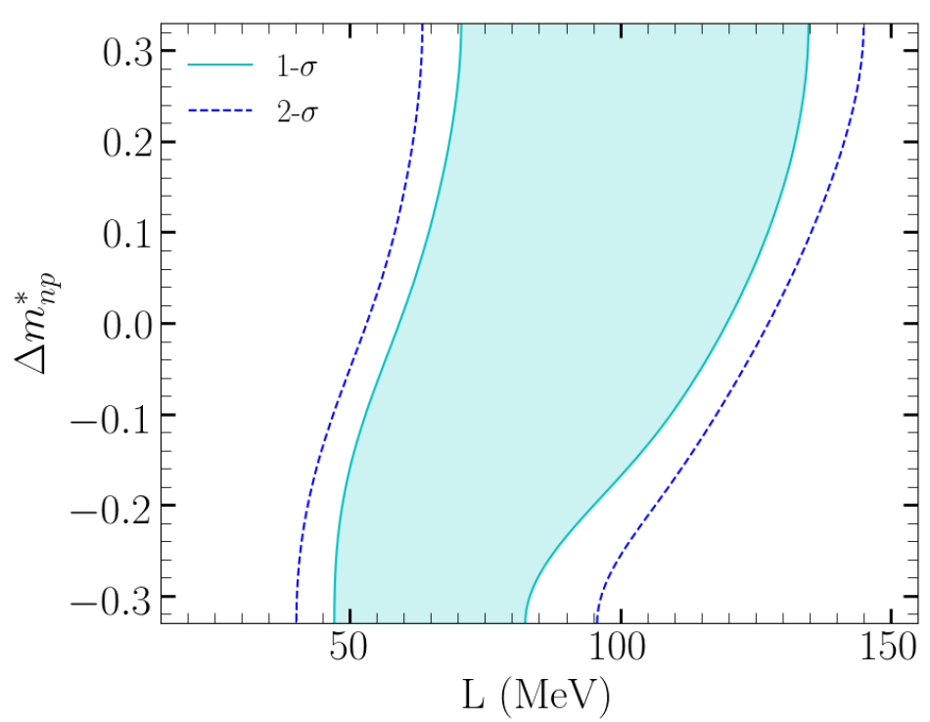
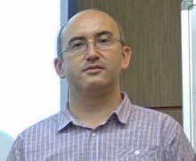
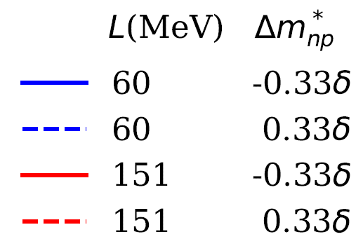
Lynch Jhang Wang
Barney Estee Tsang
Collaboration
Estee et al, PRL 126, 162701 (2021)
Dan Cozma:
dcQMD

Slide 21
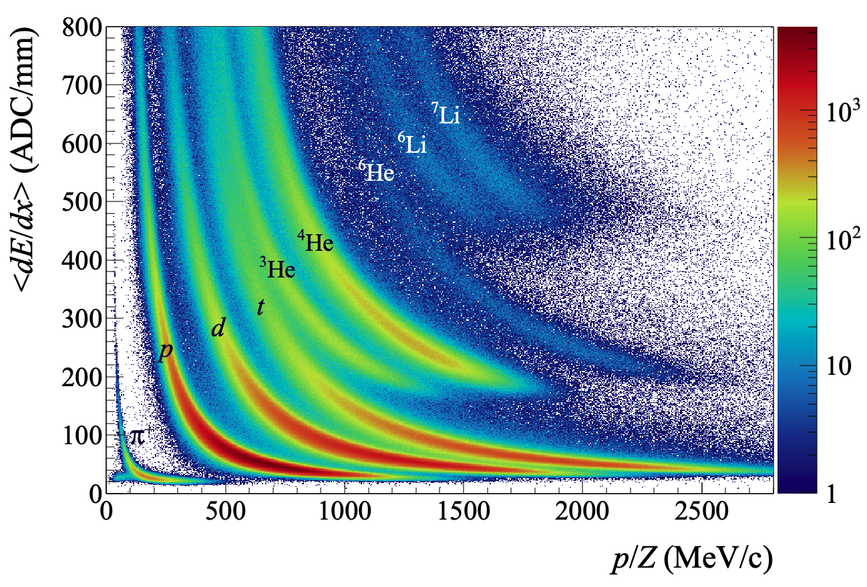
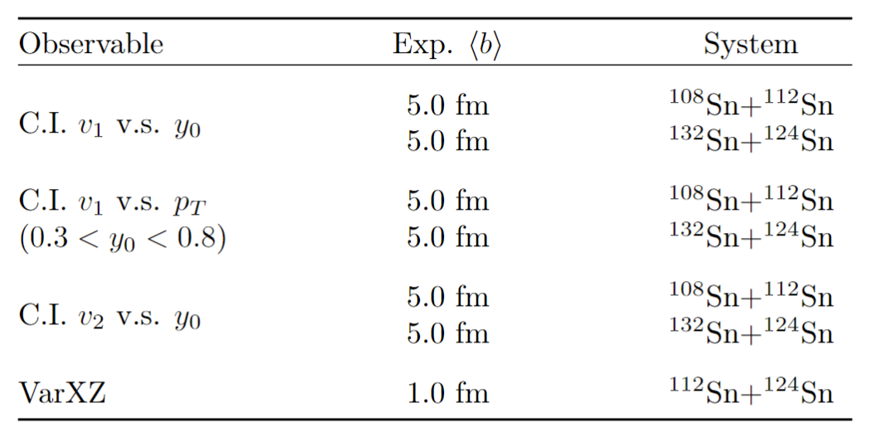

Collaboration
YX Zhang Tsang

Slide 22
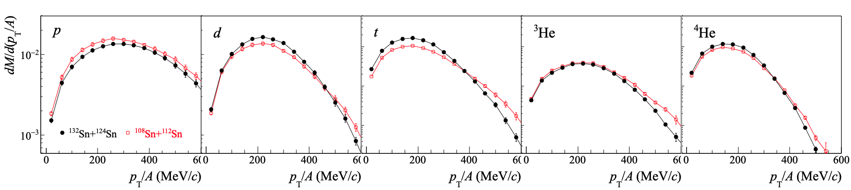
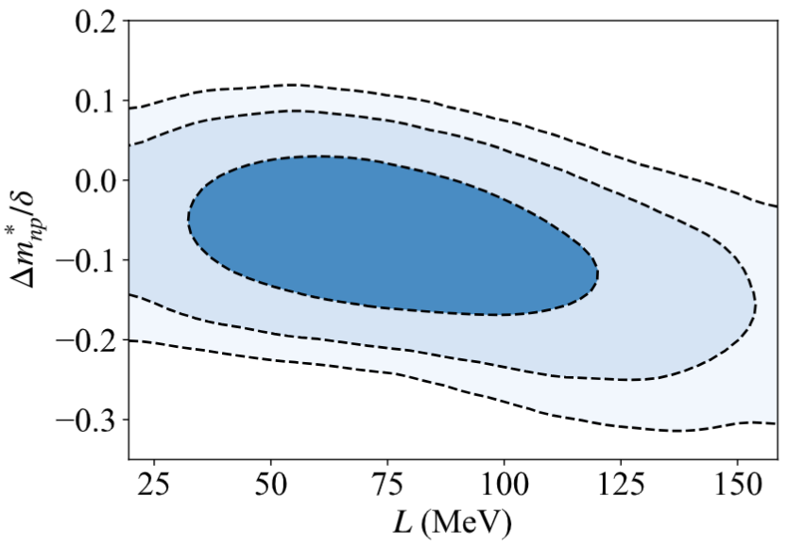
Lynch Jhang Wang
YX Zhang Tsang
Y.C. Tsang et al, submitted to PLB
Collaboration
Observables+ImQMD➔Bayesian analysis

Slide 23
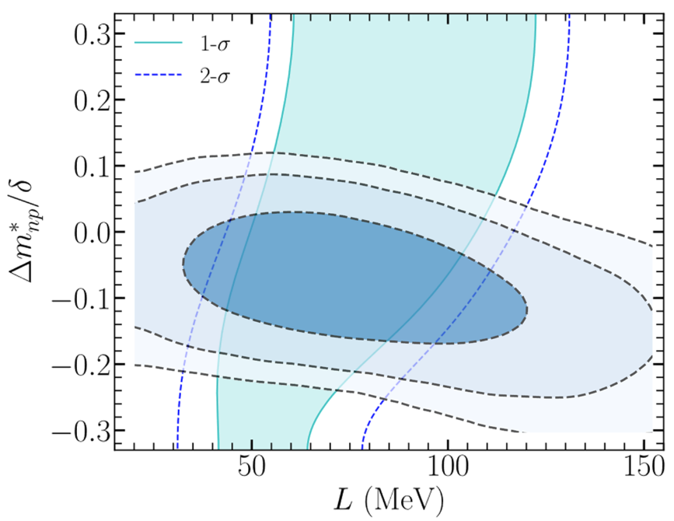
Lynch Jhang Wang
YingXun Cozma Estee Tsang
Collaboration
Dan Cozma: dcQMD
Two different constraints correlations are orthogonal to each other producing a nice overlapped region.
Different definitions of effective masses splitting in different codes
Need to be resolved in transport codes – in progress
YingXun Zhang:
ImQMD
Estee et al, PRL 126, 162701 (2021)

Slide 24
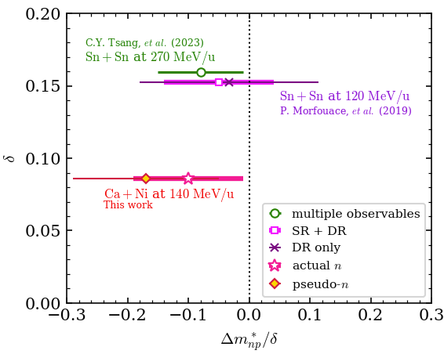

Lynch Jhang Wang
Observables+ImQMD➔Bayesian analysis
Fanurs Teh Estee Tsang
Diverse set of data with different systems, different observable at different energy
Results are consistent with b/p splitting slightly negative
Data is consistent
Transport Model Proof?

Slide 25
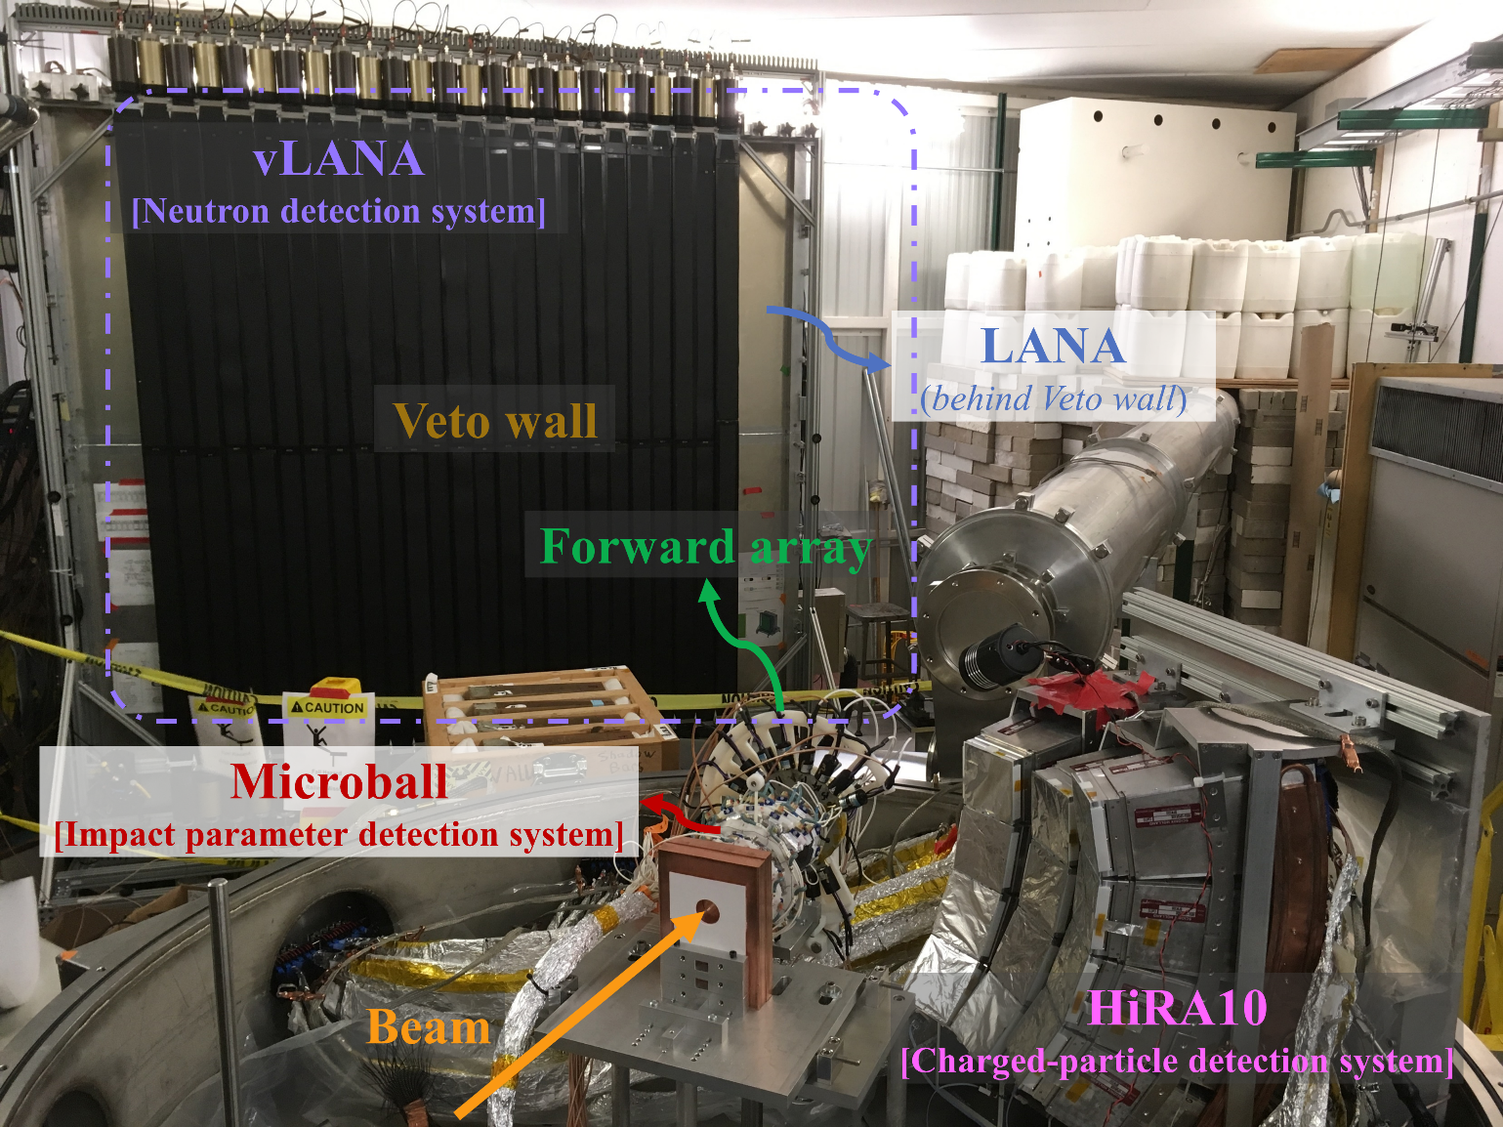
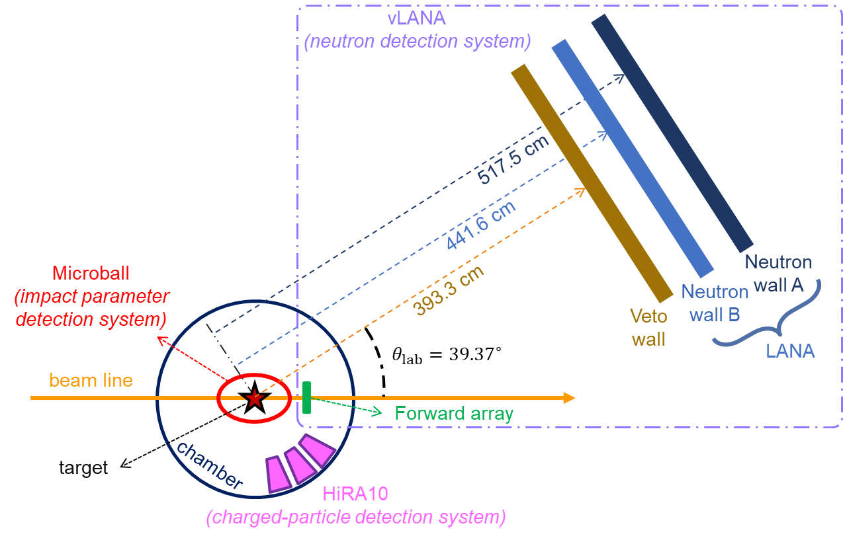
Experimental Setup – NSCL (FRIB) experiment

Slide 26

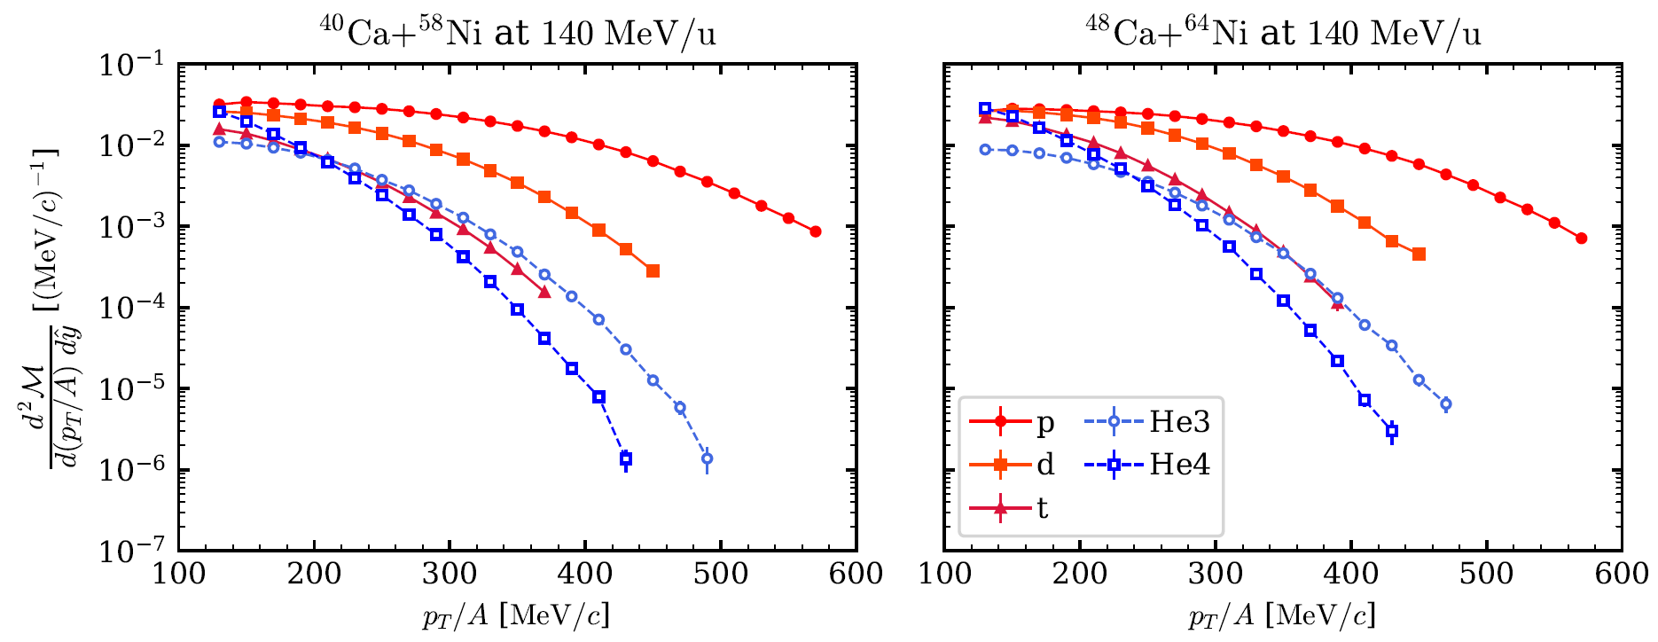
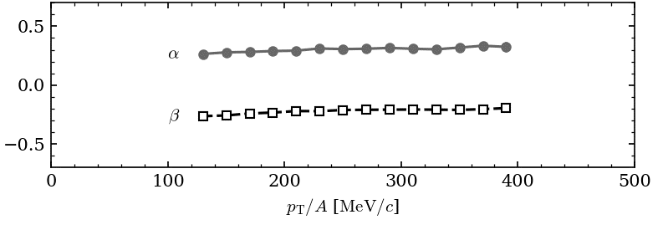

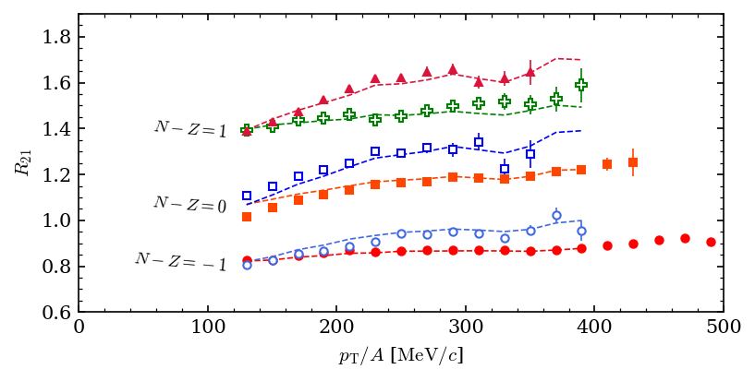


Isoscaling
Fanurs Teh
Rensheng Wang
$$R_{21}=\frac{Y_{2}\left(N,Z\right)}{Y_{1}(N,Z)}=C\exp\left(αN+βZ\right)$$
t
n
⁴He
d
³He
p

Slide 27





Isoscaling
$$R_{21}=\frac{Y_{2}\left(N,Z\right)}{Y_{1}(N,Z)}=C\exp\left(αN+βZ\right)$$
at 270 MeV/u
Kaneko; JungWoo Lee
J.W. Lee et al. EPJA, 58 201(2022)

Slide 28
Conclusion: Comprehensive cold EOS is in sight
In past decade
Astro
Great new instruments: LIGO/VIRGO & NICER ⇒great measurements.
Advances which connect experimental constraints for symmetric matter and asymmetric matter to neutron star.
Near Future
HIC(SNM)
HIC(sym)
Improvements/breakthroughs in transport model simulations.
New neutron star measurements (O4) & update of symmetric matter constraints from Hades, BES …
Improvement of symmetry energy constraints around 1.5 to 3 rho_0 (FRIB, FRIB400, RIKEN,SIS).
NEW facility (FRIB400?, FAIR), NEW experiments and NEW theories to explore the golden era of neutron star physics with HIC .
Nuclei properties

Slide 29

Nuclear structure, reactions, & Astro (15) constraints
Great science is built on the shoulder of giants.

Slide 30
The Facility for Rare Isotope Beams (FRIB) at Michigan State University (MSU) is seeking outstanding candidates for a junior faculty position at the rank of assistant professor in theoretical nuclear science establishing a program in reaction theory for energetic central reactions.
https://careers.pageuppeople.com/782/cw/en-us/job/516103/assistant-professorfribnscl-faculty

