Slide 1
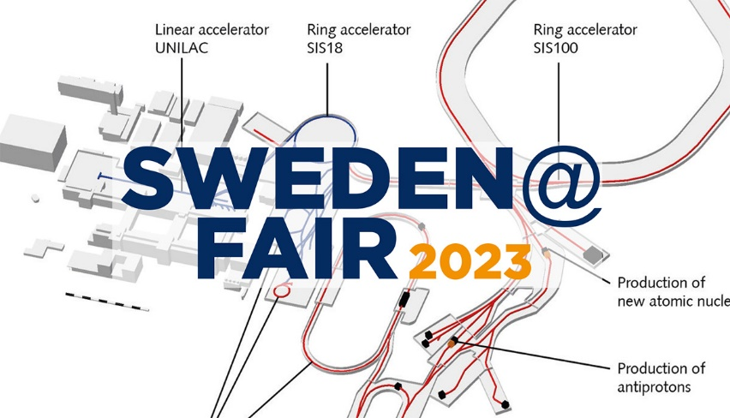



Slide 2

Time
9:00 – 9:20 | Presentation of the FAIR project, especially accelerator procurement – J. Blaurock
9:20 – 9:30 | Goals of the meeting – F. Engelmark and S. Utermann
9:30 – 10:00 | Company pitches, 3 minutes each - industry delegates
10:00 – 10:20 | SIS 100: status, plans, challenges, hopes, help needed – P. Spiller
10:20 – 10:40 | Super FRS: status, plans, challenges, hopes, help needed – H. Simon
10:40 – 11:00 | Fika & group photograph
11:00 – 11:15 | CBM: status, plans, challenges, hopes, help needed – P. Gasik
11:15 – 11:30 | NuStar: status, plans, challenges, hopes, help needed – J. Gerl
11:30 – 11:45 | APPA: status, plans, challenges, hopes, help needed – A. Bräuning-Demian
11:45 – 12:00 | Commissioning: status, plans, challenges, hopes, help needed – S. Reimann
12:00 – 13:00 | Lunch and discussions with SPLs | Trade exhibition (Foyer)
13:00 – 14:15 | Discussions with SPLs | Trade exhibition (Foyer) | Closed session (BK1, 4th floor) – invitation only
14:00 – 14:30 | Coffee is available
14:30 – 16:30 | Site tour: meet in the foyer
17:00 | End of event; bus departs for the airport.

Slide 4


Quick quiz!

Slide 5
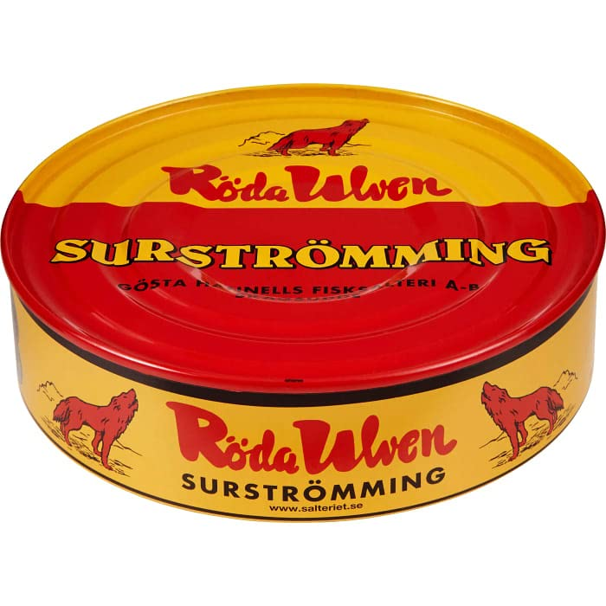
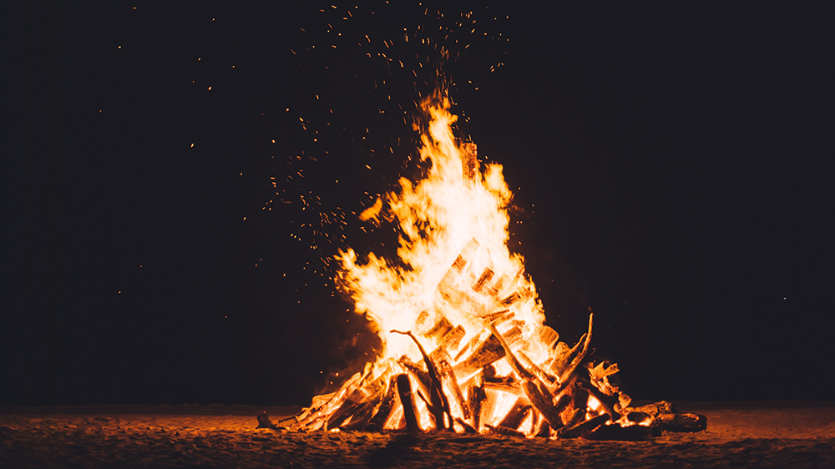


For the Germans: What does the word “Fika” mean?
2
1
3
4

Slide 6
For the Germans: What does the word “Fika” mean?
2
1
3
4

Slide 7



For the Swedes: What does the word “Notausgang” mean?
1
3
2
You will never find your way out
You are not allowed to leave

Slide 8

For the Swedes: What does the word “Notausgang” mean?
1
3
2
If the fire alarm goes off, the assembly points are in the car park

Slide 9
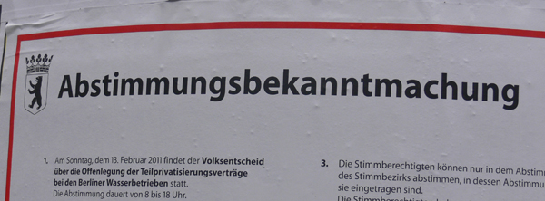
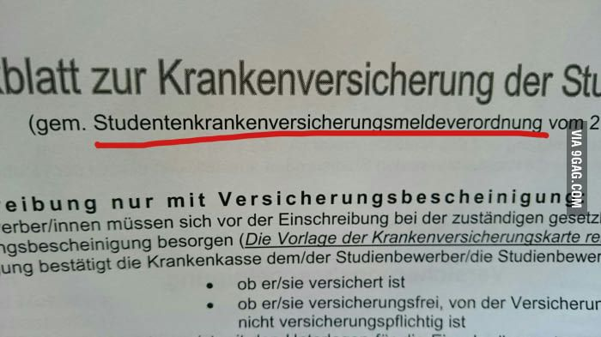
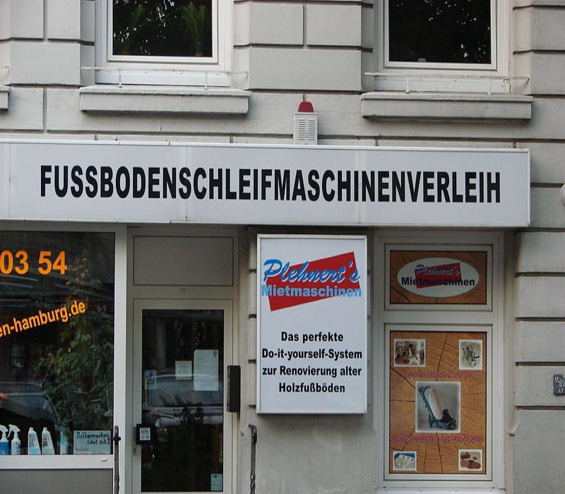
For the Swedes: what does the word “Veröffentlichungseinwilligungsformular” mean?
2
1
3

Slide 10
For the Swedes: what does the word “Veröffentlichungseinwilligungsformular” mean?
Group photo during the fika at 10:40
and during the site tour
if you don’t want us to publish your picture on social media, don’t be in the picture!

Slide 11
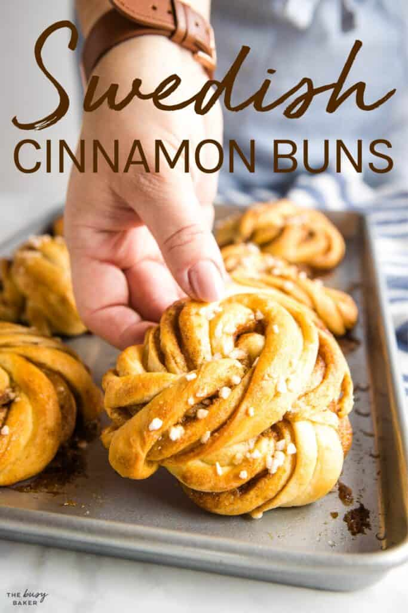

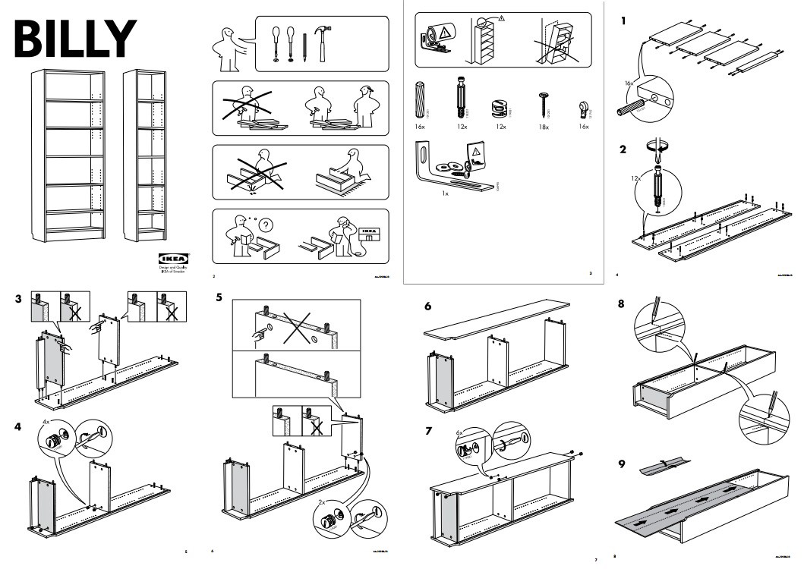

For the Germans: What is “the Swedish Guide”?
1
2
3
4

Slide 12
For the Germans: What is “the Swedish Guide”?
1
2
3
4

Slide 13
Delegates from industry and research
Time | Company/institution | Exhibition?
9:30 – 9:33 | Fagerström Industrikonsult
9:33 – 9:36 | RISE (TBC)
9:36 – 9:39 | Teledyne SP services | yes
9:39 – 9:42 | Scanditronix Magnet
9:42 – 9:45 | Chalmers University
9:45 – 9:48 | RFR Solutions
9:48 – 9:51 | The Quantum Group
9:51 – 9:54 | Exir Broadcasting | yes
9:54 – 9:57 | ScandiNova Systems | yes
More about Swedish Big Science capabilities here: www.bigsciencesweden.se

Slide 15
Time
9:00 – 9:20 | Presentation of the FAIR project, especially accelerator procurement – J. Blaurock
9:20 – 9:30 | Goals of the meeting – F. Engelmark and S. Utermann
9:30 – 10:00 | Company pitches, 3 minutes each - industry delegates
10:00 – 10:20 | SIS 100: status, plans, challenges, hopes, help needed – P. Spiller
10:20 – 10:40 | Super FRS: status, plans, challenges, hopes, help needed – H. Simon
10:40 – 11:00 | Fika – coffee break – group photograph
11:00 – 11:15 | CBM: status, plans, challenges, hopes, help needed – P. Gasik
11:15 – 11:30 | NuStar: status, plans, challenges, hopes, help needed – J. Gerl
11:30 – 11:45 | APPA: status, plans, challenges, hopes, help needed – A. Bräuning-Demian
11:45 – 12:00 | Commissioning: status, plans, challenges, hopes, help needed – S. Reimann
12:00 – 13:00 | Lunch and discussions with SPLs | Trade exhibition (Foyer)
13:00 – 14:15 | Discussions with SPLs | Trade exhibition (Foyer) | Closed session (BK1, 4th floor) – invitation only
14:00 – 14:30 | Coffee is available
14:30 – 16:30 | Site tour: meet in the foyer
17:00 | End of event; bus departs for the airport.

