Slide 1
Photo: G. Otto/GSI
  France at FAIR
  Technology Transfer
  at GSI and FAIR
  Rebecca Lang, Innovation Manager,
  Technology Transfer Staff Unit
  GSI Helmholtz Center for Heavy Ion Research GmbH
  Darmstadt, 19th April 2023

Slide 2





Transfer of Science to Society

Slide 3



GSI/FAIR Technology Transfer
Areas of Activities
Transfer via cooperation
Transfer of competences
Transfer of property rights and other IP
Transfer via start-ups/spin-offs
Utilisation
of
technologies
and know-how
Collaboration
with industry
Contract
research and manufacturing
Services
and sales

Slide 4
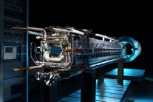
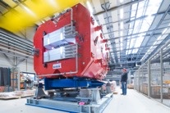
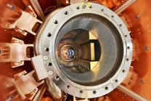
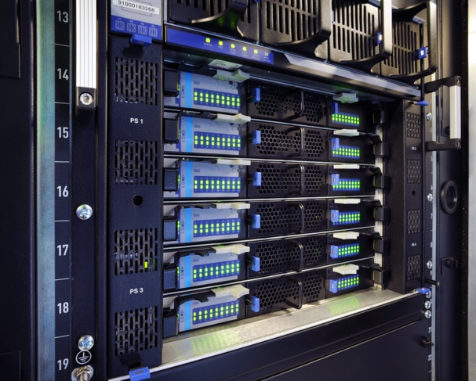
High-Tech for FAIR
Offer of Technologies, Know-how and Competencies
Superconductivity/
Cryotechnology
Magnet technology
Vacuum technology
IT-Technology/
Data processing
Electrical/
Energy technology
High-voltage/high-power pulse technology
Space Research
Nano
technology
High-frequency/ communications technology
Detector
technology
Laser
technology
(Micro-)
Electronics
Control/regulation engineering
Metrology/
Sensors
Medical
technology
Accelerator technology
Notes:
Applications in health applications and cancer therapy

Slide 5


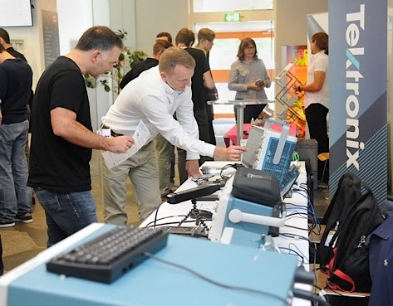








GSI/FAIR Roadshow
Industrial Exhibition & Networking
*2020-21 COVID-19 Break

Slide 6
GSI/FAIR Roadshow
Industrial Exhibition & Networking
Thursday, 20th July 2023
Thursday, 14th September 2023
Thursday, 16th November 2023
Info: https://www.gsi.de/work/administration/stabsabteilungen_stellen/technologietransfer/roadshow
Contact: roadshow@gsi.de

Slide 7


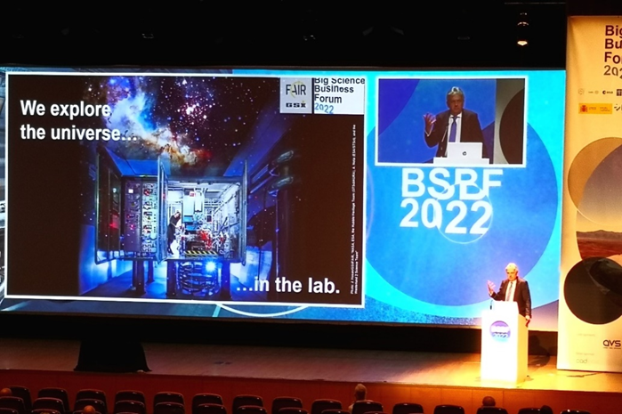

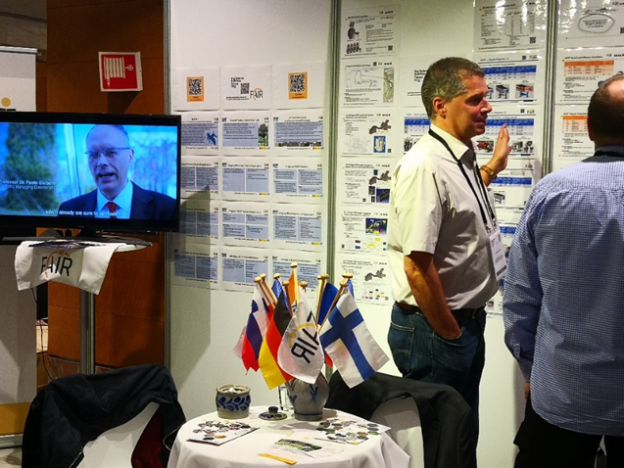



Talking to industry and finding partners
Industrial Exhibitions, AIMEs, Networks & Ecosystems

Slide 8
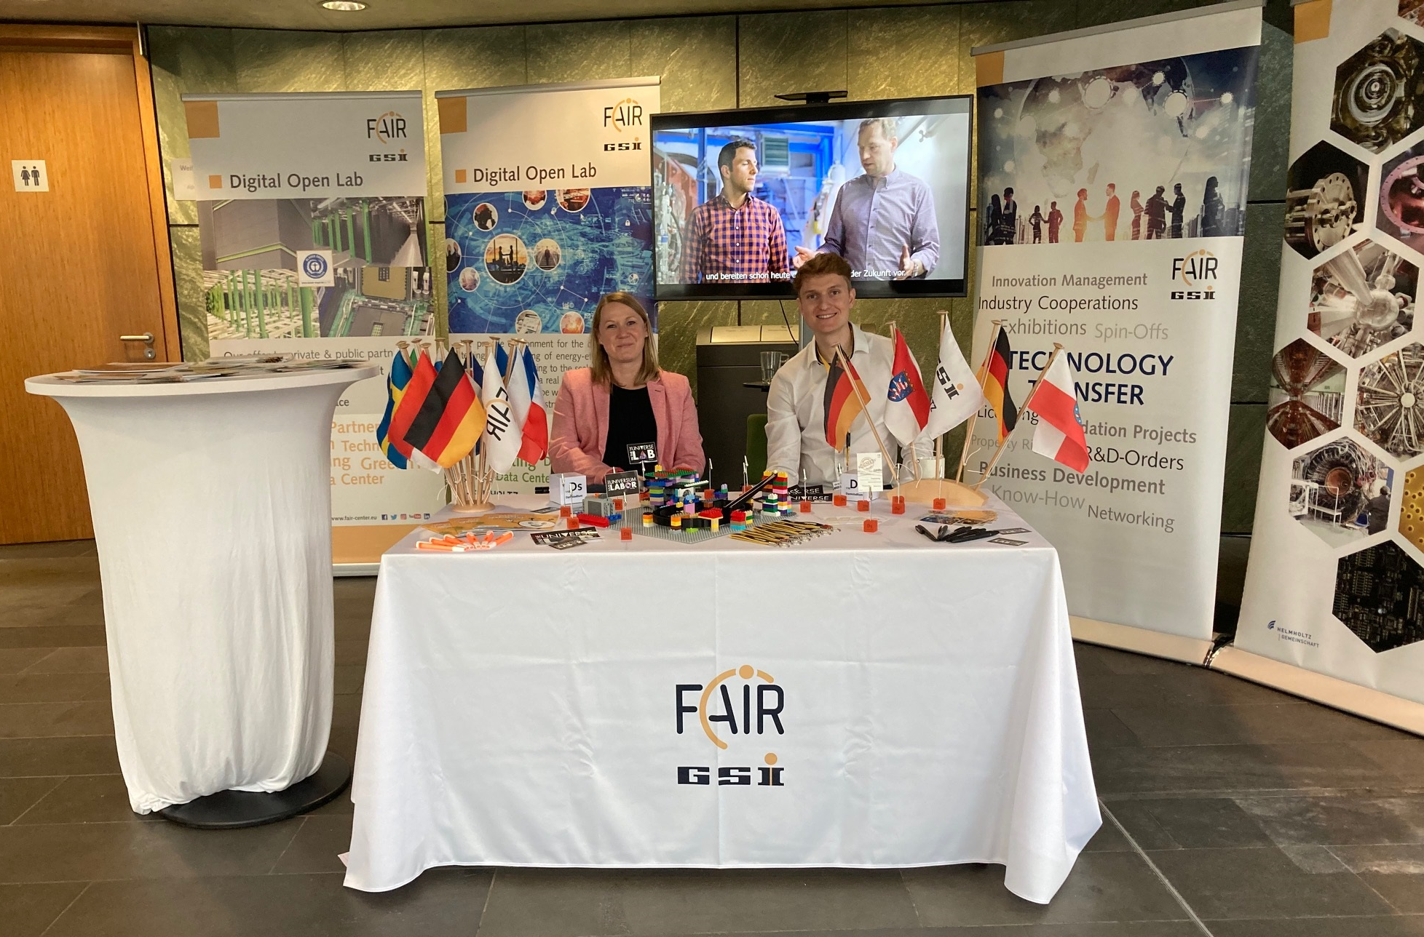
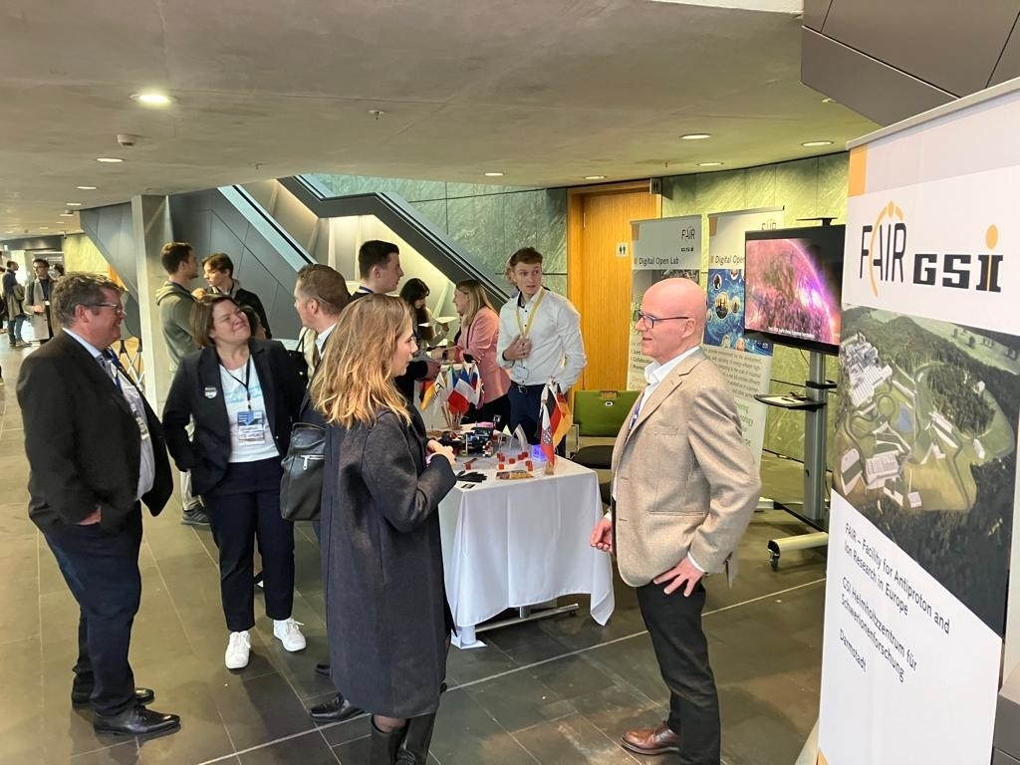
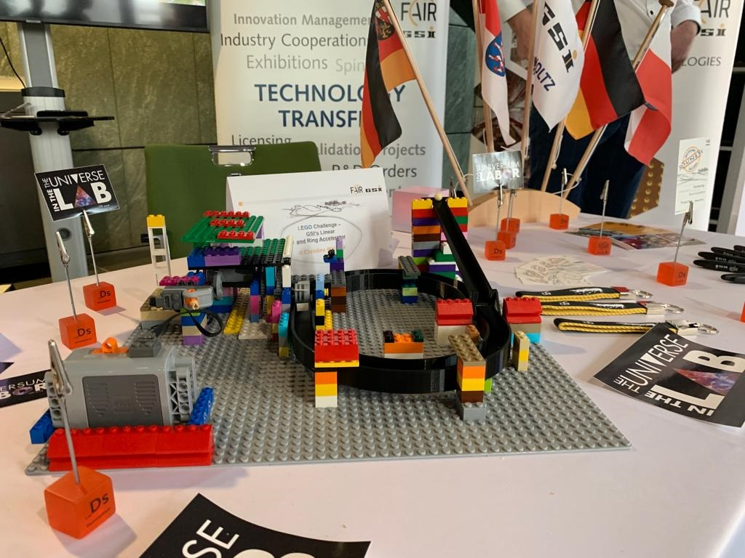

Slide 9
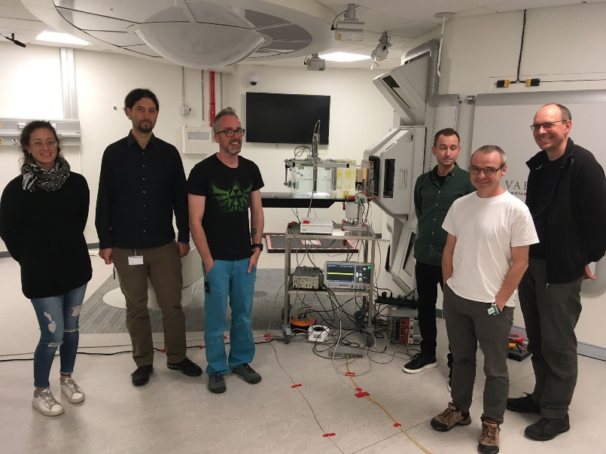

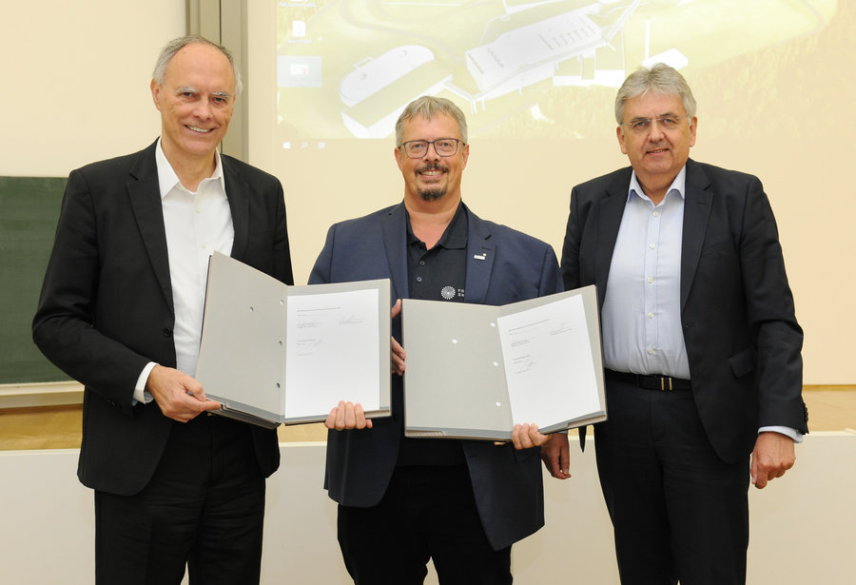

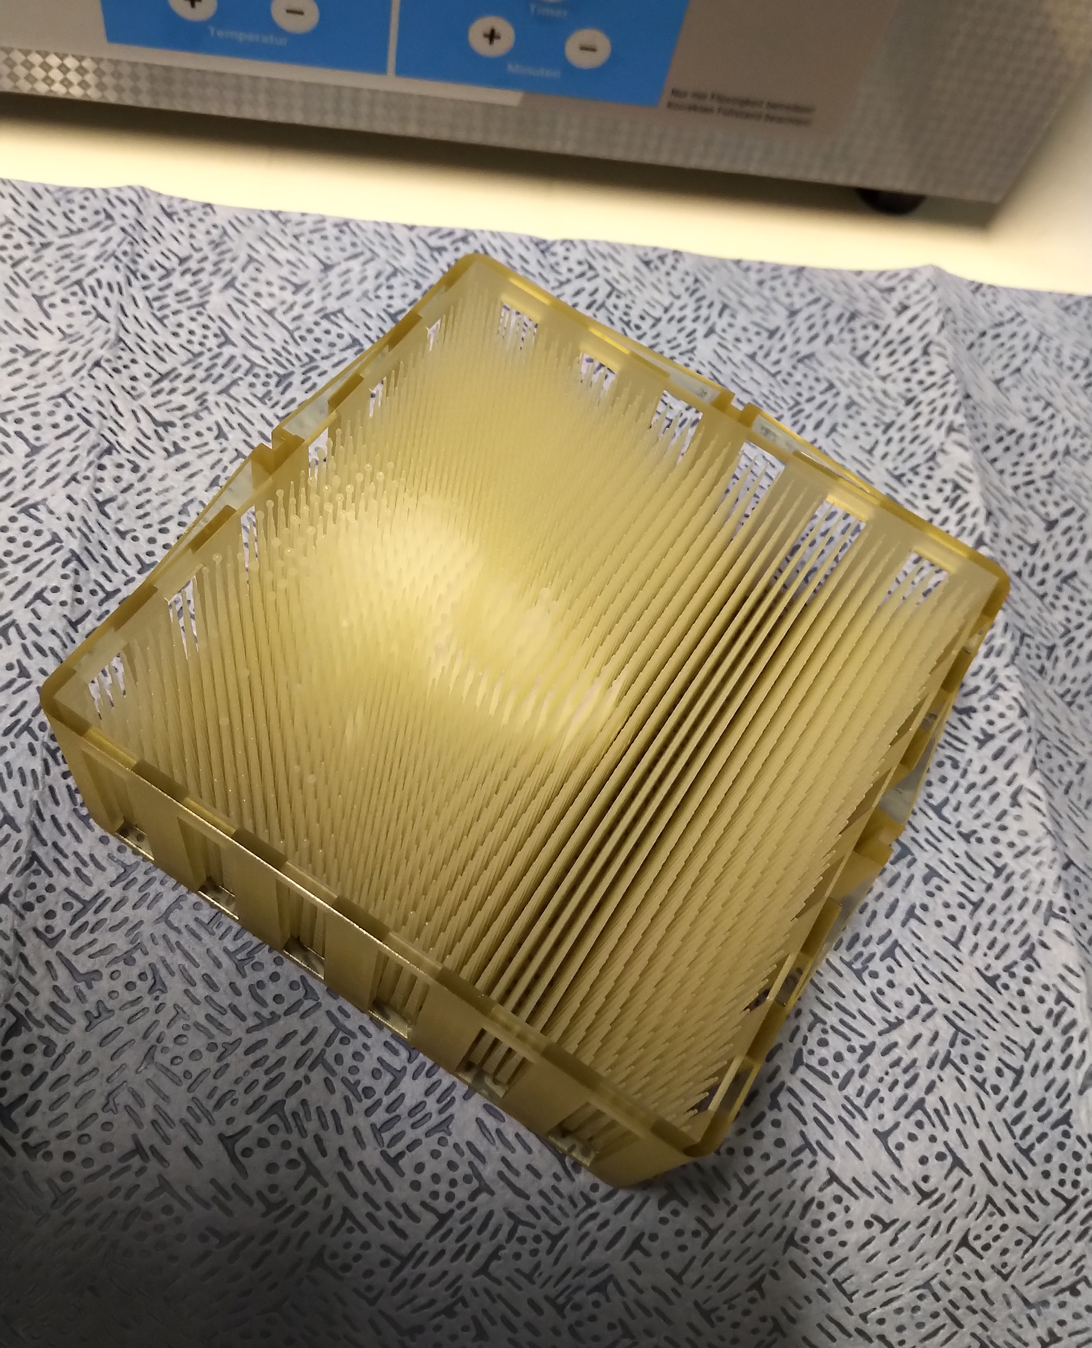
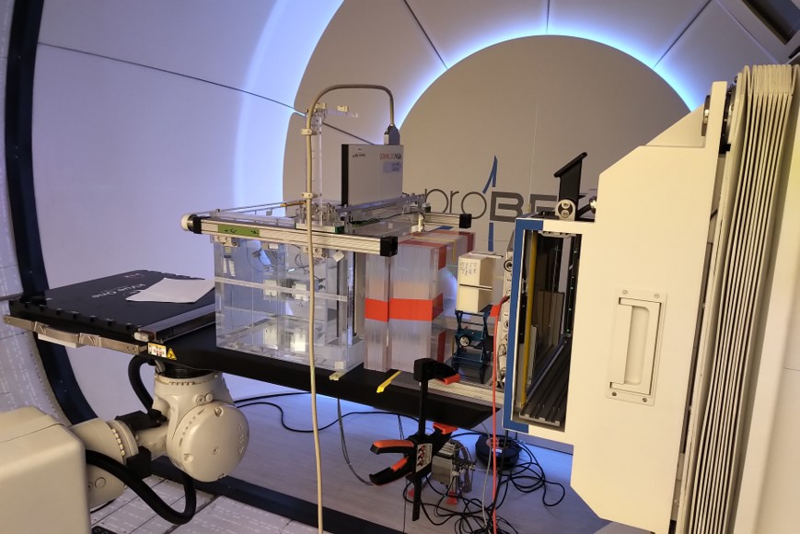
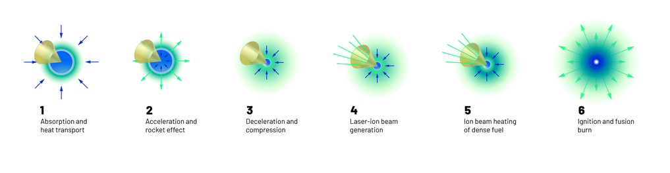
Industrial Cooperations with Industry & Start-ups
Exploring new technology topics and trends
GSI-Varian cooperation on range modulators for pFLASH
GSI/ Focused Energy cooperation -
Mapping out the parameters for inertial confinement fusion
Source: https://focused-energy.world/

Slide 10
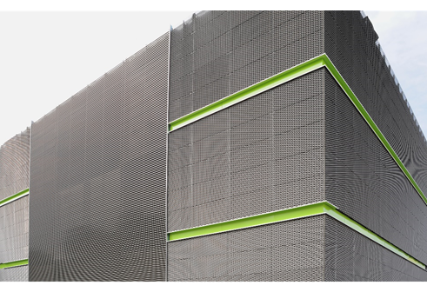
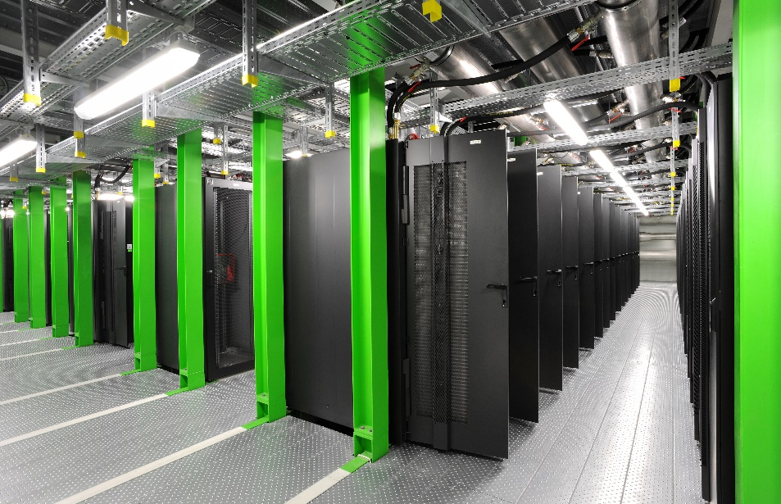




GSI/FAIR Green IT-Cube & Real-Lab “Digital Open Lab”
Open Innovation & Co-Innovation Strategy
DEVELOPING TOGETHER - Offer for provision the infrastructure and IT competences of GSI and FAIR for joint development projects around about HPC, Big Data and ultra-fast data acquisition, including software development and products.
COLLABORATIONS - access to HPC systems and-projects for external partners via collaboration projects.
PROVISION OF RACK SPACE - offer of services in the data centre.

Slide 11
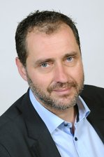
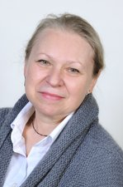
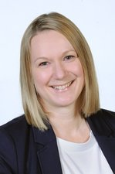
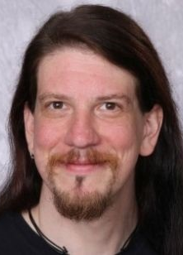
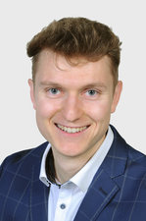
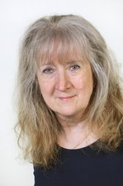
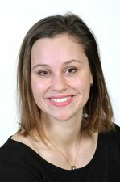


Contact details - Team
Dr. Tobias
Engert
Dr. Alicja
Surowiec
Dr. Martina
Bauer
Dr. Dominic
Fertig
Moritz
Spreng
Rebecca
Lang
Elisabeth
Dobesch
More information: https://www.gsi.de/en/work/administration/stabsabteilungen_stellen/technology_transfer
E-Mail:
re.lang@gsi.de
transfer@gsi.de
@GSIHelmholtzzentrum
@FAIR GSI en
@universeinthelab
@FAIR GSI

Slide 12

Thank you very much for your kind attention!

