Slide 1
DESIGN & INNOVATION
HIGH PRECISION PRODUCTS
Optomechanics and Micropositionning

Slide 2
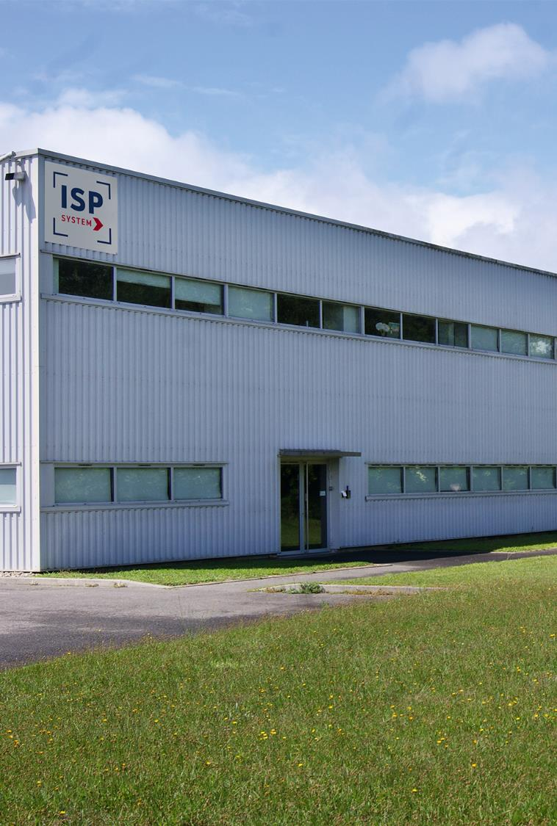

ISP
In a few words…
ISP GROUP
Turnover 2021 : 11,1 M€ - 90 employees
25 years experience in high precision products
Precision engineering including product assembly - « fabless » model.
Markets : photonics, medical, defense, aerospace, nuclear, electronics, …
ISP System : Facility in Vic-en-Bigorre (65)
Turnover 2021 : 9,2 M€, 25 % export
70 employees,
R&D with 10% turnover 70 projects/year
Quality : ISO 9001, EN 9100
ISP Aquitaine : Facility in Pessac (33)
Turnover 2021 : 1,9 M€
20 employees
Quality : ISO 9001
ISP GROUP - CONFIDENTIAL

Slide 3
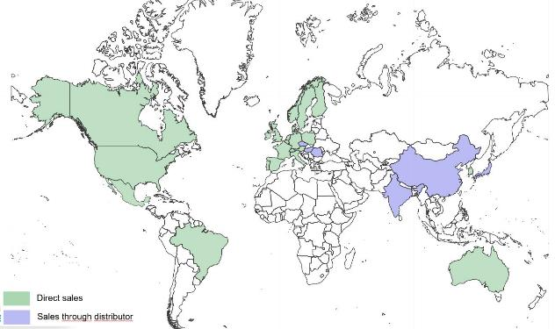
World wide Sales distribution
/ product / Market

Slide 4


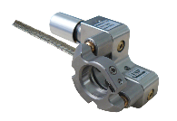
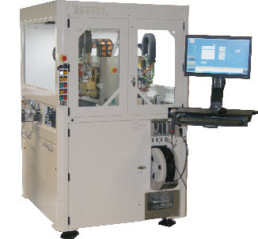
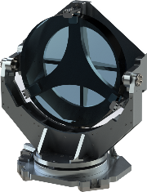
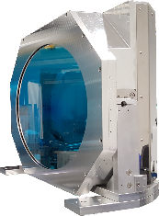
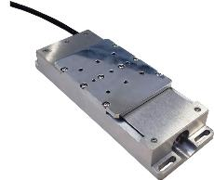
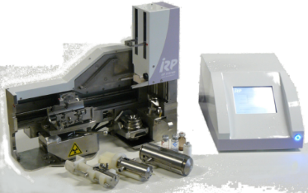
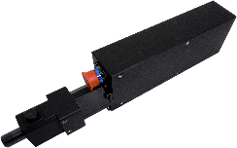



Our product portfolio
MICRO POSITIONNING & OPTICS
MACHINES & ROBOTICS
MECHATRONICS FOR
LIFE SCIENCES
ELECTRICAL EMBEDDED ACTUATORS

Slide 5
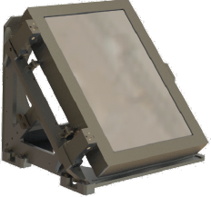
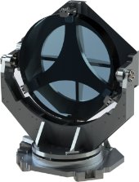
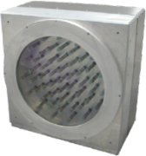
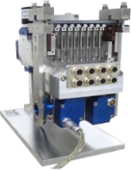
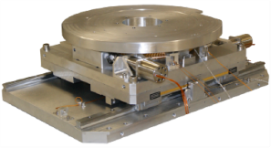
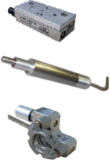
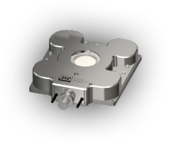
Micro-positioning / Optomechanics
RANGE | PRODUCTS | MARKETS
OPTOMECHANICS | Adaptive optics Fast Steering Mirror (FSM) Gimbal mount, tip-tilt Laser head | Photonics – Astronomy Aerospace Medical Metrology
MICROPOSITIONING | Actuators Translation – rotation stages, Goniometer,… Multi-axes stages | Photonics Scientific Space | Microscopy / Spectroscopy Defense Nuclear
LARGE POSITIONING SYSTEMS | Large positioning stages Large spectrometers | Scientific Intense lasers Nuclear

Slide 6
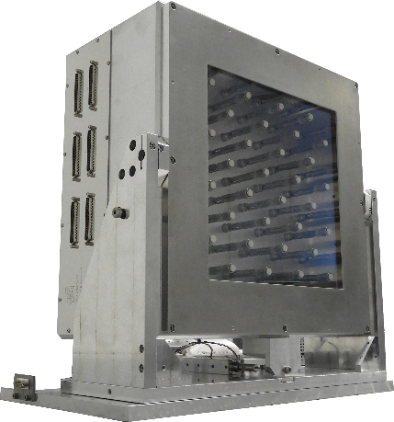
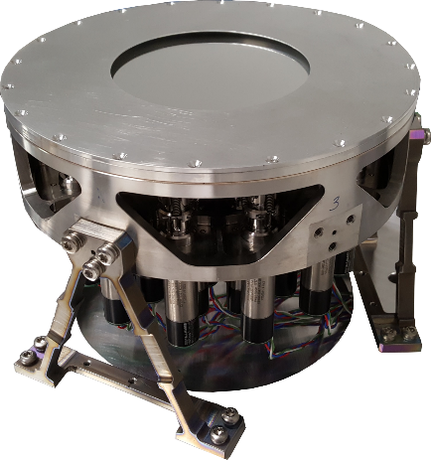
Electro-mechanical deformable mirror for
High power laser facility or for space
Complete range of DM developed to fulfill laser users requirements :
MD-AME (using stepper motors)
Space Deformable mirror
MD-Space
Stability without power
Improves imaging quality of space telescope
Patented and original technology Wavefront correction with nanometric accuracy
High linearity (> 99%), No hysteresis
Large correction amplitude
Adaptable Aperture
Space compatible
Qualified TRL 6
  Aperture from 22mm up to 550m, AOI: 0-45°
  Dielectric , metallic or hybrid coating
  HV & UHV compatible
  Tip-tilt motorized mount
  Electronic control command interfaced
  with wave front sensor

Slide 7
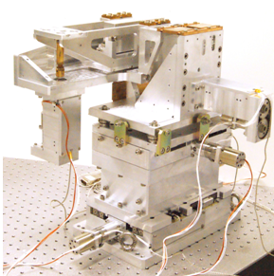
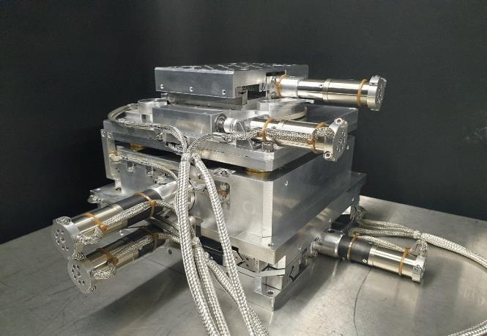
UHV multi-axis positioning device
Micro focus station
Synchrotron beamline
5DOF on each of both KB mirrors:
2 rotations, one of them with resolution: 0,15µrad
3 translations, 1µm resolution
Use under nitrogen
5 axis positioning Target Holder for intense laser
2 horizontal stages XY(Res:< 1µm)
1 vertical translation stage Z(Res:< 1µm
1 rotation RZ stage (Res:< 0.001°)
1 goniometer RY stage(Res:< 0.001°)
Use under UHV

Slide 8

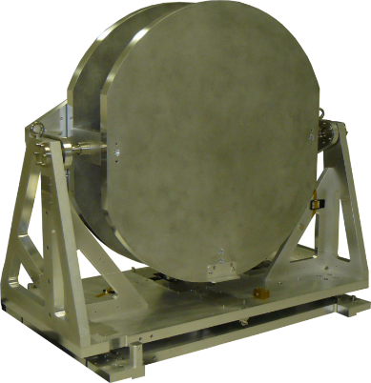
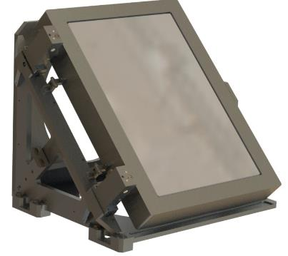
Motorized optical mounts
Precision motorized mounts realized by ISP SYSTEM, thanks to TMP and VMP range. Control electronics is also proposed.
Definition is adapted to customer requirements to be interfaced with customer optics.
Mirror mounts LULI (APOLLON 10PW)
including 2 translations TMP
Resolution < 0.15 µrad
High stiffness: first resonant requency > 60Hz
Frame 600x800mm²
HV Compatible
Large optics Gimbal mirror mount
Large optics Gimbal mount
(Ø600mm)
Control electronics available
azimuth&elevation res: 0.2µrad
Total stroke for azimuth and elevation: +/-2°
HV Compatible
- (Ø1500mm, 550kg)
Control electronics available
Azimuth&elevation res: 10µrad
Total stroke for azimuth and elevation: +/-5°
ISO7 clean room and HV

Slide 9
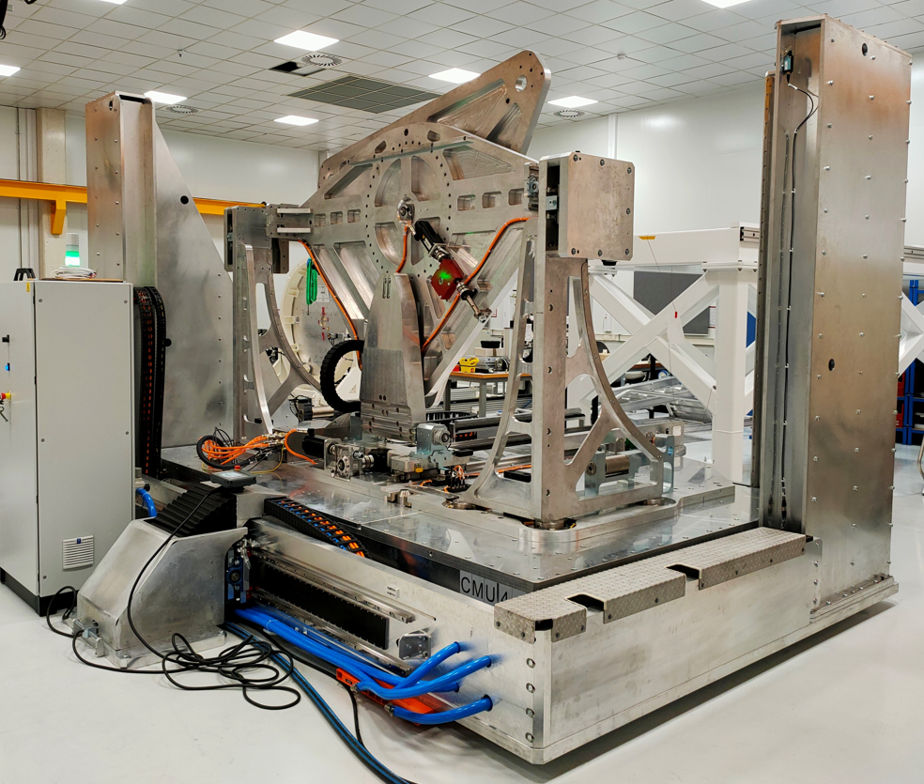
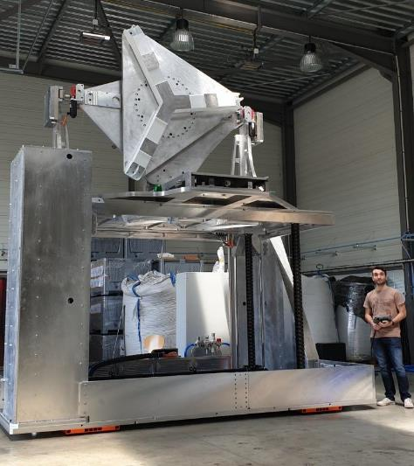
Large positioner and mount
Interferometry test bench
- Large optics (Ø2300mm, 650kg)
Travel XY of +-1250 mm
X axis on air bearing
Y axis with rigid chain technology
Azimuth and Elevation +/-5° /10µrad
In plane rotation at 360°
High stability
Vertical and horizontal optical axis

Slide 10
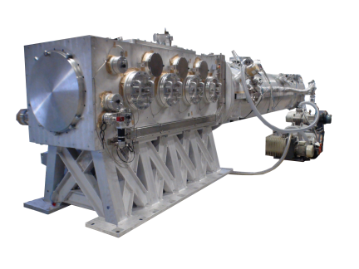
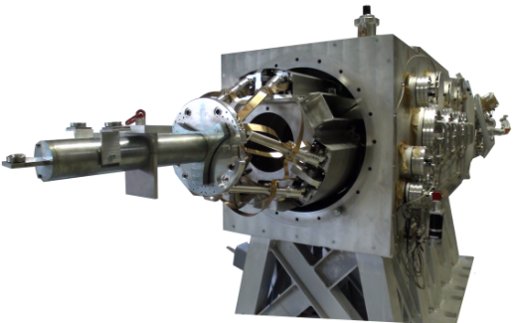
Inserting devices in hostile environment
Insertion in hostile environment
High stroke > 3m with
high precision <20µm
Insertion, positionning and orientation (6 degree)
For Optics M < 2,5kg, vacuum enclosure,
Electromagnetic and nuclear compatible hardening

Slide 11
Conclusion
ISP System is a French company with 25 years experience in high precision products
We have multidisciplinary skilled teams, specialists in their fields, for a high precision engineering knowledge.
Our expertise in precision engineering is at your disposal to deliver you solutions fitting customer’s challenging application needs.
Customized products can be offered to fully dedicated turnkey solutions, including design, testing and manufacturing.
ISP SYSTEM provides a spectrum of services including: R&D, Design, Prototype Manufacturing, Industrialization, Massproduction, Commissioning, After Sales ……
Do not hesitate to contact us.

Slide 12
Thank you for your attention
Dr.Valérie PARET
Phone: +33 (0)5 62 33 44 44
Email : valerie.paret@fr-ispgroup.com
www.isp-system.com

