Slide 2
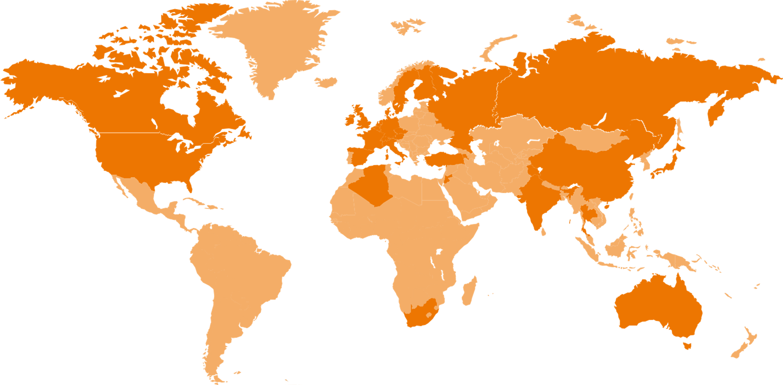
Sigmaphi provides high-tech magnetic systems for particle accelerators, from design to use
Our customers are:
Government and university research institutes (worldwide)
The major players in proton therapy
Companies / start-ups in the field of fusion
Industrials in areas such as materials processing, mass spectrometry, radio isotope production
+40 years of expertise
+150 employees
+20 M€ turnover

Slide 3
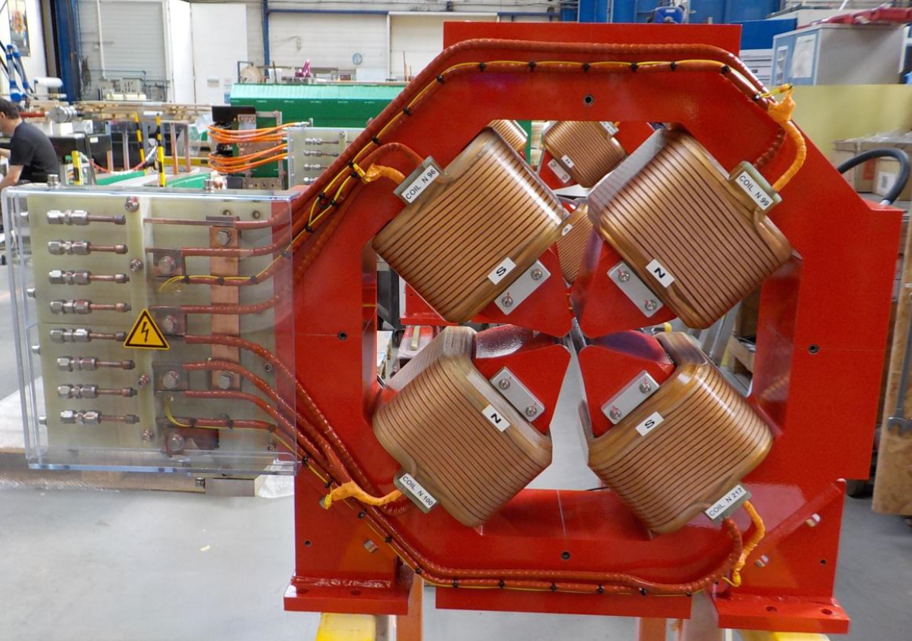
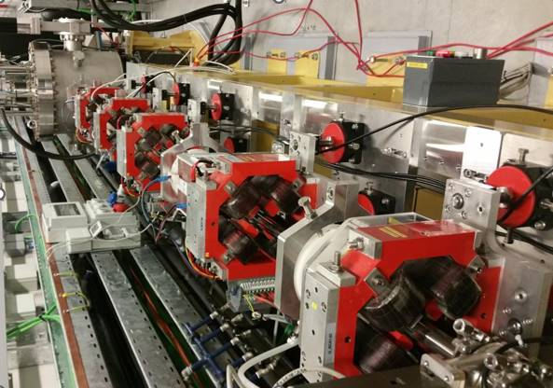
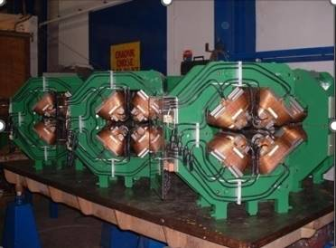
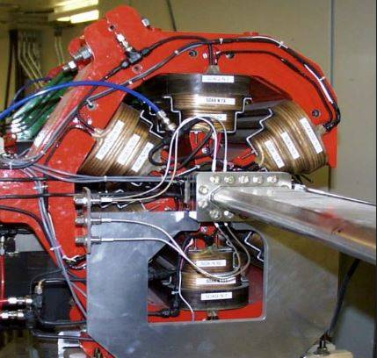
RESISTIVE MAGNETS| SUPERCONDUCTING MAGNETS | PULSED SYSTEMS
Quadrople and sextupole magnets Linac triplets Bending magnets 90° gantry bending magnet
PSI
112 quadrupoles
124 storage rings sextupoles
SOLEIL
97 quadrupoles
ELETTRA
144 multipoles
CANADIAN LIGHT SOURCE
Sextupole
BACK TO MAP

Slide 4
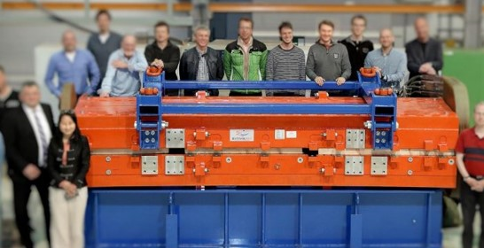
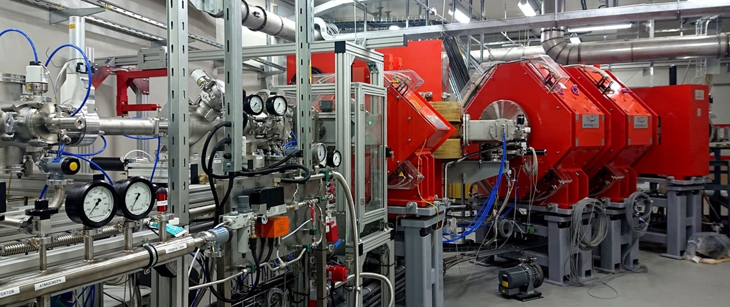
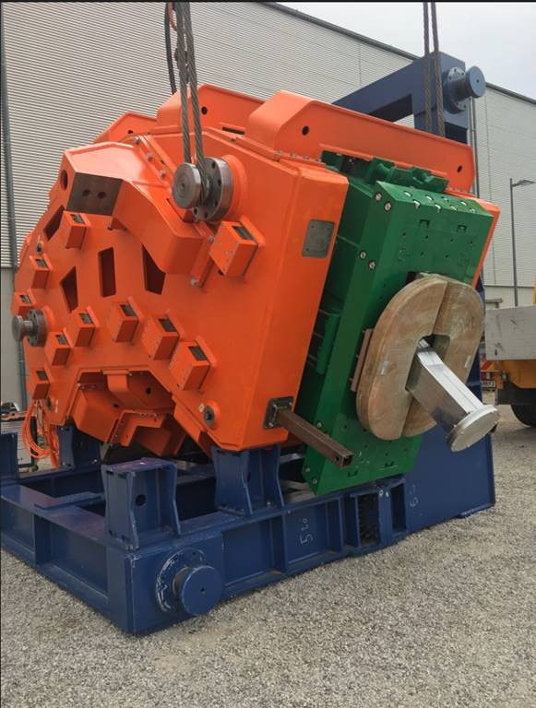
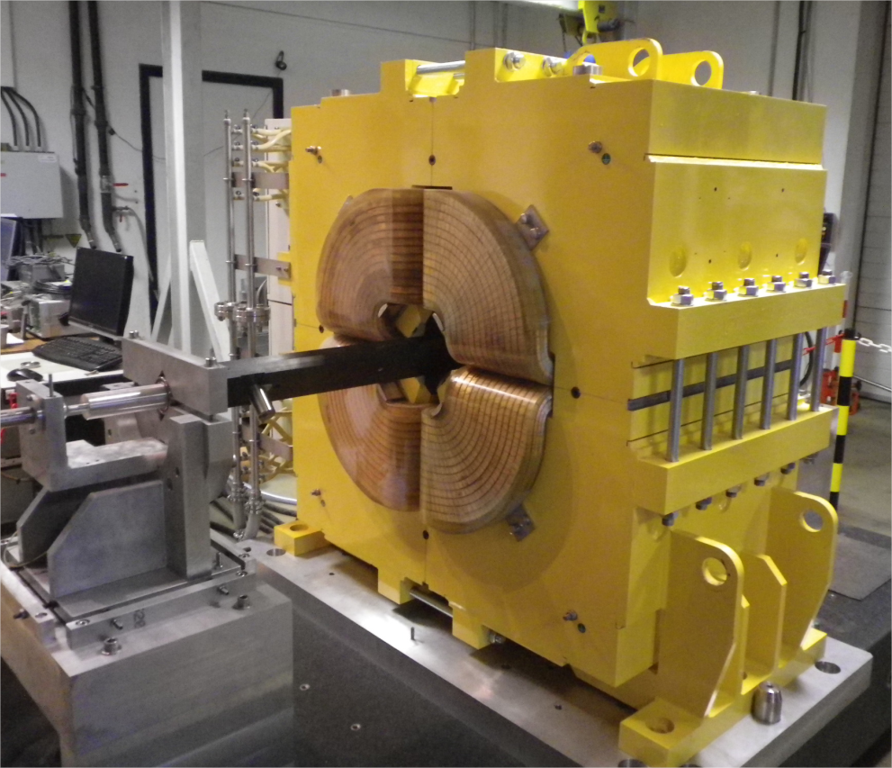
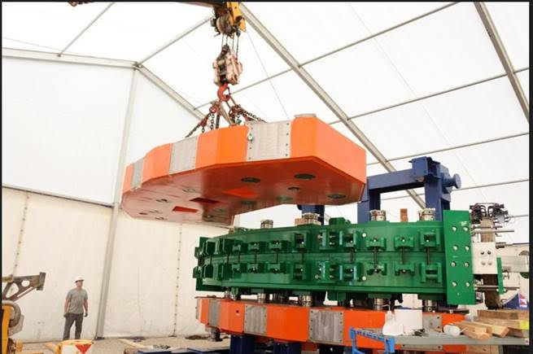
RESISTIVE MAGNETS| SUPERCONDUCTING MAGNETS | PULSED SYSTEMS
Quadrople and sextupole magnets Linac triplets Bending magnets 90° gantry bending magnet
42 dipoles
JINR
86 quadrupoles
FAIR HESR
MEDAUSTRON
BACK TO MAP

Slide 5
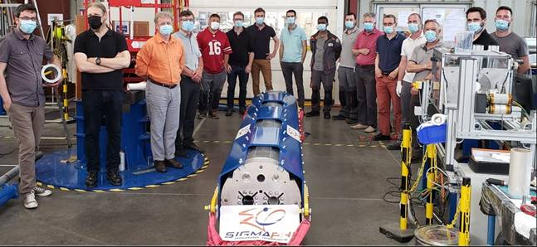
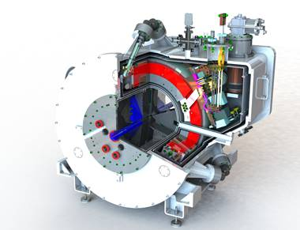
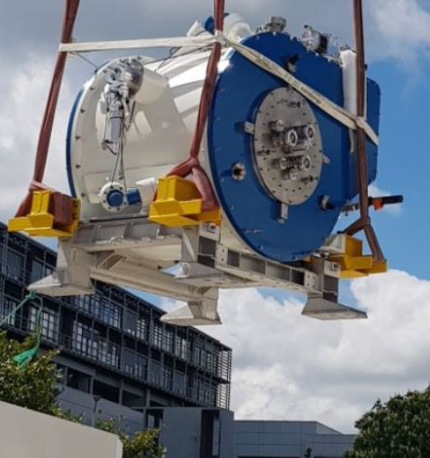
RESISTIVE MAGNETS| SUPERCONDUCTING MAGNETS | PULSED MAGNETS
PMB-ALCEN
Double aperture quadrupoles ID 90 MM
Gradient | 120T (peak field 6,1T)
NbTi 1,9K | 1,9K – 5496 A
Quadrupole
Solenoid
Weight | 2,36 T
Warm bore | 514 mm
NbTi | Helium free
Peak Current | 100 A
CERN-HILUMI
BACK TO MAP

Slide 6
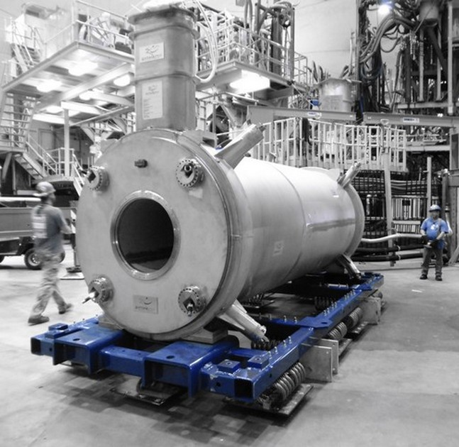
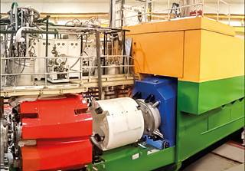
RESISTIVE MAGNETS| SUPERCONDUCTING MAGNETS | PULSED MAGNETS
JEFFERSON LAB
Weight | 24 tons
Warm bore | 600 mm
NbTi liquid helium | 4,2K
4,25 T
Current | 3500 A
Weight | 15 tons
Warm bore | 600 mm
Gradient | 16T/m
Current | 4250 A
2 quadrupoles NbTi
SHMS dipole
BACK TO MAP

Slide 7
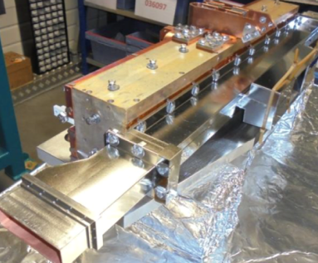
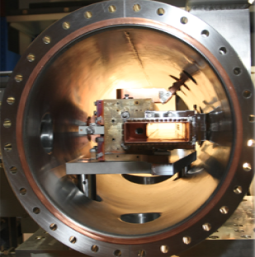
RESISTIVE MAGNETS| SUPERCONDUCTING MAGNETS | PULSED MAGNETS
Injection pulser
Injection septum
FAIR HESR
Kicker magnet
FAIR CRYING RING
BACK TO MAP

Slide 8
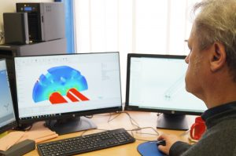
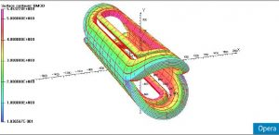
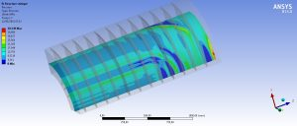
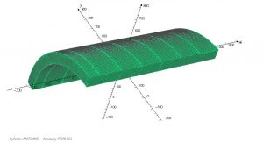
SIGMAPHI
COMMITTED,
EVERY STEP OF THE WAY
DESIGN | MANUFACTURE | TEST & MEASUREMENT | ALIGNEMENT
Design of support stands, frames, and reinforcement structures according to your principle needs : magnetic performance, dimensions, costs and energy consumption. Located in relevant areas ? We are used to designing stands compliant with earthquake resistance standards.
From A to Z | magnetism, mechanics, cryogenics, quench detection & calculation
Opera, Ansys, Tosca, Elektra, Solidworks, Tempo, Quench, …

Slide 9
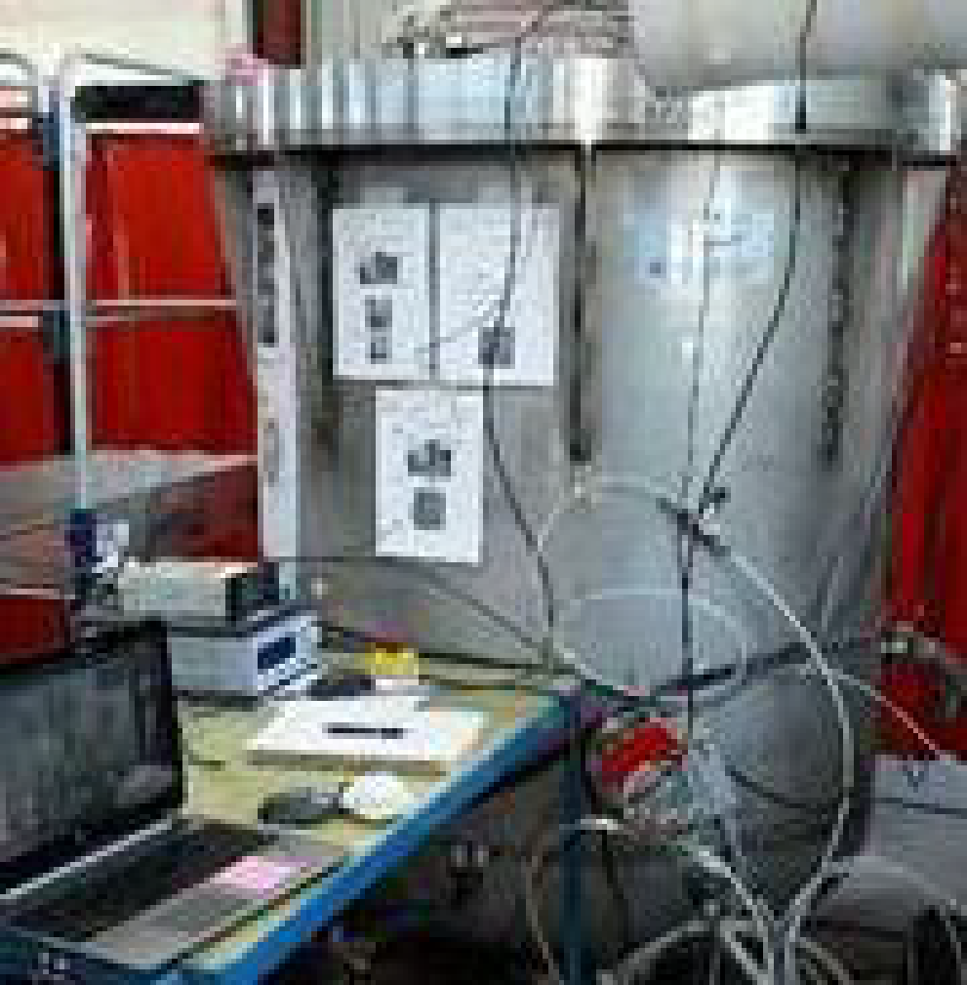
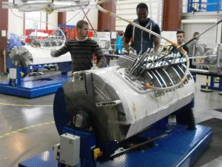
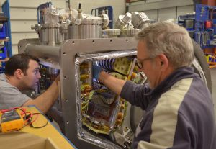
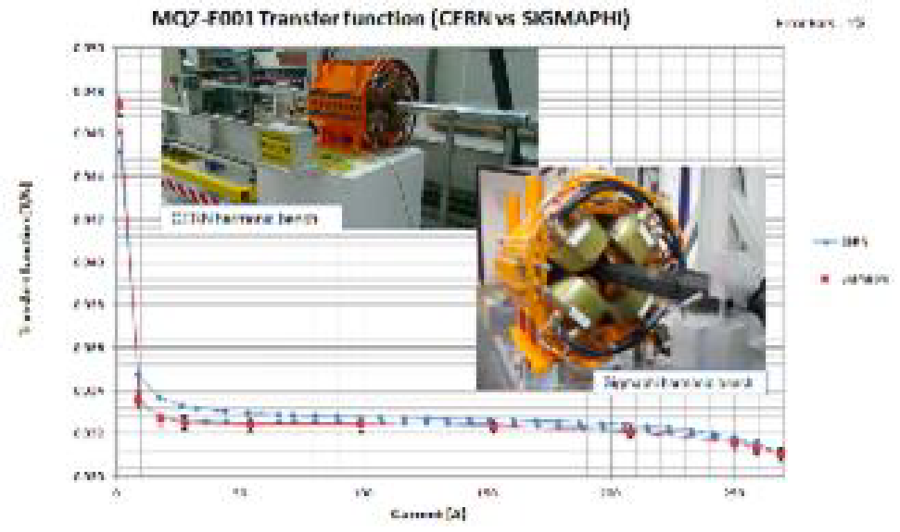
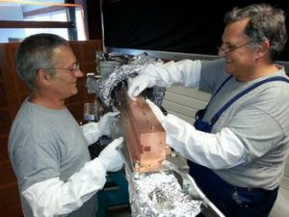
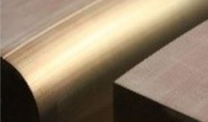
SIGMAPHI
COMMITTED,
EVERY STEP OF THE WAY
DESIGN | MANUFACTURE | TEST & MEASUREMENT
Test cryostat
Assembly
Winding
Magnetic measurement lab
Hall probe mapping table
Rotating coil bench
Stretch wire bench
Welding & Stacking
UHV Assembly

