Slide 1

CRYODIFFUSION:
Your specialist in Cryogenic Equipement
Nov 2021

Slide 2
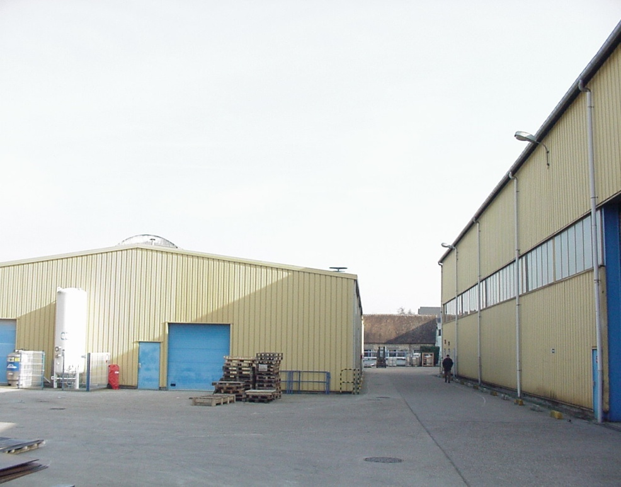

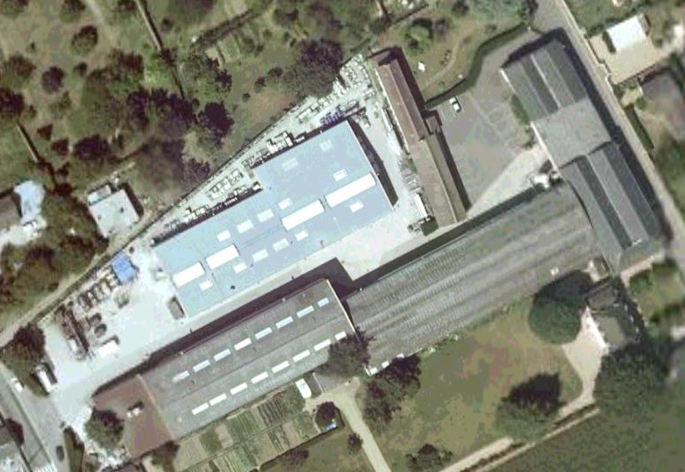
Cryo Diffusion - overview
Founded in 1965
90 km West of Paris
Facilities
  Production 8,000 m²
  Total space 15,000 m²
60 Employees
Member of Chart Industries
since 2018

Slide 3
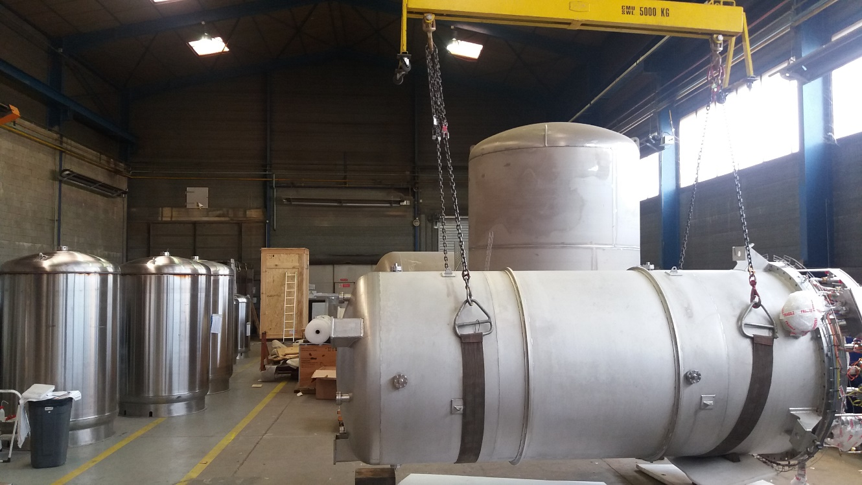
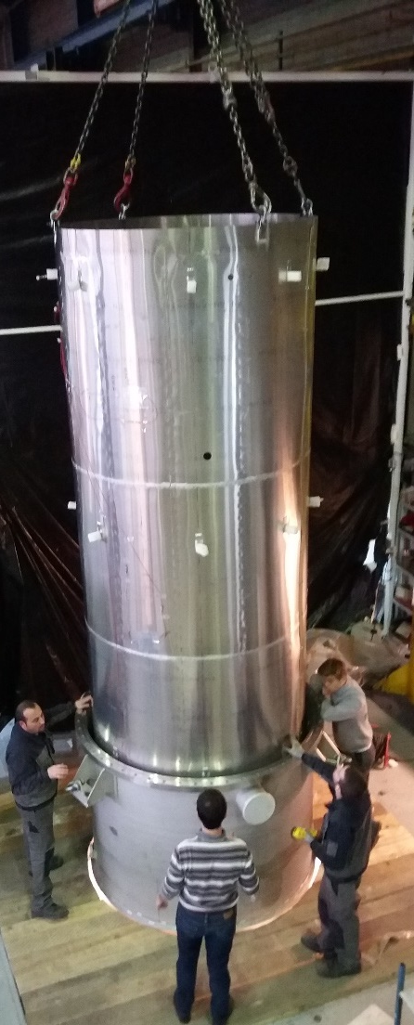
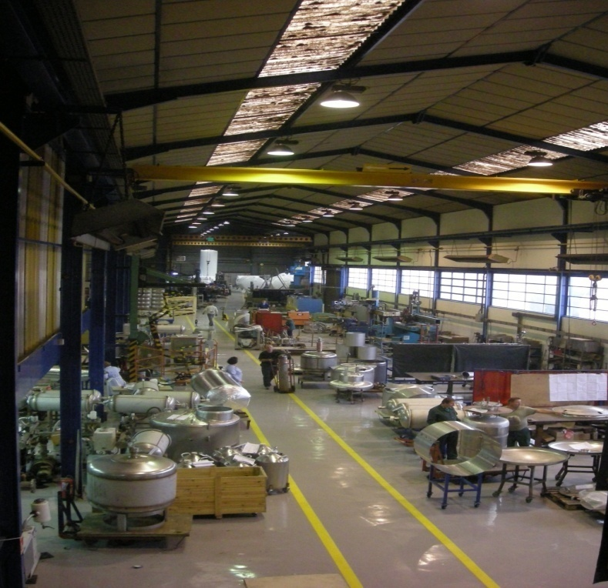
Cryo Diffusion - workshop
  Dedicated to cryogenics (austenitic stainless steels)
  35+ qualified welder
  2 tanks + 2 Lines = 4 insulation machines
  4 testing and vacuuming benches
  Pressure (pneumatic & hydraulic) test benches
  Up to 10tons crane / 8m lifting height (in 3m pit)

Slide 4
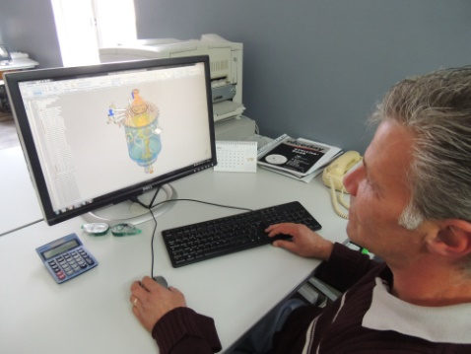
Cryo Diffusion – design dpt
  Mechanical design according to international Codes
    EN13458, EN1251,EN 13530, EN13480
    ASME VIII.1 / VIII.2 / B31.3
  Thermal and mechanical analysis
  FE Analysis: mechanical and thermo-mechanical Computation
  General Arrangements & Manufacturing drawings
  Softwares: SolidEdge, ISOCAD, Triflex

Slide 5
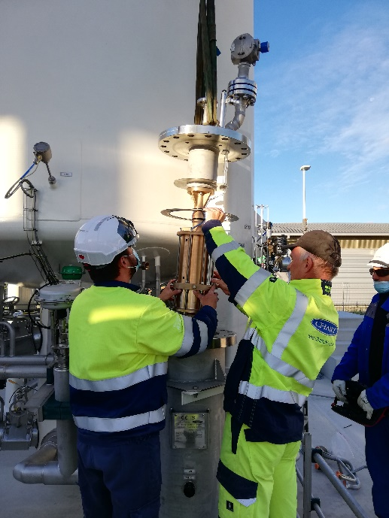
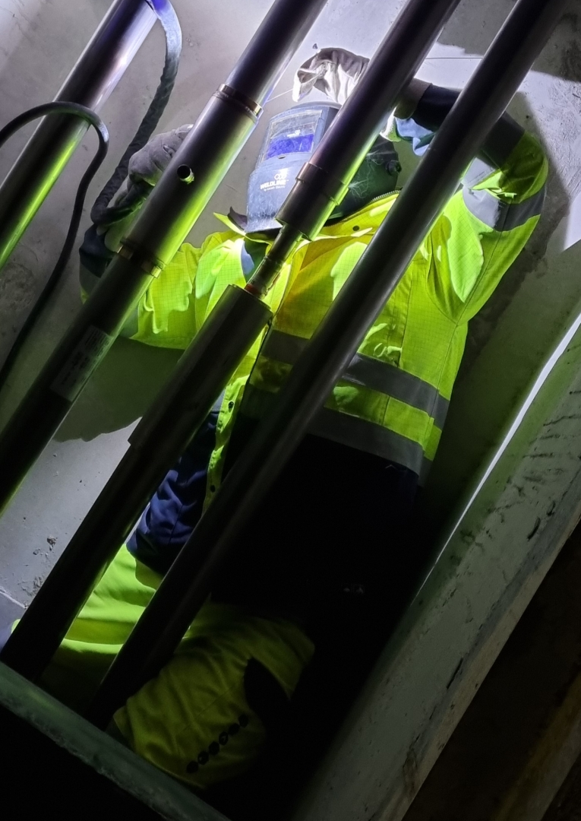
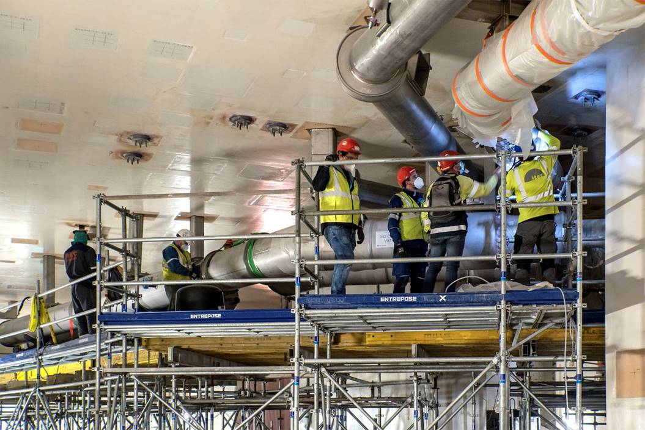
Cryo Diffusion – onsite works
  4+ qualified welder
  1 electrician
  1 site works manager
  1 LT technician
  ATEX trained and certified

Slide 6

Cryo Diffusion - quality
Since 2002 CRYO DIFFUSION holds the PED certification for qualified manufacturers exporting pressure static vessels according to 2014/68/UE Directive authorized by Lloyd’s Register.
Since 2009 CRYO DIFFUSION holds the TPED certification for qualified manufacturers exporting pressure transportable vessel according to 2010/35/UE Directive, authorized by Lloyd’s Register.
Furthermore CRYO DIFFUSION holds an ISO 9001 certified Quality System since 1994; authorized certifying body VERITAS Register Quality Assurance.
Over fifty years of experience combined with a dedicated and professional staff of high level in all departments has produced the favorable results outlined in this site.

Slide 7
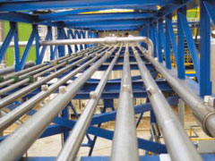
Projects References
Valves boxes
Cryostats
Cryogenic test benches
Transfer lines
Ground support equipment

Slide 8
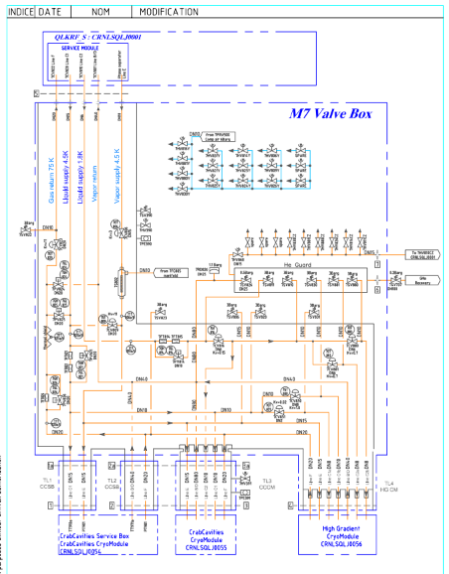
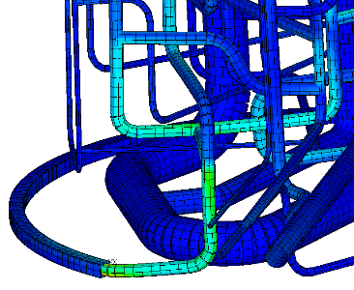
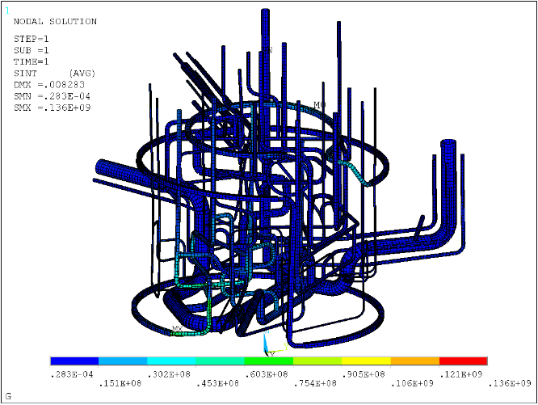
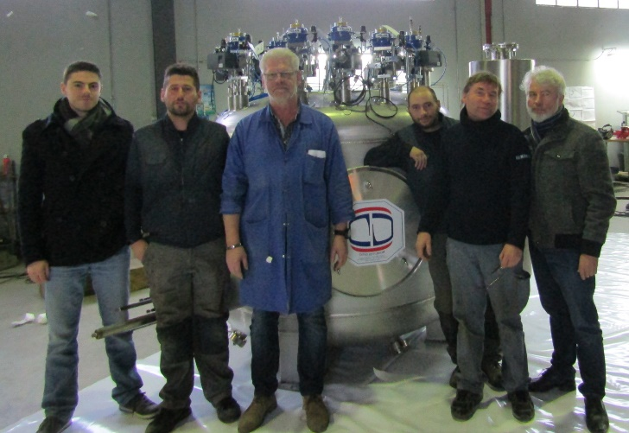
Valves box
SM18 Project
Customer CERN
December 2016 – December 2017
Topic: LHe distribution
Scope
  Design
  Manufacturing
Inputs
  Detailed PID
  Output pressures
  Output flowrates
Outputs
  Flow analysis
  Thermal & Mechanical analysis
  Instrumentation
  Valves Box
Challenges
  Complex Valves box with superfluid helium management→ know-how in Cryogenic design & manufacturing
December 2016
May 2017
December 2017

Slide 9
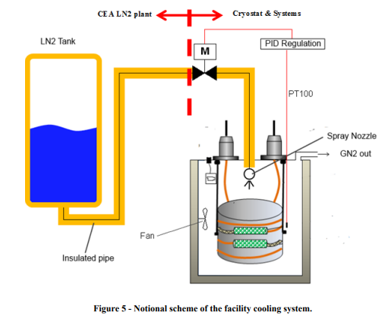
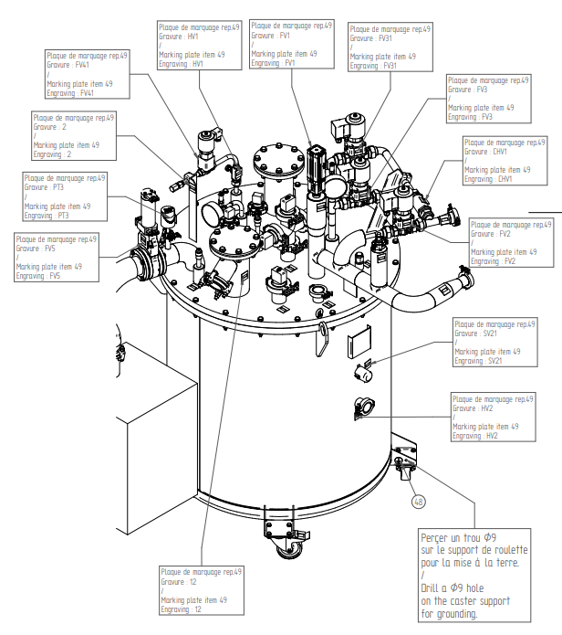
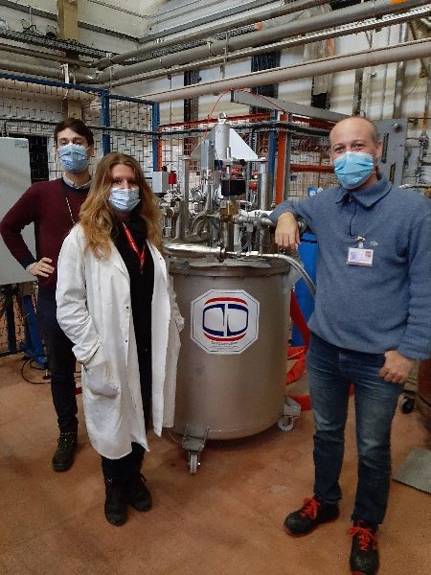
Cryostats
QDI Project
Customer ITER
Januray 2019 – October 2020
Topic: Vacuum + Cryogenic test chamber
Scope
  Design
  Manufacturing
  Installation
  Start-up
Inputs
  Functional requirement: volume, vacuum level, temperature level
Outputs
  Detailed PID
  Thermal & Mechanical analysis
  Instrumentation
  Functional Analysis
  Cryostat, Vacuum pump, Control system with HMI
Challenges
  Merging vacuum, cryogenics, automation→ know-how in Cryogenic design & manufacturing
  Covid-measures → Factory Acceptance Test organized with remote control from Customer to Factory, with embedded camera and dedicated VPN network
January 2019
May 2019
October 2020

Slide 10
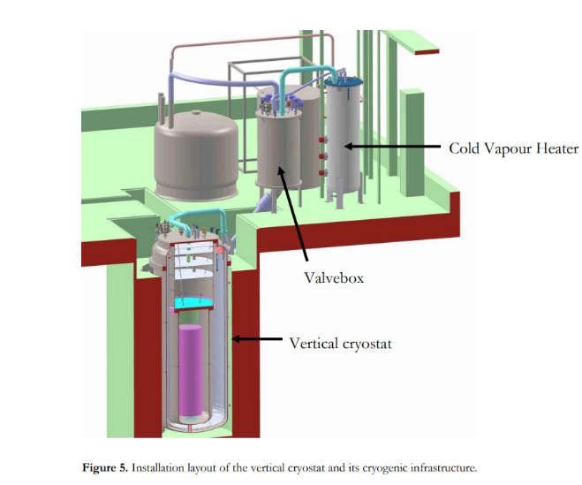
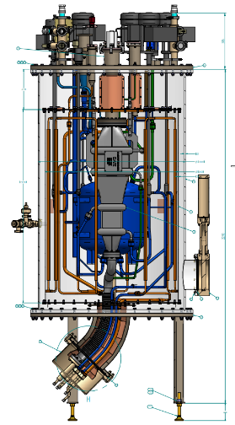
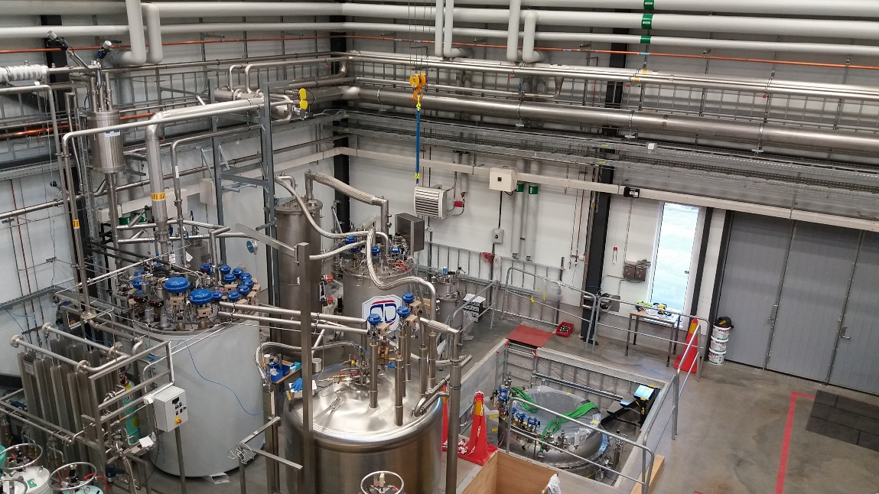
Cryogenic test bench
Gersemi Project
Customer Uppsala University
September 2015 – April 2018
Topic: Complete Cryogenic Test Bench
Scope
  Design
  Manufacturing
  Installation
Inputs
  Mechanical & Thermal Pre-study by customer
Outputs
  Detailed PID
  Thermal & Mechanical analysis
  Instrumentation
  Complete test bench
Challenges
  Merging vacuum, cryogenics, automation→ know-how in Cryogenic design & manufacturing
  2nd largest cryostat « Bain Claudet » in the world, with Stainless Steel Lambda plate → Welding and machining accuracy far beyond industrial norms
September 2015
July 2017
April 2018

Slide 11
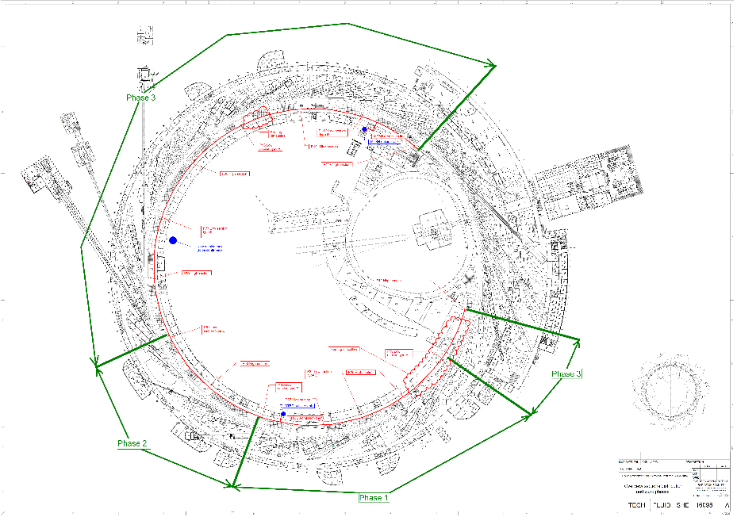
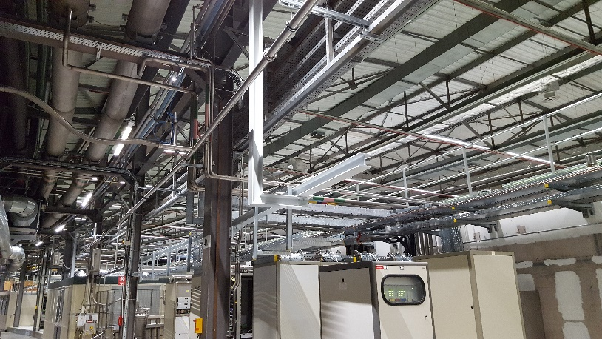
Transfer lines
EBS Project
Customer ESRF
June 2017 – June 2018
Topic: Complete Cryogenic Distribution lines
Scope
  Design
  Manufacturing
  Installation
Inputs
  Pressure, Temperature & Flowrate at each utility
  General PID
  Building ground plane
Outputs
  Thermal & Fluid analysis
  Full distribution system
Challenges
  700m installation in short delivery time → Split in 4 installation manufacturing and installation phase
  Existing building with activities → Reduced installation times with planning led by customer onsite activity
June 2017
February 2018
June 2018

Slide 12
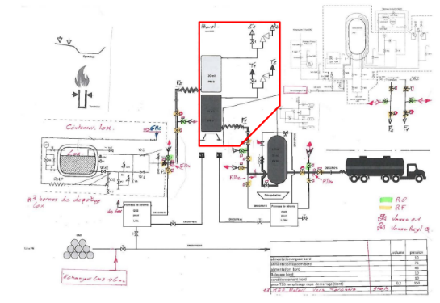
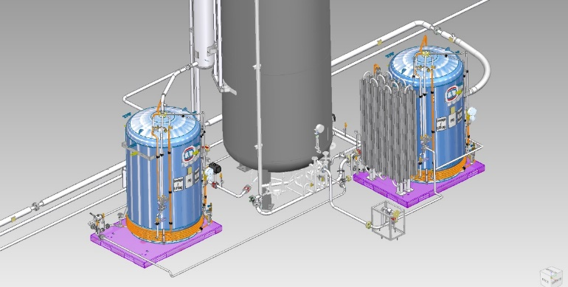
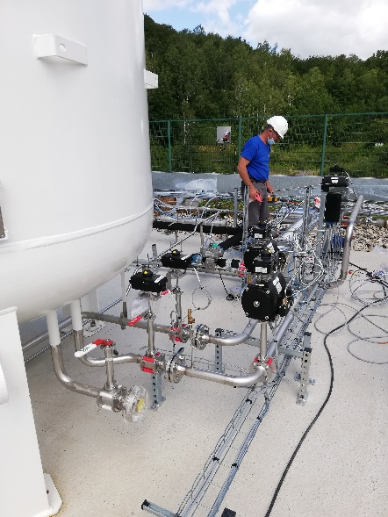
Ground support equipment
THEMIS Project
Customer Ariane Group
December 2020 – July 2021
Topic: LNG+LOX storage and distribution
Scope
  Design
  Manufacturing
  Installation
  Start-up assistance
Inputs
  General PID
  Output pressures
  Output flowrates
Outputs
  Detailed PID
  Functional analysis
  Storage tanks
  Pressurisation tanks
  Transfer lines
  Instrumentation
  Flare
Challenges
  Delivery time of piping components (Valves, safety valves…) in limited time frame during covid-disturbance → sourcing and configuration management and agile project management
December 2020
March 2021
July 2021

