Slide 1
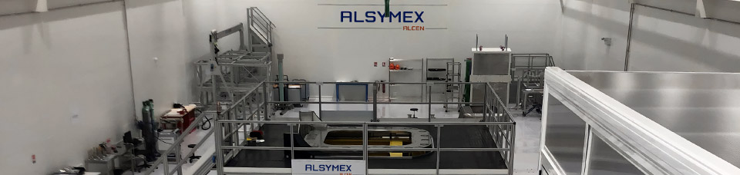
ALSYMEX
France@FAIR
April 19, 2023

Slide 2
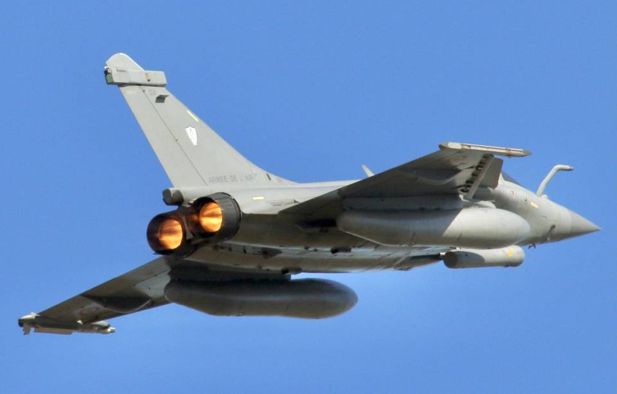
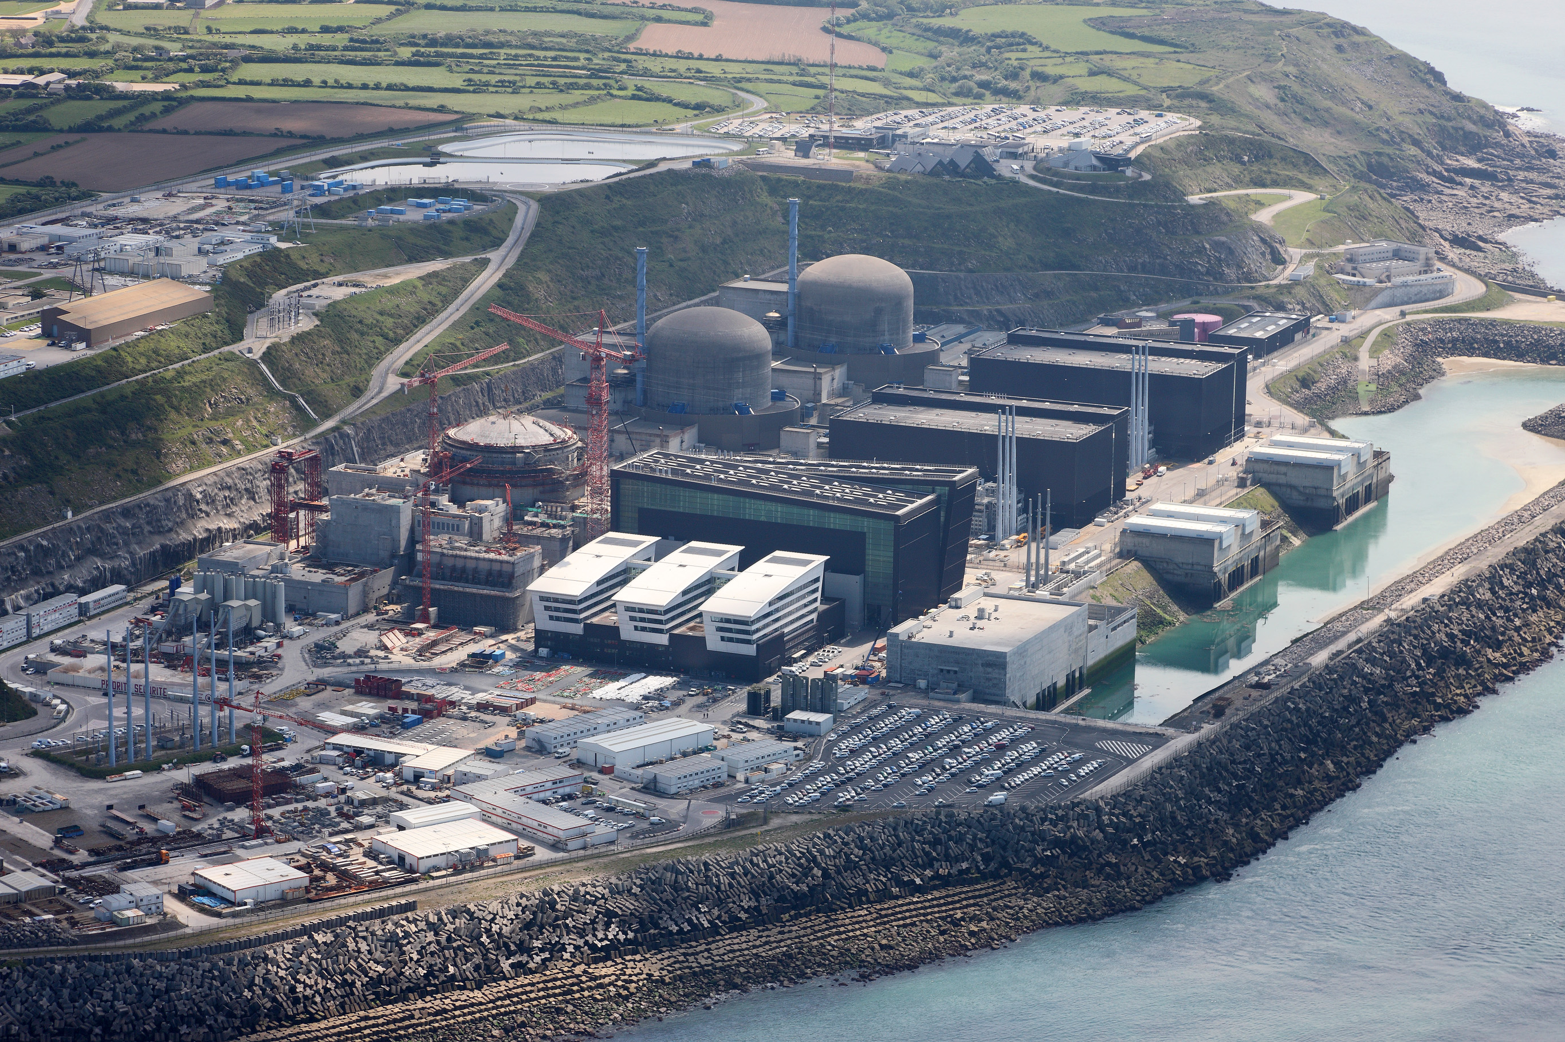
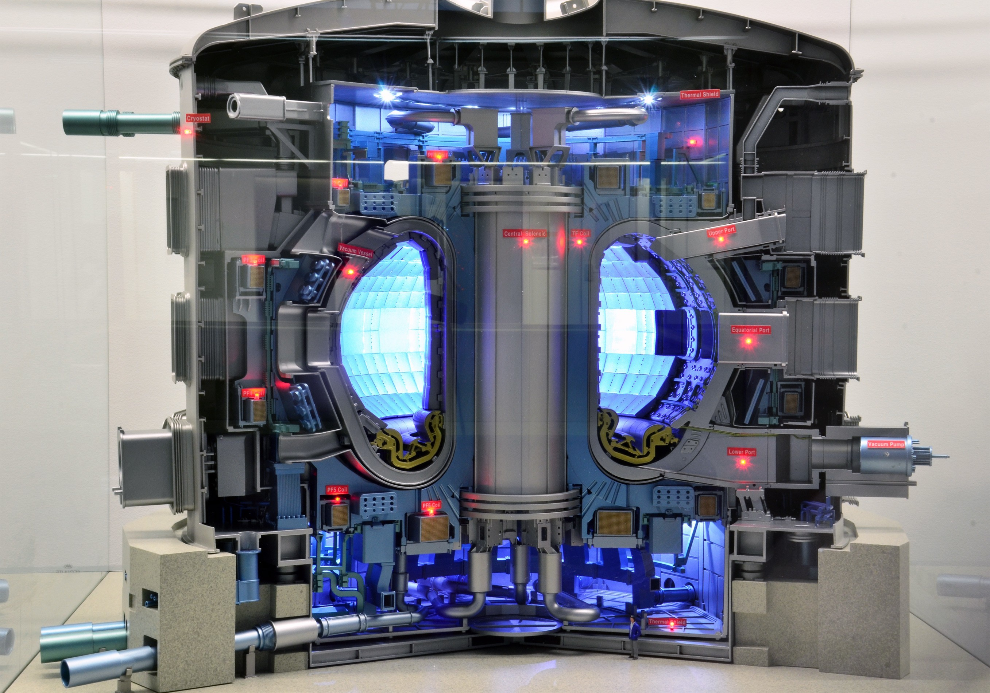
ACTIVITY & EXPERTISE
ALSYMEX is a french medium size enterprise specialized in :
Design, Engineering, Manufacture, Assembly, On site installation, Maintenance of Mechanical components / sub-systems and Multi-technology systems.
Identity
Expertise
Industrial means
Fusion
High power lasers
Particle accelerators
Defence
    Nuclear energy
    Big Science
650 employees
60% engineers
7 premises in France
1 in Tunisia
Turnover in the range of 100 MEUR

Slide 3
FIELDS OF EXPERTISE
Identity
Expertise
Industrial means
Fusion
High power lasers
Particle accelerators
Control command, Cryogenics, Hydraulics, Mechanics, Optics, Robotics, Vacuum
Development and qualification of innovative industrial processes
Management of long term multi technology programs
Mastery of constraints specific to critical environments explosive and radioactive environments, corrosive atmospheres, extreme temperatures, vacuum, cleanliness
Reliability and lifespan studies

Slide 4
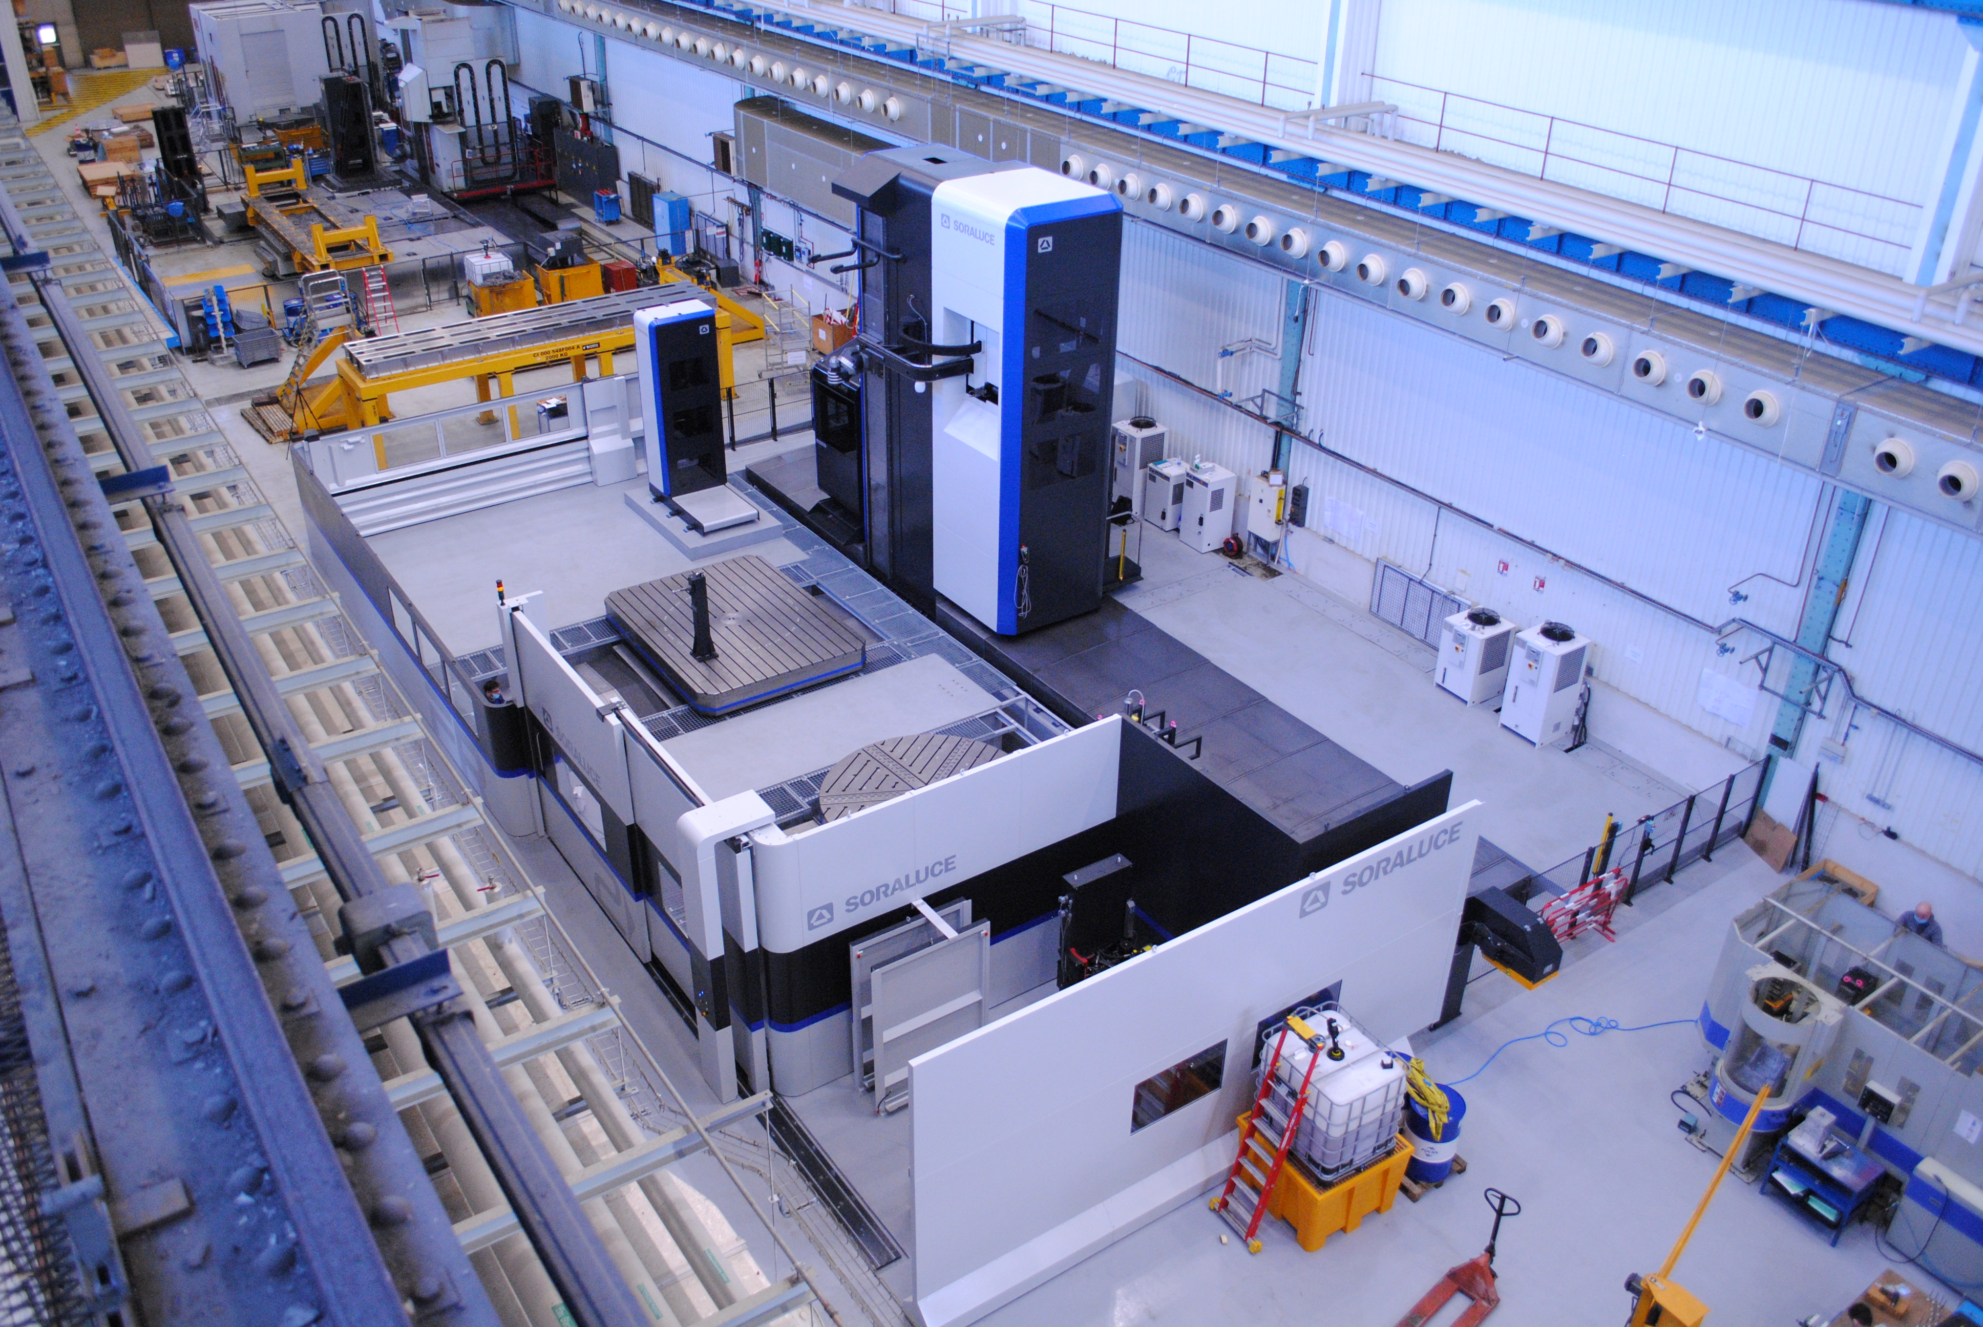
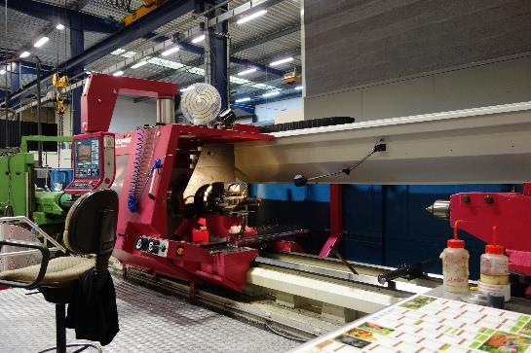
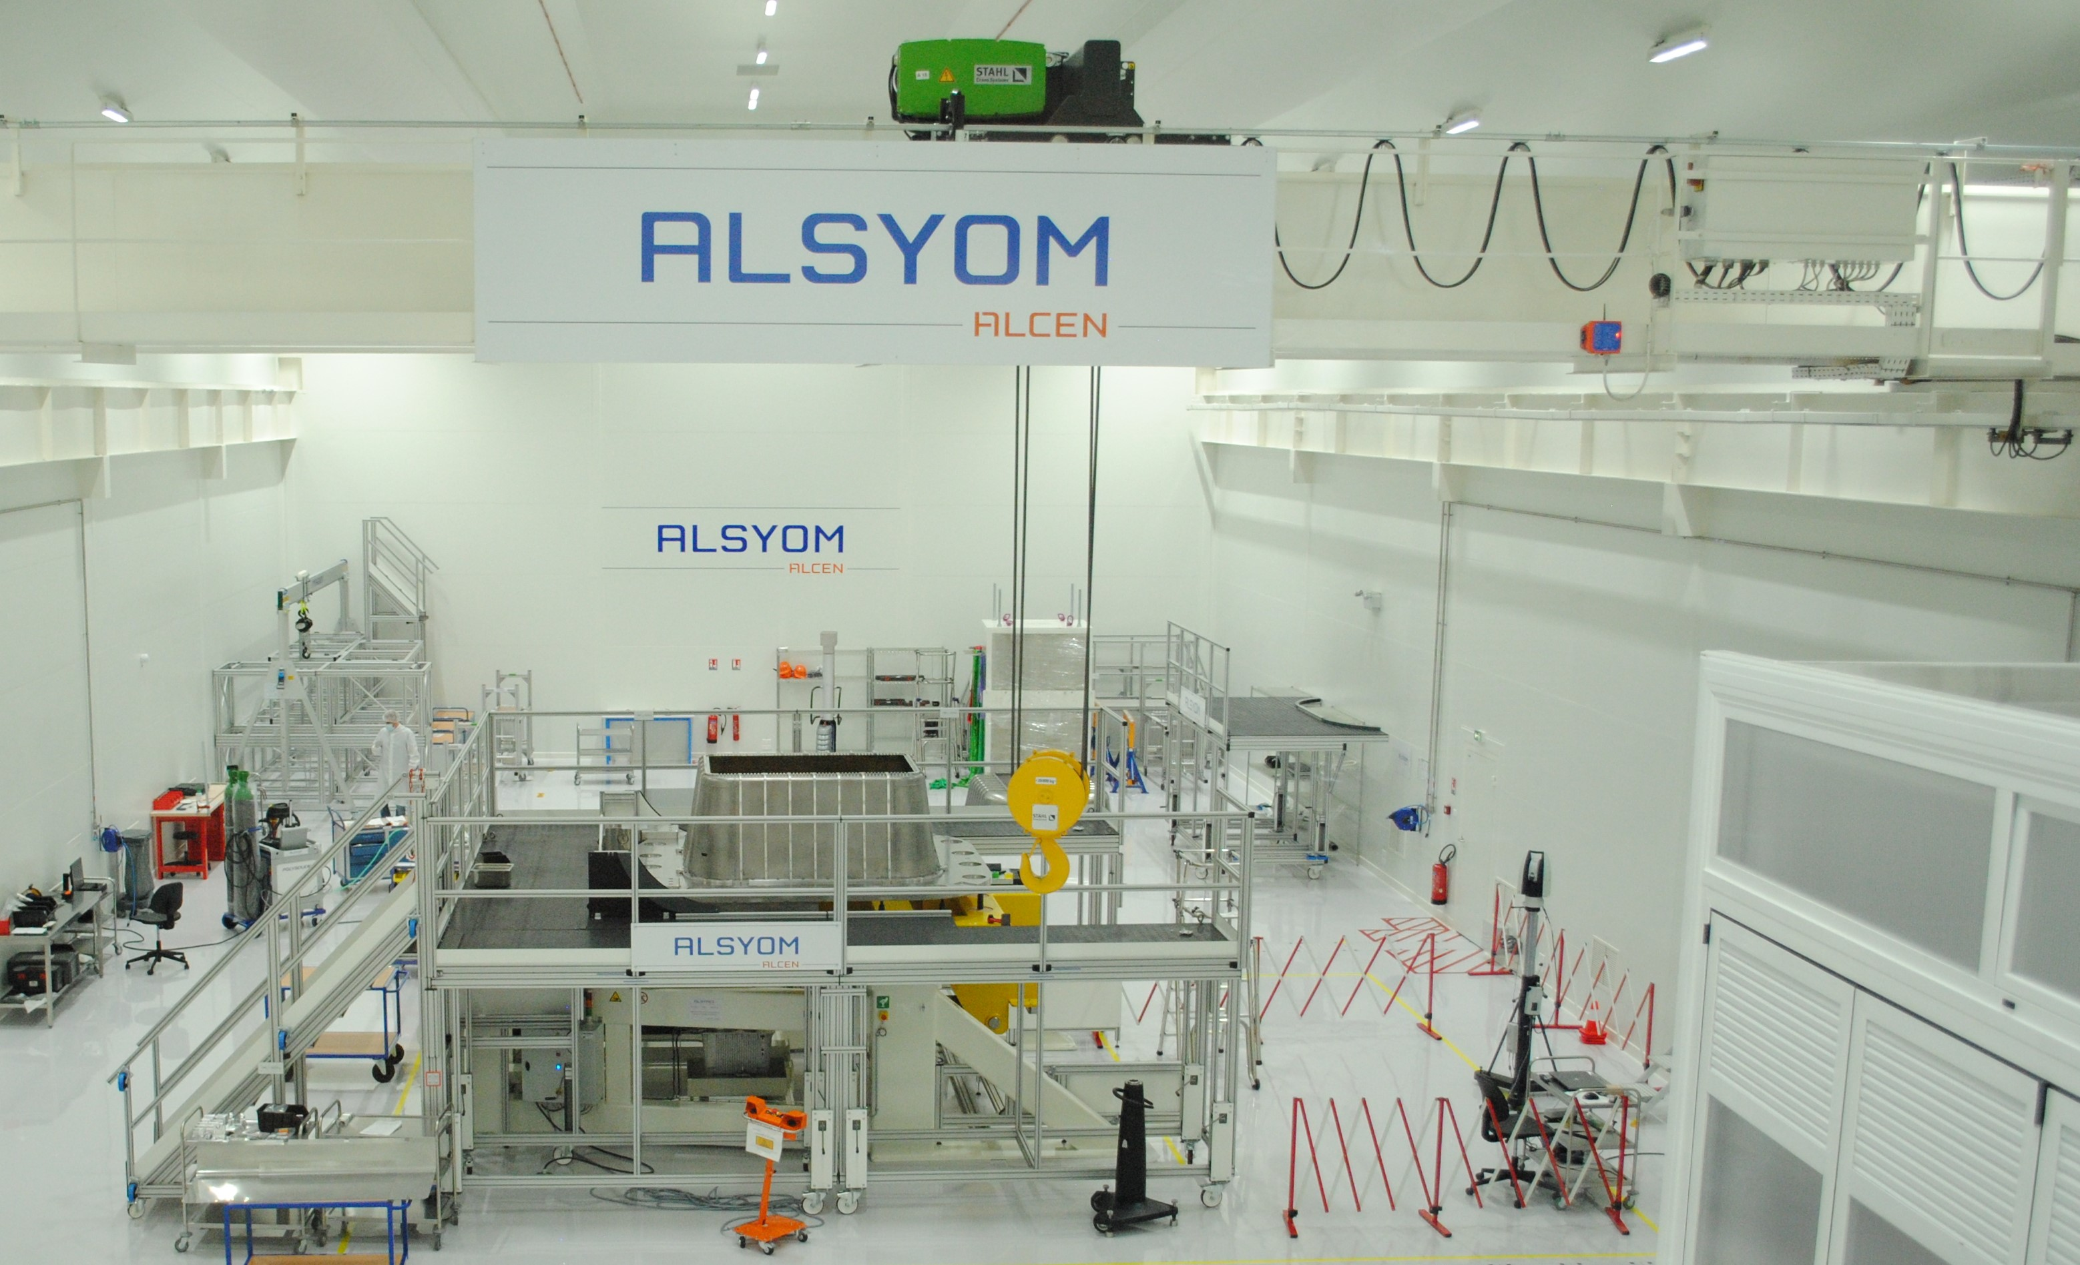
MANUFACTURE & ASSEMBLY
  More than 30 000 m² of workshops
  Machining
    Milling, turning, electro-erosion - large variety of materials
    Large dimension (up to 12 m), high precision
    One temperature controlled (20°C +/- 1°C) workshop
  Assembly
    TIG, e-beam and laser welding, High Isostatic Pressing
  Dimensional control
    3D measuring machines (up to 3m x 2m x 1.6m) - Laser trackers
  Leak and non destructive tests
    Helium leak, visual, magnetoscopy, X-ray, dye penetrant, UT tests
    20 certified inspectors according to EN ISO 9712 levels 2 & 3
  Integration and services
    More than 4 000 m² of clean rooms (ISO 5 and ISO 8)
    On site installation and maintenance works
Identity
Expertise
Industrial means
Fusion
High power lasers
Particle accelerators

Slide 5
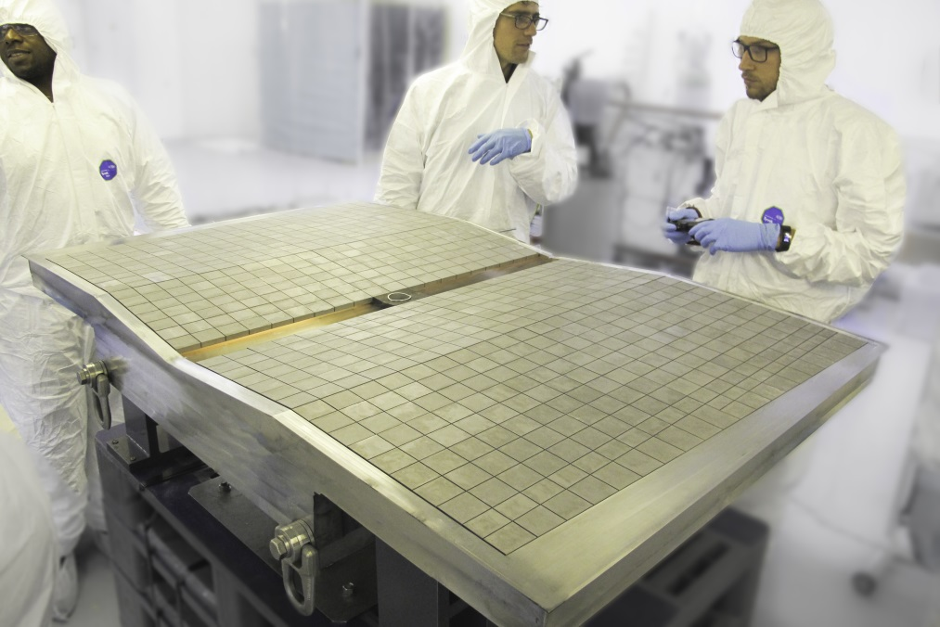
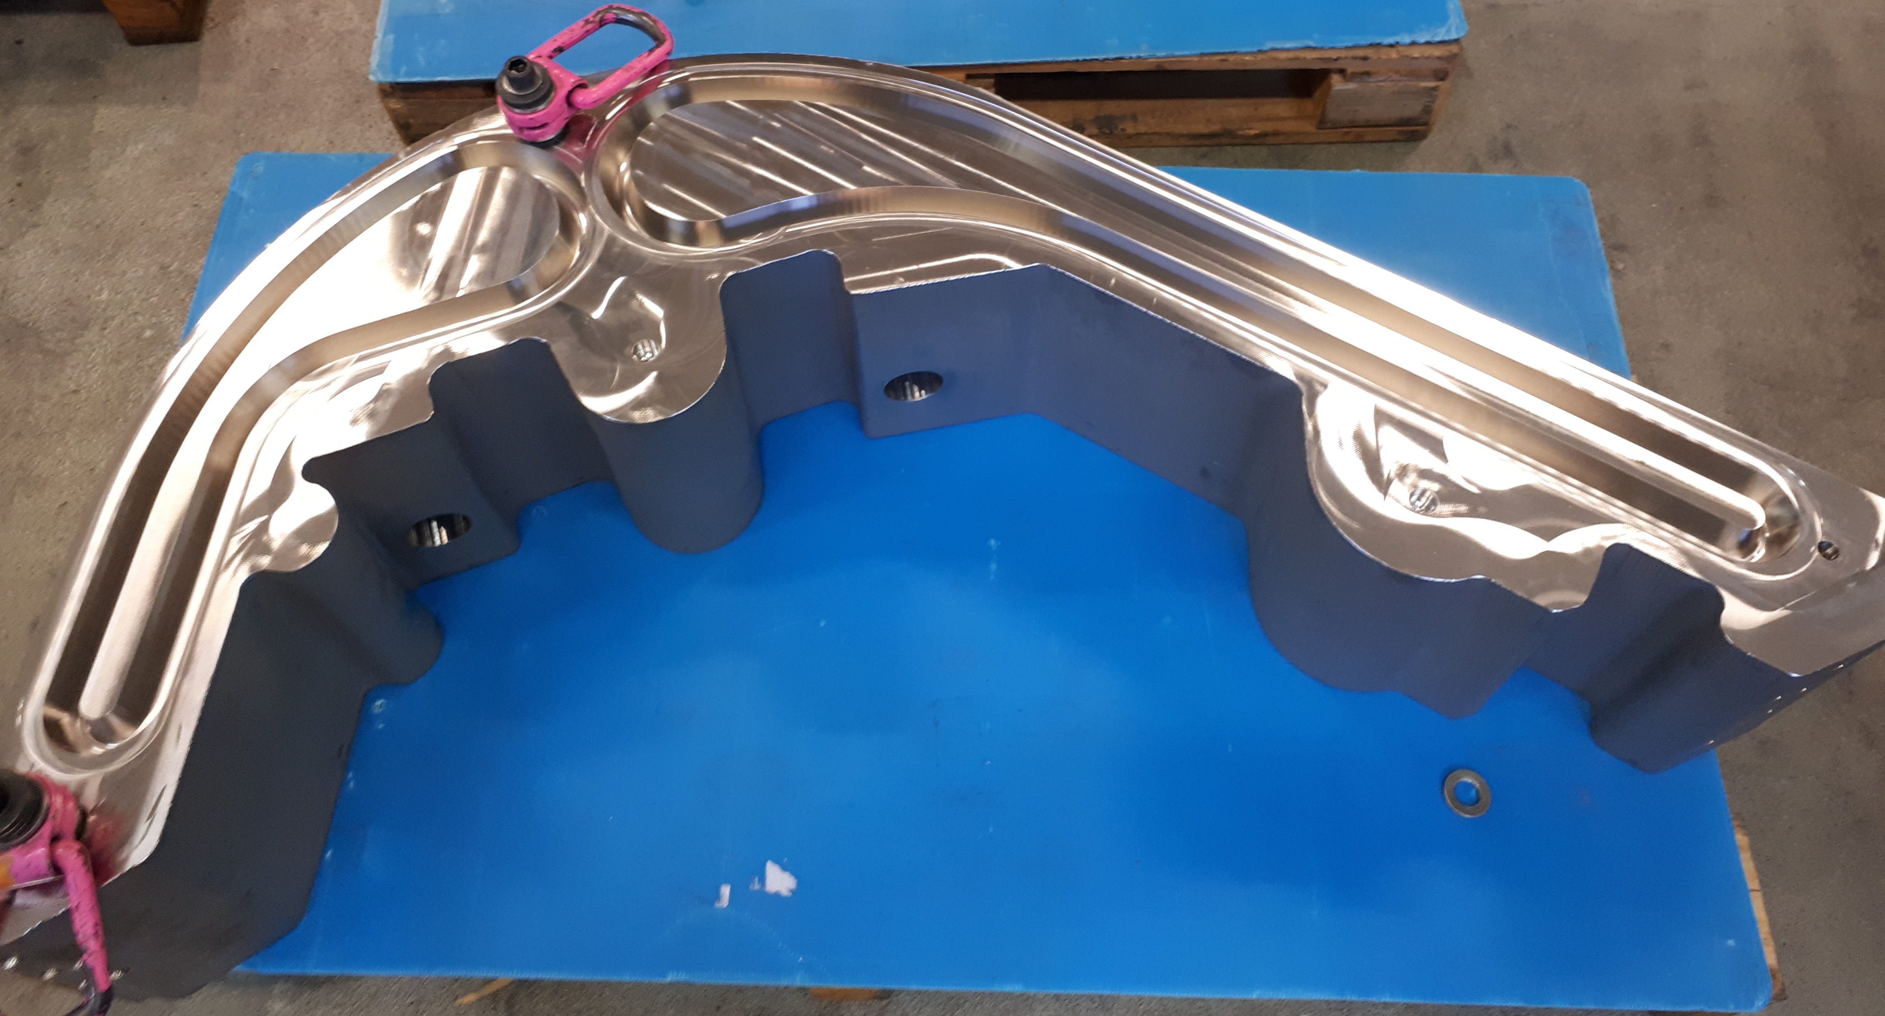
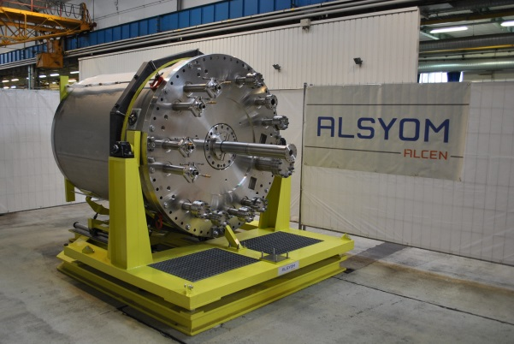
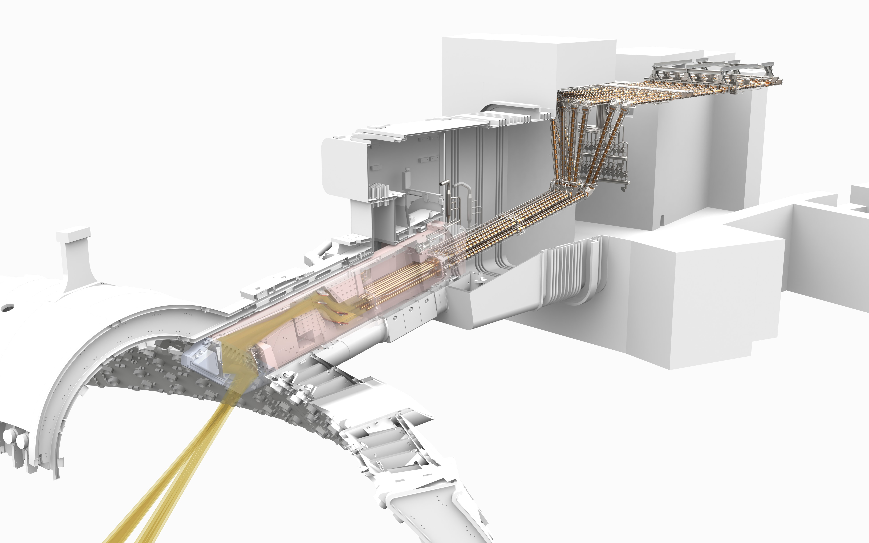
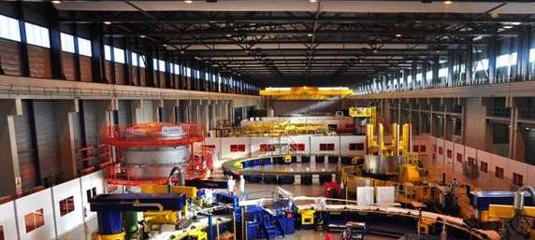
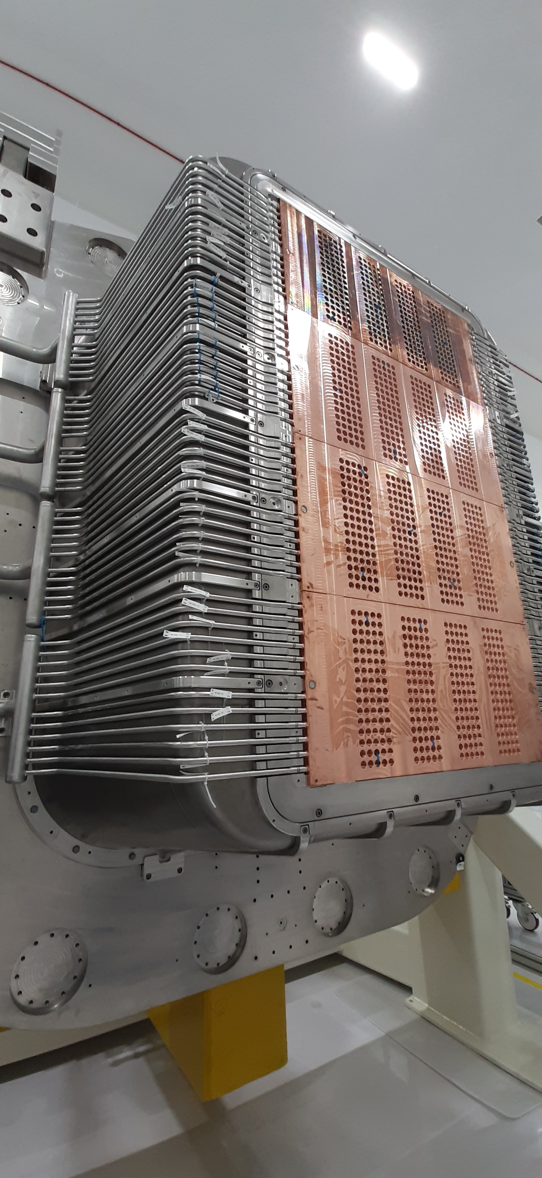
BIG SCIENCE: FUSION
Identity
Expertise
Industrial means
Fusion
High power lasers
Particle accelerators
ITER Blanket first wall panels
ITER divertor inner vertical target
ITER cryopump
ITER Electron cyclotron upper launcher
ITER poloidal field coil assembly tooling
MITICA ion beam source

Slide 6
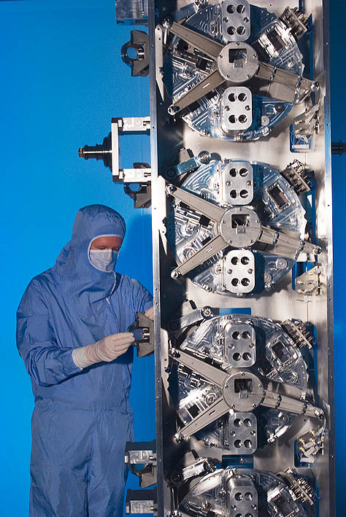
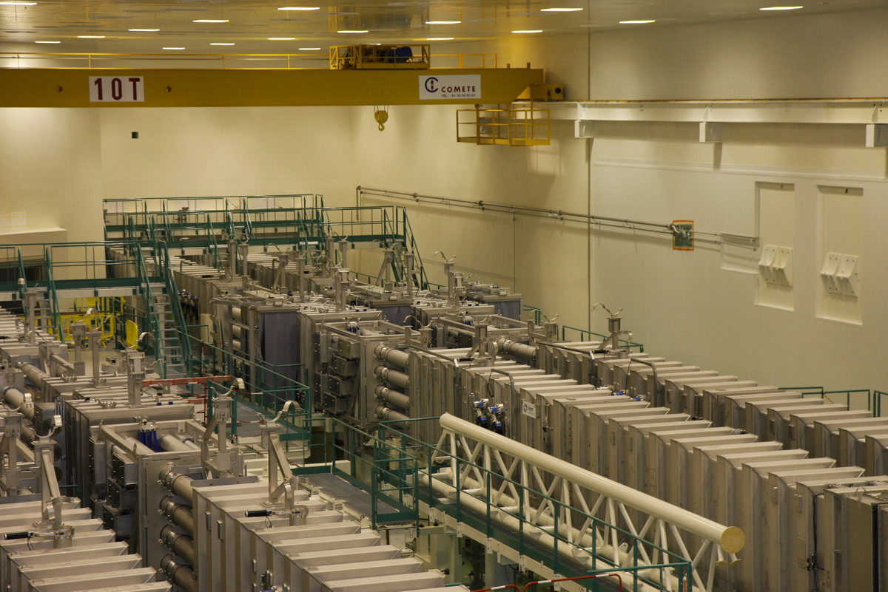
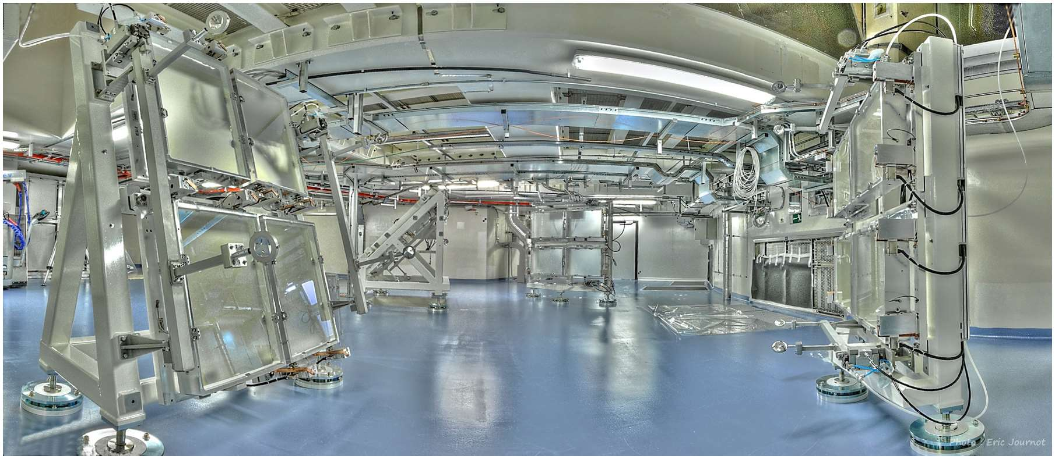
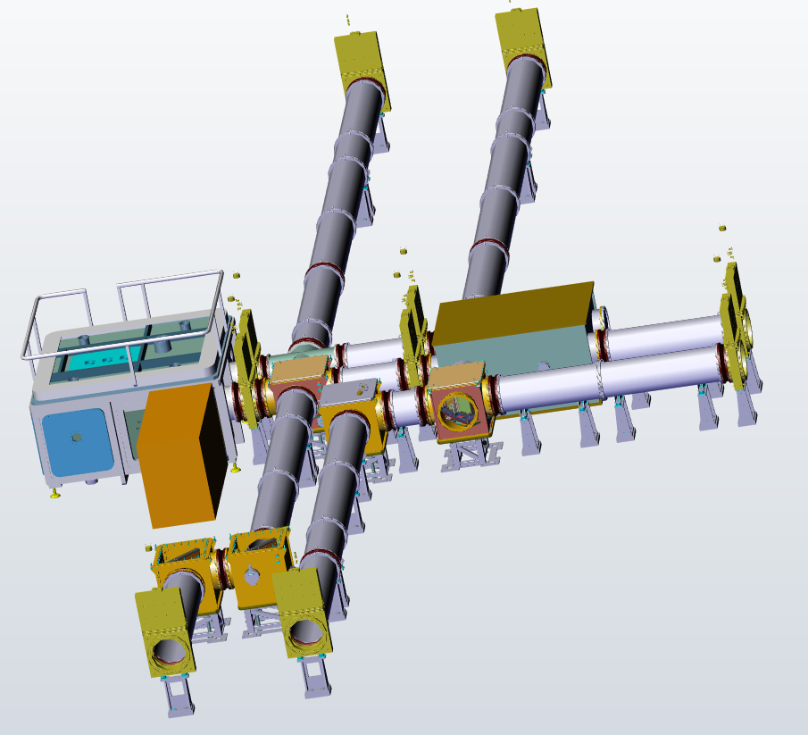
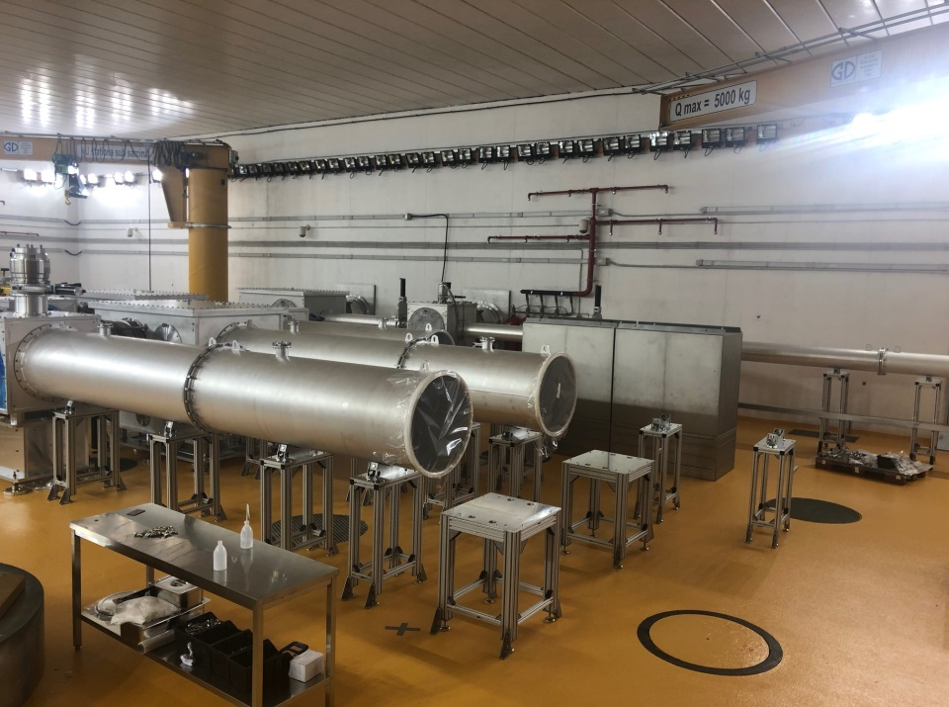
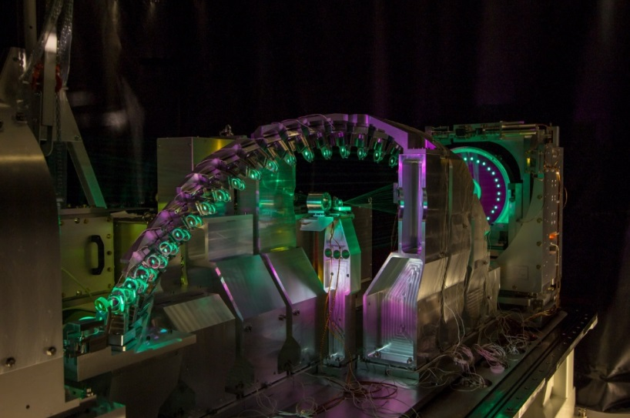
BIG SCIENCE: HIGH POWER LASERS
Identity
Expertise
Industrial means
Fusion
High power lasers
Particle accelerators
LMJ amplification and laser transport sections
ELI-NP laser beam transport system
ELI-NP Gamma beam source laser-electron interaction chamber

Slide 7
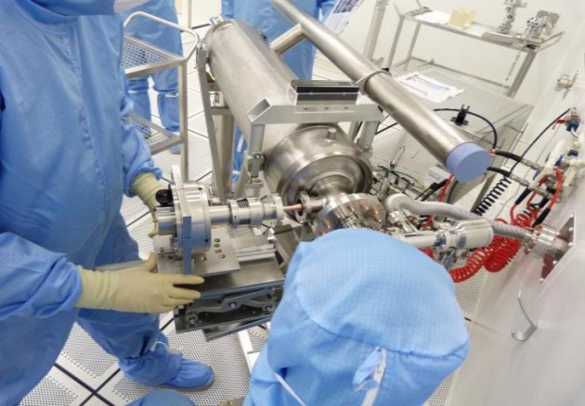
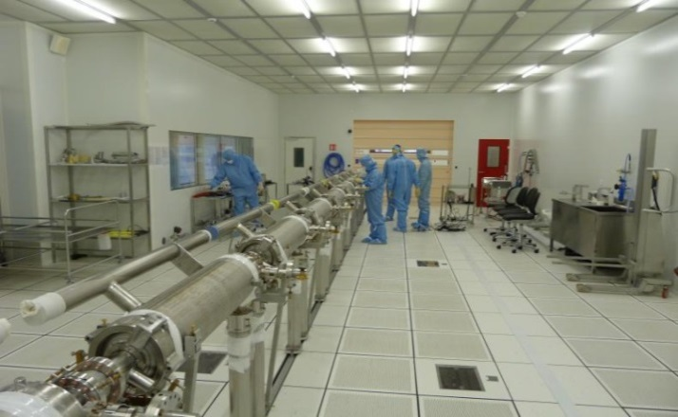
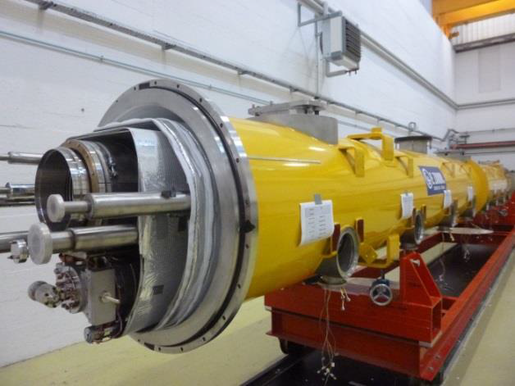
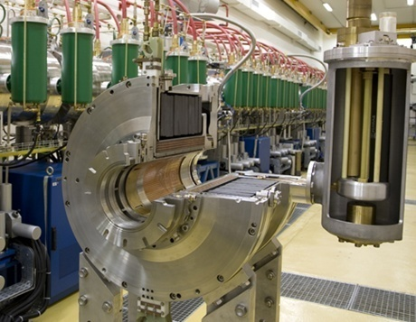
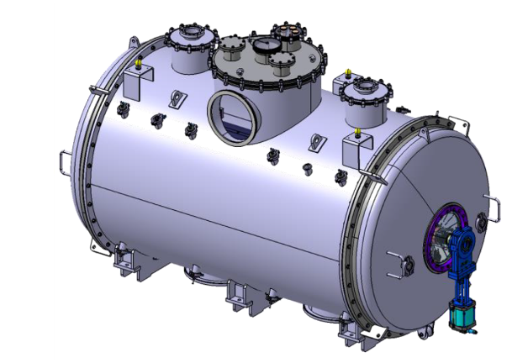
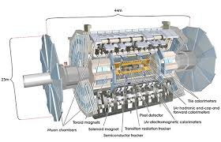
BIG SCIENCE: PARTICLE ACCELERATORS
Identity
Expertise
Industrial means
Fusion
High power lasers
Particle accelerators
Assembly of the XFEL cryomodules
AIRIX accelerating cells
ESS Spoke cryomodule vacuum vessel
Machining of bars for the CERN ATLAS detector

Slide 8
JOEL VANDEN BOSCH
BIG SCIENCE and ROBOTICS Business Development
jvandenbosch@alsymex-alcen.com
+33 (0)7 63 13 05 90
ERIC GIGUET
Sales and Business Development Director
egiguet@alsymex-alcen.com
+33 (0)6 89 82 53 90
www.alsymex-alcen.com

