Slide 1
MICROWAVE & IMAGING SUB-SYSTEMS
A MAJOR PLAYER IN POWER AMPLIFICATION

Slide 2
Thales Group
Over 81,000
70
employees
Countries Global presence
1bn €
Sales in 2021
16,2 bn €
Self-funded R&D*
* Does not include externally financed R&D
.

Slide 3
Our Business Line within Thales Group
Digital Identity and Security
Avionics
Flight Avionics
In-Flight Experience
Electrical Systems
Training & Simulation MICROWAVE & IMAGING SUB-SYSTEMS (MIS)
Land and Air Systems
Defence Mission Systems
Space
Secure Communications and Information Systems
Ground Transportation Systems

Slide 4
Worldwide leadership
SPACE
HEALTHCARE
SECURITY
N°1WORLDWIDE
for space amplification
A WORLDWIDE LEADER
for radiological digital imaging
A WORLDWIDE PRECURSOR
in the Carbon Nano Tubes Technology
(CNT)
TUBES IN ORBIT
50% OF ALL
X-ray exams worldwide use a Thales detector
FIRST
airport scanners based on CNT technology
21 000
DEFENCE
SCIENCE
INDUSTRY
N°1EUROPE
for defence amplification
N°1WORLDWIDE
for scientific amplification
N°1WORLDWIDE
for industrial amplification
LONG STANDING PARTNER
with the most prestigious research centres and laboratories

Slide 5
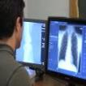
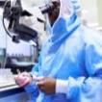
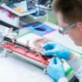
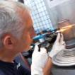
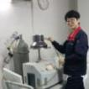
Our global presence
RF & Microwave sources
Production centres
Radiology
Production centres
Copenhagen
Denmark
Sales offices
Colorado Springs
USA
Seoul
Korea
Yokneam
Ulm
Germany
Tokyo
Japan
Vélizy
Orlando
USA
Rome
Italy
Shanghai
China
29.000m²
750 employees
Yokneam
Israel
Ulm
New Delhi
India
Thonon
Vélizy
Shanghai
25.000m²
260 employees
FRANCE
Thonon
Moirans
Moirans

Slide 6
Our specific skills & expertise
TWT
Klystrons
Gyrotrons
RF power solutions
Tetrodes
Diacrodes
More than 50 skills
Technical expertise
Heterogeneous assembly
Soldering, welding,
thermal treatments
Carburation
Chemistry
Metallisation
Thin films Coatings
Strong electric fields and high voltage tests,
Extreme conditions
Metallisation of ceramics
Ultra-high Vacuum (UHV) techniques
Amplification by RF waves / electron beam interaction
Emission and focussing of beams: cathode, grid, electron gun, line
Precision mechanics
Materials metals/ceramics
nanostructures, HT insulation
Sub-system integration, Customer Support, on-site test
RF Conception & Tests
Monitoring software & integrated tests

Slide 7
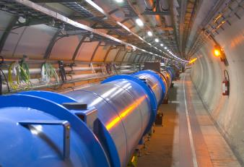
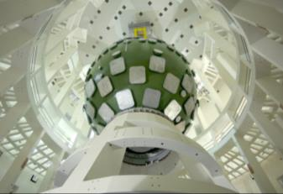
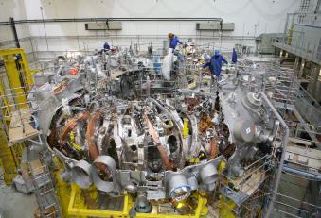
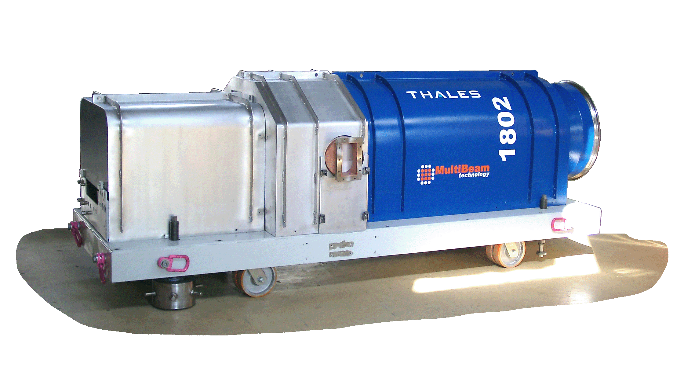
Science: our solutions
RF Sources for particle accelerators and fusion reactors
Thales power tubes and engineering systems contribute to high-tech scientific applications in the areas of particle physics, nuclear physics, particle therapy and fusion
TETRODE & ASSOCIATED CAVITIES
KLYSTRON
GYROTRON
MULTI BEAM KLYSTRON
THALES, A LONG-STANDING PARTNER TO THE MOST PRESTIGIOUS
LABORATORIES AND RESEARCH CENTRES

Slide 8
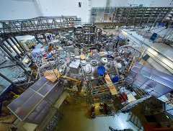
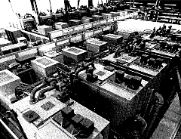
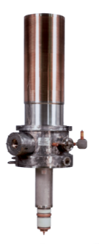
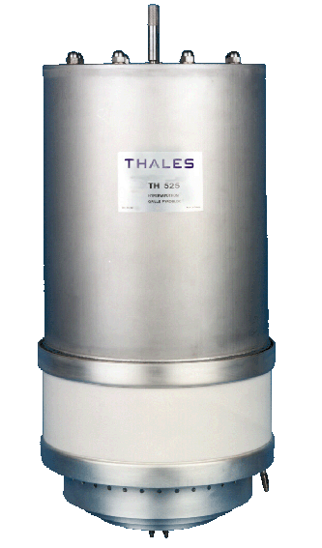
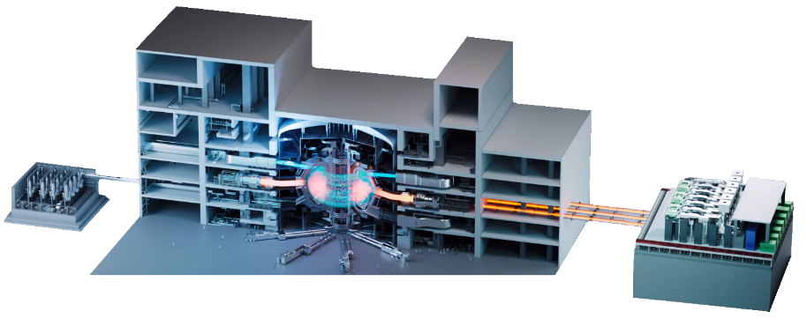
Fusion: Plasma heating system
Thales MIS contribution through RF plasma heating sources of two kinds (ECRH – gyrotron / ICRH – grid tubes)
ECRH is the most mature heating technology for fusion experiments & is top prioritized against other solutions (ICRH or NBI) by laboratories & some start-ups
Electron cyclotron resonance heating
(ECRH) system with THALES gyrotrons
Ion cyclotron resonance heating (ICRH) system with THALES tetrodes

Slide 9
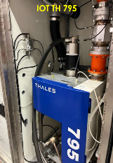
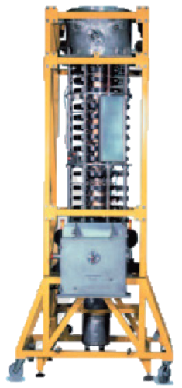
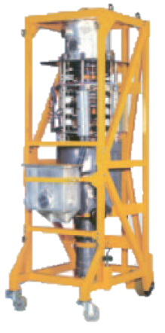
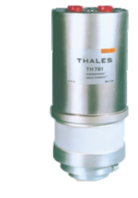
RF Sources for particle accelerators & particle therapy
Thales is a major industry player serving the international science community for particle physics
We have teamed up with universities, research organizations and laboratories worldwide to meet the demand for the most advanced equipment in international projects
Our solutions are used by the world’s most prestigious research organizations:
→ Complete klystron portfolio (UHF, L, S, C Band) up to 45MW peak output power
→ Complete grid tubes (tetrodes, IOT) portfolio (VHF, UHF Band) up to 4MW peak output power

Slide 10
MIS | These laboratories trust us for their accelerators operation
“Names, trademarks and brands mentioned in this page are the property of their respective owners”.

Slide 11
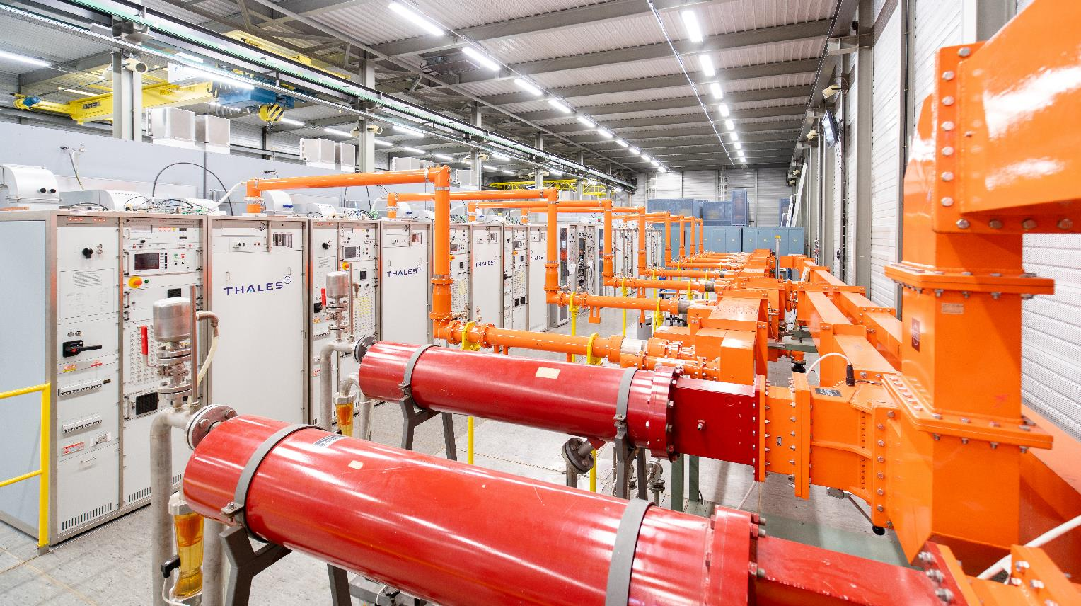
THANK YOU
Thales Microwave & Imaging Sub-Systems

