Slide 1
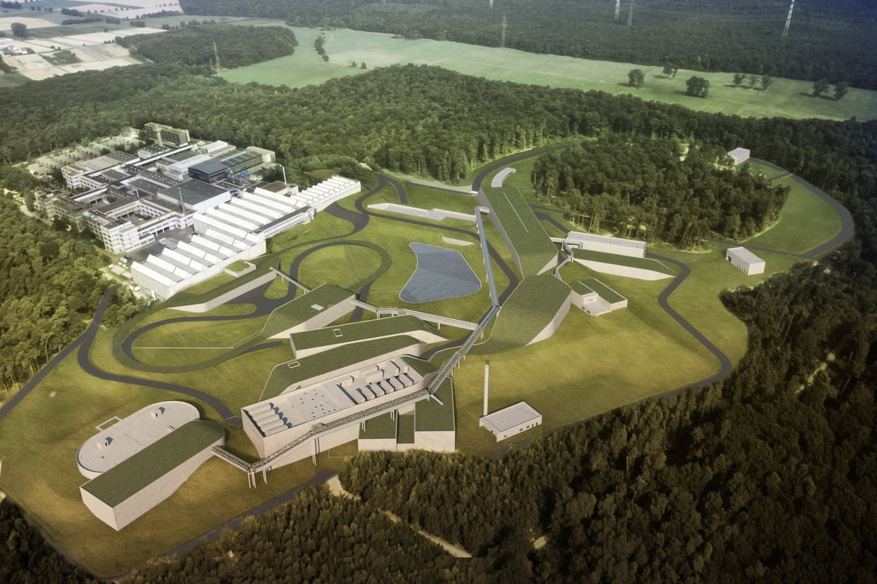

ion42
The FAIR Project
Realization of the world's unique particle accelerator facility in Darmstadt
Jörg Blaurock
Technical Managing Director FAIR GmbH & GSI GmbH
Notes:
titelseite

Slide 2
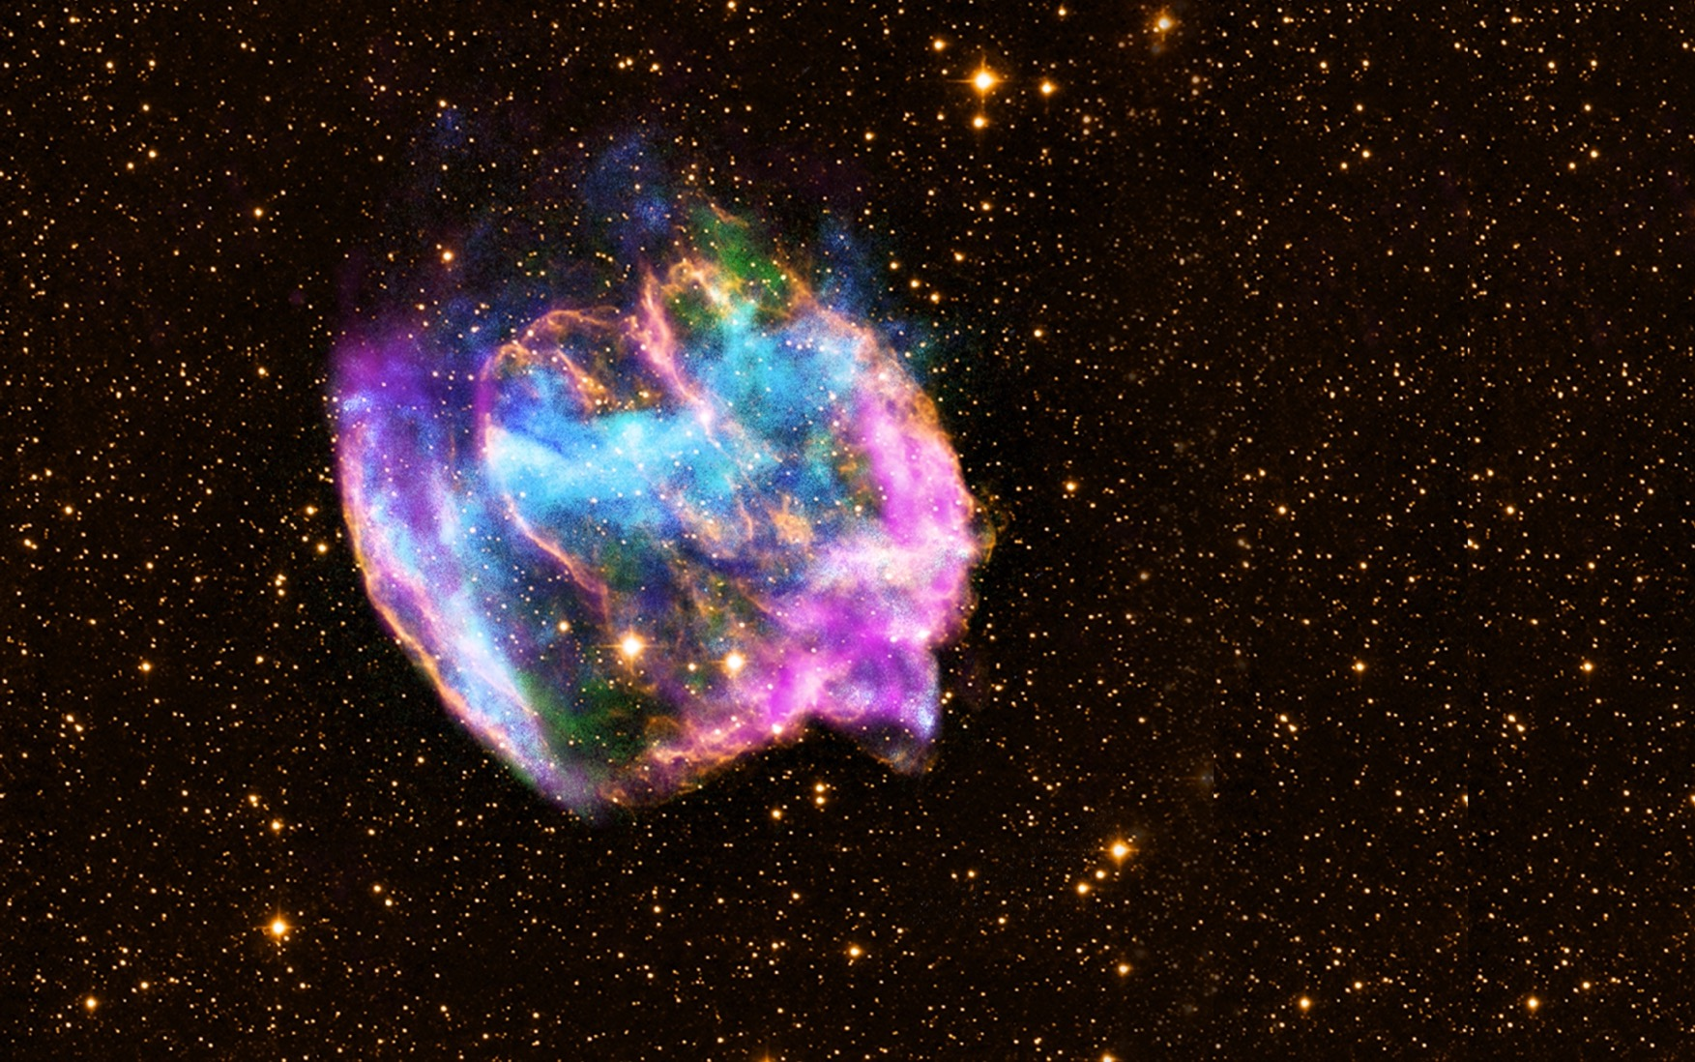

We explore the universe…

Slide 3
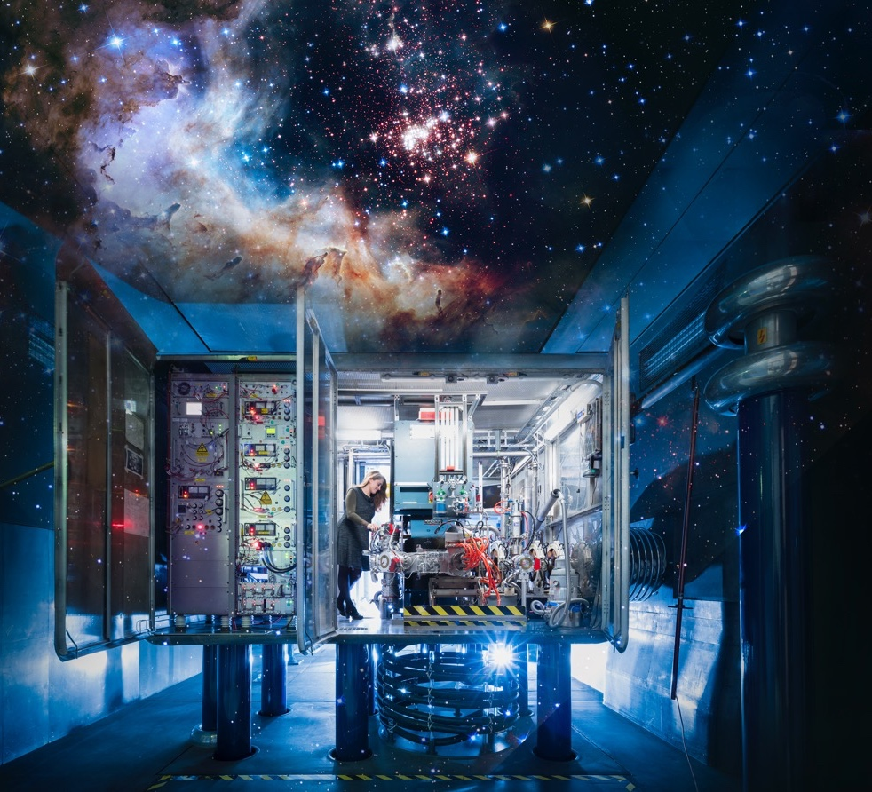
…in the laboratory.
Foto: J. Hosan/GSI, “NASA, ESA, the Hubble Heritage Team (STScl/AURA), A. Nota (ESA/STScl), and the Westerlund 2 Science Team”

Slide 4
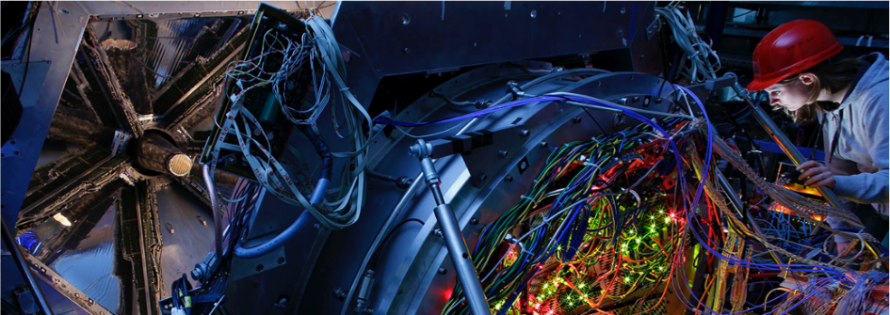
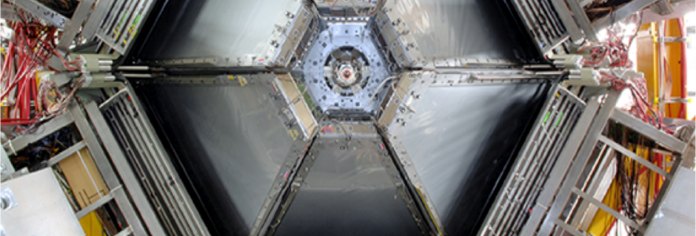
FAIR – Facility for Antiproton and Ion Research
Unique particle accelerator facility for research with antiprotons and ions worldwide
Matter as it occurs in the universe is first produced and researched in the laboratory
Fundamental research and development of applications in materials research, radiation biology, aerospace, etc.
Collaboration between several teams of top international researchers - more than 3,000 scientists
Different research programs in parallel with different ion varieties possible
FAIR develops and uses the most innovative measurement methods and techniques

Slide 5
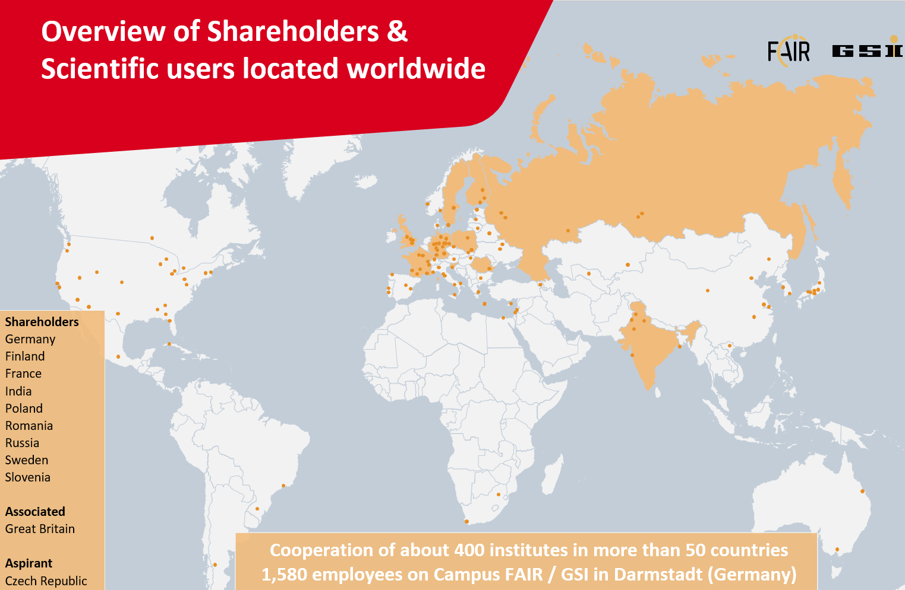

Slide 6

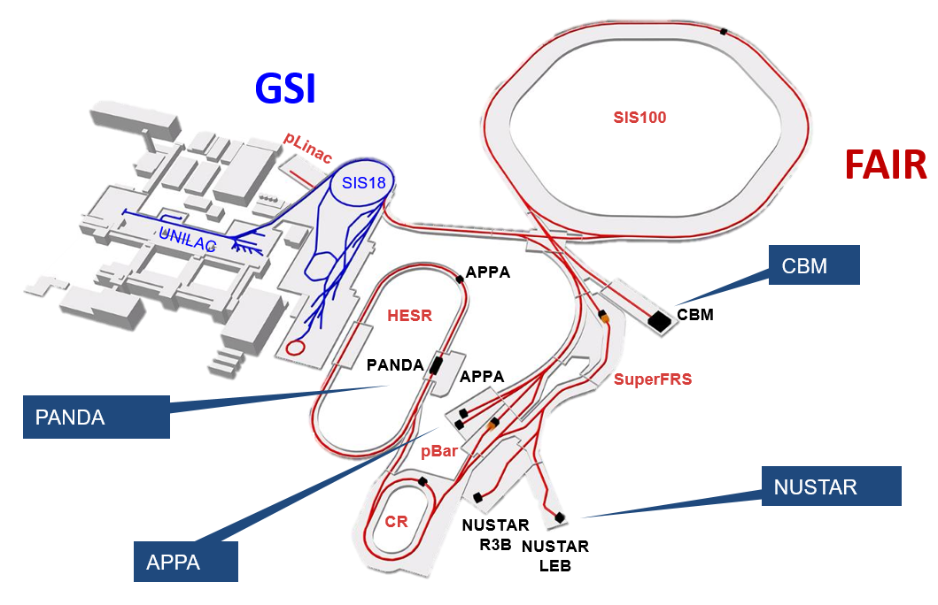
FAIR – The Facility
Existing facility
Planned facility
Experiments
20 Accelerator- and Experiment-Buildings
Underground accelerator ring
with a circumference of 1,100 m
Around 150,000 m ² total space

Slide 7
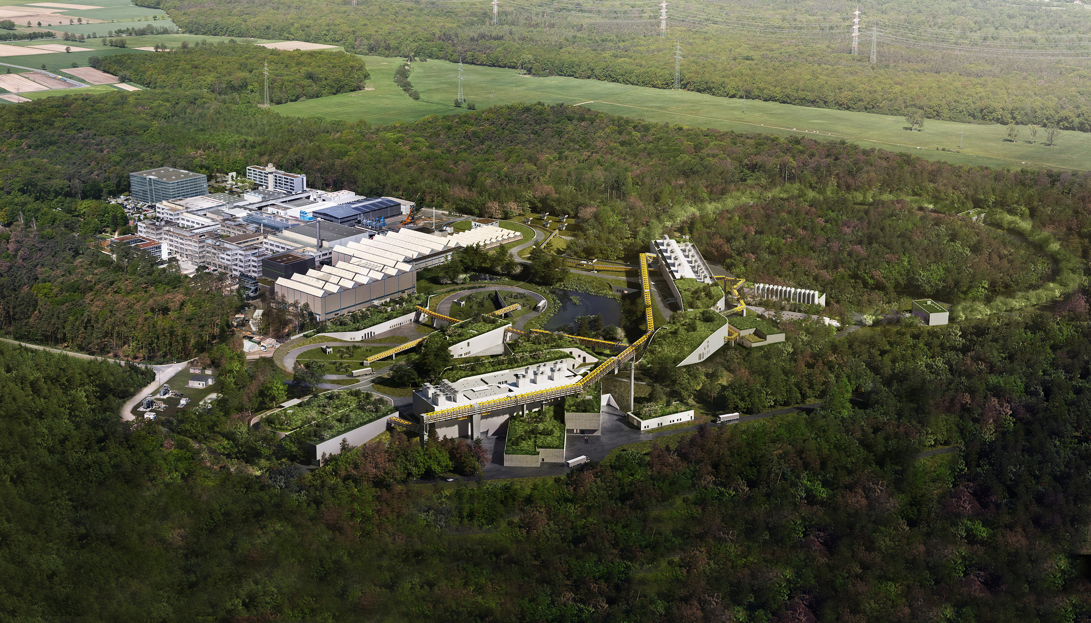
FAIR Darmstadt

Slide 8
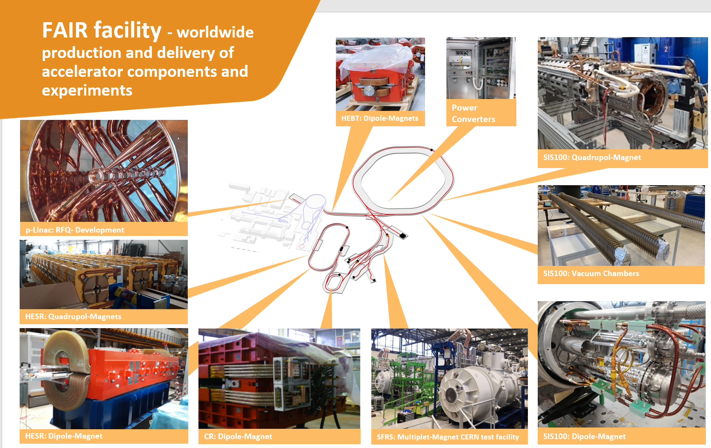
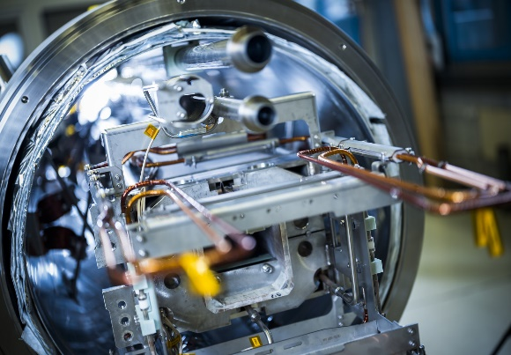

Slide 9
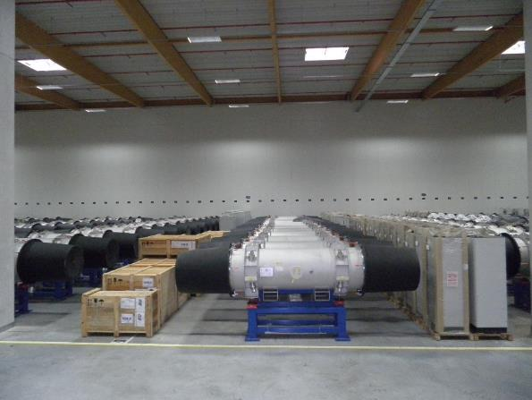
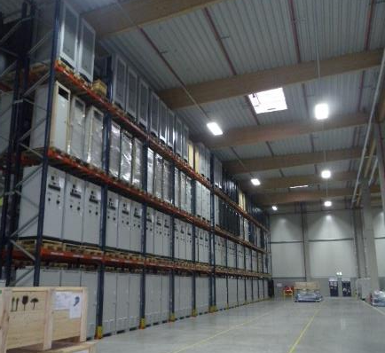
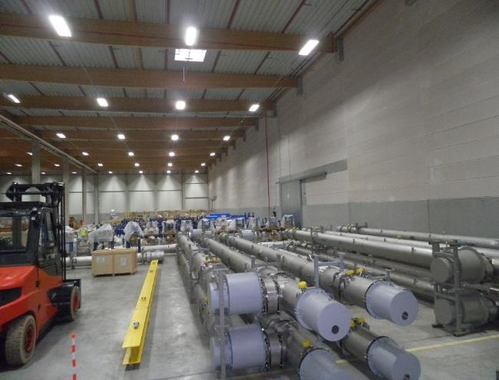
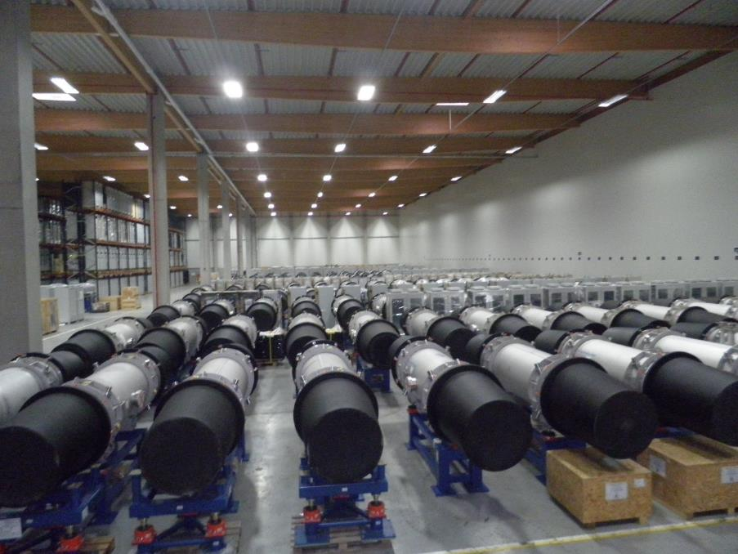
FAIR Highlights - Storage Area Weiterstadt
  Completed and delivered high-tech components for accelerator and experiments
Storage area: approx. 9.900 m²
4.195 objects (Components, assemblies, boxes, etc.)
50% of SIS100 components stored
90% of HESR components stored
9

Slide 10
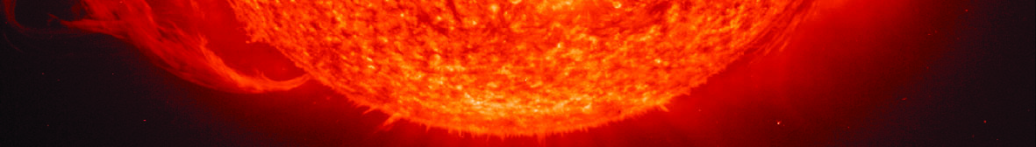
The 4 scientific pillars at FAIR
NUSTAR
Nuclear Structure, Astrophysics and Reactions: Stars and nuclei
CBM
Compressed Baryonic Matter:
Inside a neutron star
PANDA
Antiproton-Annihilation at Darmstadt: Antimatter research
APPA
Atomic, Plasma Physics and Applications:
From atoms to planets to cancer research

Slide 11
France at FAIR
France owns 2.65% of FAIR. The two equal French shareholders are Commissariat à l' Énergie Atomique et aux Energies Alternatives (CEA) and Centre National de la Recherche Scientifique (CNRS). Part of the agreement is that Germany contribute to Spiral2 at GANIL.
In total, the French commitment to FAIR is just over 51.4 M€ @ 2005. 7.5 M€ of this is in cash. The rest is in kind (contributions en nature).
In-kind ontributions are agreed with the FAIR council. France chooses costbook items that are compatible with French expertise and strategy. These items are then produced in France and delivered to FAIR in exchange for shares.

Slide 12
France at FAIR
Is founded on long-term Franco-German collaborations in heavy ion and accelerator research
Comes from our shareholders, CEA and CNRS, from French industry and through academic collaborations
Provides key components and services to the operation of FAIR from day 1
covers all major technologies needed in the accelerator
Contributes to core FAIR machines needed for beams for first science
Contributes to three of the four scientific pillars of FAIR (APPA, CBM and Nustar)
And therefore supports experiments of phase 1 both directly and indirectly

Slide 13
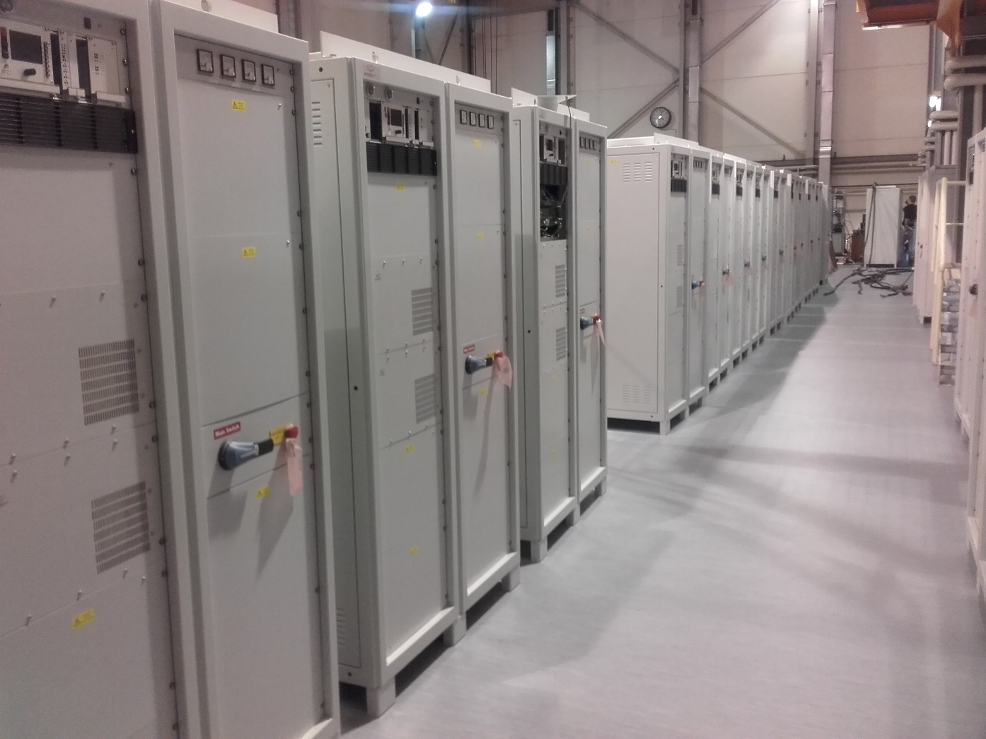
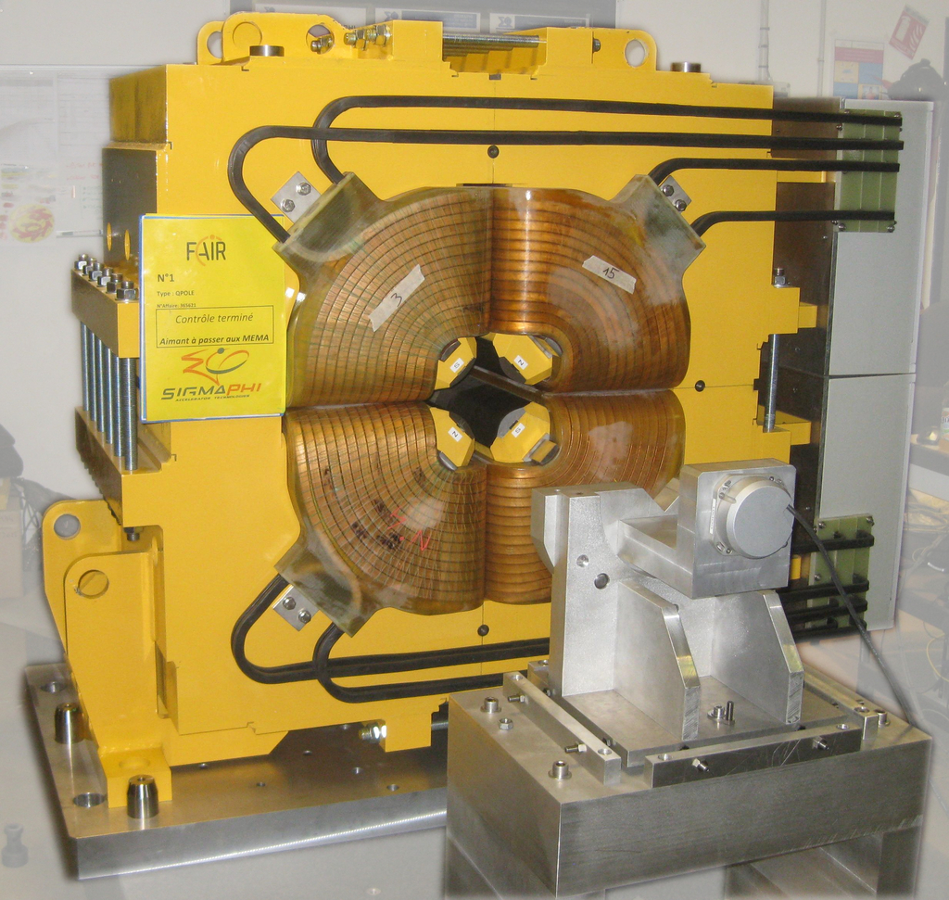
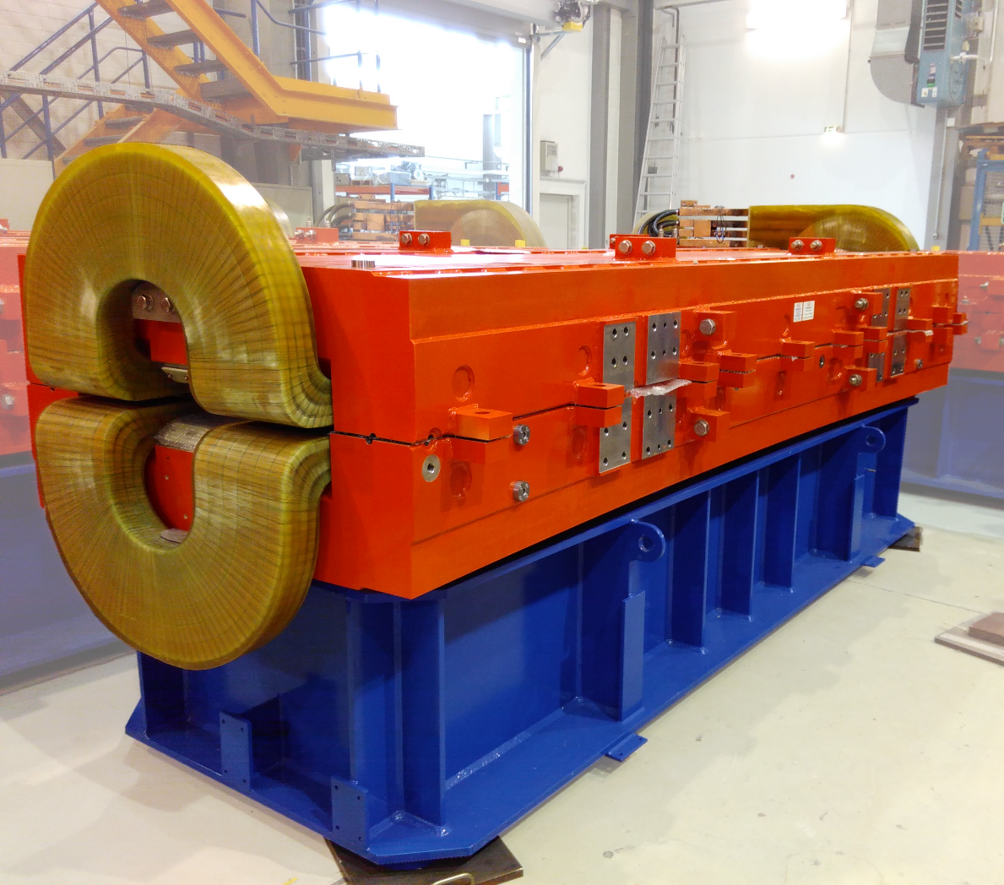
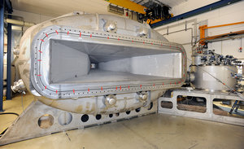
Contributions of France
You are part of FAIR
Power supplies for HESR (Sigma Phi)
Dipoles and quadrupoles for HESR (Sigma Phi)
Klystrons (CNRS/Thales)
GLAD (CEA/GSI)
Research and development
Ion source (CNRS)
Technical coordination of
Super-FRS dipoles

Slide 14
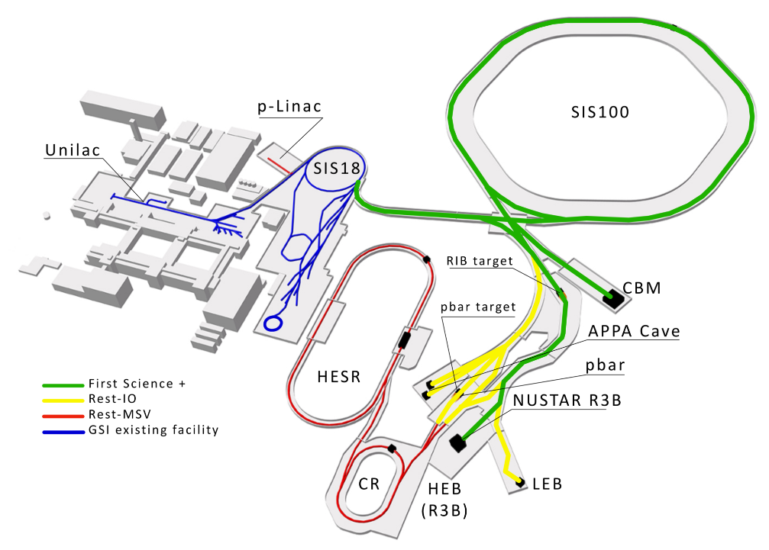
FAIR stepwise approach towards MSV
Due to budget constraints a Scientific Review panel was tasked by the FAIR Council in 2022 to perform a “First Science and Staging Review of the FAIR Project”.
The Scientific Review panel recommended in October 2022 that the scenario FS+ (SIS100, Super-FRS-HEB and CBM) would be the most appropriate starting scenario to achieve world leading science.
FAIR Council decided on 9th & 10th March 2023 to proceed with FS and to make a further decision on FS+ in July 2023.
until 2028
after 2028

Slide 15
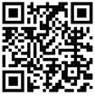
Estimated accelerator expenditure to realise FS+
Technology | Estimated expenditure (M€)
Magnets & injection/extraction | 28
Power | 20
Vacuum | 23
Cryogenics | 5
Control and beam diagnostics | 15
RF | 15
Installation | 37
Remote handling | 7
Current
procurements

Slide 16
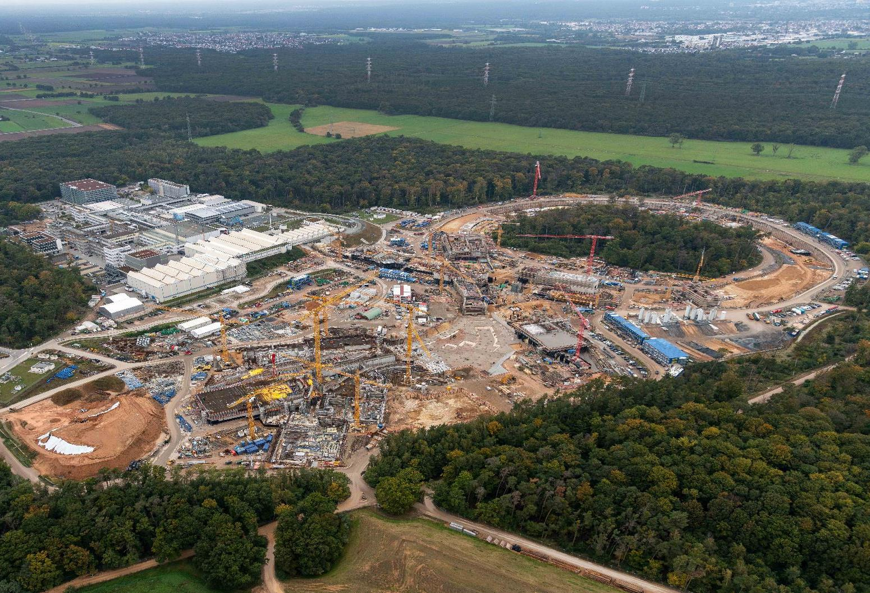
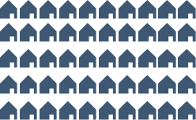
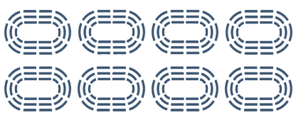
Construction Dimensions
2 Mio. m³
600.000 m³
65.000 t
Ground
Concrete
Steel
will be moved
will be installed
will be deployed
Status as of April 2023 : Concrete works - 90 % executed
  Correspond to 5,000 single-family houses
  Correspond to 8-times the football stadium of Frankfurt
  Correspond to 9 Eiffel Towers
Notes:
text anpassen schöner schreiben – letzter satz soll bleiben

Slide 17
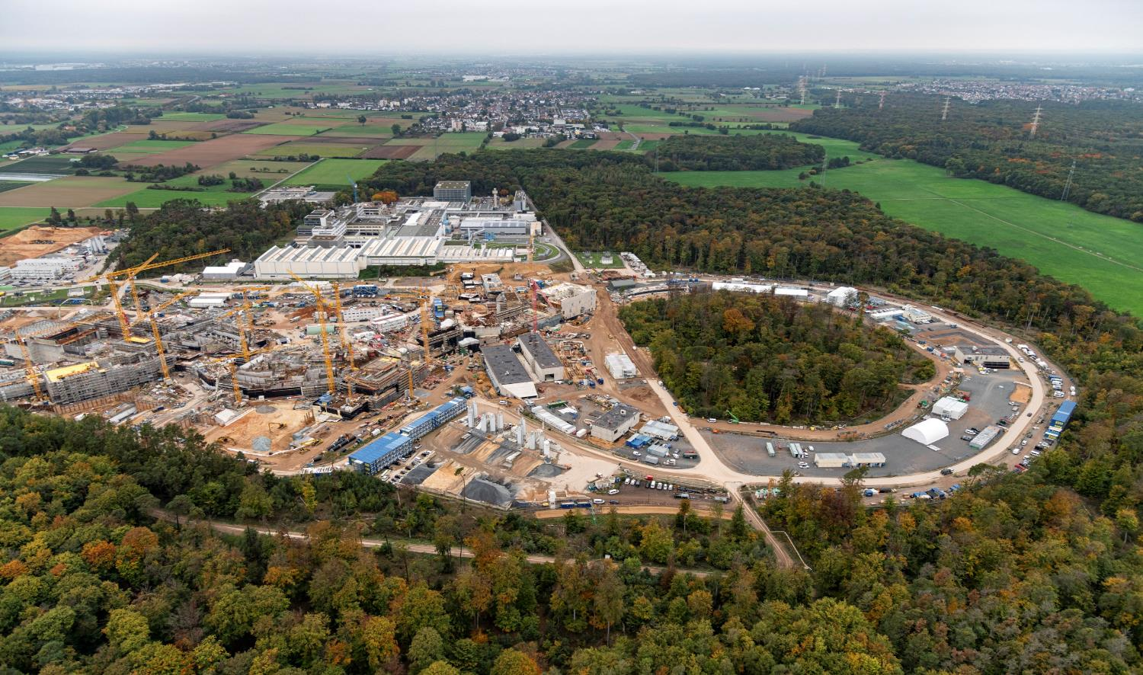
FAIR in Construction
November 2022

Slide 18
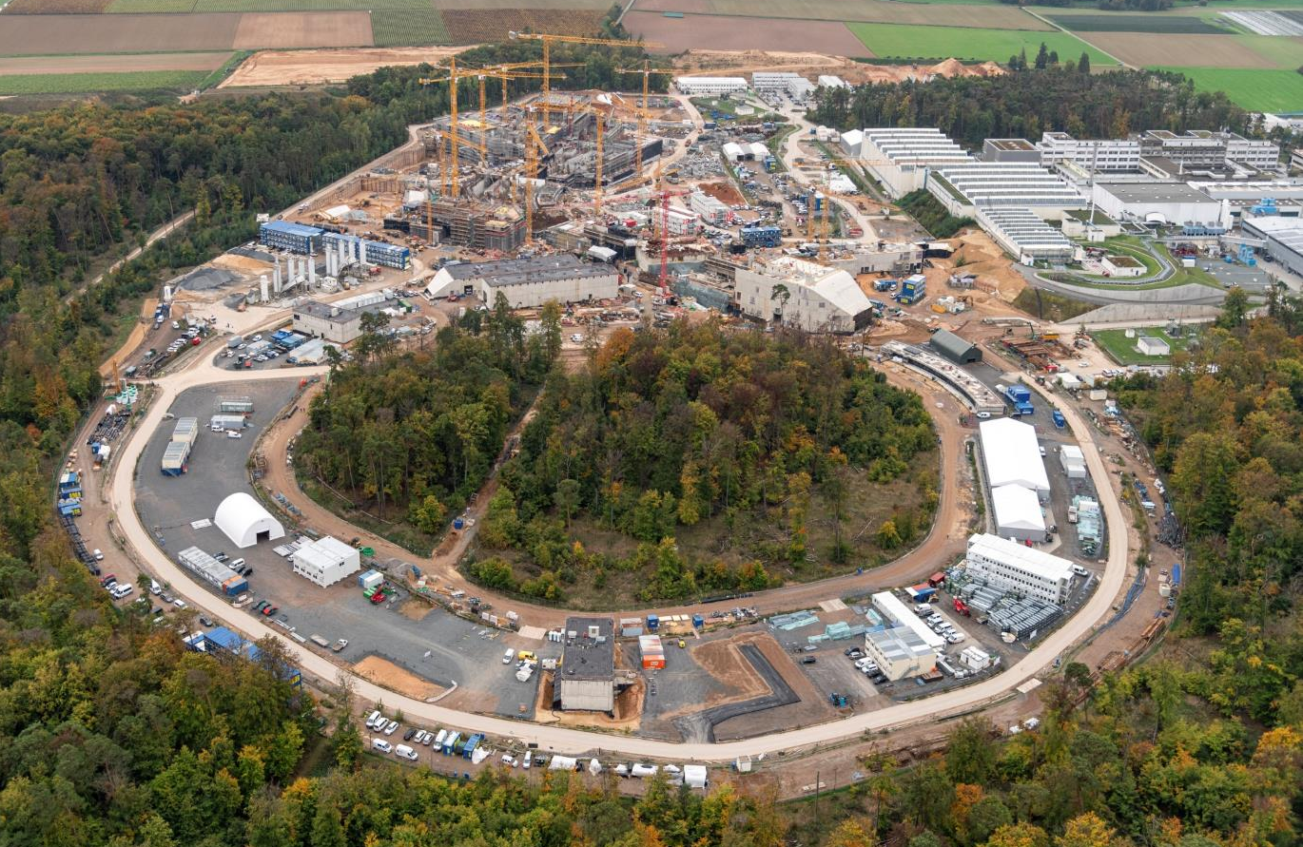
FAIR in Construction
November 2022

Slide 19
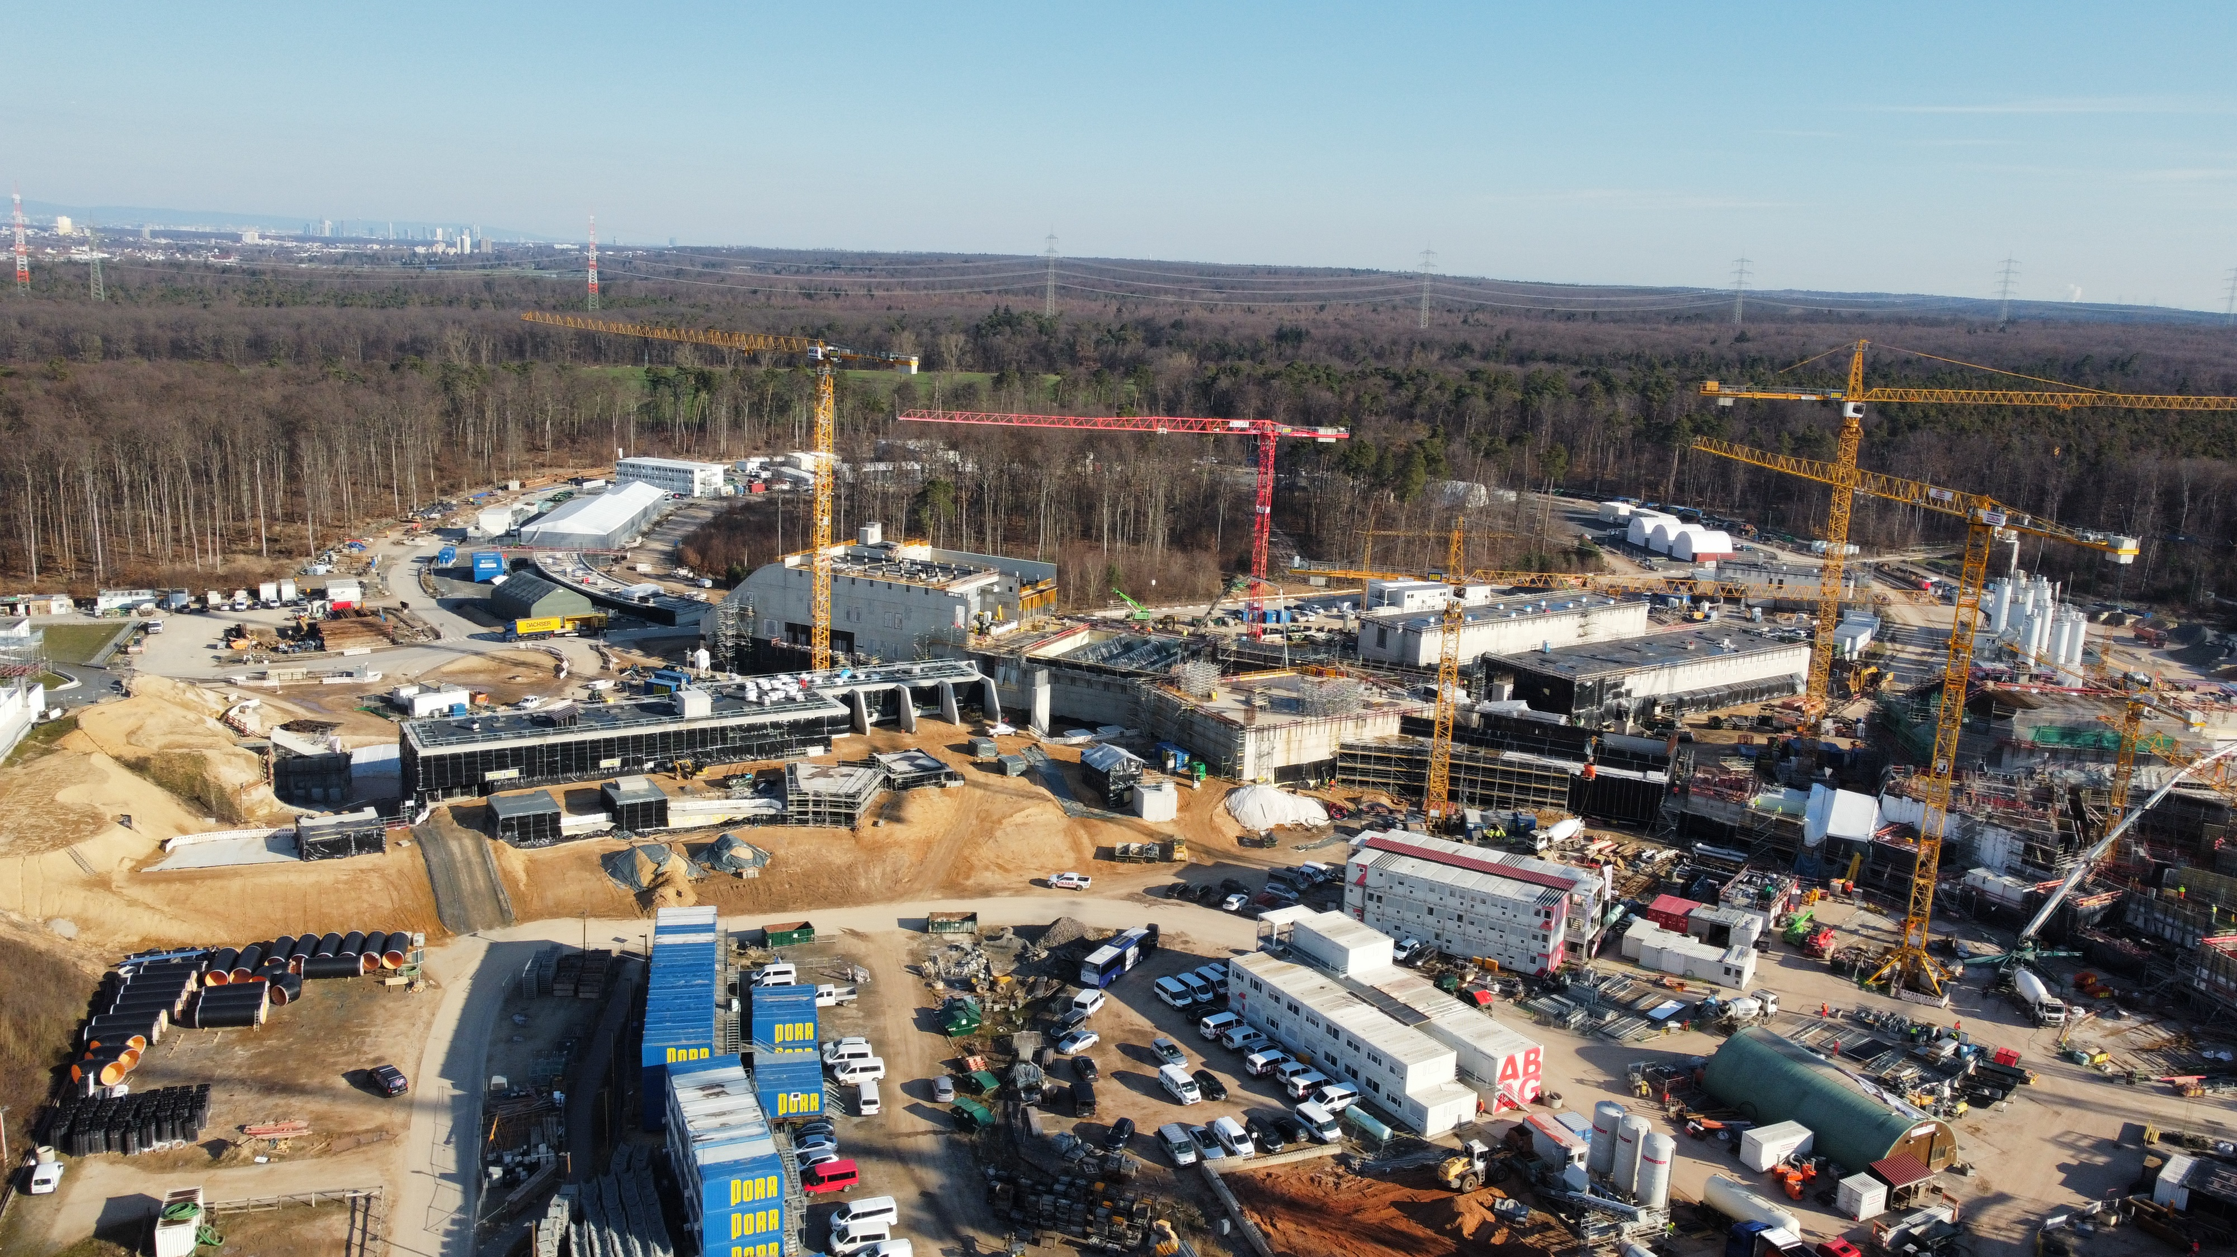
FAIR in Construction
Area North - April 2023
19

Slide 20
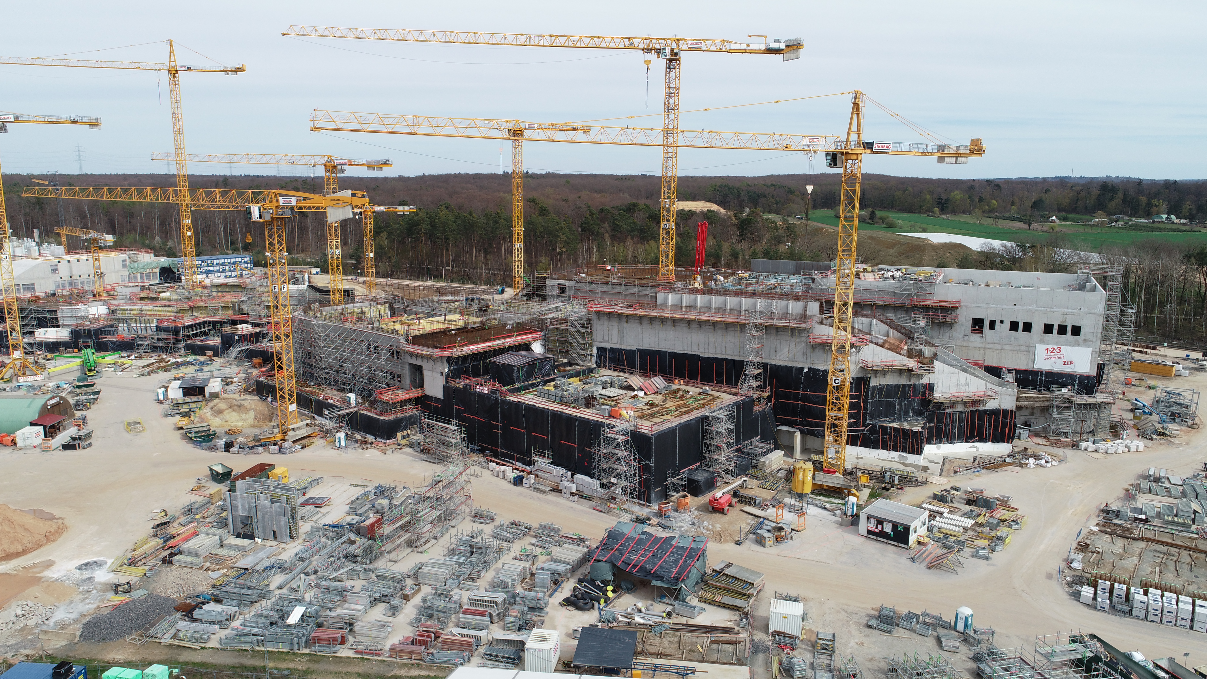
FAIR in Construction
Area South - April 2023

Slide 21
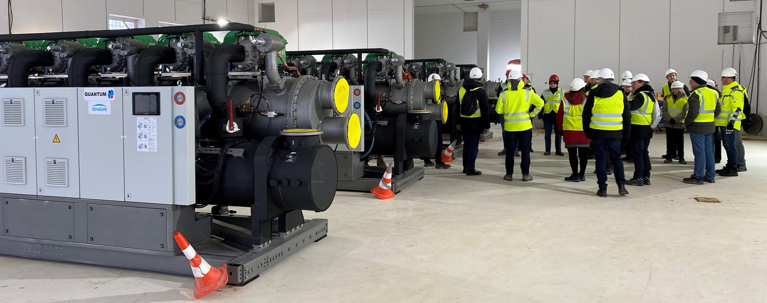
FAIR in Construction
December 2022

Slide 22
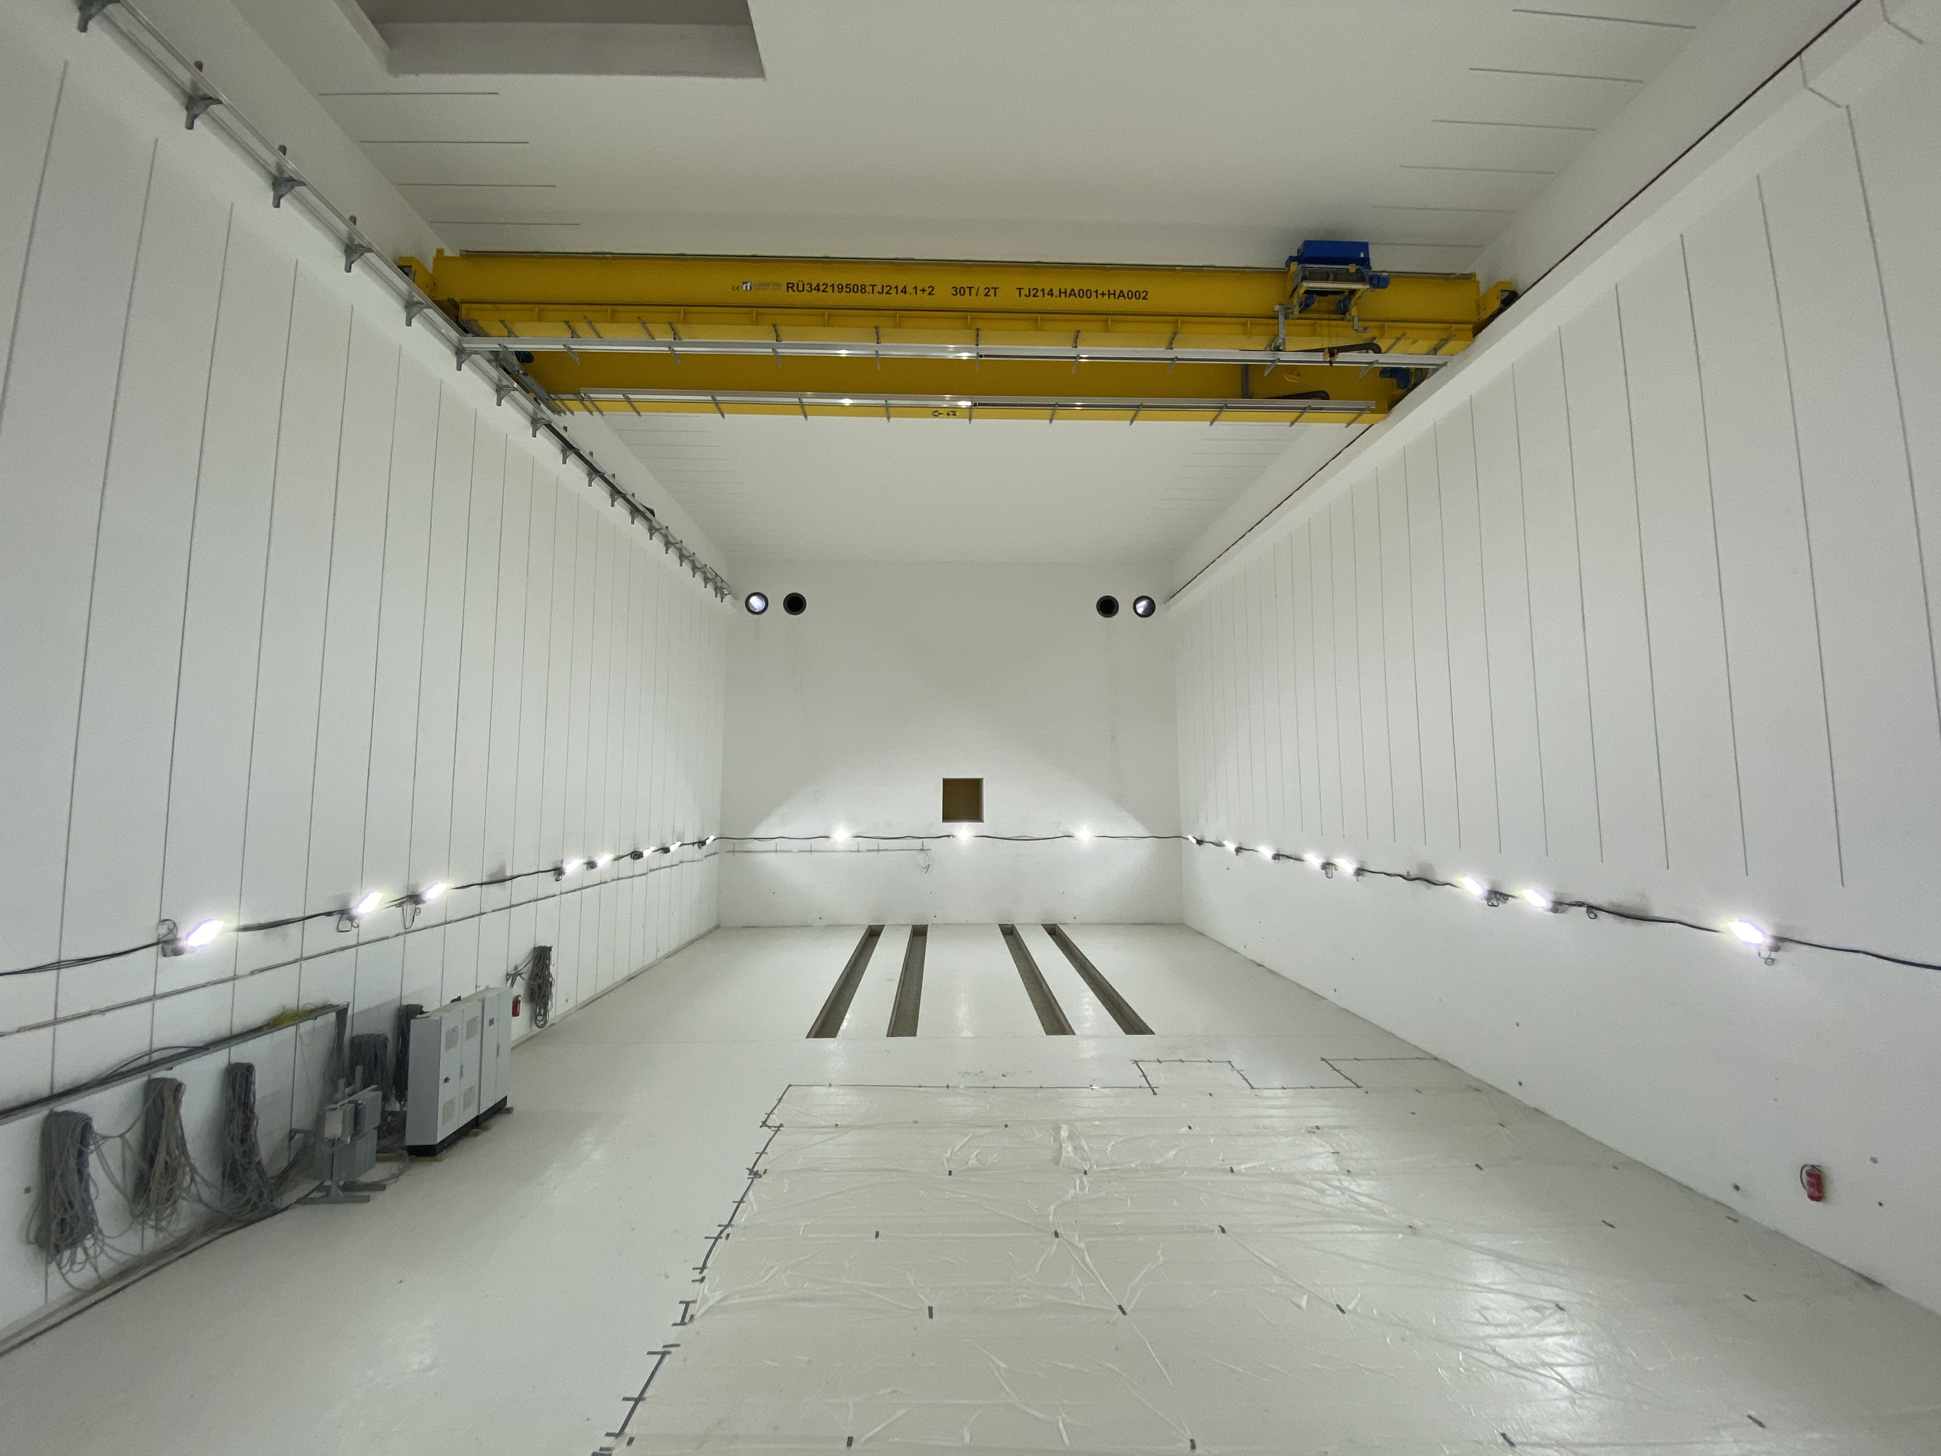
FAIR in Construction
April 2023

Slide 23
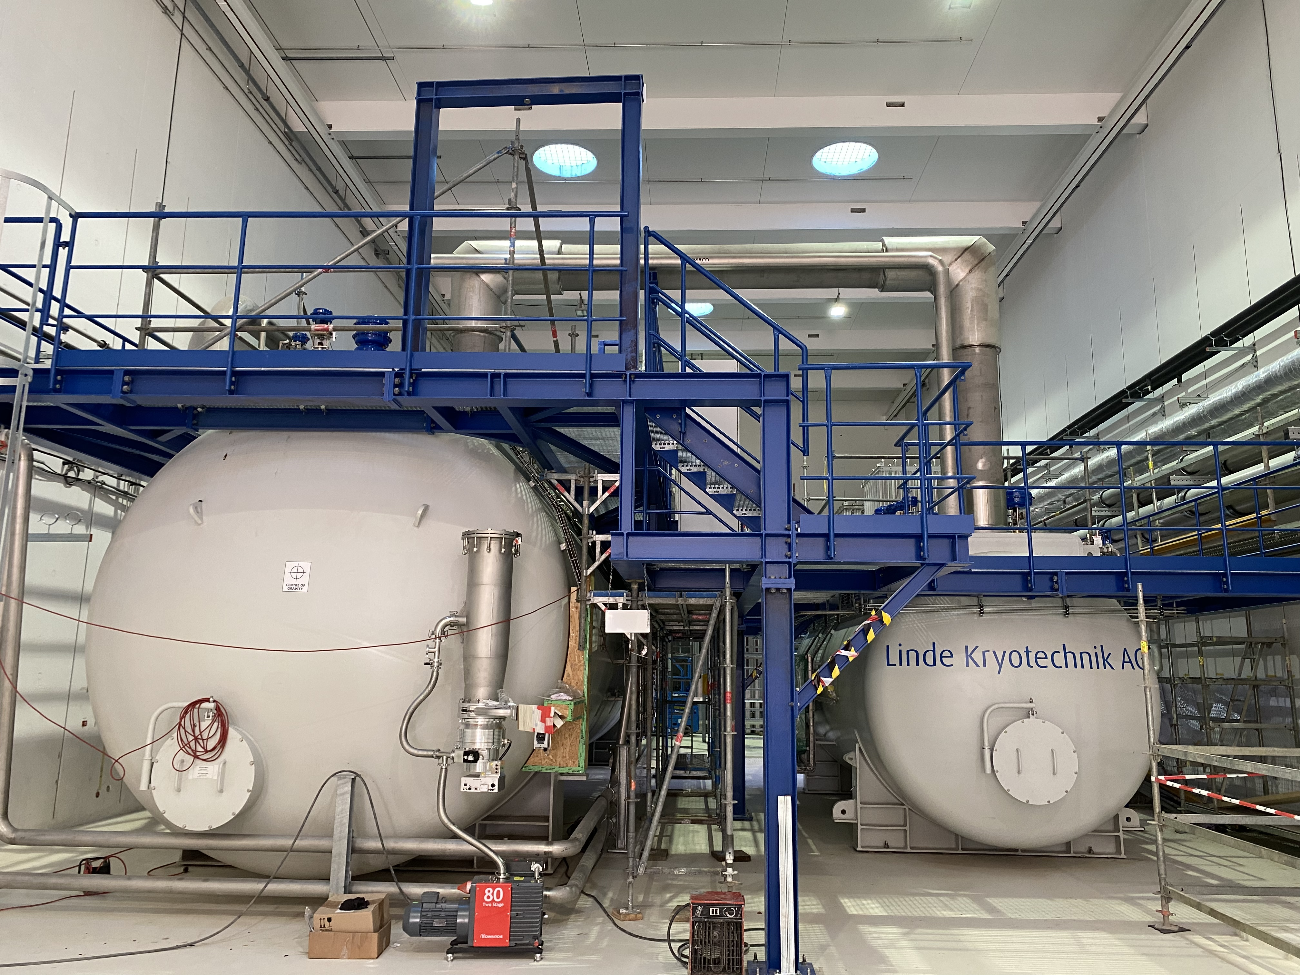
FAIR in Construction
April 2023

Slide 24
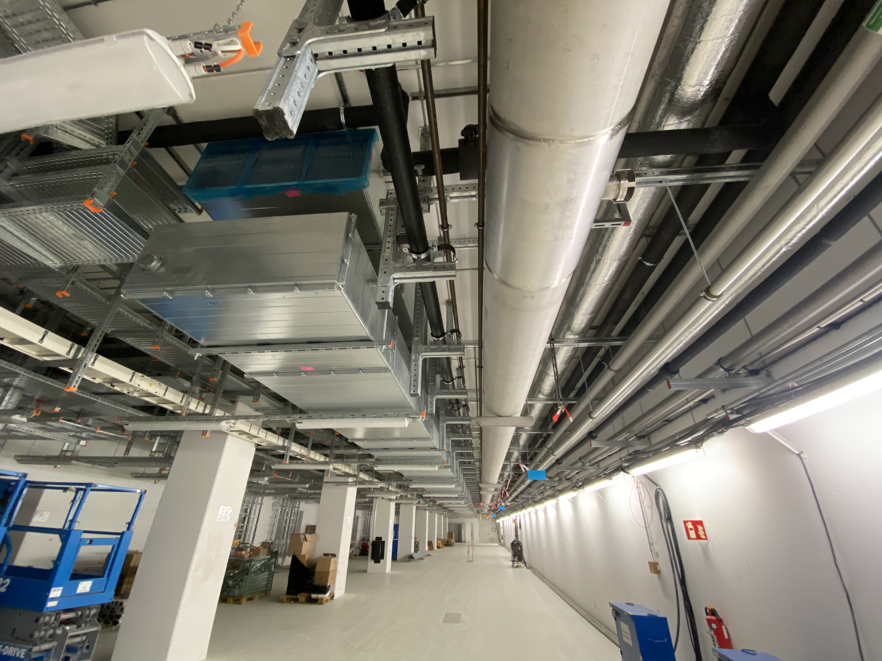
FAIR in Construction
April 2023

Slide 25
FAIR in 2028
So, the „FAIR2028“ science program will include:
  APPA experiments at the low-energy rings, at the caves at SIS18 and UNILAC, PHELIX and a limited set of experiments which could be hosted at the SIS100 caves
  NUSTAR at the SFRS with SIS100 beams, plus SHE experiments at UNILAC and ILIMA at the low-energy rings
  CBM at the new cave with SIS100 beams, and HADES at SIS18
We will optimize our efforts towards optimum use of our resources and of the space in the new caves for these goals.
For activities which will have beam only at a later stage, such as PANDA, suitable programs are being developed, when possible using the caves and beams available at GSI/FAIR.

Slide 26
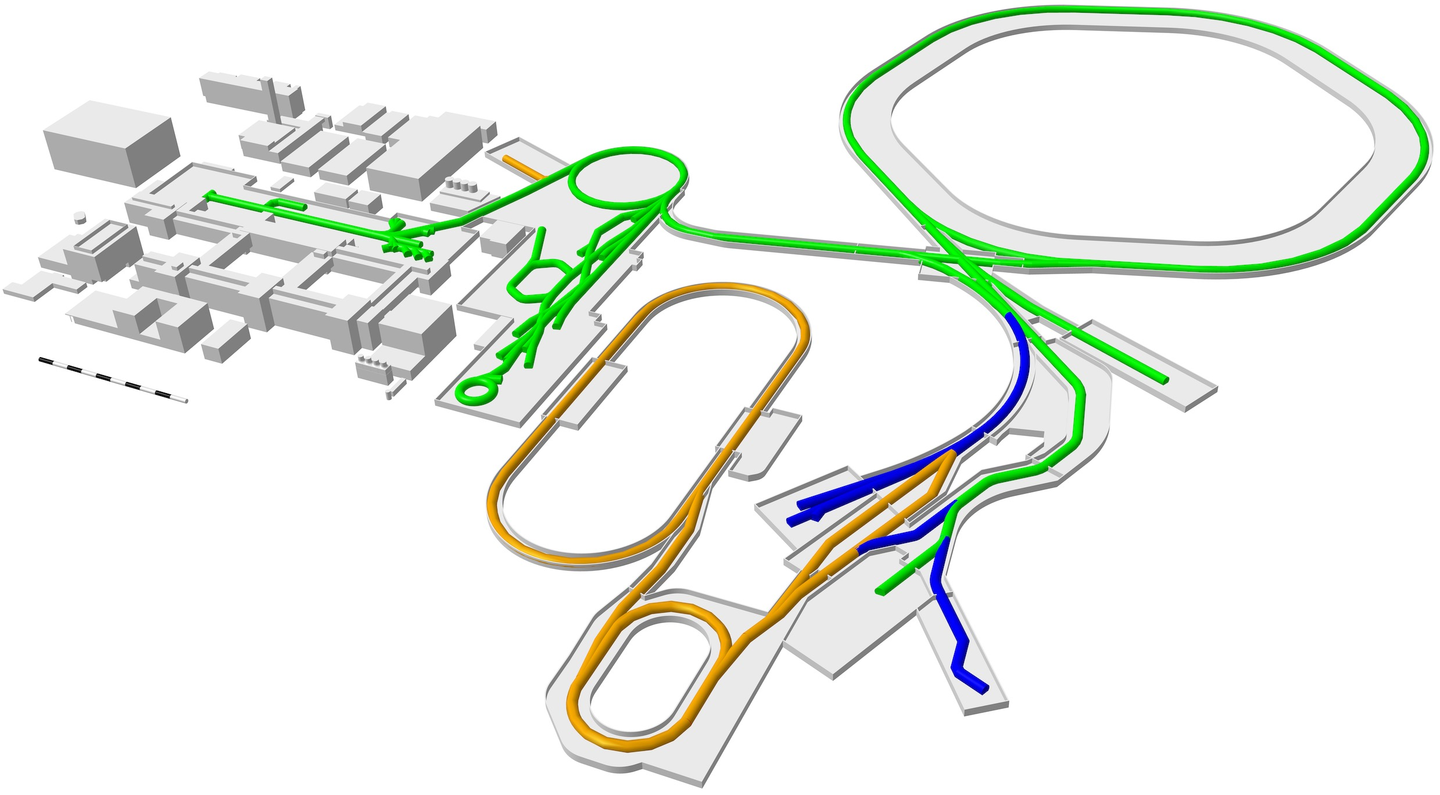
FAIR 2028
SIS100
UNILAC
SIS18
HITRAP
ESR
CBM
CRYRING
Super-FRS
First Science +
Next steps
MSV completion
NUSTAR HEB
APPA, NUSTAR and PANDA investigate options for further experiments at green lines
Continuation of APPA, CBM and NUSTAR experiments in existing facility

Slide 27
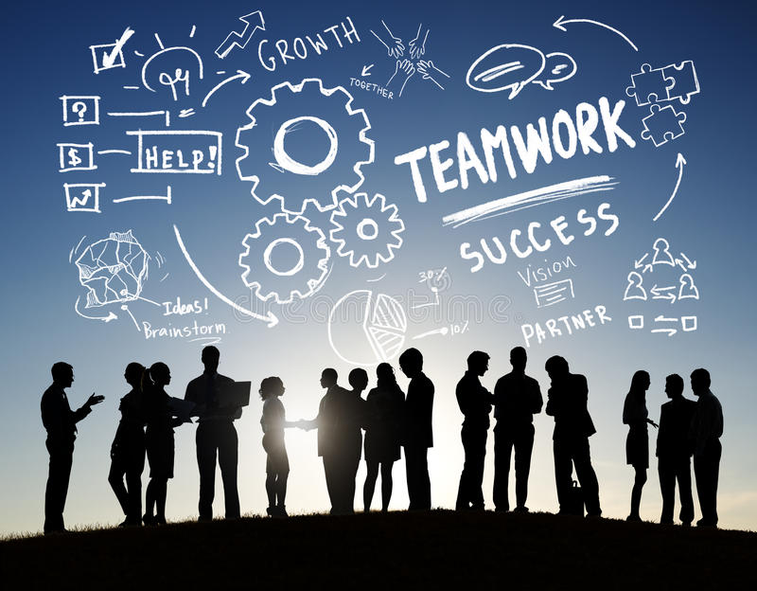
Finding a vision for future collaboration
FAIR has exciting procurement opportunities in technologically challenging fields
It’s easy to do business with FAIR, as the next presentation will show
We are looking for development collaborators as well as suppliers
We have upstream and downstream innovation opportunities for ambitious companies
Our technical and procurement experts are here ready to meet you
FAIR relies on companies like you to help us bring the universe into the laboratory
I wish us all a successful meeting doing good business together!

Slide 28
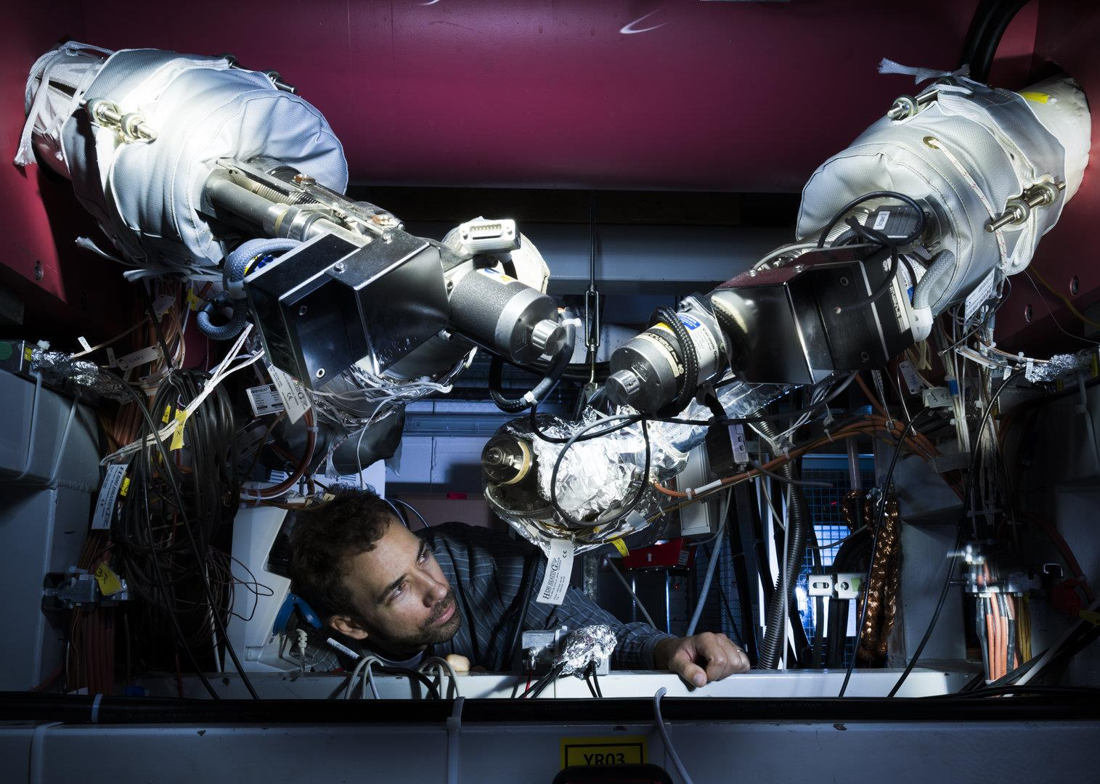

Thank you for your attention!
Merci de votre attention!

