Slide 2
Organised by
Arnauld LESERVOT
Isabel DE CALUWÉ
Sonia UTERMAN

Slide 3
Huge thanks to our industry delegates

Slide 4
Today’s agenda
Time
9:00 – 9:10 | Welcome address – A. Leservot and S. Utermann
9:10 – 9:40 | Presentation of the FAIR project by the Technical Managing Director – J. Blaurock
9:40 – 10:00 | A guide to procurement at FAIR and GSI – D. Conradi
10:00 – 10:09 | Company pitches, 3 minutes each - Alsymex, Technetics and BERTIN
10:09 – 10:30 | Vacuum at FAIR – L. Urban
10:30 – 10:55 | Group photograph followed by morning coffee break
10:55 – 11:01 | Company pitches, 3 minutes each - Omega Physics and Thales
11:01 – 11:20 | Ring-RF at FAIR – H. Klingbeil
11:20 – 11:29 | Company pitches, 3 minutes each - Cryodiffusion/Chart, Sigma Phi, Air Liquide
11:29 – 11:50 | Cryogenics at FAIR – M. Kauschke
11:50 – 12:30 | Pending FAIR procurements: technical discussions between French industry delegates and FAIR technical experts
12:30 – 13:30 | Lunch and discussions (Canteen side room)
13:30 – 13:40 | Technology transfer at FAIR – R. Lang
13:40 – 14:01 | Company pitches, 3 minutes each - Robatel, ISP, CNIM, Framatome, Nexans, Nuvia, Cegelec CEM
14:01 – 14:20 | Super-FRS hot cell – H. Weick
14:20 – 14:40 | NuStar at FAIR – J. Gerl
14:40 – 15:00 | Afternoon coffee break and meet in the foyer for the site visit
15:00 – 17:00 | Site tour: meet in the foyer; safety briefing and protective clothing; tour – H. Simon and P. Gasik
17:30 | End of event; bus departs for the airport.

Slide 5
Quick quiz:
Is it French or is it German?

Slide 6
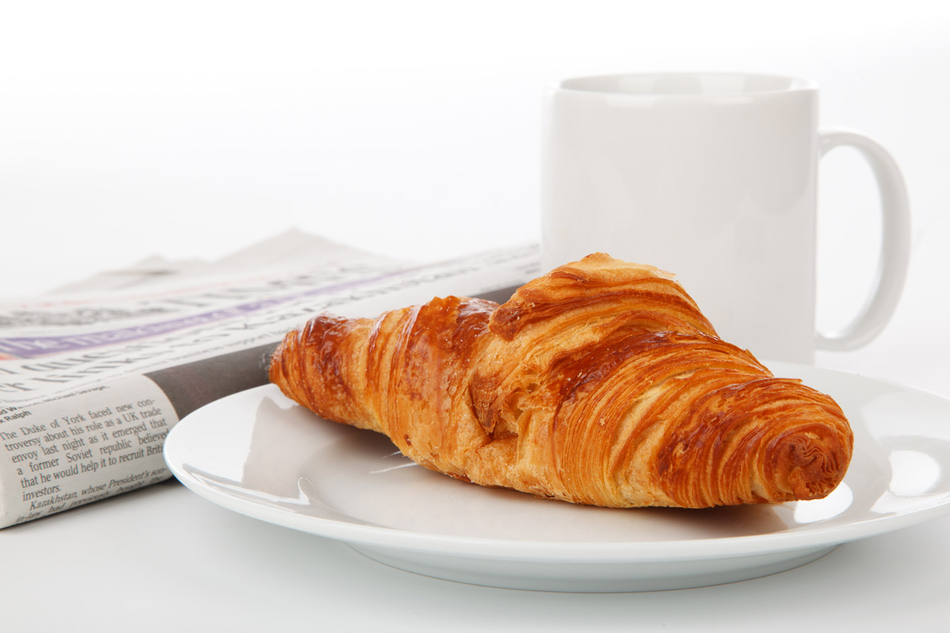
1/5: is it French or is it German?

Slide 7
1/5: is it French or is it German?
Correct! Je suis français.
{

Slide 8
2/5: is it French or is it German?

Slide 9
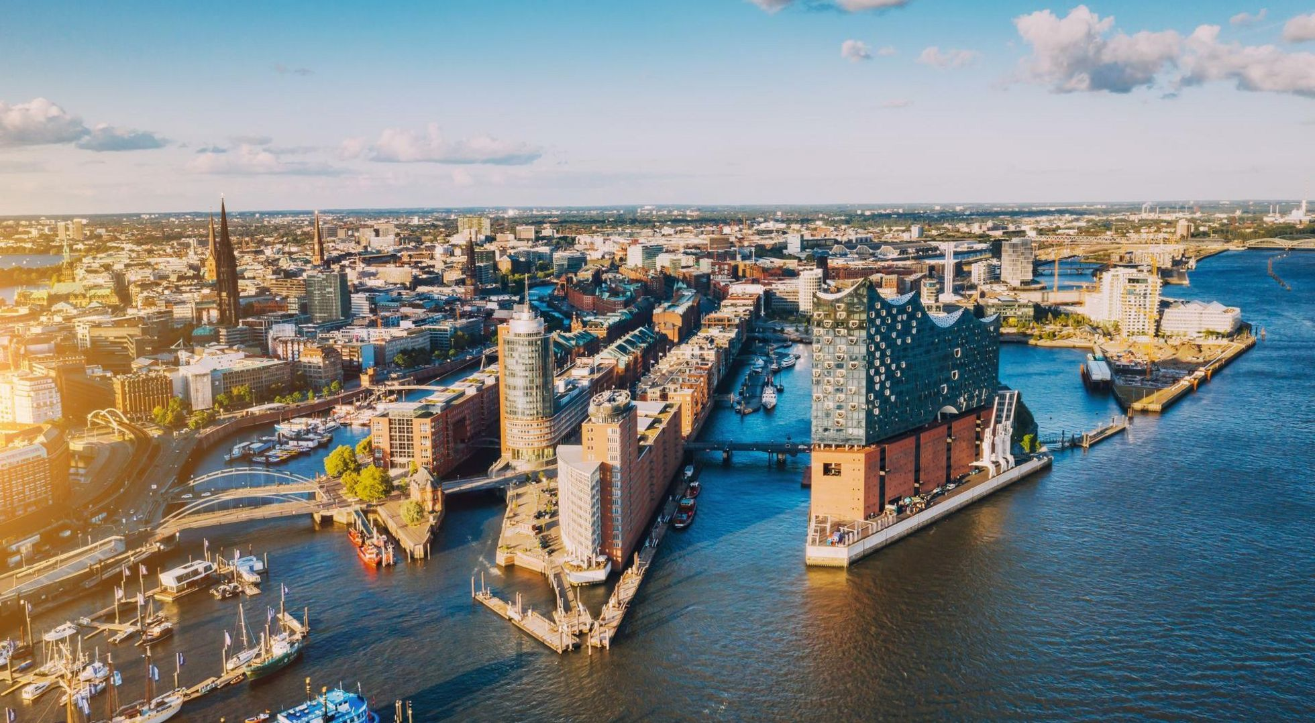
2/5: is it French or is it German?

Slide 10
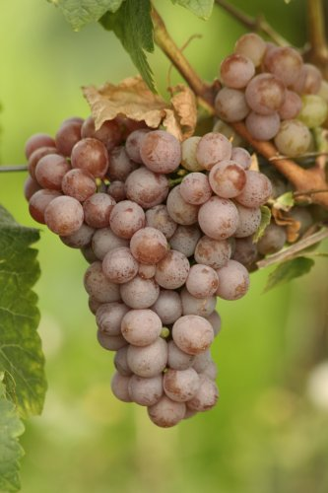
3/5: is it French or is it German?
Gewürztraminer

Slide 11
3/5: is it French or is it German?
Gewürztraminer

Slide 12
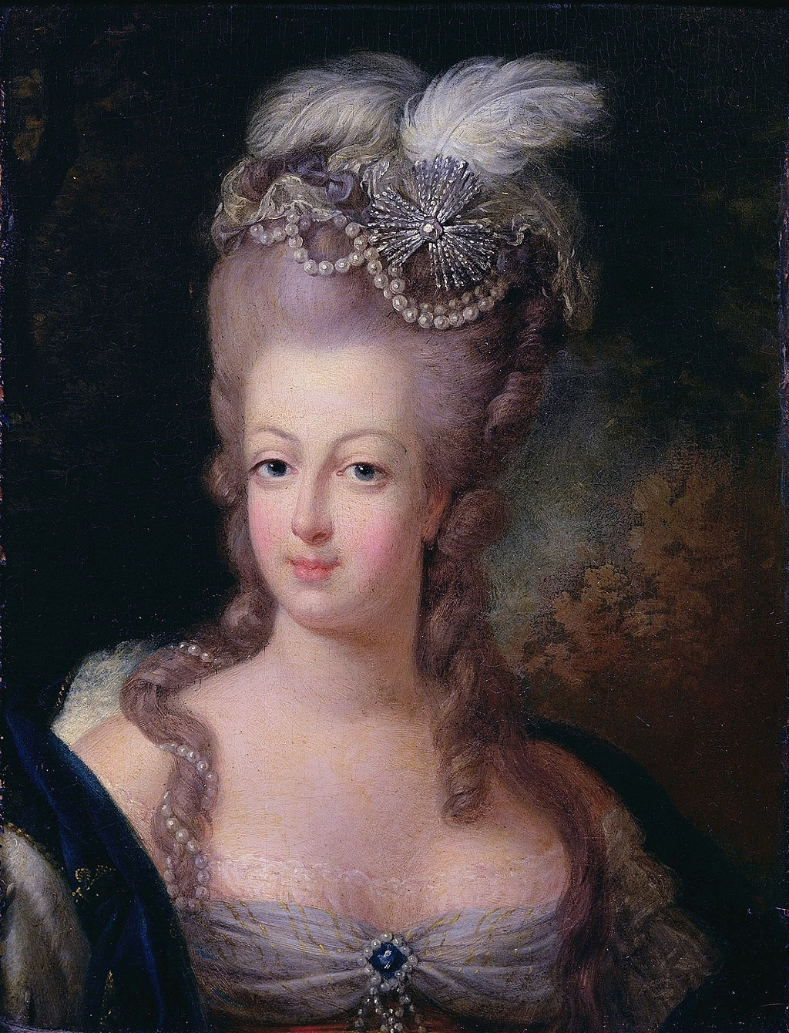
4/5: is it French or is it German?

Slide 13
4/5: is it French or is it German?

Slide 14
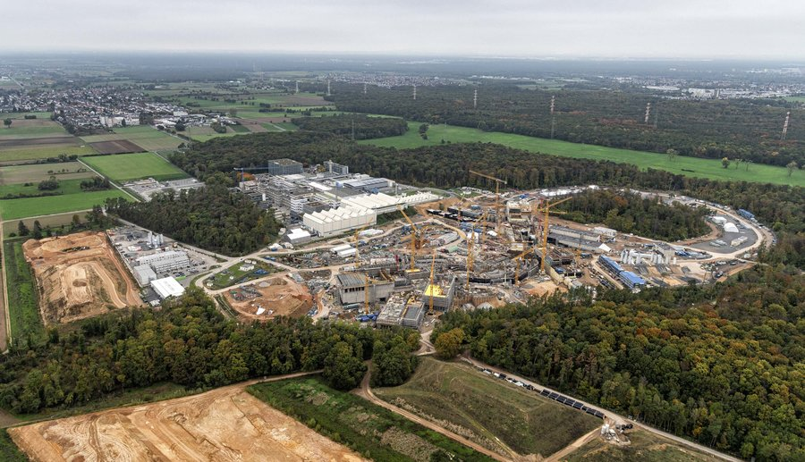
5/5: is it French or is it German?
vous êtes ici

Slide 15
5/5: is it French or is it German?

Slide 16
Today’s agenda
Time
9:00 – 9:10 | Welcome address – A. Leservot and S. Utermann
9:10 – 9:40 | Presentation of the FAIR project by the Technical Managing Director – J. Blaurock
9:40 – 10:00 | A guide to procurement at FAIR and GSI – D. Conradi
10:00 – 10:09 | Company pitches, 3 minutes each - Alsymex, Technetics and BERTIN
10:09 – 10:30 | Vacuum at FAIR – L. Urban
10:30 – 10:55 | Group photograph followed by morning coffee break
10:55 – 11:01 | Company pitches, 3 minutes each - Omega Physics and Thales
11:01 – 11:20 | Ring-RF at FAIR – H. Klingbeil
11:20 – 11:29 | Company pitches, 3 minutes each - Cryodiffusion/Chart, Sigma Phi, Air Liquide
11:29 – 11:50 | Cryogenics at FAIR – M. Kauschke
11:50 – 12:30 | Pending FAIR procurements: technical discussions between French industry delegates and FAIR technical experts
12:30 – 13:30 | Lunch and discussions (Canteen side room)
13:30 – 13:40 | Technology transfer at FAIR – R. Lang
13:40 – 14:01 | Company pitches, 3 minutes each - Robatel, ISP, CNIM, Framatome, Nexans, Nuvia, Cegelec CEM
14:01 – 14:20 | Super-FRS hot cell – H. Weick
14:20 – 14:40 | NuStar at FAIR – J. Gerl
14:40 – 15:00 | Afternoon coffee break and meet in the foyer for the site visit
15:00 – 17:00 | Site tour: meet in the foyer; safety briefing and protective clothing; tour – H. Simon and P. Gasik
17:30 | End of event; bus departs for the airport.

