Slide 1
Ideas beyond MSV and with FAIR
A perhaps not complete collection
Yvonne Leifels
Tobbaccon conference hotel Bensheim Feb 13 2023

Slide 2
Outline
Plans and ideas how to continue with FAIR Phase-0 and start-up of FAIR have been presented by the collaborations during the meeting
However, there have been some other ideas which have been brought up apart from fundamental research on fusion and polarized beams and targets
  cw Linac
  WASA@FRS
  REDTOP experiment to study rare η and η‘ decays
  Neutron target for reaction studies
  Electron accelerator at GSI
There is no claim to completeness

Slide 3
Helmholtz Linear Accelerator
Minimal configuration of a cw-linac (HELIAC) delivering long-duty cycle beams consists of
a new (18 GHz) ECR ion source
Low Energy Beam Transport Line
the existing 25%-duty-cycle injector
three accelerator cryomodules l
link to the existing beam transport system behind UNILAC.
This configuration will provide heavy ion beams of sufficient energy and duty cycle that can be injected into SIS18 and serve a compelling science program in superheavy element research, except for new element search, and a significant part of the materials research program. A cw-linac configuration with two cryomodules is not a viable option as the resulting beam energy is too low.

Slide 4
Helmholtz Linear Accelerator

Slide 5
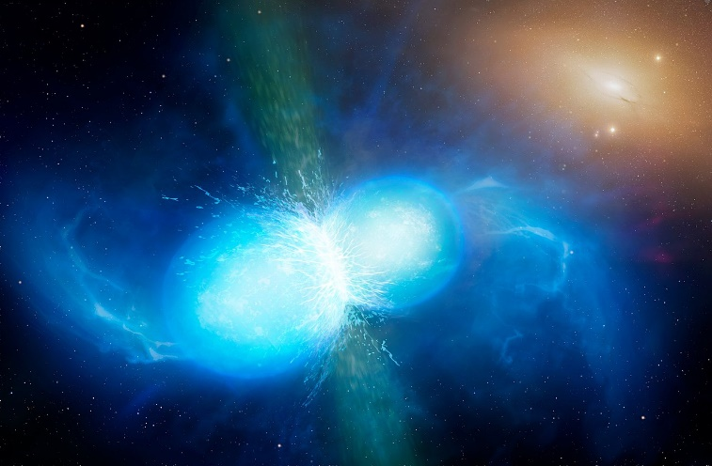
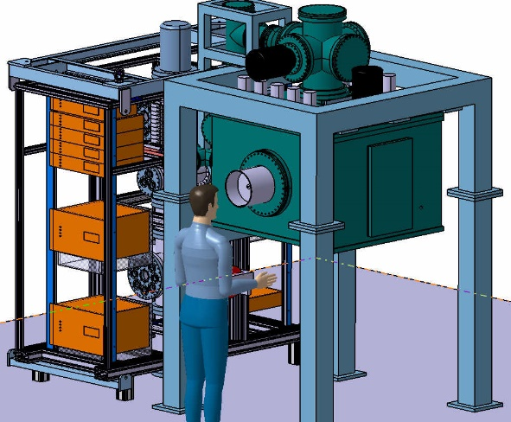
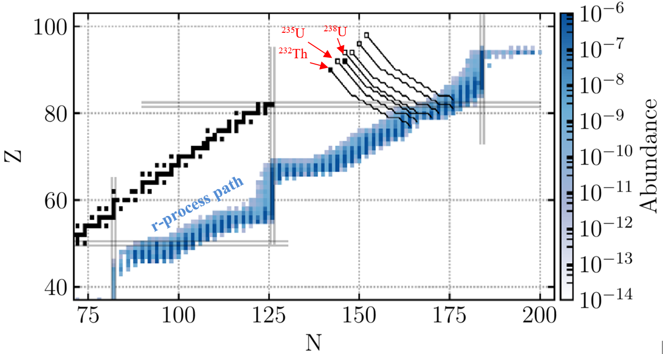
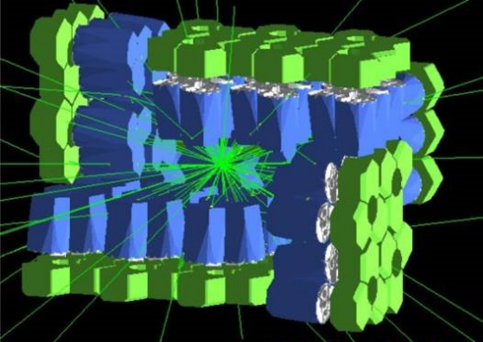
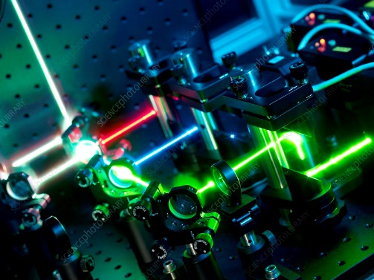
New avenues of the NUSTAR program at UNILAC/HELIAC
Multi nucleon transfer reactions at the UNILAC
Nuclear Astrophysics
Mass Spectrometry
Nuclear Structure
long-lived actinides
rare-earth peak
3rd peak
Decay Spectroscopy
Expand BSM searches
to other actinides
Laser Spectro.
beta-delayed fission studies
isomeric states in refractory elements
Discussed at dedicated workshop in `21 and presented to the sup. G-PAC in ´21
Notes:
Exploiting MNT reactions, the pulsed and unique beams the LINAC of GSI/FAIR by new and exisiting instrumentation. The goal is to reach parts of the nuclear chart not accessible otherwise at FAIR, e.g. neutron-rich with A>238.

Slide 6
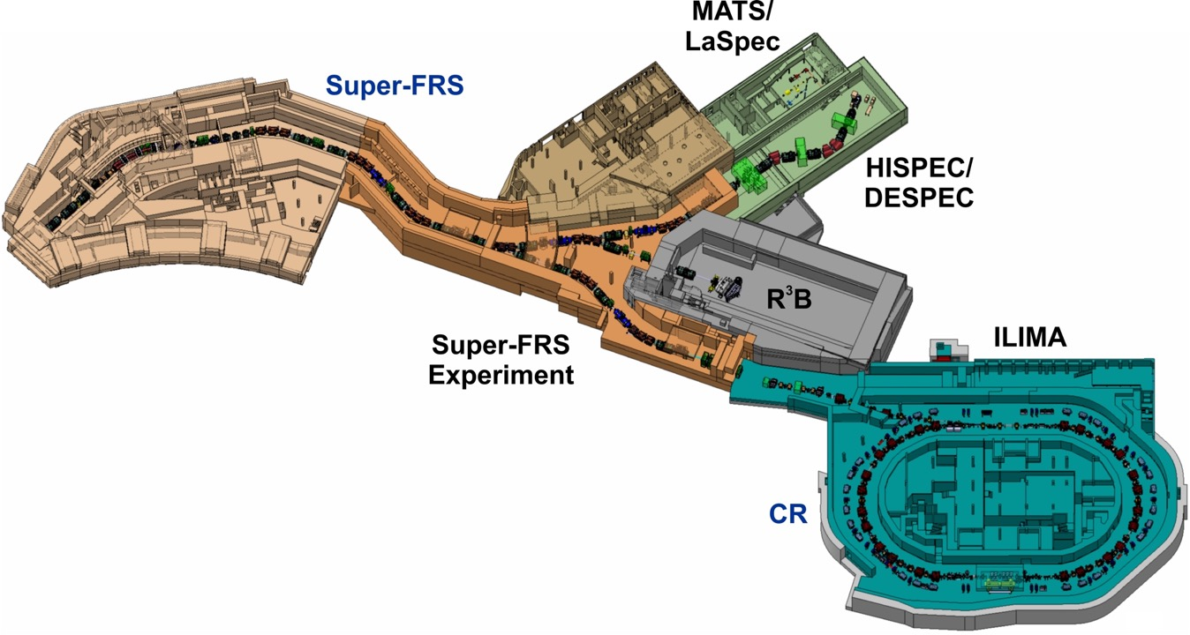
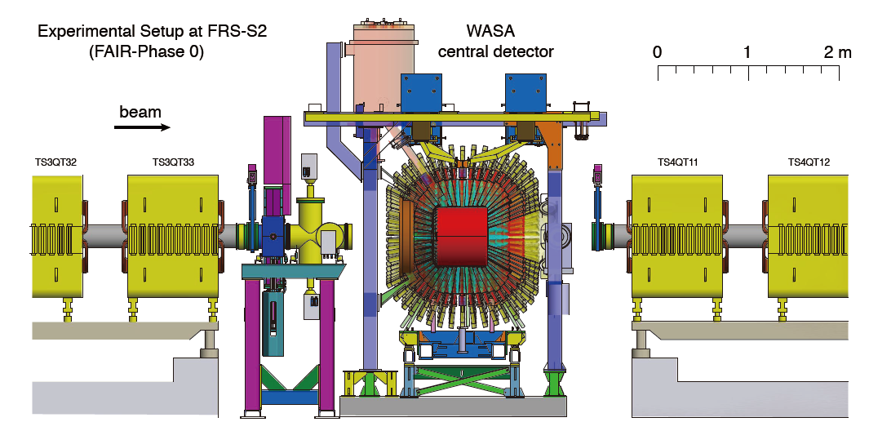
(Super) Wasa @ (Super) FRS
Production and study of (exotic) hypernuclei up to A≈20
Exotic atoms, e.g. η’-mesic nuclei
Baryon resonances in asymmetric nuclear matter
…more ideas for hadron and nuclear physics
WASA@FRS
Protons, stable ions
Moderate beam intensity
Single-stage spectrometer
Established installation scheme
Super-WASA@Super-FRS
Exotic nuclei
High beam intensity
Multi-stage separator and spectrometer
New, large super-conducting solenoid
Upgrade plans:
Inner drift chamber
New solenoid (2T)
Electric cryo-cooler
New detector development:
Large s.c. solenoid
Inner and outer detectors

Slide 7
REDTOPExperiment (https://redtop.fnal.gov/)
REDTOP is a low-energy, fixed-target experiment in its proposal stage which aims to investigate rare decays of η and η‘
The REDTOP collaboration: 13 Countries, 56 Institutions, 125 Collaborators (Home institution: Fermilab)
Goal is measuring small variations from the Standard Model by studying a large sample of events produced with an intense beam.
Usage of 1.8 GeV proton beam impinging on a target made with 10 foils of a low-Z material (lithium or beryllium) to produce about 10¹⁴ η mesons in three years of running (dedicated ring at Fermilab…)
The detector surrounding those targets will attempt to capture the decay products of the η mesons and, in particular, those that are either not expected or are suppressed up to the 10⁻¹¹ level.
η, η’ decays can produce light dark matter particles that the experiment can detect
  η is a Goldstone boson, therefore symmetry constrains its QCD dynamics
  eigenstate of the C, P, CP and G operators: I^{G}J^{PC}=0⁺0⁻⁺.
    can be used to test C and CP invariance.

Slide 8
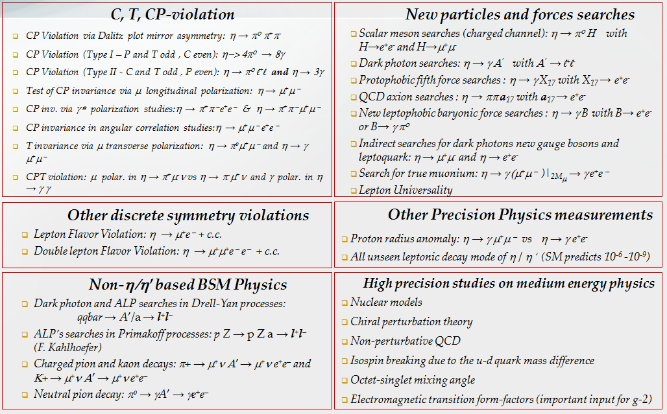
Physics processes explored at REDTOP

Slide 9
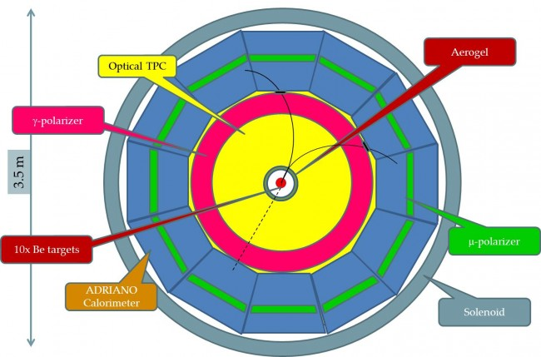
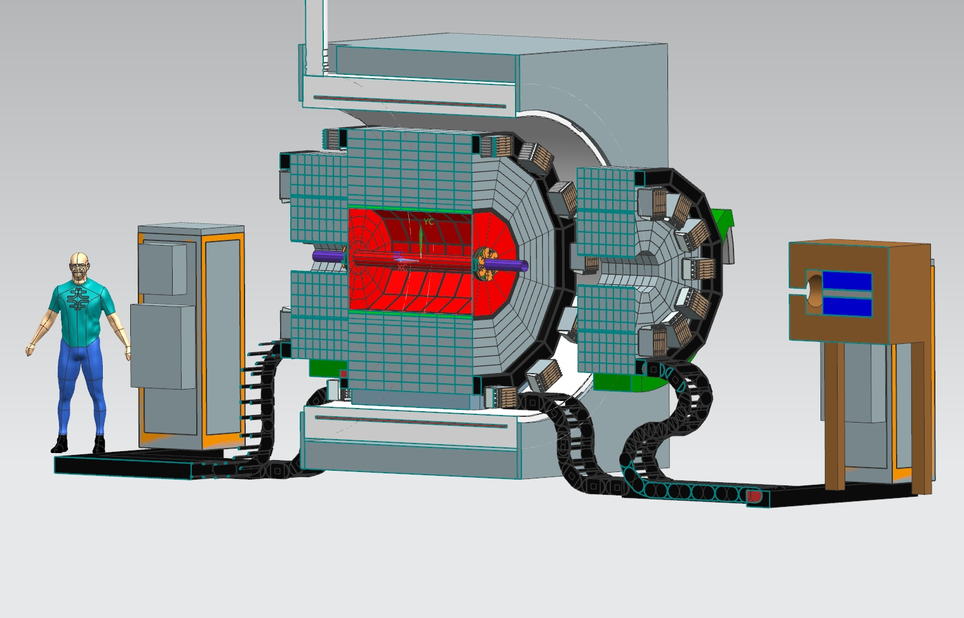
REDTOP detector
Target is sparsified, with multiple elements along the beam axis, to reduce the pile-up since the signal event and the background event will likely occur in different elements
Since the final events of interest in general contain fast leptons, the apparatus will use the Cerenkov process to detect those particles. By tuning appropriately the refractive index of the radiators, the background events with only hadrons in the final states will be mostly invisible to the experiment.
Vertex detector
Wafer scale silicon detector (ALICE 3 ITS)
Mats of scintillating fibers
Central tracker
Tracking based on LGAD‘s
Optical TPC
Verify the feasibility at GSI
Invitation of C. Gatto to GSI to present the REDTOP proposal in a seminar/colloquium
Evaluation of the proposal by the JSC

Slide 10
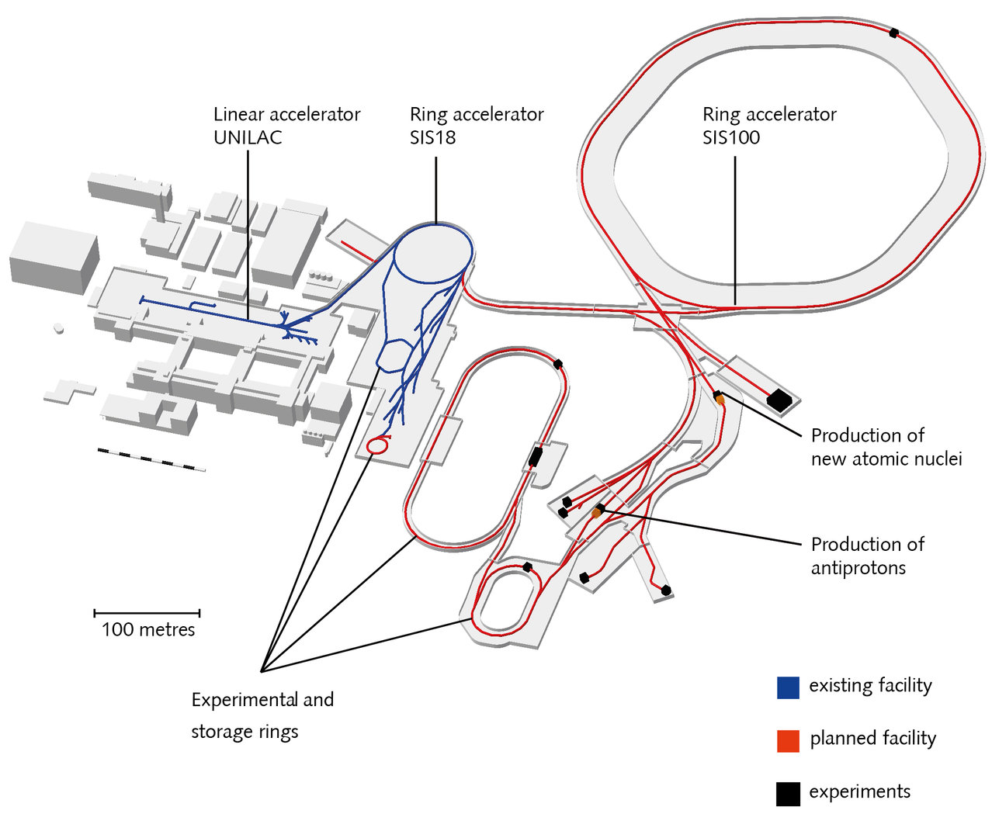
Different scenarios evaluated by Daniel and the accelerator departments
OPTION C
ESR (SIS18)
OPTION D
HESR (SIS100)
ESR
1e6 p/injection (1-2 MHz revolution rate)
Full beam usage
Lower intensity
Parallel operation of UNILAC and SIS18 exp. possible
Standard ESR exp. area needs to be dismounted
Major disruption for the already approved program
HESR or CR
Intensity fully flexible
Full beam usage
Parallel operation possible due to p-LINAC
Standard installation needs to be discussed
Actual timeline beyond 2030
Verify the feasibility at GSI
Invitation of C. Gatto to GSI to present the REDTOP proposal in a seminar/colloquium
Evaluation of the proposal by the JSC

Slide 11

Pseudoscalar mesons
With (u,d,s) quarks 9 pseudo scalar mesons can be constructed:
    9 (nonet) = 8 (octet) + 1 (singlet)
Members of the octet transform into each other
by rotation in flavour space (SU3).
$$\left|π^{0}\right\rangle =\frac{1}{\sqrt{2}}\left(. | u\overline{u}⟩+|d\overline{d}⟩\right)$$
$$\left|η_{8}\right\rangle =\frac{1}{\sqrt{6}}\left(. | u\overline{u}\right\rangle +\left|d\overline{d}\right\rangle −2|s\overline{s}⟩)$$
$$\left|η_{0}\right\rangle =\frac{1}{\sqrt{3}}\left(. | u\overline{u}\right\rangle +\left|d\overline{d}\right\rangle +|s\overline{s}⟩)$$
In reality, since SU(3) is not an exact symmetry,
the observed mesons are:
$$η=η_{8}cosθ+η_{0}sinθ \text{and} η^{′}=−η_{8}sinθ+η_{0}cosθ$$
where ϑ is the Cabibbo angle, ~ 11° degrees for pseudo scalar mesons
η was discovered 1961 in pion-nucleus collisions at the Bevatron at a time where the proposal of the „Eight Fold Way“ was leading to the discovery of new particles

Slide 12
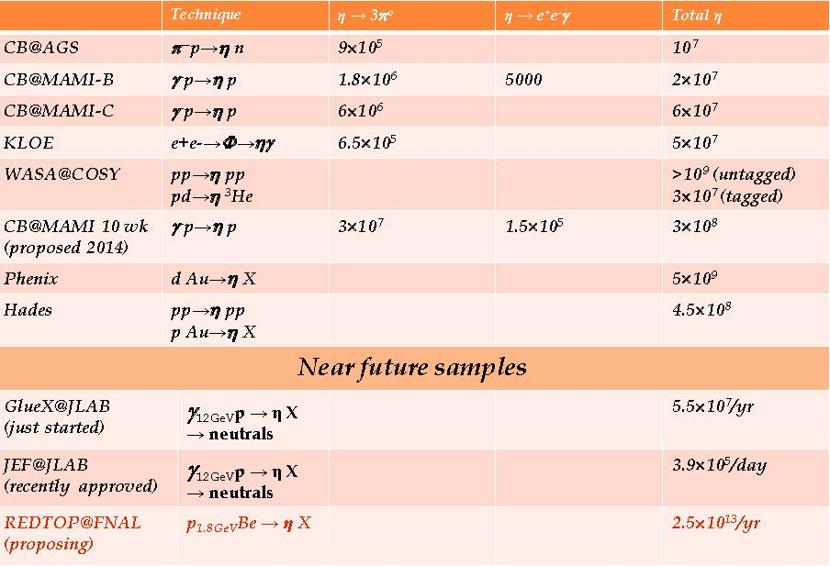
Comparison to other experiments

Slide 13
Neutron target (R. Reifarth)
Goal: Investigate astrophysical relevant neutron capture reactions in inverse kinematics using a neutron target
Current methods to investigate neutron-capture reactions use a beam of neutrons hitting a target of heavier elements. Experiments with neutrons in the astrophysical energy range are limited to isotopes with half-lives of at least a few years, completely excluding all r-process and most key s-process nuclei.
As neutrons are unstable, hence need to be constantly produced with a small spallation source. This source will be surrounded by a large moderator, which slows down the very fast spallation neutrons to room temperature. These slow neutrons will be trapped in the moderator, ready to interact with ions of well-defined beam energies

Slide 14
Concept of the neutron target
Protons (upto 10¹¹/s are hitting a heavy metal target and produce neutrons
a beam of exotic heavy nuclei is oriented perpendicular to the proton beam pipe
  beam pipes do not intersect
neutrons produced in the spallation process are slowed down by the surrounding moderator consisting out of Poly-ethylene, Beryllium or Carbon
they penetrate the ion beam and act as targets for the ion beam
usage at the rings and in the R3B cave
Budget foreseen in the ELEMENTS proposal
Evaluation of the proposal by the JSC

Slide 15
Electron acceleration at GSI/FAIR (Darmstadt)
Establishment of a state-of-the-art electron accelerator at the GSI/FAIR campus is the largest infrastructure project of ELEMENTS
  511-MeV superconducting multi-turn energy-recovery electron linear accelerator
It will provide the infrastructure for studying
  electron scattering on radioactive ion beams in the GSI/FAIR storage rings (similar to ELISE at FAIR)
  photonuclear reactions,
  electrofission reactions
  forward-looking design of a sustainable particle accelerator using energy recycling.

Slide 16
Energy recovering linacs (Darmstadt)
Floor plan of the S-Danilac at TU Darmstadt
Recovery of particles’ kinetic energy before disposing of the beam at low energy in a beam dump
Recirculating the beam on a decelerating phase within the linac transfers kinetic energy back to the cavity electromagnetic field.
Consequently, less radio-frequency (rf) power must be provided externally to maintain the acceleration process for freshly injected beam
Technology was first proposed in 1965 by M. Tigner

Slide 17
Project status
Application to DFG is being prepared
Several options on the GSI / FAIR campus are being evaluated
  ESR
    essentially using the space of the existing R3B cave
    discussion on feasibility has just started
  CR
    time schedule of the project – once approved – does allow for an installation at the CR if the building will be available in 2030
    discussion on feasibility not started

Slide 18
New projects
start with an idea, which is discussed in the community
need to be written down
presented to the GSI/FAIR scientific management
  scientific and technical case
  has to fit into the strategic goals of GSI/FAIR
and to either the JSC or the G-PAC
  JSC: huge projects involving a lot of man power and resources
  G-PAC: ideas connected with existing infrastructure
    allocation finally decided by the management
    AND the final decision is with management
  at this point a project plan including involved man power, budget, financing and operation costs is requested
and NO means NO: either revise the scientific case or the financing or whatever was criticized

Slide 19
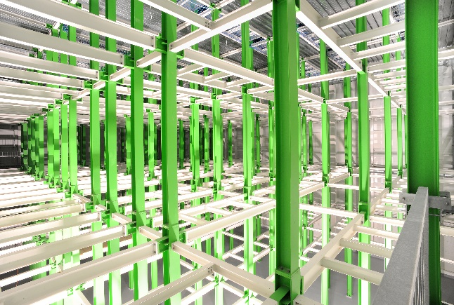
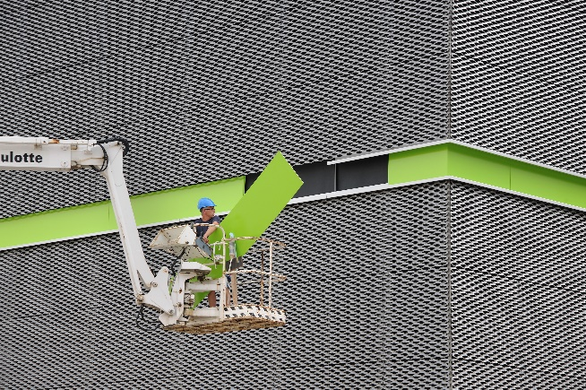
GSI computing facilities
Leading ”Green” Data Center Technology
5.5 M€ EU grant in 2022 to expand the Green-IT cube installation. Goal: further strengthen research and collaboration with industry within the FAIR Digital Open Lab (“Reallabor”)
Project started beginning of January 2022, on level 4 and a limited extent on level 3
Financing secured by the EU from the REACT-EU program and managed by the HMWK.
About 330 k€ had to be financed by GSI for necessary construction measures, that are not approved by the funds

Slide 20
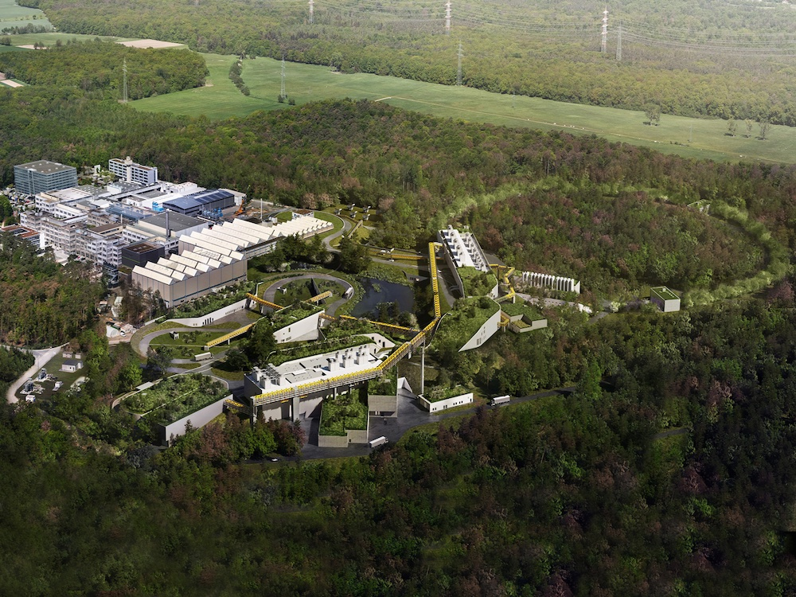
Thank You!

