Slide 1

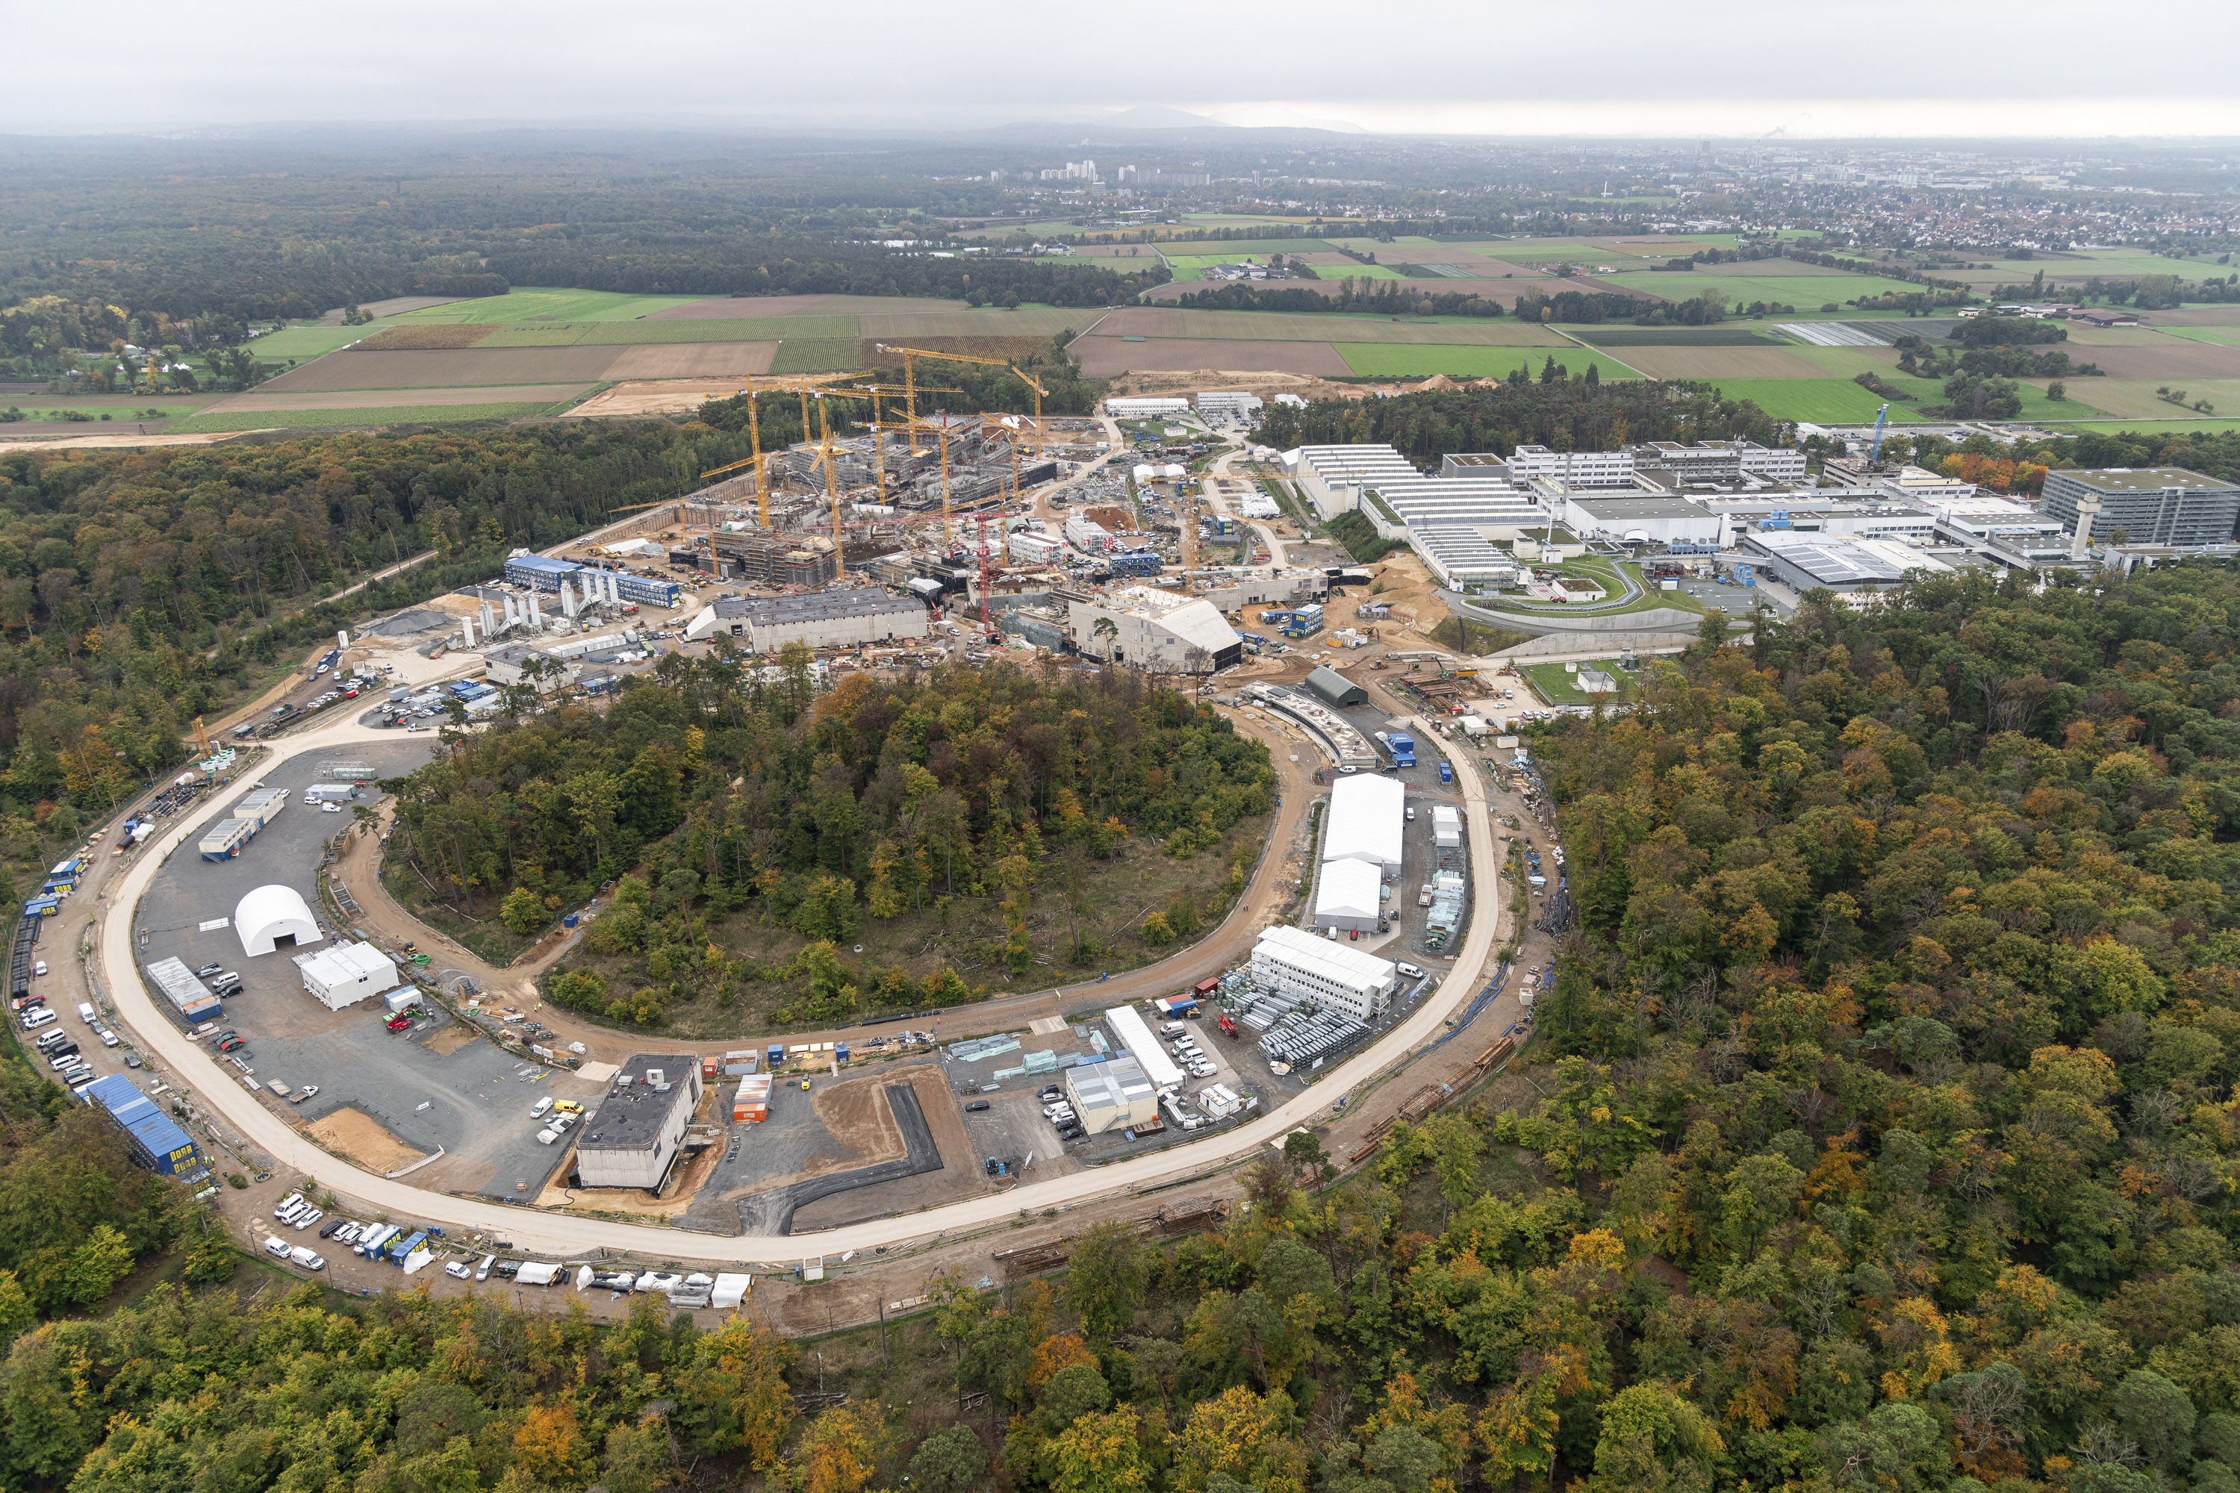
Prospects on
Inertial Confinement
Fusion Research at GSI
V. Bagnoud
material for presentation:
O. Hurricane, L. Divol, M. Roth
FAIR/GSI Research retreat

Slide 2
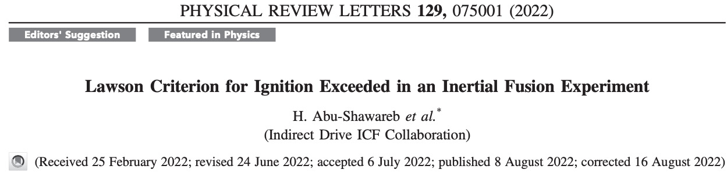
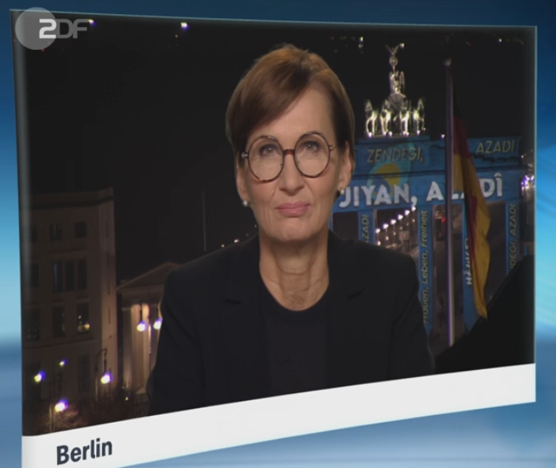
Outline
After 10 years of fusion research the National Ignition Facility produces > 1 MJ of inertial fusion energy (IFE) per shot
In Germany, some political incentive to support inertial fusion energy is being discussed in coordination with the industry and European partners
Possible development directions for GSI
"Ja, heute ist
ein historischer Tag"

Slide 3
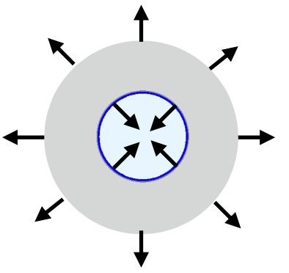
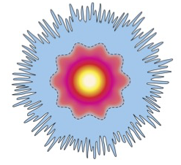
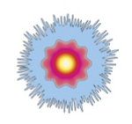
NIF’s ICF principle in a nutshell
D + T -> n (14 MeV) + ⁴He (3.5 MeV)
x-rays
Carries 4/5 of fusion energy away
Propagates the fusion reactions
D + T -> n + alpha
14 MeV 3.5 MeV
Escape
measured
Deposited in fuel
Ablation + shell acceleration V_{imp} ~ 400 km/s
Capsule absorbs ~200 kJ
Stagnation + hotspot ignition
PdV work done on hotspot ~ 20 kJ
Burn propagation during expansion
Alpha deposition ~ 600 kJ mostly re-emitted as Xrays
14 MeV neutron ~ 2.4 MJ
8% burn up fraction
PRL H. Abu-Shawareb et al.
PRE A. Kritcher at al.
PRE A. Zylstra et al.

Slide 4
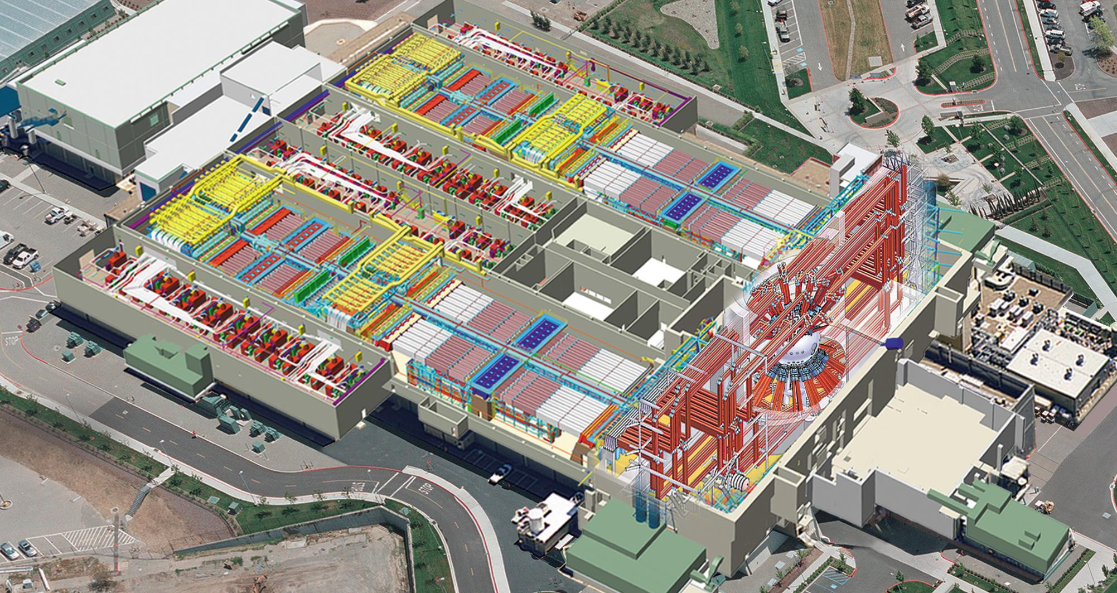
96 laser beams
The National Ignition Facility (NIF)
96 laser beams
300-400 MJ electrical energy into capacitor banks
courtesy O. Hurricane IAEA talk 01/19/2023
Notes:
Should say 1 or 2 sentence about mission of NIF -- stockpile stewardship

Slide 5
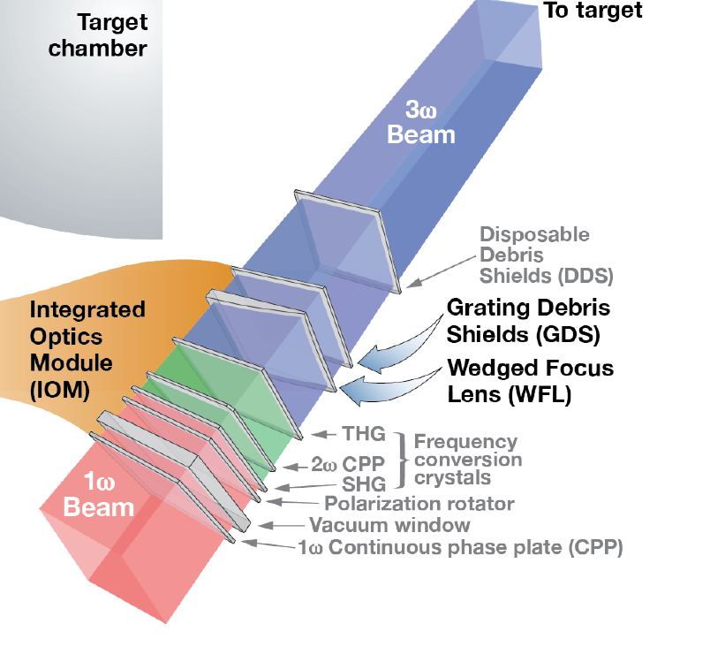
96 laser beams
The NIF delivers delivers frequency tripled (3⍵) laser light into the target chamber
96 laser beams
3 MJ of red light just before target chamber
courtesy O. Hurricane IAEA talk 01/19/2023
Notes:
Should say 1 or 2 sentence about mission of NIF -- stockpile stewardship

Slide 6
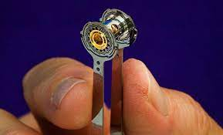
96 laser beams
The 3⍵ light is what enters the ICF target
96 laser beams
2 MJ of blue light→
courtesy O. Hurricane IAEA talk 01/19/2023
Notes:
Should say 1 or 2 sentence about mission of NIF -- stockpile stewardship

Slide 7
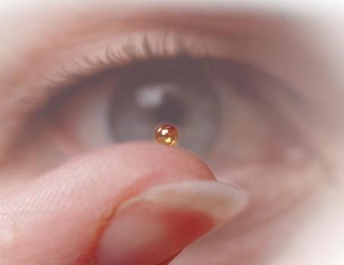
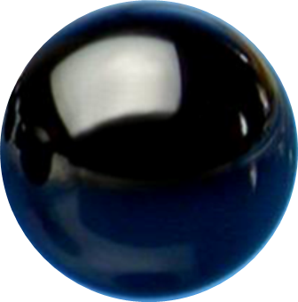
96 laser beams
Laser light is converted into a bath of x-rays that ablate the capsule
96 laser beams
250 kJ x-ray absorbed by capsule
↓
20 kJ internal energy into DT fuel inside capsule
courtesy O. Hurricane IAEA talk 01/19/2023
Notes:
Should say 1 or 2 sentence about mission of NIF -- stockpile stewardship

Slide 8
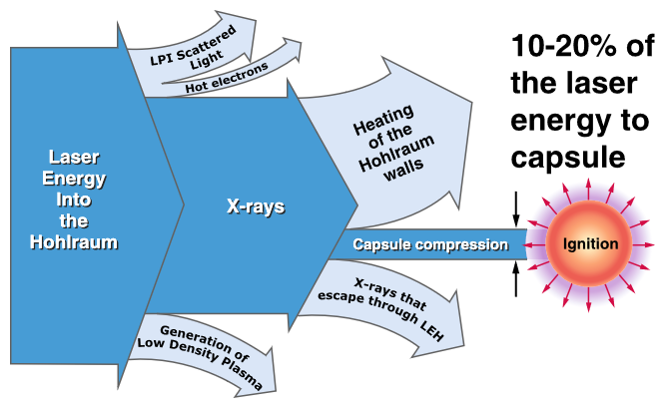
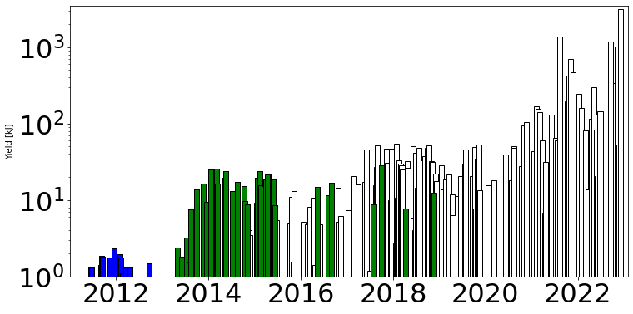
NIF’s ICF research summary
Best shots show up to 8% target burn (from a maximum value of 25%)
gain: 150, 15, 1.5, 0.01 depending on definition
laser energy
coupled x-ray energy
fusion yield (kJ)
kinetic implosion energy
years

Slide 9
Several evidence of fusion burn exist for NIF’s most recent shots
Peak neutron emission is delayed
Alpha heating maintains temperature
Hotspot gets larger
Main cooling mechanism: PdV overruns radiative cooling
0
0.5
1
1.5
Fusion yield (MJ)

Slide 10
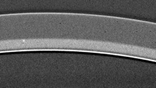
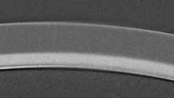

What’s next?
a 25% burn/10 MJ shot would demonstrate full ICF realization
NIF is only starting to understand how difficult ICF might be
  extreme sensitivity to inhomogeneity
    target mix
    asymmetries
    hydrodynamical instabilities
Yield ~ 100 kJ
Yield ~ 1 MJ
2019
2021
75 µm

Slide 11
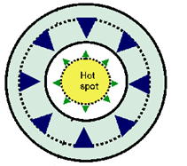
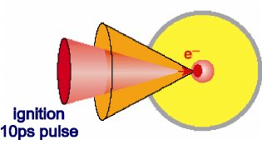
Next steps to transition from ICF to IFE research
Demonstrate efficient ICF with direct drive with 200 – 500 kJ laser energy
Explore best direct drive scenario
  hot spot ignition
  shock ignition
  fast ignition
Demonstrate wall-plug efficient laser driver – increase by x20 compared to NIF
Join MCF in reactor studies:
  100 MW = 1e17 neutron/sec/m²
  added complication of laser windows
  targetry at 10 Hz

Slide 12
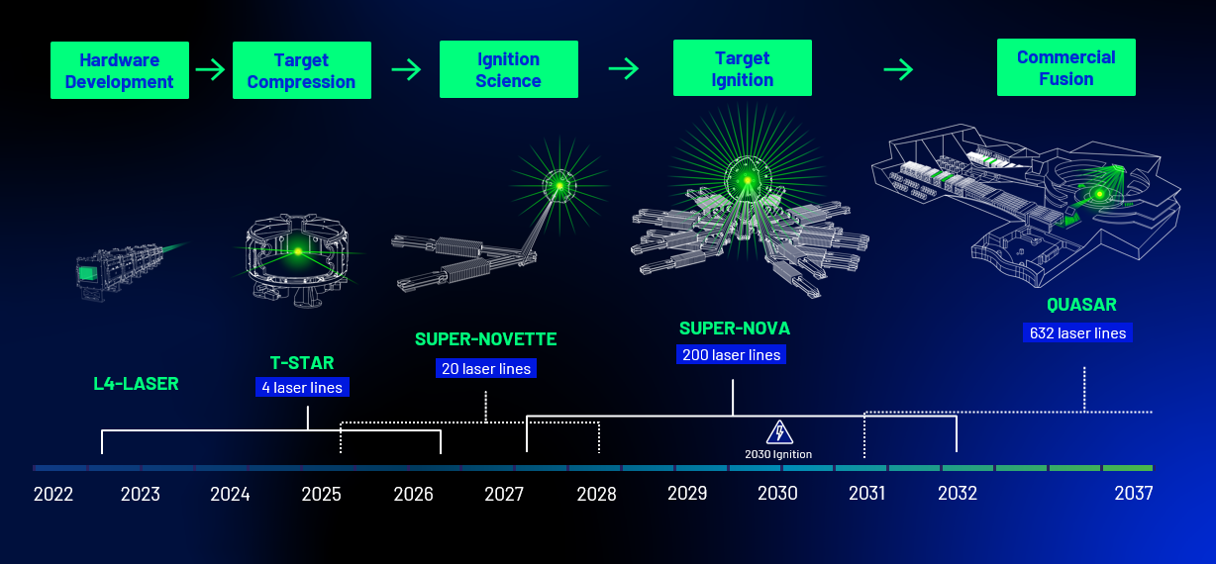
Start-up companies are surfing the fusion wave… with an aggressive schedule
Focused Energy timeline

Slide 13
Topics of possible interests for GSI
IFE-relevant basic Plasma Physics studies
  Improve the control over laser-plasma instabilities (LPI)
  Refine energy-loss measurements in plasma for parameters relevant to α-heating and proton fast ignition – also spatially resolved
High-neutron-flux studies
  materials hardness
  shielding
  biophysics
TT and common development on laser technology
  EU Project THRILL,
Topics connected to ICF that could receive funding at GSI
  Revival of the HIBALL concept / heavy-ion fusion
  Fundamental studies on nuclear transmutations with accelerators
  HiPER+ initiative (EU)

Slide 14
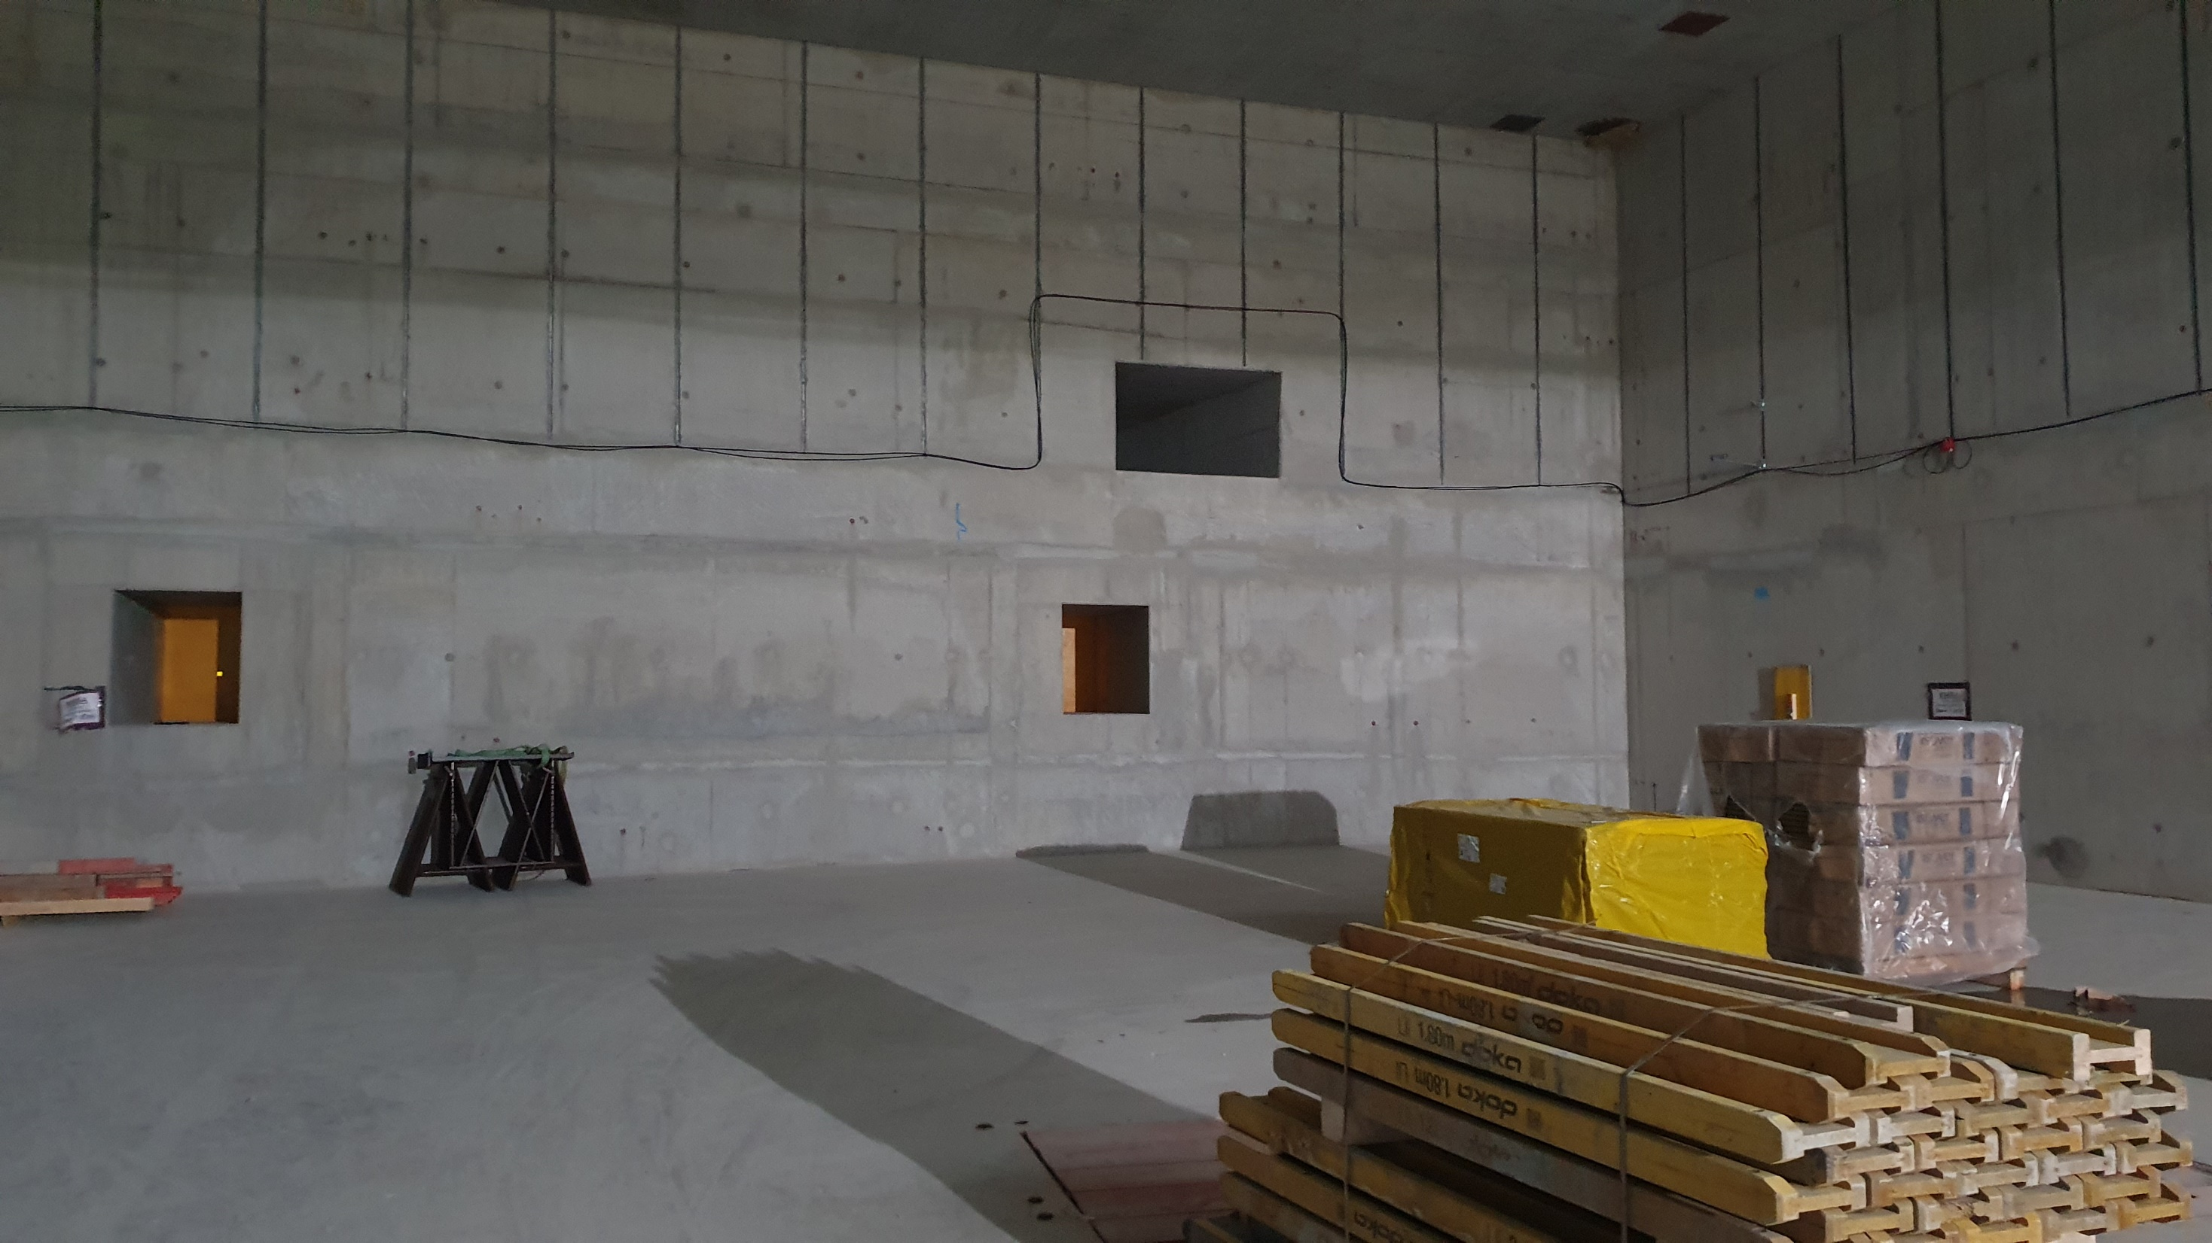
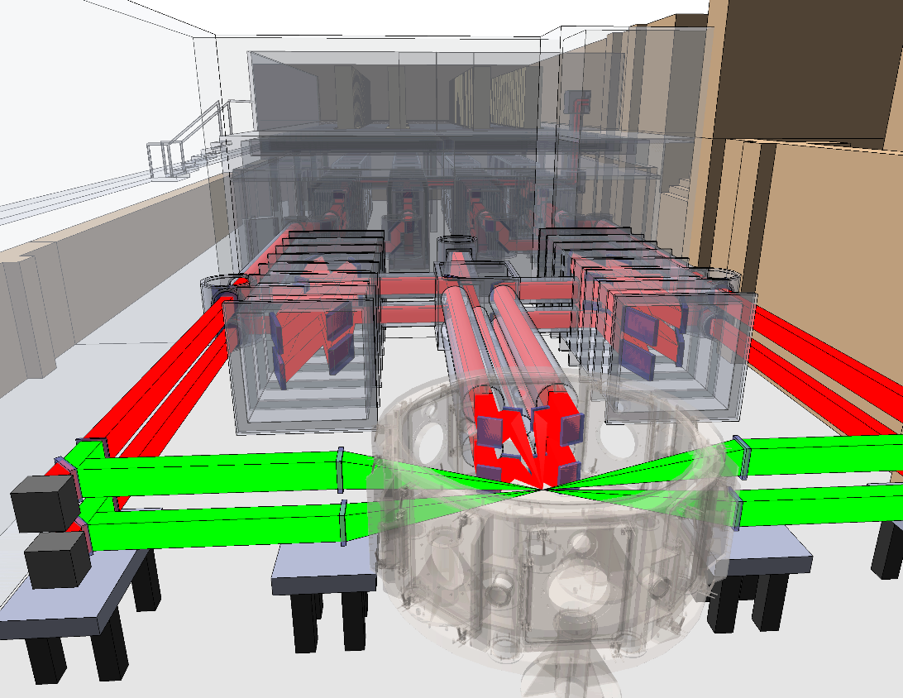
Funding opportunities: discussion of a joint-venture with Focused Energy
APPA cave
Use of APPA cave for T-Star laser until funding for heavy-on beamline is secured
  25 kJ (ns) / 5 kJ (ps)
Private/academic 50/50 use of the facility – 5 years
  joint operation GSI/FE
Laser transmitted to FAIR/GSI at the end of the period and continues IFE research as academic facility
  Equation of states of fusion-relevant materials in the 1-10 eV range using FAIR as a driver,
T-Star laser

Slide 15
Conclusion
ICF has become a reality
In the coming years, ICF research will transitions to IFE research
GSI’s expertise in laser, plasma, nuclear and radiation physics lays the basis for impactful contribution to IFE research
Possible synergies with the startup company Focused Energy are being discussed

Slide 16
Thank you!
material for presentation: O. Hurricane, L. Divol, M. Roth

