Slide 1
Plans and Challenges of NUSTAR
Research Retreat
J. Gerl
for the NUSTAR collaboration
February 14, 2023
Bensheim

Slide 2
Current NUSTAR Perspectives
*
*
*
*
* too late if >2030

Slide 3
NUSTAR Experiment Timeline
Phase-0
ES
FS
FS++
 | 2023 |  |  |  | 2024 |  |  |  | 2025 |  |  |  | 2026 |  |  |  | 2027 |  |  |  | 2028 |  |  |  | 2029 |  |  |  | 2030 |  |  |  | later
beam time
DESPEC
GSI Experiments
FAIR Experiments
HISPEC
FAIR Experiments
ILIMA
GSI Experiments
LASPEC
ext. Experiments
FAIR Experiments
MATS
ext. Experiments
FAIR Experiments
R3B
GSI Experiments
FAIR Experiments
Super-FRS EC
GSI Experiments
FAIR Experiments
SHE
GSI Experiments
 |  |  |  |  | preparation |  |  |  |  |  |  | operation
?
common NUSTAR Exp.
?
?

Slide 4
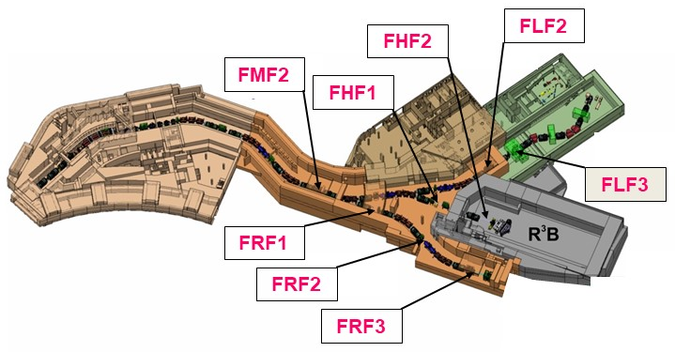
NUSTAR at FAIR ES/FS
NUSTAR at FAIR ES/FS
DESPEC
HISPEC
MATS
maximize output for ES/FS
R3B
S-FRS EC
LASPEC
Complementary experiments for consistent answers to our nuclear physics questions

Slide 5
Tasks of the Config+ Working Group
Ascertain the technical requirements (media, space, beam quality, safety…) of anticipated NUSTAR experiments for Early Start and Day one
Assess the technical facilities and infrastructure available at potential focal planes
Evaluate possible scenarios for experimental setups at various focal planes
Estimate extra cost and effort for the realization of the scenarios
Analyze risks and opportunities for the scenarios
Provide technical and financial information
Suggest scenarios

Slide 6
Prerequisites and Basic Conditions/Assumptions
Super-FRS purchasing orders have been placed for all three branches and will not be canceled
No changes of the Super-FRS layout and infrastructure (i.e. cryo-lines) will be possible (without incurring large expense and delay)
Full TBI (Technical Building Infrastructure) is expected for the HEB
Limited TBI is expected for the LEB enabling operation of HEB and final acceptance (Bauabnahme) only
Additional costs for scenarios to be paid by FAIR should stay in the order of a M€
Additional costs for scenarios to be paid by NUSTAR may be funded by Common funds or additional resources

Slide 7
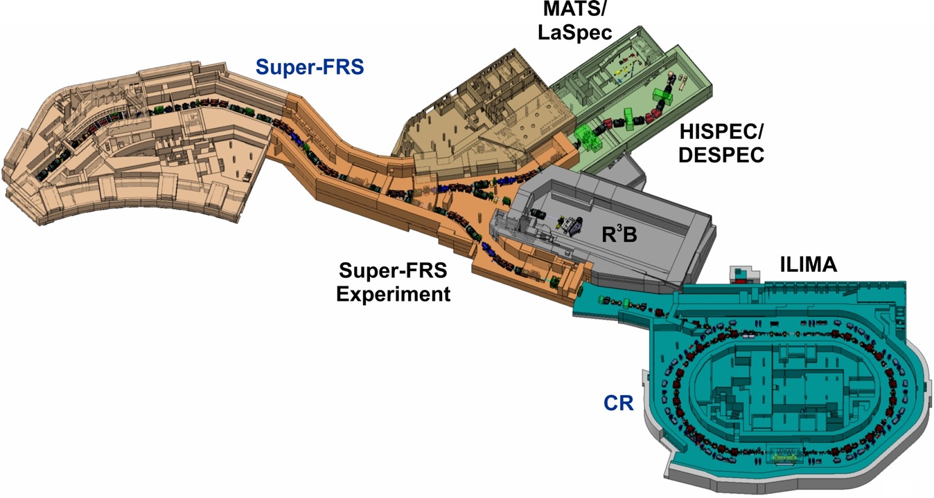
Super-FRS focal planes as potential locations for experiment scenarios
FLF2
FHF2
v
v
FMF2
FHF1
v
FLF3
FRF1
v
v
FRF2
v
v
FRF3
Config+ WG performed assessment of suitability of these focal planes…

Slide 8
Assessment criteria for focal planes
 | Impossible | Hard to solve | Solvable | No issue
Infrastructure/equip-ment | Not doable, major TBI or building change, additional costs > 1 M€ | Replanning need, additional costs >300 k€ |  | All already planed before review
PID/beam quality | No physics output possible | Low physics output due to optic/identification constraints | Not optimal but better than current GSI facility | Goal of Super-FRS
Impact time on running experiment for other collaboration | >9 months, not possible to run both setups at the same year | >3 months Need several month between setups | 1 week to 2 months | < 1 week between setup
Risk | Operation will damage lot of equipment | High (>10%) risk of damage of expensive (>100 k€) equipment | Small chance of expensive damage or high chance of acceptable damage | Standard experiment risk for equipment

Slide 9
FHF1 assessment matrix as an example…
 | HISPEC (AGATA) | CSC | DESPEC (DEGAS+AIDA)
Media supply | Yes | Yes | Yes
Space | Yes | Yes | Yes
PID/optic/ beam quality | Intensity limit at middle focal plane due to AGATA in the same area | PID and tracking assured, need degrader | PID and tracking assured, need degrader
Additional equipment | Need magnet after AGATA, Need special tracking detectors Glad no option. Need to put magnet instead of GLAD | New platform to allow faster change | New platform to allow faster change
Racks present | Enough | enough | enough
Special request | DAQ box room in roof | He recov unit, space | No rail
Impact on R3B and other NUSTAR experiments | Limited intensity, no S-FRS standard diagnostics, no CSC in // so no R3B running, if R3B with ad hoc diagnostic it run need to open AGATA and run at low intensity | Strong delays in changing setup if all 3 NUSTAR coll. at FHFx no possibility to prepare an experiment when an other one runs | Strong delays in changing setup if all 3 NUSTAR coll. at FHFx no possibility to prepare an experiment when an other one runs
Risk | Exposes expensive AGATA detector to direct radiation from mid focal plane when any experiment runs |  | Exposes expensive DEGAS detectors to direct radiation from mid focal plane when any experiment runs

Slide 10
Scenario with only the HE branch of the Super-FRS
Sub-project | location | Start of usage
NUSTAR early science | FHF2 | 2027
R3B | FHF2 | 2027
DESPEC (DEGAS) | FHF2 | 2027/28
DESPEC (no Ge det.) | FHF1 | 2027
Super-FRS EC (CSC) | FHF1 | 2027
Super-FRS EC | FMF2, FHF1 | 2027

Slide 11
Resume of 1-branch scenario
The HE branch scenario includes only one Super-FRS branch
It enables Early Science operations
First Science experiments with limited scope and efficiency will be possible for the NUSTAR projects R3B, DESPEC and Super-FRS EC
Set-up adapations and modifications are necessary and require additional resources
The operation risk is considered high
First Science experiments would be possible for the HISPEC project if considerable adaptation costs can be covered and 2-3 years interuption for any other NUSTAR experiment is accepted.
The NUSTAR projects MATS and LASPEC cannot be served

Slide 12
Scenario with two separate radiation areas
Sub-project | location | Start of usage
NUSTAR early science | FHF2 | 2027
R3B | FHF2 | 2027
DESPEC | FLF2/3 | 2027/28
HISPEC | FLF3 | 2029
Super-FRS EC (CSC) | FHF1 | 2027
Super-FRS EC | FMF2, FHF1, FLF2/3 | 2027
MATS/LASPEC | Behind FLF3 | 2029
This scenario assumes two separate radiation areas, stepwise inclusion of the NUSTAR Sub-projects, and additional funding for HISPEC (AGATA) analyzer magnets

Slide 13
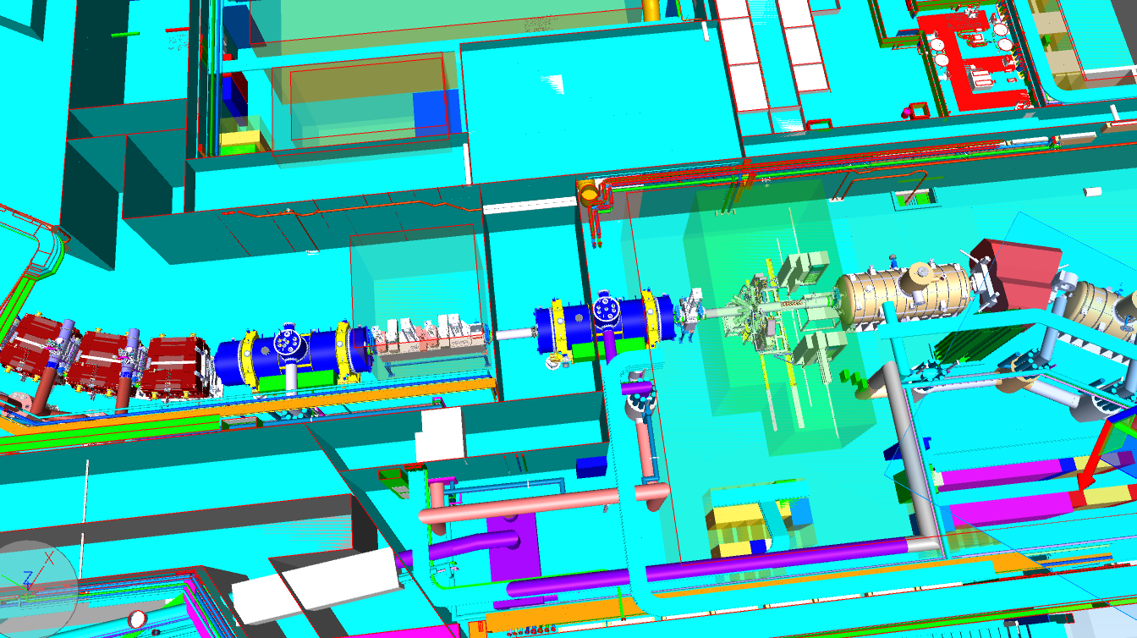
Situation at FLF2/3
radiation wall
FLF3
FLF2
TBI needed for HEB

Slide 14
Resume of 2-branch scenario
This scenario assumes that both the HE branch and the LE branch of the Super-FRS will be operational and the separate radiation area at the entrance of the LEB Cave is available
It enables Early Science operations
First Science experiments with full scope and efficiency will be possible for the NUSTAR projects R3B, DESPEC and Super-FRS EC without set-up adapations or modifications
The operation risk is considered low
First Science experiments would be possible for the HISPEC project if additional funds for the AGATA analyzer magnets can be secured
The NUSTAR projects MATS and LASPEC can be served with limited scope

Slide 15
Thank you

Slide 16
R3B Scenario
Suggested location: | FHF2
Infrastructure/equipment: | available
PID/beam quality: | as foreseen
Impact time on running experiments | Not critical if only CSC is to be placed at FHF1
Risk | standard

Slide 17
Super-FRS EC (regular set-ups) Scenario
Suggested location: | FMF2/FHF1/FLF2
Infrastructure/equipment: | available
PID/beam quality: | as foreseen
Impact time on running experiments | Not critical
Risk | standard

Slide 18
Super-FRS EC (CSC) Scenario
Suggested location: | FHF1
Infrastructure/equipment: | Movable platform needed for fast switch-over
PID/beam quality: | as foreseen
Impact time on running experiments | Not critical
Risk | standard

Slide 19
DESPEC Scenario
Suggested location: | FLF2/FLF3
Infrastructure/equipment: | Mostly available, some addtitional TBI at the border to LEB needed. If located at FLF2 the mobile wall needs to be moved upstream and only compact set-ups are possible
PID/beam quality: | as foreseen
Impact time on running experiments | not critical
Risk | standard

Slide 20
HISPEC(AGATA) Scenario
Suggested location: | FLF3
Infrastructure/equipment: | Assumes extra funding for analyzer magnets. Best solution is 1 dipole and 2 multiplets from LEB spectrometer. Other solutions are possible. Limited LEB TBI is needed.
PID/beam quality: | as foreseen
Impact time on running experiments | not critical
Risk | standard

Slide 21
MATS/LASPEC Scenario
Suggested location: | Behind FLF3
Infrastructure/equipment: | Requires limited additional LEB TBI and a connecting line.
PID/beam quality: | Without buncher the beam intensities are limited
Impact time on running experiments | not critical
Risk | standard

Slide 22
R3B Scenario
Suggested location: | FHF2
Infrastructure/equipment: | available
PID/beam quality: | as foreseen
Impact time on running experiments | Severe as sharing with DESPEC(DEGAS) requires frequent mounting/dismounting of target set-up. Sharing with HISPEC (AGATA) requires dismounting of target set-up for 2-3 years
Risk | Severe as sharing with DESPEC(DEGAS) requires frequent mounting/dismounting of target set-up

Slide 23
Super-FRS EC (regular set-ups) Scenario
Suggested location: | FMF2/FHF1
Infrastructure/equipment: | available
PID/beam quality: | as foreseen
Impact time on running experiments. | Severe if sharing tunnel with DESPEC. As this leads to non-accessability and additional mounting/dismounting
Risk | Considerable if sharing with DESPEC(DEGAS). As this leads to additional mounting/dismounting risks.

Slide 24
Super-FRS EC (CSC) Scenario
Suggested location: | FHF1
Infrastructure/equipment: | Movable platform for faster switch-over
PID/beam quality: | as foreseen
Impact time on running experiments | Severe if sharing tunnel with DESPEC. As this leads to non-accessability and additional mounting/dismounting
Risk | Considerable if sharing with DESPEC(DEGAS). As this leads to additional mounting/dismounting risks.

Slide 25
DESPEC Scenario
Suggested location: | FHF1/FHF2
Infrastructure/equipment: | Set-ups involving Ge or other radiation sensitive detectors can only run at FHF2. Special platforms are needed. Space is limited
PID/beam quality: | as needed
Impact time on running experiments | Severe as sharing with R3B requires frequent mounting and dismounting of set-ups.
Risk | Severe as frequent mounting and dismounting is required

Slide 26
HISPEC (AGATA) Scenario
Suggested location: | FMF2 or FHF2
Infrastructure/equipment: | Requires significant changes of original set-ups. Requires major changes of AGATA holding structure.
PID/beam quality: | as needed at FMF2
 | Assumed to be limited with GLAD/ALADIN as analyzer
Impact time on running experiments | Severe as FHF2 would stop R3B for 2 to 3 years
 | Severe as FHF2 would stop all other NUSTAR experiments for 2 to 3 years
Risk | Considerable due to LN2 operation with tanks (in particular at FMF2).

Slide 27
MATS/LASPEC Scenario
Suggested location: | Behind FHF2
Infrastructure/equipment: | Requires degrader/stopper and a connecting line.
PID/beam quality: | Without buncher the beam intensities are limited
Impact time on running experiments | Reduces considerably oeration of R3B
Risk | standard

Slide 28
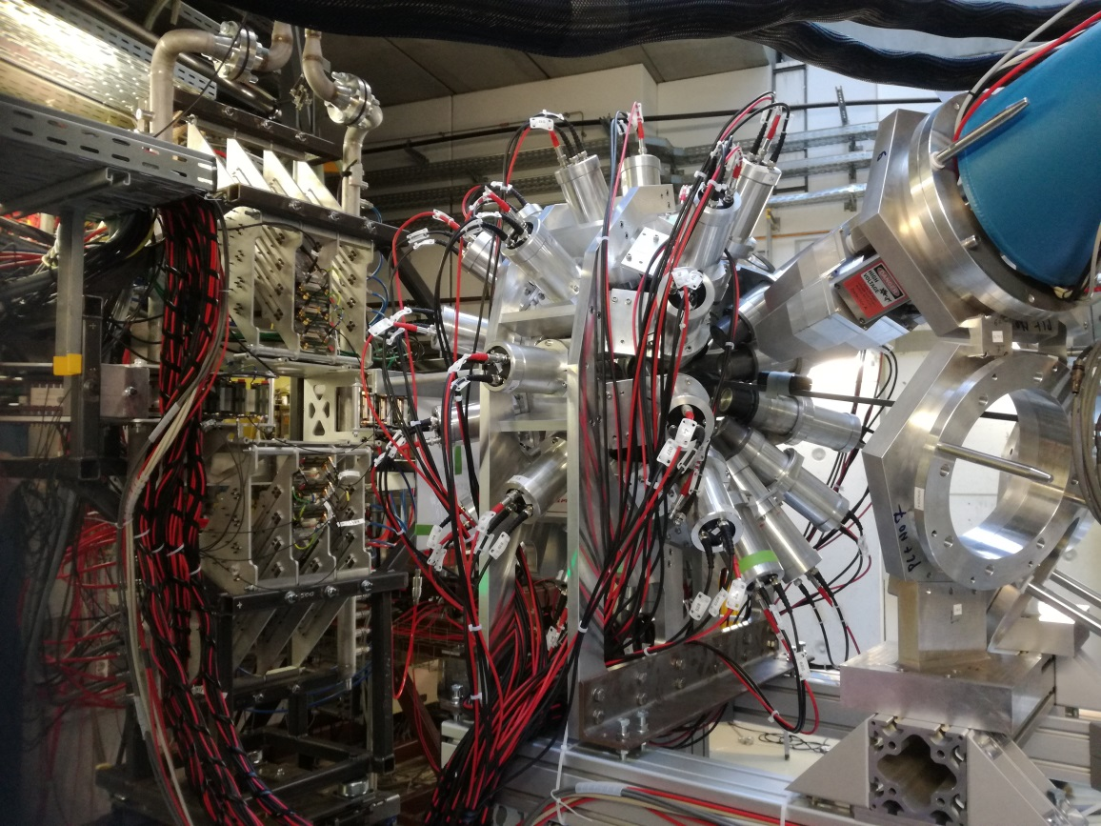
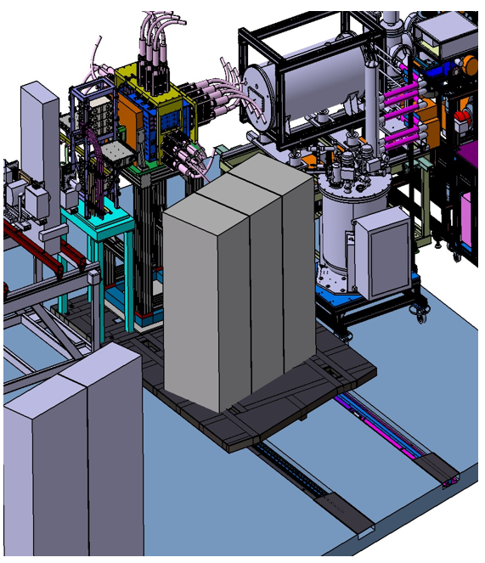
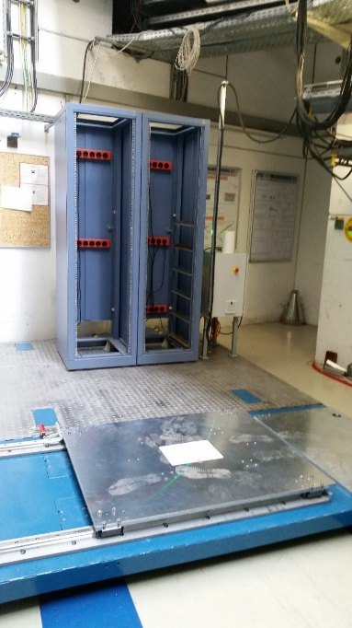
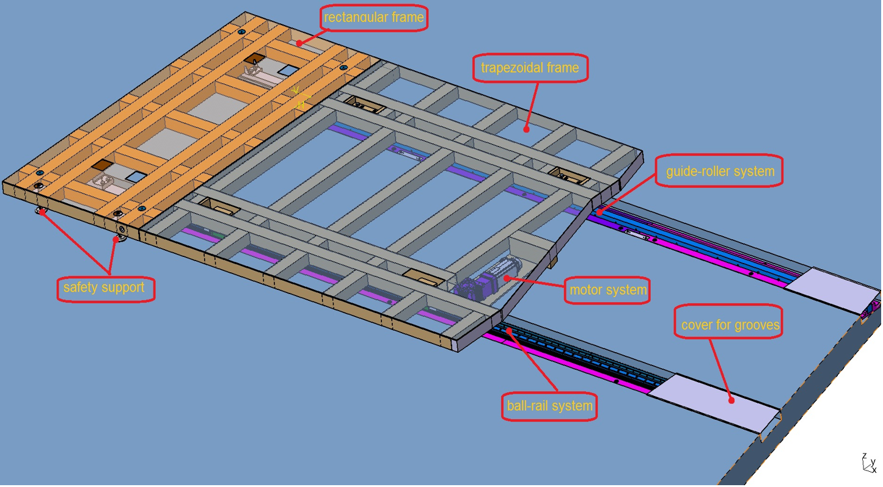
ES/FS requires special Experiment Platforms
Example of AIDA+FATIMA+DEGAS Platform
Ultrasoft acceleration and deceleration for shock-free movement…
Sub-millimeter accuracy for precise positioning of detection systems…
Precise 2D on floor movement…

Slide 29
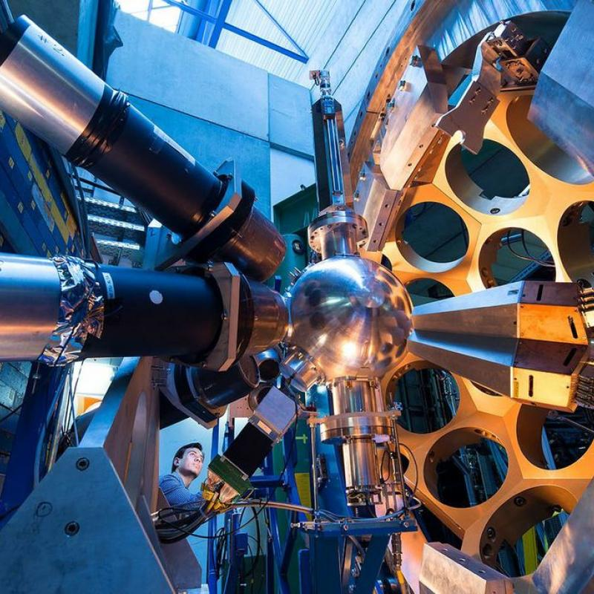
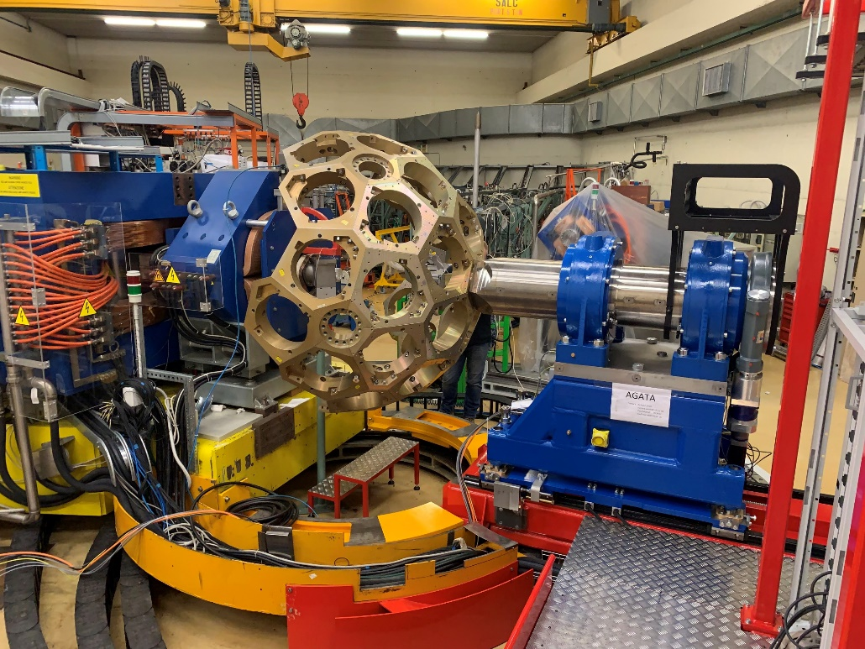
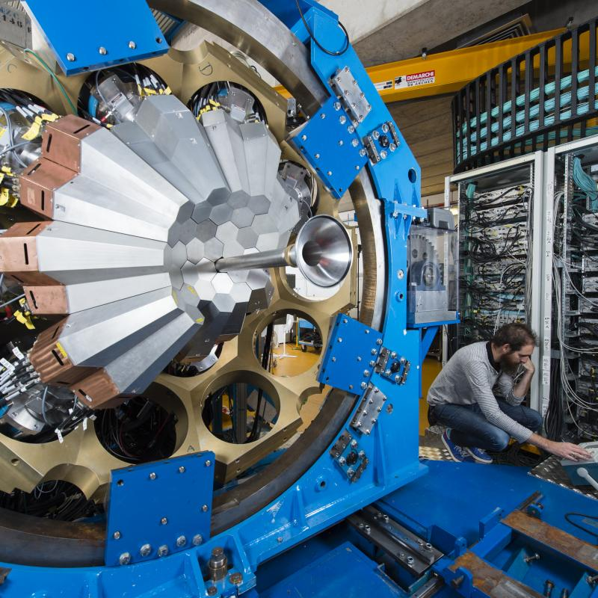
ES/FS requires special Experiment Platforms
Example of AGATA Platform
GSI
LNL
Compact high-precision rotatable honeycomb frame…
sub-mm distortions at detector heads…
GANIL

