Slide 1

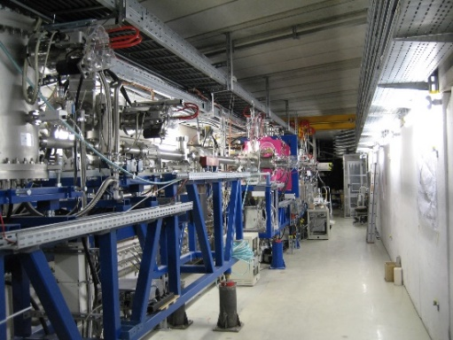
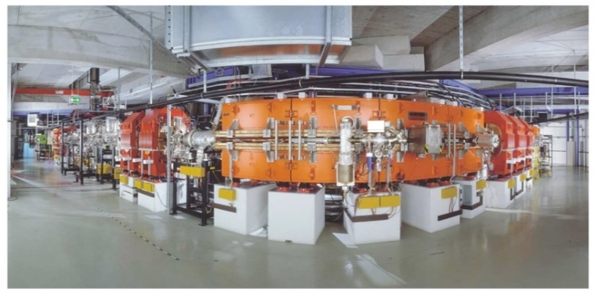
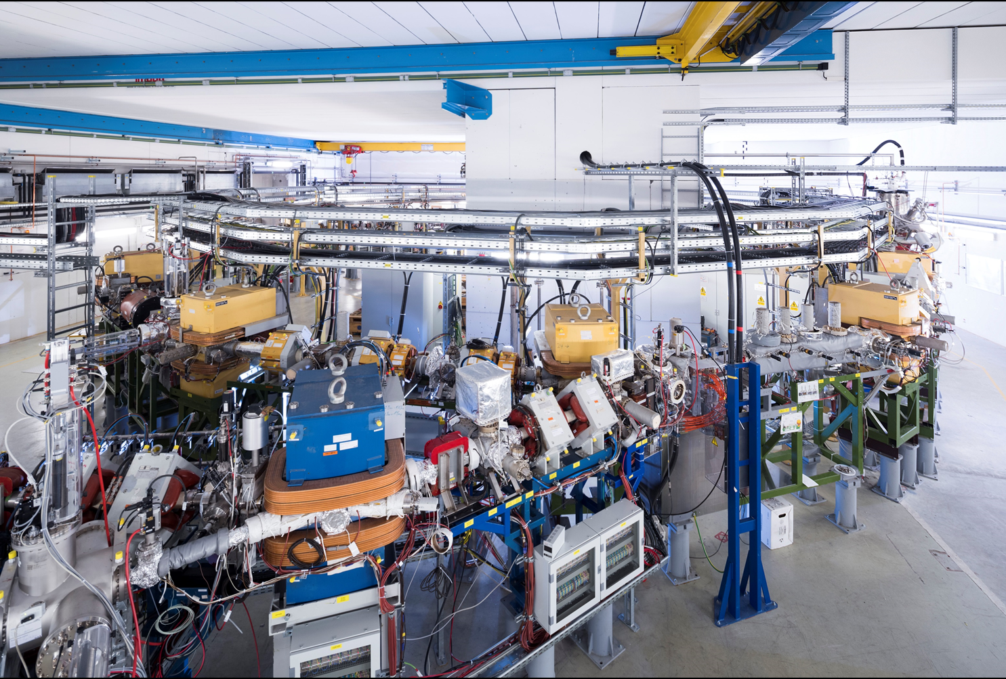
Mid-term Research Strategy of the
Stored Particles Atomic Physics Research Collaboration
Atomic, Quantum, and Fundamental Physics
Thomas Stöhlker
Helmholtz Institute Jena and Friedrich-Schiller University, Jena, and GSI

Slide 2

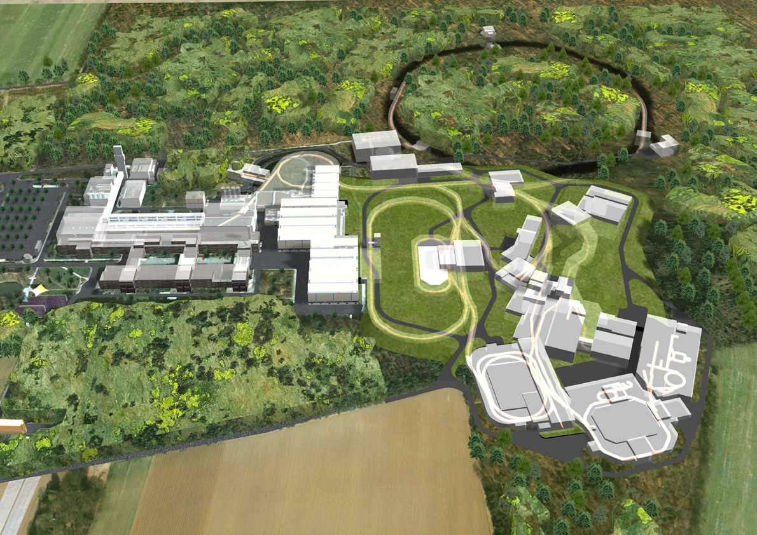



APPA Facilities at FAIR (Status 2008)
APPA Facilities at FAIR (Status 2009)
Consequences for APPA
No storage rings and traps at FAIR for experiments
No low-energy pbar
No proton radiography beam line
All APPA collaborations squeezed into a “Zero Budget” Cave
In 2009, most of the APPA work packets had to be redefined (in particular for Atomic Physics)
SIS 100/300
☹
☹
HEDgeHOB/WDM cave
☹
SPARC cave
☹
FLAIR
☹
Slide
presented in 2013
NESR

Slide 3

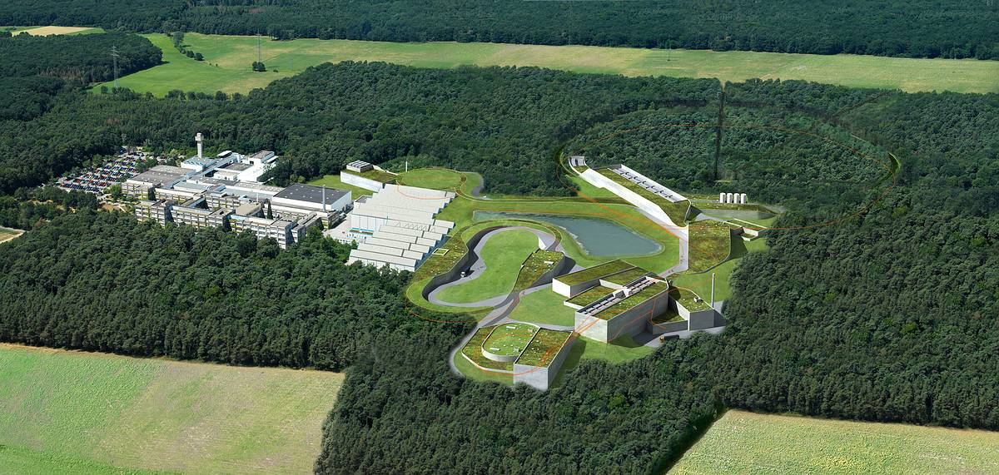
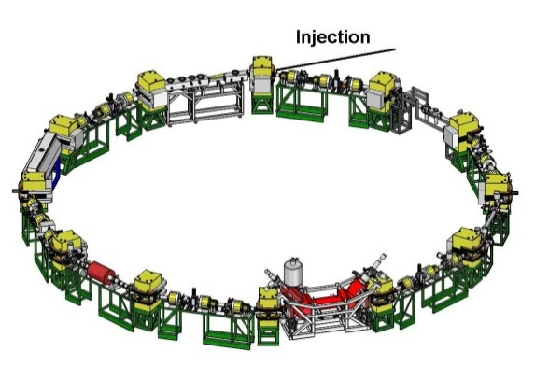
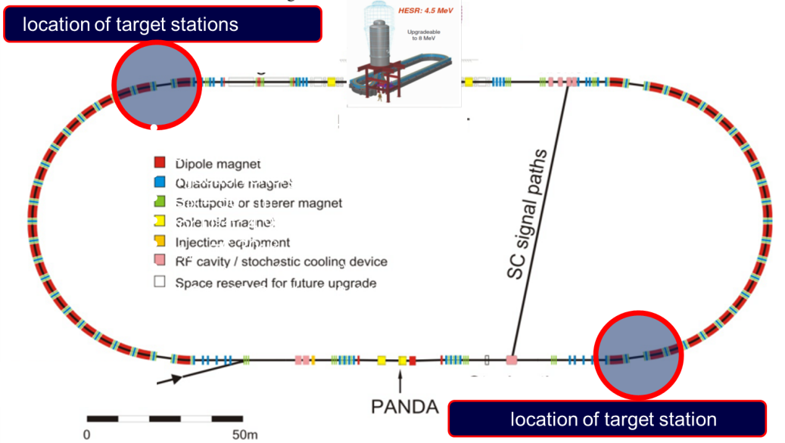
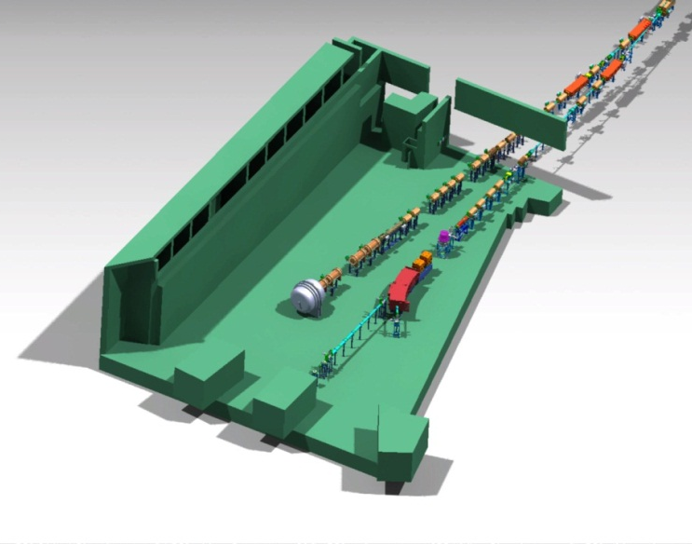
APPA (Status 2012): The Facilities
CRYRING
Cold Low-Energy Heavy Ions and Anti-Protons
HESR
Cold Relativistic Heavy Ions
APPA Cave
Slide
presented in 2013

Slide 4
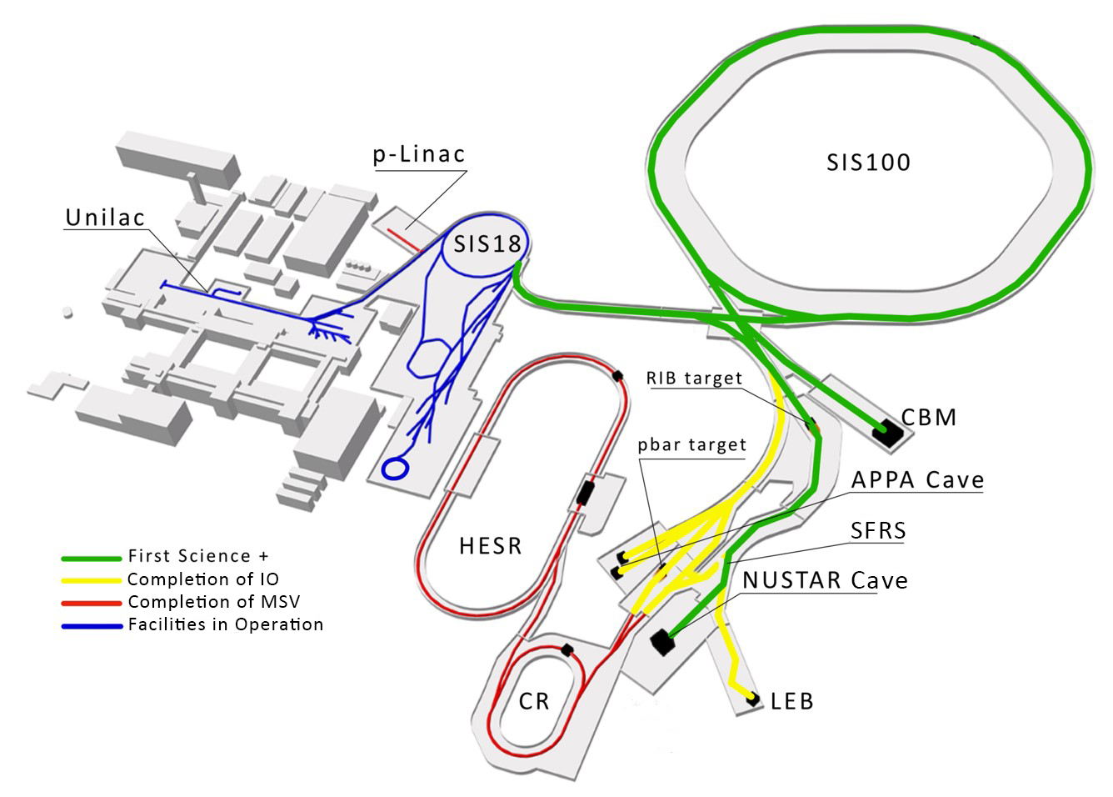
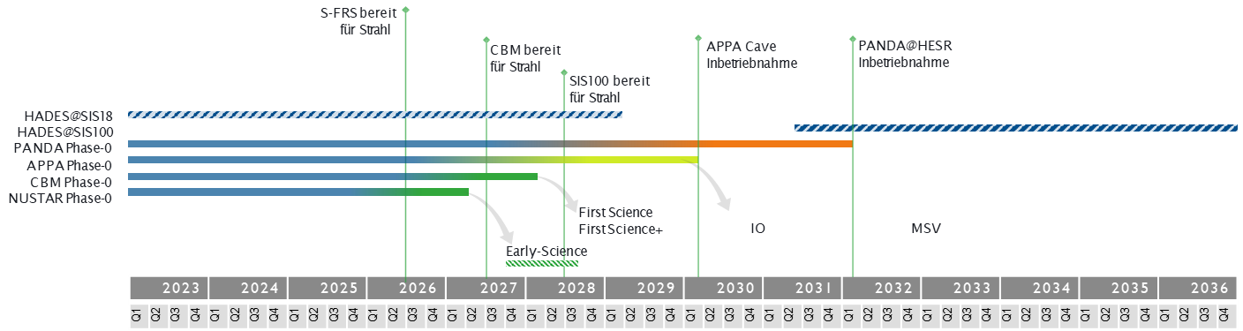
Delayed Realization of APPA Cave & HESR
For APPA, the substantial delay of its dedicated new facilities (APPA cave and HESR) needs to be compensated by sufficient beam times at HITRAP, CRYRING and ESR for the years to come!
          Producing scientific results on highest international level
          Preservation of the collaboration
          Training, education and promotion of next generation of scientists
          Continuous development of the science program
          R&D to keep instrumentation on highest technological level
Notes:
Since the MSV remains our ultimate goal, we have to make sure that activities are paused in such a way to be resumable.
Additional components will progressively be authorized construction when funds will be made available.
It is likely that this will will happen in the order APPA Cave, then LEB, then rest of IO, then CR, HESR and pLinac.

Slide 5
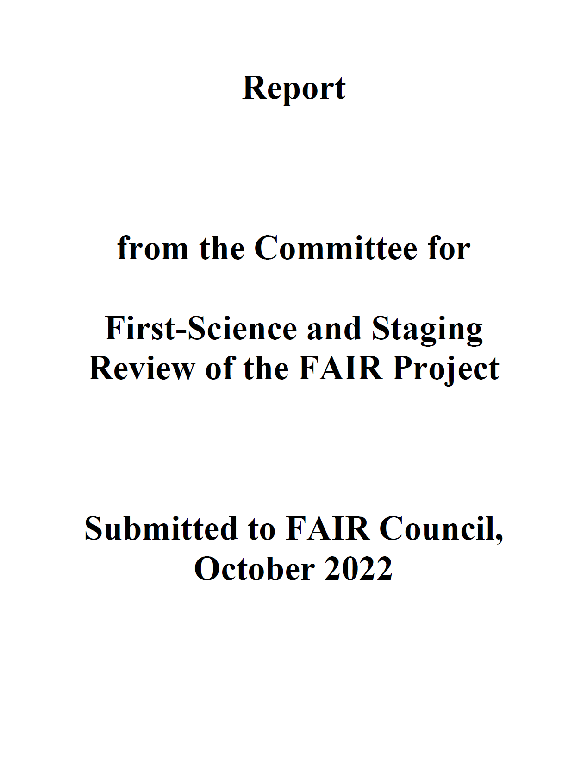
First-Science and Staging Review
“For the APPA pillar [and parts of NUSTAR], it is important for the near term that support for FAIR Phase-0 research continues at the current level. In addition to producing scientific discoveries and developing important applications, the on-going collaborations will also grow the next-generation workforce for the future of FAIR science. For the longer term, it is important that SIS100 and the APPA cave be completed in a timely manner.”
“The APPA program, as noted earlier, can continue carrying out important science with its present facilities. Moving the program into the APPA Cave will open new avenues of discovery by using the SIS100 beams with new instrumentation.”

Slide 6
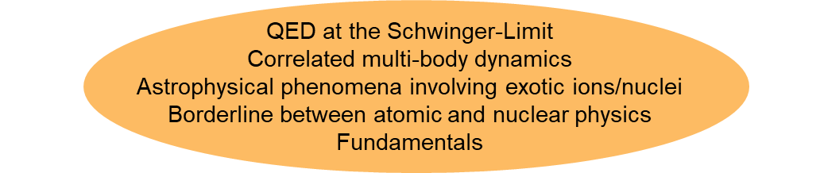
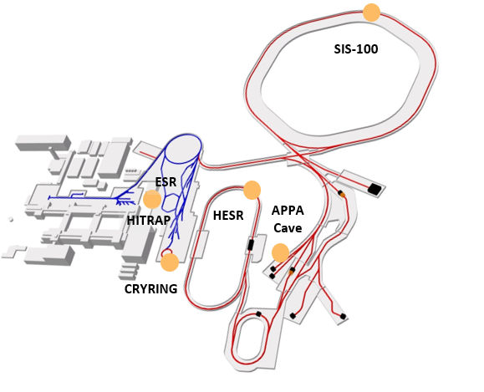
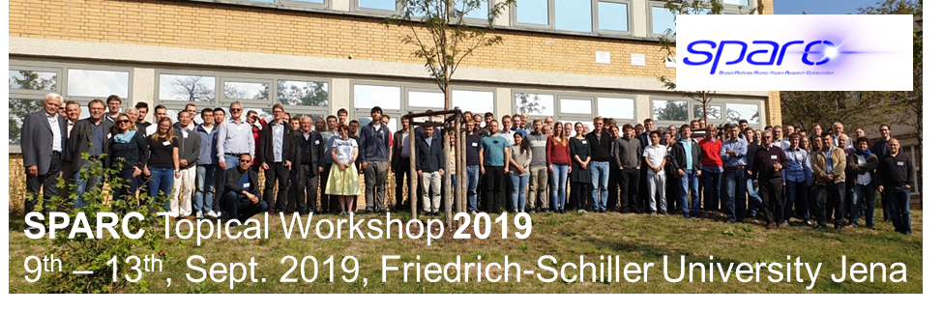
SPARC
Precision Physics, Trapping & Storage of Ions
Atomic, Quantum, and Fundamental Physics
439 members from 26 countries
(SPARC founded in 2003)

Slide 7
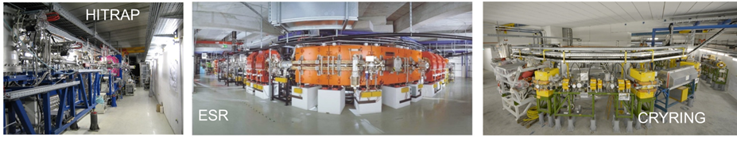
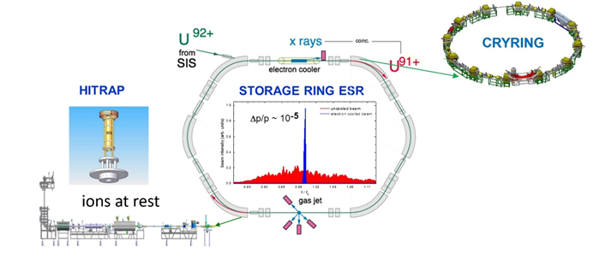
SPARC at Present GSI & FAIR Facilities
Precision Domain of FAIR: Atomic, Quantum, and Fundamental Physics
HITRAP, CRYRING, ESR are part of the MSV
For the years to come, the current MSV facilities of SPARC/APPA are highly competitive and worldwide unique.
For the exploitation of these research opportunities, the continuation of the FAIR phase-0 research program without interruption is of utmost importance.
Notes:
need to improve slide -> who has the original?

Slide 8
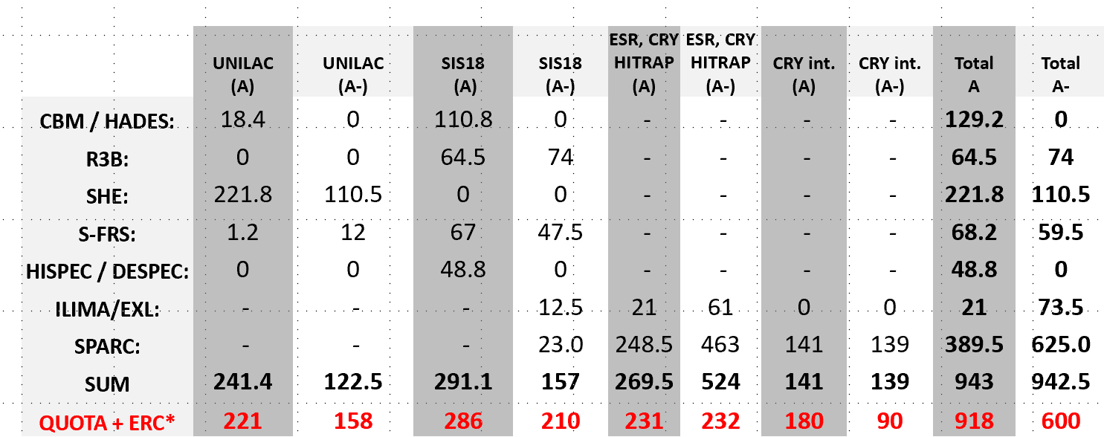
SPARC at Present GSI & FAIR Facilities
Huge demand of beam time for storage rings!
Overbooking factor for the rings: 4.5
Notes:
need to improve slide -> who has the original?

Slide 9
A & A⁻ rated G-PAC Proposals
(2024 – 2025)
ID | Title | Facility | Grade | Shifts
G-22-00025 | High-Resolution Electron-Ion Collision Spectroscopy of Berylliumlike Heavy Ions in CRYRING@ESR | ESR-CRYRING | A | 45,0
G-22-00028 | Indirect measurements of neutron-induced reaction cross sections at storage rings | ESR | A | 36,5
G-22-00038 | Dielectronic Recombination-assisted laser spectroscopy: A new tool to investigate the hyperfine-puzzle in Bi^{80+,82+} | ESR | A | 41,5
G-22-00047 | Absolute rate coefficients from dielectronic recombination for the astrophysically relevant ions Ne³⁺ and S³⁺ | CRYRING-intern | A | 54,0
G-22-00052 | Laser Excitation of the ²²⁹Th Nucleus Using Nuclear Hyperﬁne Mixing | ESR | A | 48,5
G-22-00057 | Nanostructuring of monolayer graphene by highly charged ions | ESR-HITRAP | A | 45,0
G-22-00058 | Ion beam and level population dynamics in Mg⁺ laser spectroscopy at CRYRING@ESR | CRYRING-intern | A | 51,0
G-22-00086 | Ultra-high resolution study of the ¹⁵O(α,α)¹⁵O reaction using CARME@CRYRING | CRYRING-intern | A | 36,0
G-22-00095 | Energy determination of the 1s² 2s_{1/2} → 1s² 2p_{3/2} radiative transition in Li-like uranium ions via resonant coherent excitation | ESR-HTA | A | 35,5
G-22-00134 | Precision x-ray spectroscopy of helium-like uranium using metallic magnetic calorimeter detectors | ESR-CRYRING | A | 32,0
 | SPARC research progam limited by availability of beamtime |  |  | 389,5
G-22-00029 | X-ray spectroscopy of slow Xe⁵⁴⁺ + Xe collisions | ESR-CRYRING | A- | 36,0
G-22-00037 | Atomic Processes in the Wake of Neutron-Star Mergers: Electron-Ion Recombination of Low-Charged Heavy Ions | CRYRING-intern | A- | 46,0
G-22-00060 | Proton-capture on ⁹¹Nb - A key to the explosive nucleosynthesis of the p nuclei | FRS-ESR | A- | 44,5
G-22-00068 | Towards testing three-loop effects of bound-state QED in heliumlike uranium | ESR | A- | 38,0
G-22-00070 | Dielectronic and trielectronic recombination in sulfur ions | CRYRING-intern | A- | 21,0
G-22-00072 | Commissioning and First Storage Ring Experiments of the CRYRING Transverse Electron Target | ESR-CRYRING | A- | 27,0
G-22-00072 | Commissioning and First Storage Ring Experiments of the CRYRING Transverse Electron Target | CRYRING-intern | A- | 54,0
G-22-00075 | Laser spectroscopy of the (1s² 2s2p) ³P₀ - ³P₁ level splitting in Be-like krypton | ESR | A- | 27,0
G-22-00087 | Astrophysical nuclear reactions between bare ions using FISIC+CARME | CRYRING-intern | A- | 18,0
G-22-00093 | Influence of hyperfine interaction on the nuclear electron capture decay in ¹¹¹Sn | FRS-ESR | A- | 20,5
G-22-00130 | Cooling and precision spectroscopy of ²⁰⁹Bi⁸²⁺ ion ensembles with the ARTEMIS and SPECTRAP experiments at the HITRAP facility | ESR-HITRAP | A- | 63,0
G-22-00140 | High-resolution measurement of the exotic Two-Electron One-Photon decay (TEOP) of the 1s 2s² state in Li-like uranium. | ESR | A- | 24,0
G-22-00152 | Systematic measurement of electron capture cross sections in the unexplored low collision energy regime | ESR-CRYRING | A- | 45,0
G-22-00159 | Fast Ion – Slow Ion Collisions @ CRYRING: Exploring quantum dynamics of N-body systems | ESR-CRYRING | A- | 71,0
G-22-00165 | Heavy Ion Storage Ring Experiments of Nuclear Excitation by Electron Capture (NEEC) | ESR | A- | 27,5
G-22-00172 | Exploring the limits of bunched beam laser cooling of relativistic stored ions, using 3 laser beams (pulsed and cw) | ESR | A- | 39,5
Orange shaded entries: Spearheaded by or with strong participation of groups from the ErUM-FSP APPA
9

Slide 10
Engineering Run 2023
Make ESR, CRYRING@ESR, HITRAP & Cave A fit for A rated experiments in 2024/2025
Electron cooler at ESR and CRYRING need to be back in operation in 2023
(including repair of drift tubes).
ESR: Further optimization of deceleration capability (e.g. vacuum)
ESR: Test of the accumulation in ESR of RIBs produced (stripping foil): stacking supported by stochastic cooling
CRYRING: optimize/increase the intensity of soft beams (e.g. Ne³⁺)
CRYRING: new ion species (e.g. W¹⁴⁺)
HITRAP: Around 7 days of further comimissioning with beams from ESR (e.g. light to medium-heavy ion beams)
Cave A: Test of transfer of cooled beams from the ESR to Cave A with the new control system

Slide 11
Possible Experiments at CRYRING@ESR in 2023
CRYING@ESR run with local source: Beams of Ne^{3+, 7+} and Mg⁺ are requested.
Three experiments are ready to run already in 2023:
Absolute rate coefficients from dielectronic recombination for the astrophysical relevant ions (18 shifts).
Ion beam and level population dynamics in Mg+ in laser spectroscopy at CRYRING@ESR (36 shifts).
Commissioning and first storage ring experiments of the CRYRING@ESR transversal e-target (42 shifts).

Slide 12
SPARC Experiments in 2024 and 2025
Concentration of A rated experiments at ESR, CRYRING@ESR, HITRAP & Cave A
CRYING@ESR: For the production runs the experiments will use mostly beams transferred from the ESR. Main requests are for Uranium in different charge states (bare, He-like and Be-like) and for bare Xe.
CRYING@ESR: Possibility for commissioning of the setup FISIC (POF milestone).
ESR: DR- assisted laser spectroscopy (DRALS) the accumulation of Li-like RIBs (Bi80+) with a different method (ecool-stacking) should be tested
229Th studies
ESR: Test of new laser systems to be built for the laser cooling experiment in SIS100 (FAIR- FS).
ESR/Cave A: RCE experiment with Li-like uranium

Slide 13
SPARC Experiments in 2024 and 2025
Concentration of A rated experiments at ESR, CRYRING@ESR, HITRAP & Cave A
HITRAP:
Finalize the commissioning of the facility. The extent of the commissioning activities will be defined according to the beam properties requested for the proposed experiments.
First pilot experiments on the g-factor and hyperfine splitting of highly-charged, heavy ions at ARTEMIS and SpecTrap.
First test experiments towards Quantum logic spectroscopy for frequency metrology of heavy and simple ions (new Helmholtz Young Investigator Group)
General remark: For regular user operation of HITRAP, beam time for machine development is needed and implies at least a 7-day machine tests per year.

Slide 14
Strategy and Requirements Beyond 2024-2025
The SPARC activities beyond 2025 will follow two lines:
continuation of the SPARC experiments rated with A and A- and possibly new experiment proposals.
installation, commissioning and use of new setups which are ready for use or already funded and in construction.
For HITRAP, CRYRING@ESR and ESR further technical improvements are expected beyond 2025 (e.g. ECR source for CRYRING@ESR).
Support by the host lab for the operation of accelerators is required. Also support by the various technical groups for e.g. installation of equipment and experiments is necessary.

Slide 15
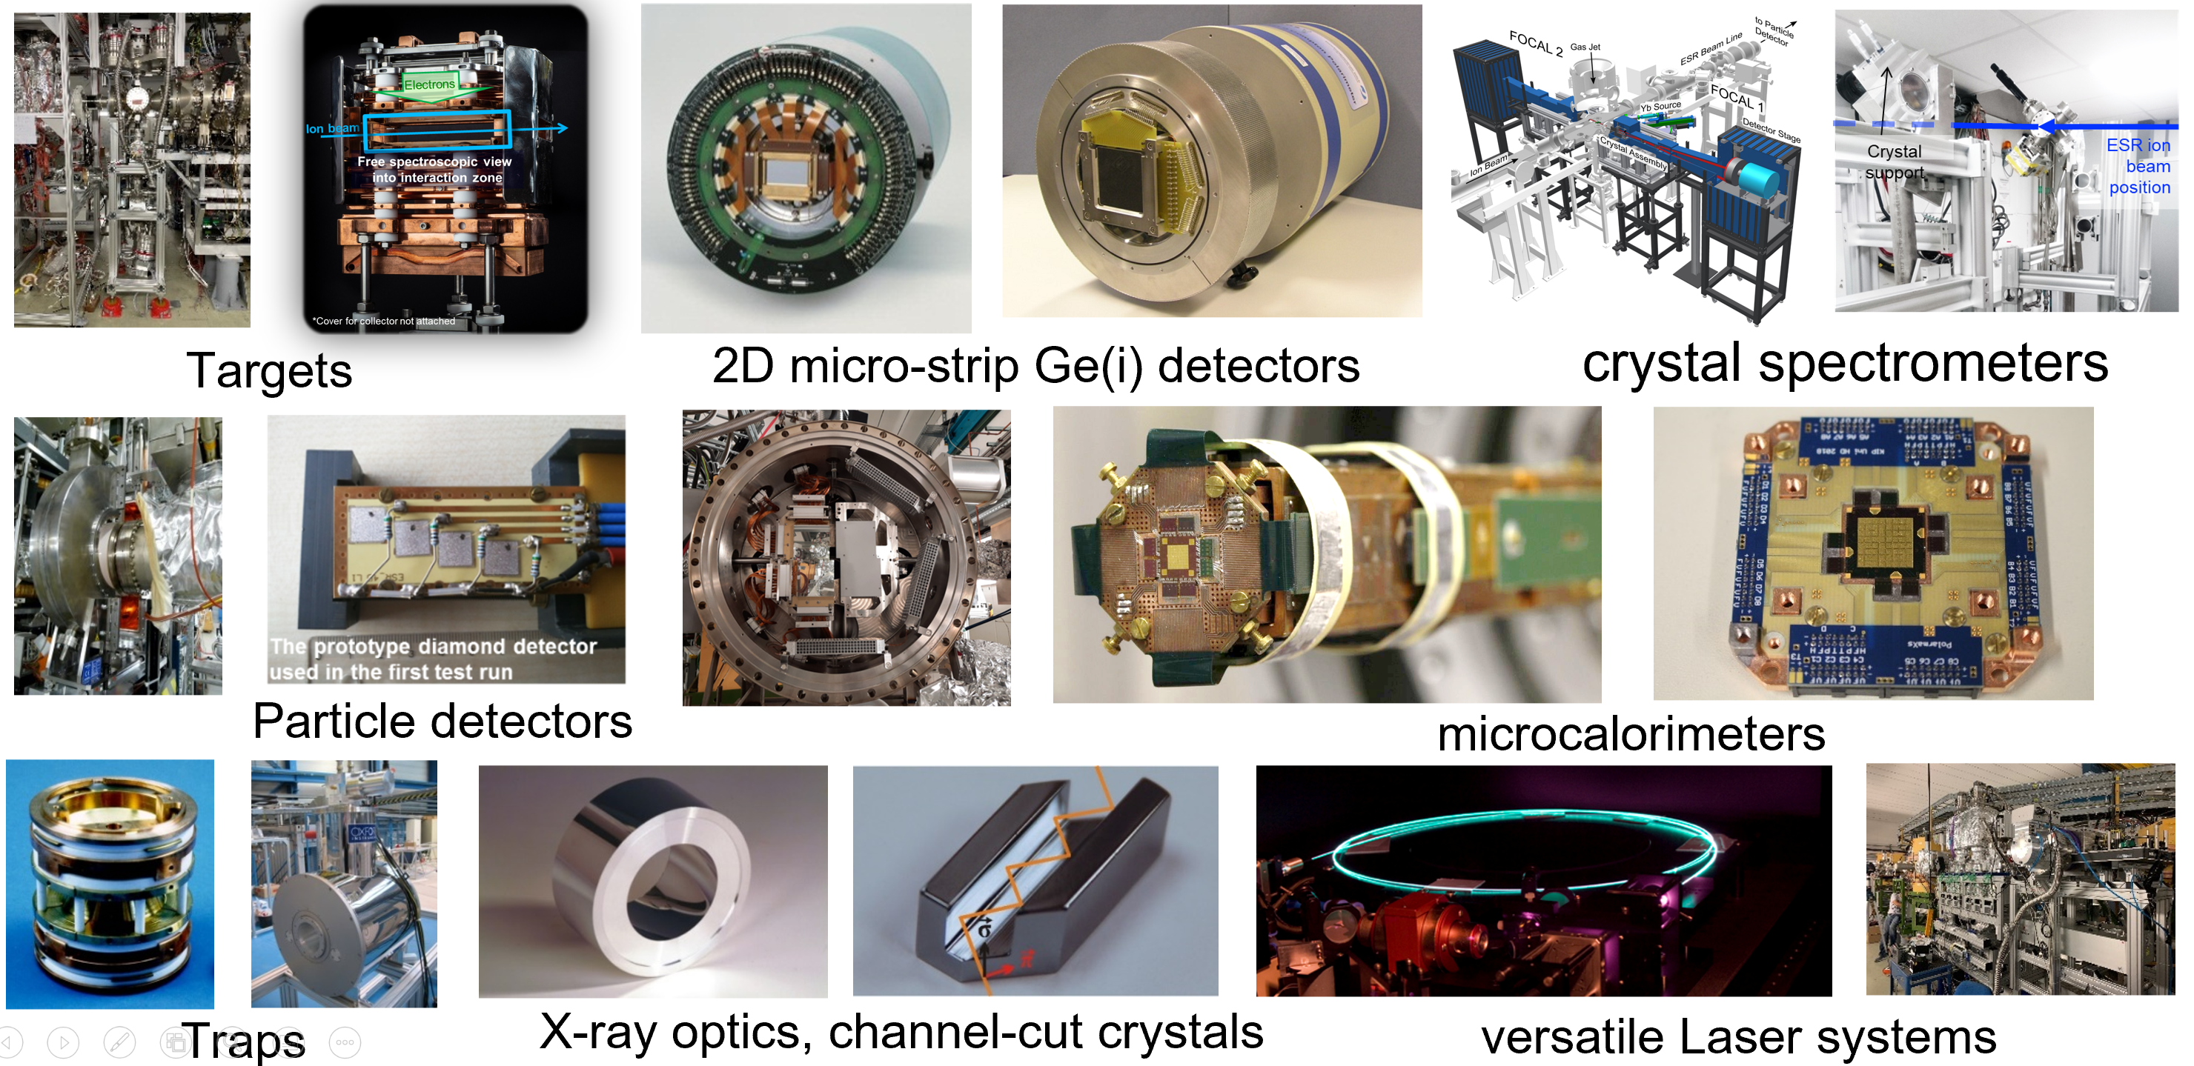
Sophisticated and Versatile Instrumentation
SPARC/APPA: Besides the facilities, instrumentation is of utmost importance. Already the large portfolio of novel FAIR instrumentation guarantees for a rich science research program at the existing facilities HITRAP, CRYRING@ESR, and ESR.
Most equipment is stored and maintained by university groups outside the campus of GSI/FAIR.
For setup assembly and testing, a work area outside CRYRING@ESR is an absolute necessity.
Notes:
do we need to repeat the details on the PAC?

Slide 16

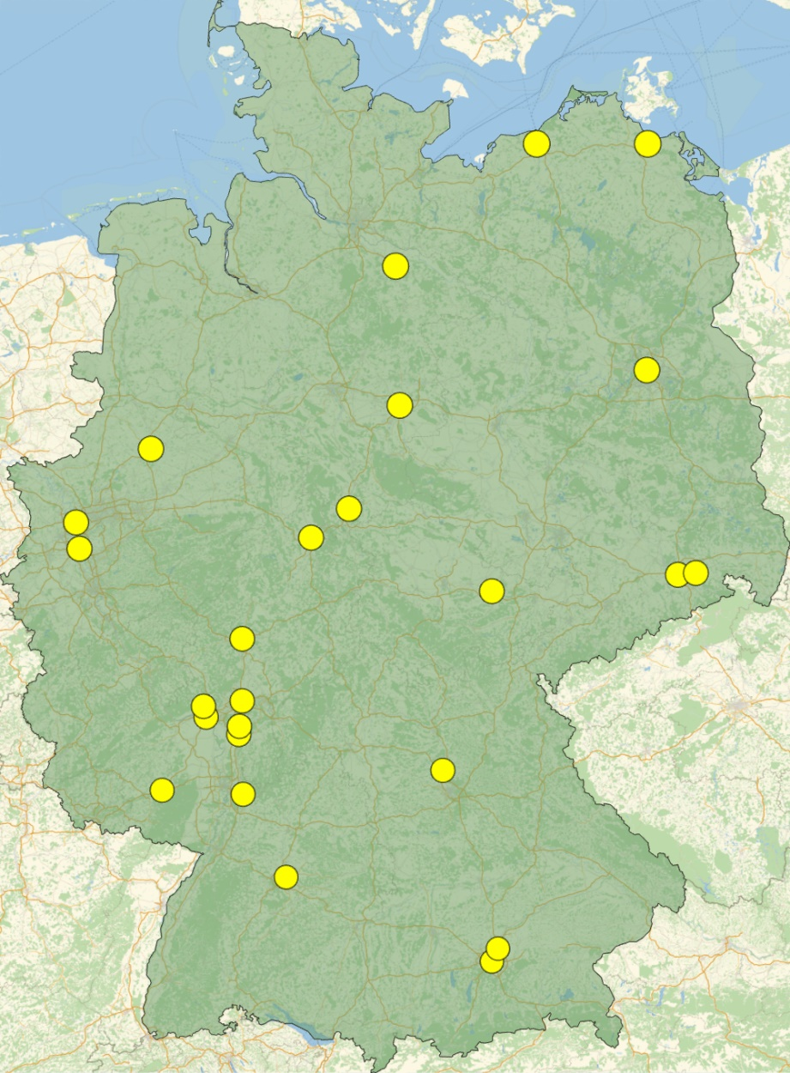
ErUM-FSP T05
“Aufbau von APPA bei FAIR”
The strategy of the national network of SPARC university groups is closely aligned to the overall strategy of the SPARC collaboration:
U Greifswald
U Rostock
U Lüneburg
HU Berlin
SPARC & HED@FAIR in 2021-2024: 7.6 M€
19 funded projects (out of 32 applied for)
U Münster
TU Braunschweig
U Duisburg-Essen
U Göttingen
Priorities for 2024-2027:
Use the still available FAIR Core-Invest (committed by BMBF) for the completion of the instrumentation.
Carry out the research within FAIR Phase-0
(granted GPAC beamtimes & supporting theory).
R&D for further advancing the technologies.
TU Dresden
U Düsseldorf
U Kassel
HI Jena
U Jena
HZDR
U Gießen/THM
HS Rhein-Main
U Frankfurt
U Mainz
HI Mainz
FAIR / GSI
TU Darmstadt
TU Kaisers-
lautern
U Erlangen-Nürnberg
U Heidelberg / MPIK
U Stuttgart
TU München
U München

Slide 17
Concluding Remarks
For the years to come and until APPA cave and HESR are online, sufficient beam times at HITRAP, CRYRING and ESR are of utmost importance:
          Producing scientific results on highest international level to compete with new emerging research fields.
          Preservation of the collaboration and strengthening SPARC related university networks.
          Training, education and promotion of next generation of scientists.
          Continuous development of the science program, including theoretical concepts and novel instrumentation.
          R&D to keep instrumentation on highest technological level.
          Also important:
          To fulfill our commitments related to SPARC activities: ERC grants, Young investigator groups, 3rd party projects such as BMBF-Verbundforschung etc.
          Cooperation and competition between research programs and centers within Helmholtz (milestones) => GSI base budget.
Reliable support by the host lab for the operation of accelerators is required. Also support by the various technical groups for e.g. installation of equipment and experiments is necessary.

Slide 18
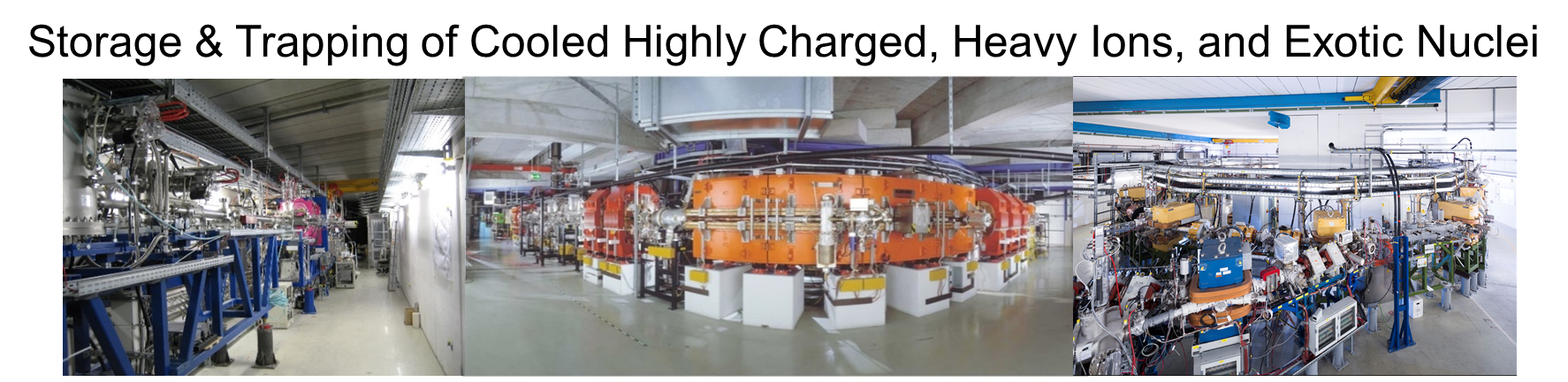
Thank You for Your Attention !
“Decisions and resource allocations for GSI and FAIR need to be optimized across the whole GSI and FAIR complex, so that the imperatives of scientific discovery, FAIR beam commissioning, and affordable facility operation can be achieved.” … “Delivering on fewer than all three imperatives will not meet scientific, public, and political expectations”. FAIR review, 2022

Slide 19
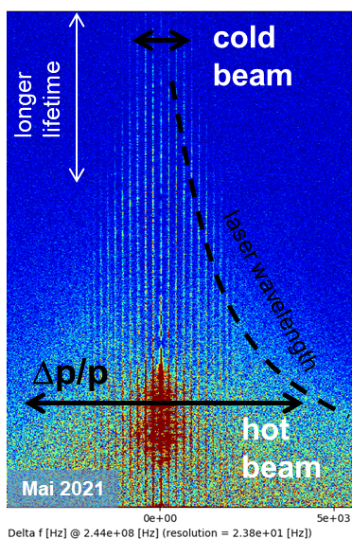
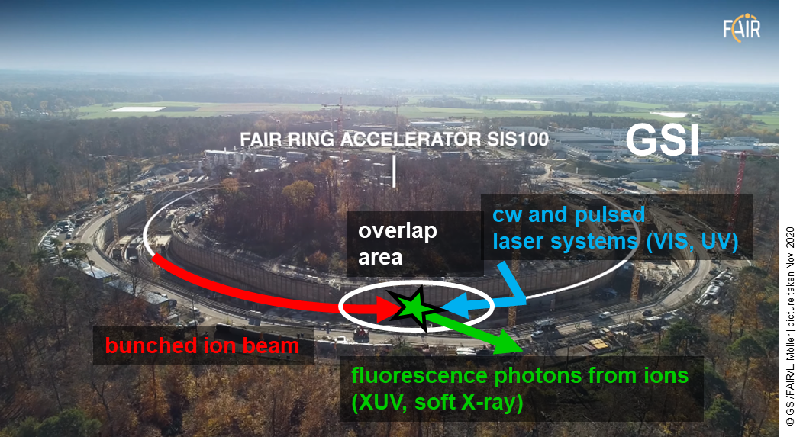
Added science with additional facilities
SPARC Experiments at SIS100
Laser Cooling of Bunched Relativistic Ion Beams at SIS100 with γ ~ 13
Laser-cooled relativistic heavy-ion beams (Z = 10 - 60)
Only cooling method at SIS100 energies (Δp/p down to 10⁻⁷ in a few sec.)
Extraction of very cold and very short ultra-relativistic ion bunches
World-wide unique!

