Slide 1
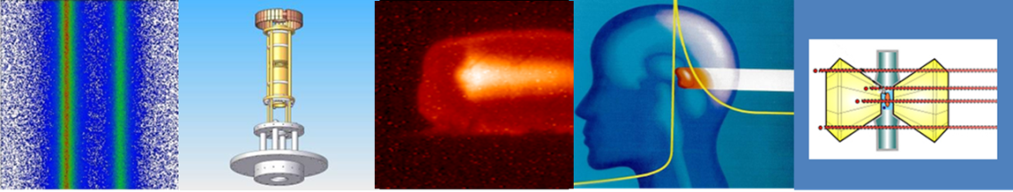



International Biophysics Collaboration
Marco Durante
Head of Biophysics Department, GSI
FAIR/GSI research retreat 13.2.2023

Slide 2
Biophysics at GSI – science with existing facilities
Space radiation protection
Particle therapy
1998 2022
First European center to treat patients with high energy ¹²C-ions (440 patients treated on site)
Now extensive research program in particle therapy covering from nuclear physics to molecular biology
Work supported by BMBF, EU (INSPIRE, HITRI, ERC AdG, EURO-LABS), NIH
Target station: Cave M (SIS18)
ESA reference facility for ground-based space radiation protection studies
Current ESA-supported programs ongoing: IBER/IRES/ROSSINI/GCRsim
ESA/FAIR Summer School in Darmstadt
EU programs: RADNEXT-HEARTS
Target station: Cave A (SIS18)

Slide 3


Added science with additional facilities - FAIR
Patera et al., Front. Phys. 2020

Slide 4
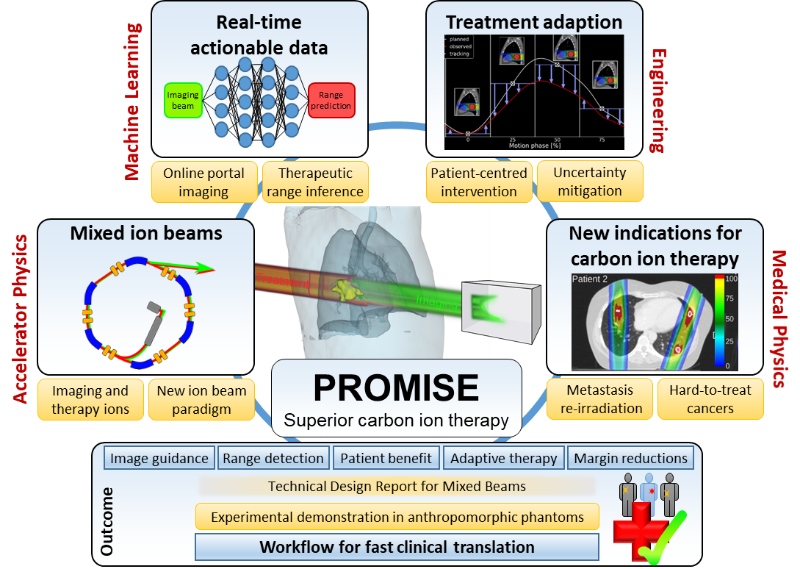
Engineering run 2023
High-intensity C-ions (⪆10¹⁰ pps) for FLASH and ERC AdG BARB
Mixed C/He test
New ERC CoG submitted by Christian Graeff

Slide 5



Physics run in 2024-25 (shifts are for 2 years)
10 experiments = 23 shifts selected with A by the 2022 Bio-PAC (6 experiments = 18.4 shifts with A-) – ¹²C-ions (high-intensity for FLASH)
18 shifts for ERC AdG BARB critical in vivo experiment – ¹²C-ions (and/or ¹⁶O-ions) high-intensity
8 experiments = 23 shifts selected by the ESA PAC (IBER experiments) – ⁵⁶Fe-ions
10 shifts ²³⁸U-ions (EU-RADNEXT and ESA-IRES - microelectronics hardness)
4 shifts EU-HEARTS ⁵⁶Fe-ions (shielding)
2 shifts for EURO-LABS (FLASH) + 2 shifts for NIH (mini-brains)

Slide 6
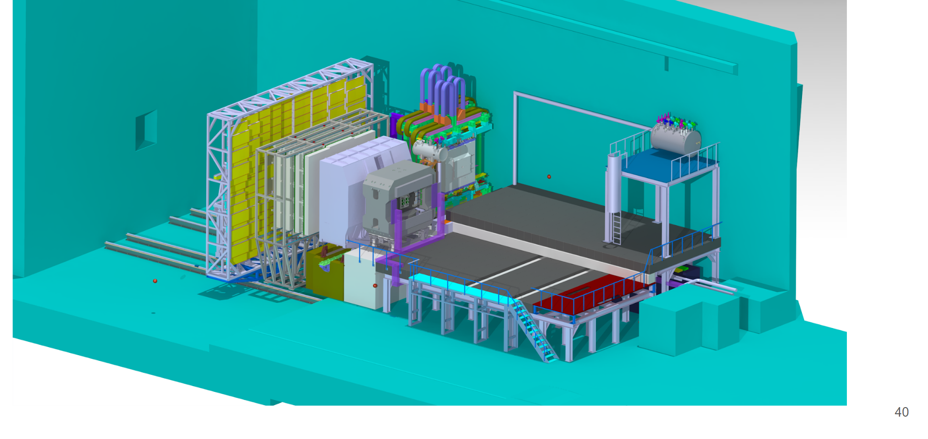
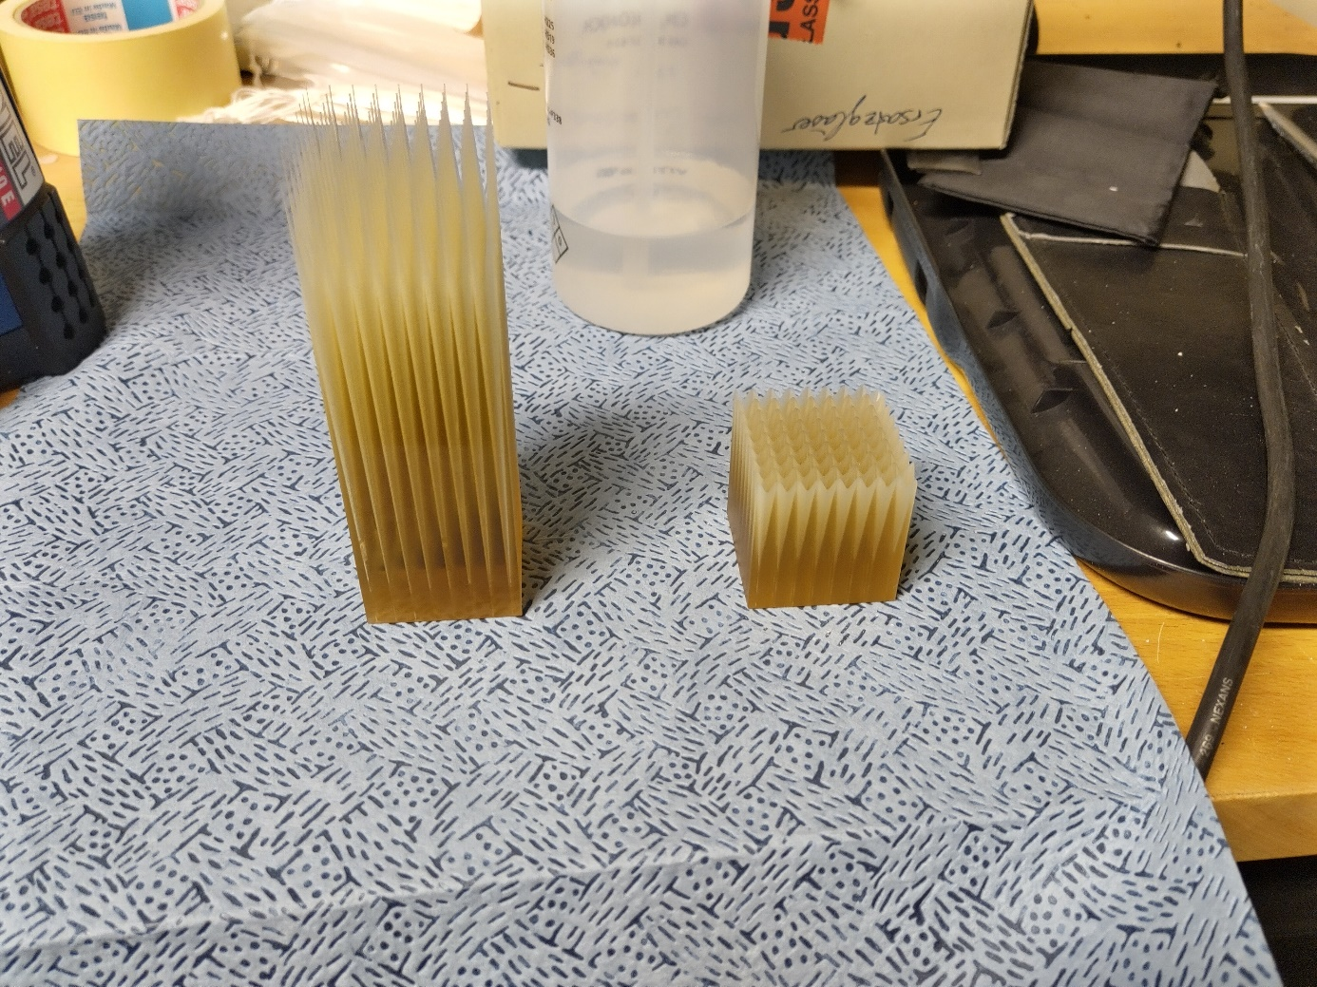

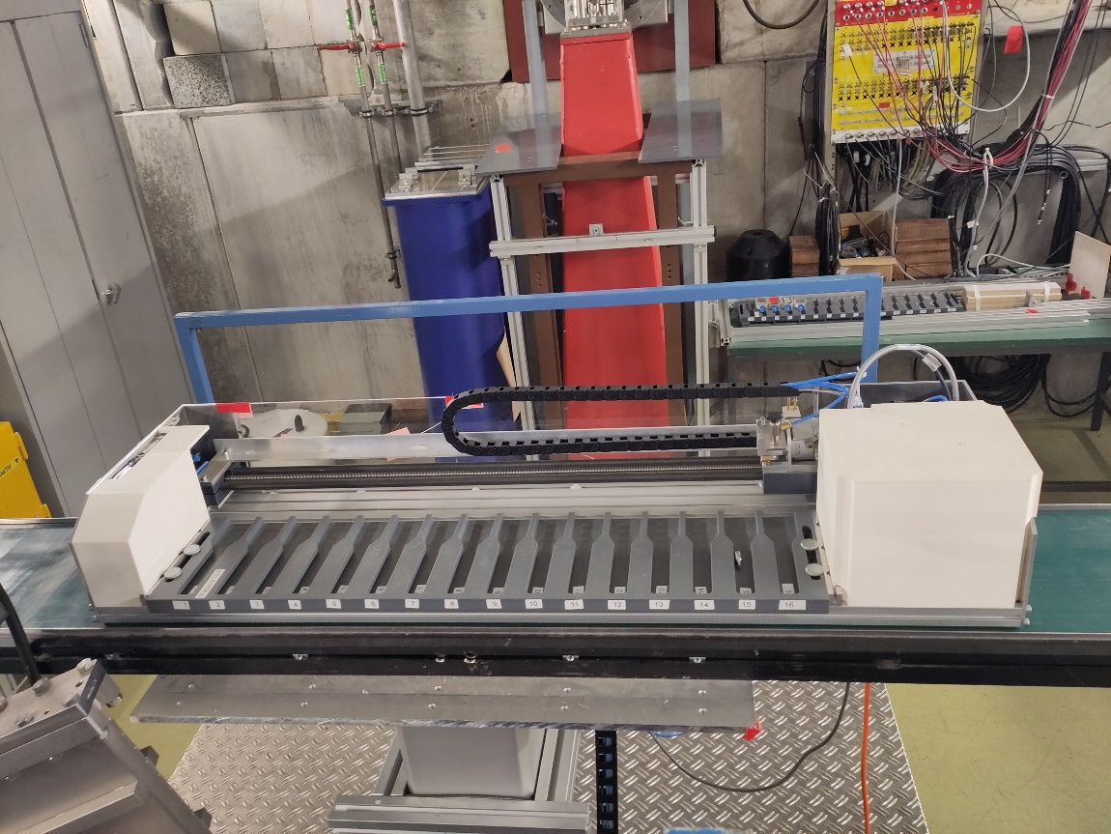

Requirements for running in 2028
⁵⁶Fe-ion beam at 10 GeV/n → worldwide best ground-based GCR simulator
BIOMAT
BIOMAT
parallel plate
IC
additional
shielding
Modulator
Beam

Slide 7
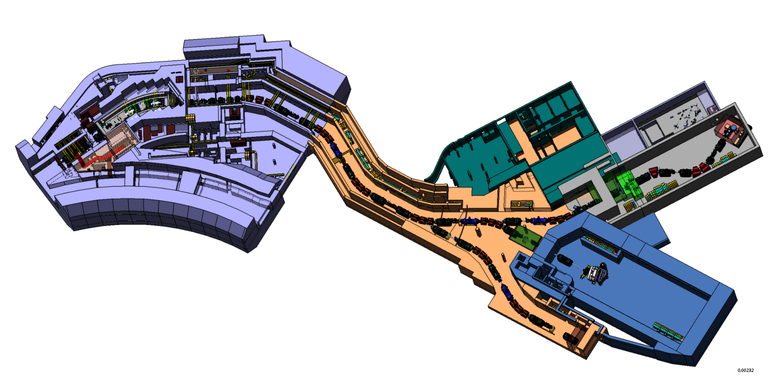
Requirements for running in 2028
Biophysics collaboration at super-FRS (post-BARB)
BIOMAT
Ring branch

Slide 8
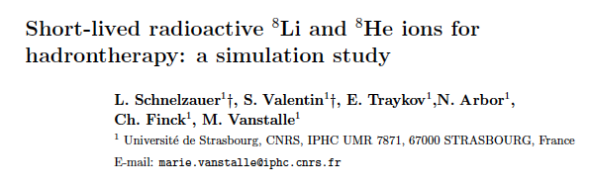
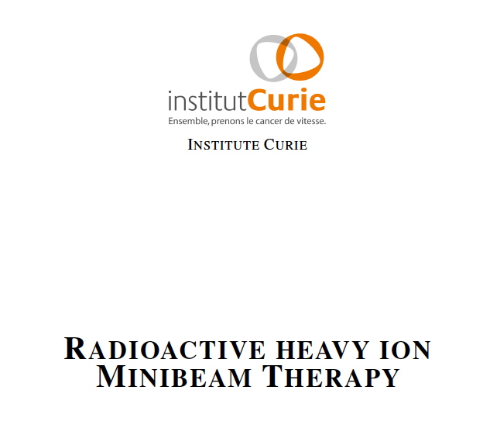
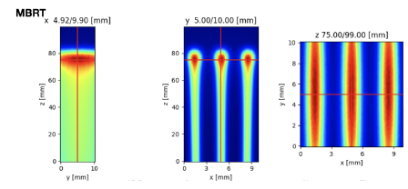
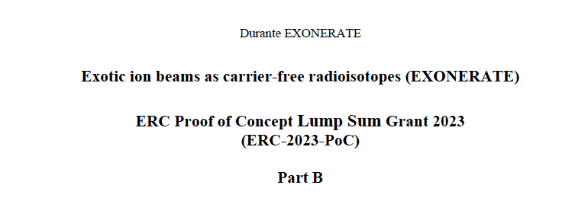
High-intensity RIB in medicine
Proposals form the collaborations
Phys. Med. Biol., 2023 in press
Submitted in January 2023

Slide 9
BIO requirements
Biophysics program can run with existing department resources at GSI (FAIR-phase-0) and in FS+. Lab space is very limited but we can find solutions on campus
Utmost important for the program is 5-years of FAIR-phase-0 toward FS+ without breaks and having high-quality beams and support of the specialized groups from the Commons subprojects
This is mandatory to keep the Biophysics Collaboration alive and to satisfy the current (1 ERC AdG, 3 Horizon Europe, 3 ESA and 1 NIH programs) and future (3 ERC proposals submitted only this year) GSI contracts (bottom line of beamtime is Drittmittel)
In FS+, the Biophysics Collaboration would like to use CBM cave (for space radiation research) and super-FRS (for RIB in medicine)
Even beyond FS+, the Biophysics collaboration will need SIS18 beams in both Cave M and Cave A as well as the FRS beam in Cave M (scanning, animals)

Slide 10
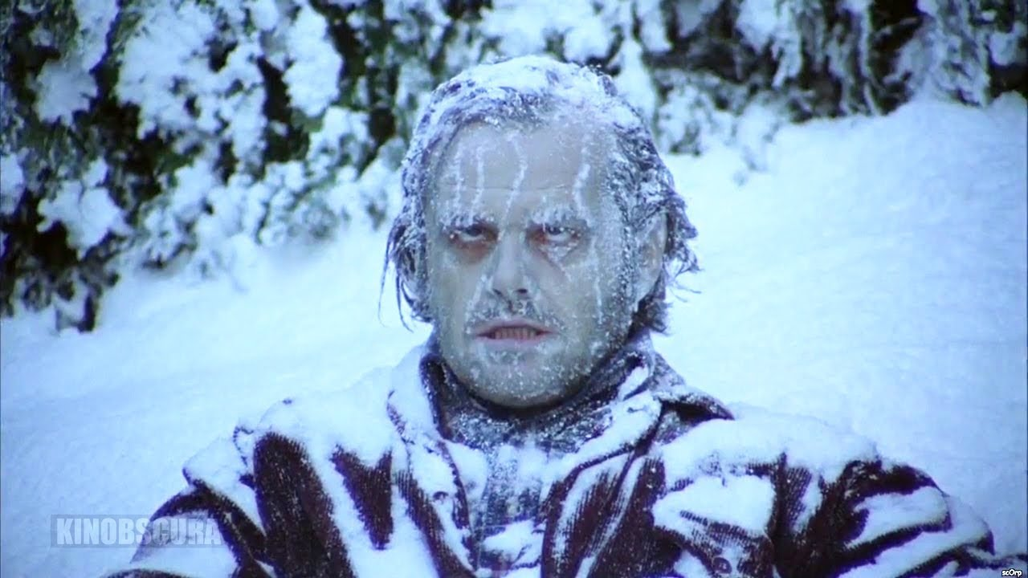

Slide 11
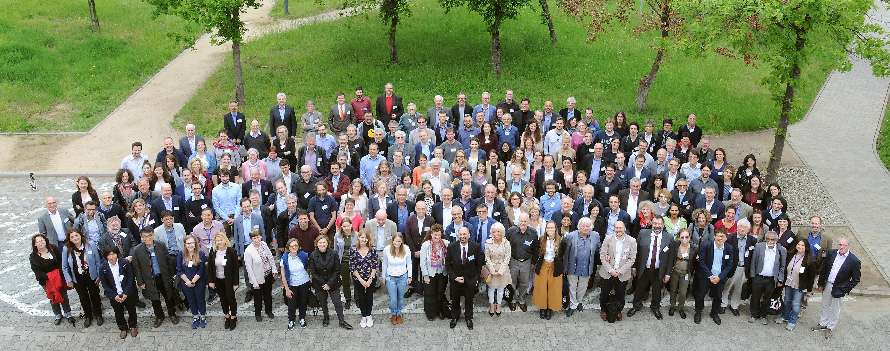
Thank you very much!
www.gsi.de/bio-coll

