Slide 1
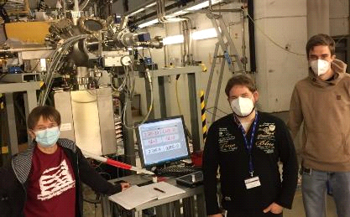
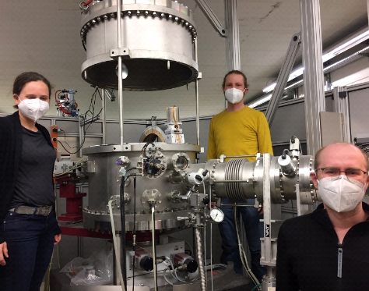
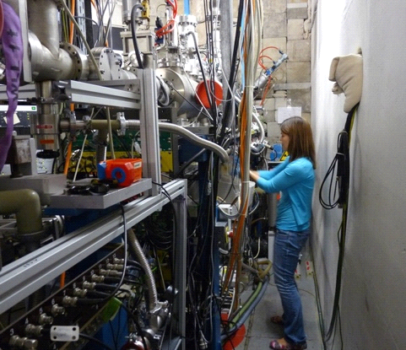
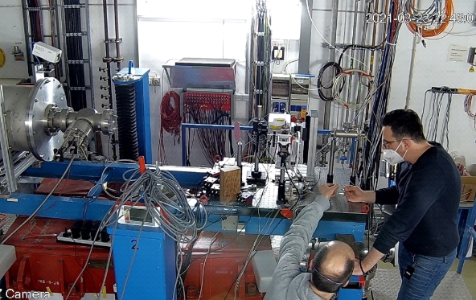
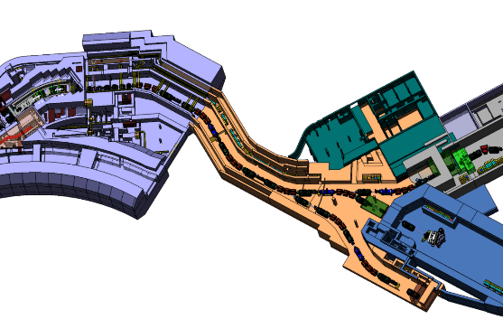
MAT requests, status and opportunities for FAIR phase-0 and First Science+
CRYRING
UNILAC
UNILAC
SIS18
interim solution for APPA cave
MAT station
M
-
branch
X0
Cave A
? ?
S-FRS
Christina Trautmann, Science Retreat, Bensheim, Feb. 14 and 15, 2023

Slide 2
MAT requests for engineering run 2023
SIS18 - HTA
Test and optimization of high-Z beams with respect to
(i) improving transmission into cave A
(ii) minimization of beam focus in combination with highest intensity
and stable beam position.
HTA beam parameters
Ion species: any high-Z ions (Xe – U),
200 – 500 MeV/u
Intensity 10⁹ ions/s
CRYRING via SIS-18 and ESR
So far the experiments with beams extracted to the MAT beamline suffered from low beam intensity.
CRYRING beam parameters
any ion species, but preferably high-Z ions (Xe – U)
1 – 10 MeV/u
Intensity as high as possible (aim ≥ 10⁷/spill)
Access to beams in 2023 would be extremely helpful
MAT experiments can be ready to start upon short-term notice (~3 weeks)

Slide 3
MAT Beamtime 2024 / 2025
Proposal | A |  | A-
shifts | main | sec | main | sec
UNILAC | 105 | 169 | 56 | 82
SIS18 | 24 | 13 | 17
ESR/Cryring/HITRAP | 12 |  | 27
standard beam conditions
UNILAC, M-branch and X0 beamline:
Sample irradiations for internal and external user groups
ion species: any ions between ~Ca and U
3.6 – 11.4 MeV/u
long pulses (1-4 ms) preferred
duty cycle (5 – 50 Hz)

Slide 4
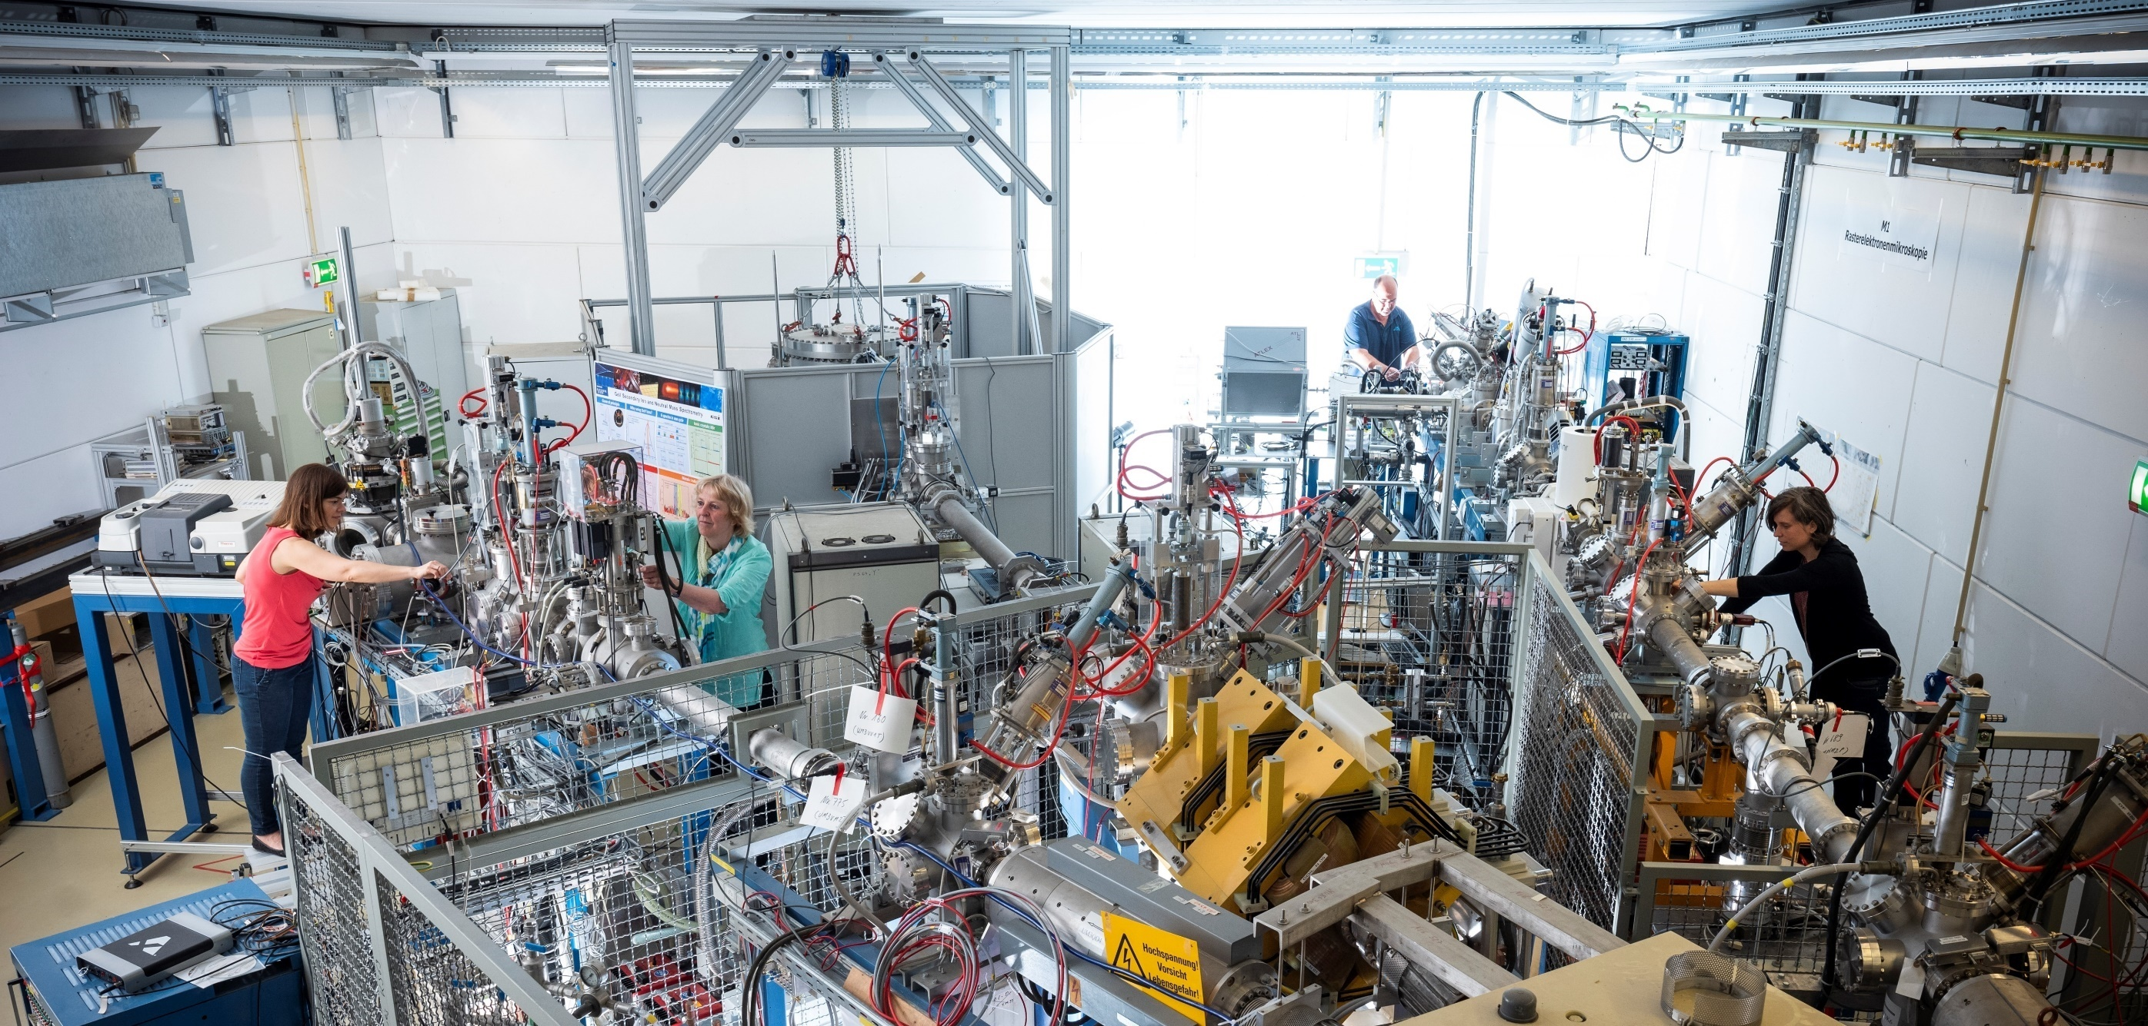
Continuation of UNILAC experiments at M-branch
Irradiation combined with in-situ / on-line analysis
M3
multi purpose
IR-spectroscopy
Raman spectroscopy
high T and cryo-stage
M2
XRD
M1
UHV chamber
SIMS/SNMS
SEM
Topics: radiation damage, sputtering/desorption, astro-chemistry, geoscience, …..

Slide 5
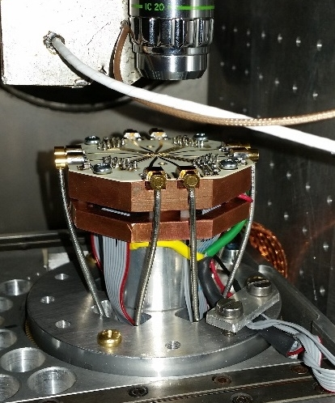
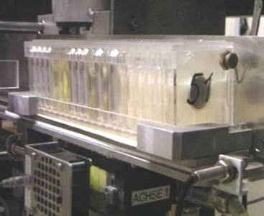
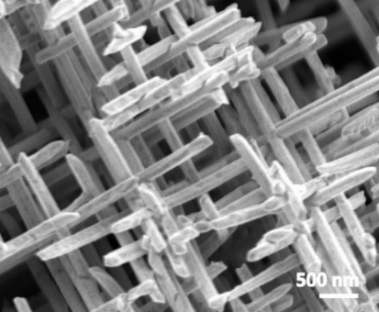
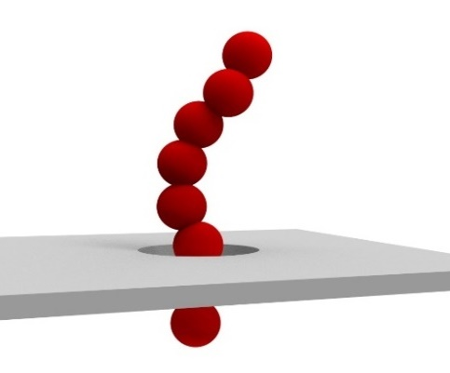
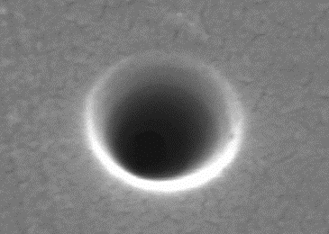
Continuation of UNILAC experiments at X0 beamline
Sample irradiation – user service - microprobe
Topics: nanotechnology …..
Radiation hardness electronics ….

Slide 6
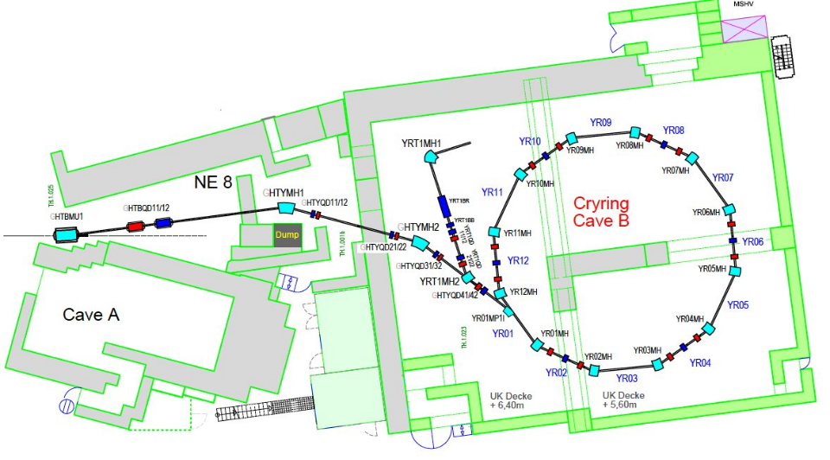
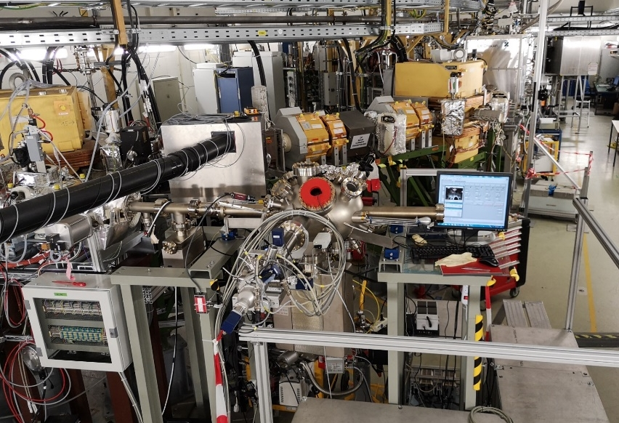
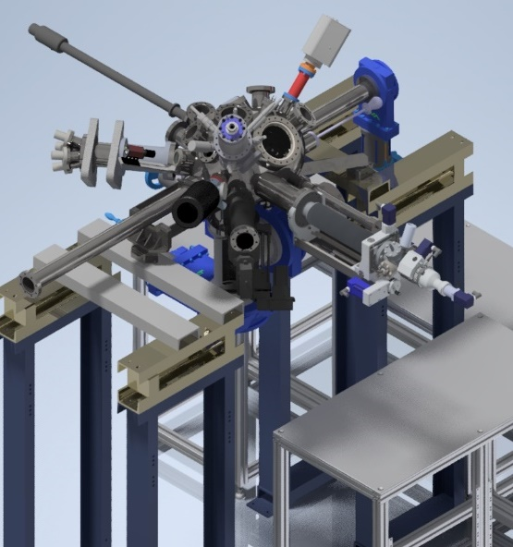
Further development of MAT station at CRYRING
UNILAC → SIS-18 → ESR → CRYRING → extraction MAT beamline
highly charged and fully stripped ions (U⁹²⁺)
kinetic energy available 0.1 – 10 MeV/u
demanding UHV conditions
anticipated intensity 1e7 /spill
Topics:
ion solid interaction as a function of potential and kinetic energy
sputtering and surface processes
interaction with 2D materials
6

Slide 7
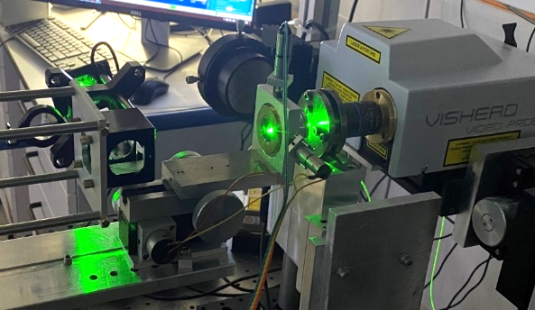
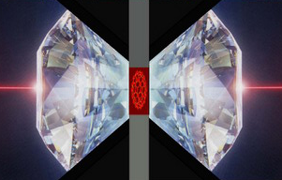


Continuation of Cave A experiments: materials under extremes
Raman spectrometer
beam
collimator
250 µm aperture
200-500 MeV/u ions
goniometer
in-situ Raman setup
In-situ Raman analysis at high-pressure irradiation platform is ready
7
7

Slide 8
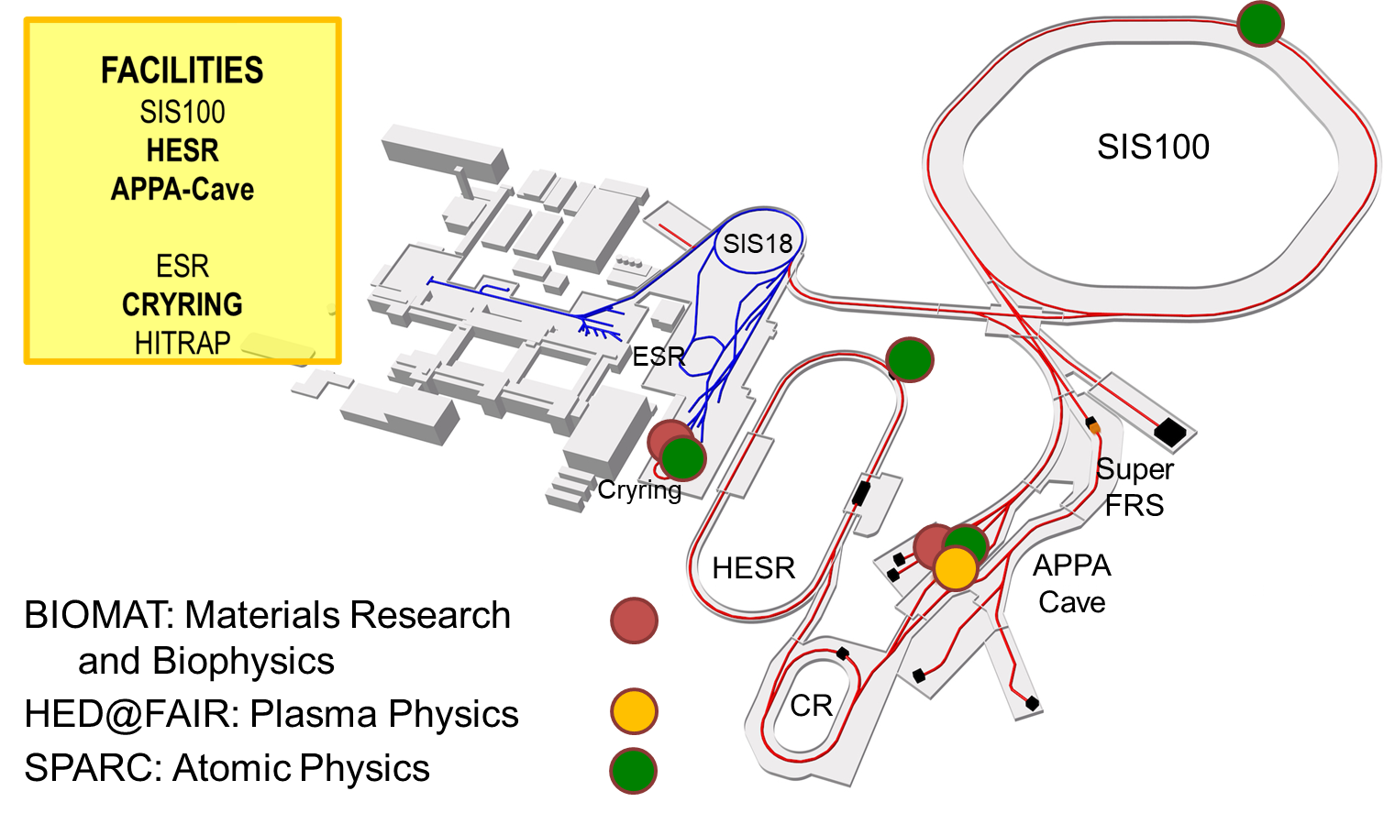
MAT alternatives at SIS-18 / SIS-100 until APPA cave available
Challenges due to delayed APPA cave
Beam Requests
intensities up to 5e9 U-ions/s
heavy beams (Z ≥ Au, preferred U)
slow and fast extraction
energy range 180 - 500 MeV/u
“small” beam focus < 5mm

Slide 9
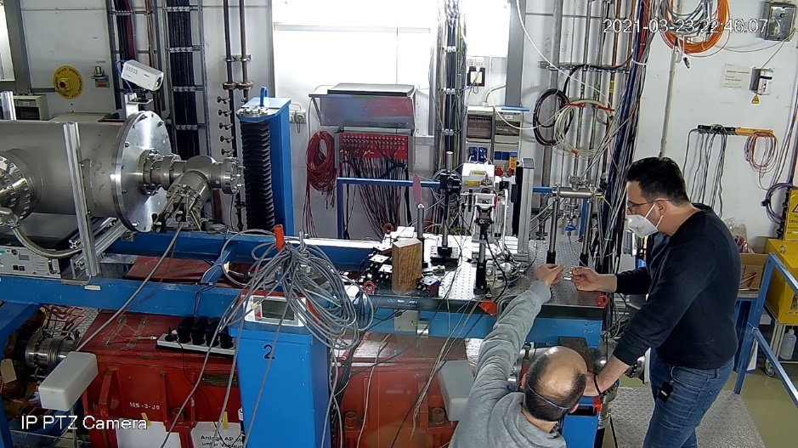
Alternatives at SIS-18 / SIS-100 until APPA cave available
Alternative 1: stay in Cave A
pro:
continuation
no extra efforts for setup
access to SIS-18 beams
parallel operation during SIS-100
contra:
beam flux limited (1e9 i/s)*
Recent flux obtained ≤1e8 ions/s
inefficient and longer irradiation times → more beamtime needed
* Betriebsgenehmigung for all GSI caves

Slide 10
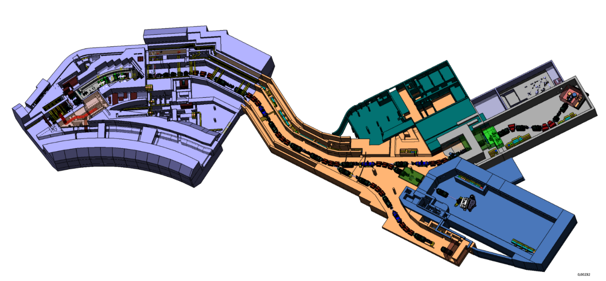
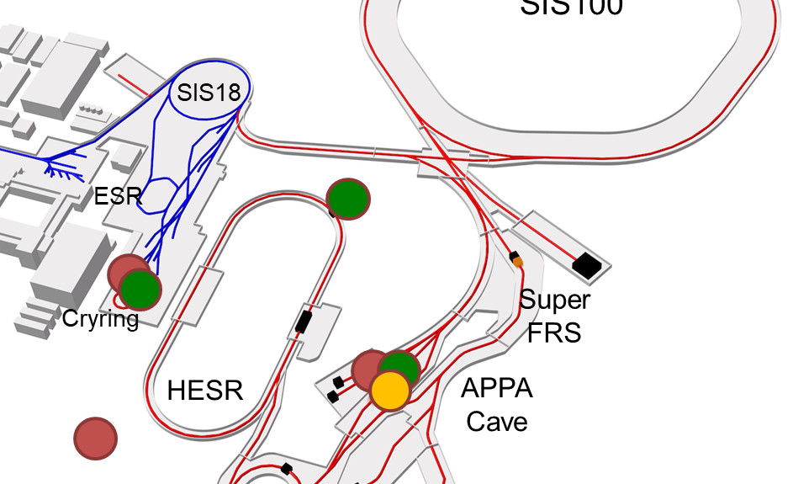
Alternatives at SIS-18 / SIS-100 until APPA cave available
Alternative 2: Ring branch (S-FRS)
pro:
early access to high flux beam
space available, no interaction/ conflict with other pillars
beam focus ok
access to SIS-18 and SIS-100
open:
beam dump needed
extra shielding required
control room
contra:
extra personnel
extra costs, unclear funding
limited access to cave
S-FRS
BIOMAT

Slide 11
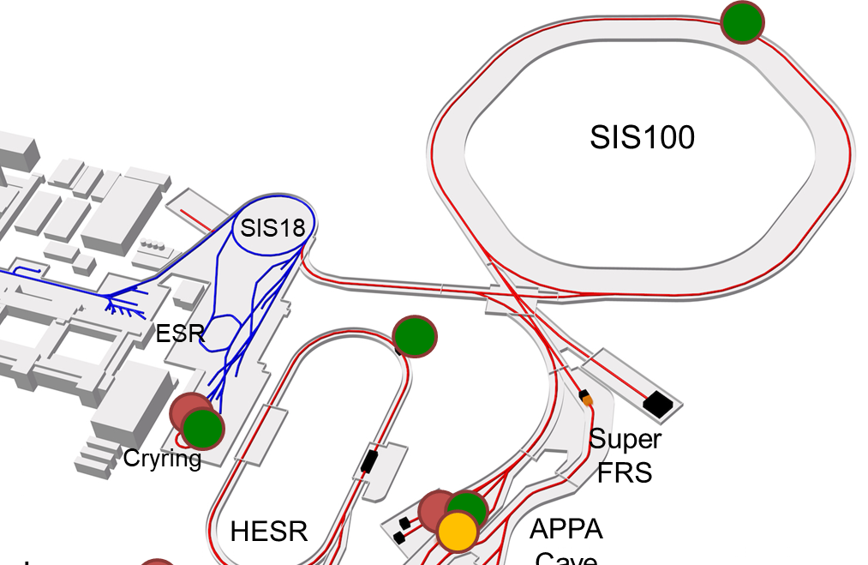
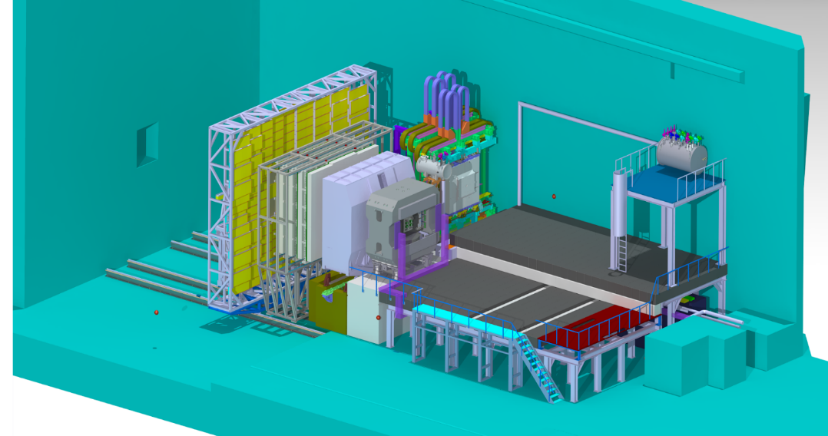
Alternatives at SIS-18 / SIS-100 until APPA cave available
Alternative 3: CBM Cave (SIS100 beam)
pro:
early access to high flux beam
open:
unclear if beam focusing @ 200 MeV/u possible
unclear if high radiation level harms CBM detector (simulations on the way)
contra:
requires extra beamline and dedicated installations
extra personnel
extra costs, unclear funding
no access to SIS18
MAT
MAT

Slide 12
MAT requests, status and opportunities
MAT program can run with existing department resources (FAIR-phase-0) with standard technical support
First Science+ requires additional personnel and lab space as requested for APPA building
CRYRING: MAT station
UNILAC: M-branch
UNILAC: X0
SIS18: cave A
interim solution for APPA cave
? ?
S-FRS

Slide 13
Summary
2024 - 2025
2026 - 2028
> 2028
continue activities at UNILAC
use alternative for APPA cave
establish access to CW-Linac HELIAC
Most important for MAT community: regular and sufficient beam access
at all MAT beamlines including UNILAC, SIS and CRYRING
keep MAT collaboration alive
keep external groups interested

