Slide 1
Beam time(s) during FAIR Phase-0: Engineering run 2023 and Beam time 2024
D. Severin, S. Reimann

Slide 2
Outline
Engineering Run 2023
Beam time schedule 2024/25
strategic beam time schedule

Slide 3
Engineering-Run 2023
S. Reimann

Slide 4
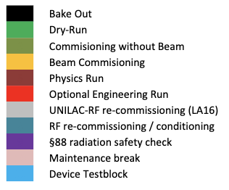
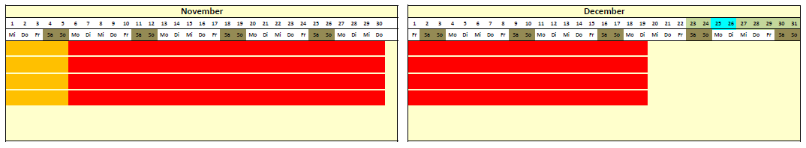

Boundary Conditions – Engineering-Run 2023
Main Goal:
Recommissioning after long shutdown (incl. LA16 renewal) to ensure full performance operation for 2024 physics run!
44 days of operation (24h 3-shift rotation and full on-call support)
energy consumption limit for 2023 (max. 43,7 GWh)
4 new persons in shift team (from Jülich via TransFAIR)
all machines fully operational
(except there is a risk that ESR will have a late start)
46 GWh*
* ca. 5% error bar
campus

Slide 5
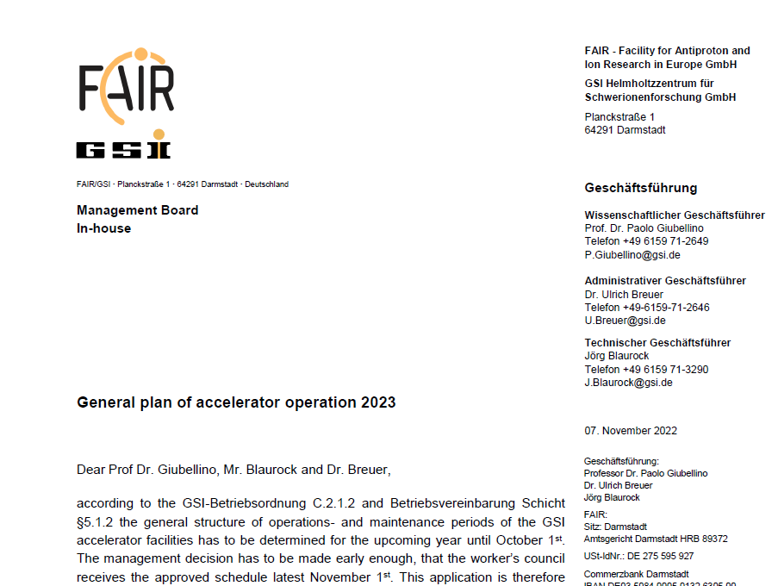
Pre-defined Topics – from general operation request
Xenon high current measurement campaign
Uranium 73+ high current campaign
operator training and Trans FAIR integration
dual isotope beam development for medical physics
pion production evaluation run for HADES
test operation for FAIR in-kind contributions
measurement of standard beam parameters behind SIS18
open slots for prioritized machine experiments
parallel beam for Cryring experiments with local source
parallel beam for cw-demonstrator operation
user driven
acc driven

Slide 6
preliminary schedule, only using pre-defined topics
Apparently
6 weeks are
not much time
HITRAP? commissioning: makes only sense if ESR and 7 days are available

Slide 7
Opportunities
start of Cryring beam operation 2 weeks earlier, if shutdown work is fast and cooler commissioning can be done early
parasitic users @UNILAC and maybe @SIS18 (limited / feasibility needs to be checked)
prolongation of beam time by single days, if energy consumption over the year is low enough and re-commissioning is fast
What I need from you
A reasonable prioritized list of topics / experiments to be flexibly included if possible
Statement whether pre-defined topics are still the hot topics
  HADES evaluation run
  dual isotope beam development for medical physics
  Xenon high current measurement campaign

Slide 8
Beam time 2024/25
D. Severin

Slide 9
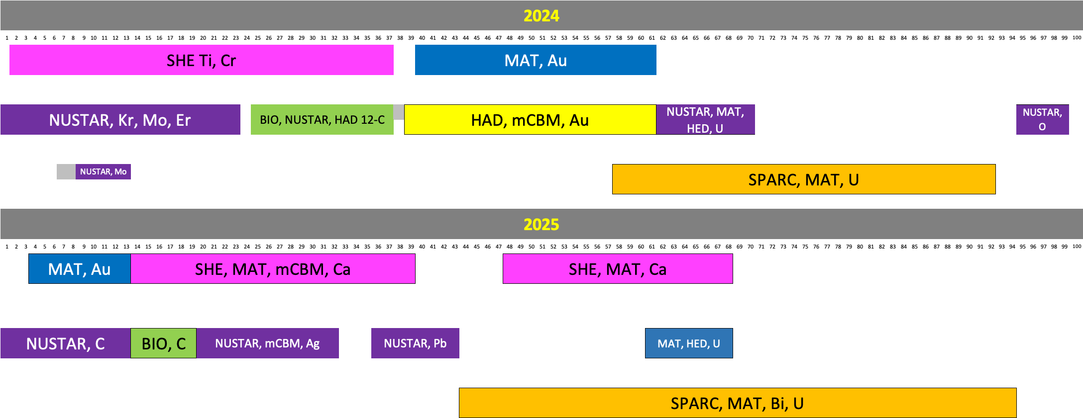
Beam time scheduling // first ideas

Slide 10
Beam time scheduling // first ideas

Slide 11
Challenges and Opportunities
Beam time scheduling: inhomogeneous beam request SIS/ESR
Less dense schedule -> only one beam at SIS
HLI restriction in 2024: 48-Ca operation only in 2025
HITRAP commissioning (Au block)
Machine performance and benchmarking
What we need to discuss
How to deal with open blocks (fill it up with A- vs. new PAC for 2025/26)
Schedule density
Possible restrictions in 2025 due to FAIR hardware commissioning

Slide 12
Strategic Beam Time Schedule
S. Reimann / D. Severin

Slide 13
FAIR/GSI strategic operation scenario
Status Jan. 2022
beam time
Acc. Operation total / days
134
120
120
120
180
180
200
240
240
beam time
Physics beam time/ days
107
100
100
100*
150*
150*
175*
200
200
* Special mode of “physics beam time” only as 2nd priority in parallel to FAIR beam com.
Project phases
FAIR Beam Commissioning
FAIR Hardware Commissioning
FAIR Installation of Accelerator Components
Facility availability
p-Linac
HESR
CR
SIS100 → CBM Cave (+ SFRS + APPA Cave)
SIS18 → SFRS
SIS18 → APPA-Cave
UNILAC → EH, SIS18 → TH, EX, FRS, ESR → HITRAP, Cryring
2022
2023
2024
2025
2026
2027
2028
2029
2030
FAIR Phase 0
FAIR Early Science
FAIR Intermediate Objective
FAIR MSV
13

Slide 14


Assumptions
new project baseline
funding of FAIR commissioning and operation budget will be available
Remarks:
UNILAC post-stripper (Alvarez) replacement not yet included
→ Decision on time window for installation and commissioning will be made at an appropriate time
no performance upgrades in existing facilities are financed (exception: pulsed gas stripper)
→ no major change in performance to be expected for early science
50Hz high duty cycle UNILAC operation is a risk for UNILAC hardware
→ recommendation is, to remove it from ACC portfolio as soon as reasonable

Slide 15
FAIR/GSI strategic operation scenario towards FS+
Update 2023 (proposal ACC)
beam time
Acc. Operation total / days
134
44
140
140
90
restricted shutdown
90
90
200
240
240
beam time
Physics beam time/ days
107
0
100
100
60
min 30*
min 30*
min 100*
180
180
*number of days to be announced for PAC call
(share is reduced due to FAIR commissioning)
Project phases (ES, FS, FS+)
FAIR Installation of Accelerator Components
FAIR Hardware Commissioning
FCC needed
FAIR Beam Commissioning
PCP reached
Facility availability
early science (ES) →
SIS18 → SFRS → NUSTAR
first science (FS) →
SIS100 → SFRS → NUSTAR
first science + (FS+) →
SIS100 –> CBM
UNILAC → EH, SIS18 → TH, EX, FRS, ESR → HITRAP, Cryring
2022
2023
2024
2025
2026
2027
2028
2029
2030
FAIR Phase 0
Early Science
Early Science & First Science+
15

Slide 16
FAIR/GSI strategic operation scenario towards FS+
Update 2023 (proposal ACC vs. RED)
beam time
Acc. Operation total / days
134
44
140
140
90
restricted shutdown
90
90
200
240
240
beam time
Physics beam time/ days
107
0
100
100
60
min 30*
min 30*
min 100*
180
180
*number of days to be announced for PAC call
(share is reduced due to FAIR commissioning)
Project phases (ES, FS, FS+)
FAIR Installation of Accelerator Components
FAIR Hardware Commissioning
FCC needed
FAIR Beam Commissioning
PCP reached
Facility availability
SIS18 → SFRS → NUSTAR
SIS100 → SFRS → NUSTAR
SIS100 –> CBM
UNILAC → EH, SIS18 → TH, EX, FRS, ESR → HITRAP, Cryring
2022
2023
2024
2025
2026
2027
2028
2029
2030
FAIR Phase 0
Early Science
Early Science & First Science+
16

Slide 17
FAIR/GSI strategic operation scenario towards FS+
Draft!
Update 2023 (proposal RED)
Acc. Operation total / days
134
44
140
140
XX
restricted shutdown
90
90
200
240
240
Main physics beam time/ days
107
0
100
100
XX
XX
XX
XX
180
180
m
Parasitic physics beam time/ days
107
XX
XX
XX
Tbd…
Project phases
FAIR Installation of Accelerator Components
FAIR Hardware Commissioning
PCP reached
FCC needed
FAIR Beam Commissioning
Facility availability
SIS18 → SFRS → NUSTAR
SIS100 → SFRS → NUSTAR
SIS100 –> CBM
UNILAC → EH, SIS18 → TH, EX, FRS, ESR → HITRAP, Cryring
2022
2023
2024
2025
2026
2027
2028
2029
2030
FAIR Phase 0
Early Science
Early Science & First Science+
17

Slide 18
Challenges and Opportunities
Parallel operation during FAIR commissioning (commissioning beam, physics FAIR targets, physics actual targets)
Define technical and resource dependent boundary conditions for parallel operation
What we need to discuss
Priority during transition phase: ratio of main and parasitic physics beam time
  - Clearly, we all want FAIR asap BUT we also want as much as possible beam time
Priority
Physics beam time
FAIR commissioning and installation

