Slide 1
Welcome to the 2023
Research Retreat
Paolo Giubellino
Tobbaccon conference hotel Bensheim Feb 13 2023

Slide 2
Objectives of this meeting 1
Discuss the prospects of research at GSI and FAIR following the Review and subsequent decisions of the funding authorities
including specific plans of each of the 4 pillars
Define the prioritized needs to successfully perform the 2024 and 2025 beam times
for GSI, results in 2024 are crucial in view of the Center Evaluation foreseen in late 2024/early 2025
in this respect, it is essential to define requests to the accelerators so that all necessary preparations can be done, in particular those to be included in the 2023 engineering run

Slide 3
Objectives of this meeting 2
Define prioritized needs for a successful 2028 FAIR/GSI run
Define the Science point of view on the planning of beam for experiments in the years 2026, 2027 and 2028 as input to the management discussions on the program
Have a very first „conceptual“ discussion of new ideas of science at GSI not necessarily included in the baseline MSV experiments
both basic science and applications/tech transfer

Slide 4
In the meantime, the construction of FAIR progresses
Civil continues fast
the Concrete works of the full IO will be finished in the course of this year, followed by technical installation on the FS+ section (if so decided by Council)
installation of first accelerator elements in a few months
major technical components such as the cryo plant are progressing
And so do accelerators and experiments
the main issue of reprocurement of Russian components is being addressed
The FAIR project has launched a reorganization to adapt the action to the new situation, keeping in mind that this is stepwise approach aiming at the end at the MSV
See the presentation by J. Blaurock

Slide 5
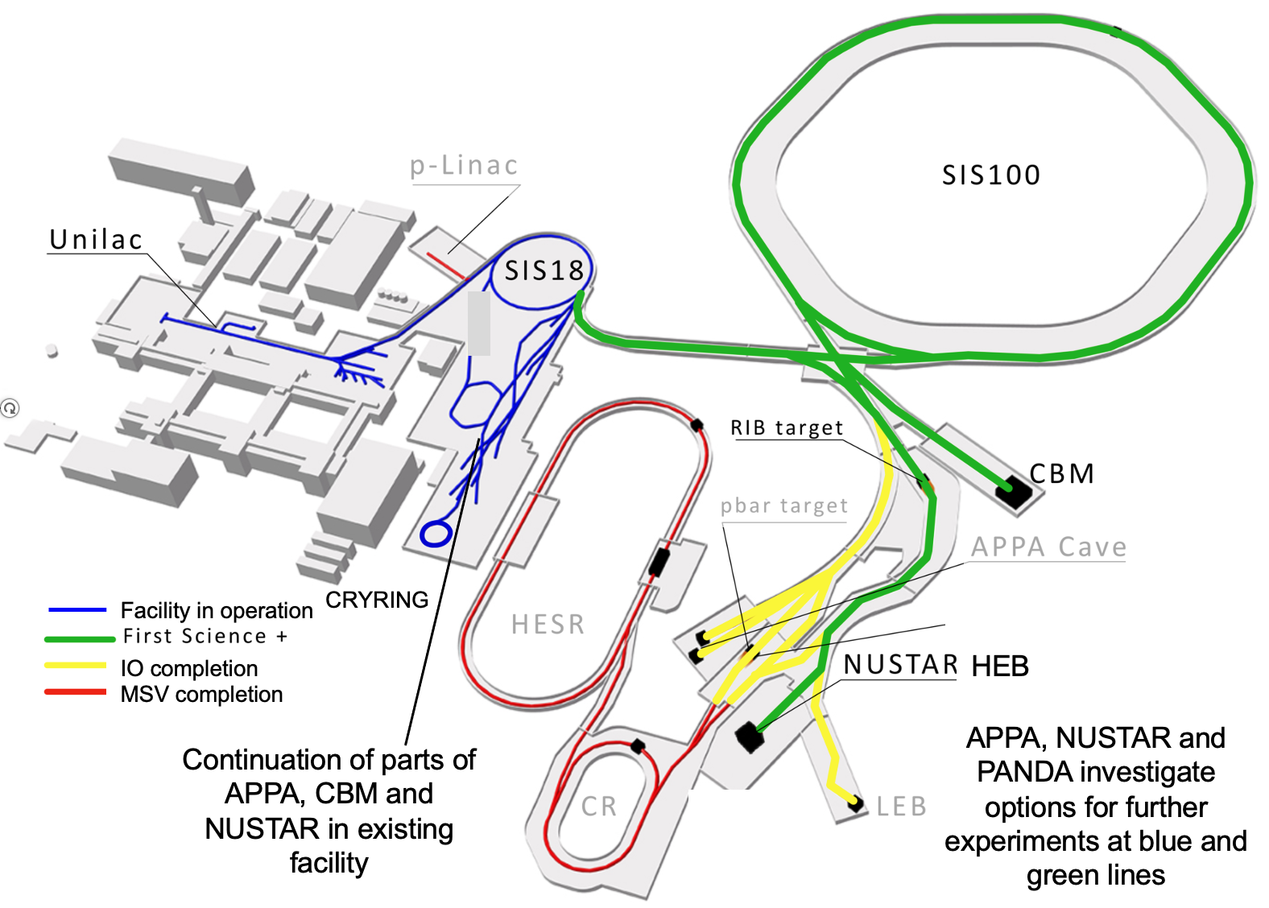
FAIR First Science and Staging Review
The international review panel has issued its report, which is publicly available in full on our website
The scientific program of all four FAIR pillars is indicated as outstanding and in many cases world leading
Given the financial constraints, a start configuration including SIS 100, SFRS with the High Energy cave and CBM (FS+) is recommended
In October 2022 FAIR Council decided to: follow the recommendation of the review and pursue a stepwise realization starting with FS+ , followed by the APPA cave, then the LEB and finally the rest of the CR, the HESR and the p-Linac
Now, we are eagerly waiting for the indispensable funding decisions

Slide 6
FAIR research plan
Up to 2025 we continue with FAIR Phase-0, from 2026 onwards we enter the mixed-mode with the commissioning of the new beamlines. Annual beam time for science will increase progressively, to reach full year operation from 2028 onwards.
„First Science+“ includes all the facilities on the GSI campus plus the Super-FRS with the High Energy Branch, SIS100 and the CBM cave.
Some experiments will start already in 2027 at the Super-FRS using SIS18 beams („Early Science“)
The amount of beam time to the new cave during Early Science will depend on the physics case, which should now be updated and detailed.
We will try to keep a broad research program on campus, which will also serve the long-term goals of FAIR.

Slide 7
FAIR in 2028
So, the „FAIR2028“ science program will include:
APPA experiments at the low-energy rings, at the caves at SIS18 and UNILAC, PHELIX and a limited set of experiments which could be hosted at the SIS100 caves
NUSTAR at the SFRS with SIS100 beams, plus SHE experiments at UNILAC and ILIMA at the low-energy rings
CBM at the new cave with SIS100 beams, and HADES at SIS18
We will optimize our efforts towards optimum use of our resources and of the space in the new caves for these goals.
For activities which will have beam only at a later stage, such as PANDA, suitable programs are being developed, when possible using the caves and beams available at GSI/FAIR.

Slide 8
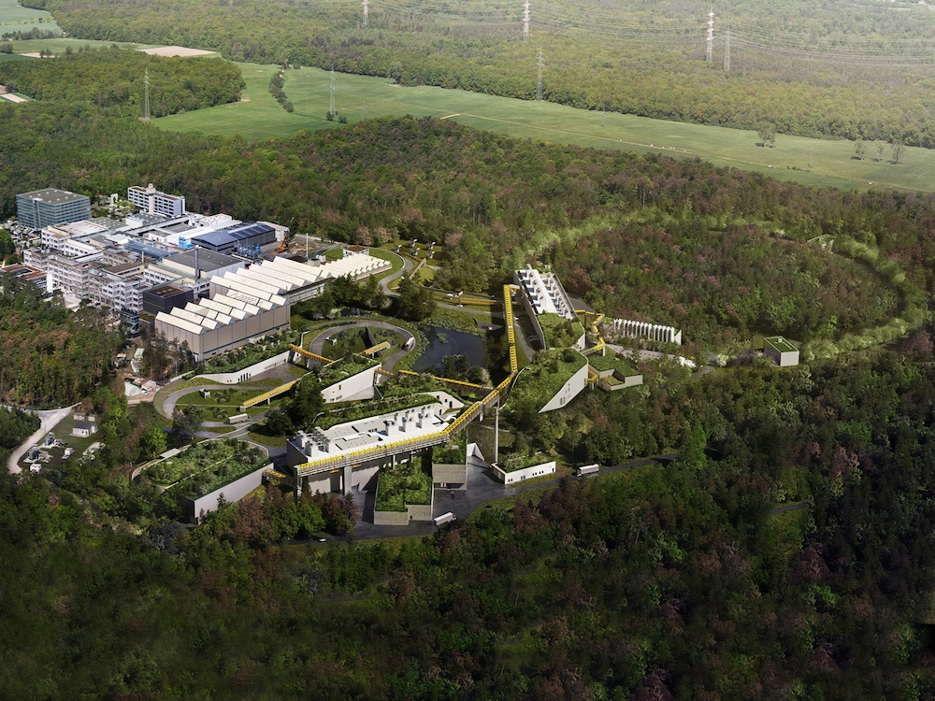
Thank You!

